Slide 1
Mini Lecture Course: Accelerator Design for a Multi-TeV Muon Collider
Lecture 5: Review of MICE and Discussion of the US demonstrator
June 23, 2025
Katsuya Yonehara
Senior Scientist

Slide 2
Scope of today’s lecture
Review of MICE experimental results
Discussion of the USMCC demonstrator channel design and objectives
Reference for today’s lecture
Drielsma’s thesis
Nature Physics
Phys. Rev. D.106.092003

Slide 3
Muon Ionization Cooling Experiment (MICE)
Aims of MICE:
  Demonstrate the feasibility of design, engineering and constructing a section of a muon cooling channel that meets the performance goals of a Neutrino Factory
  Install the channel in a muon beam and evaluate its performance under various operational modes and beam conditions, in order to explore the limits and practicality of ionization cooling

Slide 4
MICE is a Single-Particle Tracking Experiment
Enable precise characterization of individual particles by observing their dynamics
  Non-muon particle contamination is significant background
  Detectors are carefully designed for robust particle identification
Produce muons with momentum around 240 MeV/c
  This momentum range provides optimal cooling performance in the MICE channel
  Initial beam emittance is tuned using a diffuser, e.g. the initial normalized emittance values include 3 (4), 6, and 10 mm
MICE detectors achieved high-precision particle identification
  Critical for excluding contamination from pions and electrons/positrons, which introduce systematic errors in phase space measurements
Designed to measure a 10 % transverse emittance reduction with 1 % precision
  Equivalent to an absolute measurement error of 0.1 %

Slide 5
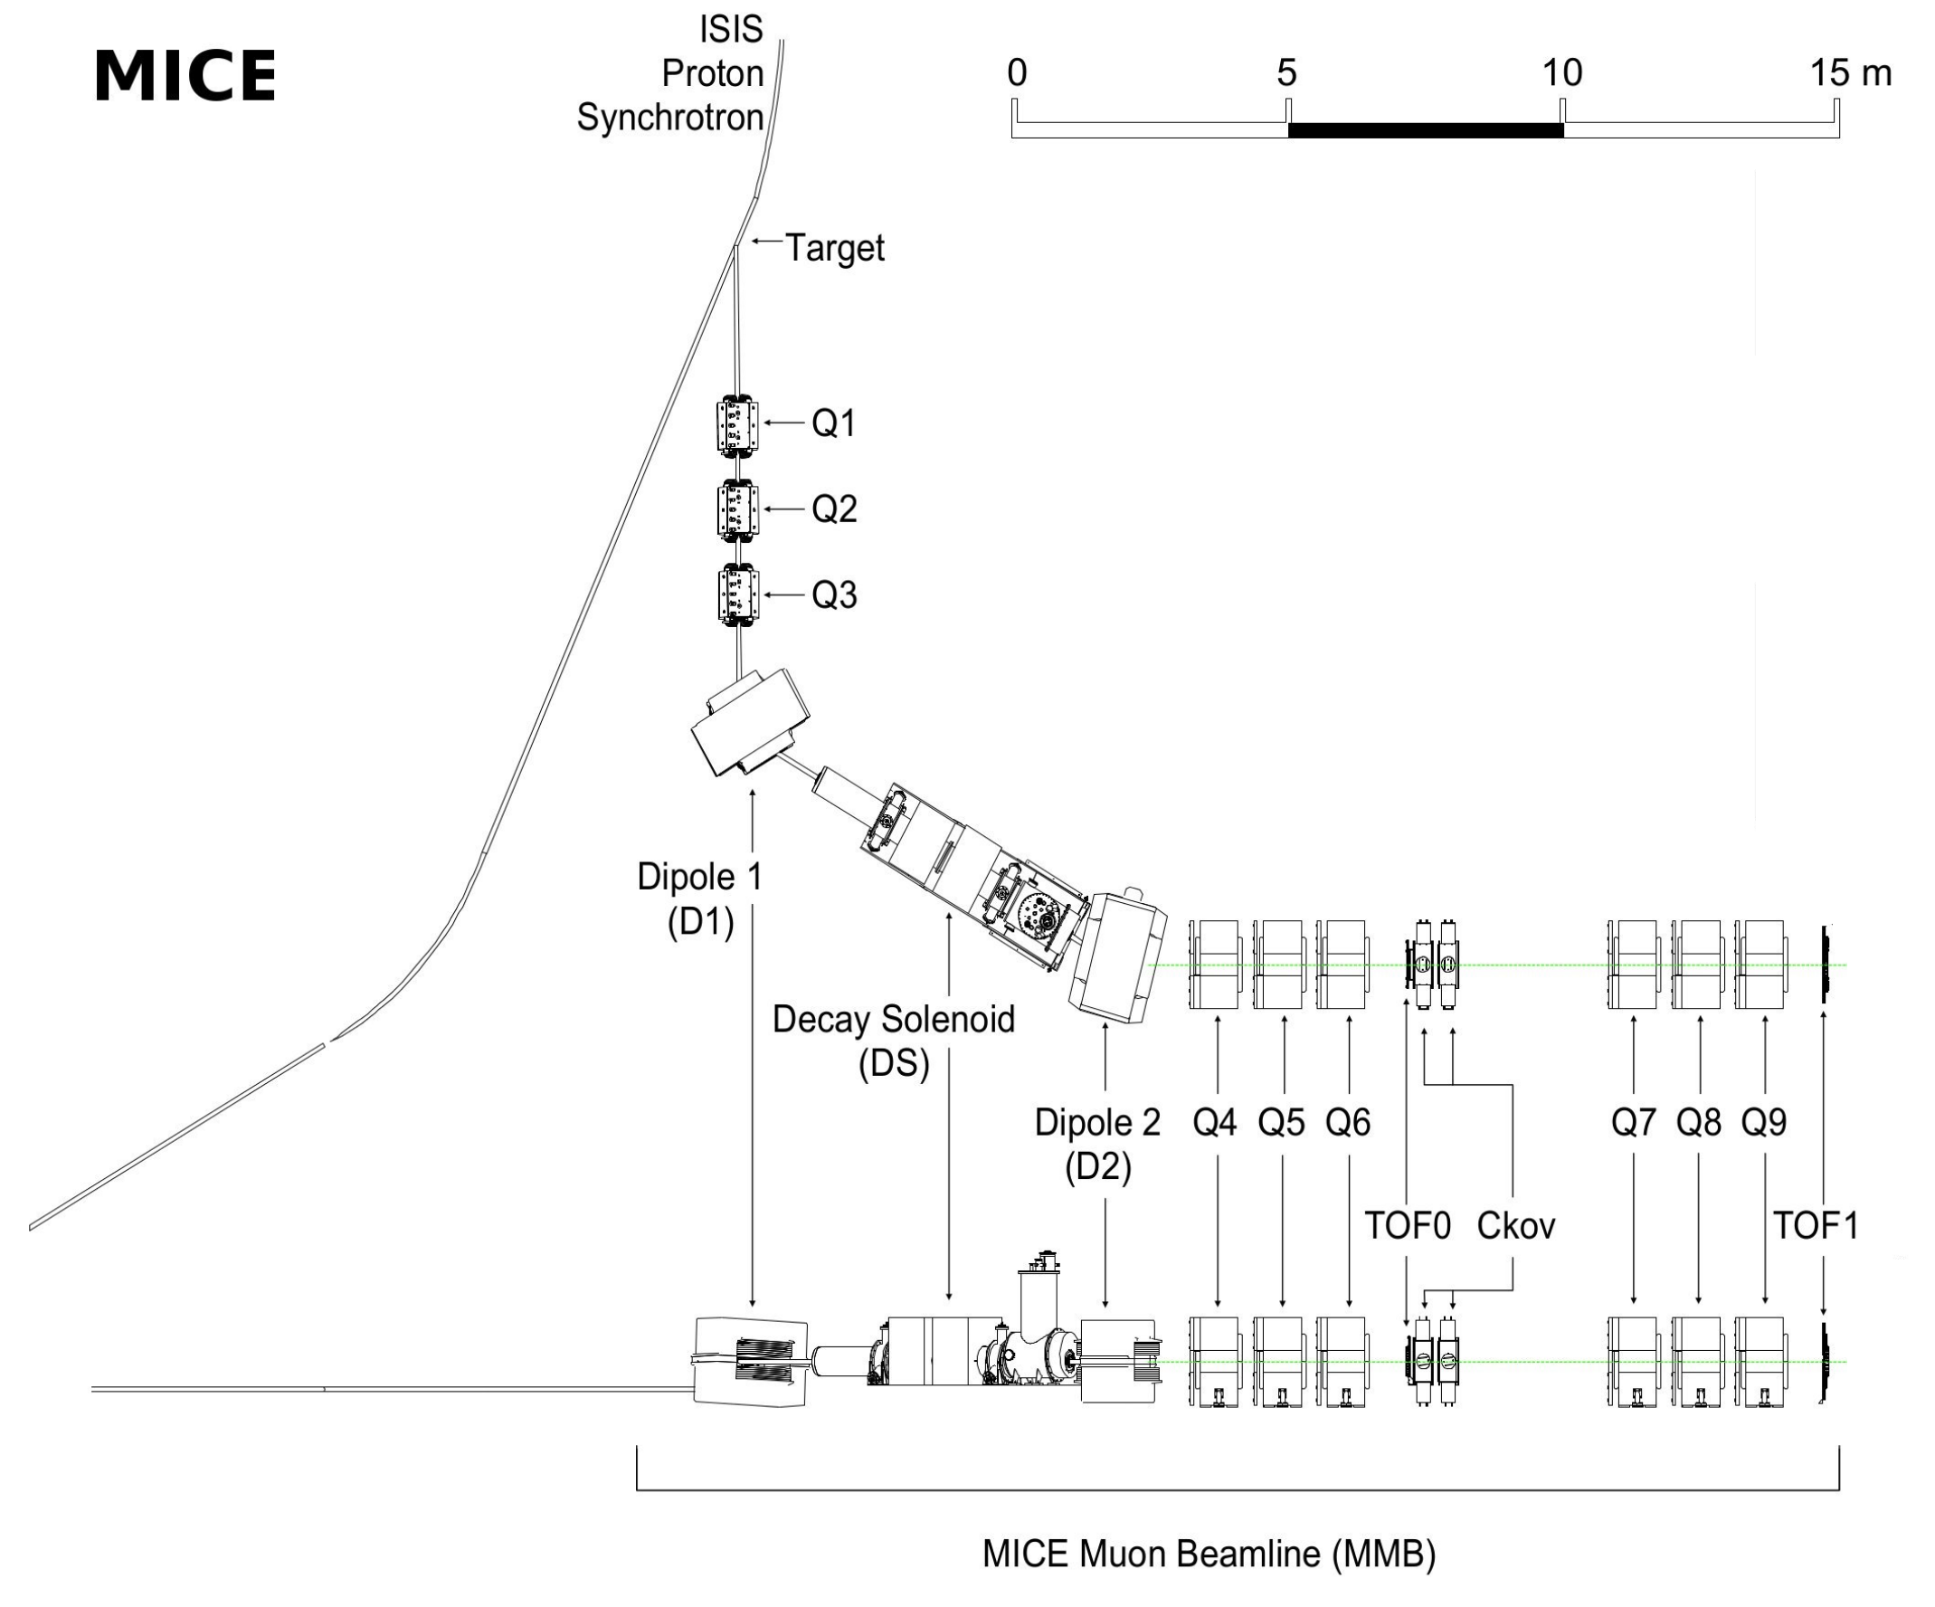
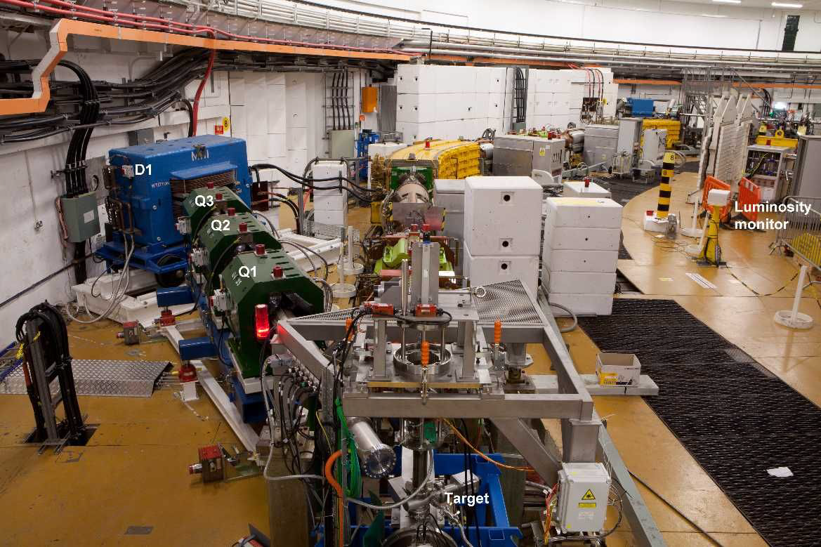
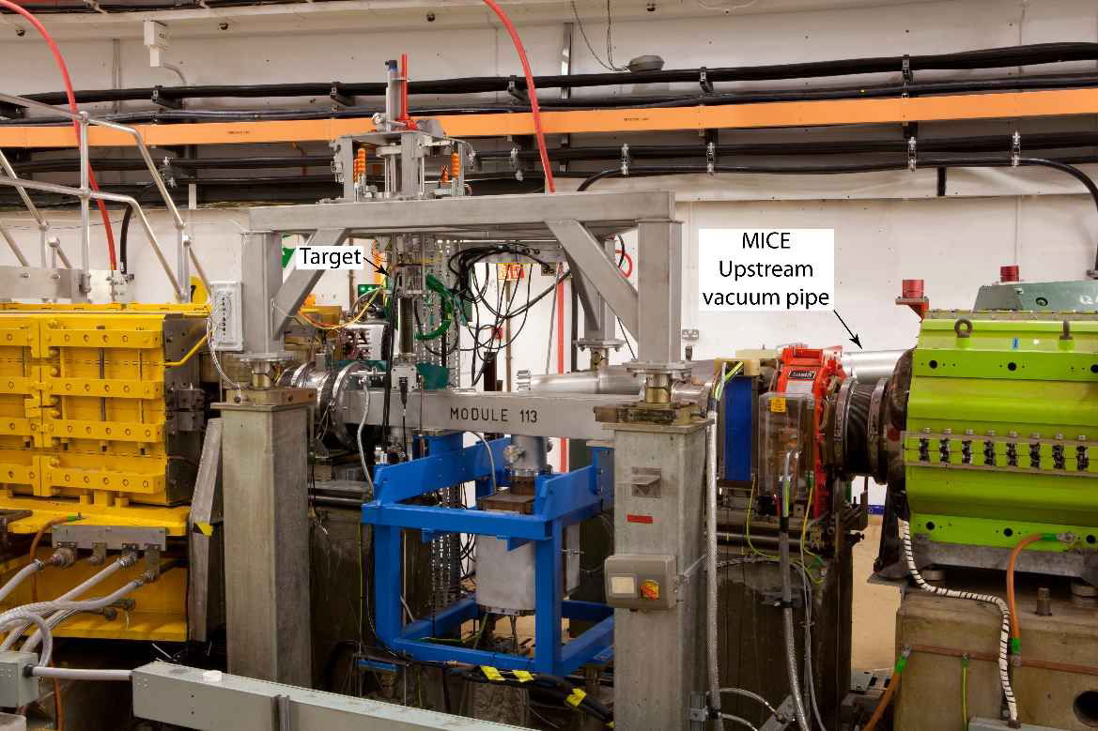
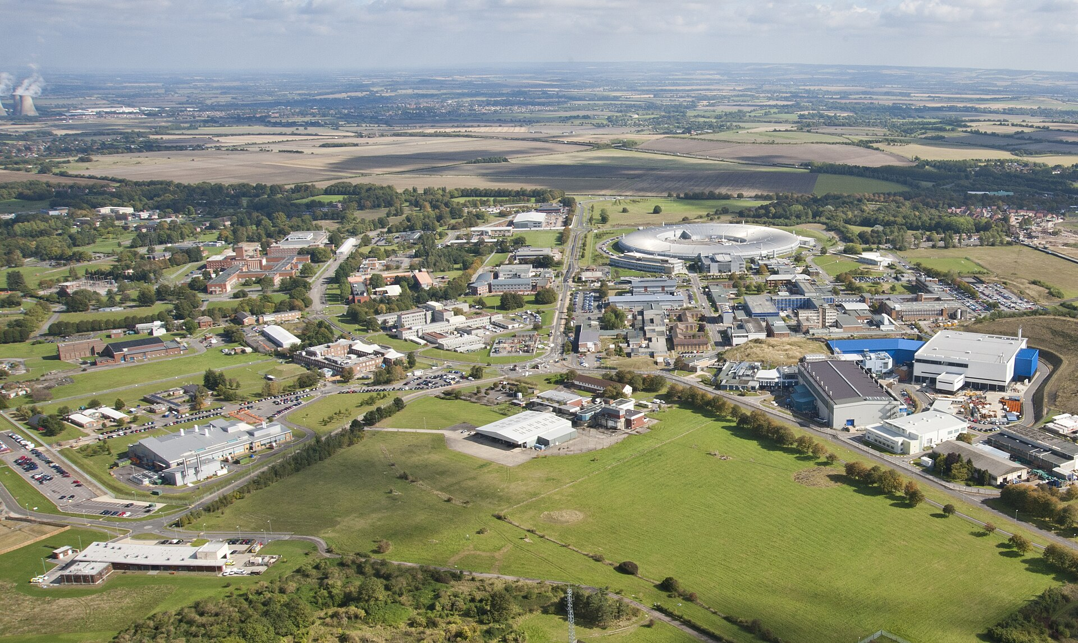
MICE Beamline at Rutherford Appleton Lab (RAL)
MICE beamline (view from proton beam)
Momentum filter
617-800 MeV proton beam striking a hollow titanium target
Decay volume
To cooling channel
ISIS

Slide 6
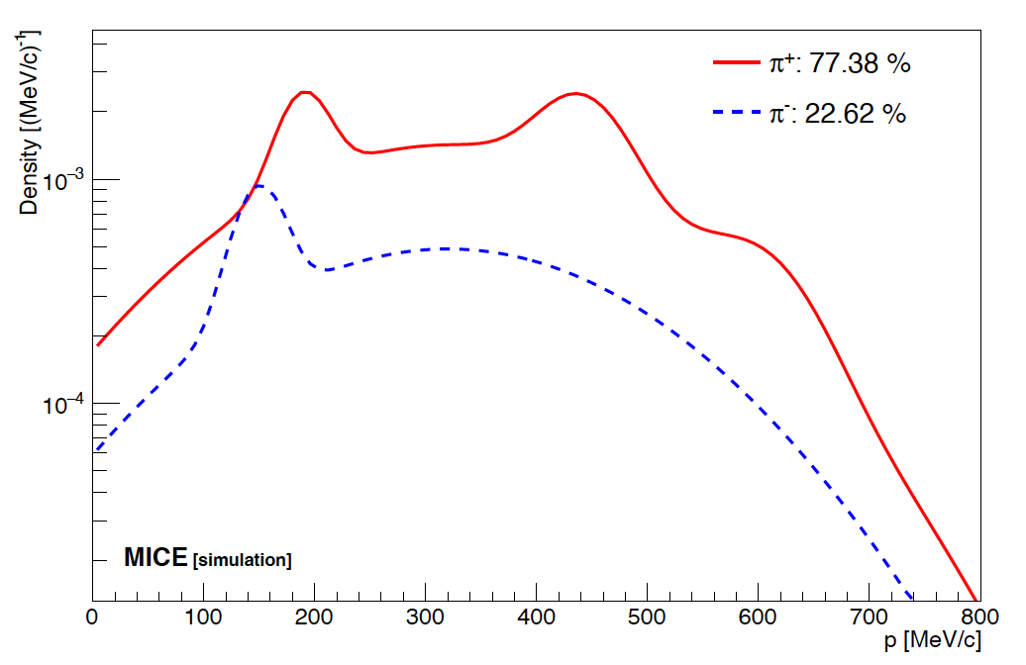



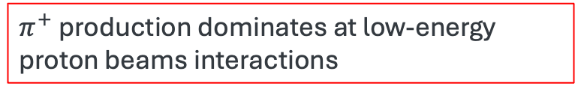

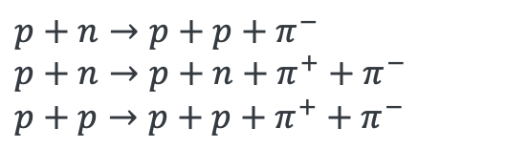
Pion production at MICE beamline
$$p+A→π^{±}+X$$
$π^{+}$ production dominates at low-energy proton beams interactions
Simulated pion momentum spectrum from titanium target
$$p+p→{p+∆}^{++}→p+p+π^{+}$$
These peaks likely originate from the delta-resonance production and decay
$$p+p→{p+∆}^{+}→p+n+π^{+}$$
$$p+n→p+∆^{0}→p or n+π^{−} or π^{0}$$
Other reaction channels contribute to a continuous spectrum
$$p+n→p+p+π^{−}$$
$$p+n→p+n+π^{+}+π^{−}$$
$$p+p→p+p+π^{+}+π^{−}$$
Pion momentum

Slide 7
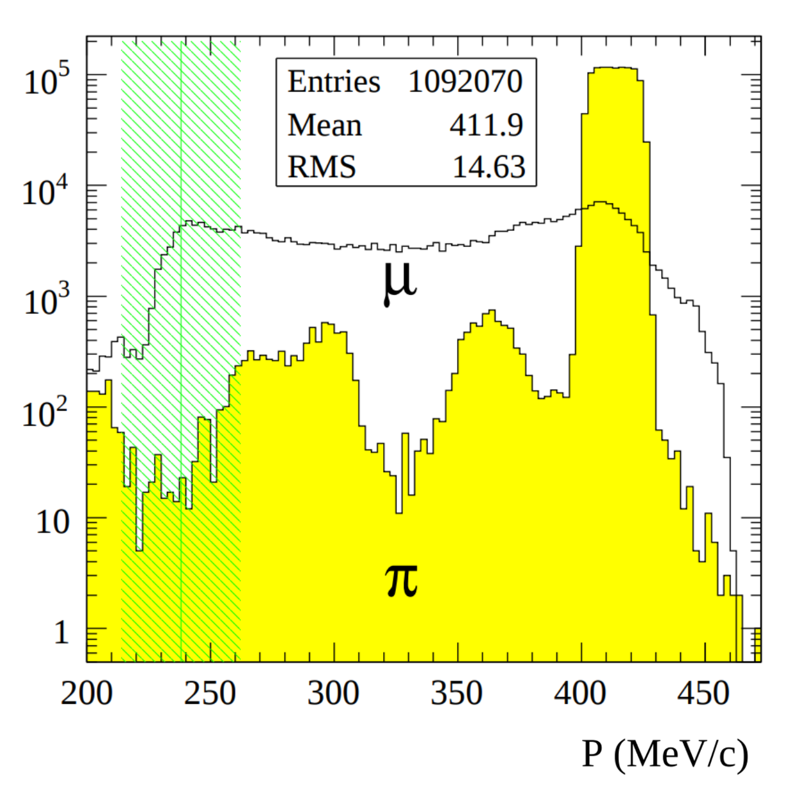
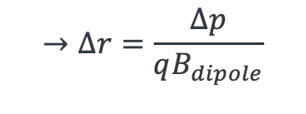
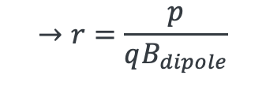
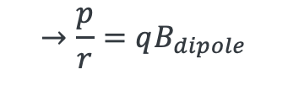
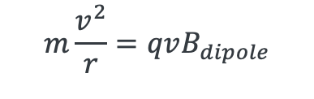
Momentum Selection after D1/D2 Dipole Magnets
Dipole magnets act as momentum selectors
$$m\frac{v^{2}}{r}=qvB_{dipole}$$
$$→\frac{p}{r}=qB_{dipole}$$
$$→r=\frac{p}{qB_{dipole}}$$
To isolate a specific momentum, a collimator defines an acceptance band:
$$→∆r=\frac{∆p}{qB_{dipole}}$$
The green shadow region indicates the selected muon momentum range after passing through the D2 dipole

Slide 8
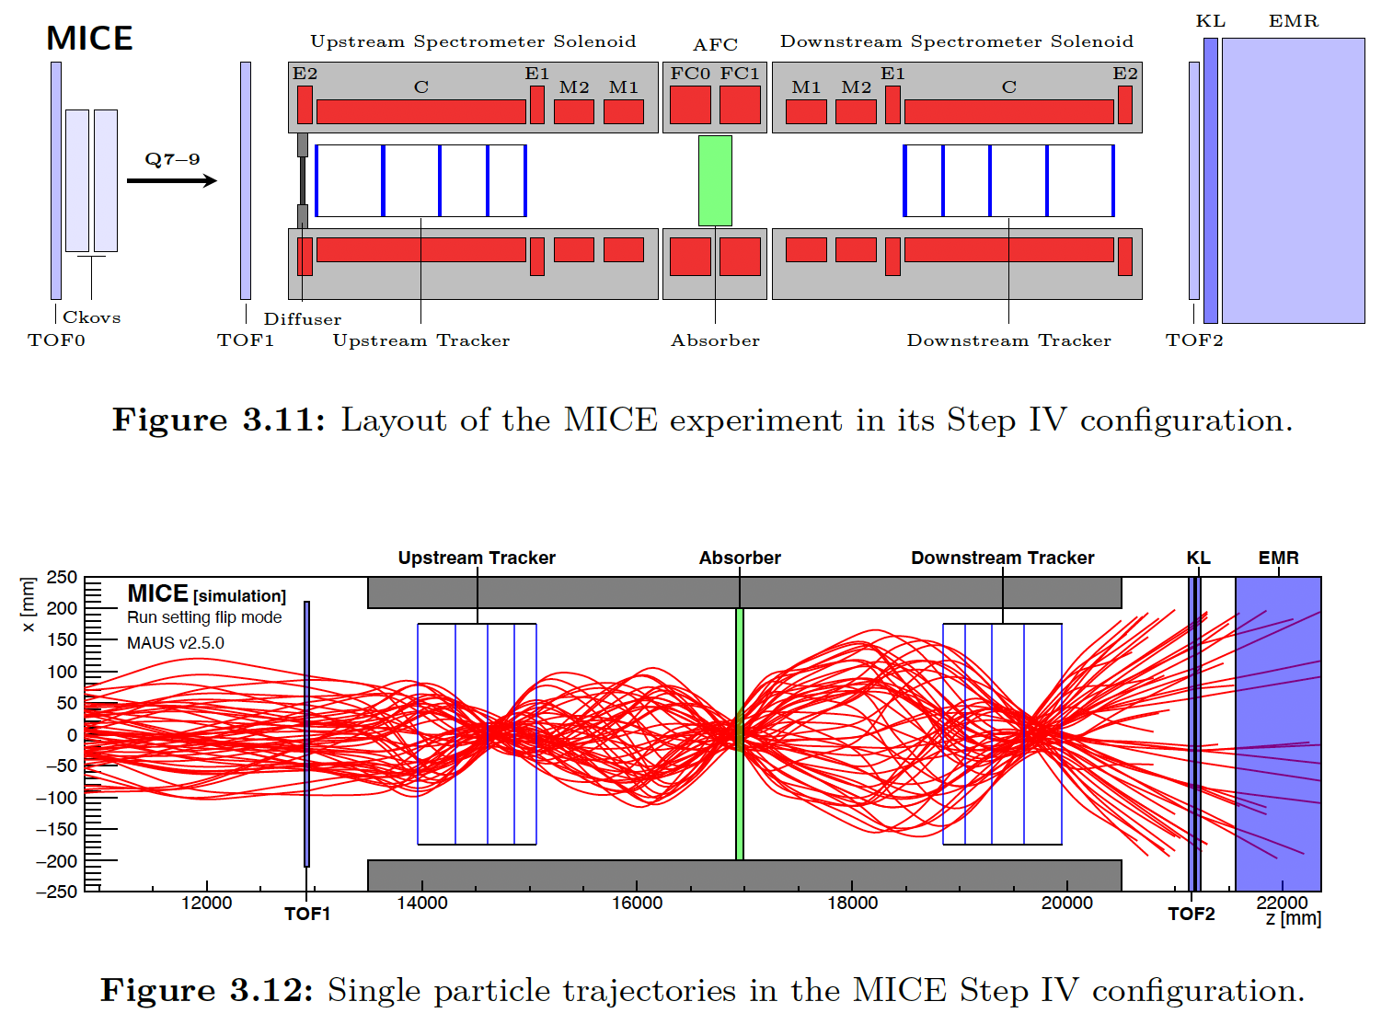




MICE Cooling Channel and Detector Layout
All detectors are optimized for precision tracking and particle ID:
TOF counter
Cherenkov detector
Solenoid-embedded Trackers (Upstream and Downstream of the absorber)
Electromagnetic calorimeter (KL+EMR)
$B_{z}\sim 3$ T
$B_{z}\sim 2$T
$B_{z}\sim −1$ T
$B_{z}\sim −2.5$ T

Slide 9
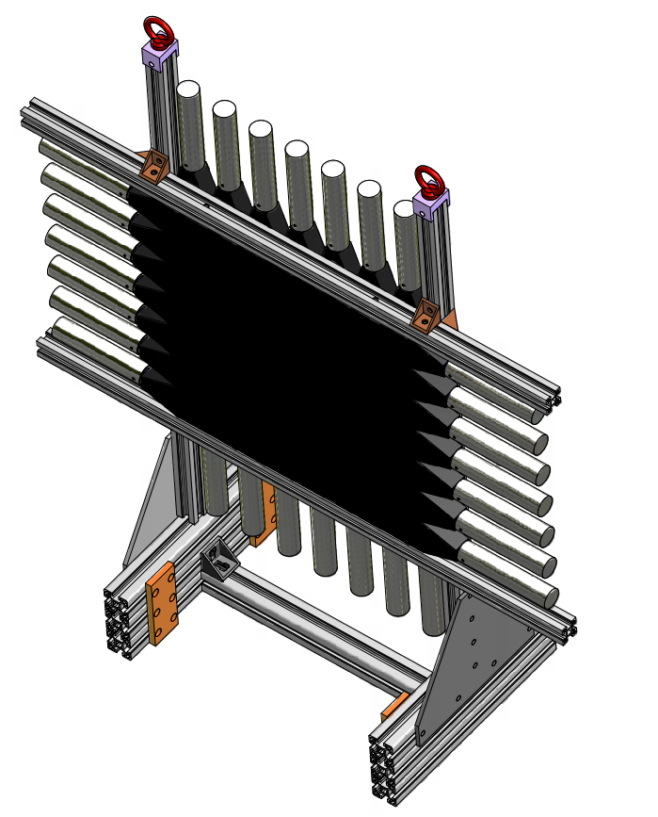
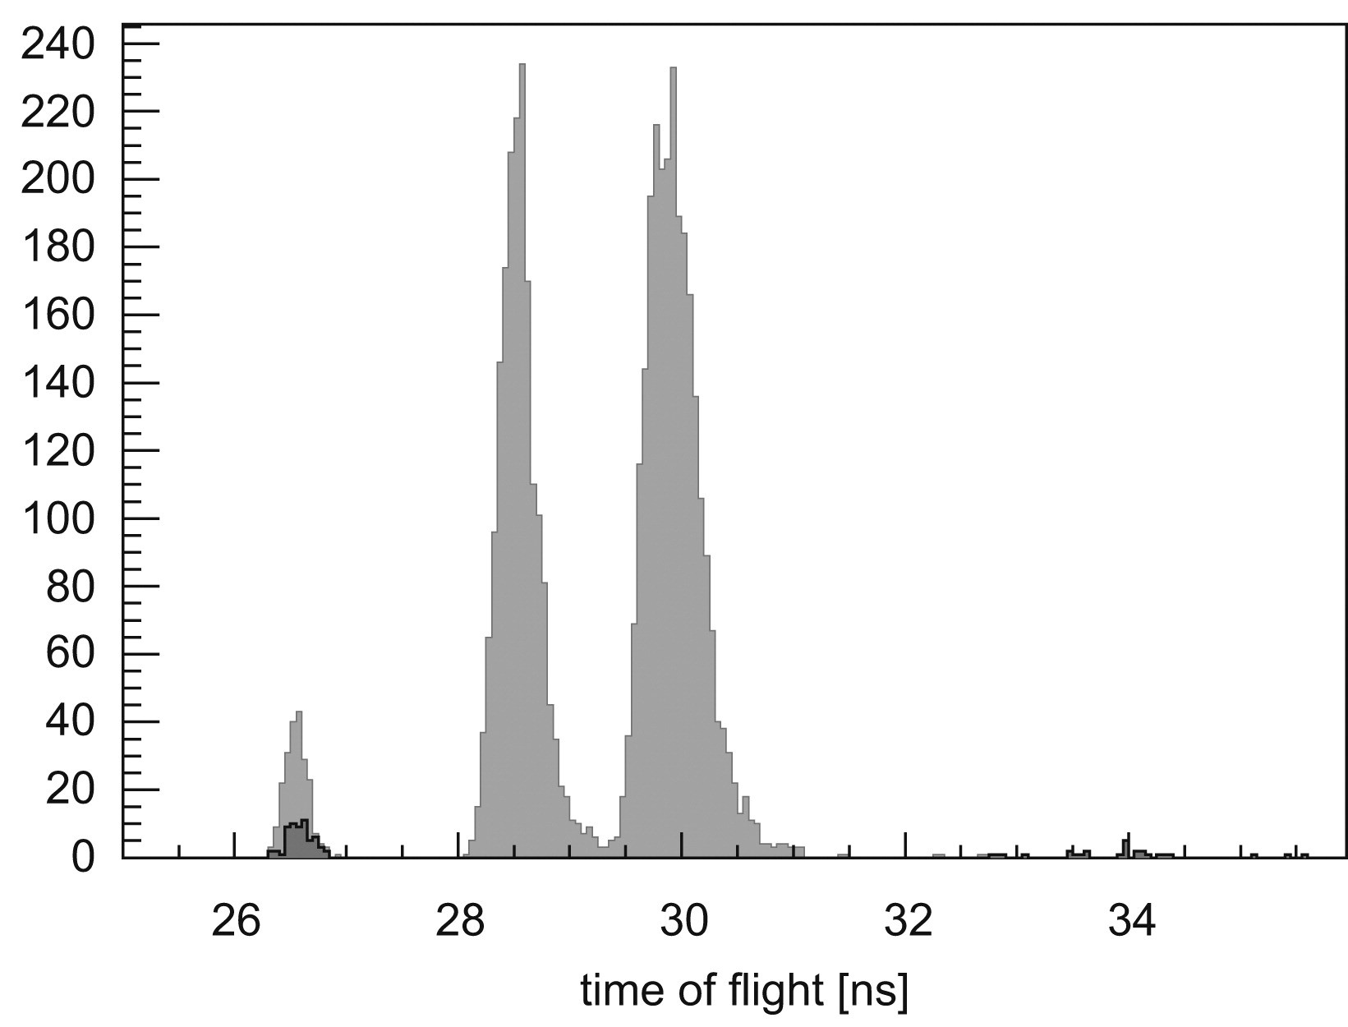
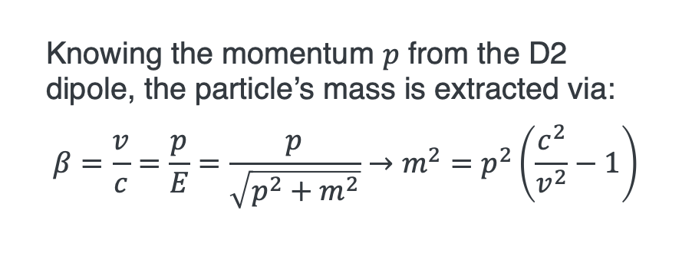

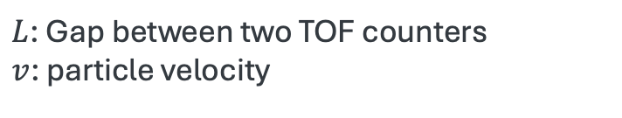
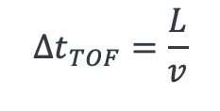
Time of Flight Counter
Knowing the momentum $p$ from the D2 dipole, the particle’s mass is extracted via:
$$β=\frac{v}{c}=\frac{p}{E}=\frac{p}{\sqrt{p^{2}+m^{2}}}→m^{2}=p^{2}\left(\frac{c^{2}}{v^{2}}−1\right)$$
muon
Time resolution $\sim$70 ps
Corresponds to momentum resolution 4-10 MeV/c
Clear separation between electrons/positrons, muons, and pions
The TOF counter (plastic scintillator telescope) measures particle velocity
$$∆t_{TOF}=\frac{L}{v}$$
$L$: Gap between two TOF counters
$v$: particle velocity
Pion
Electron/positron

Slide 10
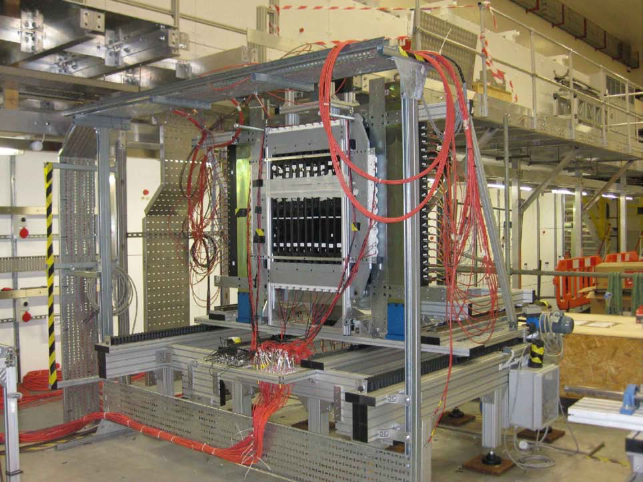
Time of Flight Counter
NB: Key feature
Designed timing resolution 50 ps which corresponds to the RF phase ~5 degrees of the 201 MHz MICE RF cavity phase
Enable RF phase tuning based on TOF data
PID efficiency exceeds 99 %
Dual-end readout improves position resolution
Picture shows TOF2 and KL calorimeter
Photo multiplier tube (PMT)
is a photon sensor
NB: Scintillating detector
Emit luminescence light when charged particles pass through. The light is collected by PMT
Scintillator
Incident particle

Slide 11
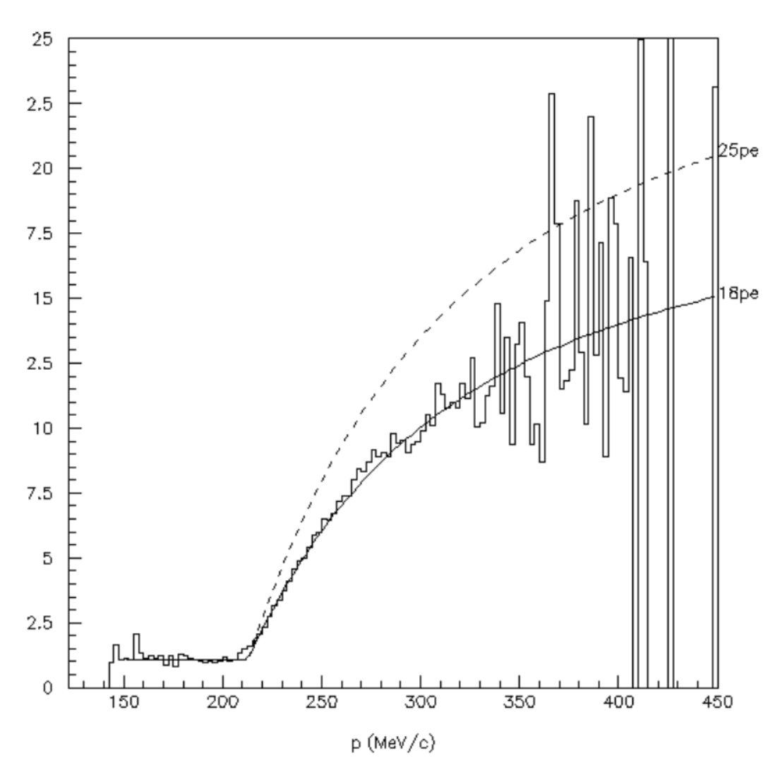
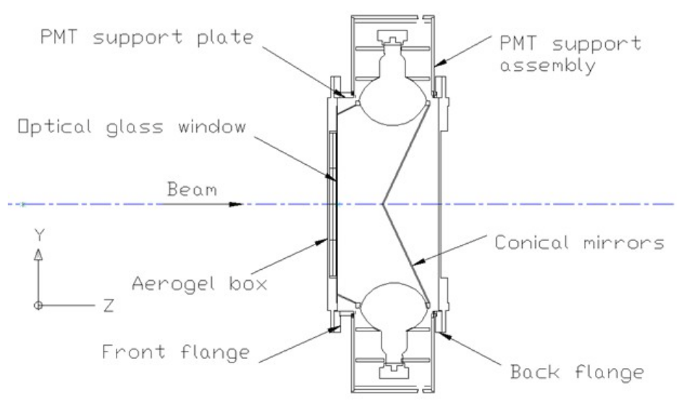
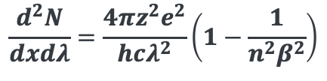
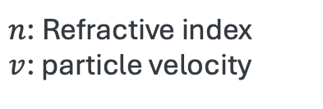
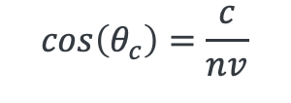
Cherenkov Detector
Radiation yield
$$\frac{d^{2}N}{dxdλ}=\frac{4πz^{2}e^{2}}{hcλ^{2}}\left(1−\frac{1}{n^{2}β^{2}}\right)$$
Light yield (arb. unit)
Use Cherenkov Detector for PID
Aerogel as a radiator
Charged particles traveling faster than the phase velocity of light in a medium emit Cherenkov radiation: Emission angle
First detector identifies p > 213 MeV/c
Second detector identifies p > 272 MeV/c
Two thresholds help in separating muons from pions and elctrons
$$cos\left(θ_{c}\right)=\frac{c}{nv}$$
$n$: Refractive index
$v$: particle velocity

Slide 12
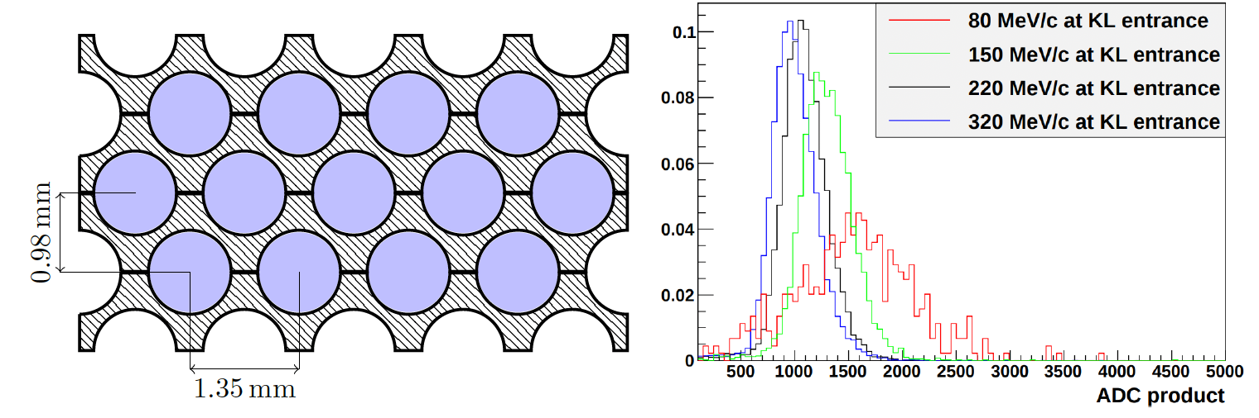
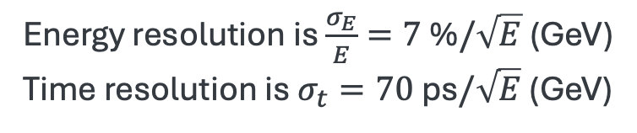
KLOE-Light preshower sampling calorimeter
NB: Calorimeter
Measure kinetic energy based on energy deposition in scintillators
Lead layers serve as absorbers to improve energy sampling and particle stopping
1-mm diameter scintillating fibers (scifi) embedded in lead layers forms part of the calorimeter and supplements TOF
Energy resolution is $\frac{σ_{E}}{E}=7$ %$/\sqrt{E}$ (GeV)
Time resolution is $σ_{t}=70$ ps$/\sqrt{E}$ (GeV)

Slide 13
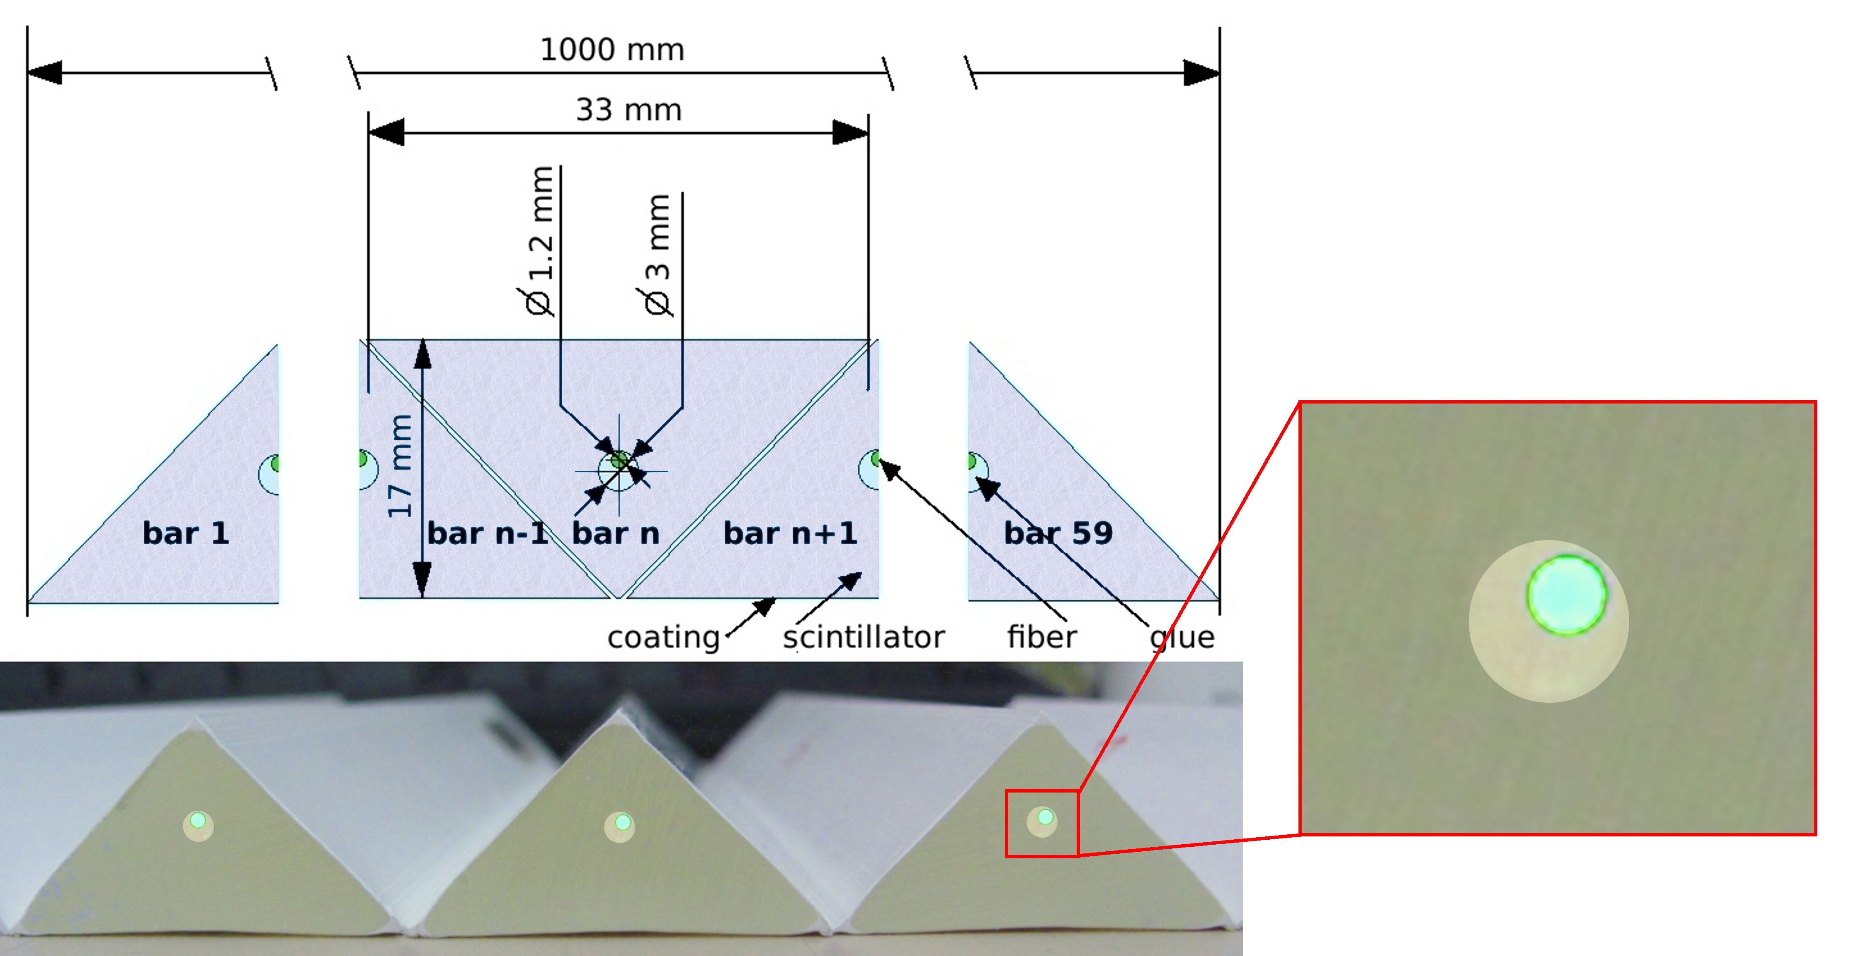
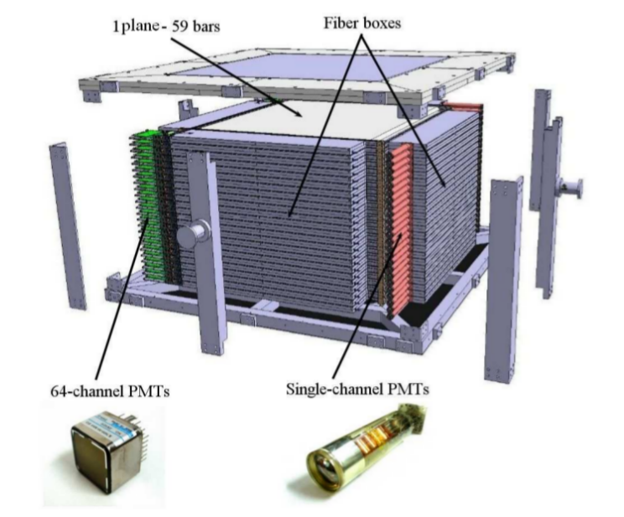
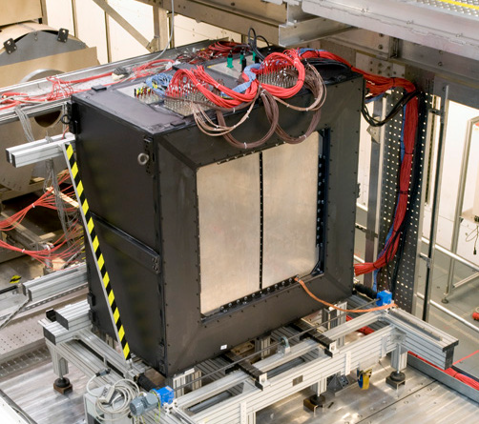
Electron Muon Ranger (EMR)
Final-stage detector for identifying muons via stopping pattern
1-meter-long bars, arranged in alternating orientations
WLS fibers glued inside scintillator bars collect light and transmit to PMTs
Combine KL calorimeter and Electron Muon Ranger to identify the incident particle
EMR consists of layers of triangle scintillating bar with embedded wavelength shifting (WLS) fibers

Slide 14
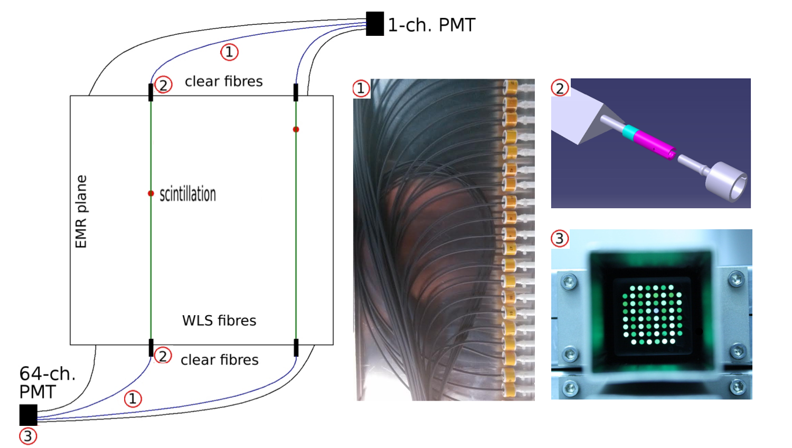
Electron Muon Ranger
Dual light output couplers, one is for integrated light yield for calorimetry and other is for processing multiplexed signals for particle tracking

Slide 15
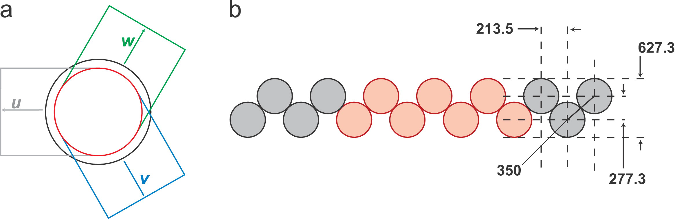
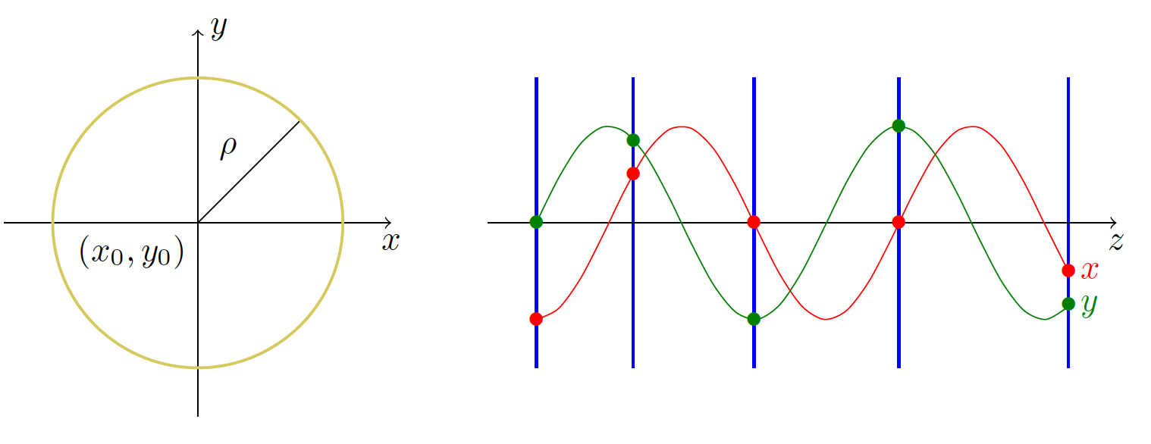
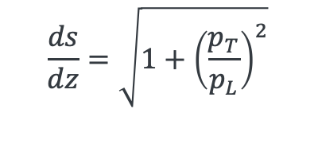
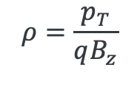
Scifi Tracker
High-resolution tracking with minimal beam disruption
Radius of sense area is 150 mm
Unit is micro-meter
5-scifi stations along beam direction
$$ρ=\frac{p_{T}}{qB_{z}}$$
NB: This formula presents the longitudinal momentum from the observed position and transverse momentum.
If the transverse momentum is small, the tracker loses the resolution for the longitudinal momentum
$$\frac{ds}{dz}=\sqrt{1+{\left(\frac{p_{T}}{p_{L}}\right)}^{2}}$$
Resolution is typically 1.264 MeV/c in transverse and 3.974 MeV/c in longitudinal

Slide 16
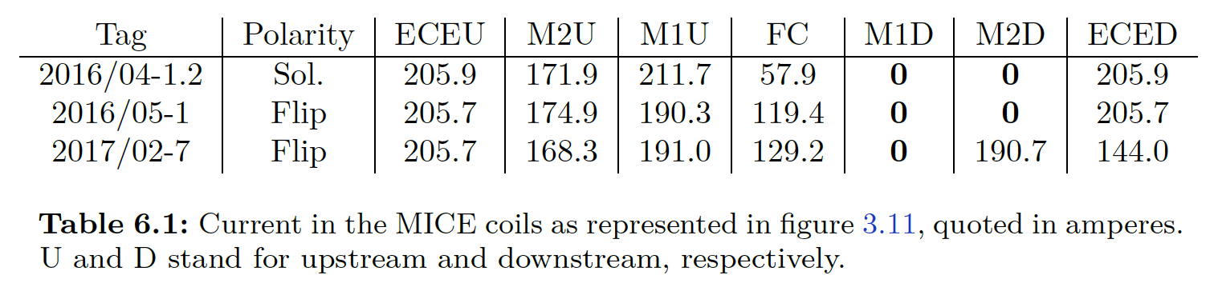
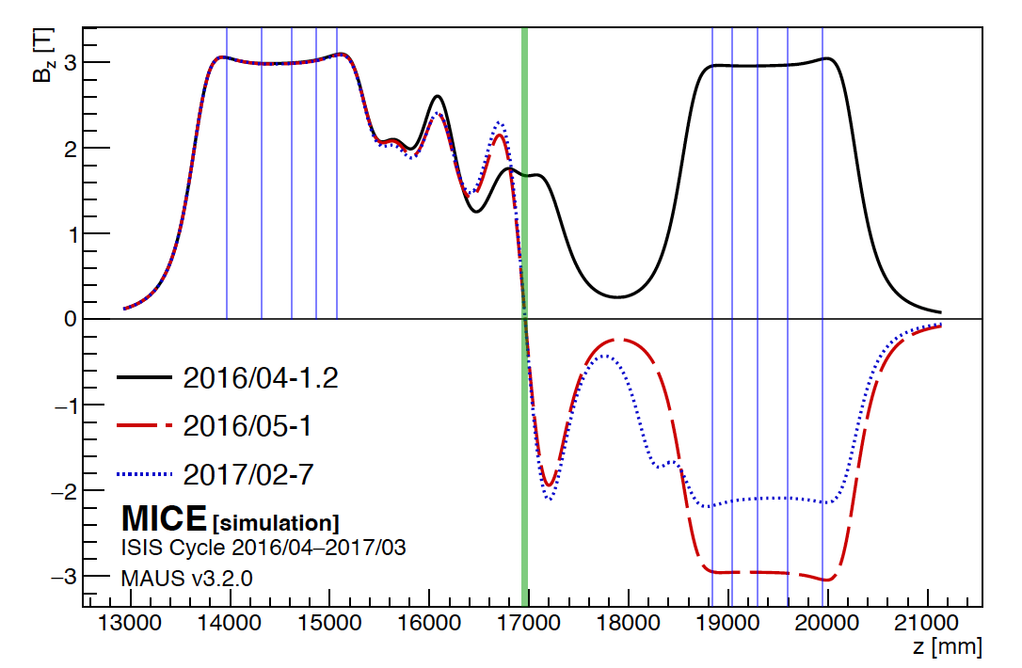
Three Magnetic Field Configurations in MICE
Absorber
The M1D magnet failed prior to the ionization cooling demo
To compensate, the team developed three alternative magnetic field configurations, listed in the table and plots
2016/04-1/2 (solenoid)
  All upstream and downstream magnets operated in the same polarity
2016/05-1 (flip)
  Downstream magnets operated with reversed polarity to enhance field symmetry
2017/02-7 (flip+M2D)
  Similar to the second, but with the M2D magnet re-activated to restore field strength downstream

Slide 17
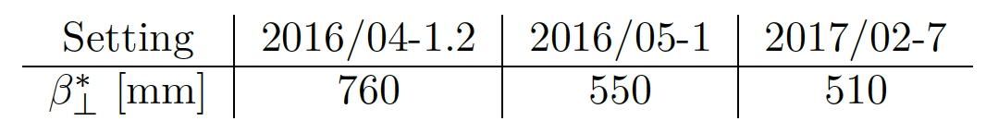
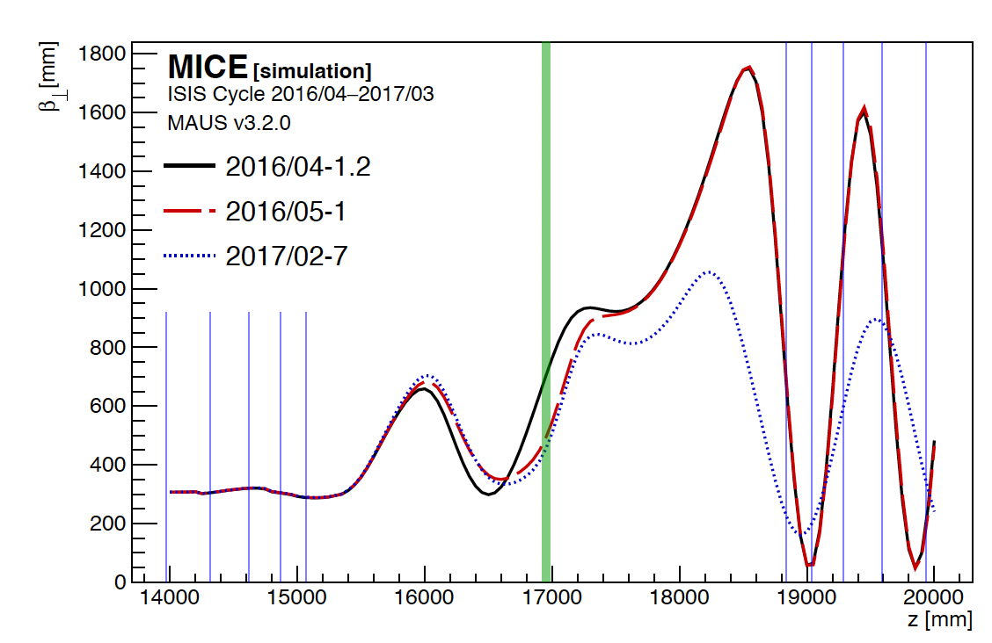
Beta functions
Absorber
Transverse beta function for each magnetic field setting
Absorber location is marked in green
The 2017/02-7 configuration (blue dotted line) shows the lowest beta function at the absorber
  Favorable for maximizing cooling efficiency

Slide 18
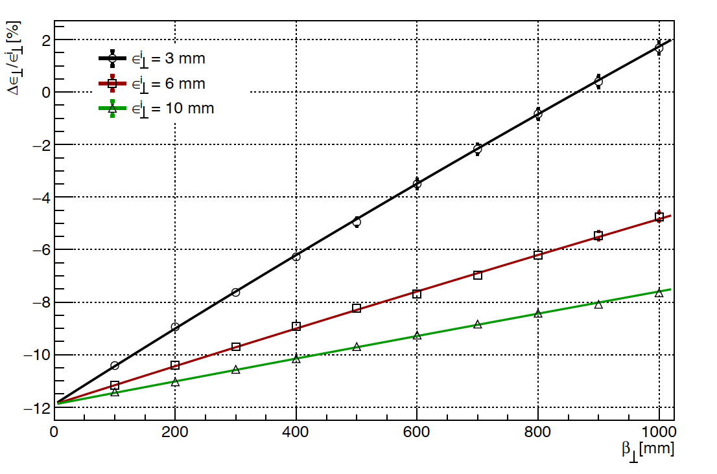
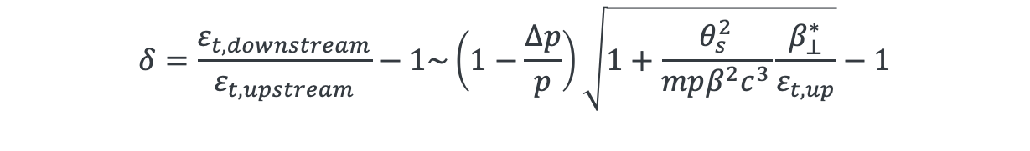
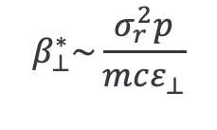
Expected emittance reduction and particle loss
NB: Beam is heated in a red circle
$$β_{⊥}^{∗}\sim \frac{σ_{r}^{2}p}{mcε_{⊥}}$$
$$δ=\frac{ε_{t,downstream}}{ε_{t,upstream}}−1\sim \left(1−\frac{∆p}{p}\right)\sqrt{1+\frac{θ_{s}^{2}}{mpβ^{2}c^{3}}\frac{β_{⊥}^{∗}}{ε_{t,up}}}−1$$

Slide 19
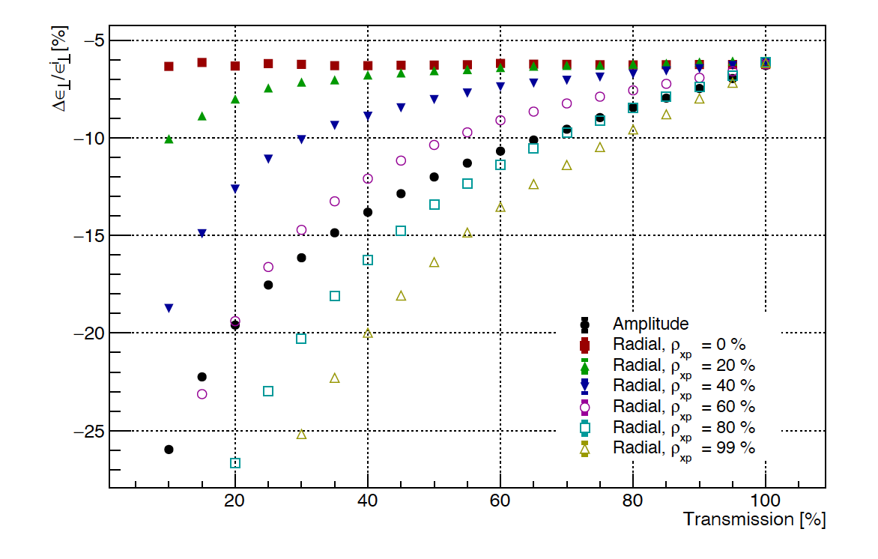
Expected Emittance Reduction and Particle Loss
NB: Plot shows relationship between transmission (%) and relative emittance change
Larger initial emittance→ lower transmission efficiency, due to beam scraping at the aperture
The MICE channel has a finite bore, often referred to as the dynamic aperture
As particles with large amplitudes are lost at the beamline boundaries, this can mimic emittance reduction, even if no cooling occurs
Caveat: A sophisticated particle selection algorithm has been developed
It aims to distinguish true ionization cooling from geometric losses
(Not covered here due to its complexity and ongoing validation…)

Slide 20
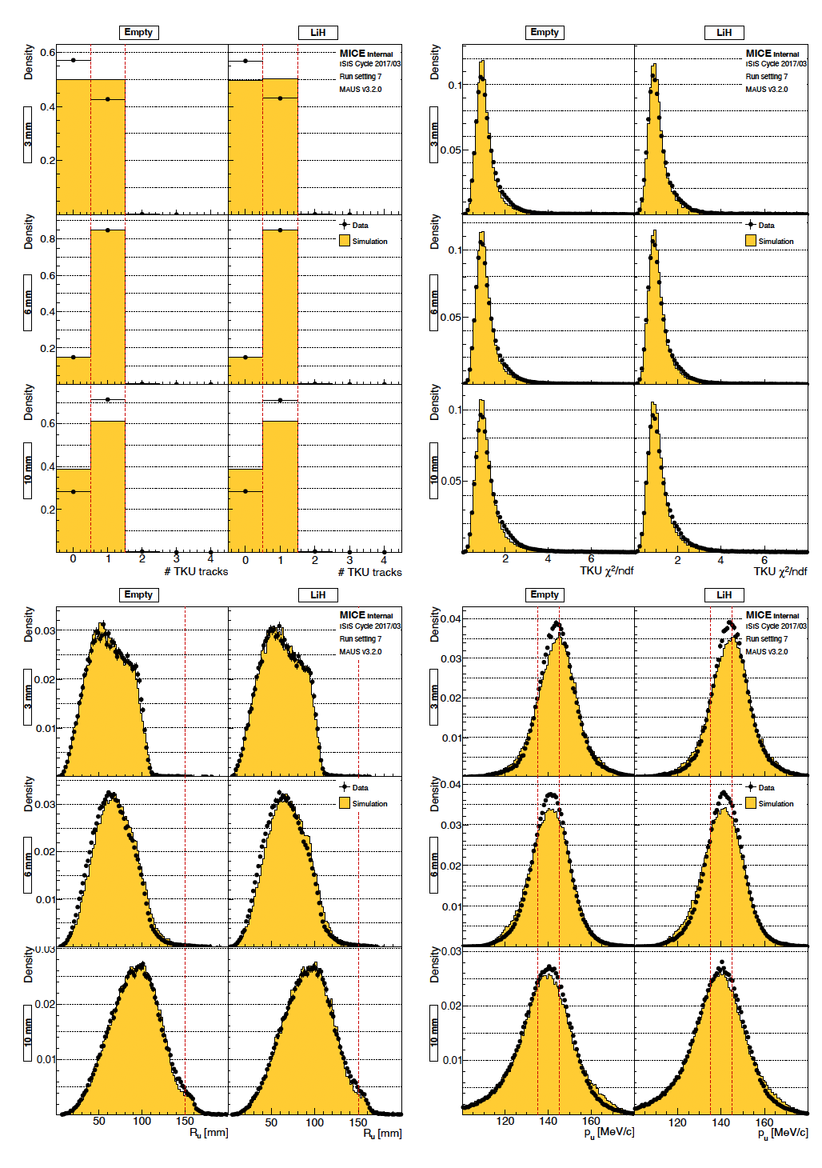
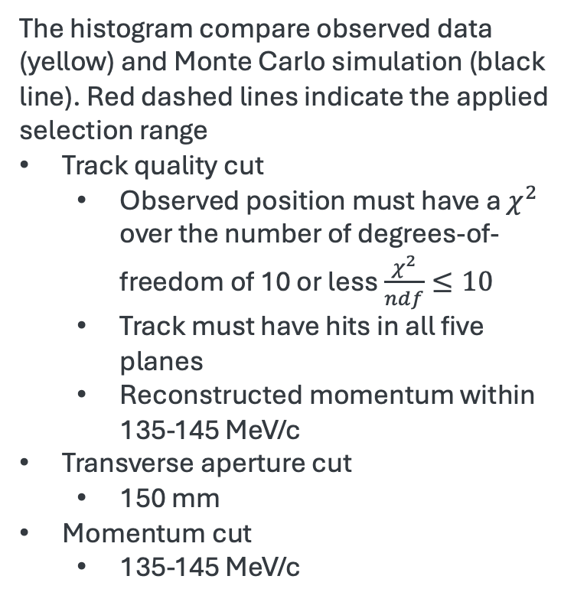
Observed Phase Space and MC Comparison for Run 2017/02-7
The histogram compare observed data (yellow) and Monte Carlo simulation (black line). Red dashed lines indicate the applied selection range
Track quality cut
  Observed position must have a $χ^{2}$ over the number of degrees-of-freedom of 10 or less $\frac{χ^{2}}{ndf}≤10$
  Track must have hits in all five planes
  Reconstructed momentum within 135-145 MeV/c
Transverse aperture cut
  150 mm
Momentum cut
  135-145 MeV/c

Slide 21
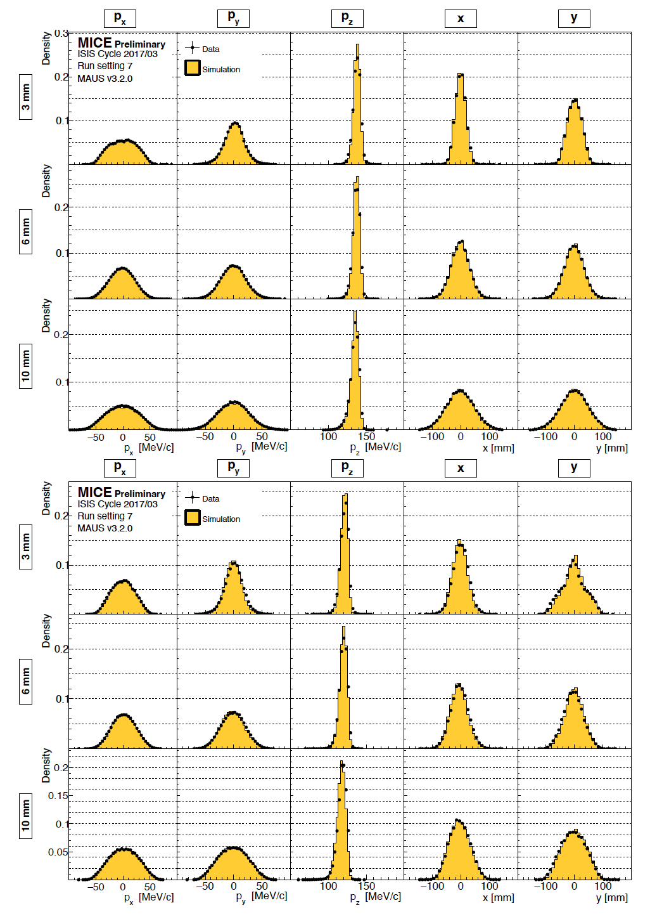
Phase Space Profiles and Transmission efficiency of 3, 6, 10 mm for 2017/02-7
The observed phase space vs Monte Carlo simulation
Both agree reasonably well

Slide 22
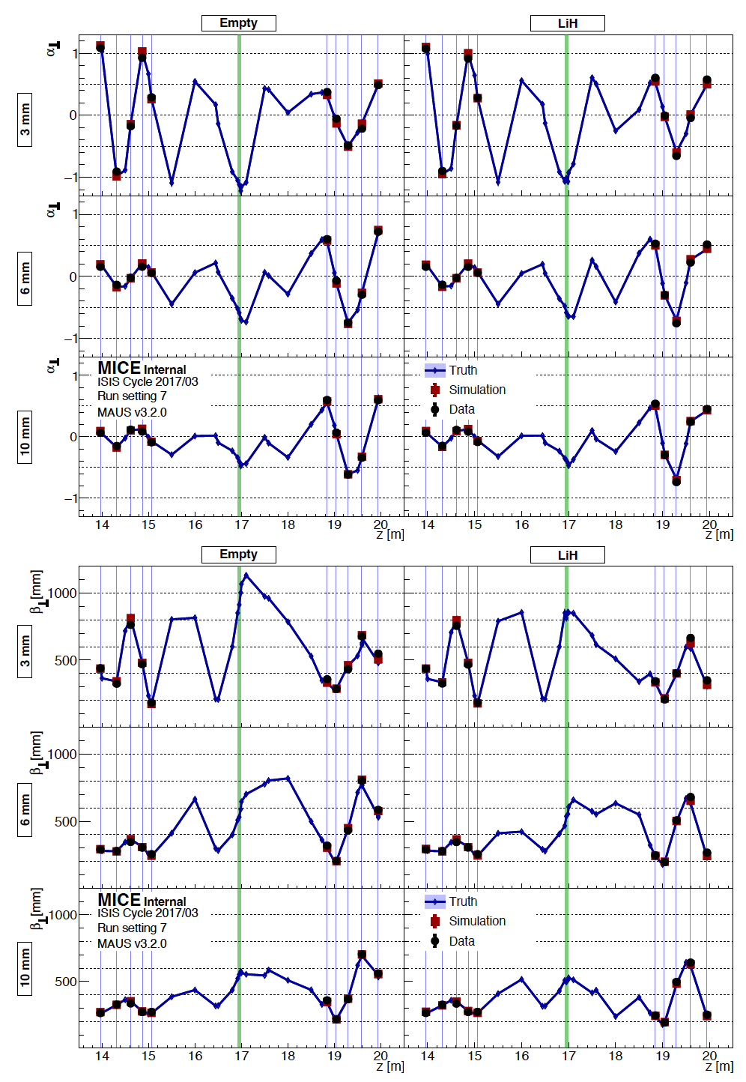
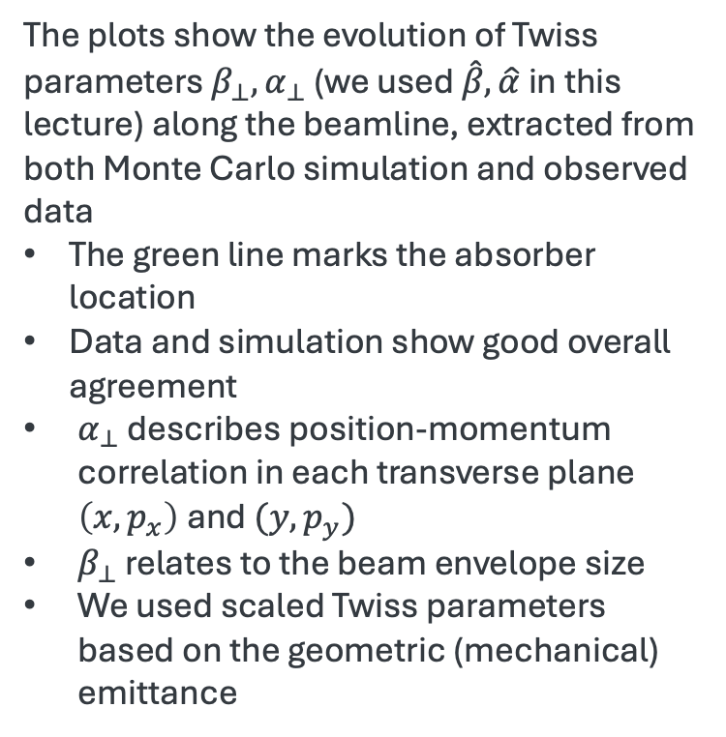
Phase space profiles and transmission efficiency of 3, 6, 10 mm for 2017/02-7
The plots show the evolution of Twiss parameters $β_{⊥}, α_{⊥}$ (we used $\hat{β}, \hat{α}$ in this lecture) along the beamline, extracted from both Monte Carlo simulation and observed data
The green line marks the absorber location
Data and simulation show good overall agreement
$α_{⊥}$ describes position-momentum correlation in each transverse plane $\left(x,p_{x}\right)$and $(y,p_{y})$
$β_{⊥}$ relates to the beam envelope size
We used scaled Twiss parameters based on the geometric (mechanical) emittance

Slide 23
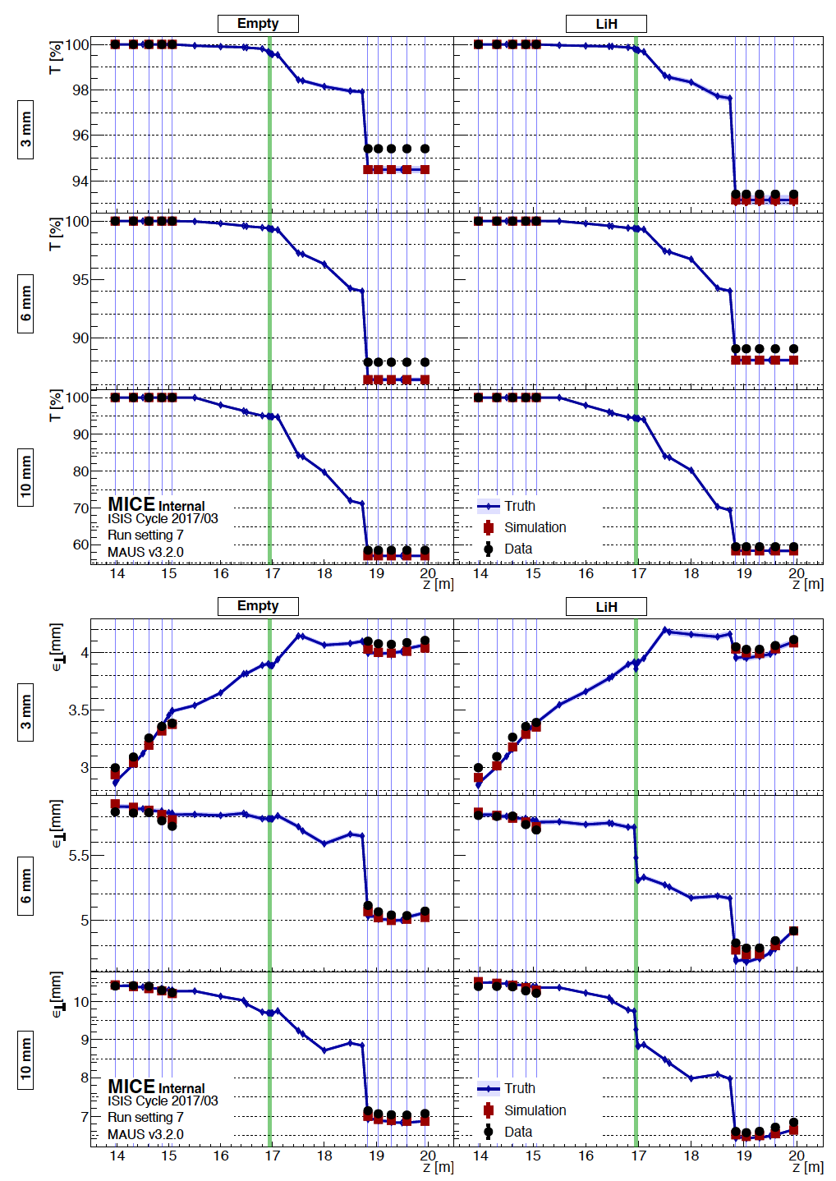
Phase space profiles and transmission efficiency of 3, 6, 10 mm for 2017/02-7
Observed behavior of RMS emittance
3-mm beam:
Exhibits strong nonlinear behavior
Apparent emittance increases, exceeding expected ionization cooling, due to nonlinear optics effect
10-mm beam:
Suffers significant particle loss, with transmission efficiency below 60 %
Apparent emittance decreases more than expected, dominated by scraping, not true cooling

Slide 24
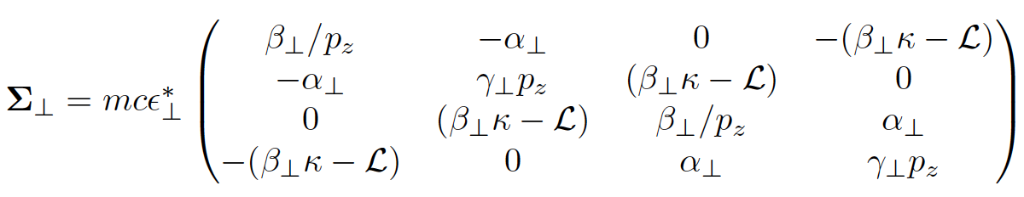






Event selection technique
Covariance matrix in solenoid B
Transverse amplitude
$$A_{⊥}=ε_{⊥}^{∗}{\left(x−\left\langle x\right\rangle \right)}^{T}Σ^{−1}\left(x−\left\langle x\right\rangle \right)\sim ε_{⊥}^{∗}∙χ_{4}^{2}$$
$$x=x,p_{x},y,p_{y}$$
$$\left\langle A_{⊥}\right\rangle =ε_{⊥}^{∗}\left\langle χ_{4}^{2}\right\rangle \sim 4ε_{⊥}^{∗}$$
If a new one event is added in the amplitude, each component varies
$${\left\langle x_{α}\right\rangle }_{n−1}=\frac{1}{n−1}\left(n{\left\langle x_{α}\right\rangle }_{n}−x_{α}^{n}\right)$$
$$α,β=x,p_{x},y,p_{y}$$
$$Σ_{αβ}^{n−1}=\frac{n−1}{n−2}Σ_{αβ}^{n}−\frac{n}{n−1}\left(x_{α}^{n}−{\left\langle x_{α}\right\rangle }_{n}\right)\left(x_{β}^{n}−{\left\langle x_{β}\right\rangle }_{n}\right)$$
They can find if the added event makes $A_{⊥}$ only true particle amplitude (sounds that they remove any particles which causes non-linear behavior or particle loss)

Slide 25




Event selection technique
If the beam transport line is linear,
$$\left[\begin{matrix}q→q \\ q^{′}→q^{′}−\frac{q}{f}\end{matrix}\right.$$
Transverse amplitude does not need correction
If the beam transport line is non-linear,
$$\left[\begin{matrix}q→q \\ q^{′}→q^{′}−\frac{q}{f}\left(1+C_{α}q^{2}\right)\end{matrix}\right.$$
Corrections applied to reconstruct true amplitude

Slide 26


Poincare Sections
These plots demonstrate the six Poincare sections of transverse emittance
The amplitude correction is applied on the right plots
Color code shows the degree of amplitude

Slide 27


Additional correction
To reconstruct the observed particle position and momentum, they simulate the particle tracking and apply the exact value to calibrate the detector resolution
This technique is standard for the neutrino oscillation experiment

Slide 28

Amplitude change in absorber
Upper plots show the amplitude distribution before and after absorber
10-mm beam shows increased density at low amplitude, indicate beam cooling
Density at high amplitude decreases, consistent with beam scraping or cooling
Cumulative Density Function (CDF) ratio
For the 3-mm beam, the CDF ratio approaches 1 at high amplitude, consistent with no net cooling or heating
A CDF>1 indicates in increase in phase space density
6-mm and 10-mm beams show increased CDF at low amplitudes, while CDF decreases at high amplitudes
→ This behavior is consistent with ionization cooling

Slide 29


Using particle selection: 9%-subemittance and 9%-emittance evolutions
KNN-based selection isolates the core beam population (9%) by excluding outliers and scraped particles. These metrics provide a more accurate estimate of beam cooling effect

Slide 30
My Reflections on MICE
MICE has successfully demonstrated ionization cooling
  Systematic studies and analysis were carefully performed
  Ionization cooling is effective for large initial phase space volumes → Consistent with simulation results
  The analysis appears model-dependent, similar as neutrino oscillation experiments
MICE does not yet represent a full cooling channel
  Matching magnet was lost → Phase space evolution must be assessed under mismatch conditions
  No RF cavity → No energy compensation for muon momentum loss
  Limited channel acceptance → Significant particle loss observed
Intensity effects remain unknown in MICE
  Space charge effects during ionization cooling not explored
  Emittance exchange between transverse and longitudinal planes needs further study
  RF behavior within magnetic fields is still untested
Stochastic process in cooling is unknown

Slide 31

Multiple Scattering Test at MICE
MICE has tested multiple scattering, one of the most significant stochastic processes in ionization cooling
  The Geant4 scattering model has been significantly improved by incorporating experimental data from the MUSCAT experiment
  However, discrepancies remain between simulation and data (see red ellipses on the plot)
Further investigation is needed for additional stochastic effects, including:
  Energy straggling
  Collective effect
MC is underestimated
MC is overestimated

Slide 32




Energy Straggling
Simulated energy spread of 200 MeV/c muons after 10 mm thick LH2 (arb. unit)
→ Shows asymmetric broadening due to energy straggling
Energy straggling refers to the asymmetric spread in energy loss due to the stochastic nature of ionization energy loss in matter
This phenomenon is typically described by the Vavilov distribution:
$$p\left(λ_{L};κ,β^{2}\right)=\frac{1}{2πi}\int_{C−i∞}^{C+i∞}{φ\left(s\right)e^{λ_{L}∙s}ds}$$
For $κ<0.01$, the Vavilov distribution approaches the Landau distribution, while $κ>10$, the distribution approaches a normal distribution
Simulated delta-ray electron (T > 1 keV) from muons traversing 10 mm LH2 (Hor. Unit: keV)
→ Delta rays contribute to the tail in energy loss
$φ\left(s\right)=e^{C}e^{ψ\left(s\right)}$ with $C=κ\left(1+β^{2}γ\right)$
and $ψ\left(s\right)=sln κ+\left(s+β^{2}κ\right)∙\left(\int_{0}^{1}{\frac{1−e^{−\frac{st}{κ}}}{t}}dt−γ\right)−κe^{−\frac{s}{κ}}$
Landau’s parameter $λ_{L}=\frac{λ_{V}}{κ}−\ln{κ}$
$$κ=\frac{ξ}{ℇ_{max}} \begin{matrix}ξ=\frac{ρKZ}{2Aβ^{2}}δx \\ { ℇ}_{max}:Maximum energy loss\end{matrix}$$

Slide 33


Current IMCC Demo Channel Design
Conceptual design

Slide 34

IMCC Demonstrator

Slide 35

IMCC Demonstrator

Slide 36

IMCC Demonstrator

Slide 37

MCC Demonstrator

Slide 38

Discussing a US Demonstrator
Objective: Identify the most critical system to develop for a future muon collider
Potential locations
  800 MeV PIP-II
  8 GeV Booster/potential PIP-III upgrade
  Construct new beam line optimized for muon production or cooling
Cost vs Physics return
  Budget range: > $100M
  Physics impact based on:
    R&D testbed (basic proof-of-principle)
    Prototype demonstrator
    Discovery machine (early physics)
  Synergies with existing or planned experiments
Single particle vs Beam measurement
  Capability of measuring collective effect
  Evaluate systematic uncertainty

