Slide 1
Availability, Efficiency and Integrated Luminosity: Rising to the challenge in the FCC-ee
Jack Heron, Hannah Dostmann, Lukas Felsberger, Daniel Wollmann, Jan Uythoven
5th May 2025

Slide 2
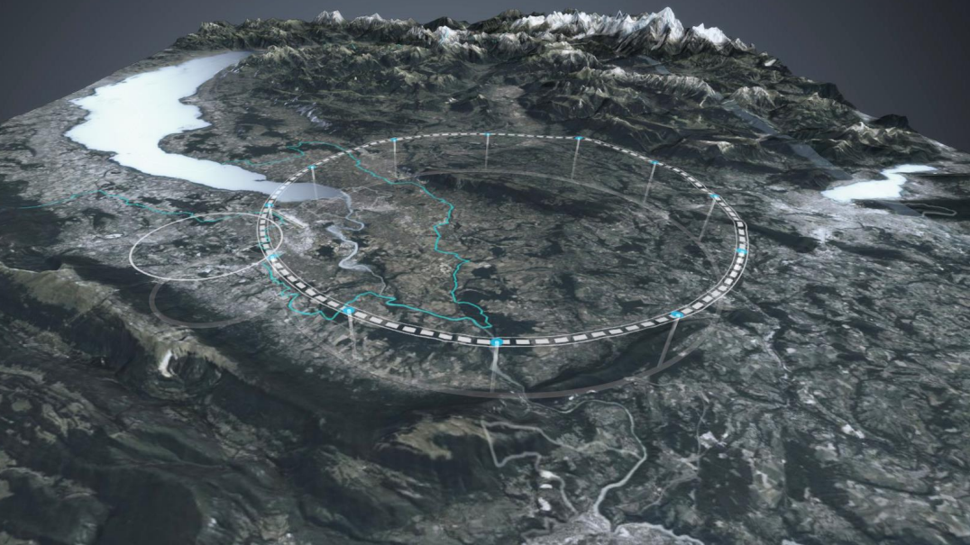
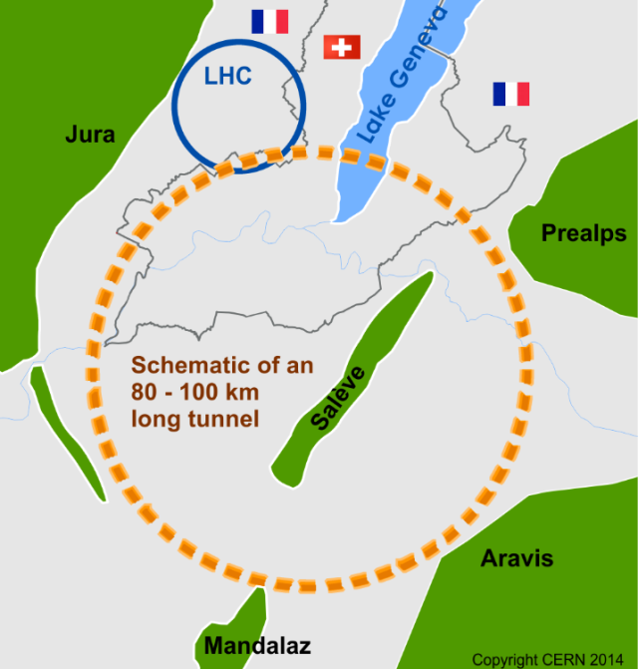
Future Circular Collider (FCC)
91km
Large Hadron Collider (LHC)
27km

Slide 3
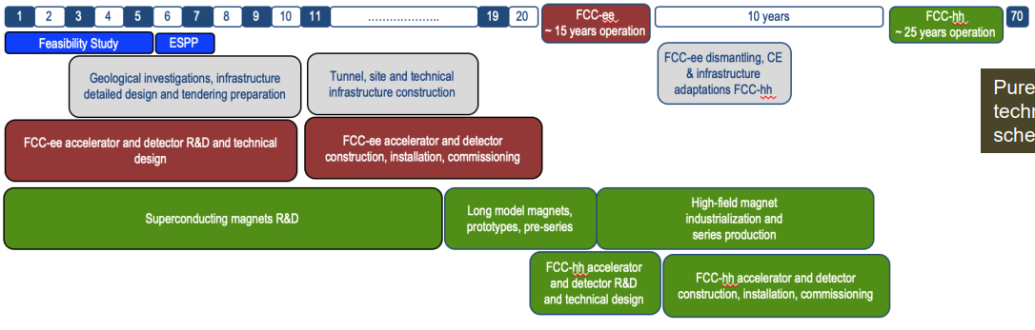
FCC Timeline
Now
2030
2044
2060
2070
2095+
…………………….
FCC-ee
91-365 GeV
FCC-hh
100 TeV

Slide 4

FCC-ee (electron-positrons)
W
Z
Operation Years
1
2
3
4
5
6
7
8
9
10
11
12
13
14
15
Energy
Integrated Luminosity
45.6 GeV
150 ab-1
80 GeV
10 ab-1
120 GeV
5 ab-1
182.5 GeV
1.7 ab-1

Slide 5

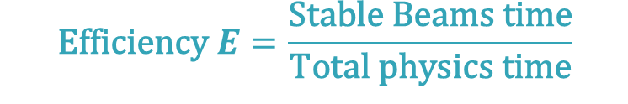
Availability and Luminosity
$$\text{Efficiency} E=\frac{\text{Stable} \text{Beams} \text{time}}{\text{Total} \text{physics} \text{time}}$$
FCC-ee:
365 days
−120 (extended shutdowns)
− 30 (annual commissioning)
− 20 (machine development)
− 10 (technical stops)
185 days for physics
$$\text{Availability} A=\frac{\text{Up} \text{time}}{\text{Total} \text{physics} \text{time}}$$
Operation
Stable Beams
Down Time

Slide 6
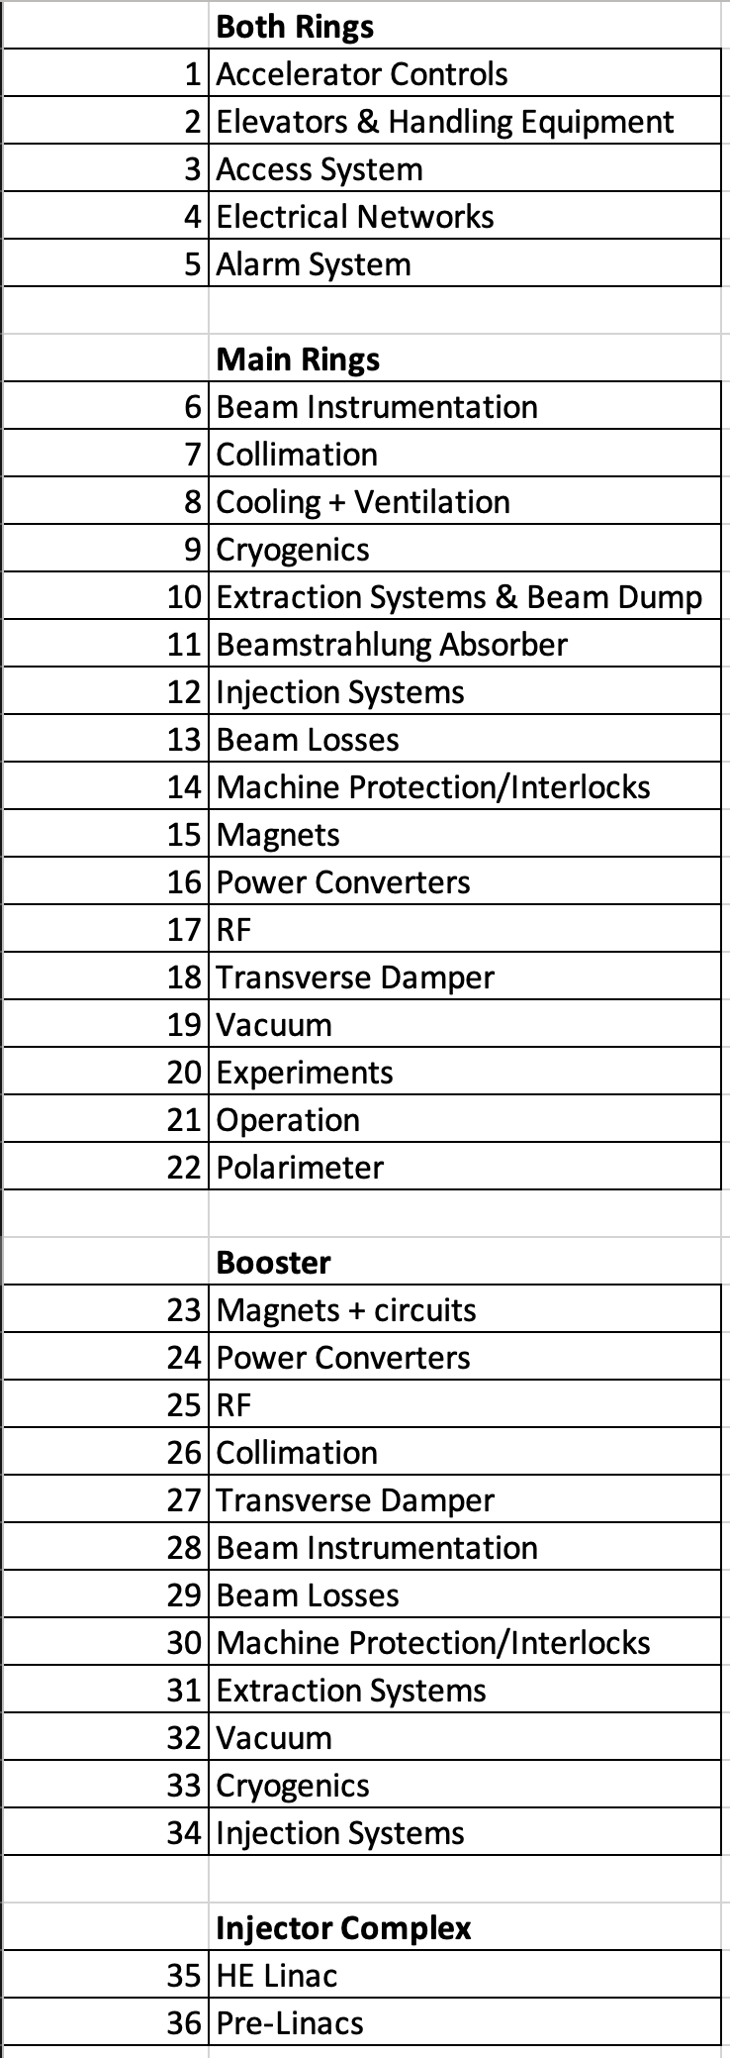


Breakdown into Systems and Subsystems
1) Systems
Failure Rate
FCC-ee
Availability
Integrated Luminosity
Repair Duration

Slide 7
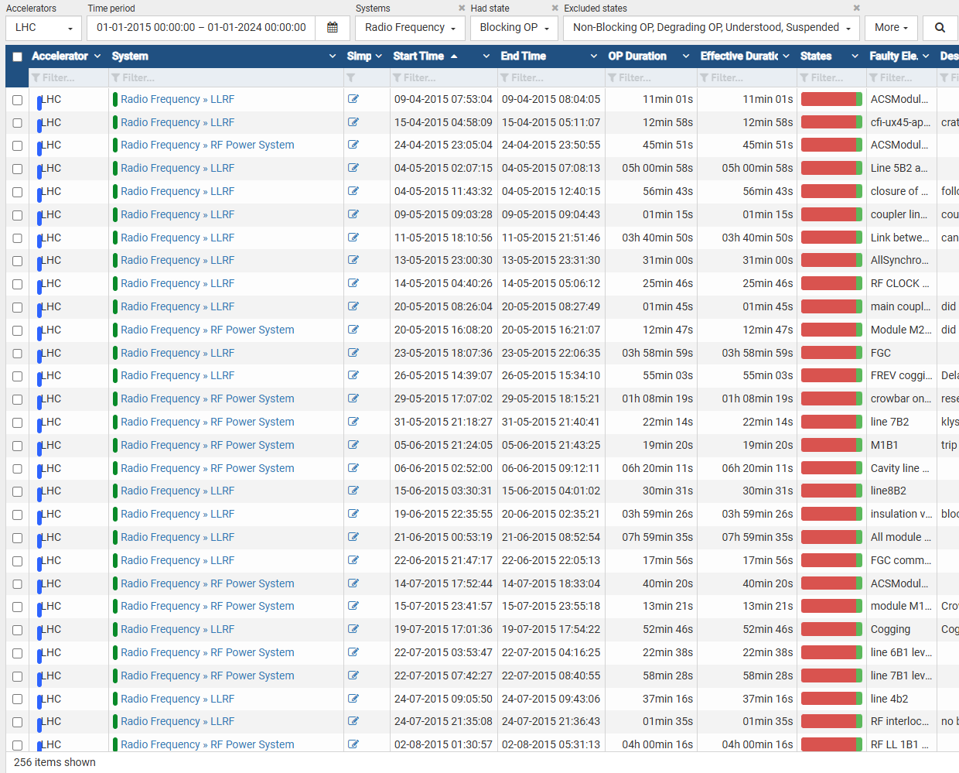
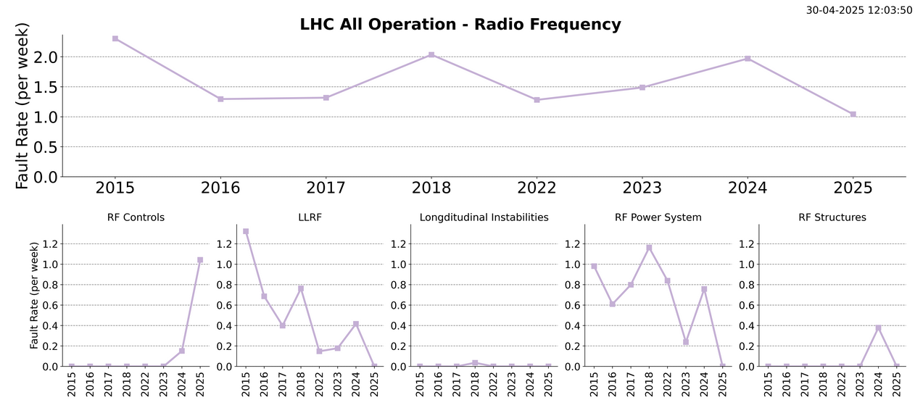
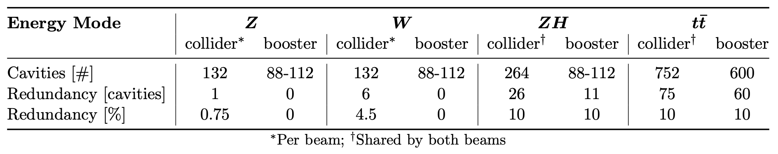
RF System
aft.cern.ch
aft-stats.web.cern.ch
Using AFT fault data 2015-2024
LHC:
  16 SRF cavities
FCCee:
Acknowledgement: Olivier Brunner, Andy Butterworth, Franck Peauger, Ivan Karpov

Slide 8
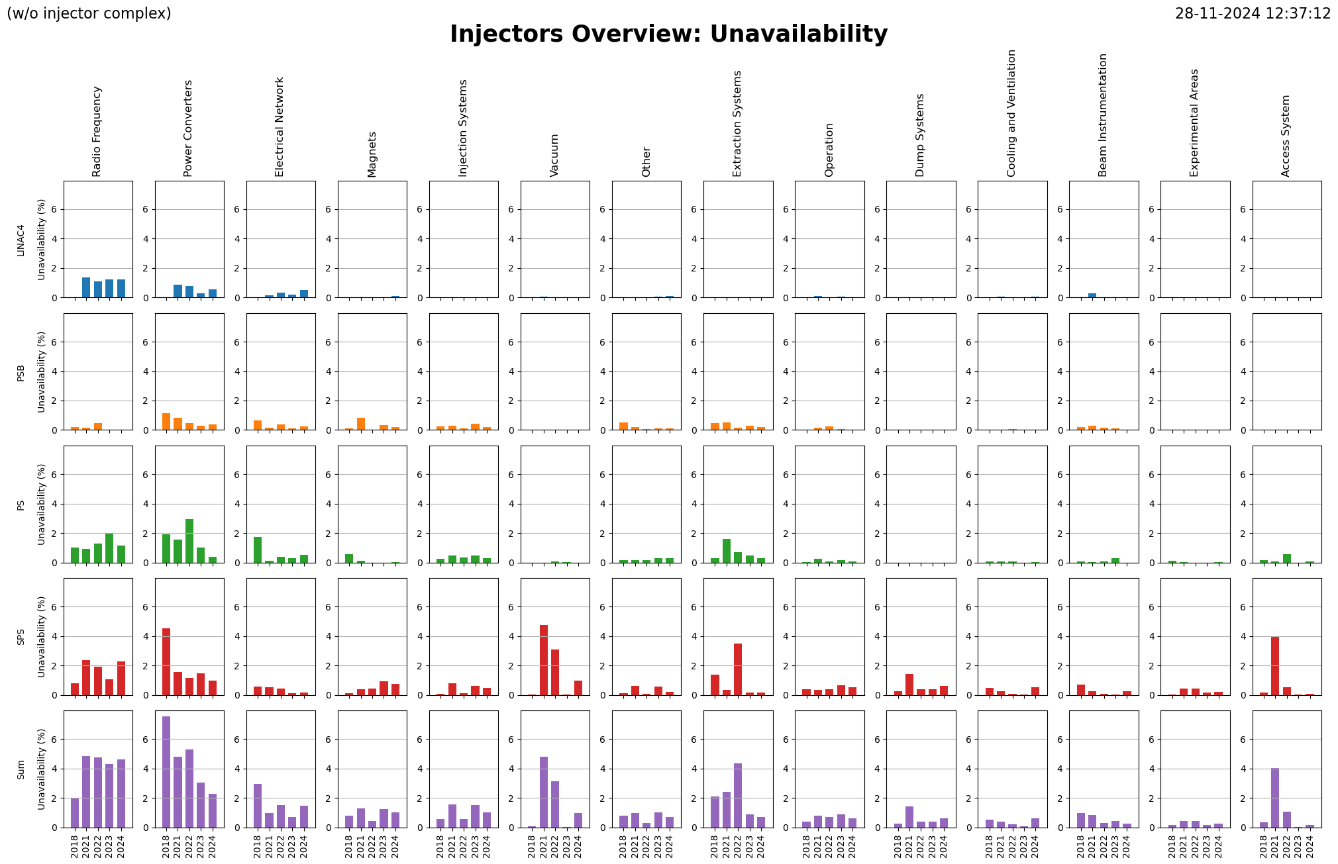
AFT data for all systems across CERN complex

Slide 9
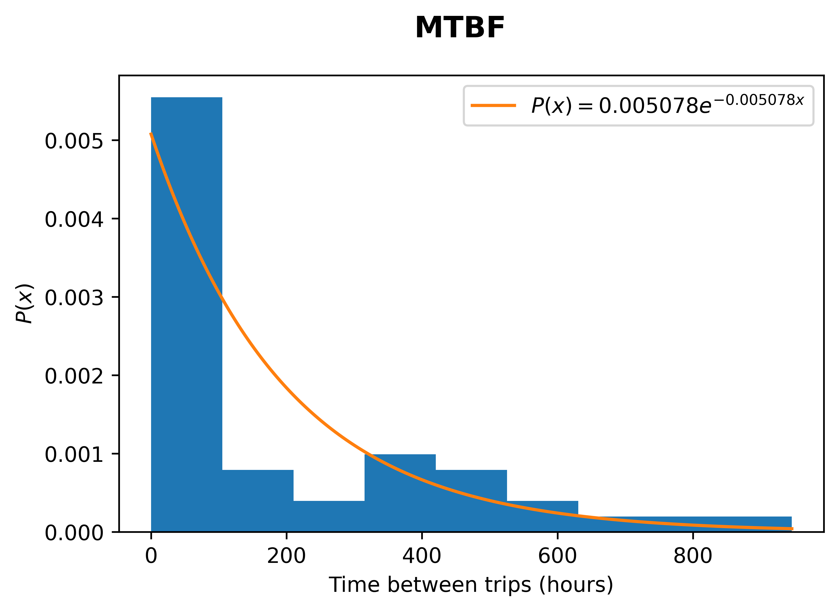
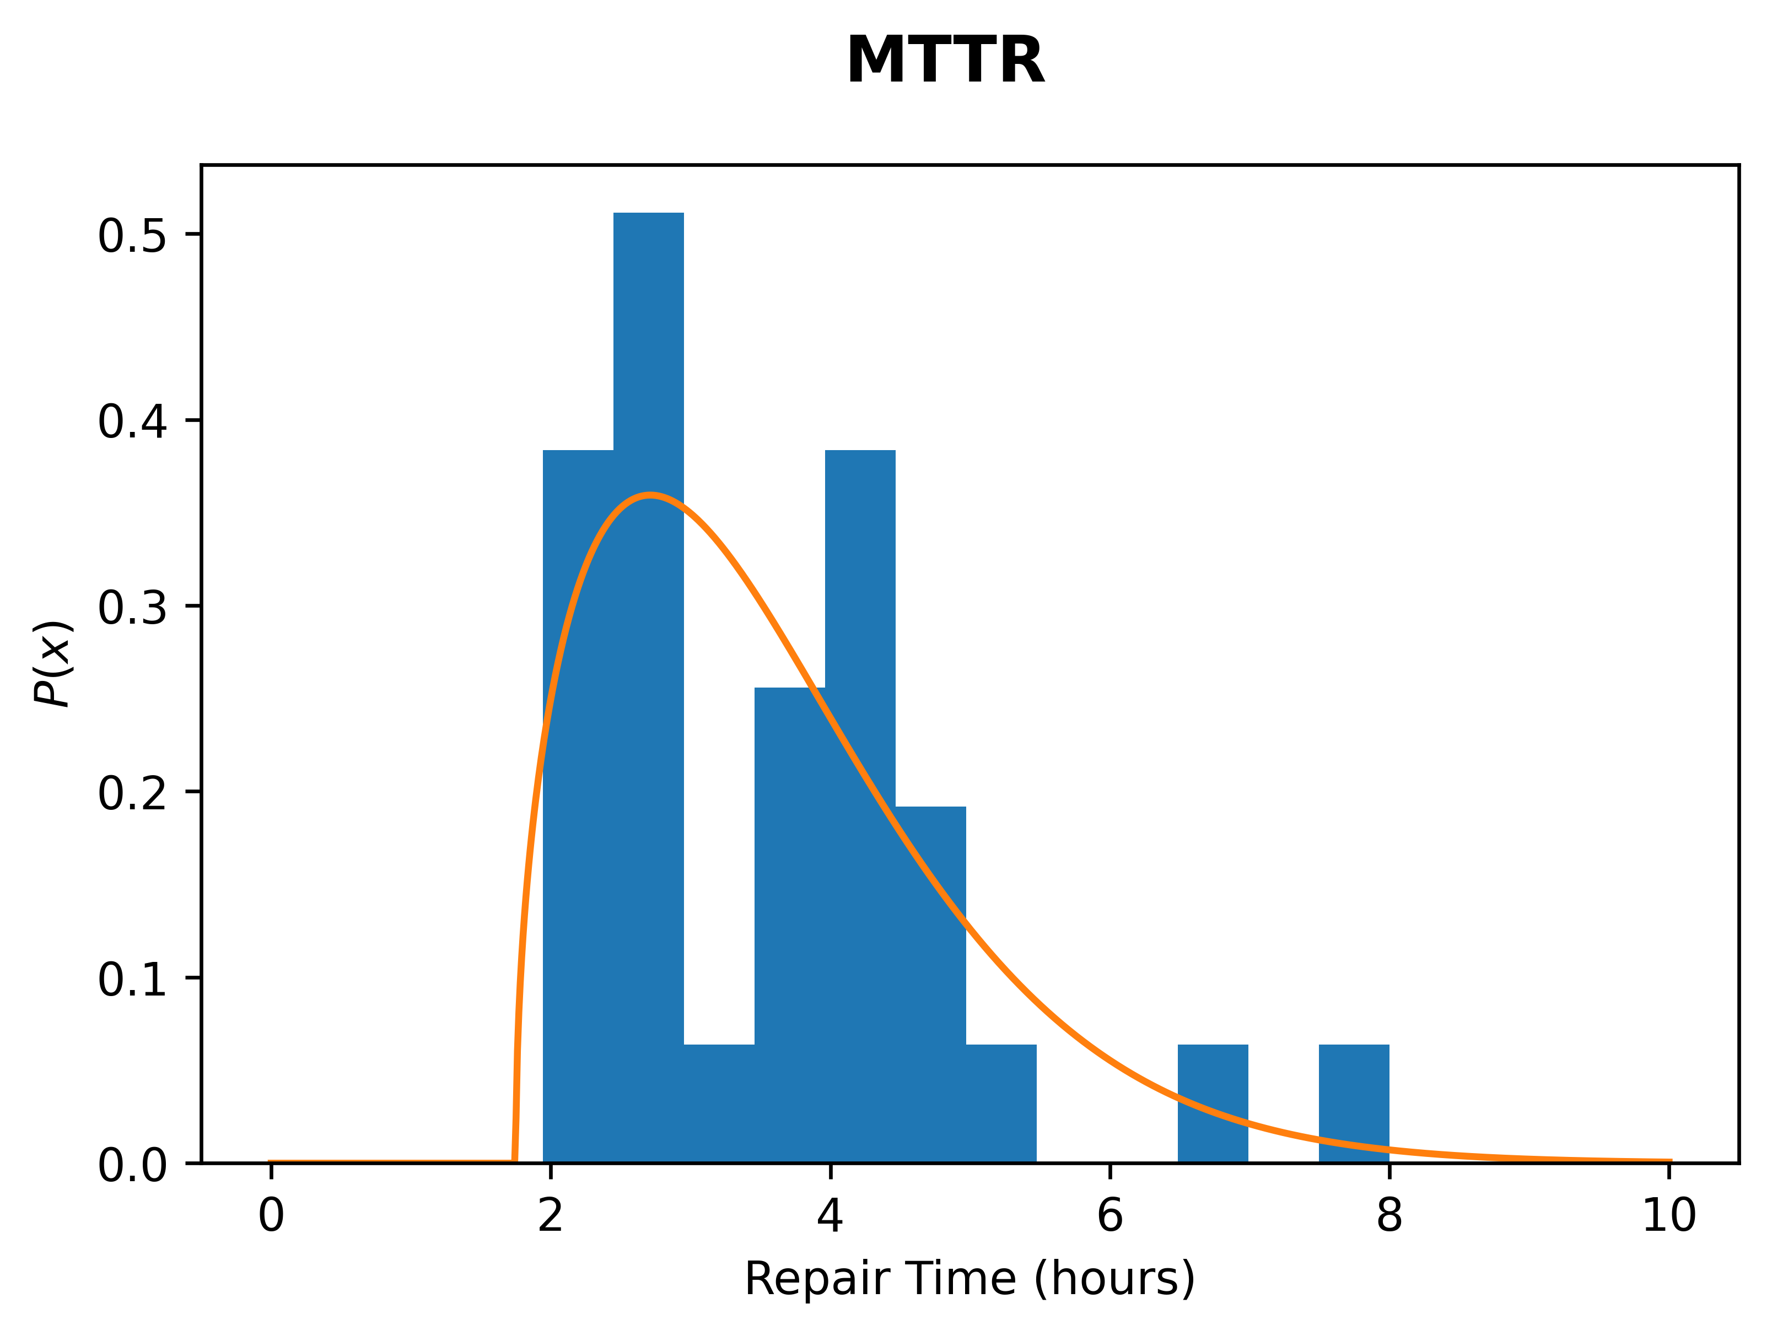
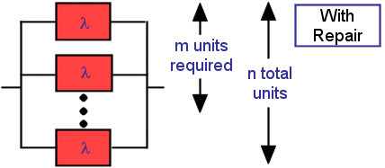
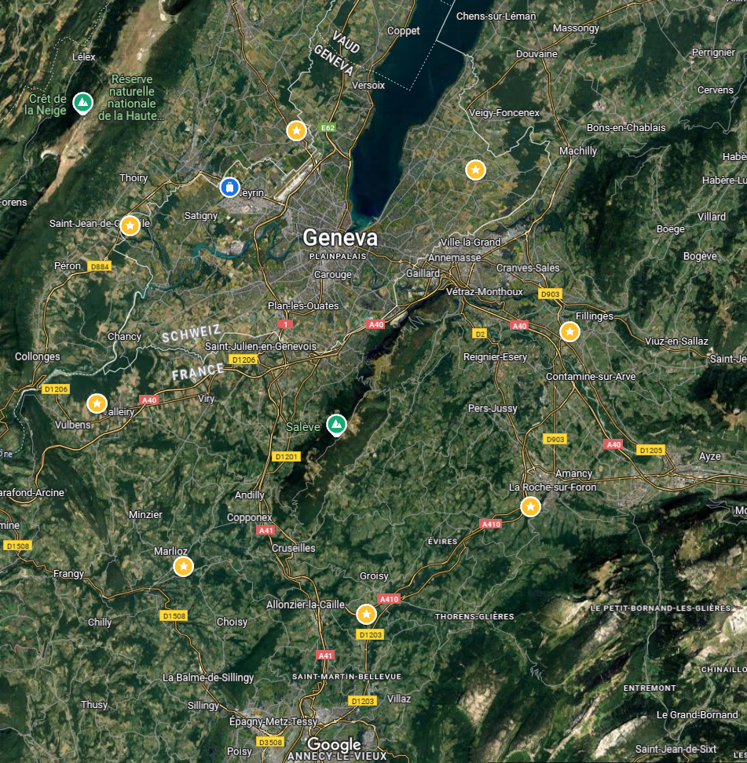
For each System
Mean time between failures (MTBF)
Mean time to repair (MTTR)
Failure data of a similar representative system:
  Fault rate (MTBF)
  Repair time (MTTR)
Scaling factor
  Elaborated w/ equipment experts based on number of critical units, complexity, etc.
Redundancy:
  “Can continue without 1 in 10 of these components”
Location:
  Drive time from CERN to relevant AP
  Cool down time at the relevant AP
https://reliabilityanalyticstoolkit.appspot.com/active_redundancy_with_repair

Slide 10
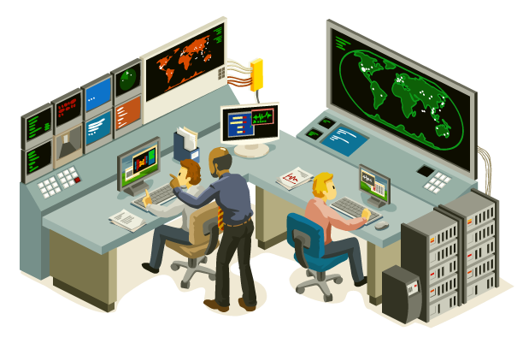

Two fault types:
Using (for example) AFT fault data 2015-2024
Remote Repair Faults
Human Repair Faults
  Requires human intervention
  Approach time 0.3-1.5 h
  Cool down time 0.7-24 h
  Repair achieved from the control room
  E.g. by resetting components
https://www.istockphoto.com/vector/isometric-control-center-gm164401684-15526568
https://www.flaticon.com/free-icon/technician_6342684

Slide 11
Breakdown into Systems and Subsystems
Failure Rate
FCC-ee
Availability
Integrated Luminosity
Repair Duration
2) Accelerator Performance

Slide 12

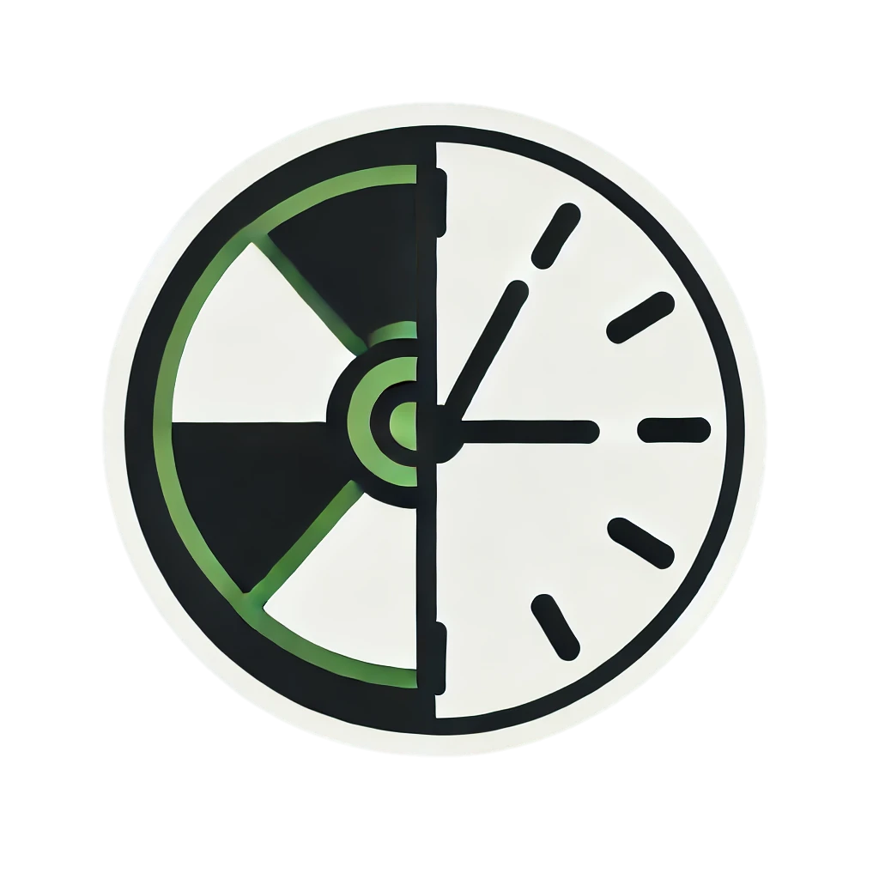
“Realistic” Repair Timeline:
Operation resumes if possible before humans are in the tunnel
Once human repairs start, they will finish.
Operation
resumes here
Fault
1 h
Diagnosis + attempts to reset from control room
We can’t fix it from here. Get someone out there!
Remote repairs
20 min – 1.5 h
Repair
Human repairs
Approach time
Humans in tunnel
Cool-Down time
45 min - 24 h

Slide 13


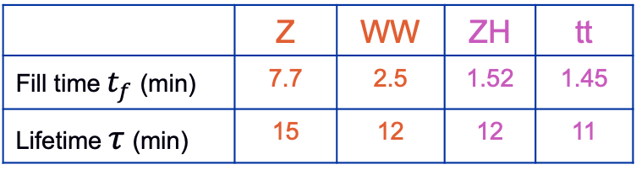

FCC-ee Operation Cycle
  $ZH$,$t\overline{t}$
Resonant depolarization is impossible
  Z,WW
Dump
Pilot bunch injection
Set Up
Physics
Polarisation
Fill
Adjust
Burn Off
10 min
10 min
1.5 h
$$t_{f}$$
10 min
20 h
$$τ$$
Down for Repair
Default
 | Z | WW | ZH | tt
Fill time $t_{f}$ (min) | 7.7 | 2.5 | 1.52 | 1.45
Lifetime $τ$ (min) | 15 | 12 | 12 | 11
Repair completed
Stable Beams
Operation
Collider failure
Injector Complex failure
Down
Time

Slide 14
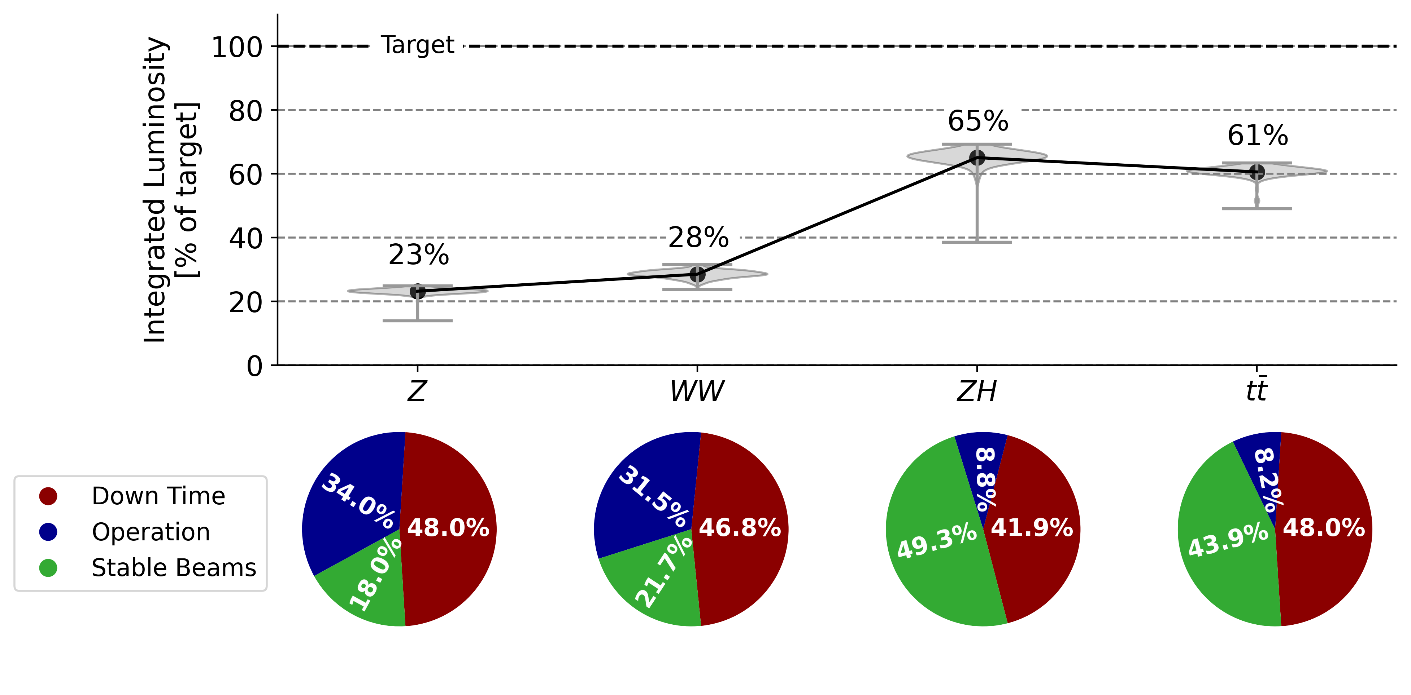
Overall Performance
Delivered integrated luminosity is low in all energy modes
Due to low availability and low efficiency
Particularly bad in Z and W modes due to long turnaround
 | Z | WW | ZH | tt
Integrated luminosity target [ab-1] | 150 | 10 | 5 | 1.5

Slide 15
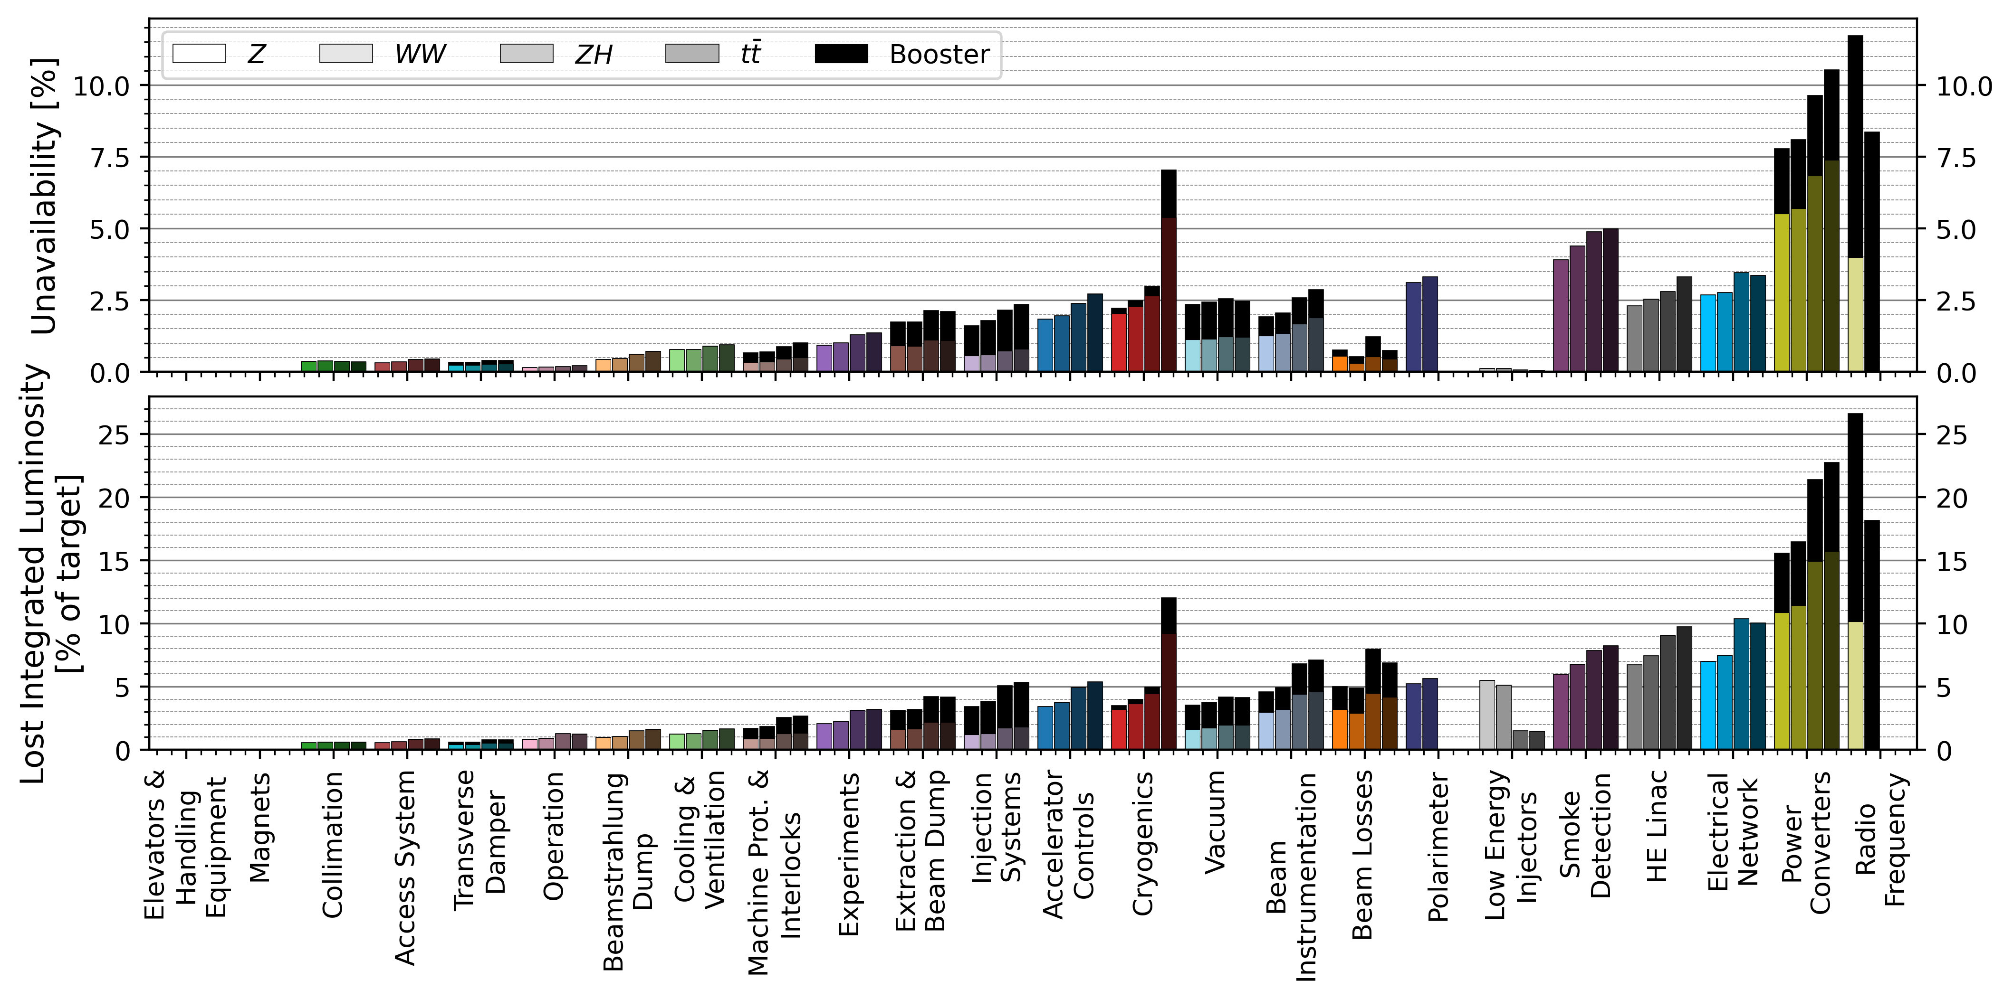
Unavailability & Lost Luminosity
Technical Infrastructure
Injector Complex

Slide 16
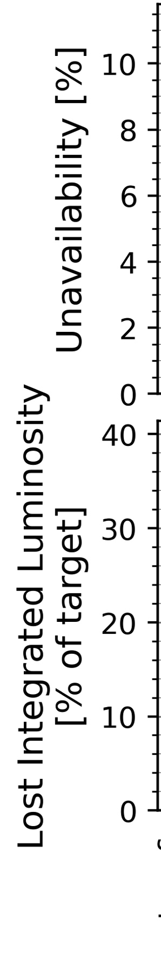
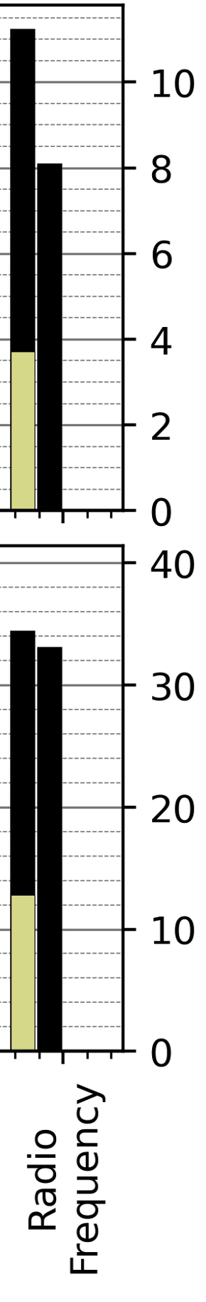
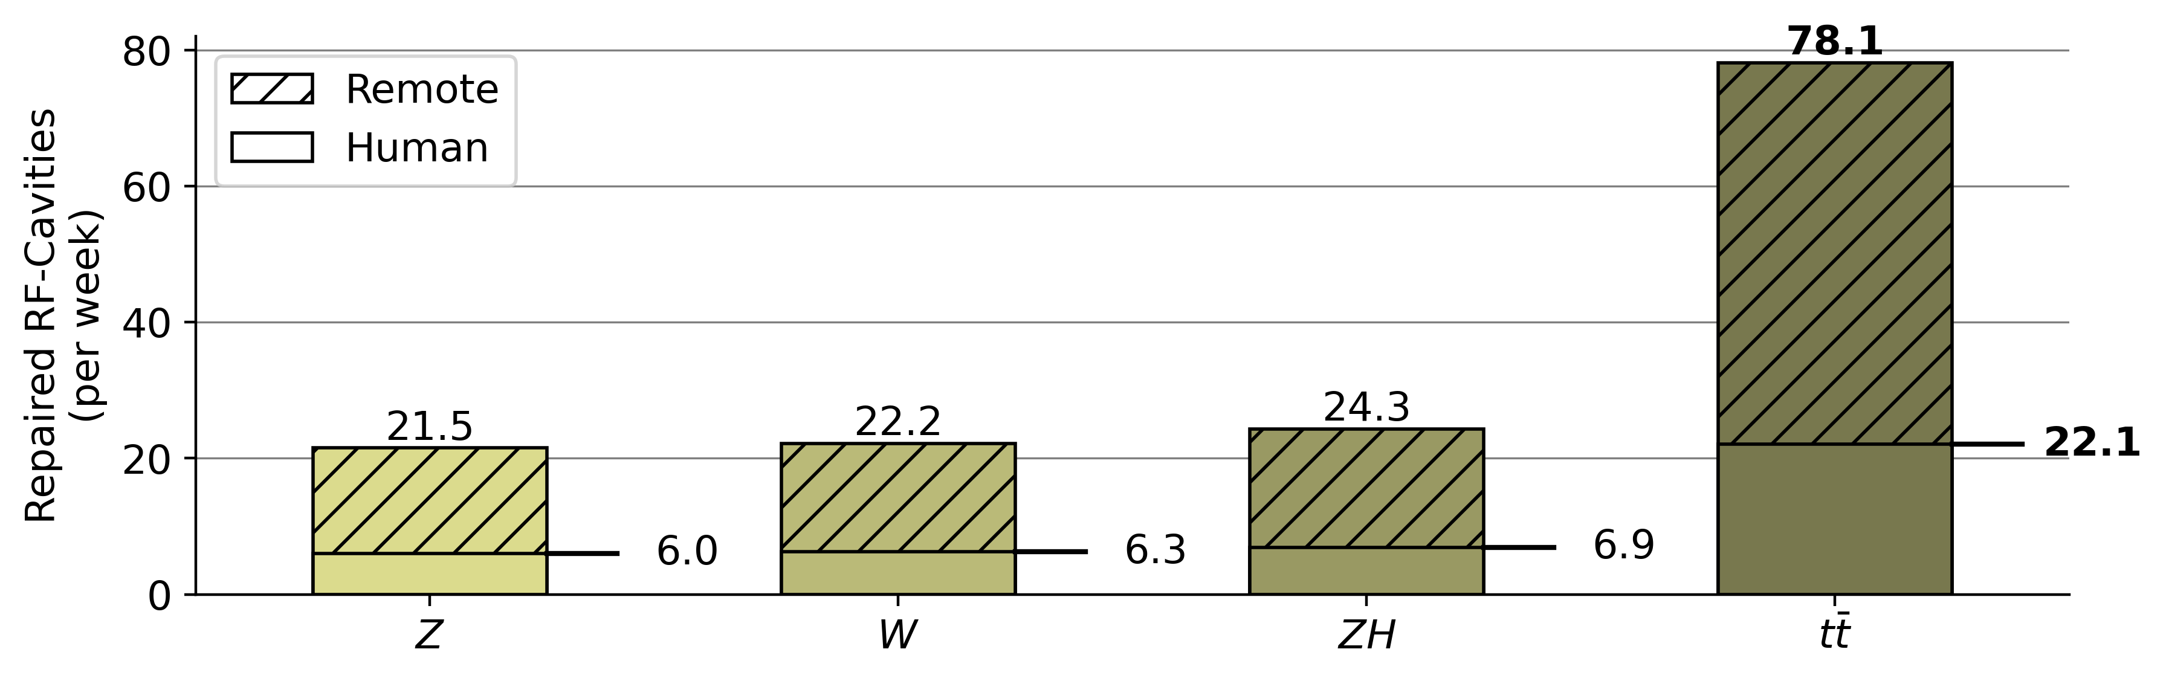
RF System
Redundancy
Collider
Booster
Z
W
H
tt
Redundancy eliminates down time completely
Operational Cost Factors:
High failure rate of cavities, esp. in tt (1352 cavities)
Requires a hard-working maintenance service
Z
W
Failed RF cavities each week
H
tt
Repairs needing human tunnel access

Slide 17
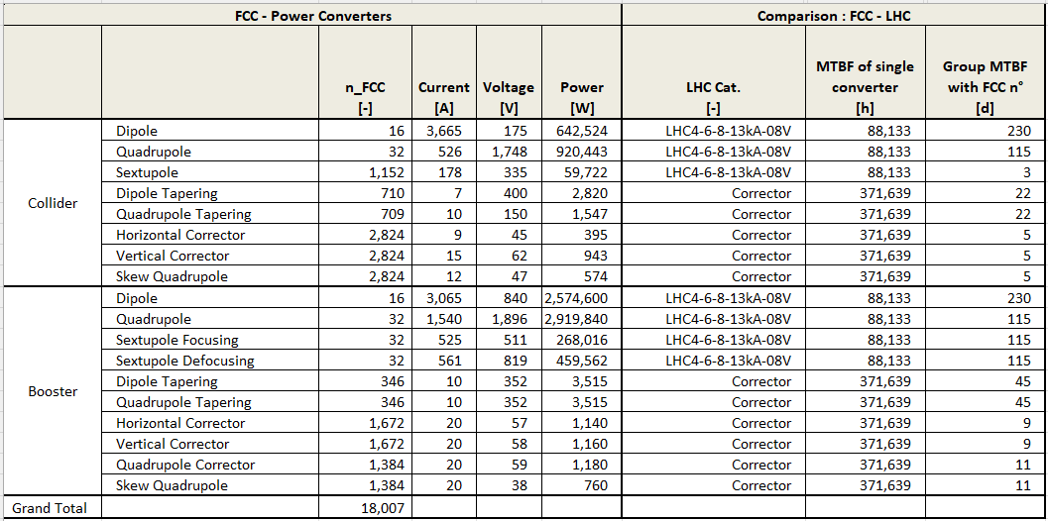
Power Converters
Collider
Booster
H
tt
Z
W
Assumes the same degree of redundancy as exists currently in LHC
tt
W
H
Z
Current optics configuration:
  Sextupoles powered in groups of four
  Correctors powered individually
How many power converters can we lose without dumping the beam?
  Needs a detailed study from optics and machine protection

Slide 18
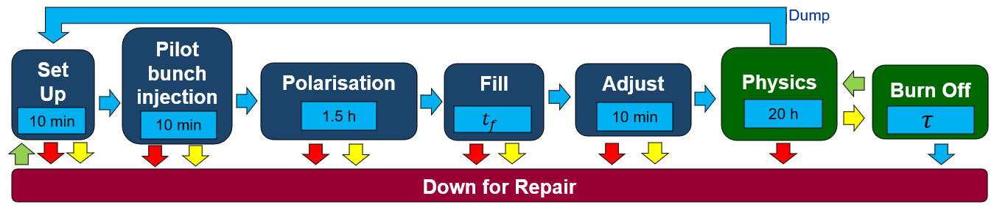
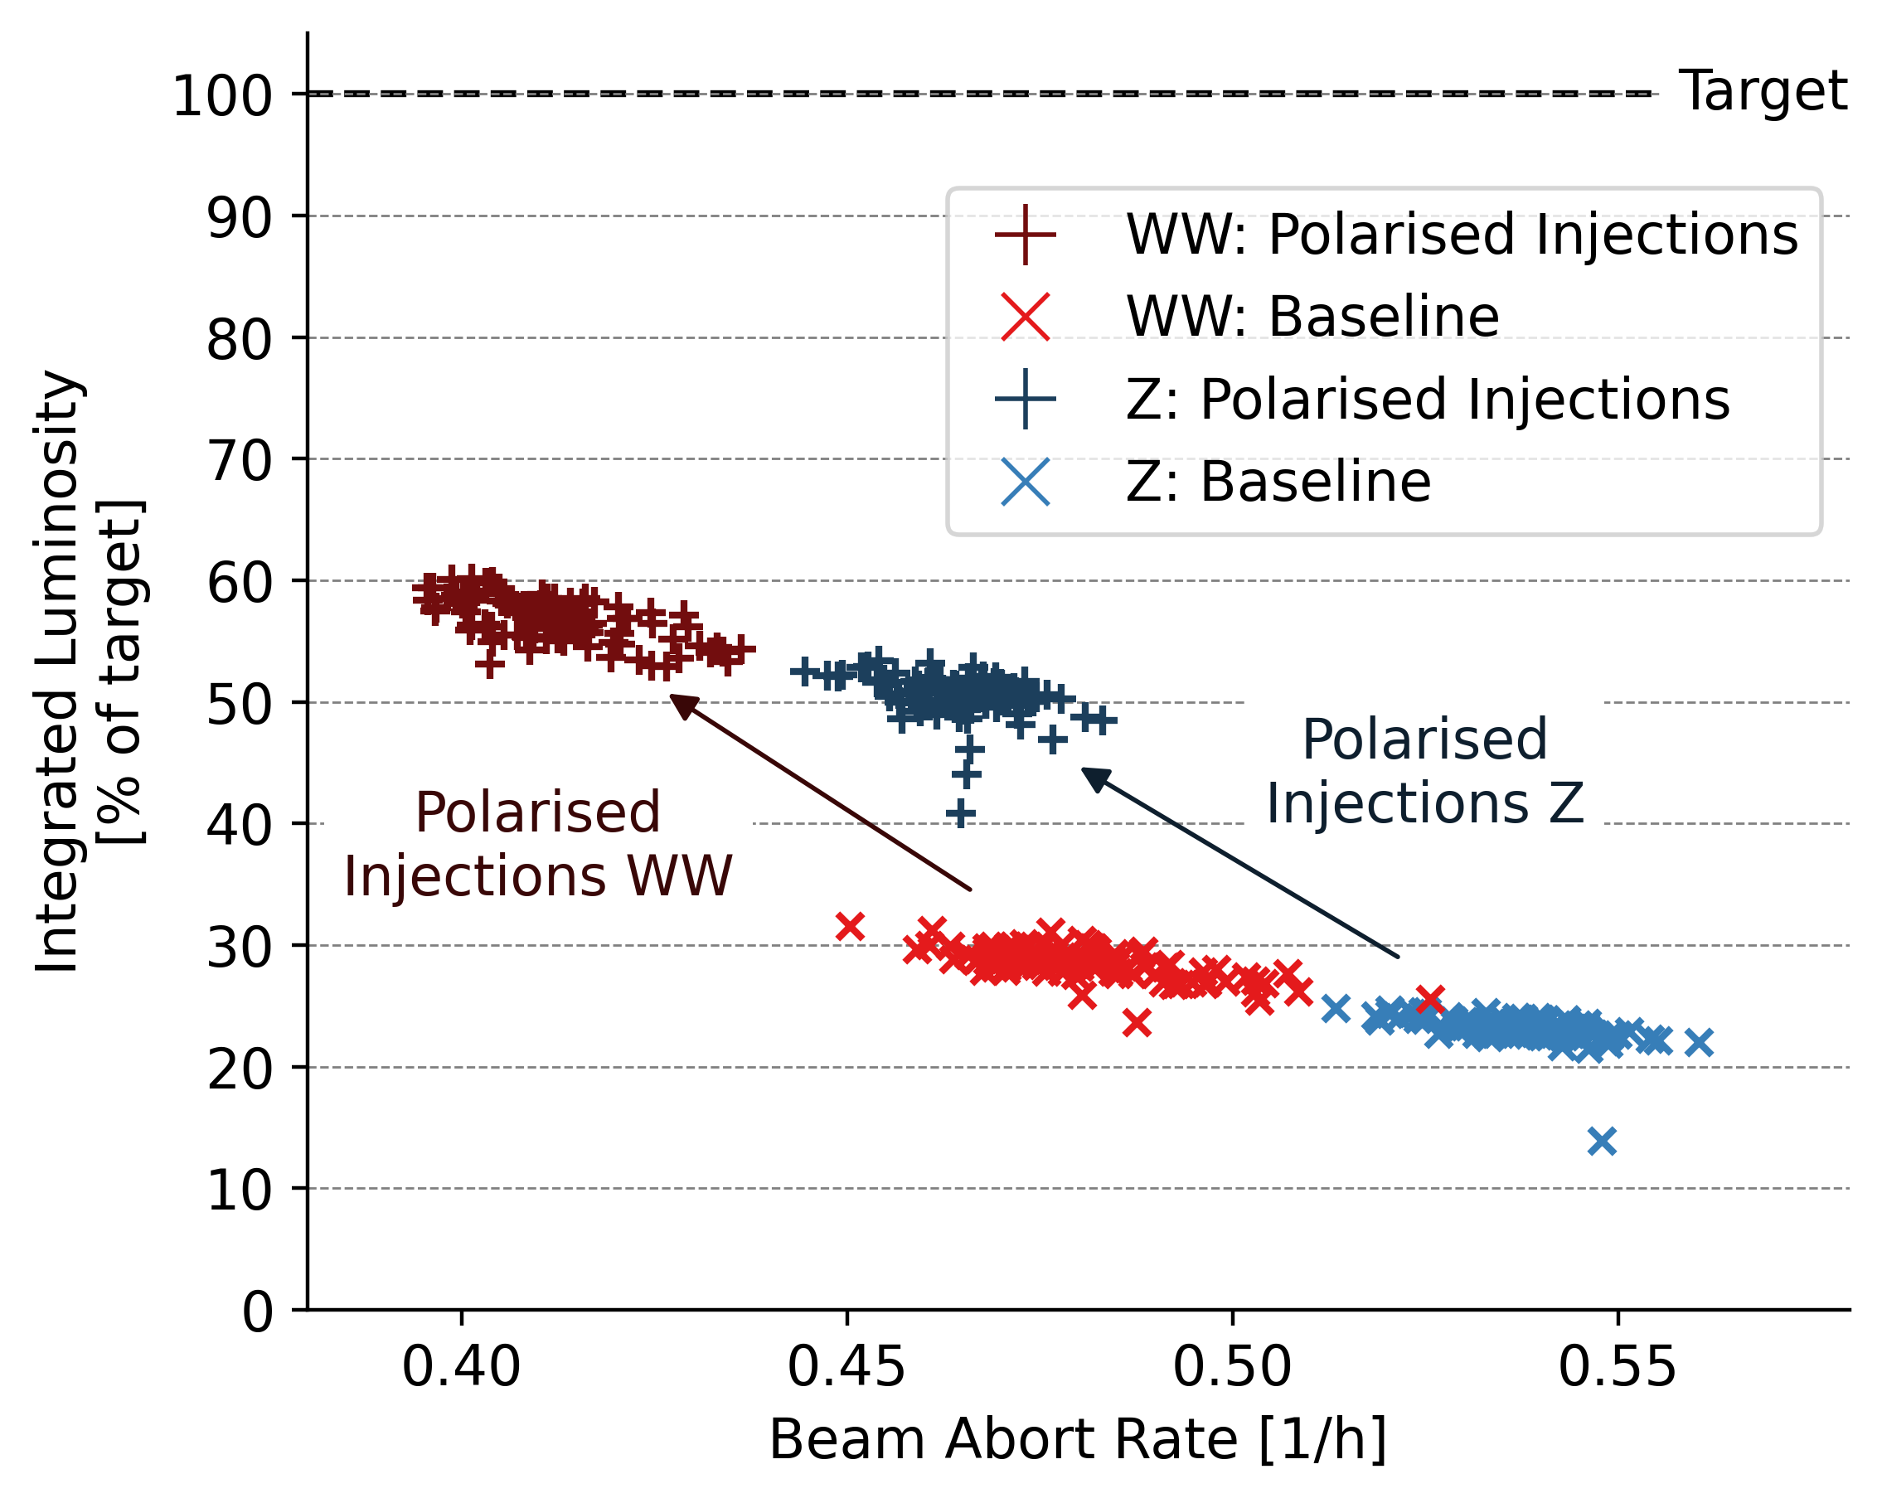
Solution: Injection of Polarised Bunches
  Z,W
More than doubles delivered integrated luminosity
 | Z | W | H | tt
Integrated luminosity target [ab-1] | 205 | 19.2 | 10.8 | 3.12

Slide 19
Reliability Targets

Slide 20
Conclusions
Forecasted integrated luminosity is low in all energy modes
  Low availability and low efficiency
Systems of highest concern:
  RF
  Power Converters
  Injector Complex
  Technical Infrastructure
  Beam Losses
R&D Opportunity:
  Injection of polarised bunches

Slide 21
Systematic Reliability/Availability Support
Success in FCCee requires machine-wide improvement in reliability
Pre-TDR phase:
  Coherent approach for all system designs:
    Requirements and milestones, performance benchmarking
    More nuanced reliability models in parallel with design process
    “Low-hanging fruit” – R&D opportunities evaluation
    Performance/Cost optimisation over the whole machine
TDR & Beyond:
    Tools, training, expertise
    Support for modular / hot-swappable design paradigm
    Diagnostics & Health Monitoring
    Fault prediction
    Fault tracking & Analytics
    Lifecycle Reliability

Slide 22
Acknowledgements
Jacqueline Keintzel
Franck Peauger
Olivier Brunner
Andy Butterworth
Ivan Karpov
Serge Pittet
David Nisbet
Davide Aguglia
Ben Todd
Byamba Wicki
Jean-Paul Burnet
Klaus Hanke
Chris Roderick
Ioan Kozsar
Alessandro Masi
Damien Lafarge
Tomasz Ladzinski
Verena Kain
Frank Zimmerman
Markus Zerlauth
Jesper Nielsen
Mario Parodi
Charline Marcel
Manfred Wendt
Roderik Bruce
Anton Lechner
Marco Calviani
Antonio Perillo Marcone
Guillermo Peon
Inigo Martin Melero
Laurent Delpraz
Yann Dutheil
Christoph Wiesner
Jan Uythoven
Jeremie Bauche
Wolfgang Hofle
Roberto Kersevan
Gregory Pigny
Rudiger Schmidt
Arjan Verweij
Benoit Salvant
Bernhard Holzer
Bettina Mikulec
Cedric Hernalsteens
Rama Calaga
Roberto Losito
Katsunobu Oide
Hannes Bartosik
Paolo Craievich (PSI)
Masanori Sato (KEK)
William Corocho (SLAC)
Ralph Boespflug (DESY)
Rainer Wanzenberg (DESY)
Michaela Schaumann (DESY)
Cristian Maccarrone (ESRF)
Laurent Hardy (ESRF)
Antoine Chance (CEA)
Jorg Wenninger
Gijs de Rijk
Daniel Valuch
Belen Maria Salvachua Ferrando
Matteo Solfaroli Camillocci
Alice Vanel
Luke Von Freeden
Robert Kieffer
Igor Syratchev
Helga Timko
Rafaele Tegas
Giacomo Lavezzari
Manuel Colmenero Moratalla
Milosz Blaszkiewicz

