Slide 1
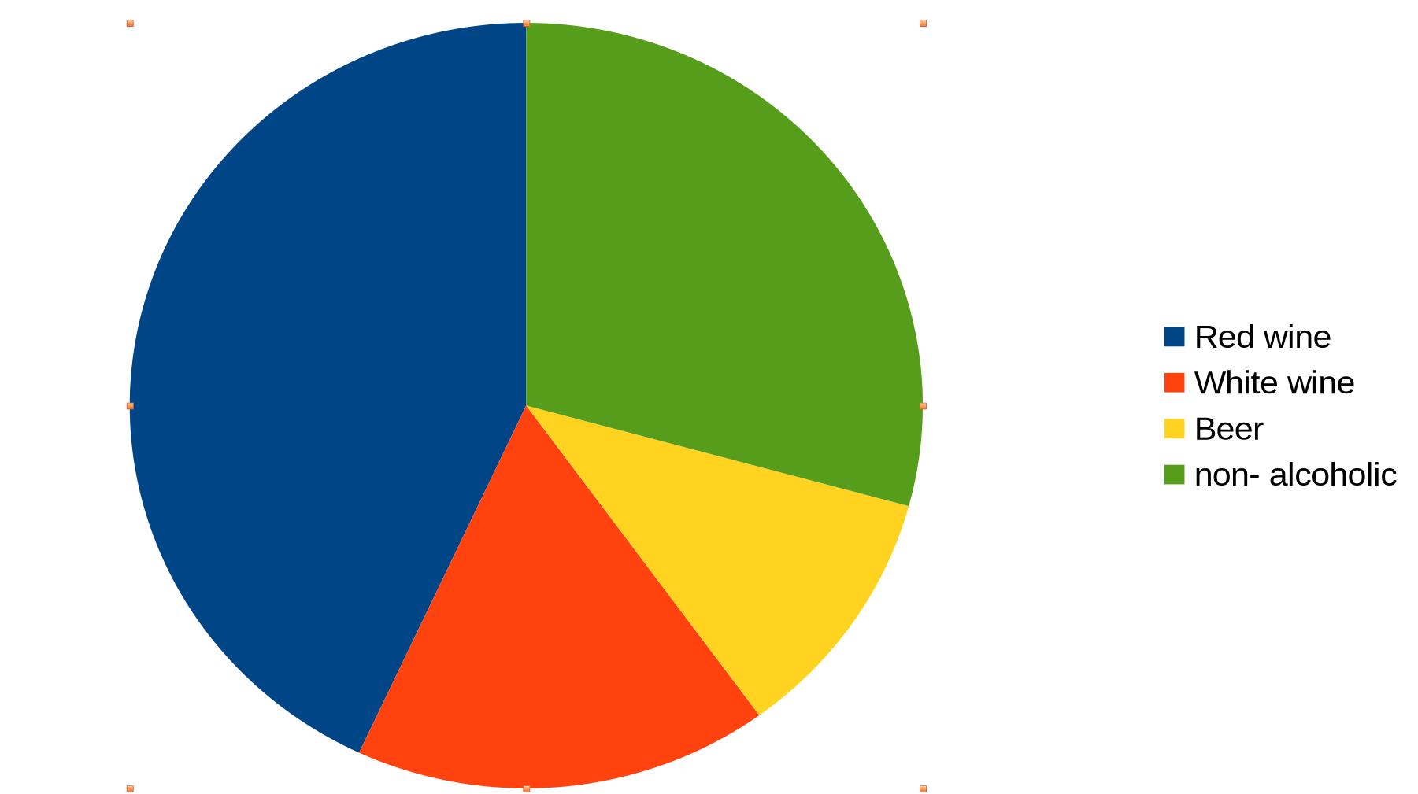
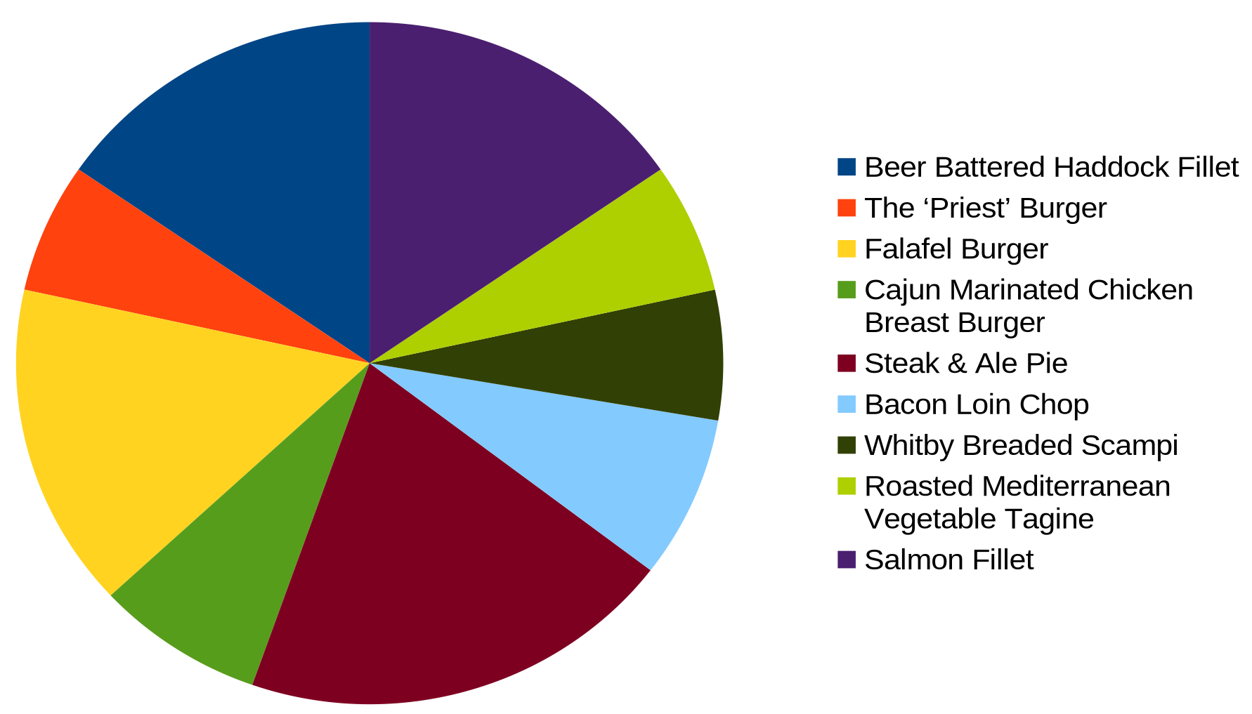
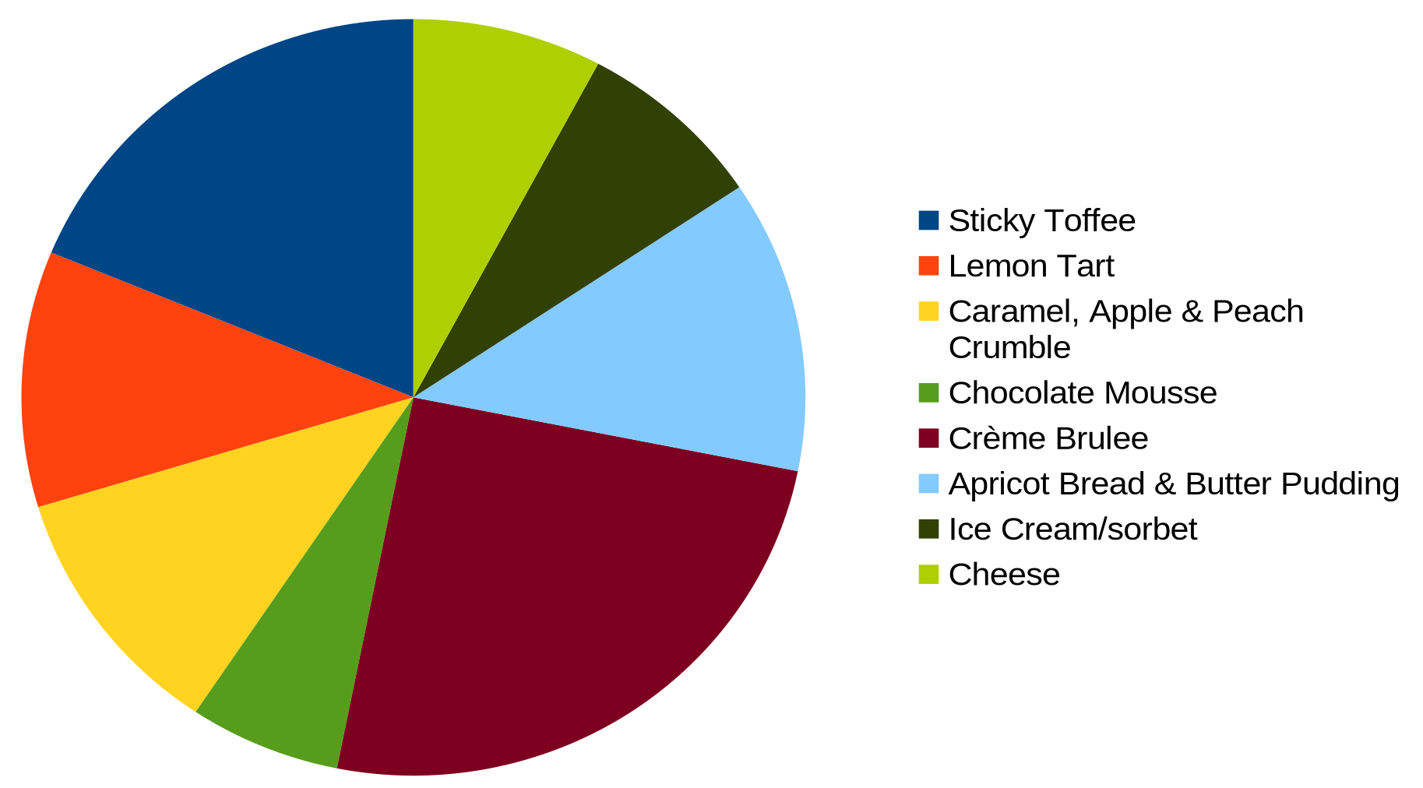
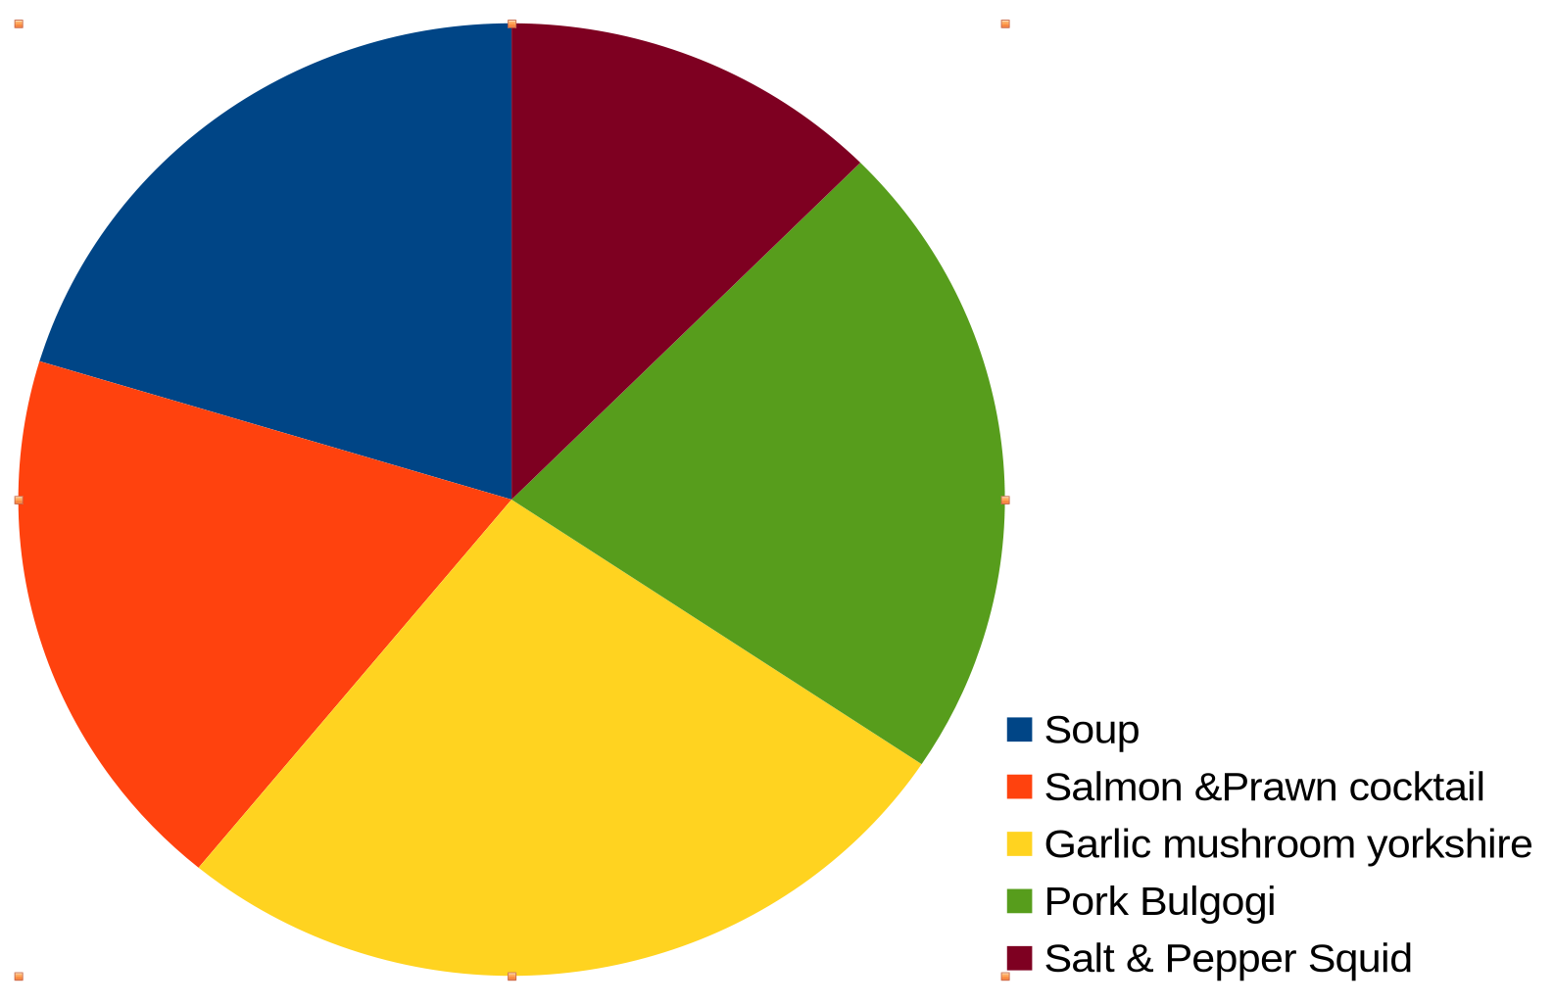
Conference Dinner Stats

Slide 2
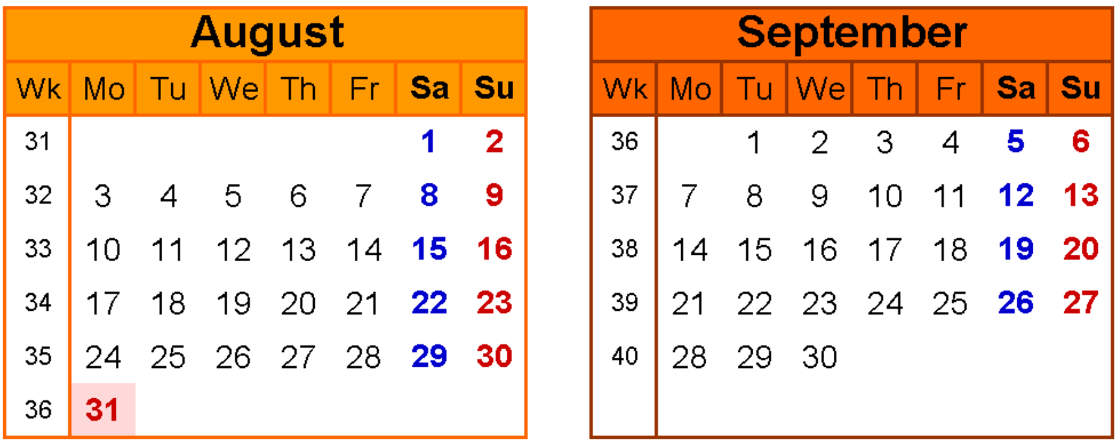
Next Ambleside Meeting Date

Slide 3
GridPP Tier-2 Storage Update
Sam Skipsey & the GridPP Storage Group

Slide 4
Items
Ceph/Xrootd Sites
Virtual Placement / Caching Sites
StashCache / PELICAN

Slide 5
Ceph Sites - Ceph
Lancaster moved from Reef to Squid
  In general, Squid has been a lot better – Reef was bad for everyone.
We are somewhat concerned, given recent history, that Tentacle is still not released...
We recommend the Clyso analyser for Ceph clusters: Ceph Analyzer by Clyso (Dan van der Ster, late of CERN Ceph things, was involved in this)

Slide 6
Ceph sites - Niggles
The Rucio file:// plugin for locally-mounted cephfs volumes is only usable by ATLAS @ Lancaster
LSST tried to use it but rely on much more random ios
  To support this, you'd need an SSD packed Ceph instance, or at least replicated not EC storage.
Ceph dev now builds against Stream: relies on containerisation of services to work on any normal distro.
  This still causes problems for services that must be bare-metal, however (cephfs hosts, for example).
  Along with the EL8 "deprecation" last year, this implies worrying things about Ceph dev culture.

Slide 7
Large sites …
Storage Infrastructure | Install Date | (Projected) Retirement Date | # Units | Total CAP Estate(RAW, TB)
 | 2019 | 2028 | 19 | 4104
 | 2021-03 | 2030 | 13 | 5408
 | 2021-08 | 2030 | 23 | 9568
 | 2022-04 | 2031 | 5 | 2080
Storage Infrastructure | Install Date | (Projected) Retirement Date | Units | Total CAP Estate (RAW, TB)
29 Dell Storage | Feb-21 | Feb-28 | 29.00 | 11136
3 Dell Storage | Apr-24 | Apr-31 | 3.00 | 1584
Many of the core Tier-2s have a significant chunk of space in older storage
  A lot of sites bought in 2019-2021...
Ceph releases, in particular, vary as to how well they cope with a high fraction of unreliable storage
  Ironically, Nautilus @ Glasgow is happier than Reef & Squid are at Lancs, Manchester, Brunel...
Storage Infrastructure | Install Date | (Projected) Retirement Date | # Units | Total CAP, Estate (RAW, TB)
 | 25/02/2019 | 28/08/2025 | 8 | 1920
 | 03/12/2019 | 28/08/2025 | 10 | 2400
 | 26/02/2021 | 26/02/2026 | 19 | 6080
 | 30/09/2021 | 30/09/2026 | 7 | 2240
 | 12/11/2021 | 12/11/2026 | 1 | 320
Lancs working on more automation to pre-emptively mark disks bad​
    Note that Squid is supposed to be able to use heuristics to do this itself...

Slide 8
Ceph Sites – Xrootd - niggles
XRoot still needs lots of monitoring to keep it working
  Redirectors really do have difficulty noticing some failure modes of servers...
Cephfs sites with local mounts need to explicitly "fix" directory ownership (so things work with file:// mount points) with their own solutions...
Still niggles with token authentication details ( eg https://github.com/xrootd/xrootd/issues/2550 )
It still seems weird that we're mostly using xrootd to do http transfers, and not using root://...

Slide 9
Xrootd & Ceph Community
Significant work being done @ Edinburgh on Xrootd config testing (in a structured way)
  Many sites have aging or repeatedly patched config
    Lancaster's is 4 year old skeleton with patches
    Glasgow's is older (with two sets for internal and external gateways)
    Both could do with rewriting from scratch to catch "legacy" problems.
Rob Appleyard has worked on a UK Research Ceph forum for CIUK, which we think would be very positive.

Slide 10
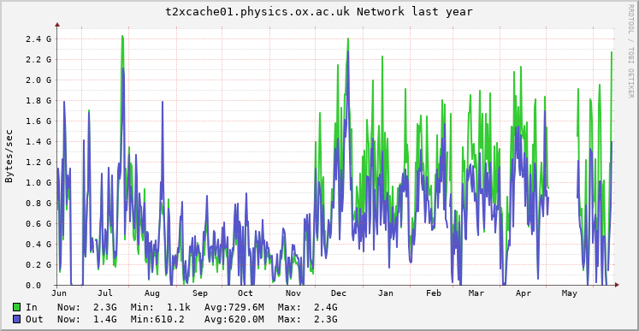
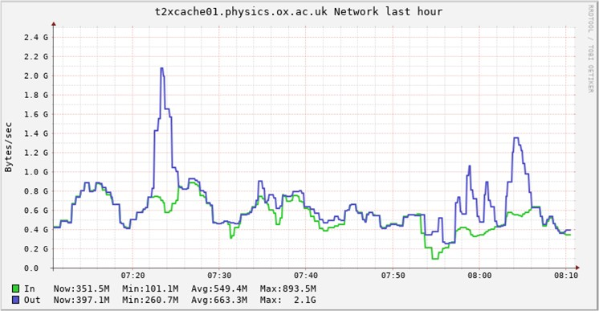
Virtual Placement / Caching Sites
256k blocks
Oxford cache more of a buffer than a cache recently with VP workloads
Tweaks to pfc.blocksize improved matters (but this also seems potentially job dependent – smaller blocks made things worse again...)
  Ideal blocksize differs from when Oxford was just a cache (not VP)…
  (thanks to Rob C for the suggestions)
Alessandra has a test setup fully at Manchester to develop firm feelings and advice on how to progress with VP etc.
  I think she would agree that she discovered Xrootd proxy caches are more complex than she had imagined (as everyone does when configuring them for the first time).
64k blocks

Slide 11
StashCache / PELICAN (Edinburgh)
Edinburgh StachCache has become surprisingly popular
  At one point, it was a de-facto single point of failure for European users.
Recent(ish) move to StashCache authentication using short-lived (3month) certificates, which are annoying to manage, esp. when you need to get them from the US, and you don't own the DNS record.
  Few options exist in the UK to satisfy short lived, browser accessible, automated and supported at the command line with HEP tooling, and zero cost to a Tier2.
other Tier1s have stepped up and brought their stashcaches back online in the last few months
  Dune can run jobs without us (and has been)
Planning to upgrade to PELICAN in September '25 (after ACF finishes preparatory work for exascale etc hosting)
  Hopefully, this helps us understand exactly what PELICAN brings that StashCache didn't &
  ...whether it's working/useful for HEP experiments in Europe, or, whether it's an OSG-centric technology.
  It is not clear if/when StashCache using communities will be forced to migrate as yet...

Slide 12
Future Thoughts
Core Tier-2 storage needs carefully planned coordination to maintain capacity to meet Dave's expectations.
Ceph "suitability" is something we need to pay increasing attention to with new releases.
Caches continue to be more complex than we expect.
  And VP continues to be an ATLAS thing that needs more attention (from all sides)
Xrootd/FTS Collaboration meeting in Barcelona this year...

