Slide 1
Science DMZ Security: Guidance and Recommendations
Tim Chown (Jisc)
GridPP54, Ambleside, 29 August 2025

Slide 2
Agenda
Discussing best practice for implementing Science DMZ security
The output of this work will be a guidance/recommendations document
A first draft doc is available – see GridPP54 indico here.
Looking to ensure it is produced through community consensus
Areas covered in the draft
Motivation
The Science DMZ model, and GridPP equivalent evolution
Science DMZ implementation – architecture, DTNs, measurement, tailored security
Other considerations – AAAI, static vs dynamic access, applying general good practice
Recommendations – we have a draft set to be discussed
Additional relevant topics and comments from the past two days here at GridPP

Slide 3
Motivation
Why does it matter?
Ensuring the “science mission” is successful
Confidentiality, Integrity, Availability (CIA) is important
But if the necessary Performance is not achieved, the mission fails
Increasingly seeing science sites connecting to Janet at 100G (or more)
Dual, resilient 100G stateful DPI firewalls are expensive, and potentially not performant

Slide 4
The Science DMZ model
Four key Science DMZ principles
A network architecture explicitly designed for high-performance applications where the science network is distinct from the general-purpose network. Separation allows each to be optimised.
The use of dedicated systems for data transfer
Performance measurement and network testing systems that are regularly used to characterise the network and are available for troubleshooting
Security policies and enforcement mechanisms that are tailored for high-performance science environments.
Separating the treatment and handling of science and day-to-day business traffic allows each to be optimised, and the Science DMZ principles to be used as a security architecture
NOT just a “firewall bypass”

Slide 5
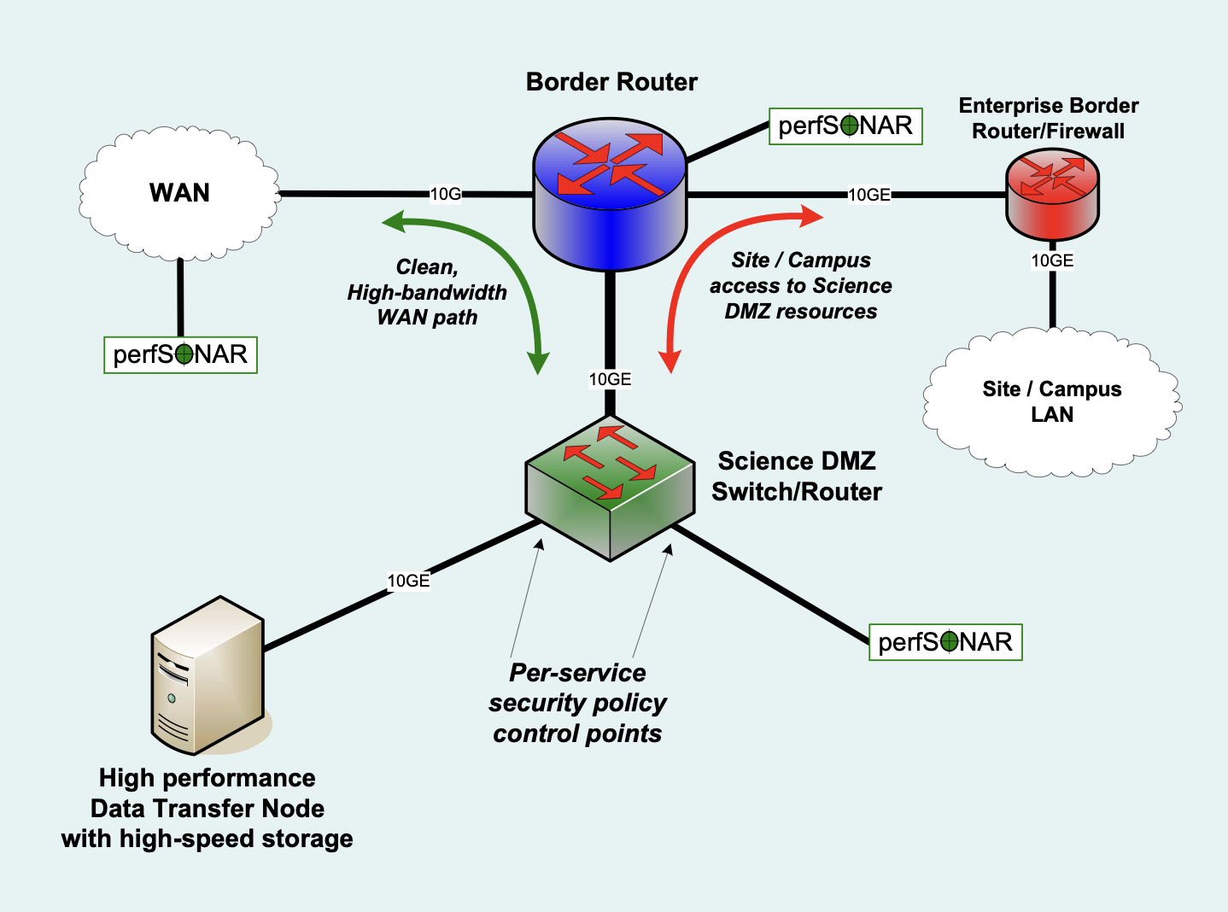
High-level Science DMZ architecture
Approach
Security is better achieved through segmentation and a risk-based approach in which controls are identified and applied against the risks and their associated impacts
Limit the risk profile for high-performance science transfers, avoiding introducing any unnecessary risks or unnecessary controls.
By removing the degrees of freedom in the infrastructure it becomes easier to secure it, to achieve the necessary performance, and to troubleshoot any issues that arise.

Slide 6
Local network architecture
Minimising network ‘friction’
Packet loss can impact throughput, more the higher the transfer distance
Seek to use dedicated links
Physical
Some Janet sites have n x 10G, e.g., 1x10G campus, 1x10G resilience, 2x10G GridPP
Some have 100G campus, 100G science
Can then treat the GridPP links differently
Virtual
LHCONE allows differential, tailored treatment at site ingress/egress
As we heard from Alastair @ RAL T1 – general R&E traffic goes via the campus firewall
Internally, dedicated Ethernet links or VLANs

Slide 7
Dedicated data transfer nodes (DTNs)
Well-tuned endpoints
Tune TCP as per the ESnet Fasterdata guidance
Use performant software – e.g., Rucio / FTS / XRootD
There is a decision to be made on DTNs as front ends to science storage (CEPH, etc)
Could route via campus firewall (as per the diagram on slide 5)
but Science DMZ may be 100G and campus 10G
and if matched big flows via the campus firewall may still impact business traffic
Could transfer via a bespoke link from the DTN(s) to the storage
Could mount CEPH/etc on the DTNs
The latter two options require strict protocol/port controls on servers/switch ACLs

Slide 8
Performance measurement
perfSONAR
Widely used in WLCG
Jisc supports it – we have servers, an archive, and Grafana viewing tools
Includes UK test mesh
See Chris’ talk next, and the T1 slides he’s presenting

Slide 9
Tailored security
Driven by risk-based assessment
If there’s budget, then a full, dual resilient stateful DPI firewall solution is OK
So long as the performance is there
Scope the stateful, DPI campus firewall to the level of business traffic
Cheaper, while matching the solution/implementation to the risk
A typical 100G-connected campus may have 10G business, the rest is science
Use host-based security and stateless ACLs for the science traffic
Minimise devices and friction on the path, reducing/eliminating packet loss

Slide 10
Other considerations
Topics we should include
Use of AAAI
Various solutions available - eduGAIN, OIDC, MyAccessID, …
Need to consider industry collaborators
Static vs dynamic access
Static – e.g., two GridPP Tier-2s
Dynamic – e.g., user accessing an LSST portal
Not forgetting good general security practice
Regular posture checks, central logging/SIEM, …

Slide 11
Recommendations
An initial set…
Use the Science DMZ model as a security architecture – tailor to science need
Adopt a risk-based led approach rather than control-based
Use dedicated networks or overlays where available and practical (LHCONE, …)
Use strong host-based security
Use appropriate AAAI for access control
Tailor internal access to/from the DTN storage appropriately (controlled disk mounts)
Don’t overlook applying other general security practices (SIEM logging, posture checks, …)
Very much open for discussion and improvement – email netperf@jisc.ac.uk

Slide 12
Relevant topics from the past two days
These need to be folded into the document
Emphasise the scope – GridPP, IRIS, DRI
Note the CAF is risk-led, not controls led (as CE is), following the NIST approach
It is NOT about not sending traffic through the “firewall” (i.e., the stateful DPI campus device)
Add a recommendation for Zeek/Suricata inspection (on a mirrored port)
Refer to the Site Security Handbook that Matt mentioned
This includes a reference to cost effectiveness of risk mitigations
Consider the SKA “Science Gateway interface” and LSST “web portal” – look at the fit
Note the LHCONE implications
A level of trust, site border treatment (yours and the peer), different R&E routing

Slide 13
Discuss!
Comments are welcome to netperf@jisc.ac.uk

Slide 14
Thank you
Tim Chown
Network Development Manager
tim.chown@jisc.ac.uk

