Slide 1


Presentation about an Exciting
Accounting
pRoject
Tom Dack
Federating Services Group Lead
UKRI STFC Scientific Computing
Notes:
The abstract pattern can be removed or repositioned if required. Be careful to ‘Send to Back’ so that it does not obscure any important information.

Slide 2
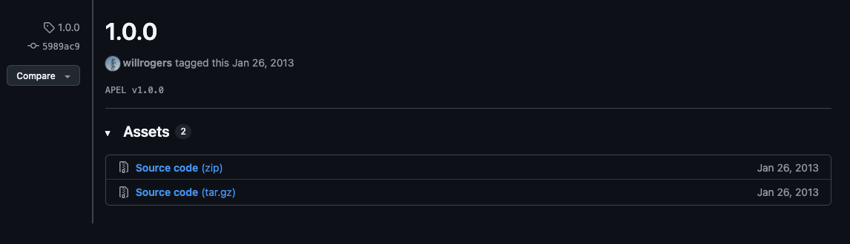
Setting the Scene:
Why do we need a new Accounting Service?
The existing APEL service is old, with APEL version 1.0 in January 2013, and the project existing in some form since at least 2005.
As a result, whilst the service meets current needs, existing technical debt means new features can be development intensive.
The APEL 1.0.0 release tag, published 26/01/13

Slide 3
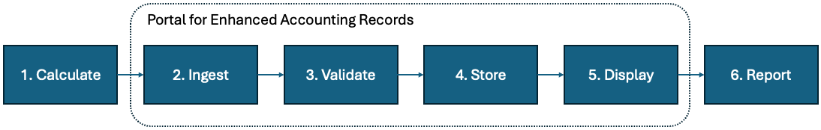
Aims of a New Accounting Platform
Develop a production quality accounting system that:
Covers resource usage data for a range of hardware resources.
This includes meeting the requirements needed for supporting HL-LHC
Is extendable with environmental related metrics.
Allows data validation at different levels.
Supports custom visual displays.
The working name for the new service is
“Portal for Enhanced Accounting Records” (PEAR)

Slide 4
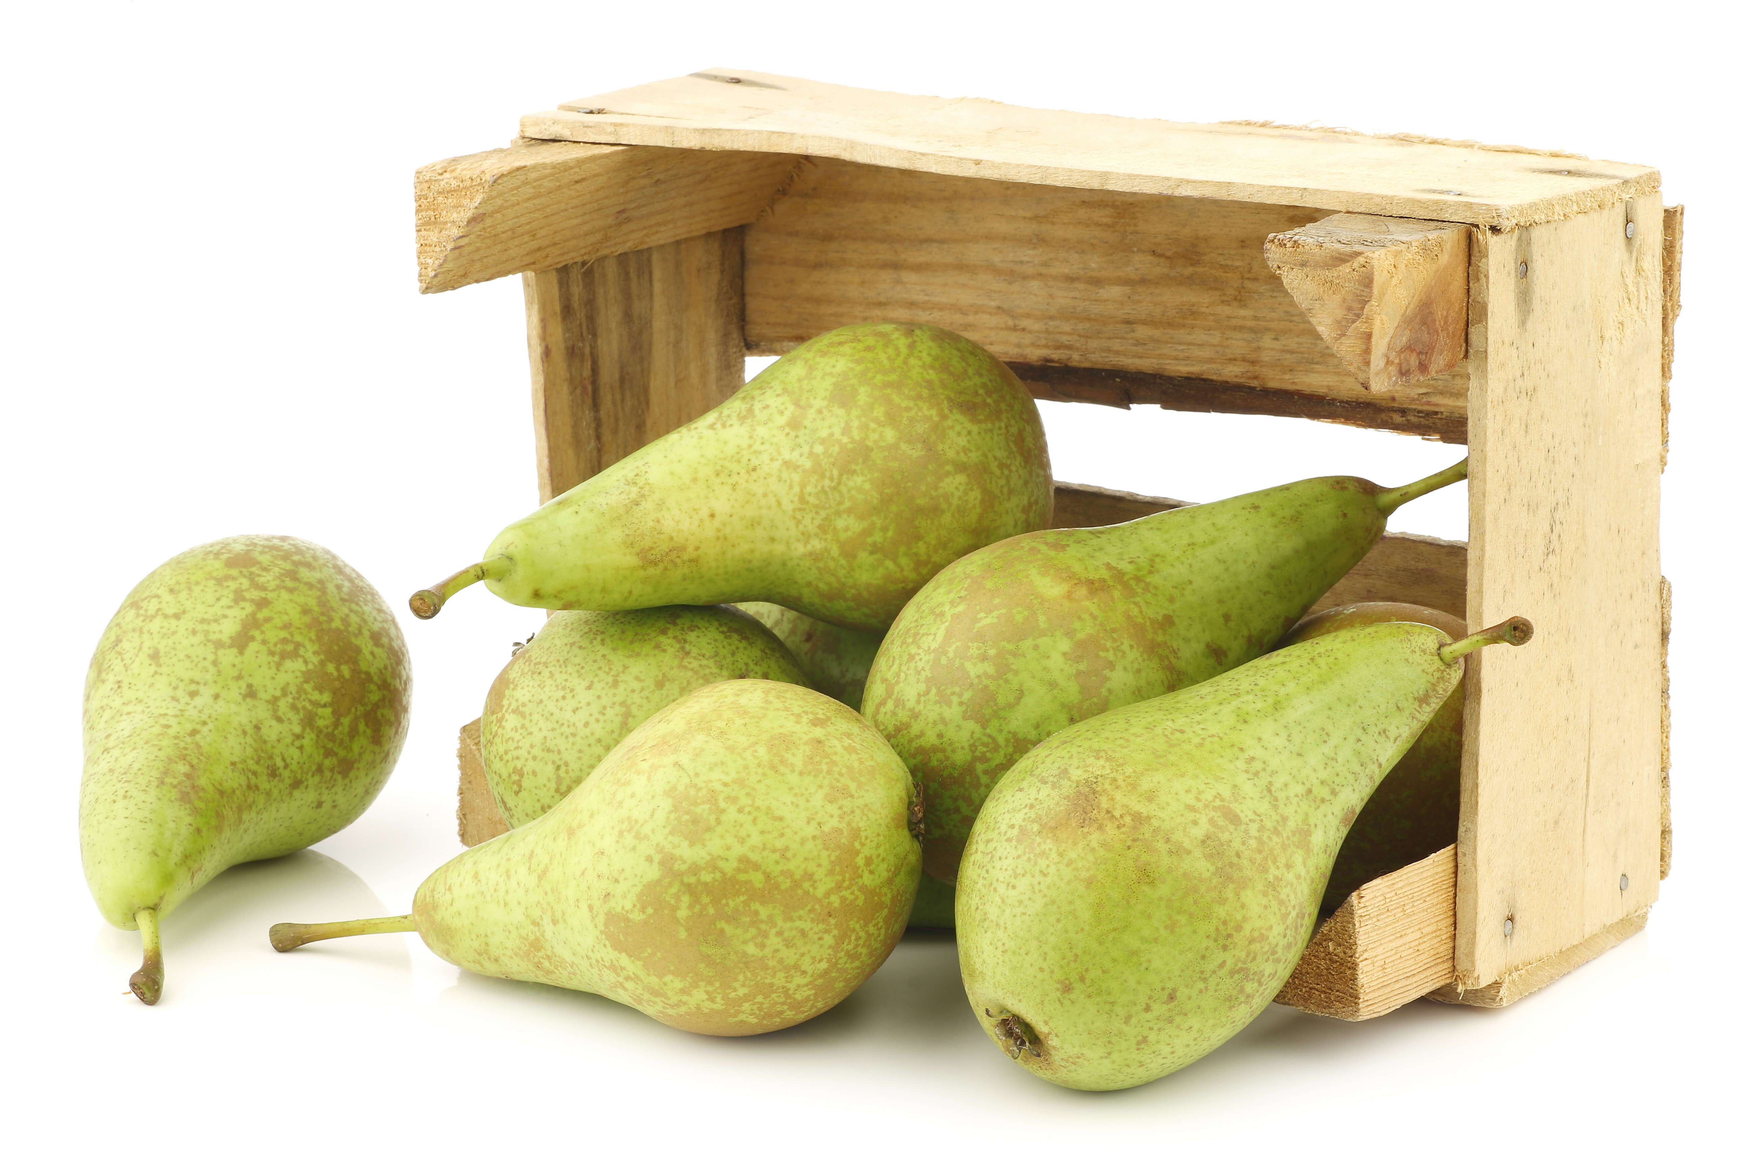
Delivering PEAR
PEAR is being proposed as part of HORIZON-INFRA-2025-01-TECH-01, bid led by EGI
As of yesterday, TECH-01 project name finalized as:
ENSURE:
ENvironmentally SUstainable digital services and practices for REsearch infrastructures
Proposal is for STFC & CERN to lead on the DB & Portal side of development
bid also involves Glasgow + Manchester on sustainability metrics
University of Freiburg will lead for client-side development
This will be delivered through improvements and enhancements to the AUDITOR tool
For more details on AUDITOR, see Michael Boehler’s talk from the 2025 WLCG Workshop

Slide 5
Application reference values/benchmarks (e.g. W-hour/execution)
Architecture
External metrics (e.g. Live Carbon intensity data from Electricitymaps.com)
Through specialised micro-services?
🍐
Mix of manual and automated validation steps
Following information model + guidelines
Environmental metrics (e.g. PUE, Carbon intensity)
Local metrics (e.g. PUE, Power consumption)
HL-LHC validator
Other validator(s)
From specialised micro-services?
HL-LHC specific GUI
TECH-01 DB (HL-LHC, XFEL, SKA, EGI)
(collect, validate, visualise)
Consumption and impact: Calculated values,
Summary records
AUDITOR
(generate, calculate, summarise, send)
Resource usage
XFEL specific GUI
Open standards,
Interoperable formats
HTCondor - done K8s - done Slurm - done
Tardis - done
OpenStack - todo with CASO?
GPU - todo Storage - todo?
Network - todo? …
EGI specific GUI
…
API
Open standards,
Interoperable formats
E.g. EOSC Accounting (GRNET); EuroHPC Federation Platform; Data Spaces
External portals and systems
Other clients
(generate, calculate, summarise, send)
Different consumption segments are reported into different systems (RI, EOSC, EuroHPC, …)
Site

Slide 6
Delivering PEAR
Project Lead: Tom Dack
Project Coordinator/Sponsor: Alastair Dewhurst
Technical Lead: Greg Corbett
Site Coordination Manager: Deniza Chekrygina
Accounting & APEL Expert: Adrian Coveney
Developer effort will also be available within Federating Services - Saiteja Vennapusa & Manoj Garai
CERN will have a graduate to report to Panos

Slide 7
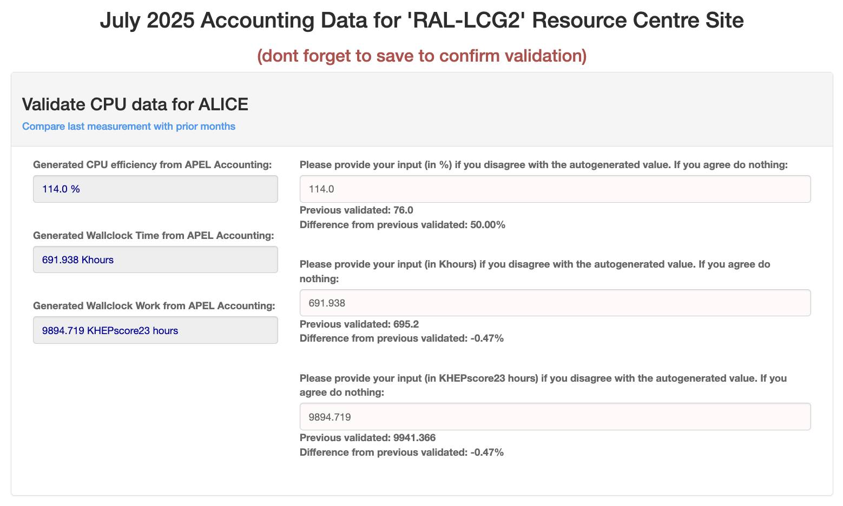
Existing Tooling
At this stage, we are looking at existing tools & solutions in the space.
Identify where ideas and concepts can be reused
Opportunities for building aspects of PEAR as plugins, such as:
CRIC validation
EOSC Accounting
Tom & Alastair are talking with developer groups, and Greg completing investigations & testing
The CRIC Validation view for RAL-LCG2

Slide 8
APELs 🍎 and PEARs 🍐
Development of PEAR is expected to be a 3 year project
During this time, STFC remains committed to development and support for the existing APEL Accounting Platform
Where sensible and possible, new portal features developed for PEAR will be made available for APEL

Slide 9
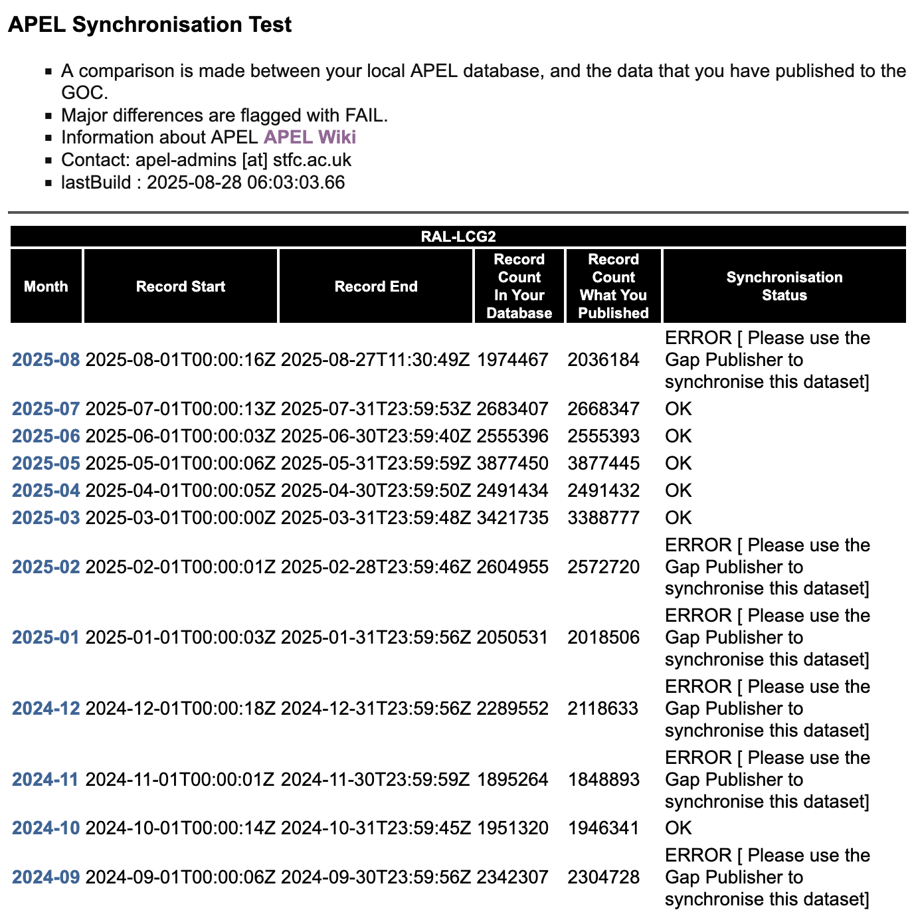
An APEL In-Development Interlude
New APEL validation pages are live, with current setup of:
https://apel-validation.stfc.ac.uk/publishing/grid/
An overview of when grid sites last published.
https://apel-validation.stfc.ac.uk/publishing/gridsync/RAL-LCG2
A view showing the synchronization status of an individual site.
Replace RAL-LCG with sitename as required: /publishing/gridsync/SITENAME/
https://apel-validation.stfc.ac.uk/benchmarks/
An overview of the latest benchmark and record type published for each submit host at all grid sites.
The views above return HTML by default, but can be set to return JSON by appending: ?format=json
For example: …/publishing/gridsync/RAL-LCG2/?format=json
A preview of the sync status for RAL-LCG2

Slide 10
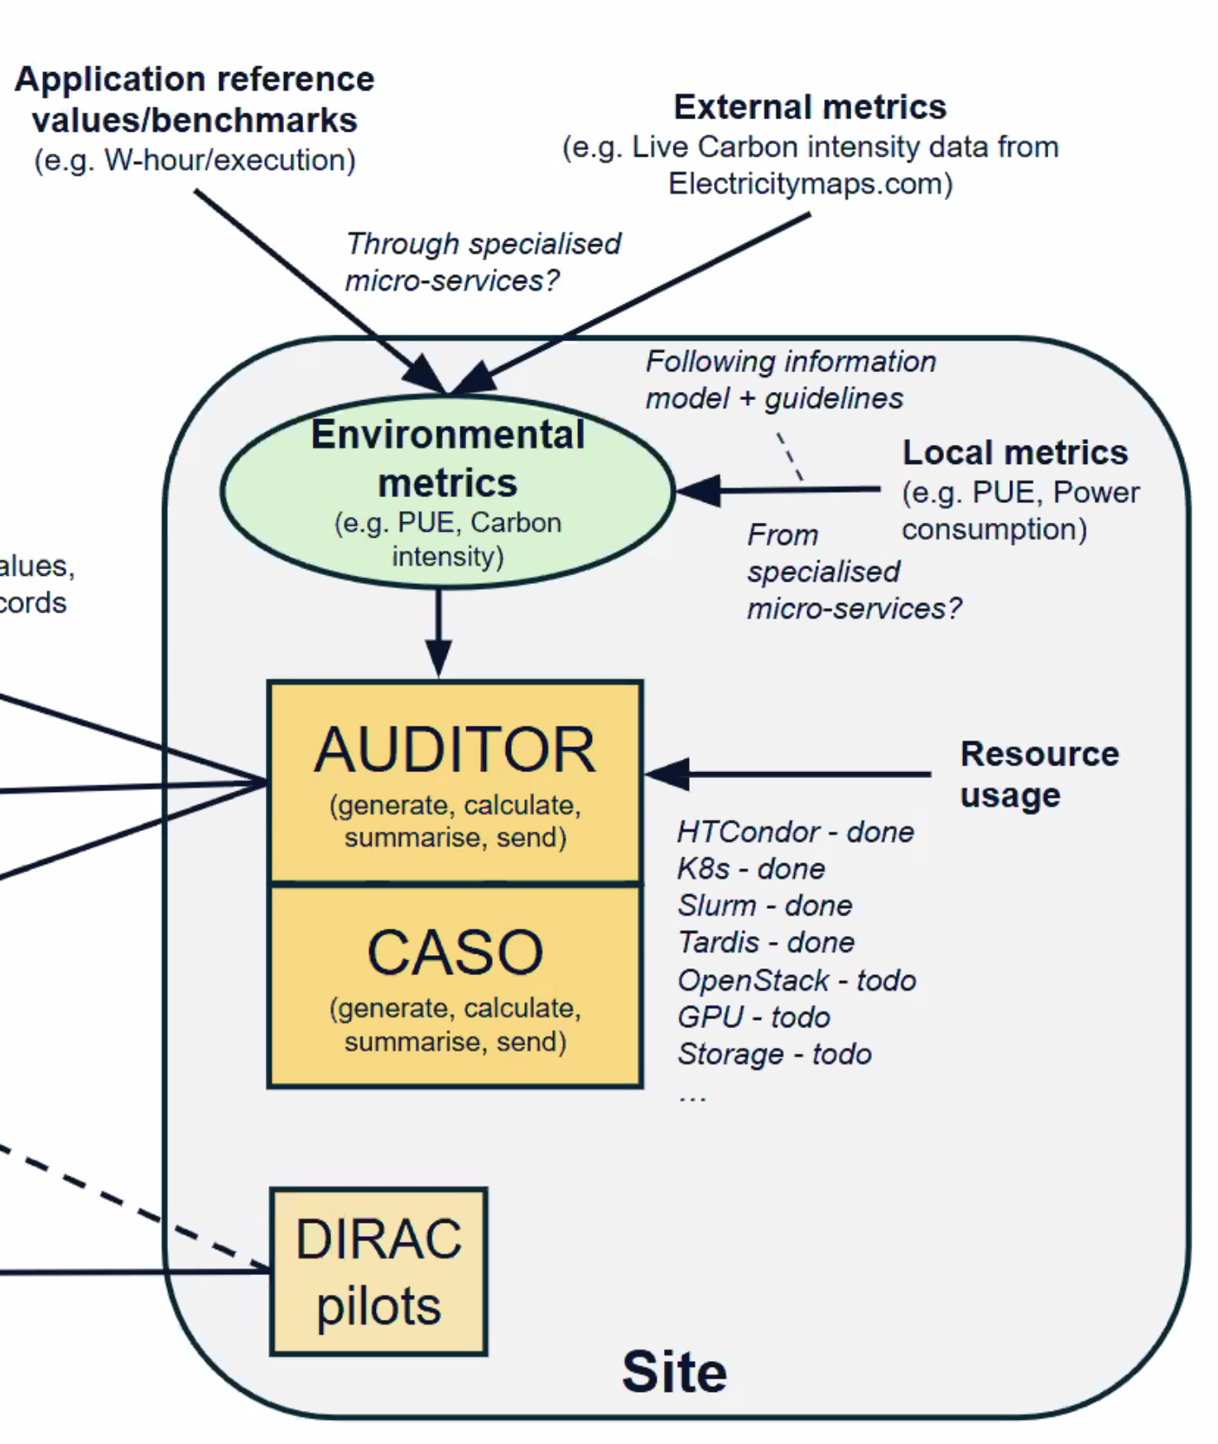
Sustainability & PEAR
In the UK we have been making significant contributions to energy and carbon usage calculations:
CHEP 2024 Paper on Simulating the Carbon Cost of Grid Sites.
CHEP 2024 Paper on Carbon Cost of Storage.
Evaluating performance and power consumption of Ceph storage configurations.
Power Accounting in Heterogeneous Compute Clusters.
We also have ongoing work calculating embedded carbon costs.
PEAR will build on this work to provide all sites with tools to accurately measure their energy and carbon usage.

Slide 11
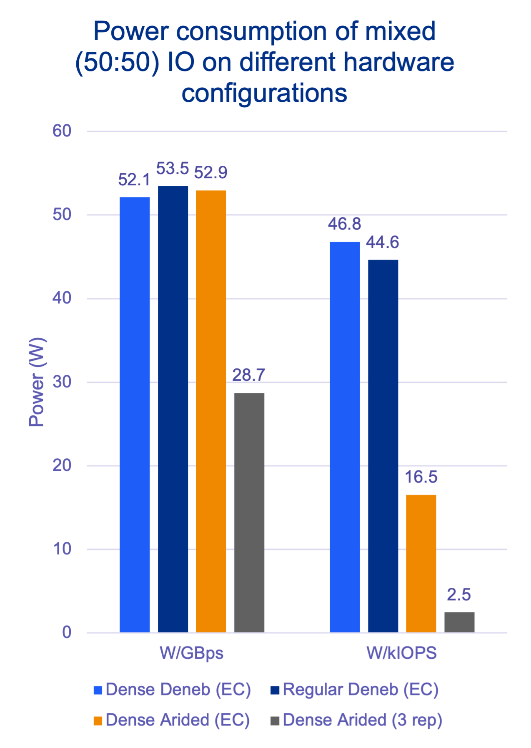
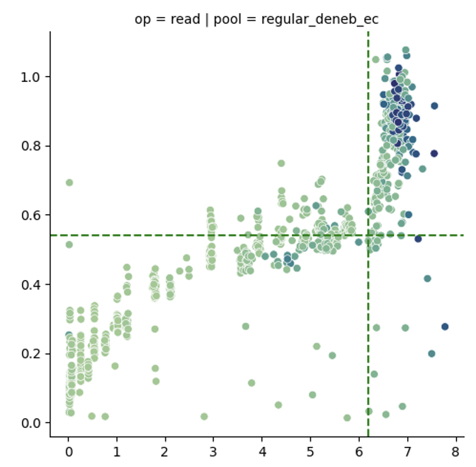
Example: Storage Accounting
Currently EGI Accounting doesn’t provide storage accounting and the WLCG storage accounting is very basic (just capacity).
The power usage of storage is dependent on the hardware setup but also the usage (throughput and IOPs).
To measure individual carbon usage. We will:
Need to add IOPs and Throughput metrics to SRR.
Provide Tools to sites to benchmark hardware, idle and with different usage patterns.
Build model that takes inputs and can estimate individual energy/carbon usage per VO.

Slide 12
Where we are now
TECH-01 project will be submitted within September, with regular Consortium meetings during this time
Intensive writing of Proposal Part B until 29th of August aiming reaching a nearly complete version.
External review of Part B 29/Aug - 4/Sep.
Finalization 8-18 of Sep.
Investigation of potential technical components has been started by Greg, and conversations have been had by Tom & Alastair
Greg has investigated the EOSC accounting tools

Slide 13
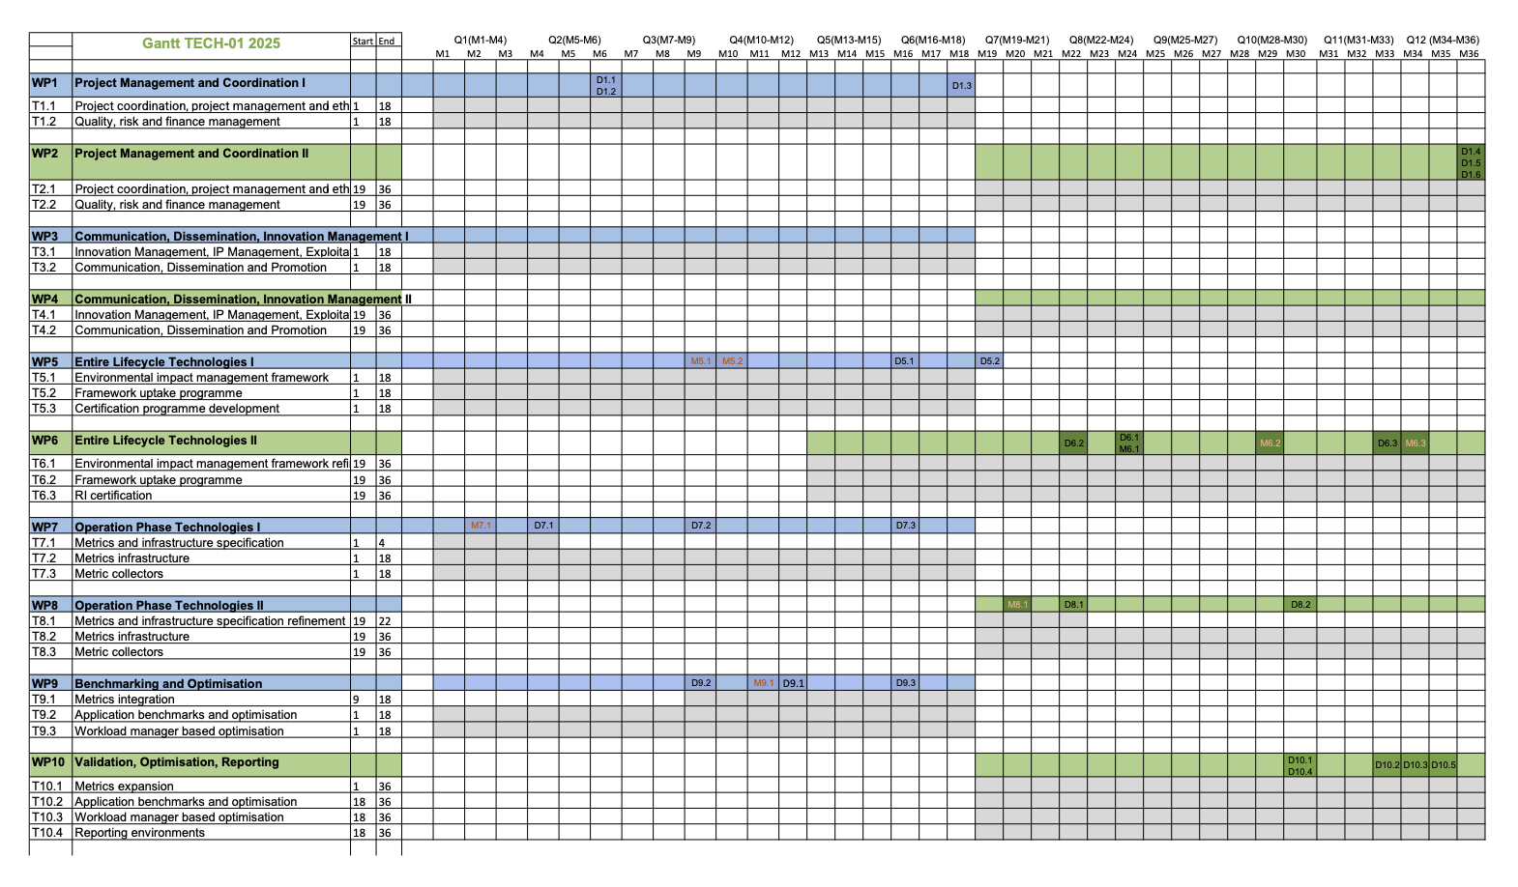
Where we are going
7.2 & 8.2 are 🍐 Infrastructure

Slide 14


Notes:
The abstract pattern can be removed or repositioned if required. Be careful to ‘Send to Back’ so that it does not obscure any important information.

