Slide 1
TCC8 dismantling
N. Quinquis, I. Angulo
14/05/2025

Slide 2
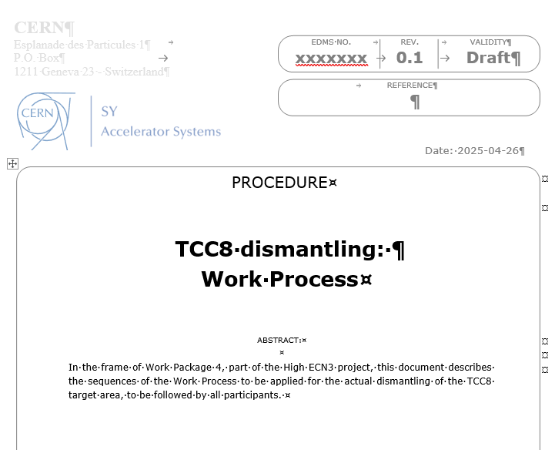
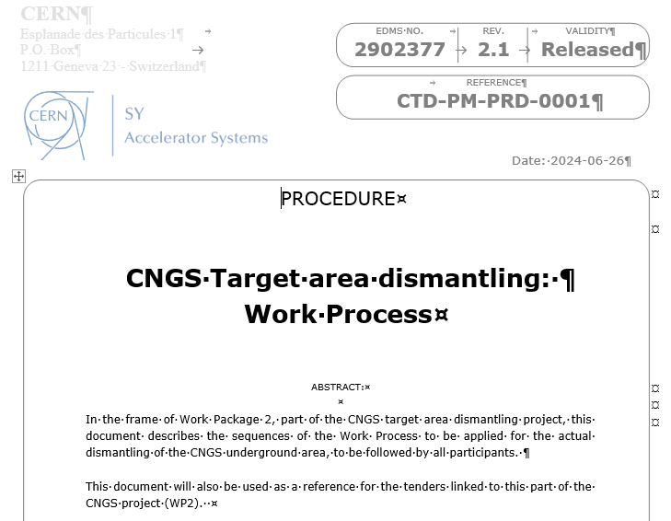
Document

Slide 3
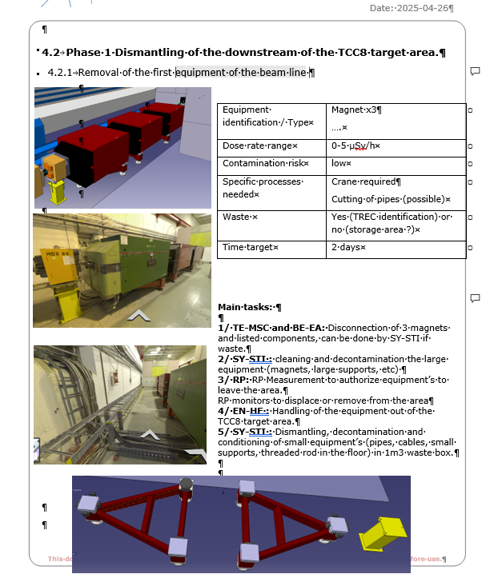
Document
Dose rate
3D model pictures
Waste
Panorama/reality pictures
Steps
I. Angulo | TCC8 dismantling

Slide 4
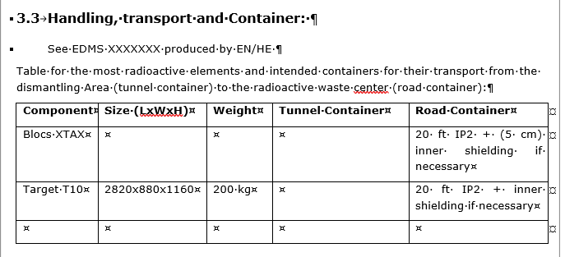
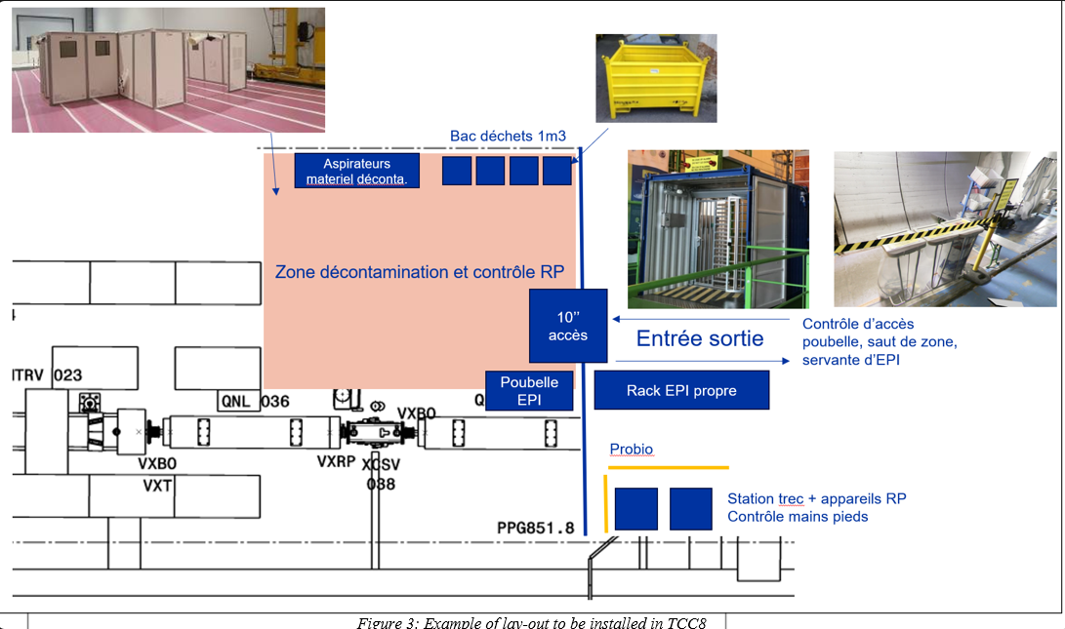
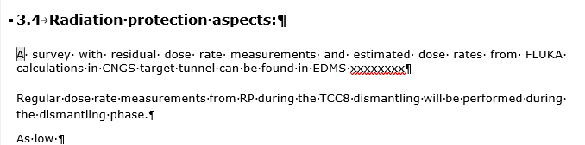
Defining procedures:
Decontamination area inside TCC8:
Transport requirements:
Radiation aspects:
I. Angulo | TCC8 dismantling

Slide 5
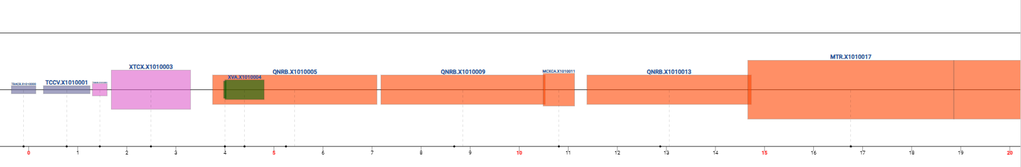
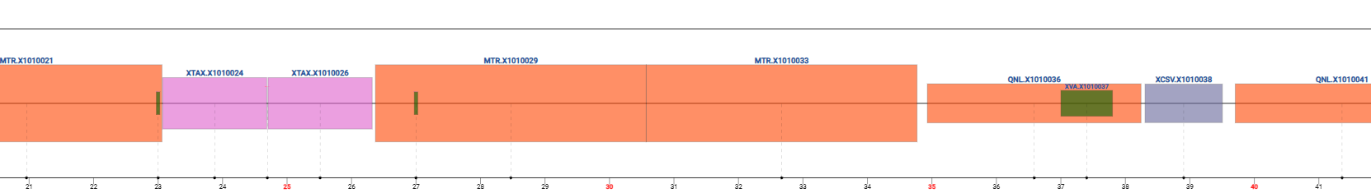
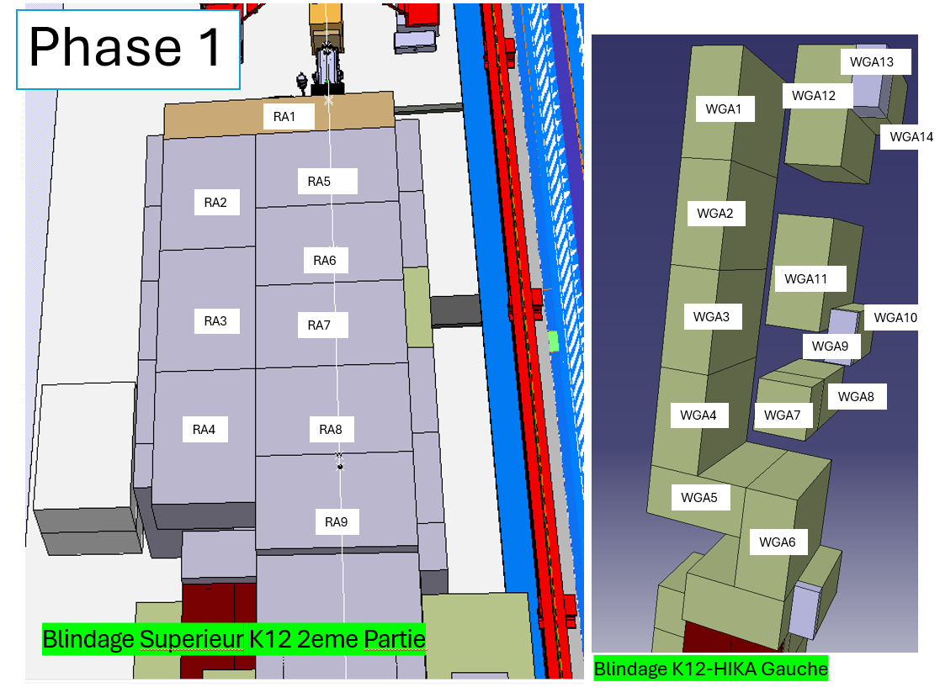
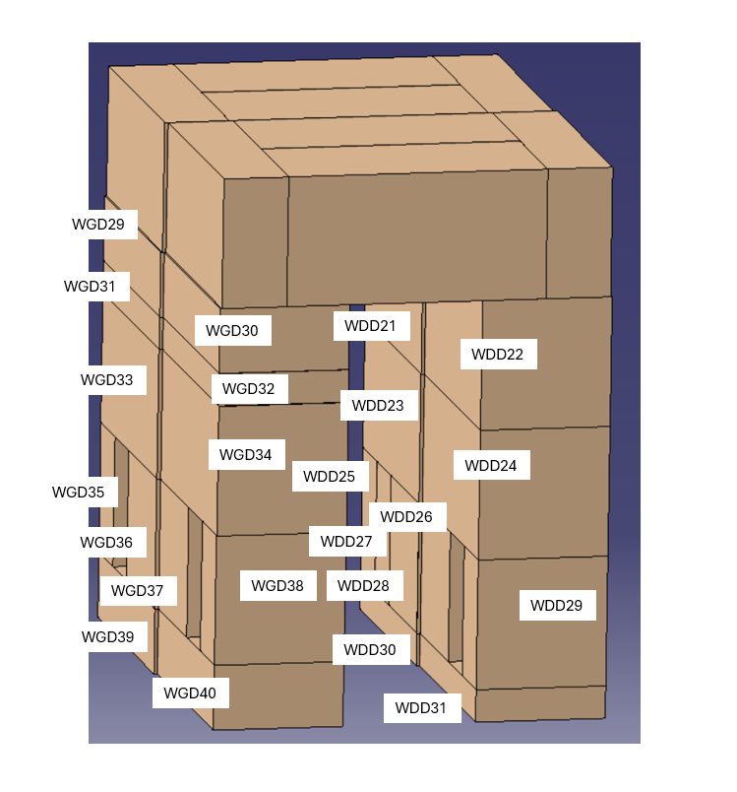
Elements identification/naming
Equipment: layout database
Blocks: Smarteam identification
I. Angulo | TCC8 dismantling

Slide 6
Table
Equipment: Layout name
Blocks: named using CAD model
Waste identification
It will match the phase in the document
Dose rates from the RP extract
I. Angulo | TCC8 dismantling

Slide 7
Conclusions
The document will provide us a specific idea of the activities to be done for the dismantling of TCC8.
It will help to build the work dose planning and the planning.
With the table, the wastes and storage space requirements will be defined.
It is still work on progress that we will need then to iterate with the different groups involved by June/July.
We expect to have the document ready by October
I. Angulo | TCC8 dismantling

