Slide 1
Target cooling station and Target complex ventilation
F. Dragoni, N.Zaric/ EN-CV ,
HI-ECN3 WP4 – TARGET COMPLEX – COORDINATION MEETING #12 – 14.05.2025.

Slide 2
Agenda
User requirements document
Target cooling station
TCC8 / ECN3 mezzanine
Service building – CV room
EL loads
F. Dragoni, N. Zaric | Target cooling station and Target complex ventilation
14.05.2025.

Slide 3
User requirements document – to be shared
Demineralized water – PCs and SHiP
PCs : changed T_{in}
SHiP: The Users will declare their pressure drop. Currently the pressure in the existing station can reach up to 24 bar, the equipment shall be rated PN25 at least. T_{in} and T_{out} are proposed.
F. Dragoni, N. Zaric | Target cooling station and Target complex ventilation
14.05.2025.

Slide 4
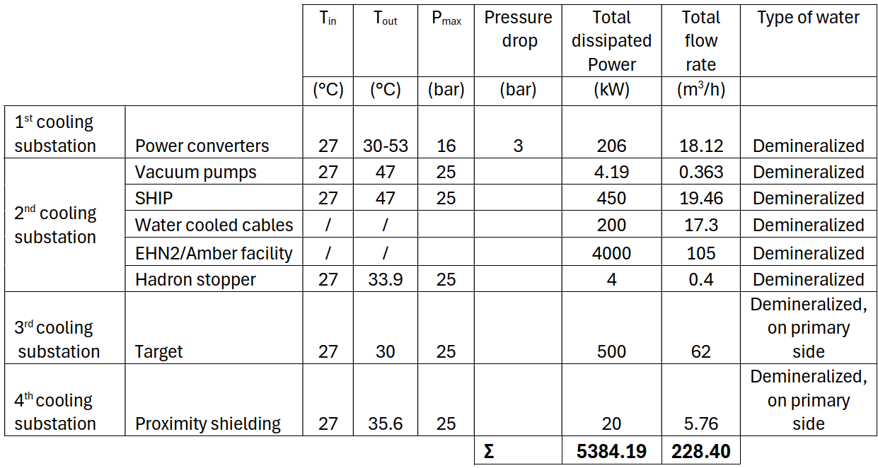
User requirements document – to be shared
Demineralized water – current status - measurement results
Demineralized water – future status
 | Total cooling Power | Total flow rate | Type of water
 | (kW) | (m³/h)
ECN3, TCC8 branch: Magnets, Power converters, WC cables, vacuum pumps, NA62 experiment | 2970 | 185 | Demineralized
EHN2/Amber facility | 4000 | 105 | Demineralized
Σ | 6970 | 290.00
There is enough capacity in terms of cooling power and flow rate of demineralized water, which is supplied from BA82.
There is no impact on CT2
F. Dragoni, N. Zaric | Target cooling station and Target complex ventilation
14.05.2025.

Slide 5
User requirements document – to be shared
Chilled water – current status - measurement results
Chilled water – future status – additional load
Nominal cooling capacity 4.4MW, flow rate 660m³/h
Cooling capacity 4.35 MW, flow rate 635m³/h
 | Branch | Cooling capacity | Flow rate
Building / Experiment | / | [kW] | [m³/h]
Beryllium facility | 4th – from BA80 | 200 | 28.7
New service building | 5th – from ECN3 | 250 | 35.9
ShiP experiment | 5th – from ECN3 | 30 | 4.3
Total |  | 480 | 68.9
NA62 experiment will be dismanled (total savings of 255 kW and 36.6m³/h)
This capacity is on 5th branch and possibly could be used for Service building and SHIP
Additional load from Berylium facility can’t be covered by potential savings from NA62 experiment
Additional loads are 175kW with 25.1 m³/h. Flow rate can be accomodated by existing pumps, but chillers can’t deliver 4.575 MW. Maximum capacity of 4.35MW happened only once (1h) in last 4 years, capacity higher than 4.225 MW happened only 7 times. It’s reasonable to stay with existing chillers providing small variation in the supply temperature for maximum 2 hours a year than installing a new chiller. With this configuration, there is no impact on CT2.
F. Dragoni, N. Zaric | Target cooling station and Target complex ventilation
14.05.2025.

Slide 6
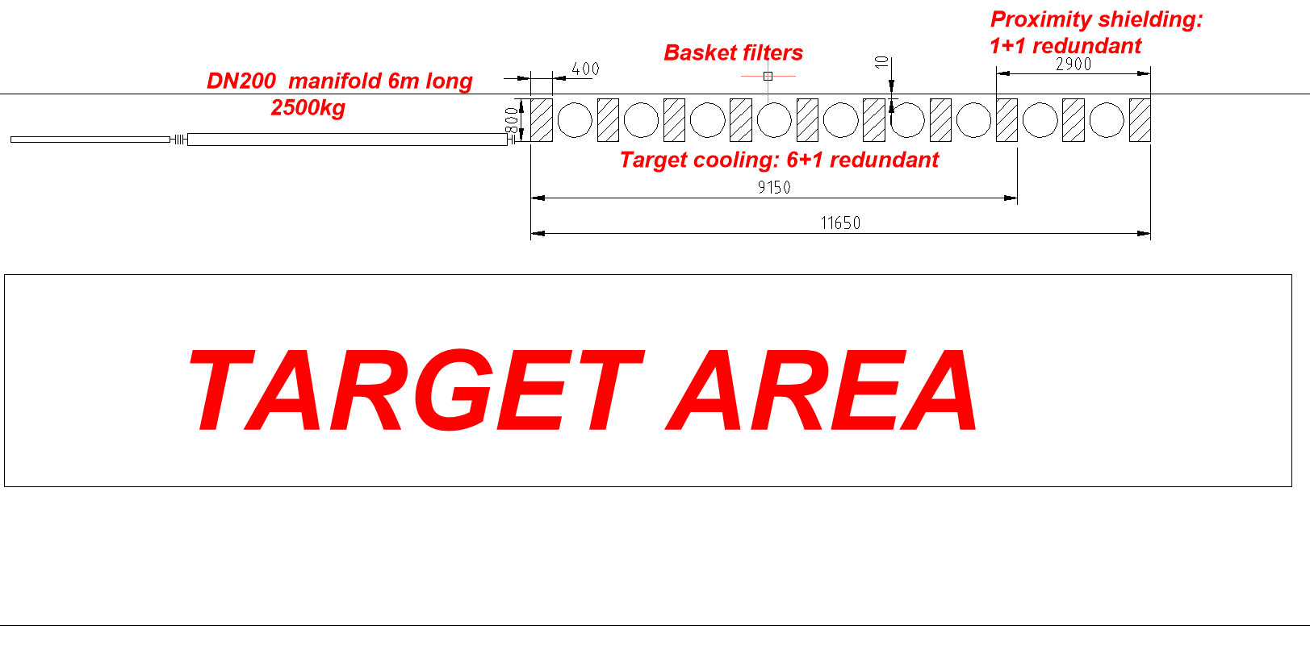
Target cooling station
3D model to be set
F. Dragoni, N. Zaric | Target cooling station and Target complex ventilation
14.05.2025.

Slide 7
TCC8 & ECN3 mezzanine
TCC8
Component | Dimension [W x H x L] | Dimension with chasing [W x H x L] | Comment
 | [mm] | [mm]
AHU | 1960 x 1960 x 5440 | 1960 x 1960 x 5440
Mixing chamber | 1960 x 1960 x 1060 | 1960 x 1960 x 1060
Fresh air damper | 610 x 1800 x 160 |  | Placed on mixing chamber
Return damper | 1500 x 1210 x 160 |  | Placed on mixing chamber
Filter section | 3 filters: 290 x 595 x400 | 1960 x 1960 x 440
 | 6 filters: 595 x 595 x 400
Electrical heating coil | 1390 x 1480 x 500 | 1960 x 1960 x 590
Chilled water coil | 1600 x 1620 x 300 | 1960 x 1960 x 590
Fan + motor | 1000 x 1250 x 1200 | 1960 x 1960 x 1300
Extraction filter | 2 filters: 290 x 595 x400 | 1650 x 1345 x 1240 | Inspection chamber is separate section
 | 4 filters: 595 x 595 x 400
ECN3
Component | Dimension [W x H x L] | Dimension with chasing [W x H x L] | Comment
 | [mm] | [mm]
AHU | 2570 x 1960 x 5900 | 2570 x 1960 x 5900
Mixing chamber | 2570 x 1960 x 1030 | 2570 x 1960 x 1030
Fresh air damper | 2400 x 760 x 160 |  | Placed on mixing chamber
Return damper | 1500 x 1210 x 160 |  | Placed on mixing chamber
Filter section | 4 filters: 290 x 595 x400 | 2570 x 1960 x 440
 | 8 filters: 595 x 595 x 400
Electrical heating coil | 2010 x 1500 x 300 | 2570 x 1960 x 470
Chilled water coil | 2200 x 1620 x 300 | 2570 x 1960 x 590
Fan + motor | 1000 x 1500 x 1500 | 2570 x 1960 x 1750
Extraction filter | 3 filters: 290 x 595 x400 | 1960 x 1650 x 1240 | Inspection chamber is separate section
 | 6 filters: 595 x 595 x 400
* inspection chambers are not included in the list of components
F. Dragoni, N. Zaric | Target cooling station and Target complex ventilation
14.05.2025.

Slide 8
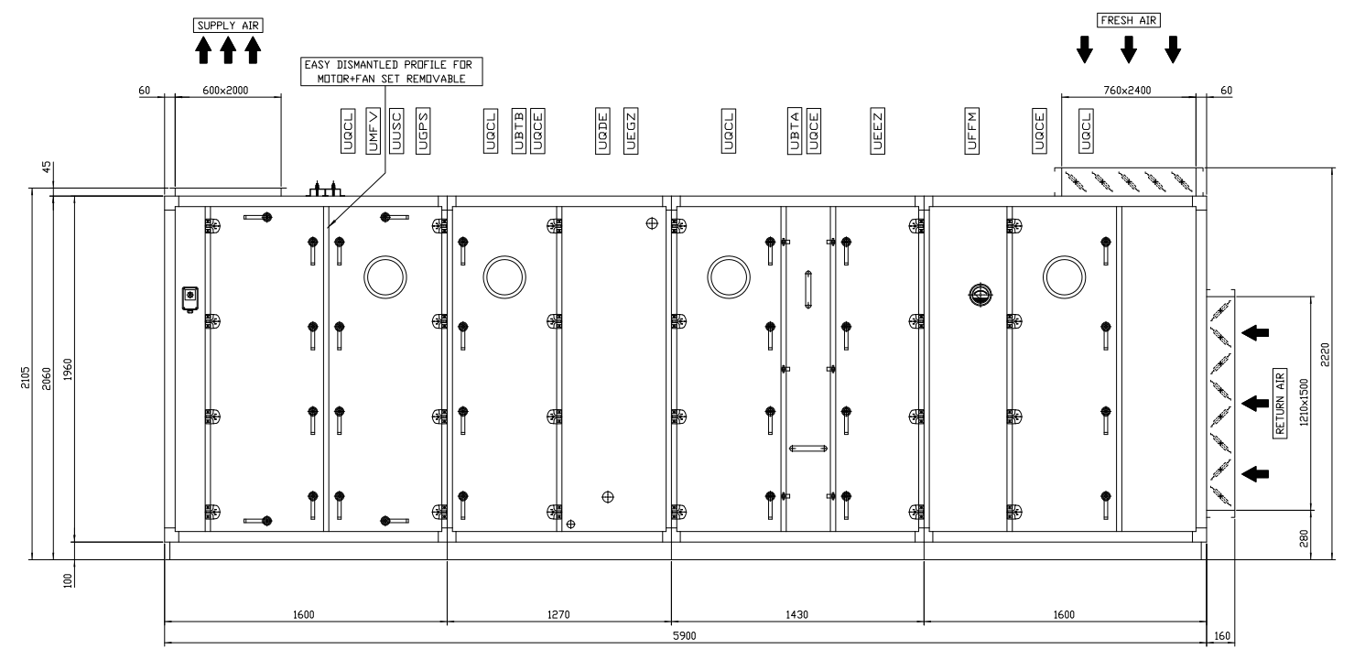
TCC8 & ECN3 mezzanine
ECN3 AHU:
  4 sections when AHU installed
  1600mm x 2105mm x 2650mm – biggest section
F. Dragoni, N. Zaric | Target cooling station and Target complex ventilation
14.05.2025.

Slide 9
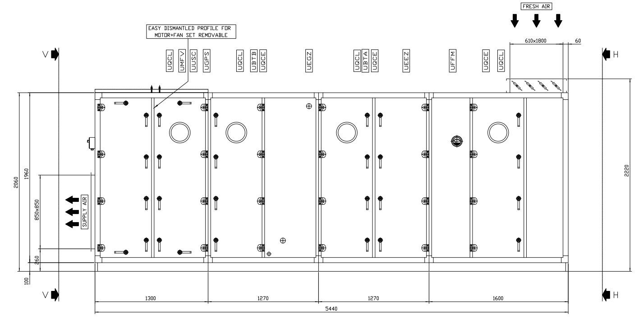
TCC8 & ECN3 mezzanine
TCC8 AHU:
  4 sections when AHU installed
  1600mm x 2060mm x 2210mm – biggest section
F. Dragoni, N. Zaric | Target cooling station and Target complex ventilation
14.05.2025.

Slide 10
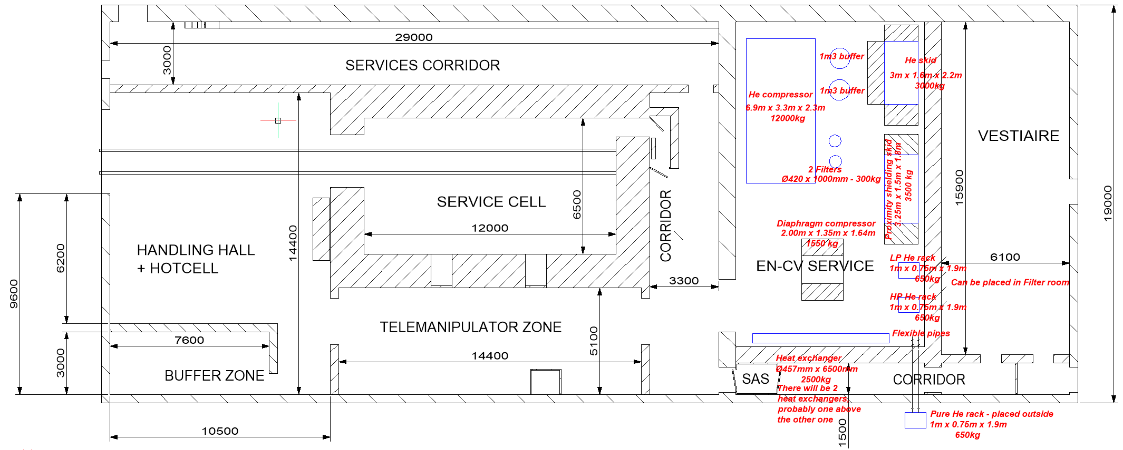
Service building – CV room
F. Dragoni, N. Zaric | Target cooling station and Target complex ventilation
14.05.2025.

Slide 11
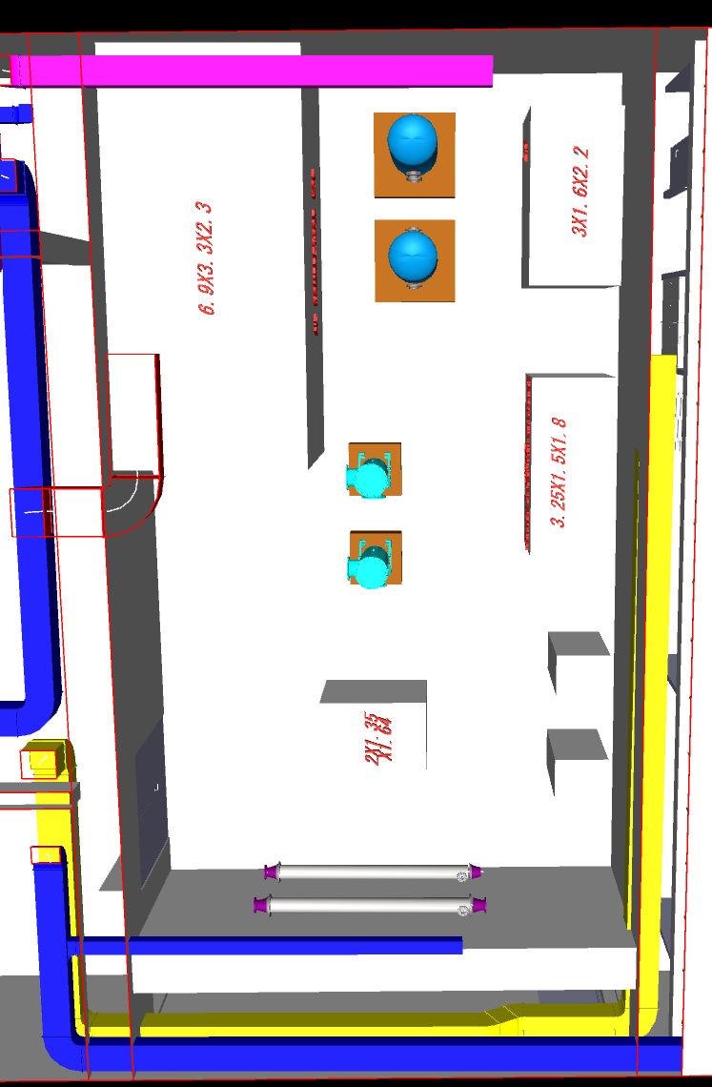
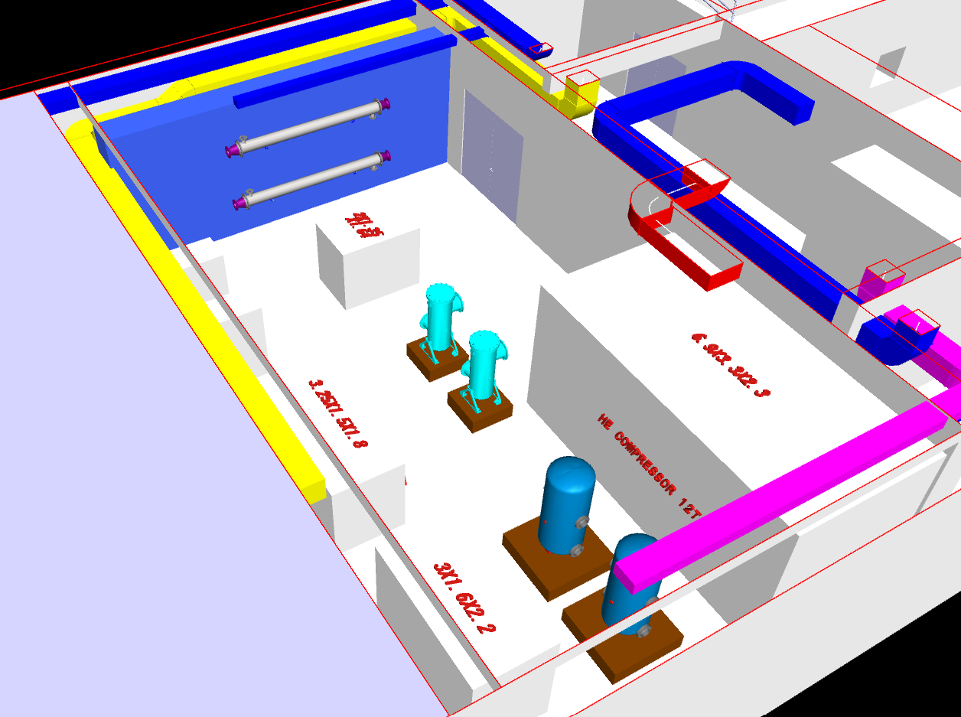
Service building – CV room
https://cernbox.cern.ch/files/spaces/eos/project/c/cv-design/BIM/0754/20_MOD/25_INT
F. Dragoni, N. Zaric | Target cooling station and Target complex ventilation
14.05.2025.

Slide 12
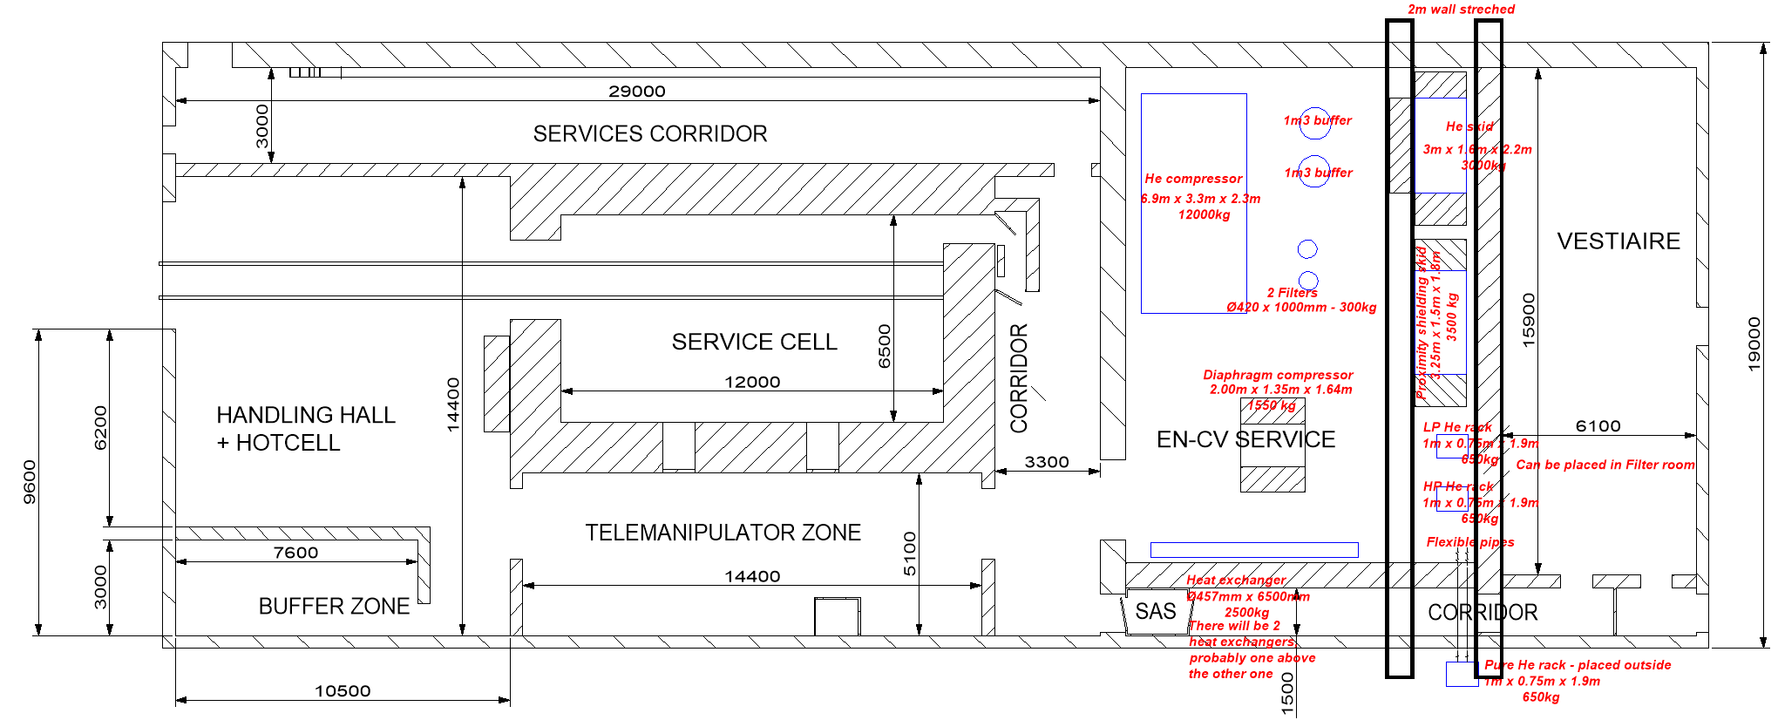
Service building – CV room
2m stretched wall
F. Dragoni, N. Zaric | Target cooling station and Target complex ventilation
14.05.2025.

Slide 13
EL loads
Electro equipment
No | System description | Consumer type | Room | Type of cabinet | Dimensions [w x h x d] | Rated current | Power
- | - | - | - |  |  | A | kW
1 | 2 | 3 | 4 |  |  |  | 5
 |  | UIAC ABB switchboard |  | Floor standing | 2840(+100) x 2270 x 650
 | He compressor | UIMV (VSD) |  | Floor standing | 400 x 2400 400 | 250 | 160.00
 |  | UIAO Control cabinet |  | Floor standing | 1000 x 2000 x 400 | 40
 |  | Motor |  |  |  |  | 7.50
 |  | Global power supply (not a cubicle)
 |  | Global power supply (on skid)
 | Proximity shielding skid - 2 pumps | UIAC - 00057 Power |  | Wall mounted | 600 x 1000 x 400 | 25 | 10.00
 |  | UIA0 - 00057 Control |  | Wall mounted | 800 x 1200 x 400 | 20.00
 | AHU S-2 system AHU S-3 system AHU S-2 system electrical coil AHU S-3 system electrical coil S-2e (extraction from AHU S-2) | UIAC ( 3 UIMV + 2x Thyristor element) |  | Floor standing | 1600 x 2000 x 600 | 200.00
 |  | UIAO |  | Floor standing | 1600 x 2000 x 400 | 20.00
 |  |  |  |  |  | 555.00
 |  |  |  |  | Adopted | 630.00
 |  | UIAC ABB switchboard (on secured power supply) |  | Floor standing
 | AHU S-1 system AHU S-1 system electrical coil (2 AHUs) | UIAC (2 x UIMV + 2 x Thyristor element) |  | Floor standing | 1200 x 2000 x 600 | 63
 |  | UIAO |  | Floor standing | 1000 x 2000 x 400 | 20.00
 | (on secured power supply)
 | S-1e ( EX also for Service cell) EX (Smoke extraction) EX(smoke extraction from Underground) | 6 x standalone UIMV (VSD) |  | Wall mounted | check dimensions | 200
 |  | UIAO |  | Floor standing |  | 40.00
 | (on secured power supply)
 | He skid | UIAC Both power/control cubicle |  | Floor standing | 1000 x 2000 x 400 | 25
 |  | UIMV (VSD) |  | Wall mounted | 400 x 2400 400 | 63 | 15.00
 | Vacuum pump for He skid | Motor |  |  |  |  | 0.45
 |  |  |  |  |  | 411.00
 |  |  |  |  | Adopted | 450.00
In case of 1 He
compressor
F. Dragoni, N. Zaric | Target cooling station and Target complex ventilation
14.05.2025.

Slide 14
EL loads
Electro equipment
No | System description | Consumer type | Room | Type of cabinet | Dimensions [w x h x d] | Rated current | Power
- | - | - | - |  |  | A | kW
1 | 2 | 3 | 4 |  |  |  | 5
 |  | UIAC ABB switchboard |  | Floor standing | 2840(+100) x 2270 x 650
 | He compressor | UIMV (VSD) |  | Floor standing | 400 x 2400 400 | 390 | 160.00
 |  | UIAO Control cabinet |  | Floor standing | 1000 x 2000 x 400 | 40
 |  | Motor |  |  |  |  | 7.50
 |  | Global power supply (not a cubicle)
 |  | Global power supply (on skid)
 | Proximity shielding skid - 2 pumps | UIAC - 00057 Power |  | Wall mounted | 600 x 1000 x 400 | 25 | 10.00
 |  | UIA0 - 00057 Control |  | Wall mounted | 800 x 1200 x 400 | 20.00
 | AHU S-2 system AHU S-3 system AHU S-2 system electrical coil AHU S-3 system electrical coil S-2e (extraction from AHU S-2) | UIAC ( 3 UIMV + 2x Thyristor element) |  | Floor standing | 1600 x 2000 x 600 | 200.00
 |  | UIAO |  | Floor standing | 1600 x 2000 x 400 | 20.00
 |  |  |  |  |  | 695.00
 |  |  |  |  | Adopted | 800.00
 |  | UIAC ABB switchboard (on secured power supply) |  | Floor standing
 | AHU S-1 system AHU S-1 system electrical coil (2 AHUs) | UIAC (2 x UIMV + 2 x Thyristor element) |  | Floor standing | 1200 x 2000 x 600 | 63
 |  | UIAO |  | Floor standing | 1000 x 2000 x 400 | 20.00
 | (on secured power supply)
 | S-1e ( EX also for Service cell) EX (Smoke extraction) EX(smoke extraction from Underground) | 6 x standalone UIMV (VSD) |  | Wall mounted | check dimensions | 200
 |  | UIAO |  | Floor standing |  | 40.00
 | (on secured power supply)
 | He skid | UIAC Both power/control cubicle |  | Floor standing | 1000 x 2000 x 400 | 25
 |  | UIMV (VSD) |  | Wall mounted | 400 x 2400 400 | 63 | 15.00
 | Vacuum pump for He skid | Motor |  |  |  |  | 0.45
 |  |  |  |  |  | 411.00
 |  |  |  |  | Adopted | 450.00
In case of 2 He
compressors
(1 redundant)
F. Dragoni, N. Zaric | Target cooling station and Target complex ventilation
14.05.2025.

