Slide 1
Re-use of PR-560 in TCC8
C. Duran Gutierrez, R. Rinaldesi – EN-HE
2025-05-05

Slide 2
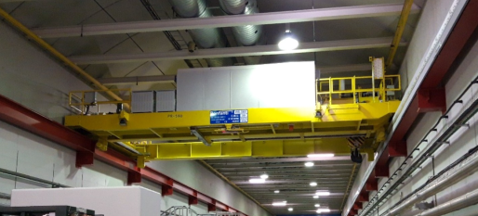
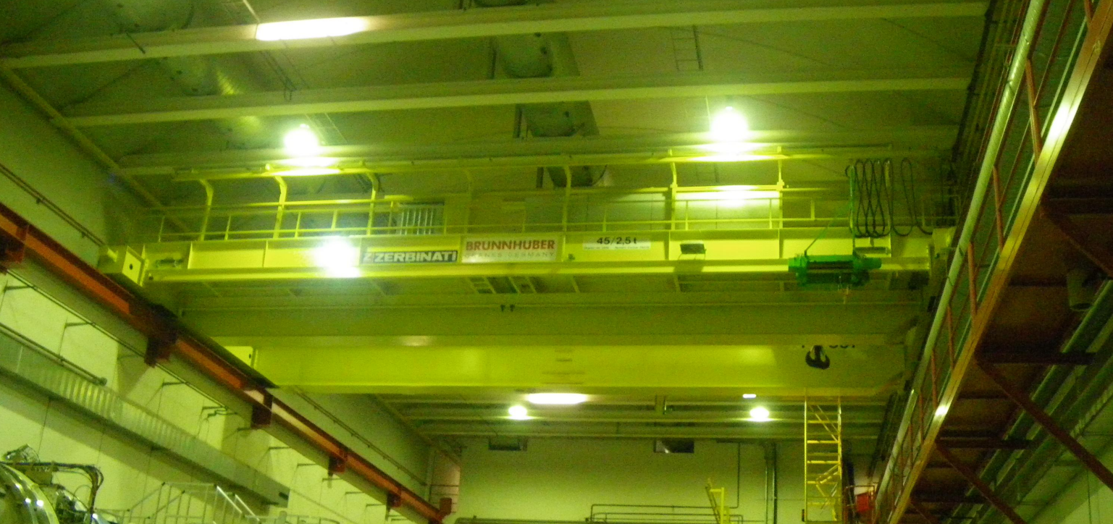
Existing situation
TCC8 tunnel
ECN3 cavern

Slide 3
Current plan
Dismantling of the existing TCC8 crane
Installation of a new crane suitable for the radioactive environment
Installation of a confinement wall
Control panel
Festoon cables
TCC8 tunnel
ECN3 cavern
Confinement wall

Slide 4
New configuration being considered
The existing crane is not dismantled and stays in the upstream part of TCC8
The new crane operates only in the downstream part of TCC8
TCC8 tunnel
ECN3 cavern

Slide 5
Impacts of the new configuration
New festoon storage area with junction box
Festoon cables will be shorter
The festoon storage area will be moved close to the confinement wall
Hook coverage of the new crane in the longitudinal direction will be smaller
Hook coverage of the existing crane in the transversal direction may be reduced to avoid conflict with the cables in fixed installation
It may be necessary to modify the maintenance walkway (handrails)
Cables in fixed installation
Existing festoon storage area
Confinement wall
Control panel

Slide 6
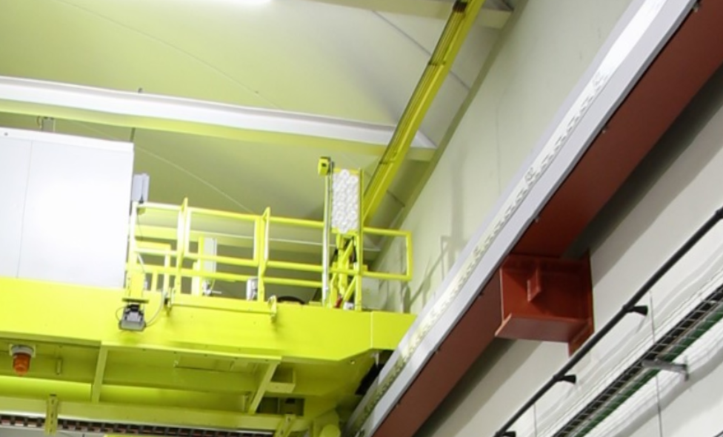
Impacts of the new configuration
It may be necessary to move the feeding line towards the centre of the tunnel
Some modification to the cabling required

Slide 7
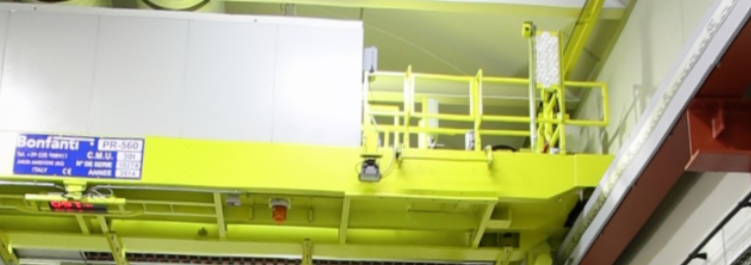
Impacts of the new configuration
Access to the existing crane for maintenance will still be possible via a removable ladder -> a corridor shall be kept clear to allow the possibility to attach a removable ladder (position can be modified)
The existing crane has electronic components on-board -> resistance to radiation to be checked

Slide 8
Impacts of the new configuration
If major works are needed on the existing crane (e.g trolley replacement) the new crane shall be dismounted first
TCC8 tunnel
ECN3 cavern

Slide 9
Conclusion
Pros | Cons
There is no need to remove the confinement wall each time we need to bring equipment into the beginning of TCC8, as access through EHN2 can be used instead. | Loss of crane coverage in the longitudinal direction (new crane) near the confinement wall due to the space required for the new festoon cable storage area.
If the confinement wall includes a door large enough to allow material transfer from the upstream part of TCC8 to the target area, access through EHN2 can be used instead of 911. For example, if the 911 shaft is closed or otherwise inaccessible. The old crane can assist with this operation if necessary. | Replacing the trolley of the old crane (though unlikely) would require dismantling the new crane and possibly partial dismantling of the SHiP experiment.
Minor works can be carried out, which are less costly than removing the entire crane. | Minor site works must be carried out and accounted for prior to the installation of the new crane.
Shorter festoons cables required for the new crane. | Hook coverage of the existing crane in the transverse direction may need to be reduced to prevent interference with fixed cable installations.
Comments
Assess the radiological protection (RP) conditions in the upstream part of TCC8, considering that the control panel is on-board and remote handling is not possible. If the residual dose rates in the target area are below 1 µSv/h one month after shutdown, it can be assumed that the residual dose rates in the upstream part of TCC8 are even lower.
Assess the impact of having two cranes in terms of electrical infrastructure.
Additional cost for maintenance of two cranes in TCC8 instead of one.

Slide 11
Extra – Hook coverage TCC8 Upstream (current)

