Slide 1
EN-HE Updates
HI-ECN3 WP4 - Coordination meeting #12 – C. Duran Gutierrez, R. Rinaldesi – EN-HE
14-05-2024

Slide 2
Content
Service Building – Equipment installation
  CV Rooms
  Interferences
Transport study: from EHN2 to TCC8
TCC8 with 2 cranes. Re-use of PR560
TCC8 Mezzanine: transport volume
Ongoing and future assessments
Extra Material
  Re-use of PR-560 in TCC8 study

Slide 3
Service Building – Equipment installation
CV Rooms
Second draft study analyzing possible sequences for the transportation and handling of CV equipment within the new service building (first installation and maintenance operations)
CV 2 – CV Room on the second floor
CV 1 – CV Room on the first floor
CV G – CV Room on the ground floor
Proposal
Access to the CV 2 through CV 1.
CV 2
CV 1
CV G

Slide 4
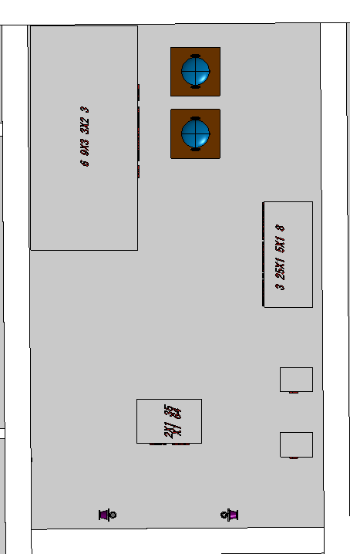
Service Building – Equipment installation
CV Rooms
CV Room Ground floor – 2nd Layout
CV Room – Ground floor
CV-Room Door | 2468 (w) x 2484 (h) mm
CV-Room Height | 3600 mm
With the current CV room height, there are only 300mm left form the He compressor to the ceiling.
Door opening
  Width at least 3400 mm
  Height > 3300 mm
Installation sequence to be planned in advance.
Identify the components most likely to require replacement; ensure a layout that facilitates easy access and replacement.
Question
Is the Helium compressor
Installed in one piece?
3300
Door width > 3300
ST1942728_01

Slide 5
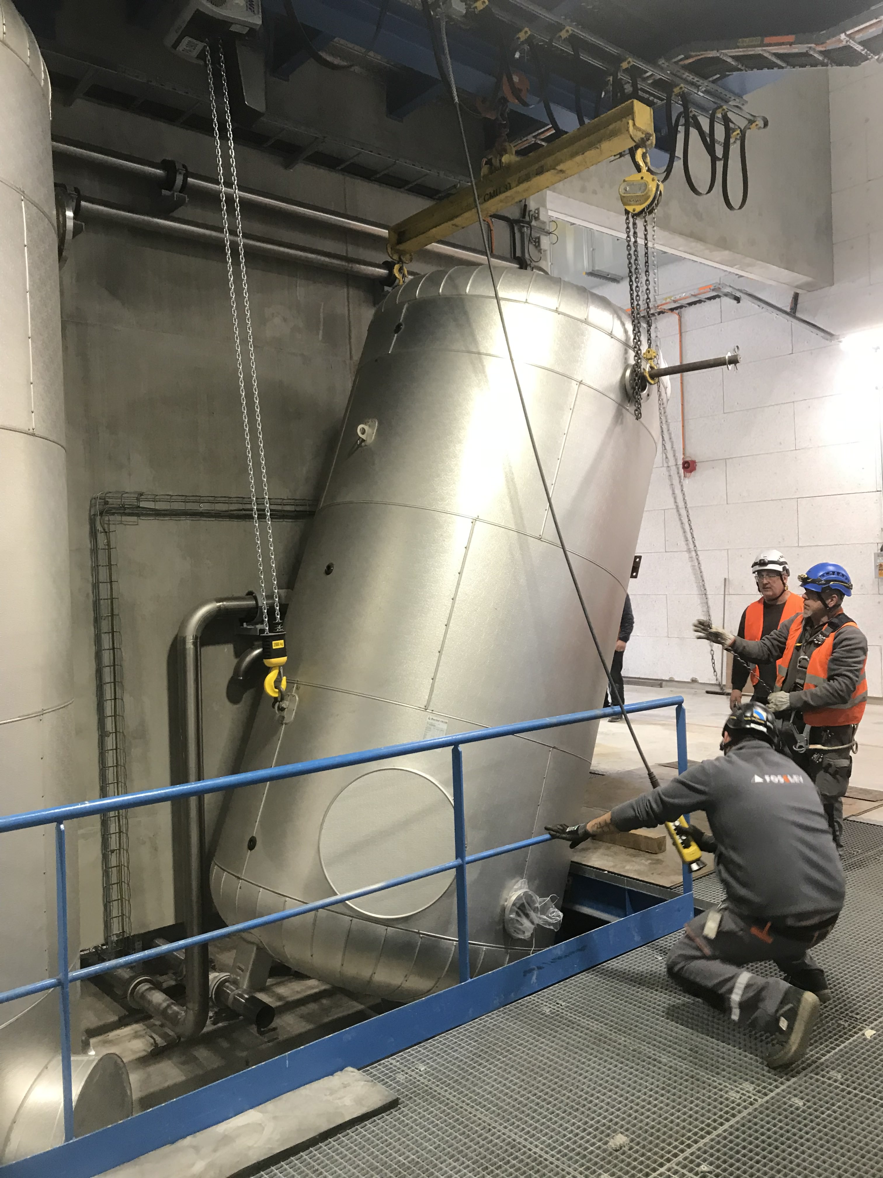
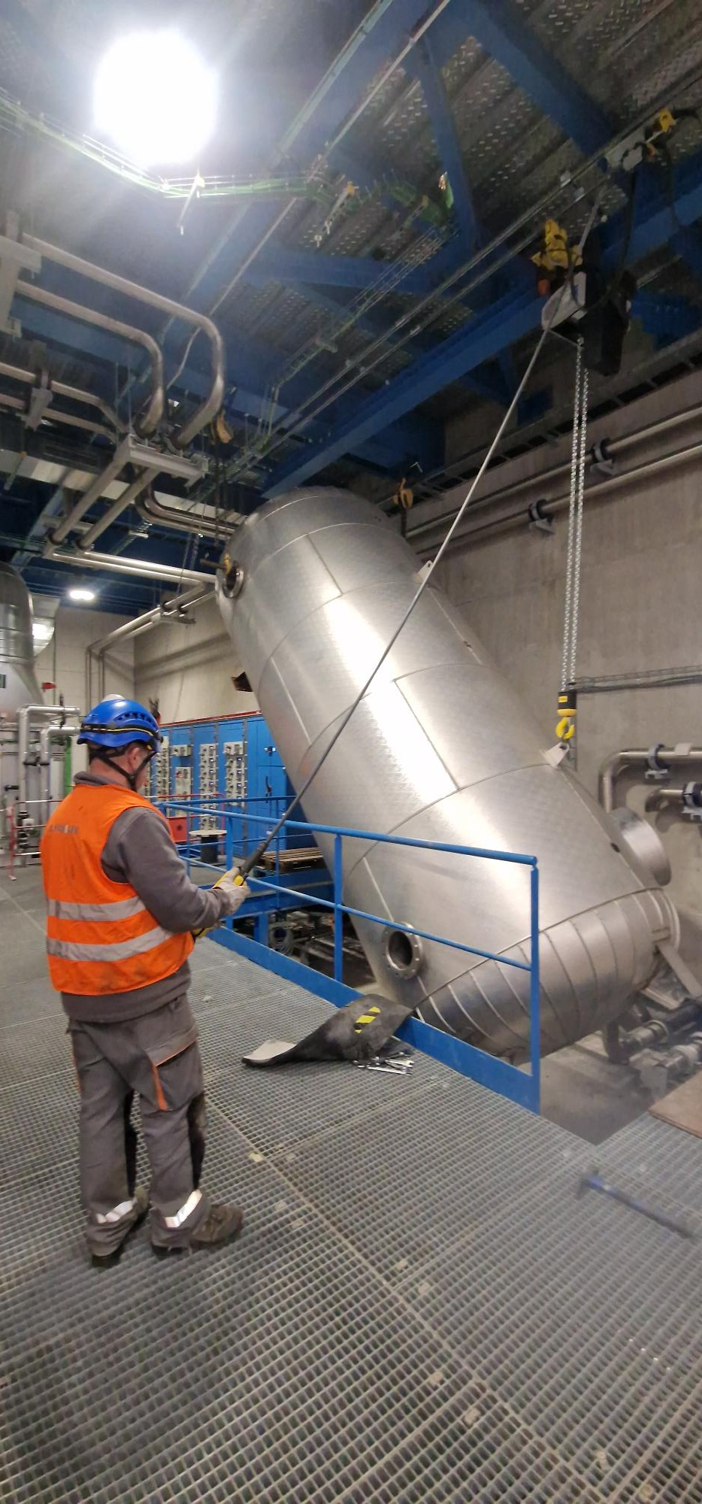
Service Building – Equipment installation
CV Rooms
CV Room – Ground floor
CV-Room Door | 2468 (w) x 2484 (h) mm
CV-Room Height | 3600 mm
Door opening
  Width at least 3400 mm
  Height > 3300 mm
Installation sequence to be planned in advance.
Identify the components most likely to require replacement; ensure a layout that facilitates easy access and replacement.
Proposal: Install rails/beam that allow for the use of hoist(s) to handle and position the equipment during installation and future maintenance.
Installation water tank SU57 (courtesy of M. Perez Ornedo)

Slide 6
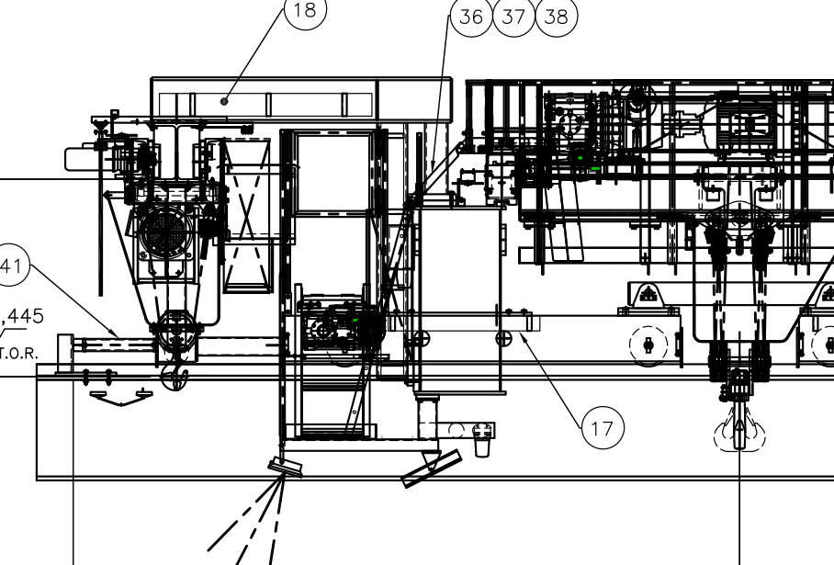
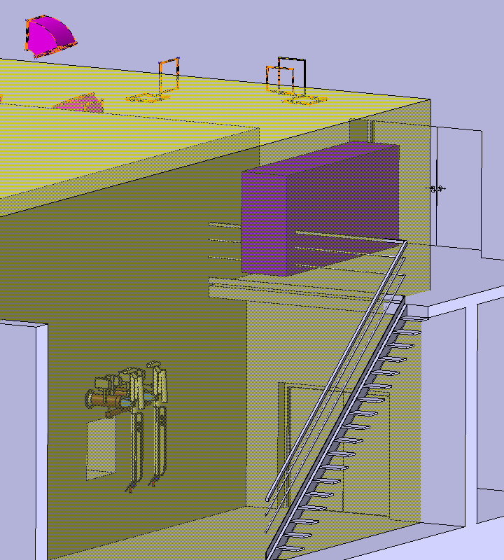
Service Building – Equipment installation
CV Rooms
Example of auxiliary hoist (PR 806)
CV Room – First floor
CV-Room Door | 2468 (H) x 2068 (W)
CV-Room Height | 4190 mm
CV Room – Equipment (first draft)
AHU unit | 4000 x 1000 x 1000 | 600 kg
Filters | 2314 x 650 x 1746 | 500 kg
Carbon Filter | 3870 x 888 x 1746 | 1110 kg
3300 + 500
Auxiliary hoist (extra crane coverage)
  Capacity to be defined (around 2.5 t)
  Extra height of 500 mm approx.

Slide 7
Service Building – Equipment installation
CV Rooms – 2nd floor
Proposed access
Enter through the 1st floor and access the 2nd floor from there.
Required equipment
Handling tools installed on the ceiling inside, to lift the equipment from the 1st floor to the 2nd.
  Rails
  Hoists
An opening large enough to allow material handling between floors is required.

Slide 8
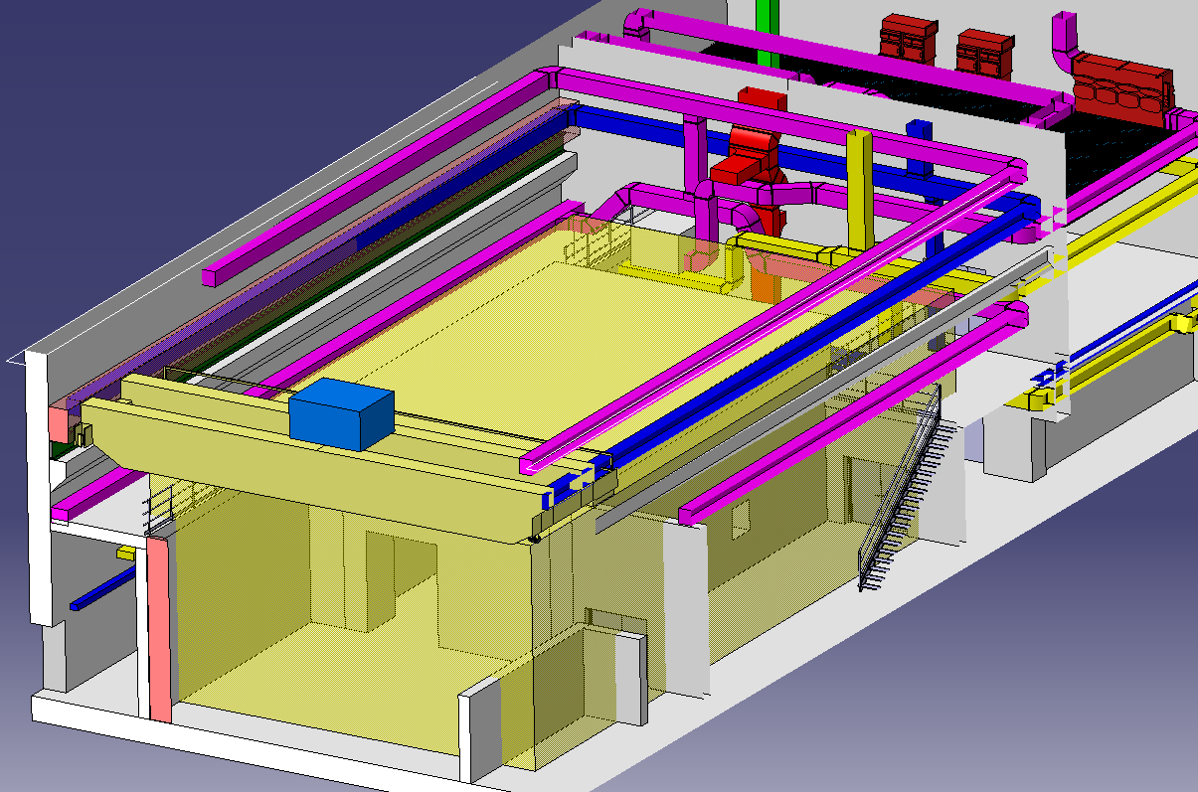
Service Building – Equipment installation
INTERFERENCES
To be assessed
Potential interferences between the CV pipes/ducts and the following:
Transport equipment (crane)
Reserved spaces (walkway)
Access points (doors)

Slide 9
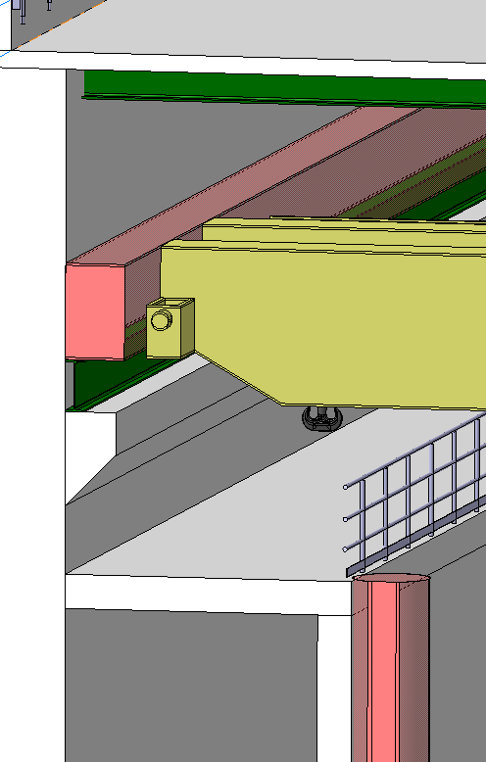
Service Building – Equipment installation
INTERFERENCES
To be assessed
Potential interferences between the CV pipes/ducts and the following:
Transport equipment (crane)
Reserved spaces (walkway)
Access points (doors)
SCE
Modification of the 3D model to incorporate the maintenance walkway and crane rails in the correct locations.

Slide 10
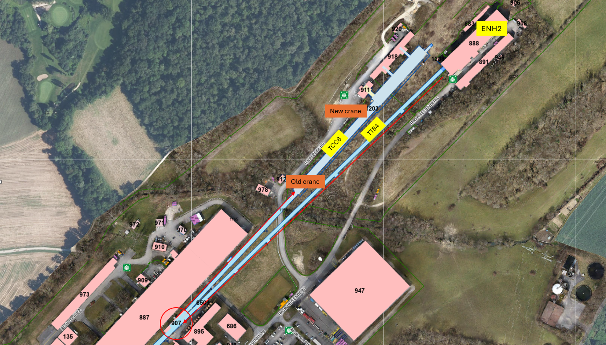
Transport study: from EHN2 to TCC8
Transport study ongoing

Slide 11
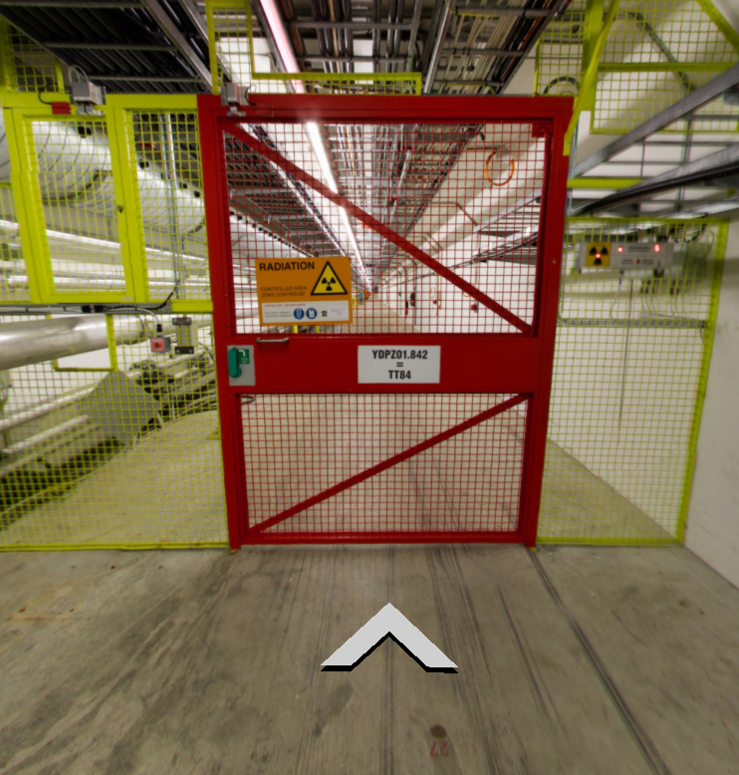
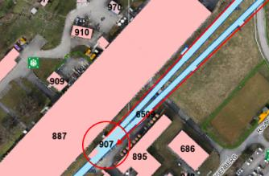
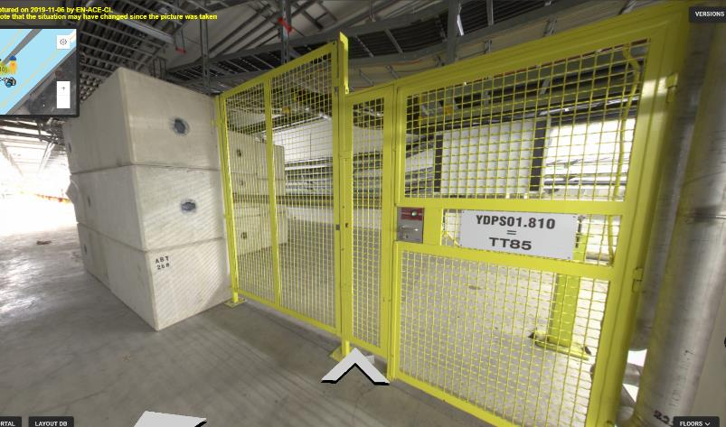
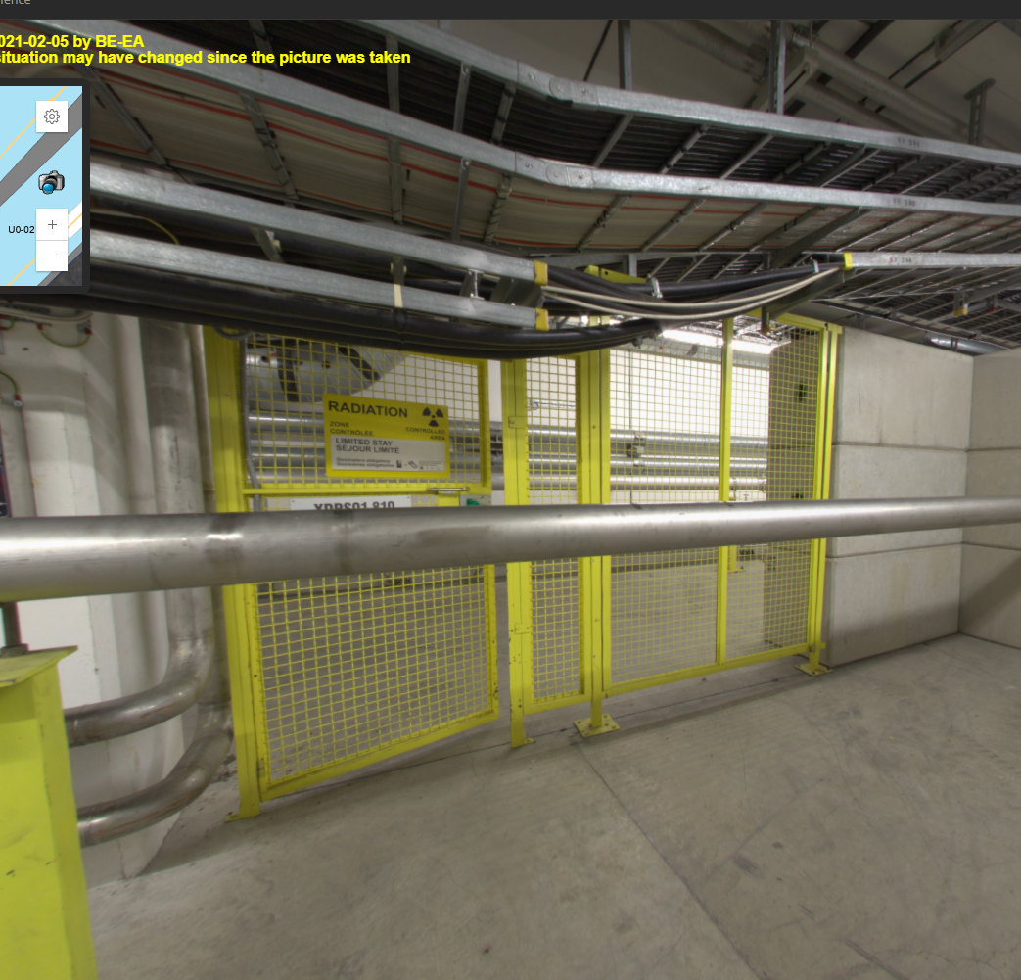
Transport study: from EHN2 to TCC8
Transport study ongoing
TT84
It is not advisable to dismantle these doors unless it is very justified and there are no alternative transport routes.
The maximum transport volume is limited by the red door opening:
Max Width = 1500 mm
Max Height = 2200 mm
TT84 Inputs
The yellow door can be dismantled
The concrete blocks can be dismantled
  (clearance height to be verified on site)
Turning radius will depend on the dimensions and configuration of the equipment to be transported.
1500
TT84 – TT85
3130

Slide 12
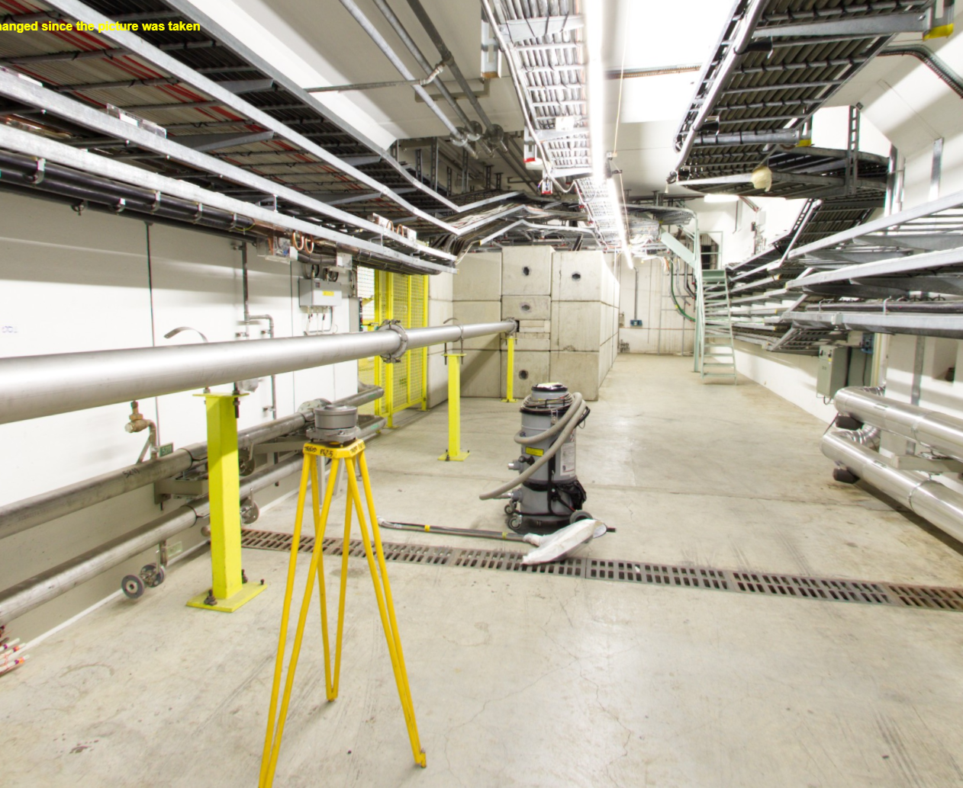
Transport study: from EHN2 to TCC8
Transport study ongoing
TT84
TT85
TT85 Inputs
A section of the beamline can be dismantled without removing the concrete blocks upstream
Turning radius will depend on the dimensions and configuration of the equipment to be transported.
TCC8 Inputs
All transport and handling activities will depend on the new layout planned for TCC8.
If the existing overhead crane is retained in that tunnel area, its hook coverage can be used to assist transport operations.
1834
1500
TT84 – TT85
3130

Slide 13
Transport study: from EHN2 to TCC8
Transport study ongoing
* Volume -1500 x 4300 x 2000 (WxLxH)
(considering forklift/trolley in L)
ST1A35215_01

Slide 14
TCC8 with 2 cranes. Re-use of PR560
Existing situation and current plan
Dismantling of the existing TCC8 crane
Installation of a new crane suitable for the radioactive environment
Installation of a confinement wall
Control panel
Festoon cables
TCC8 tunnel
ECN3 cavern
Upstream TCC8
Confinement wall

Slide 15
TCC8 with 2 cranes. Re-use of PR560
New configuration being considered
The existing crane is not dismantled and stays in the upstream part of TCC8
The new crane operates only in the downstream part of TCC8
Old crane
New crane
TCC8 tunnel
ECN3 cavern
Upstream TCC8

Slide 16
TCC8 with 2 cranes. Re-use of PR560
Pros | Cons
No need to remove the confinement wall to access the upstream part of TCC8 (access through EHN2) | New crane - Loss of crane coverage in the longitudinal direction near the confinement wall (new festoon cable storage area)
If the confinement wall includes a door - access through EHN2 can be used instead of 911 if needed. | Replacing the trolley of the old crane would require dismantling the new crane and possibly partial dismantling of the SHiP experiment. – Very unlikely
Save the cost of removing the crane | Minor site works must be carried out
Shorter festoons cables required for the new crane. | Current crane - Hook coverage in the transverse direction (upstream) may be reduced to prevent interference with fixed cable installations.
Comments
Assess the radiological protection (RP) conditions in the upstream part of TCC8, considering that the control panel is on-board and remote handling is not possible.
Assess the impact of having two cranes in terms of electrical infrastructure.
Additional cost for maintenance of two cranes in TCC8 instead of one.
Confinement wall location
Decision must be taken before September (New crane contract)

Slide 17
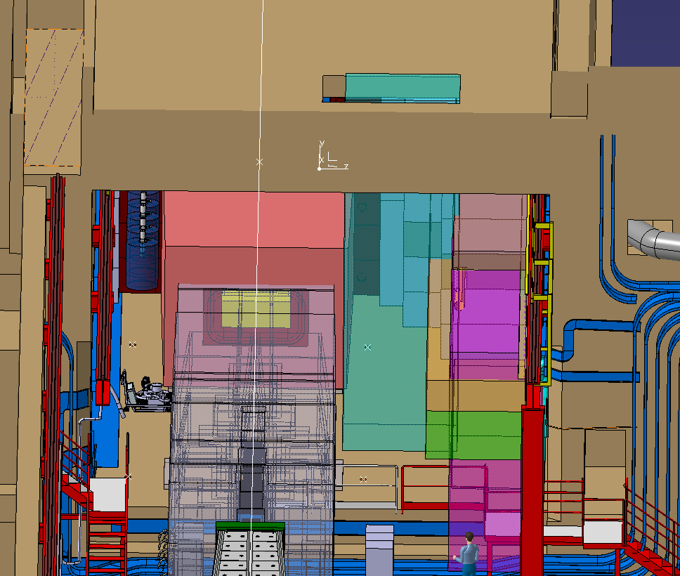
Tcc8 mezzanine: Transport volume
Current equipment
Opening – 3000 x 2000 mm
  To be verified on site
Space reservation – 2500* x 2000 mm
Max. volume – 2400 x 1900 mm (safe margin)
  Current largest footprint = 2200 x 440 (ECN3 cooling coil, no casing)
Space reservation 2500x2000 for current equipment
Space
reservation

Slide 18
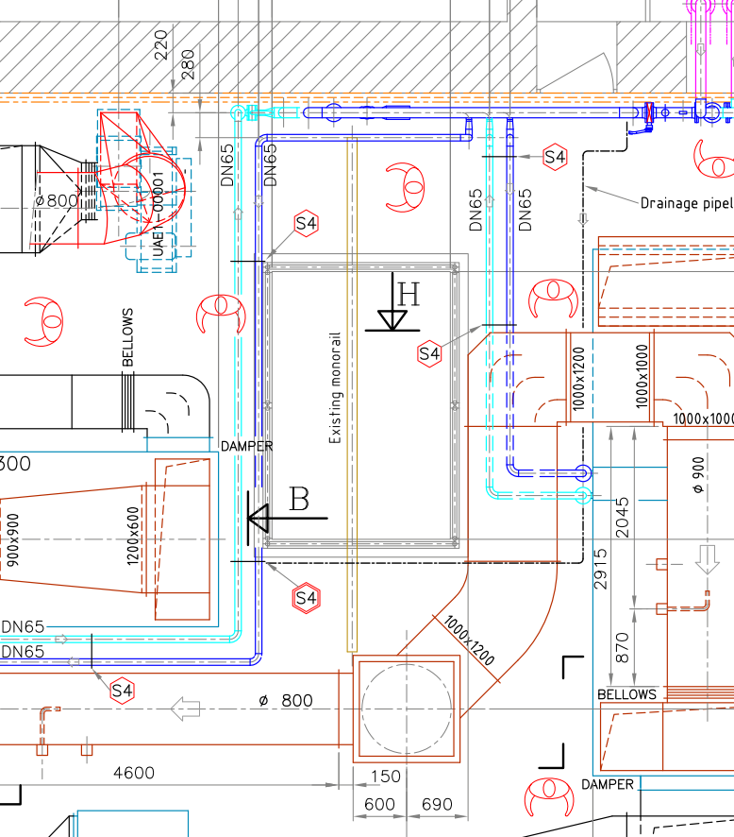
Tcc8 mezzanine: Transport volume
SPS Experimental gallery: ECN3, TCC8 and GHN300.
HVAC INSTALLATIONS DUCT WORK
Current equipment
Opening – 3000 x 2000 mm
  To be verified on site
Space reservation – 2500* x 2000 mm
Max. volume – 2400 x 1900 mm (safe margin)
  Current largest footprint = 2200 x 440 (ECN3 cooling coil, no casing)
QUESTIONS
New equipment to be installed in the mezzanine?
  Dimensions and weights
Handling rail location (2t)
  – to be verified on site
Space
reservation
Rail length ≈ 5400 mm
≈938

Slide 19
Tcc8 mezzanine: Transport volume
Confinement wall location to be defined
Current equipment
Opening – 3000 x 2000 mm
  To be verified on site
Space reservation – 2500* x 2000 mm
Max. volume – 2400 x 1900 mm (safe margin)
  Current largest footprint = 2200 x 440 (ECN3 cooling coil, no casing)
QUESTIONS
New equipment to be installed in the mezzanine?
  Dimensions and weights
Handling rail location (2t)
  – to be verified on site
Confinement wall location
Space available for manoeuvring
Manoeuvring space around the opening

Slide 20
Ongoing and future assessments
ECR - ECN3 Transfer Tables
B.754
Transport and handling studies
Service cell crane
Specifications and estimated volume
CV
Equipment installation in TCC8
Equipment installation in B754
Other handling and transport studies
From EHN2 to TCC8

