Slide 1

HI-ECN3 WP4 coordination meeting #12
Jean-Louis GRENARD
14-5-2025

Slide 2
Agenda
Target complex updates
Target station and vacuum vessel updates → Gemma
Target cooling station and target complex ventilation → Nikola & Francesco
Handling studies update → Cristina
Dismantling of TCC8 → Ixone & Nicolas
AOB

Slide 3
Service cell – design study
Technical specification for design study out
https://edms.cern.ch/document/3264680/1.0
Offers due 10th of June

Slide 4
Integration
We need continue our progress with service building integration
Please fill the shared table: Service building design parameters.xlsx
Pending one major concern cooling room size:
Need space for a second compressor to be adressed:
How long will take to replace the compressor in case of failure?
RP constrains, time to prepare the area, replacement, recomissioning, area ‘’cleaning’’
→ What downtime shall we expect out this procedure

Slide 5
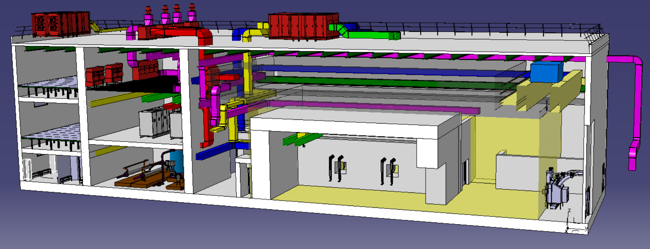
Integration - Service building

Slide 6
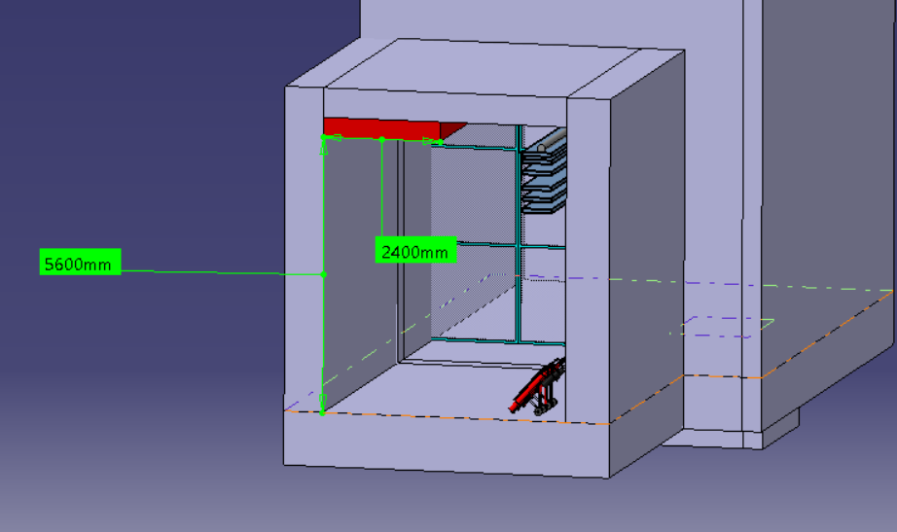
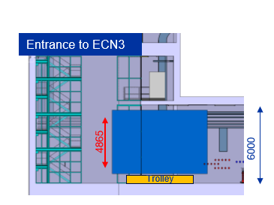
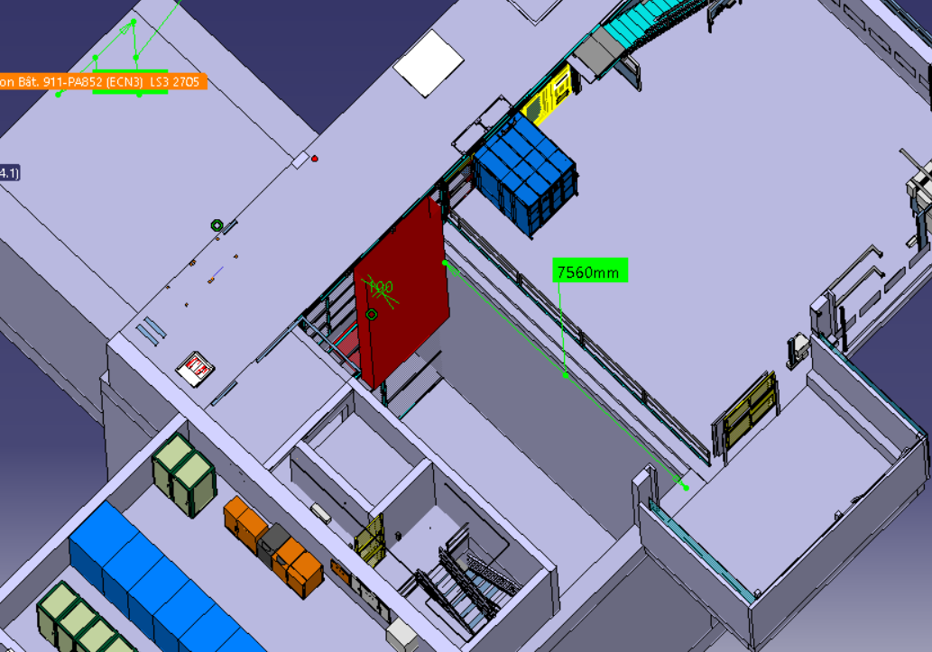
Usage of 911 shaft – tentative space reservation
Pipes and duct arrangement can be further optimised
Space reservation for pipes and duct rooting 2.4m x 0.4m
Diagonale: ~8.7m
Spectrometer magnet coil transfer in access tunnel
Now implemented in the 3d Models

Slide 7
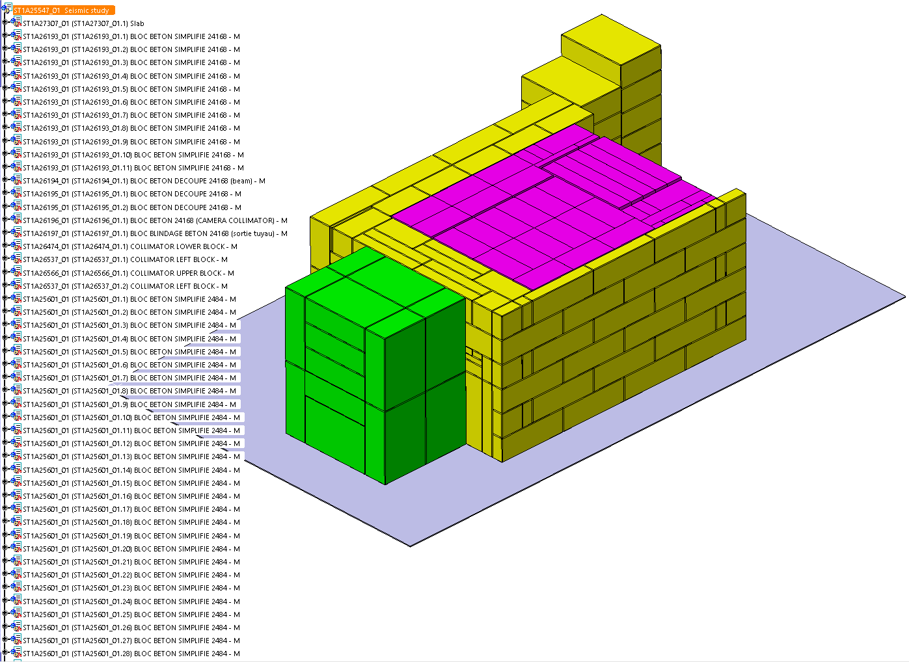
Seismic assesment of target station
Simplified 3d model for seismic assessment has been made and shared with HSE
Thanks Béa

Slide 8
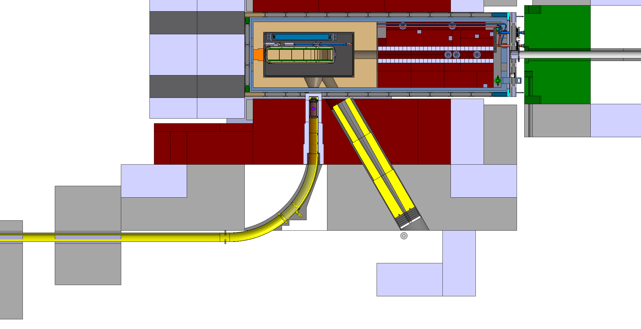
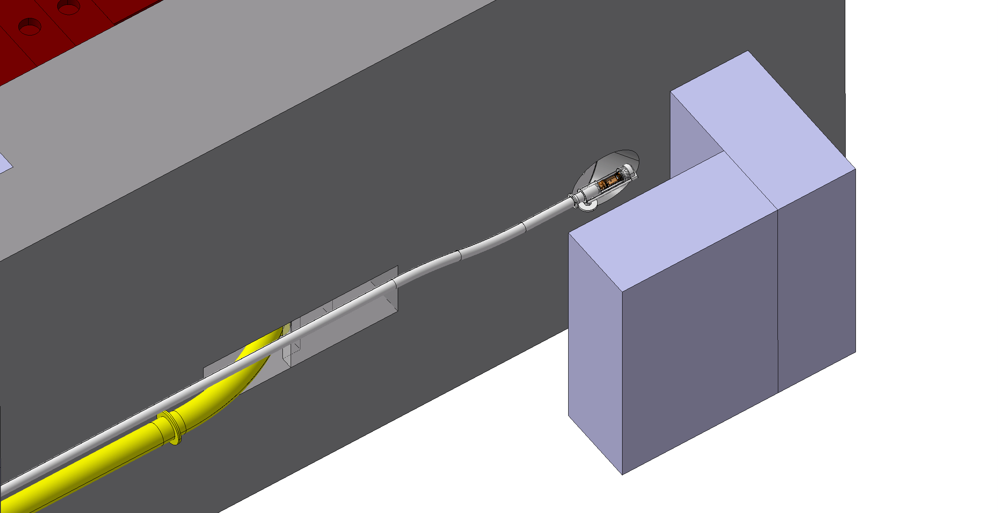
Parasitic activation station (n_ACT)
BRIS
BAIS
BEAS

Slide 9
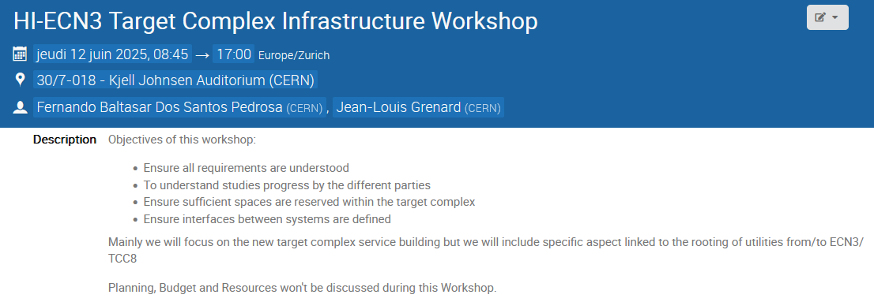
AOB
HI-ECN3 Target Complex Infrastructure Workshop (WP4 & WP7)
https://indico.cern.ch/event/1546119/

