Slide 1
Target Station Configuration and Vacuum Vessel Design Study
Gemma Humphreys
14.05.2025

Slide 2
Contents
Procurement / Testing Updates
Vacuum Vessel Design Study Update
FLUKA Model Import
Feedthroughs

Slide 3
Procurement / Testing Updates
Feedthrough Connectors:
  3 contractors with ability to provide connectors compatible with remote handling
Vessel Door Seal Testing
  Irradiation of samples to be done at CERN
  Meeting to discuss the samples this week
  Tests to be conducted:
    Compression
    Tensile strength
    Weight loss
    Leak test

Slide 4
Vacuum Vessel Design Study
Design study specification in progress
  Need to establish delivery schedule
  Check any additional constraints
Rough quote from AVS/CADINOX received
  Quote includes:
      Design: preliminary design of the vacuum chamber, including manufacturability, welding proposal, materials, etc. Deliverables: 3D model, assembly drawings, draft of the welding book, design report.
      Analysis: preliminary analysis of the chamber under EN13445. Deliverables: preliminary analysis report.
      Requirements: specifications review, definition critical parameters, technical feasibility, interfaces. Deliverables: technical specification of the chamber
      Reporting: biweekly progress meetings (VC) with CERN team. Deliverables: MoMs
      Project assessment: Deliverables: ROM budget, realistic schedule
      Production strategy definition: potential visit to discuss about production, assembly and testing strategies

Slide 5
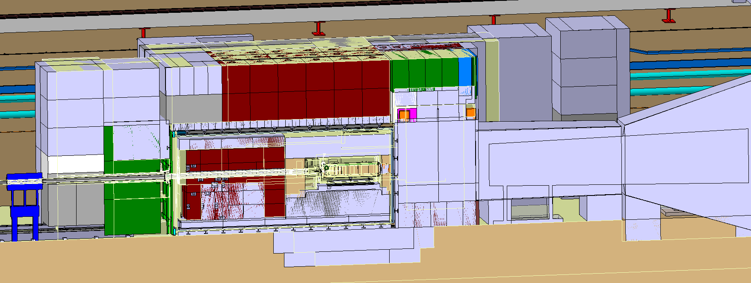
FLUKA Model Import
Initial comparisons of FLUKA model and Catia model completed
A few of the differences identified:
  Shielding pit location 58cm shifted
  Target length difference of 8.6 cm
  Target vessel not included in FLUKA
  MHS coil 25cm wider in Catia
Further comparisons will be identified and listed in the coming weeks

Slide 6
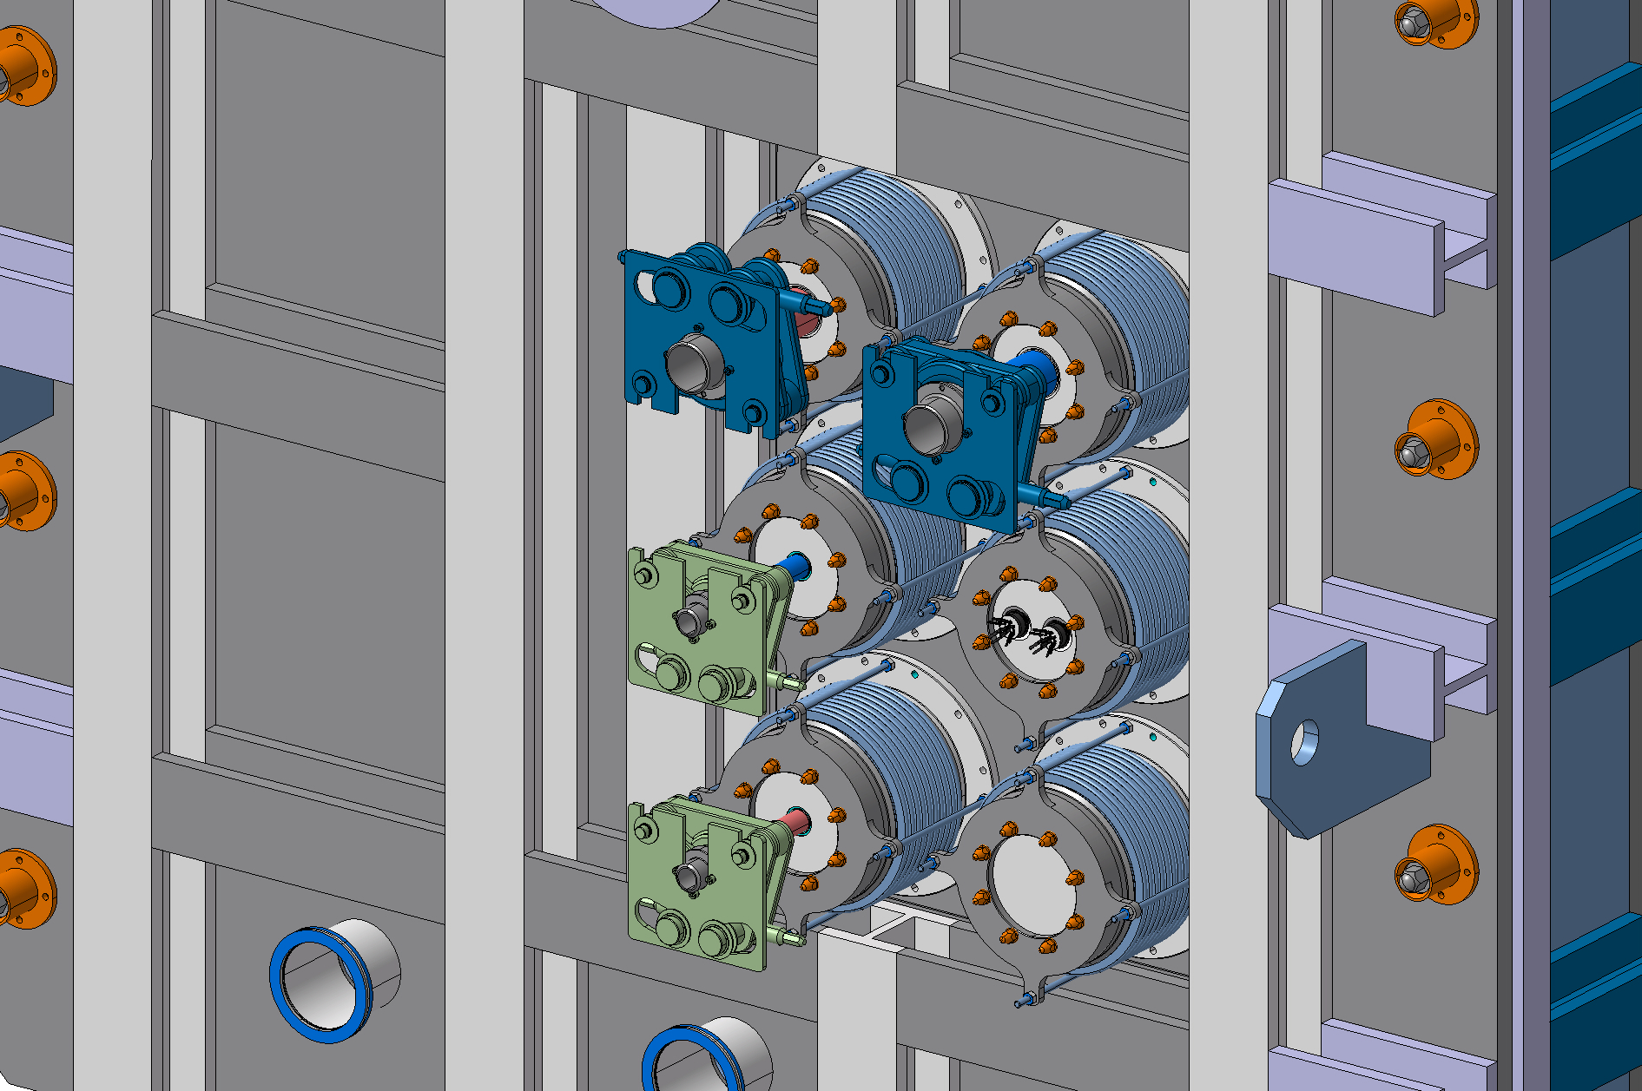
Feedthroughs
Sequence of installation and removal of connectors being developed by Christophe
Alternative feedthroughs being evaluated
Brainstorming meeting for other options next week

