Slide 1
RADSUM25 Workshop
Key Summary Points
Radiation sensitivity of HTS and modelling efforts
RADSUM Organizers:
L. Bottura
C. Scheuerlein
A. Lechner
A. Lechner (CERN), with the valuable input of many colleagues and RADSUM participants
17/04/2025

Slide 2
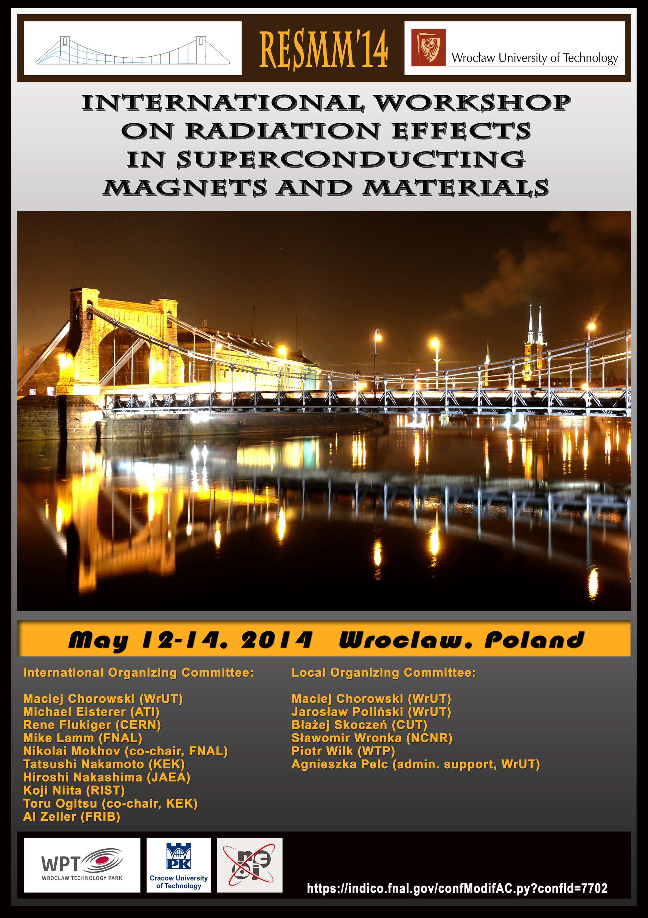

Motivation for RADSUM25 workshop
Previous RESMM workshop series (accelerator-focused, now terminated):
Radiation damage in superconducting magnets* is an important aspect for accelerator facilities, in particular for future collider projects (FCC, Muon Collider, etc.)
After the termination of the RESMM workshop series in 2015, there is no longer an accelerator-focused discussion forum around this topic
On the other hand, there are many synergies with the ongoing radiation damage research for fusion reactors (with a very active community behind, and significant experimental and modelling efforts)
The idea of RADSUM25 was to bring the different communities together and foster synergies
*In the superconductor but also other materials (insulators, spacers etc.)

Slide 3
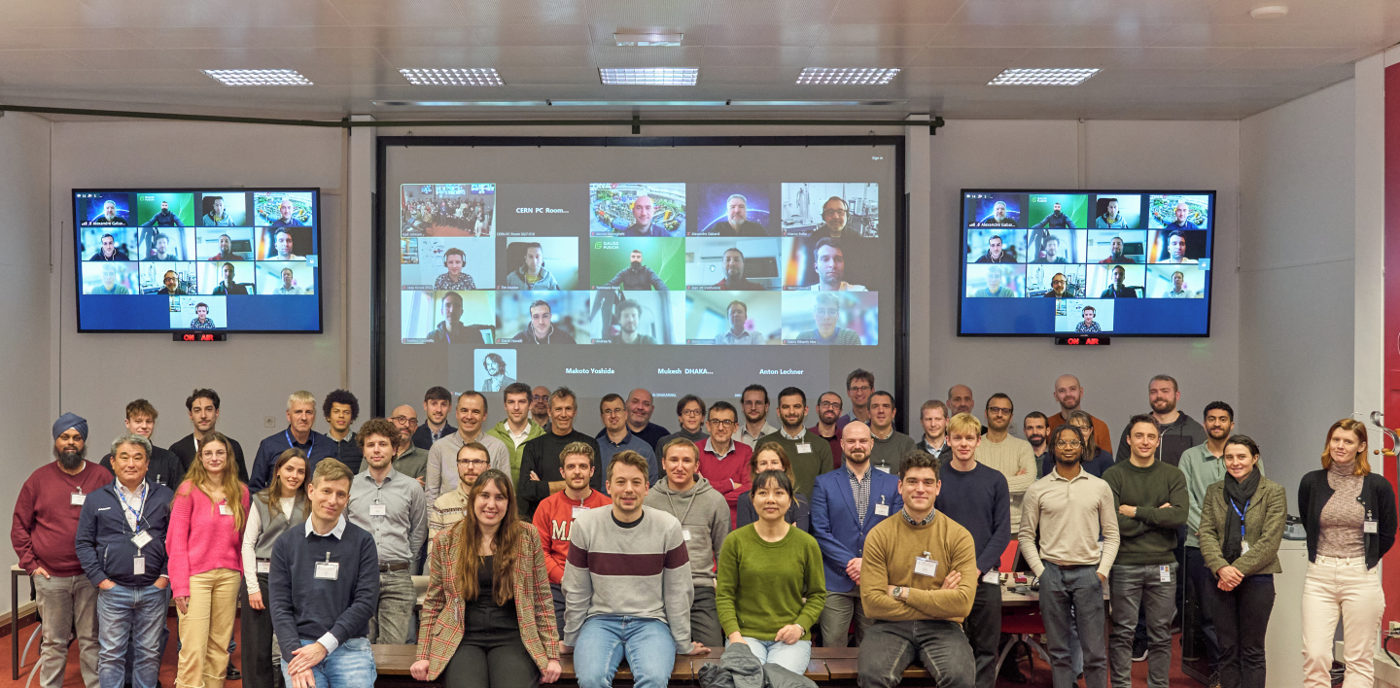
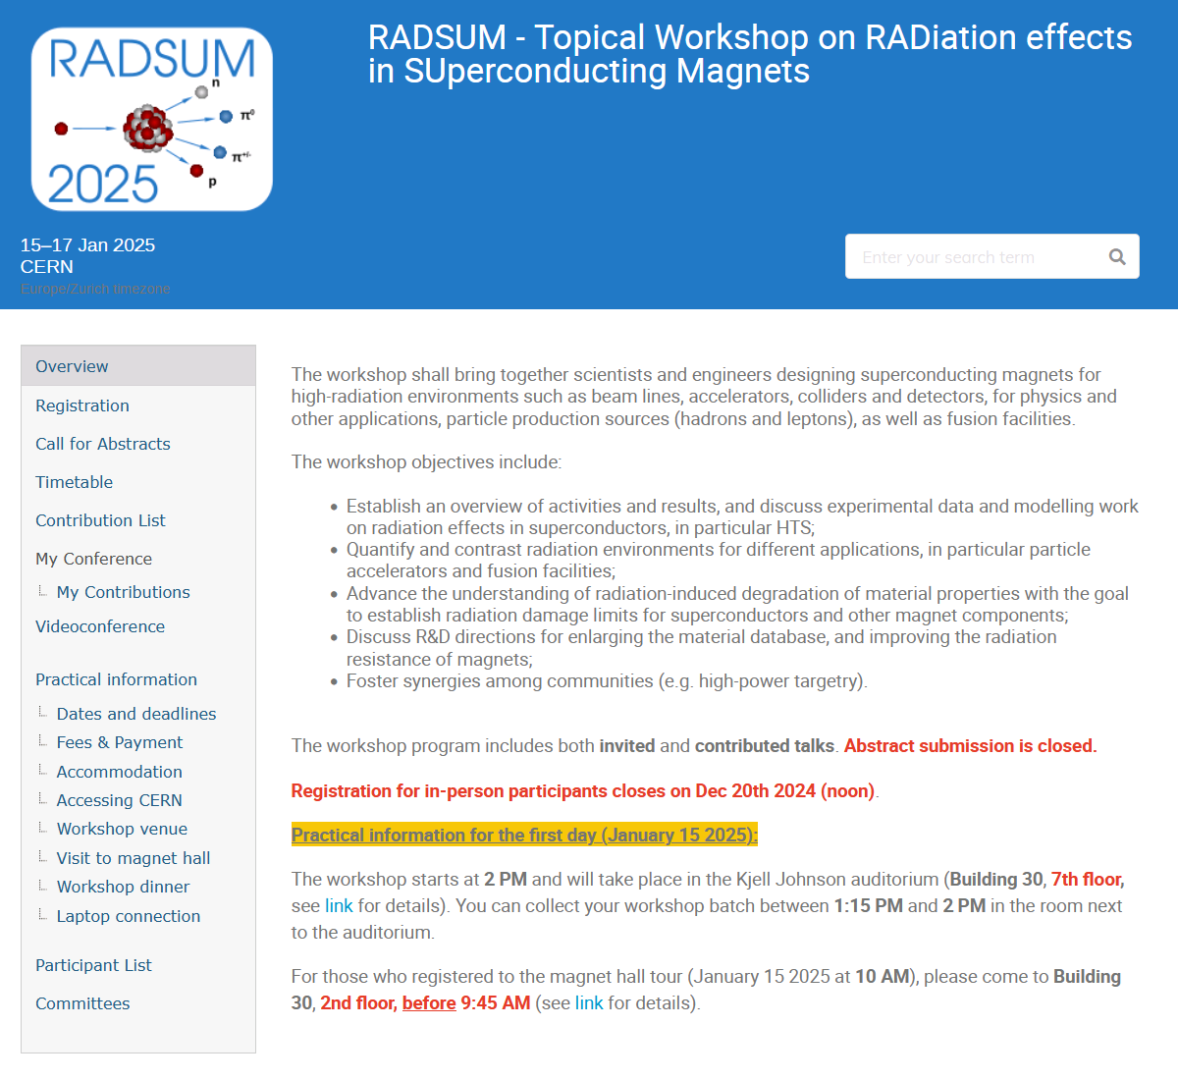
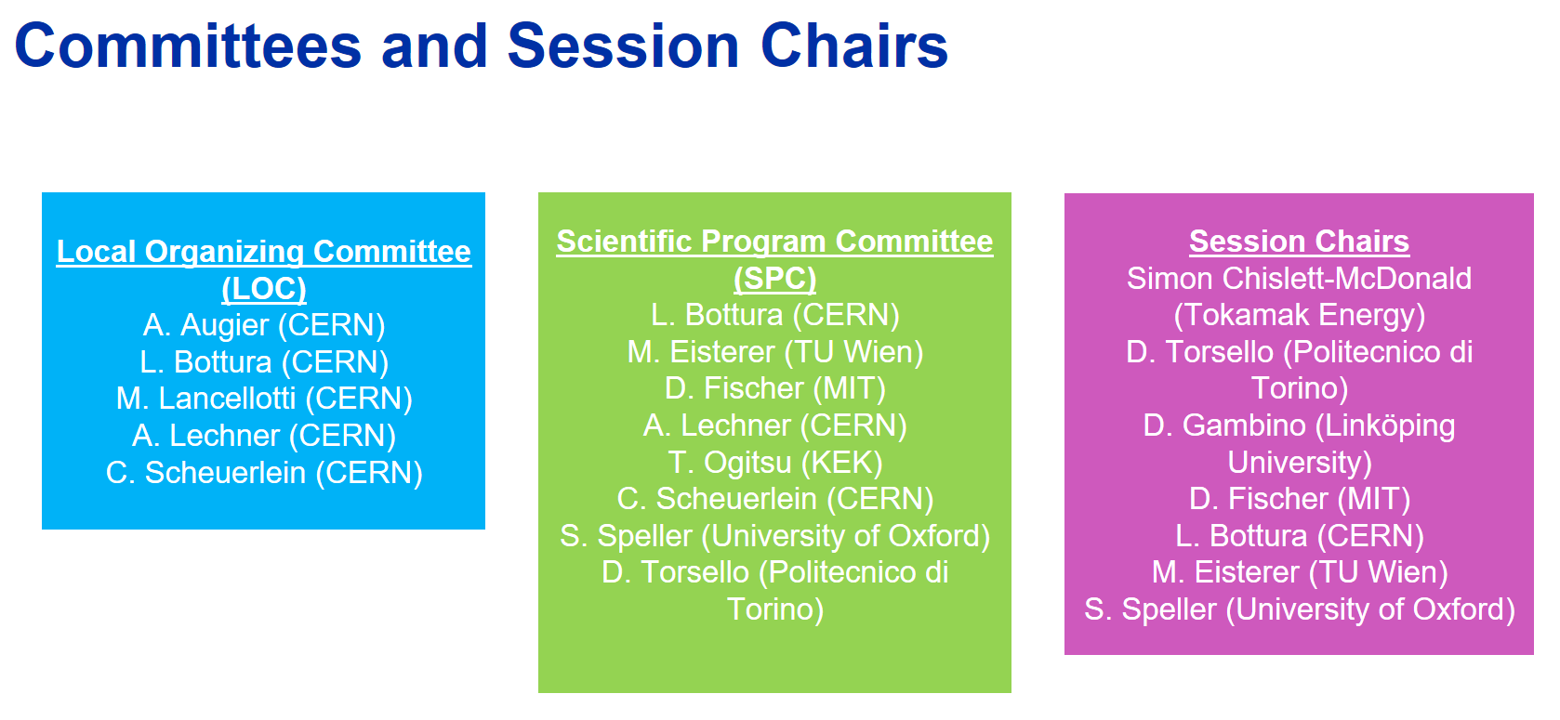
RADSUM25 workshop@CERN (Jan 15-17, 2025)
https://indico.cern.ch/e/radsum25
100+ registrants (half in person, half on zoom)
About 1/3 from fusion community

Slide 4
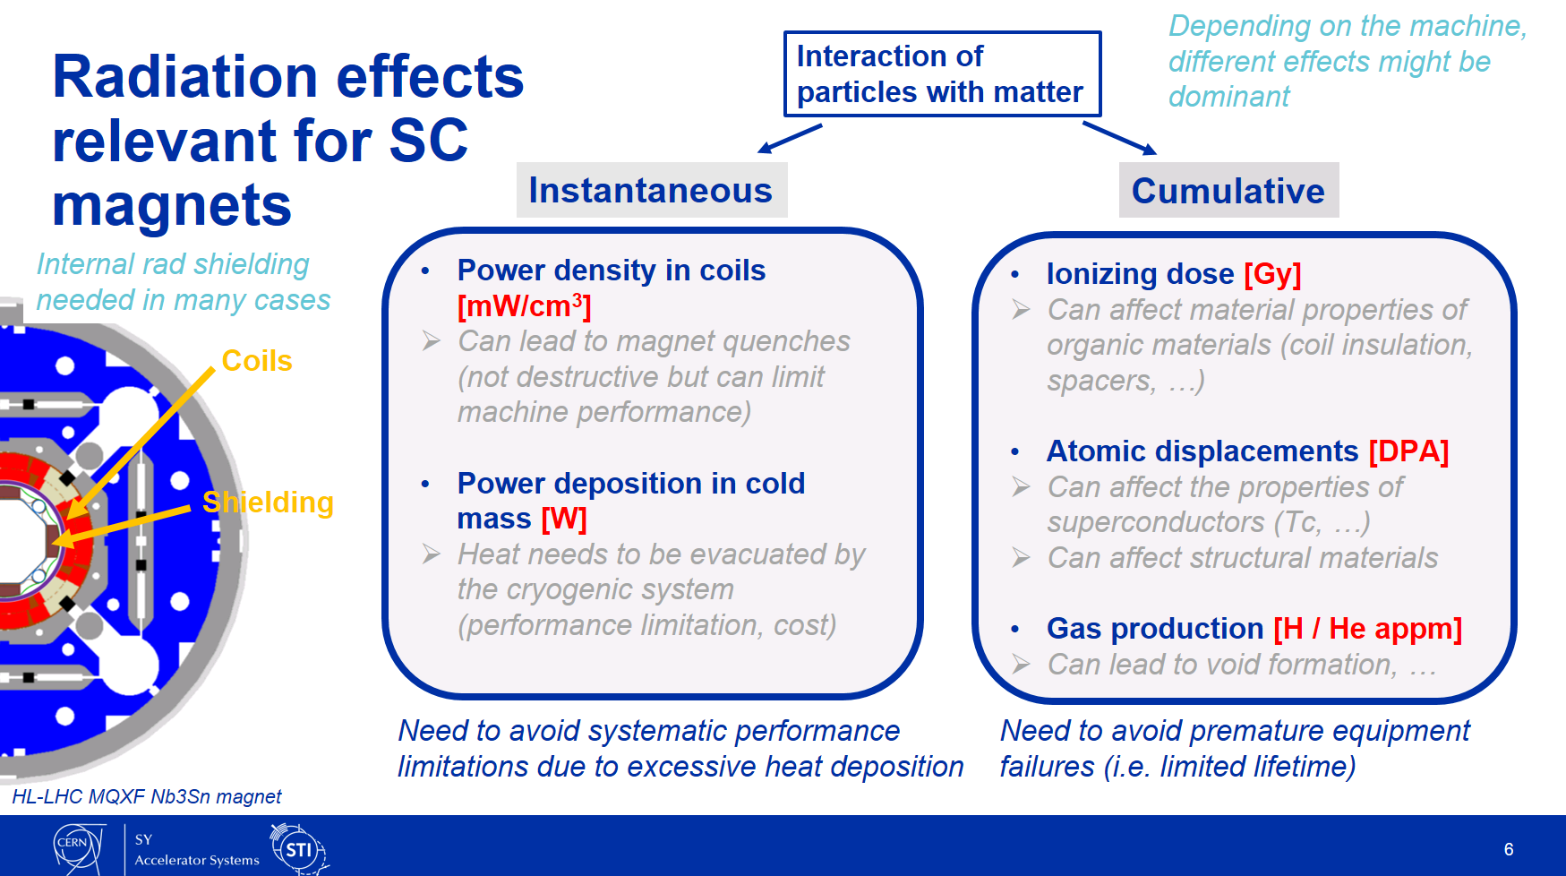
Context
The principal objective of the RADSUM workshop was to discuss cumulative radiation effects
Assessing the impact of radiations on SC magnets involves different aspects:
One of the main themes was the effect of atomic displacements (microscopic lattice defects) on the properties of HTS (REBCO)
Another theme was the effect of ionizing dose on other magnet materials (in particular insulation materials)*
*One related question was if the ionizing dose can also affect REBCO – had one talk on this topic

Slide 5
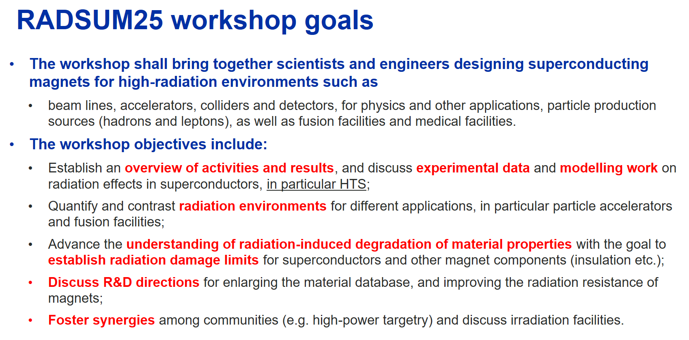
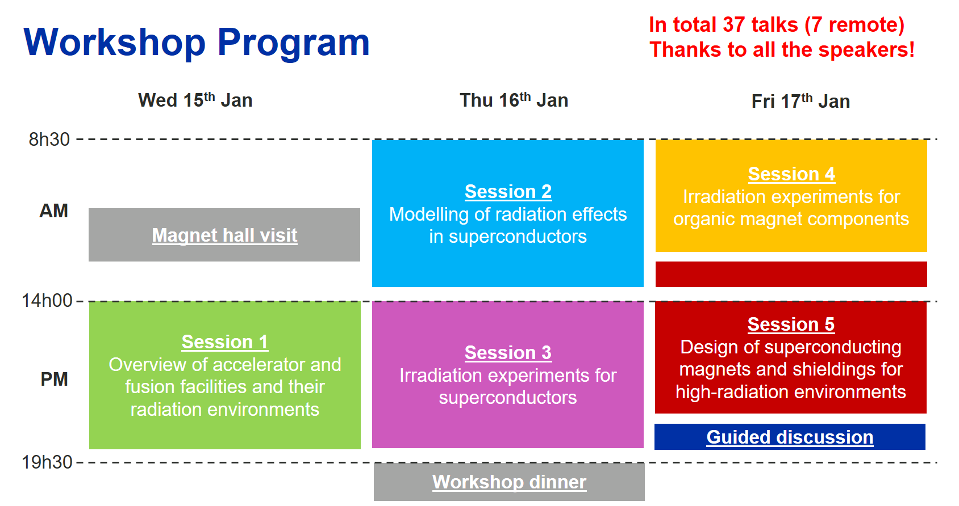
Workshop goals and program
Thanks to the Scientific Program Committee, who developed a comprehensive agenda (37 talks in 5 sessions)!
Today’s summaries:
This talk:
Summary of a few key points relevant for our applications (focus on HTS)
Talk by D. Calzolari:
A more general overview of all the topics discussed in the different talks

Slide 6
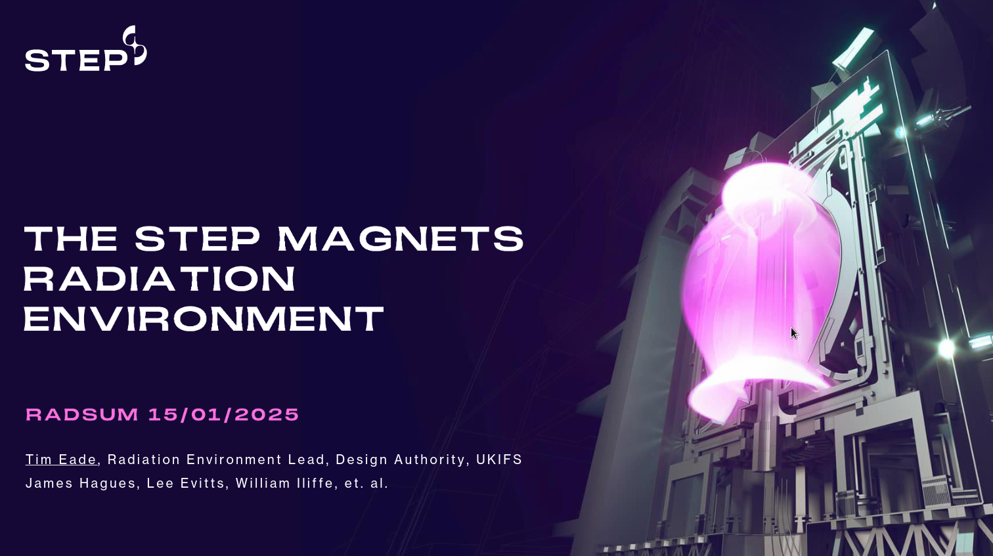
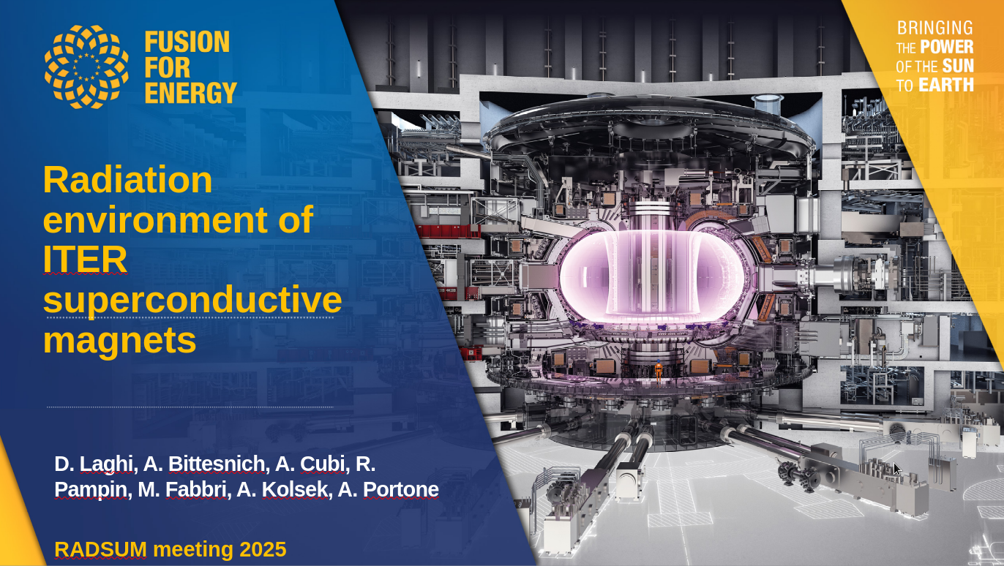
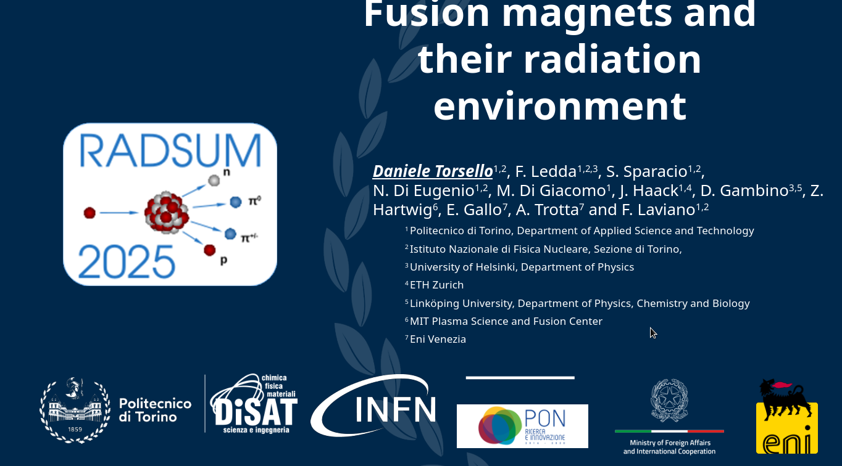
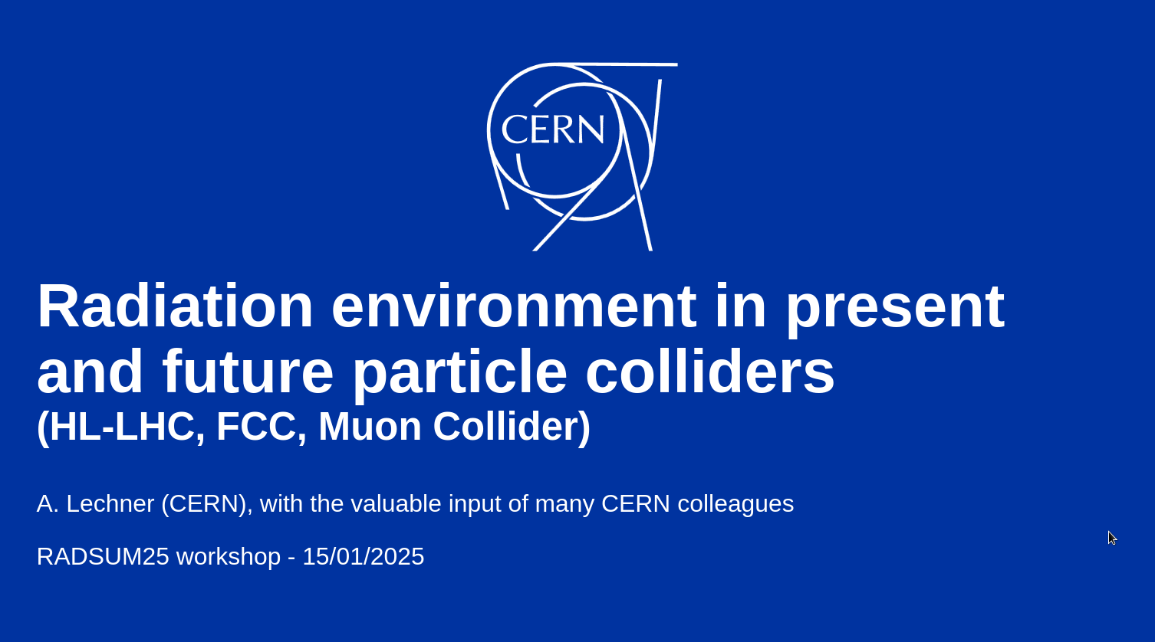
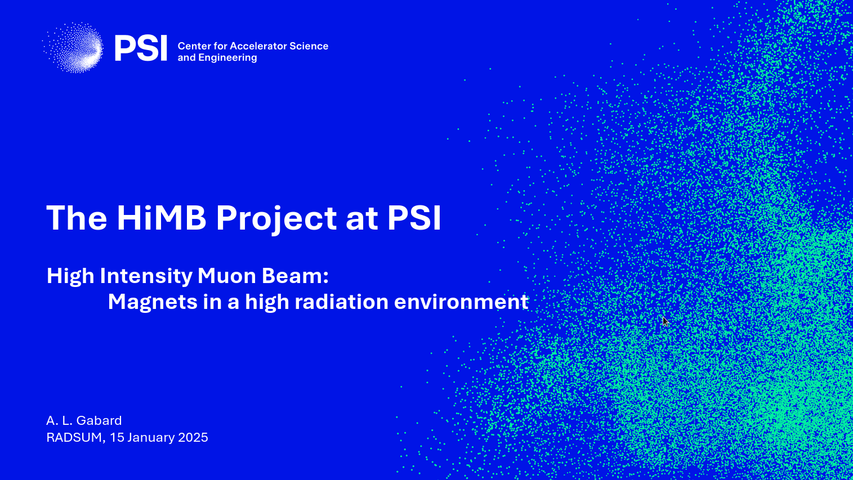
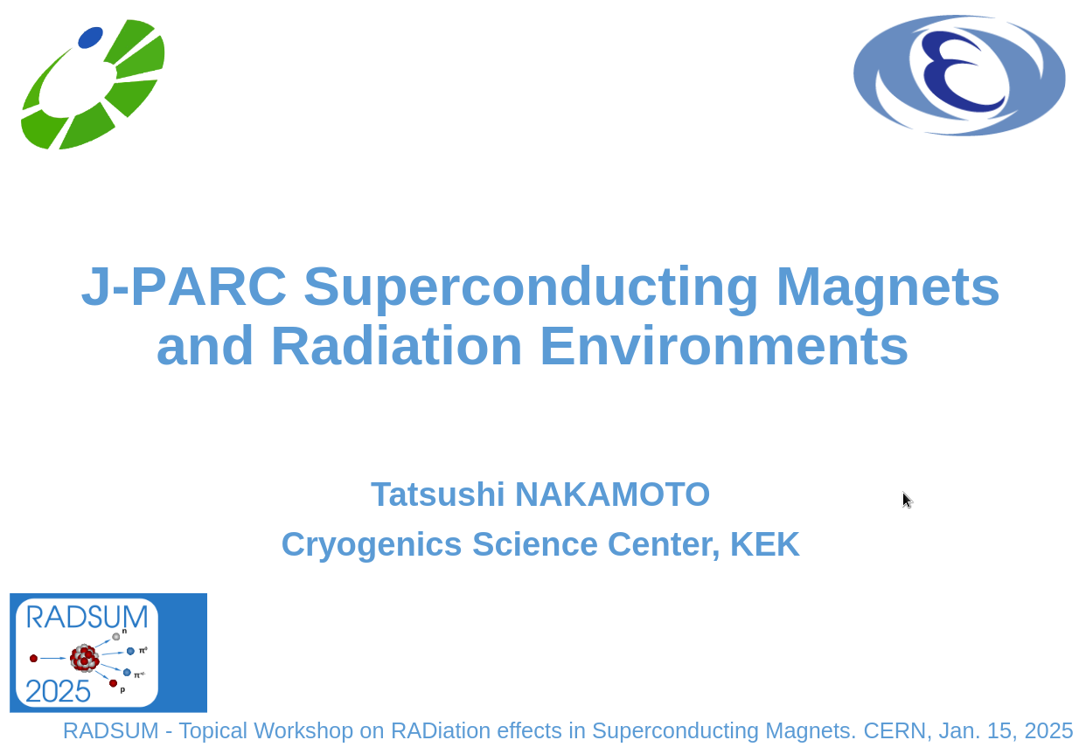
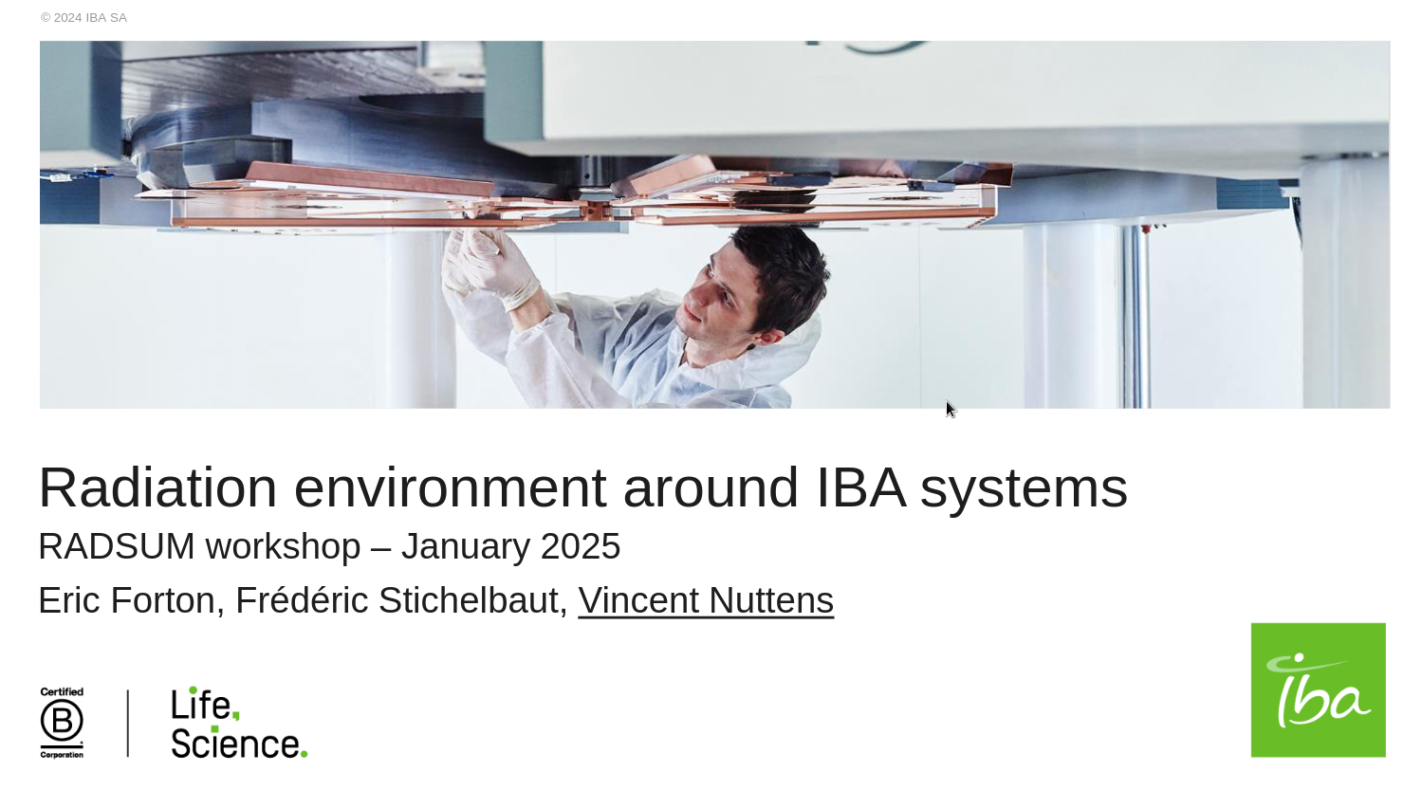
Sessions at a glance
Fusion facilities
Accelerator facilities
Medical facilities

Slide 7
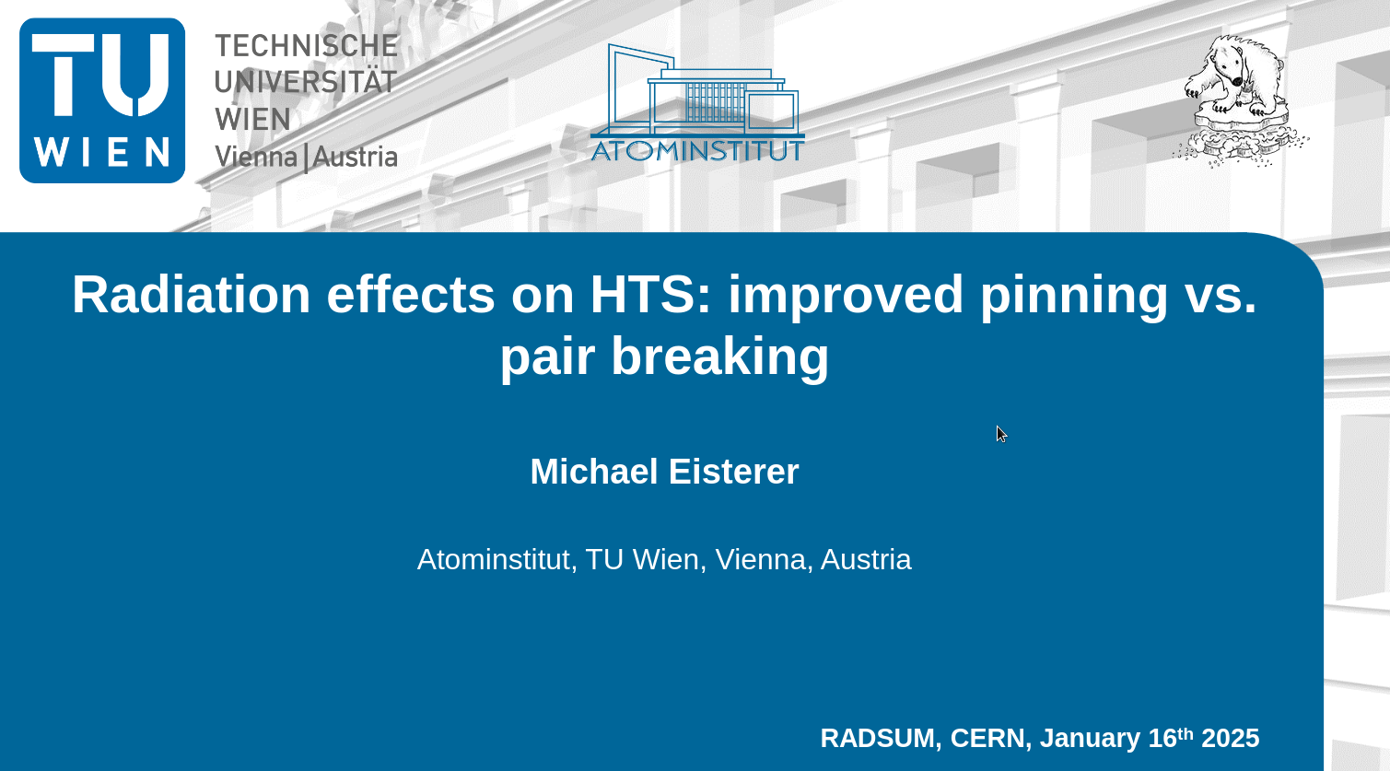
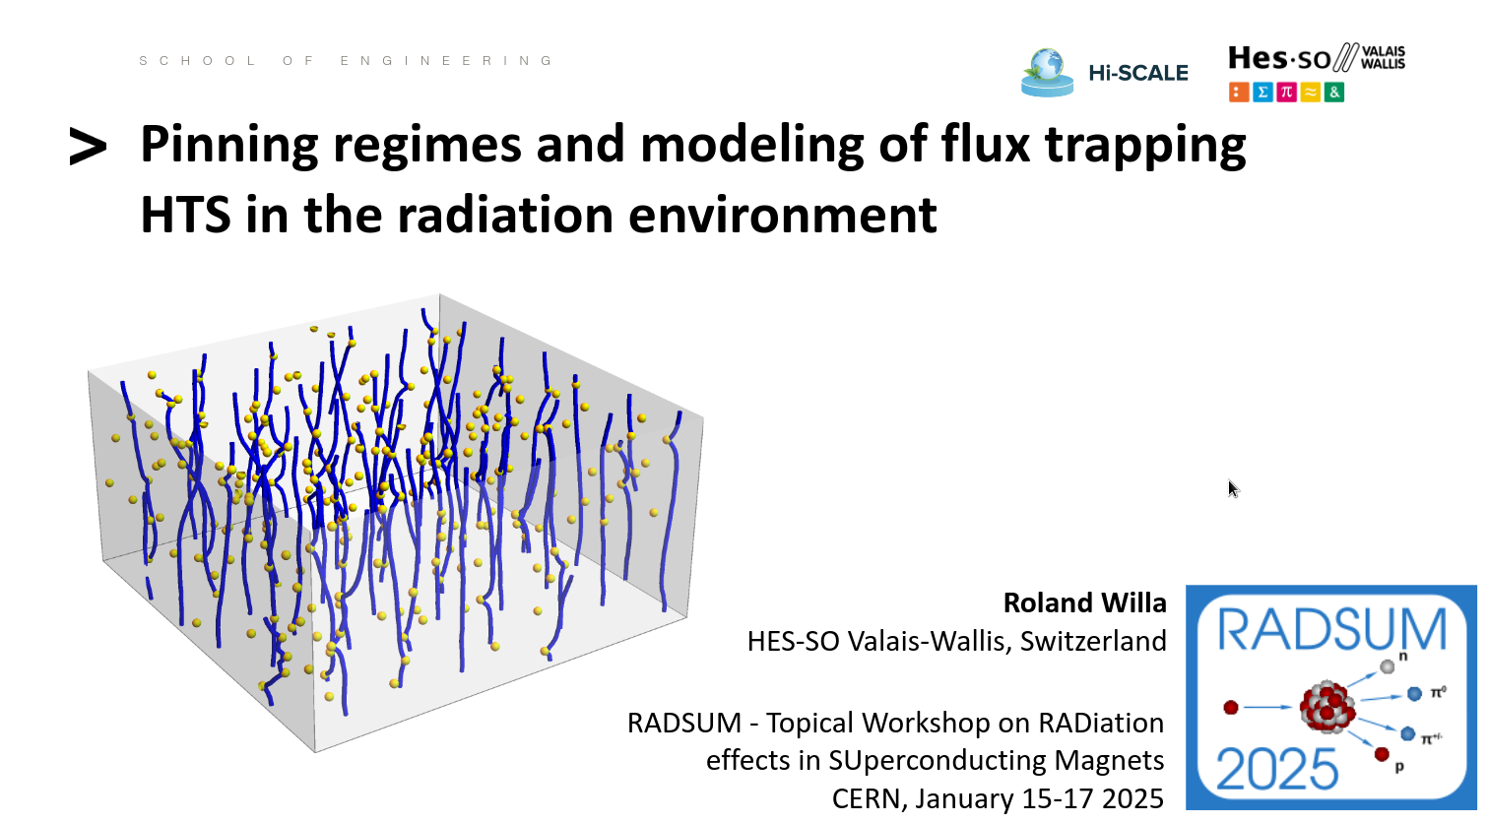
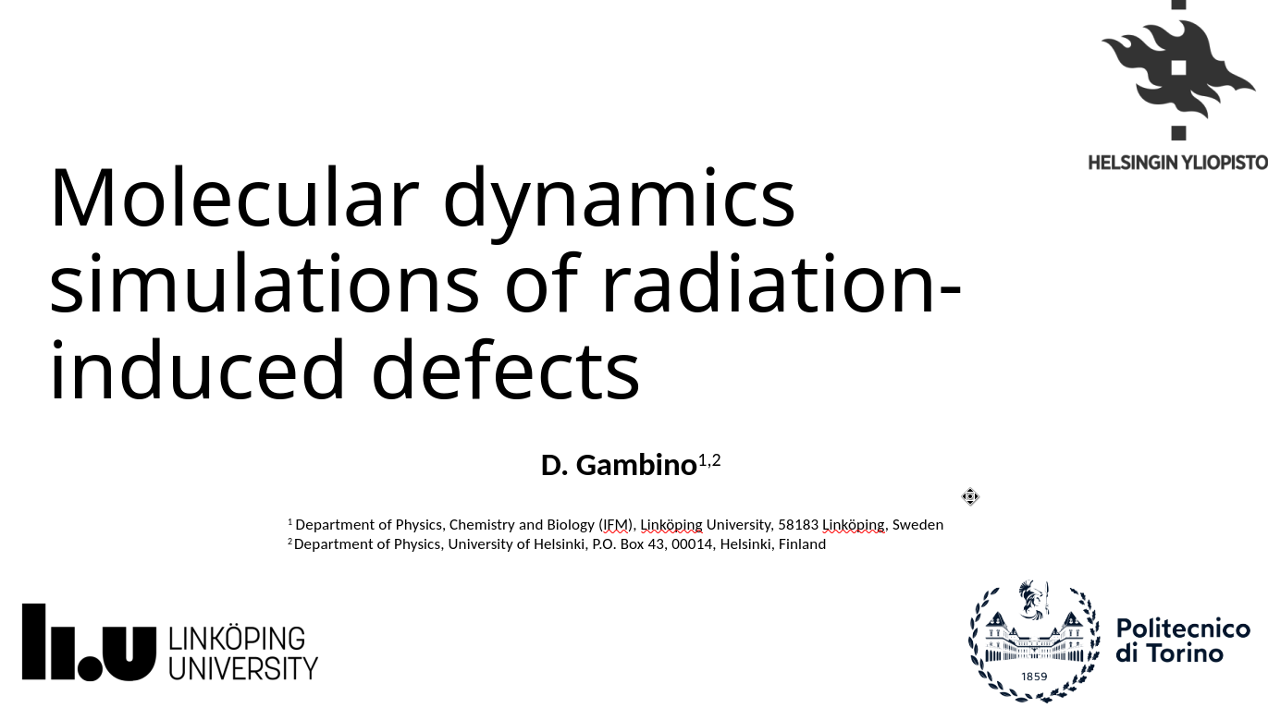
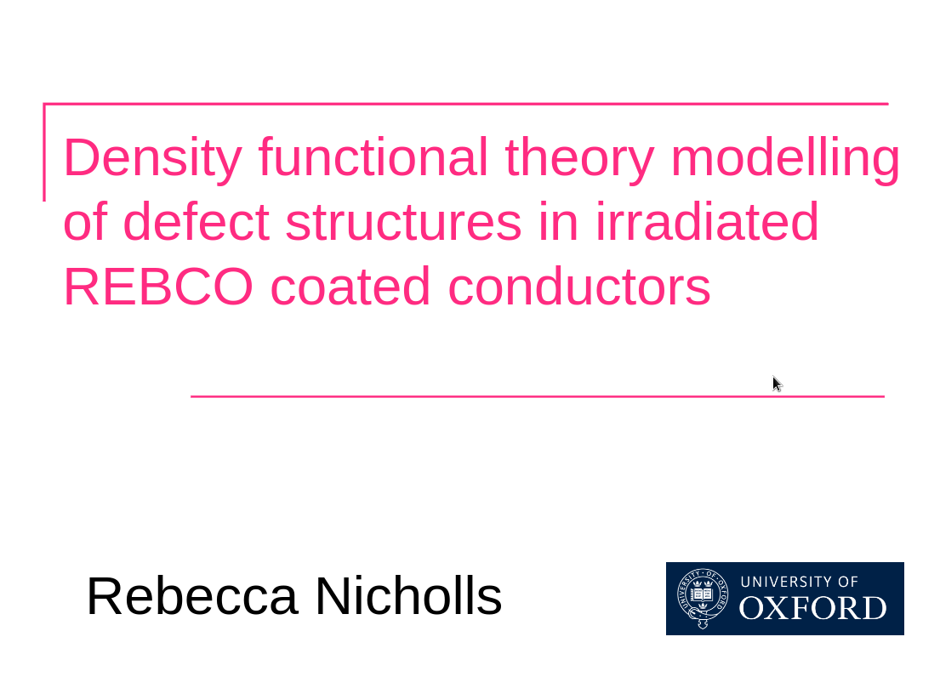
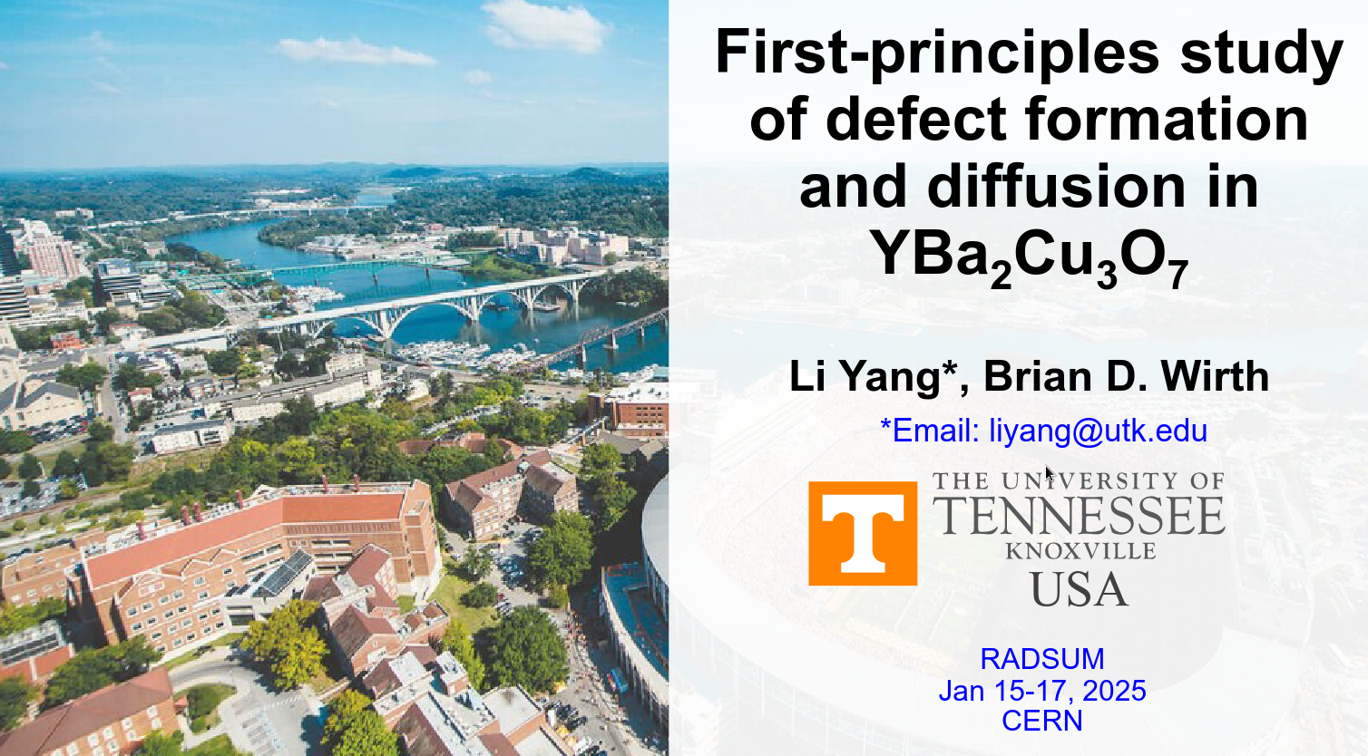
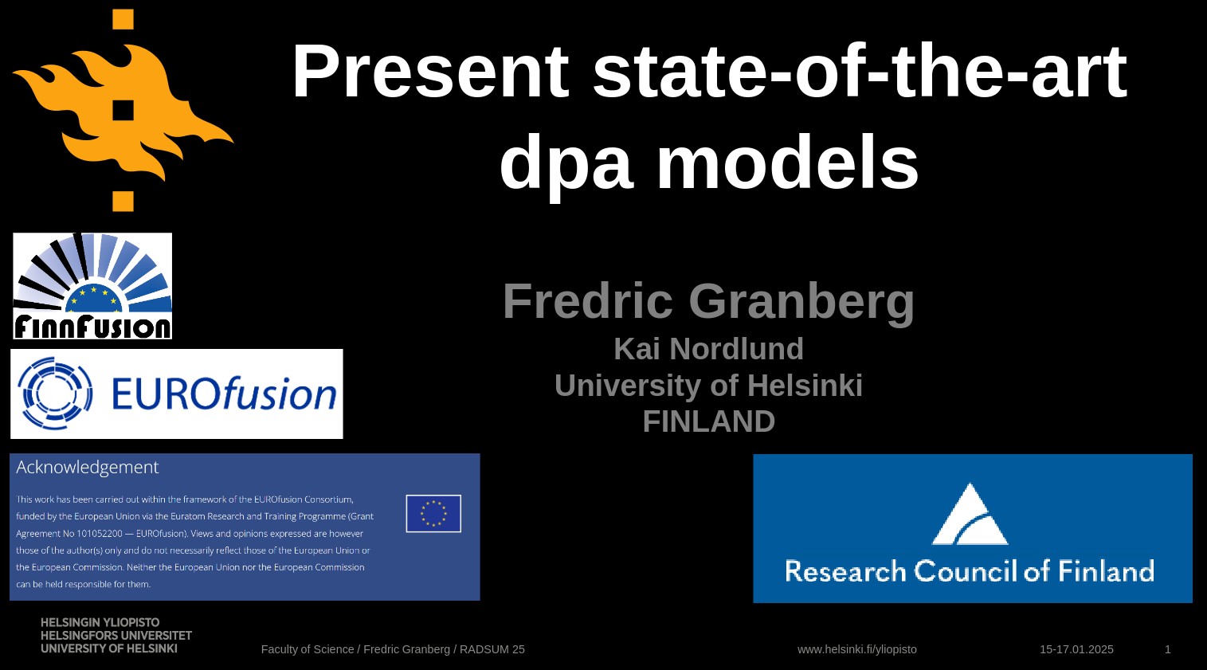
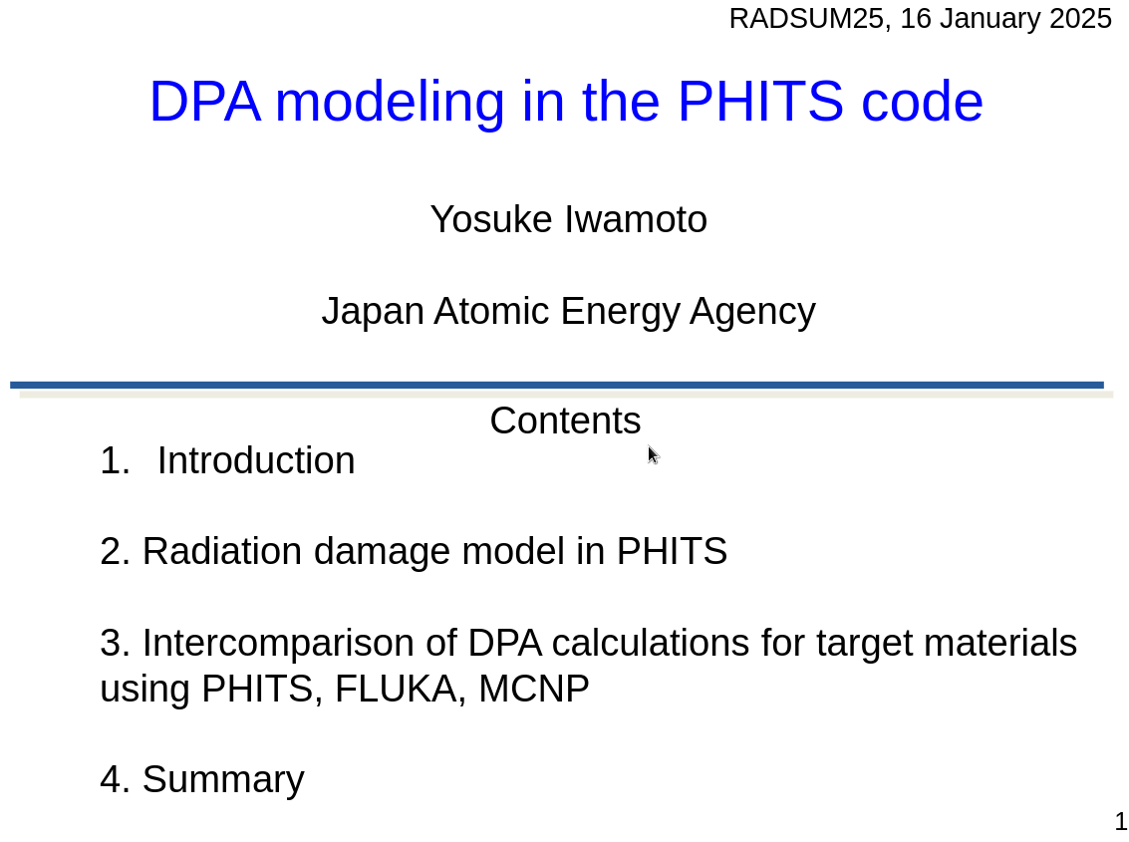
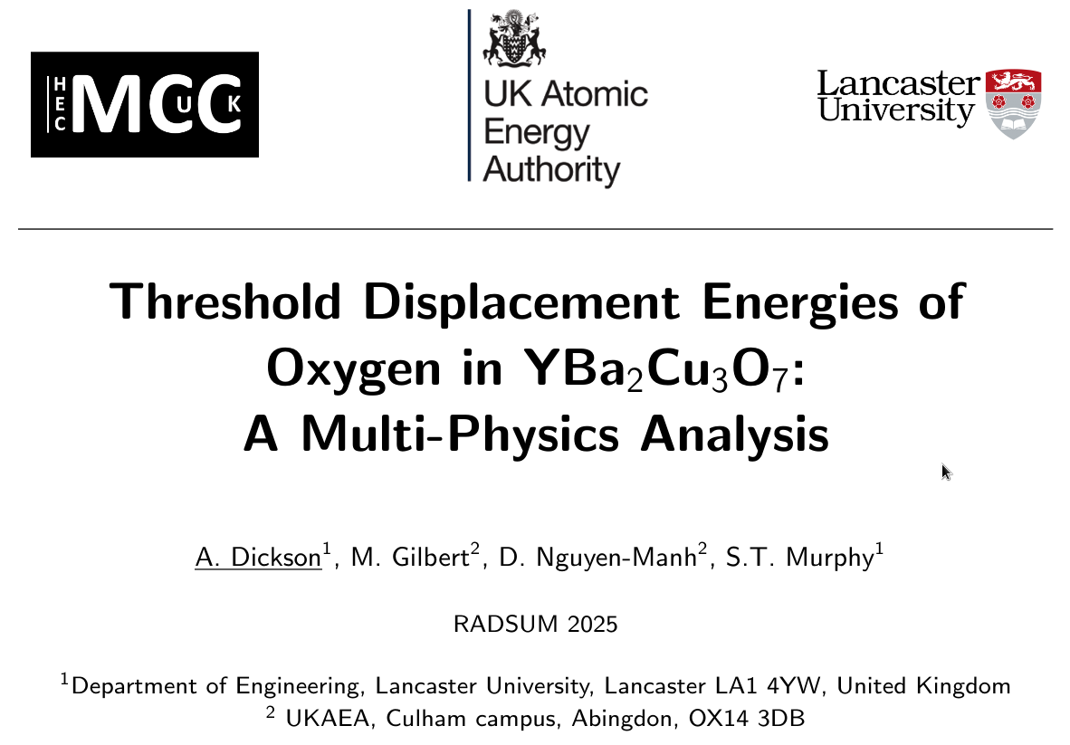
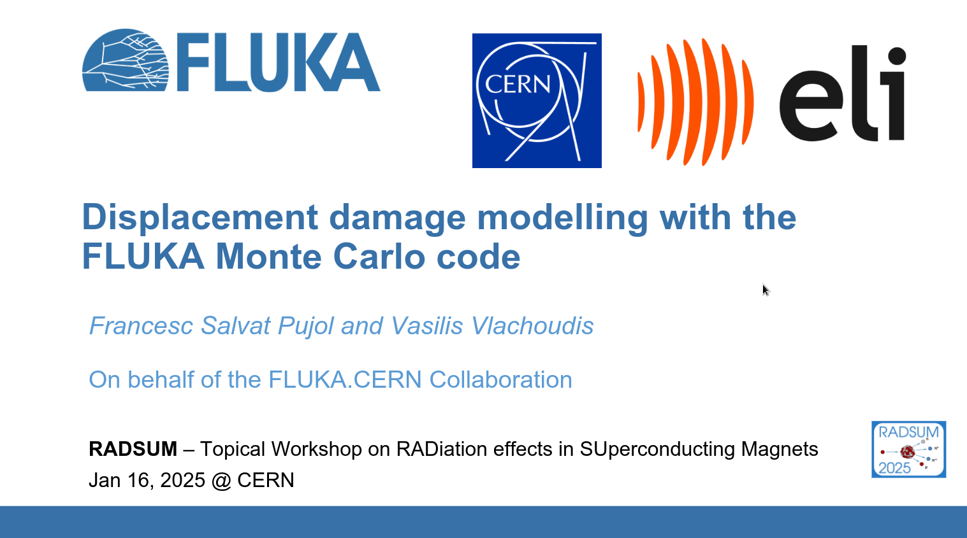
Sessions at a glance
Defects in REBCO and modelling
DPA modelling in general

Slide 8

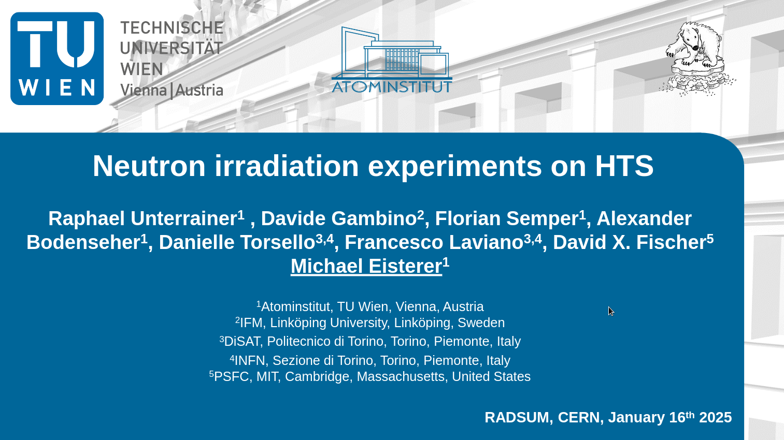
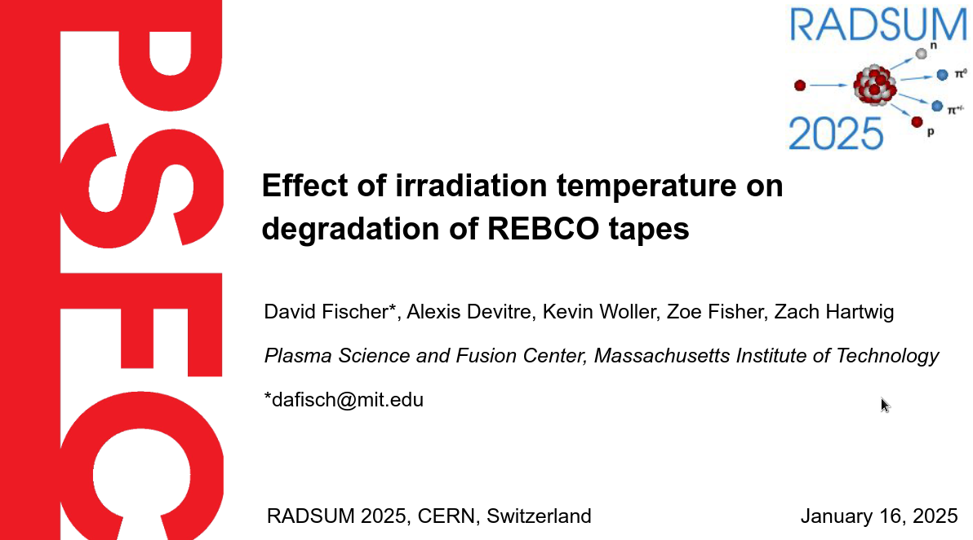
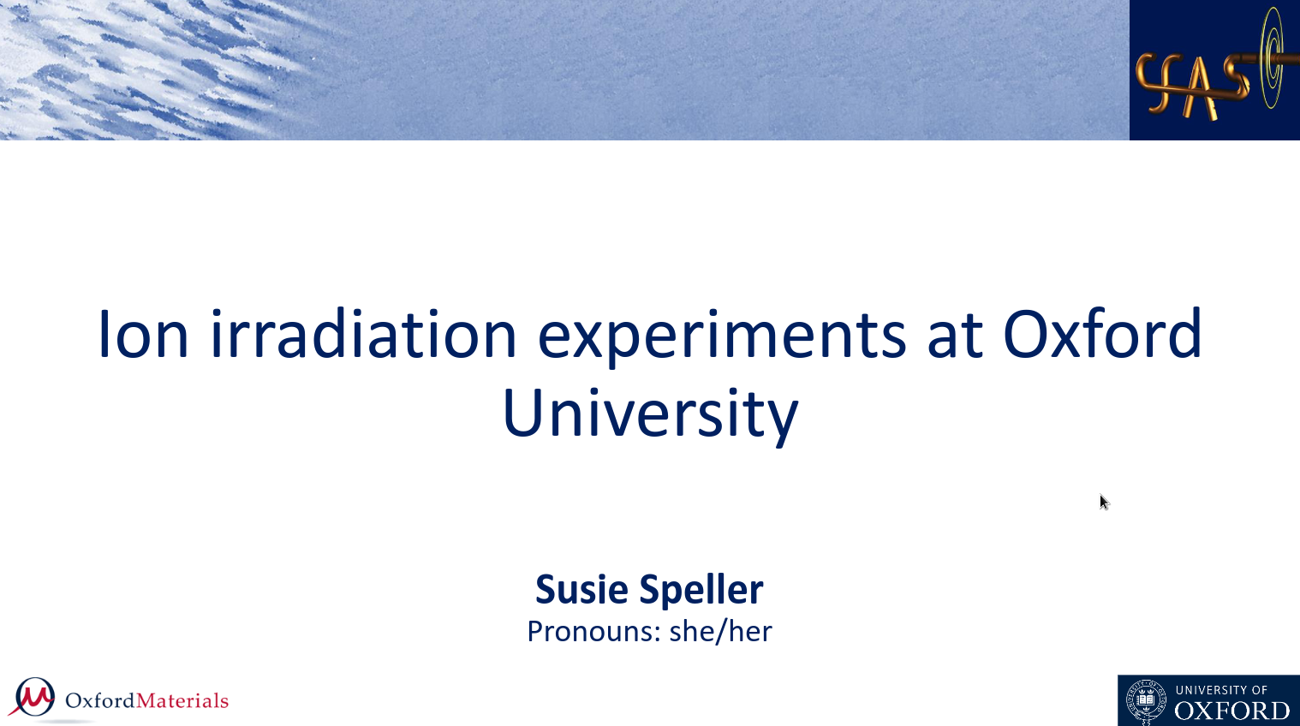
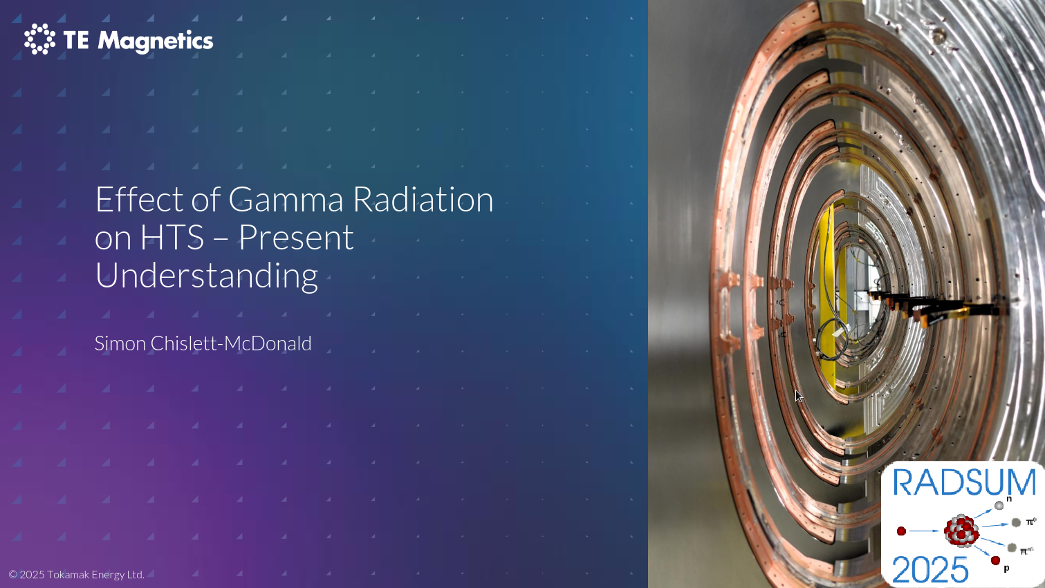
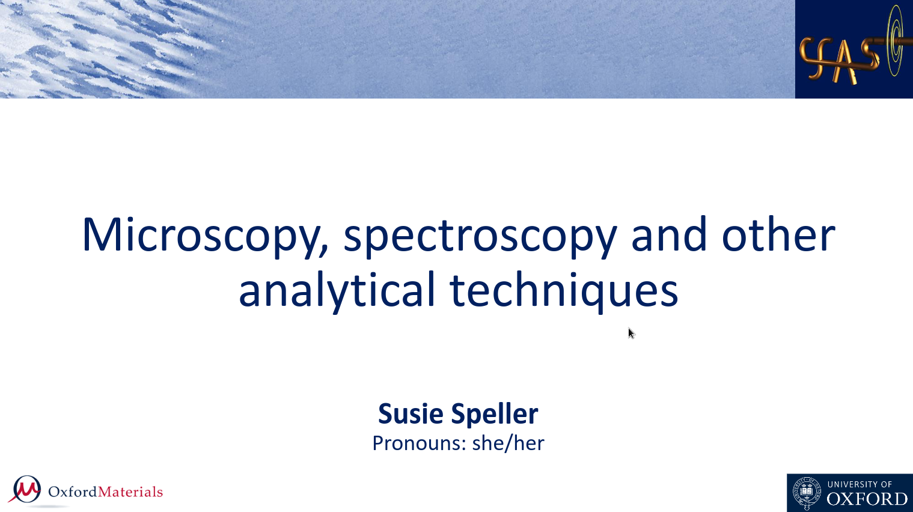
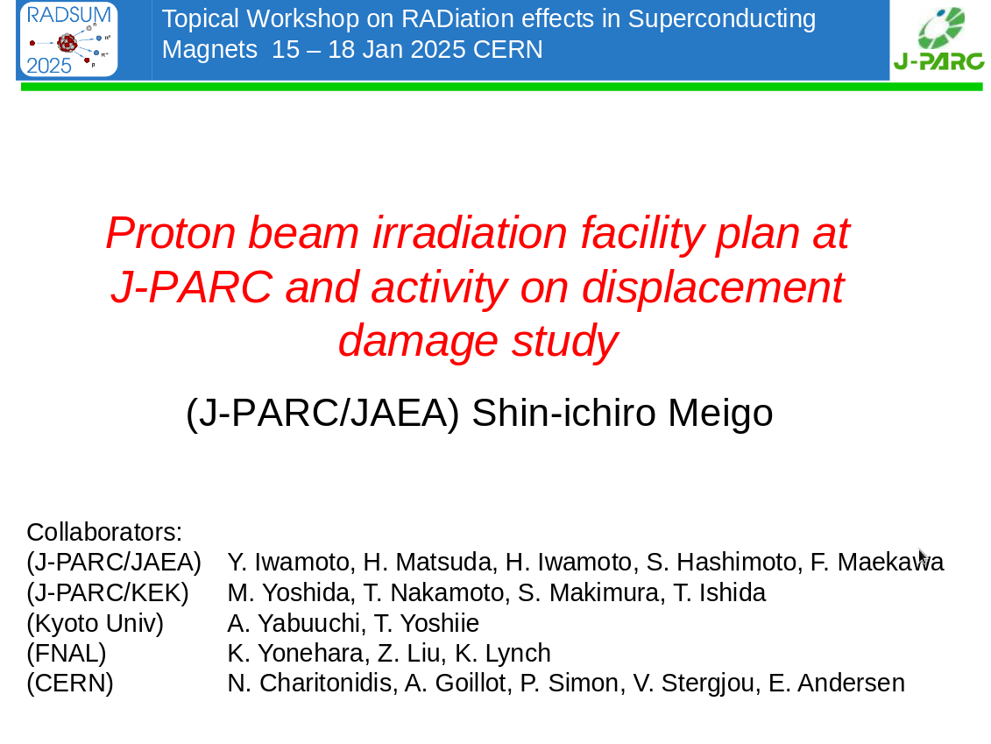
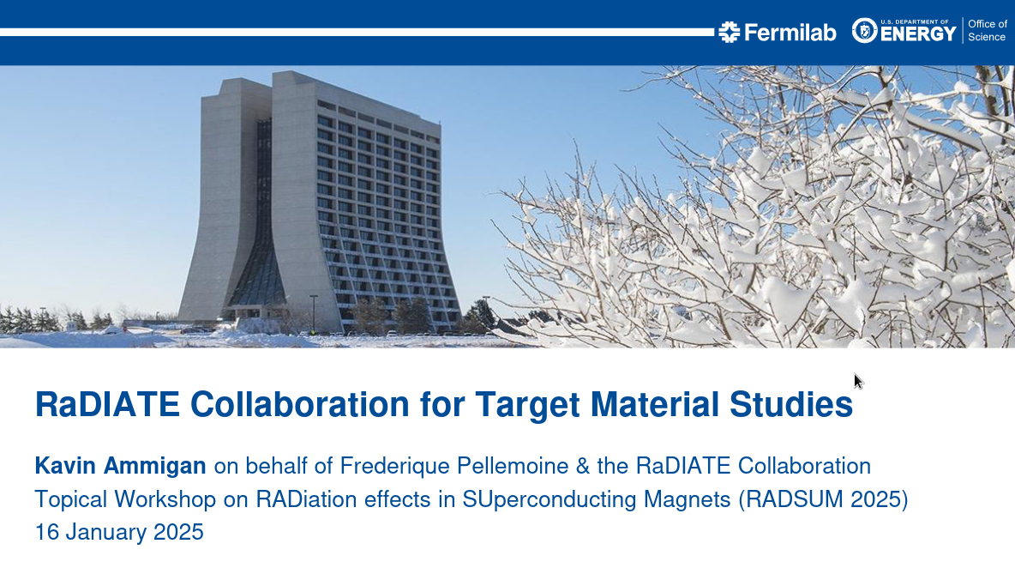
Sessions at a glance
Irradiation experiments for REBCO
Synergies with other experimental activities (targetry …)
Experimental defect analysis

Slide 9
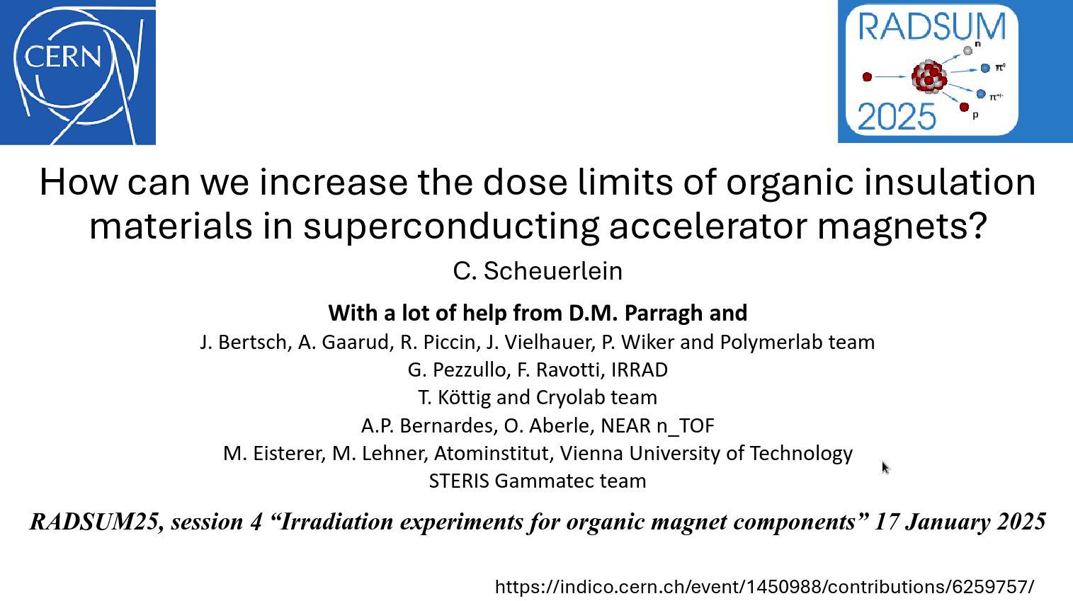
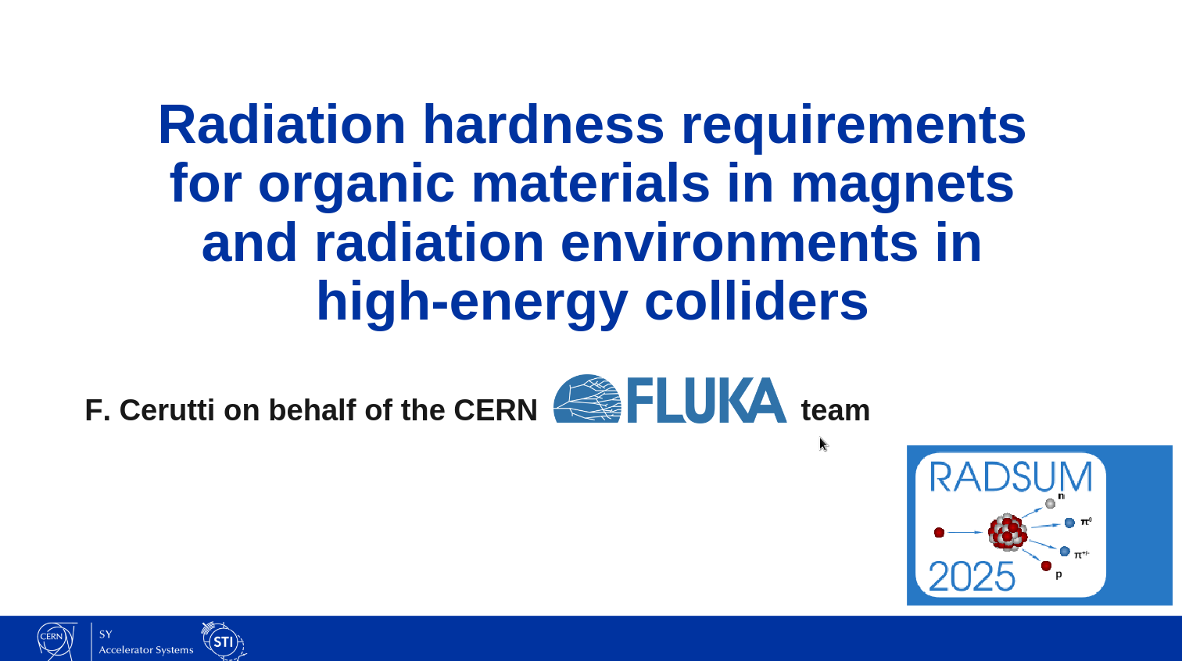
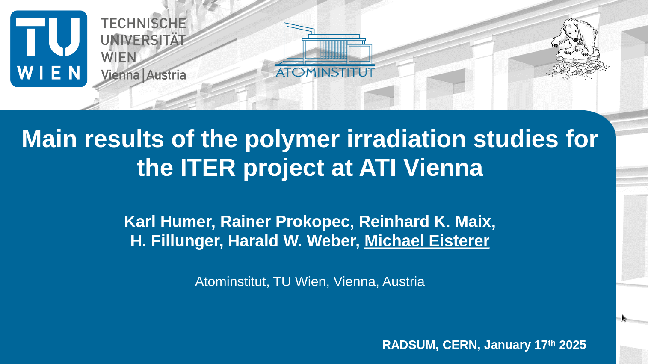
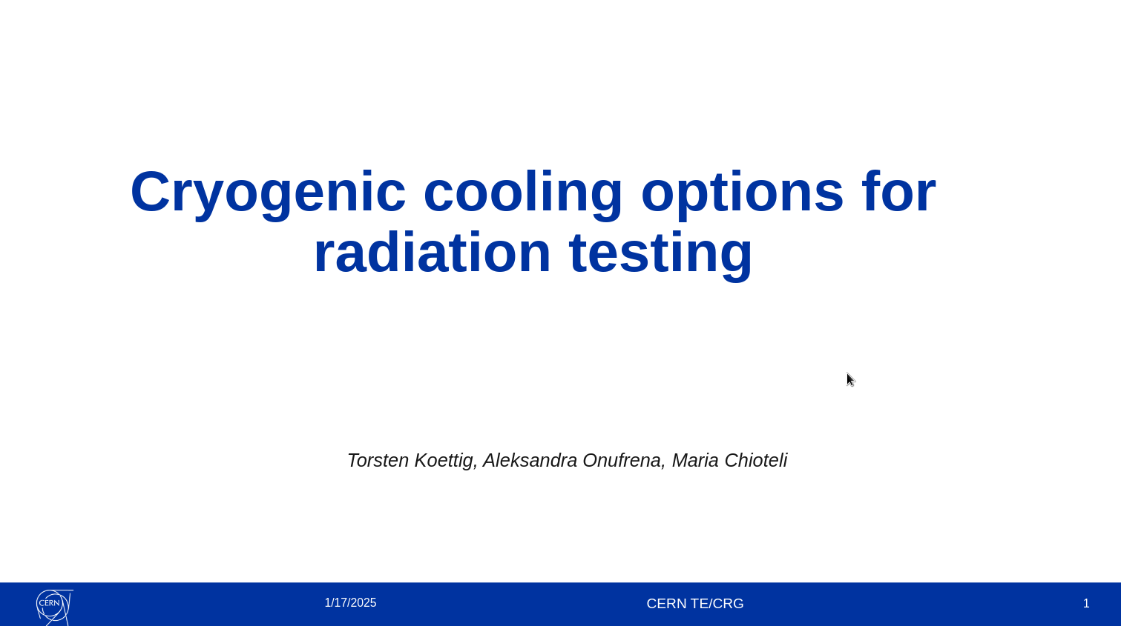
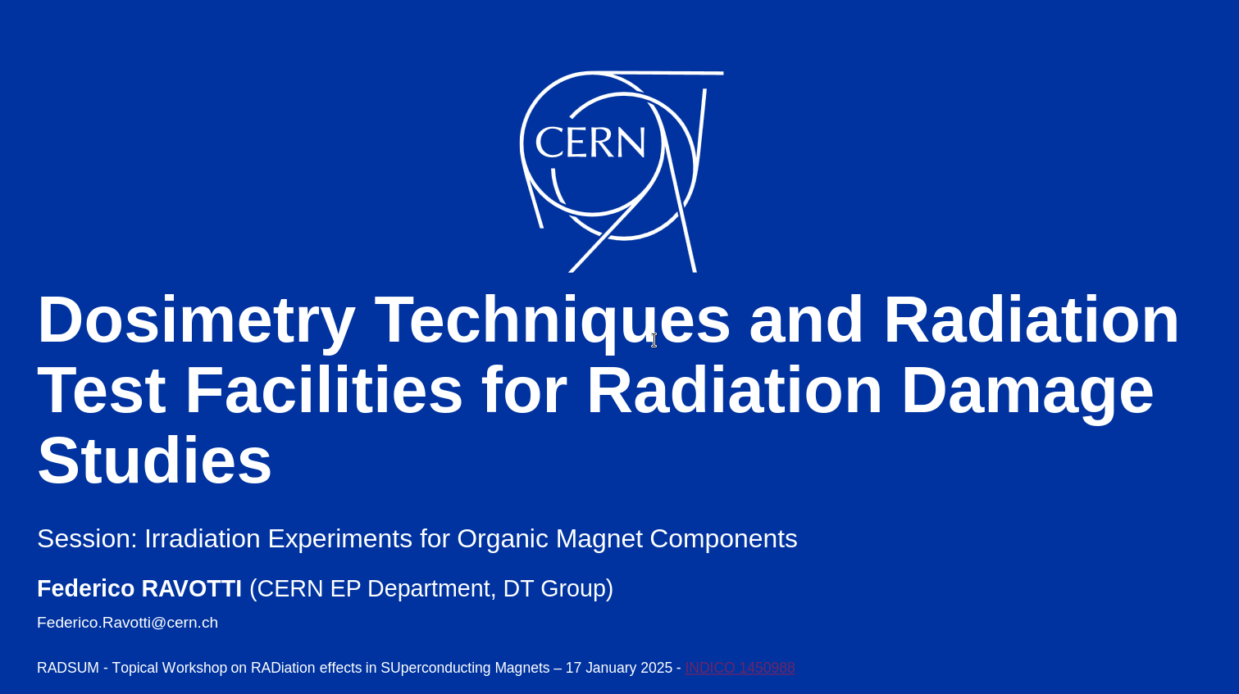
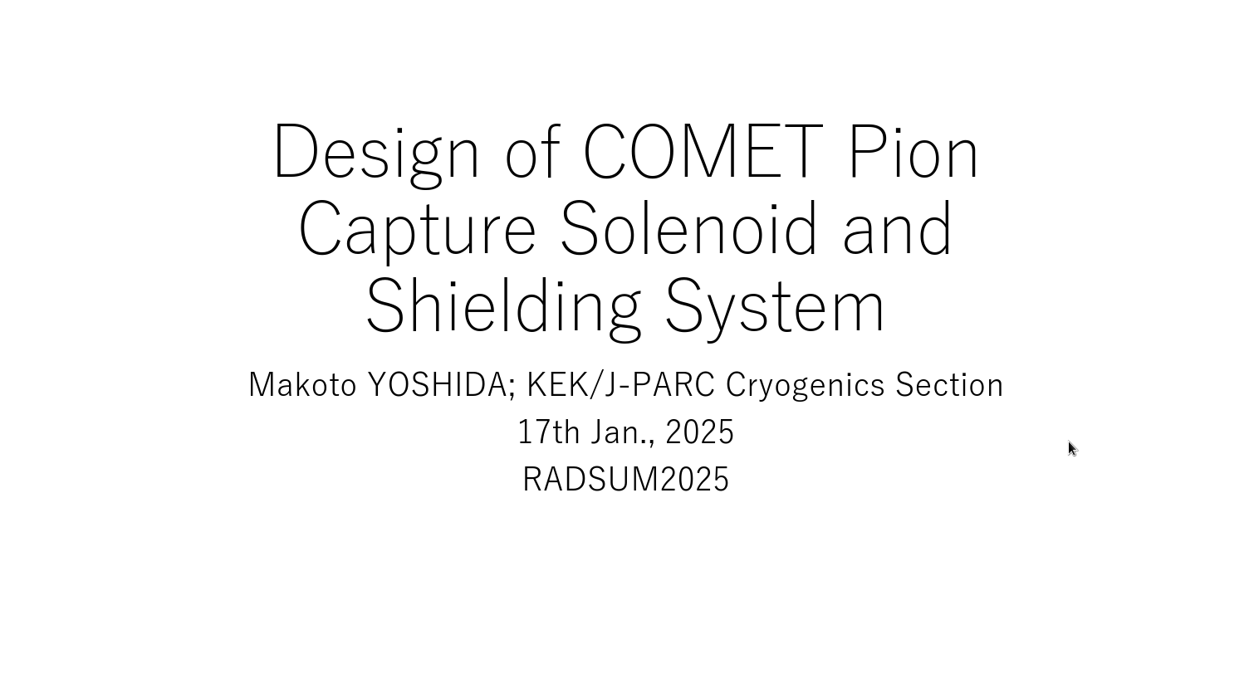
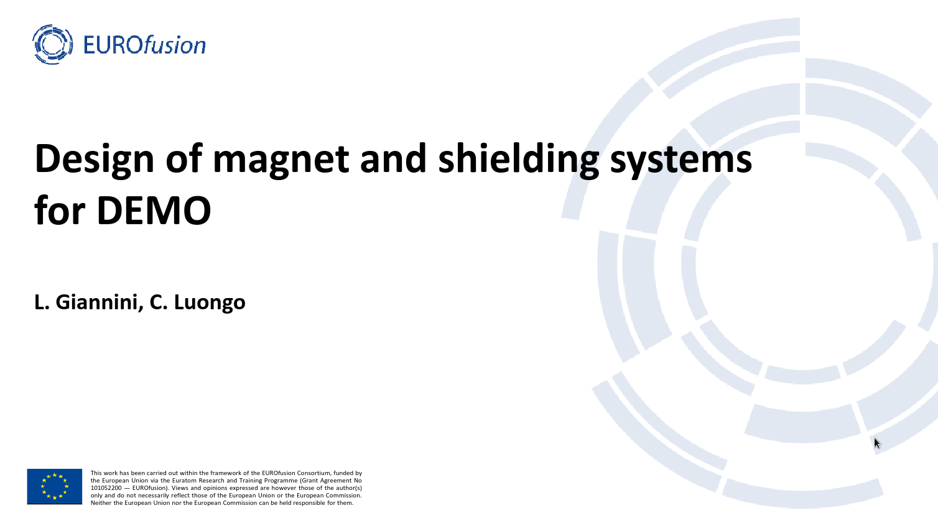
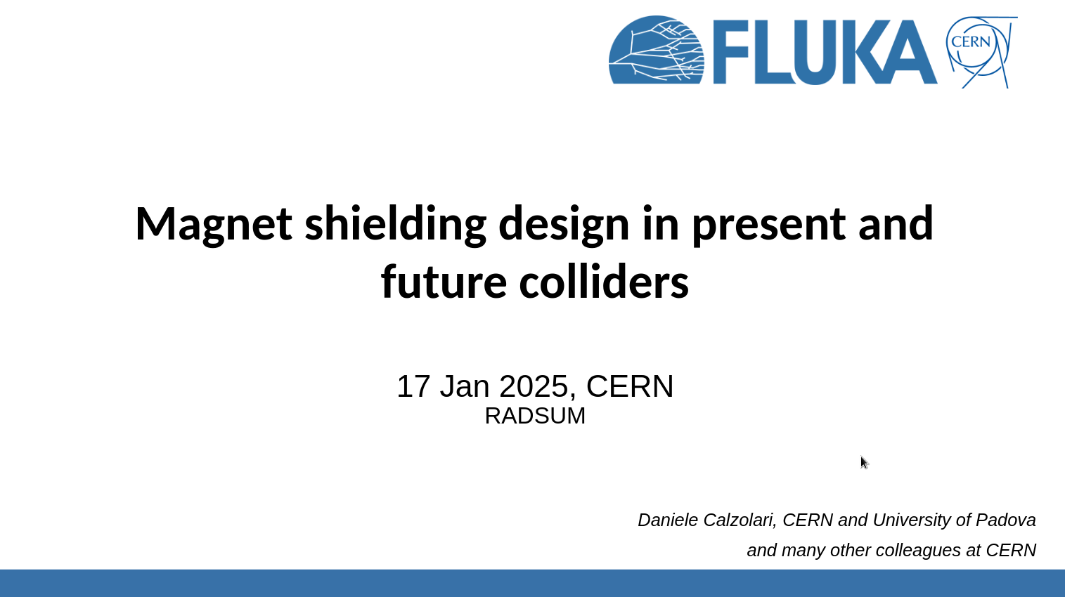
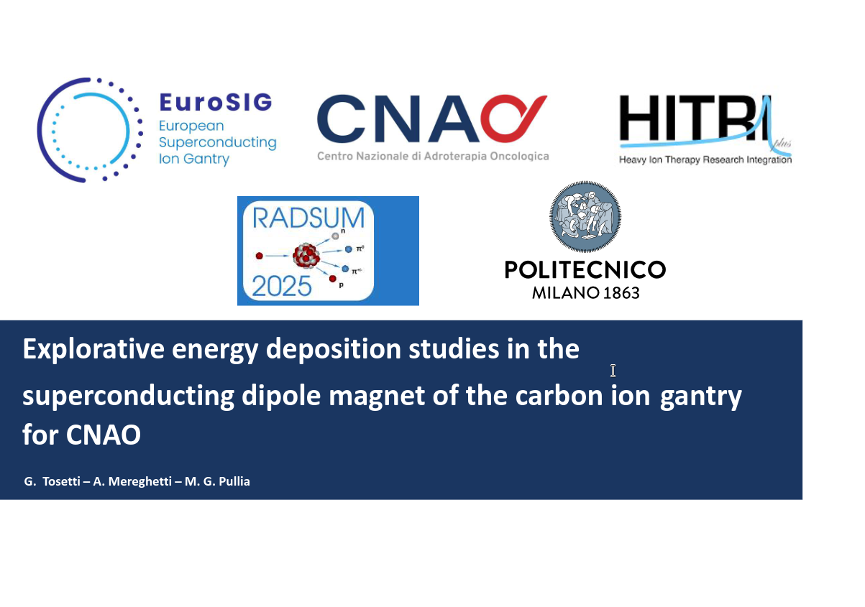
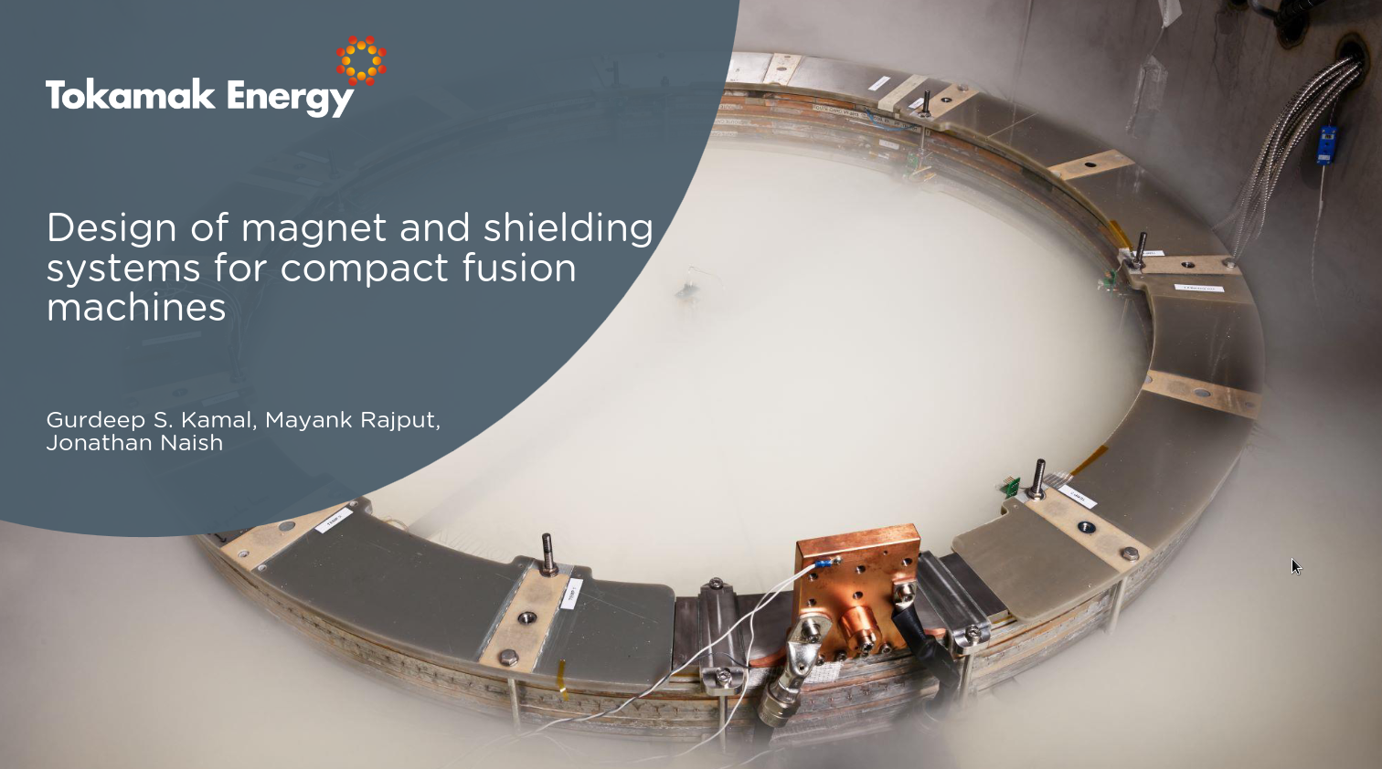
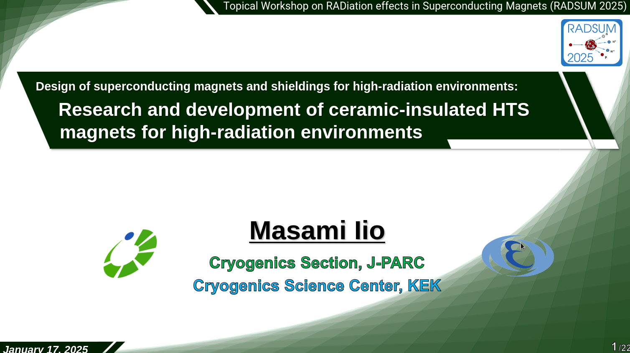
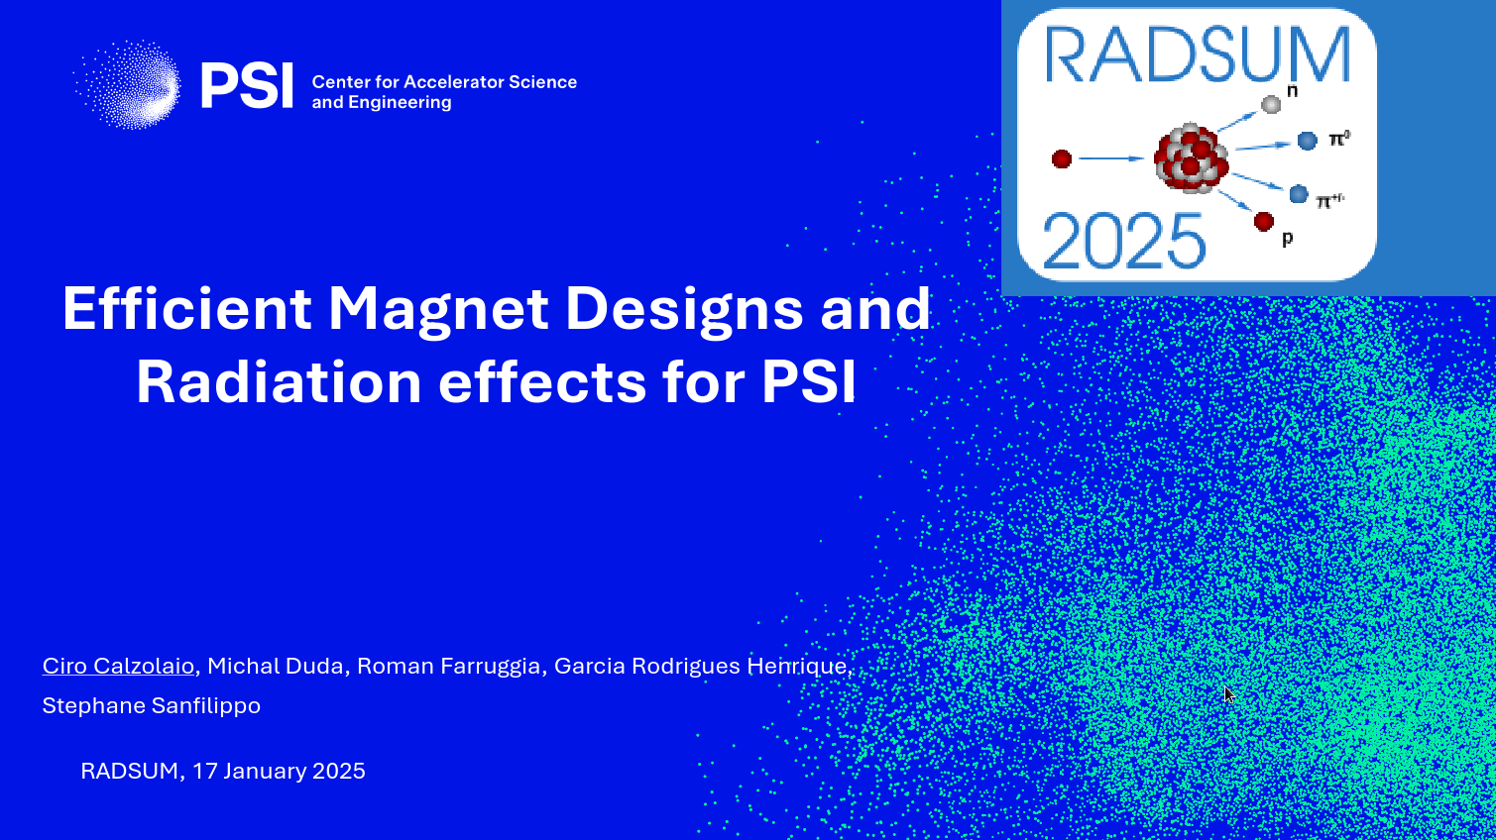
Sessions at a glance
Hardness requirements and irradiation experiments for polymers
Magnet/shielding design for high-rad env

Slide 10
Disclaimer
There were many excellent presentations at the workshop and this summary is not meant to cover all details (experimental results / modelling efforts)
I put the emphasis on certain aspects, which I believe are relevant for our applications (radiation effects in accelerator magnets)
If some aspects are not covered here, it doesn’t mean they aren’t equally important
In order to provide some context, I am adding also some additional info
I will mainly focus on radiation effects in REBCO and how we can possibly map experimental results to our applications*
*The content is based on several suggestions from M. Eisterer et al. (TU Wien) and others

Slide 11
Key questions for radiation damage in REBCO
How do REBCO coated conductors change their properties under irradiation?
How can we best quantify the expected radiation damage in future HTS (REBCO) accelerator magnets for our radiation environments?
  Is DPA a suitable measure or do we need something more sophisticated?
  Is our present workflow sufficient? (see sketch below)
Which radiation damage limits (in terms of DPA or something else) shall we consider when designing shielding assemblies for future magnets?
Shall annealing cycles be part of the strategy to recover performance?
How precise is the damage estimate if we only use DPA? Order of magnitude?
Monte Carlo (MC) radiation transport simulations (FLUKA, PHITS, …)
Particle source, magnet/shielding geometry
Application scenario: use of HTS magnets in a future facility
Quantify radiation environment
Estimate changes of HTS properties (more shielding needed?)
DPA

Slide 12
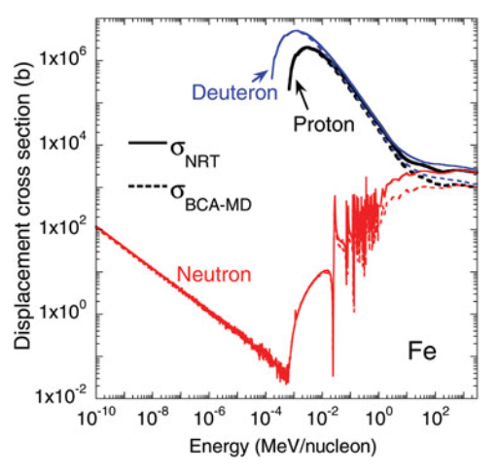
Displacement mechanism – the basics
Displacements of atoms from the lattice are caused by Primary Knock-on Atoms (PKAs), which are set in motion by the interaction of particles in matter → the PKA spectra depend on the projectile type & energy and the type of interaction → the PKAs can displace single atoms or cause collision cascades
The resulting displacement damage depends strongly on the projectile type and energy:
At lower energies (<10s MeV), protons and ions produce damage through recoils from Coulomb scattering, while at higher energies the damage is mostly due to recoils, residuals, fragments from elastic and inelastic nuclear collisions
Y. Iwamoto et al., J. Nucl. Sci. Tech., 51:1, 98-107 (2014)
Damage by neutrons can be produced by recoils from capture processes and elastic nuclear collisions (dominating below MeV), as well as by residual nuclei/fragments from inelastic nuclear collisions (from MeV energies) – neutron Xsec (resonances) depend strongly on material
The number&type of defect depends strongly on the particle fluence spectra inside our magnets

Slide 13
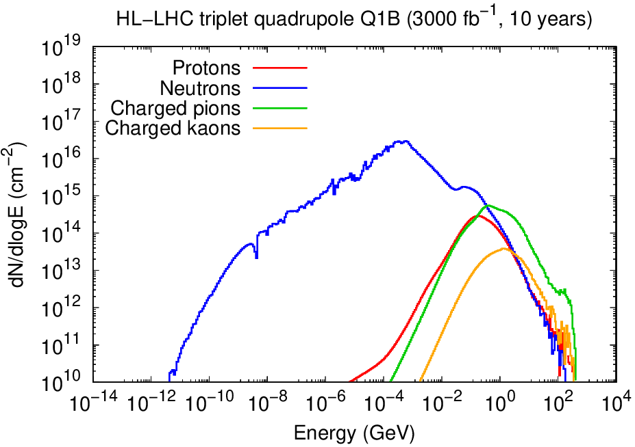
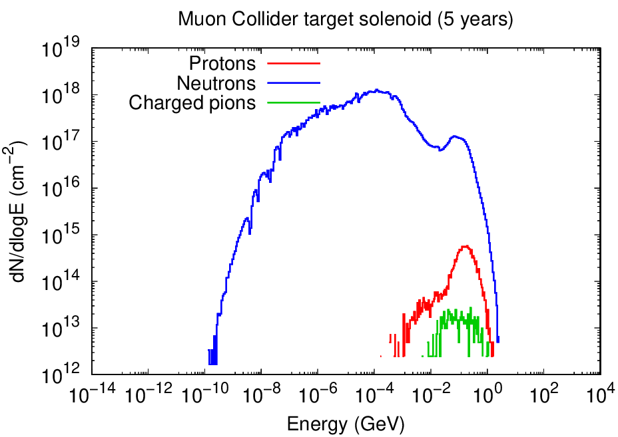
Particle spectra in accelerator magnet coils
HL-LHC inner triplet quadrupoles (1.6 cm W-alloy shielding)
Muon collider target solenoid
(35 cm W shielding + H20+BC)
FLUKA Monte Carlo results
See my RADSUM talk for details
Some key experimental results for radiation damage effects in REBCO are from fission reactors
Compared to a fission reactor neutron spectrum, we have also higher-energy neutrons (>10 MeV) in our accelerators, as well as other hadron species like protons, pions, kaons
How to apply REBCO irradiation test results to our cases? Via DPA?

Slide 14
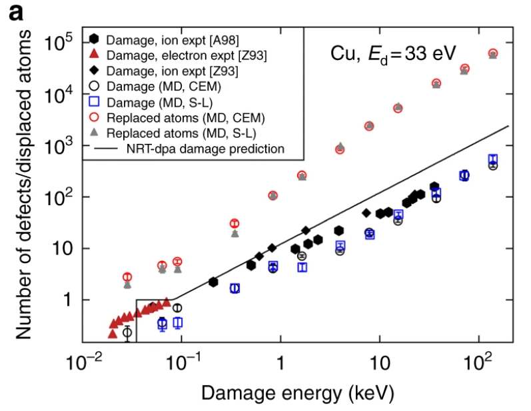
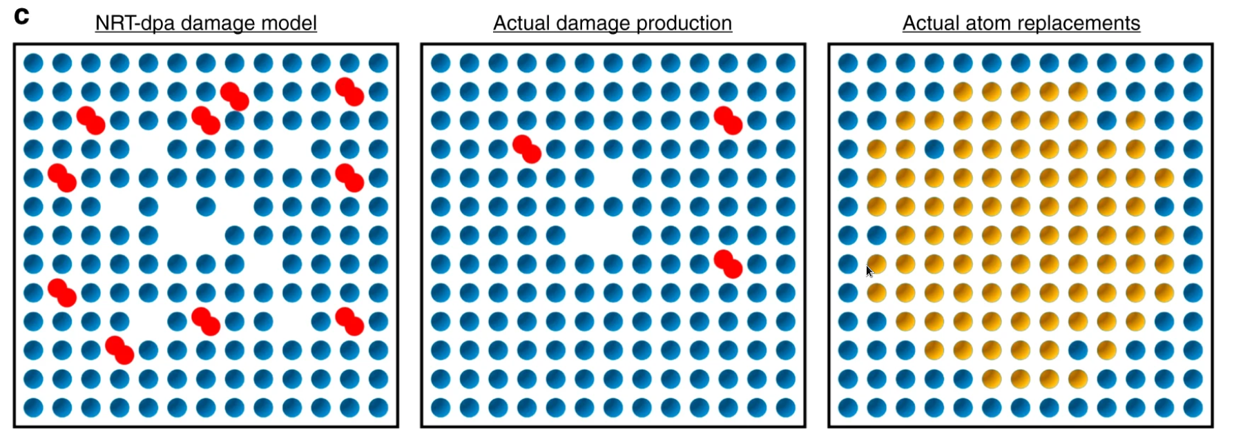
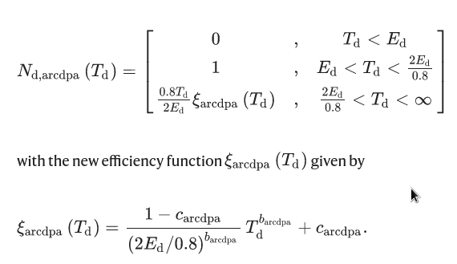
State-of-the-art DPA models in Monte Carlo codes
  Well established quantity (simple formula), which was refined over the years (from DPA-NRT to arc-DPA)
  It is possible to take into account defect creation by different particle species with different energies → DPA-NRT and arc-DPA have been implemented in different radiation transport codes (FLUKA, PHITS, MARS)
  Allows comparing radiation damage for different radiation environments → provides relationship between irradiation experiments and real accelerator environments (different particle species and spectra)!!
  Has been conceived for single element metals; what about other materials? compounds?
  Cannot predict the exact nature of microscopic damage, in particular for complex compounds like REBCO
  MC codes like FLUKA apply their DPA models for compound materials, but with an “average” damage threshold
E_{d}=damage threshold energy
T_{d}=energy available for creating atomic displacements
arc-DPA:
K. Nordlund et al., Nature Comm., 9, 1084 (2018)
Talks by F. Granberg, F. Salvat Pujol, and Y. Iwamoto

Slide 15
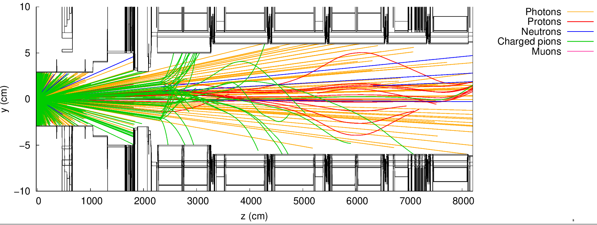
DPA (and dose) predictions for collider magnets
Derived with FLUKA
 | SC type | Radiation source | Shielding inserts (Δr) | Assumed scenario | DPA-NRT | Ionizing dose
HL-LHC final focus quadrupoles | Nb₃Sn | Proton-proton collision debris | 1.6 cm W-alloy | 3000 fb⁻¹ (10 years) | 1.5x10⁻⁴ | 20-30 MGy
FCC-hh final focus quadrupoles | Nb₃Sn / REBCO | Proton-proton collision debris | 4 cm W-alloy | 30 ab⁻¹ (20 years) | 4-5x10⁻³ | 60-80 MGy
Muon Collider (10 TeV) arc magnets | Nb₃Sn / REBCO | Muon decay | 3 cm W-alloy | 10 ab⁻¹ (5 years) | 5x10⁻⁵ | 20 MGy
Muon Collider target solenoid | REBCO | Proton beam on target | 35 cm W-alloy +H20+BC layer | 10 ab⁻¹ (5 years) | 5x10⁻³ | 50 MGy
Q2a
Q2b
Q3
D1
Assumes no annealing over the full operational lifetime
HL-LHC
Q1
The Monte Carlo simulations show, that although we have to deal with mixed radiation fields in magnet coils (p, n, π^{+/-},…), neutrons are still one of the main sources of DPA
vacuum

Slide 16
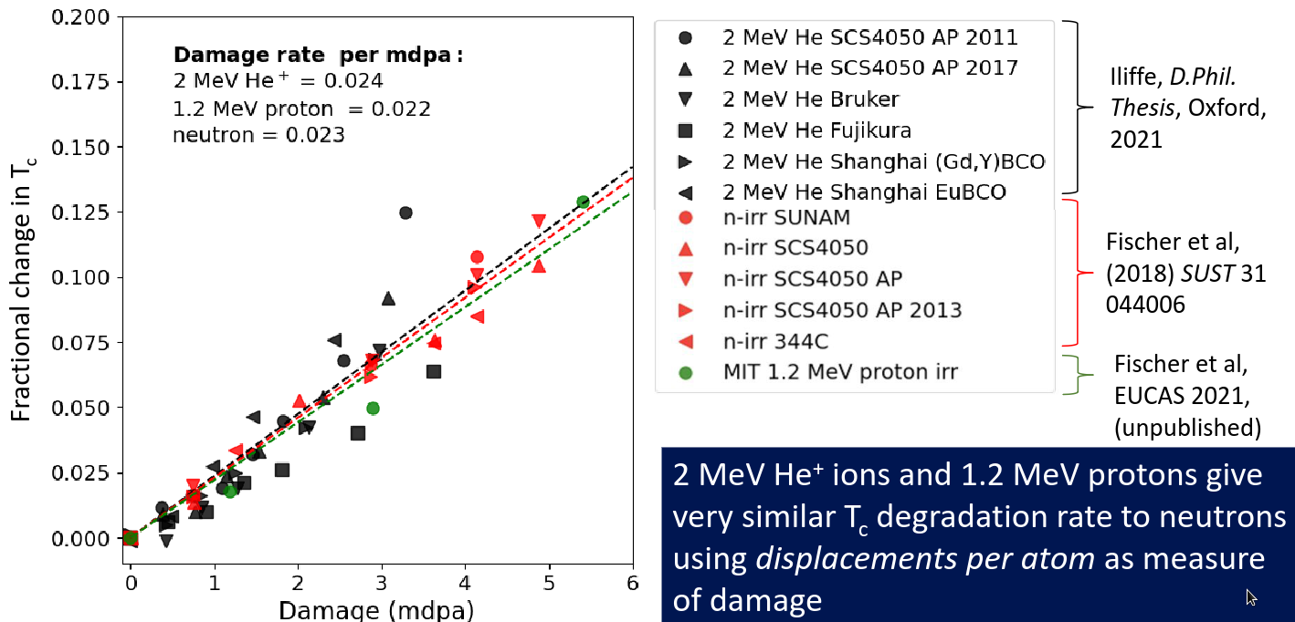
HTS irradiation experiments
Apart from particle type/spectrum, the irradiation conditions are not always the same (irradiation at room temperature vs cryogenic temperatures, ex-situ vs in-situ measurements)
Experimental activities reported at RADSUM:
  Neutron irradiation (TRIGA Mark II fission reactor) at TU Wien (Austria)
  Proton irradiation (1.2 MeV) at MIT PSFC (US)
  Light ion irradiation (2 MeV He+) at Oxford University (UK)
  Neutron irradiation at Belgian Research Reactor (BR-2) and Japan Research Reactor No. 3 (JJR-3) by KEK team (Japan)
Fusion community
Accelerator community
  REBCO is found to have a reduced radiation tolerance compared to Nb₃Sn
  REBCO properties start to be visibly affected in the range of a few 10⁻³ DPA
  Light ions and protons seem to be a good proxy for emulating radiation damage induced by fast fission neutrons – Tc change for REBCO falls on same line if normalized to the same DPA
Talk by S. Speller
So, is DPA a good metric after all? – more later

Slide 17


Selected results from HTS irradiation experiments
Relative change of critical temperature as a function of the fast neutron fluence (TRIGA Mark II fission reactor spectrum):
O(5x10⁻³ DPA)
Irradiation temperature
above RT
(< 70ºC)
10% decrease
  Monotonic decrease of T_{c} as a function of fast neutron fluence (nearly universal degradation)
  Driven by the loss of superfluid density
  Physical origin: pair breaking scattering on small defects distributed uniformly in the matrix
R. Unterrainer et al., SuST 37 (2024) 105008
Talk by M. Eisterer

Slide 18

Selected results from HTS irradiation experiments
Relative change of critical current density as a function of the fast neutron fluence (TRIGA Mark II fission reactor spectrum):
O(5x10⁻³ DPA)
Irradiation temperature
above RT
(< 70ºC)
1
2
  Non-monotonic behavior of J_{c} as a function of fast neutron fluence
  Competing effects:
    Increase driven by improved pinning
    Non-universal, depending on initial defect structure and type of radiation
    Physical origin: Flux pinning by large defects
    Decrease driven by loss of superfluid density
    Physical origin: pair breaking scattering on small defects
15 T, 30 K
R. Unterrainer et al., SuST 37 (2024) 105008
1
2
Talk by M. Eisterer
Point of degradation around 3x10²² n/m² (temperature dependent → reached earlier for higher T)

Slide 19



Selected results from HTS irradiation experiments
Relative change of critical current density as a function of 1.2 MeV proton fluence (MIT PSFC):
Talk by D.X. Fischer
Different irradiation temperatures (20K-300K) and in-situ measurements
20 K irradiation
77K irradiation
200 K irradiation
  Decrease of J_{c} as a function of proton fluence depends on irradiation temperature
  Similar results for 20 K – 200 K → 40% faster decrease than at 300 K
  Annealing of cold samples gives same results as warm irradiation

Slide 20


Selected results from HTS irradiation experiments
Back to the question if DPA is a suitable metric:
GdBCO based samples irradiated at TU Wien reactor in two ways:
Including thermal neutrons (capture on Gd causes many small defects)
Shielding Thermal neutrons shielded
Thermal neutrons shielded
Thermal neutrons shielded
WITH thermal neutrons
WITH thermal neutrons
T_{c} vs DPA does no longer fall on the same line …. DPA cannot account for different radiation sources in this case
Talk by M. Eisterer, IMCC annual meeting 2022
R. Unterrainer et al., SuST 37 (2024) 105008

Slide 21


Another metric: change of T_{c} as disorder parameter
Talk by M. Eisterer
M. Eisterer et al., arXiv:2409.01376v1
Talk by D.X. Fischer
  D = disorder resulting in a decrease of Tc by 1 K
  From M. Eisterer et al.:
  Pair breaking scattering is an obvious candidate for the degradation of the superconducting properties
  The transition temperature itself seems a suitable measure of impurity scattering
  Relative decrease of Jc for different species (protons, fast neutrons, thermal neutrons) and irradiation temperatures (cold, warm) falls on similar line when expressed as function of T_{c} change

Slide 22

Quantification of radiation damage in REBCO
DPA might not be the most suitable quantity for quantifying radiation damage in REBCO BUT it still seems to work for some cases and provides a first hint about the shielding requirements for magnets
Shall we invest in a more involved workflow? → first ideas coined at the RADSUM workshop (see below)
Ideally yes, but there are still gaps (missing interfaces / theories to be developed further)
Such approaches are also very time and resource intensive
Some of the open questions:
How to get PKA distribution for all interactions (not directly available from MC codes for condensed Coulomb interactions)
How to get the scattering rate of charge carriers from the defect structure predicted by MD simulations?

Slide 23
Quantification of radiation damage in REBCO
On the medium/longer-term it would be desirable to establish a more REBCO-specific quantity (or a set of quantities), which can be easily calculated for different radiation environments
  This would require custom “response”-functions for different particle types and energies
  Similar concepts have already been adopted for other fields (e.g. Si 1 MeV neutron-equivalent fluence for electronics → all particles contribute through different response functions)
Which quantities? (→ see also M. Eisterer’s talk at CC workshop)
  The scattering rate of charge carriers is the intrinsic parameter for quantifying the degradation in superconductors, but it is still difficult to predict from radiation damage (easier to assess experimentally)
  Increase of pinning
Still work ahead!!!
Understanding the microscopic defect morphology and the resulting change of pair breaking scattering on small defects (→scattering rate) and pinning due to large defects is crucial

Slide 24



Molecular dynamics simulations of defects in REBCO
  Workflow developed for fusion simulations (PKA distributions from MC sim are fed into MD sim)
  Many defects possible
  Oxygen vacancies/interstitials/anti-sites seem most important (highest density)
  Allow for comparison between defect structures from experiments and real radiation environment
Ek=7keV
Ek=110keV
Talks by D. Torsello and D. Gambino

Slide 25



Microscopic imaging of defect structures in REBCO
Talk by S. Speller
→ Microscopy, spectroscopy and other analytical techniques
Talk by D. Gambino
MD simulation
TEM
  Promising application of imaging techniques to understand the defect morphology for irradiated samples
  Important complement to MD simulations
  Small effects still difficult to quantify
    Direct observation of point defects on oxygen sub-lattice is challenging
    Remember: small effects considered as the main reason for the degradation (see before)

Slide 26




Back to the muon collider (target solenoid)
J. Manczak, D. Calzolari
  Cumulative dose and DPA around target with 35 cm shielding (after 5 yrs):
Target vessel
50 MGy
5x10⁻³ DPA
Solenoid
1 DPA
10⁵ MGy
E_{thr}=40eV
35 cm
E_{thr}=90eV
120 cm
35 cm
Graphite target
Tungsten
shielding
Water (few cm) +
Boron carbide (0.5 cm)
Even with a very thick shielding (35 cm), DPA in HTS coils remains high (5x10⁻³ DPA) → radiation damage likely not acceptable (shall we account for annual annealing cycles?) Other shielding materials? Just increase the shielding thickness?
Assuming 5 years with 140 days of operation per year

Slide 27


Advanced shielding materials
Talk by G. Kamal
  Space is an asset, both in accelerators and fusion reactors
  Shielding assemblies should be as compact as possible
  Significant efforts in fusion community to optimize the shielding material choice
    Promising options identified (WB, W2B5, WC), which can enhance the magnet lifetime (due to reduced neutron exposure)
    But these materials still have a low technological readiness
  What about using such materials in our accelerators?
  → First preliminary studies for accelerator environments (Muon Collider target solenoid) show limited benefits compared to the presently assumed materials, probably because of the high-energy neutron component (to be further investigated)

Slide 28
Conclusions
  The RADSUM workshop was an excellent opportunity to get an overview of radiation damage experiments and related modelling efforts for superconductors and superconducting magnets in general
  First key results for REBCO are available since several years, but there are still open questions
  In particular, the mapping of the results to real operational conditions for magnets in future accelerators remains a key task
  Further modelling efforts are needed to possibly develop a more suitable quantity for predicting radiation damage in REBCO, which could at some point replace DPA (which will nevertheless remain a key metric for first-order optimization studies)

Slide 30



Muon collider front end (muon production)
J. Manczak, D. Calzolari
Captured π^{+/-}/µ^{+/-}
Figure: two protons on target → sec. particles with E_{kin}>1MeV
  5 GeV proton beam (2 MW) on graphite target rod
  Production of charged pions → captured by solenoid fields (20 T peak field at target) → decay into muons
  Only a tiny fraction of the power is converted into useful muons → most of the power dissipated in target area
  Significant radiation shielding needed to protect magnets
Target vessel
80 cm
Beam window
35 cm
Graphite target rod

Slide 31

Radiation to solenoid around π/µ production target
J. Manczak, D. Calzolari
  Cumulative dose and DPA around target with 35 cm shielding (after 5 yrs):
Target vessel
50 MGy
5x10⁻³ DPA
Solenoid
1 DPA
10⁵ MGy
E_{thr}=40eV
35 cm
E_{thr}=90eV
120 cm
35 cm
Graphite target
Tungsten
shielding
Water (few cm) +
Boron carbide (0.5 cm)
DPA in HTS coils is mainly due to neutrons (5x10⁻³ DPA → 3x10¹⁹ n/cm2)
With 35 cm shielding, dose and DPA remain high
Thermal neutrons captured by boron
Assuming 5 years with 140 days of operation per year

Slide 32



Radiation to muon collider ring magnets
Picture shows the
horizontal plane of
a generic arc section
(dipoles only)
Magnets
Decay neutrinos:
irrelevant for
radiation load to
machine
Vacuum
Decay e⁻: bent
towards the
inner side
  Collider ring: circumference of 10 km, B=16T
  Muons are unstable → τ_{av}=0.1s at 5 TeV
  Decay e^{-/+} are a very significant source of radiation in the collider ring → 500 W/m
  Continuous shielding inside magnets needed along the full ring to reduce heat load and radiation damage
Synchrotron photons
emitted by decay e-
towards inner and outer
aperture
Similar picture applies to µ+
Inside magnets:
Secondary EM cascades (e⁻, e⁺, γ)
Neutron production (photo-nuclear interactions)
e⁻ carries on average 35% of
muon energy

Slide 33



Radiation to muon collider ring magnets
  Cumulative dose and DPA in coils of arc dipoles after 5 yrs (with 3 cm thick tungsten shielding):
Assuming 5 years with 140 days of operation per year
E_{thr}=30eV
E_{thr}=90eV
20 MGy
<10⁻⁴ DPA
No annealing due to thermal cycles of magnets considered
With 3 cm shielding, dose and DPA acceptable
DPA in HTS coils is mainly due to neutrons (10⁻⁴ DPA → 2x10¹⁷ n/cm²)
Simulation cut e⁻/γ

Slide 34


Radiation to solenoid around π/µ production target
  Secondary particle fluence around target:
Target vessel
Solenoid
35 cm
Simulation cut e⁻/γ
120 cm
35 cm
Graphite target rod
Tungsten
shielding
Water (few cm) +
Boron carbide (0.5 cm)
Simulation cut e⁻/γ
Assuming 5 years with 140 days of operation per year

Slide 35
Developing a workflow for quantifying effects in HTS
Application scenario: use of HTS magnets in future facility
How can we more accurately predict the effects for accelerator magnets?
Step 4: Design iteration for machine: more shielding needed?
Particle source, magnet/shielding geometry
Monte Carlo (MC) radiation transport simulations (FLUKA; PHITS, MARS, …) and other codes
Time-dependent Ginzburg Landau theory
Critical current density
Step 1: Quantify radiation environment
Step 3: Model flux pinning and superfluid density
Molecular Dynamics (MD) simulations, etc.
Primary knock-on-atom distributions
Step 2: Quantify detailed defect structure
Adapted from the talk by M. Eisterer
Scattering rate of charge carriers, size and density of pinning efficient defects
Workflow needs experimental verification (benchmarking experiments)

