Slide 1





Proton extraction studies for the target area of Muon Collider
8th May 2025
J. Mańczak, D. Calzolari, S.Candido R. Franqueira Ximenes, A.Lechner, G. Lerner

Slide 2
Outline
This presentation focuses on proton extraction scenarios with 10 GeV 4 MW beam.
The idea is to stick to a solenoid-based chicane trying to fine tune several parameters: horizontal shift, coil size, shielding, curvature.
For this study, the tapering length was increased to 24 meters, introducing an additional drift in a constant field of ~1.5 T – the reason behind this choice will be explained later.

Slide 3
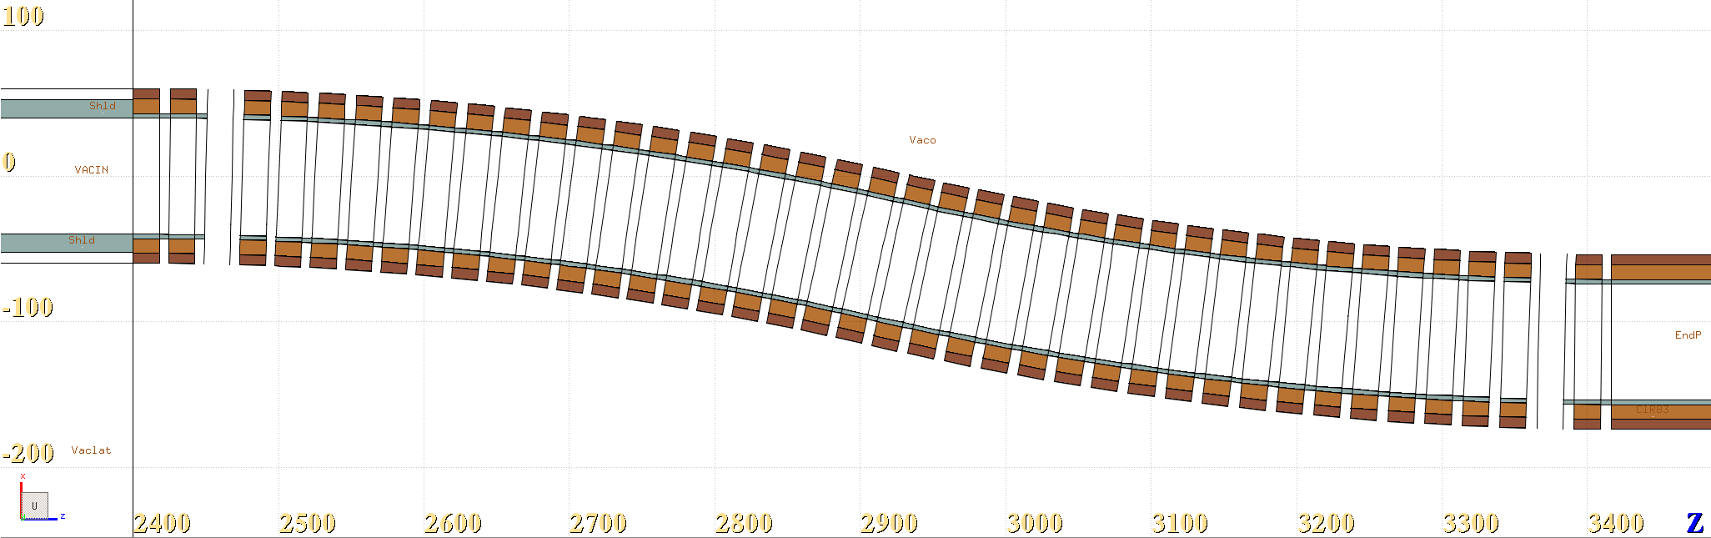
MAP Chicane
Studied in the past by Daniele
No shielding
Magnets become a proton dump directly
Bending radius | Opening Angle
22.917 m | 12.5

Slide 4
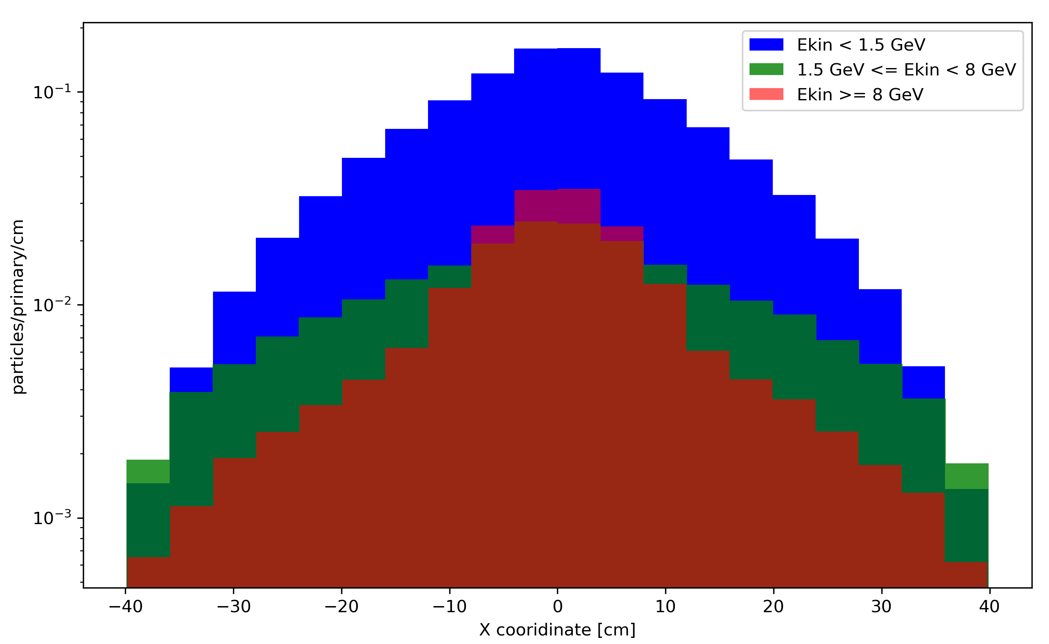
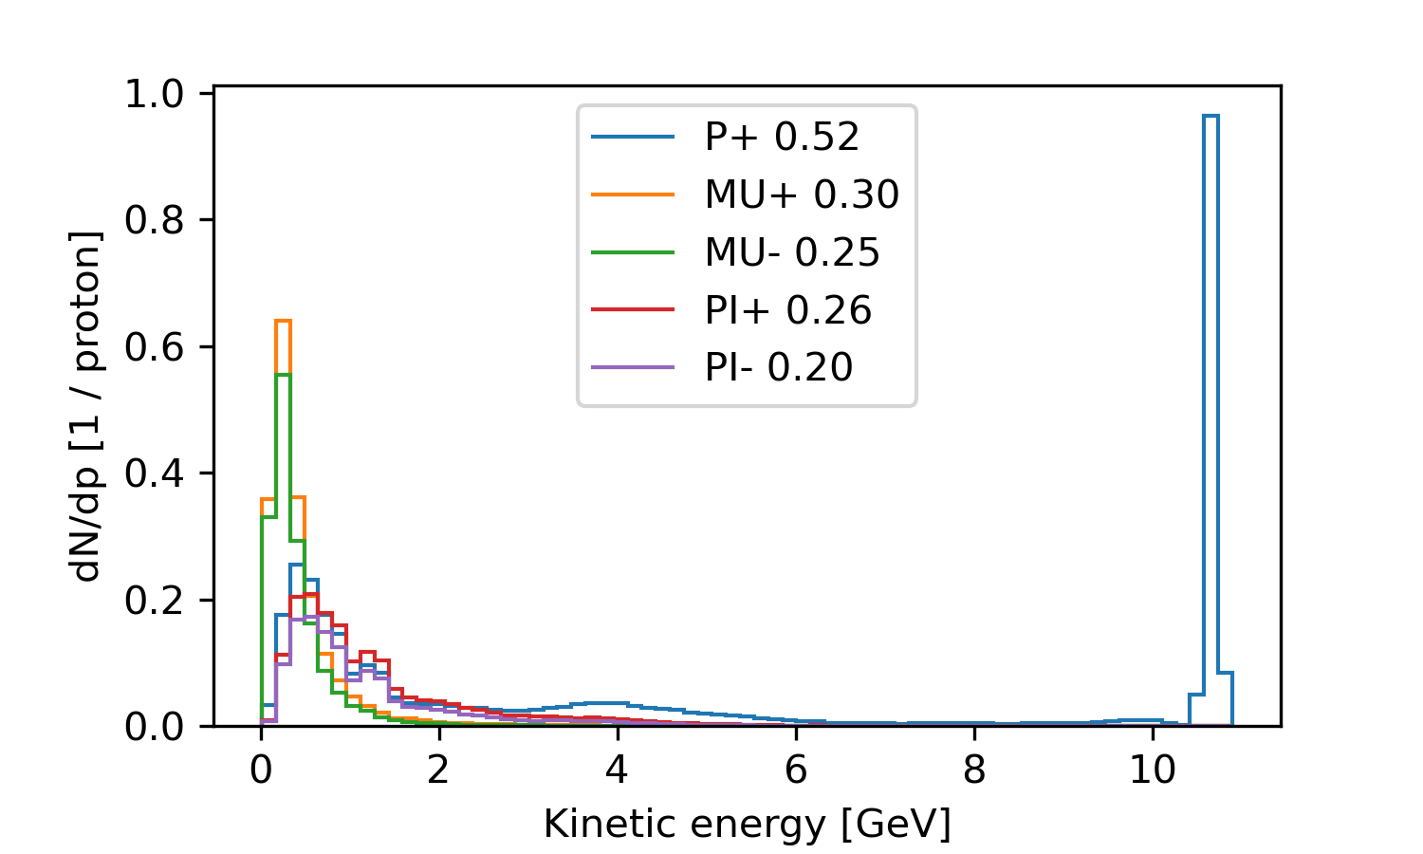
The need for extraction
Momentum distribution of particles arriving at the end of the 24M taper
The high energy spent protons are mostly focused around the primary beam direction
The secondary protons seem to be the main problem since their distribution cover the whole shielding aperture!

Slide 5
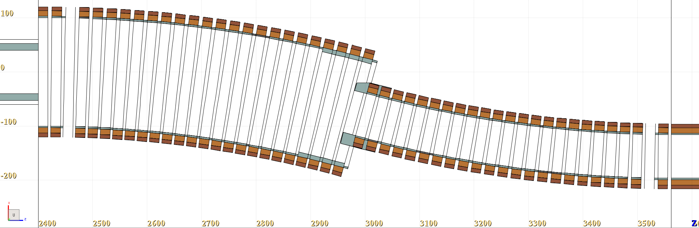
Chicane Concept 2, small shielding, small aperture
+20 cm
-20 cm
Bending radius | Opening Angle
22 m | 15
Small shielding included
Studies concluded the need for big extraction aperture ~40 cm size

Slide 6
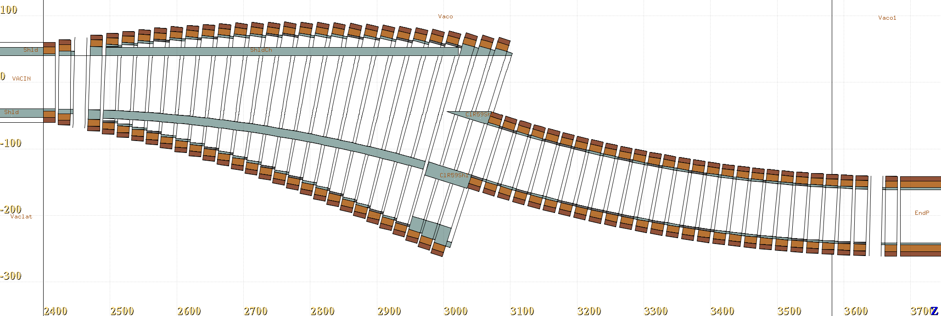
IncApt max 153 cm, large aperture, large shielding
~ +40 cm
-44 cm
Increasing magnet aperture keeps the current densities more stable (at least in my fitting script!)
Bending radius | Opening Angle
21 m | 18
Magnet aperture increases linearly up to 1.53 m
Significant shielding introduced inside the chicane
The aperture follows the size of the tapering end!

Slide 7
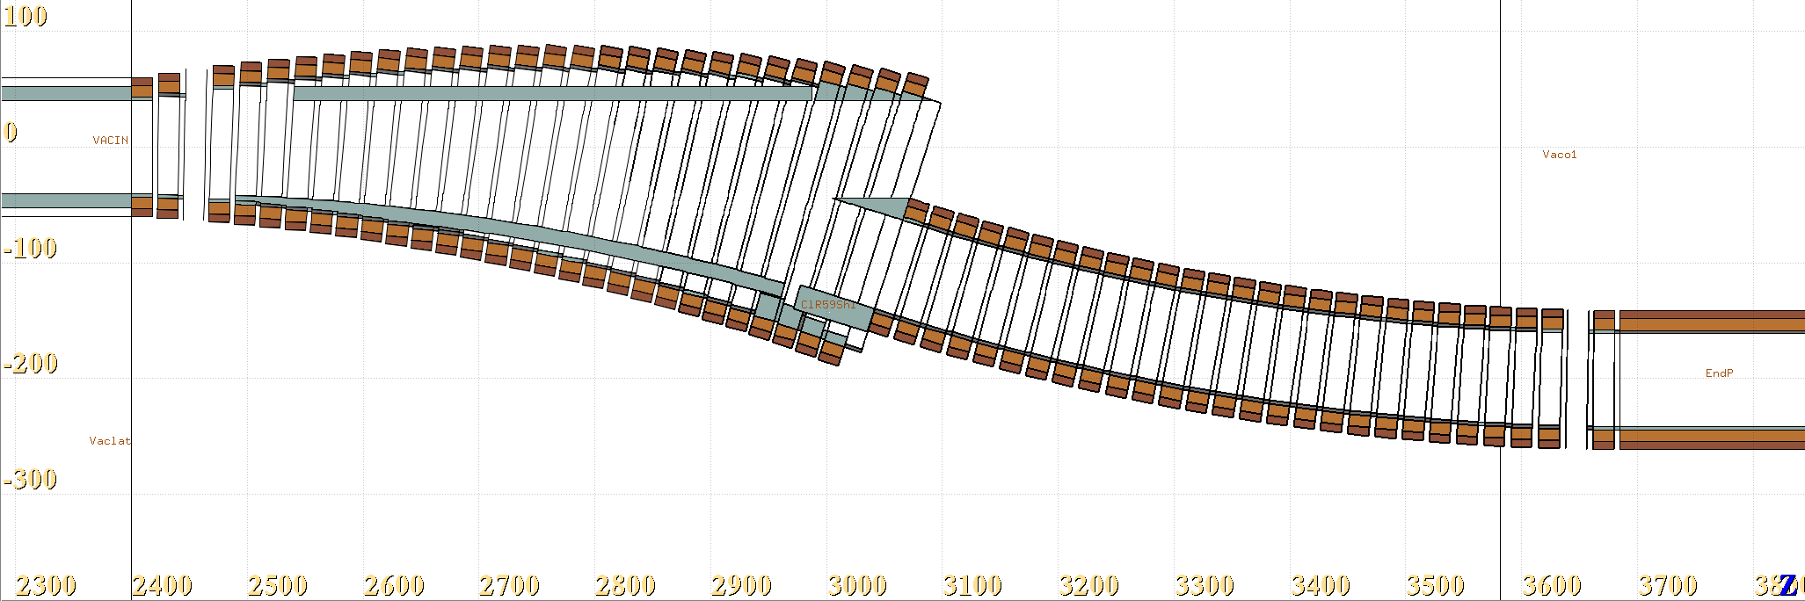
IncApt max 113 cm, large aperture, large shielding
~ +40 cm
-44 cm
35 cm
Bending radius | Opening Angle
21 m | 18
Magnet aperture increases linearly up to 1.13 m
Horizontal shift linearly increases up to 35 cm
The aperture follows the size of the tapering end!

Slide 8
Shielding idea
The longer tapering (24M) was introduced to allow secondaries emerging from the target at low angle to dissipate in the shielding before entering the shielding, the efficiency of this solution is still under investigation.
After the studies with small aperture chicane, it became clear that shielding inside the chicane has to be increased to protect the magnets in next to the extraction aperture.

Slide 9
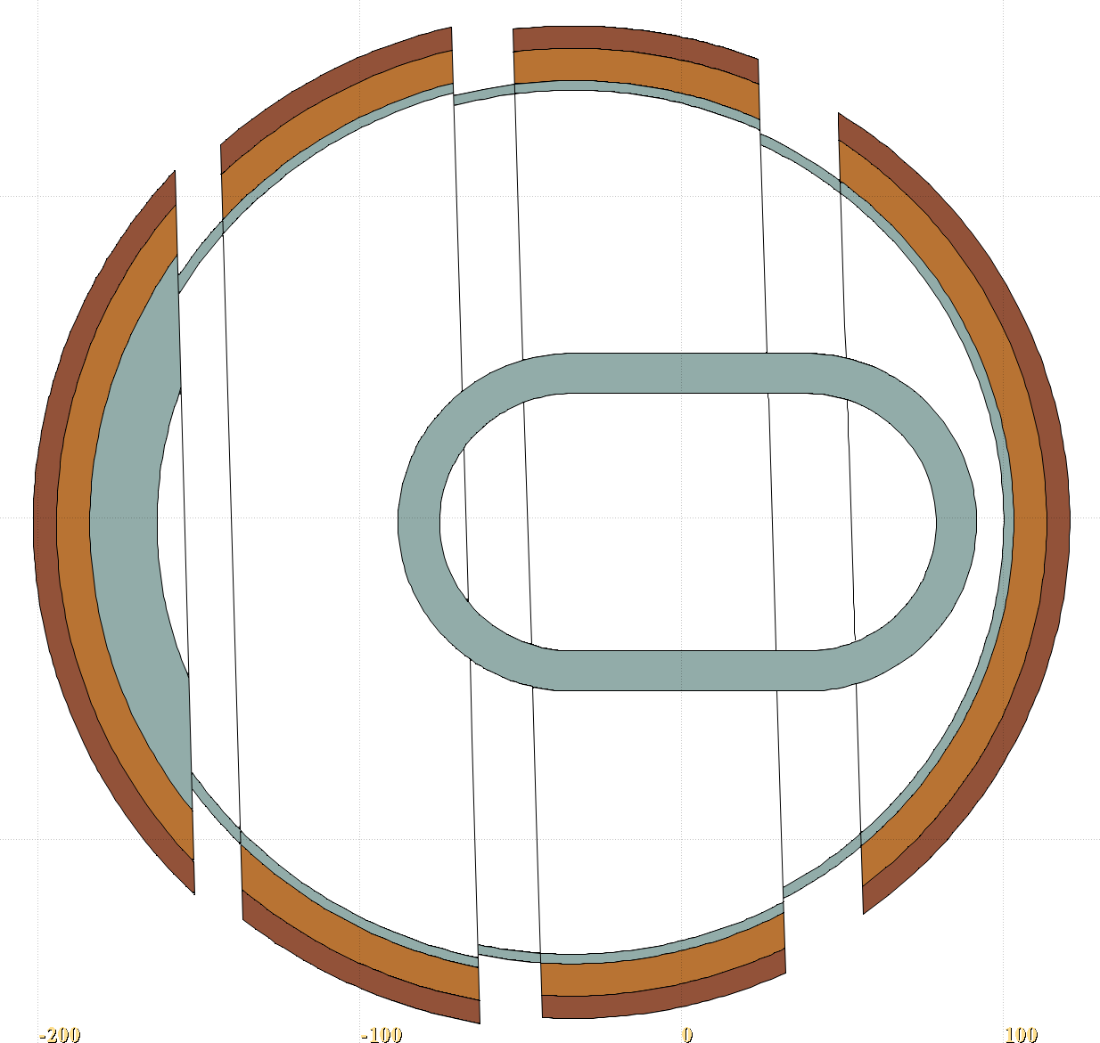
Shielding idea
The secondaries are expected to dissipate along the shielding inside the chicane, depositing their more uniformly energy on a wider distance
The nozzle shape not to intervene with the spent beam path
Shielding shape follows two cylinders connected as depicted
One cylinder is the extension of the tapering final aperture
The second one follows the curvature of the chicane, always centered around the magnet center

Slide 10
Yield and radiation load comparison
All the yields are shown with a momentum cut p < 500 MeV/c (for the moment, expected acceptance region)
The absorbed dose is not always delivered in the same part of the magnet, but it’s always the first magnet of the small chicane

Slide 11
Yield and radiation load comparison
Configuration | μ⁺/proton | μ⁻/proton | π⁺/proton | π⁻/proton | Max abs dose [MGy/year]
MAP Chicane | 0.22 | 0.19 | 0.026 | 0.021 | -
Small extraction, no shift | 0.21 | 0.18 | 0.022 | 0.019 | ~1000
IncApt, no shift SHIELDED | 0.20 | 0.17 | 0.018 | 0.016 | ~100
IncApt, no shift NOT SHIELDED | 0.21 | 0.18 | 0.019 | 0.016 | ~4000
IncApt, x shift SHIELDED | 0.17 | 0.14 | 0.013 | 0.011 | ~80
IncApt, x shift NOT SHIELDED | 0.17 | 0.14 | 0.013 | 0.011 | -
END TAPERING / REFERECE | 0.22 | 0.19 | 0.053 | 0.045

Slide 12
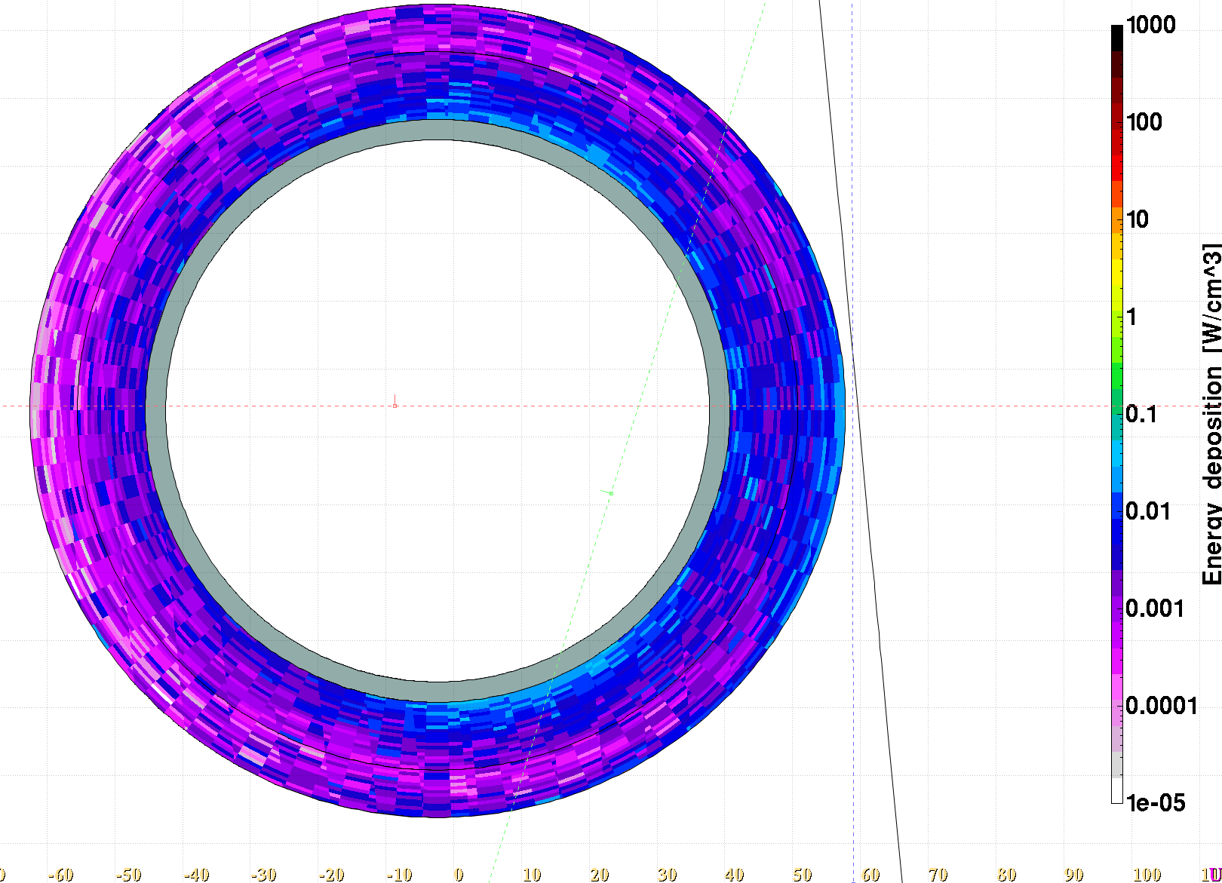
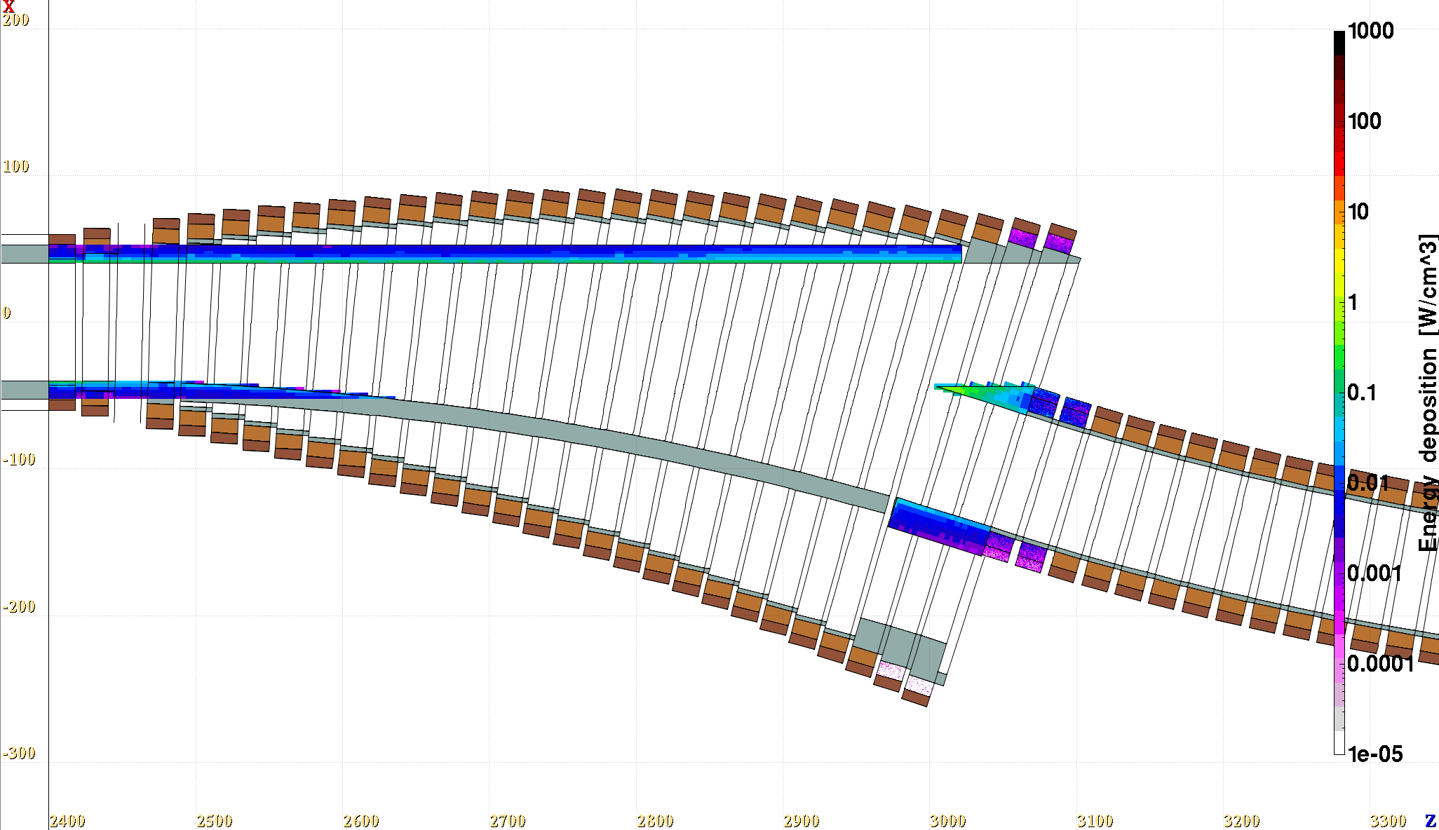
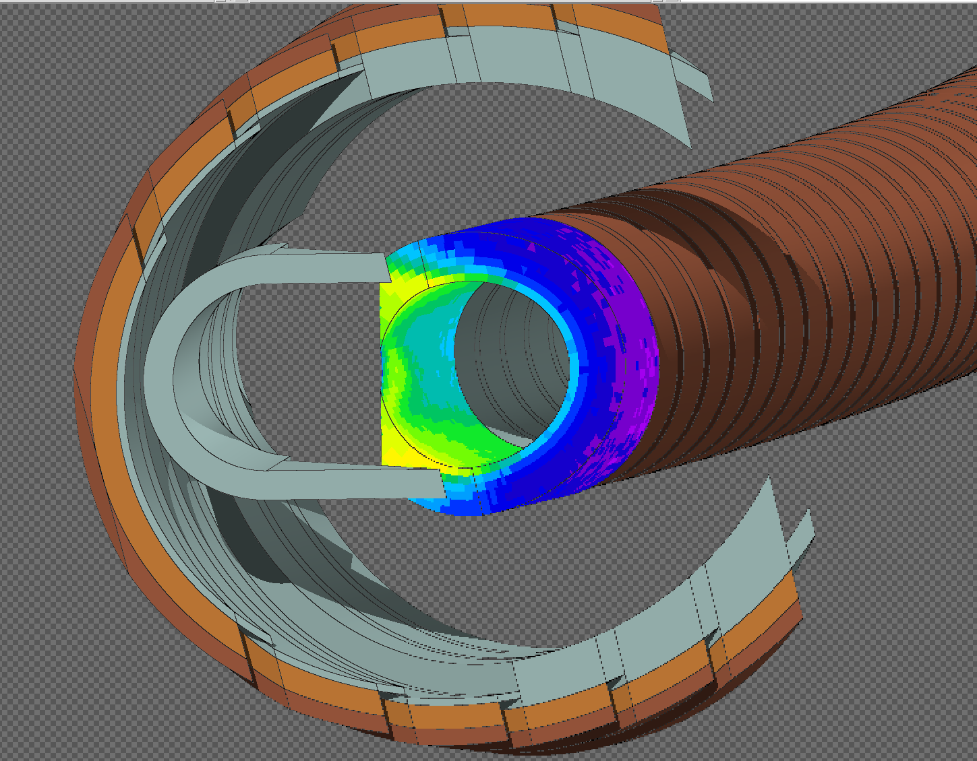
Radiation load – a closer look
A lot of power delivered to the nozzle

Slide 13
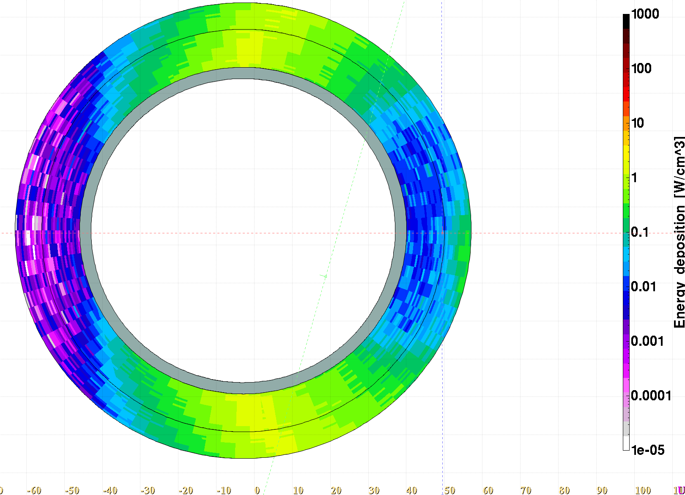
Radiation load – a closer look
WITH shielding
WITHOUT shielding
The dose at this small part stays high as it intercepts the tail of the spent beam
The two hot spot areas are caused by charge separation of pions and low energy protons, they can be mitigated efficiently with shielding

Slide 14
Conclusions
A horizontal shift reduces the yield but allows to keep the magnet aperture smaller – a compromise between the two must be optimized.
The large shielding concept does not seem to disrupt the yield significantly but is essential to reduce radiation load to the chicane coils.
More details to come at the annual meeting.

