Slide 1

ECR/Documents for Information and Approval
Giulia Romagnoli and Natalya Kahn for BE-EA, 2025-04-22
EA Documents - Agile Board - CERN Central Jira

Slide 2
LIST OF DOCUMENTS for Info
FOR INFORMATION EATM
Summary | Reporter | EA Projects | EDMS number | EDMS Status
SEISMIC RISK ASSESSMENT OF THE GBAR SHIELDING BLOCK CONFIGURATION | Marco Andreini, Tiago Nico | AD | 3263138 - AD-K-SR-0001 | Released
HI-ECN3 Tente - CE Proposal | Francois Butin | North Area, HI-ECN3 | 3292755 - SPSX-LJ-ER-0002 | Under Approval
Power converter requirements for North Area interlocking | Antoine Colinet | North Area, NA-CONS, HI-ECN3 | 3253361 - SPSX-R-SPC-0003 | Engineering check
BA81 Buffer Zone | Frederic Aberle | North Area | 3288664 - SPSX-J-SPC-0005 | Engineering check
HI-ECN3 - BDF Target Complex Integrated Service Cell | Jean-Louis Grenard | North Area, HI-ECN3 | 3203029 - SPSX-PM-MEMO-0004 | Released
Responsibilities for the TCC8/ECN3 Decabling Activity for HI-ECN3 | Melania Averna | North Area, HI-ECN3 | 3225508 - SPSX-ED-MEMO-0001 | Engineering check
MBSA Magnet - Functional Specification | Philip Schwarz | North Area, NA-CONS | 3238175 - SPSX-M-SPC-0004 | Under Approval
Clean Room Functional Specification | Krystian Sidorowski | North Area | 3189466 - SPSX-J-SPC-0004 | Under Approval
Pre-DEC from BE-EA following the office identification | Alicja Ostrega | North Area, NA-CONS | 3152086 - SPSX-E-LST-0024 | Under Approval
NA-CONS Fire Safety & Access WP5.1.3 Fire-retardant Partitions | Adem Kaymak | North Area, NA-CONS | 2816009 - SPSX-SF-WD-0006 | Under Approval
NA-CONS - WP 5.1.3 - Fire-resistant partitions - Provisional Schedule | Adem Kaymak | North Area, NA-CONS | 3118794 | Released
BOREAL Converters List in TT20 and North Area | Ivan Josifovic | North Area, NA-CONS | 3180776 - SPSX-E-LST-0035 | Released

Slide 3
LIST OF DOC for FUTURE APPROVAL
ECR INFO/FUTURE APPROVAL EATM
Summary | Reporter | EA Projects | EDMS number | EDMS Status
Production/Installation of the Horizontal Beamline Section in TELMAX (AD/ELENA) | Francois Butin | AD | 3284097 - AD-LJ-EC-0027 | Under Approval
MDX Magnet Installation for User Set-Up in T10 | Maarten Van Dijk | East Area | 3212841 - PSZ-M-EC-0002 | In Work
NA-CONS Fire-Resistant Partitions 3 - Partitions #09, #10, #11, #12, #13, #14, #17 and #33 | Adem Kaymak | North Area, NA-CONS | 3286649 - SPSX-SF-EC-0017 | Engineering check
User Requirements for XTAX Absorbers in North Area Beamlines | Miguel Santos | North Area | 2747997 – SPSX-T-ES-0003 | Under Approval
GIF++ Bunker Extension in Phase 2 | Martin Jaekel | North Area | 3223563 – SPSX-J-EC-0011 | Under Approval

Slide 4
LIST OF DOCs for APPROVAL
ECR APPROVAL EATM
Summary | Reporter | EA Projects | EDMS number | EDMS Status
Displacement of Beam Instrumentation from H4 to H2 Beamline for Neutrino Platform Operation in 2025 | Nikolaos Charitonidis | North Area | 3252924 – SPSX-B-EC-0017 | Under Approval
Shortening of Vacuum Chamber in IRRAD Zone 1 for the HEARTS Run | Federico Ravotti | East Area | 3267946 - PSZ-V-EC-0002 | Under Approval

Slide 5
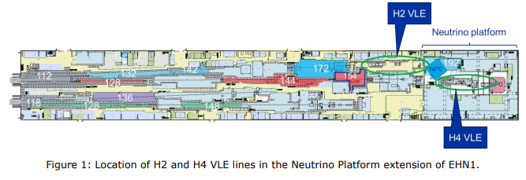
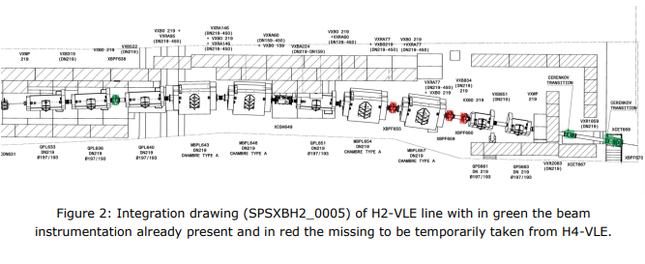
ECR for Approval
SPSX-B-EC-0017
Version 0.2
Displacement of Beam Instrumentation from H4 to H2 Beamline for Neutrino Platform Operation in 2025
By Nikolaos Charitonidis
Some beam instruments are to be moved from H4-VLE to H2-VLE in order to accommodate the operation of H2-VLE beamline during 2025.
H4-VLE will not require beam in 2025 so instrumentation can be temporarily relocated.
The current installed beam instrumentation on H2 is not enough for the momentum reconstruction nor for the correct triggering that the physics scope of NP02 necessitates.
The instrumentation will be returned to H4-VLE in YETS 25-26.

Slide 6
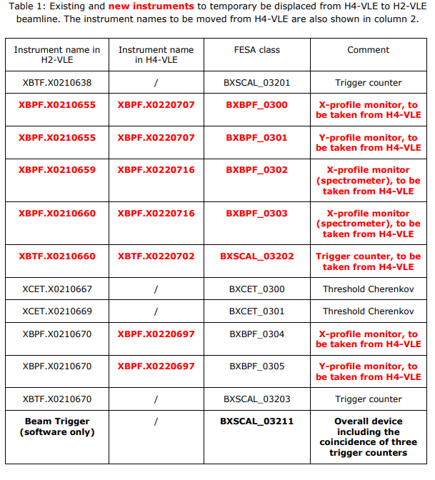
ECR for Approval
SPSX-B-EC-0017
Version 0.2
Displacement of Beam Instrumentation from H4 to H2 Beamline for Neutrino Platform Operation in 2025
By Nikolaos Charitonidis

Slide 7
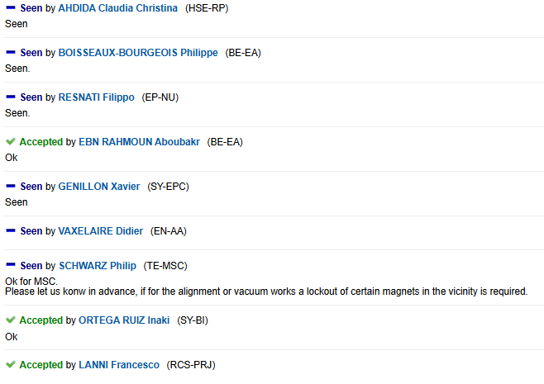

ECR for Approval
SPSX-B-EC-0017
Version 0.2
Displacement of Beam Instrumentation from H4 to H2 Beamline for Neutrino Platform Operation in 2025
By Nikolaos Charitonidis
Seeking approval from EATM

Slide 8
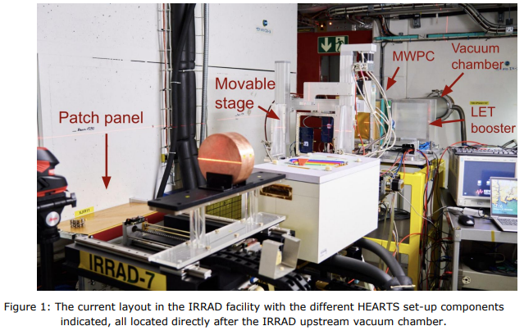
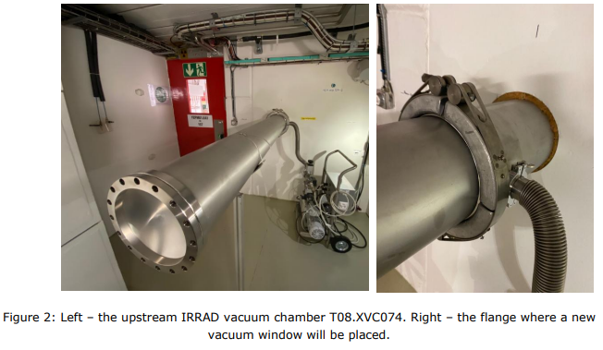
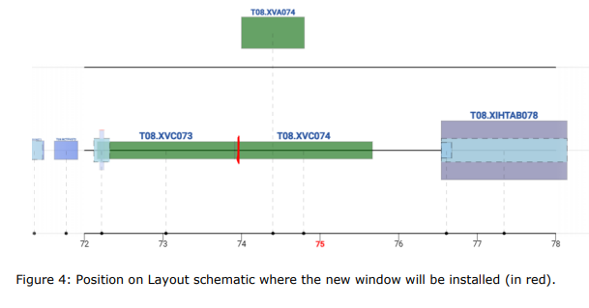
ECR for Approval
PSZ-V-EC-0002
Version 0.2
Shortening of Vacuum Chamber in IRRAD Zone 1 for the HEARTS Run
By Federico Ravotti
This ECR describes the temporary shortening of the vacuum chamber located at the upstream end of the IRRAD facility to accommodate more efficient use of IRRAD Zone 1 for the HEARTS project.
The current layout means it is difficult to install, modify or uninstall test set-ups and to conduct RP surveys.
The vacuum chamber T08.XVC074 will be replaced by the vacuum window T08.XVC073 and the vacuum pump T08.XVA074’s flexible pipe will be replaced by a longer one. This will allow all systems to move upstream by 1.7 m, thereby increasing space, facilitating movement and reducing dose.
The original vacuum pipe will be put back in place after the ion run during YETS and before restarting proton operation.

Slide 9
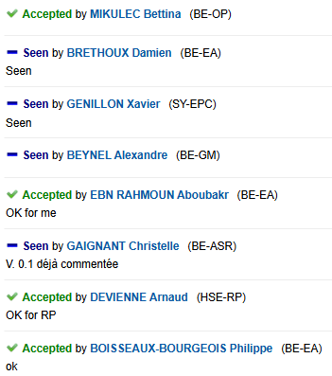
ECR for Approval
PSZ-V-EC-0002
Version 0.2
Shortening of Vacuum Chamber in IRRAD Zone 1 for the HEARTS Run
By Federico Ravotti
Seeking approval from EATM

Slide 10
Thank you!

