Slide 1

Report for MuCol WP7
Magnets
Luca Bottura, B. Bordini, S. Fabbri, F. Boattini (CERN),
B. Caiffi, S. Mariotto, M. Statera (INFN)

Slide 2
Outline
Objectives of the Work Package
Management procedures and methods
Workplan and degree of execution
Expected potential scientific, technological, economic, competitive and social impact, and plans for using and disseminating results
Results dissemination
Beneficiaries’ contributions
CAVEAT: this is only a partial view of the results achieved, selected to give a good impression of effort, progress and impact

Slide 3
Objectives of the WP
The objective of this work package is to address feasibility and technology limits of the magnet and powering systems, assess technology readiness and R&D timeline.
value of the maximum field and free bore of the solenoids for the target, capture and cooling complex;
concept and feasibility of the fast accelerator chain;
design options for the magnets of the collider complex.
Combination of conceptual design work, targeted tests and specific characterization measurements.
Exploit synergies with on-going developments in other fields (high magnetic field science, NMR, fusion) and programs (EU High-Field Magnets R&D, US-MDP).

Slide 4
Management
The work package is divided in four tasks:
Task 7.1 - Technical Coordination and Integration (CERN)
Task 7.2 - Target, Capture and Cooling Magnets (INFN)
Task 7.3 - Fast Cycled Accelerators (CERN)
Task 7.4 - Collider Ring Magnets (INFN)
Work is coordinated through
Meetings at task level, as needed to discuss technical issues and solutions: Solenoids (https://indico.cern.ch/category/16091/), Accelerators (https://indico.cern.ch/category/15910/) and Collider (https://indico.cern.ch/category/16194/)
Regular meetings of the work package to communicate and report on progress, the Muon Magnets Working Group (https://indico.cern.ch/category/13958/)
Very active and fruitful exchange, both within each task and the work-package, about 200 technical meetings so far
Discussion space shared with the High Field Magnet programme, coordinated by CERN
All material presented is stored in indico

Slide 5
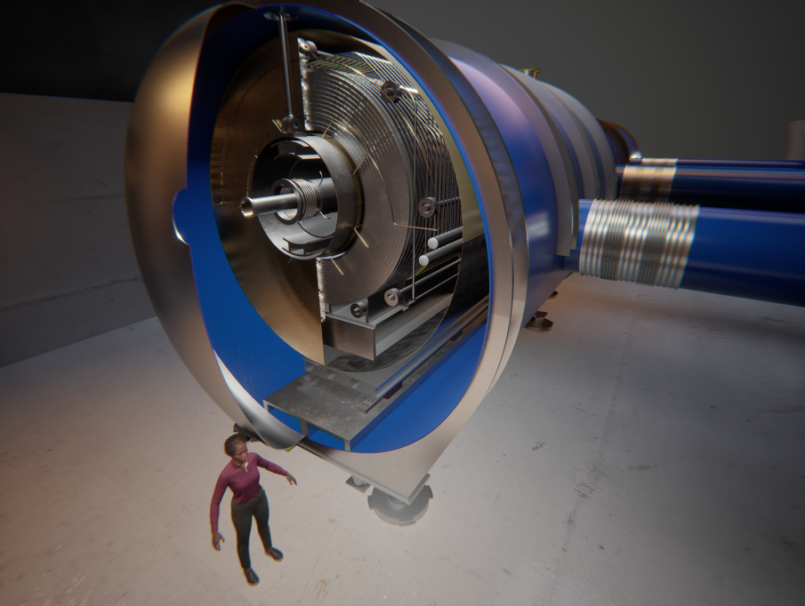
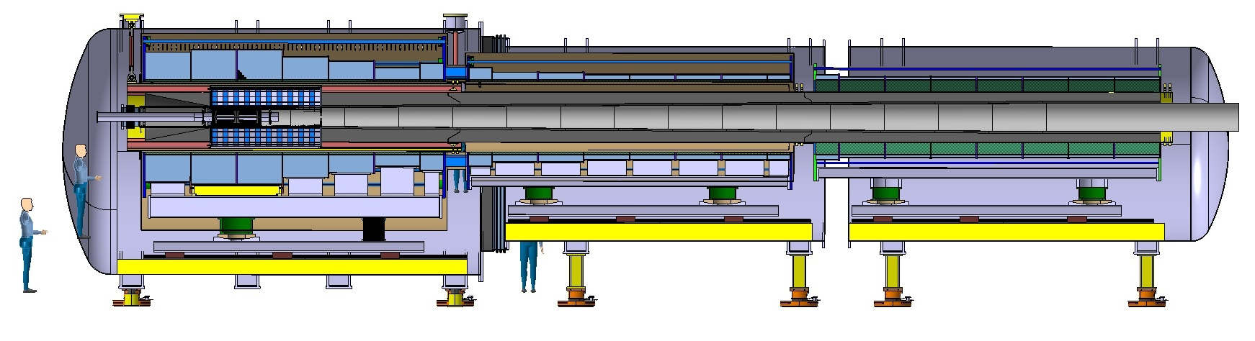
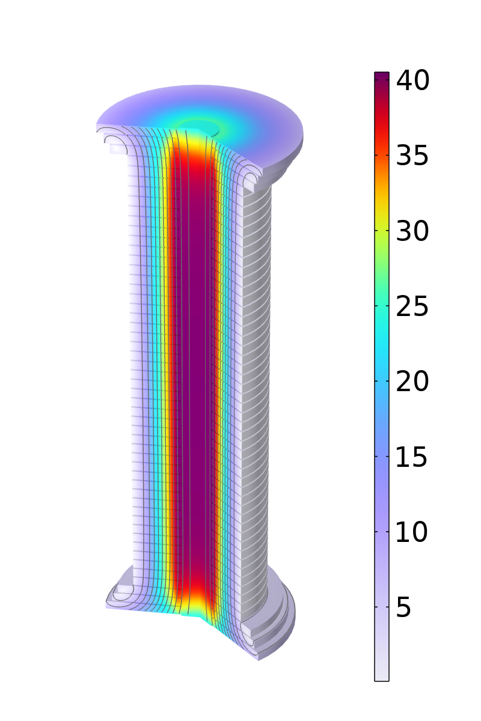
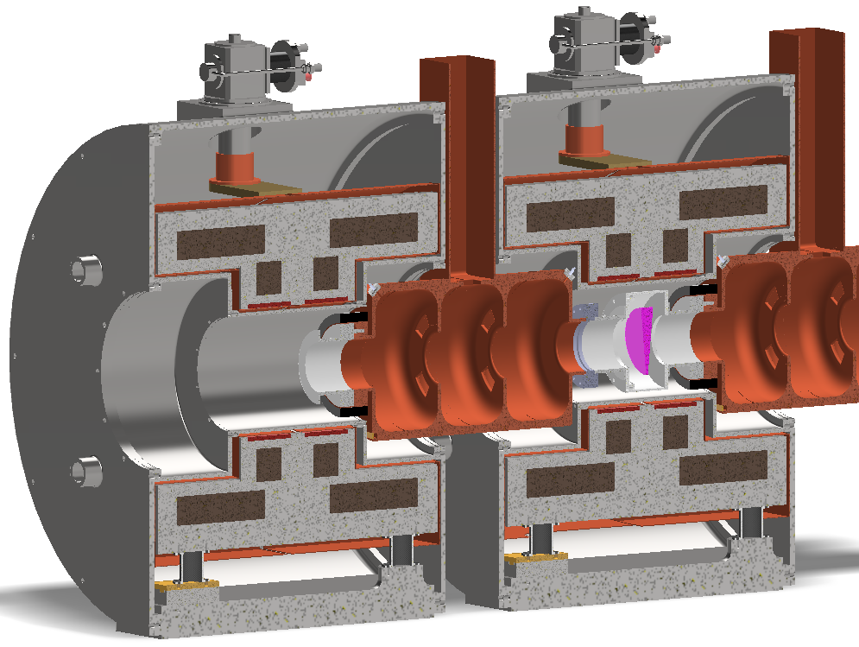
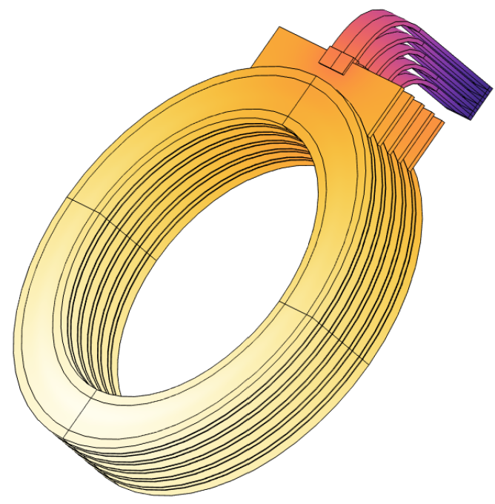
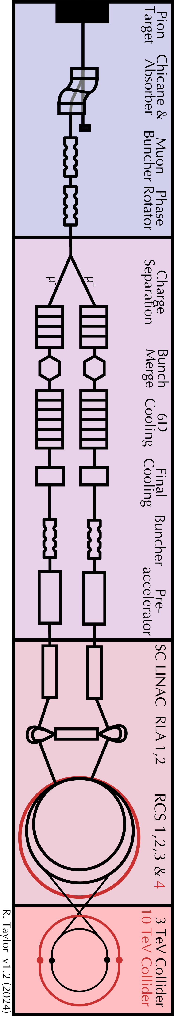
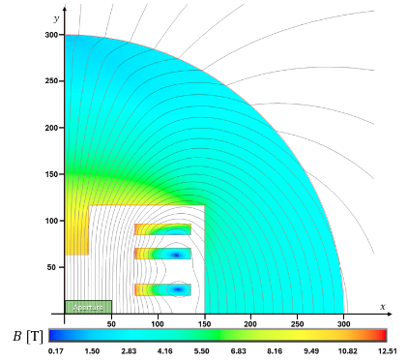
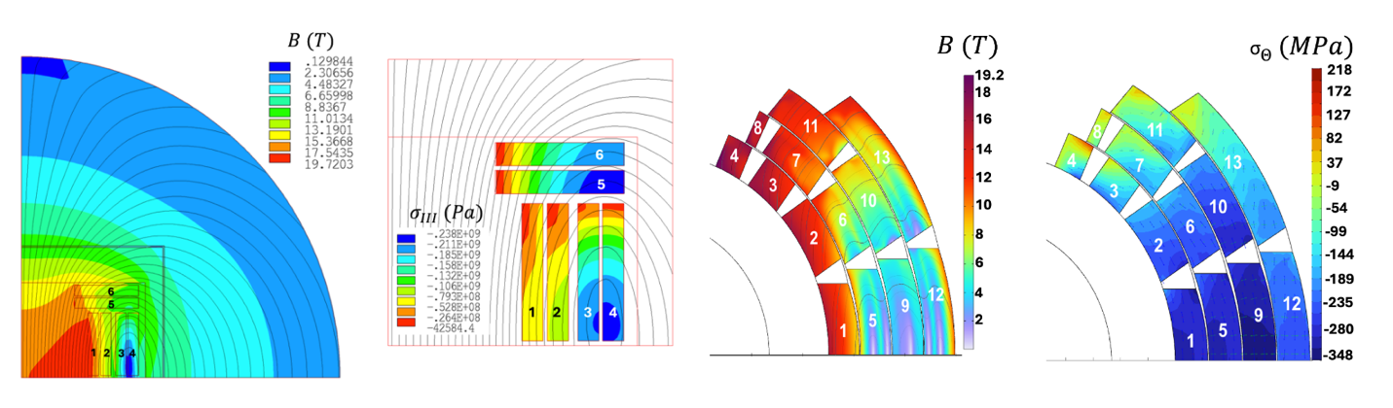
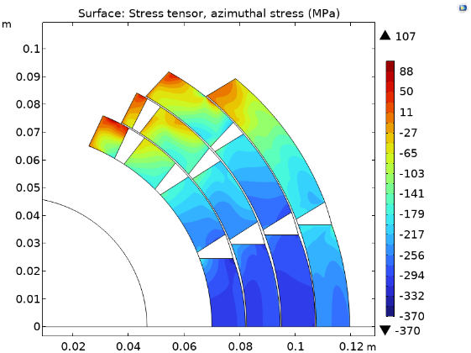
Target and capture solenoid
23 solenoids: 20 T, 1.4 m bore
3000 solenoids: 2 to 14 T, 90 mm to 1.5 m bore
Muon beam cooling solenoids
17 solenoids: 40 T, 60 mm bore
Accelerator and collider magnets
5 km: 10 T, 30(V) x 100 mm (H) dipoles
10 km 14 T, 140 mm bore dipoles

Slide 6
Workplan and degree of execution
Task 7.1
Activity | Status
Summary of current technology status based on design work and identification of major technology gaps | Done
Development of TRL-based framework for magnets and powering systems and visualization of estimated TRLs for key technologies | Done
Use of TRL mapping to determine appropriate R&D scale (models vs. prototypes) and definition of R&D planning strategy beyond MuCol | Ongoing
Coordination of efforts and communication of results | Ongoing

Slide 7
Workplan and degree of execution
Task 7.2
Activity | Status
Definition of new baseline for target, decay and capture solenoid, based on HTS technology, reducing mass to 100 tons, stored anergy to 1 GJ and consumption to 1 MW | Done
Analysis of US-MAP baseline 6D cooling channel (826 cells, ~970 m, 3000 solenoids) | Done
Development of solenoid design and optimization rules, incorporating engineering constraints and integration in beam optics optimization | Done
Application of optimization tools to new 6D optics configuration (3030 solenoids), including integration and spacing constraints | Ongoing
Definition of 40 T field target and small 50 mm bore for compact R&D testing, choosing non-insulated windings and pre-compression as new technology vehicle | Done
Engineering development of modular pancake-based solenoid over past 12 months and initial winding tests as feedback to conceptual design, and development of radial pre-compression mechanical structure | Ongoing

Slide 8
Workplan and degree of execution
Task 7.3
Activity | Status
Selection of resonant power converters and capacitor-based energy storage for magnet powering, and design of uni- and bi-polar resonant circuit for RCS | Done
Exploration of resistive dipole magnet geometries: hourglass, window-frame, H-type | Done
Development of interactive global optimization tools using Matlab, Python and FEMM, scanning geometric and electrical variables to minimize cost function | Done
Assessment of field errors, AC losses during magnetic field ramps, 3D effects | Ongoing
Global optimization of magnets, power converters, and energy storage systems | Ongoing
Development of superconducting dipole magnets for Hybrid Cycled Synchrotrons (HCS), targeting 10 T at 20 K, using HTS technology for rectangular aperture dipole | Done
Engineering design of HCS superconducting dipole to ensure large operating margin and reduced power consumption, accommodating periodic heating from muon decay bursts | Ongoing

Slide 9
Workplan and degree of execution
Task 7.4
Activity | Status
Identification of collider magnet challenges and integration with beam optics | Done
Definition of AB, AG, AGB plots for dipoles, quadrupoles and combined function magnets, using different SC materials (Nb₃Sn, REBCO, Nb-Ti) operated at different temperatures (1.9 K to 20 K) and including cost limits (400…800 kEUR/m) | Done
Establishment of performance targets for dipoles (11 T for Nb₃Sn @ 4.5 K, 14 T for REBCO @ 20 K) and required aperture (158 mm @ 4.5 K, 138 mm @ 20 K) | Done
Validation of Nb-Ti as candidate for 3 TeV stage dipoles (5 T @ 4.5 K) | Done
Engineering design of superconducting dipoles based on HTS at 20 K, considering alternative coil geometries | Ongoing
Global optimization of magnets performance and cost vs. beam optics requirements | Ongoing

Slide 10
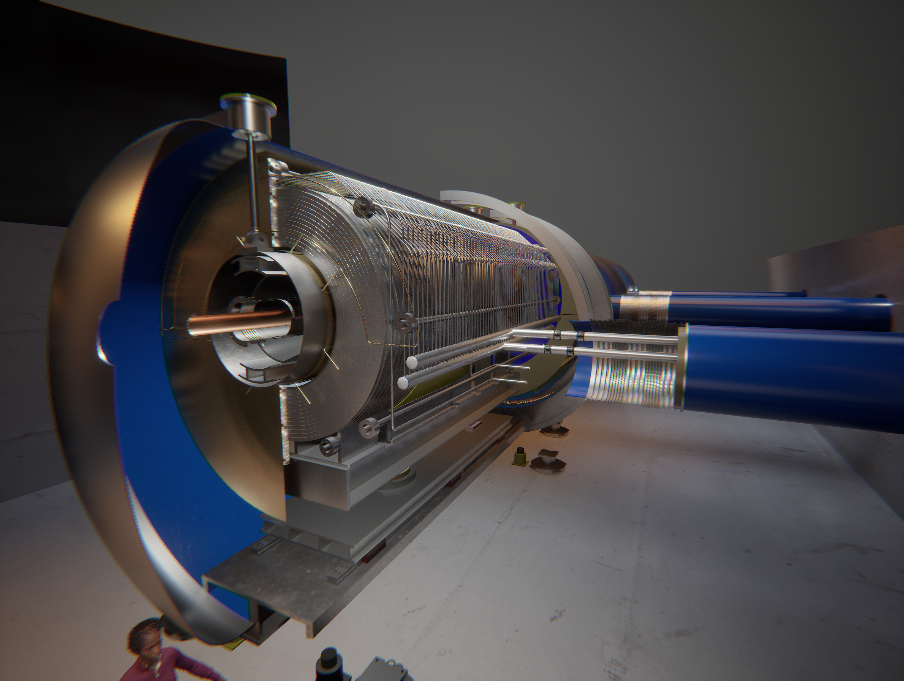
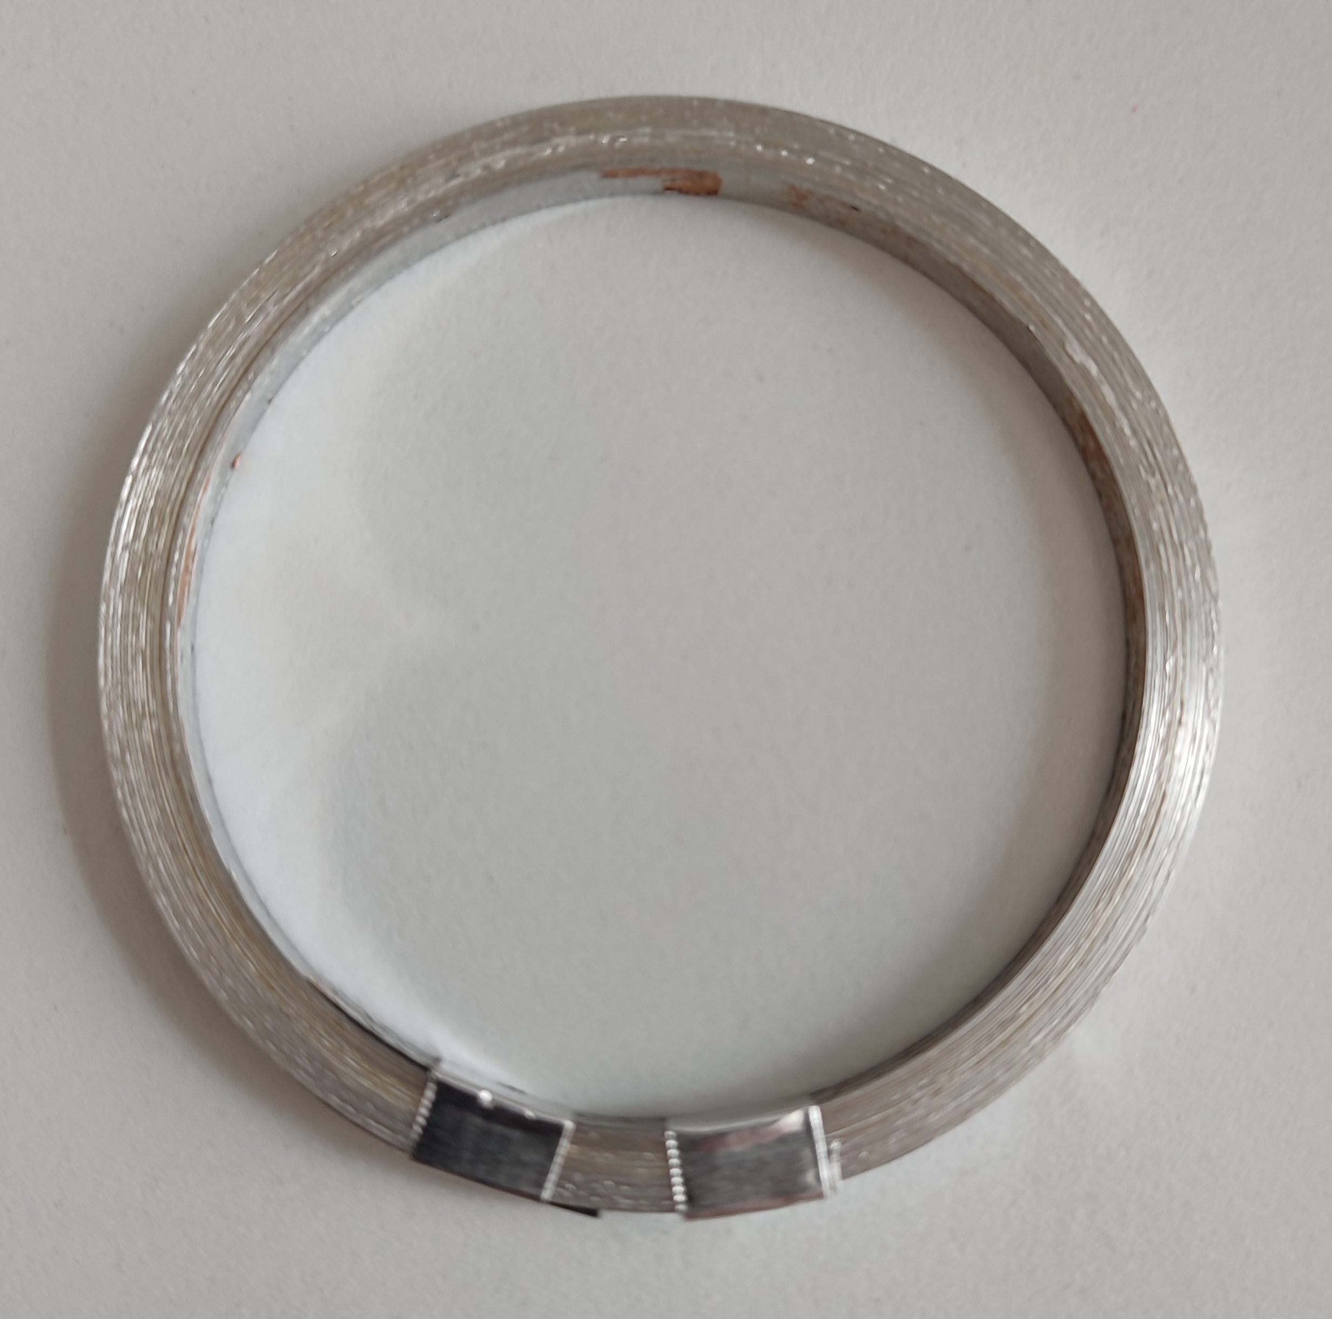
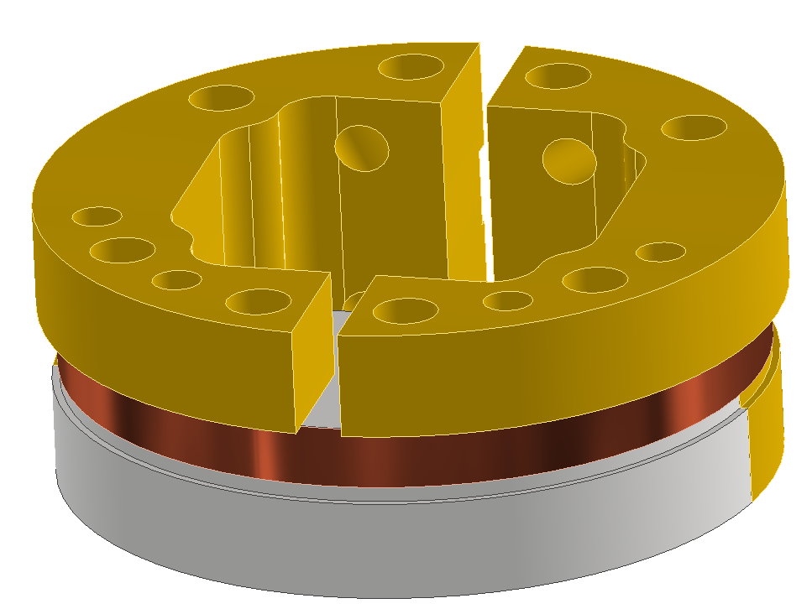
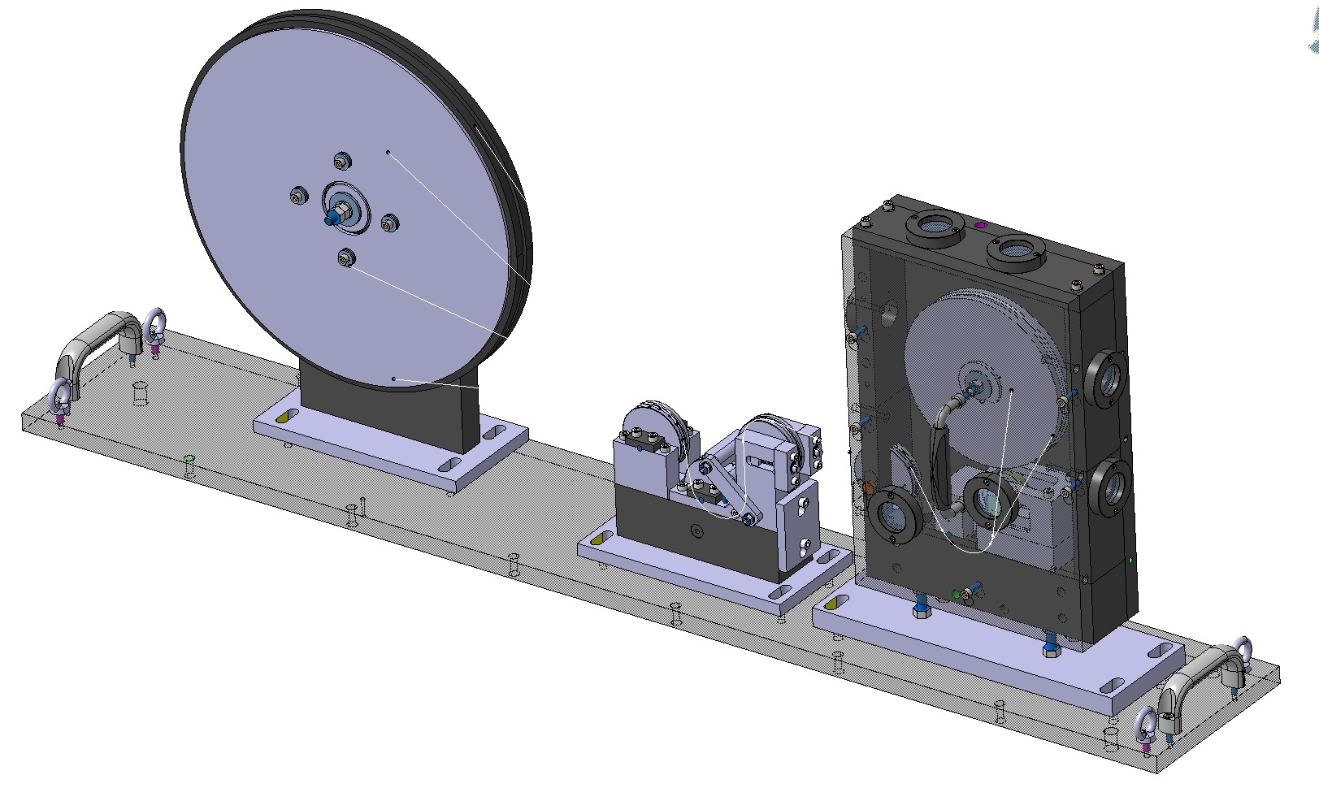
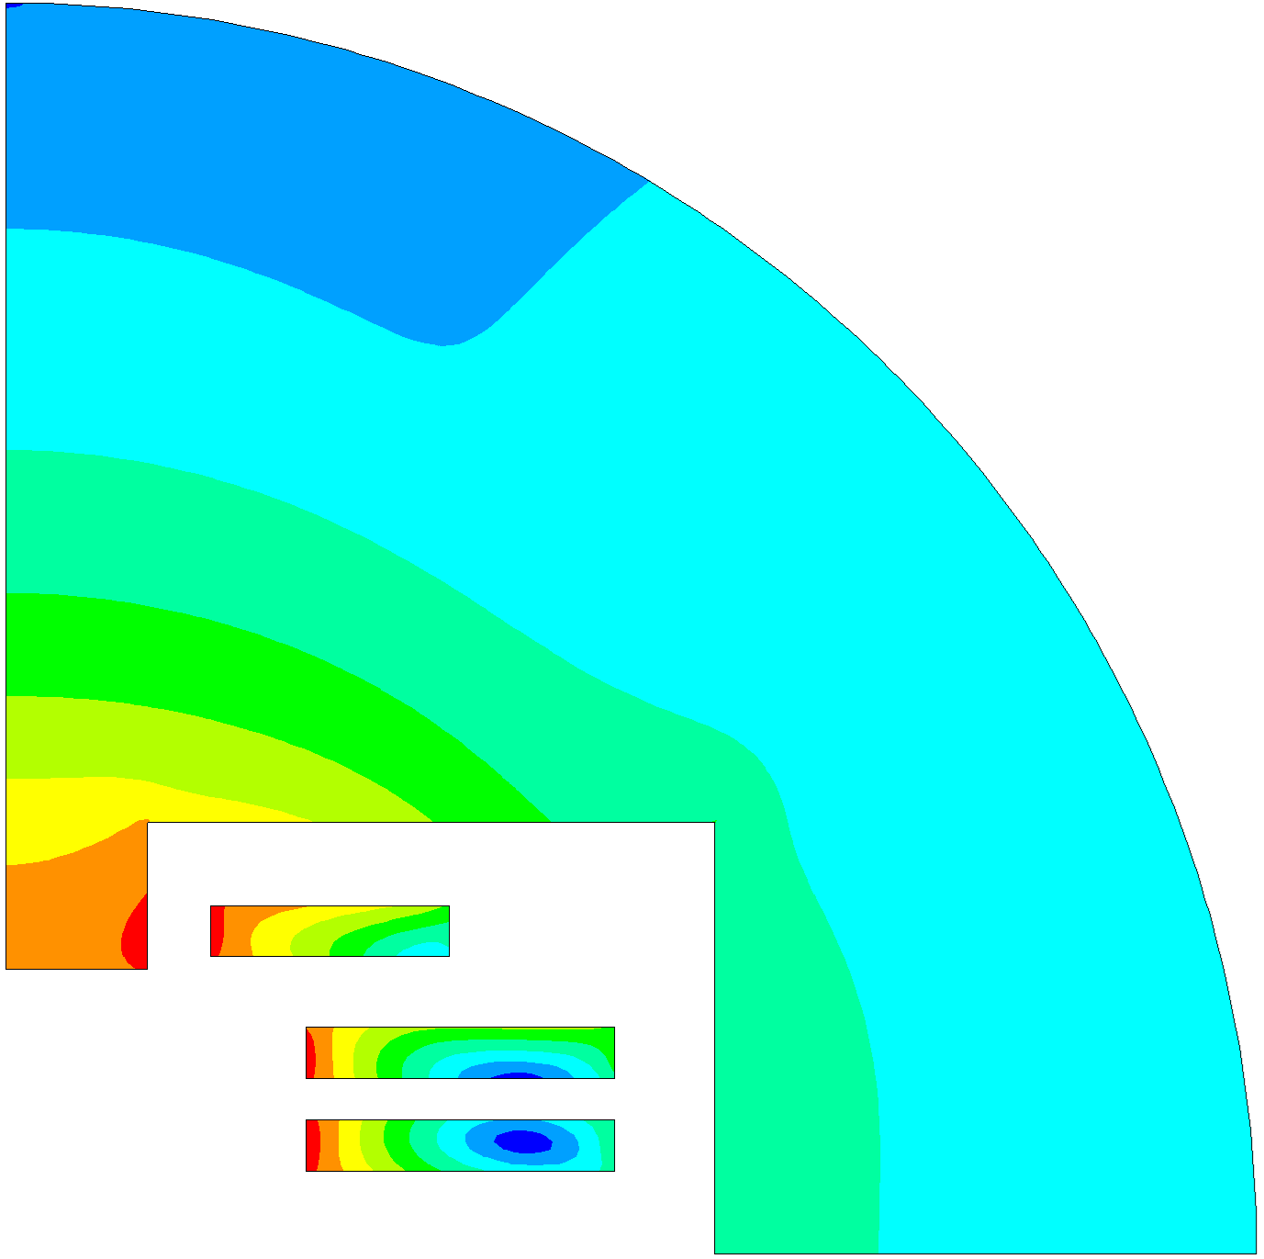
Highlights from the work
Engineering design of target system
Delamination limits of HTS tapes
First winding tests of 40 T final cooling solenoid pancake
B
F
I
Winding tooling
And many more advances !
HTS accelerator and collider dipole design

Slide 11
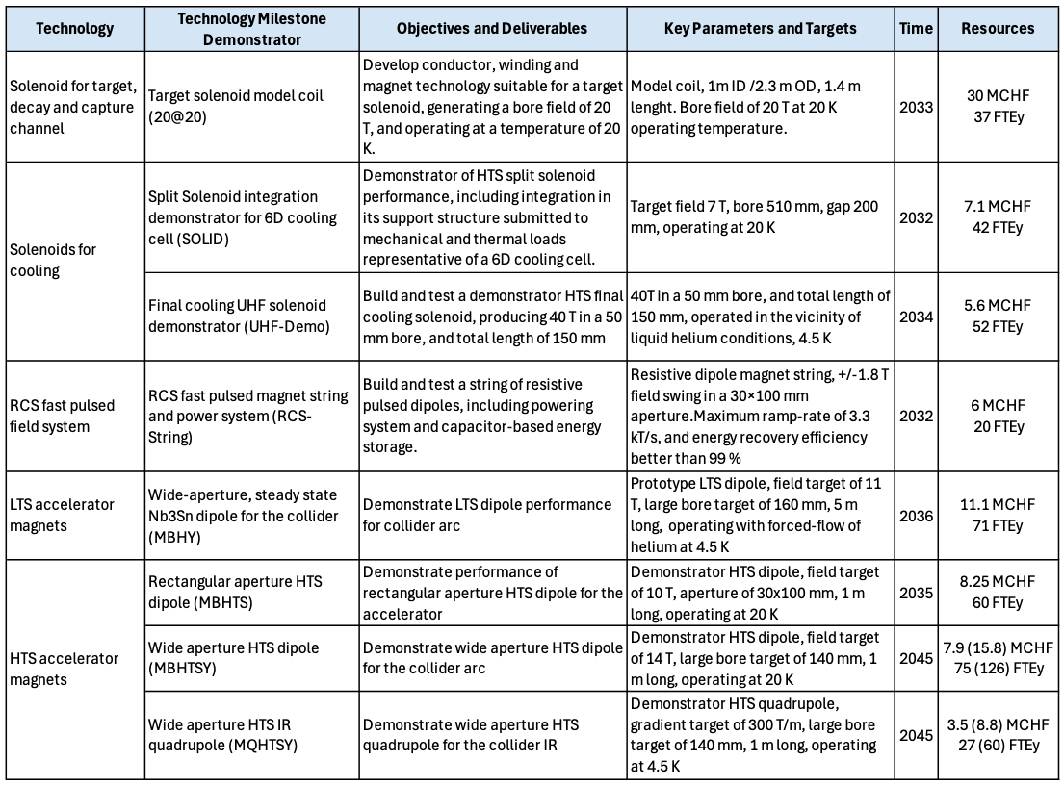
Scientific, technological, economic, competitive and social impact
The activities in the scope of MuCol have led to the formulation of a comprehensive R&D plan to advance magnet technology to the Technology Readiness Level required for a decision on project construction
The goal is to achieve TRL6 over a period of 7 to 10 years, depending on the specific magnet technology
Note: TRL6 is the appropriate level to initiate prototyping and industrialization
The study and design work performed in MuCol, leading to the R&D plan, have a major potential for impact on other fields of scientific and societal application of magnet technology

Slide 12
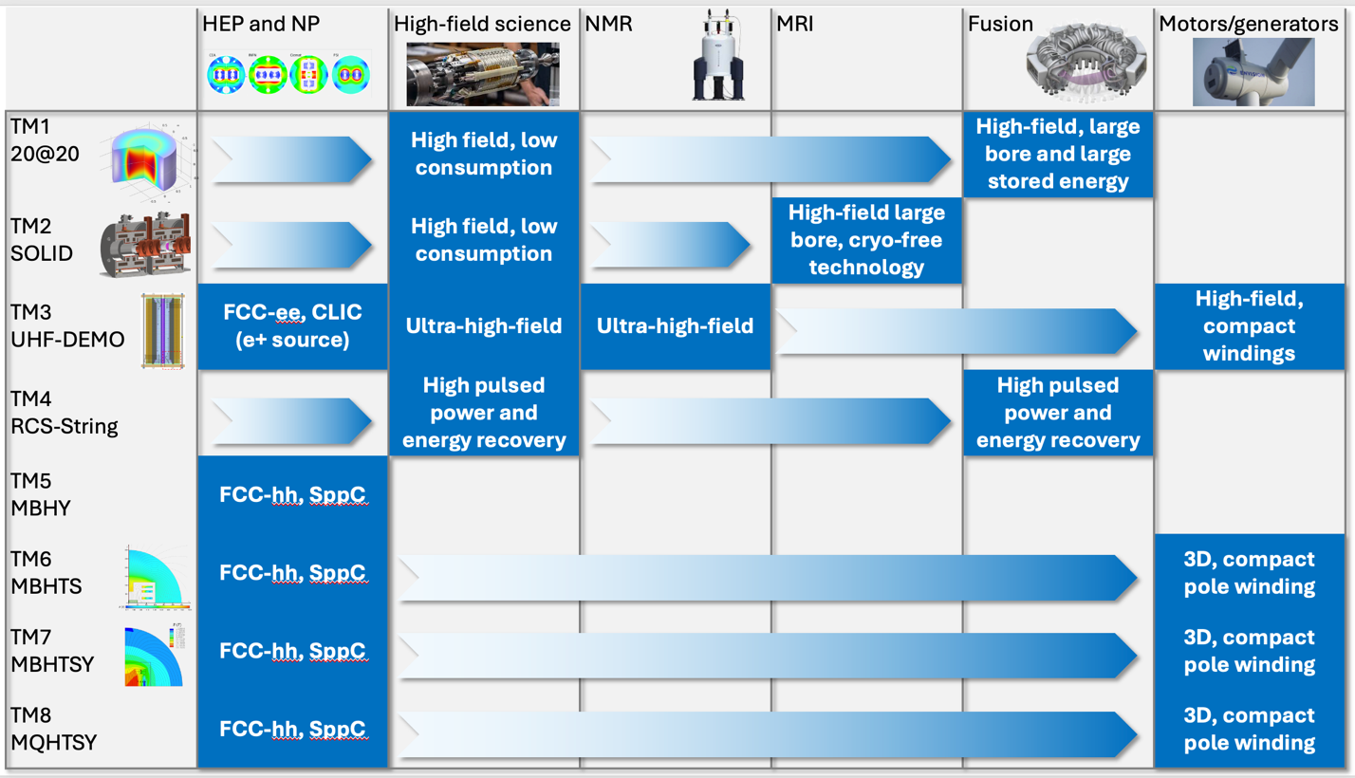
Task Impact Matrix
Impact potential clearly identified in the following fields:
Material and life sciences in high magnetic fields, beyond present state-of-the-art
Nuclear magnetic resonance instruments with improved analysis capability
Cryo-free MRI scanners
Compact thermonuclear fusion power stations
Motors and generators with higher power density for power generation and transport/mobility applications
High energy and nuclear physics other than the Muon Collider (e.g. FCC)

Slide 13





Impact catalysed by MuCol activities
Fusion for Energy (ITER EU Domestic Agency)
Framework agreement and first addendum in final negotiation
Contribution to the design of the HTS target solenoid, relevant to the central solenoid of DTT
EUROFusion (next step European fusion reactor)
Framework agreement signed in 2023, first addendum signed in 2024
Contribution to the design of the HTS target solenoid, relevant to the magnets of a Volumetric Neutron Source proposed as next step in the European fusion strategy
Gauss Fusion (one of the leading EU fusion start-ups)
Consultancy agreement signed in 2023
CERN contribution to the design of the LTS/HTS GIGA stellarator magnets, based on advances in the HTS target solenoid
ENI (oil and gas energy giant)
Framework agreement and first addendum signed in 2024
Collaboration on the conceptual design and project proposal for the CERN construction of a large bore HTS solenoid (20@20 model coil) relevant to the muon collider and fusion
IFAST-2 proposal to INFRA-2025-TECH-01-02 (CERN, INFINEON, PSI)
Proposal of fast pulsed power cell + magnet system sent to IFAST-2 coordination for ranking at TIARA
Industrial interest in rapidly pulsed and large energy/power supplies

Slide 14
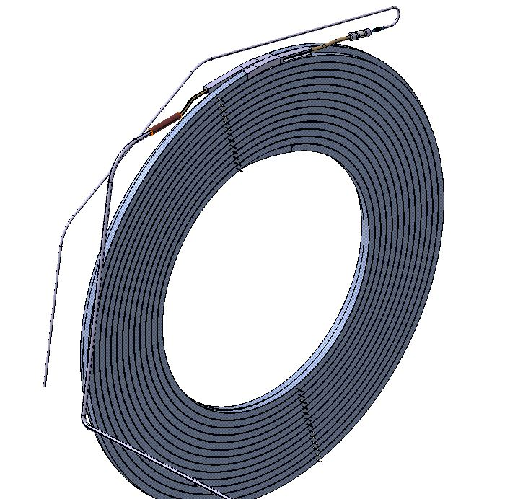
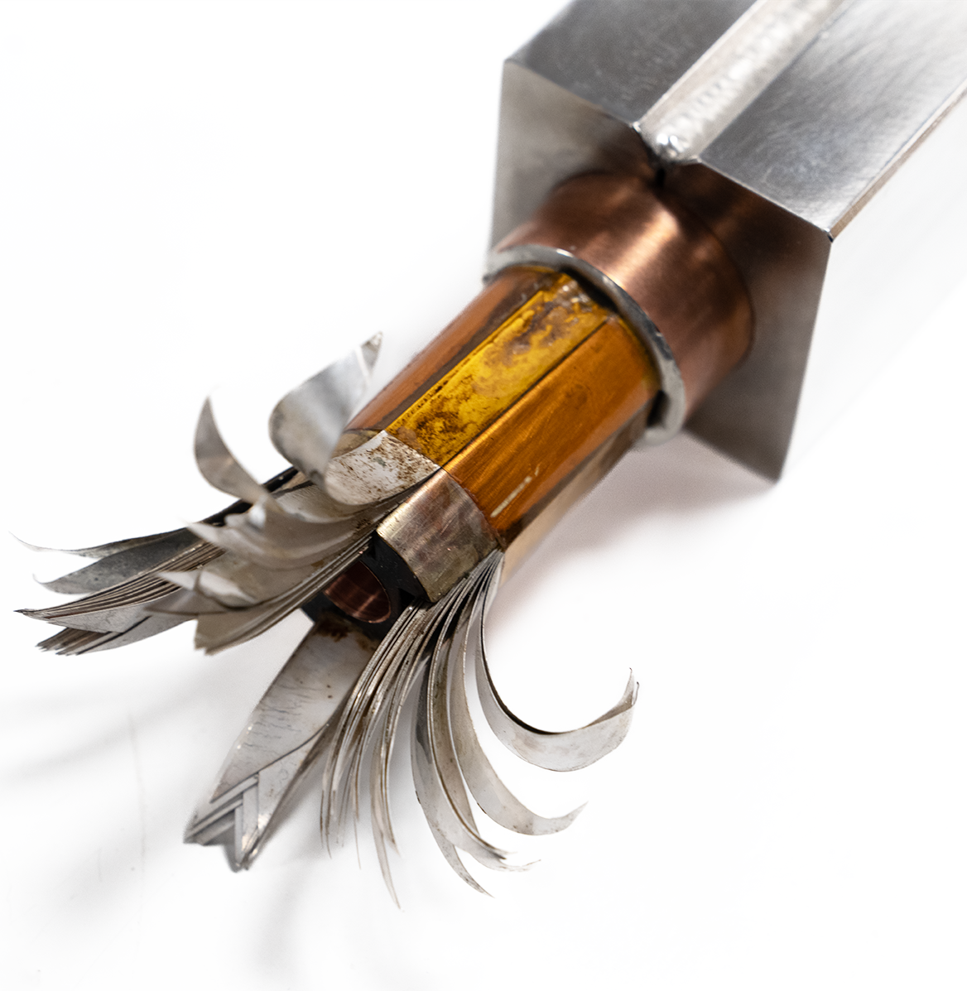
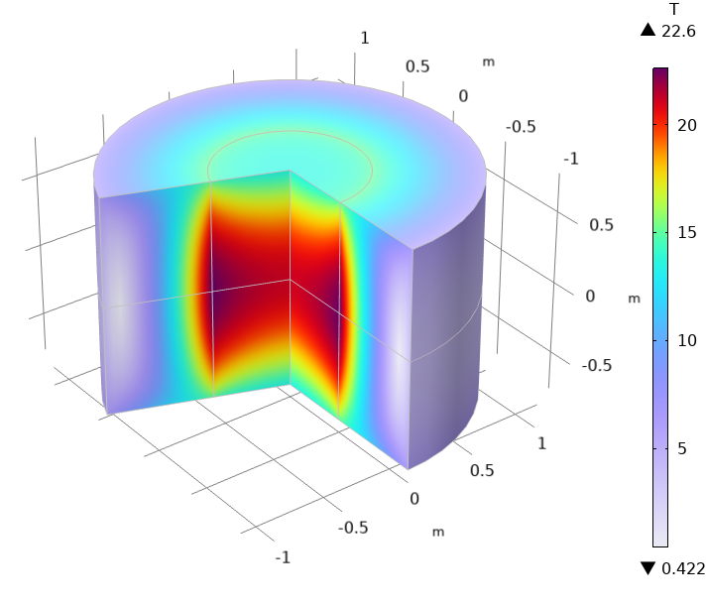
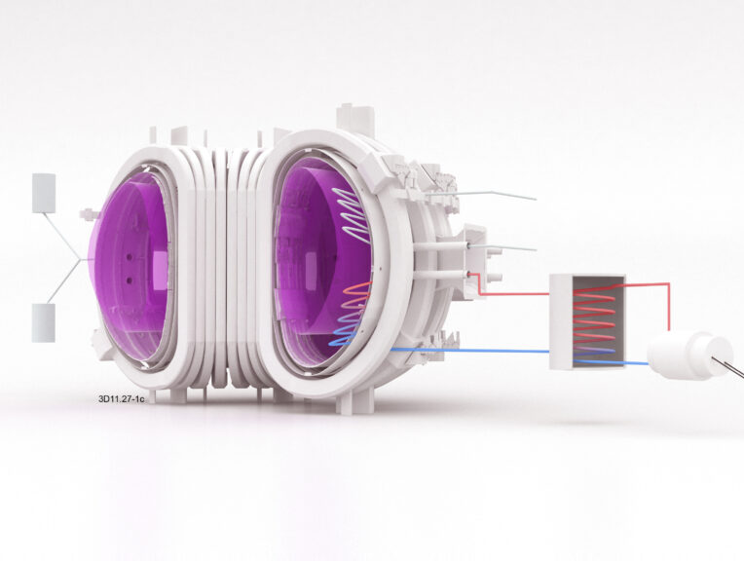
Future impact potential – 1/3
20@20: Solenoid Model Coil
A model coil with inner diameter of 1 m, operated at 20 K and generating 20 T bore field, demonstrating the technology required for the muon beam production, is attracting significant interest from fusion
Public and private fusion initiatives are pursuing similar objectives, and the realization of this model coil will very likely profit from collaboration and external contributions in the EU (on-going negotiations)
Such a model coil is:
A major milestone for high field technology in Europe (HEP, fusion, HFS)
A spectacular challenge for European industry
A vehicle to re-establish the EU as the prime player in HTS magnet technology

Slide 15
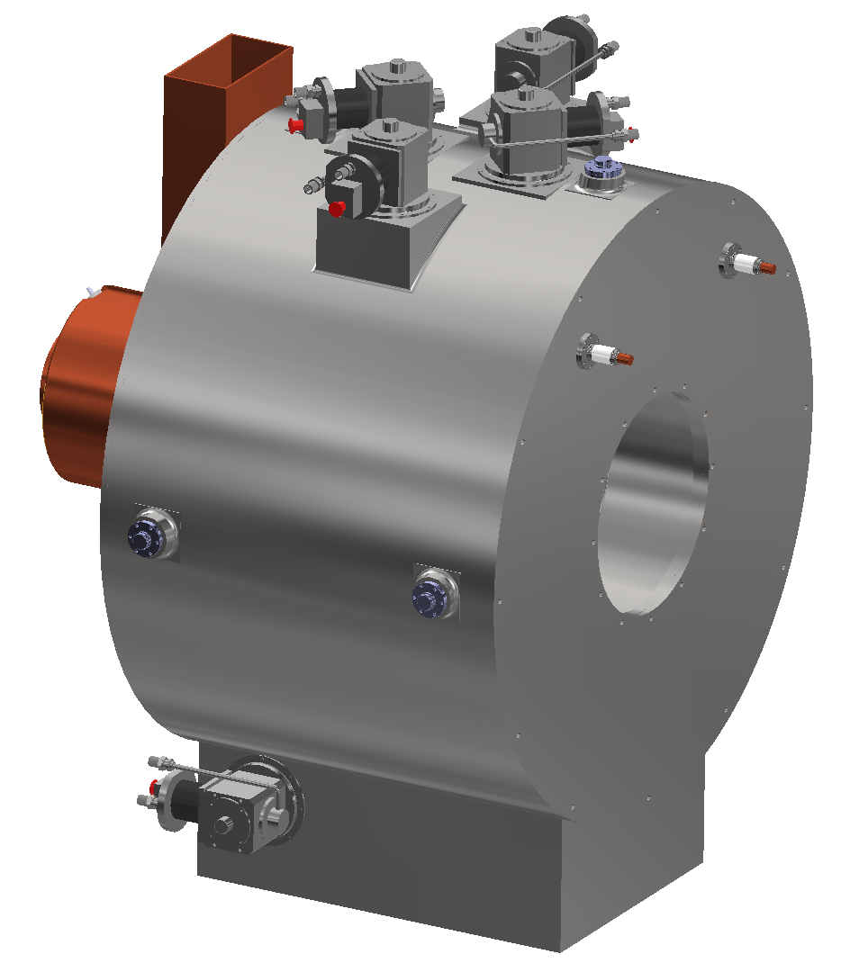
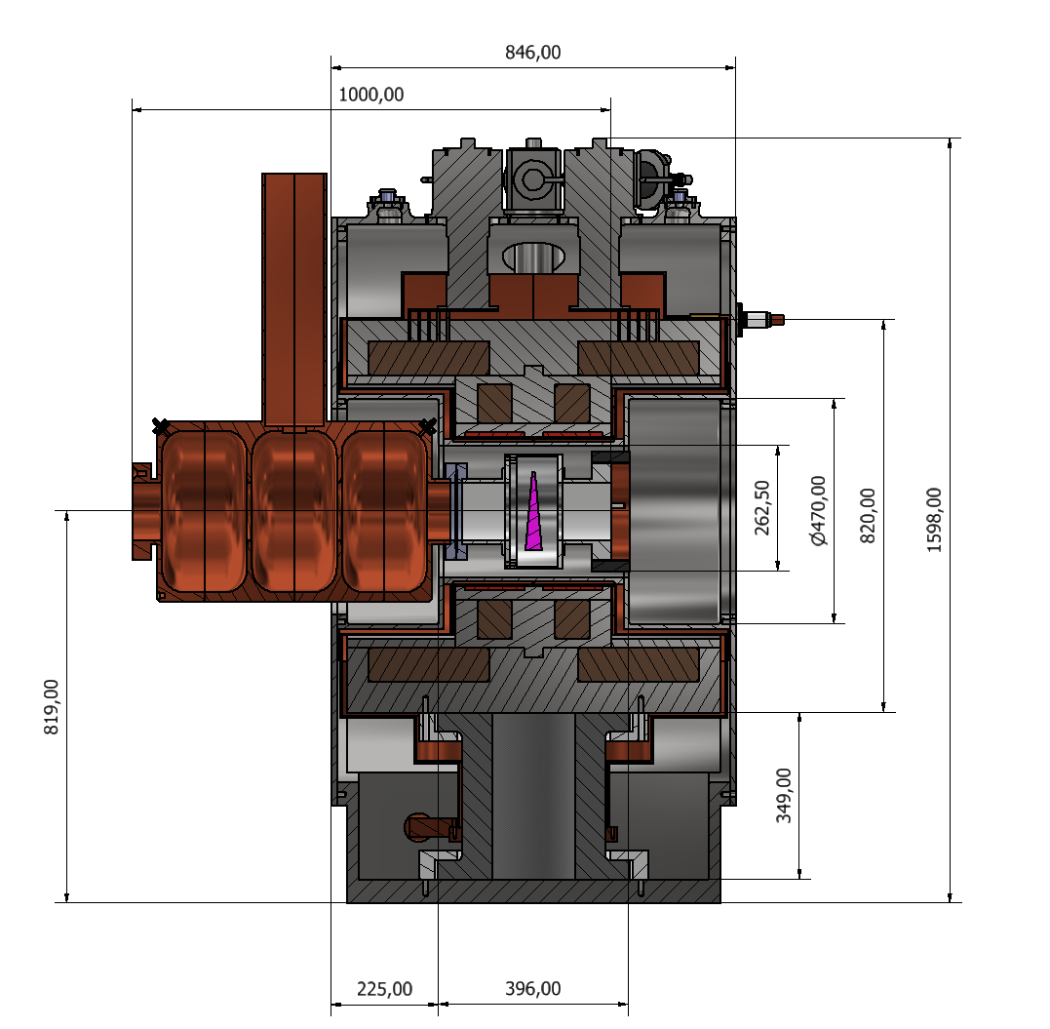
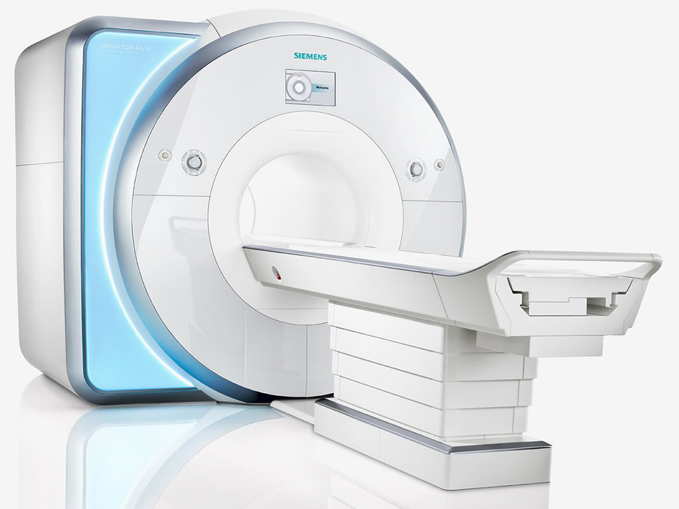
Future impact potential – 2/3
SOLID: split SOLenoid Integration Demonstrator
7T, 510 mm bore, 200 mm gap
An HTS split solenoid, producing a bore field of 7 T in a large bore of 510 mm, and operated at 20 K, will require technology relevant to the future generation of cryo-free MRI machines
Advanced MRI is already targeting HTS, either to achieve ultra-high-field performance (functional brain imaging), or simplify engineering, operation and maintenance (market penetration in under-developed or remote areas)

Slide 16
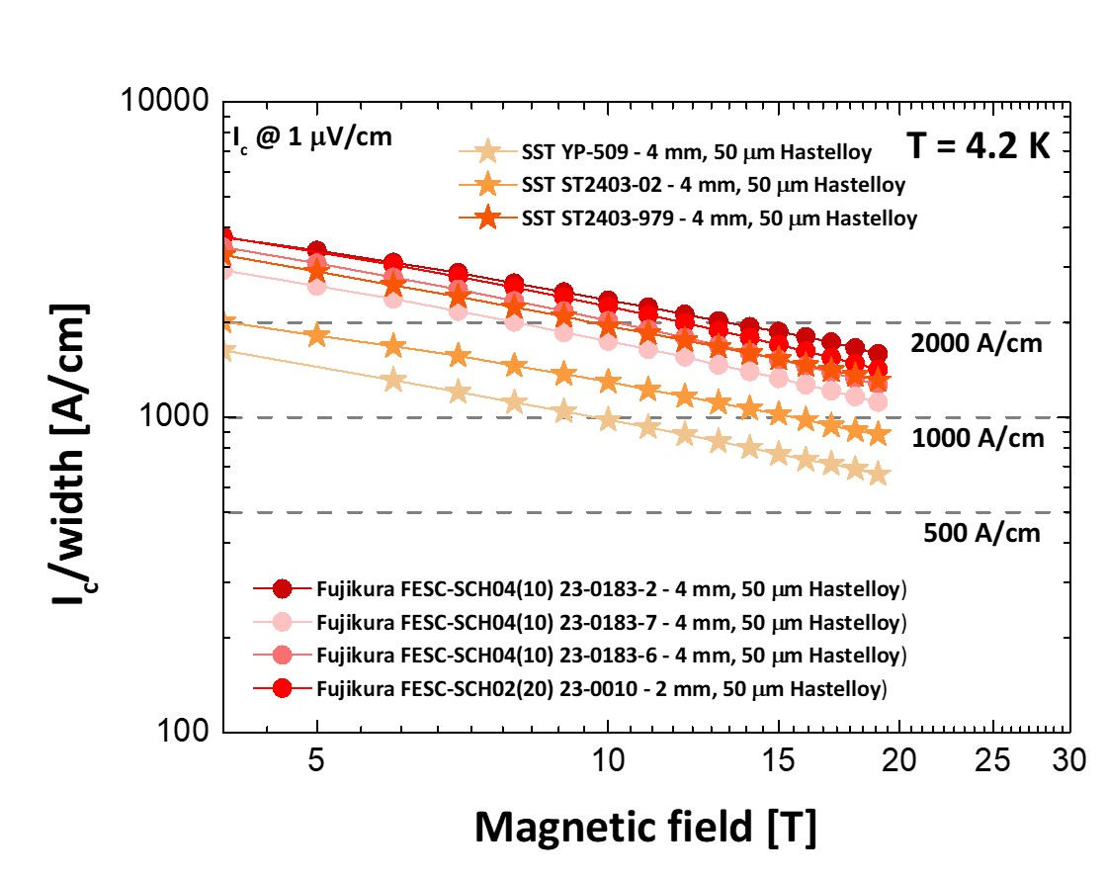
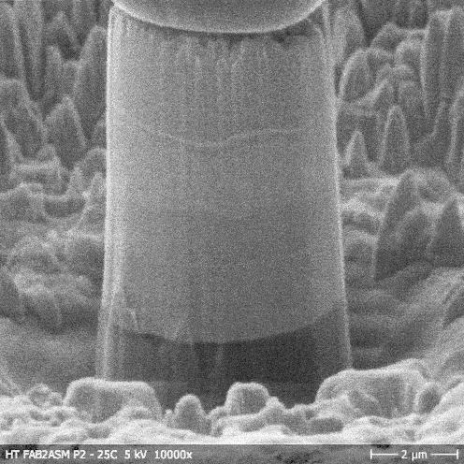
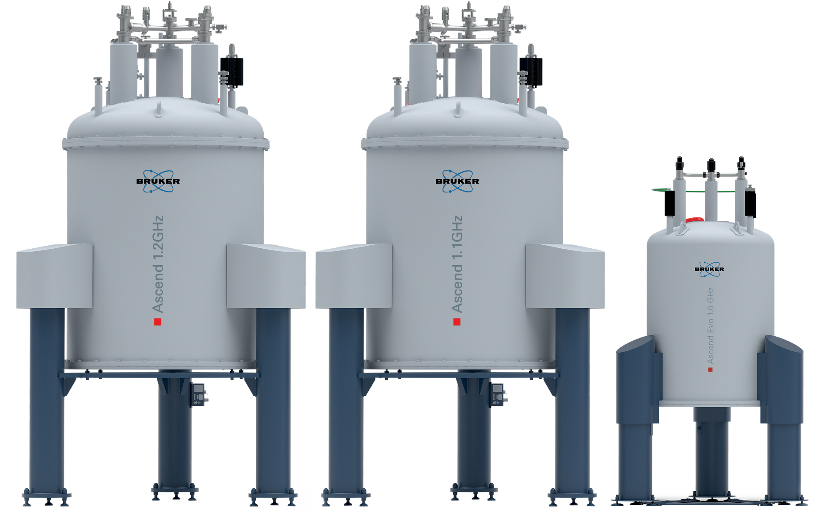
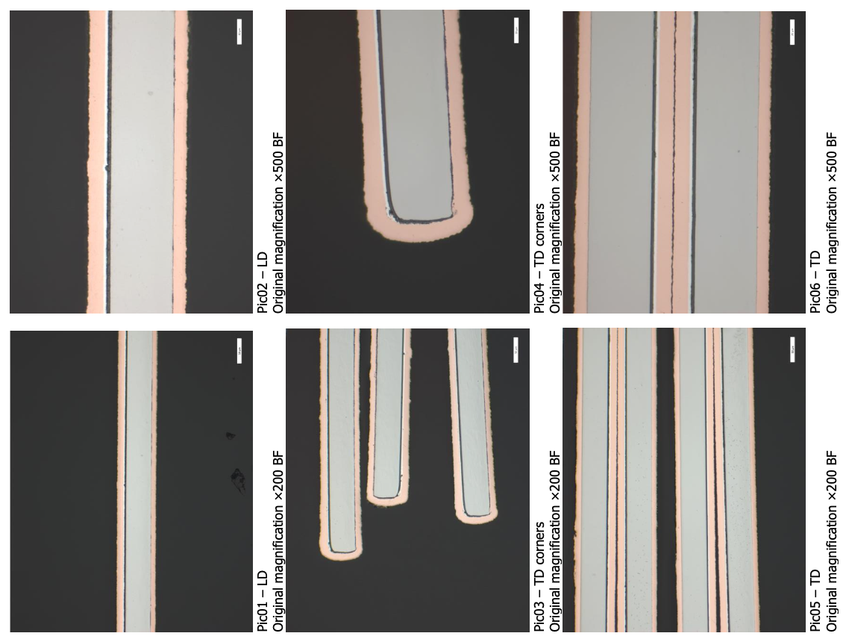
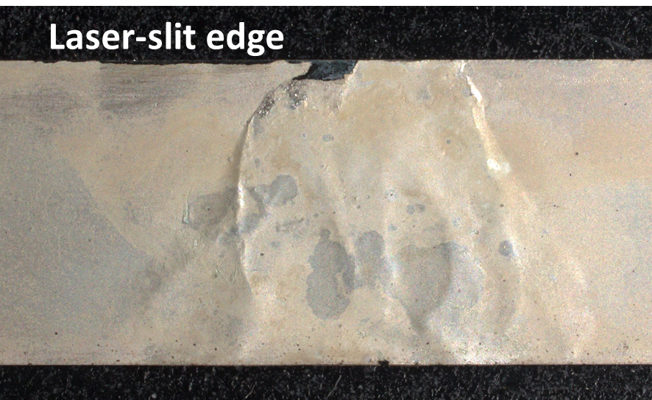
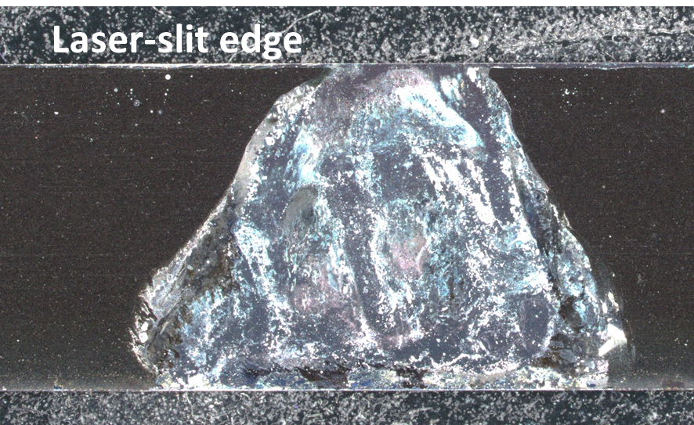
Future impact potential – 3/3
UHF-Demo: UHF HTS solenoid
40 T, 50 mm bore, 500 mm length
An HTS solenoid producing a bore field of 40 T in a bore of 50 mm, is directly relevant to the next generation of all-HTS high field user facilities for material and life sciences (EMFL), as well as the next generation of NMR instruments
50
500
40 T
170

Slide 17
Results dissemination
The work package is very active in several ways
Publication of key scientific and technical advances at international workshops and conferences (over 40 scientific publications)
International Magnet Technology conference (MT)
Applied Superconductivity Conference (ASC)
International Particle Accelerator Conference (IPAC)
European Conference on Applied Superconductivity (EUCAS)
And other: CHATS-AS, Compumag, SOFT, ICM, FEMS EUROMAT
Organization of topical workshops on aspects crucial to the magnet R&D
MuCol Mini-Workshop on Rapid Cycled Synchrotrons, pulsed magnets and powering (https://indico.cern.ch/event/1388830/)
RADSUM - Topical Workshop on RADiation effects in SUperconducting Magnets (https://indico.cern.ch/event/1450988/)
Strategic papers, submitted to the European Strategy for Particle Physics 2026
Magnet R&D for the Muon Collider (https://indico.cern.ch/event/1439855/contributions/6461515/)
HTS Potential and Needs for Future Accelerator Magnets (https://indico.cern.ch/event/1439855/contributions/6461516/)

Slide 18
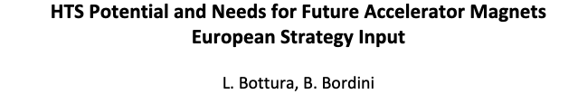
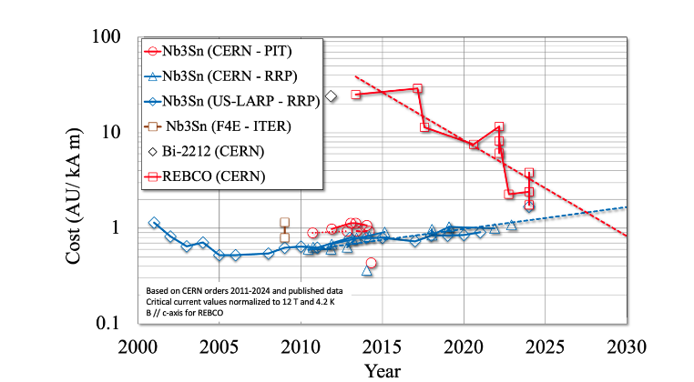
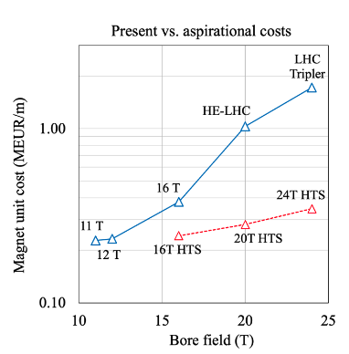
Dissemination Highlight
Cost target for a future circular collider
The work performed in MuCol has clearly identified the strategic interest in HTS for any future circular collider, now part of the ESPPU discussion

Slide 19
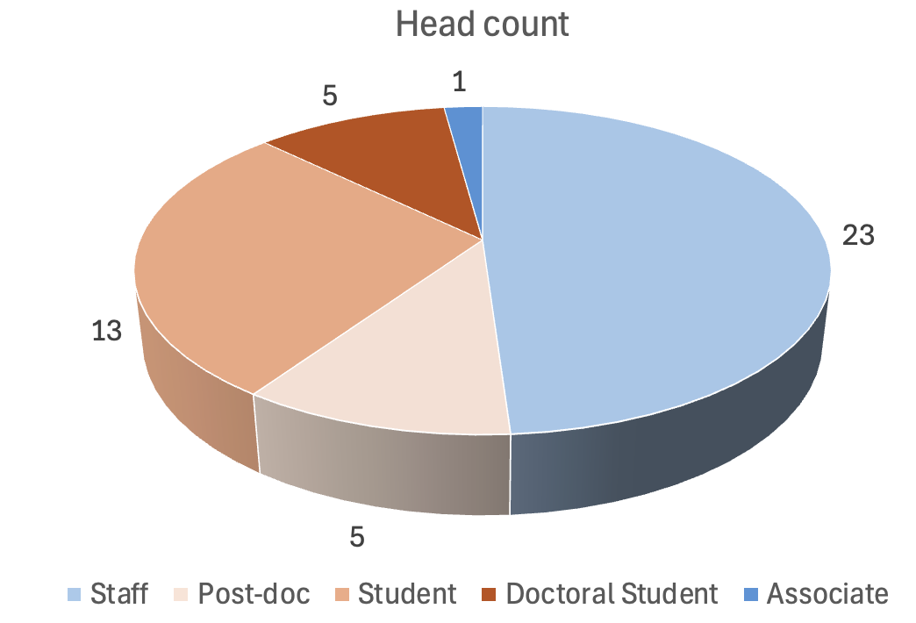
Beneficiaries' contributions
The personnel participating to WP7 is well above the original plan (7 FTEy financed by the EU), witnessing strong interest in the development results and the associated impact potential
We could attract further additional interest from universities (e.g. Tampere, Malta) and industry (e.g. Tokamak Energy, Commonwealth Fusion Systems)
Work beyond the plan (matching funds) is justified on the basis of sharing the scientific and technology challenges that are in common with the roadmaps of the participants (leveraged)
Count of persons that have participated to the work in WP7 since the kick-off of MuCol

