Slide 1


Material Properties
for Accelerator Magnets
N. Sammut & M. Buzio
With special thanks to
L. Bottura, F. Boattini, R. Beltron,
U. Martinez Hernandez, G. Deferne, D. Drevard, M. Dantas
June 2025

Slide 2
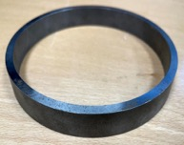
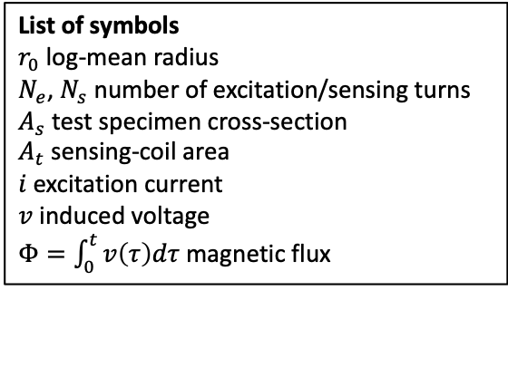




Measurement Principle
Toroidal ring test method for soft ferromagnetic materials DC characterization, based on the fluxmetric method (transformer configuration).
IEC-compliant test specimen
The standard IEC 60404-4 [3] provides guidelines for the characterization at room temperature and the operational procedures
$$H=\frac{N_{e}i}{2πr_{0}}$$
$$B=\frac{1}{A_{s}}\left[\frac{Φ}{N_{s}}−μ_{0}H{(A_{t}−A}_{s})\right]$$
$$u\left(H\right)/H≤1 \%$$
$$u\left(B\right)/B≤1 \%$$
List of symbols
$r_{0}$ log-mean radius
$N_{e}$, $N_{s}$ number of excitation/sensing turns
$A_{s}$ test specimen cross-section
$A_{t}$ sensing-coil area
$i$ excitation current
$v$ induced voltage
$Φ=\int_{0}^{t}{v\left(τ\right)dτ}$ magnetic flux
[1] K.N. Henrichsen, “Permeameter”, Proceedings of the Second International Conference on Magnet Technology, 1967
[2] P. Arpaia, M. Buzio, L. Fiscarelli, G. Montenero, L. Walckiers, 2010 IEEE Instrumentation & Measurement Technology Conference Proceedings, 2010
[3] IEC 60404-4, “Magnetic materials - Part 4: Methods of measurement of DC magnetic properties of magnetically soft materials”, International Electrotechnical Commission, 2000

Slide 3
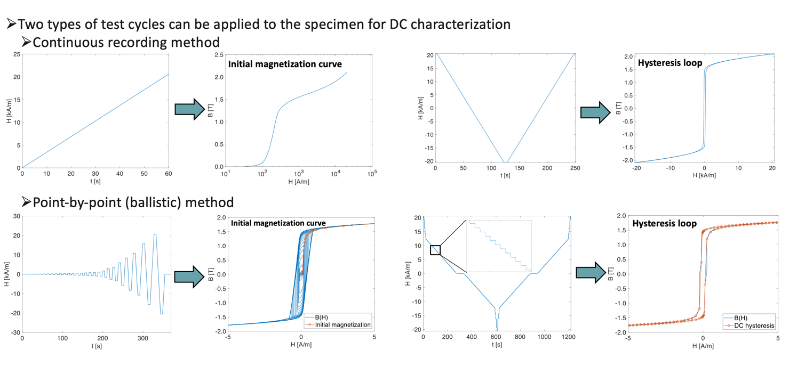
Measurement Principle

Slide 4
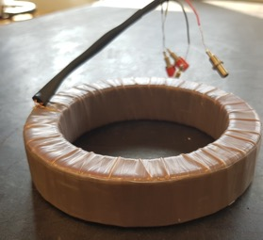
Measurement Principle
Custom-winding permeameter
Manual winding of the coils allows to cover a wide range of sample sizes, aspect ratios and winding turn counts
Fewer excitation turns can be used to measure low magnetic fields (<10 A/m) by using conveniently high currents at high frequencies
Dynamic characterization possible in the kHz range for some materials (skin effect is ignored for now)
Typical maximum field limited to 10~20 kA/m at RT for thermal reasons (depending on the current density that you can have in the conductor and the cooling used)

Slide 5
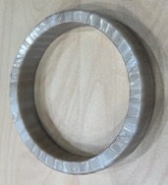
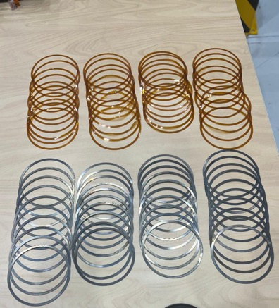
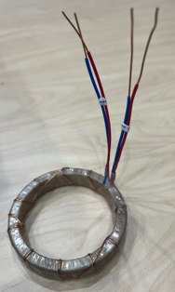
Sample Preparation
50 µm Kapton rings
ring stack
Sample 1: FeCo only
Sample 2: FeCo interleaved with Kapton
excitation/detection windings
250 µm steel rings

Slide 6
Sample Preparation
Sample 1: - FeCo only
- inner diameter: 75.5mm
- outer diameter: 82.8mm
- lamination thickness: 0.25mm
- mounting: FeCo rings stacked vertically fixed with tape
- number of rings: 40 FeCo rings
- sensing wire: 0.8mm diameter; 3 turns
- excitation wire: 0.8mm diameter; 10 turns
- Area of coiling around sample: 5mm*10.5mm
Sample 2: - FeCo interleaved with Kapton
- inner diameter: 75.5mm
- outer diameter: 82.8mm
- lamination thickness: 0.25mm
- mounting: FeCo rings stacked vertically with Kapton tape in between laminations cradled in a 3D printed PLA casing
- number of rings: 40 FeCo rings interleaved with 39 Kapton tape between laminations
- sensing wire: 0.8mm diameter; 3 turns
- excitation wire: 0.8mm diameter; 10 turns
- Area of coiling around sample: 7.5mm*14.5mm

Slide 7
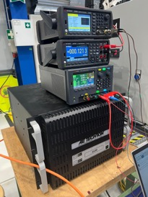
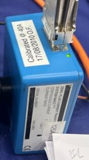
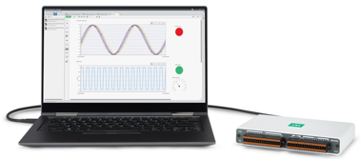

Test Setup
PC
Keysight 33500B
Waveform Generator
DCCT (120A/10V)
Zero-Flux Multi-Aperture
Current Comparator MACC
multimeter
Sample
PC & NI mioDAQ
DCCT power supply
AE Techron 2120
current amplifier

Slide 8
Test Campaign
(December 2024)

Slide 9
First Results – Excitation Curves
First results: 52 different current pulses up to 1.2 T, 28 kT/s
Example: 100 A, 16 ms current pulse, FeCo rings only
Drop sharper than rise
→ clearer final decay transient

Slide 10

First Results – Eddy Current Time Const $τ$
- Notice the low difference in time constant
- Maybe penetration is stopped by the skin effect, or the ring chemical treatment?
- Maybe there is no reason to insulate the laminations?
- Maybe the eddy currents are anyway confined to the outer rings?

Slide 11
First Results – Hysteresis

Slide 12
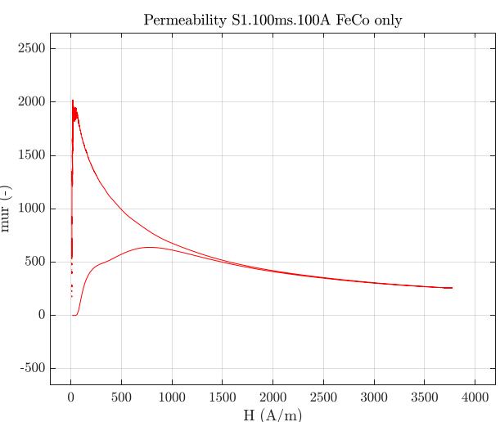
First Results – Permeability

Slide 13
Conclusion
- These results demonstrates the capability of the test setup to achieve field ramp rates well above the target range
Further Work
- LabVIEW programme to replace function generator to generate input voltage to current amplifier
- use of faster DAQ system for better voltage offset estimation (integrator drift correction)
(currently 500 kS/s or use AI simultaneous mode 1MS/s))
- improve current control to achieve higher fields (eliminate current plateau decay)
- Full (bipolar) hysteresis loop tests
- results comparison with independently tested sample (to check system integrity)
- reproducibility tests
- Series material tests

