Slide 1
News 17 July 2025
European Strategy Open Symposium: https://agenda.infn.it/event/44943/overview
Presentations and papers are public, you are kindly invited to browse them
Quoting K. Jacobs:
“The aim of the Strategy update should be to develop a visionary and concrete plan that greatly advances human knowledge in fundamental physics through the realisation of the next flagship project at CERN. This plan should attract and value international collaboration and should allow Europe to continue to play a leading role in the field.”

Slide 2
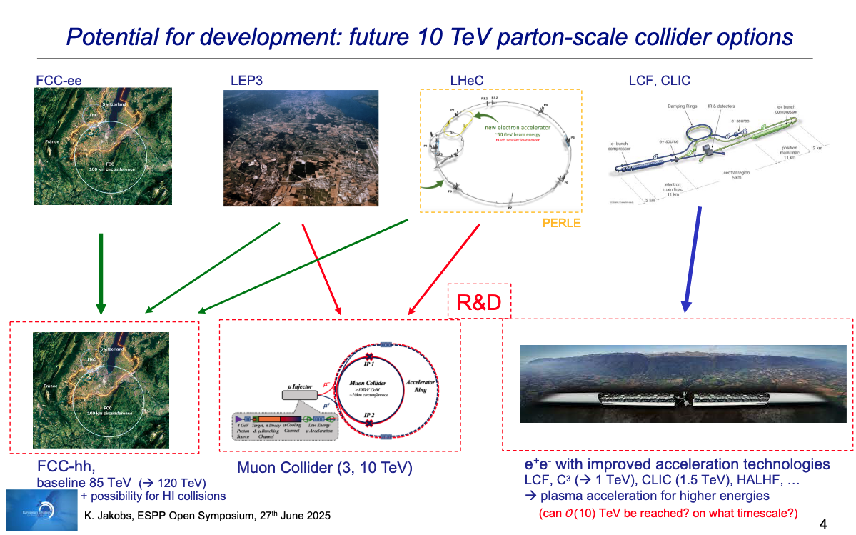
Landscape summary

Slide 3
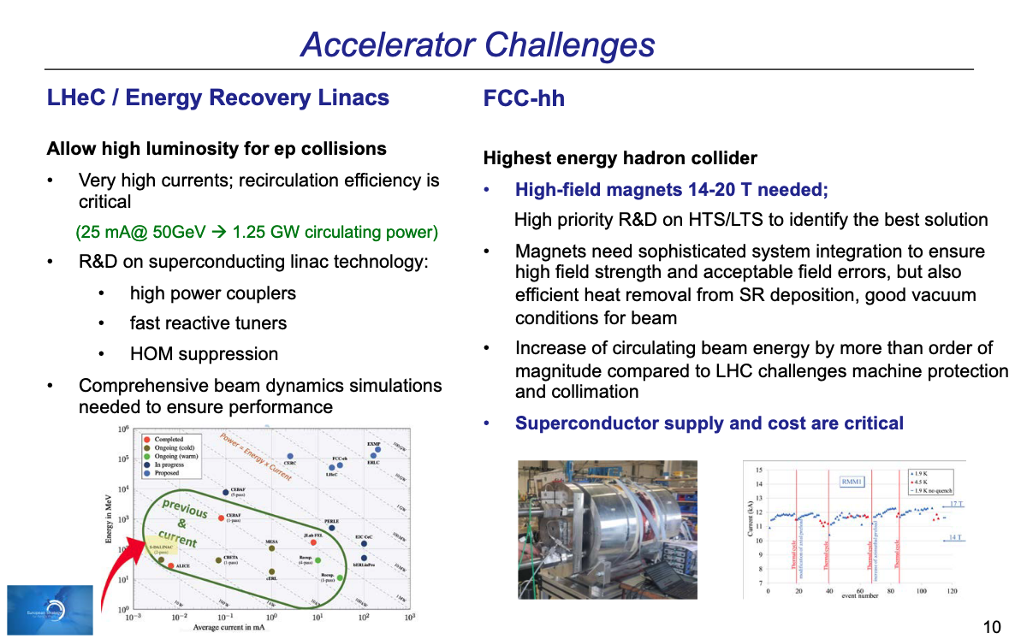
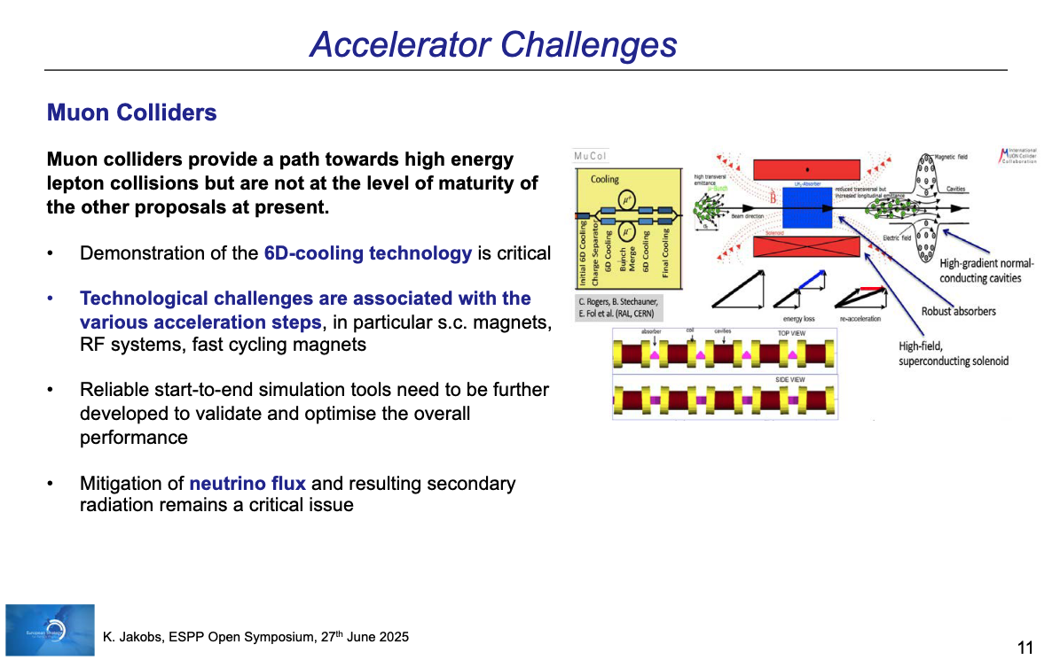
Two important messages
Superconductor supply and cost are critical
This is why we focus on HTS magnet technology
Technological challenges are associated with […] s.c. magnets, […] fast cycling magnets
The proposed R&D program is vital

