Slide 1

Testing of Superconductors for Fusion
Kamil Sedlak
June 16, 2025

Slide 2
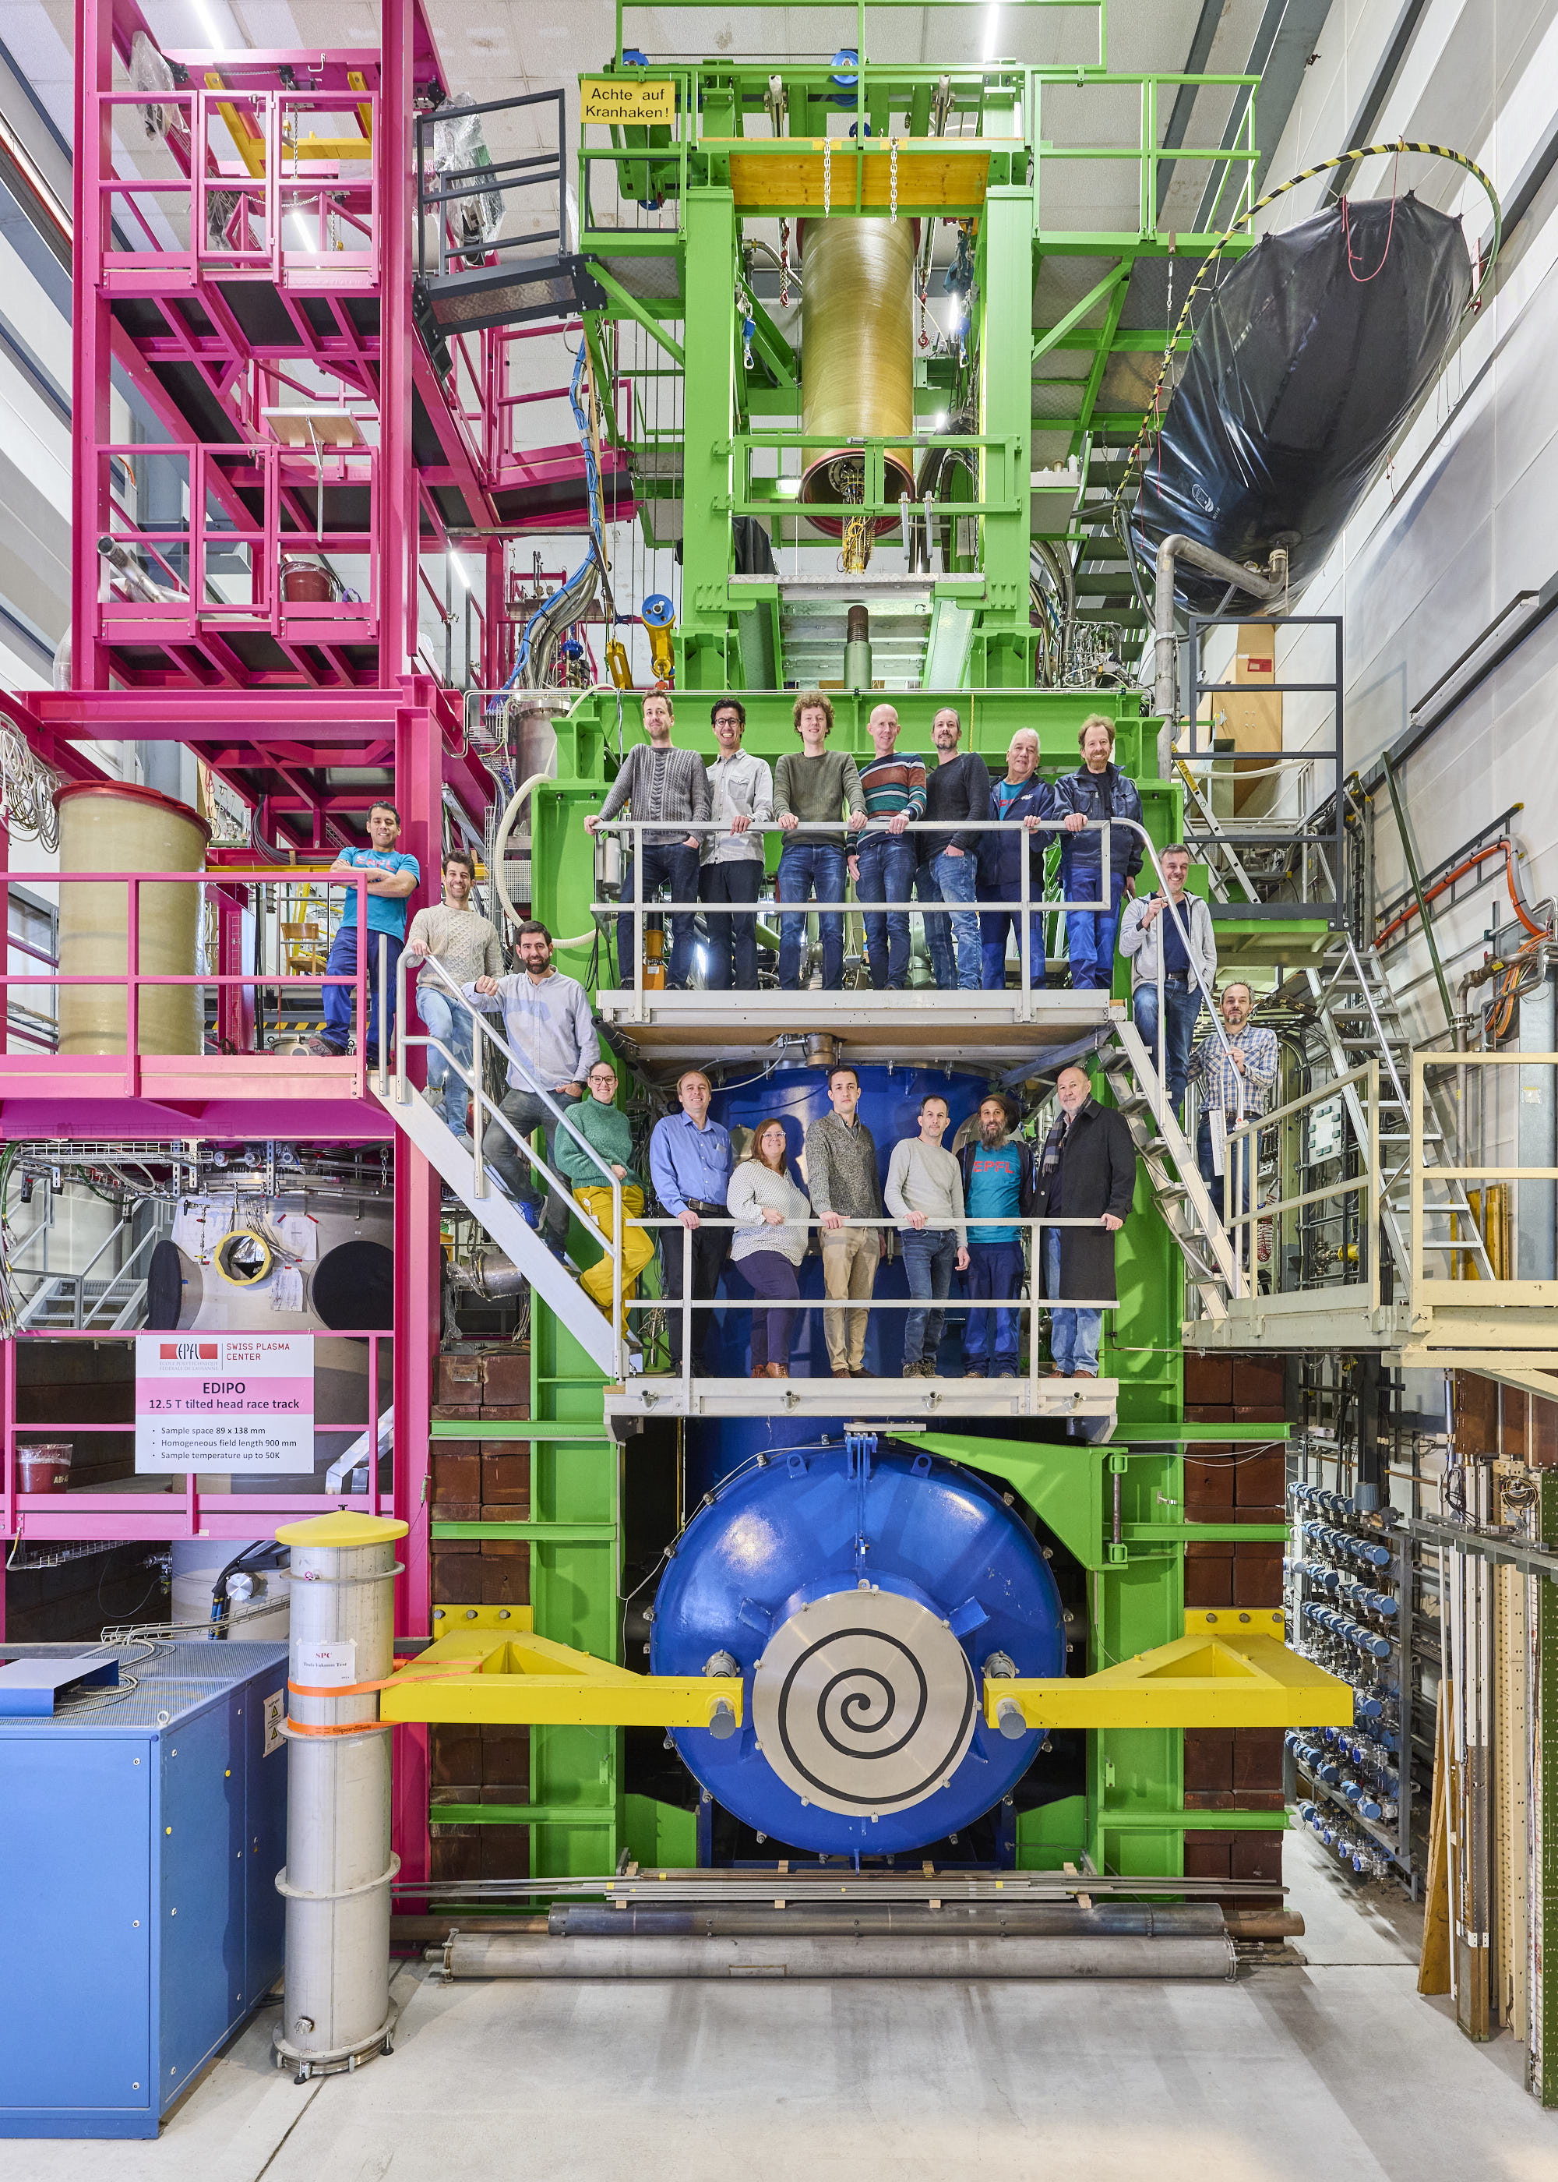
Our Test Facilities
Testing of superconductors for fusion magnets, i.e. tokamaks and stellarators:
  Sample assembly
  Sample testing
SULTAN (“SUpraLeitende Test ANLage”) (11T)
our work-horse, build in 80s, and still the only facility worldwide, where ITER-like conductors can be tested in real operating conditions.
EDIPO (“European DIPOle”) (15T)
a facility that shall become even more powerful than SULTAN. (Under construction.)

Slide 3
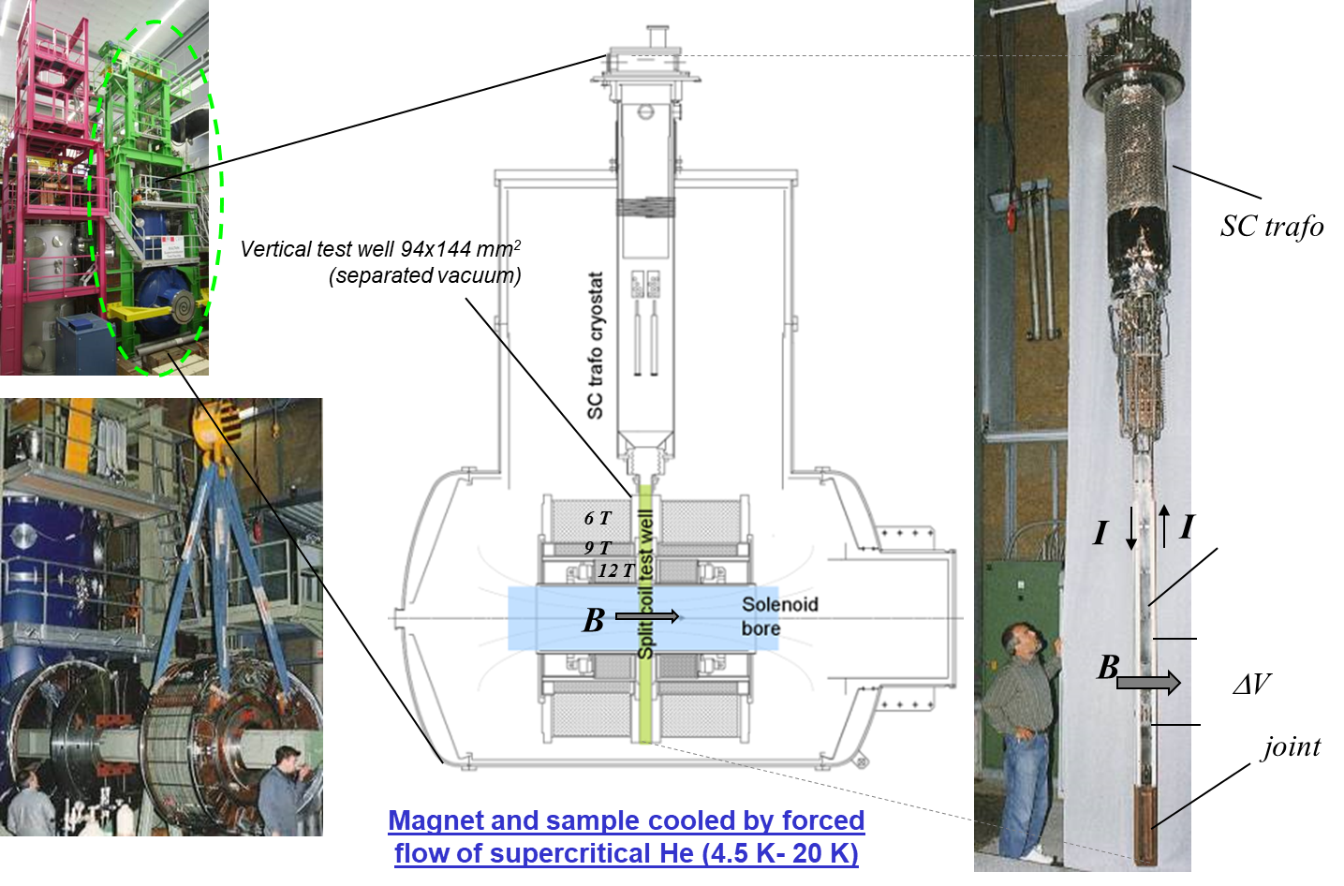
SULTAN Test Facility – DC Field up to 10.9 T

Slide 4
Preparation of a SULTAN Sample

Slide 5
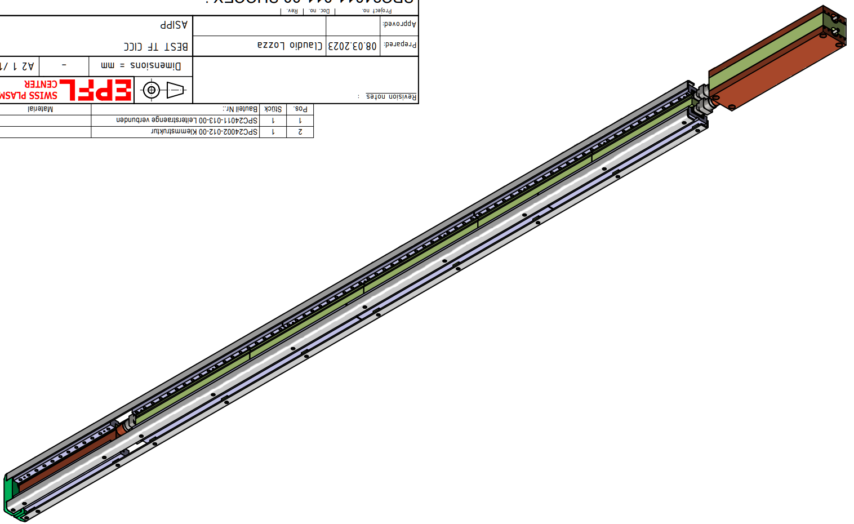
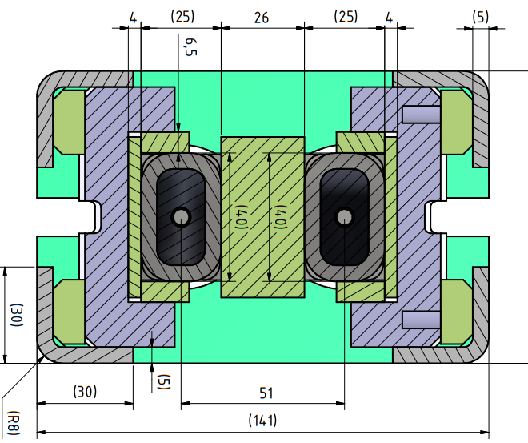
How Does the SULTAN Sample Look Like?

Slide 6
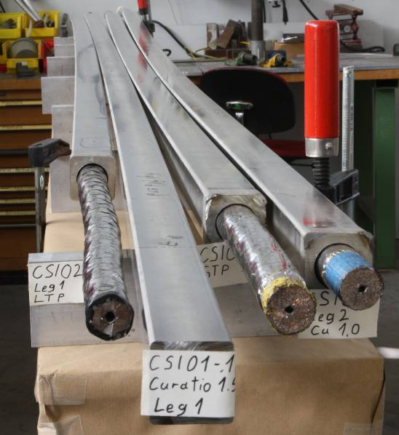
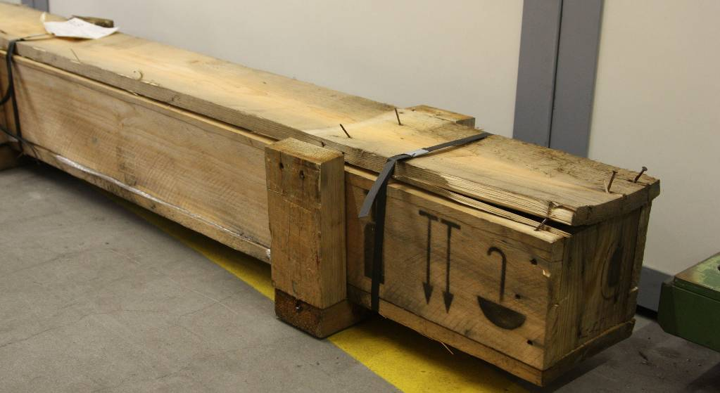
Conductor Lengths delivery at SPC Villigen
A box with a superconductor shiped to Villigen from China, Korea, Japan, USA, Europe, ...
Example conductors – ITER Central Solenoid

Slide 7
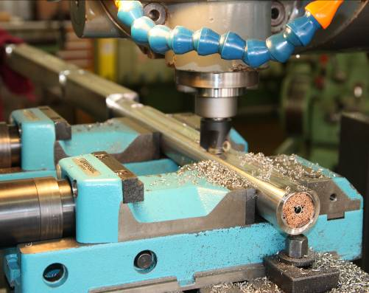
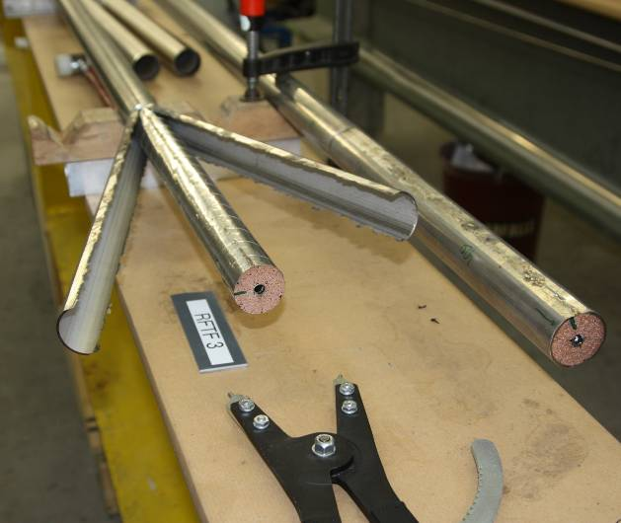
Removal of the Steel Jacket at the Terminations
Milling of the steel jacket in the termination region.
Removal of the steel jacket (ITER Toroidal Field conductor)

Slide 8
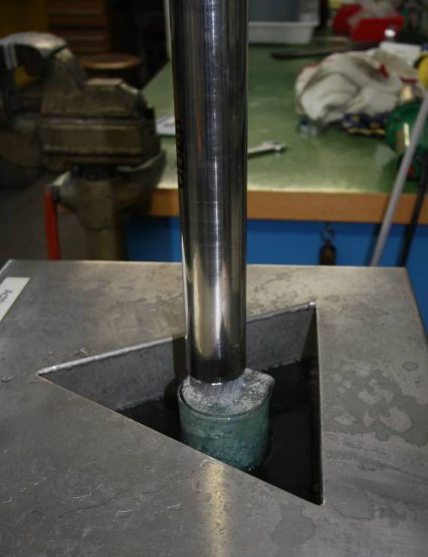
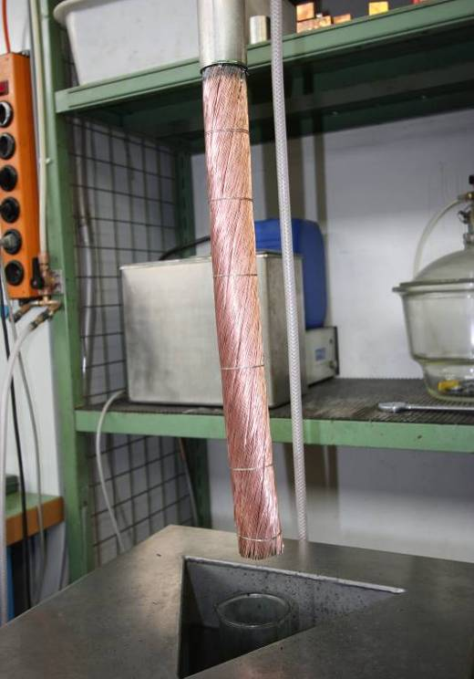
Chemical Removal of Cr Plating
Chemical removal of Cr plating from the surface of superconducting (Nb₃Sn) strands.

Slide 9
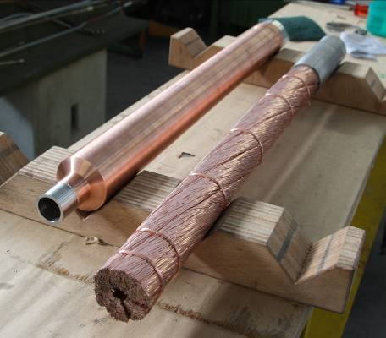
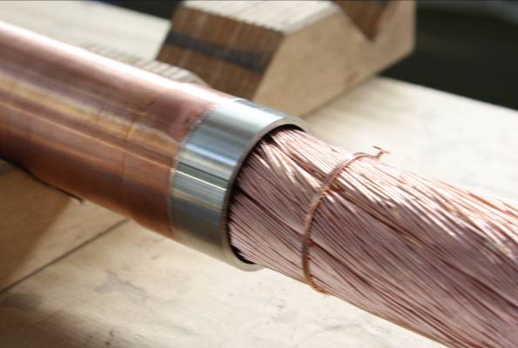
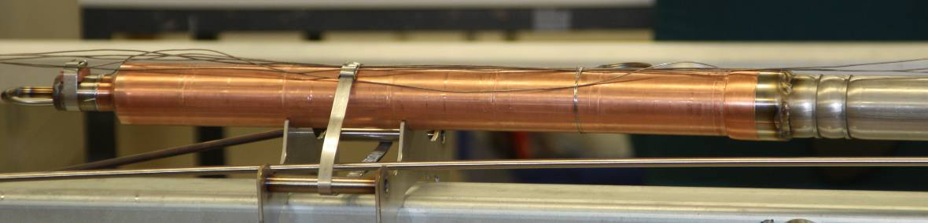
Insertion of the Cable Terminations into Copper Sleeves
Installation of Copper sleeve at the conductor terminal

Slide 10
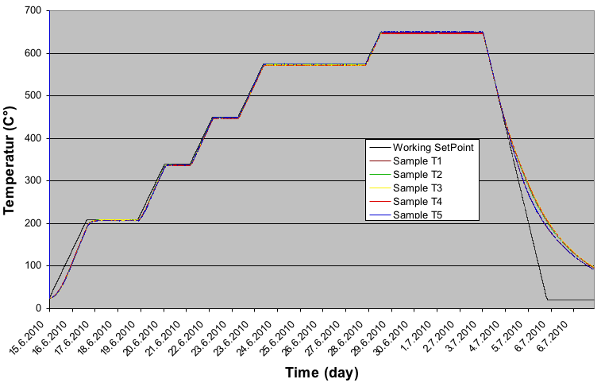
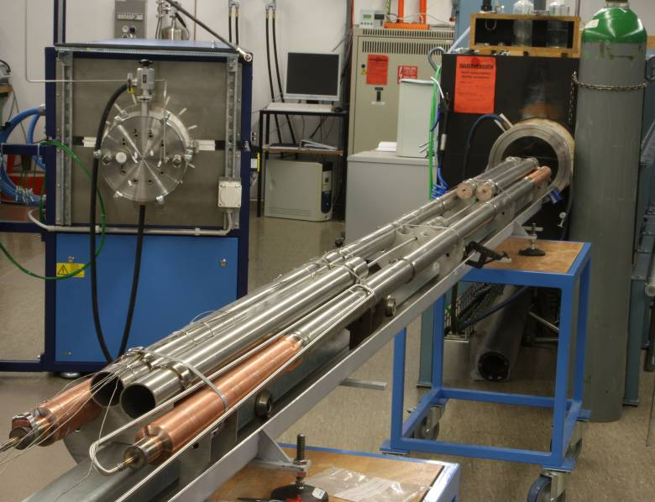
Heat Treatment (only for Nb₃Sn)
Heat treatment in steps up to 650℃
Total duration 3-4 weeks

Slide 11
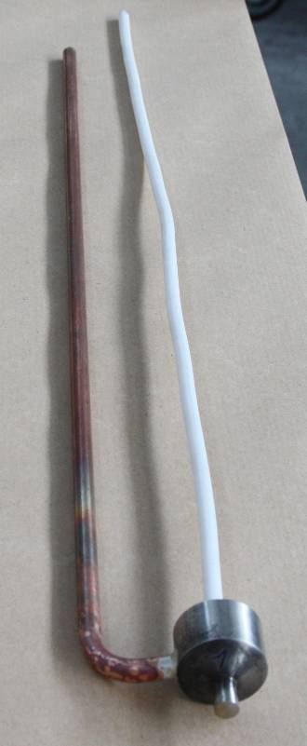
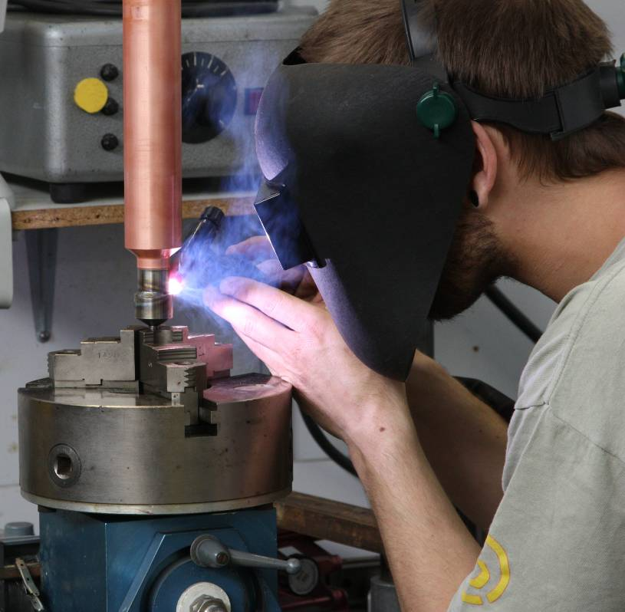
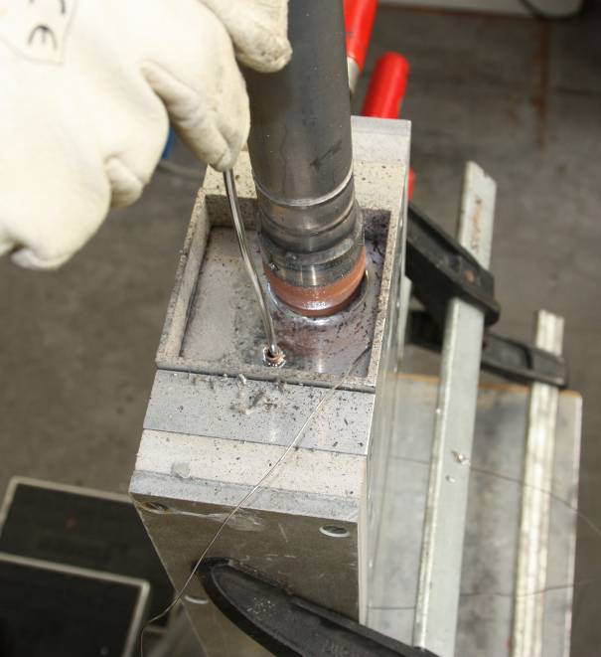
Solder Filling of the Terminations
Filling the termination region by a solder for as low as possible electrical resistance of the sample termination.

Slide 12
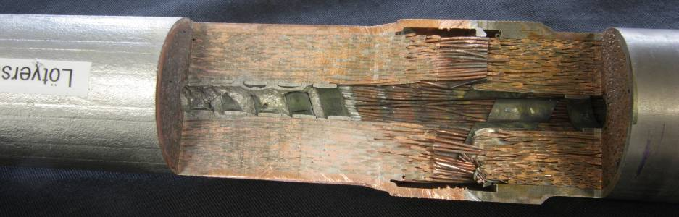
Solder-Filled Termination
Section of a solder filled termination

Slide 13
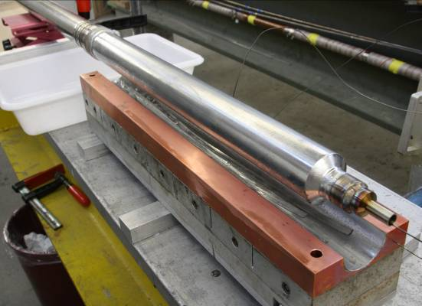
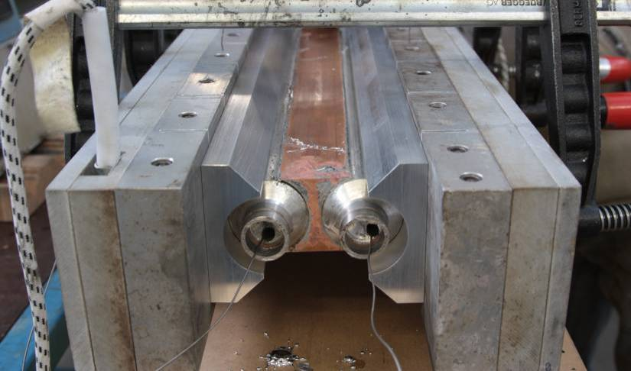
Attaching Copper Blocks to the Terminations
Upper termination soldered into a copper block. Upper termination will be later connected to current source (superconducting transformer)
Bottom joint, where current must pass from one conductor to the neighboring one

Slide 14
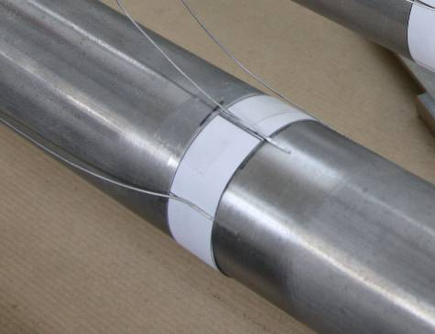
Instrumentations – Voltage Taps and Temp. Sensors
Spot-welded voltage taps. By measuring the voltage over the 50 cm of the conductor (over the high-magnetic field region of SULTAN) we can determine when the superconductor switches to normal state.
Temperature Sensor CERNOX (3x3mm²) measures precisely the temperature.
Is it OK to measure the voltage and temp. on the surface of the steel jacket?

Slide 15
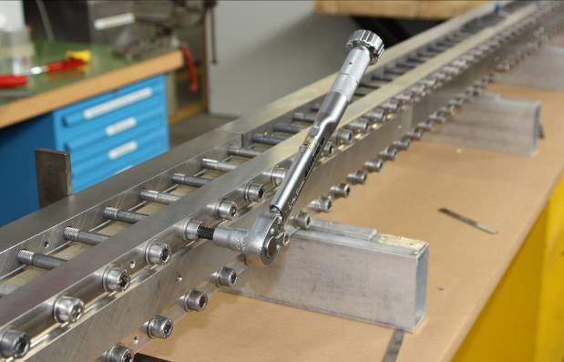
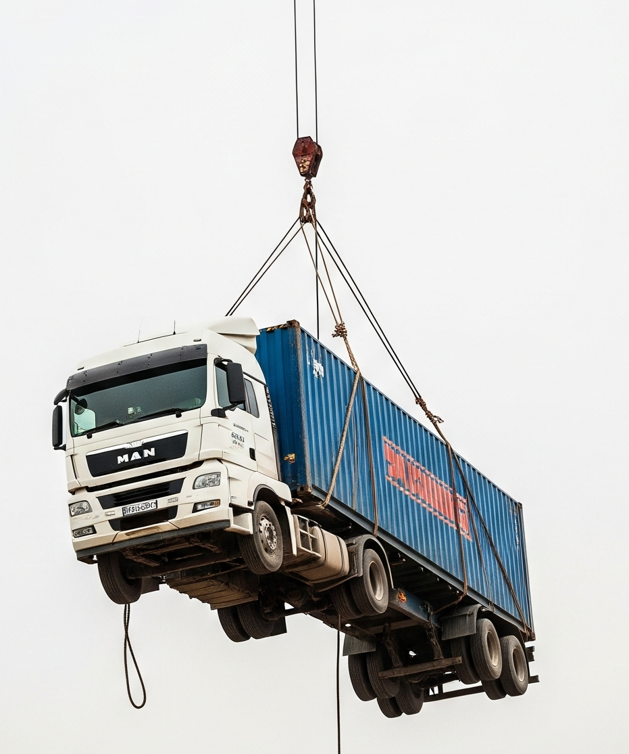
Lorentz Force between the Two Legs
The two sample legs must be hold together by clamps to withstand the Lorentz force between the conductors:
F = 11T * 68kA * 0.5m = 374 kN
… an equivalent of a fully loaded (37.4 ton)
semi-truck

Slide 16
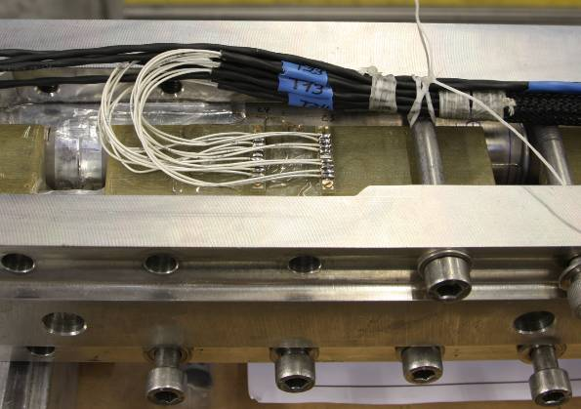
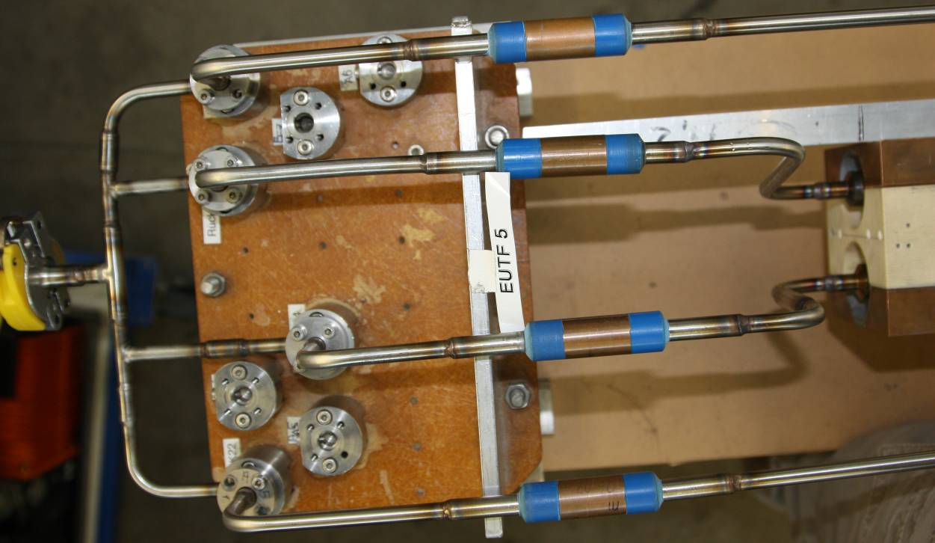
Attaching Readout Wires and He Cooling Pipes
Instrumentation wires
Cooling pipes for supercritical Helium

Slide 17
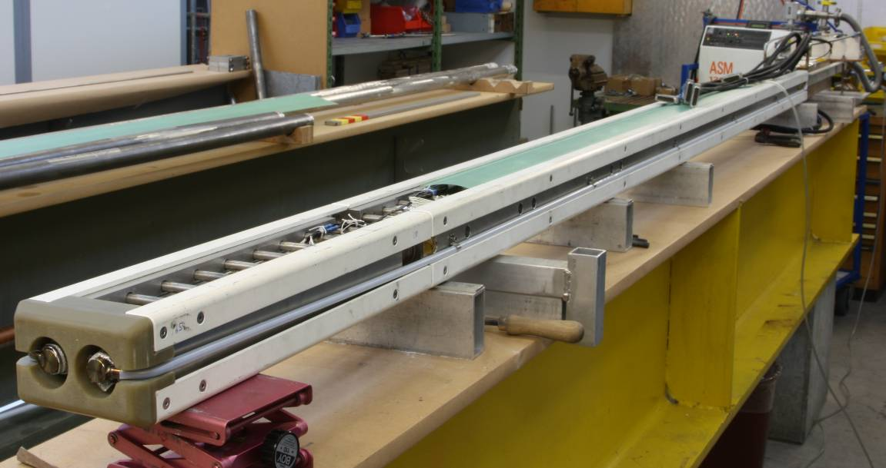
Sample Ready for the Test in SULTAN
It takes 2-3 months to manufacture a SULTAN sample.

Slide 18
Testing in SULTAN

Slide 19
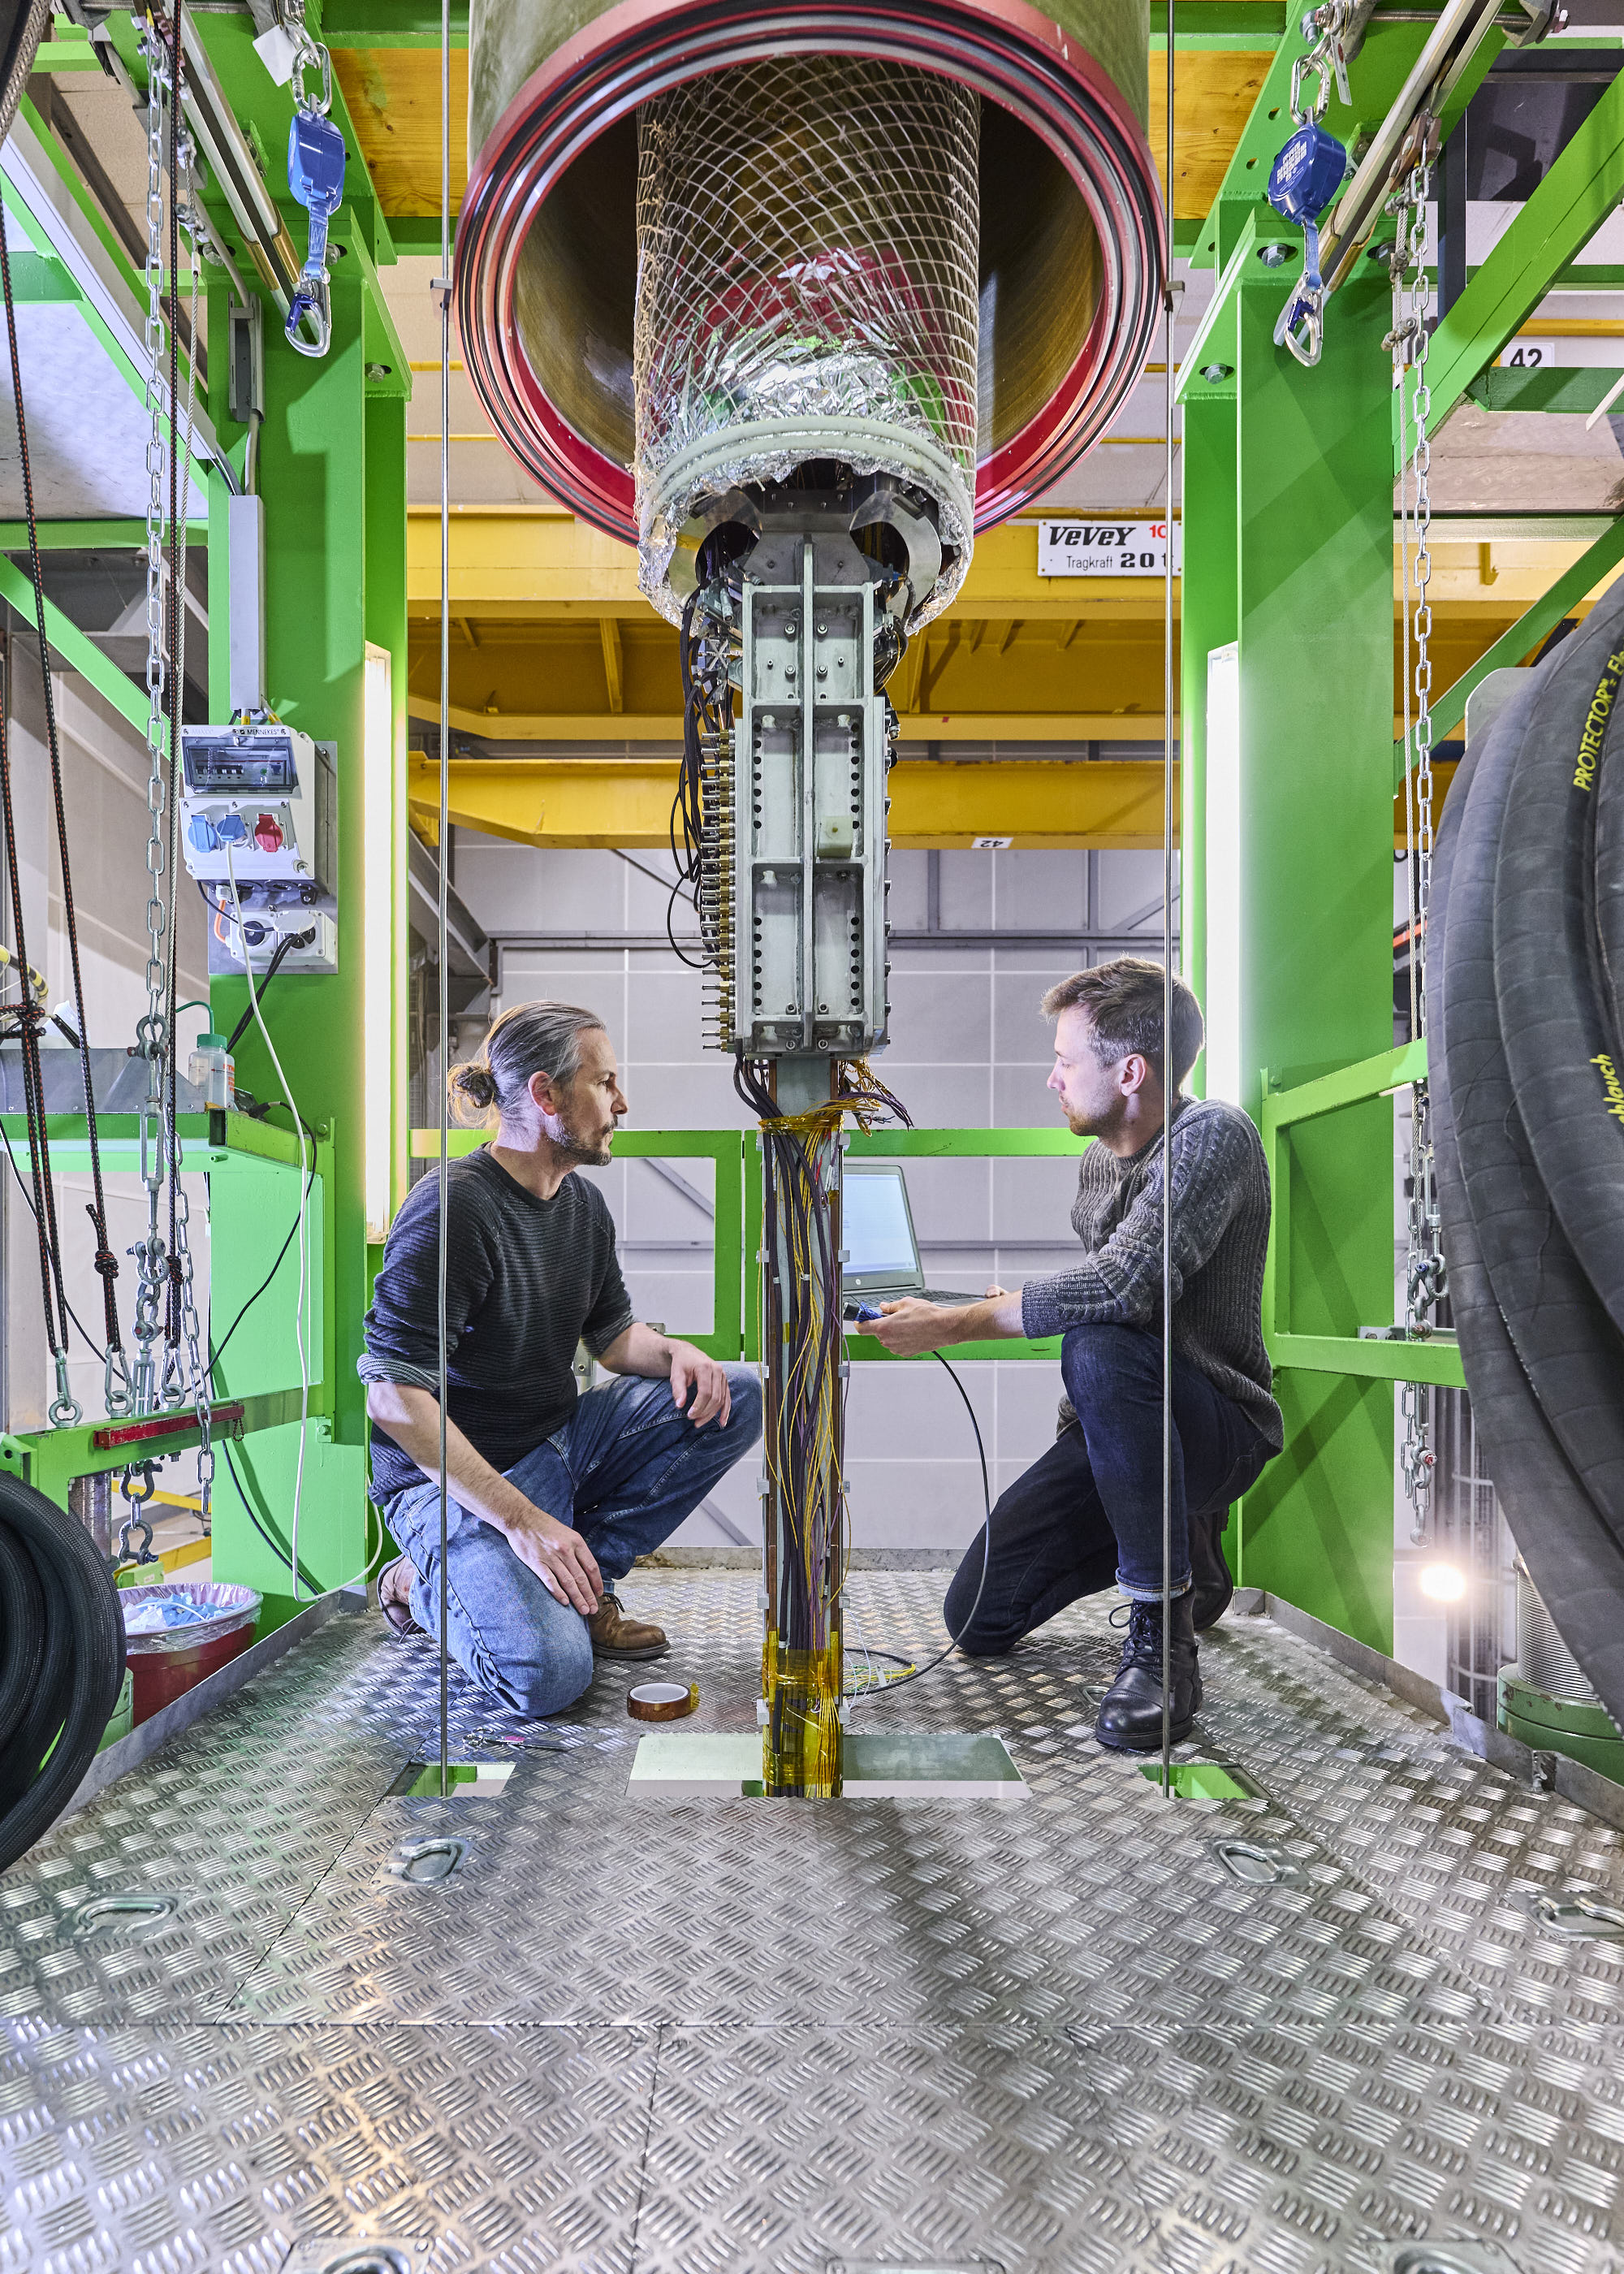
A Typical Test Week
Sample is attached to the superconducting transformer (photo) on Friday noon, and afterwards it is lowered into the SULTAN test well.
Cool down of the sample is started on Friday afternoon, and proceeds over the weekend (48 hours are needed).
Monday morning – Wednesday afternoon: testing
Wednesday evening – start of sample warm up.
Thursday – removal of the sample (0℃) out of the test well into Nitrogen protective gas to avoid moisture condensation on the sample.
Friday morning – sample is uninstalled such that the next one can be mounted.

Slide 20
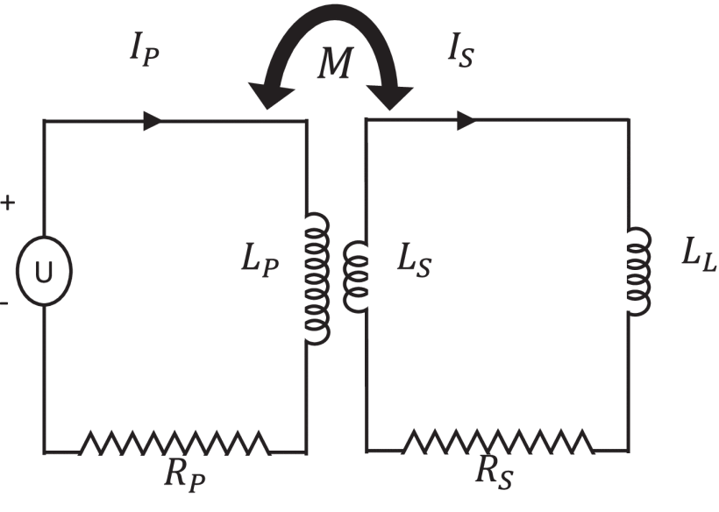
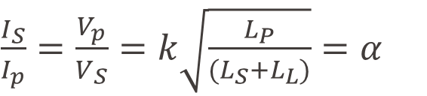
Superconducting Transformer
Provides sample current I_{S} up to 100 kA.
Primary coil: 3700 turns of NbTi wire with current up to 200 A.
Secondary coil: 8 turns of a NbTi cable with current up to 100 kA.
Rising current in primary coil induces current in the secondary coil. Amplification factor α= 290.
Coupling coef.: k = 0.63
$\frac{I_{S}}{I_{p}}=\frac{V_{p}}{V_{S}}=k\sqrt{\frac{L_{P}}{{(L}_{S}+L_{L})}}=α$
(assuming R_{P} and R_{S} = 0Ω)

Slide 21
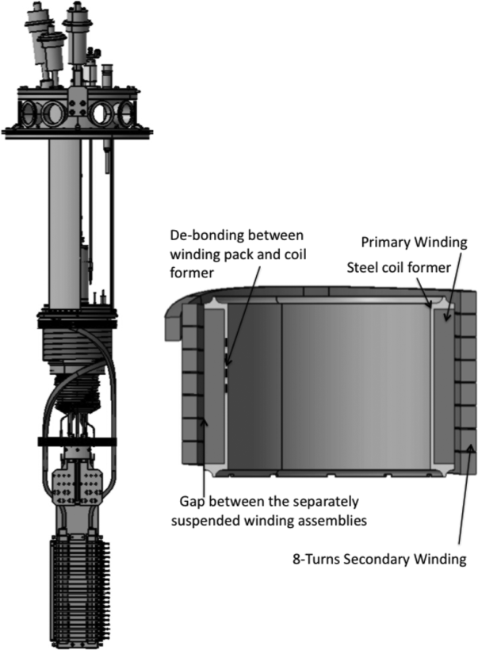
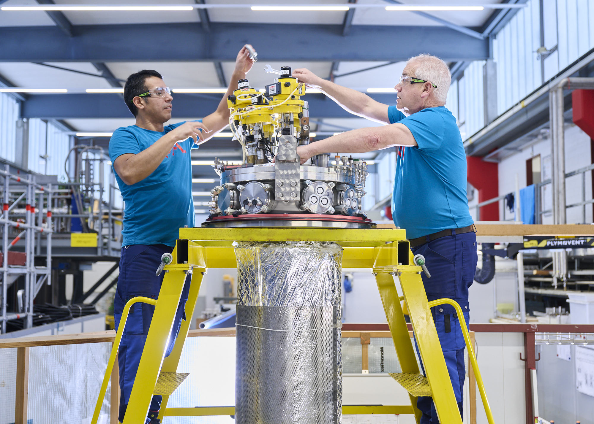
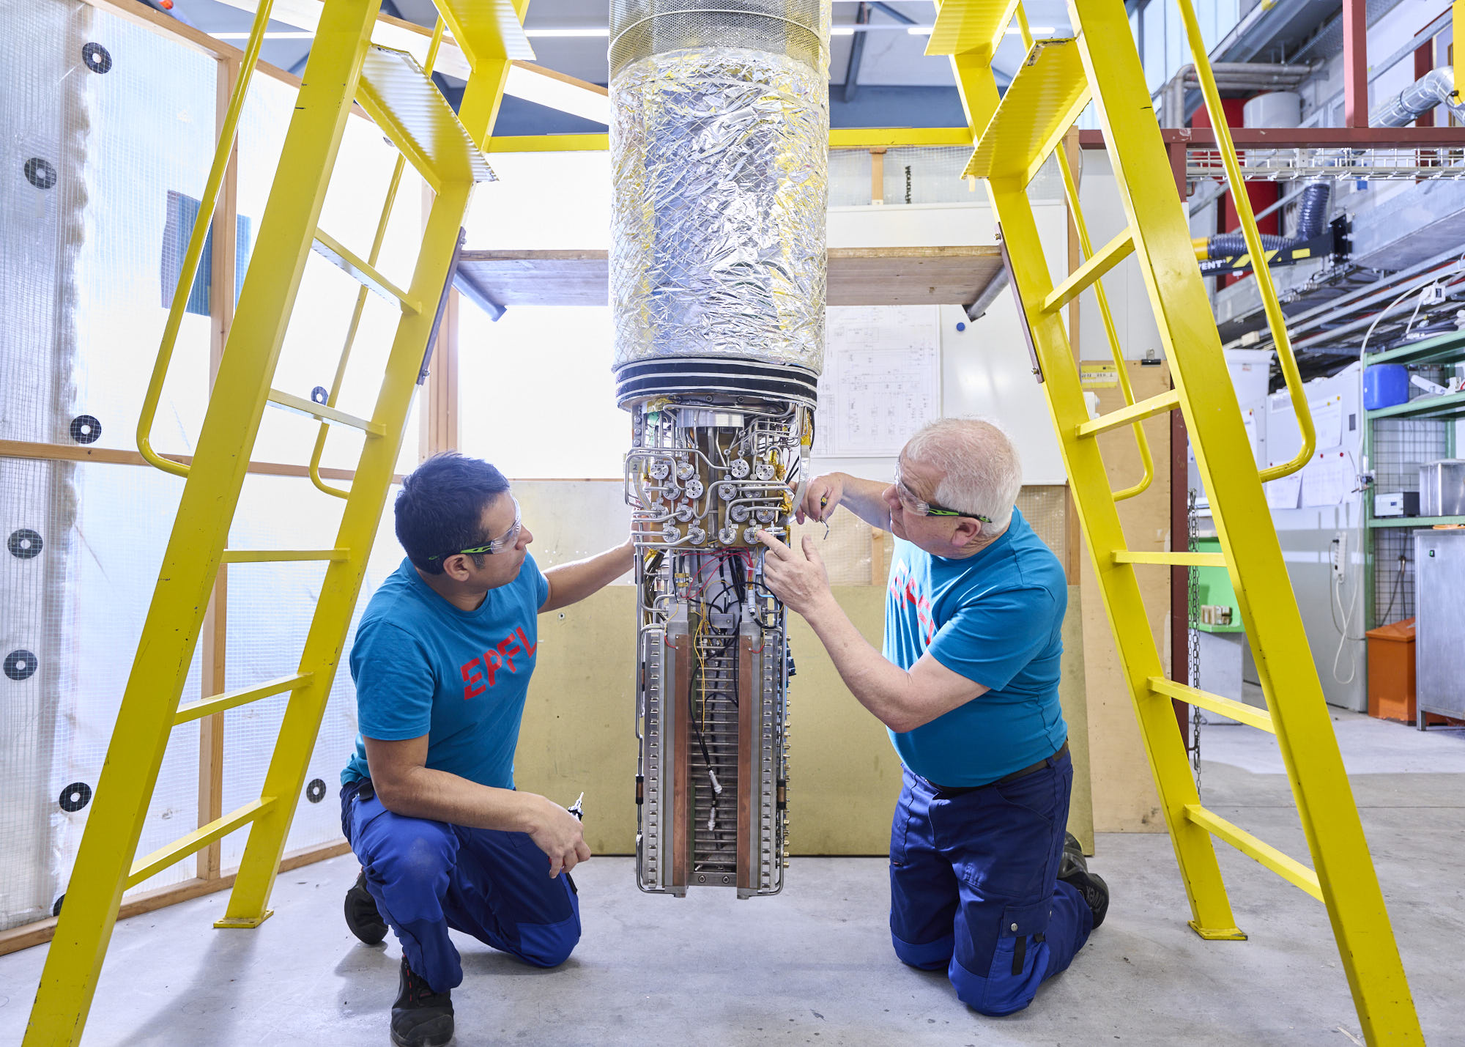
Superconducting
Transformer

Slide 22
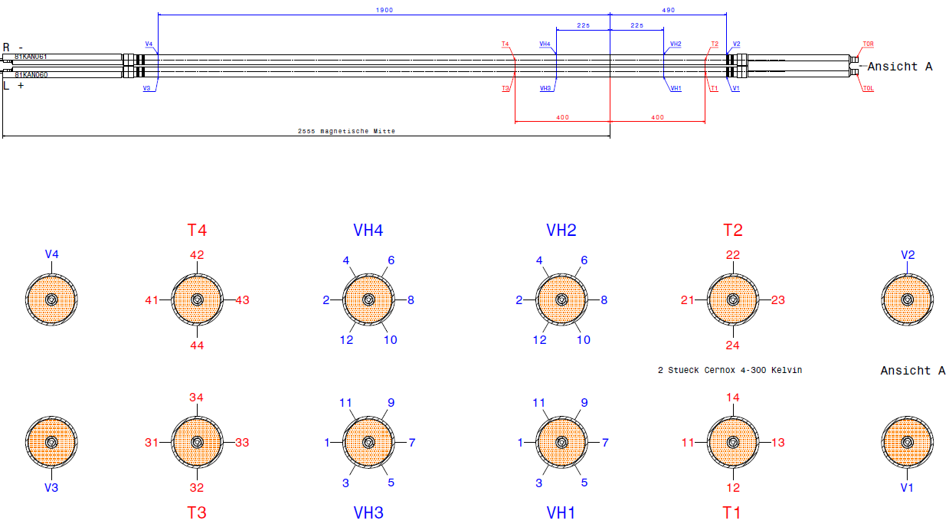
Sample Instrumentation

Slide 23
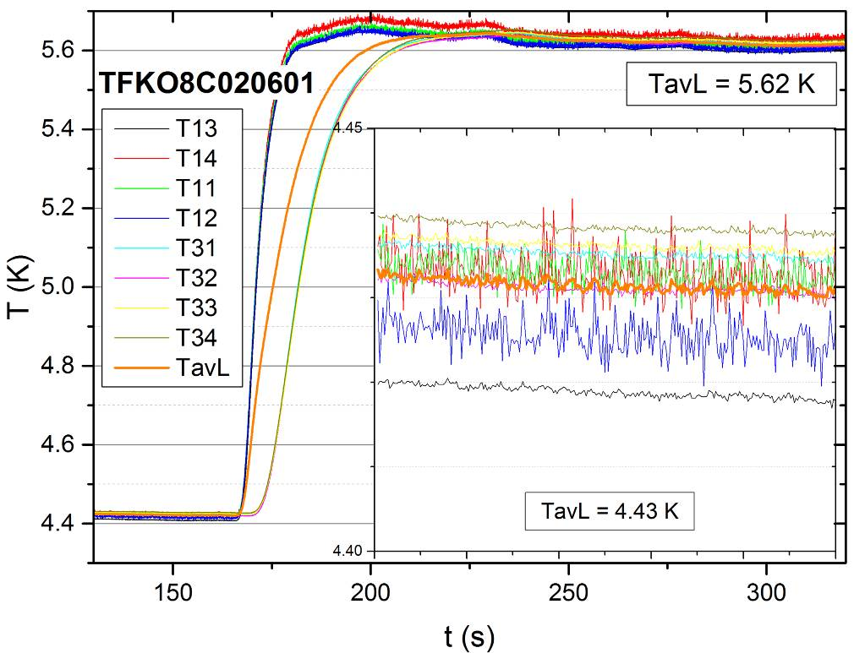
Check of Temperature Sensors – Heat Slug
ITER TF
Step-like increase of He inlet temperature. We check that:
Temperature sensors show the “same” temperature (both before and after the heat slug).
That upstream sensors react before the downstream sensors.
The temperature increase corresponds to the heater power and He mass flow.

Slide 24
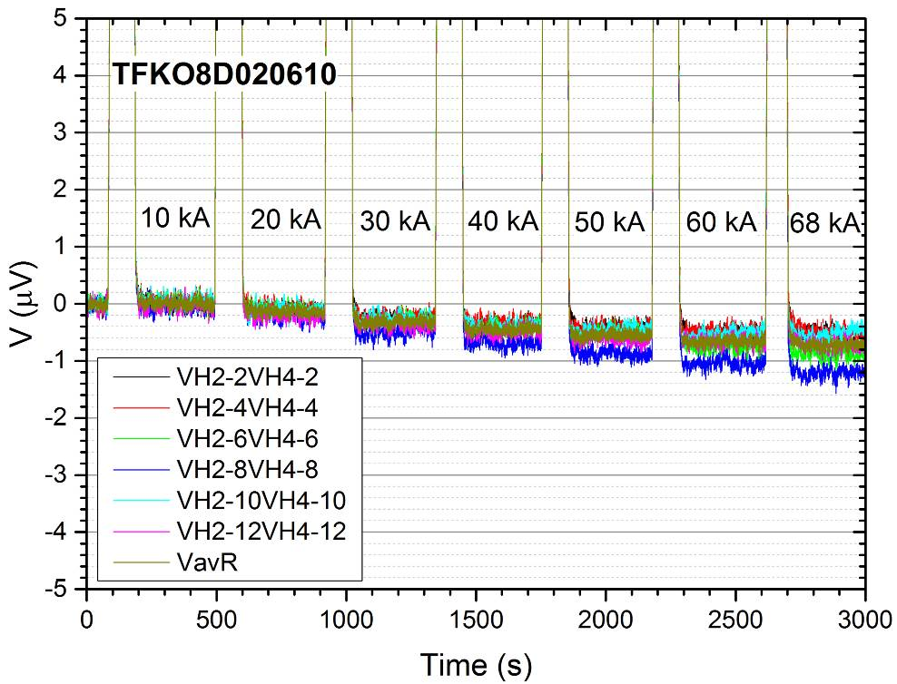
Voltage Response to Increasing Current
Step-like increase of current up to 68 kA.
Inductive voltage during ramping.
Voltage should ideally be zero at current plateaus.
In reality:
Spread between the 6 voltage tap pairs positioned over the same high-field region, but at different angular positions → Averaging usually helps to get closer to 0 µV.
If it does not work → ITER introduced a procedure to correct for V(I) slope, which is not due to resistive behavior.
ITER TF

Slide 25
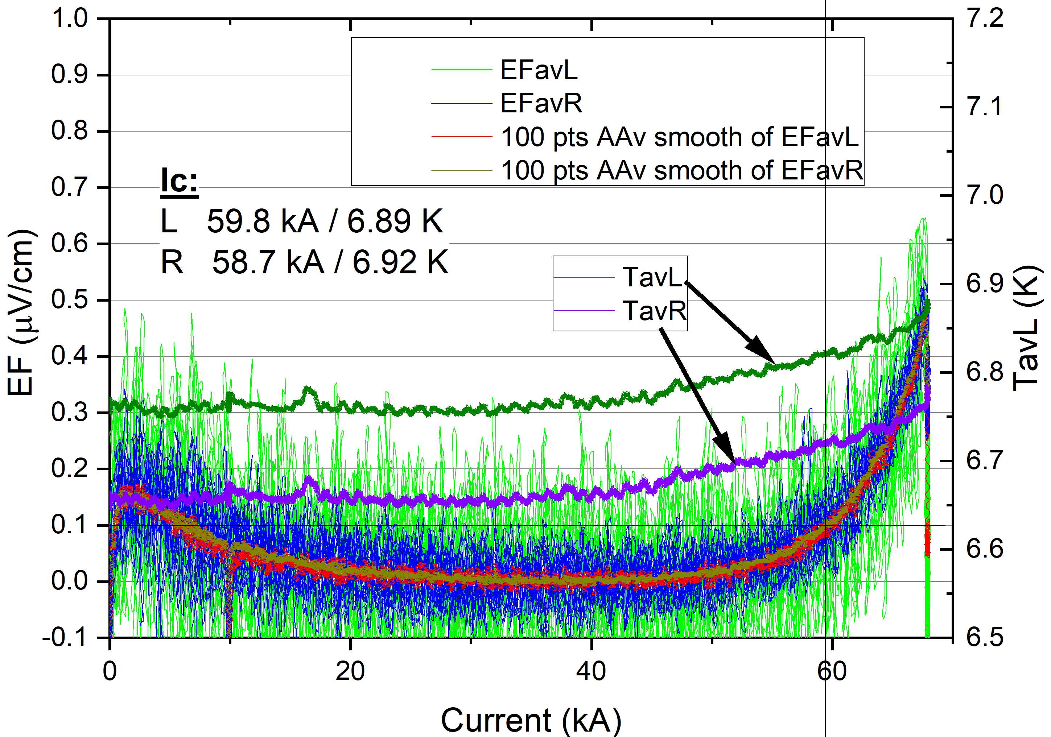
Ic (Critical Current) Run
Magnetic field is set to required value, i.e. 11 T.
Initial temperature is set to required value.
Current is increased continuously.
Inductive voltage is subtracted in the plot.
Ic is defined as the current, at which the lines cross critical EF = 0.1 µV/cm.
Note that the temperate increases during run (ohmic heating in the bottom joint).

Slide 26
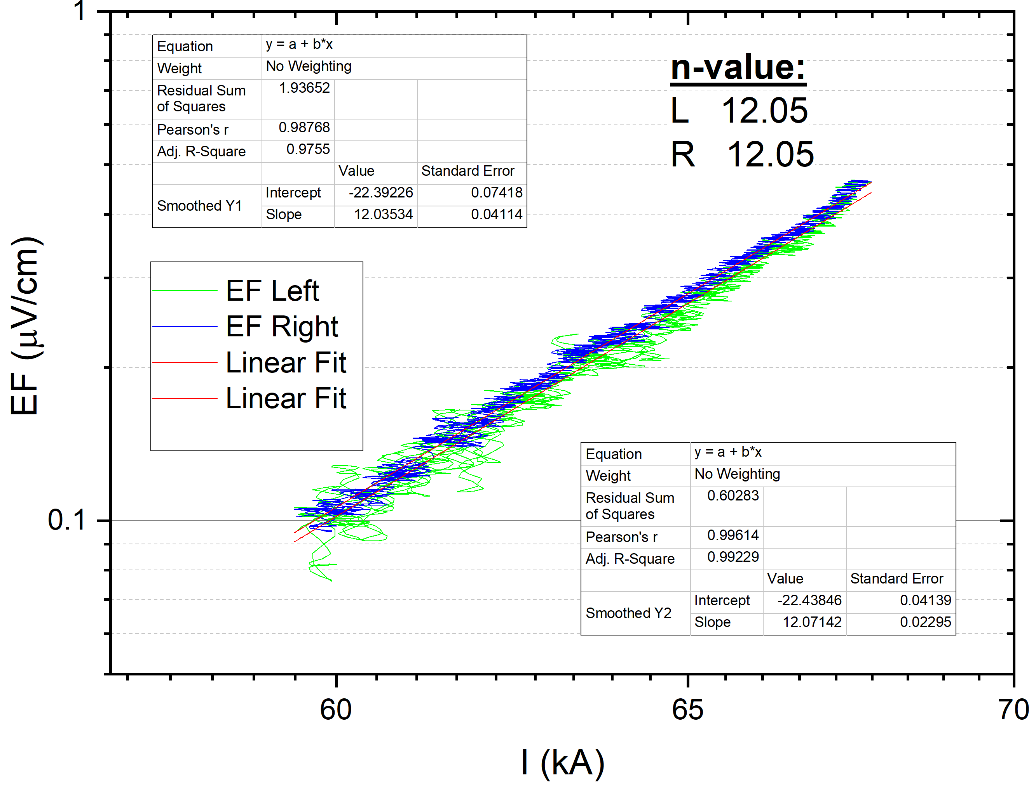
n-Value Determination from the Ic Run
EF(I) is plotted in log-log plot.
n-Value is fitted, ideally in the EF range of 0.1 – 1.0 µV/cm.

Slide 27
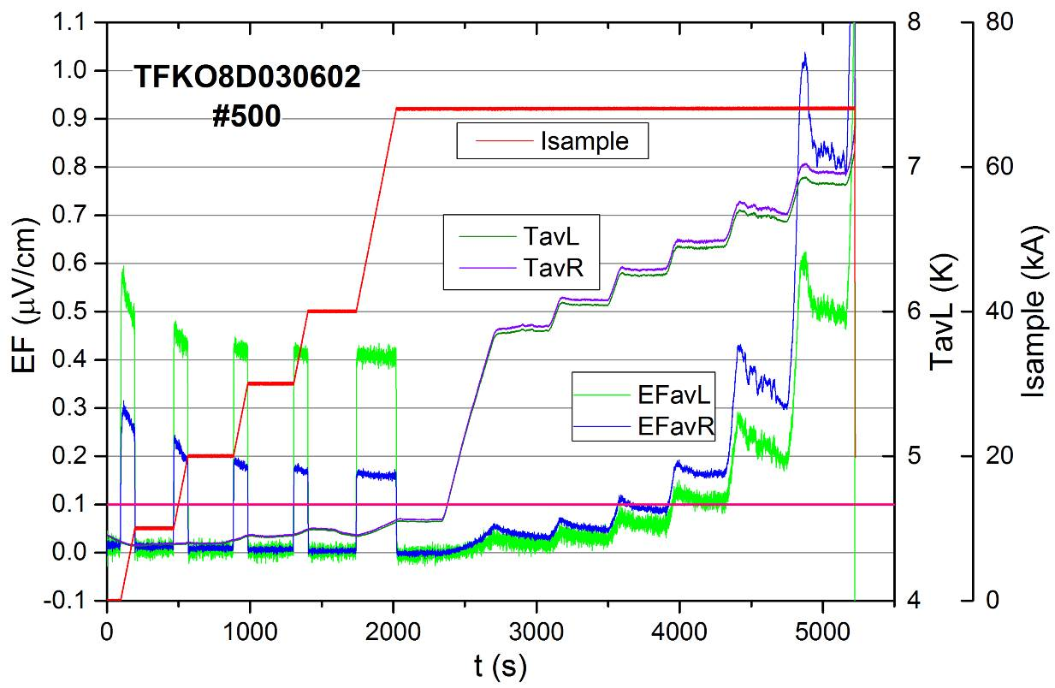
Tcs (Current Sharing Temperature) Run
Magnetic field is set to required value, i.e. 11 T
Current is increased in steps to required I_{OP} .
Temperature is increased in steps with waiting time of 5min.
Notice the relaxation of the electric field (EF) during the temperature plateau.
For the Tcs assessment, EF vs. temperature graph is constructed – see next slide.
ITER TF

Slide 28
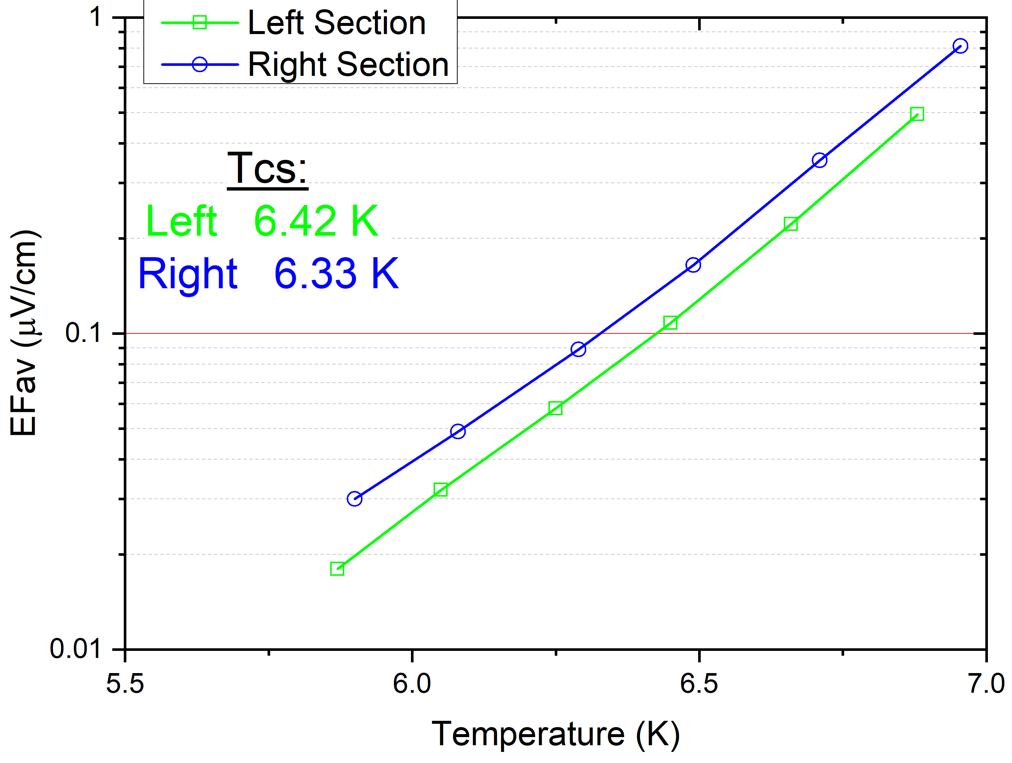
Tcs (Current Sharing Temperature) Run
EF vs. Temperature is plotted as log-log graph.
Tcs is defined as the temperature, at which the lines cross critical EF = 0.1 µV/cm.
In SULTAN, usually there are two independent cooling circuits for the left leg and right leg. This allows us to adjust the temperature in each leg independently.

Slide 29
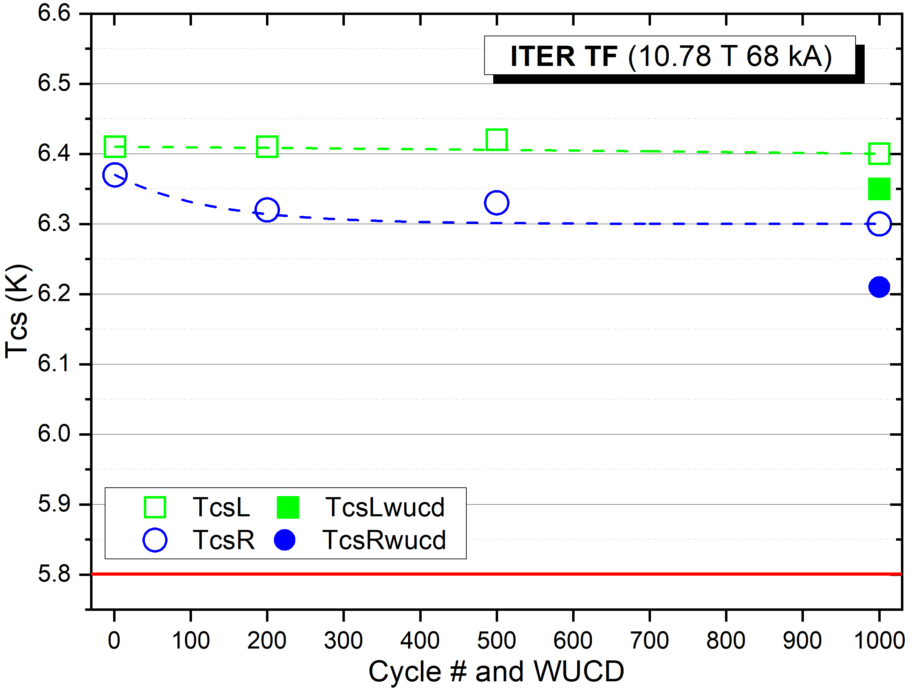
Evolution of Tcs along Cyclic Loading
Conductor performance may change (degrade or improve) along cyclic electromagnetic loading or due to a thermal cycle.
Usually, the biggest degradation is seen at the beginning of the test campaign, and when electromagnetic and thermal cycles are combined.

Slide 30
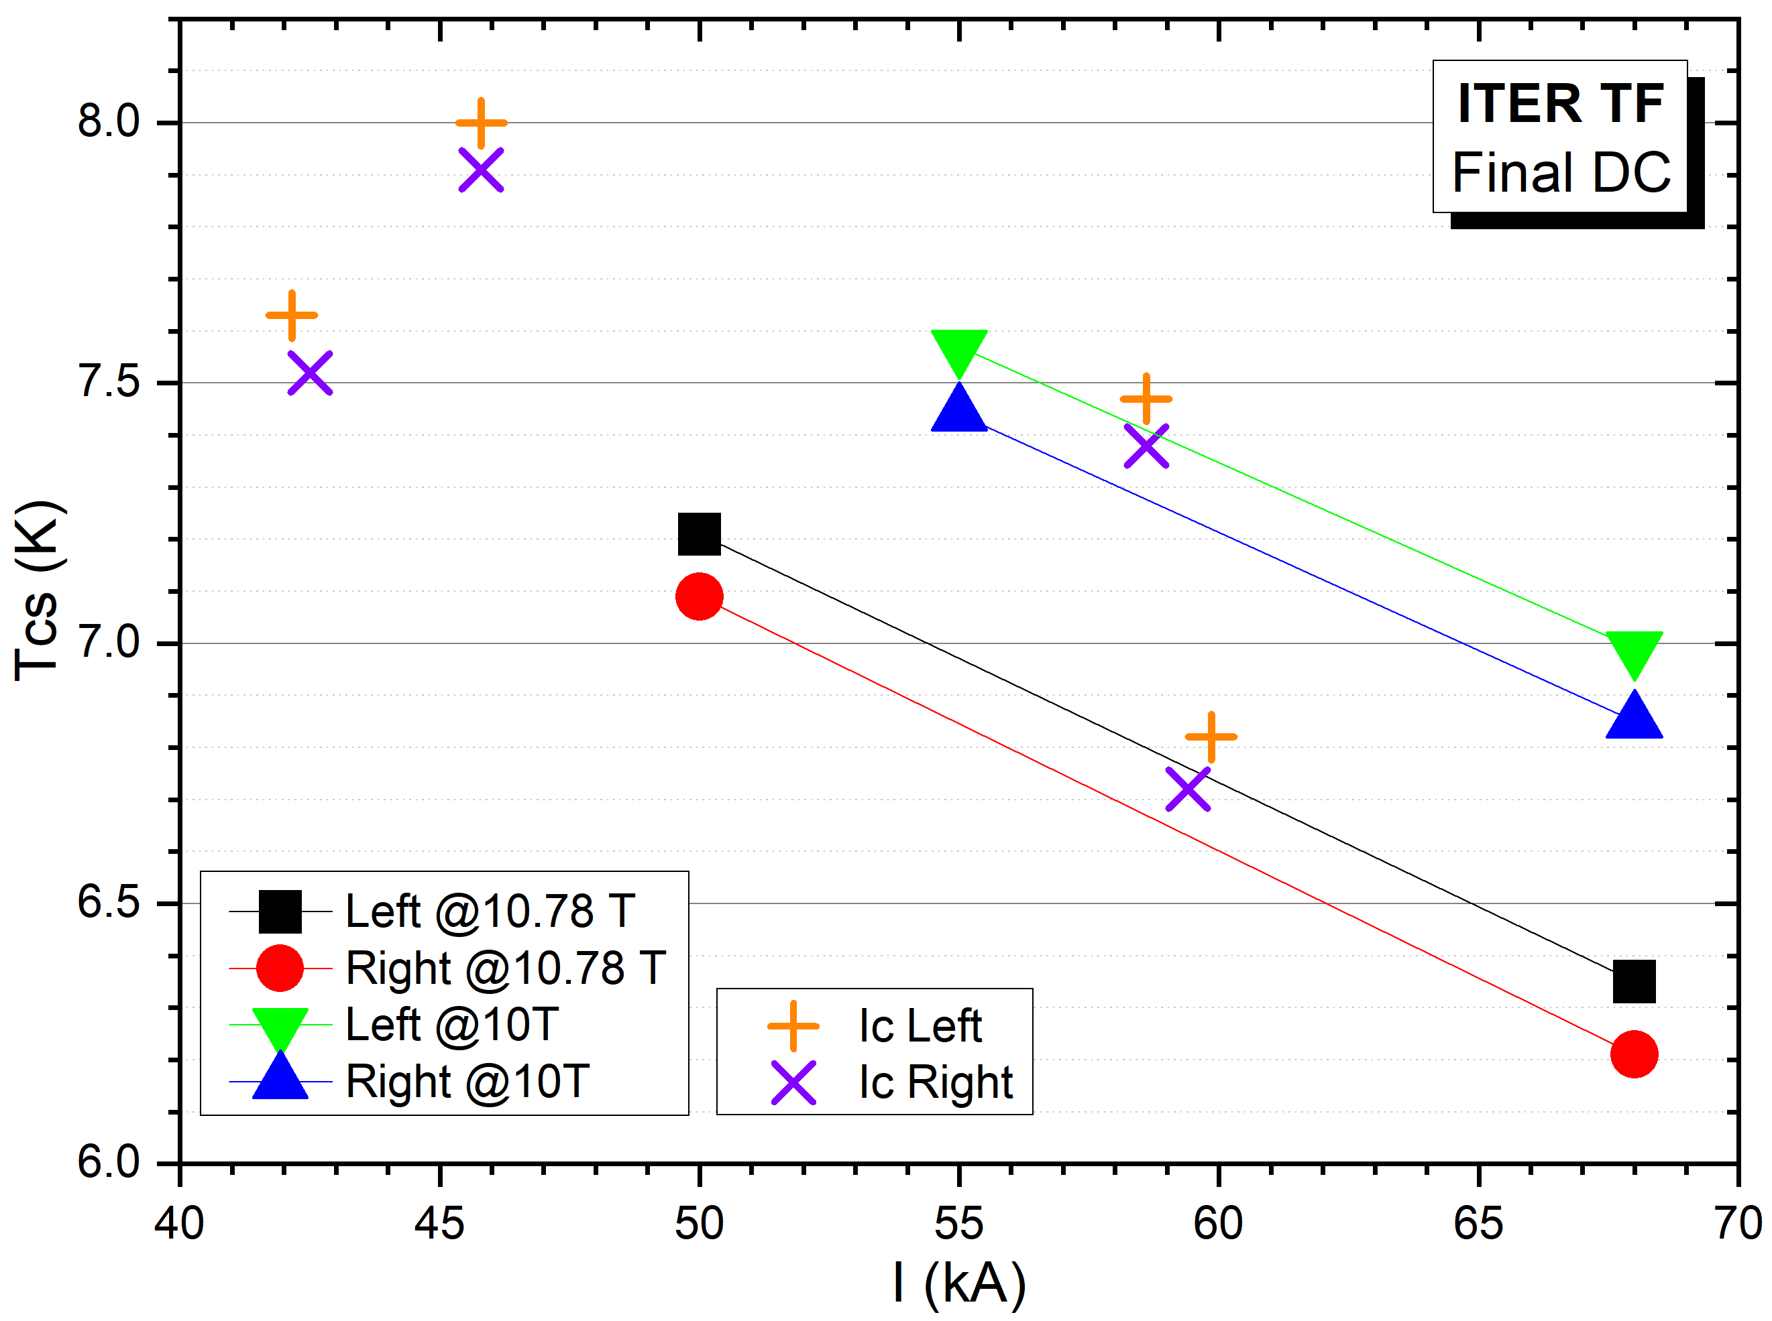
Final DC Results
Conductor performance may change (degrade or improve) along cyclic electromagnetic loading or due to a thermal cycle.
Usually, the biggest degradation is seen at the beginning of the test campaign, and when electromagnetic and thermal cycles are combined.
B_{b} = 10.78 T
B_{b} = 10 T

Slide 31
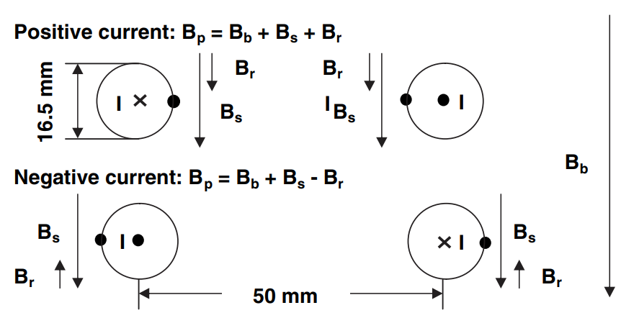
Self-Field Effect
The magnetic field in the sample is a superposition of three fields:
B_{b} = SULTAN background field; B_{s} = self field of the conductor itself; B_{r} field generated by the other conductor leg

Slide 32
Self-Field Effect
“Positive current configuration”: Bs, Bb and Br are aligned – highest effective field (higher than just the SULTAN background field). Conductors in the sample are repelled.
“Negative current configuration”: when Bs is aligned with Bb than Br is pointing in the opposite direction → Beff is smaller compared to the “positive current”. Conductors in the sample are attracted.

Slide 33
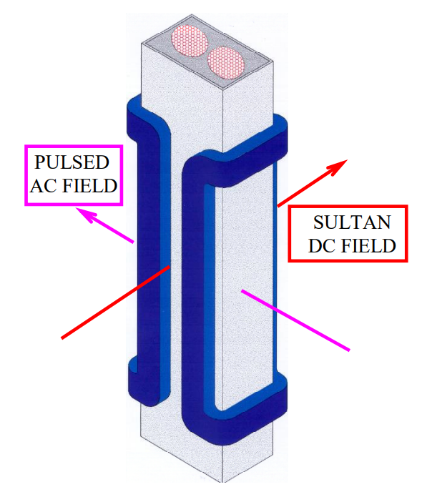
AC Coil in SULTAN
AC magnetic field perpendicular to the DC magnetic field can be generated.
AC field up to 0.4 T in repetitive sinusoidal pulses, (0.02 Hz – 10 Hz).
AC field up to 4 T in a single pulse mode (capacitor bank used instead of power supply).

Slide 34
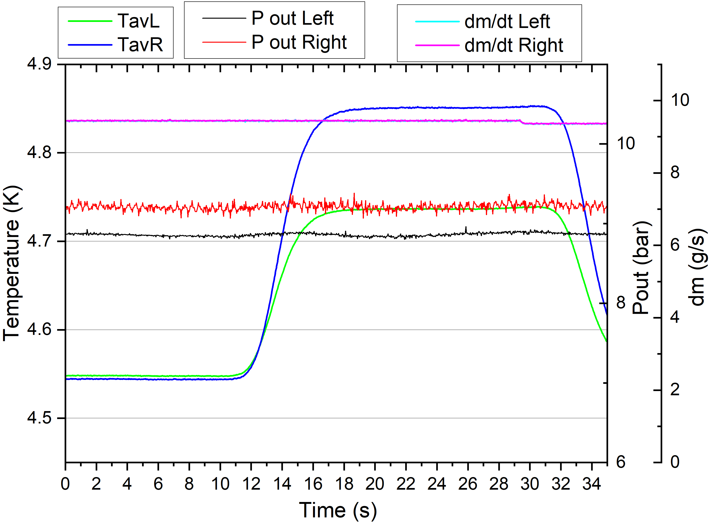
AC Loss
AC loss is measured when AC magnetic field is generated by a dedicated AC coil.
Function of AC field amplitude (typically 0.4T) and frequency (0.1 Hz – 10 Hz).
Usually at 2 T SULTAN background field.
AC loss can be determined from the temperature increase due to AC field, mass flow rate and pressure using enthalpy calculation.
f = 0.6 Hz
ΔB = 0.3 T
B = 2T

Slide 35
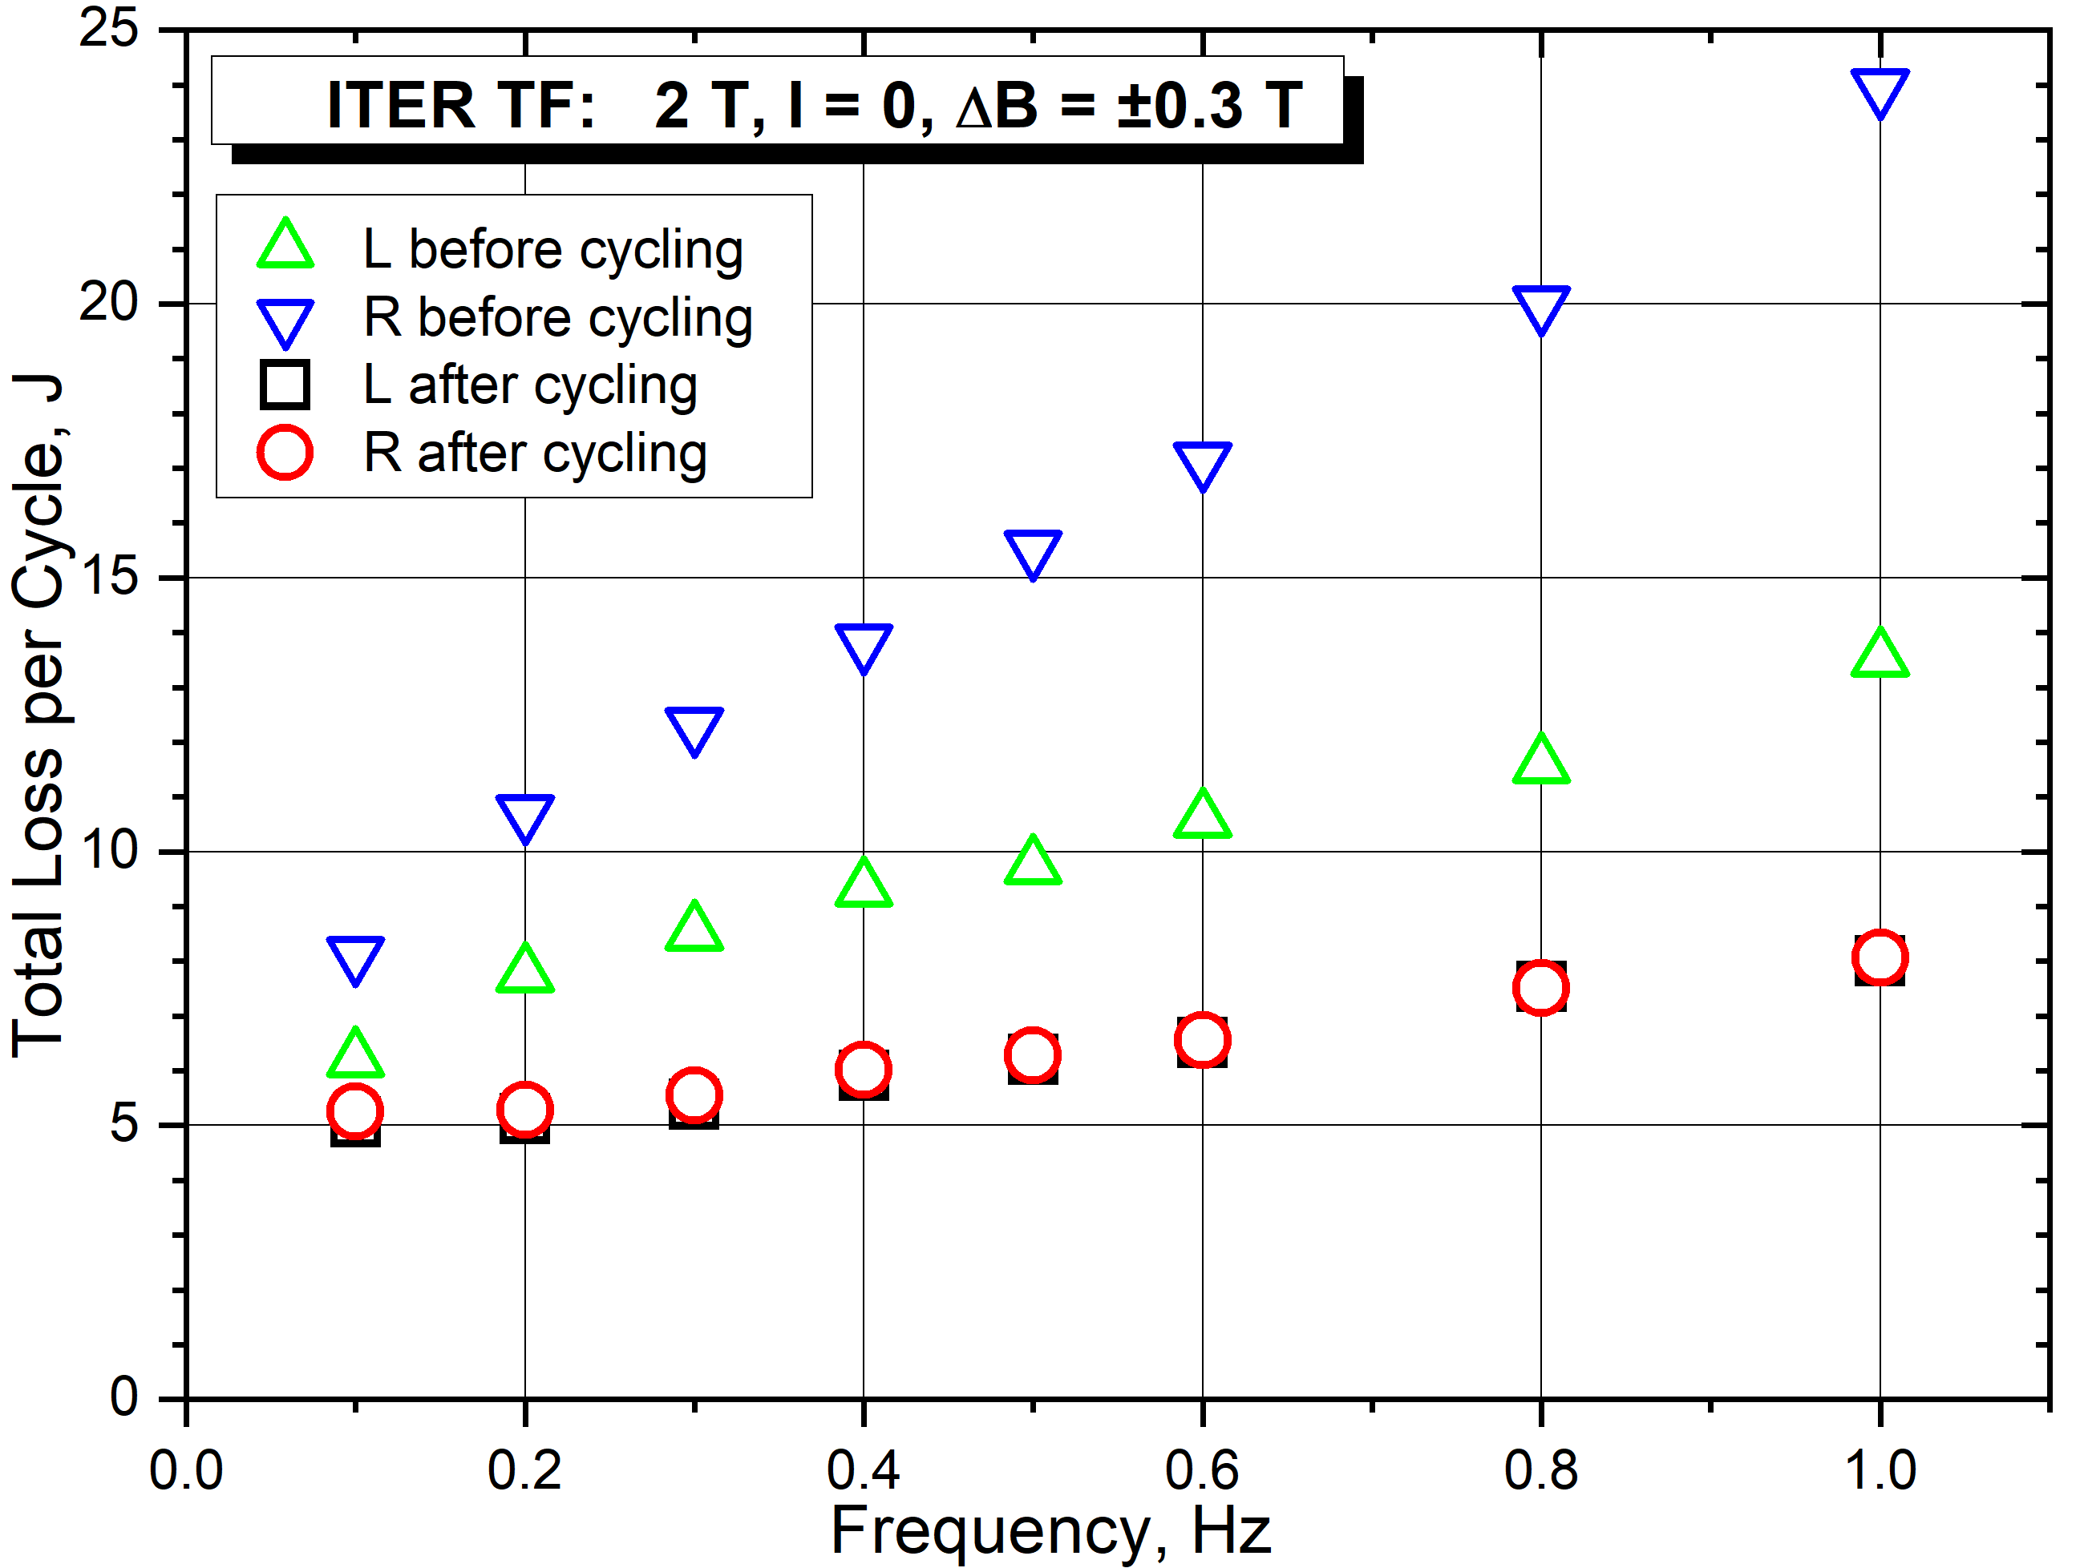
AC Loss
Assessment of the previous graph will add one point to the overall AC loss graph, here shown as AC = AC(f).
For Nb3Sn, the losses in pristine conductor are usually higher than losses in the conductor after cyclic loading.

Slide 36
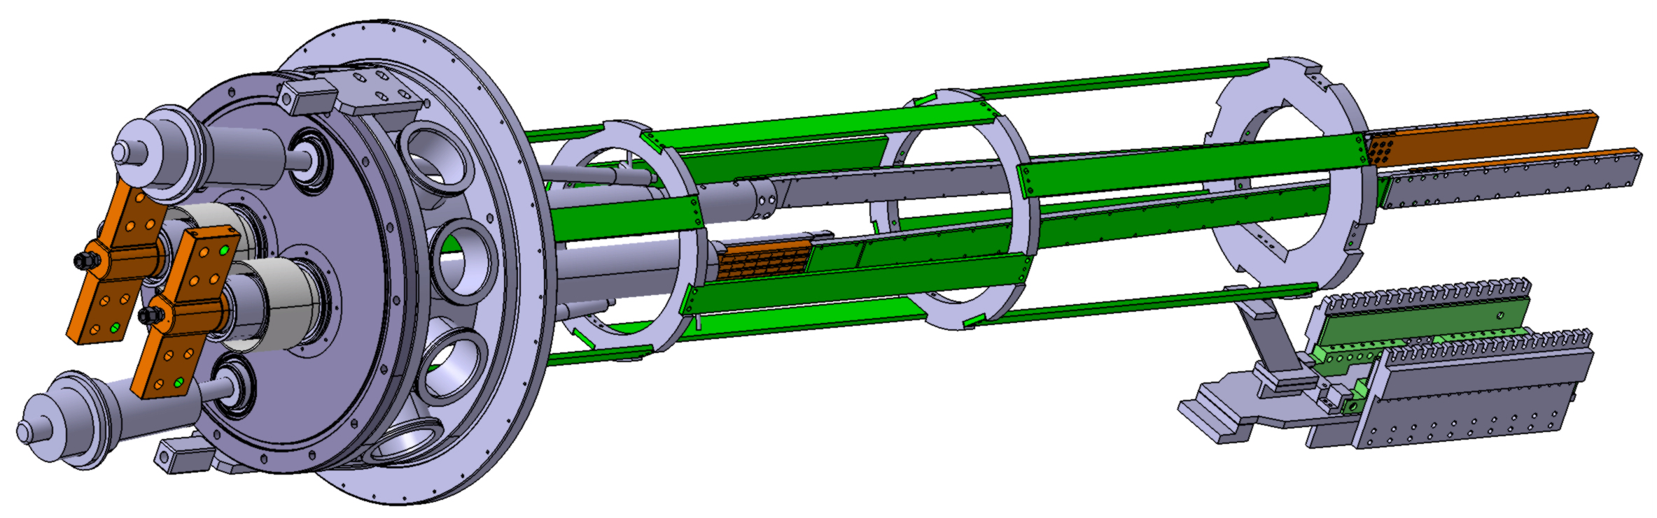
Additional SULTAN Capabilities
Quench Propagation Studies:
  Power supply is used instead of superconducting transformer, but with a limited current (max. 15 kA).
HTS samples: An HTS Adaptor needs to be inserted between the superconducting transformer and the sample, to allow temperature gradient between the transformer (cold end, up to ~8K) and HTS sample (up to ~50K).

Slide 37
Take-Away Message
It may take 2-3 months to prepare a SULTAN sample.
Unlike in small cryostats, T_{CS} measurement is preferred in SULTAN to I_{C} due to repeatability of the operating conditions: B and I can be set precisely, T can be measured precisely, but it cannot be set precisely. This is important especially when effect of cyclic loading needs to be studied, or high measurement accuracy is required.
Superconducting transformer may provide high current, but only for limited time. Resistance in the sample loop (joints) needs to be very small (<10nΩ).
Cyclic loading is usally the key test that a well-designed conductor needs to withstand.

