Slide 1
ITER Magnet Testing
Nicolai Martovetsky
TIDM²xSC Magnets Lecture Series
3-18 June 2025

Slide 2
Large magnets testing (my involvement)
Project | Location | Year
T-15, first Nb3Sn tokamak | Moscow, IAE, USSR | 1985-1988
Toshiba SMES | JAERI, Naka, Japan | 1994
Toshiba SMES | LLNL, Livermore, US | 1997
CSMC Test Facility + CS Insert in the bore | JAERI, Naka, Japan | 1999-2000
TF Insert in CSMC | JAERI, Naka, Japan | 2001
TFMC, TFMC+LCT | KIT, Karlsruhe, Germany | 2001-2002
Nb3Al Insert in CSMC | JAERI, Naka, Japan | 2002
PF Insert | JAERI, Naka, Japan | 2008
CS Insert in CSMC | JAERI, Naka, Japan | 2015
TF Insert | JAERI | 2017
CSMM | GA | 2018
CSM1 | GA | 2020

Slide 3
Projects (continued)
Project | Location | Year
CSM2 | GA | 2021
CSM3 | GA | 2021
CSM4 | GA | 2022
CSM5 | GA | 2023
CSM6 | GA | 2024
CSM7 | GA | 2025
CSM3 | GA | 2025

Slide 4
Why test large magnets
Every test has a purpose, it is an expensive activity and must be justified
Guarantee that magnet components will work in the assembled machine
R&D – way to move forward high-risk extensions
Verify prediction models
Qualify design
Qualify fabrication processes
Verify and qualify components (conductor, joints, structures, insulation, etc.)
Risk reduction

Slide 5
What was discovered in large magnets tests that was not revealed in strands or conductor tests
Degradation in a Nb3Sn coil is hard to predict from a straight sample test
Effect of strain in Nb3Sn magnets windings
Losses in Nb3Sn reduction after EM cycles
Losses in NbTi increase or remain stable after EM cycles
Long lengths of conductor in magnetic field allow easier assessment of the Tcs due to higher voltage, especially in NbTi
Hoop strains improve Tcs and Ic in Nb3Sn

Slide 6
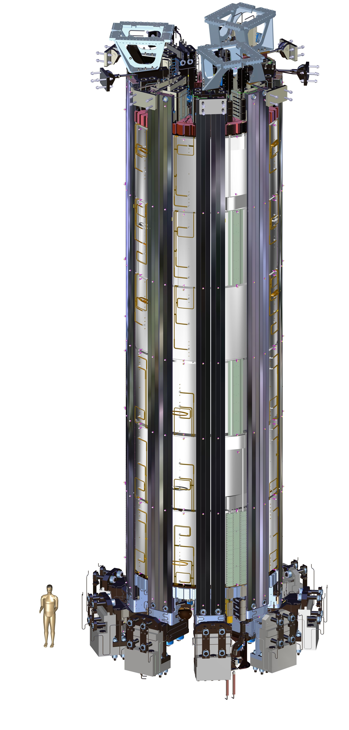
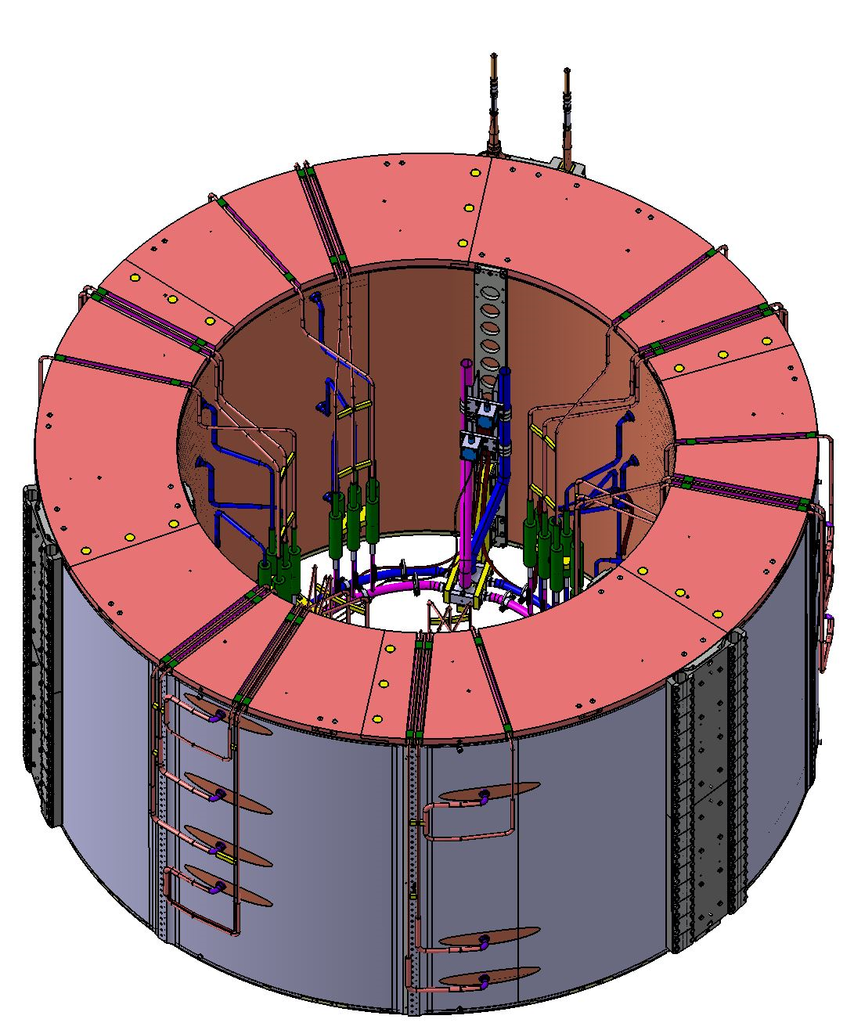
How to assess performance of the test object and the magnet system
ITER Central Solenoid-17 m tall CS stack of 6 modules and precompression structure
I max=40 kA
Bpeak 13 T
4.2 m OD 2.2 m tall CS module
Imax =40 kA,
Bpeak=8 T

Slide 7
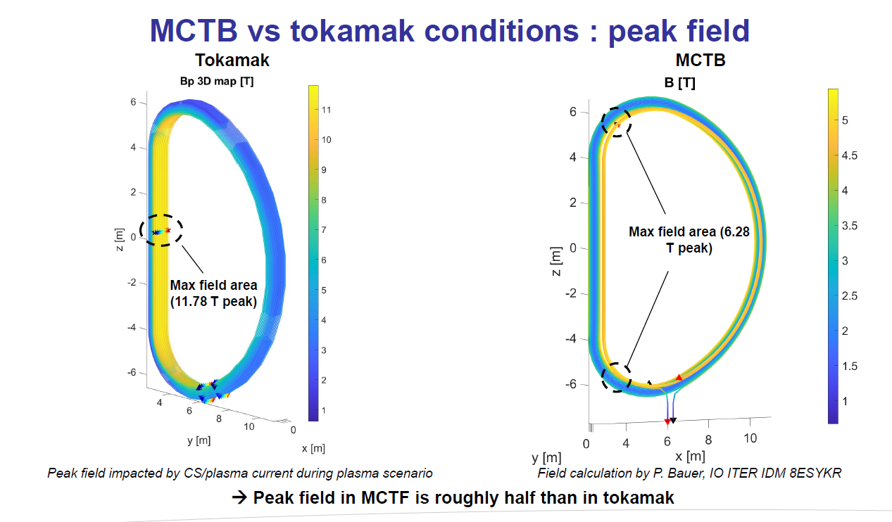
TF coil in the assembly and in the stand-alone mode

Slide 8
How to predict performance of the coil in an assembly from stand alone coil
In tokamaks, CS modules are assembled in a stack, but modules are tested in a stand-alone mode
Issues:
a) field distribution is different
b) strains and stresses are different
c) no effects from plasma, PF and other CSM dB/dt effects
What needs to be had:
Reliable correlation Ic(T, B, eps for the conductor)
Tests to evaluate performance margin
Good models and predictions in the useable conditions to project test results to the performance of the assembly

Slide 9
What are the most important things for testing big magnets
Knowledgeable and responsible personnel
Reliable and well-maintained facility
Careful preparation of the tests, plans, procedures and checks
Redundant and systematic checks of the system functionality, especially critical elements: instrumentation, DAQ, Power Supply, Quench Detection system and Quench Protection system (switchyard and dump resistor)
Redundancy in QD and QP systems
Safety features: interlocks, authorized personnel access, effect of the magnetic field on field sensitive equipment, including vacuum gauges, electromotors, heart pacemakers and loose ferromagnetic parts

Slide 10
Load line B(I) issues
In a stand-alone mode the load line is determined B(I) and has no flexibility
How to create a flexibility of different B and different I?
An Insert coil and a bore of the background field magnet
Example is CSM Test Facility in QST, Naka, Japan

Slide 11
CSMC Test Facility in Naka

Slide 12
CSMC Naka Test Facility capabilities
Parameter | Value
Current in the CSMC | +/-50 kA
Current in the Insert | +/-50 kA
Peak field | 13 T
Stored energy | 640 MJ
Power supply max voltage | 15 V DC, 4.8 kV pulsed
Max dB/dt | +/-2 T/s
Cryoplant power at 4.5 K | 5 kW

Slide 13
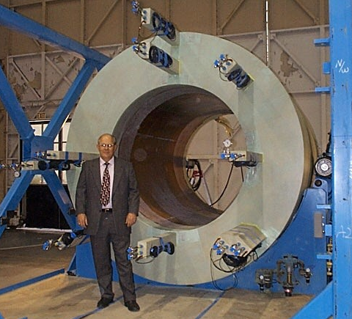
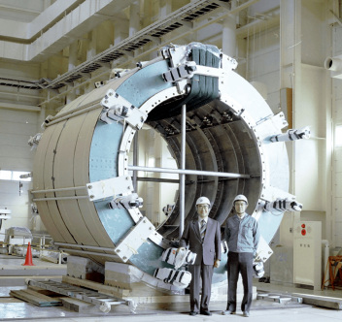
CS Model Coil
Inner Module
(US)
Outer Module
(JA)

Slide 14
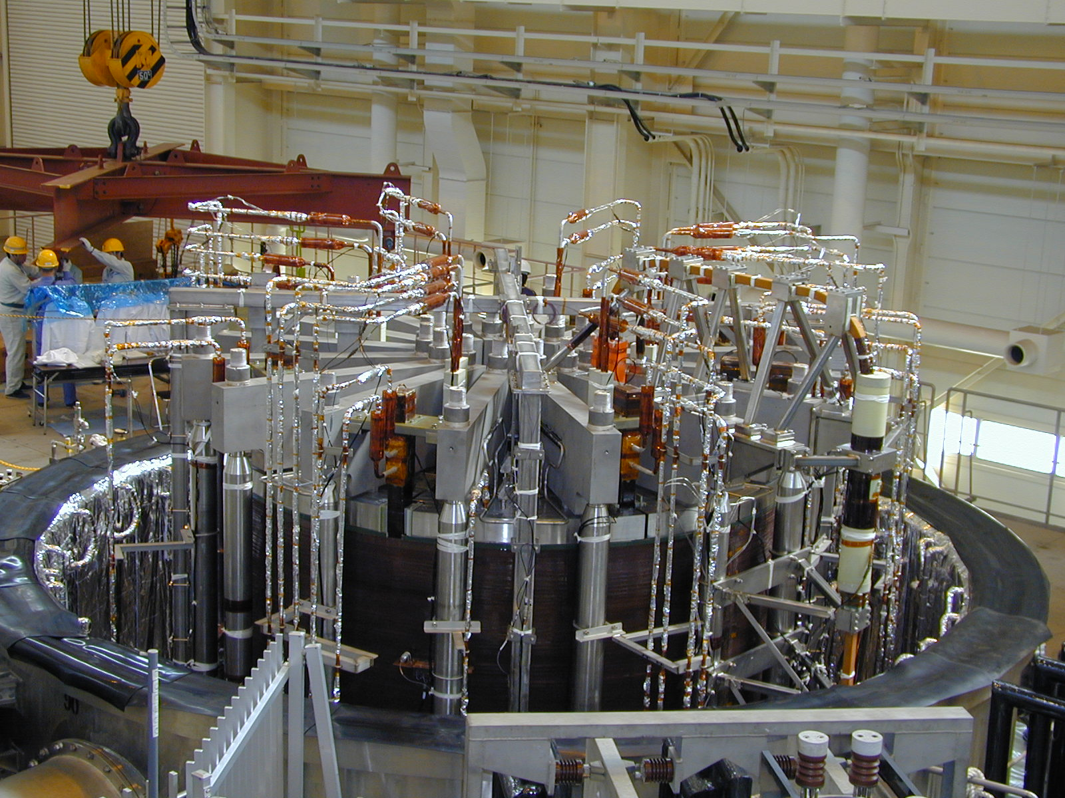
CSMC and CS Insert installed in CSMC Test Facility 1999

Slide 15
Naka Facility
One of the most flexible facilities in the world
Most ITER related R&D and conductor verification tests are performed there
The only facility that had a capability to apply high voltage high power pulses to study dB/dt up to 2 T/s with 13 T swing. Unfortunately, high voltage PS is not available since early 2000-s.
Plenty of DAQ channels, slow (1 Hz) and fast (1 kHz) sampling rate for fast events
Reliable QD (quench detection) and QP (quench protection) systems

Slide 16
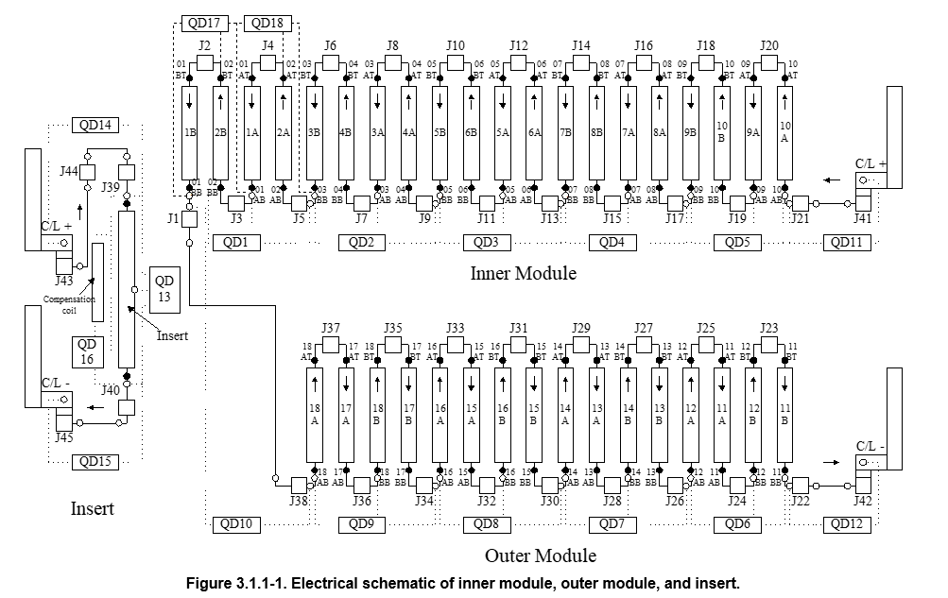
Electrical schematic and instrumentation in CSMC and Inserts

Slide 17
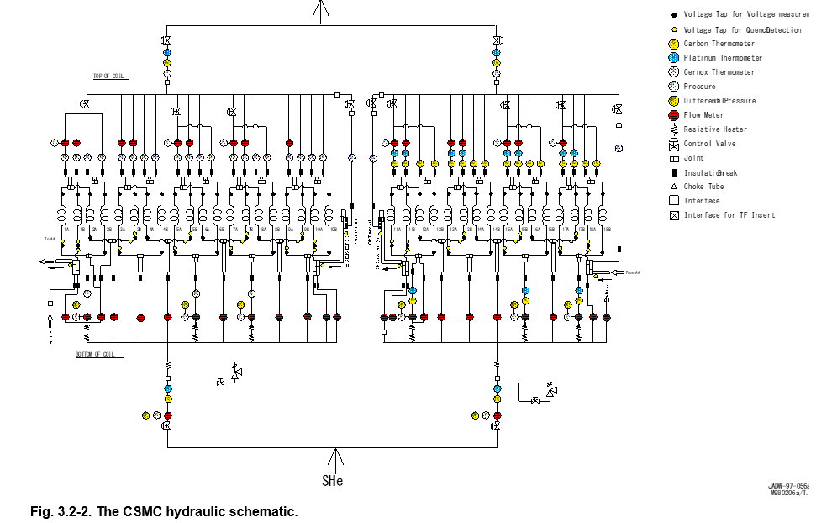
Thermo-hydraulic instrumentation in CSMC facility

Slide 18
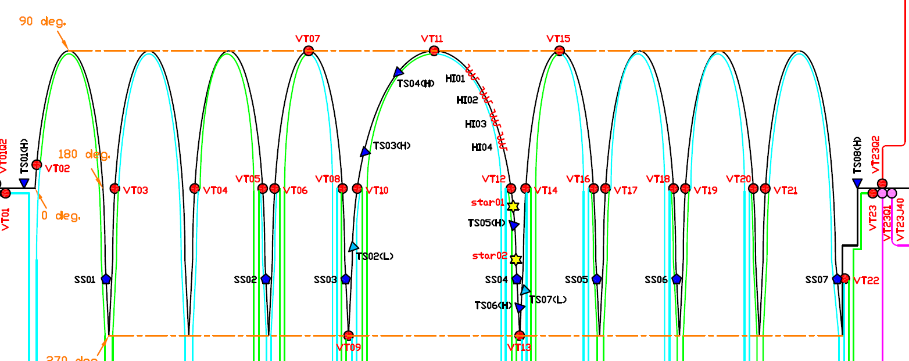
CSI 2015 Instrumentation map
VT- voltage taps, SS – strain sensor, TS - temperature sensor, HI- inductive heater

Slide 19
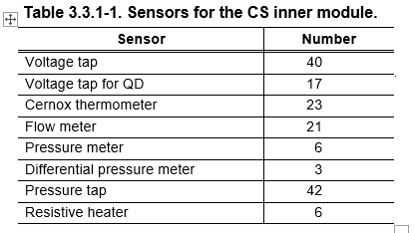
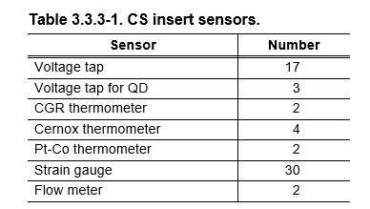
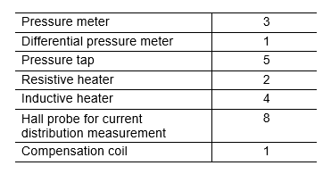
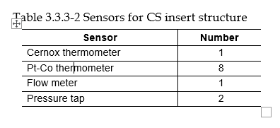
Instrumentation channels in Naka Facility
Good instrumentation is of an essence for testing
Inner and outer modules have the same number of channels available. CS Insert is separate. Structure have additional channels

Slide 20
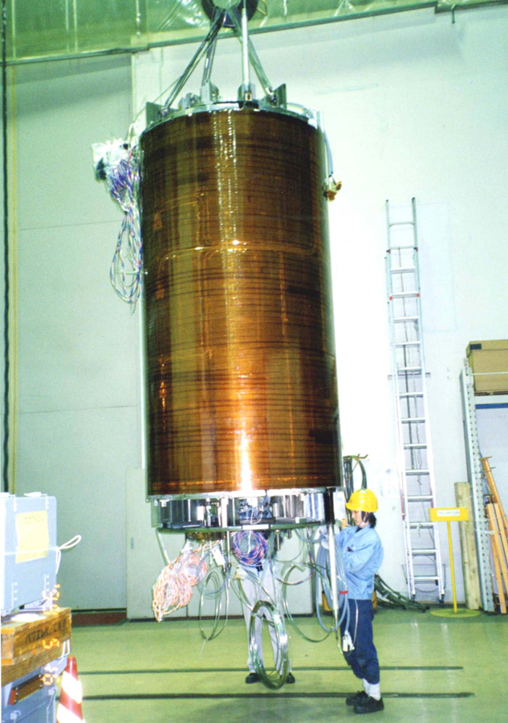
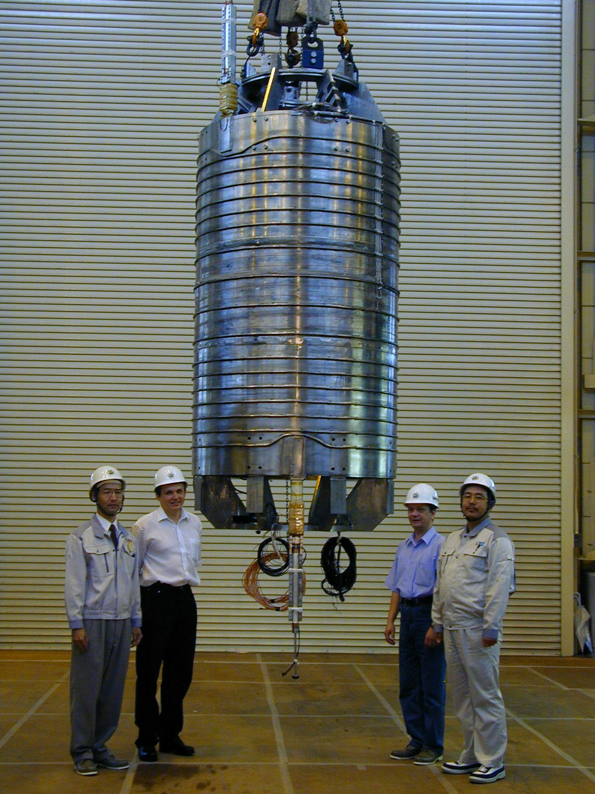
CS Insert (1999) and TF Insert (2001) EFDA
Mitsubishi, Japan
Efremov Institute, Russia

Slide 21
Main findings from 2000 campaign
CSI:
Slight degradation from lateral force IxB
N-value decreases with cycles
Noticeable degradation from EM cycles/quenches
Gain in Tcs due to hoop strain and low CTE jacket Incoloy 908
AC loss reduction vs cycles
Low ramp rate sensitivity up to 1.2 T/s, loss of stability at 2 T/s
Overall – good performance, green light for ITER CS
CSMC:
Slight degradation of the CS conductor vs cycles
Good performance overall

Slide 22
TF Insert results 2001 and PF 2008
Predictable degradation from SS jacket- 30% more than Incoloy 908 jacket
No Tcs degradation from cycles
Overall, good performance – demonstration that TF conductor with a thin jacket in a strong SS support is acceptable – gives a green light to TF coil conductor and structure for ITER as opposed to a strong jacket TF conductor
PF Insert –no degradation, more stable than a short sample in SULTAN at high currents

Slide 23
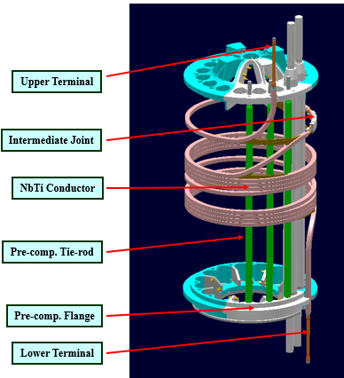
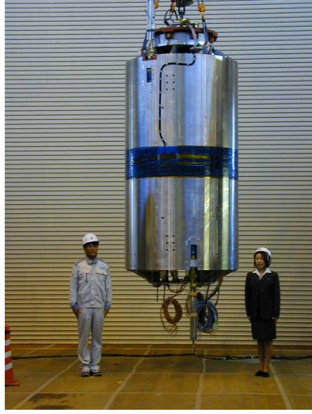
Nb3Al and PF Insert EFDA
Tesla Engineering, UK
Hitachi, Japan

Slide 24
Nb3Al Insert (2002) main results
It is possible to produce Nb3Al CICC in industry
Nb3Al demonstrated no strain sensitivity in contrast to Nb3Sn
N - value did not drop, even increased a little bit
Good predictability of performance of the coil from the strand parameters

Slide 25
Results from ITER tests at Naka

Slide 26
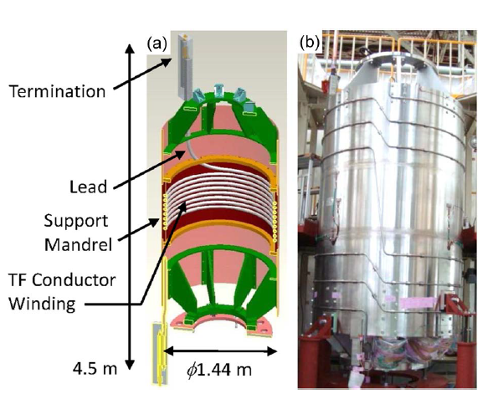
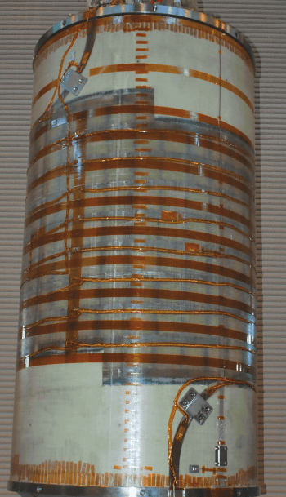
CS Insert (2015) and TF Insert (2017)
Mitsubishi, Japan
Hitachi, Japan

Slide 27
CSI 2015 testing background
CSI 2000 showed decent performance
ITER went through re-design to reduce cost by reducing size, but also by boosting Ic in SC magnets
New CS conductor showed unacceptable performance, high degradation versus EM cycles and WUCD cycles
SULTAN results were challenged for several reasons
In 2013 CS conductor was redesigned, short samples showed promising results but needed CS Insert verification before full scale production of the CS conductor

Slide 28
CS Insert 2015 results
CSI with a new cabling pattern demonstrated expected performance and confirmed ITER CS conductor qualification
Showed no sensitivity to EM cycles and WUCD (warm-up – cooldown) cycles
It was a concern that SULTAN testing cannot provide reliable performance data on the CS conductor– resolved
Obtained reliable data on AC loss, stability, hot spot temperature at quench, hydraulics, quench propagation, properties vs length, etc

Slide 29
TF Insert 2017 test background
TF Insert in 2001 and TFMC in 2002 showed expected degradation due to high CTE SS jacket, but no degradation due to EM cycling and WUCD
A new TF conductor with an advanced strand had high sensitivity to EM loading and very high to the WUCD

Slide 30
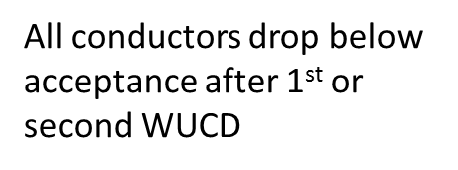
TFI conductor in SULTAN
TFI conductor was made, tested in SULTAN and used for TFI construction

Slide 31
Concerns about ITER TF life
Basis for gain in T margin(0.3 K) from 8 to 14 g/s – (see my separate presentation on that)
0.6 K gain from reduction of the length in B peak
-0.3 K due to lower hoop strain in TF vs TFI
Overall net gain is 0.6 K over previous acceptance if high mass flow is employed

Slide 32
Summary in CSMC Naka facility tests
Qualified CS conductor in relevant conditions
Characterized CS conductor in the field of the parameters Ic (T, B, eps)
Identified and quantify problems with TF conductor
Characterized Ic(T, B, eps) for TF conductor
Obtained lots of information unavailable from other tests (quench detection, hot sport temperature, stability, AC loss reliable data) extremely valuable for ITER

Slide 33
GA Facility background
CS acceptance in PA required only the first CSM tests at full current (actually 50 kA) and the rest of the modules at a low current (2 kA or so)
US ITER decided to test all the modules to assure low risk in ITER operation
Several options explored for CSM testing (QST Naka, KIT Karlsruhe, CEA Saclay)
DoE decision in 2014 – build test facility at GA from scratch

Slide 34
Final CSM Test Facility at GA

Slide 35
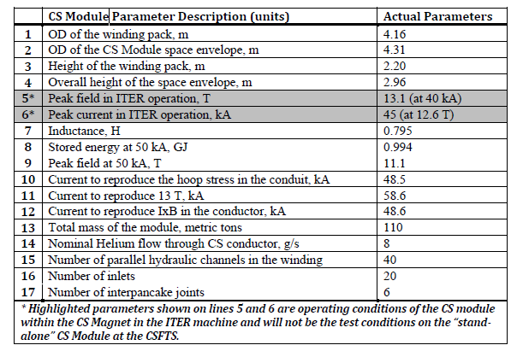
CSM parameters

Slide 36
CSM3 Test Program main items
Tests | Comments
HV Tests, including Paschen tests for coil and the facility | 15 kV Paschen, 30 kV ambient, 7 kV facility
Cooldown | Dynamics, shrinkage
Tc, R(T) | SC transition
Hydraulics | Impedance, flow balance
Charging to 40 kA in steps | Ability to charge, facility functioning, joint resistance
AC loss in dumps and hysteresis | Hysteresis, coupling AC loss
Electrical characteristics, R, L, QD noise | Critical properties
Mechanical characterization | Young modulus, linearity of dz(F)
Inductive noise cancellation | Ability to detect quench
Tcs verification tests | Up to 9 K in Tcs inlet
Cold and warm leak test | Coil tightness
HV tests after cold tests | Dielectric strength

Slide 37
Lessons learned during
Power supply commissioning
A vendor performs acceptance tests with a resistive load only. An inductive load usually is not available and most of the problems are discovered when warranty period is expired. Synchronization of the bridges and operation in the reverse mode gave us problems.
Switch yard
Sensitive to timing of the bypass switch
May not open the circuit if the time interval between the switch open and capacitor counter pulse is too short
Sensitive to the capacitor charge setting
Very important parameter, too low voltage will not break the arc, which may lead to a facility and the coil significant damage
DAQ
Needs constant attention, channels sometimes malfunction and that is discovered too late to rerun the test of interest
Cryogenics
Thermal acoustic oscillations
Supercritical Helium circuit operation
Valves operation, including dumps and quench conditions
High voltage equipment
Cameras’ location
HV feedthroughs
Paschenization of the coils, instrumentation, joints, hydraulic insulating breaks, whole facility etc.
Wire exits breakdowns

Slide 38
Daily checks and checks after each reconfiguration of the facility
Cryogenics
Vacuum
Insulation condition
Critical temperature, pressures, flow
QD functionality
Switch yard functionality
PS functionality

Slide 39
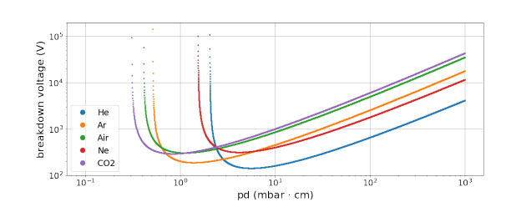
HV testing issues
ITER CS and PF see HV up to 14 kV in normal operation or 29 kV at faults
To assure sufficient dielectric strength Paschen testing need to be carried out (HV tests in all vacuums)
Became ITER mandatory since 2003
Before that – relied on high vacuum dielectric strength
Paschen test has no alternative!
Facility must have equipment to detect breakdowns
Must be done before and after Cold testing and EM loadings

Slide 40
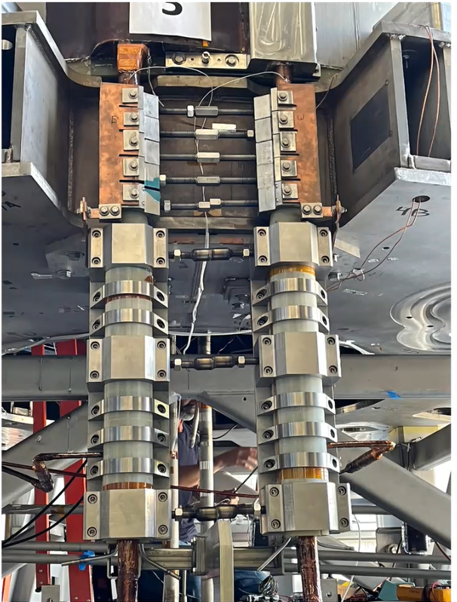
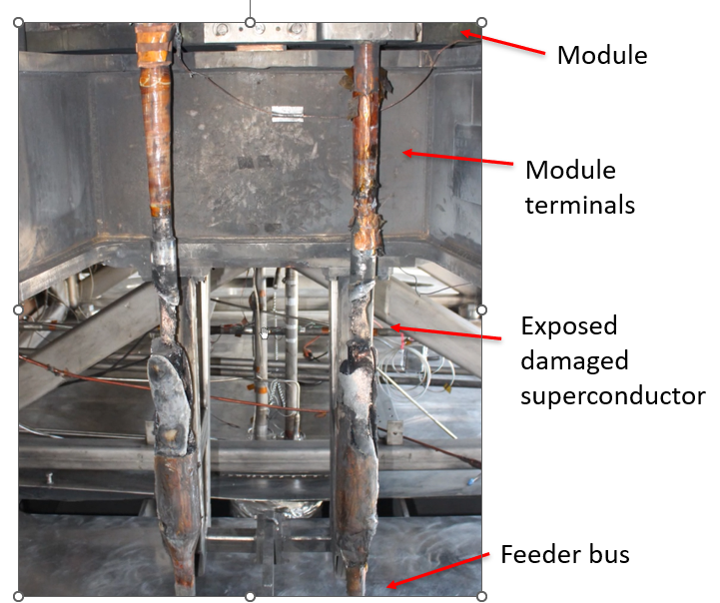
CSM3 Breakdown
Damage from 15 kA breakdown (10% of nominal stored energy)

Slide 41
Summary
Testing of the large magnets is expensive and technically challenging
It gives information that cannot be achieved by any other method with high confidence
Building and commissioning of the test facility is a big task. Investment protection is essential
Too many modes of failures requires good planning, systematic checks and attention to unusual behavior, do not ignore

Slide 42


Life is full of surprises, and they are rarely pleasant!
However, there may be an opportunity for improvements and overcoming challenges!

