Slide 1
Helium Cryostats Design
Vittorio Parma
CERN – SY/RF Group
TIDM² x SC Magnets Lecture Series 2025, online, 19 June 2025

Slide 2
Our goal today, understanding …
Some history and how cryostat have evolved along the years from classic Dewar
The difference between accelerator cryostats (ex. LHC) and test cryostats
Helium thermophysical properties: phase diagram, enthalpy, latent heat, etc.
Heat transfer mechanisms (conduction, convection, radiation) with minimum set of equation and constitutive laws
Cryostat thermal design to minimize heat loads to the He bath (vacuum, thermal shielding+MLI, heat intercepts)
Some details of numerical tools that are commonly used
Some practical examples (HFM cryostat or similar)
→ “The students learn how to design a cryostat and what are the main issue to do so”

Slide 3
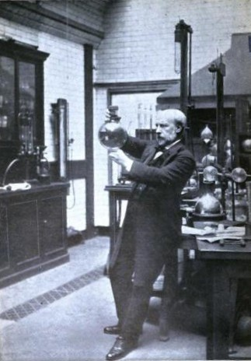
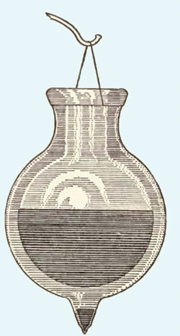
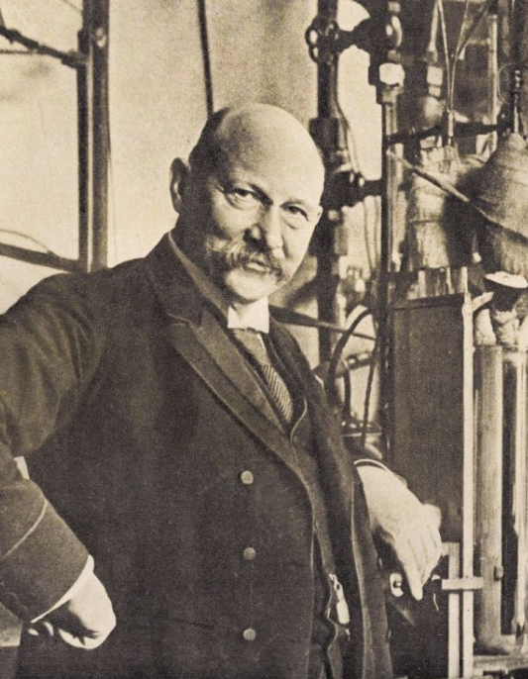
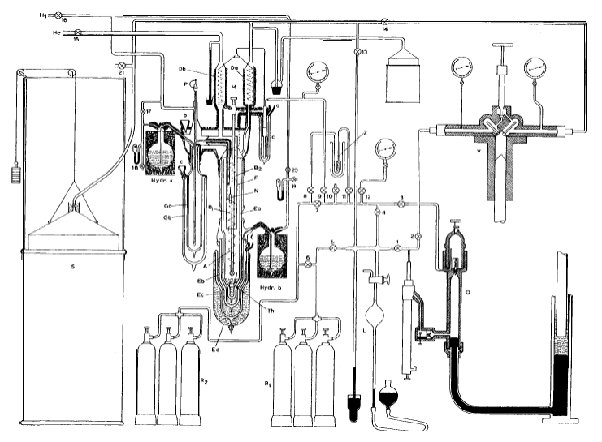
A bit of History
Cryostat (from cryo meaning cold and stat meaning stable): “a device used to maintain at cryogenic temperatures samples or devices mounted within the cryostat”
Sir James Dewar invents the “dewar”, 1892, London
A dewar: the first “cryostat”
  silvered, double-walled, glass vacuum flask to contain cryogenic liquids → glassblowing “enabling technology”
  J.Dewar: 1st liquefaction of H₂ in 1897
  …but did not manage liquefaction of He, and did not “patent” his invention…
Heike Kamerlingh Onnes : 1st liquefaction of He in 1908 and serendipitous discovery of superconductivity (Hg) in 1911 (Nobel Prize 1913)
Founded the “Leidse Instrumentmakersschool” (still existing!: https://www.lis.nl/ )
Sir James Dewar (1842-1923)
dewar
Helium liquefaction stage with liquid hydrogen precooling
Kamerlingh Onnes (1853-1926)

Slide 4
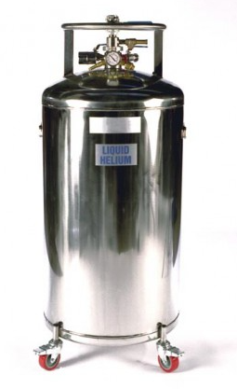
Cryostats by their application
Cryostats
Liquid storage/transport
SC devices for accelerators
Test cryostats
Accelerator devices
SC devices for medical applications
Commercial vertical test cryostat
SC magnet cryostats
SCRF cavities cryostats
Specific test cryostats
Transfer Lines
Industry, medical applications, research science
Valve Boxes
240l LHe storage
«Cryostats»
«Cryomodules»

Slide 5
Cryostat Design for SC devices for accelerators/test facilities:
A multidisciplinary activity
Heat Transfer
Applied
Superconductivity
Mechanics
Cryostat
Design
System
Integration
Cryogenics
Vacuum

Slide 6
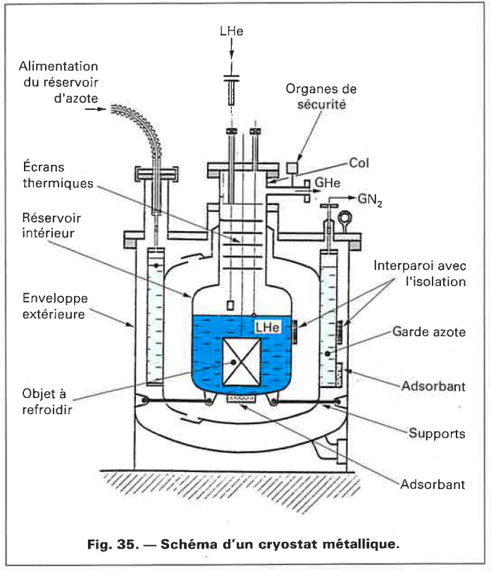
Helium cryostats
As a minimum:
Helium tank (containing or not a SC device)
Supporting system of the helium tank
Thermal shielding: actively cooled with MLI
Vacuum vessel
Overpressure safety devices
External supporting/adjusting system
Additional:
SC device powering feedthroughs (current leads, RF Fundamental Power Coupers)
Instrumentation feedthroughs
Cryogenic ancillaries (valves, ph.separators, control instrumentation, heaters etc.)
CRYOGENIE, SES APPLICATIONS EN SUPRACONDUCTIVITE, IIF/IIR 1995, Techniques de l’ingenieur.

Slide 7
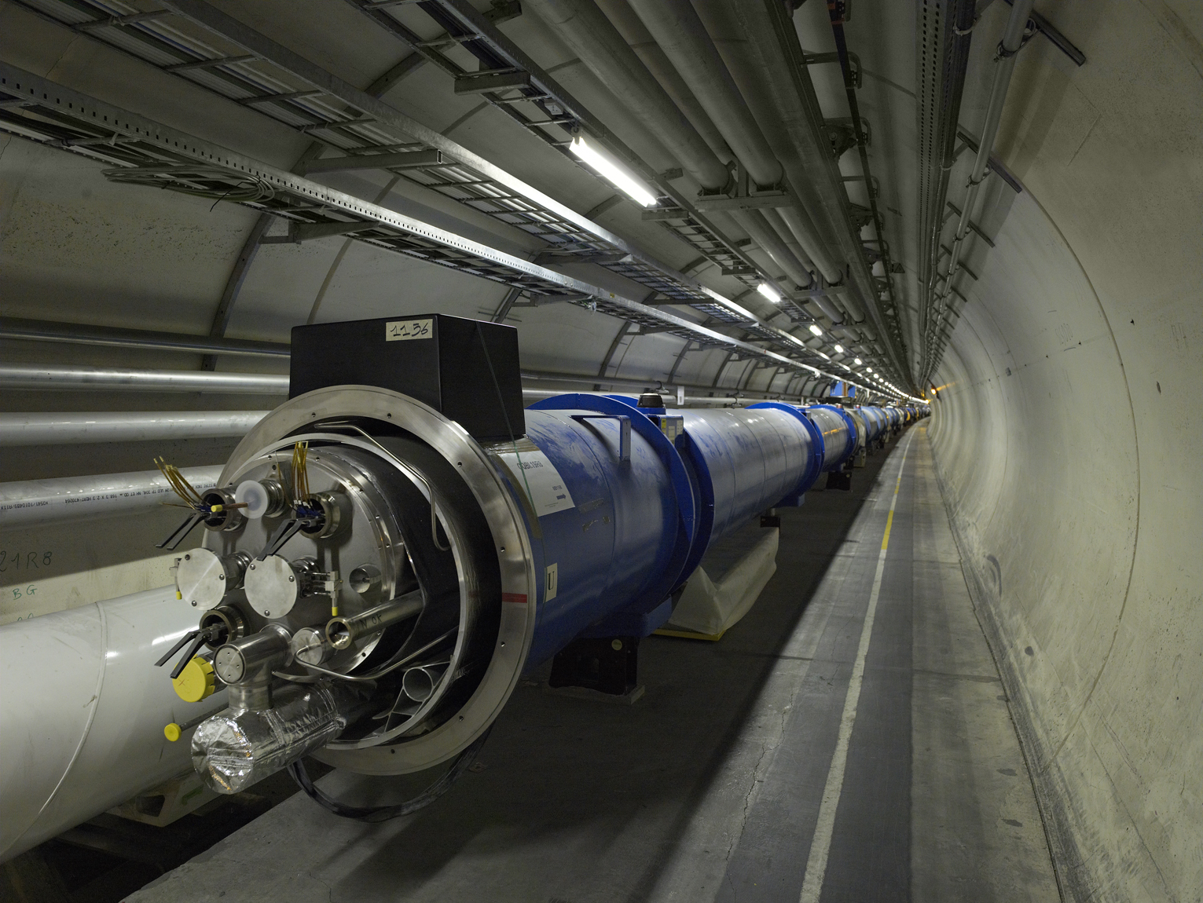
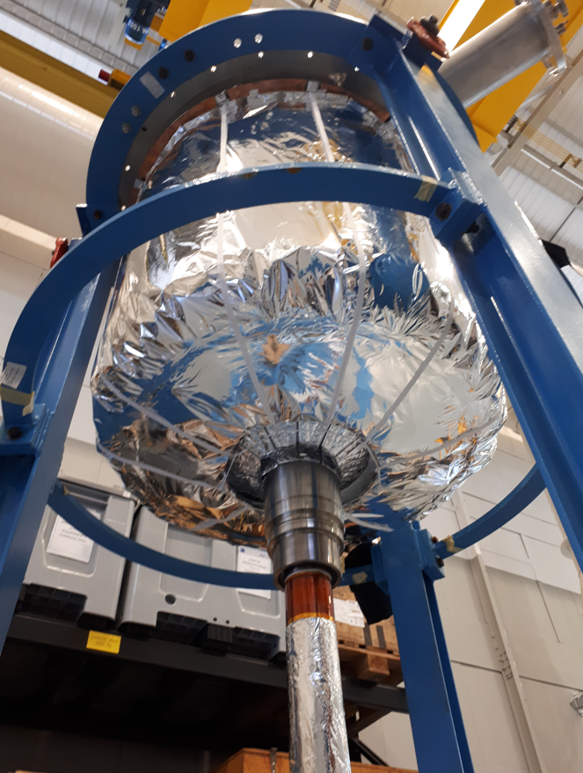
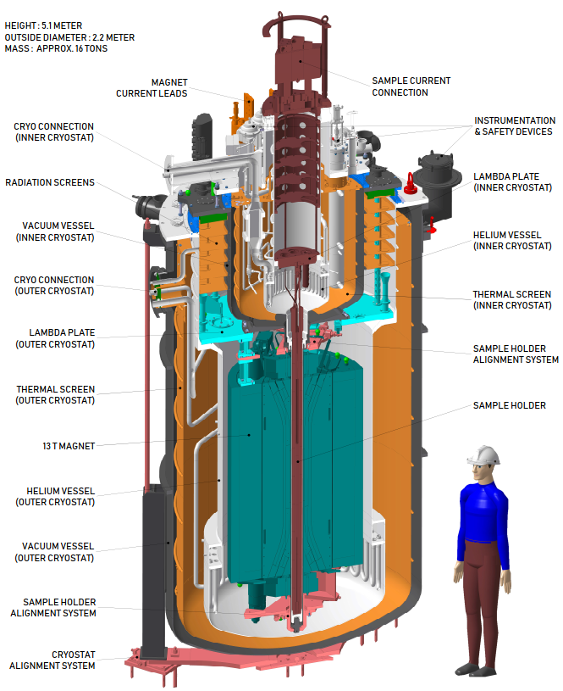
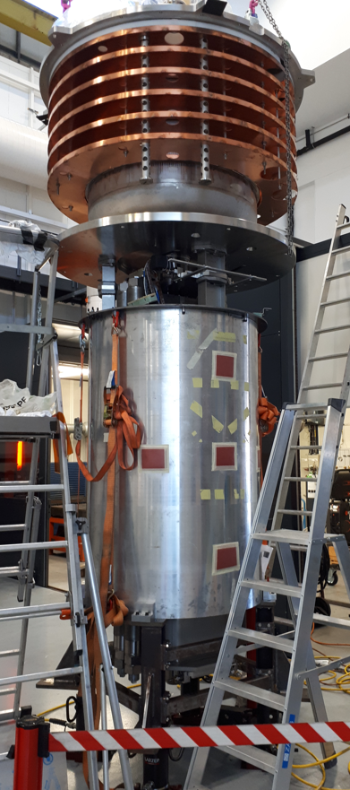
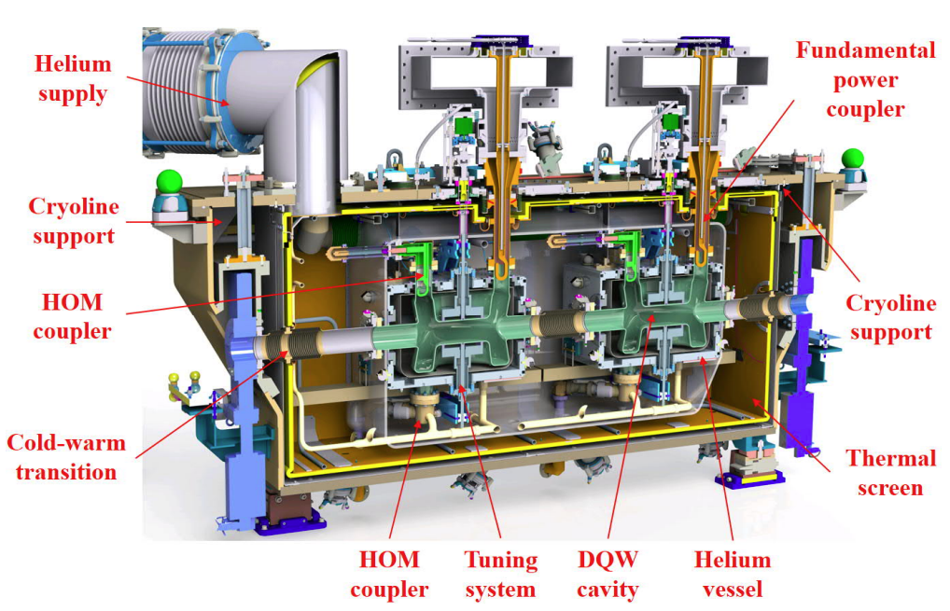
A few examples at CERN
Sample holder
The LHC cryostats
Fresca 2: test station for new SC cables critical current in High Field (~15 T)
HFM 13 T dipole
HL LHC Crab Cryomodule

Slide 8
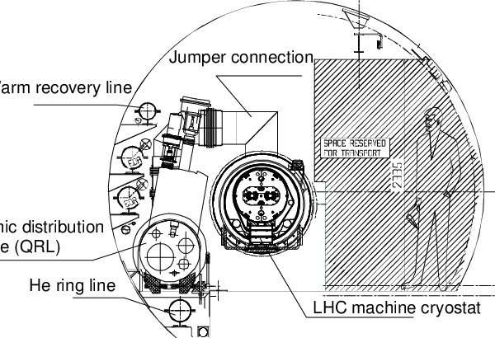
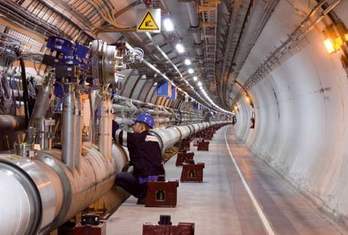
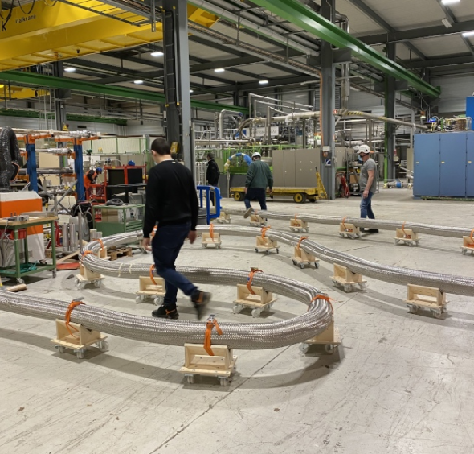
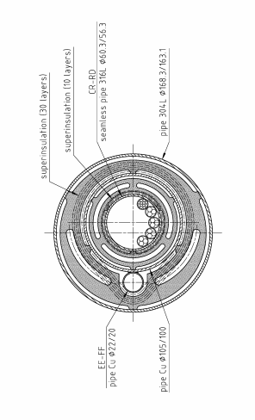
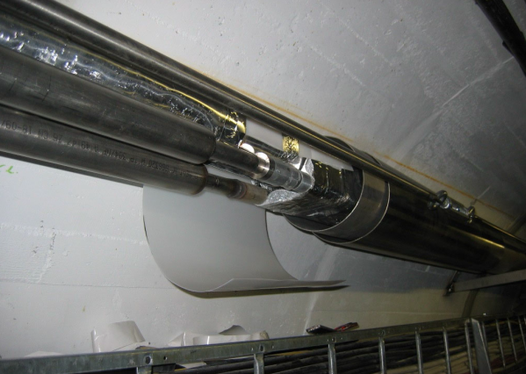
A few examples at CERN transfer lines, valve boxes
Rigid SC power line in LHC
Flexible SC power line for HL LHC

Slide 9
Main functions in Cryostats
1. Mechanical housing of the device:
  Supporting of device, positioning accuracy needs of device
2. Thermal efficiency:
  Allow cooling to cryogenic T_{op} : CD/WU
  Good thermal insulation during operation: steady state, static/dynamic heat loads
Often conflicting → calls for trade off design solutions

Slide 10
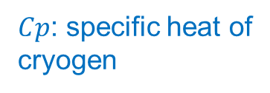
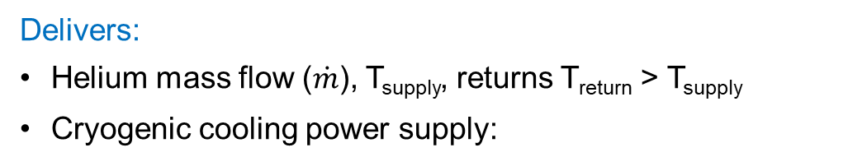






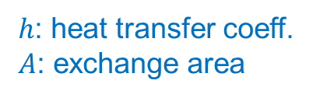
Cryostats and cryogenic operation
W_{el}
(plug power)
Cryoplant
SC device
(magnets or cavities in cryostats)
$$\text{T}\text{return}$$
$$\text{T}\text{op}$$
$\dot{Q}$(heat load)
T_{supply}
Cryogen transfer line
Delivers:
Helium mass flow ($\dot{m}$), T_{supply}, returns T_{return} > T_{supply}
Cryogenic cooling power supply:
Needs:
T_{op}, reached “conveniently” → transients
Cryogenic cooling power received:
$Cp$: specific heat of
cryogen
$$≥$$
$h$: heat transfer coeff.
𝐴: exchange area
$\dot{m} Cp (\text{T}\text{return}$- T_{supply})
$\dot{m} h A (\text{T}\text{op}$– T_{supply})
→ Cryostat designed to minimise Heat Loads from environment (T_{ambient})
→ Cryostat (and the SC device) designed to ensure cooling heat exchange

Slide 11
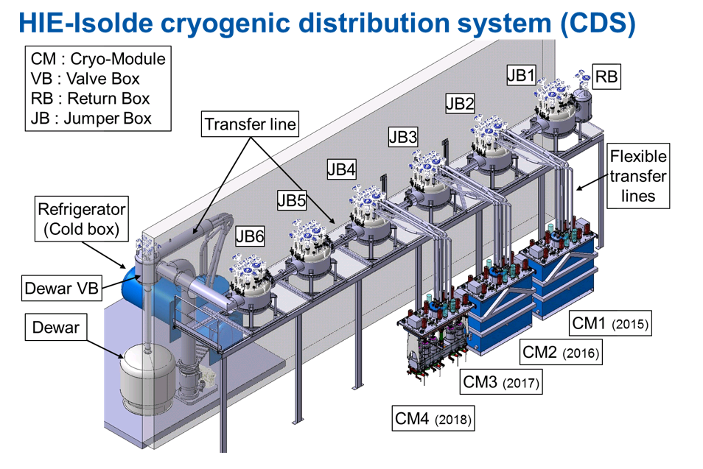
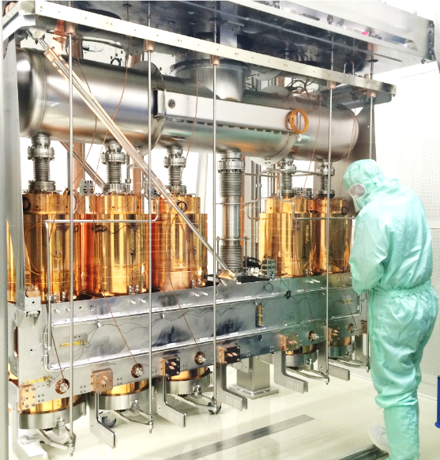
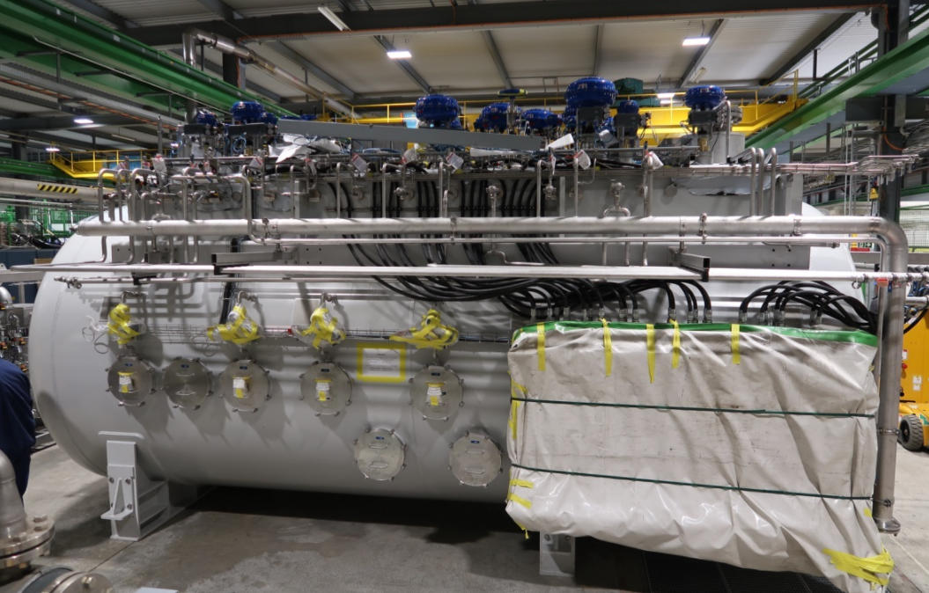
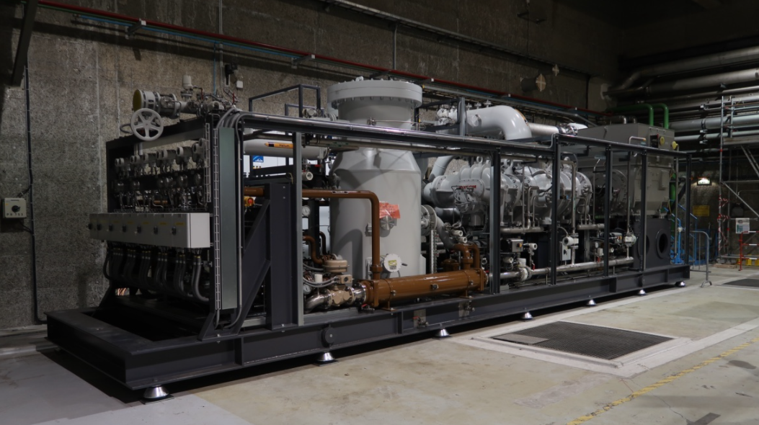
Example of HIE ISOLDE cryo system
Cryoplant
SC device
Cryogen transfer line
Linde 35 g/s coldbox
Warm compressor station (Mayekawa)
Inside a HIE Isolde Cryomodule

Slide 12
Positioning of SC devices

Slide 13
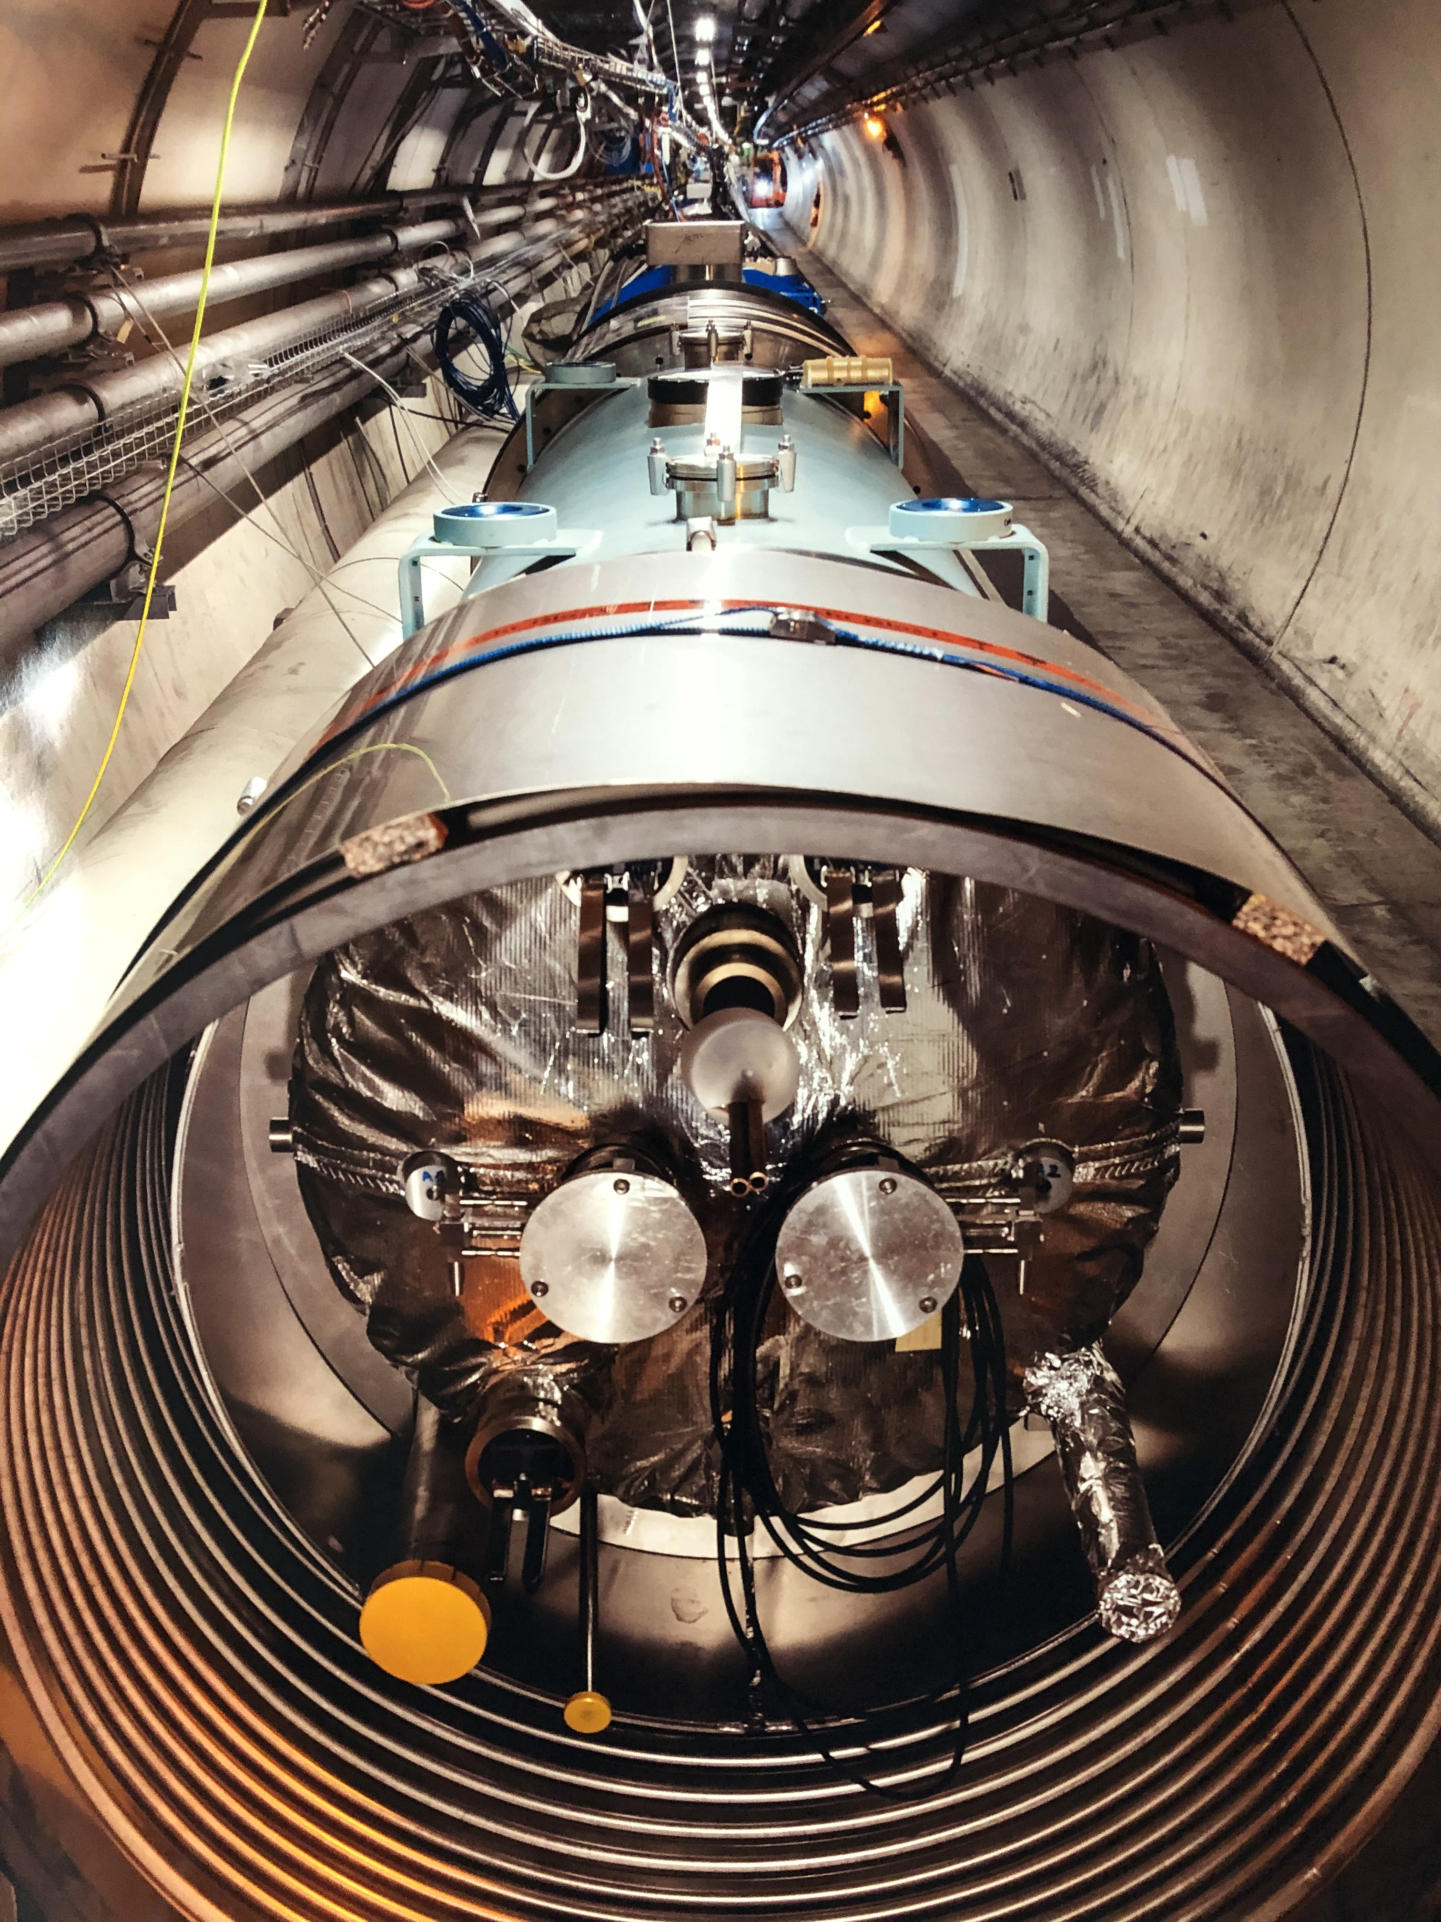
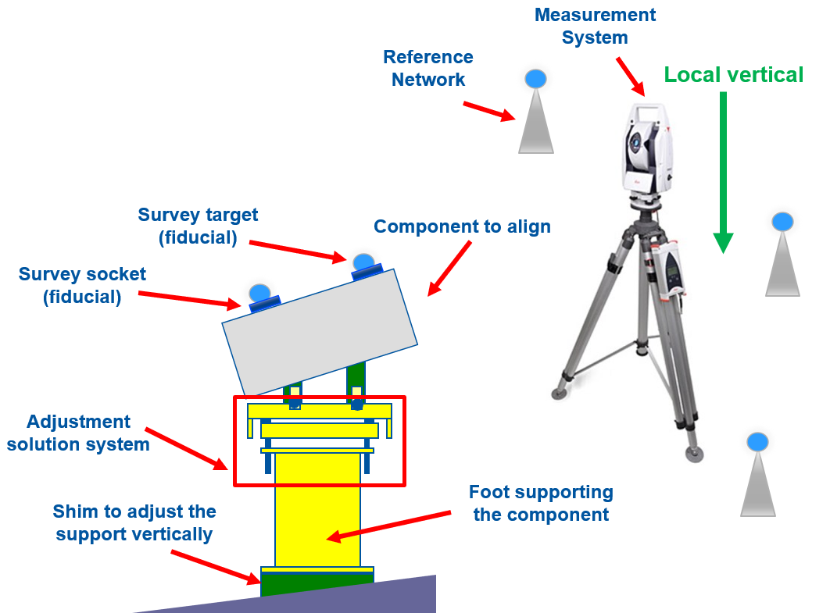
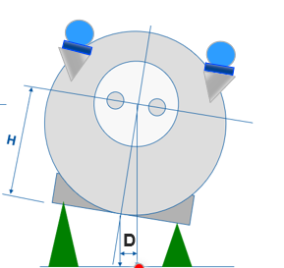
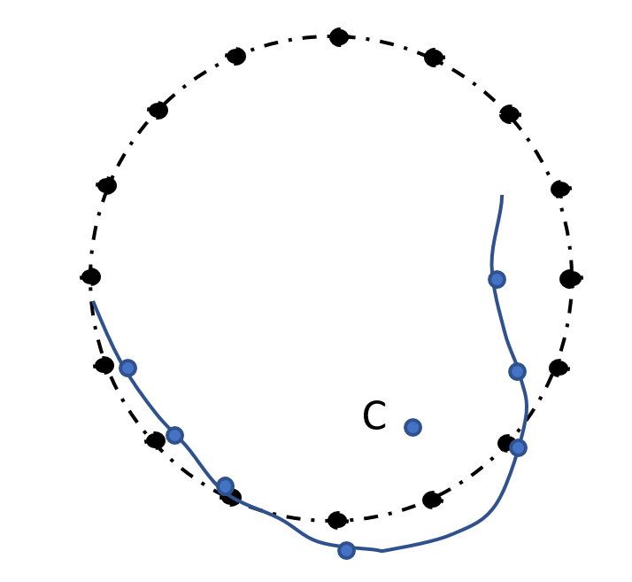
Positioning of a SC device in the accelerator
Accurate & reproducible alignment of the SC device w.r.t. a tunnel geodesic network
Survey team measures fiducials on the cryostat vessel (not directly the SC device inside the vessel!)
Typically, alignment within a few tenths of mm w.r.t. nominal positions
Laser-tracker
Alignment jacks
Aligning elements in a ring
Survey consider cryostat and SC device are rigid bodies !
Alignment is done by adjusting external jacks

Slide 14
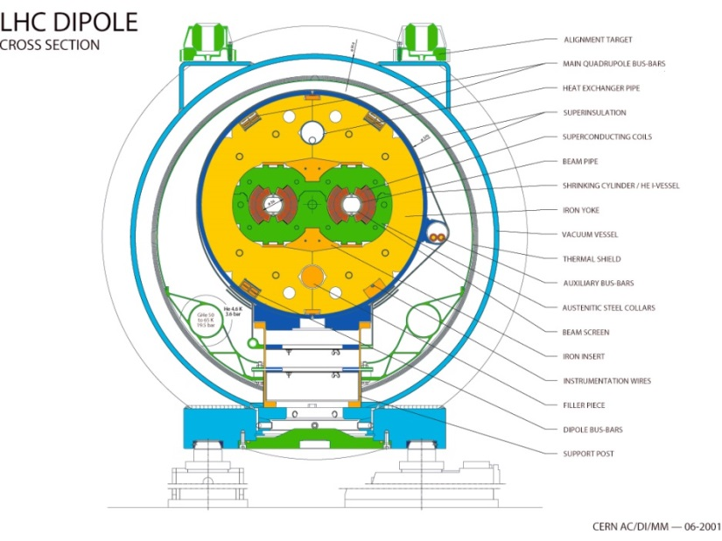
Reproducible positioning, a tough requirement !
Cryostats/SC device are not rigid bodies:
SC devices are “weakly” supported inside the cryostat (thermal efficiency!)
Cryostat vessels are (generally) “relatively” rigid, and not subject to “excessive” permanent deformation
SC device supporting system: designed to guarantee “accurate & reproducible positioning of the SC device w.r.t. to cryostat fiducials”
Main dipole
Note: internal monitoring excluded for cost reasons in large machines (LHC, XFEL, etc.)

Slide 15
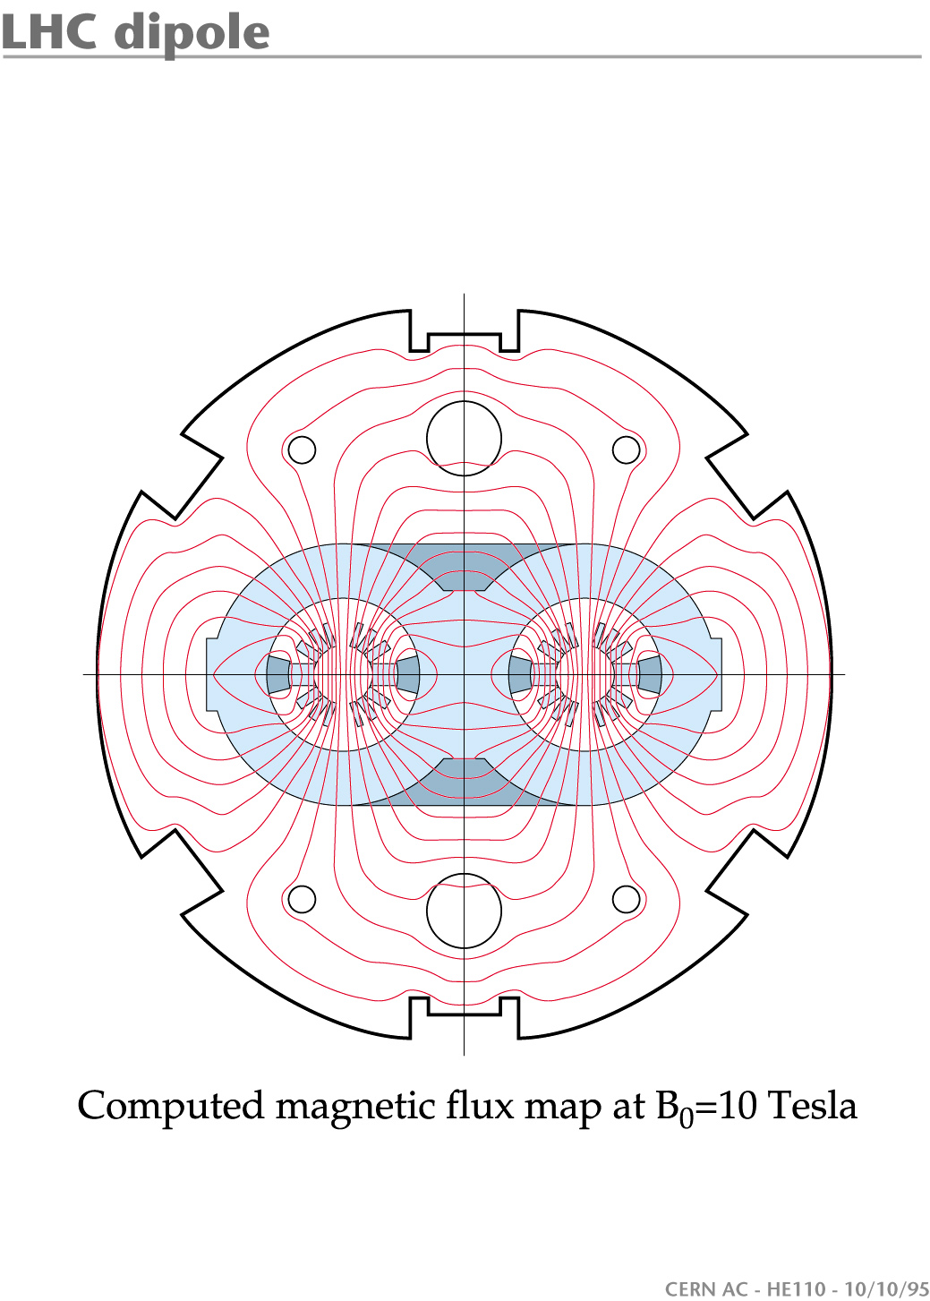
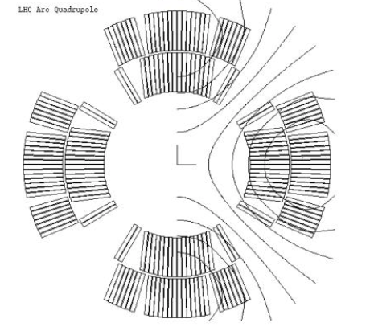
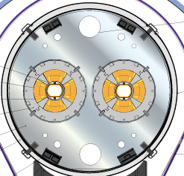
Positioning of magnets in cryostats: how accurate/reproducible ?
LHC dipole
Dipole magnet positioning:
  Transverse (x-z): tolerant (field has no horizontal axis). (LHC < 0.5 mm (rms))
  Roll (about y): sensitive (gives a kick out of orbit plane). (LHC < 0.5 mrad (rms))
Quadrupole magnet positioning:
  Transverse (x-z): sensitive (magnetic axis). (LHC < 0.25 mm (rms))
  Roll (about y): tolerant (LHC < 1 mrad (rms))
z
x
y
LHC quadrupole
z
x
y
Reminder: 1 mrad ~ 1mm/m (small angles)

Slide 16
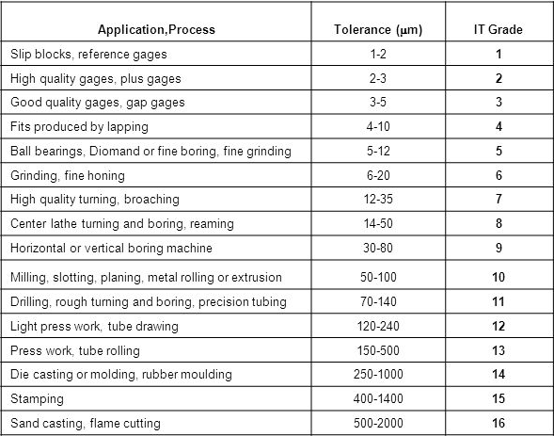
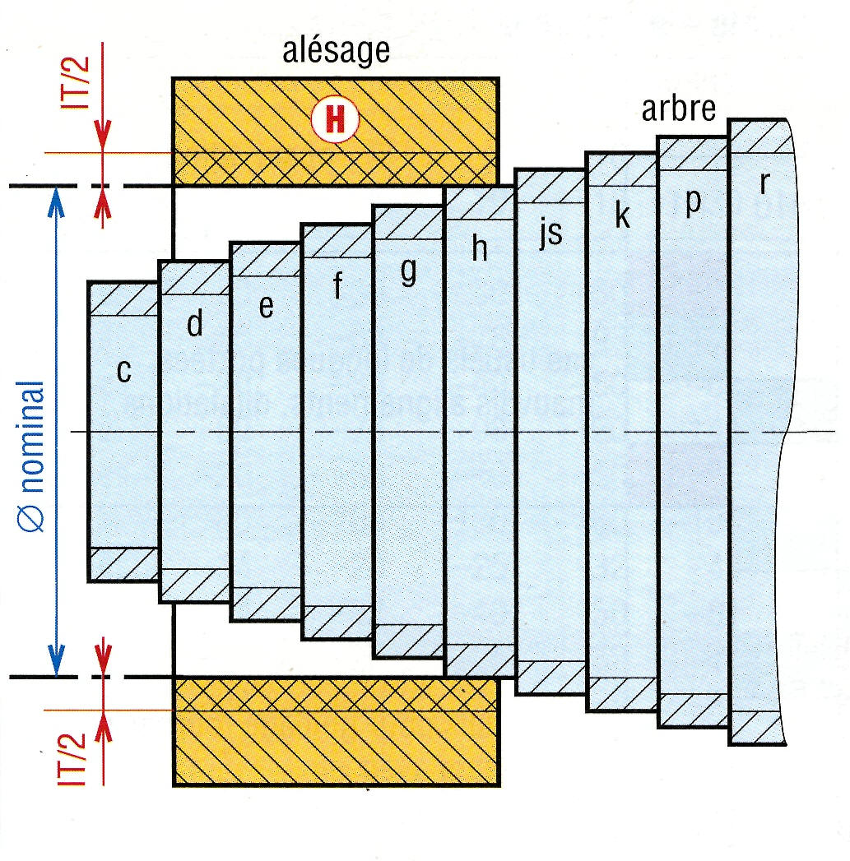
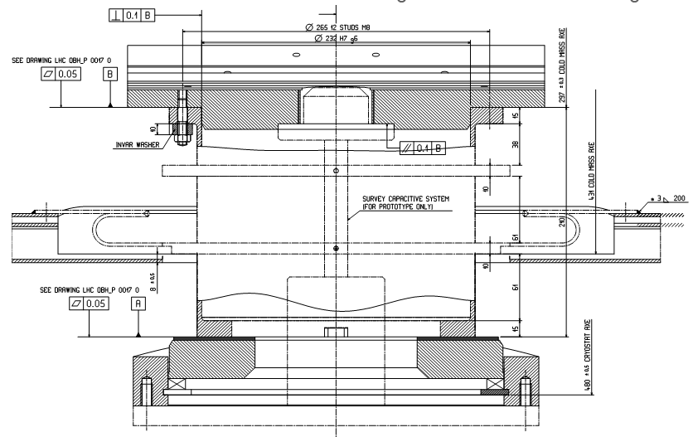
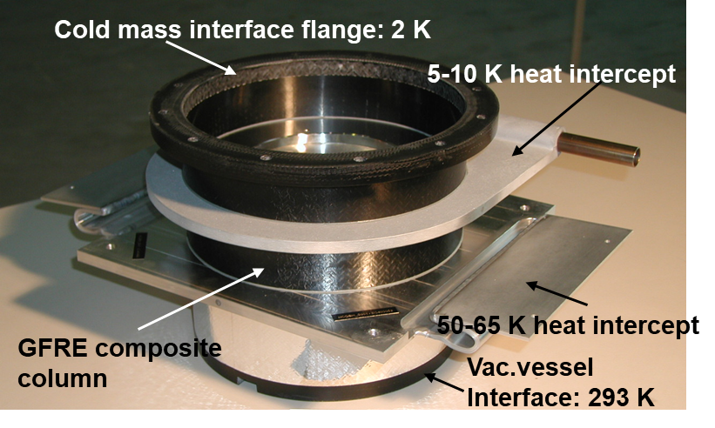
Mechanical tolerances for accuracy in cryostats parts/assembly
Positioning accuracy is ensured by precision fitting and adjustments at assembly
Typical machining IT Grade range: 8-10
Typical close fits: H7/g6
Main dipole
xc
xc
Central support post interfaced to vessel/coldmass
(232 H7/g6 → play: 15-90 microns )

Slide 17
Helium-4 cryogenics

Slide 18
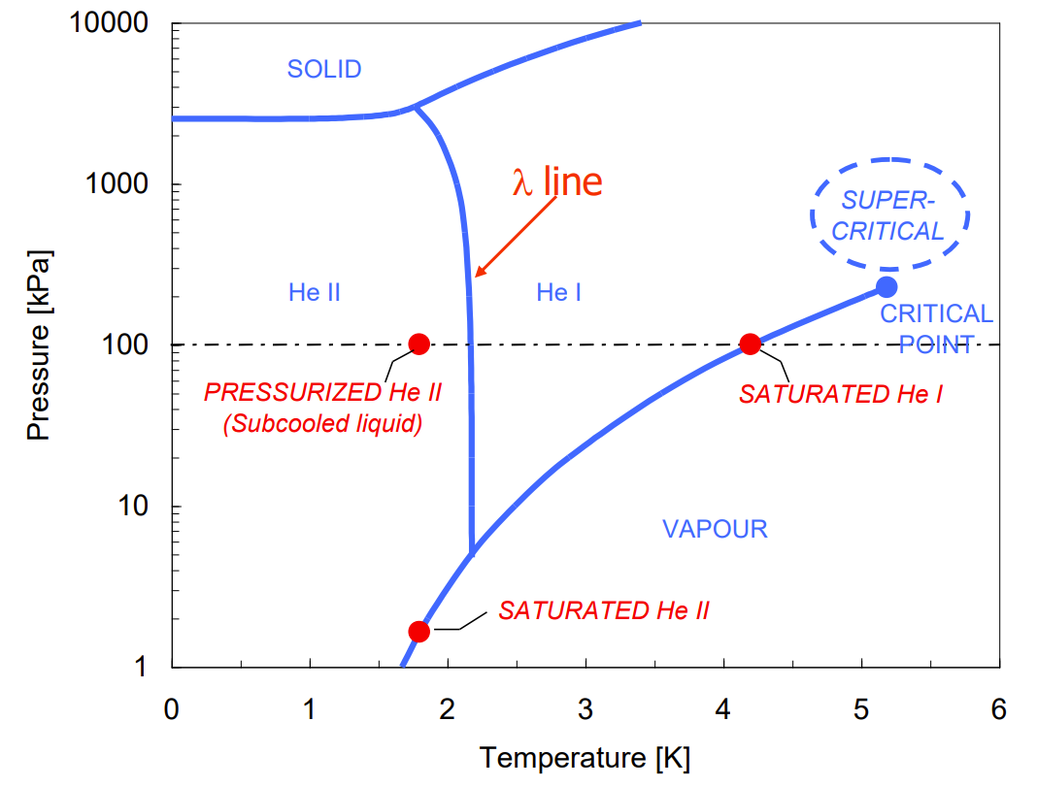
Helium phase diagram

Slide 19
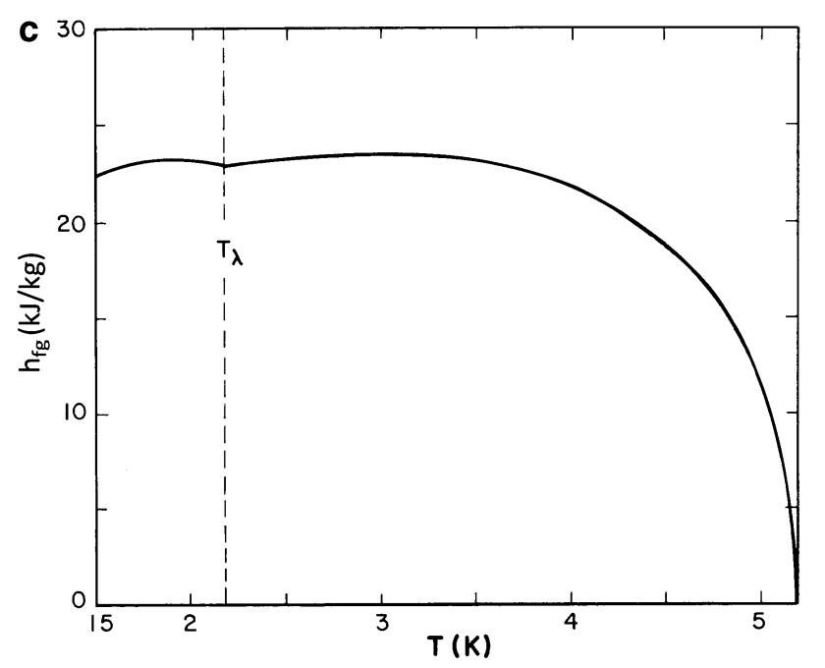
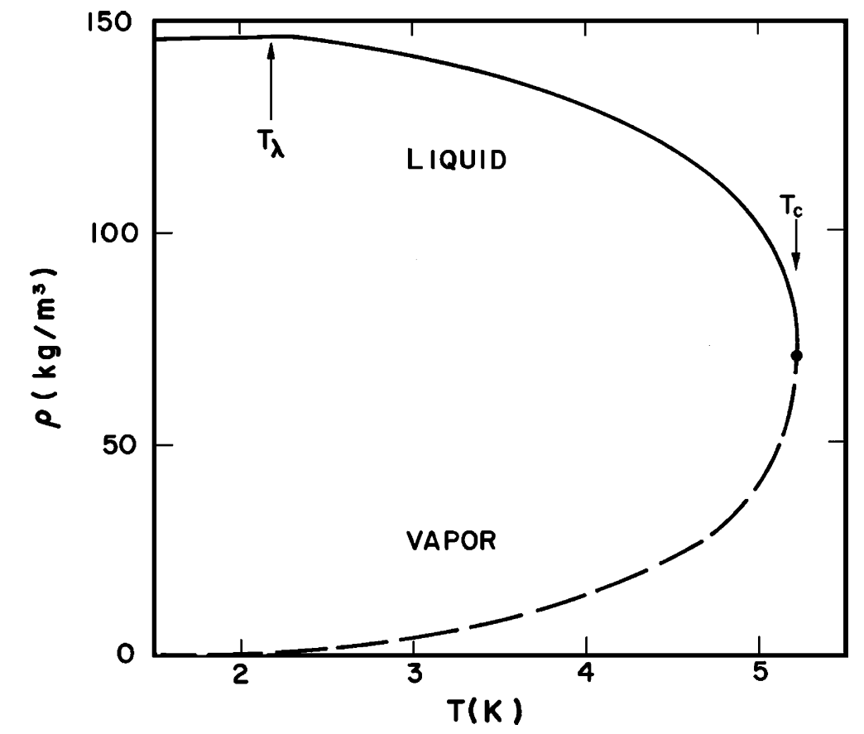
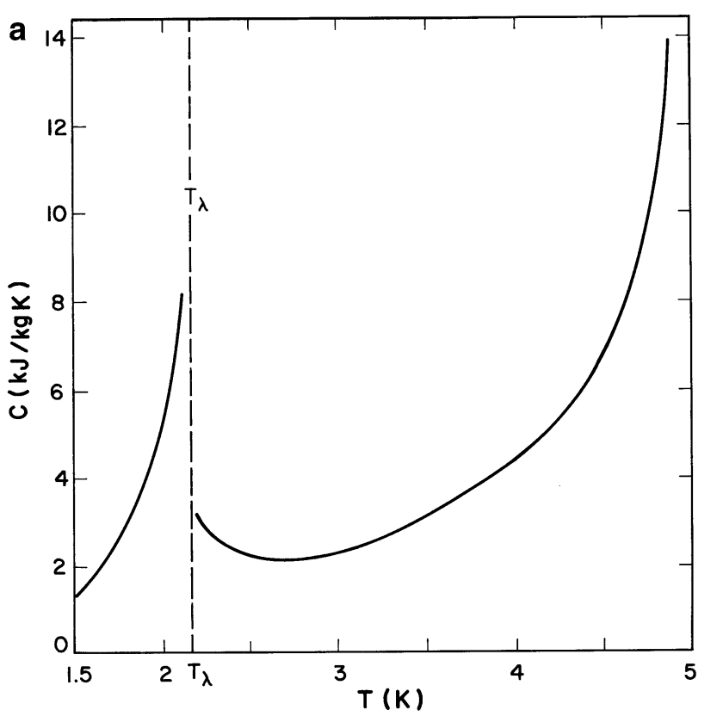
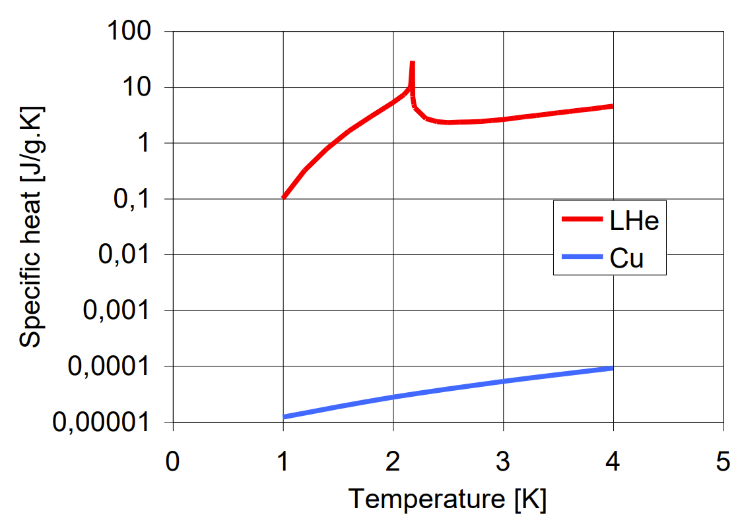
Thermophysical properties of interest in helium
Property | Units | ⁴He | N₂
Boiling T (at 1 atm) | K | 4.2 | 77.3
Critical temperature | K | 5.2 | 126.1
Critical pressure | 10⁵ Pa | 2.23 | 33.1
Latent Heat of evaporation (at 1 atm) | kJ/kg | 21 | 199
Enthalpy between T boiling and 300K | kJ/kg | 1550 | 233
Liquid density (boiling at 1 atm) | kg/m3 | 125 | 810
Saturated vapor density (at 1 atm) | kg/m3 | 17 | 4.5
Gas density (at 1 atm 273.15K) | kg/m3 | 0.18 | 1.25
Liquid viscosity (at boiling T) | μPa.s | 20 | 17
(ref. S. Van Sciver, Helium Cryogenics)
Latent heat of vaporization
Density of saturated liquid helium
Vaporisation under 1 W heat load
Cryogen | Latent Heat (at 1tm) [kJ/kg] | [mg/s] | [l/h] (liquid) | [l/min] (gas NTP)
Helium | 21 | 48 | 1.38 | 16.4
Nitrogen | 199 | 5 | 0.02 | 0.24
Specific heat of saturated liquid
~ 10⁵ times Cu per unit mass
(~ 2x10³ times Cu per unit volume)

Slide 20

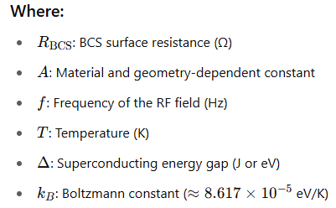
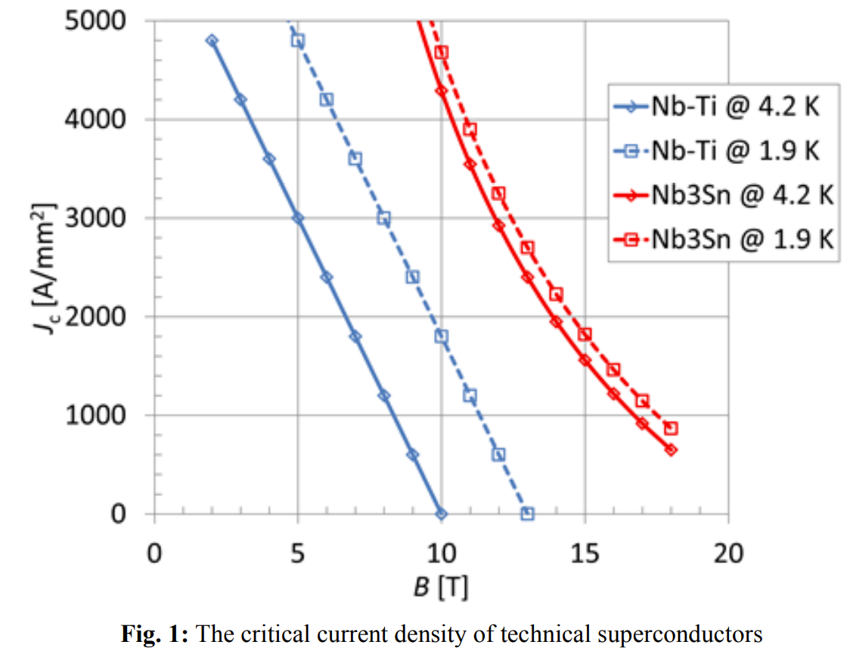
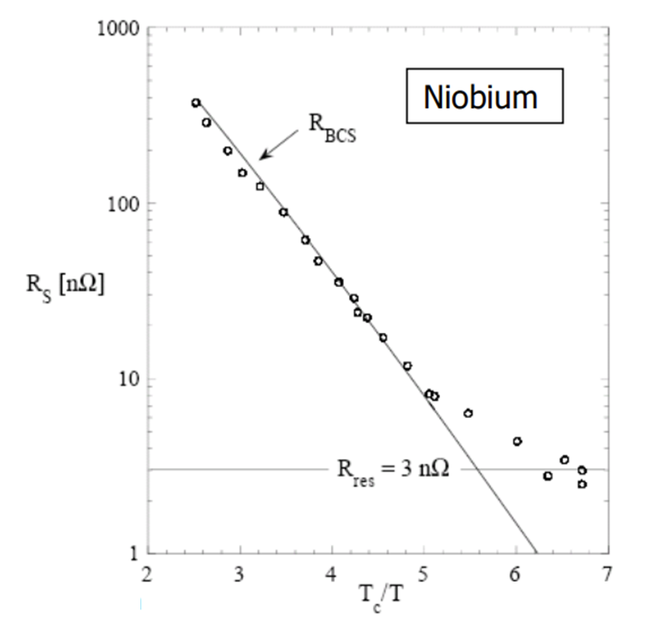
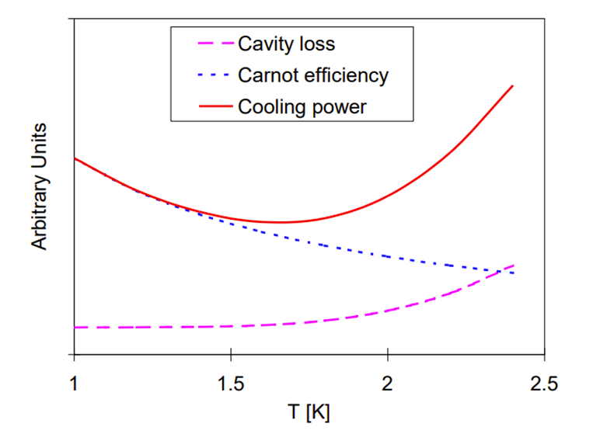
The interest of low T in SC applications (magnets and RF cavities)
SC magnets
SRF cavities
Boosting current-carrying capacity of NbTi at fields in excess of 8 T
Exponential drop of BCS losses with T/T_{c}, Carnot increase → optimum ~ 2K-4K range (depends on frequency and cavity technology) for accelerators

Slide 21
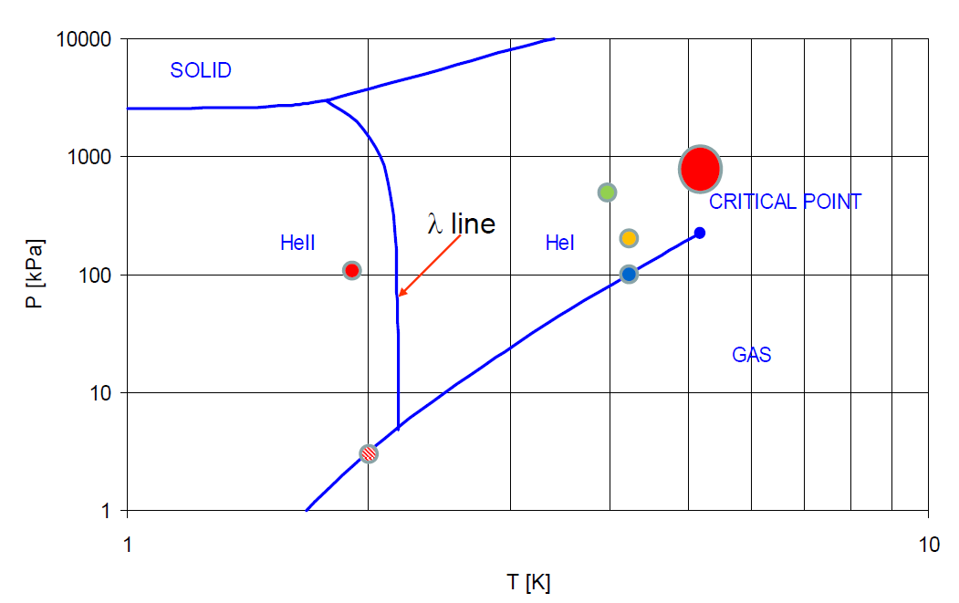
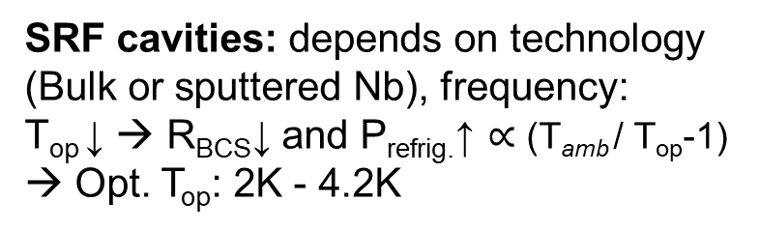
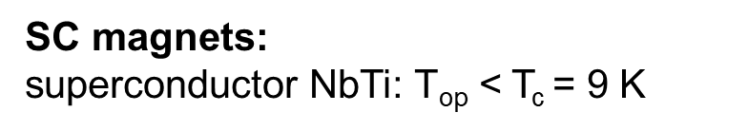
What temperature $\text{T}\text{op}$ (and pressure) for SC devices ?
SC magnets:
superconductor NbTi: $\text{T}\text{op}$ < T_{c} = 9 K
Phase diagram of helium-4 (⁴He)
1.9 K He II, Magnets (LHC, Tore Supra)
4.2 He I, Magnets (HERA, Tevatron)
P: > 1 bar (1.3-5 bar) for higher voltage breakdown (Paschen curve in He)
SRF cavities: depends on technology (Bulk or sputtered Nb), frequency:
$\text{T}\text{op}$↓ → R_{BCS}↓ and P_{refrig.}↑ ∝ ($\text{T}\text{amb}$/ $\text{T}\text{op}$-1) → Opt. T_{op}: 2K - 4.2K
(5.2 K, 2.27 bar)
(1.9 K, 1.3 bar)
Saturated He II (2K), CEBAF, SNS, EXFEL, ESS, PIP-II, ILC
Pool boiling, He I (4.2K), HERA, LEP, LHC, KEKB
(2.17 K, 49.7 mbar)
P: 31mbar / 1 bar (saturation line)
Thermal shields (∼50 K), heat intercepts (5-50 K):
Non-isothermal cooling (ΔT ~ 5-20 K)
→ supercritical helium
(1.8 K, 16 mbar)
(2 K, 31 mbar)
4.2 k

Slide 22
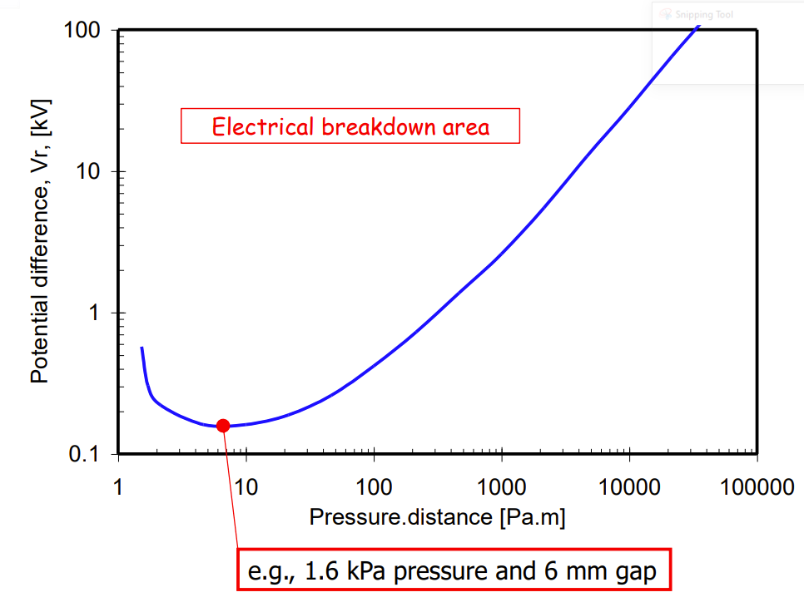
Paschen curve for gaseous He at 300 K
(Ref. Cooling with Superfluid Helium, Ph. Lebrun and L. Tavian, CERN)

Slide 23
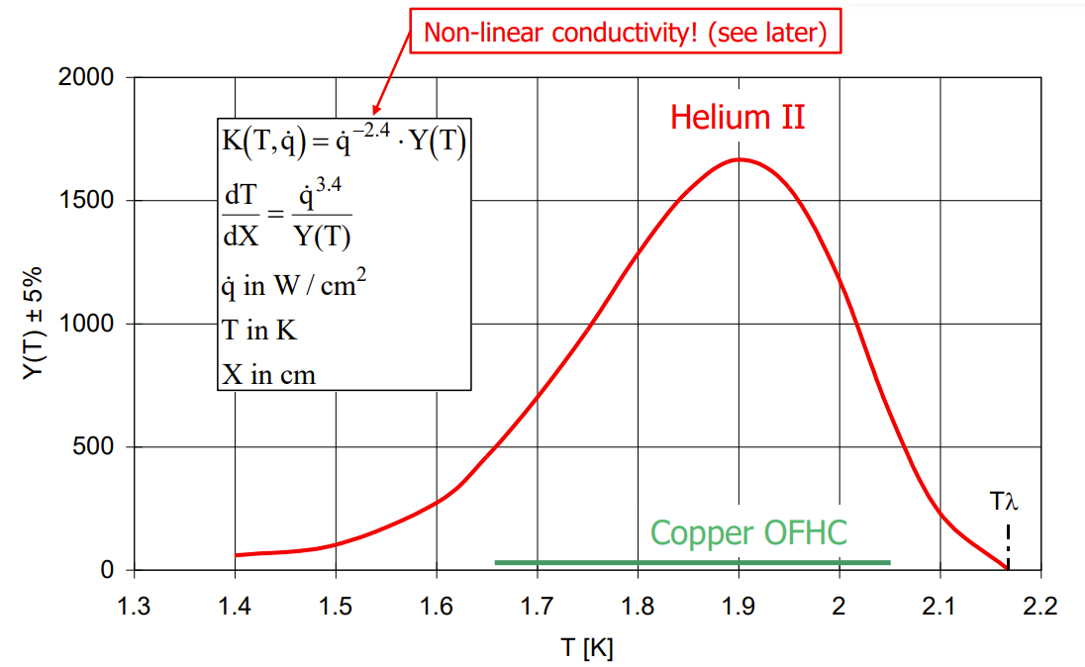
Enhancing heat transfer mechanisms in HeII
Low viscosity → permeation, better wetting of insulated superconductors
Very high specific heat → cryo stabilization of superconductors
Very high apparent thermal conductivity
  ~ x 10³ that of OFHC copper
  maximum at 1.9 K
  highly non-linear and heat flux dependent
Note: Y(T) for a heat flux of 1 W/cm-2
Ref. Practical data on steady state heat transport in superfluid helium at atmospheric pressure, G. Bon Mardion, G. Claudet, P. Seyfert. Cryogenics 19 (1979)
Ref. Cooling with Superfluid Helium, Ph. Lebrun and L. Tavian, CERN

Slide 24
References for thermophysical data on helium
REFPROP (by NIST) (can be downloaded on CMF), but does not cover the superfluid range. Covers several cryogenic fluids.
HEPAK (by CRYODATA), functions also available in Excel (HeCalc)
(contact person at CERN: B. Bradu, TE-CRG)
Parameter = HeCalc (Index, Phase, Input1, Value1, Input2, Value2, Unit)

Slide 25
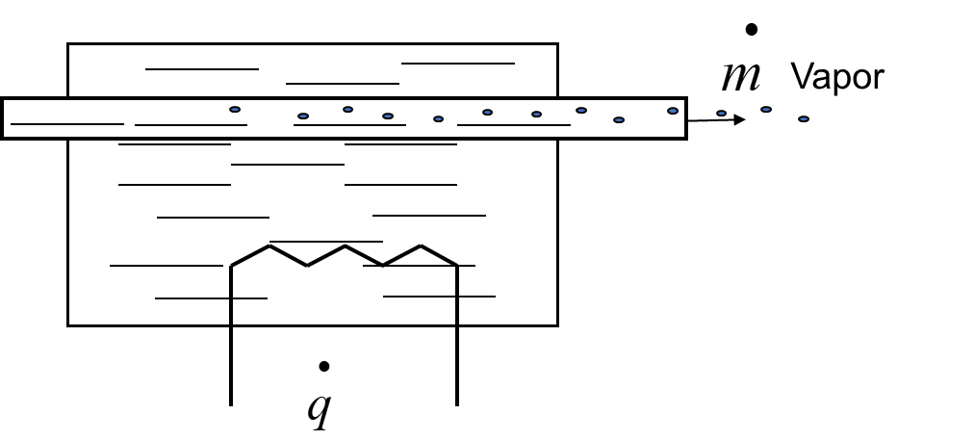

Two cooling mechanisms of interest
1. Vaporisation in 2-phase helium
  Latent Heat (Lv) of vaporisation
  Isothermal cooling (T constant if P constant)
Vaporisation under 1 W heat load
Cryogen | Latent Heat (at 1tm) [kJ/kg] | [mg/s] | [l/h] (liquid) | [l/min] (gas NTP)
Helium | 21 | 48 | 1.38 | 16.4
Vapor
$$\overset{•}{q}=\overset{•}{m}⋅Lv$$
Pool boiling
(cavities)
Pressurize bath
with heat exchanged
(magnets)
2. Forced internal (tube) convection of single-phase fluid:
  Non-isothermal cooling: enthalpy change of fluid (c_{p} assumed constant)
  Used in cooling of thermal shields
T_{in}
T_{out}
U

Slide 26




He II in vertical test cryostats
High Filed Magnet test cryostat
Very complex tightness
of St.steel λ plate
High HL to HeII
solved with Teflon seal
Steel λ plate
steel flange seat
(HeII volume = 5.6 m3)

Slide 27





Refrigeration power and efficiencies
Extracts a heat load at Tc < RT and rejects it at Tw (normally ambient T=293 K)
Minimum mechanical work (i.e. Maximum Coefficient of Performance, COP_{max}), depends solely on Tw and Tc
Tw
Qw
1st and 2nd laws of thermodynamics
Work (W_{el})
$$Qc+Wel=Qw$$
Qc
$$\frac{Qw}{Tw} ≥\frac{Qc}{Tc}$$
Tc
$$Wel ≥Qc \frac{Tw−Tc}{Tc} =\frac{Qc}{\text{COP}\text{max}}$$
$$\text{COP}\text{max} \text{(}\text{Carnot}\text{)}= \frac{\text{Tc}}{\text{Tw}\text{−}\text{Tc}}$$
Real machines (irreversibilities) : efficiency expressed in fraction (or %) of Carnot
State-of-the-art figures for large cryo-plants (LHC-like, ~18 kW @ 4.2K):
  COP @ 2 K : ~ 15% of Carnot (1 W_{th} costs 990 W_{el})
  COP @ 4.2 K : ~ 30% of Carnot (1 W_{th} costs 210 W_{el})
  COP @ 50 K : ~ 30% of Carnot (1 W_{th} costs 16 W_{el})
($\text{COP}\text{max}$ @ 4.2 K = 0.014)
→ To minimize cryostat refrigeration costs: heat extraction at higher T levels:
  Heat intercepts at higher T on all conduction feedthroughs (at least one)
  Actively cooled thermal shield (capture thermal radiation at ~50 K)

Slide 28

Heat Loads
Static:
    Very much cryostat related (supports, shielding, feedthroughs, etc.)
    always present when machine is cold
Dynamic:
    SC device operation (e.g. RF surface resistive heating)
    Beam interaction (e.g. synchrotron radiation, HOM)
    Can be dominant, but only present during machine operation (duty cycles)
3 heat transfer mechanisms:
    Convection → vessel under vacuum (~10⁻⁶ mbar) → negligeable
    Radiation → sizeable !
    Solid conduction → sizeable !
RF surface resistive heating

Slide 29
Thermal radiation

Slide 30







Thermal Radiation
Stefan-Boltzmann’s law:
$$σ=5.67 {10}^{−8} W m^{−2}{ K}^{−4}$$
Stefan-Boltzmann’s constant
Q $=ε σ {A T}^{4}$
$$gray body, ε<1$$
$Power exchange between gray bodies$:
E, effective emissivity, a function of view factors and emissivity $ε1$and $ε2$of the bodies
A, T area and temperature of the bodies, 𝜀 emissivity
$$Q_{1−2}=E12 σ A1\left({T_{1}}^{4}−{T_{2}}^{4}\right)=E21 σ A2\left({T_{1}}^{4}−{T_{2}}^{4}\right)$$
For 2 enclosed cylinders or spheres (not necessarily concentric!), F₁₂=1 :
$$q_{1−2}=\frac{σA1(T1^{4}−T2^{4})}{\frac{1}{ε1}+\frac{A1}{A2}\left(\frac{1}{ε2}−1\right)}$$
A1
A2
Radiation between flat surfaces (A1=A2=A), F₁₂=1 :
T1
T2

Slide 31



Radiation with an intermediate floating shield(s)
With 1 intermediate floating shield and same ɛ :
$$q_{1−2}=\frac{σ A (T1^{4}−T2^{4})}{2(\frac{2}{ε}−1)}$$
${\text{T}\text{s}}^{4 }$= $\frac{{T_{1}}^{4}+{T_{2}}^{4}}{2}$
Ts
→ ½ of the power exchange without shield
T1
T2
…
With N intermediate floating shield and same ɛ can be generatized:
1
…N
$$q_{1−2}=\frac{σ A (T1^{4}−T2^{4})}{(N+1)(\frac{2}{ε}−1)}$$
→ 1/(N+1) of the power exchange without shield

Slide 32

N shields → Multi Layer Insulation (MLI)
T
Tw
T_{ext layer}
Insulating mechanism:
Multi-layer to enhance radiation protection:
  N+1 radiation shielding
Low emissivity of aluminium layer
Minimal thermal conduction between reflective layers → interposing of isolating layers (e.g polyester net):
Enhanced performance at low T → use actively cooled shield:
  Lower emissivity of reflective material layers at low T
  Extract heat at higher thermal shield T → thermodynamic efficiency
Tc
x
Tw
Tc < Tw
Warm wall
Colder wall (actively cooled
thermal shield)
Q_{c}
Interleaved reflectors and spacers
Q_{r}
Actively cooled (50-80 K range) thermal shield with MLI is a must in all cryostats
Reflective film
Insulating spacer

Slide 33


MLI performance
Typical values (for a thermally well optimized large-scale application like LHC) :
  293 K to 50 K thermal shield with 30 MLI layers: → ~1 W/m² (take 1.5 W/m² for preliminary design)
  50 K to 2 K magnet with 10 MLI layers: → ~ 50 mW/m² (take 75 mW/m² for preliminary design)
LHC MLI Features:
1 blanket (10 reflective layers) on cold masses (1.9 K)
2 blankets (15 reflective layers each) on Thermal Shields (50-65 K)
Reflecting film: 6 µm thick polyethylene teraphthalate (PET) film coated with 400 Å minimum aluminium on each side
Spacer: polyester net of very low weight (< 5 g/m2)
Stitched Velcro™ fasteners for rapid mounting and quality closing
1 blanket on CM, 2 on thermal shield
MLI on Cold-to-Warm
transitions

Slide 34









MLI application: sound practice for performance
Thermal path warm to cold layers
Handle MLI with gloves
(fingerprints are a black body!)
loose at RT
(MLI contracts more than metal support)
T_{hot}
Velcro TM
Reflective layer
T_{cold}
T_{hot}
T_{cold}
Some tapes are
resin coated = black body !
Check conductivity
Not tool much MLI
(risk of thermal shorts)
(images: courtesy of Meyer Tool & MFG.)

Slide 35

Heat Loads in 1 m length
LHC magnet Cryostats
Static Heat Loads:
  0.25 W/m at 1.9 K
  5 W/m at 50-65 K
Heat exchange: 0.45 W/m at 1.9 K
Dynamic Heat Loads (resistive heating + beam induced effects):
  ~ 0.2 W/m at 1.9 K (magnet)
  ~ 0.15 W/m at 4.6-20 K (beam-screen)
Thermal radiation from vacuum vessel at room temperature (293 K) to thermal shield (50 K)
Thermal radiation from thermal shield (50 K) to magnet (1.9 K)
Heat extraction: 5 W/m at 50 K
Refrigeration power (for 1 m cryostat)
0.05 W per support
Heat extraction: 0.15 W/m at 10 K
0.5 W per support
7 W per support

Slide 36



Feedthroughs in cryostats and heat intercepts
Solid conduction paths:
Supporting systems
Current leads
RF main coupler
Instrumentation feed-throughs
Beam tubes Cold-to-Warm (CWT) transitions
…
LHC Main dipole
Magnet Support Posts (GFRE)
Current leads
LHC instrumentation capillary at assembly
CWT SPL cryomodule
SPL cryomodule
LHC Quadrupole cryostat
Vertical cold magnet test cryostat

Slide 37
Thermal conduction

Slide 38

Thermal Conduction
Tc
Tw
ΔT in a body → heat transfer from the high T to the low T (Fourier Law):
For one-dimensional problems (ex. a bar or tube):
k is the thermal conductivity (W m⁻¹ K⁻¹), normally a function of P,T, material structure, non-homogeneity, anisotropy (ex. Composite materials).
k is strongly T-dependent and non-linear at low T
6 orders of magnitude !
“good conductors” vs. “poor conductors” → k range ~ 5-6 orders of magnitude

Slide 39

The conduction equation (unidirectional case)
(Fourier law of heat conduction)
(change of internal energy)
Longitudinal
conduction
Internal
heat
generation
Thermal
inertia

Slide 40

No heat deposition and steady-state
with boundary conditions:
x=0, T=T₀
X=L, T=T_{L}
If k constant with T:
If k = k(T):
T₀
$$\dot{q}$$
T_{L}
L
(Linear solution)
Thermal conductivity
Integral (conductance)
T
For metal alloys (ex.steels) at low T:
T₀
T_{L}
(quadratic solution)
L
x

Slide 41

Thermal conductivity integrals (conductance) for some materials [W/m]
4.2K
Tw
$$Qc=\frac{A}{L}⋅\int_{4.2K}^{Tw}{k(T)dT}$$
Qc
Highest T (Lowest T =4.2 K) | 20 K | 80 K | 290 K
OFHC Copper | 11000 | 60600 | 152000
DHP Copper | 395 | 5890 | 46100
Aluminium 1100 | 2740 | 23300 | 72100
Aluminium 2024 | 160 | 2420 | 22900
Stainless steel AISI 304 | 16,3 | 349 | 3060
Typical Glass-fiber/Epoxy Composite G-10 | 2 | 18 | 153
x 1000
x 20
Cryogenic Materials Data Handbook: Durham et al. C13.6/3.961; MetalPak: computer code produced by CryoData http://www.htess.com/software.htm ; CryoComp: computer Code produced by Eckels Engineering http://www.eckelsengineering.com/ ; Proceedings of the International Cryogenic Materials Conferences (ICMC)

Slide 42

Thermal conduction with uniform heat deposition
t
To
x
Beam of length L, thickness t, width w (= 1m);
beam thermalized on one side at To
uniform heat deposition from one side, q (W/m²)
considering k constant with T
Boundary conditions: a) for x= 0 T=To (heat sink); b) q=0 for x=L (isolated tip)
Integrating and imposing the 2 boundary conditions:
T
T_{L}
T₀
L
practical interest:
calculate minimum thickness to limit ΔT_{max}
$$t=\frac{q⋅{L^{2}}^{}}{2⋅k⋅ΔTmax }$$
x

Slide 43



Exercise: calculate a thermal shield thickness in an LHC-type cryostat
L, $ΔTmax$
q
$$tmin=\frac{q⋅L2}{2⋅k⋅ΔTmax }$$
q_{x}(x)
Symmetry: point opposite of cooling line is an isolated tip
Diameter thermal shield: 0.75 m → A_{s}= π x 0.75 x 1 = 2.35 m²
Take ½ shield: L = $\frac{1}{2}\frac{As}{1 m }$ = ½ 2.35 m = 1.17 m
Uniform heat deposition (previous exercise): $q= \frac{\text{q}\text{shield}}{As}$ $=\frac{2.55 W}{2.35 m2}=1.08 W/m2$
Let’s set the maximum $ΔTmax$ = 5 K
Take k aluminium (Al6061) at ~80 K: 85 W/(K m)
t_{min} = 1.7 mm
As, Ts ɛs
q_{shield}
Ae, Te , ɛe
Remark:
If thermal shield in Cu alloy (e.g. CuNi70-70)→ k= 37 W/(K m) → t = 0.74 mm …too thin sheets for mech. stability

Slide 44
Heat intercepts (heat sinking) at intermediate temperatures
Tw=293K
simple solid conduction
A
L
Tc=2K
1 heat intercept at optimal distance
L₁
A
Q @ 80K
L
→ L₁
2 heat intercepts at optimal distance
L₁
A
Q @ 80K
L₂
L
Q @ 10K
C1, C2, C3, COP at relevant T
→ L₁, L₂

Slide 45


LHC supports
Cold mass interface flange: 2 K
5-10 K heat intercept
Two intercepts, 5K & 75K
Minimizing using efficiency factors:
C₁ = 16 w/w @ 75 K
C₂ = 210 w/w @ 5 K
C₃ = 990 w/w @ 1.9 K
One intercept, 75K
No intercepts
50-65 K heat intercept
GFRE composite
column
Vacuum vessel
Interface flange: 293 K
>10 tons vertical compression load
4-mm thickness, glass-fiber epoxy
Manufactured by Resin Transfer Moulding (RTM):
  Suited to a large-scale industrial production (4’700 units)
  High reproducibility in thermo-mechanical properties

Slide 46





Vapour cooling in solid conduction
Vapor cooled wall
Assuming perfect exchange (T_{vapor} = T_{wall})
Tw
$$k(T)⋅A⋅\frac{dT}{dx}=\overset{•}{Q}bath+\overset{•}{m}⋅Cp⋅\left(T−Tl\right)$$
A
With $\overset{•}{Q}bath$the residual heat to the bath
If $\overset{•}{Q}bath$ is equivalent to the evaporation mass flow → self-sustained mode:
L
x, T(x)
$$\overset{•}{→Qbath=}\overset{•}{m}⋅Lv Lv, \text{latent} \text{heat} \text{of} \text{evap}\text{.}$$
$$\overset{•}{Q}bath=\frac{A}{L}⋅\int_{Tl}^{\text{Tw}}{\frac{k(T)}{1+\frac{\left(T−Tl\right)⋅Cp}{Lv}}}⋅d\text{T}$$
$$\overset{•}{Q}bath$$
@ T_{l}
Large enthalpy in He vapours (1550 kJ/kg from 4.2K to 300K) → usable cooling capacity
attenuation factor (w.r.t. solid conduction)
thermal conductivity integral (4K - 300 K) | Conduction [W.cm⁻¹] | Self-sustained vapour-cooling [W.cm⁻¹] | % Ratio
ETP copper | 1620 | 128 | 8%
OFHC copper | 1520 | 110 | 7%
Aluminium 1100 | 728 | 39.9 | 5%
Nickel 99% pure | 213 | 8.65 | 4%
Constantan | 51.6 | 1.94 | 4%
AISI 300 st. steel | 30.6 | 0.92 | 3%
Ideal values
Real case depends on how good the
heat exchange is

Slide 47



Application: Current leads and RF power couplers
Vapour/forced flow cooled current leads (conventional or HTS)
Vapour/forced flow cooled RF couplers external conductors
Cold flange (2 K)
Double-Walled Tube (DWT)
Inlet gas pipe (40 mg/s helium at 4.5 K)
Outlet gas pipe
Antenna
Waveguide
Warm flange (300 K)
SPL RF Coupler
CERN `LHC 13 kA HTS leads
Effectiveness:
Reduced static heat conduction
Partial intercepting of RF resistive heating
Regulation flexibility (stand by, RF power on)
Effectiveness:
Reduced static heat conduction
Partial intercepting of I²R resistive heating

Slide 48
Materials and mechanical design considerations

Slide 49
Typical breakdown of a SC device cryostat/cryomodule
Helium tank (for SC device, ph.separator, etc.):
  austenitic st.steels (Fe-Cr-Ni): 304L(1.4307), 316L(1.4404), 316LN
  titanium alloys (Grade 7, Grade-5 (Ti-6Al-4V)) in SRF
Internal (cold) supporting system
  Composites (e.g. GFRE, CFRP, ULTEM)
  St.steel, titanium alloys (tie rods)
Thermal shielding/MLI:
  aluminum alloys (series 5xxx, 6xxx, 7xxx)
  Copper (Cu OF, Cu OFE)
Vacuum vessel:
  Low carbon steels (e.g. DIN GS-21 Mn5)
  st.steels (304L)
Cryogenic piping and expansion joints (bellows):
  st.steel (304L)
  Cu (HX tubes)
Current leads (for SC magnets)
  Cu, HTS, st.steel, elect. insulating (Kapton), thermal insulating (G10),etc.
RF Couplers/HOM (for SRF):
  St.steel Cu plated, Nb, ceramics, etc.
Magnetic shielding (for SRF, as needed)
  μ-metal, Cryoperm®, etc.
Main dipole
basic components

Slide 50
Relevant mechanical failure mechanisms in cryostats
Helium tanks:
  Rupture (rare!) or permanent deformation due to excessive mechanical stress (pressure loads)
  Helium leaks in welds or material micro-crack
Cryogenic lines/expansion joints:
  Buckling of expansions joints with or without rupture/leaks
  Helium leaks in welds or material micro-crack
Vacuum vessels:
  Buckling under external pressure
  Permanent deformations due to excessive stress concentrations
Internal supporting systems:
  Failure due to excessive mechanical stress
  Failure due to thermo-mechanical stress
  Buckling under compressive load
Thermal shields:
  Permanent deformation due to thermo-mechanical stress (CD/WU transients)
Alignment jacks:
  Break of floor/fixations due to excessive load

Slide 51


Thermal expansion of some materials

Slide 52





Thermal stress in composite material assemblies: 3 cases
ΔT
A) Restrained component
$$ε=α⋅ΔT$$
$σ=$ $α⋅ΔT⋅E$
B) Assembly of different materials
ΔT
Material 1: α1, E1, A1
restrained
Material 2: α2, E2, A2
$$σ1=\frac{E1 E2 A2}{E1 A1+E2 A2}\left(α2−α1\right)⋅ΔT$$
$$σ2=\frac{E1 E2 A1}{E1 A1+E2 A2}\left(α2−α1\right)⋅ΔT$$
C) Different cooling ΔT₁(t) ≠ ΔT₂(t) (different material diffusivity or different cooling)
ΔT₁(t)
Material 1: α1, E1, A1
restrained
ΔT₂(t)
Material 2: α2, E2, A2
$$σ1=\frac{E1 E2 A2}{E1 A1+E2 A2}\left(α2 ΔT2−α1 ΔT1\right)$$
$$σ2=\frac{E1 E2 A1}{E1 A1+E2 A2}\left(α2 ΔT2−α1 ΔT1\right)$$

Slide 53

Pressure vessel codes regulations
Pressure European Directive 2014/68/EC (PED) is a legal obligation in the EU since 2002
  Applies to internal pressure ≥ 0.5 bar gauge
  Vessels must be designed, fabricated and tested according to the requirements defined
  Establishes the conformity assessment procedure depending on the vessel category, which depends on the stored energy, expressed as Pressure x Volume in bar.l
Category | Conf. assessment module | Comment
SEP | None | The equipment must be designed and manufactured in accordance with sound engineering practice. No CE marking and no involvement of notified body.
I | A | CE marking with no notified body involvement, self-certifying.
II | A1 | The notified body will perform unexpected visits and monitor final assessment.
III | B1+F | The notified body is required to approve the design, examine and test the vessel.
IV | G | Even further involvement of the notified body.
Pressure vessels
Article 4, paragraph 3
Vacuum vessels
For vessels with non-dangerous gases (cryogenic liquids are treated as gas)

Slide 54
Main take-aways from this talk
After more than 100 yrs since Dewars, cryostats are today conventional technology in industrial applications
Specific and sophisticated engineering solutions are employed in research cryostats and in particular for accelerator SC devices and their qualification tests
Accelerator SC cryostats are generally a trade-off between tight positioning requirements and thermal performance
All cryostats need to have at least 1 actively cooled thermal shield. MLI remains the key technology for thermal performance. Special care in MLI application is key to performance
Test cryostats have less stringent positioning needs, but have to be frequently and easily opened/closed for testing SC devices → complexity in engineering solutions
Materials: mostly commercial grades (st.steels), aluminums, coppers (OFHC), sometimes more specific (Ti alloys)
Beware of Pressure vessels and legal liability (PED), and do not forget overpressure protection devices

Slide 55
Interested in learning more ? CERN Technical Training
Course on: Cryostat Engineering for Helium Superconducting Devices
Format: 3 days
Lectures (including tutorials) in classroom on cryostat design, helium cryogenics (including LHeII)
Tutorials, case study in classroom (by groups of students)
Visit of a CERN cryogenic installation
When: 22-24 October 2025 (a few places still available)
Place: CERN training centre
Trainers: Ph. Lebrun (ESI, formerly CERN), J. Casas and V. Parma (CERN)
Contact: technical.training@cern.ch
Note: open to external participants from laboratories (no. of places limited)

Slide 56











Thank you for your attention

Slide 57
References and selected bibliography
A.Bejan, Heat Transfer, J.Wiley & Sons, Inc
CRYOGENIE, SES APPLICATIONS EN SUPRACONDUCTIVITE, IIF/IIR 1995, Techniques de l’ingenieur.
Superconducting Magnets, M.Wilson, Oxford Science Publications
R.R.Conte, Éléments de Cryogénie, Masson & Cie, Éditeurs.
Steven W.Van Sciver, Helium Cryogenics (Second Edition), The International Cryogenics Monograph Series, Springer.
K. Mendelssohn, The quest for absolute zero, McGraw Hill (1966)
R.B. Scott, Cryogenic engineering, Van Nostrand, Princeton (1959)
G.G. Haselden, Cryogenic fundamentals, Academic Press, London (1971)
R.A. Barron, Cryogenic systems, Oxford University Press, New York (1985)
B.A. Hands, Cryogenic engineering, Academic Press, London (1986)
S.W. van Sciver, Helium cryogenics, Plenum Press, New York (1986)
K.D. Timmerhaus & T.M. Flynn, Cryogenic process engineering, Plenum Press, New York (1989)
Proceedings of CAS School on Superconductivity and Cryogenics for Particle Accelerators and Detectors, Erice (2002)
  G. Vandoni, Heat transfer
Proceedings of CAS School on Superconductivity, Erice (2013)
  B. Boudoy, Heat transfer and cooling techniques at low temperature
J.Ekin, Experimental Techniques for Low-Temperature Measurements: Cryostat Design, Material Properties and Superconductor Critical-Current Testing
CRYOCOMP® is a database code of the state and thermal properties for technical materials.
NIST Cryogenic Materials database: http://www.cryogenics.nist.gov/MPropsMAY/material%20properties.htm

