Slide 1
Expectation from magnet designer to magnet testing
TIDM² x SC Magnets Lecture Series 2025
Susana Izquierdo Bermúdez
susana.izquierdo.bermudez@cern.ch
https://indico.cern.ch/event/1540071, 03/06/2025

Slide 2
Outline
Setting the scene
  Superconducting magnet in a nutshell
  What do I expect from a magnet test?
Definition of basic concepts:
  Margin
  Quench
  Training
What do I need to know?
  Quench performance
  Electrical integrity
  Quench protection
  Field quality
  Mechanics
The MQXFB example
Conclusions

Slide 3
Outline
Setting the scene
  Superconducting magnet in a nutshell
  What do I expect from a magnet test?
Definition of basic concepts:
  Margin
  Quench
  Training
What do I need to know?
  Quench performance
  Electrical integrity
  Quench protection
  Field quality
  Mechanics
The MQXFB example
Conclusions

Slide 4
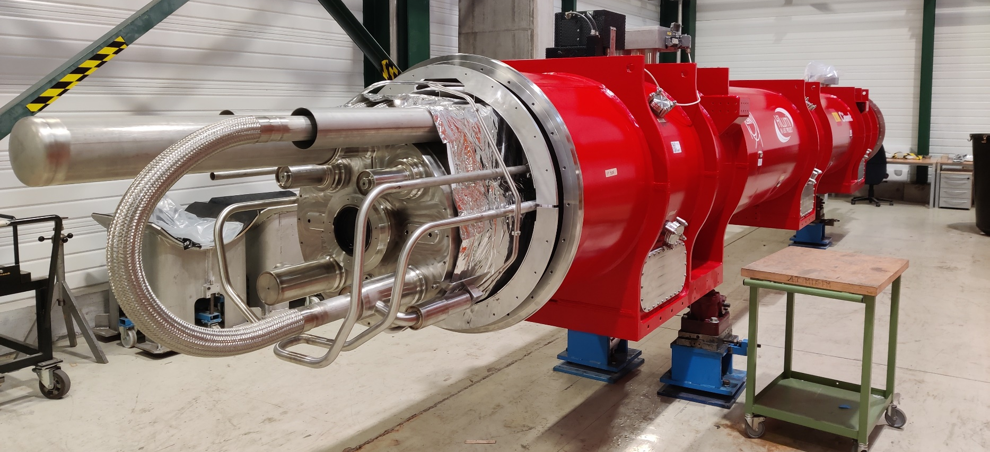
Superconducting magnet in a nutshell
A superconducting magnet is an exciting, fancy and dirty mixture of physics, engineering, and chemistry

Slide 5
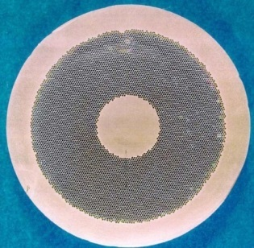
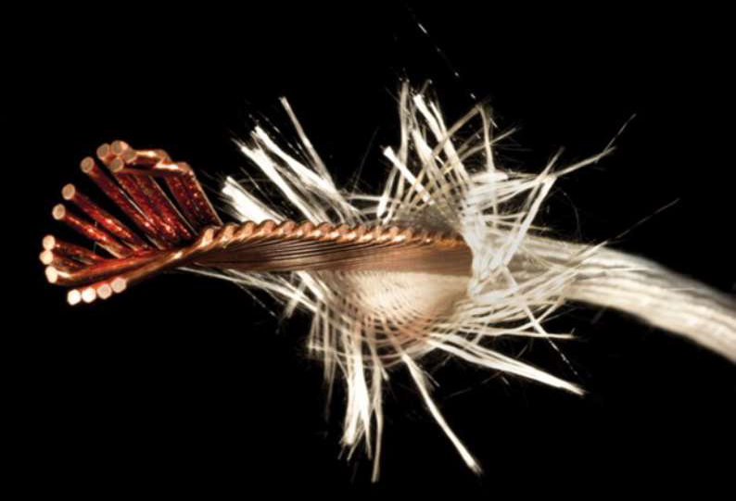
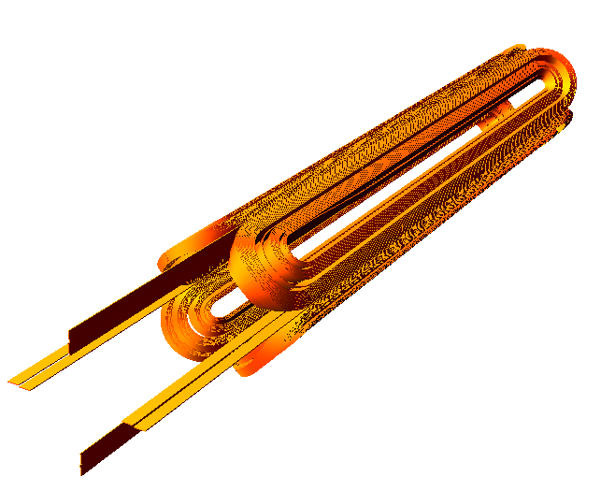
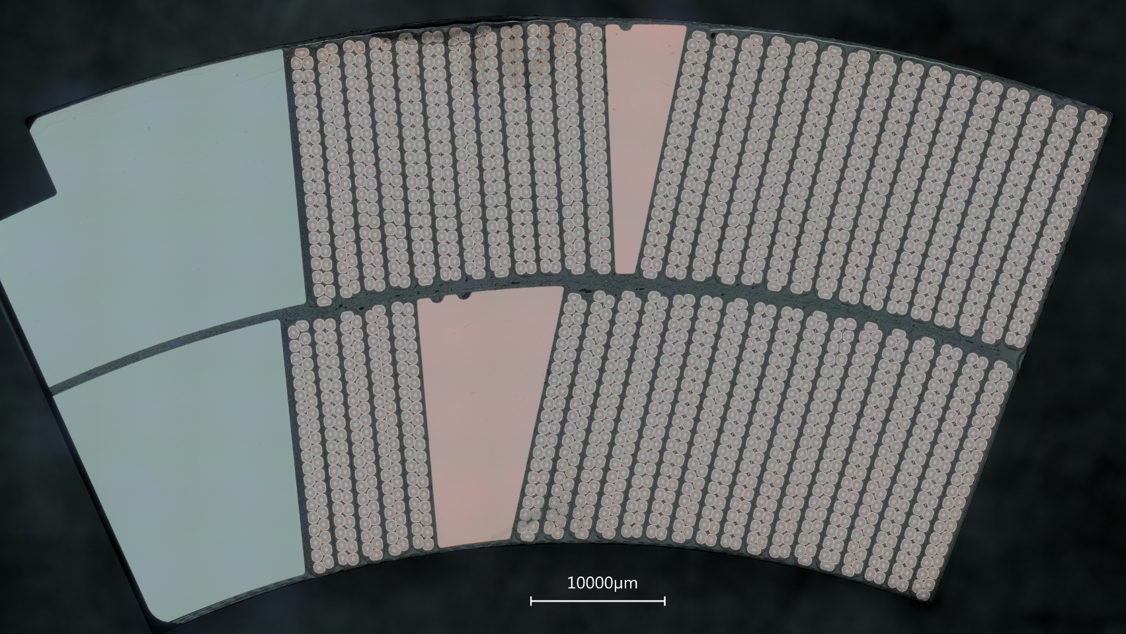
Superconducting magnet in a nutshell
A superconducting magnet is an exciting, fancy and dirty mixture of physics, engineering, and chemistry
Quantum physics:
Superconductivity
Material science
Superconducting materials
Strand
Cable
Coil

Slide 6
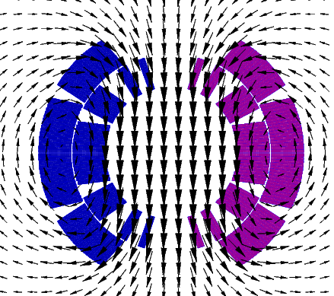
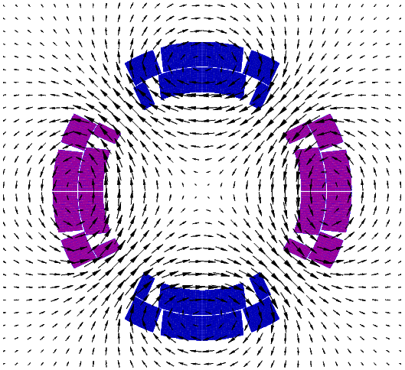
Superconducting magnet in a nutshell
A superconducting magnet is an exciting, fancy and dirty mixture of physics, engineering, and chemistry
Quantum physics:
Superconductivity
Material science
Superconducting materials
Classical electrodynamics
Magnet design

Slide 7

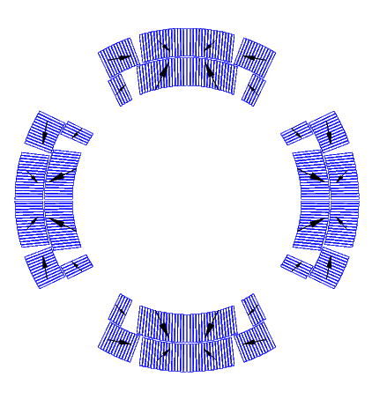

Superconducting magnet in a nutshell
A superconducting magnet is an exciting, fancy and dirty mixture of physics, engineering, and chemistry
Quantum physics:
Superconductivity
Lifting every meter 1360 x
Material science
Superconducting materials
HL-LHC MQXF
Nb₃Sn, B_{p} = 11.3 T
F_{x} = 6.8 MN/m
σ_{θ,em} = 100-110 MPa
F_{z} = 1200 kN
Classical electrodynamics
Magnet design
F_{z}
Mechanical engineering:
Handling of the Lorentz forces
Lifting 25 x

Slide 8
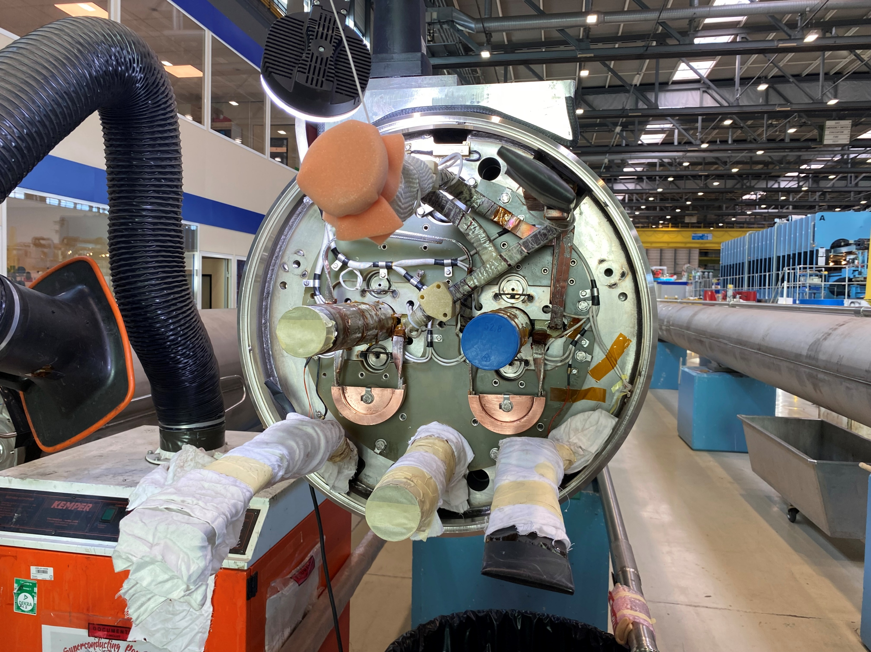
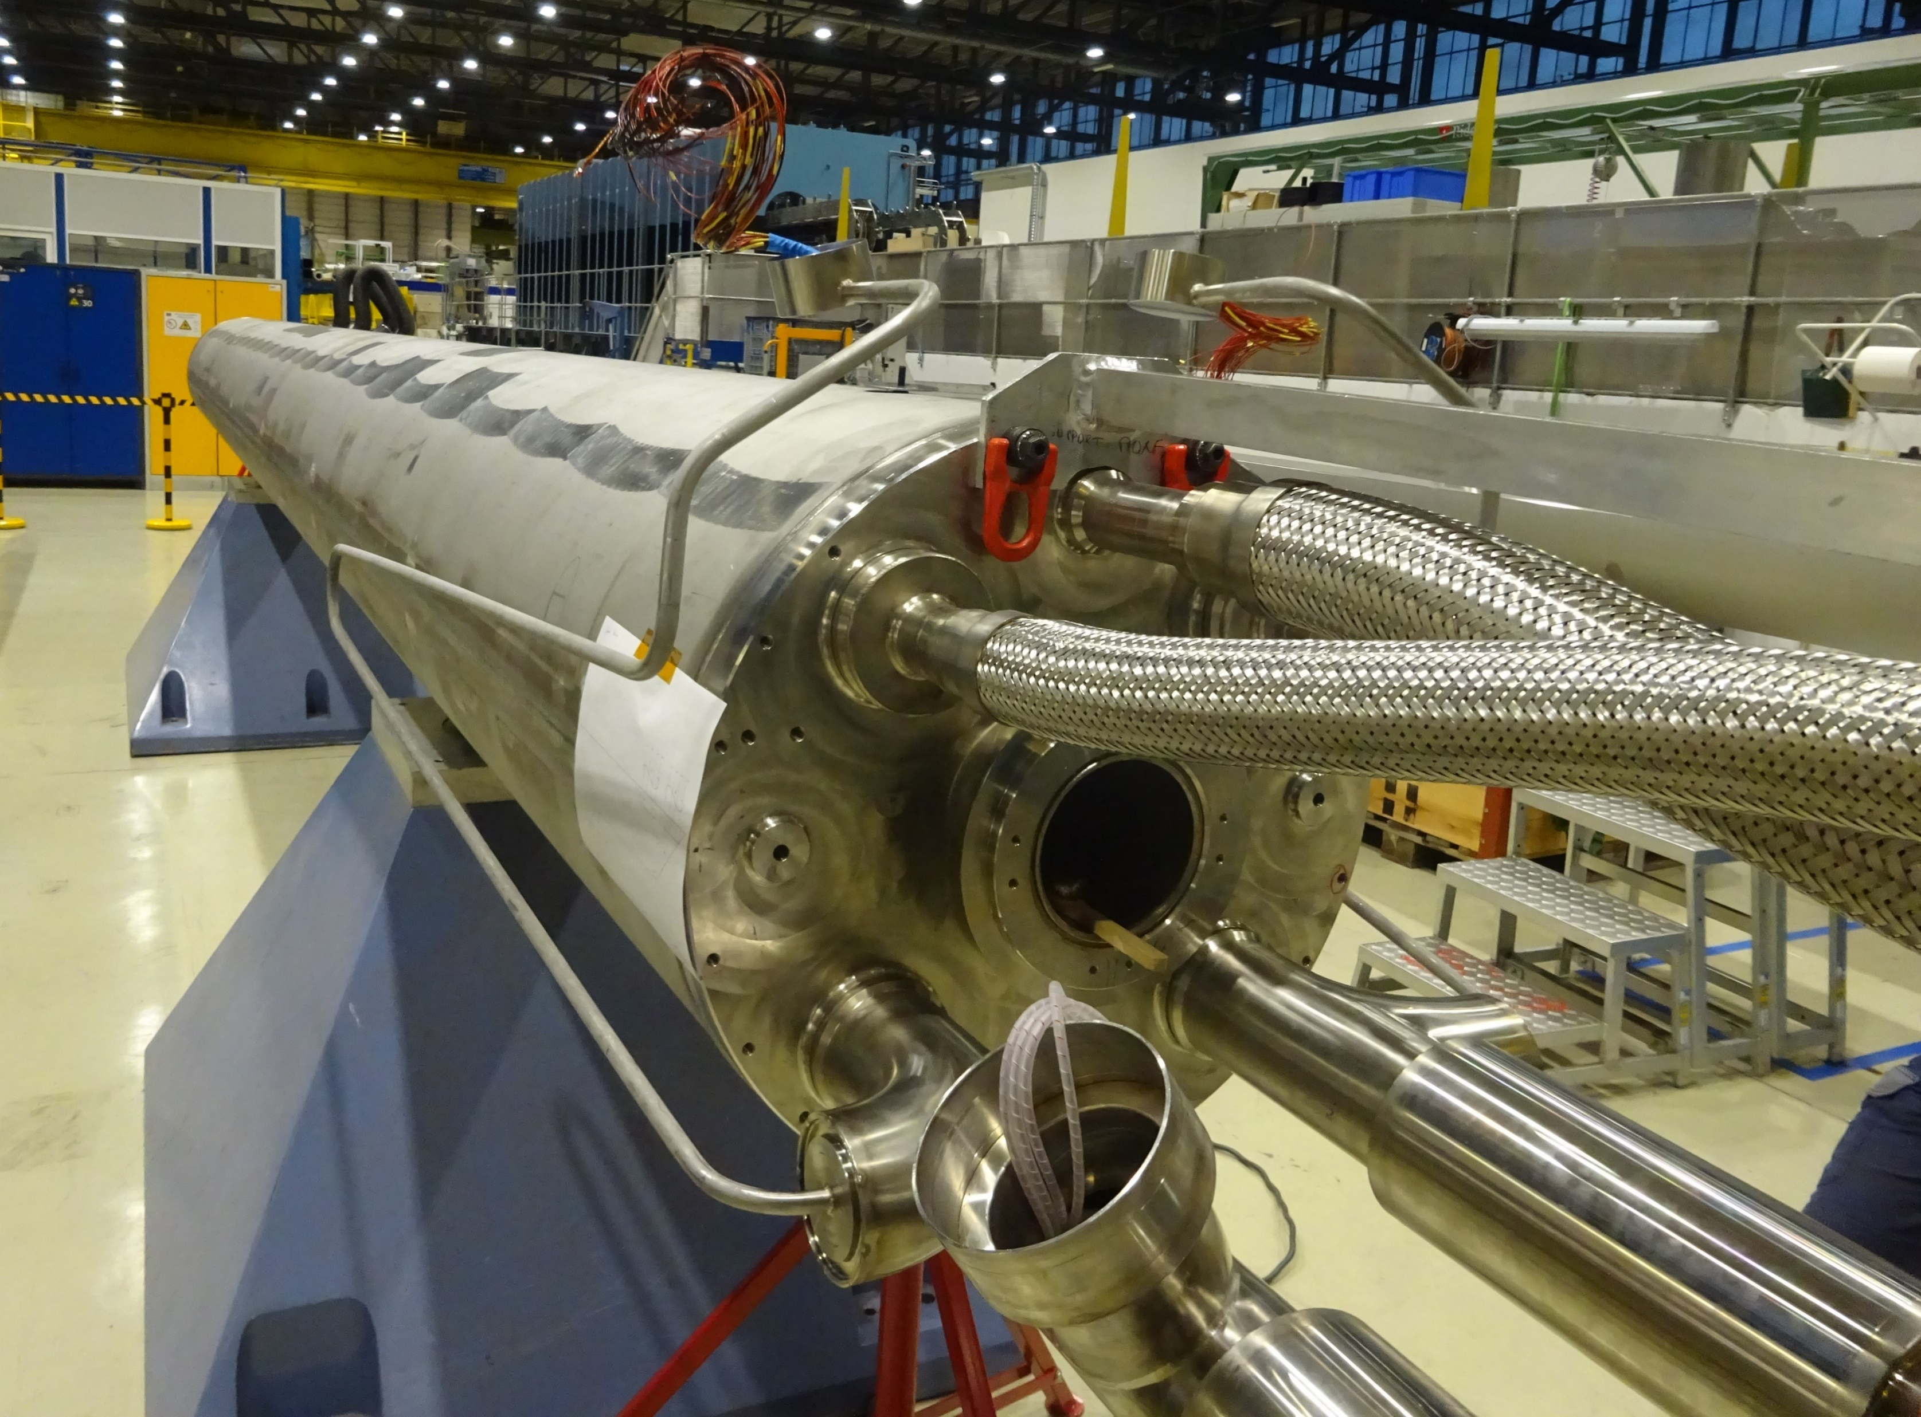
Superconducting magnet in a nutshell
A superconducting magnet is an exciting, fancy and dirty mixture of physics, engineering, and chemistry
Quantum physics:
Superconductivity
Material science
Superconducting materials
Classical electrodynamics
Magnet design
Electrical engineering:
power and protect
Mechanical engineering:
Handling of the Lorentz forces

Slide 9
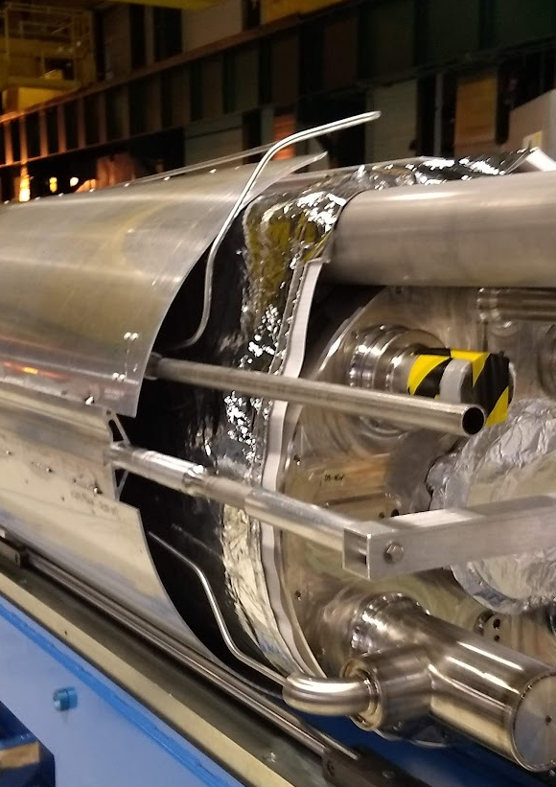
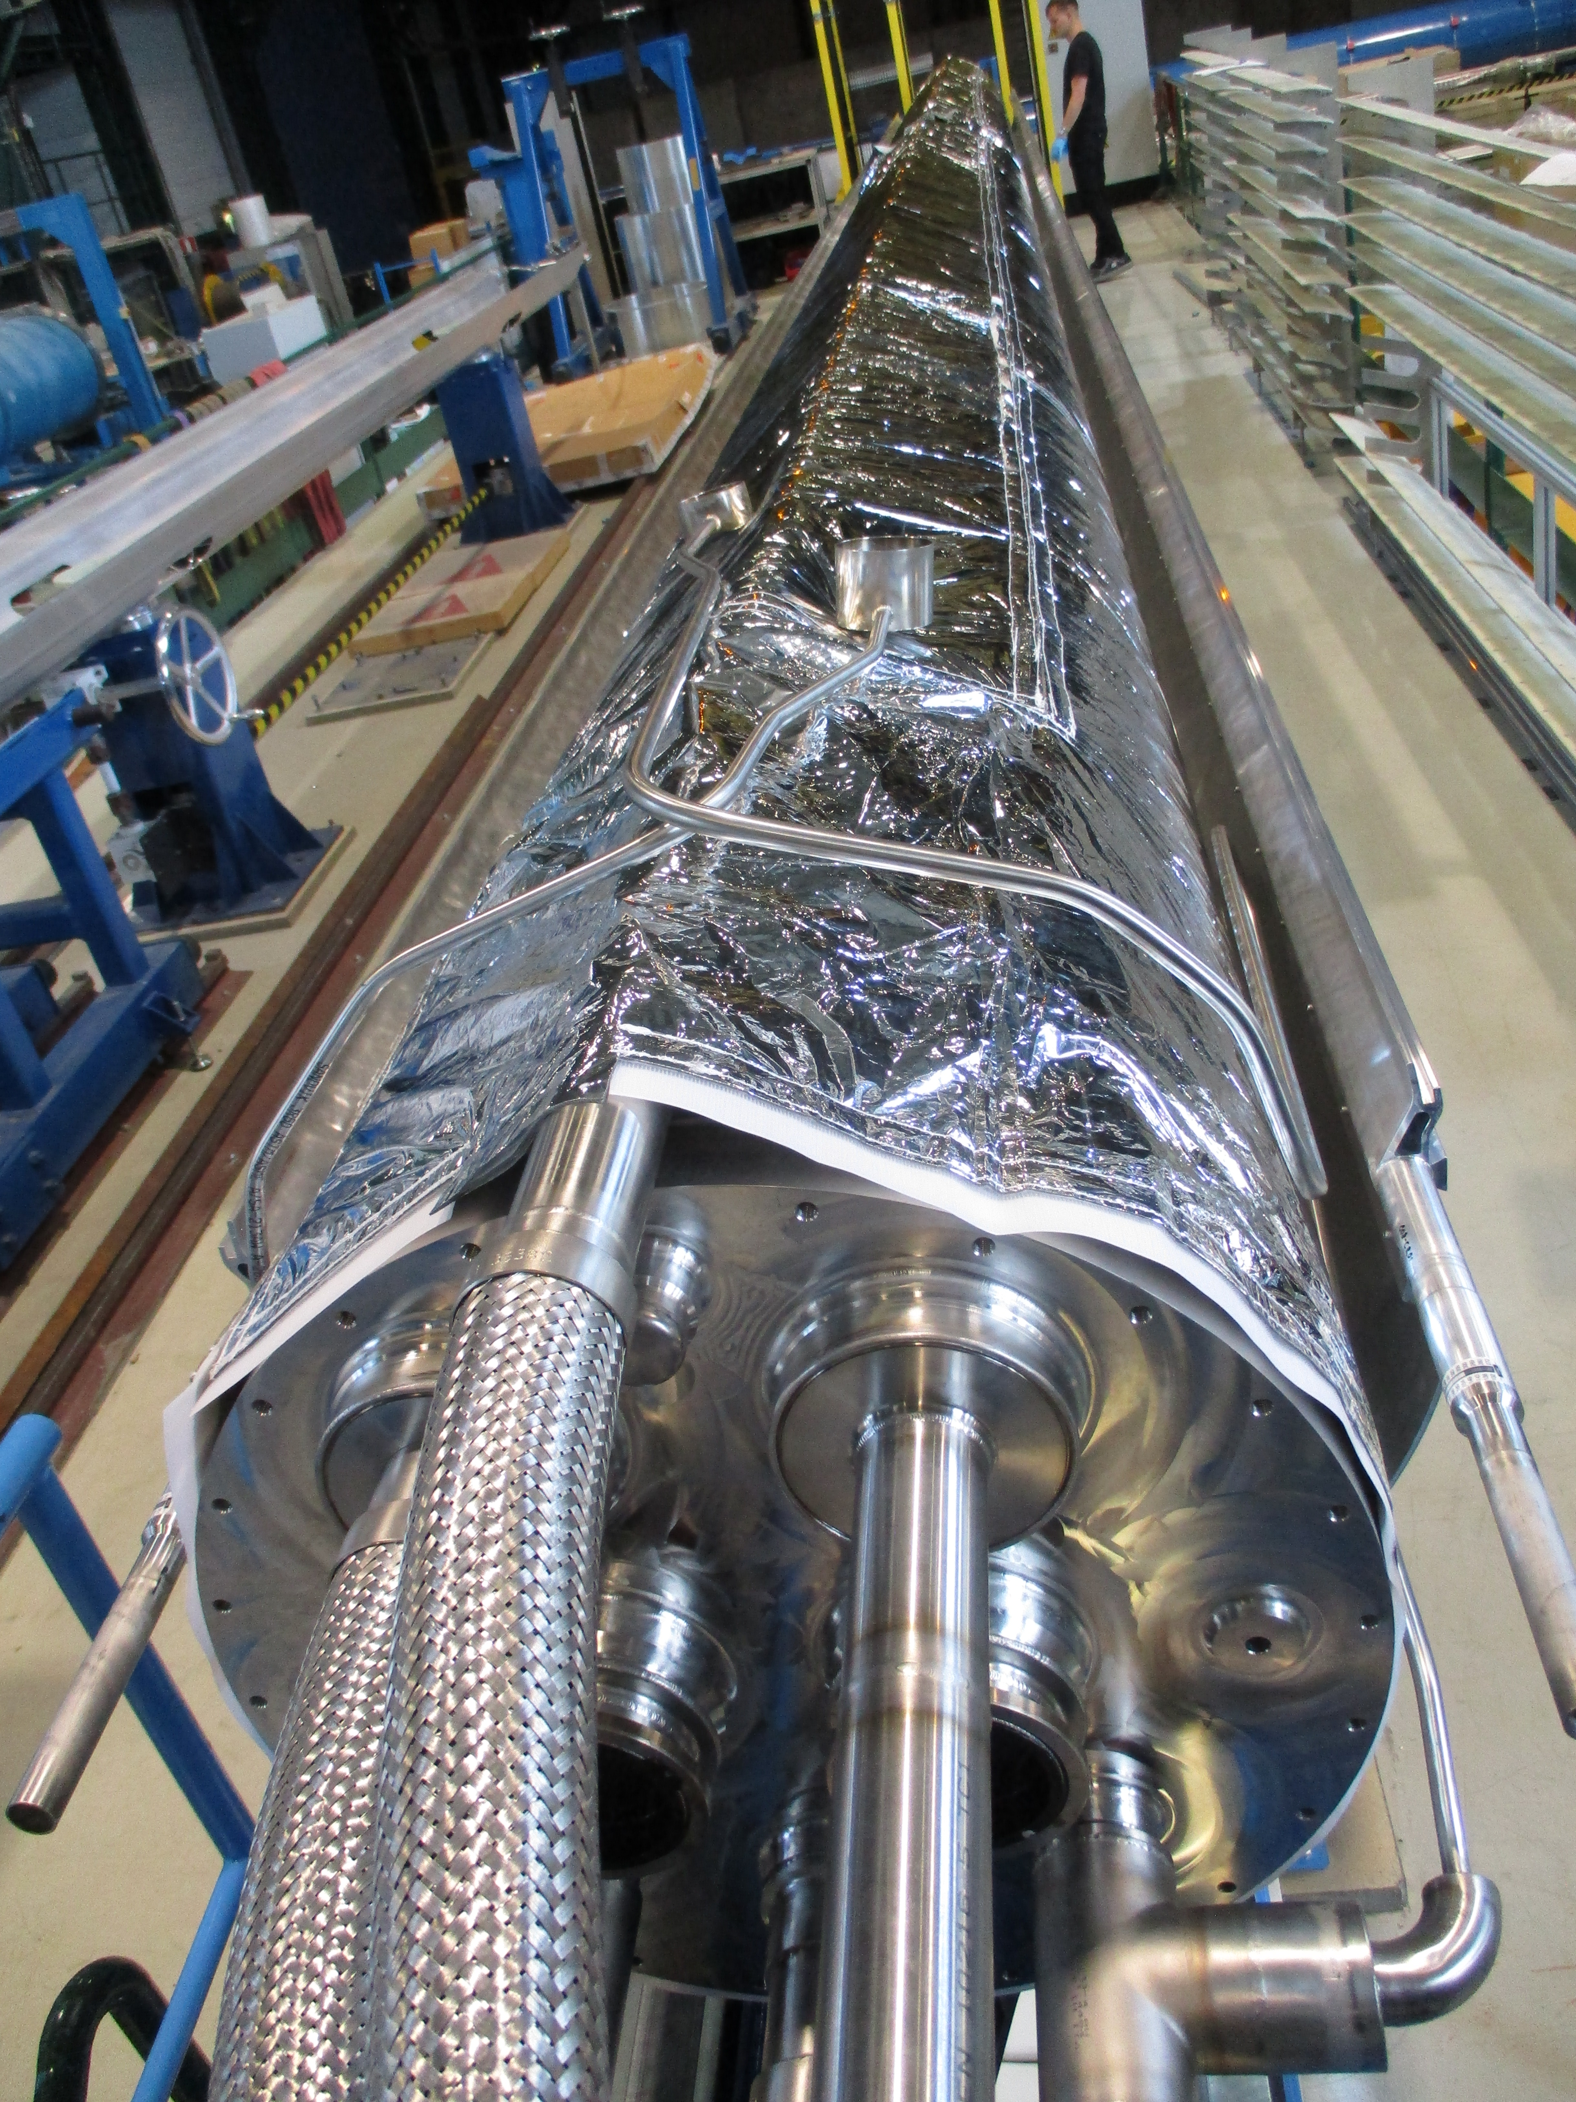
Superconducting magnet in a nutshell
A superconducting magnet is an exciting, fancy and dirty mixture of physics, engineering, and chemistry
Quantum physics:
Superconductivity
Material science
Superconducting materials
Cryogenics:
keep them cool
Classical electrodynamics
Magnet design
Electrical engineering:
power and protect
Mechanical engineering:
Handling of the Lorentz forces

Slide 10
Superconducting magnet in a nutshell
A superconducting magnet is an exciting, fancy and dirty mixture of physics, engineering, and chemistry
Quantum physics:
Superconductivity
Cost!
Material science
Superconducting materials
Cryogenics:
keep them cool
Classical electrodynamics
Magnet design
Electrical engineering:
power and protect
Mechanical engineering:
Handling of the Lorentz forces

Slide 11
What do I expect from a magnet test?
Superconducting magnets are complex and challenging systems. The construction of magnets for accelerators goes through different phases:
  Model/prototype testing: understanding design/manufacturing/limits (training, quench protection, etc etc).
    You can afford to have special instrumentation for a full characterization.
  Series testing: training before installation in the machine & making sure all systems (not just the magnet) work OK: splices, busbars, instrumentation, etc
    Much cheaper to find non-conformities in the surface during the standalone test than in the tunnel, with 150 other magnets in series cold (~few months for replacement)
    Series magnets must find the best compromise between instrumentation and operation: every wire coming out is a risk
The test shall be a factual assessment

Slide 12
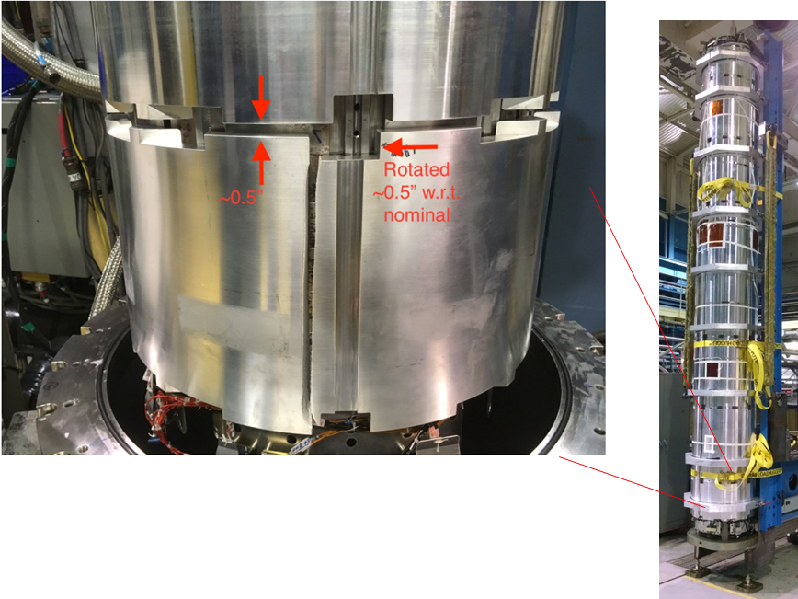
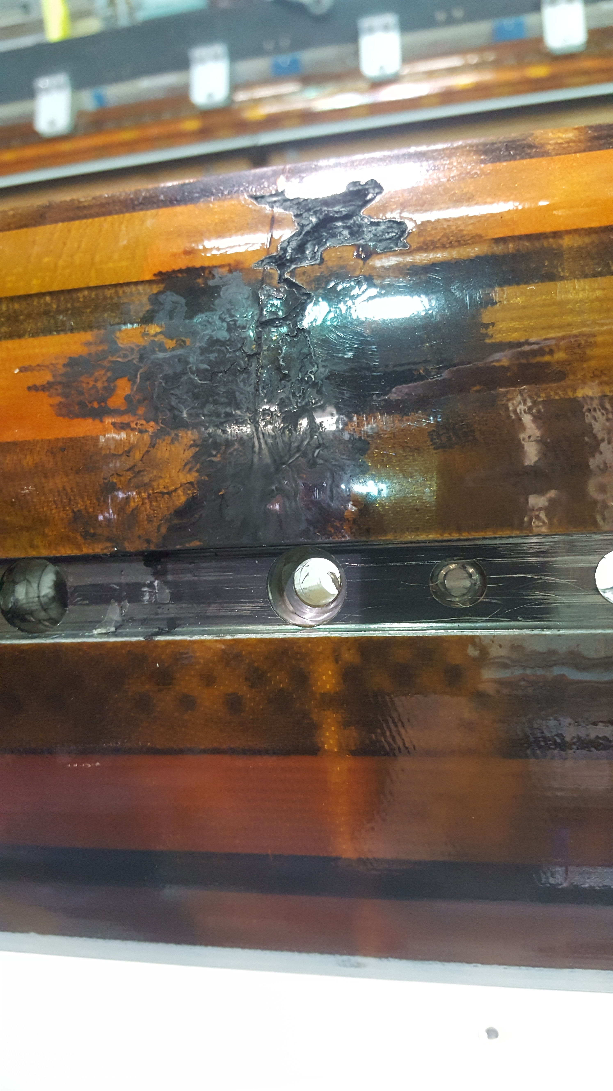
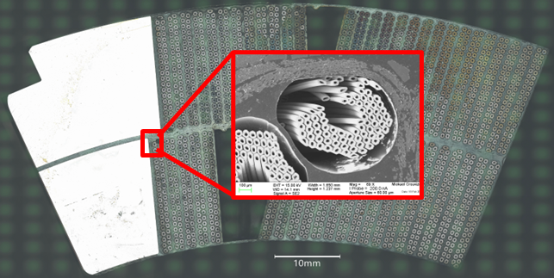
The importance of testing in the initial phases
In some cases, it is easy to find the problem and feedback to the design/manufacturing/testing process can be quickly implemented. In others, it takes a bit longer ☺
Broken Al-support cylinder in MQXFAP2, result of a non-conforming material + not sufficient design margin
Electrical short circuit quench heater to coil in a Nb₃Sn coil in MQXFAP1, result of a non-conforming testing procedure
Broken sub-elements in MQXFBP1 coil, systematic coil fabrication problem (longest Nb₃Sn accelerator coils ever built)
V. Marinozzi et al., IEEE Vol 31 2021
G. Ambrosio et al, IEEE Vol 31, 2021
S. Izquierdo Bermudez et al, IEEE, vol 33, 2023
Time needed to find the problem
Days Weeks-Month(s) ≈ 2 Years

Slide 13
Outline
Setting the scene
  Superconducting magnet in a nutshell
  What do I expect from a magnet test?
Definition of basic concepts:
  Margin
  Quench
  Training
What do I need to know?
  Quench performance
  Electrical integrity
  Quench protection
  Field quality
  Mechanics
The MQXFB example
Conclusions

Slide 14
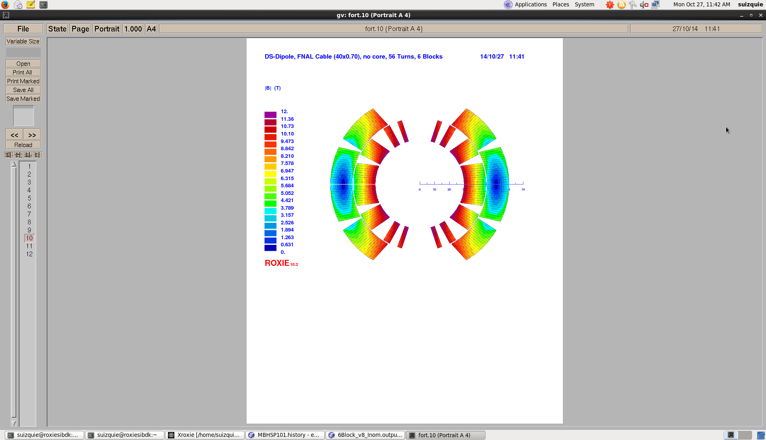
Peak Field, Aperture Field and Margin
A material is superconducting below a given current, temperature and magnetic field, the so-called critical surface
The margin of a magnet is defined with respect to its weakest point, i.e. the peak field
What matters for the margin is the peak field in the coil, not the field in the aperture
B_{p} = 11.6 T
current density
(A/cm )
2
7
10
critical surface
6
10
10
5
4
B_{ap} = 11.2 T
10
3
5
10
5
10
T_{op}
10
15
15
20
20
Temperature
magnetic field
(K)
(T)

Slide 15
Margin
Among magnet engineers, a commonly used concept is the loadline margin
  The concept is always criticized (not physical) but never replaced: the success of a magnet judged on its ability of reaching the max performance
    LL_{margin} = 1−I_{𝑜𝑝}/I_{𝑆𝑆}
High field accelerator magnets typically are design to operate at ≈ 80% of the short sample level (20 % margin)
Operation point

Slide 16
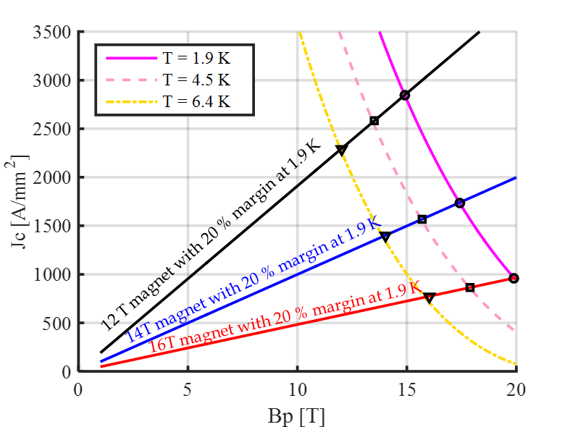
Considerations on margin
For Nb₃Sn and Nb-Ti the temperature margin depends only on the loadline margin and very weakly on the field.
For a given a material and an operational temperature, load line margin and temperature margin are equivalent
For a given LL margin, Nb₃Sn T margin is about 2.5 times greater than NbTi T margin
Nb₃Sn
Temperature margins at 20% on loadline
Operational temperature | 1.9 K | 4.2 K
Nb-Ti | 2.1 K | 1.2 K
Nb₃Sn | 4.5 K | 3.0 K

Slide 17
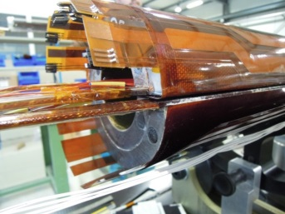

Quench definition
Quench = irreversible transition to normal state
  Heat generation > cooling
What do we do when a magnet quenches?
  thermal energy (redistribute the energy in the whole coil volume, joule heating)
  Conversion magnetic energy
$$J^{2}η$$

Slide 18
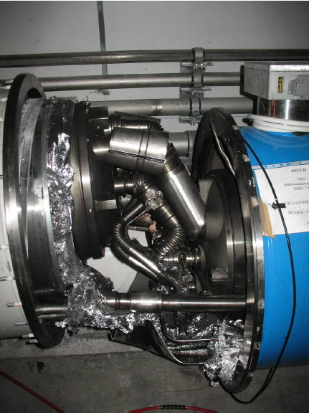
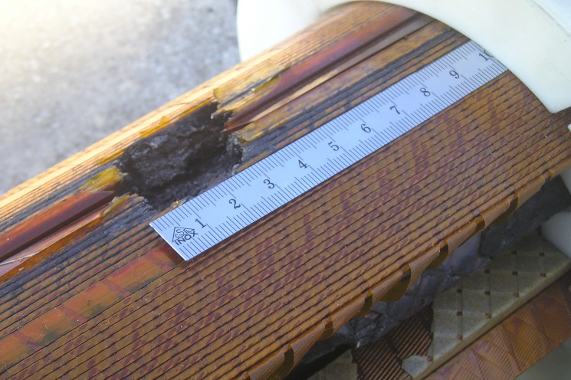
Quench: why it can be a problem ?
Quench is the result of the resistive transition, leading to appearance of voltage, temperature increase, thermal and electro-magnetic forces, and cryogen expulsion
If the process does not happen uniformly: as little as 1 % of the magnet mass may absorb the total energy – large damage potential !
Result of the chain of events triggered by a quench in an LHC bus-bar
Result of degradation due to local heating in a NbTi coil
Result of electrical short circuit quench heater to coil in a Nb₃Sn coil

Slide 19
Quench
Quench, two scenario:
  (1) Conductor limited quenches:
    The superconductor carries its critical current, the rest flow in the stabilizer
    If power is high enough and cooling low enough, temperature in the superconductor increases → critical current decreases → more current in the stabilizer, less in the superconductor → more dissipation → irreversible transition and quench
Cu
SC

Slide 20
Quench
Quench, two scenario
  (2) Energy-deposited or premature quenches:
    Disturbance → release of energy → increase of temperature of the conductor.
    If power is high enough and cooling low enough, temperature in the superconductor increases → critical current decreases → more current in the stabilizer, less in the superconductor → more dissipation → irreversible transition and quench
    Different sources
      Mechanical events: frictional motion, epoxy cracking
      Electromagnetic events: Flux-jumps, AC loss
      Nuclear events: Particle showers
      Thermal events: Degraded cooling
Cu
SC

Slide 21
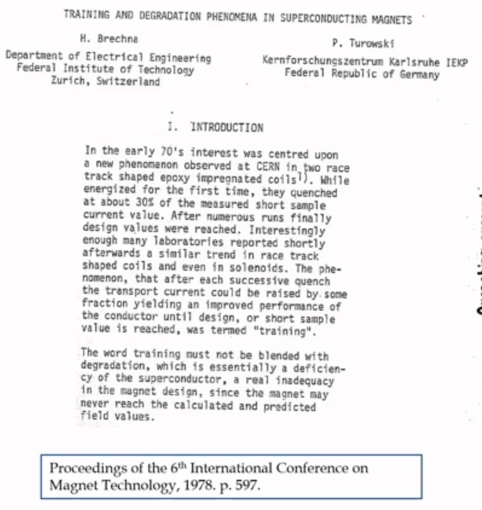
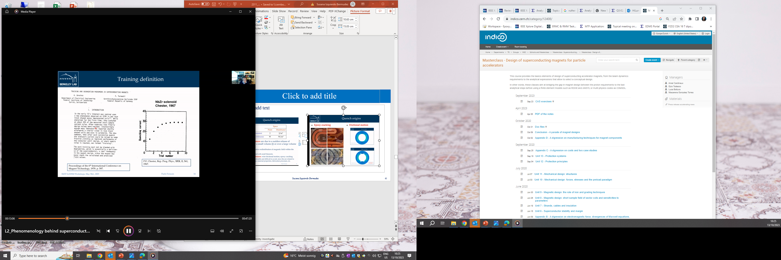
Training
Superconducting magnets typically quench before reaching their nominal performance, the so-called training
Training is characterized by two phenomena:
  The occurrence of premature quenches
  The progressive increase of the quench current
    Irreversible change in the coil’s mechanical status
    Somehow the magnet is ‘improving’ or getting better quench after quench
  Mechanical induced quenches are considered the main causes of training in a superconducting magnet (frictional motion & epoxy failure)

Slide 22
Training
Main identified causes :
  Frictional motion
    E.m. forces → motion → quench
    Coil progressively locked by friction in a secure state
  Epoxy failure
    E.m. forces → epoxy cracking → quench
    Once epoxy locally fractured, further cracking appears only when the e.m. stress is increased.
Main features relevant for operation
  The ability to reach the target current with adequate margin (virgin training)
  The retraining expected during operation (i.e., memory after thermal cycle)

Slide 23
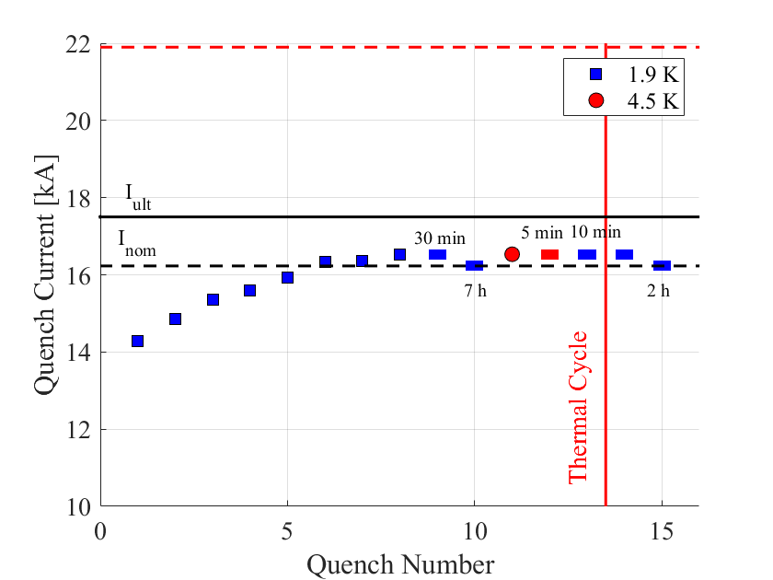
Example of training
MQXFB03 quench performance
Reached nominal current after 4 quenches
I_{ss} at 1.9 K
Target current after 8 quenches
Good memory after thermal cycle (i.e., no need to re-train in the machine)
Stable operation at 1.9 K
Reach target current at 4.5 K (i.e., large temperature margin for operation)

Slide 24
Training for accelerator magnets
Magnet performance has an intrinsic variability that even for mature technologies is not totally understood/controlled
  This does not prevent us from building reliable accelerators based on superconducting magnets – a challenge in magnet design is finding the good balance between margin/cost/risks. Some examples:
    RHIC: 14 % of the magnets were tested
    For the LHC all magnets were tested at 1.9 K
    For HL-LHC all magnets are/will be tested with thermal cycle (also NbTi)
Memory after cycle is important to avoid training in the accelerator (time consuming, i.e., $$$$)
  In general, memory is better in Nb₃Sn than in NbTi

Slide 25
Training in the LHC dipoles
LHC dipoles assembled by three manufactures (series 1000, 2000 and 3000)
  Build to print, same procedures with few exceptions
All magnets individually tested at 1.9 K
  All powered above nominal (11850 A, 8.3 T, 7 TeV)
  About 50 % powered to ultimate (8 % more than nominal, 12850 A, 9 T)
    Requirement: ≤ 2 quenches to nominal, ≤ 7 quenches to ultimate
  Less than 10 % went through thermal cycle (biased sample)
    Magnet not reaching 12850 A within 9 quenches were tested after thermal cycle
    Requirement: no quench to nominal, 3 quenches to ultimate
  Bonus strategy:
    Magnets reaching “rapidly” ultimate were given a bonus (1% bonus for magnets going to 9 T with ≤ 3 quenches)

Slide 26
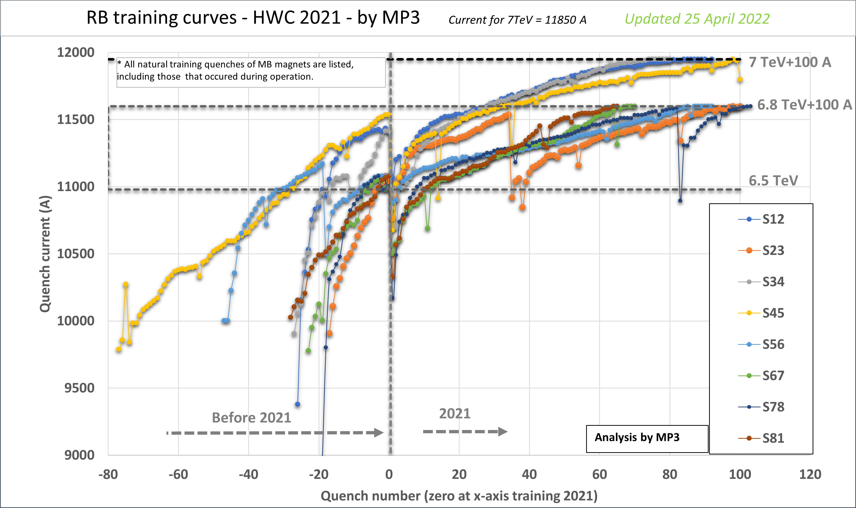
LHC dipoles in the LHC machine
In the LHC we have 1232 magnets, connected in series in 8 circuits (i.e., 154 magnets per circuit)
If every magnet needs to quench once to reach nominal → 154 quenches per sector, and we can do only 2-3 quenches per day → training in the machine is very expensive and that is why memory after thermal cycle is VERY important!

Slide 27
Training in the HL-LHC magnets
HL-LHC magnets are built in different places all around the world (China, Italy, Japan, Spain, US). Collaboration agreements between CERN and national laboratories, with the laboratories steering the production of the magnets as in-kind contributions to CERN (except Q2 which is fully produced at CERN).
All magnets are tested at 1.9 K and 4.5 K. In most of the cases, the magnet is tested first vertically in stand-alone configuration and then assembled & tested in a cold mass.
Testing strategy:
  Nb₃Sn magnets are powered to nominal (16230 A, 11.3 T, 7 TeV) at 4.5 K, to nominal + 300 A at 1.9 K.
  NbTi magnets are powered to ultimate current at 1.9 K ( 8 % more than nominal)
  All magnets go through a thermal cycle. The magnets shall be able to reach nominal field after a thermal cycle with a target of ≤ 1 quench and a maximum of ≤ 3 quenches.
The time needed to test a cold mass horizontally is ≈ 9 weeks (3 weeks are high current tests at cryogenic temperature, the rest (6 weeks) is for preparations, cool down and warm up).

Slide 28
Outline
Setting the scene
  Superconducting magnet in a nutshell
  What do I expect from a magnet test?
Definition of basic concepts:
  Margin
  Quench
  Training
What do I need to know?
  A couple of trivial statements before start…
  Quench performance
  Electrical integrity
  Quench protection
  Field quality
  Mechanics
The MQXFB example
Conclusions

Slide 29
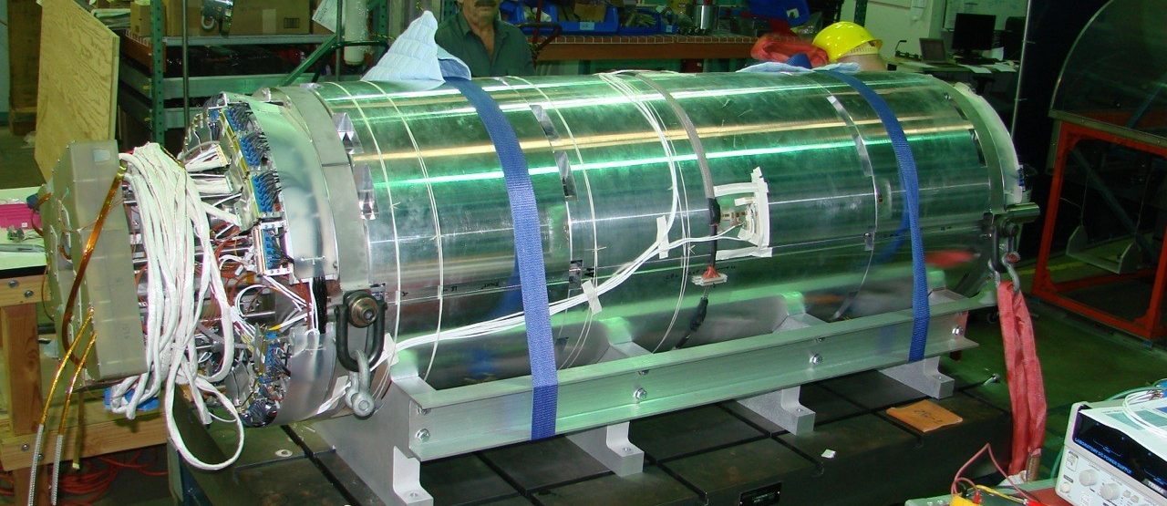
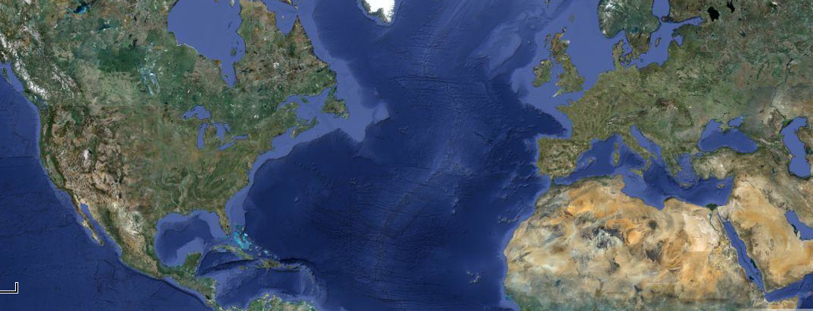
The first MQXFS short magnet
Designed and fabricated by multiple laboratories
  Test 2.5 years after the selection of the aperture (i.e., start of the design)
  It might look trivial, but communication, engagement and sharing of knowledge/information is fundamental
MQXFS1, 2 coils from CERN, two coils from LARP
MQXFS1
FNAL
Coil 3-5
CERN
LBNL
Coil 3-5
BNL
Coils 103-104
Structure 1

Slide 30


MQXF key milestones timeline
First validation of the coil fabrication (1.2 m length, MQXFSM1), testing in a mirror coil configuration, T₀ + 2 y
First validation of the magnet design (1.2 m length, MQXFS1), T₀ + 2.5 y
MQXFA coil fabrication process validated with the test of a 4 m length coil in mirror structure (MQXFAM1), T₀ + 3 y
First 2 MQXFA prototypes did not reach requirements. First magnet fulfilling requirements was MQXFA03, T₀ + 6 y
First two long prototype magnets did not reach performance requirements. MQXFBP3 first MQXFB magnet reaching requirements, T₀ + 9 y
First final cold masses LMQXFA01(A03/A04) and LMQXFB01 (BP2), T₀ + 10 y
‘Series Production’: 4-5 MQXFA and 2-3 MQXFB magnets qualified per year, T₀ + 11 y
All this after 10 years of R&D from LARP and the US & CERN building the same magnet but different lengths!
A14
A13b
MQXFAM1
A08b
A07b
A18
T₀, aperture selection
A05
A10
A13
A15
A12b
A06
A11
It is a marathon, not a sprint. We must build on previous experience and testing is the tool to understand and improve what we build.
MQXFSM1
MQXFAP1
MQXFA03
A07
A17
MQXFS1
MQXFAP2
A04
A08
A0304-Q3
A0405-Q1
MQXFBP3
B03
B04
B05
MQXFBP1
MQXFBP2
B02
BP2-Q2
MQXFS3
MQXFS5
MQXFS6
MQXFS7
MQXFS8
BP3-Q2
2013 | 2014 | 2015 | 2016 | 2017 | 2018 | 2019 | 2020 | 2021 | 2022 | 2023 | 2024
Grey means not reaching performance requirements

Slide 31
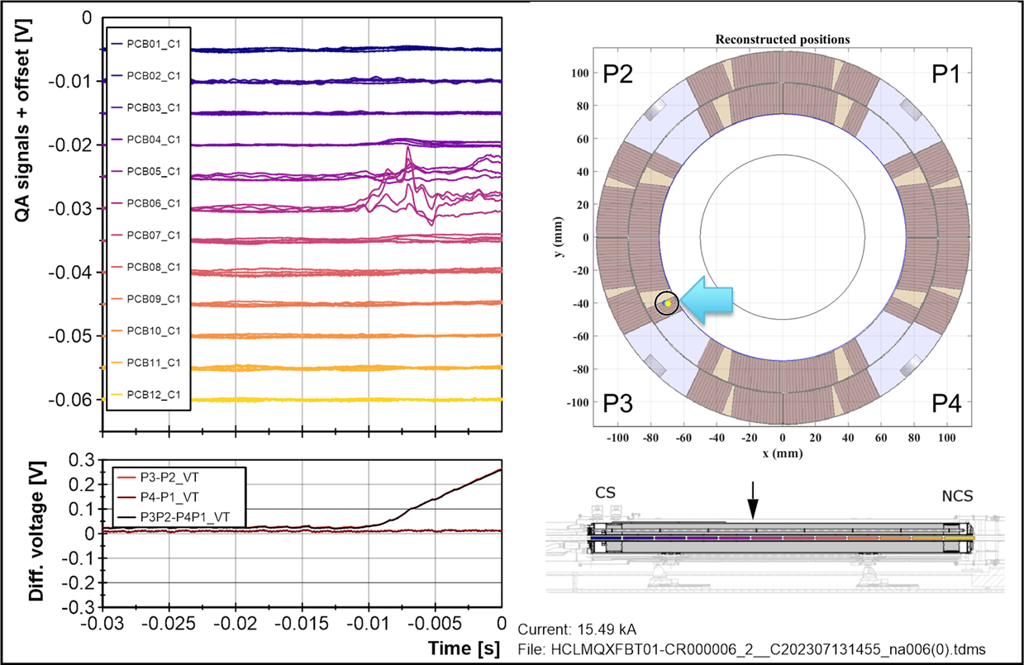
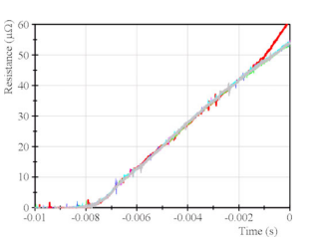
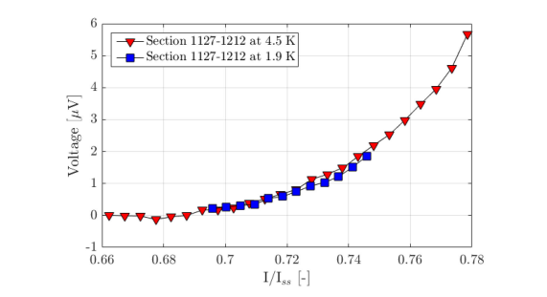
Quench performance - diagnosis
Specially when things don’t go as expected, it is important to have good diagnosis tools for quench localization
Quench localization using quench antenna in MQXFB02 [L. Fiscarelli]
VI measurement in MQXFBP2, indicating conductor limitation in the pole turn segments
Fast resistance build up in the mid-plane of a 11 T coil, attributed to excessive stress during collaring
F. Mangiarotti et al, IEEE vol 32 2022
G. Willering et al, IEEE vol 28 2018

Slide 32
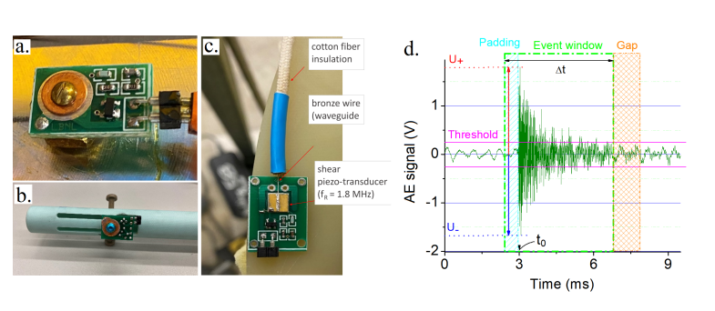
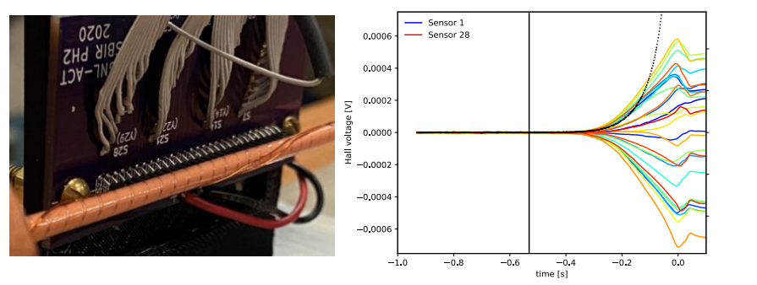
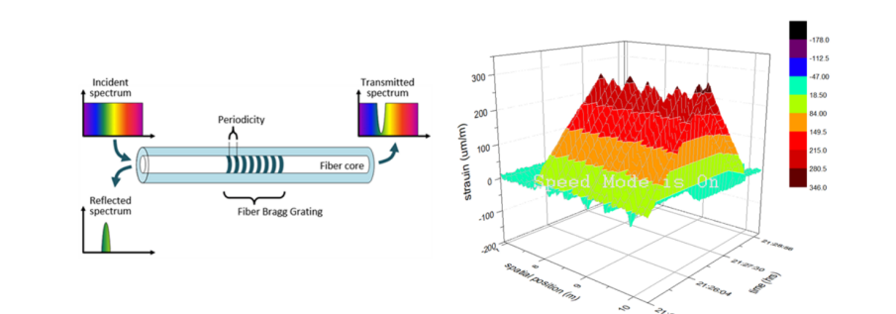
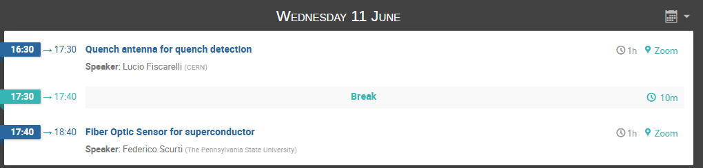
Quench performance - diagnosis
A field of research with a lot of on-going developments, see M. Marchevsky et al. ”Advancing Superconducting Magnet Diagnostics for Future Colliders“, arXiv:2203.08869 [physics.acc-ph] (pdf).
Acoustic emission
Hall sensors array
Fiber optics

Slide 33
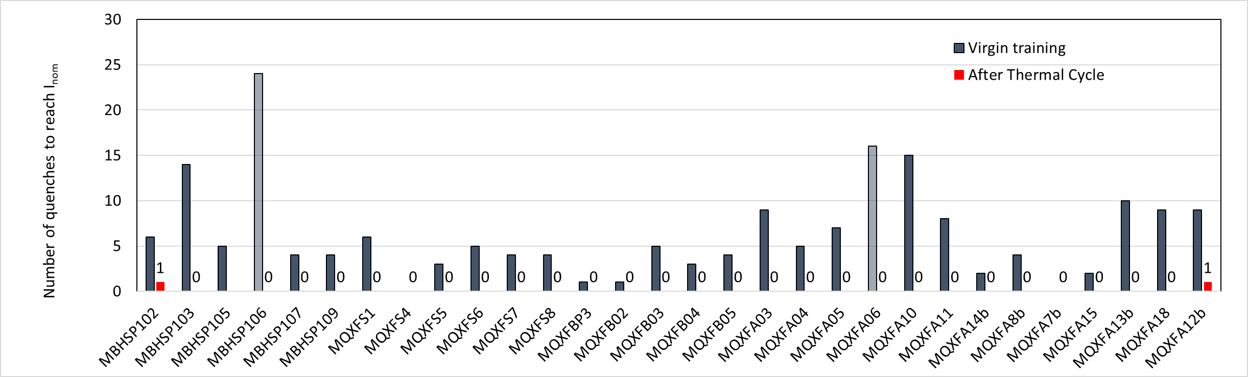
Quench performance – interesting observations
In general, less than 10 quenches needed to reach nominal (less than 5 in MQXFB and MQXFS)
In 30 magnets, two needed one re-training quench to reach nominal.
The two magnets where the training was done at 4.5 K (MBHSP106 and MQXFA06) had longer training
  Longer training at 4.5 K is also observed in CCT NbTi HL-LHC magnets
CLIQ impacts training: the two coils that see a positive current during CLIQ discharge do not train S. Stoynev, IEEE App. Sup. Vol 34 2024
MBHS
MQXFS
MQXFB
MQXFA
*
*
*Training at 4.5 K

Slide 34

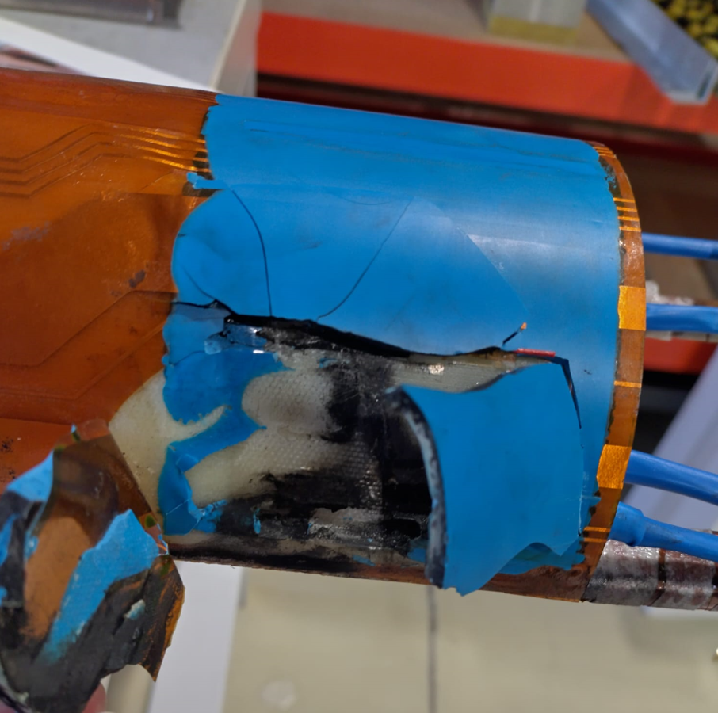
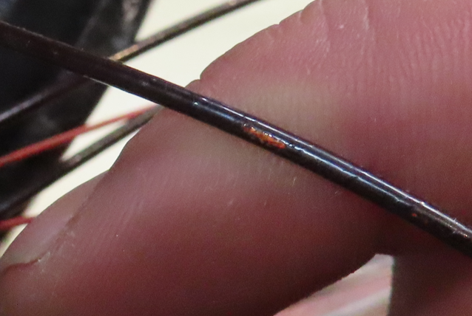
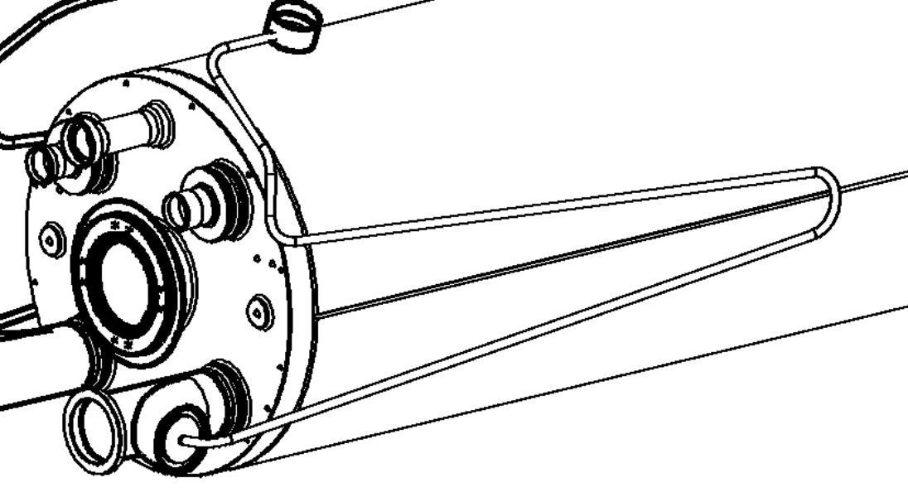
Electrical integrity
Electrical integrity:
  Mandatory for all magnets – at different steps of the fabrication, installation and operation
  The sooner you intercept faults, the better it is
  Typical rule:
    Testing voltage at 1.9 K is twice the maximum voltage expected during operation plus 500 V. Typically is 2.5 – 3.5 kV
    After test, apply 5 times less voltage at RT (presence of He)
Courtesy of C.A. Cabrera

Slide 35
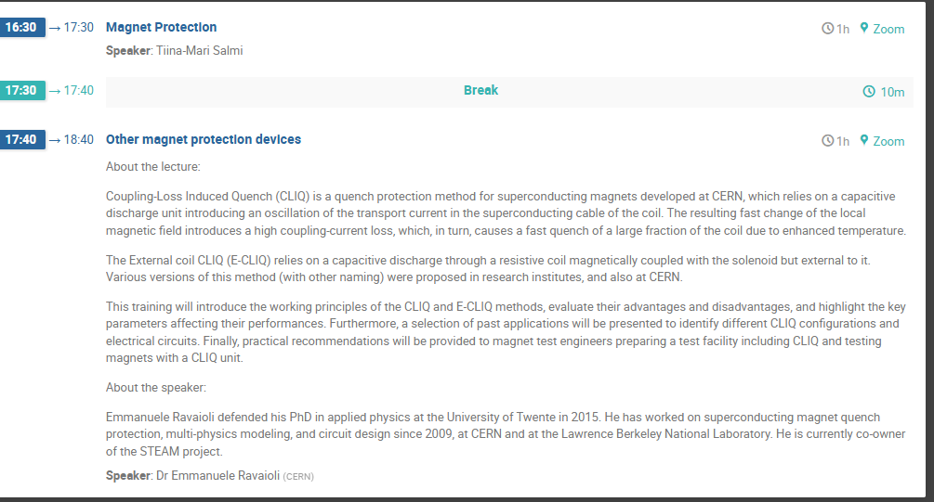
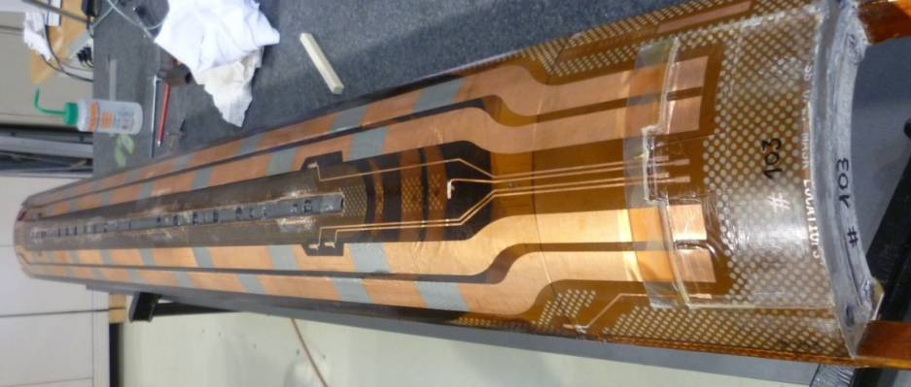
Quench protection
Several significant observables, to benchmark simulation codes and validate quench protection performance:
  Quench detection and quench velocity → gives an idea if we are close to the conductor limit or not, validates de protection thresholds
  MIITs during quench → validates the estimates on Thot
  Quench heater delay and minimum heater energy → validates the choice of the protection strategy
Model: 0.1 mm S2 glass
Model: 0.0 mm S2 glass

Slide 36
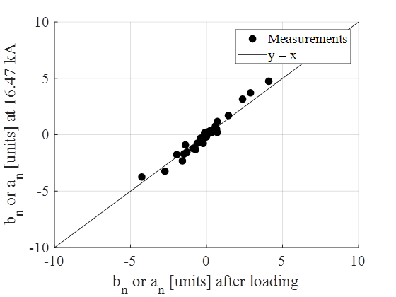
Field quality
Some components can be measured only at 1.9 K/4.5 K (iron saturation, persistent currents, dynamic effects), however, a sampling on a fraction of the magnets (10 %) allows building effective magnetic models (see Fidel).
Correlations from RT and 1.9 K/4.5 K measurements effective to reduce the testing program at cryogenic temperature.
Transfer function of the MBH-11 T magnet
Cold warm correlation on MQXFS magnets

Slide 37
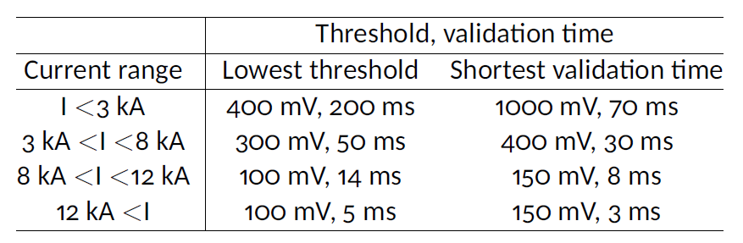
Flux jumps and stability in Nb₃Sn
Nb₃Sn shows large peaks in the measured differential voltage due to flux jumps
  Thanks to the variable detection threshold strategy, magnet safely protected at all current levels
  We had no previous experience in the scale up with the length of flux jumps, MQXFB experience validated the mitigation actions developed based on the short model experience
Power convertors need to deal with the flux jumps, and the impact on the field was assessed to be acceptable for the beam.
Measured flux jumps effect in differential voltage in MQXFBP2
Measured field stability in MQXFBP3
Franco Julio Mangiarotti
Lucio Fiscarelli

Slide 38
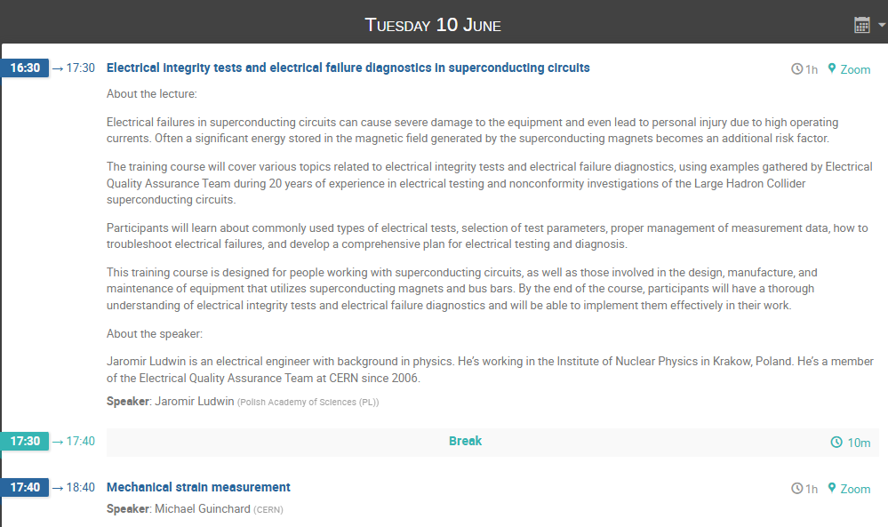
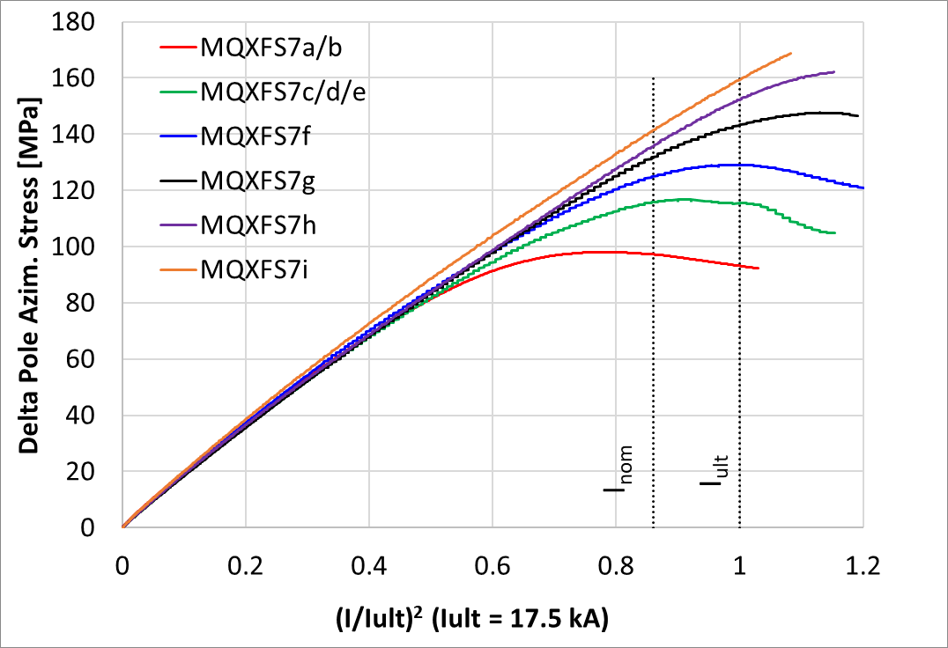
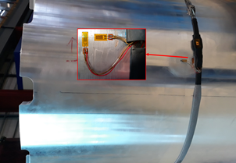
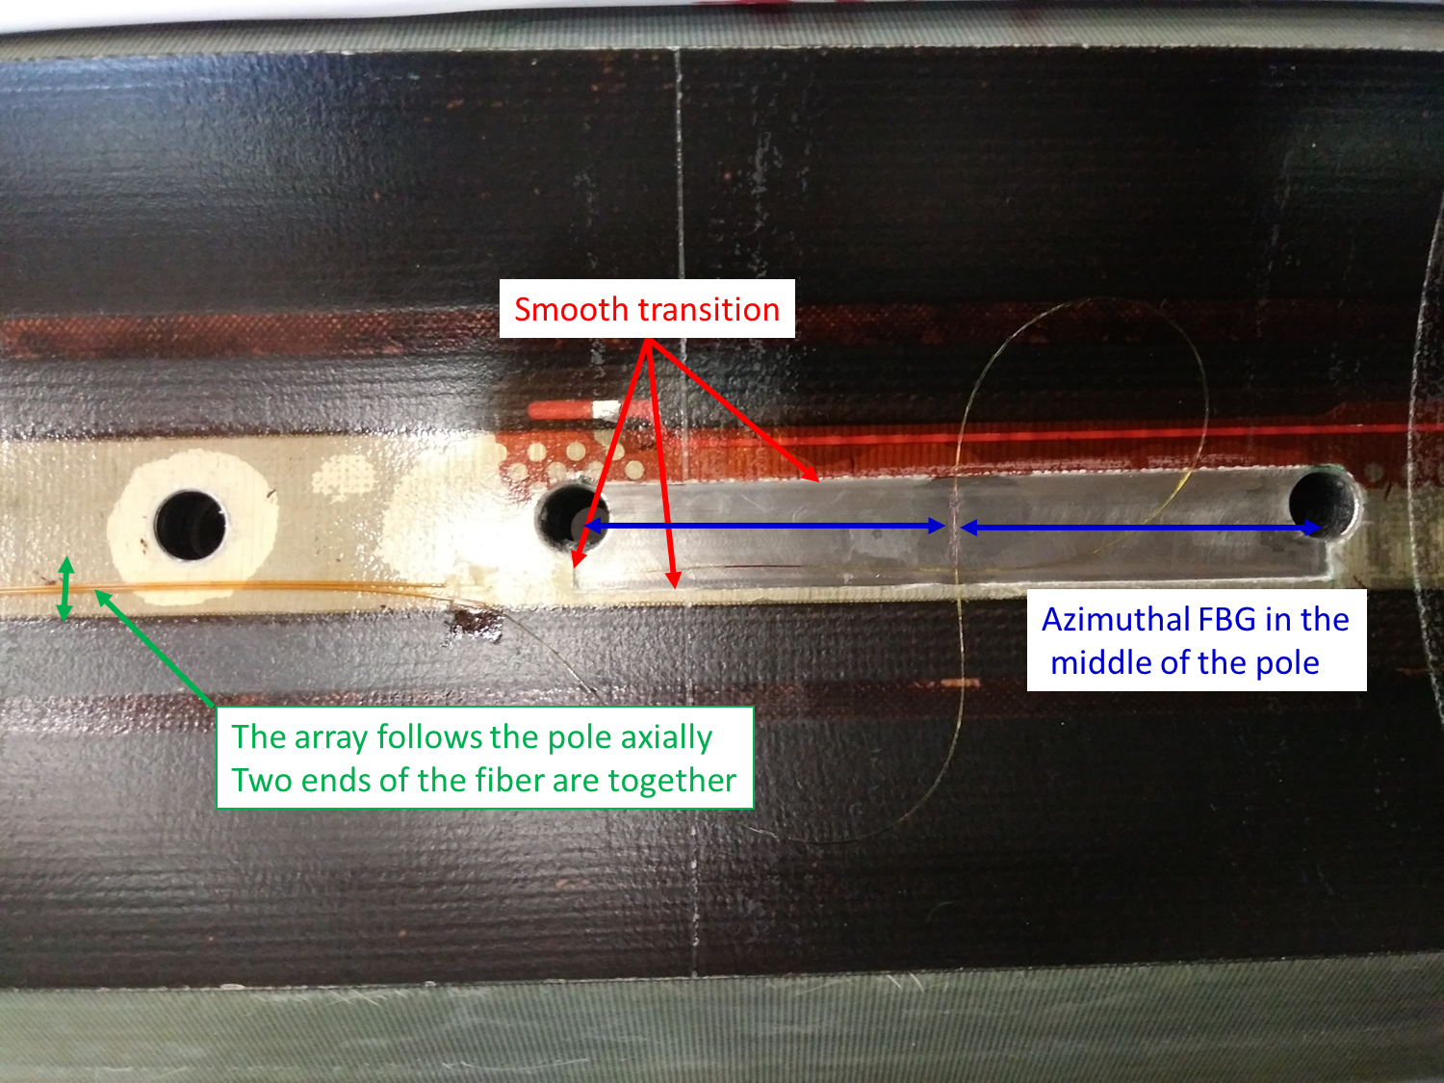
Mechanics
Allow to have an experimental verification of the mechanical behavior
It is usually challenging to find a good place to measure, but it is very important to have reliable measurements to understand how your magnet works: start thinking how you are going to measures since the very early state of the design!
Strain gauges are the usual way to measure, but new technologies (fiber optics) are emerging
Strain gauges installed in MQXF Al-cylinder
Strain gauges installed in MQXF coils
by M. Guinchard

Slide 39
Outline
Setting the scene
  Superconducting magnet in a nutshell
  What do I expect from a magnet test?
Definition of basic concepts:
  Margin
  Quench
  Training
What do I need to know?
  Quench performance
  Electrical integrity
  Quench protection
  Field quality
  Mechanics
The MQXFB example
Conclusions

Slide 40
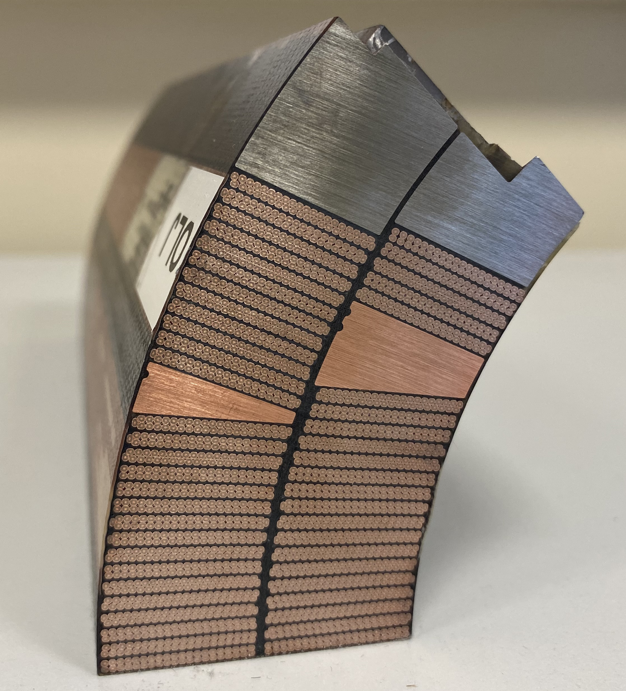
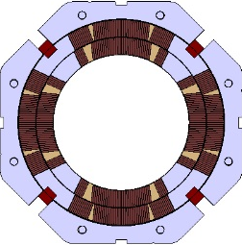
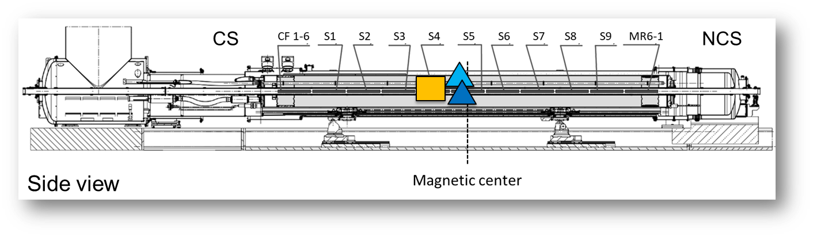
The MQXFB Prototype Performance
The first two prototype magnets, BP1 and BP2 were limited below nominal current at 1.9 K (~15 and ~16 kA respectively).
4.5 K behaviour compatible with magnet on the critical surface (70% of the short sample limit in MQXFBP1, 73 % in MQXFBP2).
No retraining after thermal cycle and magnet performance did not degrade with temperature cycles, quenches and current cycles.
In all the cases, the quench location was on the inner layer pole turns near the mechanical center of the magnet.
MQXFBP1
MQXFBP2
P2
P1
(7.5 TeV)
(7 TeV)
CS view
Pole turn inner layer
P3
P4
F. J. Mangiarotti et al., "Power Test of the First Two HL-LHC Insertion Quadrupole Magnets Built at CERN," in IEEE Transactions on Applied Superconductivity, vol. 32, no. 6, pp. 1-5, Sept. 2022, Art no. 4003305, doi: 10.1109/TASC.2022.3157574.
Susana Izquierdo Bermudez, ASC22

Slide 41
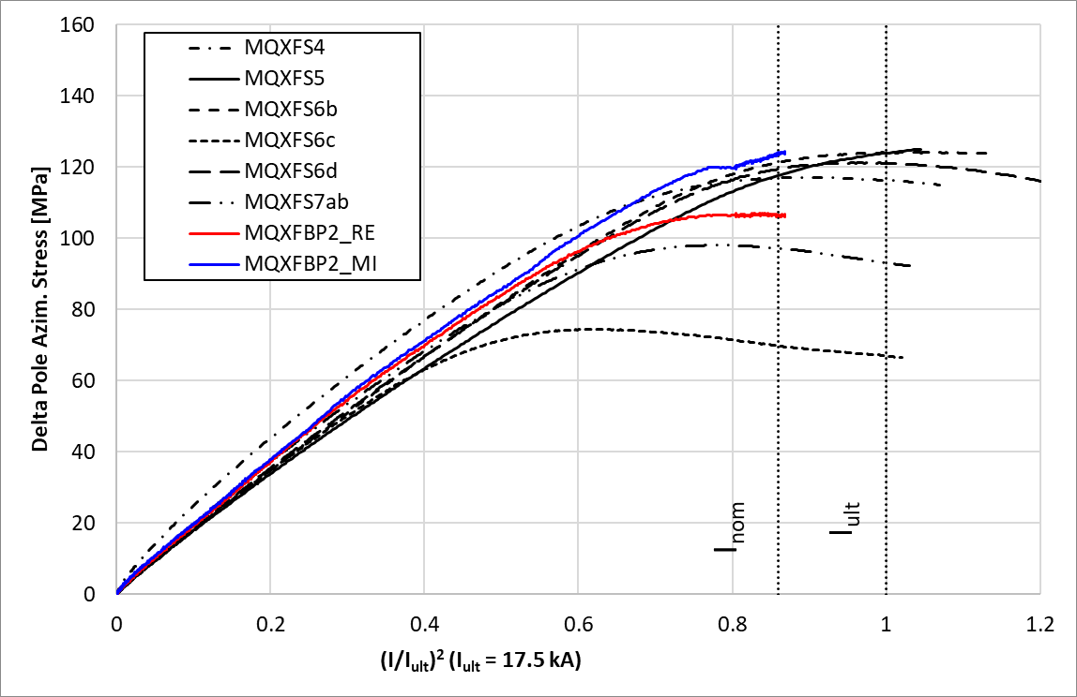
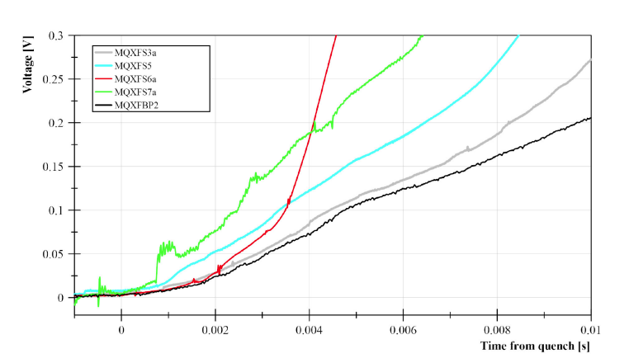


The MQXFB Prototype Performance
No anomalies from the mechanical point of view
‘Normal’ quench propagation velocity, comparable to propagation measured in short models for inner layer pole turn quenches
‘Normal’ temperature and ramp rate dependencies, i.e., higher temperature lower quench current; faster ramp lower quench current
  The change of quench origin and decrease of quench current with the ramp was an indication of a weakness.
Signs of a resistive transition before quench (VI)
F. J. Mangiarotti et al., "Power Test of the First Two HL-LHC Insertion Quadrupole Magnets Built at CERN," in IEEE Transactions on Applied Superconductivity, vol. 32, no. 6, pp. 1-5, Sept. 2022, Art no. 4003305, doi: 10.1109/TASC.2022.3157574.

Slide 42

MQXFBP2 trimmed powering
Power circuit modification (in red) to evaluate the performance of non-limiting coils: coil P1 (limiting coil) was powered with less current than the other three
  The modification was first applied and validated in a short model magnet, a fundamental tool along the full construction process!
Other two coils also limited with similar mechanism (straight part), at 16.5-17 kA – no quenches in the heads, and no degradation with thermal cycle → systematic problem

Slide 43





MQXFBP1 post-mortem inspection
The limiting segment in MQXFBP1 was analyzed using mainly two techniques:
  Copper etching of transverse cuts, revealing collapsed filaments in the upper edge of the inner layer pole turn
  Metallographic inspection after fine grinding and polishing , showing that the extension of the damage is ≈ 100 mm.
Longitudinal
cut
Transverse
cut
Approx. 30 mm
11 strands damaged
16 strands damaged

Slide 44

Coil post-mortem inspection
Systematic inspection in coil 108 (limiting coil in BP1) through transverse cuts and copper etching in 1 m of coil with 50 mm granularity showed a systematic problem in the pole-to-pole transitions
  Out of the 20 samples, only the samples around the transitions two transitions showed damaged strands
Longitudinal distribution of the damage in CR108
20 slices 50 mm length,
damage only in the slices around transitions
A virgin coil, never assembled in a magnet, shows similar defects but much smaller extension
  Only 2 out of the 8 transitions examined had defects, and the extension of the defect in the longitudinal direction was 3 mm.
A. Moros et al., "A metallurgical inspection method to assess the damage in performance-limiting Nb₃Sn accelerator magnet coils", submitted for publication
I. Aviles Santillana, S. Sgobba et al., "A metallurgical inspection method to assess the damage in performance-limiting Nb₃Sn accelerator magnet coils", submitted for publication
Virgin coil CR126

Slide 45

Coil fabrication
After reaction, a vertical deflection of the outer layer pole with respect to the base plate of 1-2 mm is typically observed after the opening of the reaction fixture.
After impregnation, the coil is azimuthally bigger in the middle (≈ 0.1 mm per mid-plane).
Pole to pole transitions, where collapsed filaments are found in destructive inspections, have been identified as stress concentration region during the closure of the impregnation fixture

Slide 46




Coil fabrication modifications
  Modifications aimed at reducing the friction between coil and reaction mold
    Pole gap increase
    Partial compensation of the curing cavity
    Removal of the ceramic binder from the outer layer of the coil
New generation coil measurables point to a coil which is more ‘relaxed’ after RHT
  No coil ‘hump’ after reaction
  No bigger coil azimuthal size towards the middle after impregnation
  More homogeneous torque required to close the impregnation fixture
4 magnets assembled with new generation coils (out of 8 needed for installation) reached requirements with no indication of conductor degradation

Slide 47
Outline
Setting the scene
  Superconducting magnet in a nutshell
  What do I expect from a magnet test?
Definition of basic concepts:
  Margin
  Quench
  Training
What do I need to know?
  Quench performance
  Electrical integrity
  Quench protection
  Field quality
  Mechanics
The MQXFB example
Conclusions

Slide 48
Conclusions
A superconducting magnet is a complex system which needs to work in an accelerator: every single detail needs to be engineered
  It involves many different levels of expertise.
  There are several ways to design and build a superconducting magnet, the solution is not unique!
  The test of a magnet is the final assessment of its conformity to requirements before installation.
Several aspects: electrical integrity, performance, protection, mechanics, field quality. Each problematic has specific features requiring different approaches
Testing is a cost, and a challenge in magnet design is finding the good balance between margin/cost/risks
  Personal note: for new technology such as Nb₃Sn, test as much as and as fast as you can afford, especially in the initial phase of models, prototype and pre-series

Slide 49
Conclusions
Testing is not just validation — it’s a tool to guide and improve design and construction decisions.
It's important to clearly distinguish between test results and their interpretation. Both are necessary, but they serve different purposes and should be treated separately. The test must be factual.
The more observables we define, and the more accurately we measure them, the better our understanding — leading to meaningful improvements over time.
  Wherever possible, simplify measurements and observables. When non-experts can understand and use them, the potential for broader collaboration and innovation increases.
Superconducting magnets are complex, and multiple interdependent factors are always at play. It’s okay not to have all the answers — what matters is that we continue thinking, measuring, iterating, and working together.

Slide 50
Few references
USPAS - Superconducting Magnets for Particle Accelerators https://indico.cern.ch/event/440690/
E. Todesco, “Masterclass – Design of superconducting magnets for particle accelerators” https://indico.cern.ch/category/12408/
CERN Accelerator School on 'Normal- and Superconducting Magnets’, https://indico.cern.ch/event/1227234/

Slide 51
Additional slides

Slide 52
Abstract
About the lecture:
Superconducting magnets are at the heart of advanced scientific and industrial applications — their development presents great challenges. These are inherently complex, multiphysics systems in which many parameters remain uncertain or only partially understood. Achieving reliable, high-performance operation requires meticulous design and engineering across a wide range of disciplines. At the same time, cost constraints demand careful performance optimization: simply adding operational margin is often prohibitively expensive, making the search for the optimal design a critical part of the development process.
As one of the first lectures in this series focused on superconducting magnet test stands, this talk will provide an introduction to essential concepts such as training and quench, and will frame the critical role of testing in the broader magnet lifecycle. Drawing on my experience in magnet design and construction, I will outline the key information that designers and builders need from testing facilities in order to refine designs, ensure reliability, and ultimately enable the construction of affordable and effective superconducting systems.
About the speaker
Susana joined the CERN magnet group in 2010 to work on the preparation activities for the Large Hadron Collider (LHC) First Long Shut down. In 2012 she started working in the Magnet Design and Technology Section, on the development of high field Nb3Sn accelerator magnets. Susana leads now the HL-LHC WP3 (link), in charge of the IR magnets for the upgrade in the LHC. She is also responsible for the Large Magnet Facility section at CERN, overseeing the construction of magnets and cold masses for the HL-LHC project.

Slide 53



The 12 T challenge – coil fabrication
Wind and react technology → coil undergo a heat treatment step to ≈ 650 º C to form the superconducting phase
  Volumetric expansion of the conductor of ≈ 3 %, tooling must provide enough space to avoid over-compaction, potential cause of degraded performance
  Limited choice of materials (operation range 1.9 K - 950 K), but must provide good electrical insulation
Stringent protection requirements (time margin to reach 350 K T_{hot} is 40 ms instead of 90 ms for the LHC-MB dipoles) call for quench protection heaters placed as close as possible to the coil
After curing
After reaction
After impregnation

Slide 54




The 12 T challenge – length
Management of thermal contractions and dilatations (from 1.9 K during magnet operation to 650 º C during coil reaction) of the different components is still one of the main challenges
  They scale with the magnet length, and need to be properly engineered with particular attention to transitions

Slide 55


The 12 T challenge – current density
LHC MB
NbTi, B_{p} = 8.6 T
Eq. coil width: 27 mm
J_{strand} = 475/616 A/mm²
HL-LHC MBH 11 T
Nb₃Sn, B_{p} = 11.7 T
Eq. coil width: 28 mm
J_{strand} = 770 A/mm²
HL-LHC MQXF
Nb₃Sn, B_{p} = 11.3 T
Eq. coil width: 36 mm
J_{strand} = 715 A/mm²

Slide 56
The 12 T challenge – e.m. forces
≈ 2 times more force/stress than in the LHC-MB dipoles, in a brittle conductor
LHC MB
NbTi, B_{p} = 8.6 T
F_{x} = 3.4 MN/m
σ_{θ,em} = 50-60 MPa
F_{z} = 265 kN
HL-LHC MBH 11 T
Nb₃Sn, B_{p} = 11.7 T
F_{x} = 7.2 MN/m
σ_{θ,em} = 100-110 MPa
F_{z} = 450 kN
HL-LHC MQXF
Nb₃Sn, B_{p} = 11.3 T
F_{x} = 6.8 MN/m
σ_{θ,em} = 100-110 MPa
F_{z} = 1200 kN
F_{x} per half magnet; F_{z} per aperture

Slide 57
The 12 T challenge – protection
T_{hot} ≈ 100 K higher than in the LHC-MB dipoles, half the time margin
LHC MB
NbTi, B_{p} = 8.6 T
J_{overall}(I_{nom}) = 356/442 A/mm²
J_{cu}(I_{nom}) = 763/932 A/mm²
e_{m} (I_{nom}) = 71 J/cm³
HL-LHC MBH 11 T
Nb₃Sn, B_{p} = 11.7 T
J_{overall}(I_{nom}) = 522 A/mm²
J_{cu}(I_{nom})= 1440 A/mm²
e_{m} (I_{nom})= 124 J/cm³
HL-LHC MQXF
Nb₃Sn, B_{p} = 11.3 T
J_{overall}(I_{nom})= 462 A/mm²
J_{cu}(I_{nom}) = 1311 A/mm²
e_{m} (I_{nom})= 120 J/cm³

