Slide 1
Current Leads and Superconducting Transmission
Amalia Ballarino, CERN
04/06/2025

Slide 2
Outline
Transmission of electrical current from room temperature to the cryogenic environment (current leads) and transmission of electrical current at cryogenic temperature (bus-bar and superconducting links)
  Conventional and superconducting current leads
  Superconducting materials
  Cryogenic options for the cooling
  Impact of electrical circuit
Optimization of cryogenic and electrical performance
Protection
The material presented in these slides is discussed in
https://inspirehep.net/literature/1341662 (CAS Proceedings)
where references can also be found

Slide 3
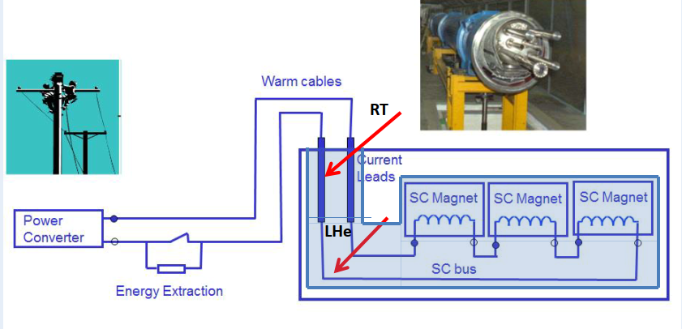
Current Leads in a Magnet Circuit

Slide 4
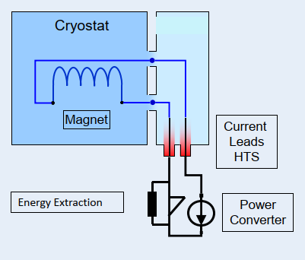
Circuit with a Single Magnet

Slide 5
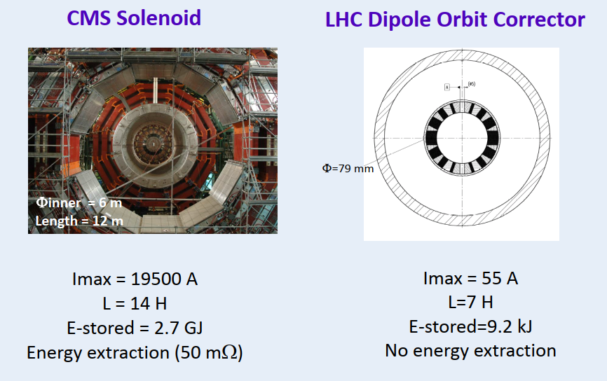
Magnets Individually Powered

Slide 6
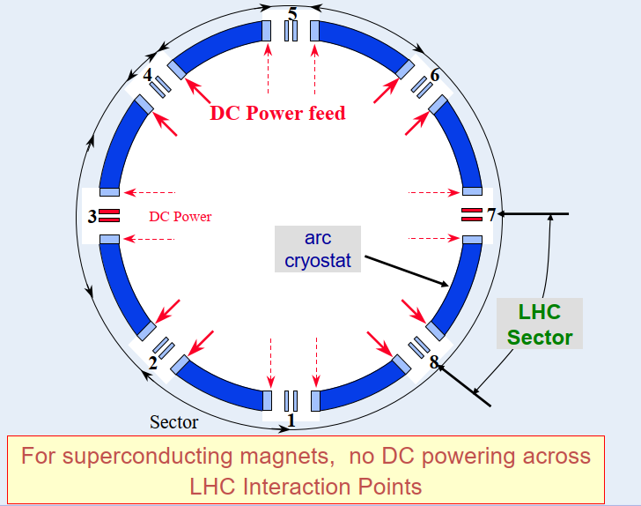
Powering of the LHC Machine
The LHC main lattice circuits are fed from the even points, left and right

Slide 7
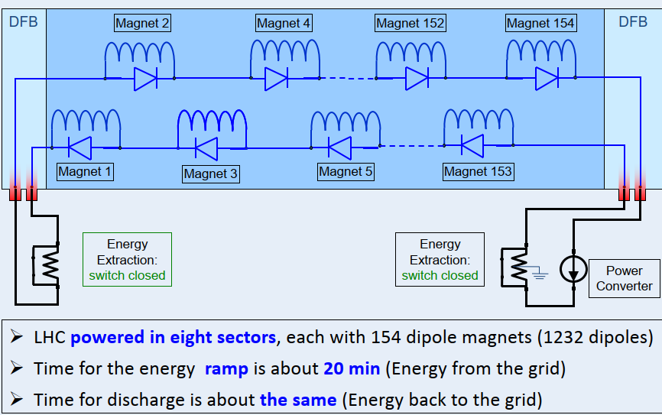
LHC Main Dipole Circuit

Slide 8
Current Leads
Current leads are usually the dominant source of heat leaking into the magnet(s) cryostat
Objective of a current lead design: minimisation of the heat leak introduced by the transmission of a given current and of the cryogenic cost of the electrical transmission
Sources of heat: thermal conduction from room temperature to the cryogenic environment and ohmic loss

Slide 9
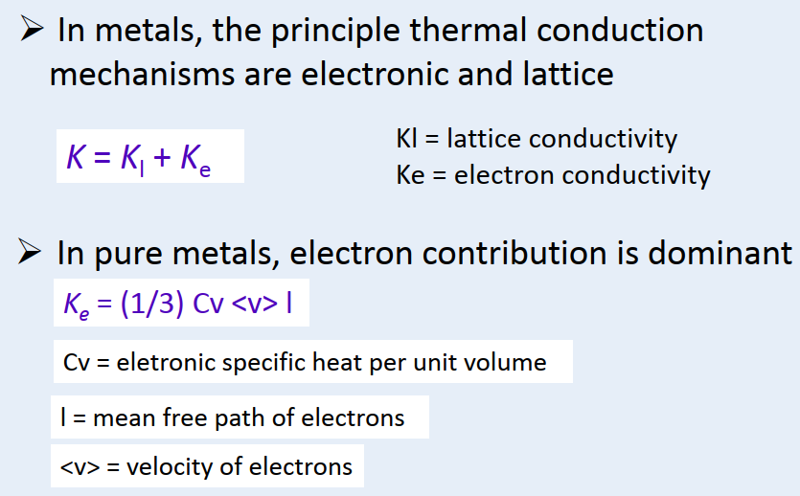
Thermal Conductivity in Metals (1/2)

Slide 10
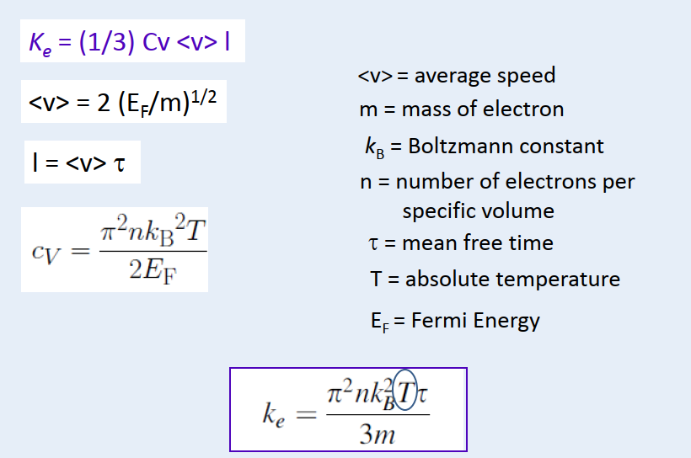
Thermal Conductivity in Metals (2/2)
1/2
(1.381×10⁻²³ J/K)
Ke derived from Boltzmann
transport equation

Slide 11
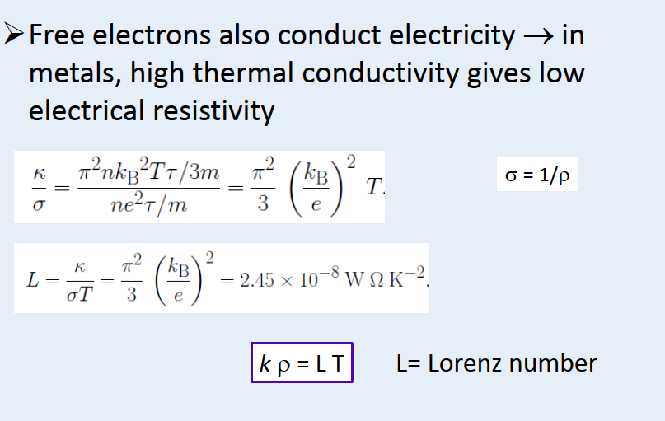
Wiedemann-Franz Law (1/2)

Slide 12
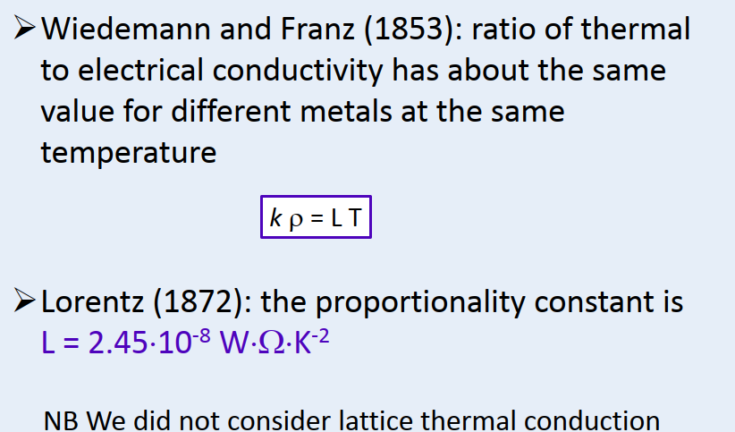
Wiedemann-Franz Law (2/2)

Slide 13
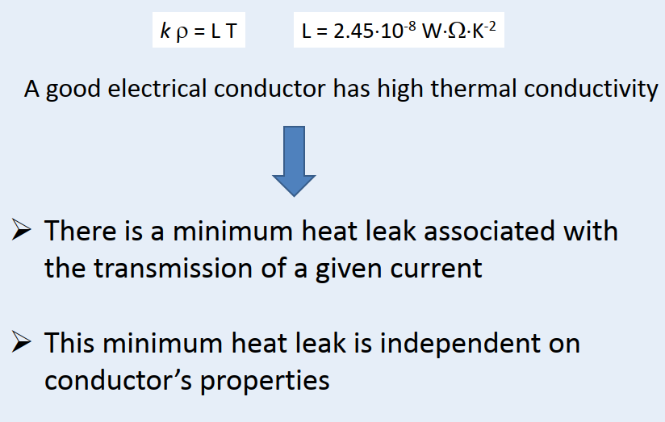
Optimization of a Current Lead

Slide 14
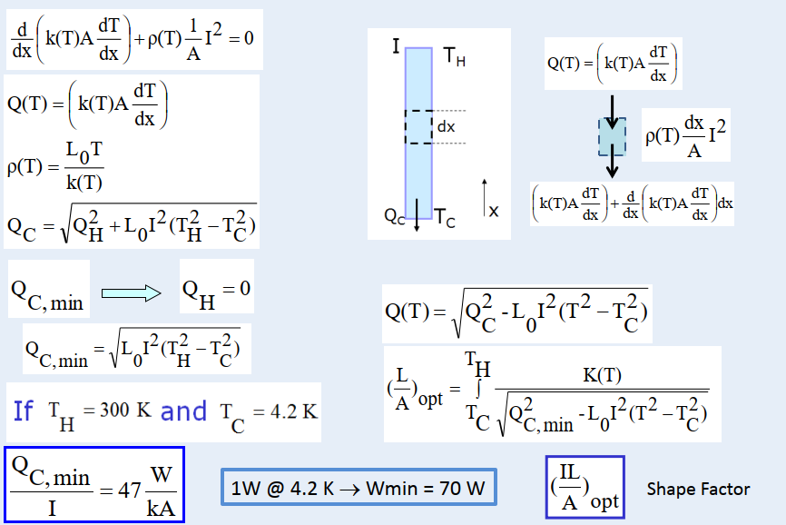
Conduction Cooled Current Leads
Steady state, mono-dimensional, Wiedemann-Franz Law

Slide 15
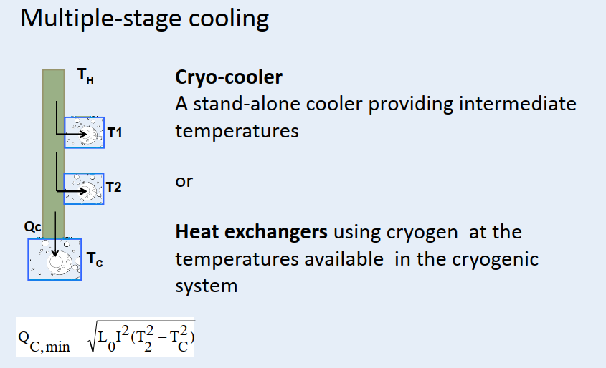
Conduction Cooled Current Leads

Slide 16
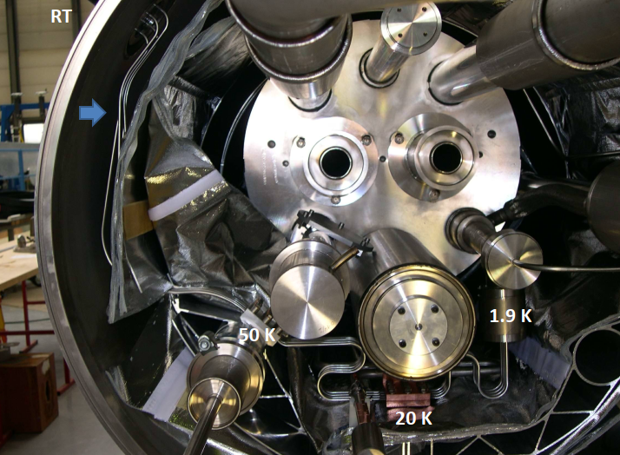
LHC Dipole Correctors Current Leads

Slide 17
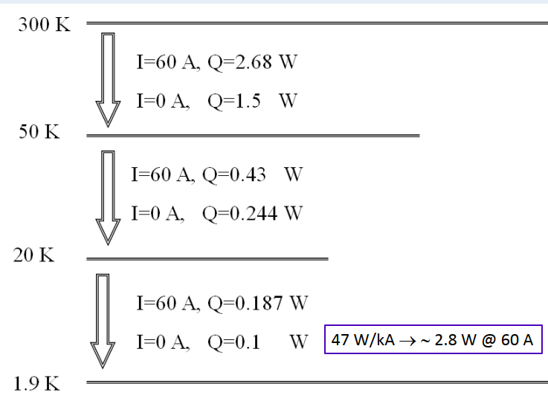
LHC Dipole Correctors Current Leads

Slide 18
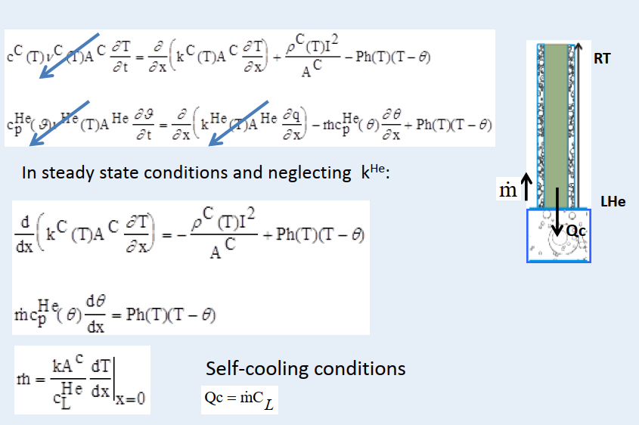
Self-Cooled Current Leads (1/3)
System of non-linear second-order partial differential equations – mono dimensional configuration
x

Slide 19
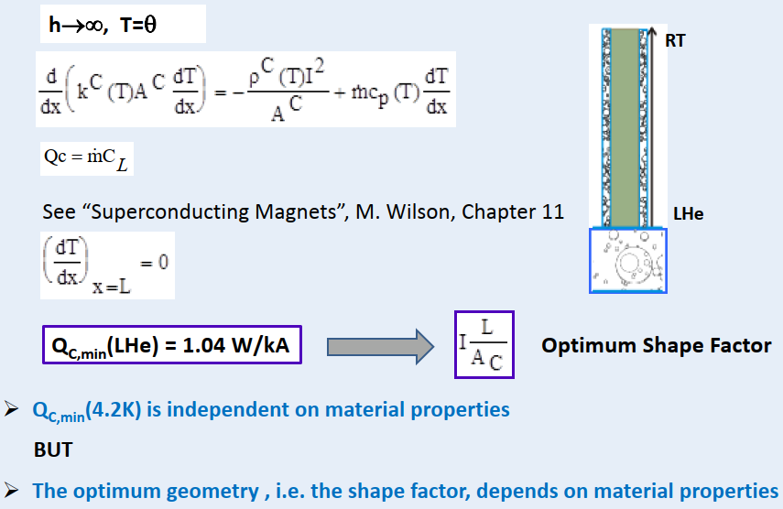
Self-Cooled Current Leads (2/3)
QC,min(LN₂) = 23 W/kA

Slide 20
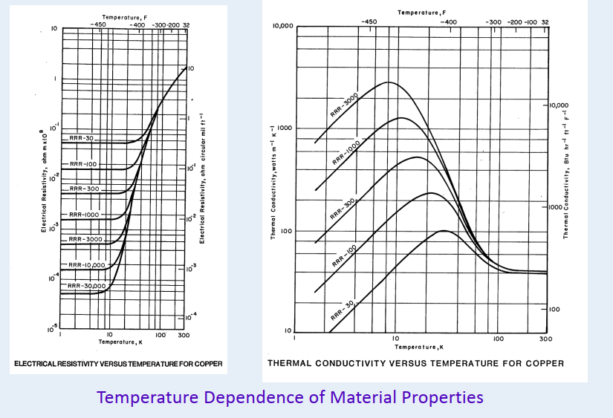
Electrical Resistivity and Thermal Conductivity

Slide 21
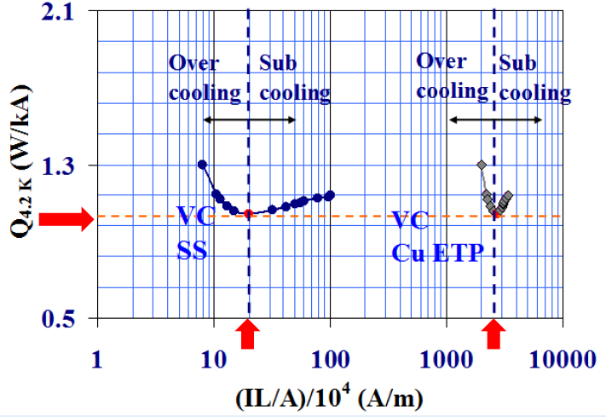
Self-Cooled Current Leads (3/3)
VC = Vapour (self) cooled
SS = Stainless Steel
Cu ETP = Copper Electrolytic Tough Pitch
Notes:
Cu ETP: a highly pure copper variety, refined through electrolysis

Slide 22
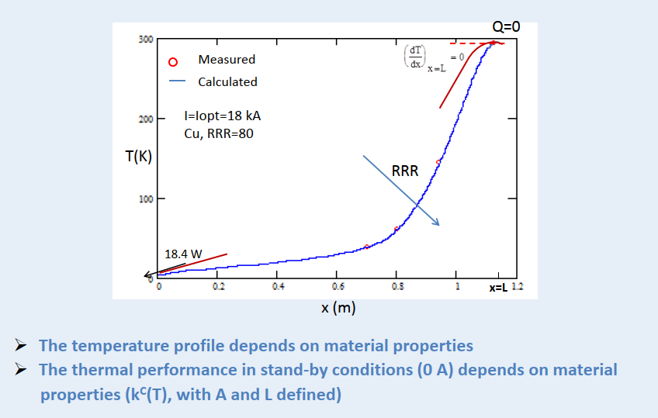
Temperature Profile of
Optimized Self-Cooled Current Lead

Slide 23
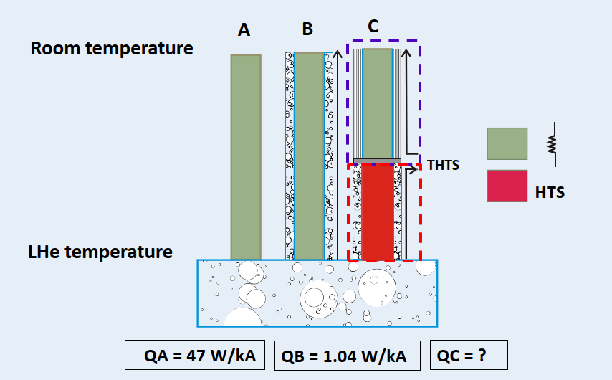
Conventional vs HTS Current Leads

Slide 24
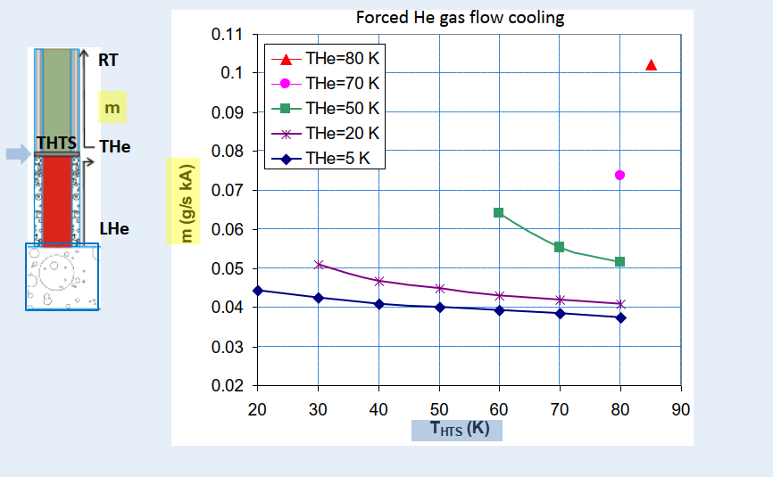
HTS Current Lead: Resistive Part (1/4)
The most efficient cooling schemes for HTS leads are based on independent cooling of the resistive and HTS parts. For a self-cooled HTS current lead, the reduction in exergetic cost of the refrigeration is only ∼ 15 %

Slide 25
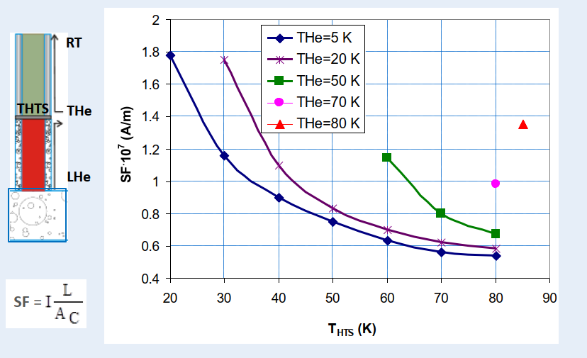
HTS Current Lead: Resistive Part (2/4)
Cu with RRR = 70

Slide 26
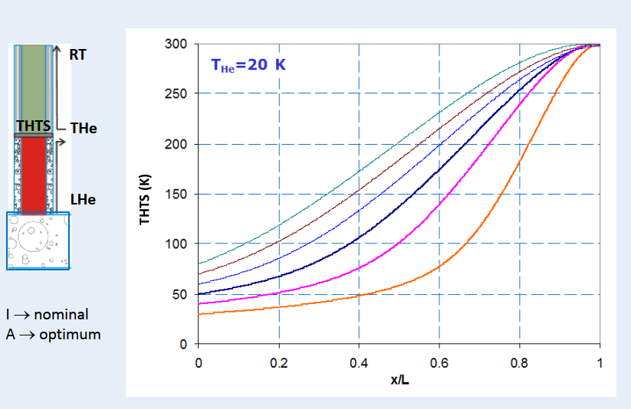
HTS Current Lead: Resistive Part (3/4)

Slide 27
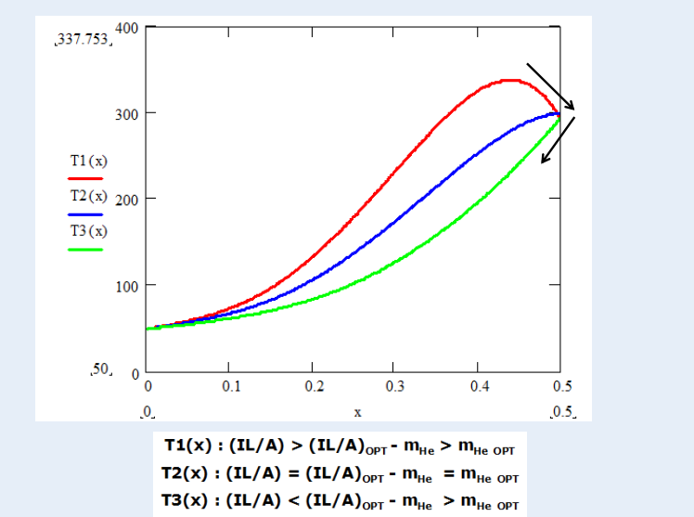
HTS Current Lead: Resistive Part (4/4)

Slide 28
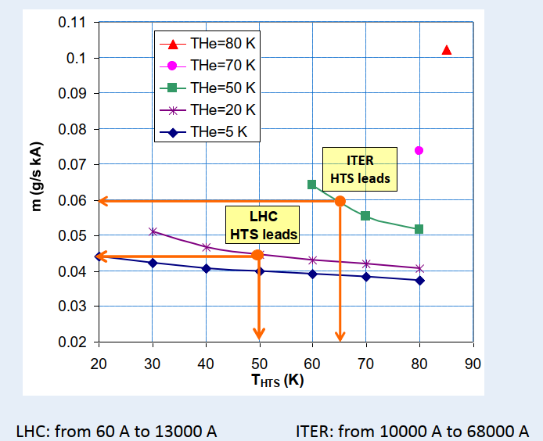
LHC and ITER Current Leads

Slide 29
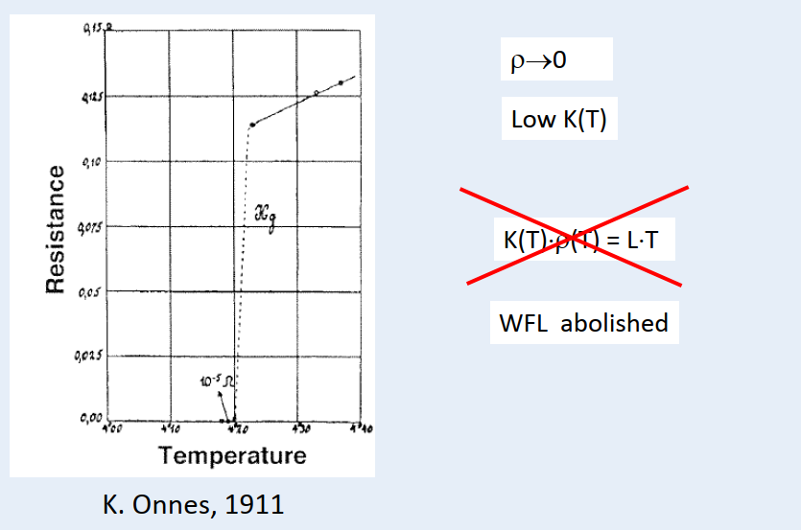
HTS Current Lead: HTS Part

Slide 30
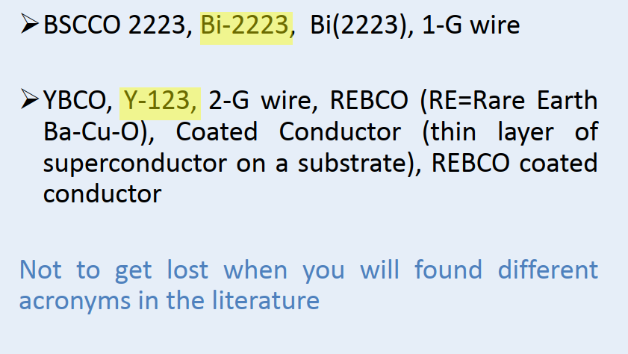
HTS for Current Leads

Slide 31
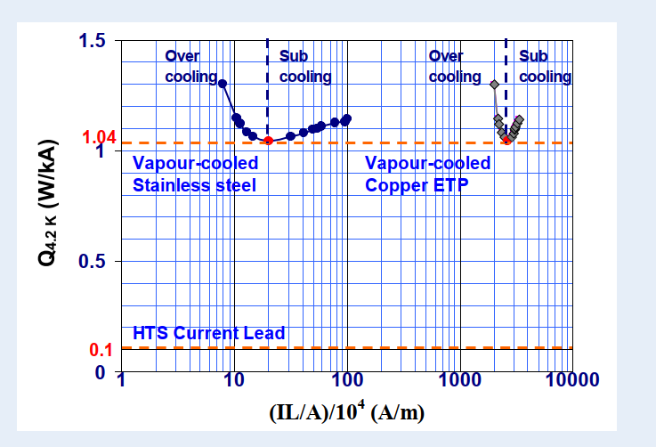
Conventional vs HTS Current Leads

Slide 32
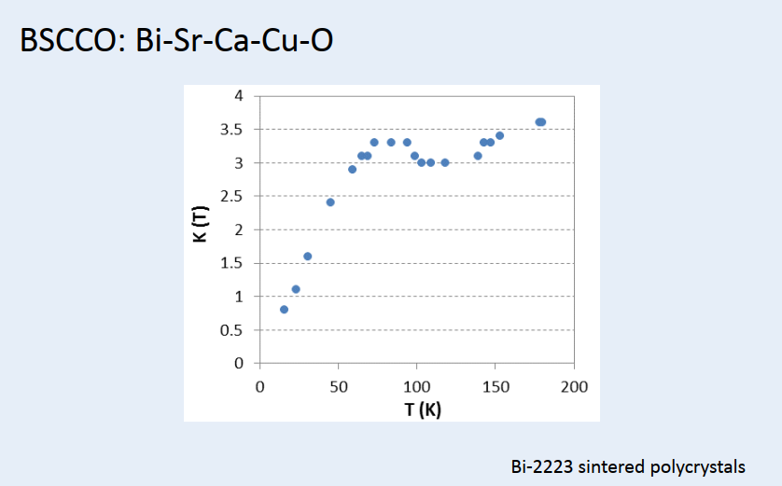
Thermal Conductivity of Bi-2223

Slide 33
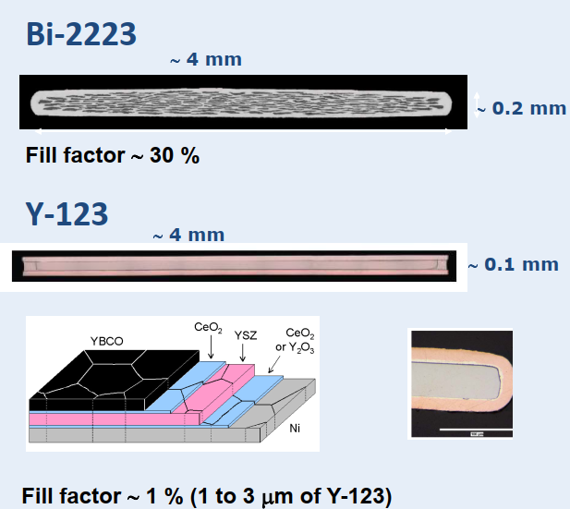
High Temperature Superconductors
Ag Matrix
Bi-2223 filaments
Ag is a good thermal conductor !
Metallic substrate
Buffer layers
REBCO layer

Slide 34
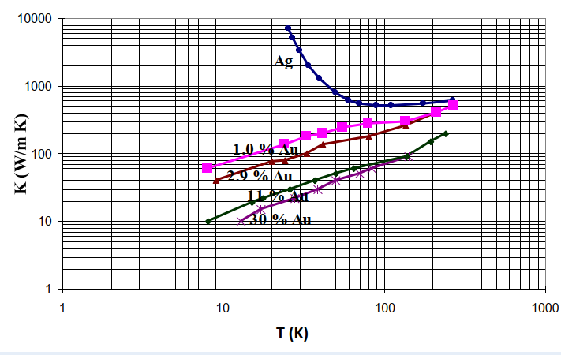
Silver-Gold Alloy
Alloying of silver with gold to reduce the thermal conductivity of the matrix wrt pure silver
N.B. The thermal conductivity of an alloy is not a weighted average
of its elemental constituents - the bonding structure strongly affects the heat transfer

Slide 35
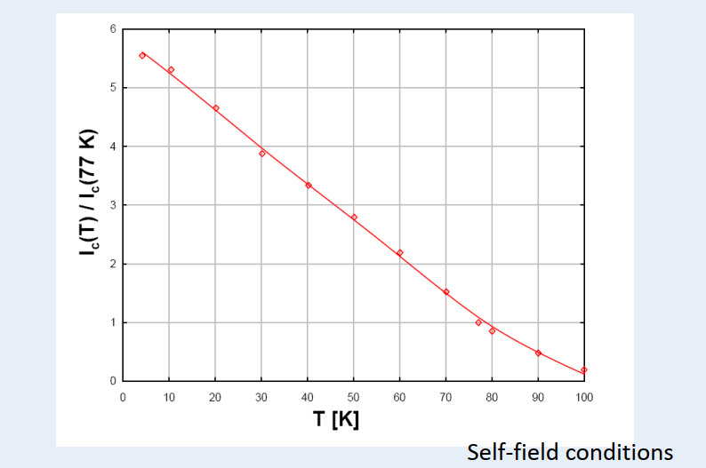
Ic(T) Dependence – BSCCO 2223

Slide 36
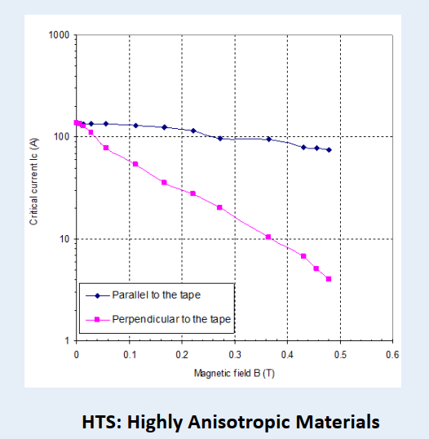
Ic(B) Dependence – BSCCO 2223
77 K

Slide 37
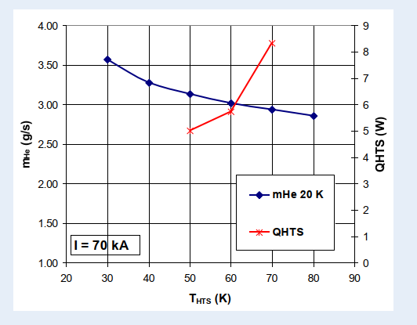
Operating Temperature - THTS

Slide 38
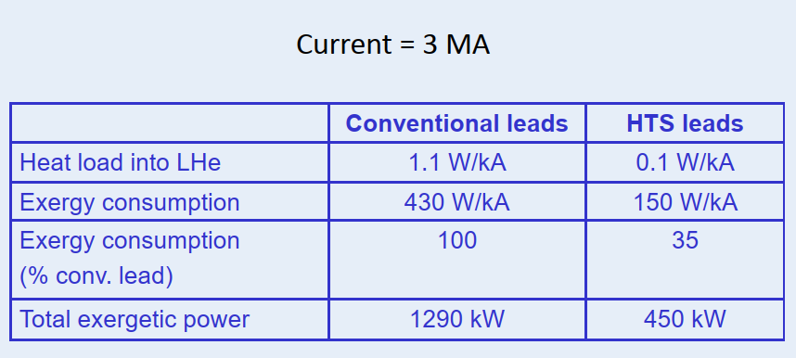
LHC Current Leads: Saving

Slide 39
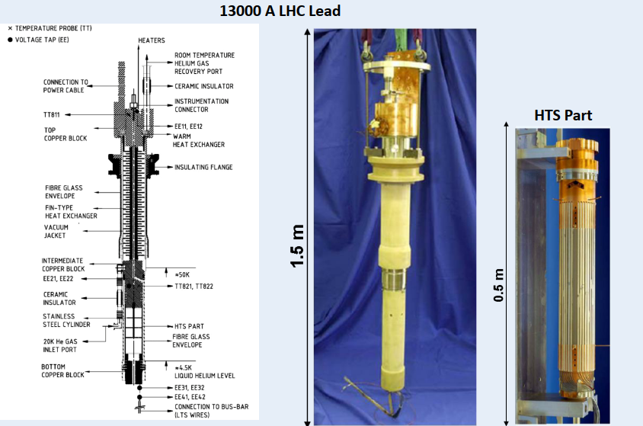
LHC HTS Current Leads

Slide 40
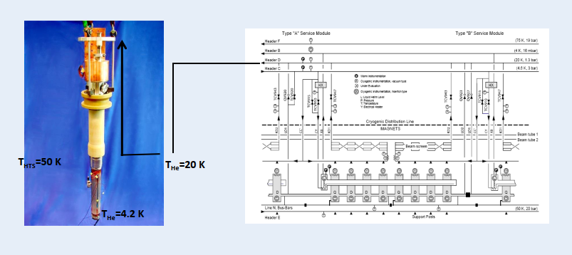
LHC HTS Current Leads

Slide 41
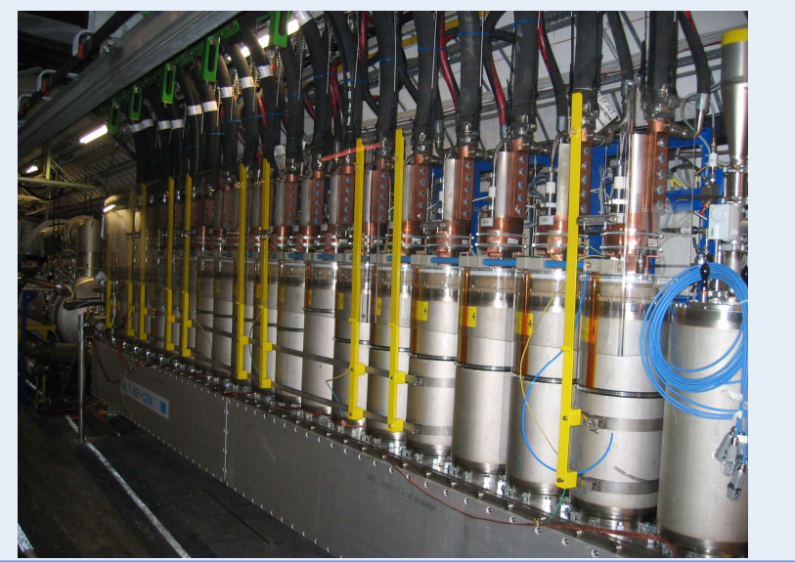
LHC HTS Current Leads in the Tunnel

Slide 42
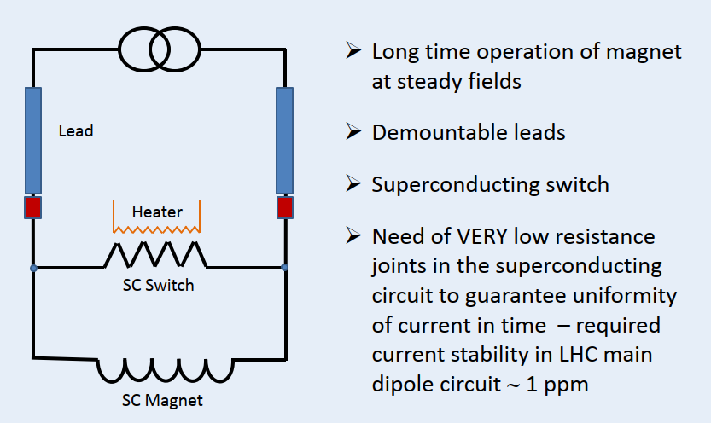
Persistent Current Mode Operation

Slide 43
Protection of Current Leas and Bus-Bar
A conventional self-cooled current lead needs to be protected against thermal run-away
The resistive and the HTS part of a HTS lead need to be protected against respectively thermal run-away and resistive transition (quench)
In most cases, the superconducting bus needs to be protected against resistive transition

Slide 44
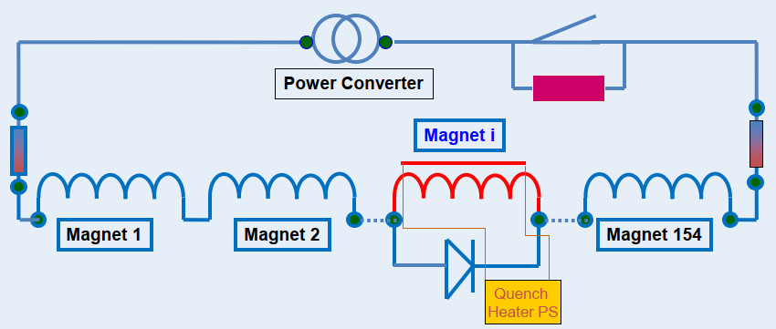
Protection of Current Leas and Bus-Bar
Ex. LHC Dipole circuit
When one magnet quenches, quench heaters are fired for this magnet. Resistance is switched in the circuit
The current in the quenched magnet decays in about 200 ms – it flows through the bypass diode

Slide 45
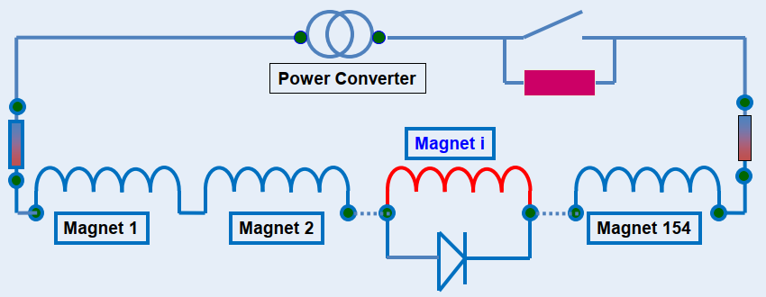
Protection of Current Leas and Bus-Bar
Ex. LHC Dipole circuit
The time constant of the LHC Main Dipole circuit is 107 s. This “rapid” current decay is obtained by switching an external resistance into the circuit
If the leads or bus-bar quench, the time constant for the discharge is given by the circuit (107 s for the LHC Main Dipole chain)

Slide 46
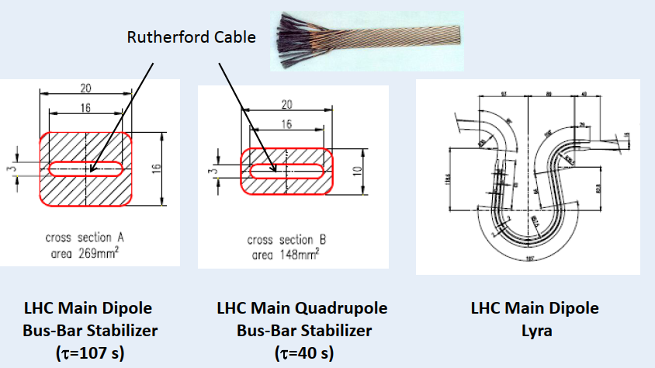
Protection of Bus-Bar
Ex. LHC Dipole circuit
Bus-Bar: Nb-Ti Rutherford Cable with copper stabilizer

Slide 47
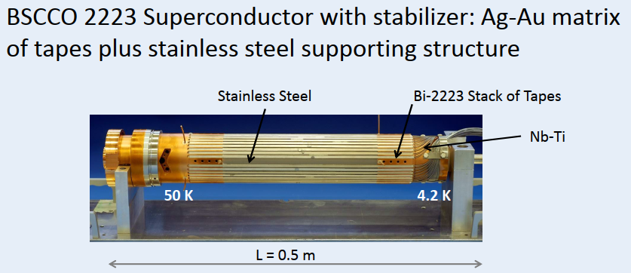
Protection of HTS Part of LHC Current Leads
NB: The long time constant of a circuit may make the use of HTS leads not appropriate. Ex. ATLAS toroid current leads (20.5 kA) are conventional (slow discharge of the circuit: τ ∼ 3 hours)

Slide 48
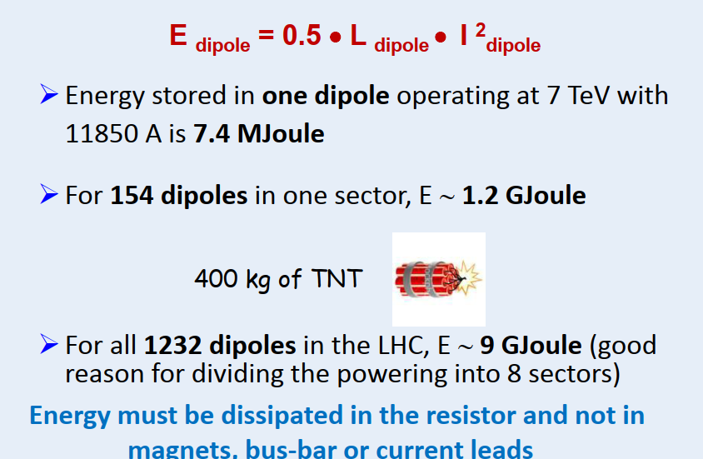
Energy Stored in LHC Dipole Magnets

Slide 49
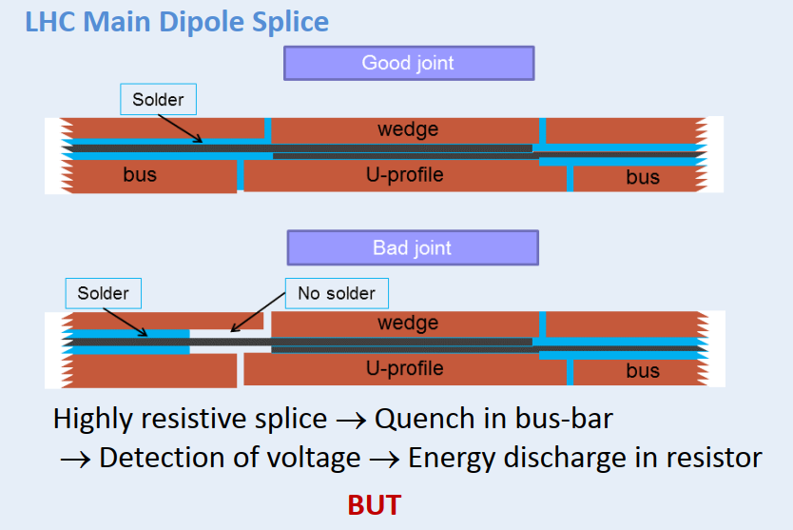
Protection of LHC Bus-Bar

Slide 50
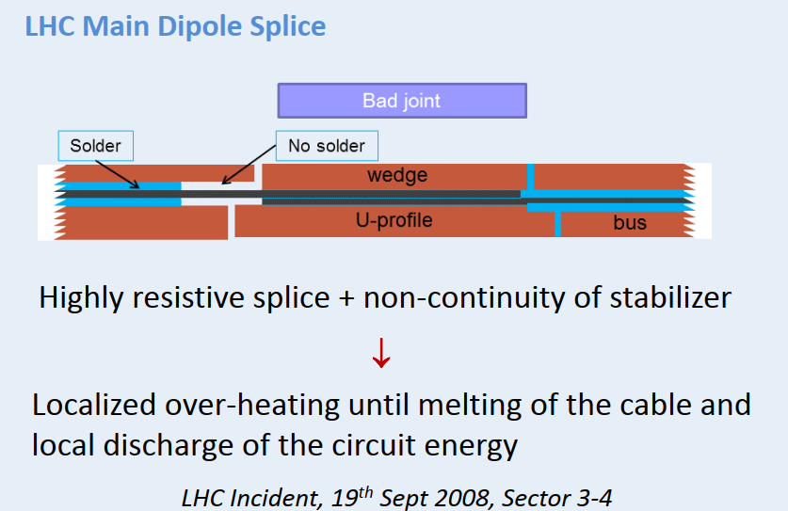
Protection of LHC Bus-Bar

Slide 51
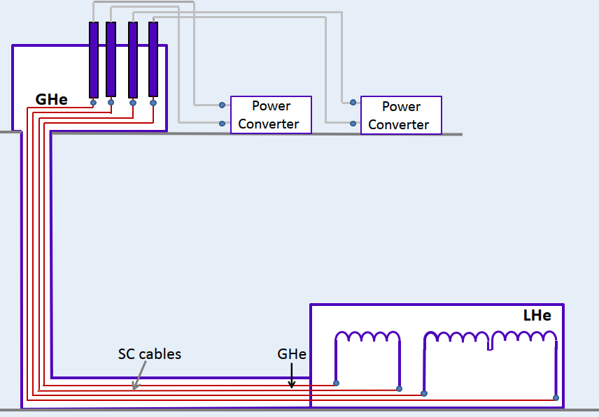
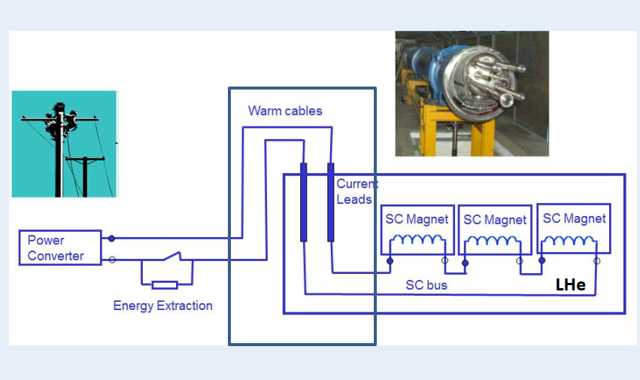
Superconducting Links
HL-LHC Configuration
LHC Configuration
SC Links

Slide 52
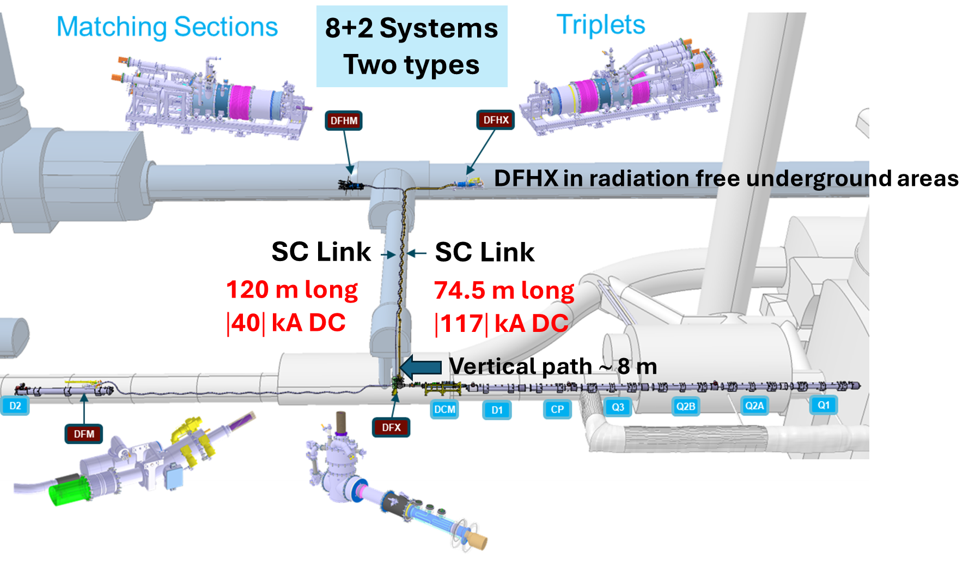
Superconducting Links for HL-LHC

Slide 53
Superconducting Links for HL-LHC
Itot up to 117 kA DC
Room Temperature cables – instead of SC Link - would not be an option because of power consumption and volume
Removal of current leads from the LHC tunnel

Slide 54
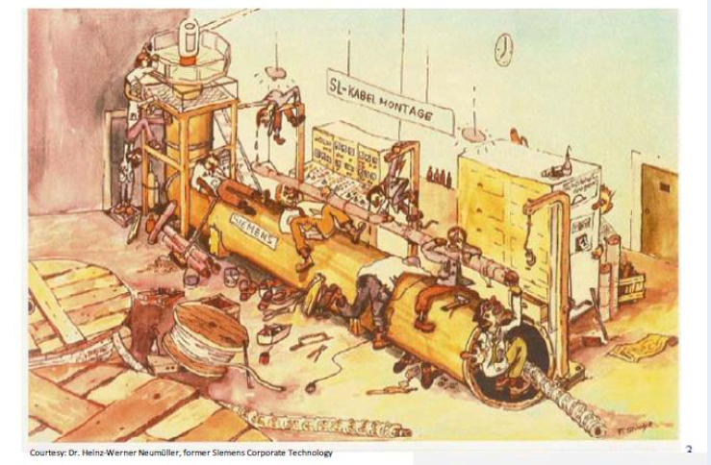
Thanks for your attention !

