Slide 1
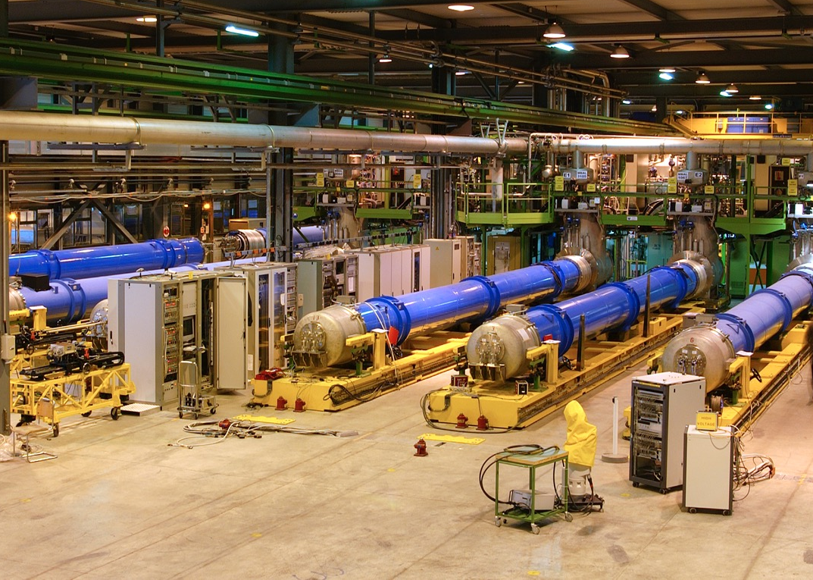

SUPERCONDUCTING MAGNET TESTING
Marta Bajko,
European Organization for Nuclear Research
(CERN TE-MPE-SF)
TIDM² x SC Magnets Lecture Series 2nd edition 2025

Slide 2

STRUCTURE OF THE LECTURE
Basics of Superconductivity
Few Relevant Features of Superconducting magnets
Measurements: why and how?
Test Stand and their components
Summary and References

Slide 3
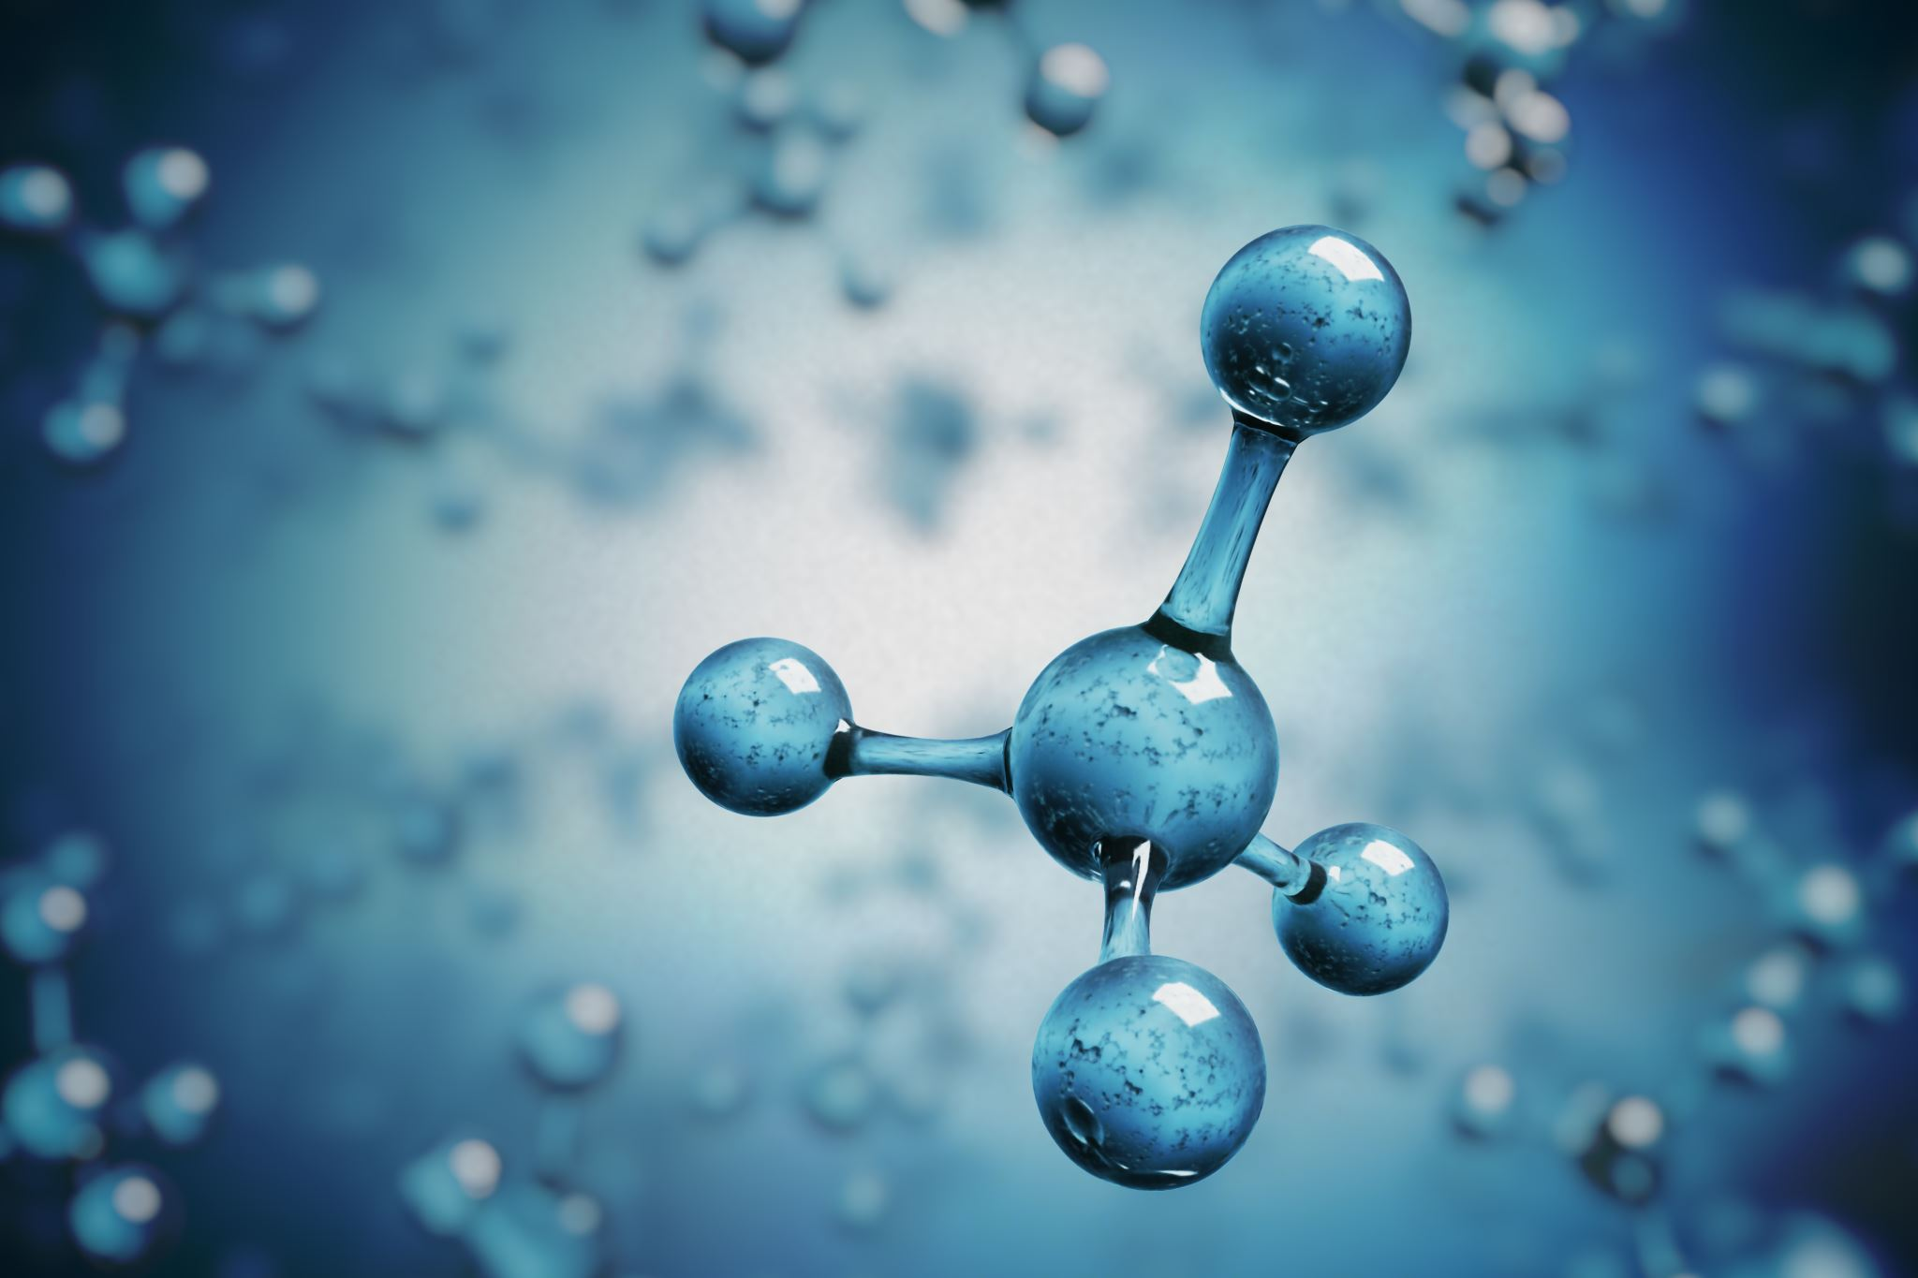
BASICS OF SUPERCONDUCTIVITY
Superconductivity is a remarkable state of matter characterized by zero electrical resistance and the expulsion of magnetic fields, achievable under certain conditions:
  temperature,
  magnetic field, and
  current density

Slide 4
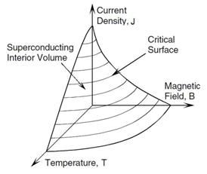
CRITICAL
SURFACE
The critical surface of a superconductor is a three-dimensional boundary in the space defined by
  temperature (T),
  magnetic field (B), and
  current density (J),
within which the material remains in its superconducting state.
Outside this surface, the material transits to a normal, non-superconducting state.

Slide 5
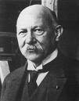

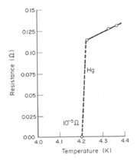
CRITICAL
TEMPERATURE
In 1911, Kamerlingh Onnes discovers the superconductivity of mercury. His team was investigating properties (resistivity, specific heat) of materials at low temperature. This discovery has been made possible thanks to his efforts to liquefying Helium, a major technological advancement needed for the discovery.
Superconductors can be classified based on their critical temperature (Tc) — the temperature below which they exhibit zero electrical resistance.
a. Low-Temperature Superconductors (LTS): typically metallic alloys or compounds require cooling with LHelium
b. High-Temperature Superconductors (HTS): usually ceramic materials, can be cooled with LNitrogen
Heinke Kamerlingh Onnes
(18 July 1853 – 4 February 1928)
Nobel prize 1913

Slide 6


CRITICAL
CURRENT DENSITY
See talk of Susana
The critical current density (Jc​) for a superconducting material is the maximum current density that the material can carry while remaining in its superconducting state. Beyond this critical value, the material transit from the superconducting state to the normal resistive state.
$$J_{c}=\frac{I_{c}}{A}$$
Ic​ is the critical current and A is the cross-sectional area
Ic is the current at which the superconducting state breaks down, and A is the area through which the current flows.

Slide 7
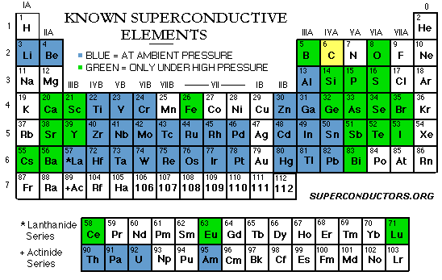
SUPERCONDUCTORS
Aluminum (Al), Cadmium (Cd), Indium (In), Lead (Pb), Mercury (Hg), Niobium (Nb), Tantalum (Ta), Tin (Sn), Titanium (Ti), Zinc (Zn), Silicon (Si) (under high pressure), Carbon (C) (under extreme conditions)
There are 53 elements in the periodic table that exhibit superconducting properties under certain conditions. These elements become superconductors at very low temperatures, often close to absolute zero.
  BUT THEY ARE NOT PRACTICAL

Slide 8
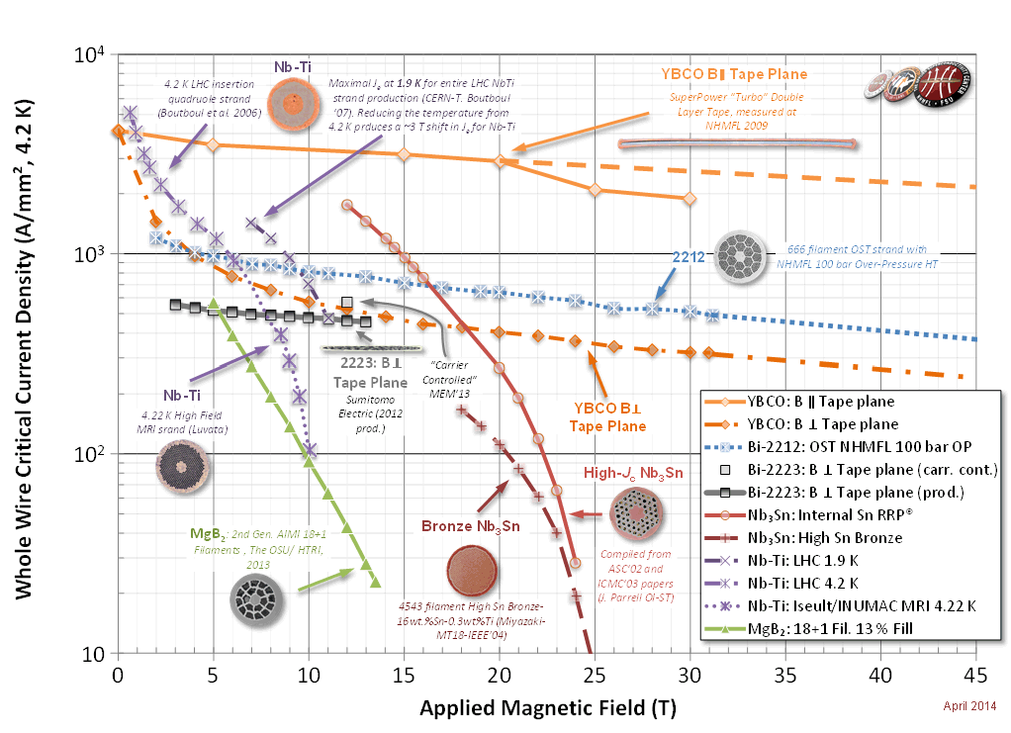
PRACTICAL SUPERCONDUCTORS
NbTi (1962)
Critical temperature of 10 K, critical field of 15 T
All superconducting magnets for accelerators are made with Nb-Ti till today.
LHC uses this technology (for 8 T magnets)
  Nb₃Sn (1954)
  Critical temperature of 18 K, critical field of 30 T
  Must be formed reacting it at 650 C for several days with tight tolerances on temperature.
  HL-LHC uses this technology where higher field is necessary ( > 11 T). It is strain dependent
Is using
Critical current density in the superconductor versus field for different materials at 4.2 K [P. J. Lee, et al]
https://nationalmaglab.org/images/magnet_development/asc/plots/JeChart041614-1022x741-pal.png

Slide 9
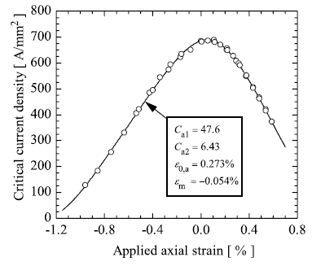
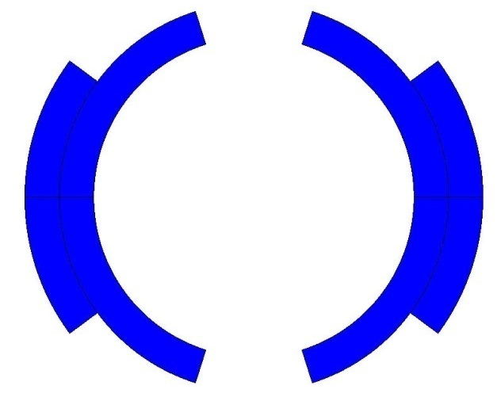
CRITICAL
STRAIN?
Typical for Nb₃Sn
See talk of Susana
So now we have to care ALSO about the mechanics!! And the strain sensitivity
A. Godeke et all 2006
In the presence of a magnetic field B, a conductor element carrying current density j (A/mm²) is subjected to a force density f [N/m³]
  Ex. LHC dipole :
  F_{x} = 340 t per meter

Slide 10
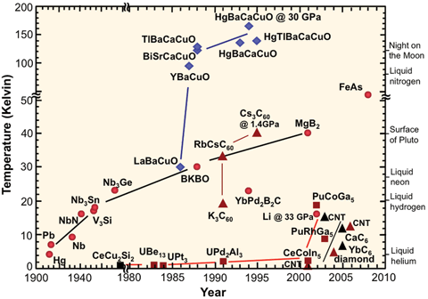
High Temperature SUPERCONDUCTORS
77 K LN₂
High Field SUPERCONDUCTORS
Practical coolants ?
4.2 K LHe
In fact, in addition to their superior properties at relatively higher temperatures, HTS materials also come along with significantly expanded magnetic field capabilities.
Is using
Critical current density in the superconductor versus field for different materials at 4.2 K [P. J. Lee, et al]
https://nationalmaglab.org/images/magnet_development/asc/plots/JeChart041614-1022x741-pal.png

Slide 11
STRUCTURE OF THE LECTURE
Basics of Superconductivity
Few Relevant Features of Superconducting magnets
Measurements: why and how?
Test Stand and their components
Summary and References

Slide 12
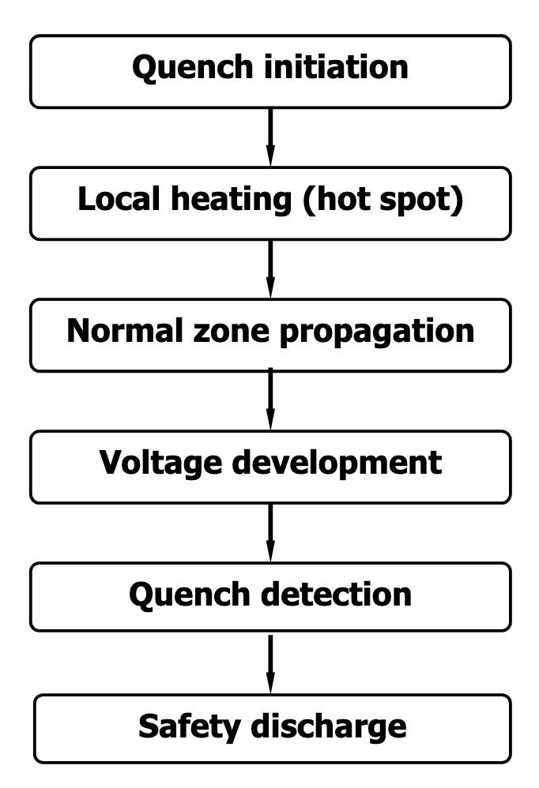
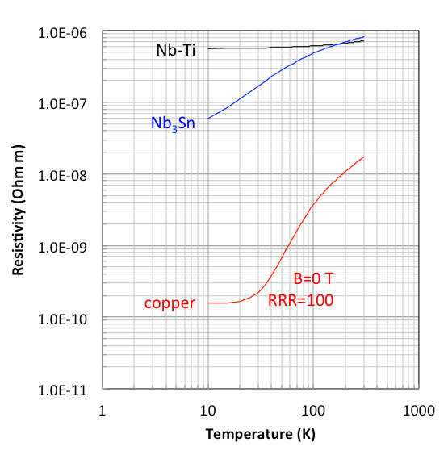

quench
See talk of Susana
  good superconductors are
  bad normal conductors
Typically, the normal state resistivity of LTS materials is two to four orders of magnitude higher than the known good conductors
The QUENCH is the result of a transition in a superconducting magnet, leading to appearance of voltage, strain, temperature increase, thermal forces, and cryogen expulsion.
L
T < T_{cs}
T(or J)> T_{c} (J_{c})
R
Sc I
Sc I
$$R_{Sc}$$
R= variable = f( Iop, B, RRR, T)

Slide 13
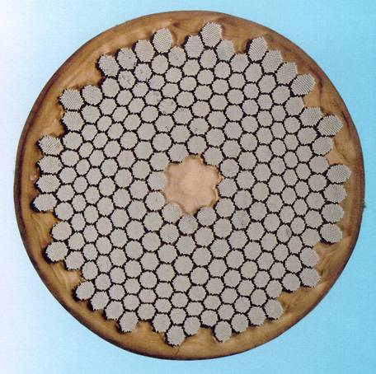
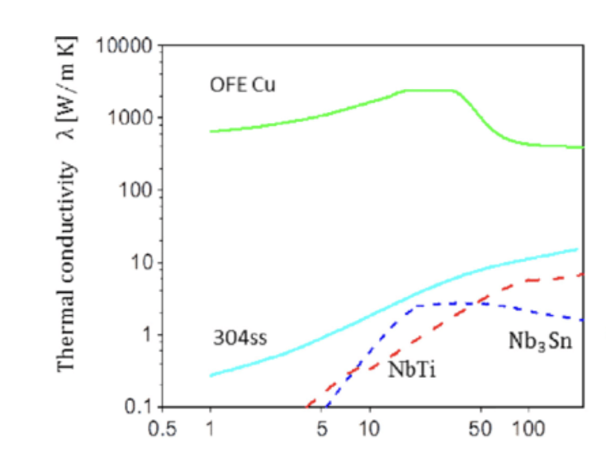

STABILISATION
Solid Sc wire is replaced with an array of thin Sc filaments embedded in Cu matrix. If the filament loses its Sc state , the current will be redirected into the surrounding Cu stabiliser.
T < T_{cs}
Reduces resistivity (ρ) by using copper matrix
(3x10⁻¹⁰ Ωm, factor 2000 !)
and
increases thermal conductivity (λ) by using copper
(> 200 W/mK, factor 2000
L
T > T_{c}
Cu
Cu I
Sc I
Sc I
Cu
R
Cu I
$$R_{Cu}$$

Slide 14
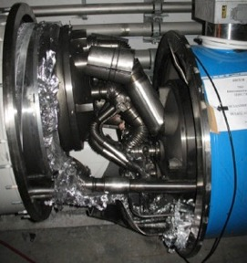

STORED ENERGY
See talk of Susana
LHC Dipole cold masses. Consequence of the 2008 incident: anomalous high contact resistance with high current evaporating the LHe.
The energy stored in the magnetic field generated by the current flowing through the coil is
$E_{m}$=$\frac{1}{2}$L$I^{2}$
Example
The 14-m long LHC dipole has a stored energy of 7 MJ at
the design field of 8.4 T
0.7 MJ of energy is sufficient to heat up from 4 K and melt ~1 kg of Cu
Superconductivity is DESTROYED when loosing any of the critical conditions: temperature, current density, magnetic field
The formula shows that the energy is directly proportional to both the Inductance (L) and the square of the Current (I).
Where:
E is the electromagnetic energy stored in the coil ( J),
L is the inductance of the coil (H),
I is the current passing through the coil ( A).

Slide 15
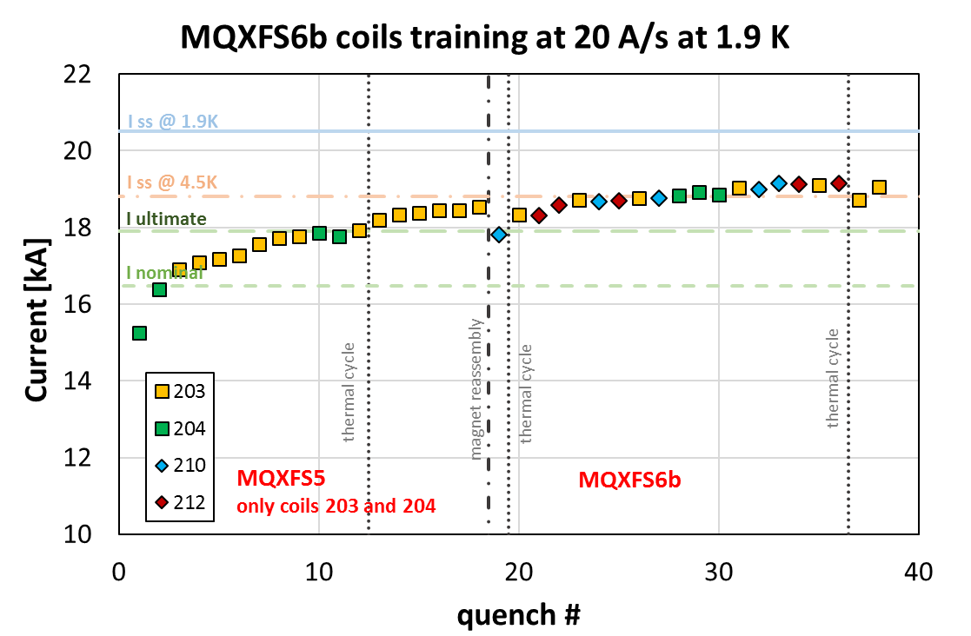
TRAINING and MEMORY
TRAINING
MEMORY
See talk of Susana
When the current in a magnet is ramped up for the first time, it usually quenches at a level below the short sample limit. During the next trial, it typically performs better. This sequence of events is known as training.
The magnet "remembers" the previous point and becomes stabilized through consecutive thermal cycles. This is known as memory.

Slide 16
STRUCTURE OF THE LECTURE
Basics of Superconductivity
Few Relevant Features of Superconducting magnets
Measurements: why and how?
Test Stand and their components
Summary and References

Slide 17
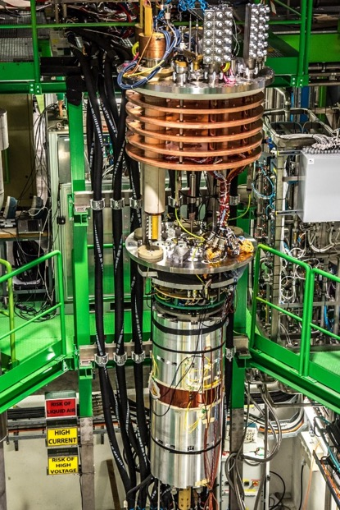
magnet ON to the test stand
See talk of Hugo
The cryostat “insert”
It is a non negligible and precise work!
Do not forget that cryogenic test are long processes ( cool down and warm up are long and therefore no room for mistakes!
you have to deal with vacuum, low temperature and high current
Instrumentation is going thought several intermediate connections but they still need to bring the signals CLEAN out from the cryostat to communicate with the magnet
The magnet

Slide 18
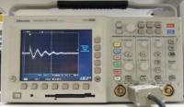
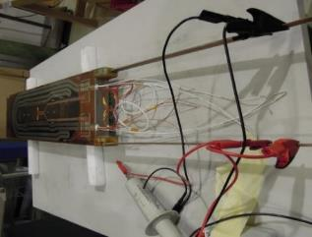
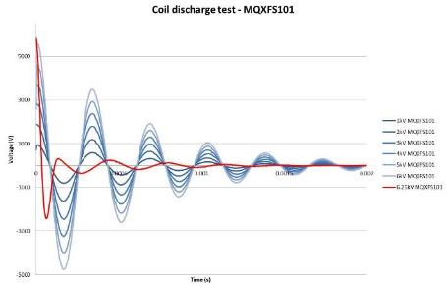
Electrical integrity checks
CONTINUITY
Verify the correct wiring of the instrumentation placed inside the magnet for:
Diagnostique
Quench detection
See talk of Jaromir
HIGH VOLTAGE TEST
Verify the correct electrical insulation of the magnet components. Pay attention to the safety at execution!

Slide 19
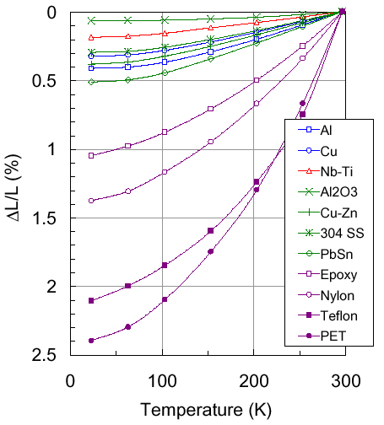
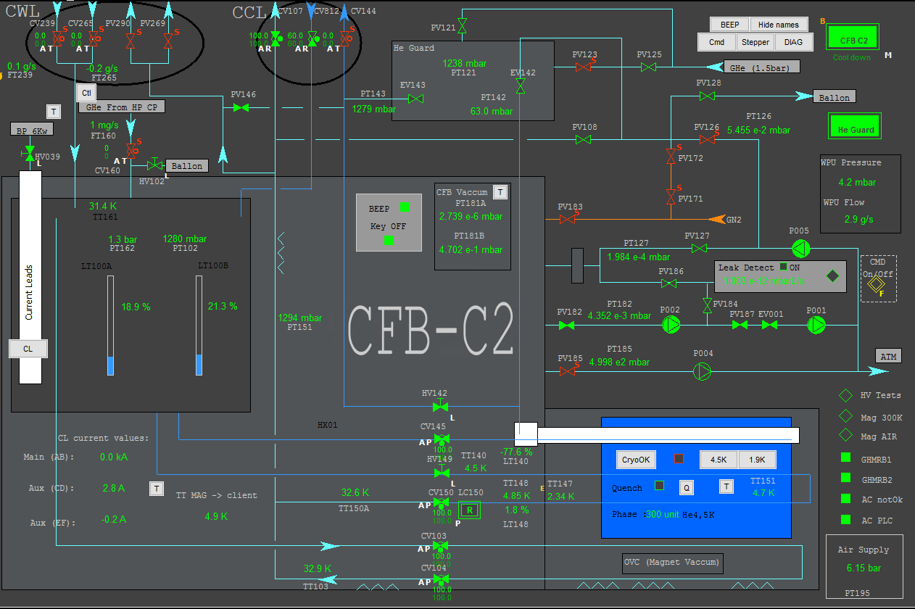
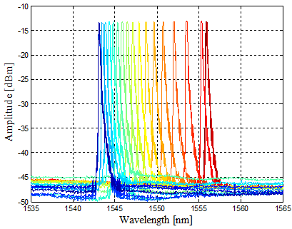
TEMPERATURE MEASUREMENT
Reduce the gradient
to limit thermal contraction induced stress
See talk of Bertrand, Federico
In general rule we limit the colling speed to a max thermal gradient in the magnet not exceeding 30 K.
Effect important > 100 K
ρ_{a}: photo elastic coefficient
ξ: thermo-optic coefficient
α: thermal expansion coefficient

Slide 20
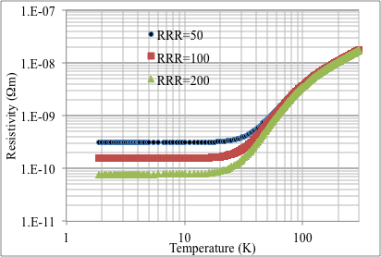
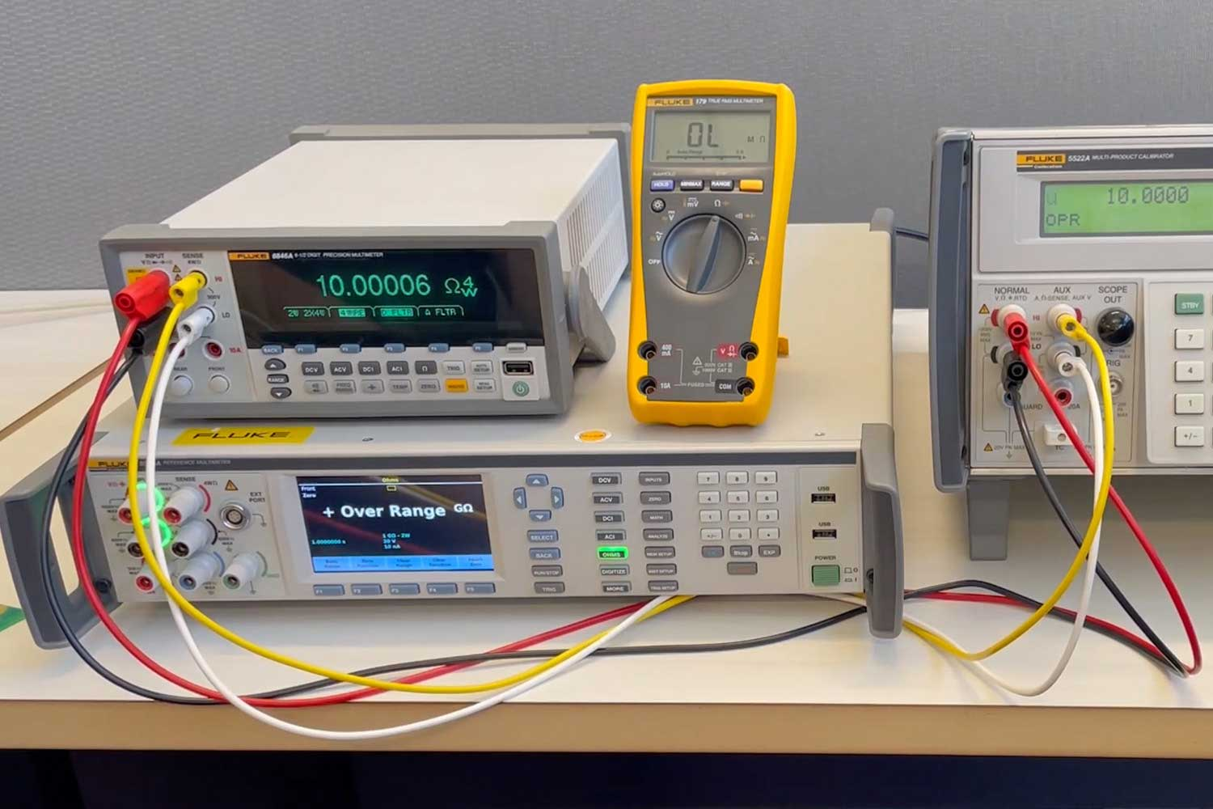

RESISTANCE MEASUREMENTS
Stabilization: During transitions to a resistive state, the copper layer carries the current and dissipates the heat.
This measurement is ideally performed during the magnet's warm-up.
Quench Propagation: During a quench, low-resistivity copper quickly conducts heat away from the hot spot, preventing excessive temperature rise and spreading the quench more evenly across the magnet.
RRR is defined as the ratio of the resistivity of copper at room temperature (300 K) to its resistivity at a very low temperature (typically 4.2 K):
$RRR=$ $\frac{ρ_{300K}}{ρ_{4.2K}}$
High RRR in copper it indicates purity and lack of defects so low resistivity at low temperatures.
us.flukecal.com

Slide 21
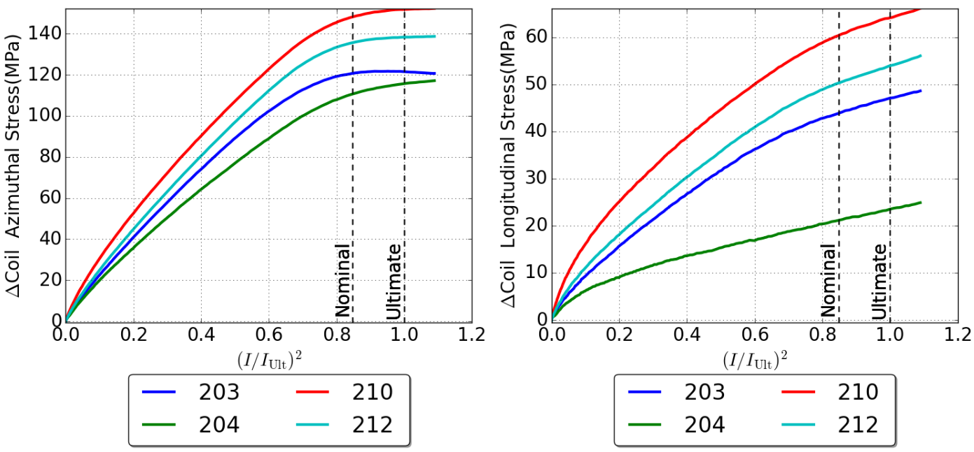
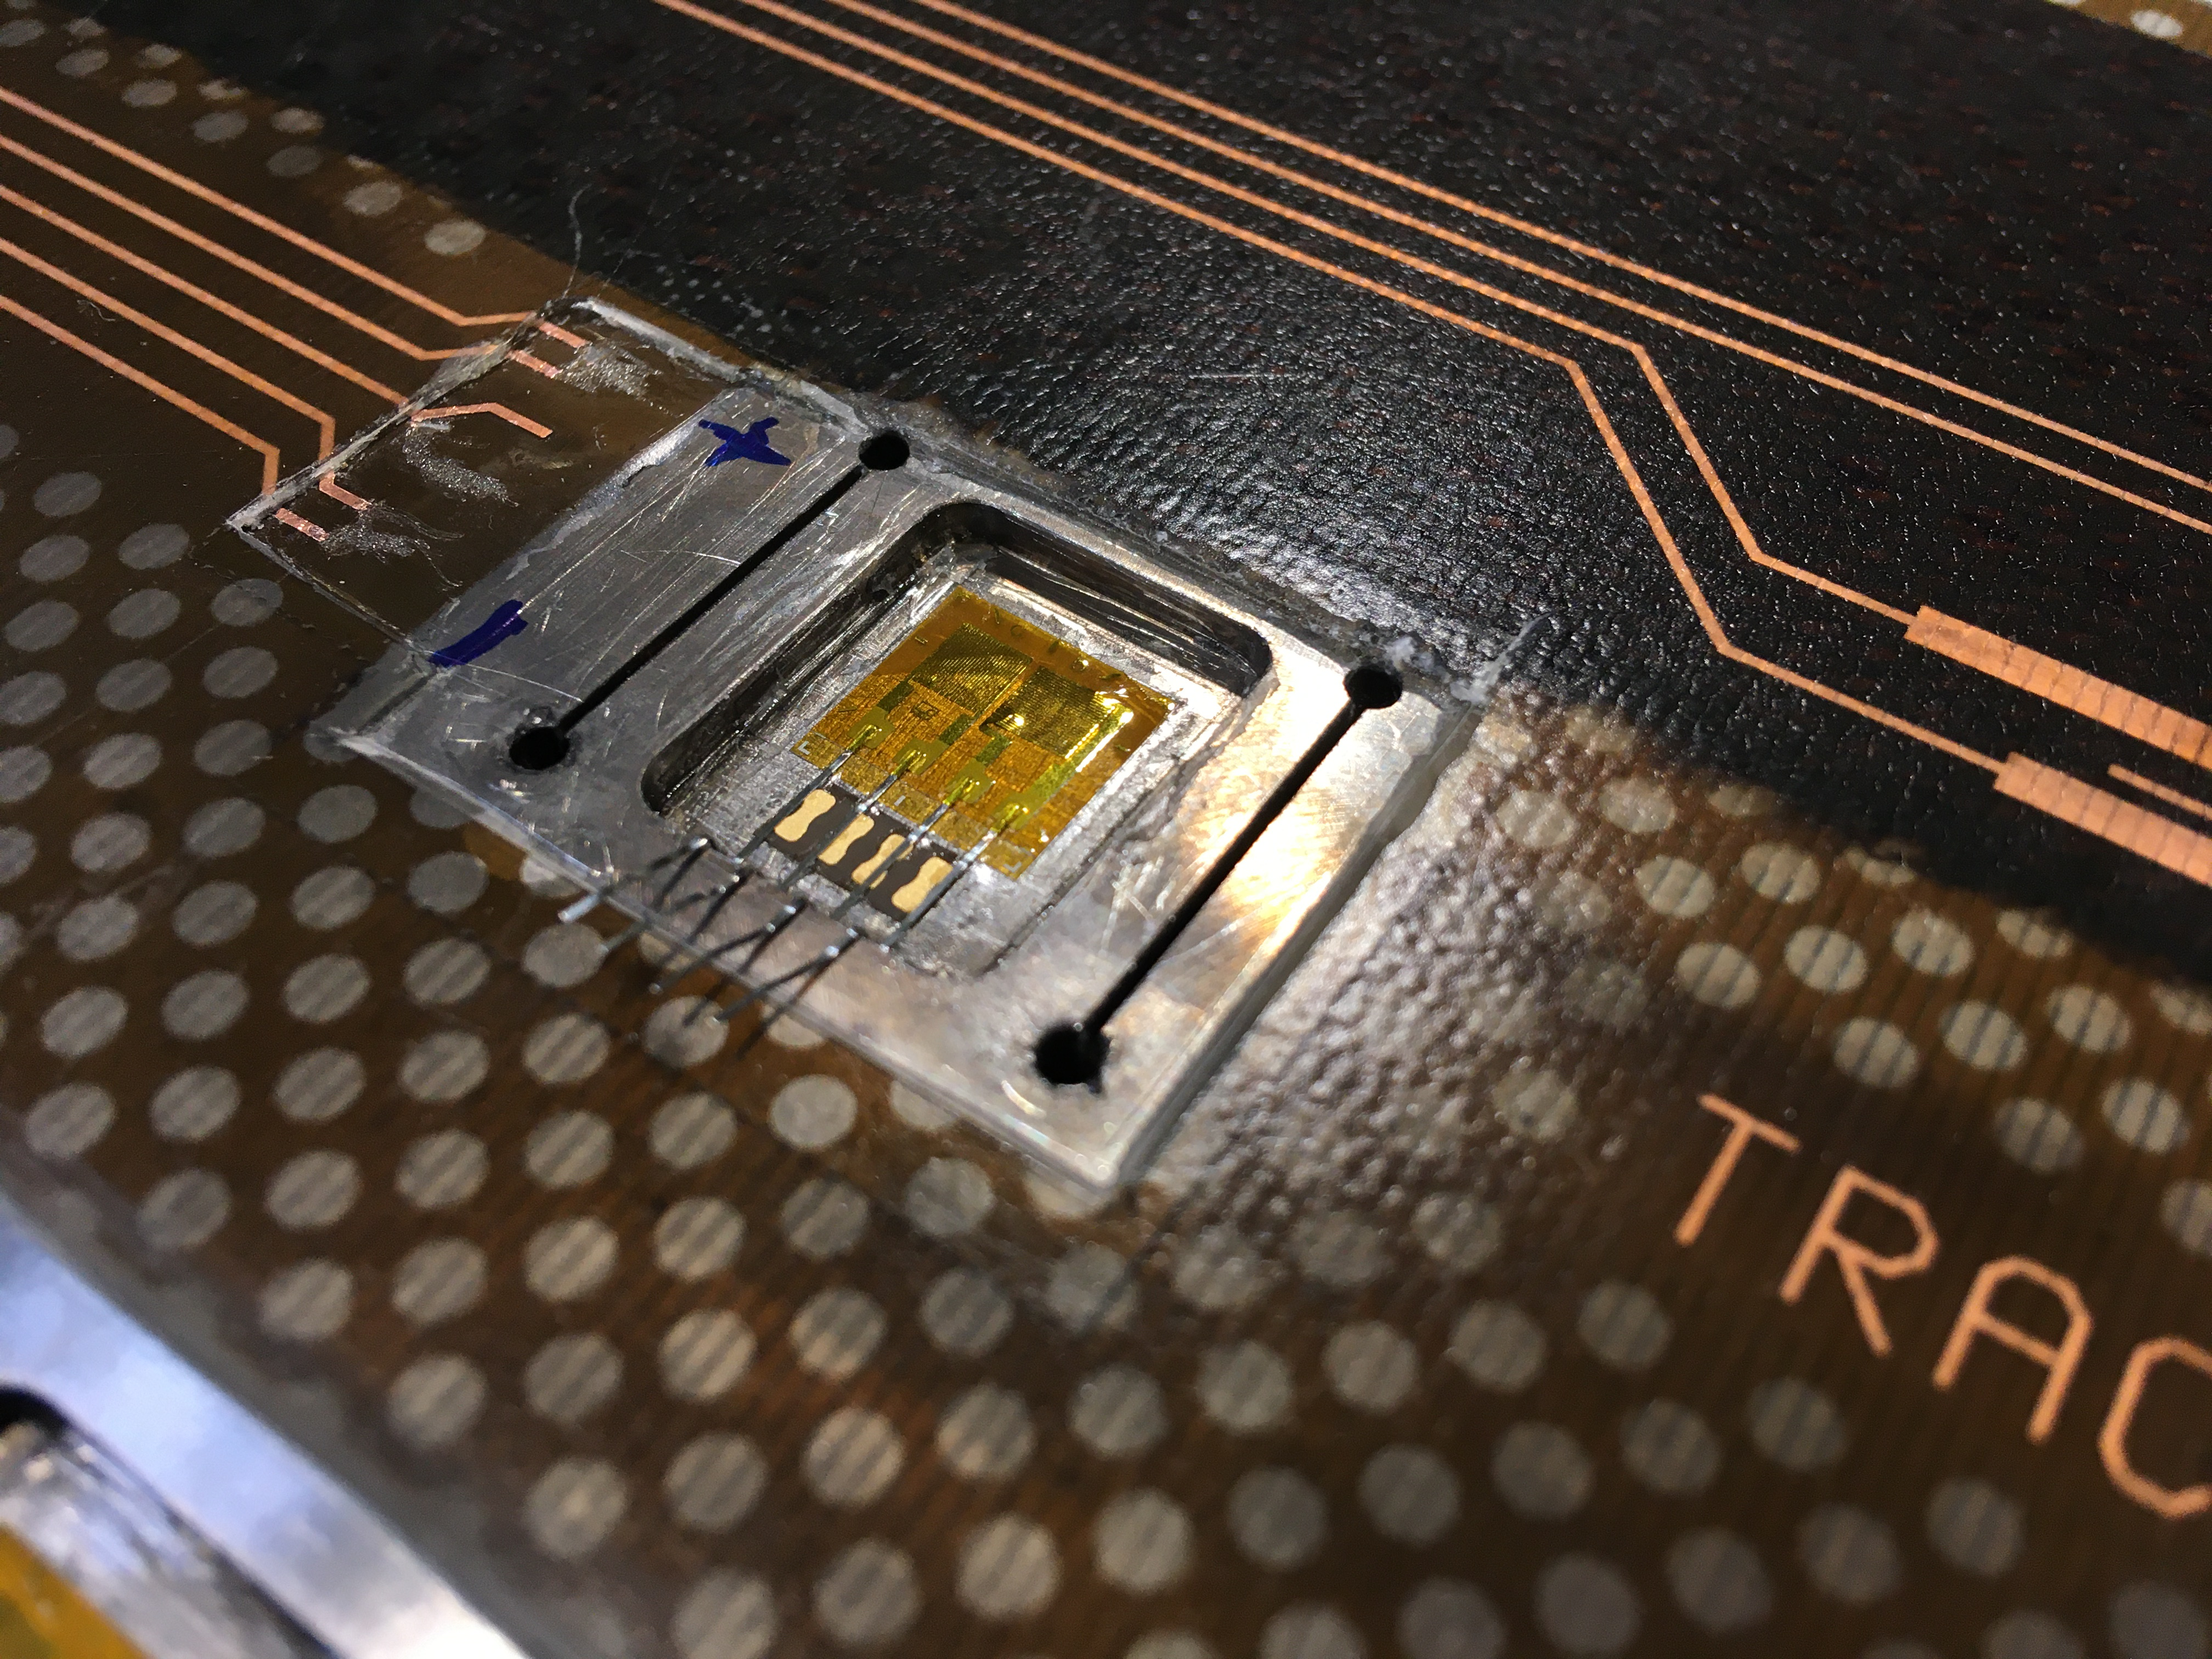
Strain measurement
See talk of Susana, Michael, Erica
Electromagnetic forces can induce mechanical stresses that may induce deformations and so impact the filed quality often of a key importance.
Superconducting materials are sensitive to strain. Even small amounts of strain can alter their performance).
Monitoring strain helps in understanding the performance limits.
Strain measurements can detect early signs of mechanical instability that might lead to a quench
Electrical strain gauges

Slide 22
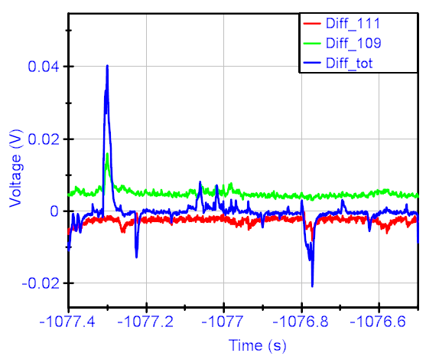
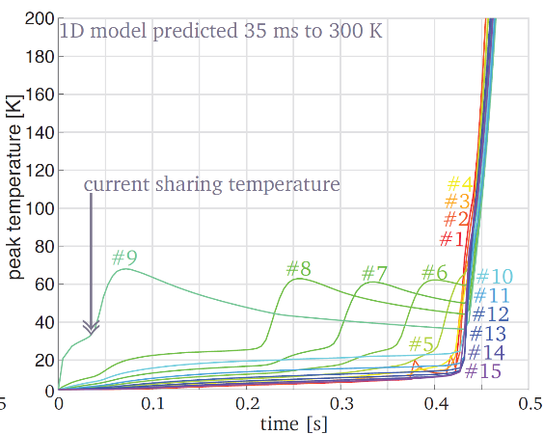
Voltage Signal
The primary method for quench detection involves monitoring the voltage across different sections of the superconducting coil and their combination.
QUENCH DETECTION
See talk of Tiina, Erica
Quench detection systems rely on monitoring various signals from the superconducting magnet. These signals can be combined in different ways to provide reliable detection of a quench.
Detecting a quench quickly allows the system to activate protection mechanisms, such as bypassing current or safely discharging the magnet.
Temperature Sensors
Temperature sensors (e.g., thermocouples, Optical Fibers) are placed along the magnet to detect local temperature increases due to a quench. In case of HTS where the quecnh propagation is slow is particularly adapted.

Slide 23
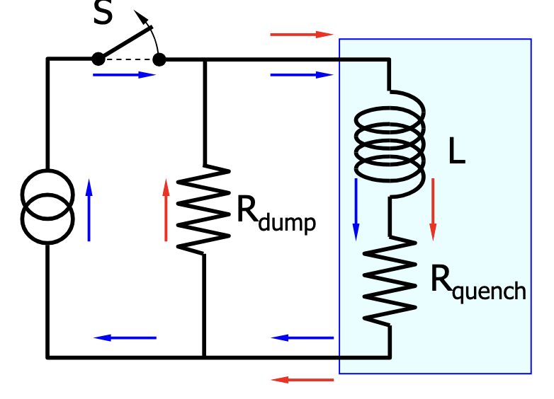
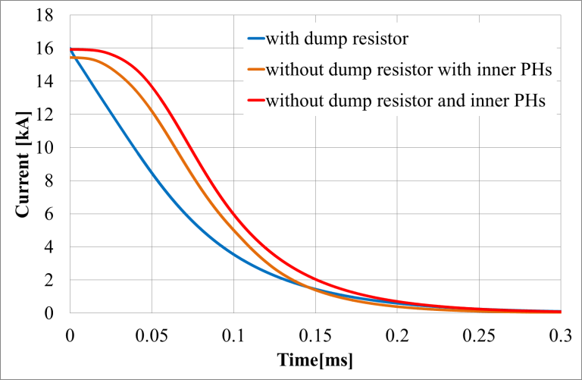




Energy extraction
See talk of Tiina
For a fast de-excitation in the case of a quench, a magnet can be equipped with external energy extraction systems with circuit breakers and energy-absorbing dump resistors.
Efficent extraction outside the cryostats
$$\frac{R_{quench}}{R_{dump resistor }}=50−60\%$$
$$I=I_{0}e^{−\frac{t−t_{quench}}{τ}}$$
$$τ=\frac{L}{R}$$
…..but adding an external dump resistor creates a voltage at the magnet leads, proportional to the dump resistor. So the resistor size is limited by magnet insulation.
$$V_{max}=I R_{dump resistor}$$
Arcing (gas discharge) may start uncontrolled energy release and eventually destroy the magnet. Therefore, in practice Rdump is limited to keep the maximal allowable magnet voltage 𝑉𝑚𝑎𝑔 𝑚𝑎𝑥 < 1000 V

Slide 24
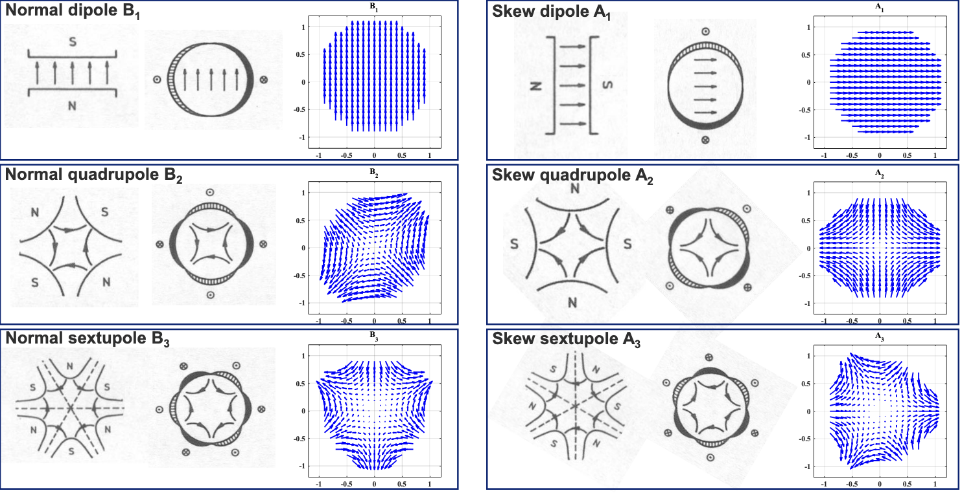
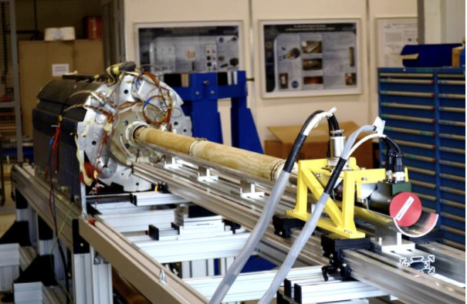
MAGNETIC measurement
See talk of Susana, Lucio
Magnets are designed for stringent field quality. The as-built magnets almost never exhibit the perfect design field quality. This is partially due to limitations of computational tools, but largely due to systematic and random construction errors.
Couretesiyof L. Fiscarelli
Lectures on Superconducting Magnet Test Stands, Magnet Protections and Diagnostics -SMTF & IDSM Workshops
It is necessary, therefore, to measure the field and iterate the design if any systematic errors are noticed.
The measurements can also be used to monitor trends and random errors in a large magnet production run.

Slide 25
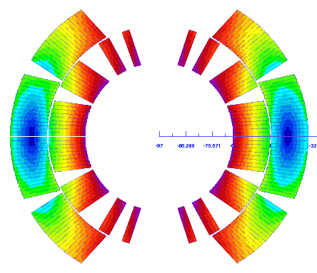
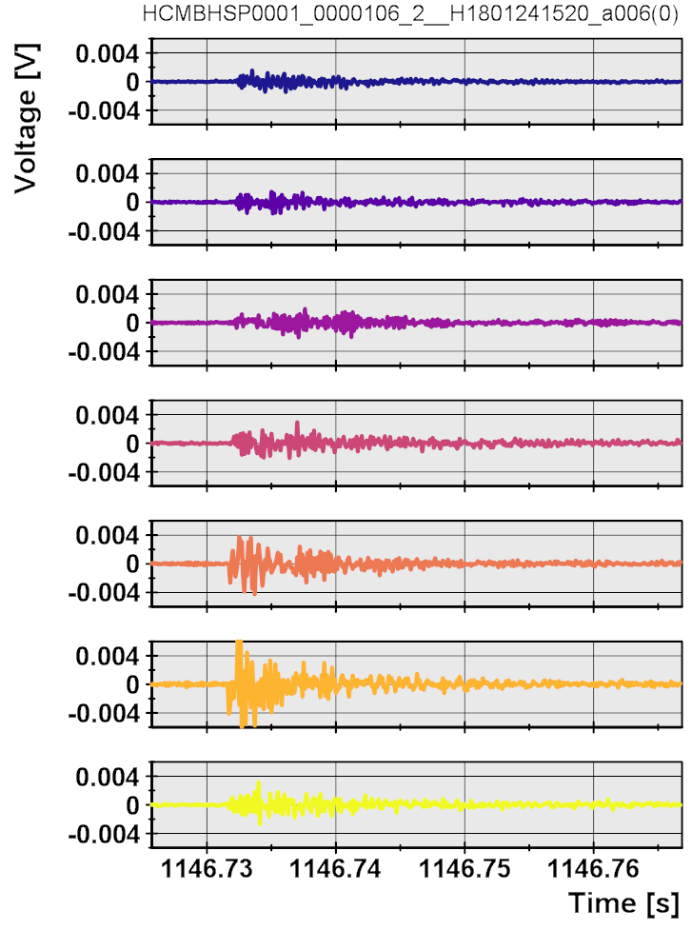
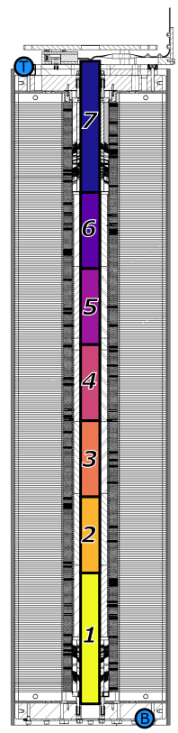
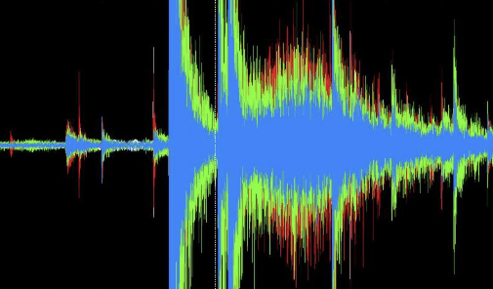
QUENCH LOCALISATION
A
C
See talk of Lucio
E
QUENCH ANTENNAS are used typically in long magnets, where inductive pickup coils detecting re-distribution of current in the quenching cable allowing to localize quenches and understand their origins.
QUENCH ANTENNAS
Shorter R&D magnets equipped with Vtaps uses the TOF methods.
ACOUSTIC EMISSION detection triangulation system uses arrays of piezoelectric sensors to detect mechanical events quench
precursors in the magnet, and also to localize quenches using triangulation technique.
AQUSTIC EMISION

Slide 26
STRUCTURE OF THE LECTURE
Basics of Superconductivity
Few Relevant Features of Superconducting magnets
Measurements: why and how?
Test Stand and their components
Summary and References

Slide 27
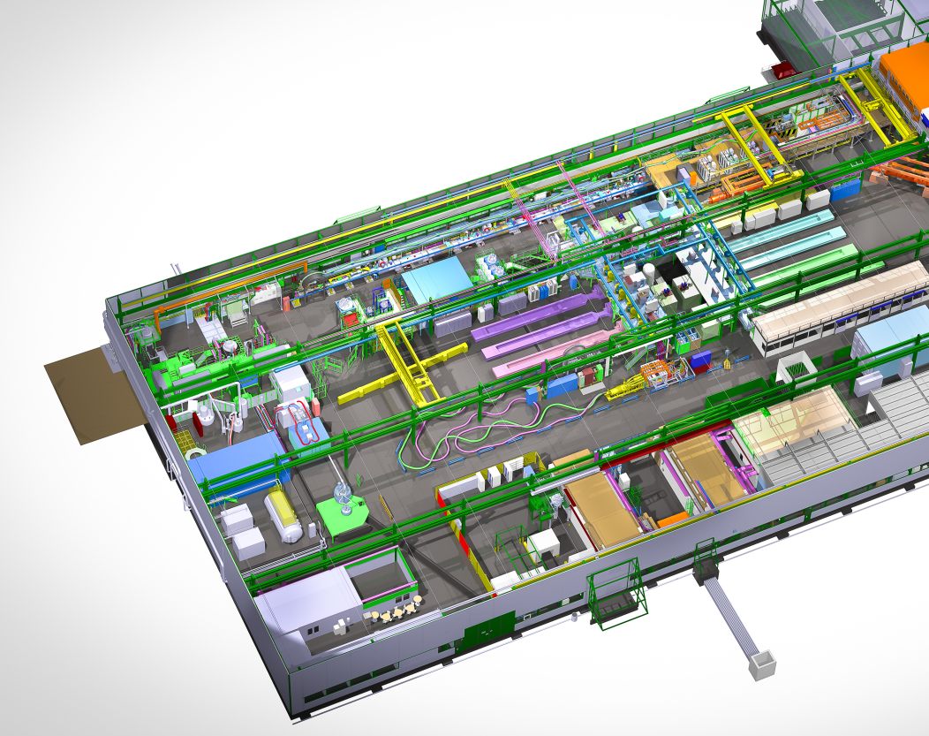
TEST STAND’S components
Courtesy of A. Kosmicki

Slide 28
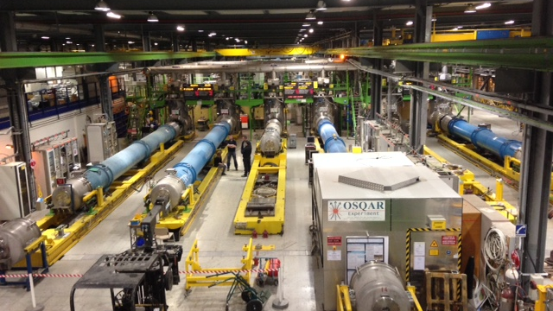
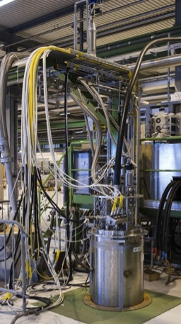
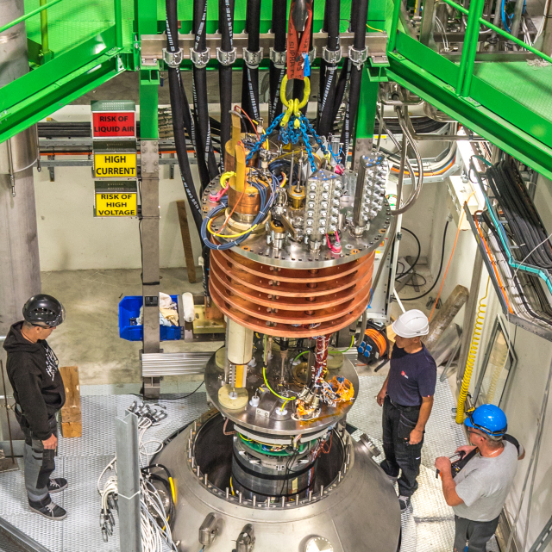
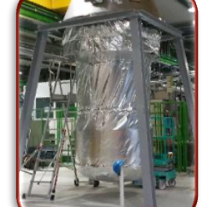
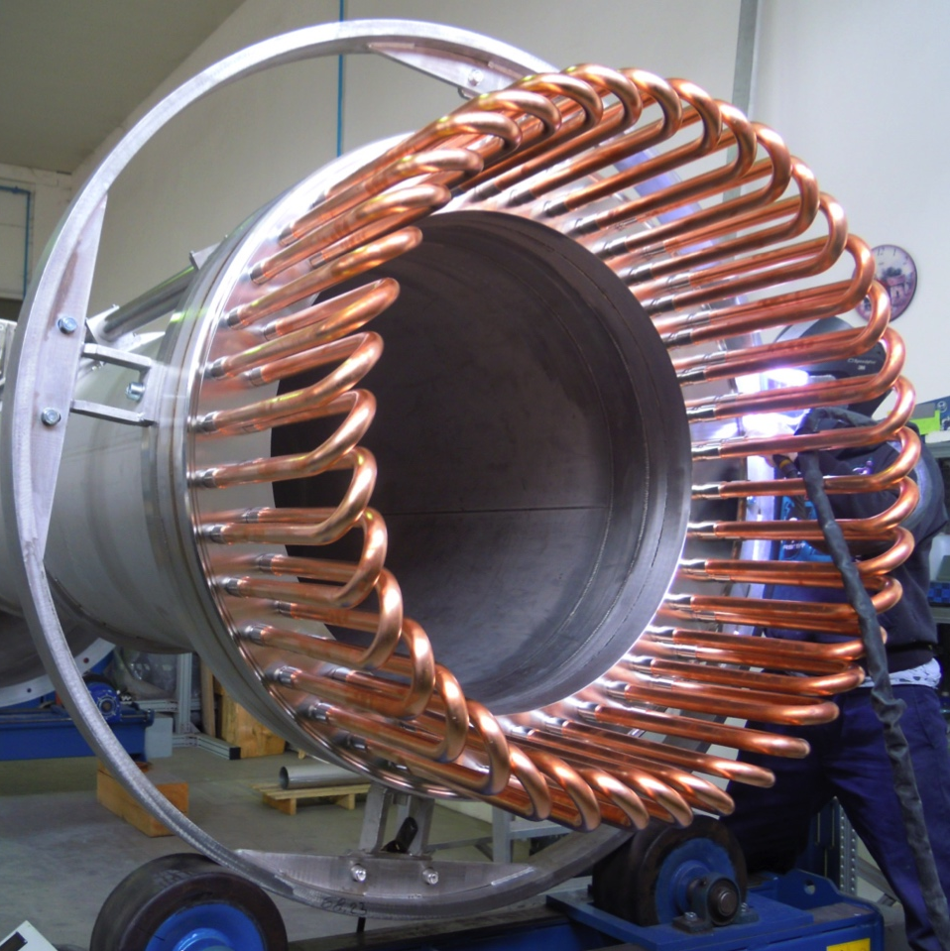
CRYOSTATS
LHe cryostats are essential for achieving low temperatures . Their design and operation involve significant challenges related to helium management, thermal insulation ect. Advances in cryostat technology, such as the integration of cryocoolers and automated helium recovery systems, are helping to reduce the costs and complexities associated with operating at cryogenic temperatures. See talks of Vittorio and Bertrand

Slide 29
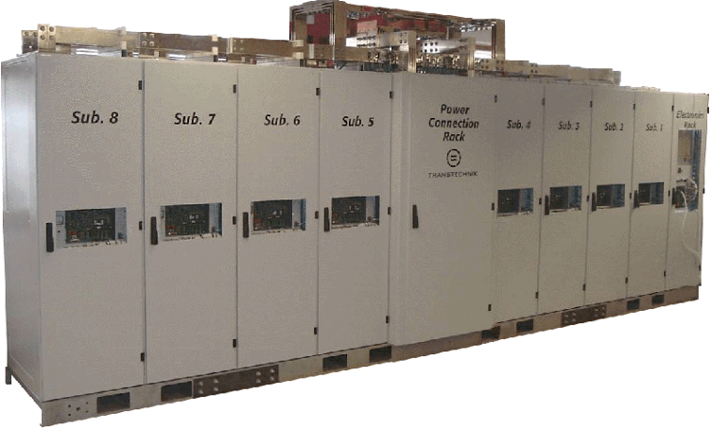
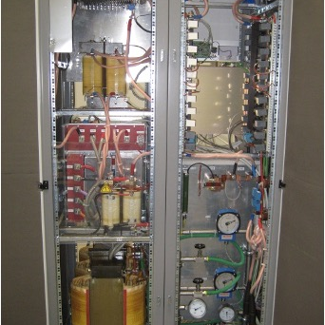
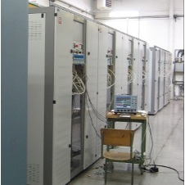
POWER CONVERTERS
Power converters for superconducting (SC) magnets are critical. These converters are responsible for supplying and regulating the precise current needed to maintain the magnetic fields generated by superconducting magnets. Converters are often integrated with quench detection systems as they must rapidly reduce the current to prevent damage to the magnet. See talk of Samer.

Slide 30
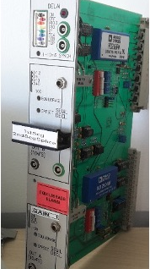
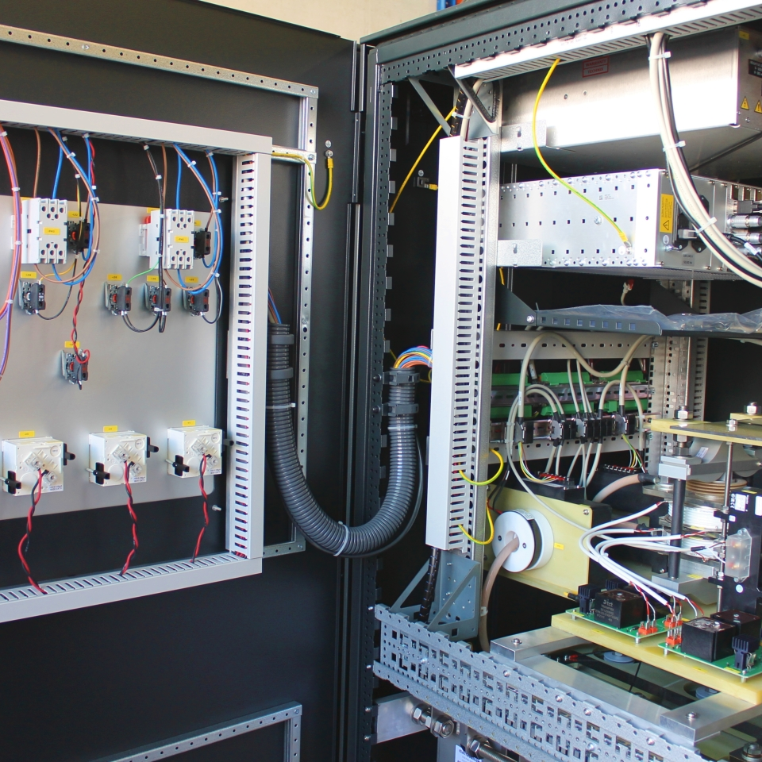
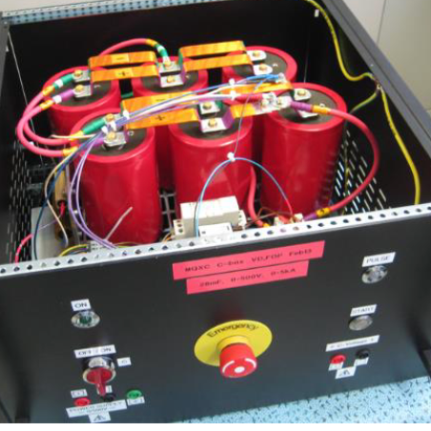
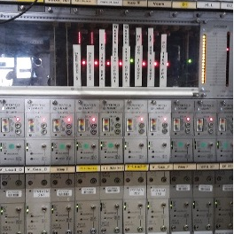
QUENCH PROTECTION DEVICES
Protection systems are crucial for ensuring their safe operation. Ex. The quench protection devices are triggered when a quench is detected. It delivers a high-voltage pulse to the quench heaters or the coils. These power supplies need to be highly reliable and capable of delivering the required energy quickly. They typically store energy in capacitors, which can discharge rapidly when needed. See talk of Emmanuele.

Slide 31


ENERGY EXTRACTION SYTEMS
The energy extraction system redirects the stored magnetic energy into external resistive loads where it can be safely dissipated as heat. It is composed by a dump resistor (resistive elements) connected to the magnet through fast-acting switch. When a quench is detected, these resistors are engaged, allowing the stored energy to flow out of the magnet and be converted to heat in the resistors.

Slide 32




WATER/AIR COOLED CABLES
Water-cooled cables typically consist of a central conductor, often made of copper, surrounded by channels through which water flows. The demineralized water is circulated through these channels to remove the heat generated in the conductor. Proper insulation is necessary to prevent electrical losses and to ensure that the cooling system does not interfere with the electrical performance of the circuit. See talk of Samer

Slide 33



CURRENT LEADS
Current Leads connect the superconducting magnet coils (operating at cryogenic temperatures) to the room-temperature power supply via the water cooled cables. These leads must carry large currents with minimal heat transfer to the superconducting region. Optimised gas cooled resistive leads are well adapted, but hybrid ( Cu and HtS leads) are also interesting options. See talk of Amalia.

Slide 34




HANDELING TOOLS
Handling tools used in superconducting (SC) test stands for lifting, moving, and positioning heavy components, such as superconducting magnets, cryostats, and other large equipment, are essential parts of the test stand and critical for operations. Given the weight and delicate nature of these components, overhead cranes play a vital role in ensuring safe and precise operations.

Slide 35



CRYOGENIC INFRASTRUCTURE
The design of the cryogenic infrastructure is complex and tailored to meet the specific needs of SC testing. Key components include cryogenic liquefiers and refrigerators, cryogenic distribution systems, low-pressure pumping units, and more. Thermally insulated lines, vacuum systems, cryogenic safety valves, along with a well-optimized control system, are all integral parts of this infrastructure.

Slide 36




DATA ACQUISITION SYTEM
These systems collect and process a wide range of data, including electrical, thermal, and mechanical parameters. A well-designed DAS is crucial for the precise characterization and protection of SC magnets. Data storage and online analysis are integral parts of the system. Depending on the recorded signal and analysis requirements, the frequency and duration of data acquisition can vary, optimizing both the hardware and associated costs.20

Slide 37
SAFETY and SAFETY INTERLOCK
Pay attention to the safety of the personnel in the environment of the test stand!!( LHe, High V, High I), Oxigen deficiency, high load, coactivities ect.
Safety interlocks are essential for ensuring the safe operation of superconducting (SC) magnet circuits and test stands. These systems are designed to protect both the equipment and personnel by automatically shutting down or adjusting the operation when unsafe conditions are detected.

Slide 38




OPERATING TEAM
The team running a test stand is usually also the one that designs and specifies it. They are responsible for the operation of the test stand and the test itself, working in close collaboration with magnet designers and specialists in all the domains mentioned here. The team consists of technicians, engineers, and physicists who complement each other. They develop interdisciplinary knowledge that is difficult to acquire elsewhere than at a test stand itself. Training them is a very good investment!

Slide 39
STRUCTURE OF THE LECTURE
Basics of Superconductivity
Few Relevant Features of Superconducting magnets
Measurements; why and how?
Test Stand and their components
Summary and References

Slide 40


YOU CAN ONLY MAKE AS WELL AS YOU CAN MEASURE
Joseph Withworth

Slide 41
REFERENCES
Lectures on Superconducting Magnet Test Stands, Magnet Protections and Diagnostics (as integral part of SMTF & IDSM Workshops) https://indico.cern.ch/event/1281454
5th Superconducting Magnet Test Facility Workshop , Instrumentation and Diagnostics for Superconducting Magnets Workshop https://indico.psi.ch/event/16393/
4thSuperconducting Magnet Test Facility Workshop , Instrumentation and Diagnostics for Superconducting Magnets Workshop https://agenda.infn.it/event/32061
3rd Superconducting Magnet Test Facility Workshop https://indico.uu.se/event/596
2nd Superconducting Magnet Test Facility Workshop https://indico.cern.ch/event/704235
1st Superconducting Magnet Test Facility Workshop https://indico.cern.ch/event/507584
CAS Normal- and Superconducting Magnets", 19 November - 02 December 2023, St. Pölten, Austria https://indico.cern.ch/event/1227234
Quench protection analysis integrated in the design of dipoles for the Future Circular Collider https://cds.cern.ch/record/2281387/files/CERN-ACC-2017-0080.pdf
Analysis of Uncertainties in Protection Heater Delay Time Measurements and Simulations in Nb3 Sn High-Field Accelerator Magnetshttps: //ieeexplore.ieee.org/stamp/stamp.jsp?tp=&arnumber=7112456

Slide 42
TEST
Give me two LTS and two HTS material
Give the definition of the RRR and explain why it is important in SC maganet protection.

