Slide 1
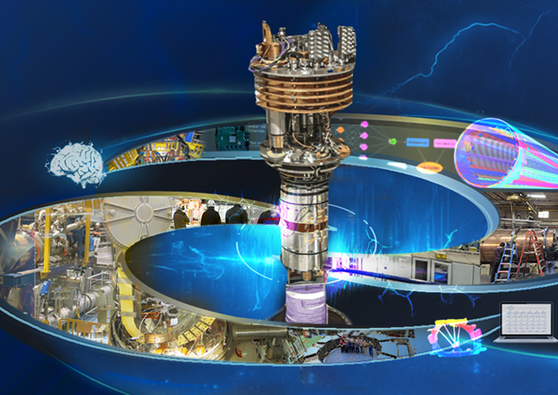
TIDM² X SC MAGNETS LECTURE SERIES 2025: MODUS OPERANDI
The origin of the lecture and its goal
The organising team and the work
The timing of the lectures
Exam for credits
Survey for improvement
Thanks

Slide 2
THE ORIGIN OF THE LECTURE
The SMTF Workshop aims to foster collaboration, coordination, and progress in the field of superconducting magnet testing, with a particular focus on aligning test capabilities with the evolving needs of major scientific projects. The workshop’s original mission was to assess the status, identify necessary upgrades, and ensure the readiness of global test facilities for superconducting magnets.
Since its launch in 2016, five editions of the workshop have been held. Over time, the scope has expanded to include measurement methods and diagnostics, which have become a structural component of the event. This evolution has encouraged the exchange of innovative techniques within the community.
As a result, the focus on classical measurement methods has been reduced—these are now considered more appropriate for dedicated training sessions rather than for workshop presentations.

Slide 3
THE GOAL OF THE LECTURES
To address this gap, I proposed and helped organize a lecture series in 2023 (link), aimed at newcomers, technicians, and anyone interested in gaining a deeper understanding of test stands and diagnostic techniques.
Working in a superconducting magnet test stand is a demanding and multidisciplinary task, with no established formal training currently available. This lecture series offers a unique opportunity for those looking to reorient their careers or to gain valuable insight into the challenges, of this specialized field or just improve their knowledge in the different domains presented by experts.
For this series of 22 lectures, speakers from worldwide laboratories : ASIPP, CEA, CERN, CFS, EPFL, FNAL, IFJ PAN, IPP CAS, LBNL, ORNL, PSI, Pennsylvania State University, PSFC MIT, Tampere University will help us to learn and deepen our knowledge related to Superconducting Magnet Testing.

Slide 4
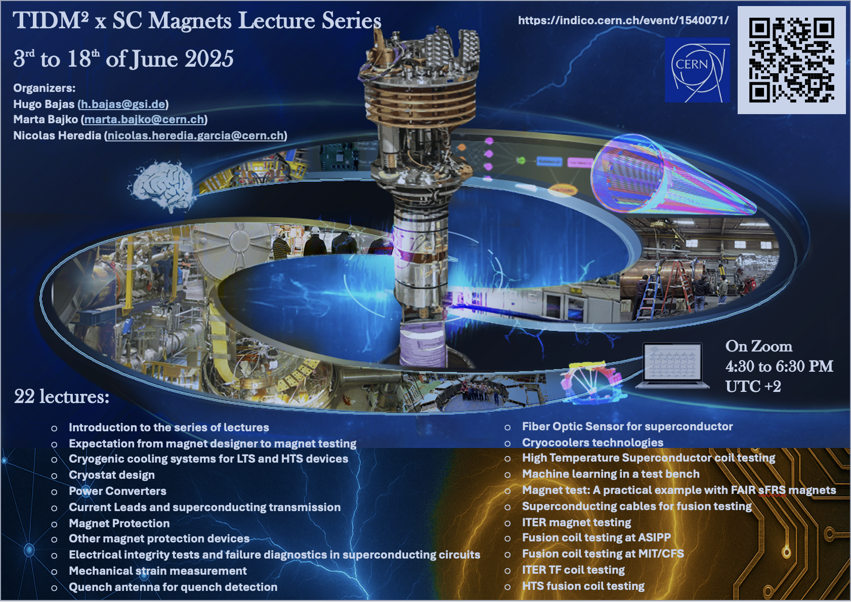
THE ORGANISING TEAM
THE WORK
Program
Logo
Choice of lecturer
Contact lecturers
Poster
Indico page
Registration
Zoom
Exams
Survey
Statistics

Slide 5
Part 1
In the first part, I, Marta) will start with few basics on Superconductivity and major components of a test stand . Susana will address the questions and needs of superconducting magnet designers in relation to the test teams. We will then begin examining the infrastructure and technical services required for superconducting magnet test stands: cryogenic cooling systems with Bertrand, cryostat design with Vittorio, power converters for superconducting magnets with Samer, and finally superconducting current leads with Amalia.

Slide 6
Part 2
This part of the course focuses on quench detection presented by Tiina, the protection methods by Emmanuele, as well as specialized measurements for various goals and techniques—such as strain measurements with Michael, quench antennas by Lucio, optical fibers with Federico, etc. Particular emphasis will be placed on the testing of HTS coils with Michal and the associated challenges, including cooling with cryocoolers with Torsten. The electrical integrity checks and its importance will be introduced again by Jaromir. This second part will conclude with a talk by Hugo, a practical example: a showcase of accelerator magnet testing.

Slide 7
Part 3
We explore this topic after reviewing what can be achieved today using large volumes of data and emerging techniques. The focus is on how we can enhance quench detection. For the first time, the course will include a lecture on machine learning, delivered by Maira.

Slide 8
Part 4
As in our last workshop, we now introduce the fourth part of these lectures, dedicated to fusion magnets in EU, USA and China and their testing—including both LTS- and HTS-based coils, along with the related infrastructure and challenges. We begin with conductor and cable testing with Kamil, followed by a session on ITER coil testing with Nicolai. We then explore how key challenges are addressed in fusion devices through talks by Zichuan and Zach or Theodor. More practical examples with descriptions of testing with Erica from CFS.

Slide 9
THE TIMING
22 lectures – max. 2 per day:
16h30-17h30 40 min of lecture 10 min of QA
17h40-18h30 40 min of lecture 10 min of QA
There are no lectures on the
9th of June.

Slide 10
THE EXAM FOR SUPPORT FOR ACADEMIC CREDITS
We offer support for students who wish to obtain academic credit for their participation, provided their university agrees to recognize the training.
Attendance is tracked via Zoom for each participant. Upon request, we can issue a Certificate of Attendance directly to the university.
Additionally, we provide a short exam consisting of two questions per lecture, made available on Indico for a 48-hour window. Each participant can submit his answer for the exam only once. If requested, your responses can be compiled and sent to you or your university for evaluation.
To be noted that in the 24h following the lecture we will upload on the indico page the record of the lecture and so complete the information provided by the lecturers via their slides.
We do not determine the number of credits, the required attendance rate, or the expected accuracy or completeness of the answers — these criteria are set solely by your university.

Slide 11
THE SURVEY
We are committed to continuously improving our training, and we need your help to do so. At the end of the 22 lectures, we kindly ask you to complete a short survey totally anonym:
List the three most interesting subjects
Name your three favourite lecturers
Share your opinion on the timing of the sessions
Suggest any new topics you would like to see covered in future lectures
Provide any additional feedback you may have
Thank you for helping us improve!

Slide 12
STATISTICS

Slide 13
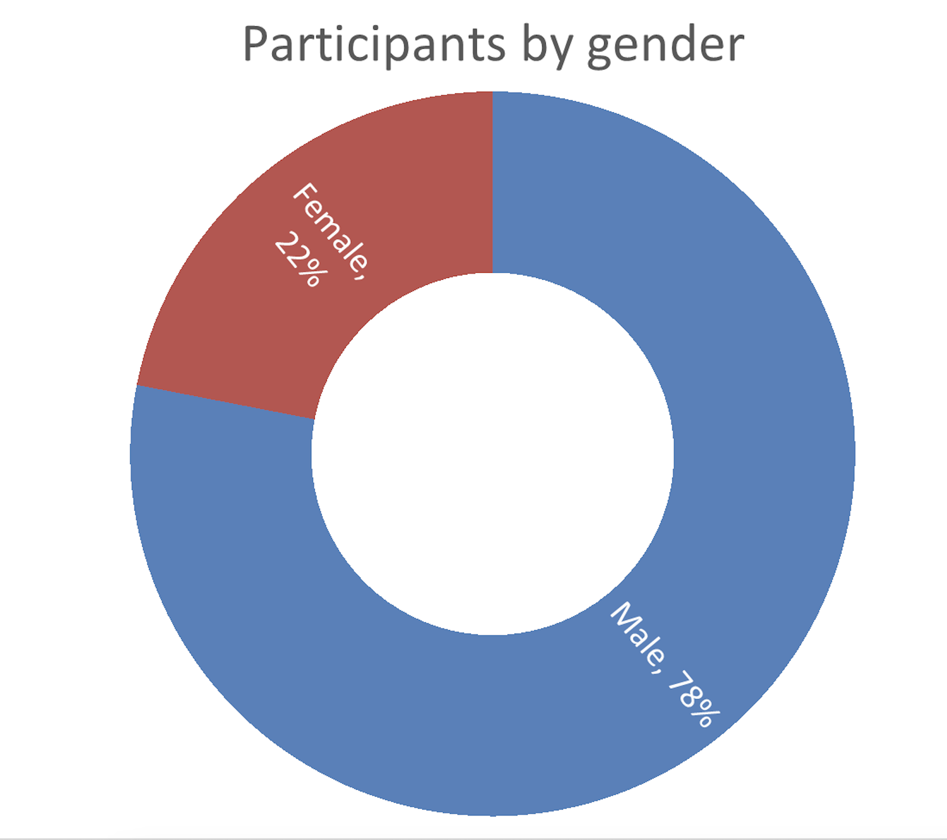
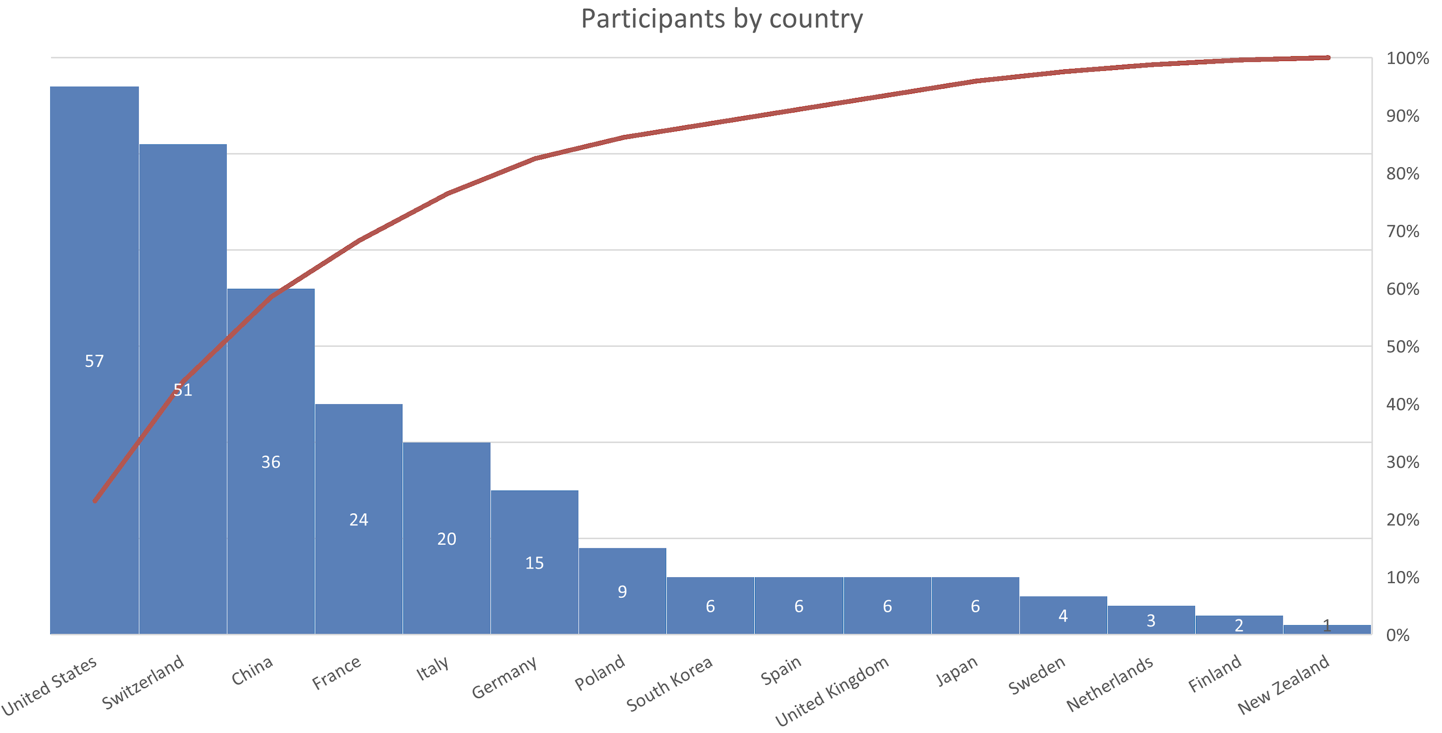
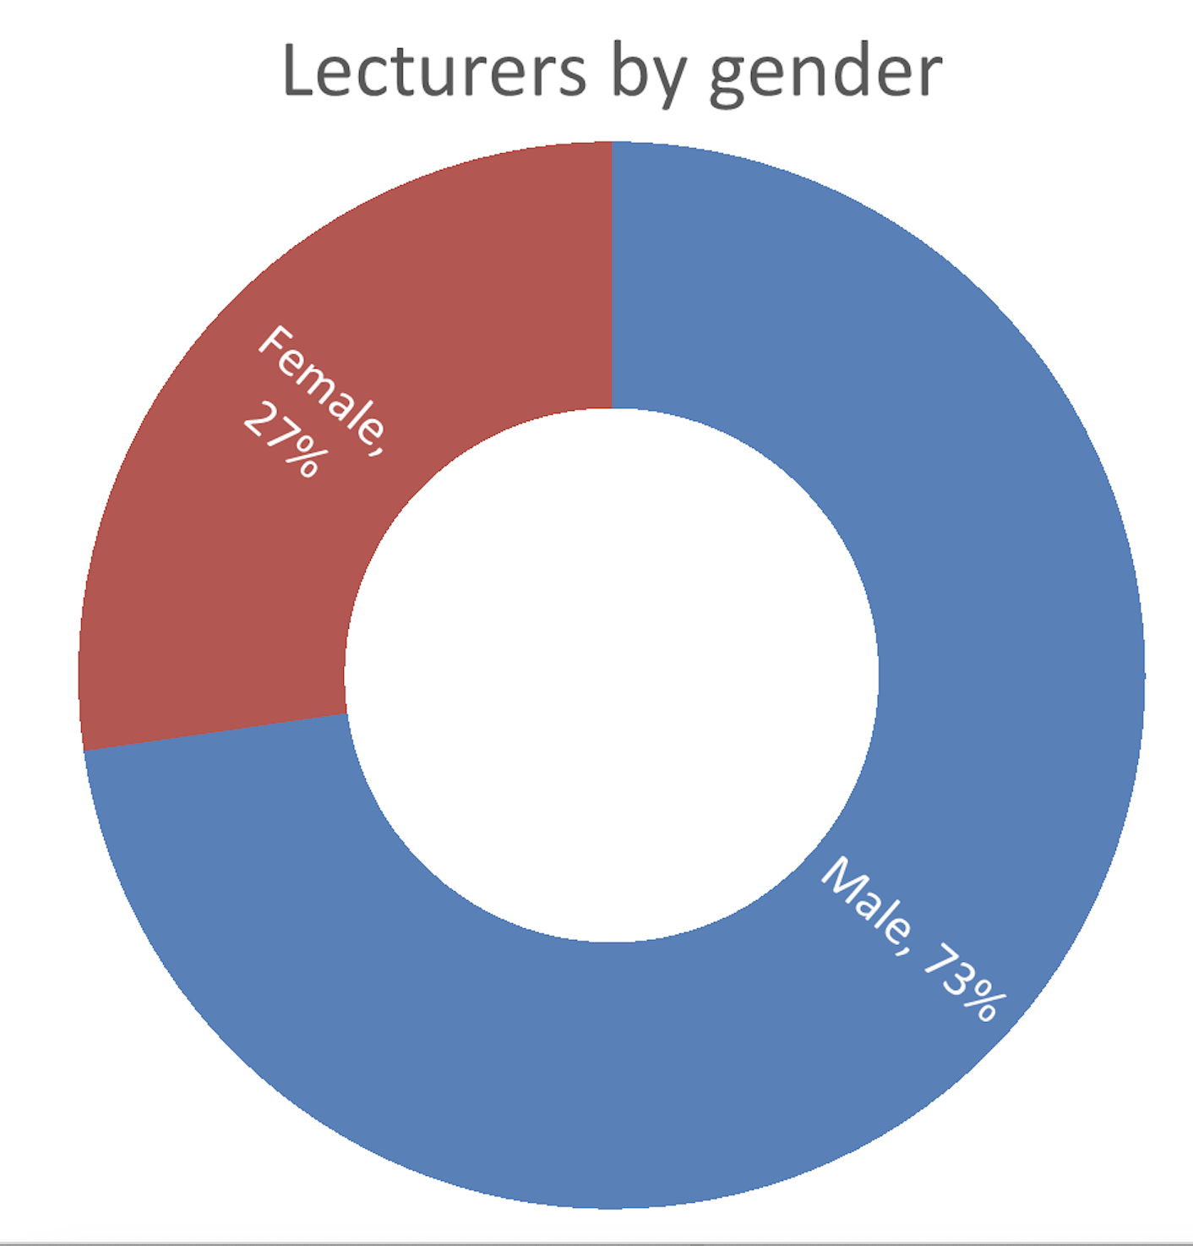
STATISTICS

Slide 14
THANKS
Thank you to all the lecturers who generously accepted to dedicate their time voluntarily.
Thank you to all the participants for showing your interest — your engagement justifies the effort we put into making this happen.

