Slide 1
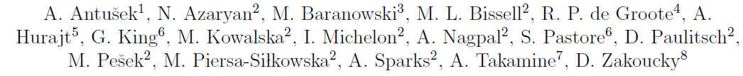
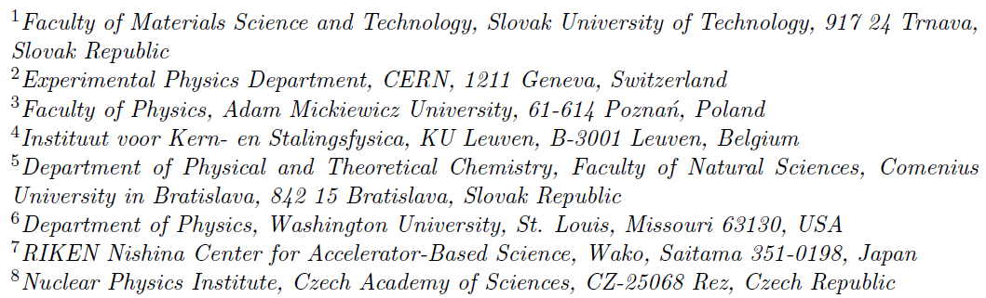

Magnetic moment of ¹¹Be with ppm accuracy
CERN-INTC-2025-034 /
INTC-P-655-ADD-1
Addendum to proposal on:

Slide 2
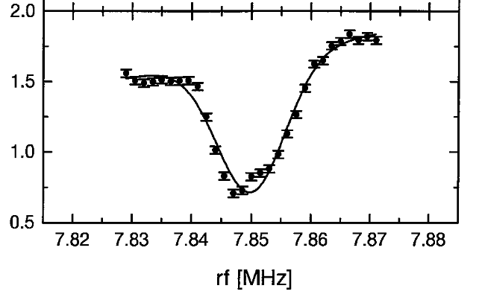
Original proposal P-655
Aims:
Measure with ppm accuracy the magnetic moment of ¹¹Be
Combine it with precise value of hyperfine structure constant A from literature
=> determine hyperfine anomaly / Bohr Weisskopf effect for ¹¹Be
Combine it with atomic (Pachucki, Puchalski) and nuclear (Pastore) calculations
To obtain information on the distribution of the neutron halo
Technique:
Beta-NMR on liquid samples at the VITO beamline
Improve by 2 orders of magnitude precision reached at COLLAPS in 1990’s
β-asymmetry

Slide 3
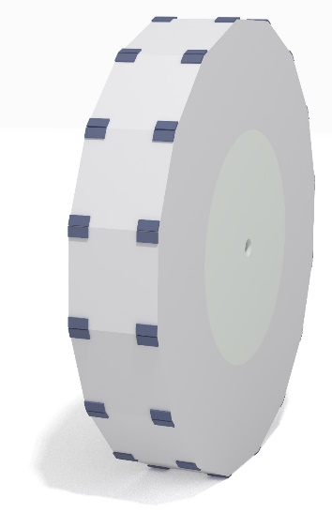
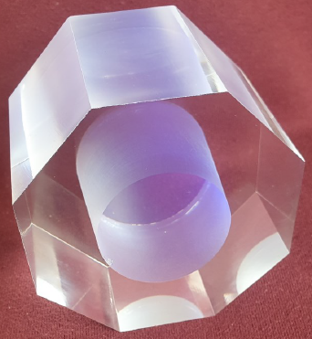
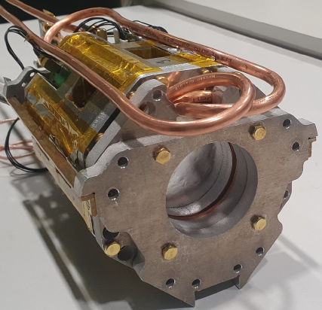
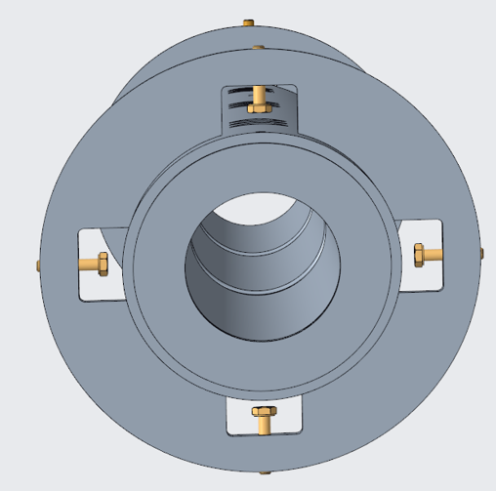
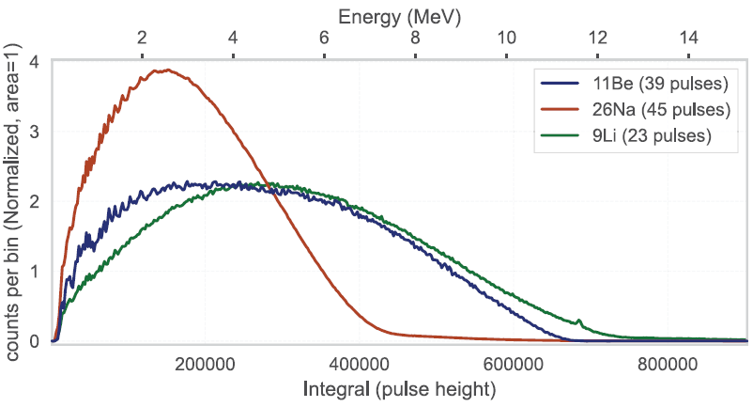
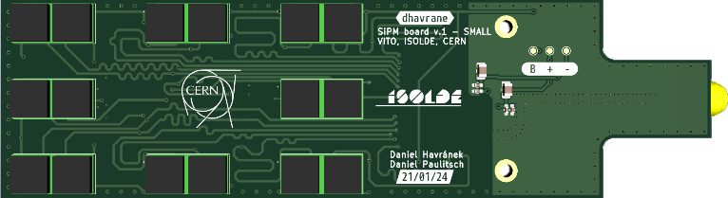
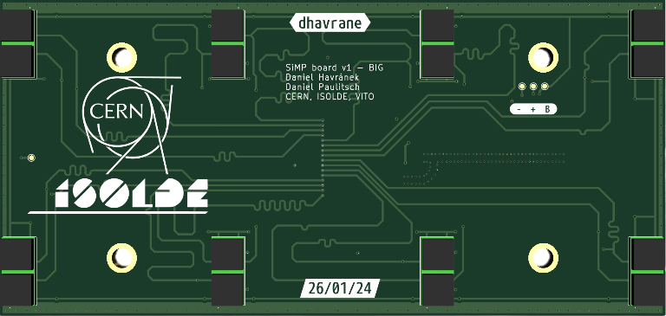
Upgrades before November 2024
UV excitations: new laser laboratory, laser free-path transport: sufficient (100 mW) UV light transported to VITO
High degree of polarisation: segmented optical-pumping section (pump from 2 HFS states)
Increased β asymmetry: energy-resolving beta detectors to select β events populating only the ground state : plastic scintillator, plastic ’diffuser’, PCB with SiPMs and pre-amplifiers
Master thesis of D. Havranek
PhD thesis of D. Paulitsch

Slide 4
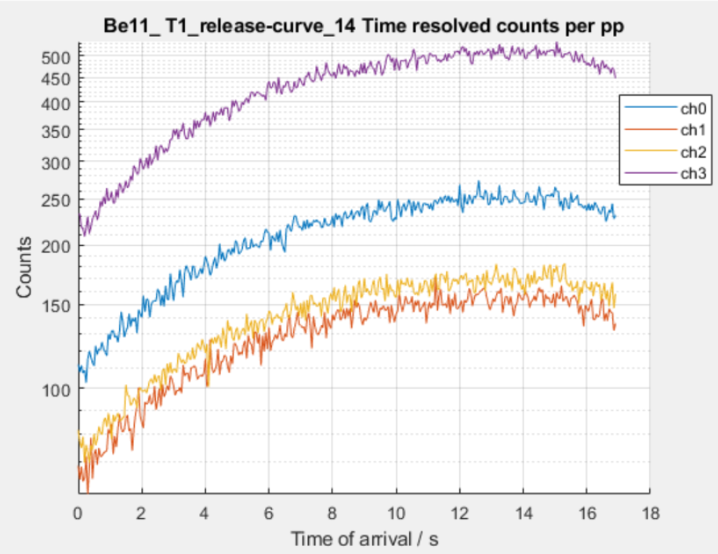
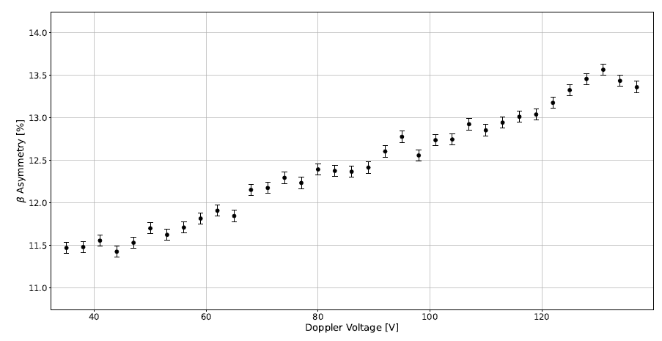
November 2024 beamtime
Only 1 out of 2 energy-resolved detectors ready:
  => unable to plot β-asymmetry based on β events populating only ground state (for higher asymmetry)
Release of ¹¹Be measured at VITO min 2 x slower than measured by target team:
  Needed longer time between p pulses (up to 36-48 s)
  longer time spent on one scan
β counts

Slide 5
November 2024 beamtime
Only 1 out of 2 energy-resolved detectors ready:
  => unable to plot β-asymmetry based on β events populating only ground state (for higher asymmetry)
Release of ¹¹Be measured at VITO min 2 x slower than measured by target team:
  Needed longer time between p pulses (up to 36-48 s)
  longer time spent on one scan
GPS separator beam-tune very mass dependent for light masses and time-depended mass factor for 1 mass:
  Tune for stable ⁹Be lead to beam steering at VITO for ¹¹Be
  Slope in β-asymmetry for HFS scans
Precise voltage divider not available: > 20 V uncertainty in HV
  2-wider scan range than required to cover ¹¹Be HFS
Regular drops in intensity or losses of beam
  only 6.5 shifts over 4 days with full ¹¹Be intensity
  (all 11 shifts counted)
β counts
β-asymmetry
No unambiguous sign of polarisation above baseline,
β-NMR study not possible
¹¹Be HFS scan

Slide 6
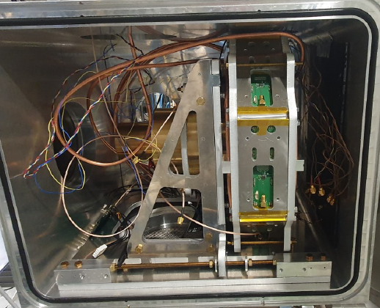
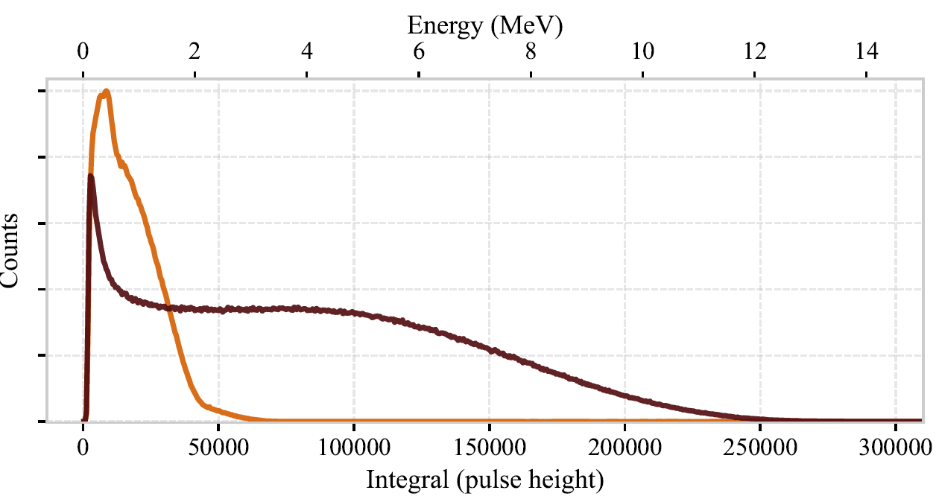

Actions after November 2024 beamtime
2nd energy-resolving β detector successfully commissioned with sources (in January) and ⁸Li beam (last week):
  selection of β events populating ground state possible
  increase in observed β asymmetry
Plan agreed how to move precision voltage divider from HRS to GPS
  Will be attempted already for ⁸Li run in June
  Much better determination of GPS HV
  2 x reduction in scanned Doppler-tuning voltage range
Follow-up on slow ¹¹Be release
  Release measured at VITO probably comparable to standard release
  Possible problem with tape-station measurement in Nov (sudden drop in counts after 5s)
  => longer time between proton pulses should be kept
8Li
108Ru
β’s
¹¹Be

Slide 7
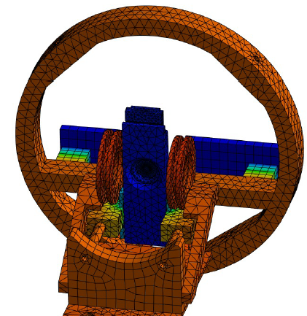
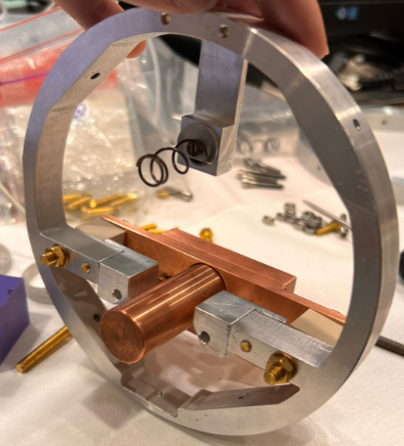
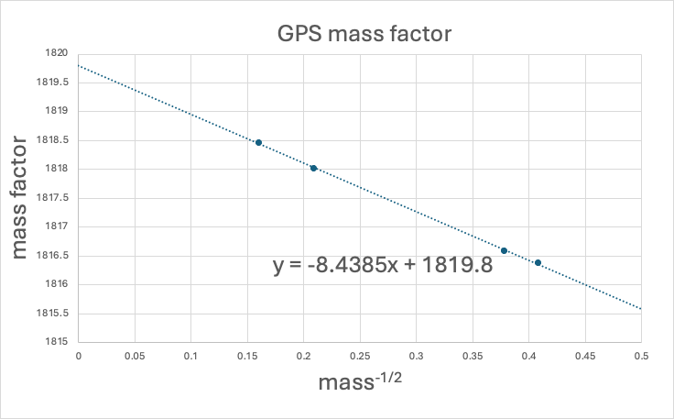

Actions after November 2024 beamtime
Improved beam-tuning of light masses from GPS achieved last week:
  Time-dependent GPS mass factor (due to hysteresis) solved by cycles: M_{old}-> ²³⁸U -> ⁴He -> M_{new}
  mass-dependent mass factor: inferred offset of 38 uT in GPS magnet tesla-meter reading
  offset in HFS scans should be gone => easier observation of peak above baseline
Sample cooling to LN₂ temperature
  New elements simulated (LN₂ temp to + 200 C), manufactured, and ready to be put into beamline
  To be used for ⁸Li beamtime in June
  => slower relaxation of polarisation => higher observed asymmetry
at 30kV
to transmit 6Li, 7Li, 23Na and 39K
¹¹Be
¹¹Be
38 uT readout offset
sample

Slide 8
Beamtime request
As in original proposal:
UCx or Ta target with laser ionisation, for which we expect still yields of about 5 × 106 ions/μC
Scanning in the original Doppler-voltage range (precision HV divider)
Possibility to select β’s populating ground-state (2 energy-resolving detectors).
Changes compared to original proposal:
Possibly rather longer release time (and some beam-tuning effects).
Sample cooling to achieve the same polarisation as during COLLAPS experiment in 1990’s.
=> We plan to use of 1 proton pulse every 36 s instead of 24 s planned before.
shift estimate increased by factor 1.5
Task (as in original proposal) | Shifts
Establish the highest possible laser polarisation and β asymmetry in ¹¹Be, using single-frequency laser polarisation and subsequently laser re-pumping. | 3 -> 4.5
Locate the correct rf resonance frequency using β-NMR in the solid-state host. | 1 -> 1.5
Measure asymmetry relaxation rates in the two potential liquid hosts, BMIM-COOH and EMIM-DCA. | 1 -> 1.5
Perform rf-modulation scans in order to locate the narrow resonance in the chosen liquid and define the final modulation-free scanning range. | 2 -> 3
Acquire at least three independent high-resolution scans in separate liquid samples. | 4 -> 6
11 -> 16.5 online shifts +1 stable beam tuning

Slide 9
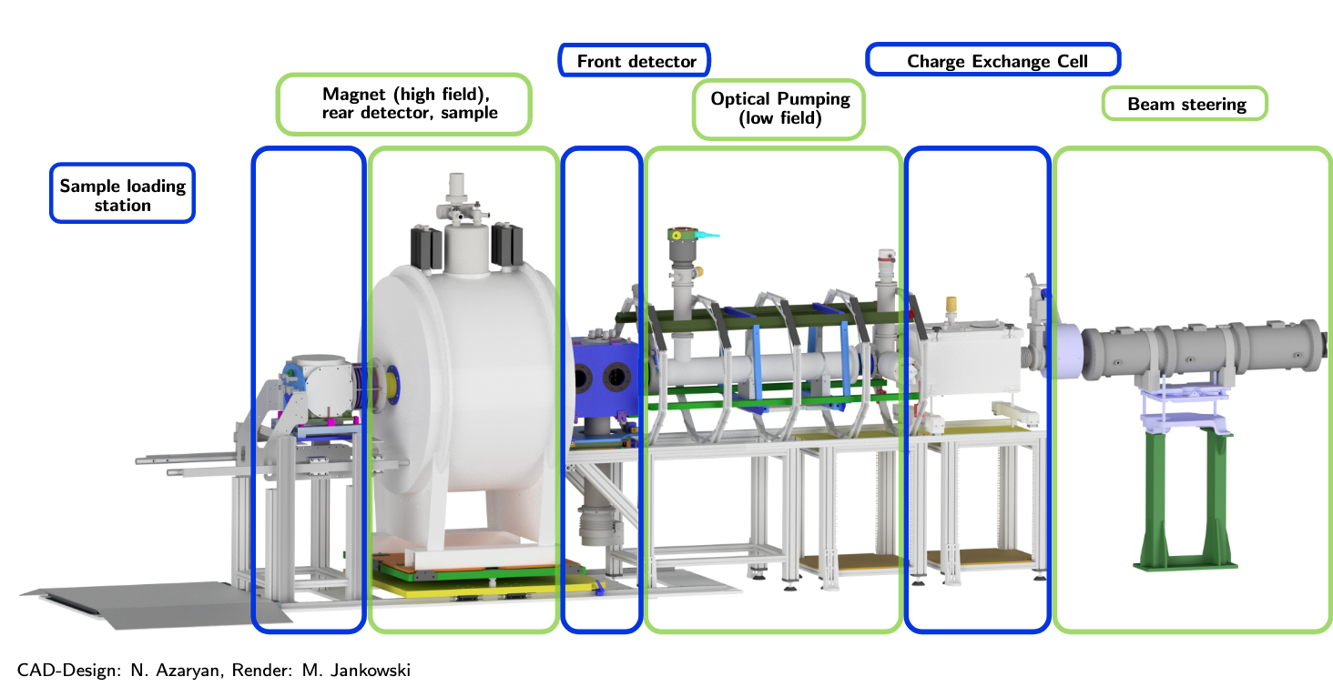
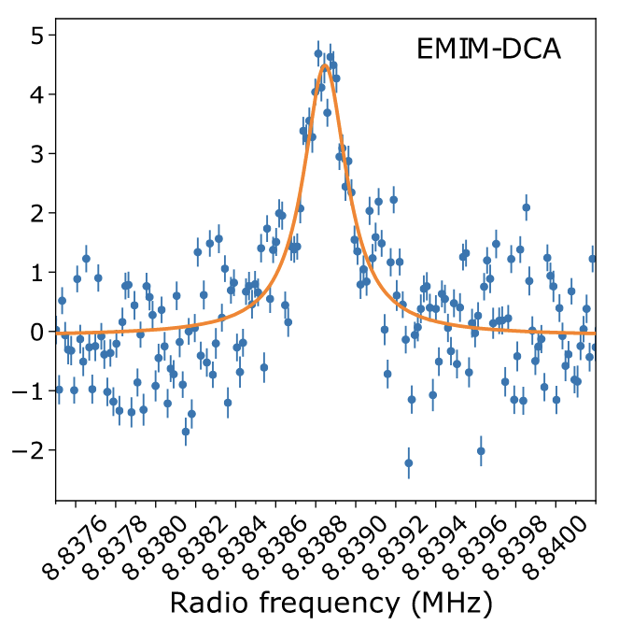
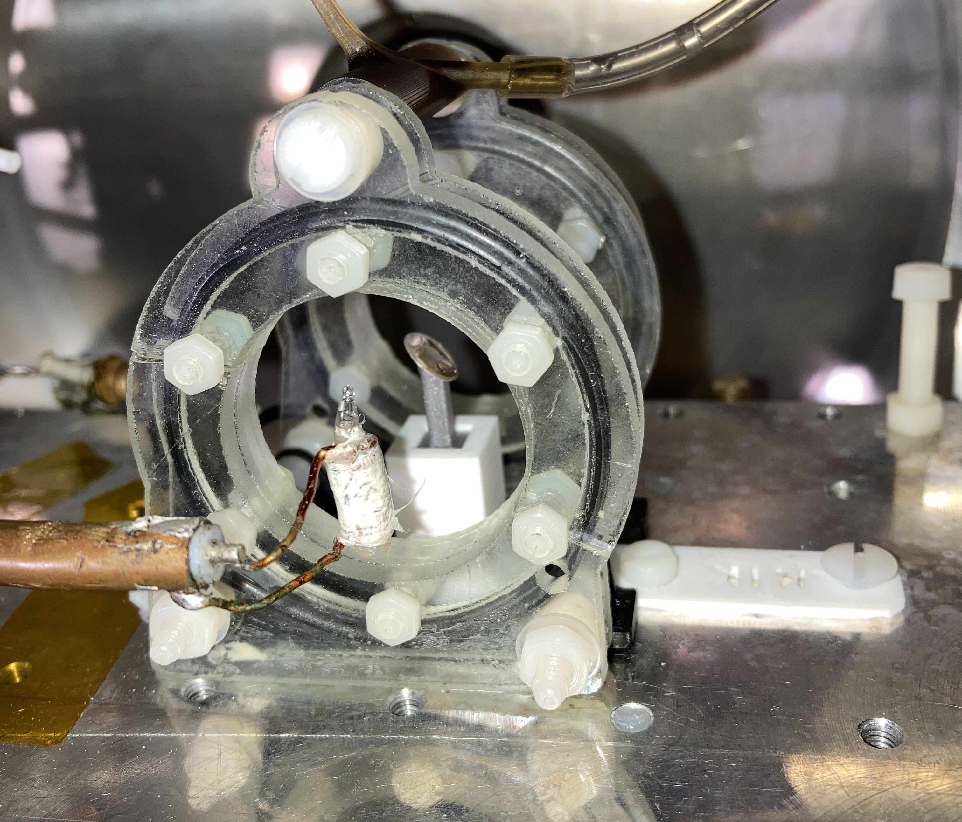
The VITO Beamline
R. D Harding et al., PHYS. REV. X 10, 041061 (2020)

Slide 10
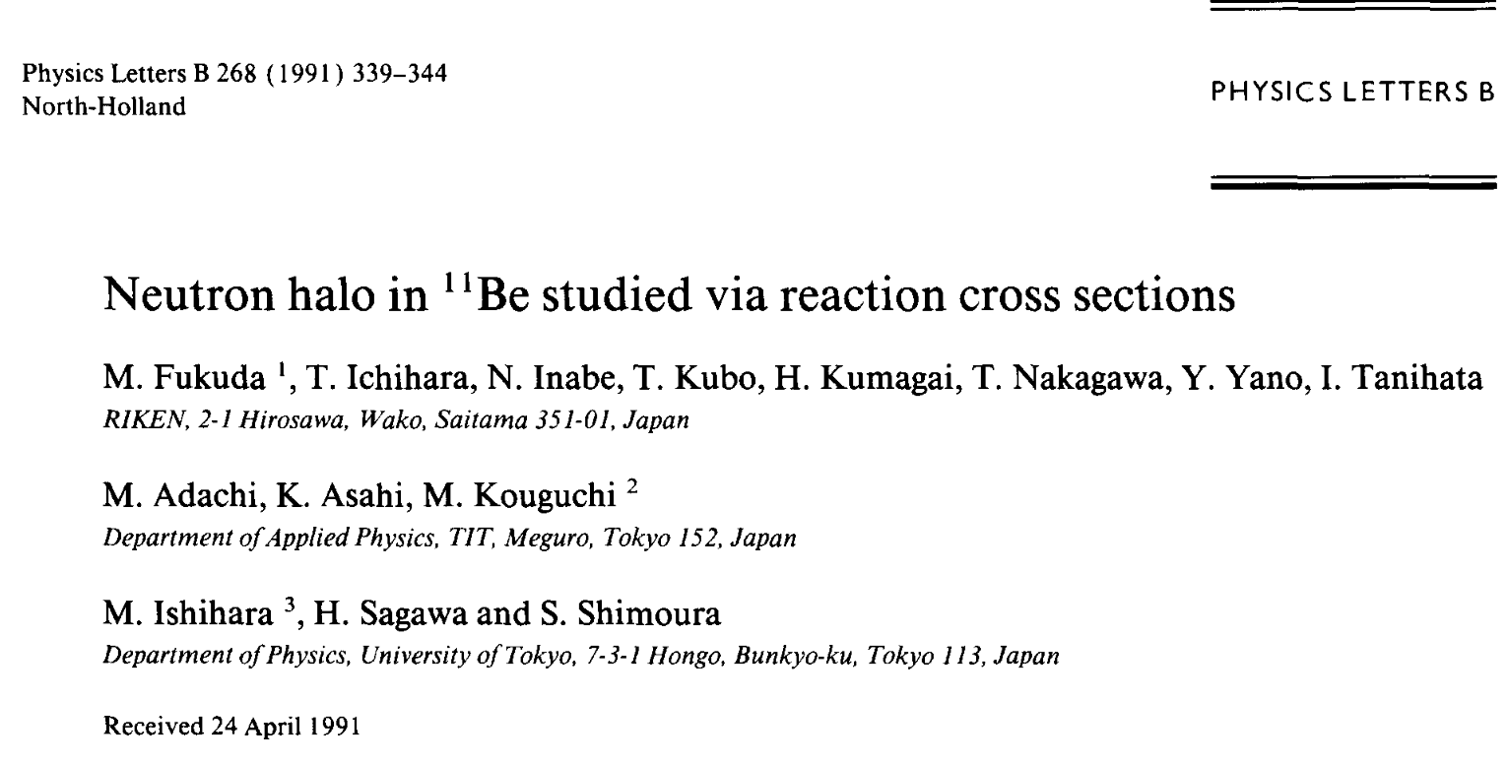
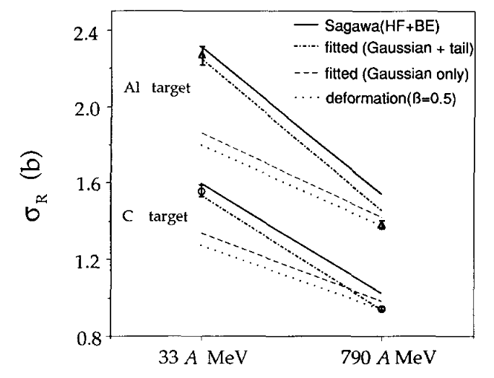
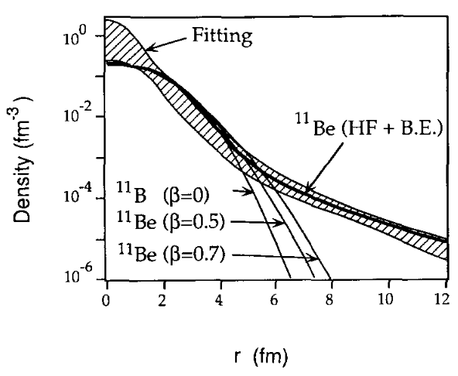
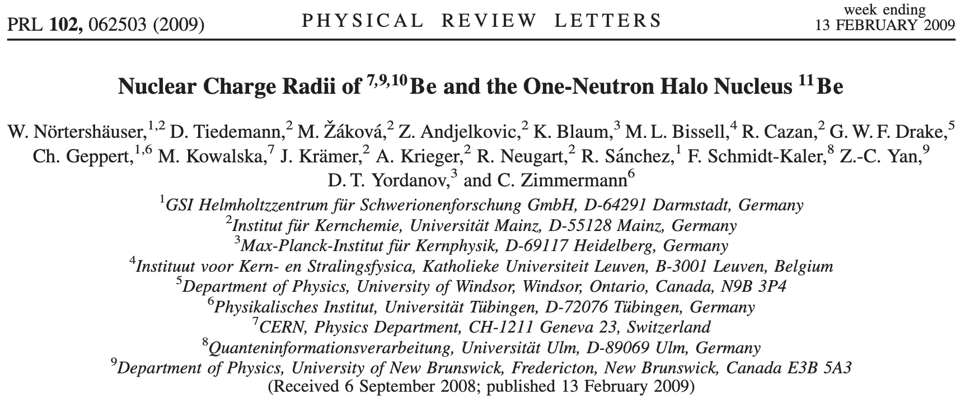
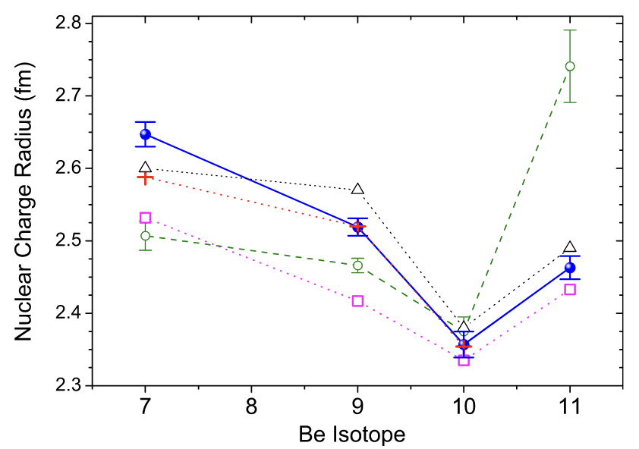
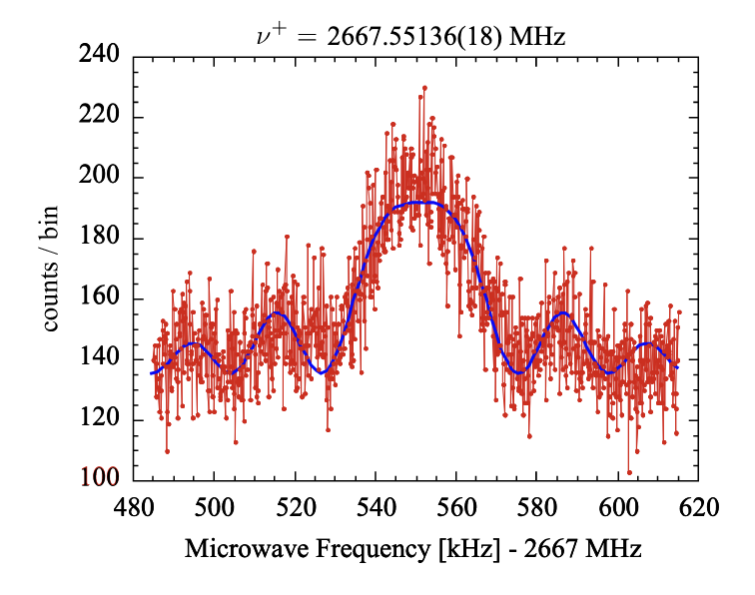
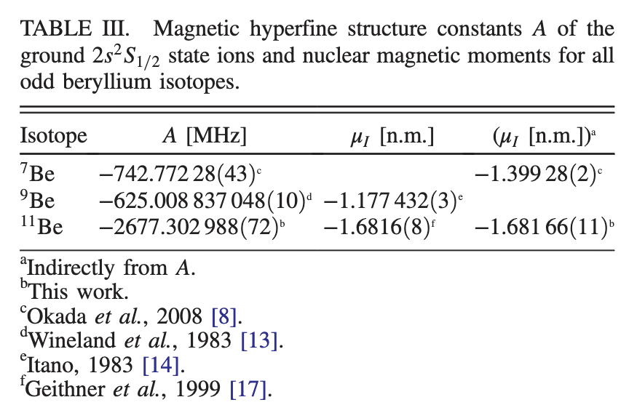
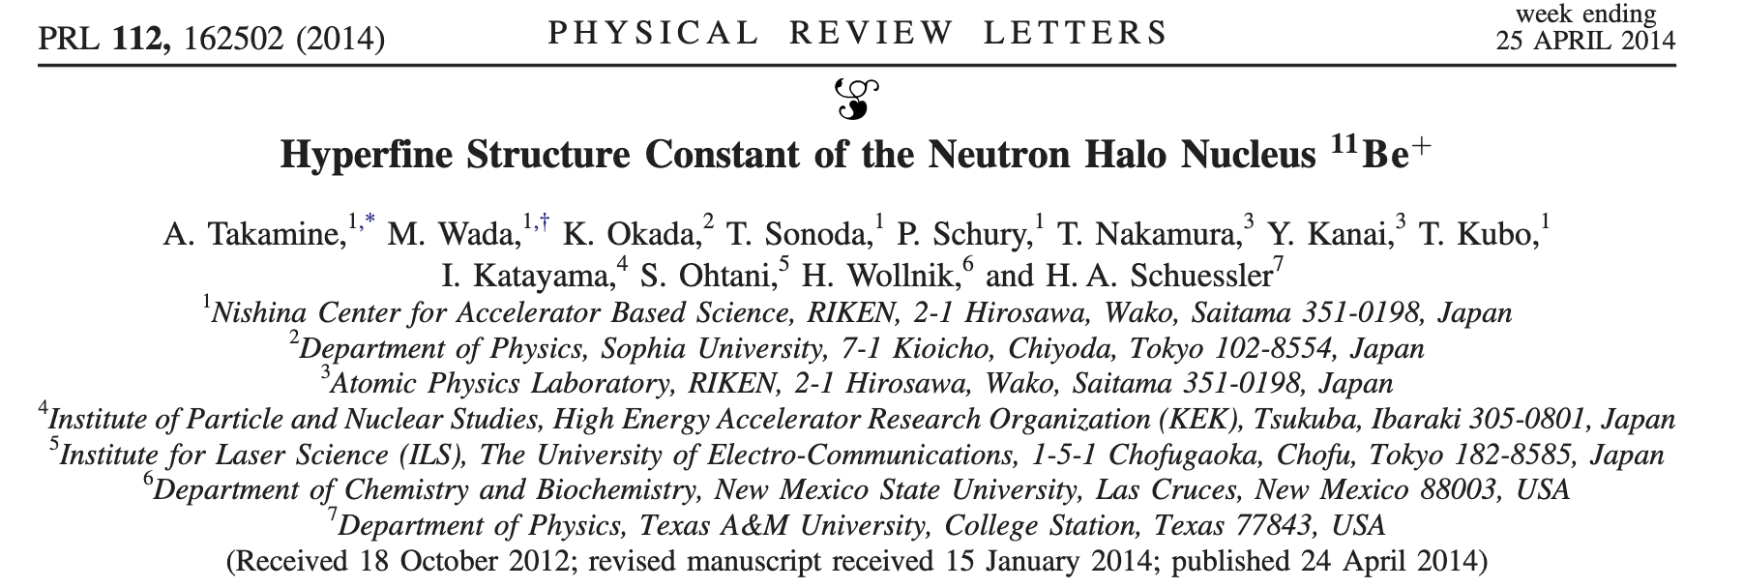
What do we know about ¹¹Be?

Slide 11
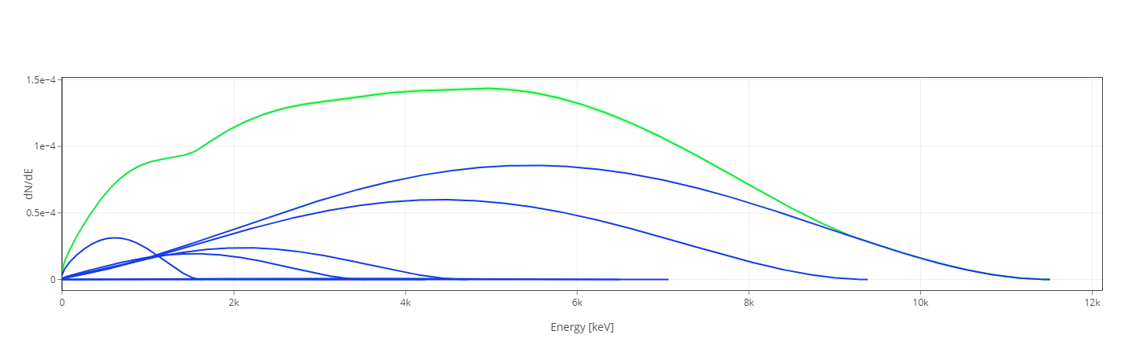
Beta energy selection in 11Be

Slide 12



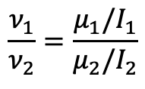
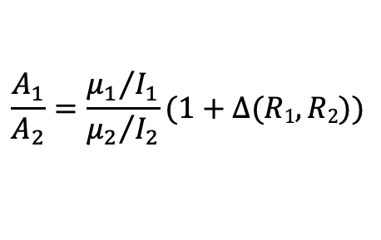
What is the Hyperfine Anomaly?
B
$$μ$$
$$μ$$
$Δ\left(R1,R2\right)=\frac{A_{1}}{A_{2}}$/ $\frac{ν_{1}}{ν_{2}}−1$
R_{M}
$$\frac{ν_{1}}{ν_{2}}=\frac{μ_{1}/I_{1}}{μ_{2}/I_{2}}$$
$$\frac{A_{1}}{A_{2}}=\frac{{μ_{1}}/{I_{1}}}{{μ_{2}}/{I_{2}}}(1+Δ(R1,R2))$$
NMR
Atomic Spectroscopy

Slide 13
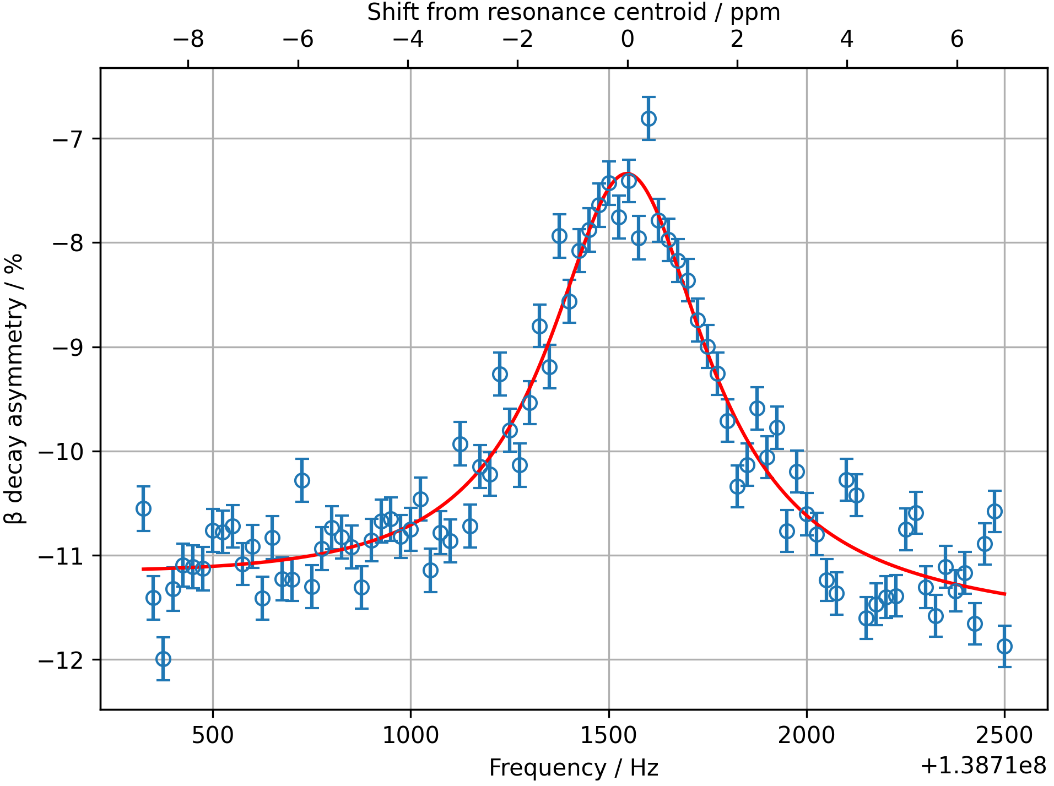
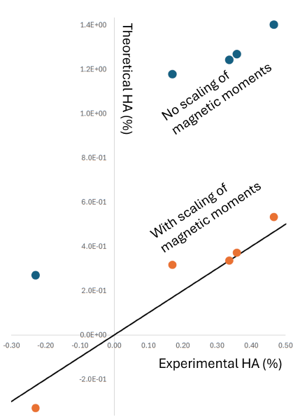
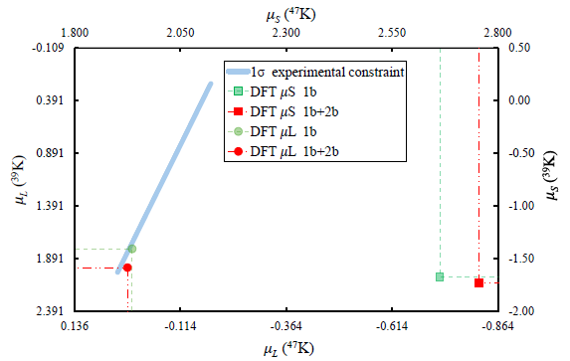
Example from recent measurements
Atomic theory (Jacinda Ginges, Georgy Sanamyan)
+
Density Functional Theory (Jacek Dobaczewski, Markus Kortelainen)

Slide 14
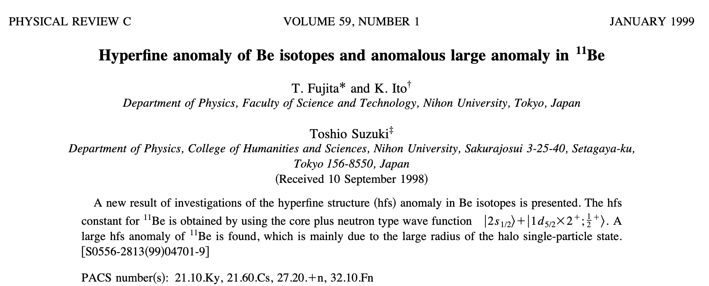
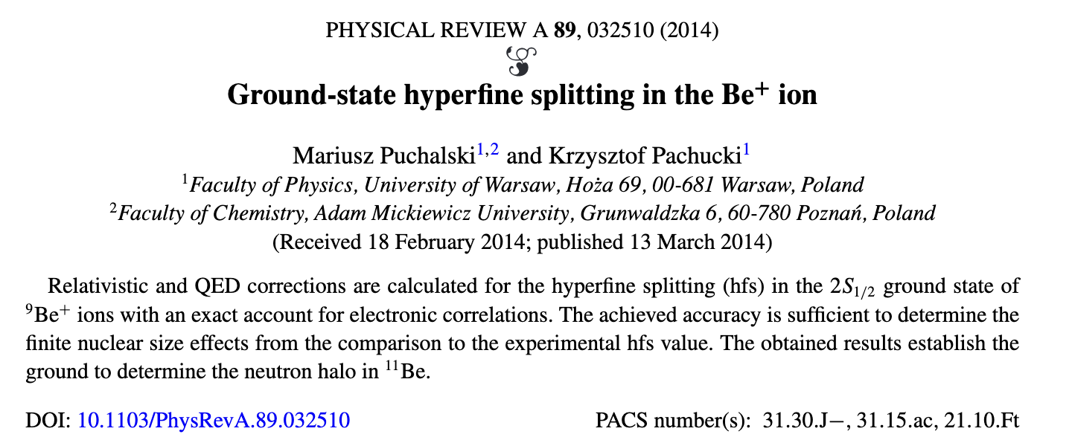
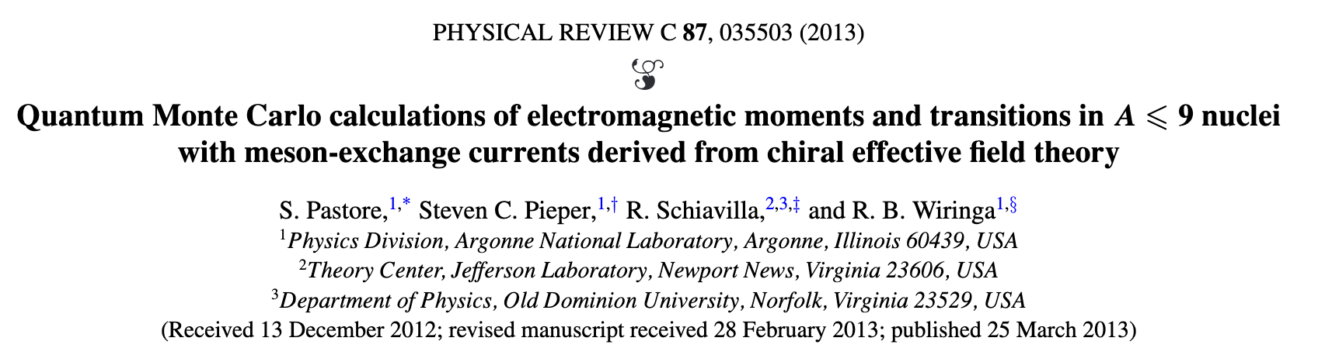
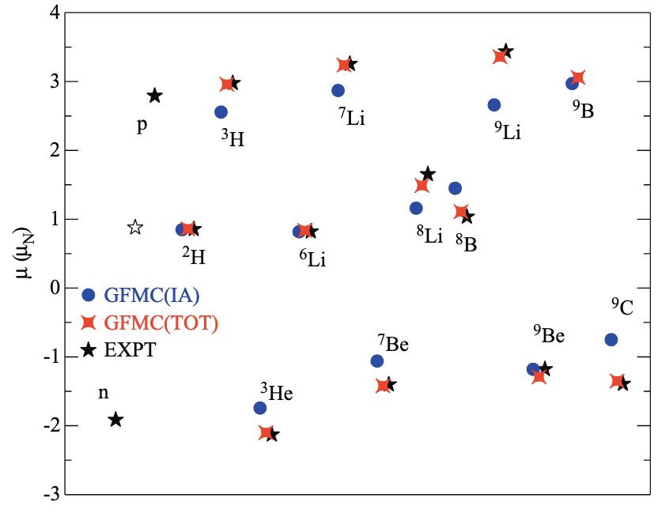

Theoretical Background
Further refinements from Perfrenova and Leclercq- Willaim¹.
$$9∆11 ≈ 200→300 ppm$$
State-of-the-art atomic theory
Sound theoretical prediction
Extention of GMFC to ¹¹Be
1) Phys. Rev. C 72, 024312 (2005).

