Slide 1
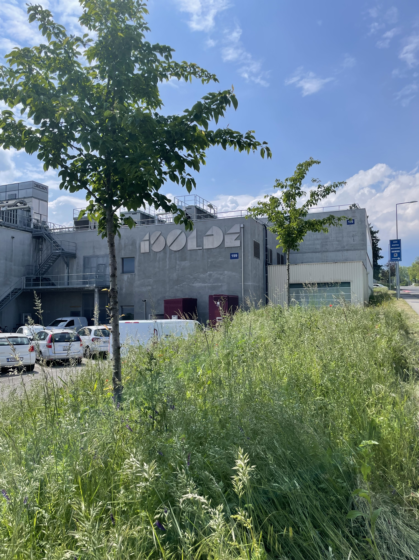

ISOLDE report
INTC 79
Hanne Heylen
with input from SY and BE
May 2025

Slide 2
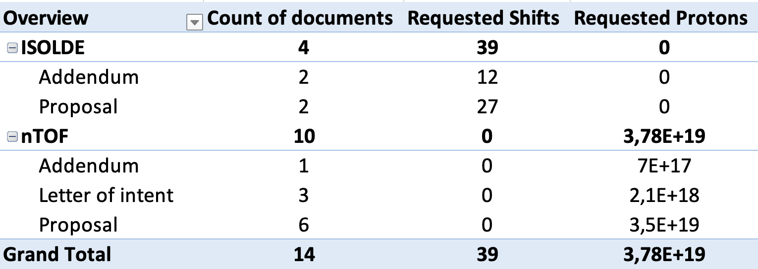
INTC 79 summary
+ parasitic irradiation
1 shifts = 8 hours; 1 day~ 1 x 10¹⁷ protons

Slide 3
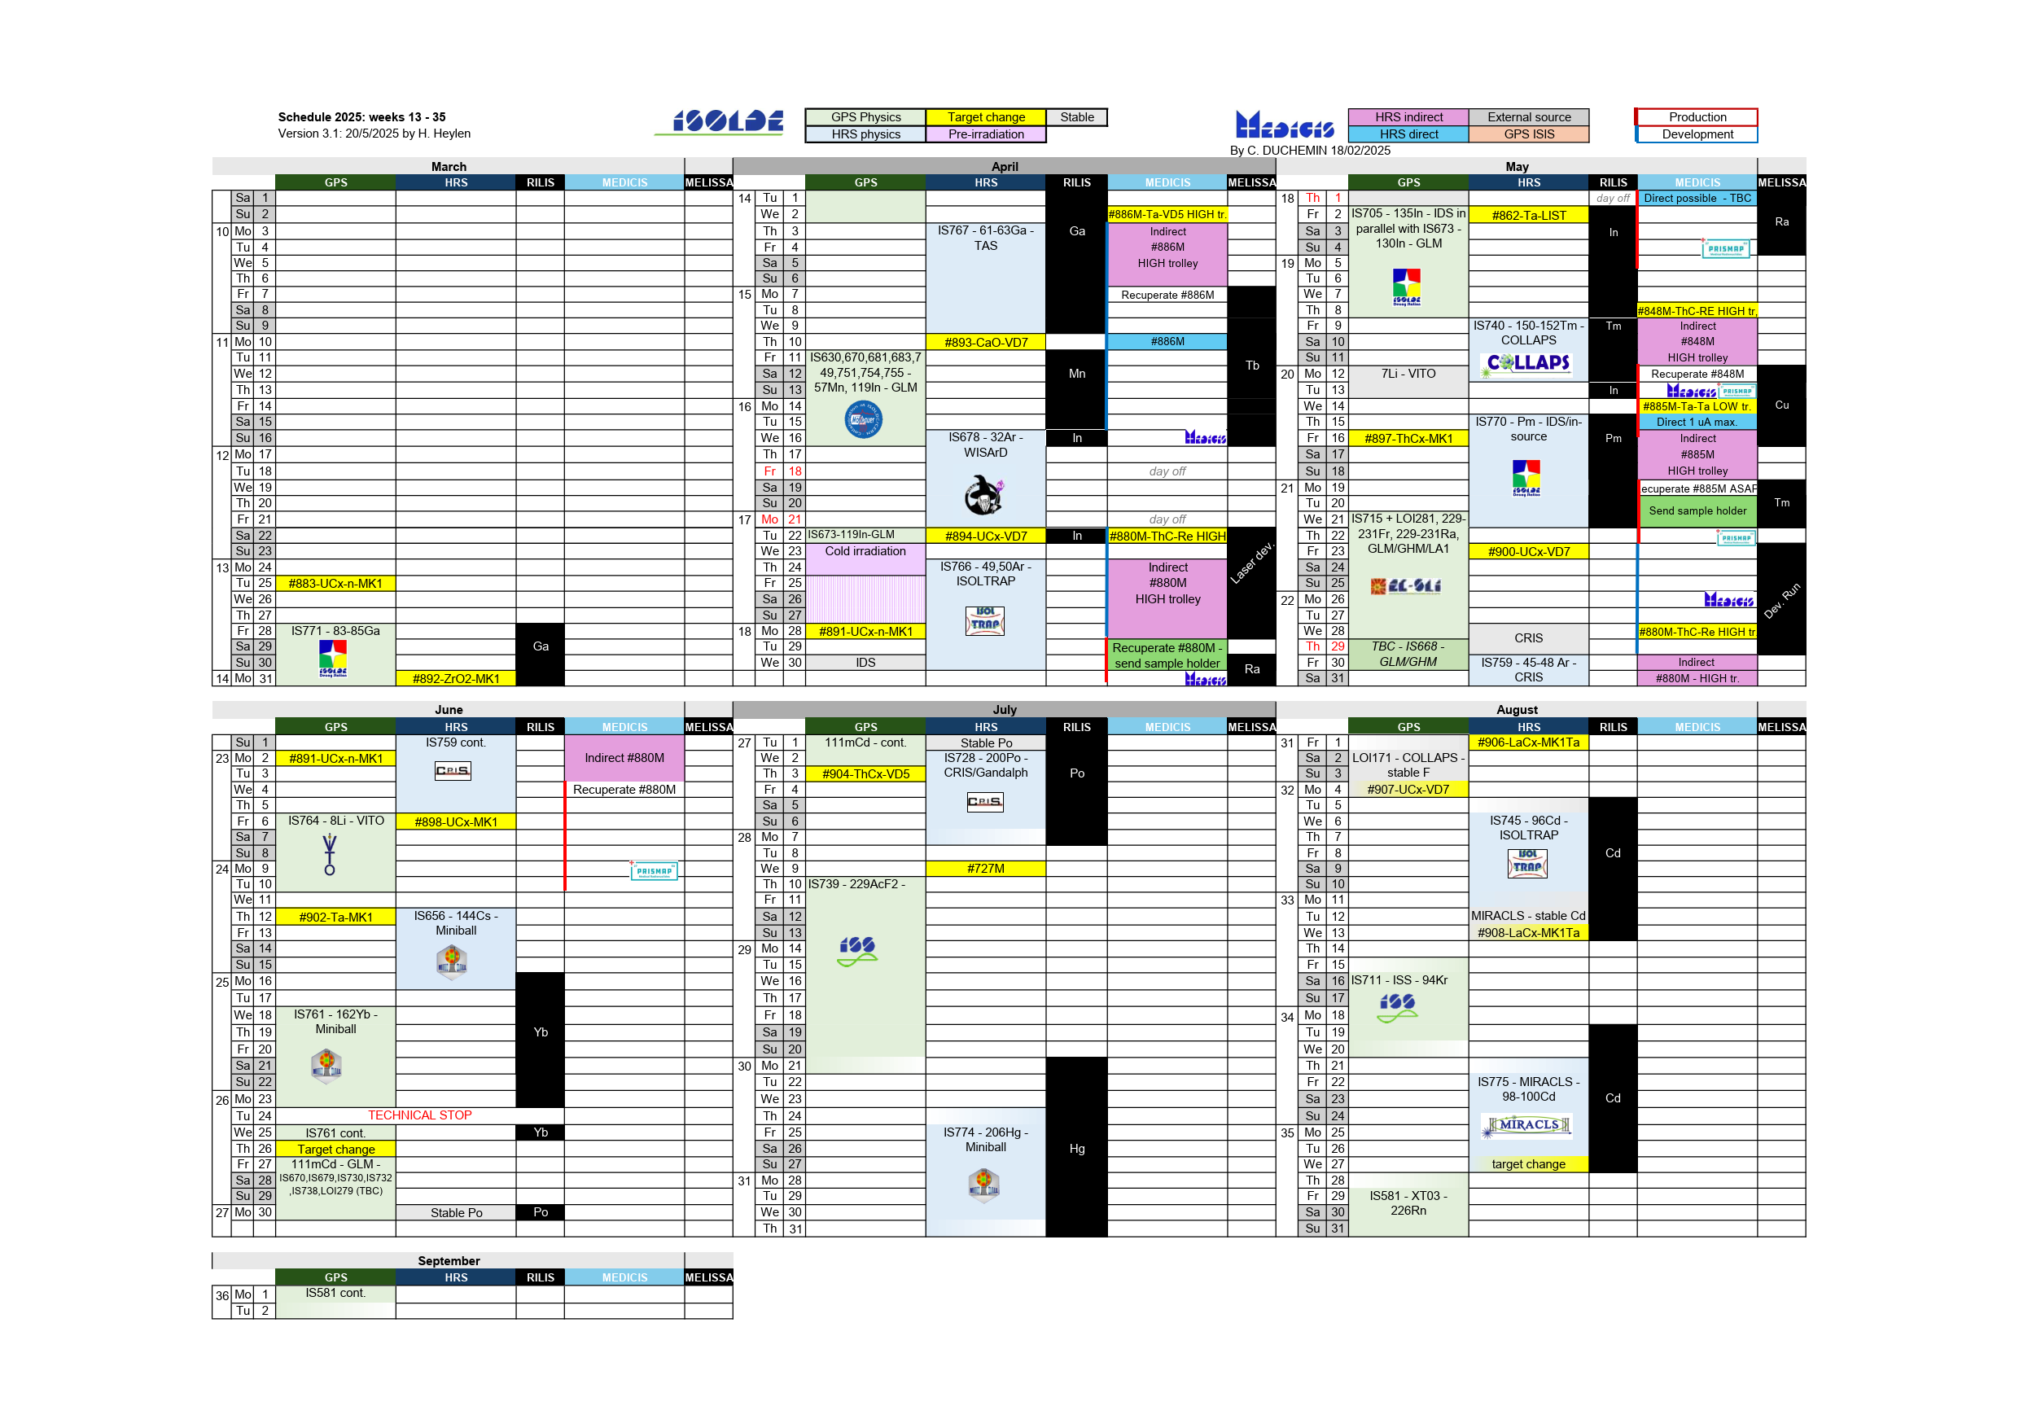
Schedule 2025
Key dates
Protons for low energy physics - March 28th. (started 1 day early)
Physics for HIE ISOLDE is expected to started around June 13th.
Protons will stop for ISOLDE on December 8th.
No winter physics campaign in 2025 nor 2026
Note: LS3 for ISOLDE: no physics in 2026 and 2027, restart in Q2 2028 (not aligned with LS3 for LHC)

Slide 4
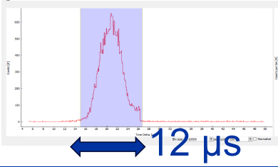
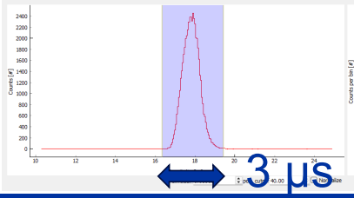
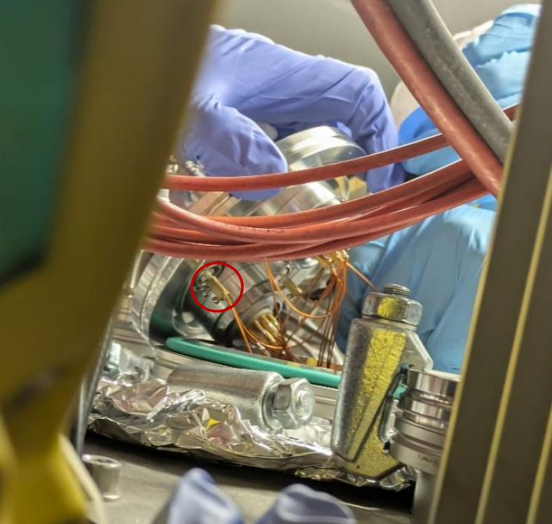
Update on restart of ISOLDE
Nov. 2024
Mar. 2025
YETS activities
Intervention on ISCOOL cooler-buncher
  Larger voltage instabilities observed by laser spectroscopy experiments since 2022 vs 2018
  Intervention to reduce cross talk → Better energy spread and ToF-profile
Beam gates
  HRS: replaced hardware control by software control (increased flexibility of operation)
  Replaced switches with commercial solutions → easier maintainability and reliable short (>1 us) beam gating
Restart
Beam for physics started 1 day earlier than scheduled
HIE-ISOLDE commissioning ongoing

Slide 5
Update physics
Delivered shifts
Very few major difficulties from the technical side → in most cases, the physics goals could be (partially) completed
Suspension of GLM/GHM activities since April 2024
Statistics (until 12/5/2025)
  101 shifts scheduled for physics, 83 counted
    15 separate INTC approved experiments were scheduled, some with only a few shifts
    Approx.15 shifts impacted by GLM/GHM suspension so far
  Only low E experiments, balance between installations

Slide 6
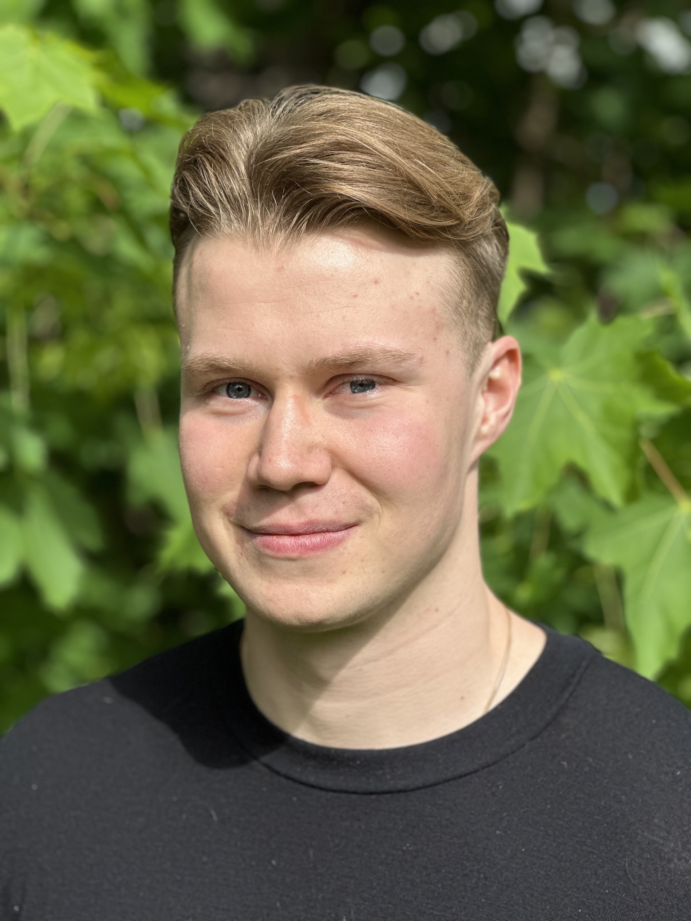
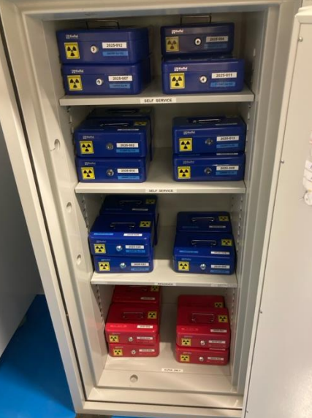
Announcements
Oscar Fjeld, the ISOLDE technician started since the beginning of March
  508 workshop almost re-opened
  Help experiments with technical tasks
    Avoid last-minute requests!
Since 1st of May: official RILIS on-call
Approval of cryomodule CM1 refurbishment for
HIE-ISOLDE during LS3
Management of radioactive sources, radioactive samples and contaminated equipment:
  New centralized location (170/R-020) for RP sources and cupboard for contaminated equipment
  Pool of RP sources → source responsible person
Approval of clinical trials for MEDICIS by CERN council

Slide 7
Reminder
No access to ISOLDE hall without dosimeter, helmet and safety shoes
  No shorts or short skirts (long trousers, long skirts, or short skirts with tights are ok)
Check yourself on the hand-foot monitor every time before leaving
No safety clearance = no beam!
  Fully up-to-date safety file
  General and electrical safety inspection
  Relevant procedures known by participants (including required PPE and trainings)

