Slide 1



Future High-Energy Nuclear Physics Experiments at HIAF From H-NS to EicC
ExHIC-d 2025-Nov Jeju
Aiqiang Guo (guoaq@impcas.ac.cn)
Institute of Modern Physics, Chinese Academy of Sciences

Slide 2
Outline
Introduction of HIAF
H-NS at HIAF
EicC at HIAF
Summary

Slide 3
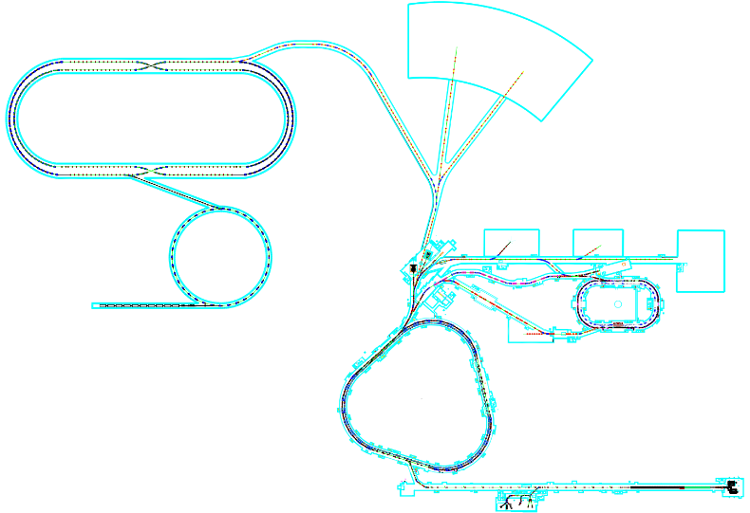
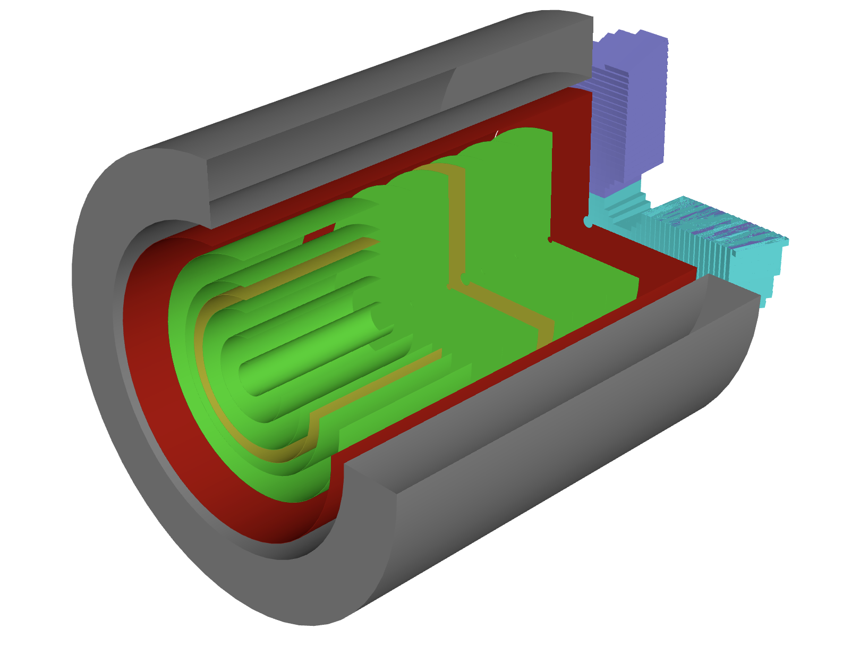
HIAF
Phase 0-ongoing: HIAF for nuclear physics
Ion | Intensity (ppp) | Kine_Energy (GeV/u)
²³⁸U³⁵⁺ | 2.0×10¹¹ | 0.84
²³⁸U⁷⁶⁺ | 5.0×10¹⁰ | 2.5
¹²⁹Xe²⁷⁺ | 3.6×10¹¹ | 1.4
⁷⁸Kr¹⁹⁺ | 5.0×10¹¹ | 1.7
⁴⁰Ar¹²⁺ | 7.0×10¹¹ | 2.3
¹⁸O⁶⁺ | 8.0×10¹¹ | 2.6
p | 5.0×10¹² | 9.3
Hyperon-Nucleon Spectrometer (H-NS)
Focus on Hyperon and Nucleon polarization
Fix target experiment
HIAF

Slide 4
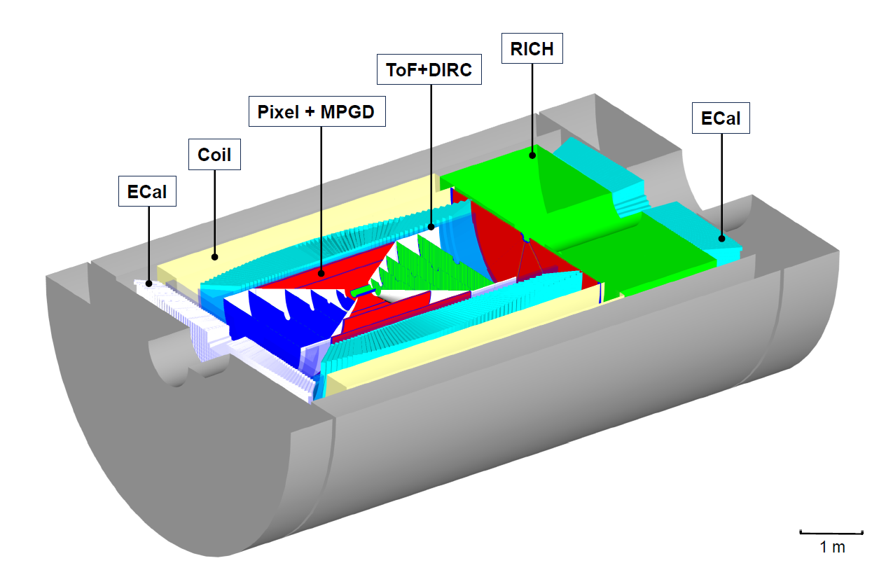
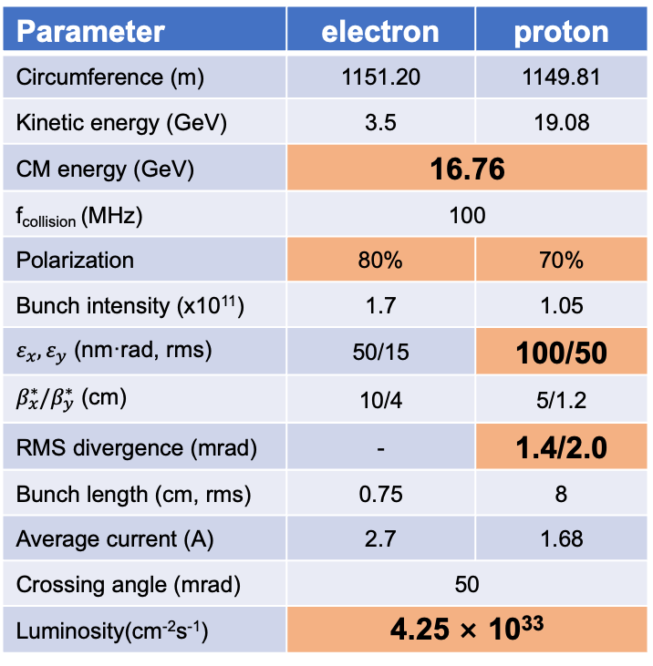
HIAF upgrade
Phase 0-ongoing: HIAF for nuclear physics
Phase 1: HIAF upgrade for applied science
EicC
EicC: Nucleon structure
Parameter | electron | proton
Circumference (m) | 1151.20 | 1149.81
Kinetic energy (GeV) | 3.5 | 19.08
CM energy (GeV) | 16.76
f_{collision} (MHz) | 100
Polarization | 80% | 70%
Bunch intensity (x10¹¹) | 1.7 | 1.05
$ε_{x},ε_{y}$ (nm·rad, rms) | 50/15 | 100/50
$β_{x}^{∗}/β_{y}^{∗}$ (cm) | 10/4 | 5/1.2
RMS divergence (mrad) | - | 1.4/2.0
Bunch length (cm, rms) | 0.75 | 8
Average current (A) | 2.7 | 1.68
Crossing angle (mrad) | 50
Luminosity(cm⁻²s⁻¹) | 4.25 × 10³³
Collider ring ~1149.07 m
Electron ring ~287.80 m
2.8 GeV ~ 5 GeV
eLinac
HIAF
BRing_N ~569.10 m
BRing_S ~ 574.54 m
Proton energy up to 24.85 GeV
电子对撞环eRing ~ 1151.20 m
Proposed in the next “5-year-plan”

Slide 5
Future Experiments at HIAF
18 | 19 | 20 | 21 | 22 | 23 | 24 | 25 | 26 | 27 | 28 | 29 | 30 | 31 | 32 | 33 | 34 | 35 | 36 | 37 | 38 | 39 | 40
十三五 |  |  | 十四五 |  |  |  |  | 十五五 |  |  |  |  | 十六五 |  |  |  |  | 十七五
HIAF
Accelerator
HIAF-U
EicC
Detector
H-NS DEMO
H-NS construction
H-NS run
EicC
H-NS DEMO running at HIAF
A smooth transition from H-NS to EicC, in terms of both physics and hardware

Slide 6

Spin and its polarization
Polarization: spin of particles in a system is aligned in a preferred direction.
$${\hat{S}}_{z}$$
Reference plane

Slide 7
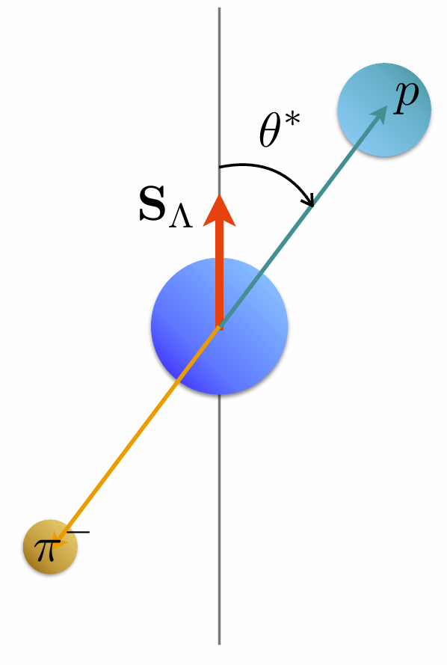
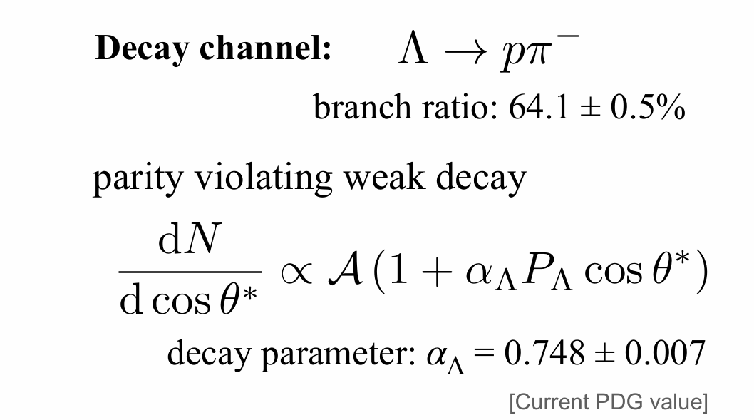
Spin and its polarization
$Λ^{0}$ serves as its own spin analyzer through the decay $Λ^{0}→p+π^{−}$

Slide 8
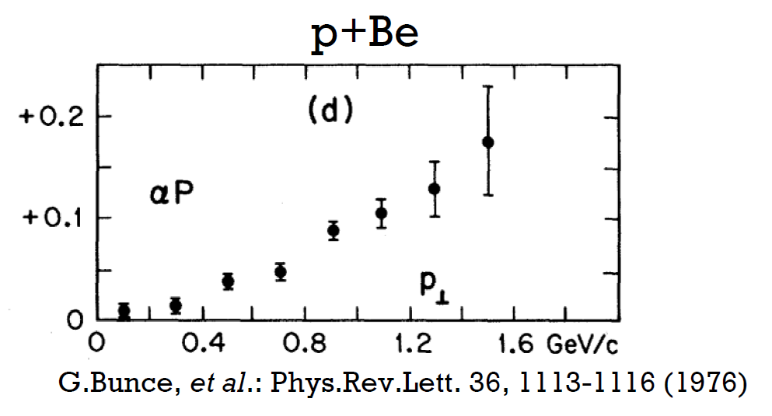

First observation of $Λ^{0}$ polarization
Hyperons can be produced polarized in collisions of unpolarized particles
Discovered at Fermilab in the 1970’s in p + Be collisions: 300 GeV protons on Beryllium
The origin of polarization cannot be explained under perturbative QCD

Slide 9
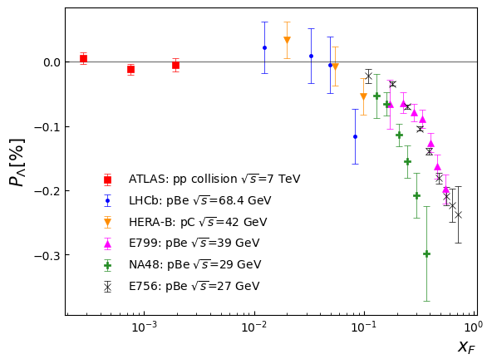
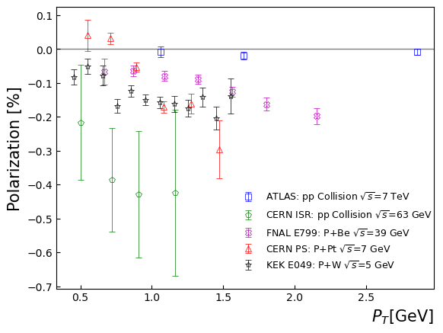
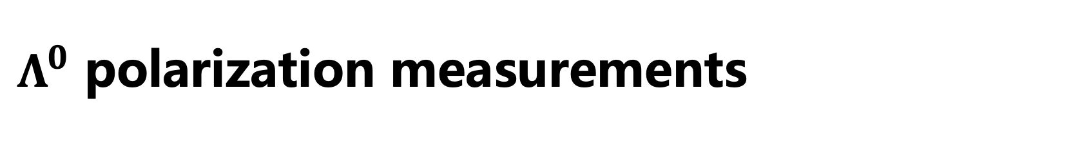
$Λ^{0}$ polarization measurements

Slide 10
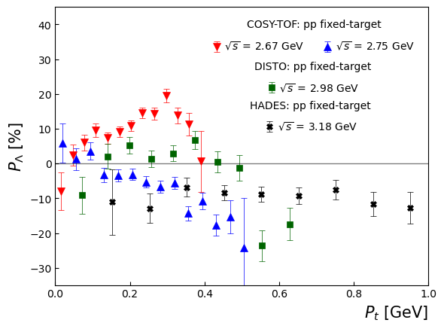
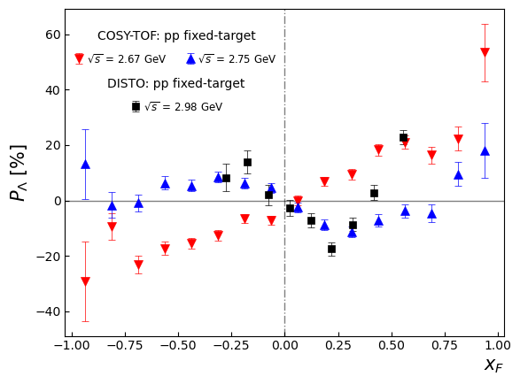
Puzzle in low energy collisions

Slide 11
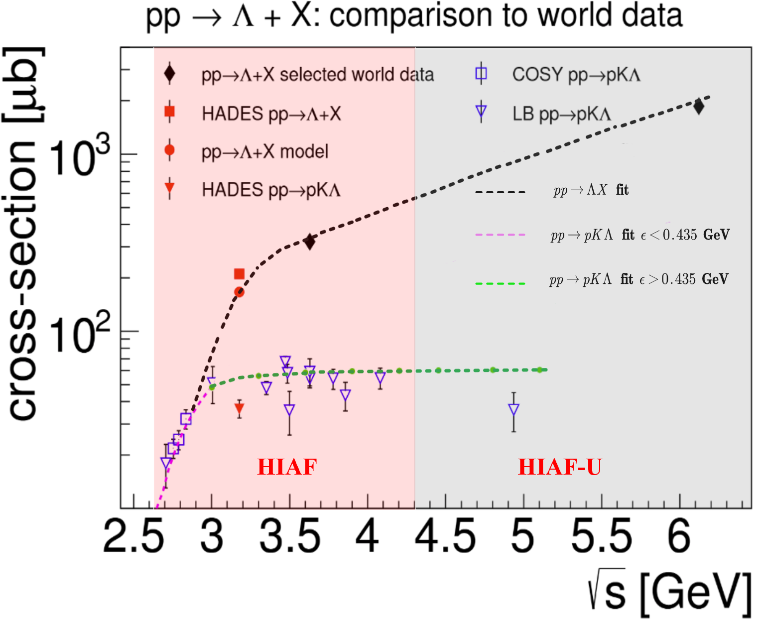
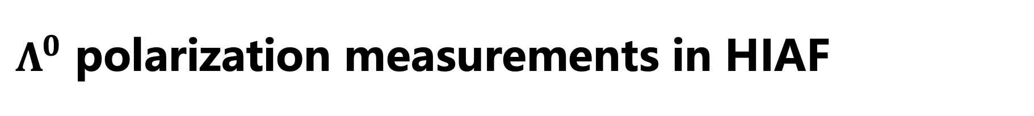



$Λ^{0}$ polarization measurements in HIAF
Hyperon-Nucleon Spectrometer (H-NS)
𝚲 polarization measurements cross energy region and collision system
$$pp(A)→ΛX$$
polarization through hadronization
Zuo-tang Liang, and C. Boros, Phys. Rev. Lett. 79, 3608 (1997); PRD 61, 117503 (2000).
H. Dong and Zuo-tang Liang, PRD 70, 014019 (2004); PRD 72, 033006 (2005).
$$pp→ΛKp$$
$Λ$ polarization in exclusive processes
R. Machleidt, K. Holinde and C. Elster, Phys. Rept. 149, 1 (1987).
B. C. Liu, B. S. Zou, PRL 96, 042002 (2006).

Slide 12
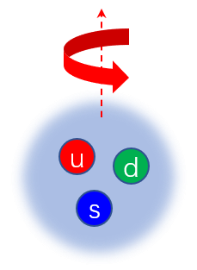
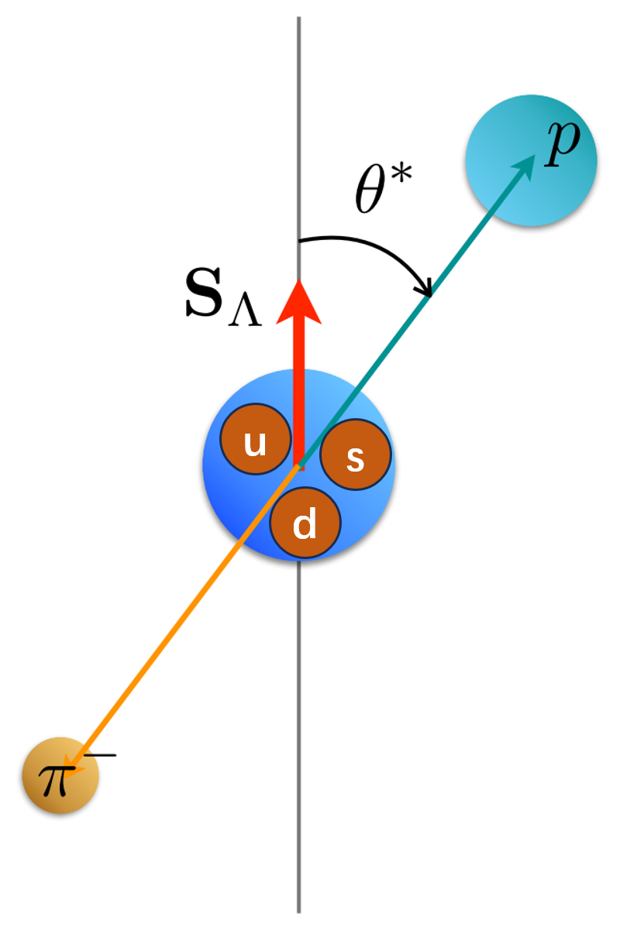
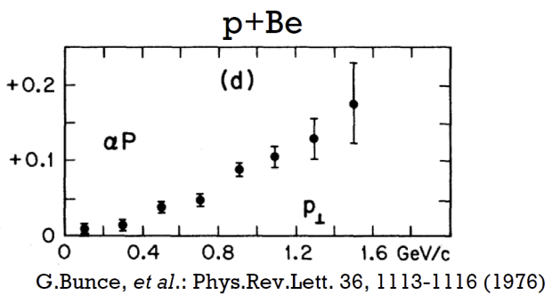
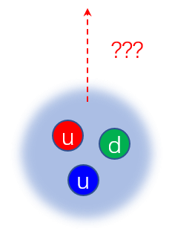
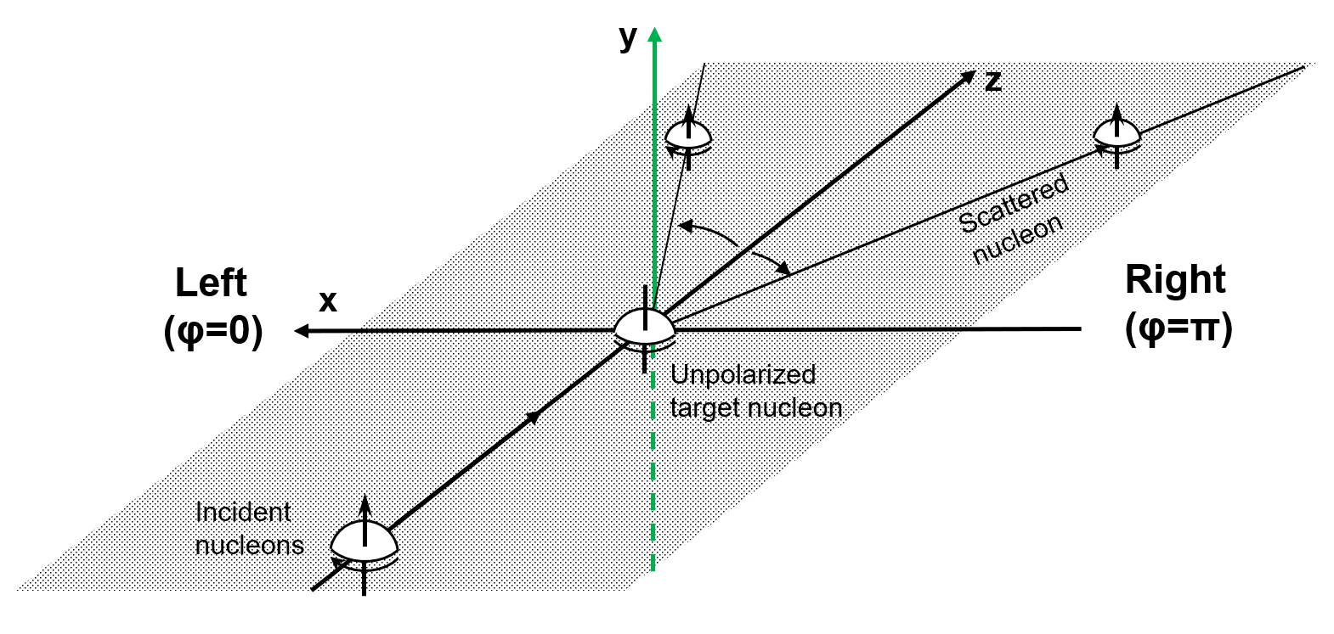
An question: Is proton polarized as well?
pp → p K Λ
超子弱衰变角分布测量超子极化
pp → p + X
???
核核弹性散射测量核子极化
12

Slide 13
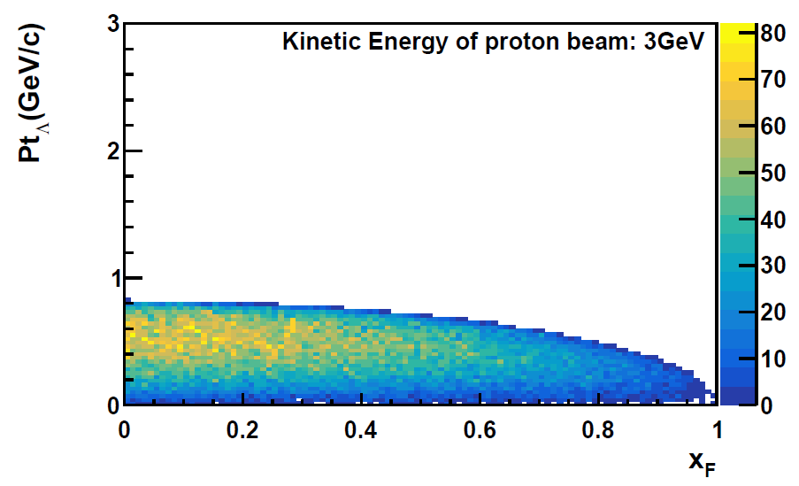
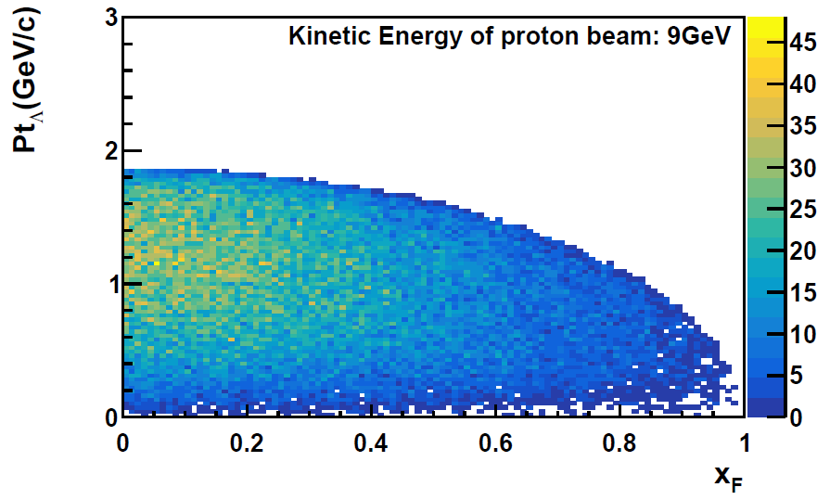
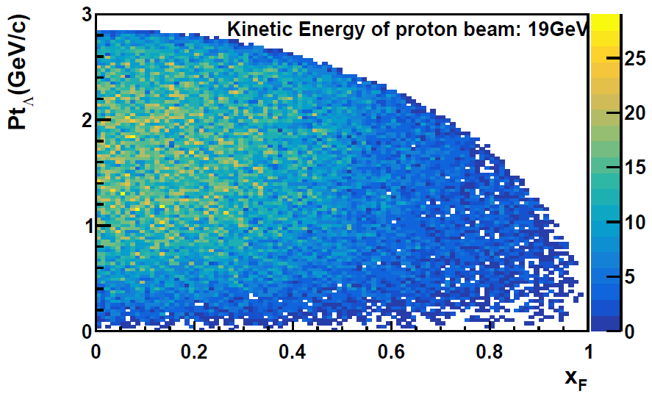

HIAF kinematics coverage
3 GeV → 9 GeV → 20 GeV
Allow for a multi-dimensional mapping of the $Λ^{0}$ polarization and production
Beam energy scan
p→p, p→A, A→A data taking

Slide 14
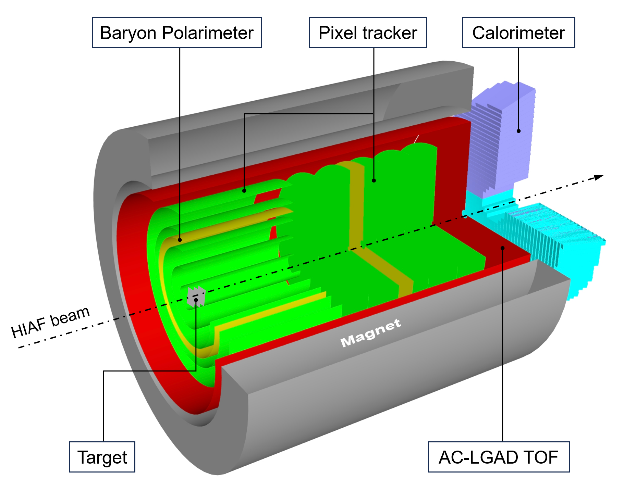
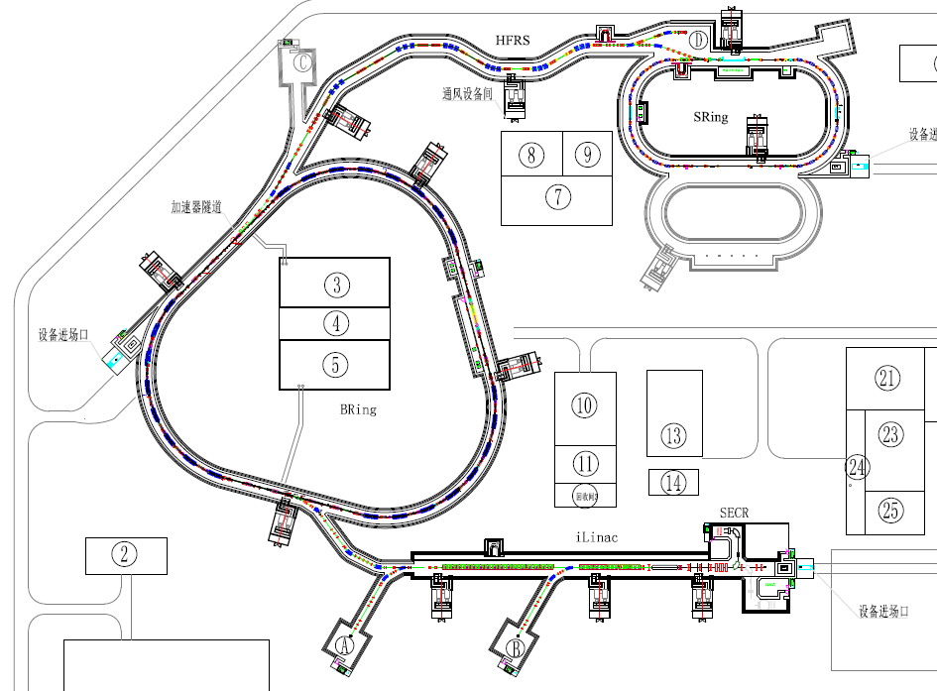
Hyperon Nucleon Spectrometer (H-NS)
proton beam up to 9.3 GeV
ion beam up to 4.25 GeV/u
p + p
p + A
A + A
@ event rate ~ MHz
High Energy Nuclear Physics Terminal
MIC6 MAPS

Slide 15
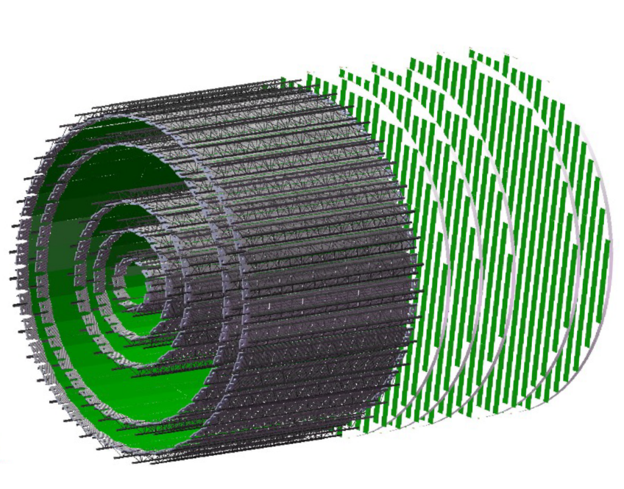
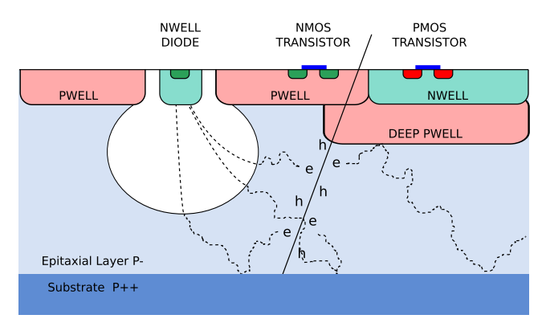
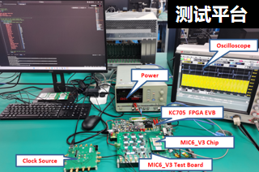
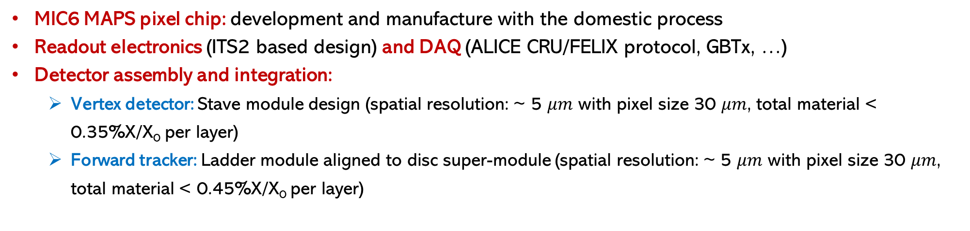
Silicon tracker at H-NS
The Monolithic Active Pixel Sensors （MAPS）
MIC6 development at CCNU
MIC6 MAPS pixel chip: development and manufacture with the domestic process
Readout electronics (ITS2 based design) and DAQ (ALICE CRU/FELIX protocol, GBTx, …)
Detector assembly and integration:
Vertex detector: Stave module design (spatial resolution: ~ 5 $μm$ with pixel size 30 $μm$, total material < 0.35%X/X₀ per layer)
Forward tracker: Ladder module aligned to disc super-module (spatial resolution: ~ 5 $μm$ with pixel size 30 $μm$, total material < 0.45%X/X₀ per layer)

Slide 16
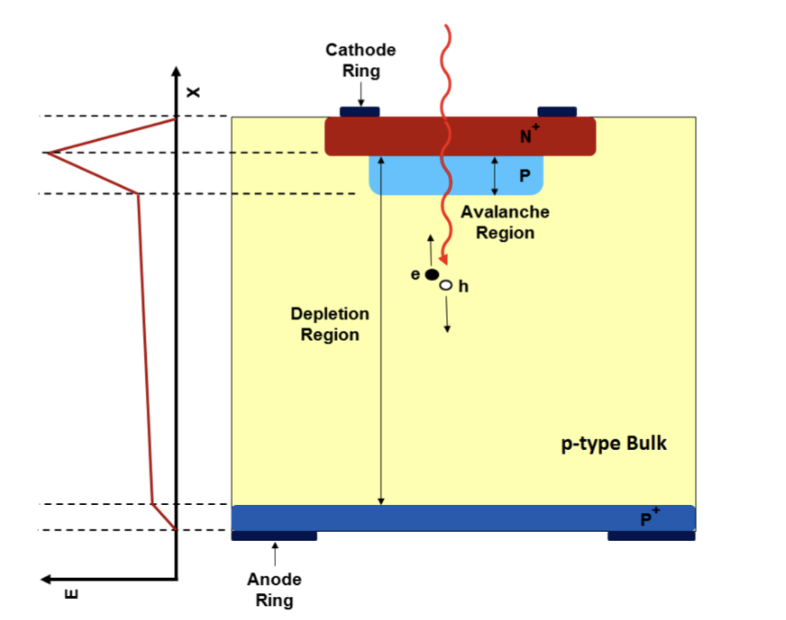
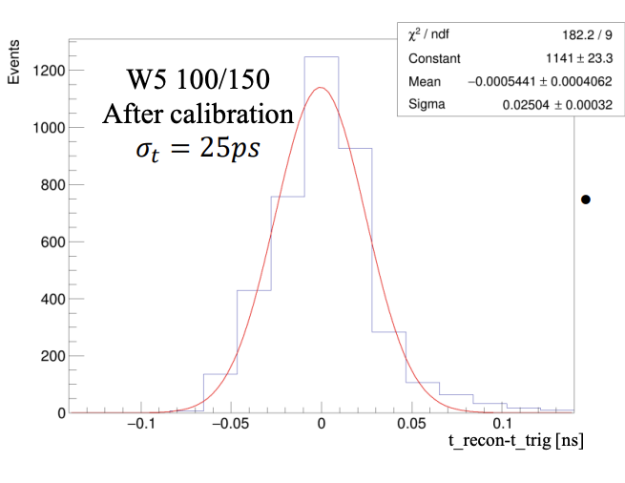
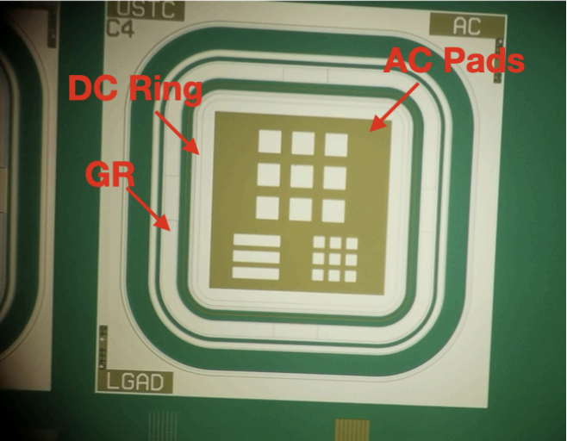
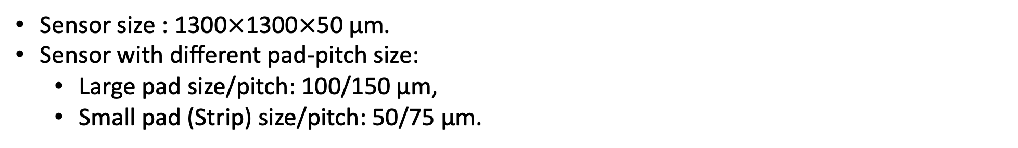
Low Gain Avalanche Diode Detector (LGAD)
Recent development at USTC:
Sensor size : 1300$×$1300$×$50 μm.
Sensor with different pad-pitch size:
Large pad size/pitch: 100/150 μm,
Small pad (Strip) size/pitch: 50/75 μm.

Slide 17
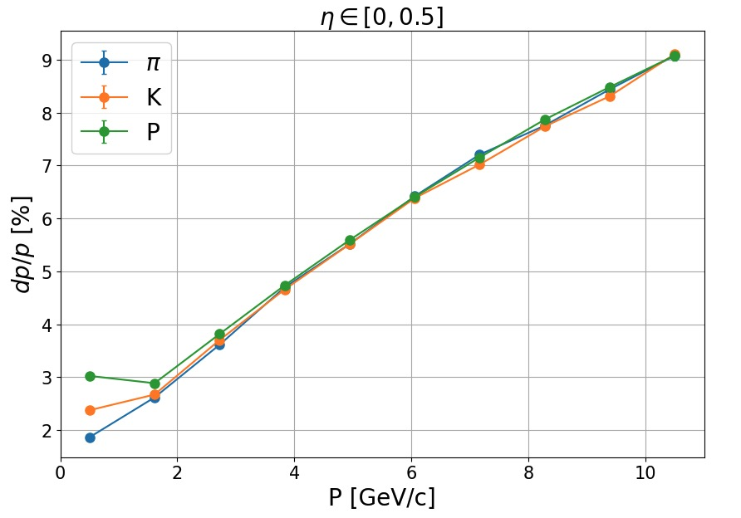
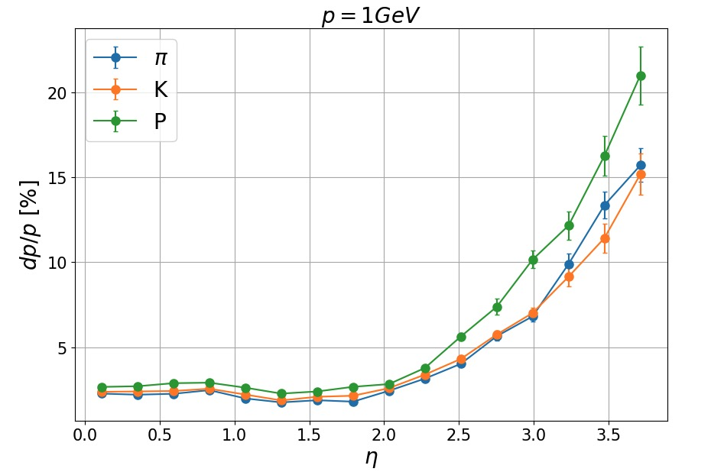
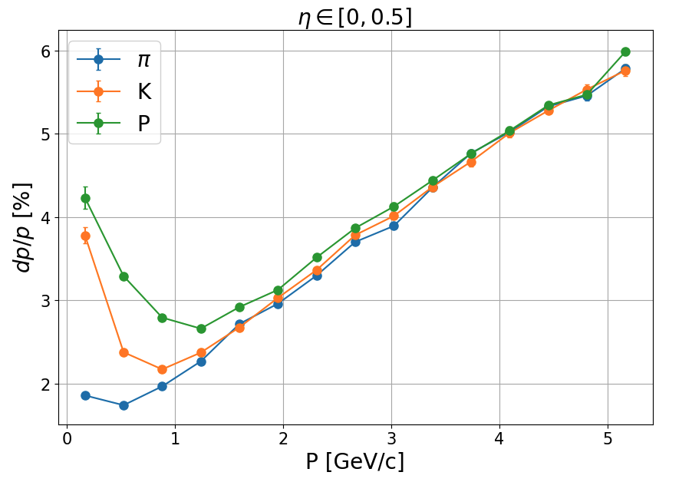
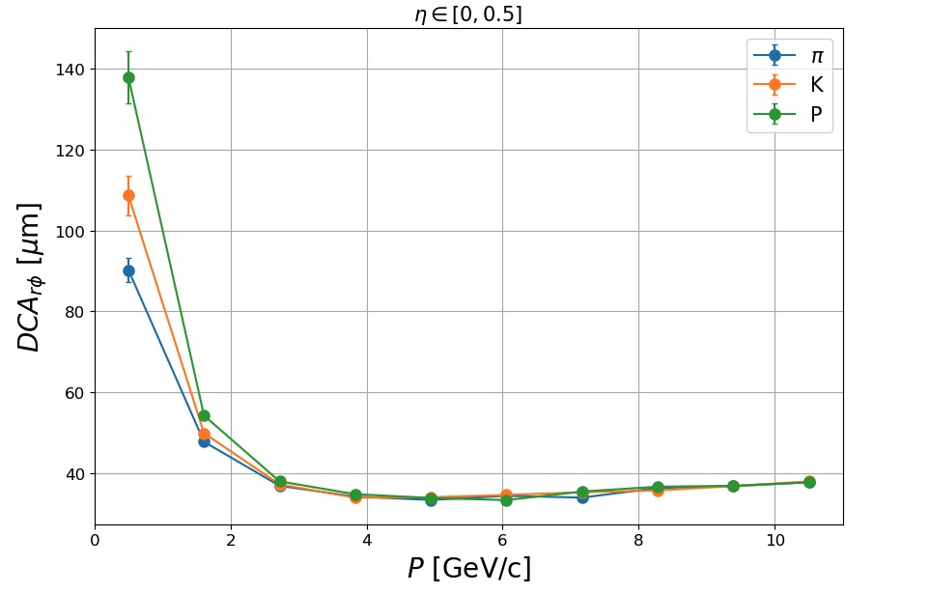
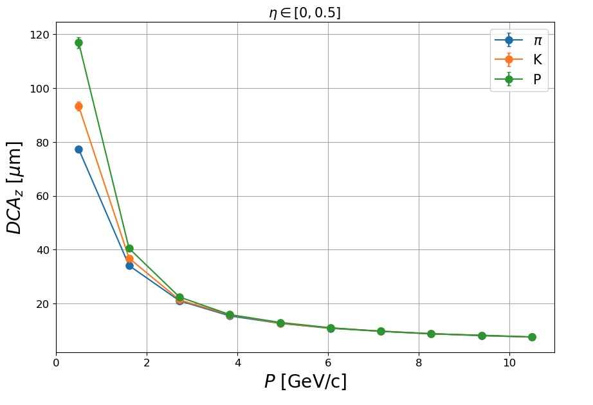
Momentum and vertex resolution

Slide 18
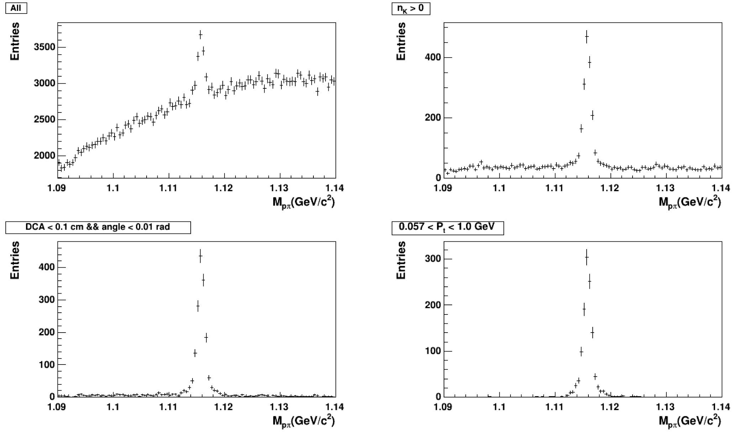
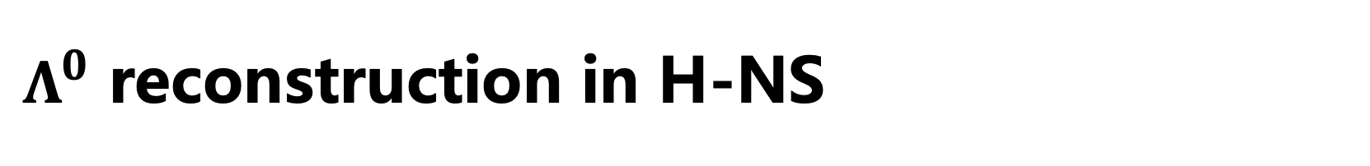
$Λ^{0}$ reconstruction in H-NS
PID
PID+Topo.

Slide 19
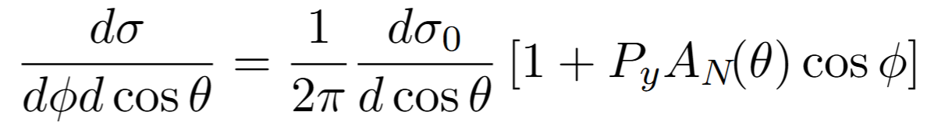
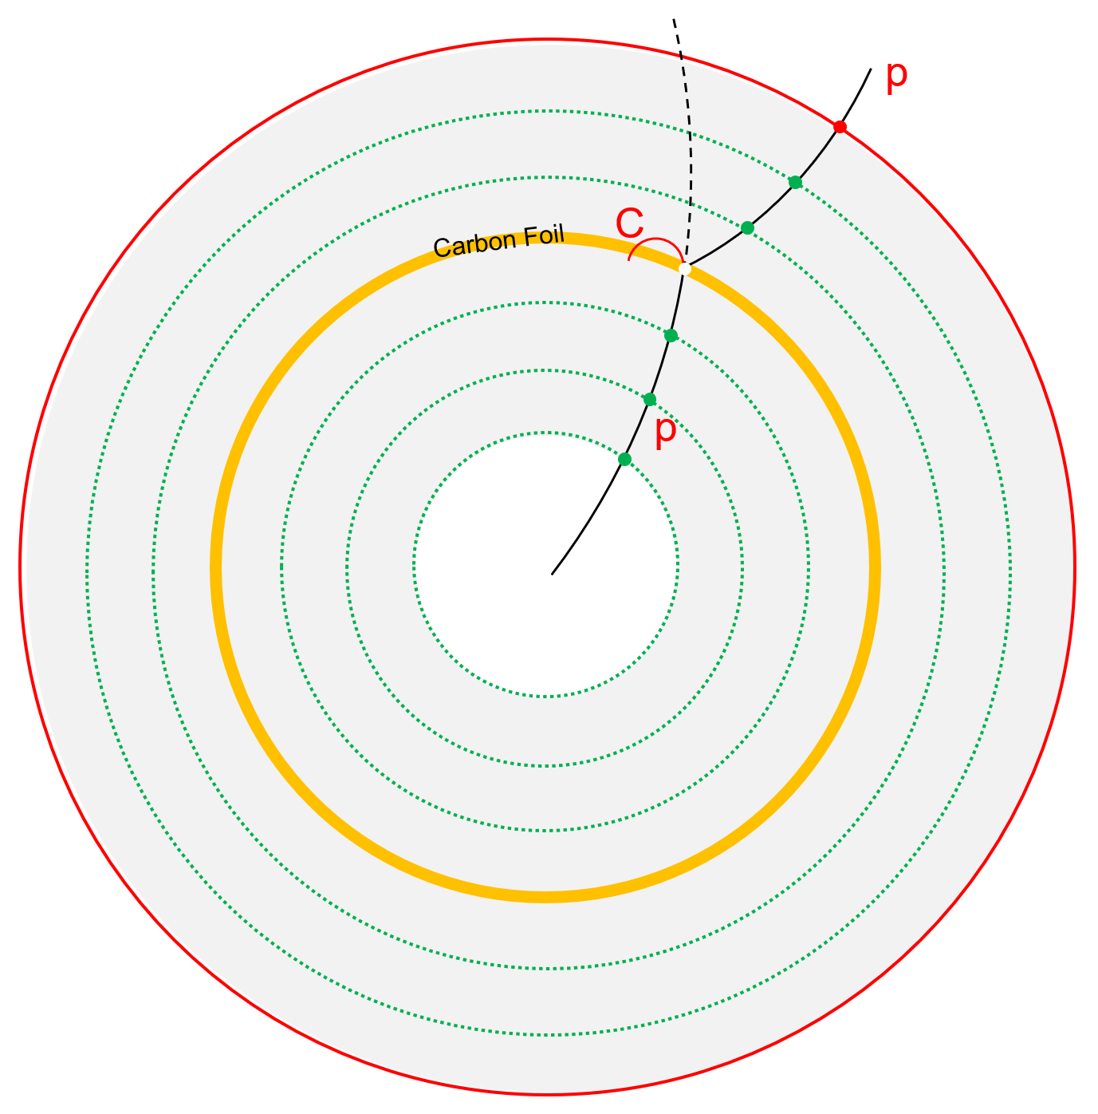
Baryon polarimeter
Determining proton polarization via elastic scattering
Transversely polarized protons
Carbon foil
x
Ф
θ
C
Carbon Foil layer
~1 mm thickness
Material budget: <1% X/X₀
Probability: pC (1E-3)
Position : in-between the tracking devices
Detailed in YuTie’s talk on 26th!
Y. T. Liang et. al. Phys. Rev. D 112, L031502 (2025)

Slide 20
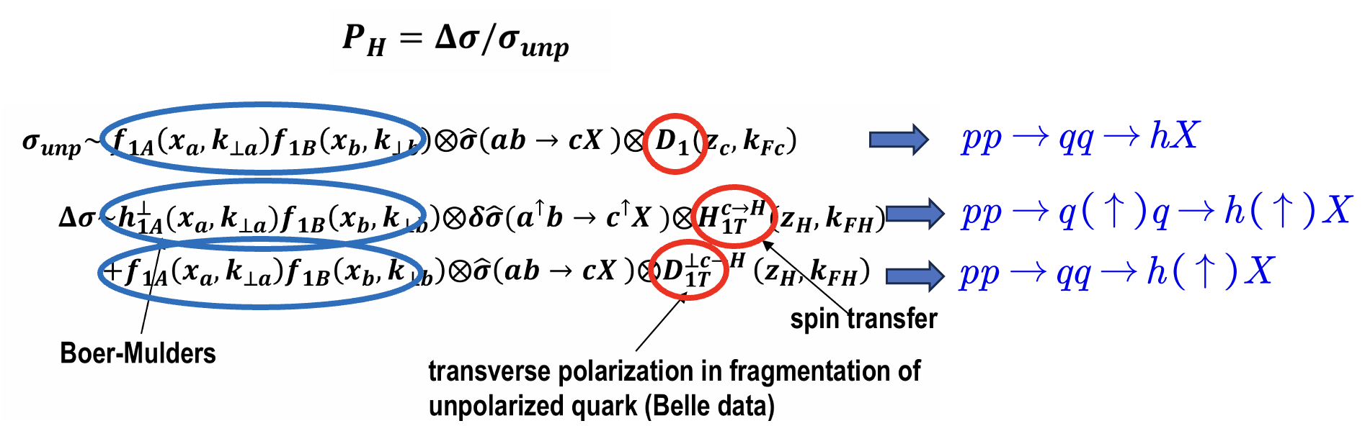
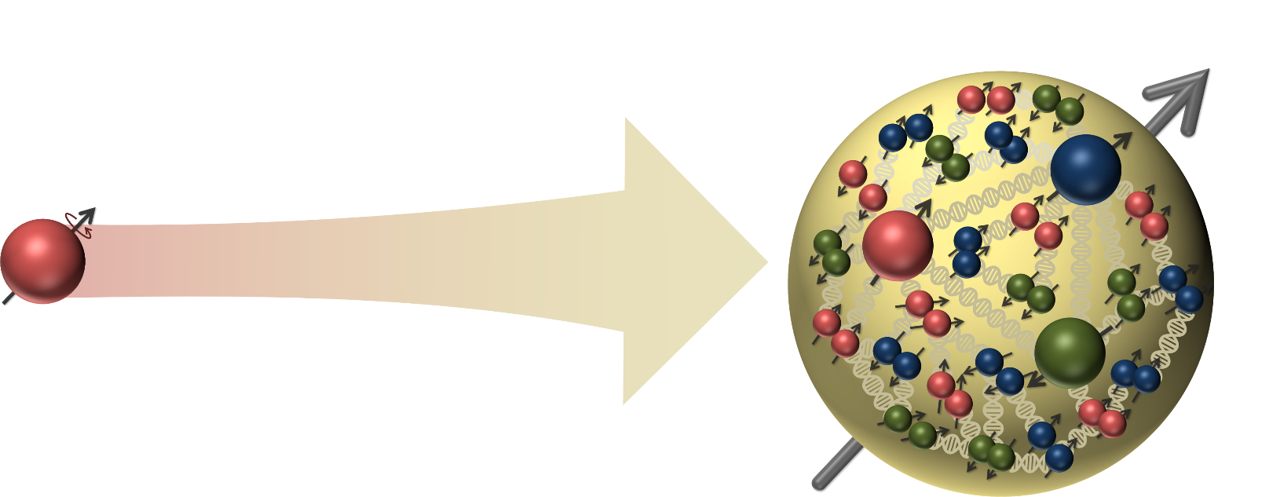
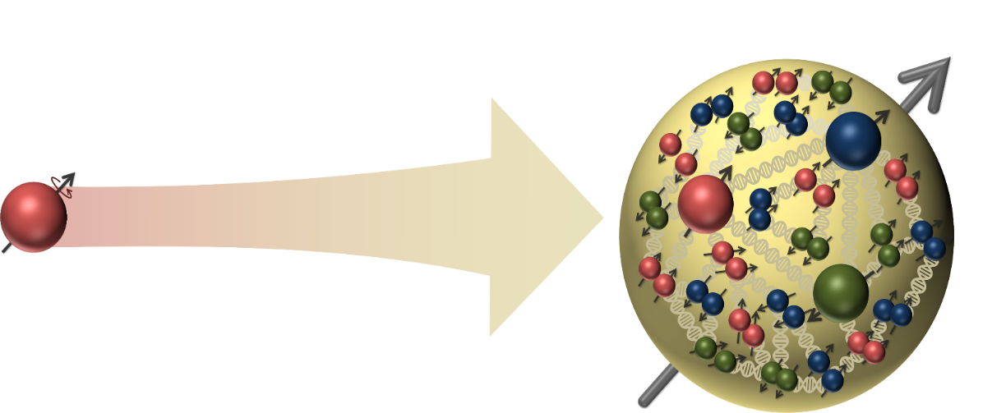



Origin of $Λ^{0}$ polarization?
Possible explanation:
Fragmentation?
Spin transfer?
$$p$$
$$Λ$$

Slide 21
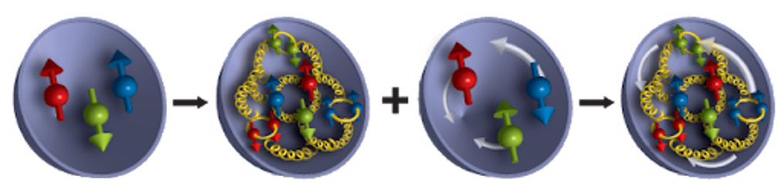
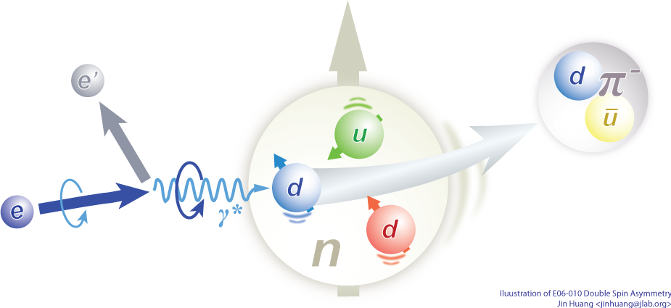

About nucleon spin structure
1988 EMC experiment → “Spin crisis”
Electron-ion scatering process
Pion/Kaon
1970s
1980s/2000s
Now
Spin decomposition:
$S_{tot}=\frac{1}{2}= \frac{1}{2}∆Σ+∆G+$ $𝓛_{q}+𝓛_{g}$
Quark spin
Gluon Spin
Quark OAM
Gluon OAM
We have a framework for the understanding of the spin structure of the nucleon

Slide 22
HIAF upgrade
Phase 0-ongoing: HIAF for nuclear physics
Phase 1: HIAF upgrade for applied science
EicC
EicC: Nucleon structure
Parameter | electron | proton
Circumference (m) | 1151.20 | 1149.81
Kinetic energy (GeV) | 3.5 | 19.08
CM energy (GeV) | 16.76
f_{collision} (MHz) | 100
Polarization | 80% | 70%
Bunch intensity (x10¹¹) | 1.7 | 1.05
$ε_{x},ε_{y}$ (nm·rad, rms) | 50/15 | 100/50
$β_{x}^{∗}/β_{y}^{∗}$ (cm) | 10/4 | 5/1.2
RMS divergence (mrad) | - | 1.4/2.0
Bunch length (cm, rms) | 0.75 | 8
Average current (A) | 2.7 | 1.68
Crossing angle (mrad) | 50
Luminosity(cm⁻²s⁻¹) | 4.25 × 10³³
Collider ring ~1149.07 m
Electron ring ~287.80 m
2.8 GeV ~ 5 GeV
eLinac
HIAF
BRing_N ~569.10 m
BRing_S ~ 574.54 m
Proton energy up to 24.85 GeV
电子对撞环eRing ~ 1151.20 m
Proposed in the next “5-year-plan”

Slide 23
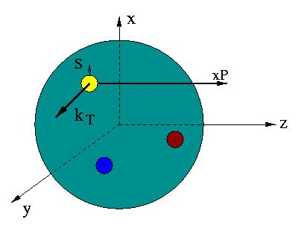
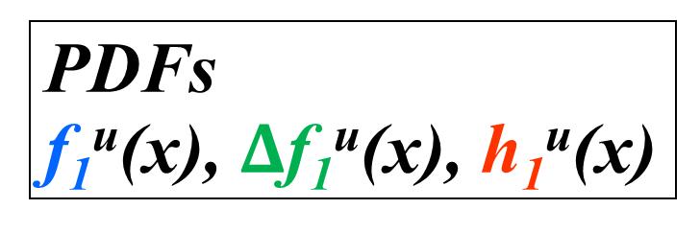
Unified view of nucleon structure
6D Dist.
W_{p}^{u}(x,k_{T},r ) Wigner distributions (X. Ji)
6D Dist.
d³r
d²k_{T} dr_{z}
TMD PDFs f₁^{u}(x,k_{T}), .. h₁^{u}(x,k_{T})‏
GPDs/IPDs
3D imaging
dx &
Fourier Transformation
d²k_{T}
d²r_{T}
Form Factors
G_{E}(Q²),
G_{M}(Q²)‏
PDFs
f₁^{u}(x), $Δ$f₁^{u}(x), h₁^{u}(x)‏
1D

Slide 24
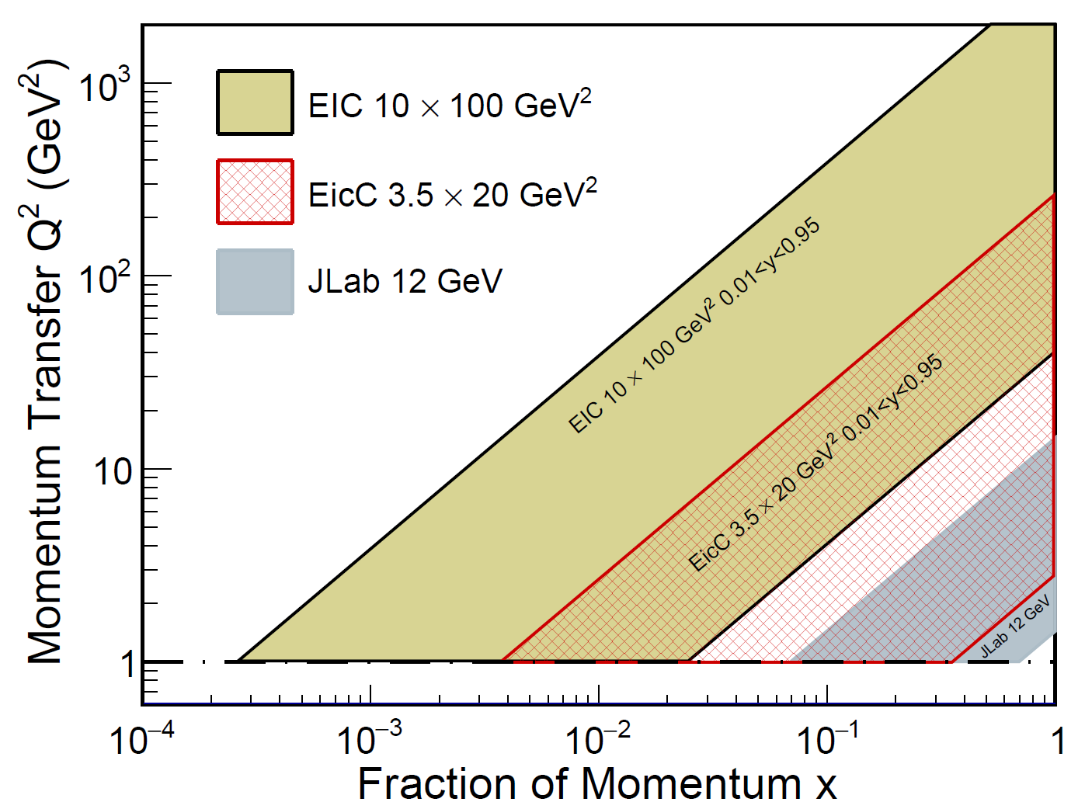
Highlighted physics topics
Spin of the nucleon: 1D, 3D
polarized electron + polarized proton/light nuclei
Partonic structure of nuclei and the parton interaction with the nuclear environment
unpolarized electron + unpolarized various nuclei
Exotic states with c/cbar, b/bbar (BESIII community in China)

Slide 25
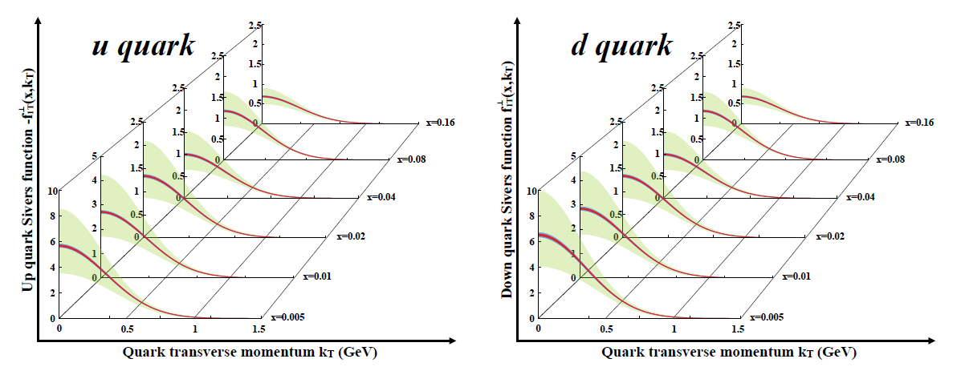



Highlighted physics topics
Spin of the nucleon: 1D, 3D
polarized electron + polarized proton/light nuclei
Partonic structure of nuclei and the parton interaction with the nuclear environment
unpolarized electron + unpolarized various nuclei
Exotic states with c/cbar, b/bbar (BESIII community in China)
﻿1D polarized quark distributions
TMD：Sivers
Green: Current accuracy
Red: stat. error only
Blue: sys. Error included

Slide 26

Highlighted physics topics
Nuclear PDFs
Spin of the nucleon: 1D, 3D
polarized electron + polarized proton/light nuclei
Partonic structure of nuclei and the parton interaction with the nuclear environment
unpolarized electron + unpolarized various nuclei
Exotic states with c/cbar, b/bbar (BESIII community in China)
﻿sea quark distribution in Pb at Q² = 10 GeV²

Slide 27



Highlighted physics topics
Spin of the nucleon: 1D, 3D
polarized electron + polarized proton/light nuclei
Partonic structure of nuclei and the parton interaction with the nuclear environment
unpolarized electron + unpolarized various nuclei
Exotic states with c/cbar, b/bbar (BESIII community in China)

Slide 28


Detector Requirements
The primary physics topic is spin physics, we need to explore the DIS, SIDIS, DVCS etc.
the scattered electrons provide crucial information to most of processes
Kinematics of the scattered electron at various Q²

Slide 29

Detector Requirements
The primary physics topic is spin physics, we need to explore the DIS, SIDIS, DVCS etc.
the scattered electrons provide crucial information to most of processes
The hadrons in the final states are essential for SIDIS, HF, etc.
Kinematics of the scattered electron at various Q²

Slide 30


The EicC detector

Slide 31

The EicC detector
Vertex and tracking detecter

Slide 32








EicC vertex&tracking detector design
The 3rd generation MAPS
Pixel size：~20x20$μm$
Material budget：0.05%
The 1st generation Monolithic Active Pixel Sensors （MAPS）
Pixel size ：~30x30$μm$
Material budget：0.85%
MPGD
Pitch size：~150$μm$
Material budget：1%

Slide 33

The EicC detector
PID system

Slide 34






Barrel DIRC for PID
Detector of Internal Reflection Cherenkov lights (DIRC):
DIRC achieve PID through reconstructing their Cherenkov angles, by measuring the transit time and exit position/angle of Cherenkov photons induced by different particles.
Consisted of fused silica(n=1.47) as Cherenkov radiator and MCP-PMTs as photosensor array
Compact structure as barrel detector
Achieve 3σ π/K separation up to 6 GeV/c with angle resolution ~ 1mrad
Reference from “Simulation, Reconstruction, and Design Optimization for the PANDA Barrel DIRC”, 2016
refractive index of synthetic fused silica with n = 1.47
Reference from PANDA & EIC
2025/11/15

Slide 35




mRICH: Lens-based Focusing Aerogel Detector Design
Lens-Based mRICH Design
Modular RICH is a Cherenkov detector based on aerogel radiator.
It uses a Fresnel lens to generate focusing effect to improve position resolution.
It has compact and flexible structure, and PID power with large momentum coverage.
Sensor plane
focal length 7.62cm (3”)
2025/11/15
Notes:
photosensors’ pixel size is 3 mm and the tracking angle resolution is 1 mrad

Slide 36




The EicC detector
ECal

Slide 37




Ecal Design in Simulation
General design of whole Ecal Detector.
Cesium Iodide (CsI) crystal is applied in e-endcap, Shashlik style is applied in both barrel and ion-endcap
The actual distances of the two endcaps to IP depend on the available space of the EicC design
Shashlik module
Z=2.4 m
Z=-1.5m +
R=0.9m
CsI module
 | EMC | type | z/r[m] | Length[cm],X₀ | Coverage[cm] | pseudorapidity | Tower size
EicC | e-endcap | CsI | Z=-1.5 | 30, 16X₀ | 15.0<r<128 | (-3.0, -1.0) | 4.0*4.0(front)
 | barrel | Shashlik | R=0.9 | 45, 16X₀ | -105.8<z<187.5 | (-1.0, 1.5) | 4.0*4.0 (front)
 | Ion-endcap | Shashlik | Z=2.4 | 45, 16X₀ | 24.0<r<113 | (1.5, 3.0)

Slide 38

Simulation framework & software
Structure of EiccRoot
Top level: ROOT, Virtual MC, etc.
Middle level: FairRoot framework manages the general infrastructure with simulation and tasks
EiccRoot: implementation of the EicC detector sim. and rec. inside FairRoot framework
Notes:
FairRoot is a software framework mainly for high energy and nuclear physics experiments.
FairRoot is developed based on ROOT. In this plot, the top level shows the common used softwares, such as ROOT and Geant4. FairRoot depends on these softwares.
The middle level shows the structure of FairRoot. It manages the general infractructure with simulation and tasks.
The bottom level shows the specific experiment implementation using FairRoot. Currently, there are many experiments using FairRoot, such as PANDA, CBM, and EicC.

Slide 39






The performance
Momentum resolution
电子束流
离子束流
DCA resolution
Primary vertex residual

Slide 40

Summary
H-NS
Two experiments are proposed at HIAF:
1. 2027-2035: H-NS,
fix target experiment
hyperon and nucleon polarization in pp, pA and AA
2. 2035-: EicC:
Polarized election and ion collider
Nucleon spin structure
Detector R&D is ongoing!
EicC
Thank you for your attention!

Slide 41

Thank you !

Slide 42
backups

Slide 43



The ﻿Monolithic Active Pixel Sensors (MAPS).
Based on domestically developed technology, we have developed the fully-functional MAPS chip MIC6_V3 with similar performance as ALPIDE chip.
Key features:
﻿high granularity: pixel size: ~30 $μm$
High speed: integration time: 5~10 $μs$
Low Power Consumption： ～30mW/cm² ~low material
1.5x3.0 cm

Slide 44





Micromegas detector
Feature
high granularity: spatial resolution: ~ 65 $μm$
High speed: 100~200 kHz/cm²
Electron beam test（5GeV at DESY）
X-Y 2D readout
Efficiency：>98%
σ_{X}=65 μm
σ_{Y}=65 μm
Jianxin Feng, Zhiyong Zhang, Jianbei Liu et al., NIM-A 989 (2021) 164958.
Micromegas prototype 40x40 cm

Slide 45









Modularized structure
Power bus
Stave module structure
FPC
2x7 chip array
Cooling board
Length in Z (mm): 1477.5 mm (NICA ITS outer layer)
HIC module No. in stave: 2 $×$ 7 (NICA ITS outer layer)
Stave material budget: ~0.85% X₀
Support
~1.5m, ~ 80g

Slide 46







DIRC Prototype setup
Hamamastu R10754 (available)
DIRC protype consisted of
Fused silica radiator (HERAEUS SUPRASIL) ,
Optical focus system
MCP-PMT array. Timing resolution ~ 10ps, developed by USTC-STCF group.
北方夜视 N6021
Notes:
Spatial resolution? MCP-PMT: Hamamatsu R10754 (pixel size: 5.2mm x 5.2mm) or Photek MAPMT253 (pixel size: 1.6mm x 1.6mm)

Slide 47






mRICH Design and Simulation
• Composed of 64 aerogel modules (located at z=1080
~ 1380 mm, radius 100 ~ 670 mm); • The cross section of each module is 108 × 108 mm²,
with a thickness of 25 ~ 35 mm; • The center of each module is at z=-1230 mm and tilted
towards the collision center point; • Fresnel lens focal length L=76.2 mm (3 inches, n=1.47,
Edmund Optics).
pi/K separation up to 9 GeV/c at best
e/pi separation up to 2 GeV/c at best
Separation power decrease with increasing polar angle
3 sigma separation up to 9 GeV/c when particle launched at the center of aerogel
3 sigma separation up to 8 GeV/c when particle launched at 10 degrees
2025/11/15

Slide 48
Module (7x7) array simulation result
Ye Tian (IMP)
Shashlik simulation result
CsI simulation result
Energy resolution
Energy resolution
Position resolution
Position resolution

Slide 49



Shashlik ECal cosmic ray test result
Ye Tian (IMP)
Assembled Shashlik module
Shashlik module measuring with cosmic ray
Horizontal test setup
Module
Trigger scintillator

Slide 50



“Scaling” of $Λ^{0}$ polarization ?
R608: 10.1016/0370-2693(87)91556-5

Slide 51

The conceptual design of H-NS detector
Momentum resolution:
~2%@1GeV when $η$<2.5
PID:
K, $π$ separation (~3$σ$) up to 2 GeV/c
K, p separation (~3$σ$) up to 5 GeV/c
Vertex resolution:
Excellent vertex resolution for background suppression
Material budget (<10%)
Acceptance:
5 to 100 degree
High event rate
1MHz
Baryon Polarimeter → determine final state proton’s polarization

Slide 52

Projection of Λ and proton polarization

Slide 53

Lepton-Nucleon Scatterings
QED tool to study QCD nature of the nucleon
[1]
QED probe is clean
α_{EM} ~1/137 with broad Q coverage
One-photon exchange approximation:
~1% accuracy
Detection scale is determined by Q:
200MeV ~ nucleon size
[3]
[2]
Observe scattered electron/muon [1]
Observe current jet/hadron [1]+[2]
Observe remnant jet/hadron as well [1]+[2]+[3]
→ inclusive
→ semi-inclusive
→ exclusive

Slide 54

SIDIS processes for flavor decompositions
Electron-proton scattering
Pion/Kaon
Fragmentation Functions
Experimental observable: polarized structure functions g1
input
input
Leading Order picture
Extracted nucleon structure information: polarized PDFs (helicity distribution)

Slide 55
Spin of the nucleon-helicity distribution
A NLO impact study
See arXiv:2103.10276
JHEP08(2021)034
EicC white paper

Slide 56




Gluon helicity distribution
One can perform double spin asymmetry ALL measurements in the e+p → e′ +D⁰ +X process to access the gluon helicity distribution:
$$=\frac{∆g(x,Q)∗f(g→D^0 )}{g(x,Q)∗f(g→D^0 )}=∆g/g$$
With lower center-of-mass energy, the EicC will push the measurement in the relatively high-x region, where ∆g/g is supposed to be larger compared to the small-x region.

Slide 57








Spin-dependent TMDs (Leading-Twist )
 |  | Quark polarization
 |  | Unpolarized (U) | Longitudinally Polarized (L) | Transversely Polarized (T)
Nucleon Polarization | U
 | L
 | T
f₁ =
h₁⊥ =
Boer-Mulders
g₁ =
h_{1L}⊥ =
Helicity
Worm Gear
h₁ =
f _{1T}⊥ =
Transversity
g_{1T} =
Sivers
Worm Gear
h_{1T}⊥ =
Pretzelosity
Nucleon Spin
Quark Spin
Survive the k_{T} integration, yield 1D pdfs
Left items: The correlation between parton transverse momentum and the spin of quarks
Notes:
Add the meaning of each item
Why we have 2 empty boxes ??

Slide 58



TMDs in SIDIS Cross Section
Target SSA, beam-target DSA measurements

Slide 59
Spin structure of the nucleon-TMDs
u/d Sivers EicC vs world data
LO analysis
EicC SIDS data:
Pion(+/-), Kaon(+/-)
ep: 3.5 GeV X 20 GeV
eHe-3: 3.5 GeV X 40 GeV
Pol.: e(80%), p(70%), He-3(70%)
Lumi: ep 50 fb⁻¹, eHe-3 50 fb⁻¹
Green: Current accuracy
Red: stat. error only
Blue: sys. Error included
EicC, precise measurements.
sea quark Sivers function dynamically generated via Spin depenendent odderon
leads to a unique predication for s-quark: quark and anit-quark Sivers functions flip sign
H. Dong, D. X. Zheng, J. Zhou, 2018

Slide 60
Problems for cold nuclear matter effect
arXiv:2107.12401

Slide 61

Problems for cold nuclear matter effect
arXiv:2107.12401

Slide 62

Nuclear PDFs study with ion beam
EicC coverage
With only a few hours of running

Slide 63



Charm in-medium modification and hadronization at the EicC
Fragmentation and hadronization can be very different in different system.
Because of the shorter formation time of heavy flavor mesons, they have stronger interaction with nuclear matter than light mesons.
Their measurement at the EIC is expected to avoid most of the heavy-ion background
Baryon-to-meson ratio $R=\frac{Λ_{c}^{+}}{D^{0}}$ can be studied at Eicc to investigate the effect of cold nuclear medium
Patron fragmentation varies with different system.
Data is produced by pythia8 and two fragmentation model (QCD-CR and MPI-CR) are used.

Slide 64






Relation between EicC and EIC
Different x, different inner plot
Wild Q² coverage：
QCD evolution
Non-perturbative →perturbative
Gluon-dominated
Gluon + sea quark
Flavor quark

Slide 65
Gluon helicity distribution
One can perform double spin asymmetry ALL measurements in the e+p → e′ +D⁰ +X process to access the gluon helicity distribution:
$$=\frac{∆g(x,Q)∗f(g→D^0 )}{g(x,Q)∗f(g→D^0 )}=∆g/g$$
With lower center-of-mass energy, the EicC will push the measurement in the relatively high-x region, where ∆g/g is supposed to be larger compared to the small-x region.

Slide 66



The far forward detector
Photon and Neutron
detection
Charged particle

Slide 67

Luminosity and polarization monitor

