Slide 1

UNIX Shell Scripting
Iliomar Rodriguez Ramos
University of Puerto Rico at Mayaguez

Slide 2

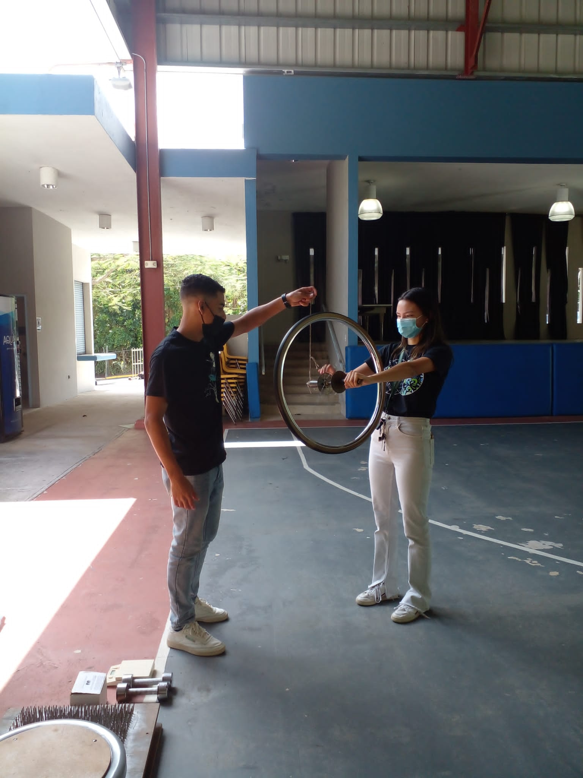


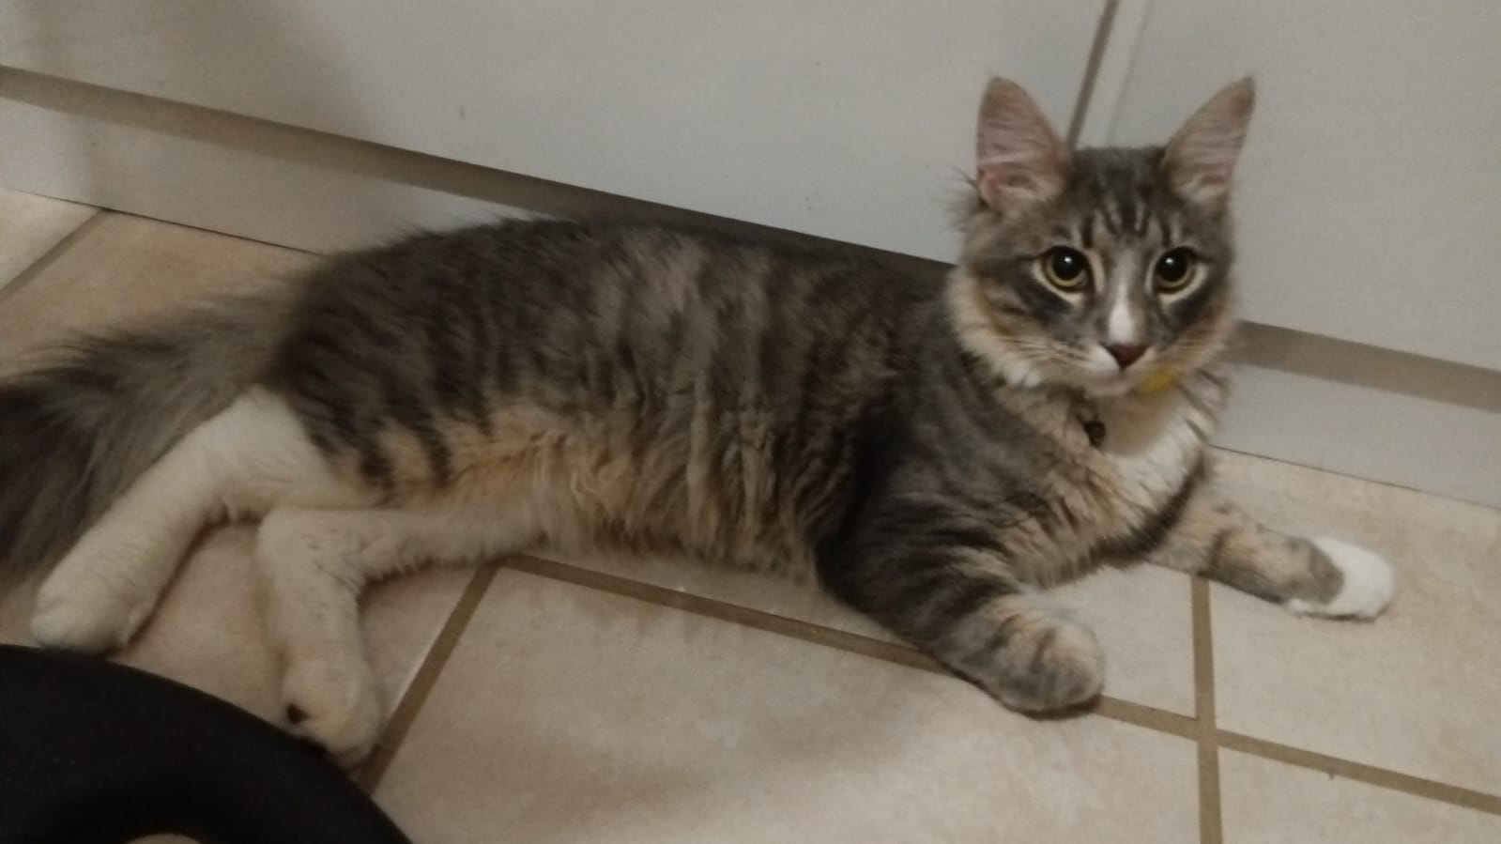

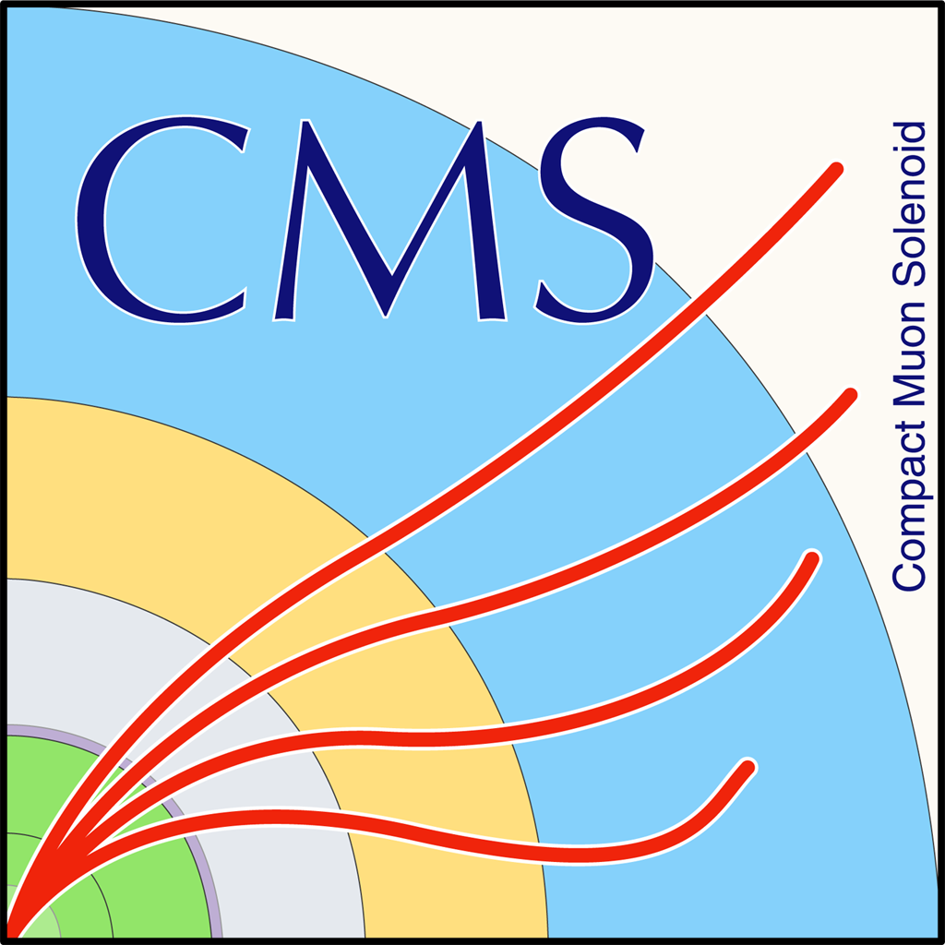
Iliomar Rodriguez Ramos
1st year MS Student
University of Puerto Rico at Mayaguez

Slide 3
Heavily based on 2023/2024 presentation by Marco Mambelli/Mitanshu Thakore

Slide 4
Goal
Familiarize ourselves with Command Line interface (CLI)
Learn shell scripting
Develop enough understanding of CLI and the Linux/Unix Terminal to be able to explore further on our own

Slide 5
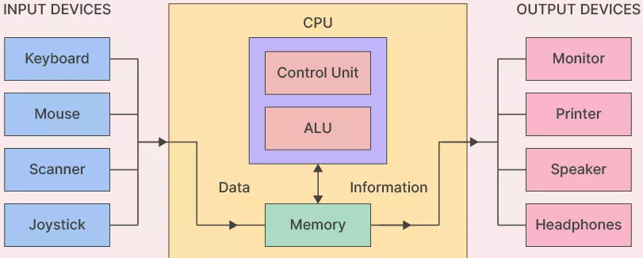
Computer Architecture

Slide 6
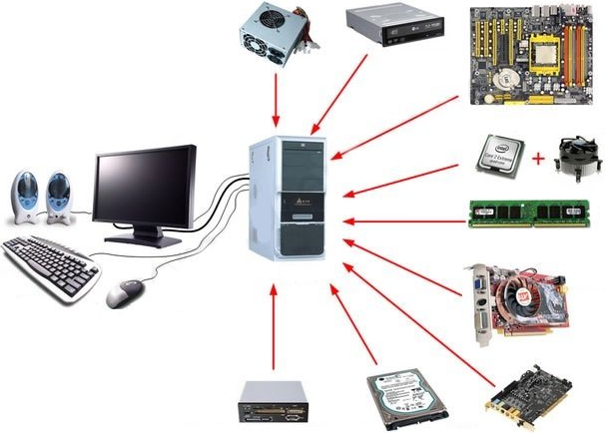
Hardware

Slide 7





Software

Slide 8

Operating Systems (OS)
Middle layer between your applications and the hardware.
It manages resources like memory, CPU time, storage, and devices.
Without an OS, your software wouldn’t know how to interact with the hardware.

Slide 9
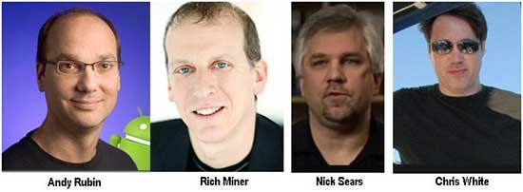



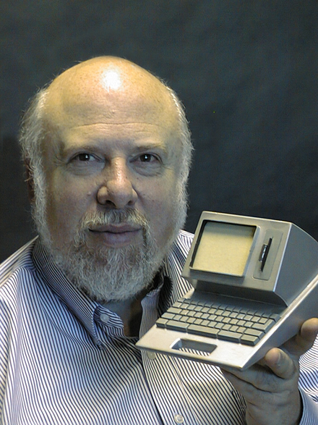
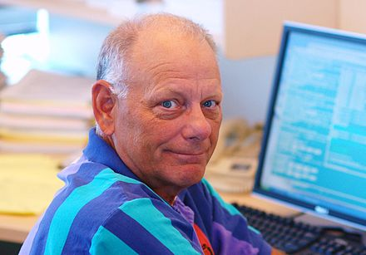

Operating Systems (OS)
Jef Raskin
Scott A. McGregor
Linus Torvalds

Slide 10
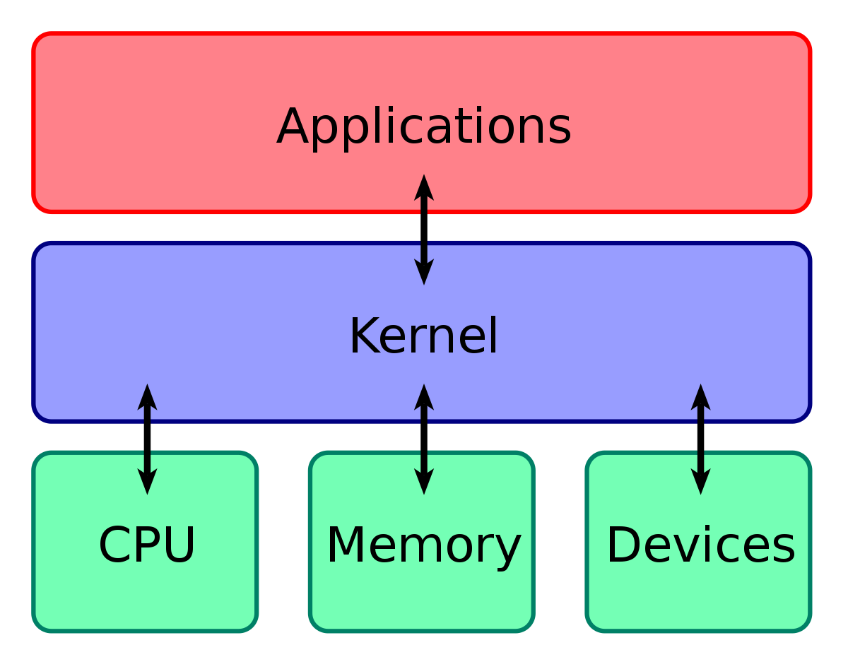
Kernel
Core of the operating system - It connects the hardware and software.
Manages resources - Controls CPU, memory, storage, and devices.
Handles system calls - Executes requests from applications to access hardware.
Ensures protection - Keeps different processes separate and secure.
Runs all the time!

Slide 11

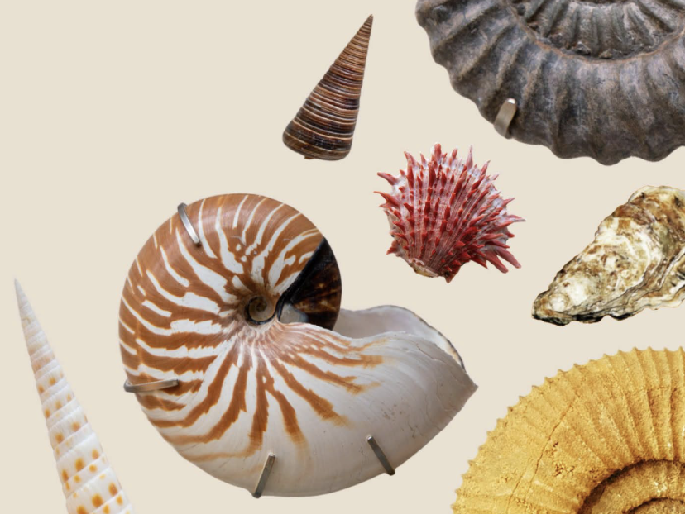
What is a Shell?
A shell is a program that lets users interact with the operating system by typing commands.
It acts as a command-line interface (CLI) between the user and the system’s core (kernel).

Slide 12
What is a Shell?
Two types of shells:
Command-line shells – e.g., sh, csh, tcsh, ksh, Bash, Zsh
Graphical shells – e.g., GNOME Shell, KDE Plasma

Slide 13
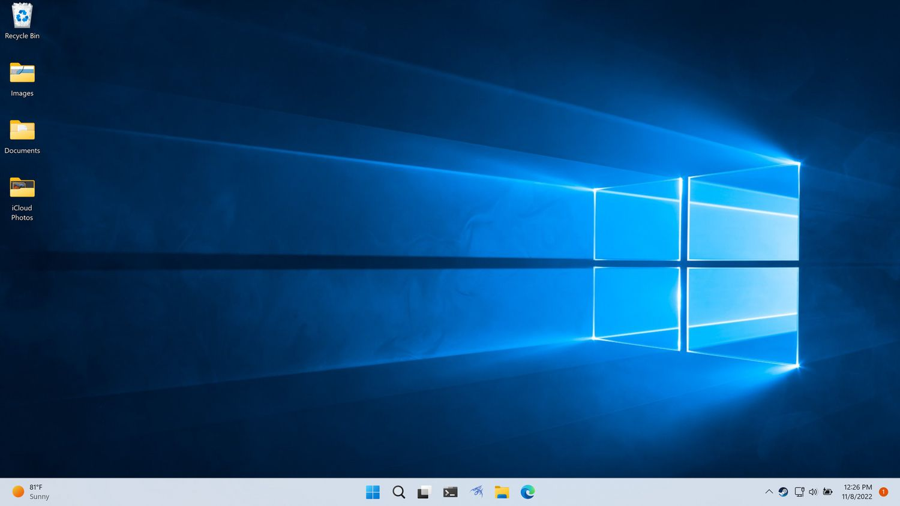
Graphical User Interface (GUI)

Slide 14
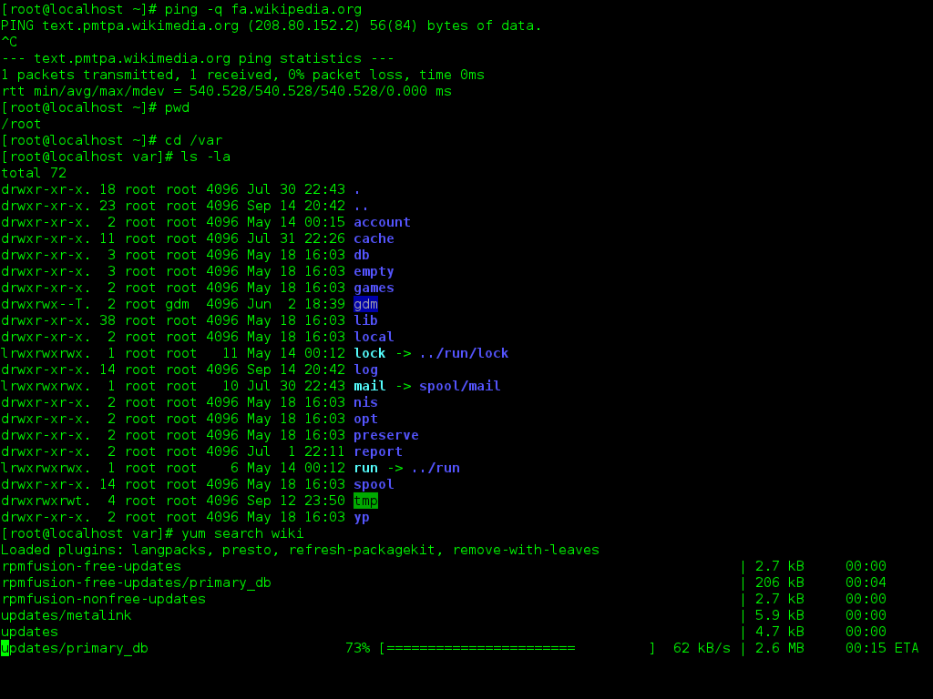
Command Line Interface (CLI)

Slide 15
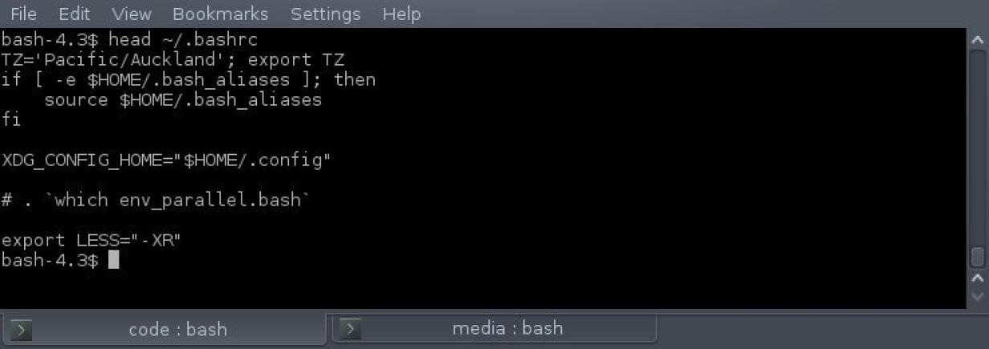
Terminal

Slide 16
Linux shells
bash (sh)
zsh
ksh
tcsh (csh)
fish

Slide 17
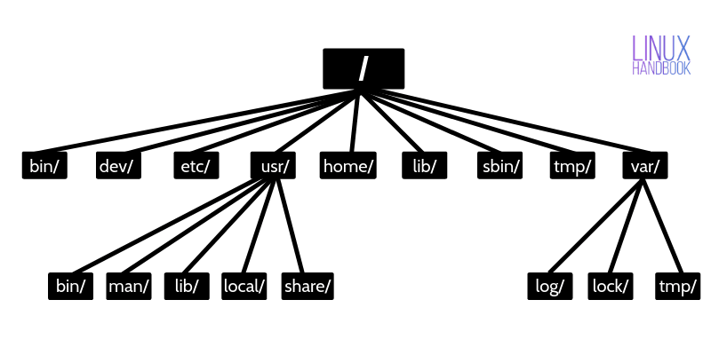
Unix File System
Everything is a file
Regular file
Directory
Link
Devices, …
Standard streams
stdin (0)
stdout (1)
stderr (2)
https://en.wikipedia.org/wiki/Unix_filesystem
https://linuxhandbook.com/linux-directory-structure/

Slide 18
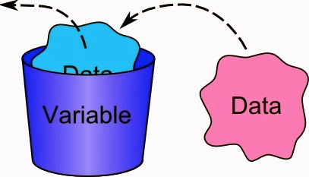
Variables
Used to store information to be referenced and manipulated in a computer program. Variables have a name, value, representation, a type
also have a scope which is the part of the program where you can access it
and a lifetime or a duration for which a variable exists
Notes:
Name - how you reference, call, the variable
Value - the current value, the content of the memory/disk storing the variable
Representation - how the variable is stored in memory/disk (determines the amount of space used, how easy are some operations - two's complement very efficient for sums, max int)
Type - the set of possible values that a variable can assume (sometime is dynamic)

Slide 19
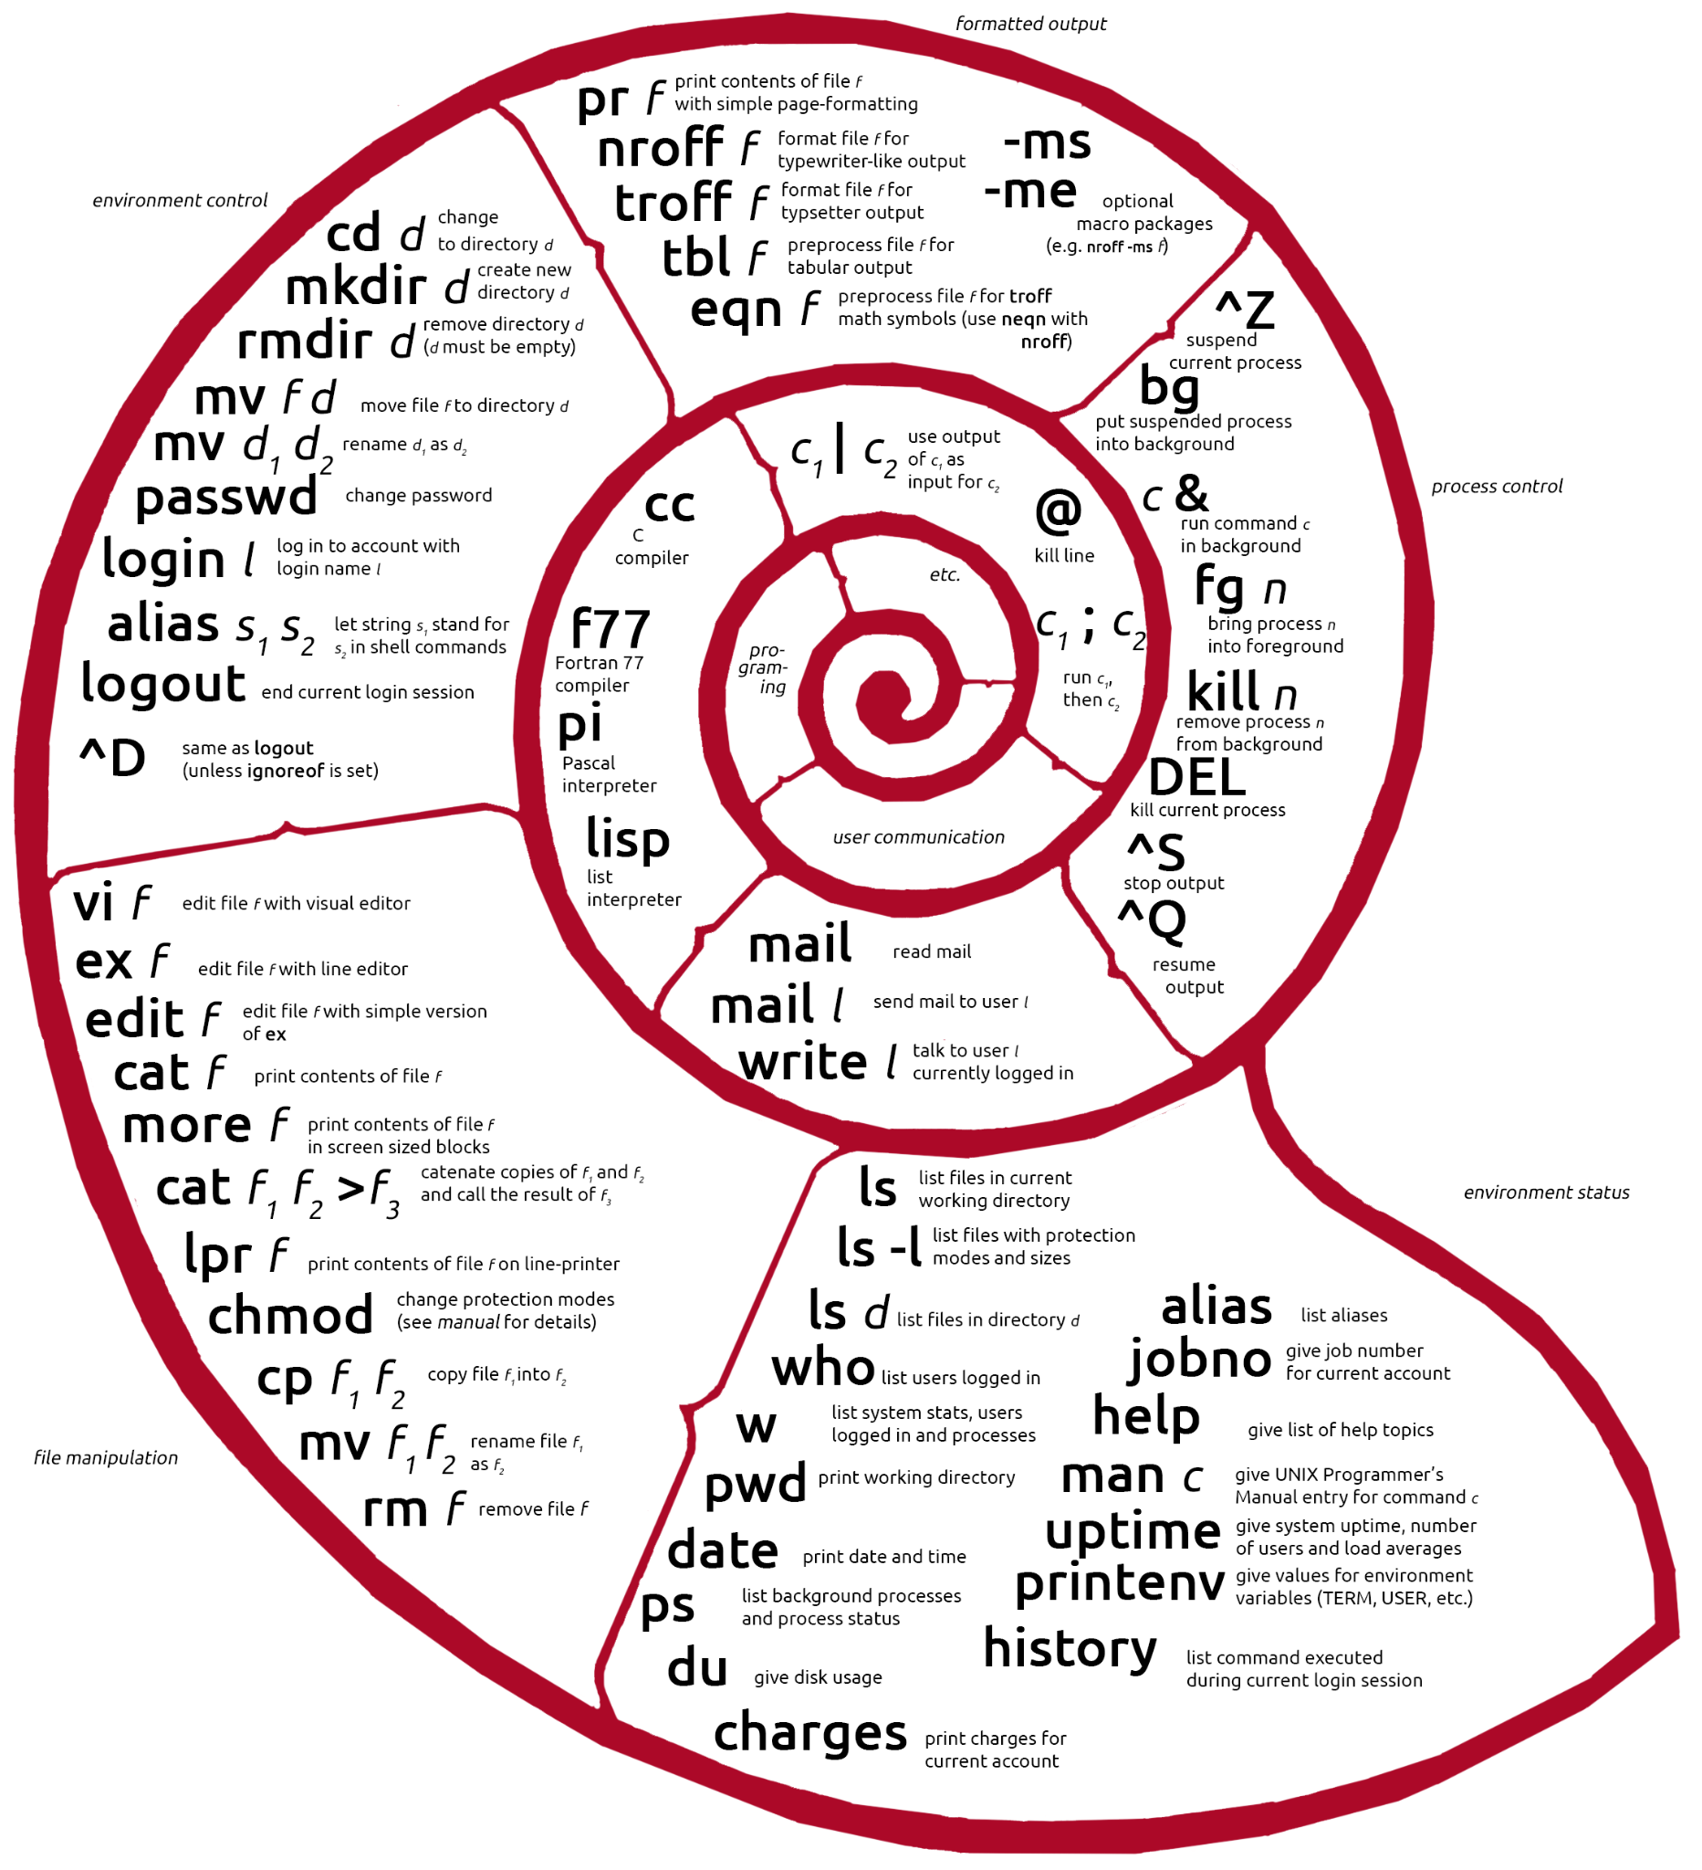
Unix
Shell
Commands

Slide 20
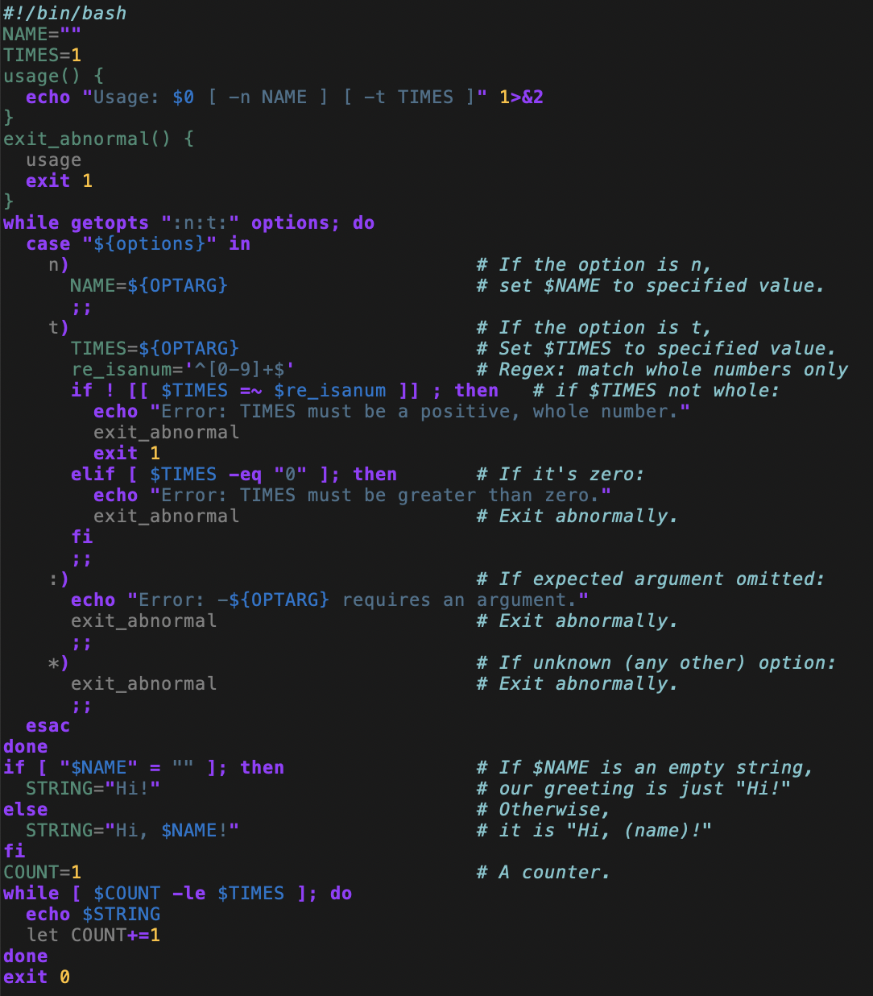
Script
File with (bash) code
Shebang (#!)
Variables
Functions
Options and Arguments
Flow control
Output
stdout, stderr
Exit code
https://github.com/glideinWMS/glideinwms/blob/master/factory/tools/gwms-logcat.sh
https://www.computerhope.com/unix/bash/getopts.htm

Slide 21
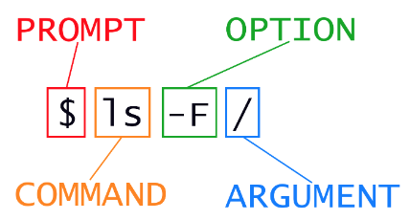
Command line
Command, options, [subcommand, subcommand options,] arguments
-o short option
--option long option
--help to get a list of valid options and what they do
man command or info command will also provide information
Tokenization separating the element in the command line
Use quotes (single or double) to avoid separating on spaces
Expansion substituting variables, wildcards, …
${varname} variable value
$(command) output of the command
$((expression) output of the math expression
* ? many or one character
Use single quote to avoid expansion

Slide 22
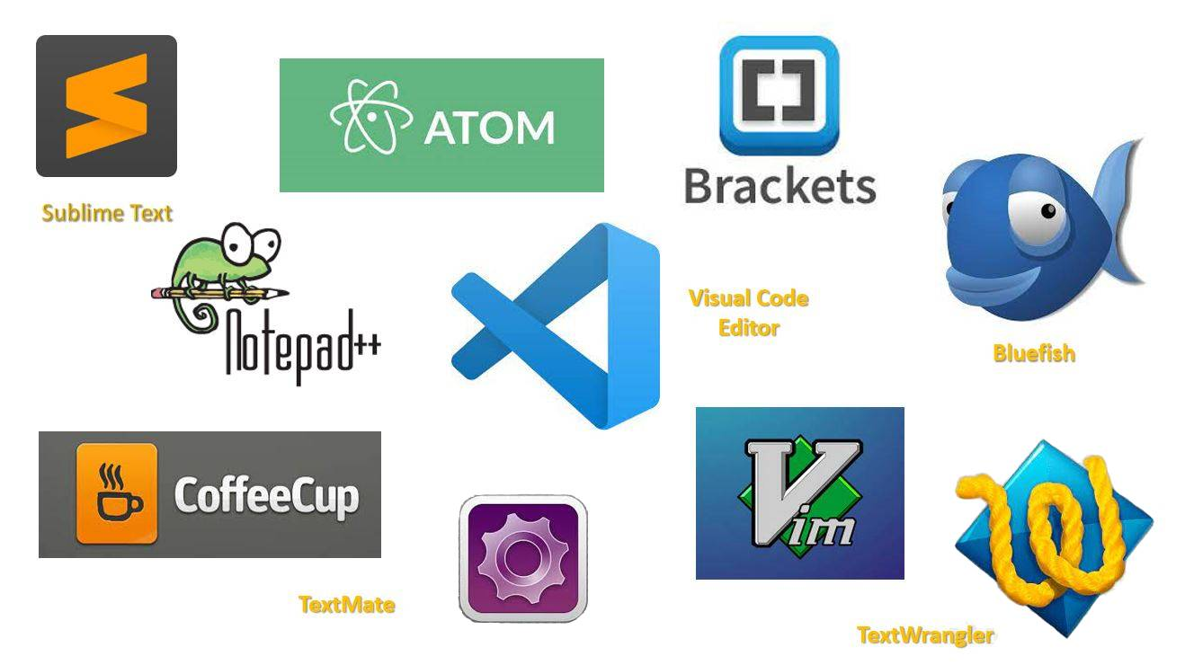
Text editors

Slide 23
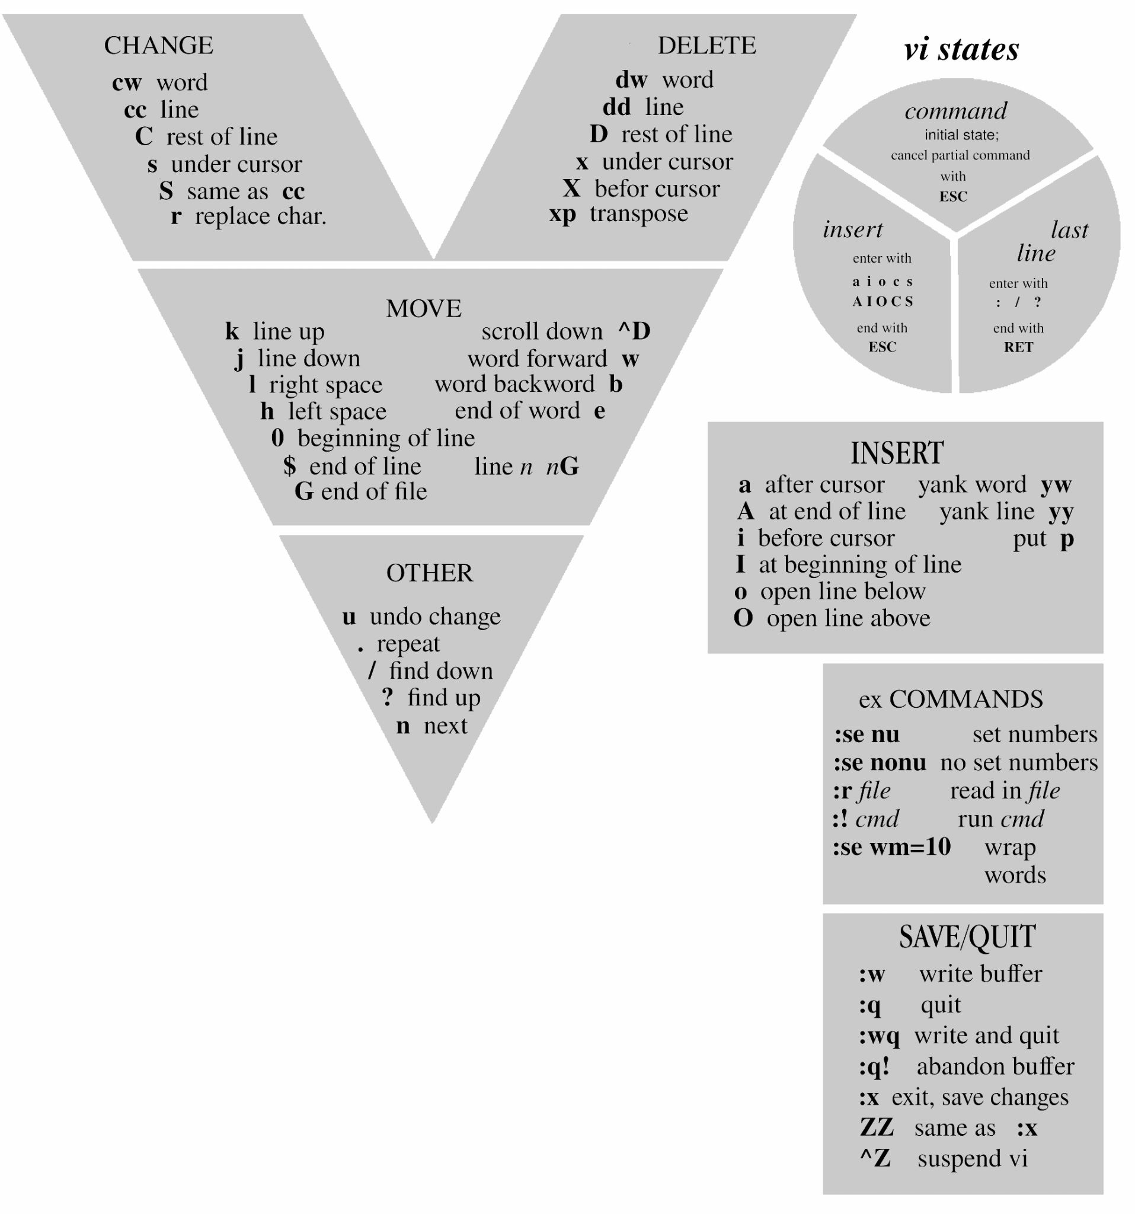
vi (vim)
Commands
summary
http://marvin.cs.uidaho.edu/Teaching/CS112/vimRefCard.pdf

Slide 24
More about bash
Here a couple of cheat sheets with shell commands:
https://appletree.or.kr/quick_reference_cards/Unix-Linux/Linux%20Command%20Line%20Cheat%20Sheet.pdf
https://github.com/LeCoupa/awesome-cheatsheets/blob/master/languages/bash.sh
And a few more references:
Classic: http://www.tldp.org/LDP/abs/html/
Break it down: http://explainshell.com
Great guide: http://wiki.bash-hackers.org/
Good to know: https://mywiki.wooledge.org/BashPitfalls

Slide 25
Useful tools
bat - cat alternative with syntax highlighting and git integration https://github.com/sharkdp/bat
fzf - fuzzy finder https://github.com/junegunn/fzf
fd - simple and fast alternative to the traditional find https://github.com/sharkdp/fd
fish - the friendly interactive shell https://github.com/fish-shell/fish-shell
exa - ls alternative https://github.com/ogham/exa
tmux - terminal multiplexer https://github.com/tmux/tmux

Slide 26
What You Will Learn Today
Navigating the filesystem
Creating, copying, and moving files
Pipes and redirection
Writing simple scripts
Automating tasks and chaining commands

