Slide 1
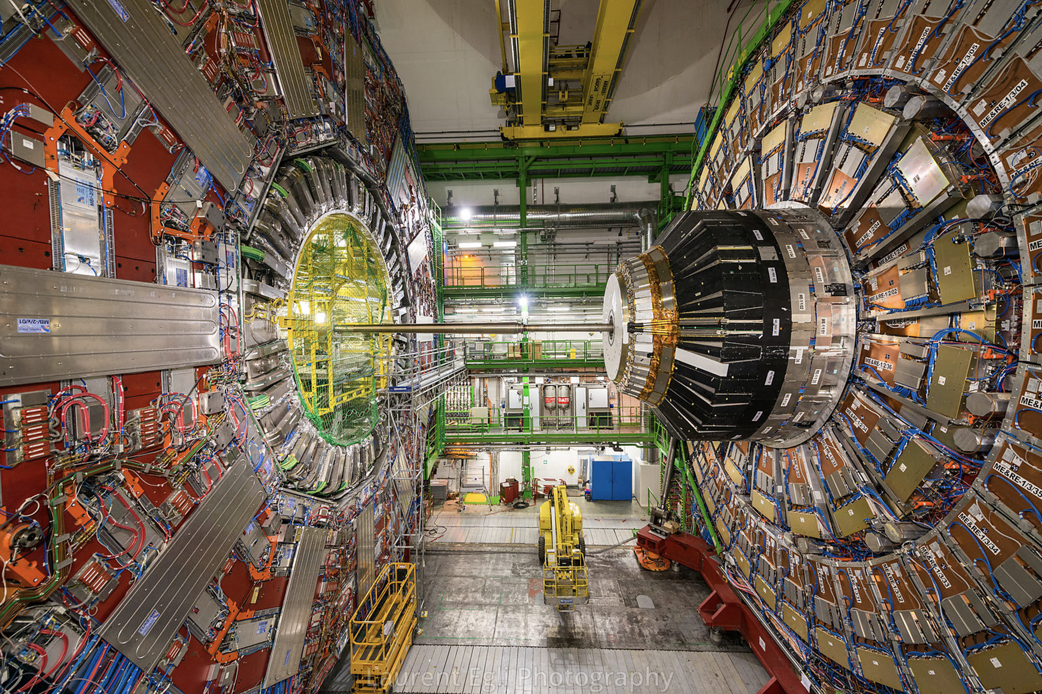
LHC and CMS
S. Nahn
PURSUE Undergraduate Summer Internship
May 27th, 2025

Slide 2

Meet the Detector Guy
Physics interests
  EW and Higgs Physics
Good at:
  Programming clocks and VCRs
  Herding Cats
Problems with
  Humility ☺
  Herding Cats
Eyes on
  New Discoveries at the LHC
Hobbies
  Sailing, Soccer, Skiing, Music Appreciation

Slide 3
Subatomic Particles 101
In the interest of time, playing fast and loose with the subtleties. If you want details, go to Grad School

Slide 4
Building Blocks of Nature
Generation I
II
III
Beautiful symmetry
  12 “things” in 3 sets of 2 pairs (+ anti-things mirror)
    way easier than chemistry
  3 types of interactions
“Standard Model” (SM)= building particles and interactions from these items
  Following certain rules
  Very successful!
    Meaning, hard to break!
g
Strong
Spin 1 Bosons
u
c
t
γ
Electromagnetic
d
s
b
Weak
Spin ½ Fermions
Leptons Quarks
Z
Spin 0
Boson
e
μ
τ
W
H
ν_{e}
ν_{μ}
ν_{τ}
e
Proton =
Neutron =
u
u
d
d
u
d
W
ν_{e}
d
u
Beta Decay:
u
u
d
d
Notes:
It starts with the canonical periodic table of the subatomic world - a mandatory graphic we must show depicts the “Standard Model” of physics. Fermions make up the matter particles – there are quarks, which form hadrons like the proton or the pion via the strong interaction, and leptons, which do not partake in the strong interaction. Add to that the bosons, the force carriers for the Electromagnetic, Strong, and Weak interactions, and that’s all you need to make up the Standard Model universe. And there’s beautiful symmetry in this picture – just three copies or flavors of a pair of leptons and a pair of quarks.
But, when you take a look at the mass spectrum, the symmetry is gone. Here’s the mass spectrum for just the quarks, listed along the x axis, where the font size is proportional to the mass – no real clear pattern here, which is our first quandry – what’s going on in the particle mass spectrum – why do these things have the mass that they do?

Slide 5
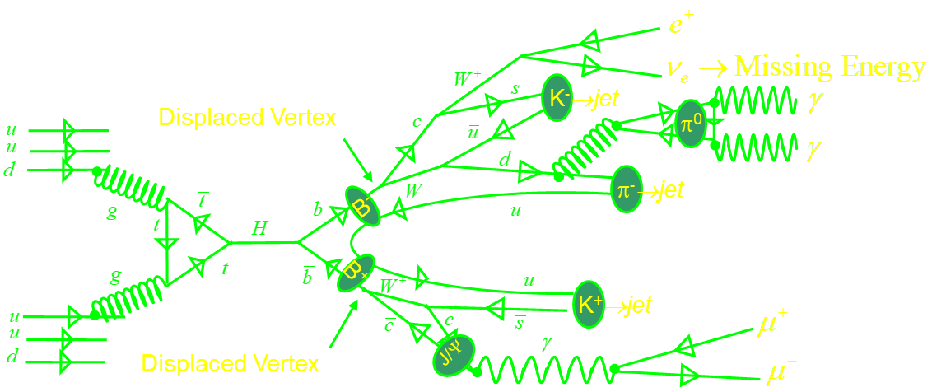
But can get complicated quickly
pp → H →bb
  Leptons, Photons, “Jets” of Hadrons, Missing Energy, Secondary particles/vertices

Slide 6
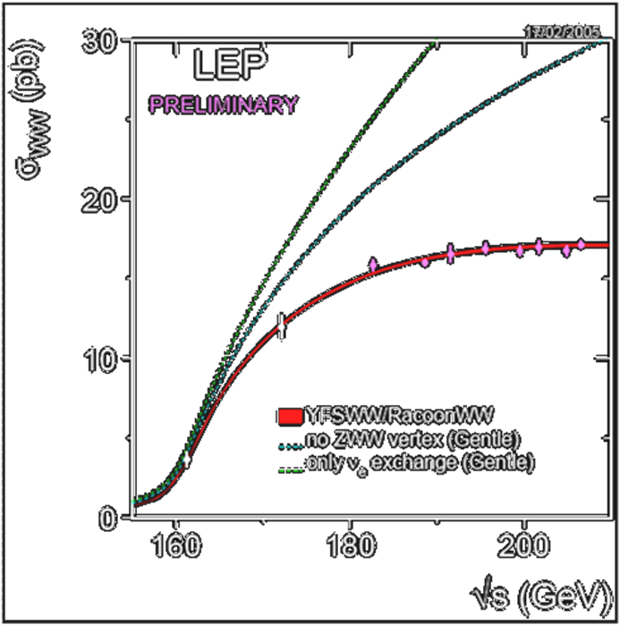
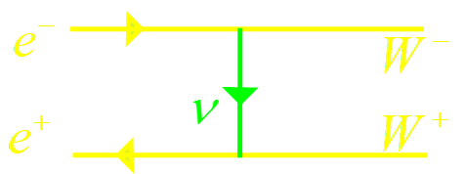
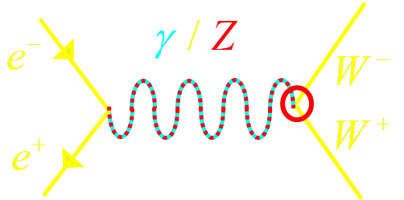
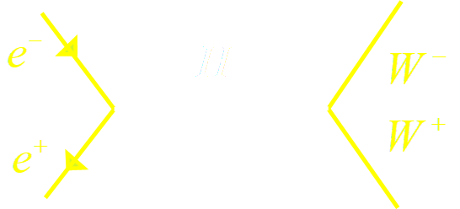
Rules → Discovery
Symmetries imply Conserved Quantities (Noether’s Theorem)
    eg. Translation in space, time → Momentum, Energy conservation
  Laws of motion must preserve these symmetries
  Special type of Symmetry: Gauge symmetry
    Sorta like measuring in feet rather than meters
      You have the freedom to choose, and Nature doesn’t care
    Naïve mass term in Standard Model violate Gauge Invariance! Need a trick!
Probabilities should not exceed 100% (“Unitarity”)
  J=1 amplitudes cancel nicely
  J=0 amplitude also diverges
    “wrong helicity” ~ mass
  Need something to cancel with scalar coupling to mass

Slide 7
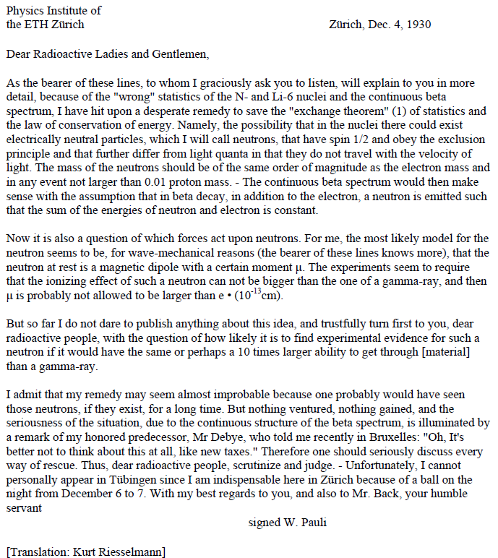
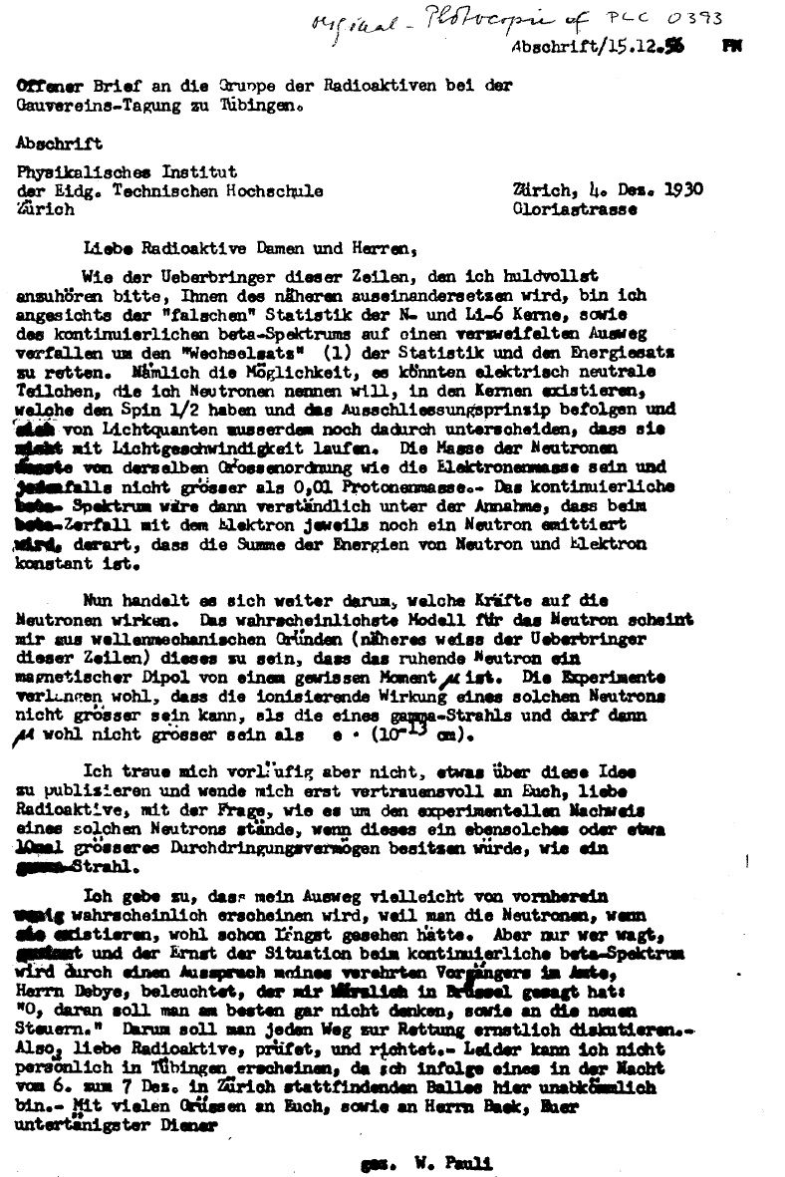
You can’t just invent a new particle!
Pauli, December 4th, 1930, Birthday of ν
Notes:
So now you might think it is a little strange to invent a new particle to fix a problem – “I’m sorry Professor Black, the Wesley Boson ate my pset” but there’s a lot of past examples of exactly this. One famous one can from Wolfgang Pauli, in a “desperate letter” in 1930. And though I know many German speakers who sometimes forget, I don’t speak German, so here’s the translation.
He starts off “Dear Radioactive Ladies and Gentlemen”! The important part is here “ a desperate remedy to save the exchange theorem of statistics and the conservation of energy. Namely, the possibility that in the nuclei there could exist electrically neutral particles” Here’s Pauli, inventing the neutrino to fix some theoretical problems. In fact, of relevance 80 years latere, he comments that the neutrino does not travel at the speed of light - although from the rest of the letter he thinks they travel more slowly, not the opposite.
He is a little circumspect about his postulate and is really asking whether it could be measured, but he is willing to take the risk of at least sending the letter out to think about. He does not however deliver the letter himself, because he has a dance to go to – so either he is a little nervous about the immediate response or the parties in Zurich are really really good.
The message here is that it is perfectly ok to invent a particle like this, even if it doesn’t get discovered until 26 years later.

Slide 8
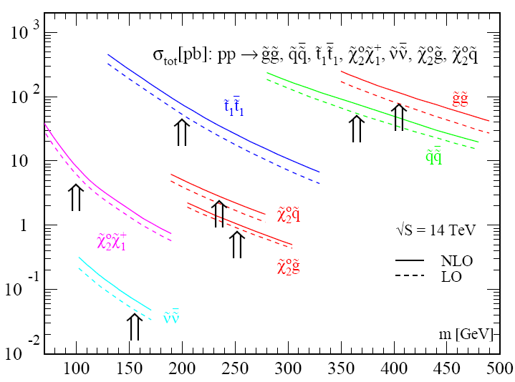
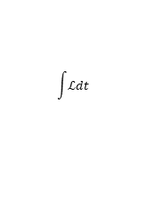







Higgs causes other problems
$$W_{}^{−},Z,t,H$$
$$H$$
$$H$$
Electroweak Paradox
  EW observables ⇒ light H
  EW corrections ⇒ heavy H
Supersymmetry: Eliminate large corrections without destroying EW theory
  For each particle, a sparticle with opposite spin statistics
    Fermions ⇒ Sfermions, Bosons ⇒ Bosinos (“Charginos”,”Neutralinos”)
  R parity
    Conservation of sparticle #
    Lightest sparticle stable
$$W^{+},Z,\bar{t},H$$
$${\tilde{W}}_{}^{−},\tilde{Z},\tilde{t},\tilde{H}$$
$$H$$
$$H$$
$${\tilde{W}}^{+},\tilde{Z},\tilde{\bar{t}},\tilde{H}$$
> 100 events in “first year”
σ (pb)
$$\int{ℒdt}$$
Prediction from Prospino pre-LHC

Slide 9
The LHC is not only about the Higgs
Dark Energy ???
Dark Matter
Visible World
Next new particle ?=? Dark Matter
And unify the strong and electroweak forces
Supersymmetry does this
And cure further theoretical ailments
And … fix the government?
Notes:
What else might we find? Well, there is this problem that all those Standard Model particles only account for 4% of the Energy density of the universe The other 96% is divided between 73% Dark Energy, which is new and mysterious in that noone really knows what it is, and 23% Dark Matter, which we know interacts gravitationally, but does not give off light Perhaps at the LHC we may produce new particles, which could be this Dark Matter component we’re looking for. If it falls in the right mass range, we also kill a few other birds with the same stone, unifying the strong and electoweak forces into the same force at a high energy scale, and it could provide further mechanisms for theoretical problems similar those I was discussing with the Higgs mechanism, which appear at higher energies.

Slide 10
The discovery process

Slide 11


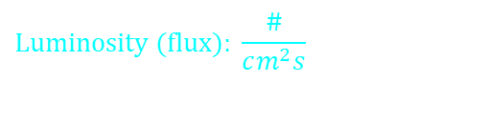
How to probe Subatomic World
$$\text{Luminosity} (\text{flux})\text{: }\frac{\#}{cm^{2}s}$$
Basic Recipe:
  Send in a flux of particles
  Measure what comes out vs
  (Energy, angle, frequency …)
Need High E to resolve small structures
⇒ Build Accelerators
What to measure?
  Rate/Scattering Cross Section:
    Distributions in E,α…
  Spectroscopy of Excited states
Object
$$ℏc=197 \text{MeV} \text{fm} p=10 \text{GeV}→0.02\text{fm}$$
Total Cross Section
Unit:
$$1\text{barn}\text{=1}{\text{0}}^{−24}cm^{2}$$
Rate
$$R\left(E,α...\right)=ℒσ\left(E,α...\right)$$
Lumi

Slide 12
The accelerator

Slide 13
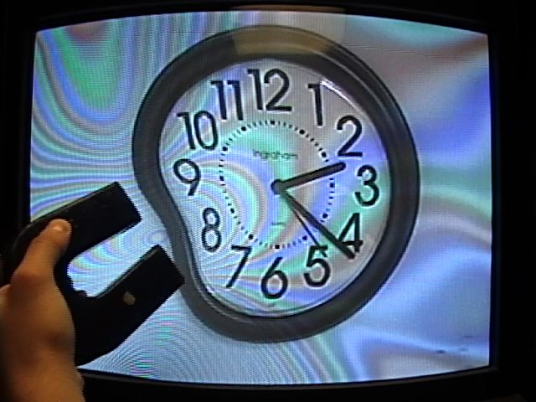
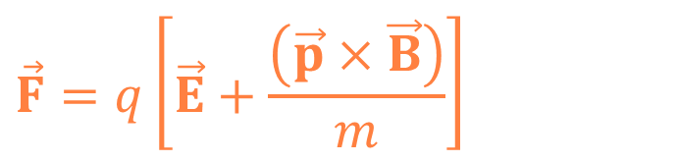
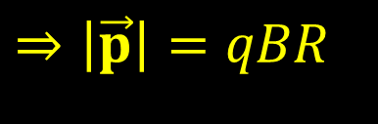



How to move a particle in a circle?
Electromagnetism!
  Acceleration
  Circular motion
Have to ramp up B during acceleration to keep particles in the ring at fixed R
Need big B, big R to get highly energetic particles
⇒ Large Storage Rings
$$\vec{F}=q\left[\vec{E}+\frac{\left(\vec{p}×\vec{B}\right)}{m}\right]$$
$$q\vec{E}=\frac{Δ\vec{p}}{Δt}$$
$$\frac{qpB}{m}$$
$$=\frac{p^{2}}{mR}$$
$$⇒\left|\vec{p}\right|=qBR$$
Notes:
So before I talk about the accelerators, back to a little physics. The way we moved charged particles around is with the lorentz force, which has two components
First, there’s the electric field, which will accelerate a particle, changing its momentum. This is used in electricity all the time. Maybe not so commonly known is that a magnetic field also changes a particle trajectory, but it doesn’t change the magnitude of the momentum, just the direction – it bends the particle into a circular orbit. As a kid I used to be able to make funny patterns on the TV screen precisely due to this effect. So we use the magnetic effects to bend particles into a circular orbit. Of course, from a little math, it’s easy to see both that
-at fixed radius, as we increase the momentum we have to increase the magnetic field and
For very high energy particles, we want to maximize both B and R.
So, we have large storage rings

Slide 14
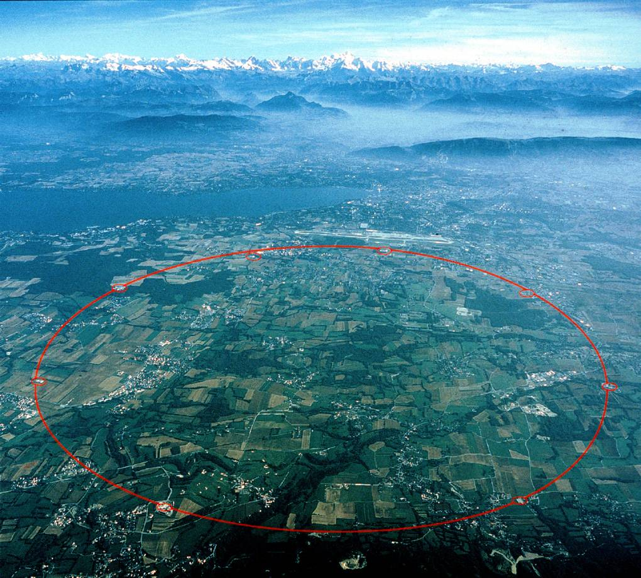
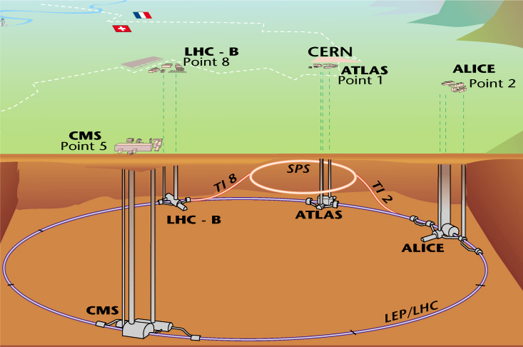
Recycling: The Large Hadron Collider
Proton - Proton Collisions
Initially: 10⁶ events/s, 7 TeV
Eventually: 10⁹ events/s, 14 TeV
(Lead Ions
2.76 → 5.5 TeV/nucleon)
`
`
`
`
`
`
`
`
`
`
`
`
`
`
`
`
`
`
`
`
`
`
Notes:
Our stage is a recycled 27 km ring at a lab called CERN in Geneve Switzerland, possibly because of the proximity of the Alps.
This is the location of the Large Hadron Collider, where they will eventually collide protons at 14 TeV, the largest Energy collider ever, starting at one million collisions per second, hopefully reaching one billion collisions per second.
They started out slow, but have been adding more and more particles to the ring which leads to the increase in data size you’ll see later

Slide 15
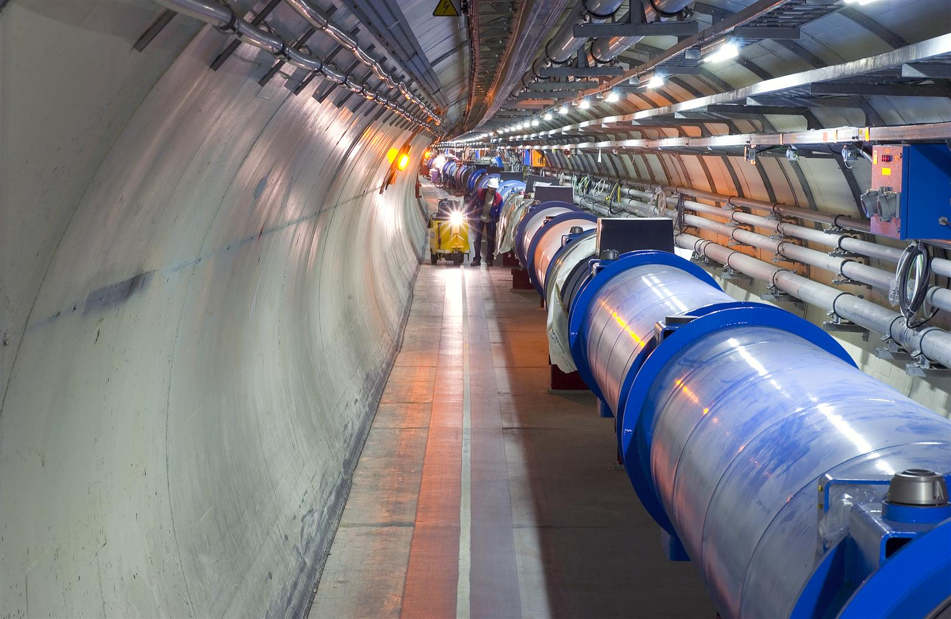
Notes:
A 27 km storage ring, with a string of very strong magnets laced around it to keep the protons in place

Slide 16
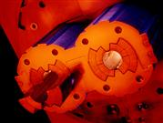

Superconducting Double Dipoles
$$\left|\vec{p}\right|=0.3BR=7000 GeV \\ B=\frac{7000}{0.3×4300}=5.5T⇒8T$$
$$≈\text{100,000}×\text{Earth} \text{field}$$
Notes:
The heart of the LHC is this unique “double dipole” superconducting magnet, which provides a field of ~ 1000000 times the Earth over bending parts of the 27 km (the orbit is not actually a perfect circle, it has straight sections and bending sections). This is the big step up in technology

Slide 17


A BIG Step
$$\text{Luminosity} \left[μb^{−1}s^{−1}\right]$$
LHC
CLEO, B factories
ILC
Tevatron
HERA
More Chance of
making Rare things
LEP
RHIC
SLC
SppS
More Chance of making Heavy things
$$E_{\text{beam}} \left[\text{GeV}\right]$$
LHC has the reach in Luminosity and Energy to
  Find the higgs ✓
  Find more
Notes:
So, what matters in terms of great stage for discovery? Here’s the world’s stages of particle physics plotted as a function of average beam energy and luminosity. Basically, if you haven’t seen something, either it is too heavy, so you have a better chance at higher beam energy, or it is too rare a process, which means you have a better chance at higher luminosity. The LHC comes in up in the top corner, about one order of magnitude in Energy and two in Lumi from the previous frontier at the tevatron, and that is what makes this a great stage – it is the one where we have the reach to discover the higgs anywhere in the mass range.

Slide 18
The detector

Slide 19


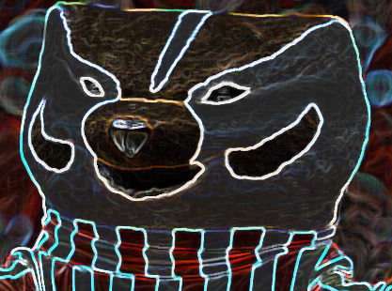
What is a detector?
Many synchronous cameras looking at same event
Rather complicated
  ~ 100 “Mpix”
  40 MHz shutter speed
    Real-time filtering
Notes:
What is a detector – think of a camera taking pictures of every event simultaneously through different filters, to catch different aspects if the same event. However, the camera is built not to be sensitive to light, but to the particles traversing it (including light), and very fast – we need zillions of events and don’t want to wait forever), very detailed (high resolution for the best measurements) and very sophisticated) 40 MHz * 100 Mpix = 4 Tbit/sec og 500 GB/sec – can’t keep it all!

Slide 20

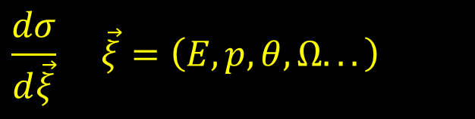
Detector Mission Statement
Goal: Measure observables, compare with theory
  Cross sections
  Particle Properties
    m, Γ, Branching Ratios, Spin, Parity …
  Interactions and Couplings
    ZWW (“Trilinear gauge”) coupling, quark mixing matrix, …
  Violations of the Standard Model
    Parity or other symmetry violation, proton decay…
Mandate for the Detector
  Collect as precise data as possible
    Resolution on
  Collect as much relevant data as possible
    Cover all of 4π
    Filter (“trigger”) in face of limited bandwidth
    Robustness in design and operation
$$\frac{dσ}{d\vec{ξ}} \vec{ξ}=\left(E,p,θ,Ω...\right)$$
$$\left(E,\vec{p}\right) \text{and} \left(ct,\vec{x}\right)$$

Slide 21

Measurements
Position: Follow trail left by ionization/Energy deposition
  Intersections = Interaction vertices, decay vertices
Energy/Momentum: Bend in , measure E via calorimeter
Particle ID
  m via β: Čerenkov effect, dE/dx, Time of Flight
  Q from curvature, particle species from range
Figures of Merit
Resolution
Response Time
  Time needed to make signal after particle passage
Dead Time
  Minimum interval between successive detections
Efficiency: Capability to see events
  Acceptance (Geometrical) – how many events fall in fiducial volume
  Intrinsic – how many in fiducial are triggered/reconstructed/recognized
$$\vec{B}$$

Slide 22








Particles vs Signatures
Complex!
  Reconstruct final state particles
  Filter on intermediate invariant masses
  Work back towards primary interaction
Theory |  | Experiment
e±,μ±,γ | → | e±,μ±,γ
τ± | →W±ν_{τ} W±→lν_{l},qq | e±,μ±,ν,jets
u,d,s,c b | “Hadronize” | Tracks+jets, ID: p,π,K “ “ + displaced vtx
t | →W⁺b | above, + W±→lν_{l},qq
ν | → | ∅: Missing E,p
$$e^{+}$$
$$W^{+}$$
$$ν_{e}→\text{Missing} \text{Energy}$$
$$s$$
K⁻→jet
$$γ$$
Displaced Vertex
$$c$$
π⁰
$$u$$
$$\bar{u}$$
$$γ$$
$$u$$
$$d$$
$$d$$
$$W^{−}$$
π⁻→jet
$$g$$
$$\bar{t}$$
$$b$$
B⁻
$$\bar{u}$$
$$t$$
$$H$$
$$g$$
$$t$$
$$\bar{b}$$
B⁺
$$W^{+}$$
$$u$$
K⁺→jet
$$u$$
$$\bar{c}$$
$$c$$
$$\bar{s}$$
$$μ^{+}$$
$$u$$
Displaced Vertex
^{J/Ψ}
$$γ$$
$$d$$
$$μ^{−}$$

Slide 23

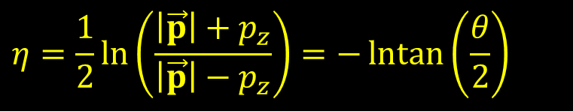


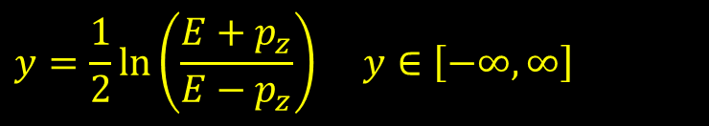

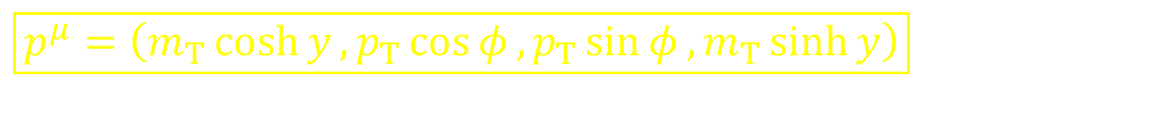




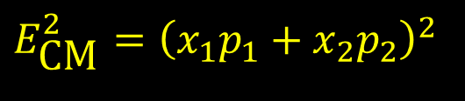



Hadron Kinematics
$$p_{2}$$
$$f$$
$$D$$
$$x_{2}p_{2}$$
Energy set by PDFs f(x_{i} )
Usually: Boosted along z
⇒ Use parametrization conducive to boosts along z
Rapidity:
  Additive under boosts: Δy is invariant
  m→ 0: Pseudorapidity
Transverse Momentum: p_{T}
  Transverse mass and Energy
Azimuth: φ
$$\hat{σ}$$
$$E_{\text{CM}}^{2}={\left(x_{1}p_{1}+x_{2}p_{2}\right)}^{2}$$
$$x_{1}p_{1}$$
$$p_{1}$$
$$f$$
$$D$$
$$p_{1}=p_{2} \text{but} x_{1}≠x_{2}$$
$$y=\frac{1}{2}\ln\left(\frac{E+p_{z}}{E−p_{z}}\right) y∈\left[−∞,∞\right]$$
$$η=\frac{1}{2}\ln\left(\frac{\left|\vec{p}\right|+p_{z}}{\left|\vec{p}\right|−p_{z}}\right)=−\operatorname{lntan}\left(\frac{θ}{2}\right)$$
$$m_{T}=\sqrt{p_{T}^{2}+m^{2}}$$
$$E_{T}=E\sin{θ}$$
$$\boxed{p^{μ}=\left(m_{T}\cosh{y},p_{T}\cos{φ},p_{T}\sin{φ},m_{T}\sinh{y}\right)}$$

Slide 24
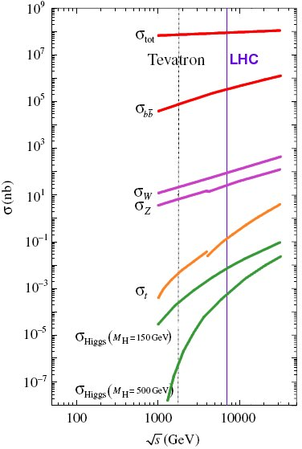
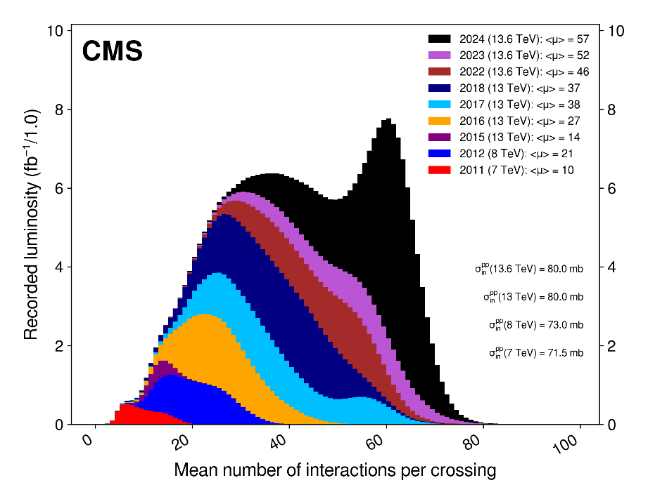
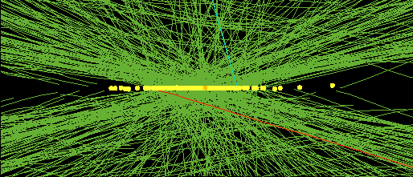
Multiple levels of haystacks
10¹⁰
Interesting events swamped by mountain of uninteresting background
Multiple interactions within same proton bunch crossing obfuscate the single “hard scatter” with “pile-up” events
Flugge, Future Research in High Energy Physics
CERN Yellow Report CERN 94-04
1

Slide 25


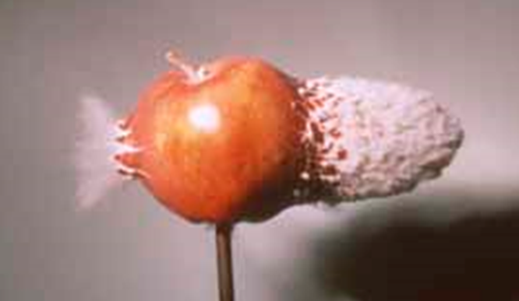
Questionable Detector Analogies
Tracking
Muons/Particle ID
Calorimetry

Slide 26
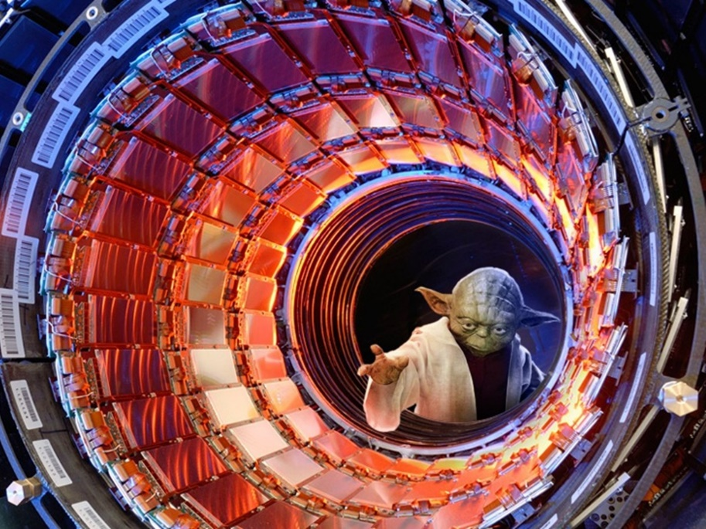
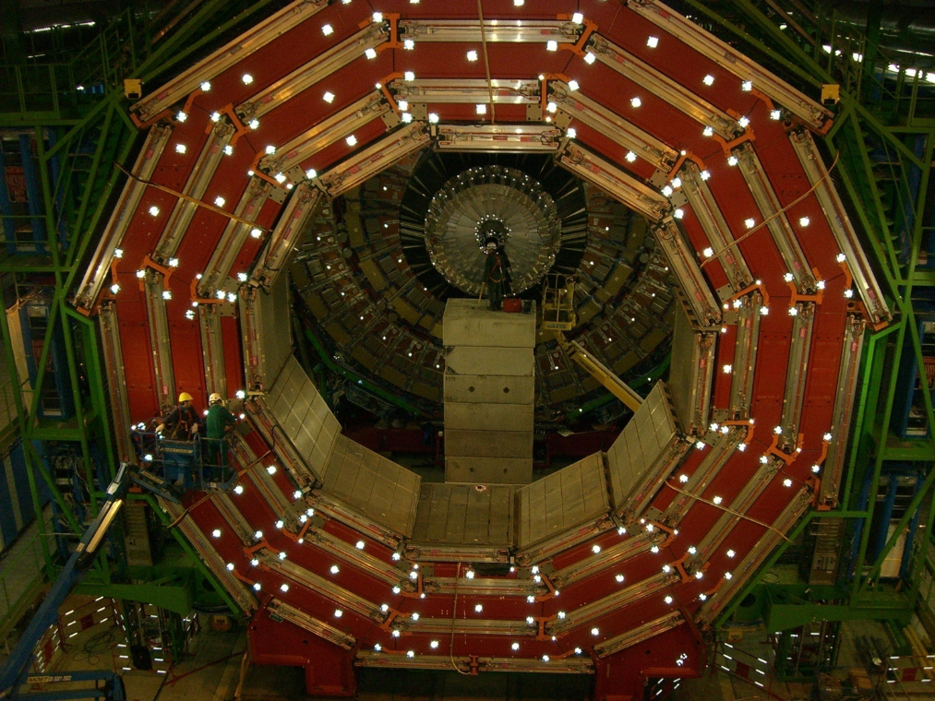
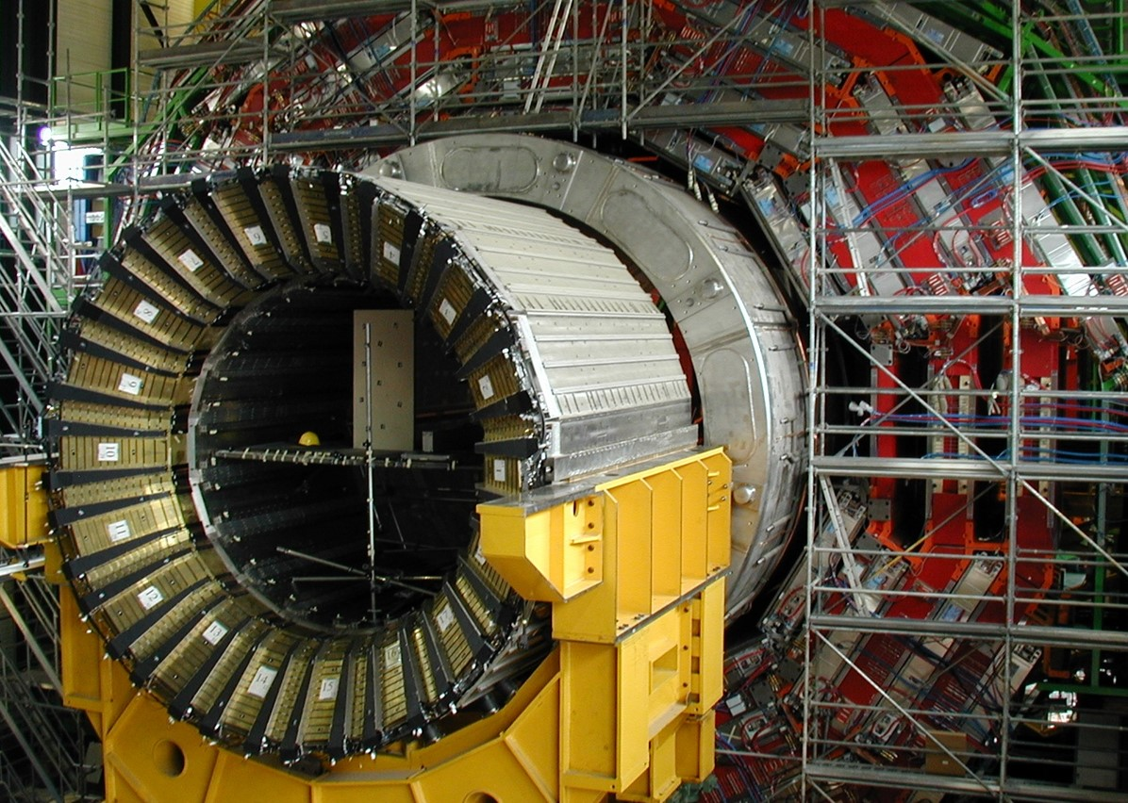
Questionable Detector Analogies

Slide 27
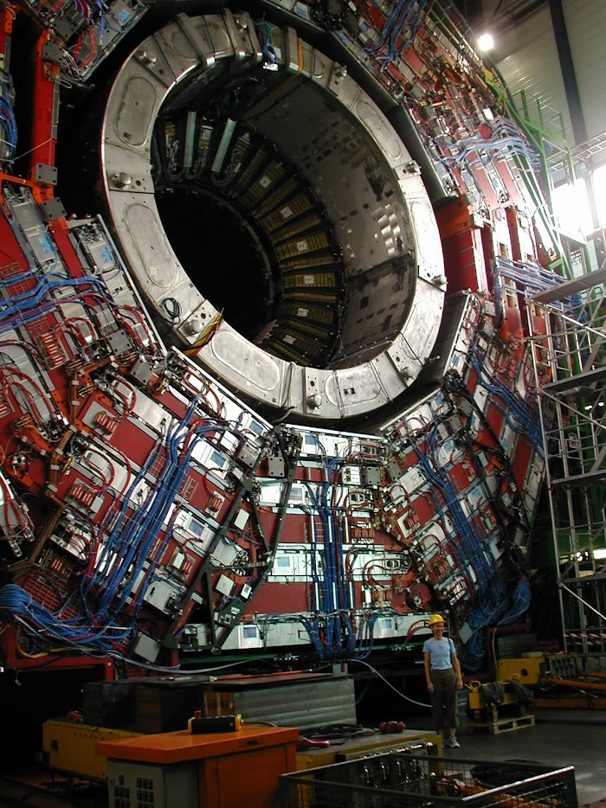
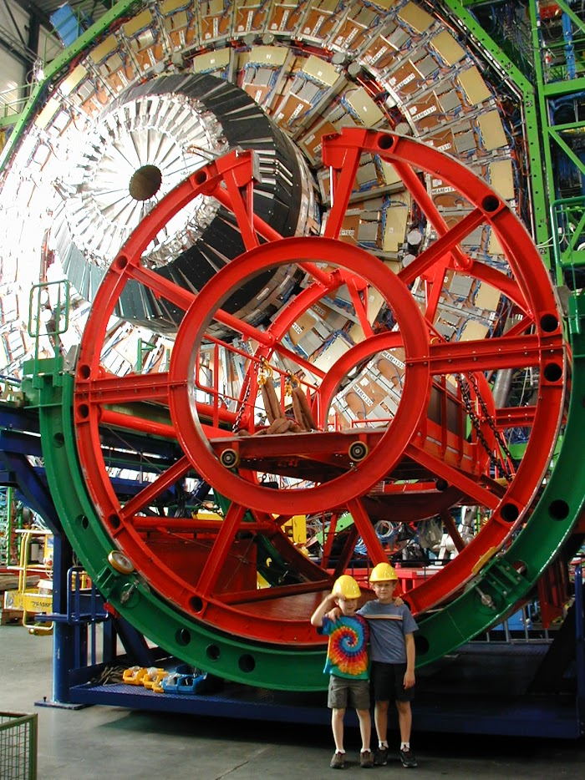
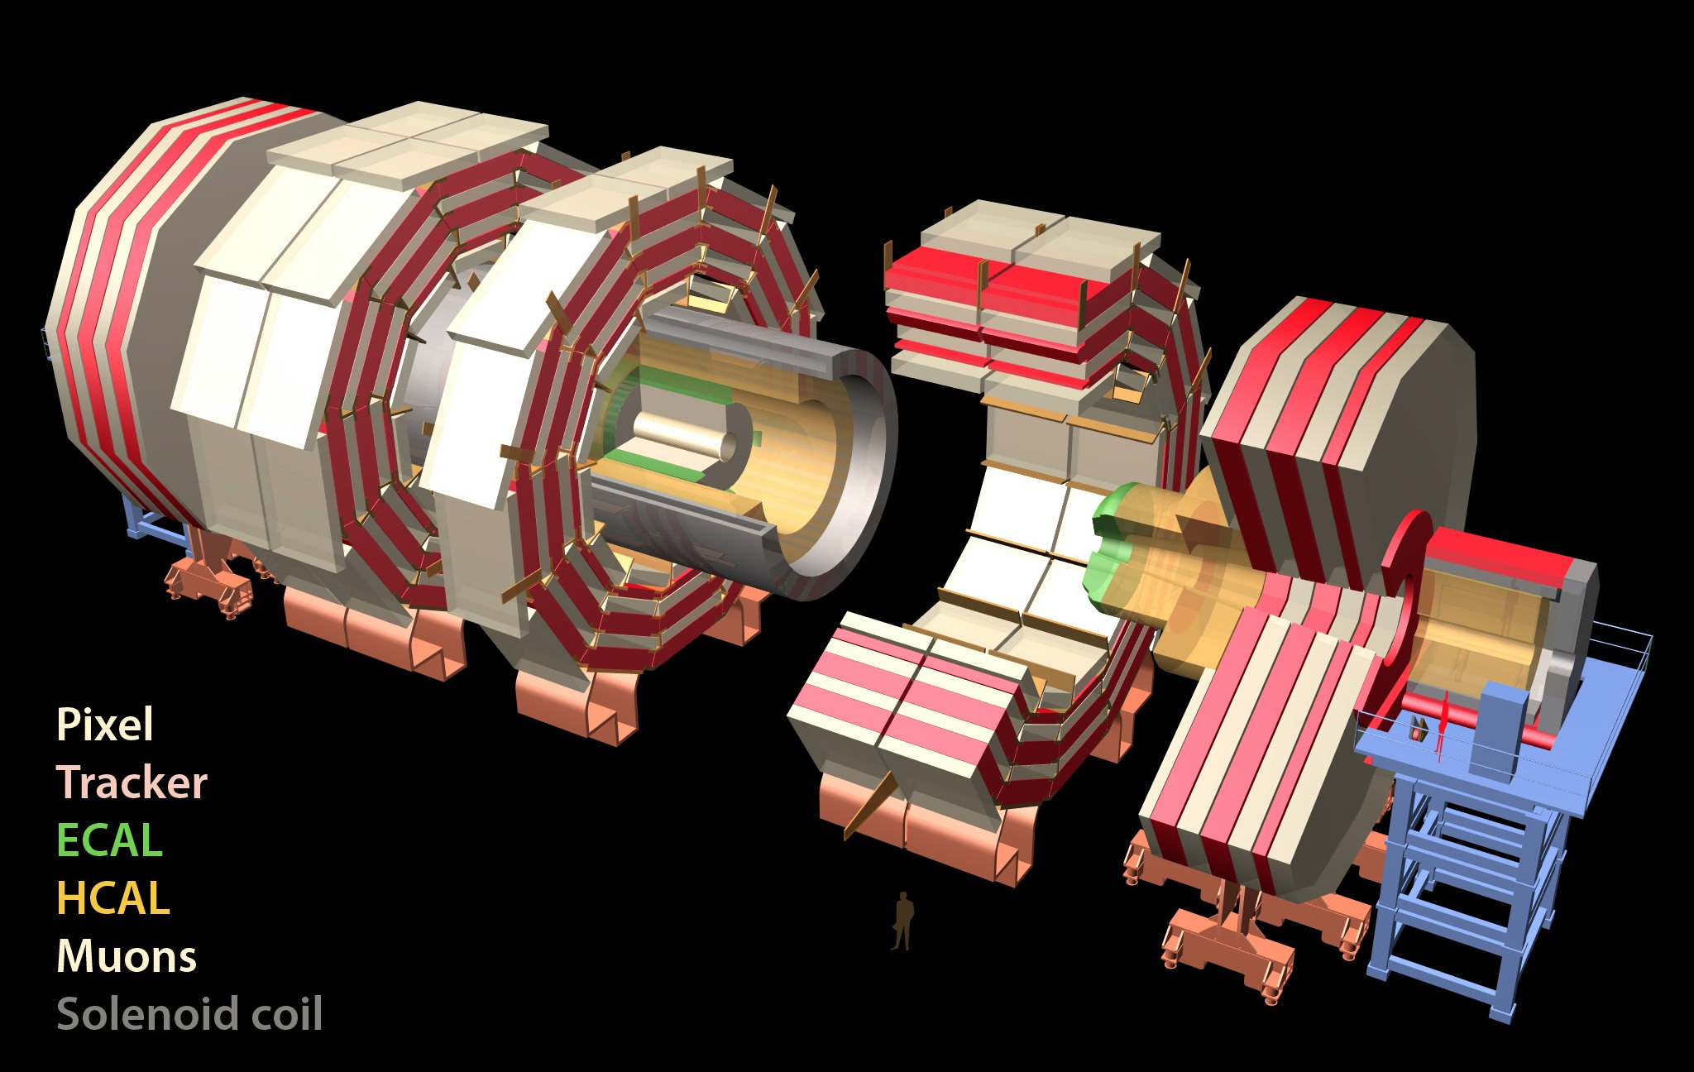
CMS
Total weight 14000 t
Overall diameter 15 m
Overall length 28.7 m
76k scintillating
PbWO₄ crystals
ECAL
Scintillator/brass
Interleaved ~7k ch
MUON ENDCAPS
HCAL
473 Cathode Strip Chambers (CSC)
432 Resistive Plate Chambers (RPC)
3.8T Solenoid
IRON YOKE
Preshower
Si Strips ~16 m²
~137k ch
YE1-3
YBO
Foward Cal
Steel + quartz Fibers ²~k ch
YB1-2
Pixels & Tracker
Pixels (100x150 μm²)
~ 1 m² ~66M ch
Si Strips (80-180 μm)
~200 m² ~9.6M ch
MUON BARREL
250 Drift Tubes (DT) and
480 Resistive Plate Chambers (RPC)
These people are now older than you

Slide 28
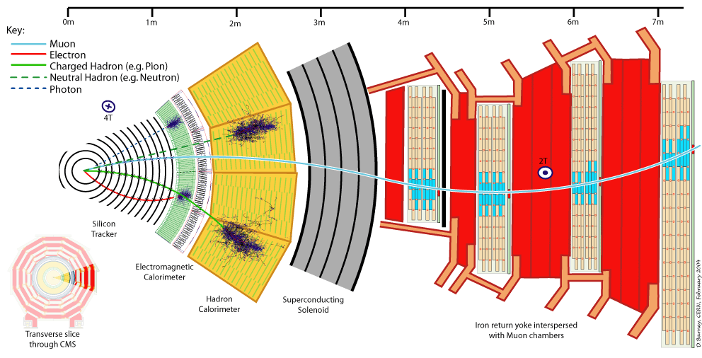
B
7 meters
Neutrino
L1 Trigger samples Calorimeter and Muon content @ 40 MHz
  Selects 1 of ~800 in 4 μs for further analysis → full detector readout
High Level Trigger fully reconstructs event @ 50 – 100 kHz
  Selects 1 of ~1000 for data storage → offline reconstruction and analysis
Notes:
Here’s a 30 degree cross section of the detector, showing the signals in each piece. From inside out
Tracker – charged particles – muons, electrons, hadrons, bend according to their momentum, tracker measures the bend
Photons, neutrals – nothing in the tracker
Electromagnetic calorimeter – eats photons and electrons, measures energy very well ~ 3%
Hadronic calorimeter – eats charged and neutral hadrons (“jets”) measures energy pretty well
Muons – don’t get eaten! Make it out to muon chambers, complimentary to tracker bend
Neutrinos – not even see at all – but can sum up everything else and infer their presence -> MET

Slide 29
CMS Design Features
Very large Solenoid – 6m diameter x 13 m long
  Tracking and calorimetry fits inside the solenoid
    Particles measured inside solenoid coil and cryostat, which would degrade resolution
  Very strong field – 3.8 T
    Excellent momentum resolution (~ B² )
    Coils up soft charged uninteresting particles
All-Silicon fine granularity inner Tracking system
Lead Tungstate crystal calorimeter for photon and electron reconstruction
Brass Hadron Calorimeters for jet and missing E_{T} reconstruction
  provides coverage to η ~ 5
Tracking chambers in the return iron track and identify muons (only detectors outside solenoid)
  This makes the system very compact
  Weight of CMS is dominated by all the steel and is 14,000 Tonnes

Slide 30
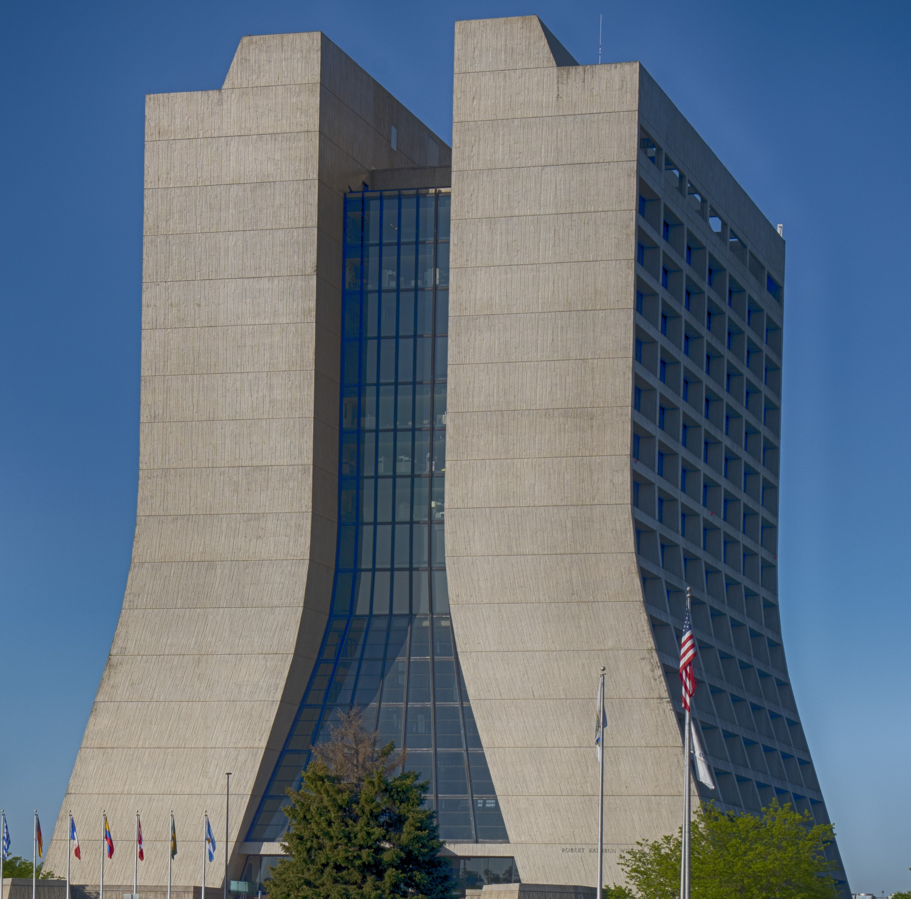
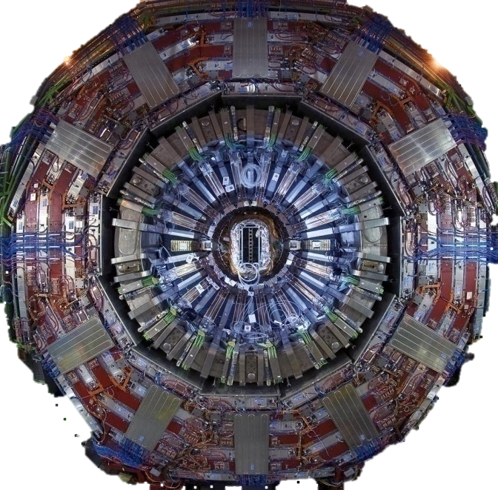
~ scale…

Slide 31

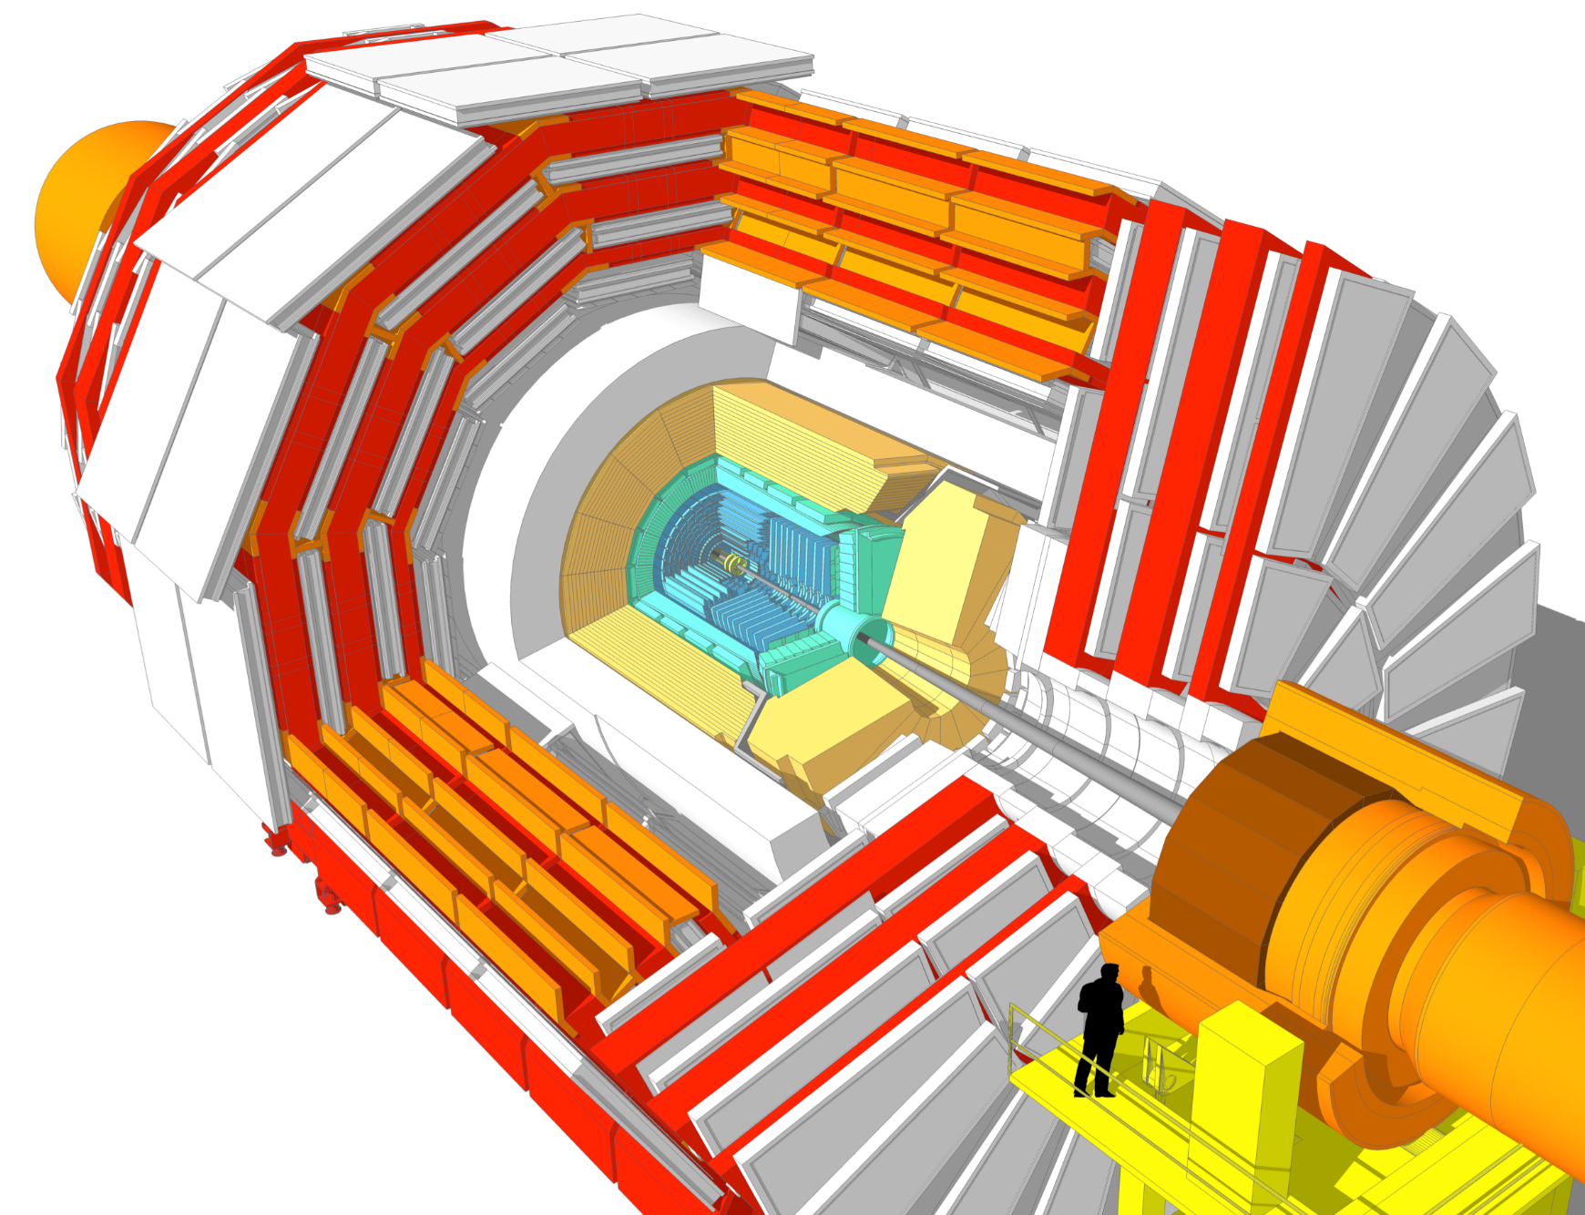
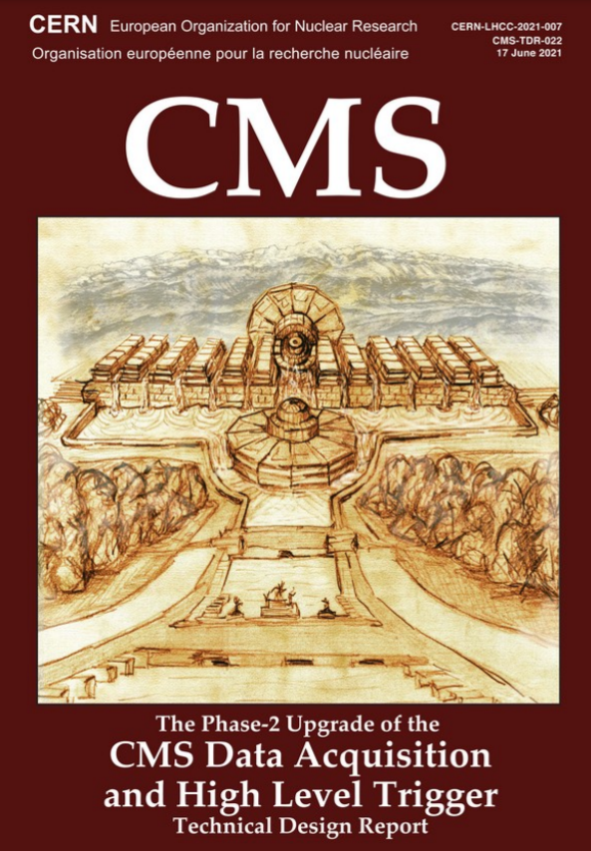
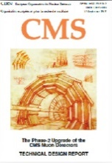
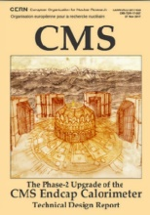
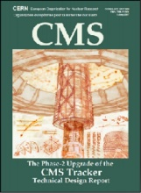
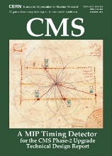



But before HL LHC: Upgrade!
L1 Trigger/HLT/DAQ
L1 40 MHz in/750 kHz out
with tracking for PF-like performance
HLT 7.5 kHz out
Barrel Calorimeters
ECAL single crystal granularity in L1 Trigger with precise timing for e/γ at 30 GeV
ECAL and HCAL new back-end electronics
Muon Systems
DT & CSC new FE/BE readout
New GEM/RPC
Extended coverage to
$$1.6<\left|η\right|<2.4$$
$$\left|η\right|<3.0$$
Beam Radiation and Luminosity, Common Systems,
Infrastructure
Calorimeter Endcap
Si, Scint + SiPM in Pb-W-SS
3D shower imaging with precise timing
MIP Timing Detector
< 70 ps resolution
Barrel: Crystals + SiPMs
Endcap: LGADs
Tracker
Si Strip Outer Tracker designed for L1 Track Trigger
Pixelated Inner Tracker extends coverage to
$$\left|η​\right|<3.8$$

Slide 32
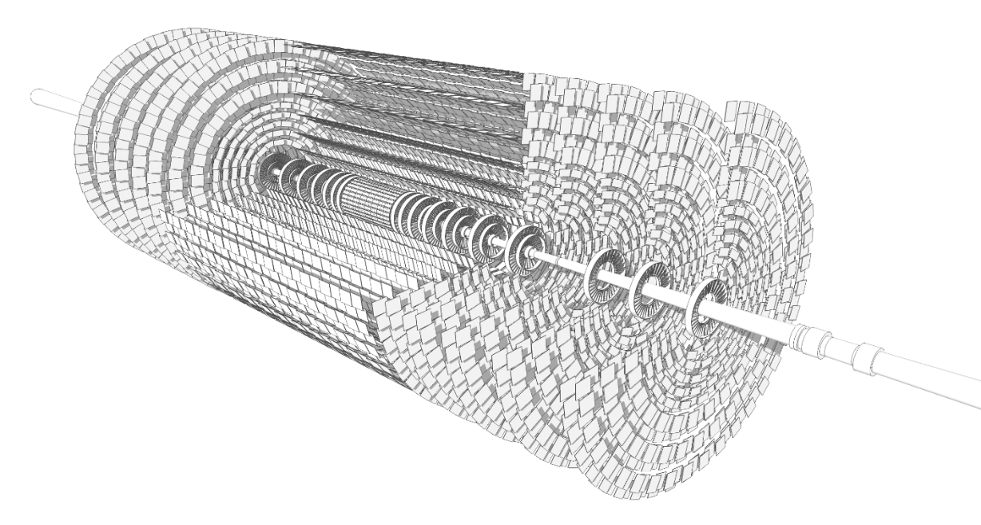
New Tracker
5.3m
Current version doesn’t survive HL LHC dose
Features
  ~200 m² of Silicon!
    ×10 increase
  Extended coverage
  Increased granularity
  Reduced multiple scattering
  Tracking information in L1 Trigger
TFPX
1.2 m
TBPX
Endcap Disks (TEDD)
TFPX
TEPX
Barrel Cylinders
Inner TBPS
Outer TB2S
Endcap Disks (TEDD)

Slide 33
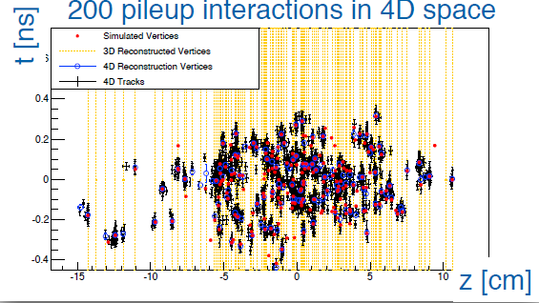
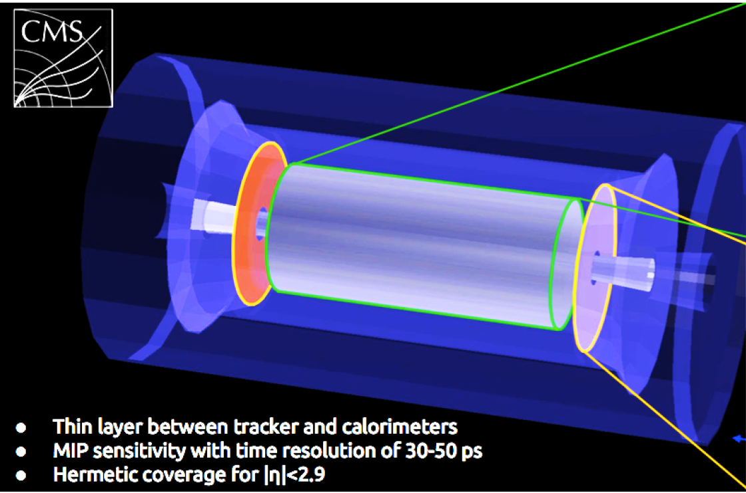
New Timing Layer
Defeat pile-up with separation in time
  Analogous to spatial separation in tracker
Large coverage with ~ 30 ps timing resolution
  Restores pile-up conditions to pre-HL LHC levels
Font of innovation!
  New handle for CMS
  Extremely valuable for Particle ID in Heavy Ions, for instance
    First step towards “Quantum Worldline Detector” ;)
Barrel
Endcap

Slide 34





New Endcap Calorimeter
2.3 m
Current version doesn’t survive dose
Novel “Imaging Calorimeter”
  Highly segmented (×250) 4-D jet image
    Silicon section in high radiation area
    Scintillator (cheaper!) in lower radiation area
2.2 m

Slide 35


New Muon Systems
New GEM and RPC detectors deployed to increase coverage
  GEM GE 2/1 installed and running in 2023!

Slide 36


New Electronics
Coping with ×5-7 collision rate
  Physics/sec: L1 rate 100 → 750 kHz
  Background/sec: decision time 4 → 12 μs
Level 1 Trigger (L1T)
  High bandwidth optics brings new/more info into Powerful FPGAs
    Longer decision time ⇒ complex algorithms with multiple detectors
  New! C++ ⇒ FPGA algorithms
    Exploits scientist creativity!
Muons, Calorimeter Backend
  Increased bandwidth to keep up with L1A rate

Slide 37
Excellent times at the LHC, and more to come
Last 13 years the LHC has been a prolific source of results on a broad spectrum of questions addressable at colliders
  Testing the Standard Model at higher and higher precision, including the resolution of a 50 year old outstanding question
  Constantly pushing the boundaries of where Physics beyond the Standard Model may hide
Success resulted from excellent accelerator and detector performance
  The only way to lose at the LHC is to not be able to play the game
There is a lot more to do
  (Very!) Challenging Upgrades employing cutting edge technologies
  Analyzing the 95% of the data to come – results for the next 20 years!
    Up next: The computing challenge to turn data into results!

Slide 38
An assortment of older slides

Slide 39

Rain Delay, 2008
MIT Technical Services Group – Classical E&M demo
Magnet
Magnet
Switch
DC Power
Resistor
Above: 12 H solenoid at 30 A ⇒ 5.4 kJ
LHC Dipoles: 154 × 0.11 H at 9 kA ⇒ 690,000 kJ
Notes:
Not without pitfalls, however…We teach all students at MIT what happens when you break a magnetic circuit…you get a big spark! 680,000,000/5400 ~ 127,000

Slide 40

A Series of Unfortunate Events
Arc: He at 1.9K ⇒ Insulation vacuum (Room Temp)
Relief Valves overwhelmed - 30 tons on Vacuum Barriers
  Moved tons by ~meter
Cost one year, initial running at 7 TeV (½ design)
CERN
CERN
Notes:
Ended up with repair and some very careful reassessment! Cost one year, and downgrade of initial energy to 7 TeV to run with acceptable safety margins.
But now the stage has been up for two years…so move on to the set

Slide 41
LHC reloaded

Slide 42


The Collaboration
54 countries
5385 Members
2104 Authors
239 institutes
Notes:
Let’s introduce our cast. It is customary to acknowledge others who play a role in the scientific results one is about to present; however, in the case of experimental particle physics, it takes some explaining.
You might be wondering, with good reason, “Why is he showing us a bunch of penguins” – well, particle physicists and penguins have a lot in common. First, everyone loves penguins. Second, in a penguin colony there are a lot of penguins, and they all sort of look alike, which is also true of particle physics collaborations. But the real commonality they share is that a penguin colony is extremely collaborative society, which is necessary to thrive in the extreme environment of Antarctica, and similarly particle physicists are the same way, in order to thrive in the extreme environment of the energy frontier.
So this production has a cast of thousands, as you can see from the list of authors on CMS. White names are non-US, yellow is the US fraction, something funding agencies are interested in.

