Slide 1

Introduction to PyROOT and RDataFrame
USCMS Undergraduate Summer Internship 2025
June 3, 2025

Slide 2
What to expect
Lecture + exercises
Lecture: 7 modules
Exercises: Work together in the afternoon
Run everything with Jupyter Notebook

Slide 3
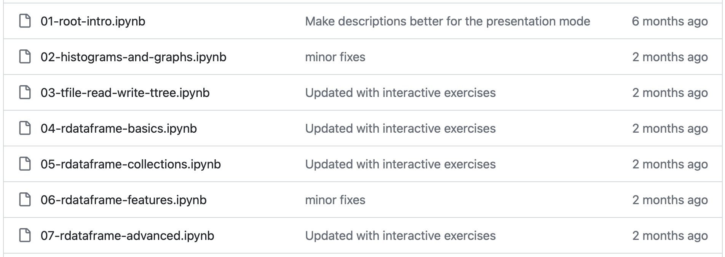
Lecture and exercises overview:
https://github.com/Ari-mu-l/software-carpentry/tree/PURSUE2025

Slide 4
What to expect
Lecture + exercises
Lecture: 7 modules
Exercises: Work together in the afternoon
Run everything with Jupyter Notebook

Slide 5
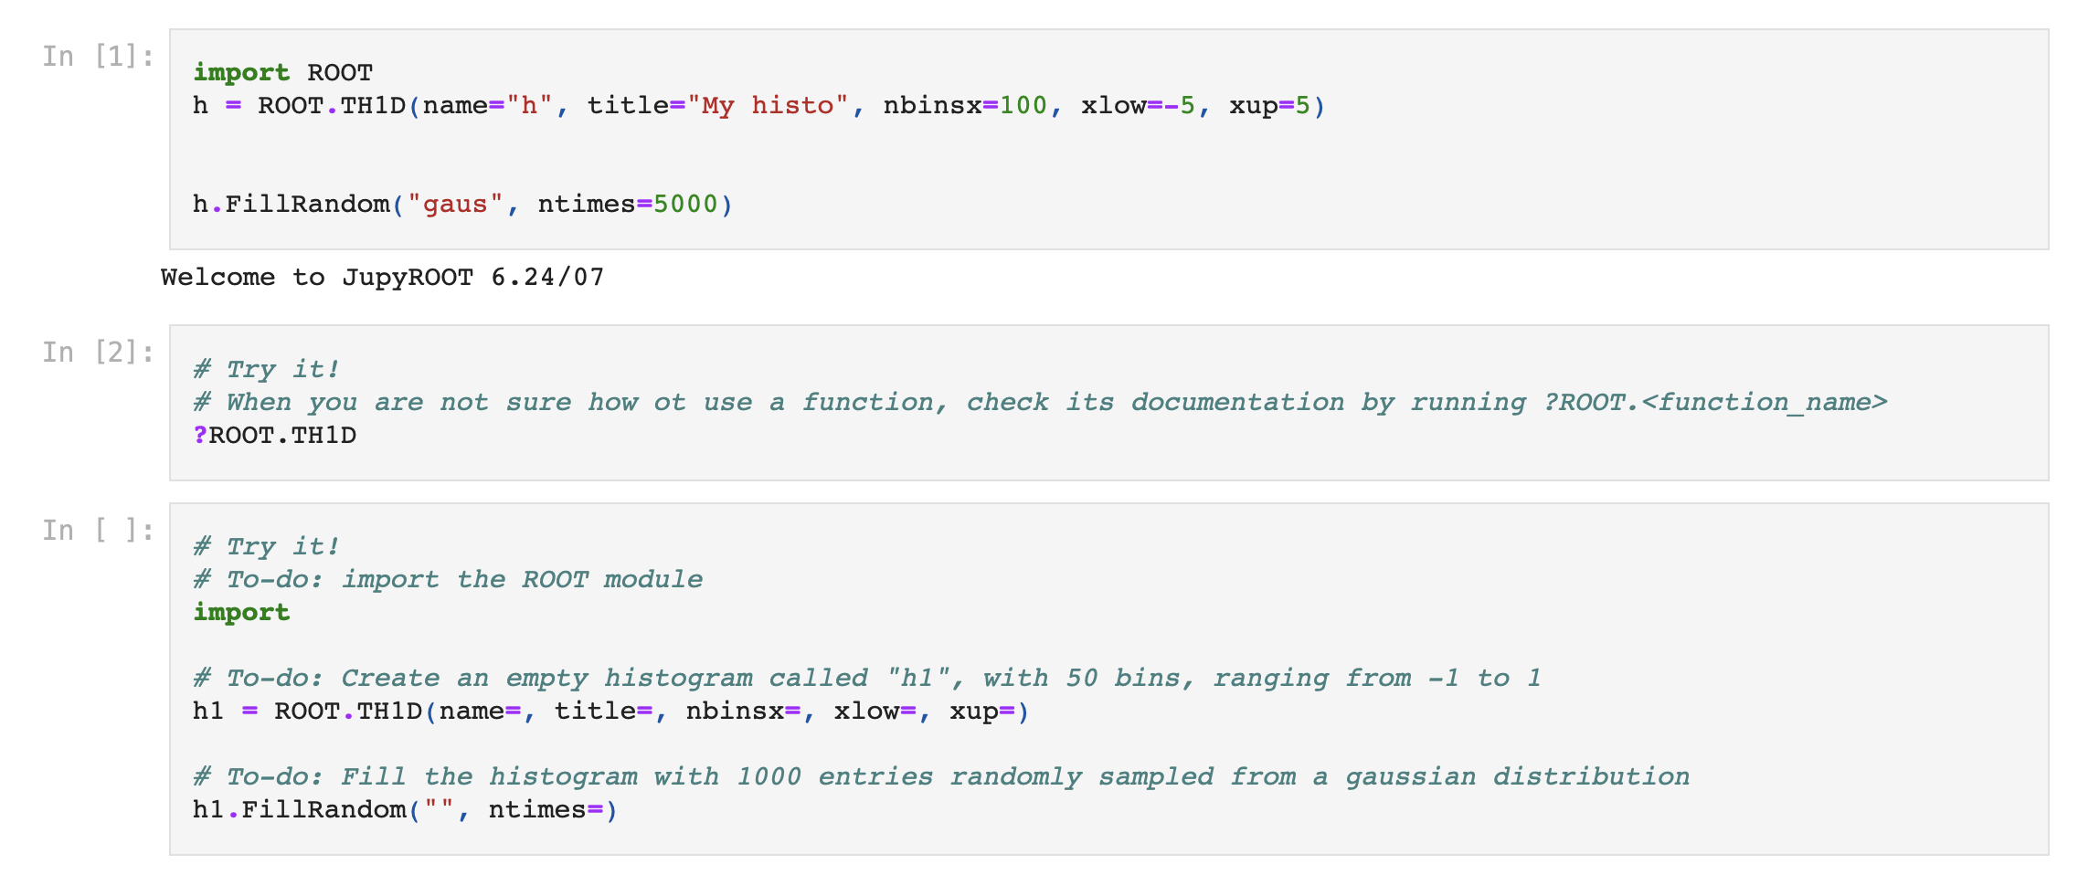
Each module:
Code examples
Execute
Directed small hands-on tasks that helps you to deepen your memory
Fill-in blanks

Slide 6
What to expect
Lecture + exercises
Lecture: 7 modules
Exercises: Work together in the afternoon
Run everything with Jupyter Notebook

Slide 7

Goal
Learn the basics of pyROOT and RDataFrame
Learn how to look for answers
  It’s normal to not remember all the details of each function or tool
  What’s more important than trying to memorize them is to establish the ability and habit of reading documentations and online resources, so that you know how and where to find answers when you work on your research projects!
3. Get familiar with cmslpc clusters
  You will very likely be working on cmslpc clusters for the rest of the internship

Slide 8
Goal
Learn the basics of pyROOT and RDataFrame
Learn how to look for answers
  It’s normal to not remember all the details of each function or tool
  What’s more important than trying to memorize them is to establish the ability and habit of reading documentations and online resources, so that you know how and where to find answers when you work on your research projects!
3. Get familiar with cmslpc clusters
  You will very likely be working on cmslpc clusters for the rest of the internship

Slide 9
Goal
Learn the basics of pyROOT and RDataFrame
Learn how to look for answers
  It’s normal to not remember all the details of each function or tool
  What’s more important than trying to memorize them is to establish the ability and habit of reading documentations and online resources, so that you know how and where to find answers when you work on your research projects!
3. Get familiar with cmslpc clusters
  You will very likely be working on cmslpc clusters for the rest of the internship

Slide 10
Setting up
CMS Offline Software (CMSSW) contains all the packages we need in this workshop. It is also what we use to perform physics analyses
Access CMSSW using cmslpc clusters
Follow the instructions in the github repository (https://github.com/Ari-mu-l/software-carpentry/tree/PURSUE2025)
If you cannot access cmslpc, access the repository through this link https://mybinder.org/v2/gh/Ari-mu-l/software-carpentry.git/PURSUE2025

