Slide 1
MQXFS4f test results analysis
F. Mangiarotti, G. Willering, V. Di Capua, J. Feuvrier, J.L. Guyon, M. Boczan
2025.05.06
https://edms.cern.ch/document/3296952

Slide 2
Basic analysis

Slide 3
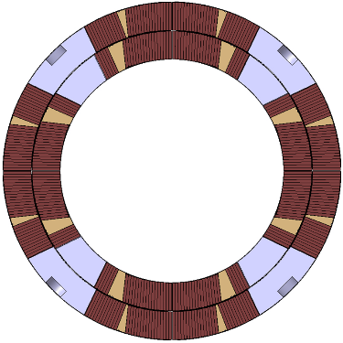
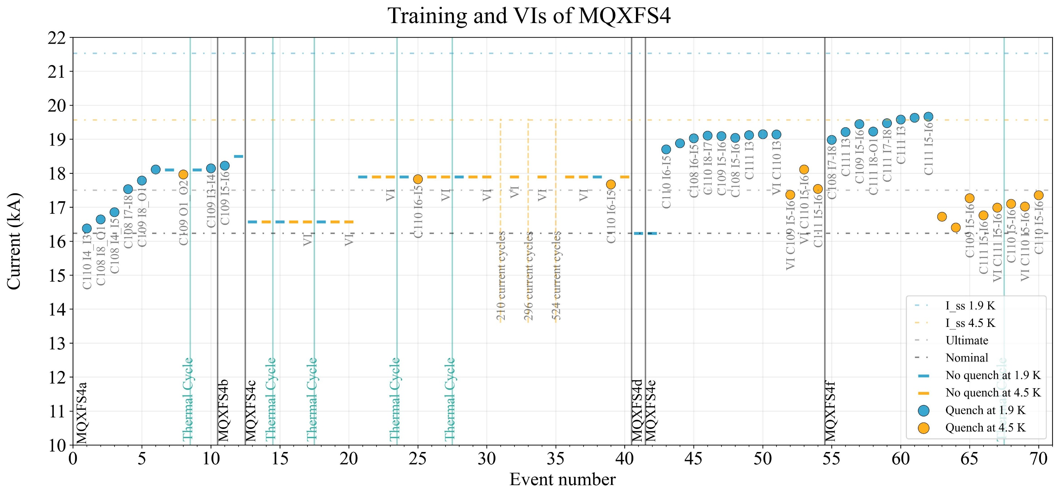
Quench plot (20 A/s and VI)
110
108
MQXFS4
109
111

Slide 4
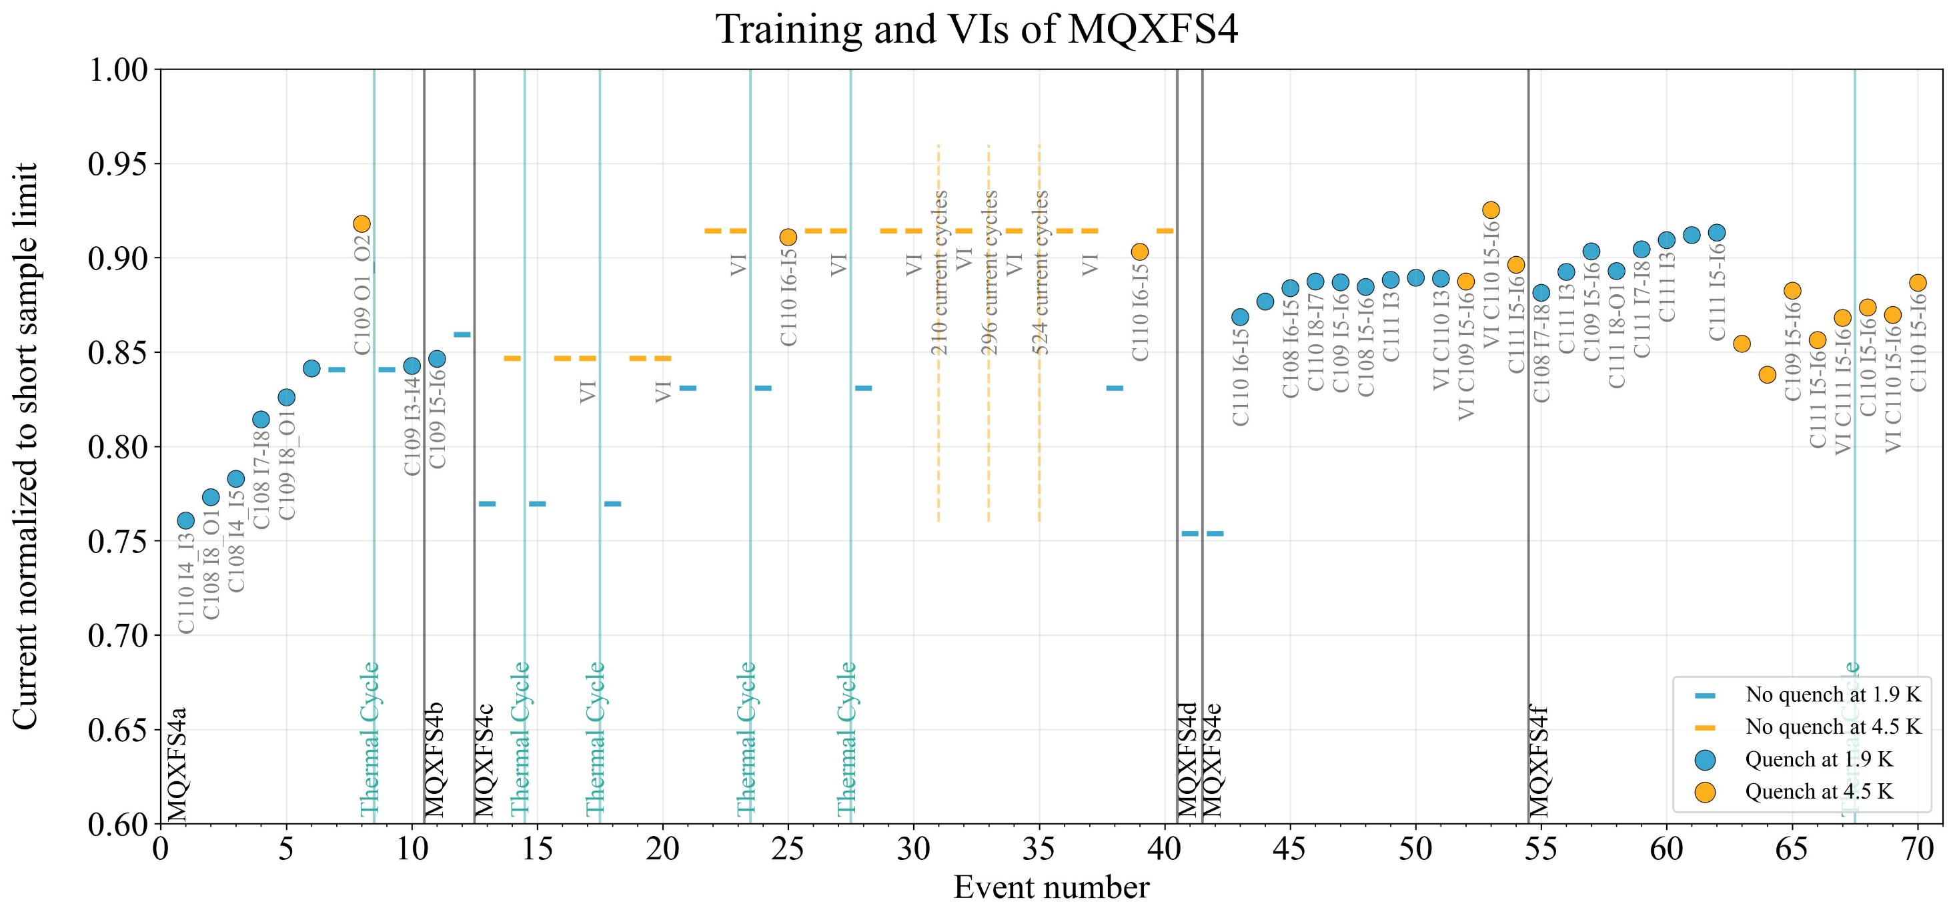
Quench plot (20 A/s and VI)
110
108
MQXFS4
109
111

Slide 5
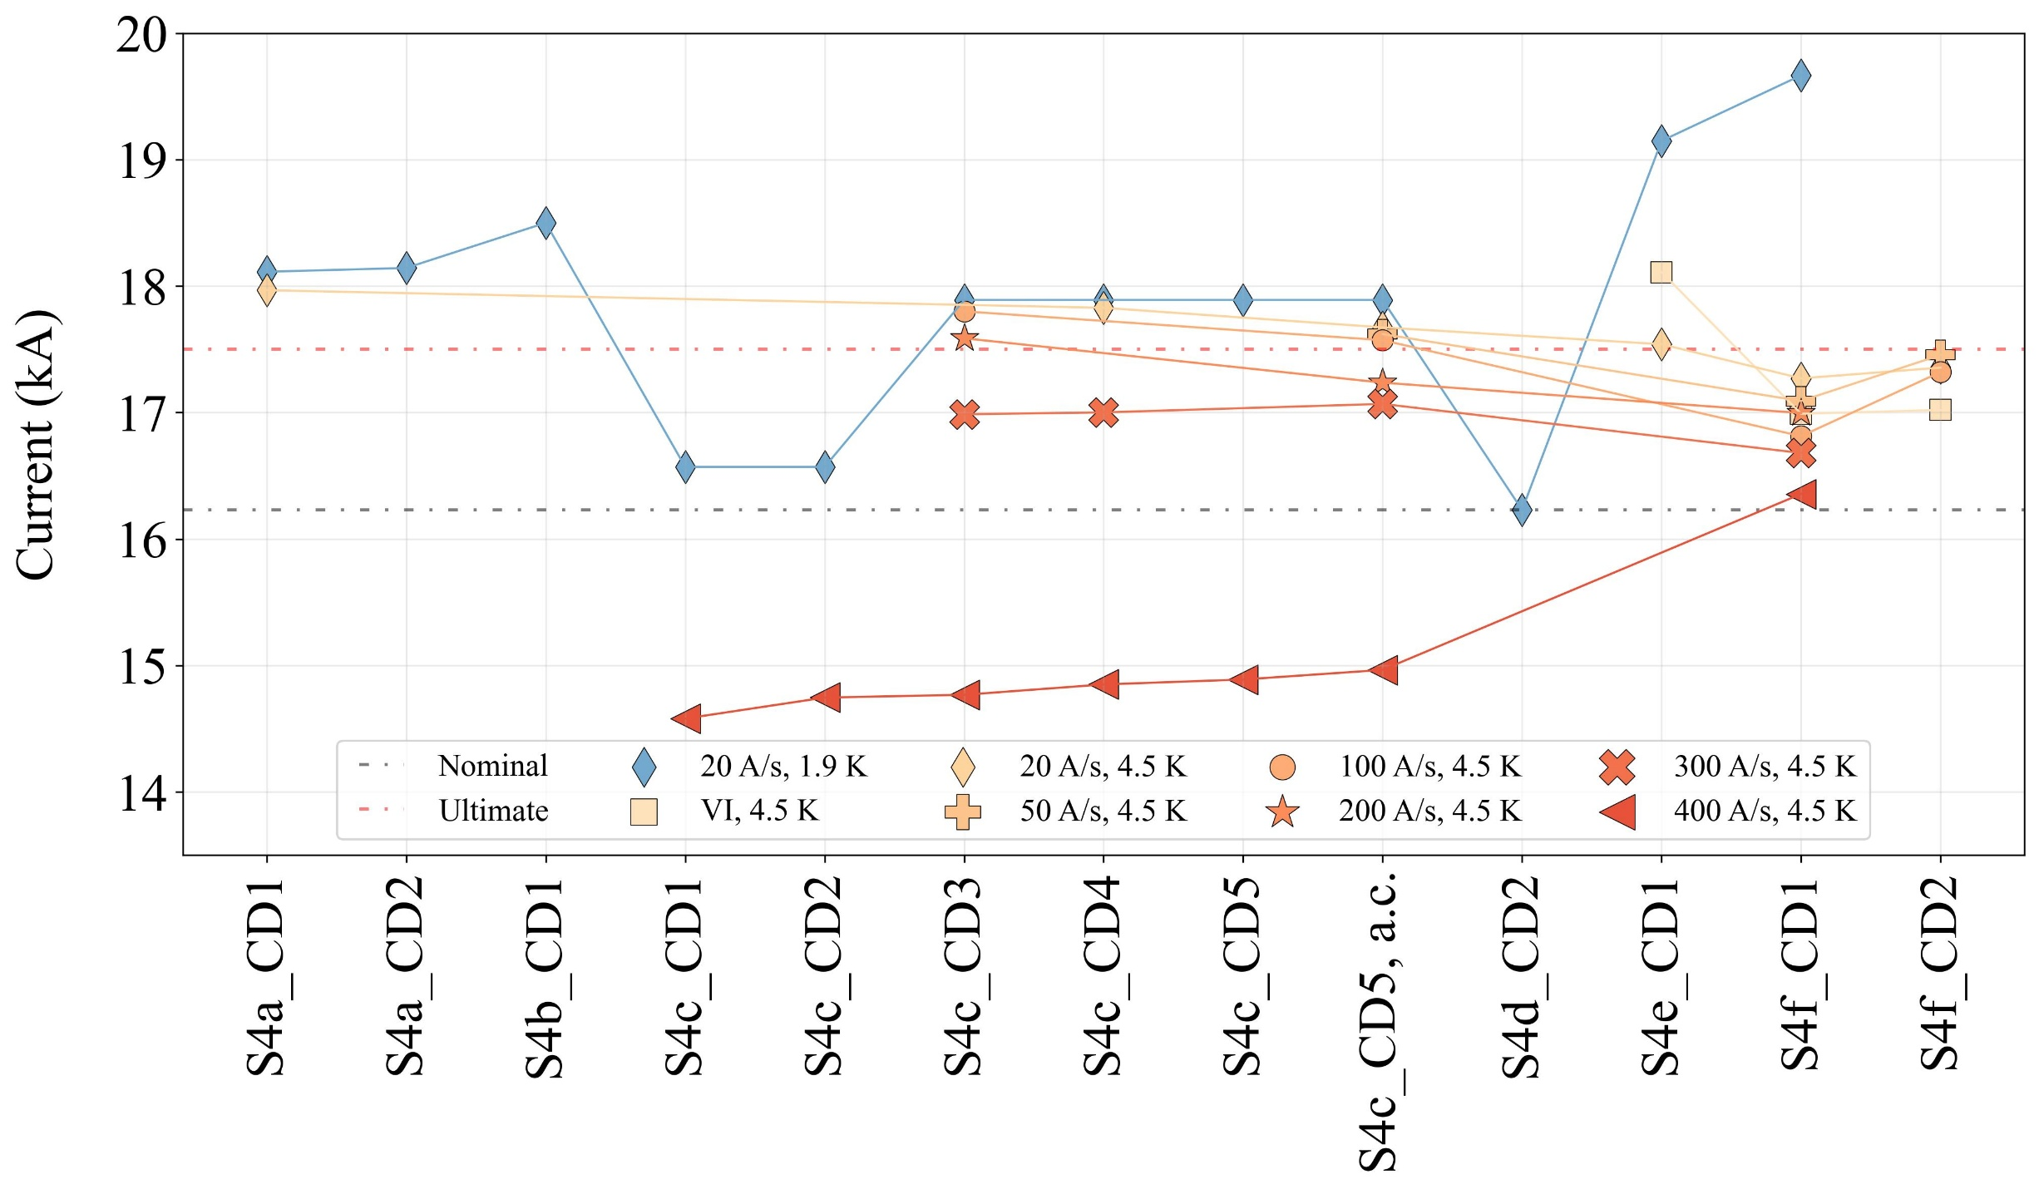
Historical plot
NQ
NQ
NQ
NQ
NQ
NQ
NQ
NQ: no quench at 1.9 K

Slide 6
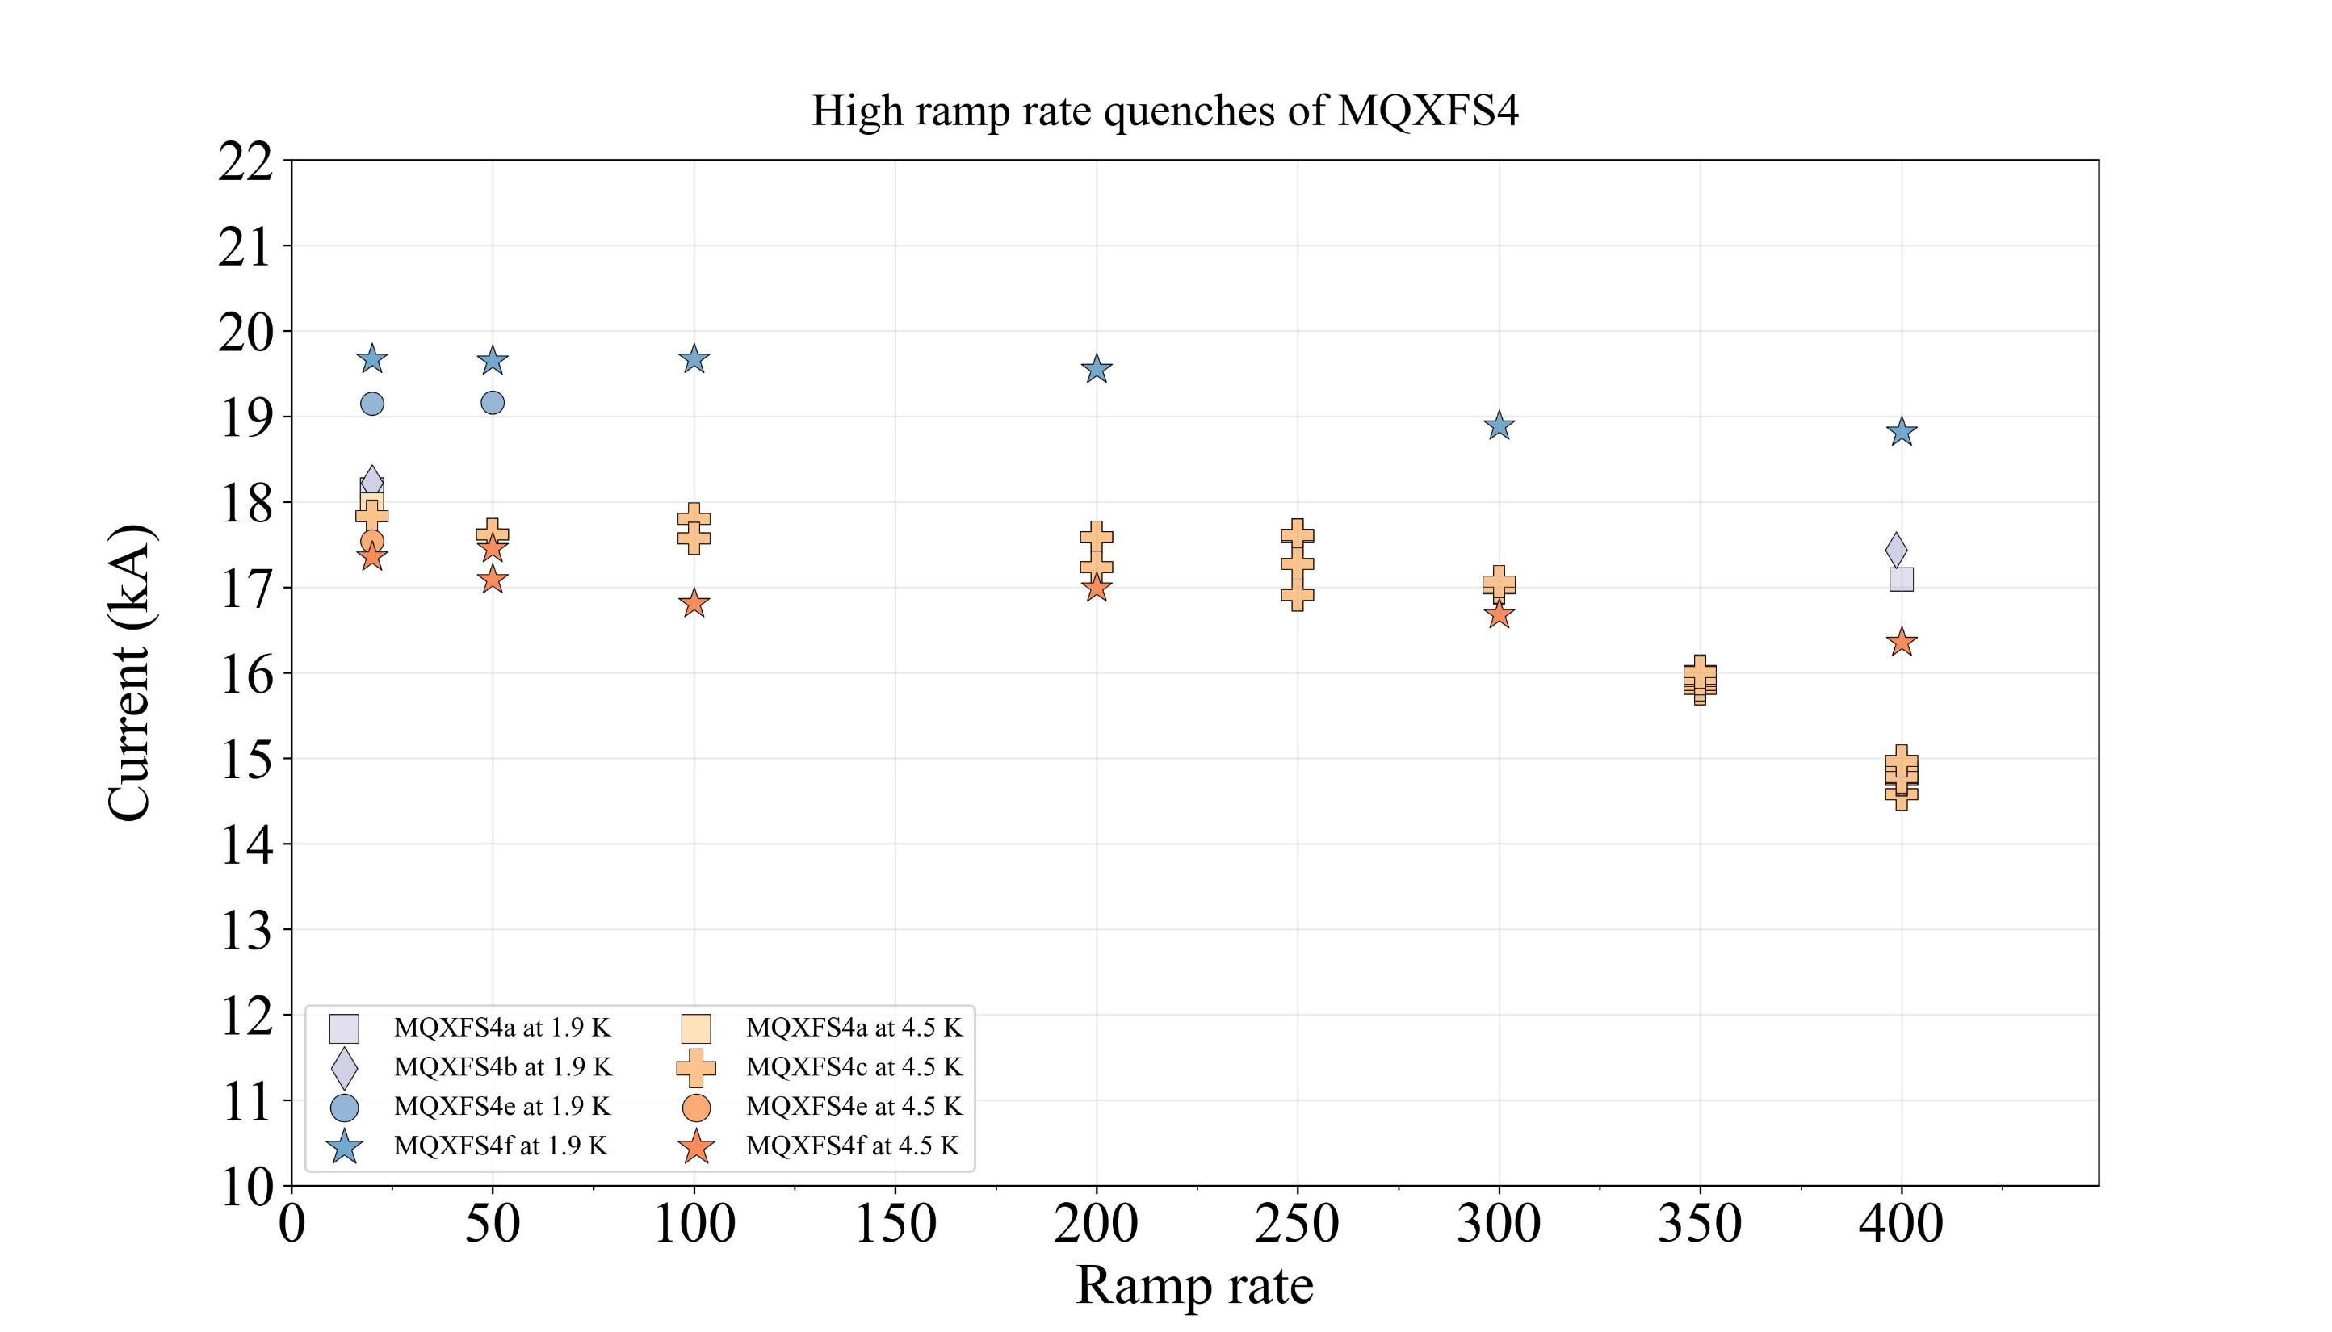

Slide 7
Quench-by-quench study

Slide 8
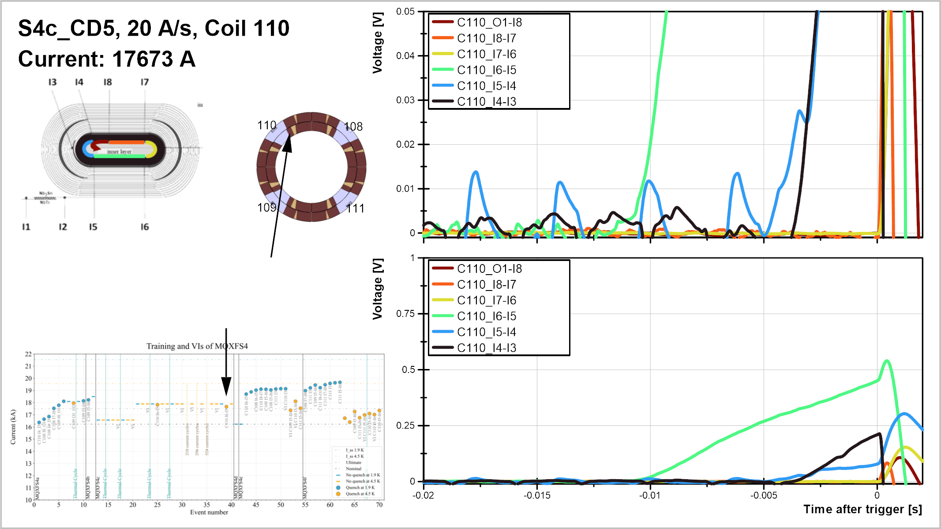

Slide 9
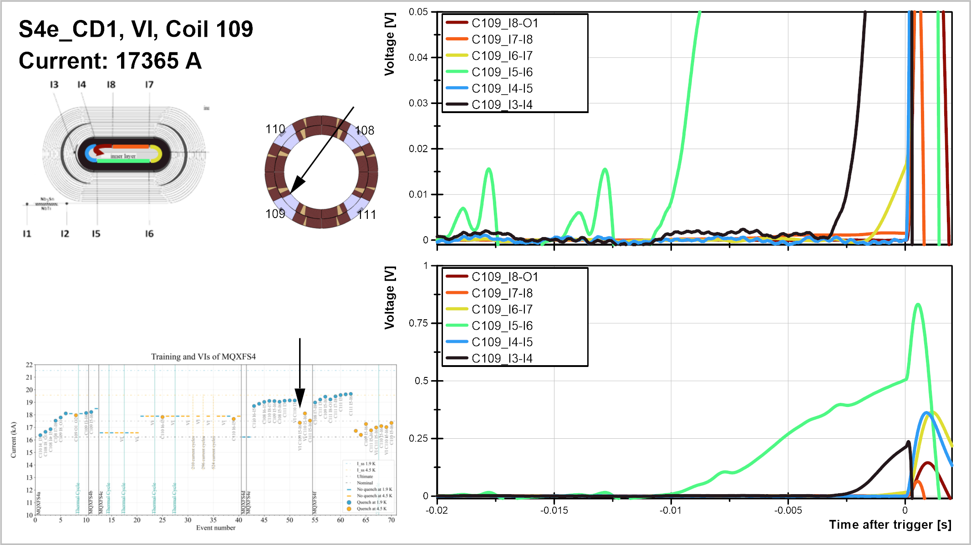

Slide 10
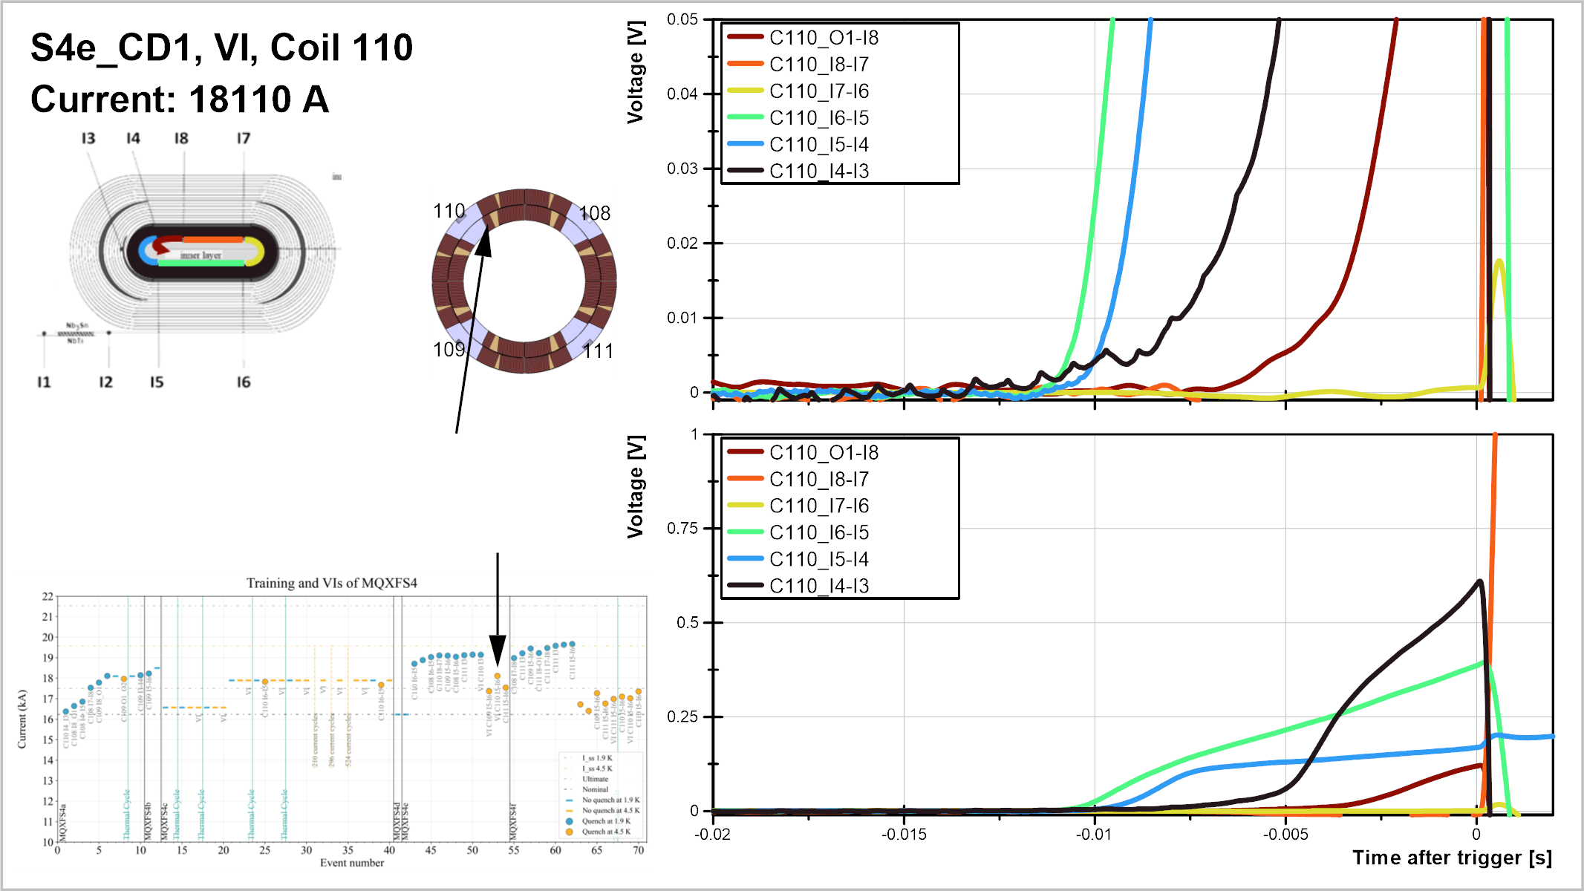

Slide 11
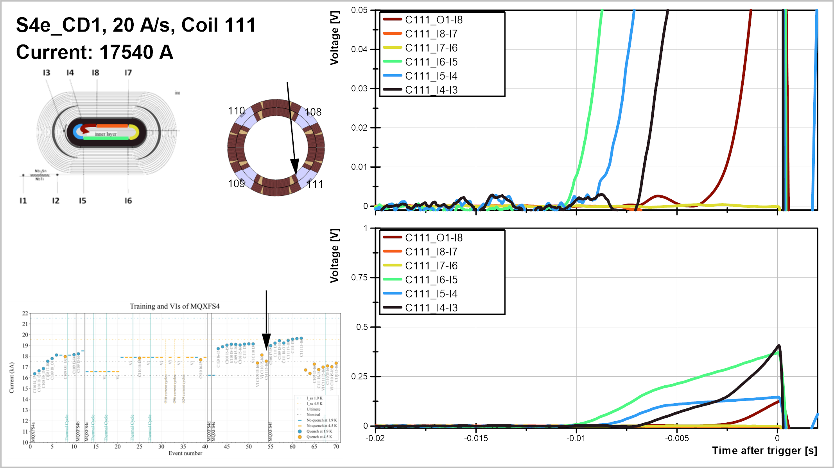

Slide 12
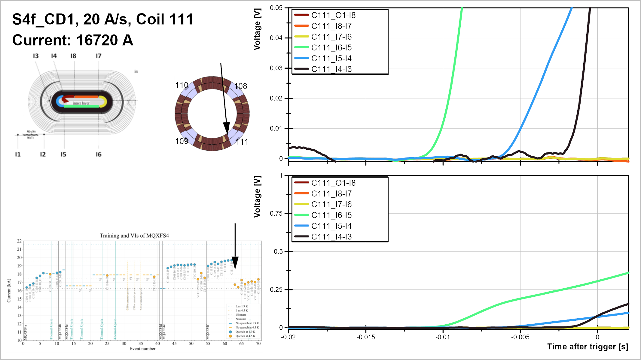

Slide 13
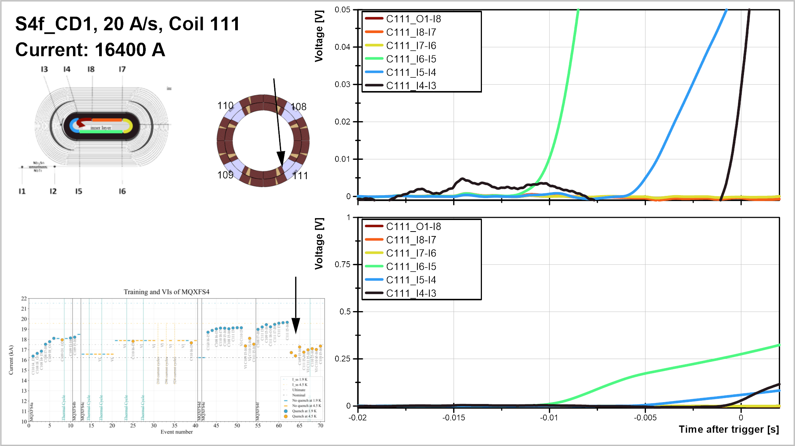

Slide 14
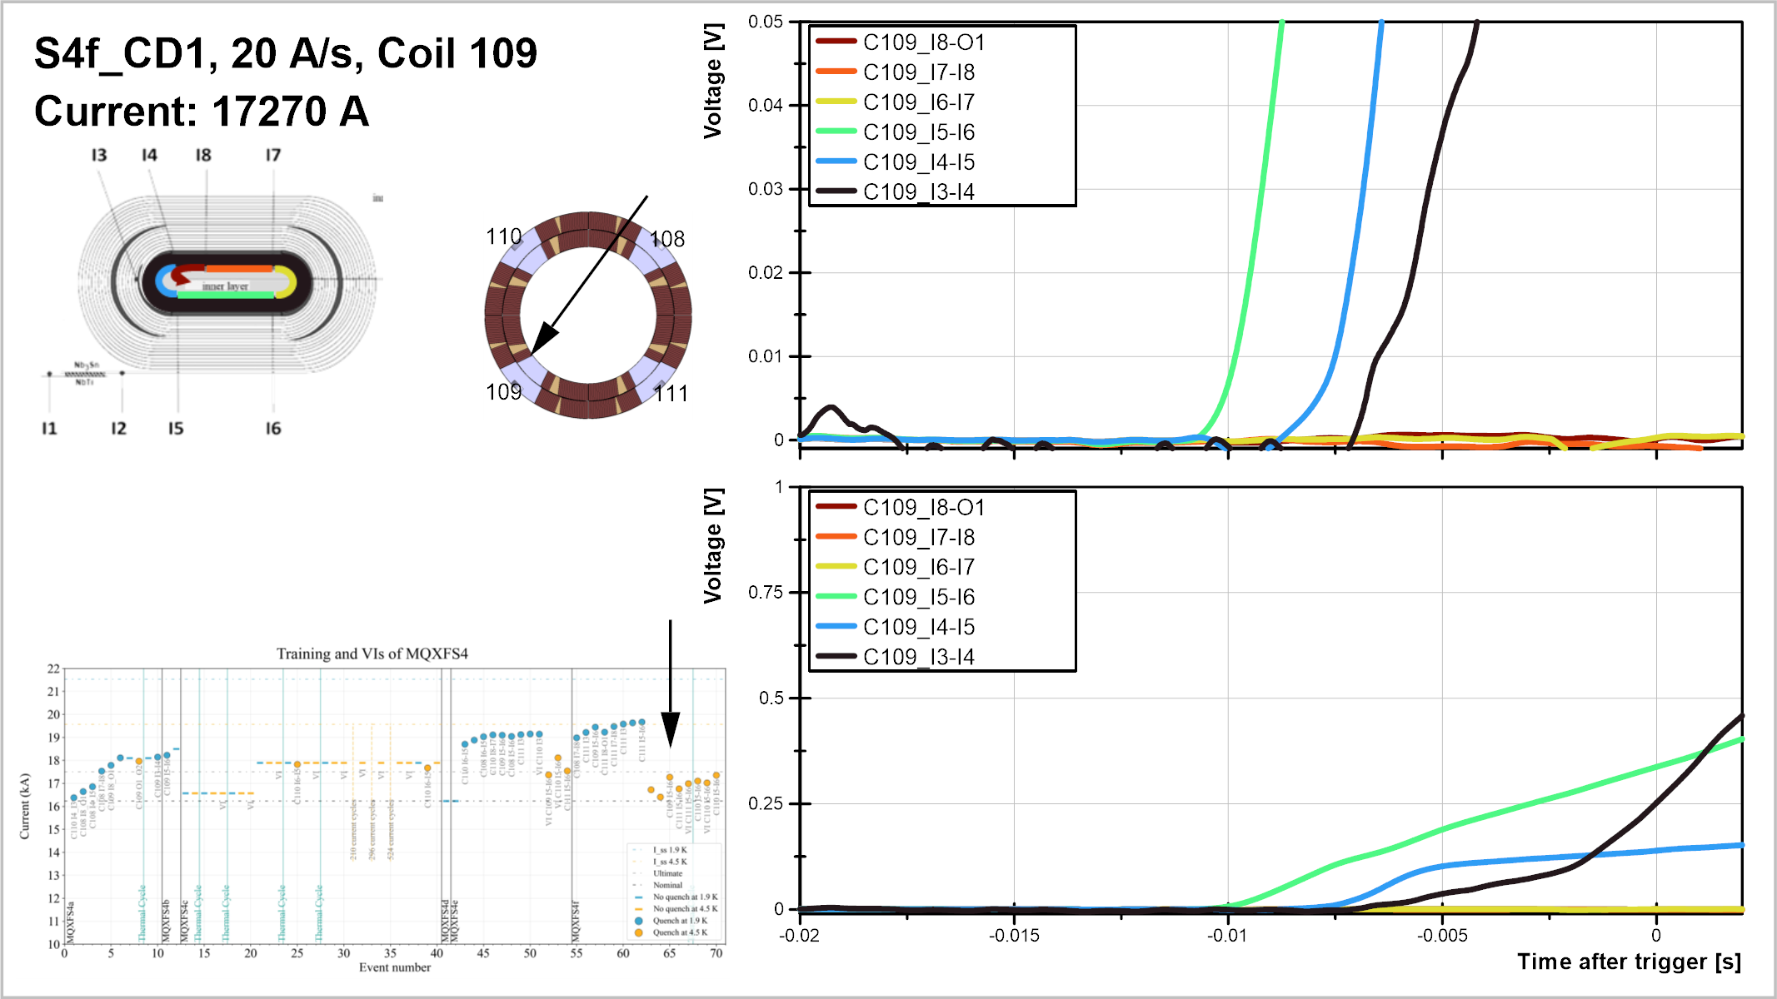

Slide 15
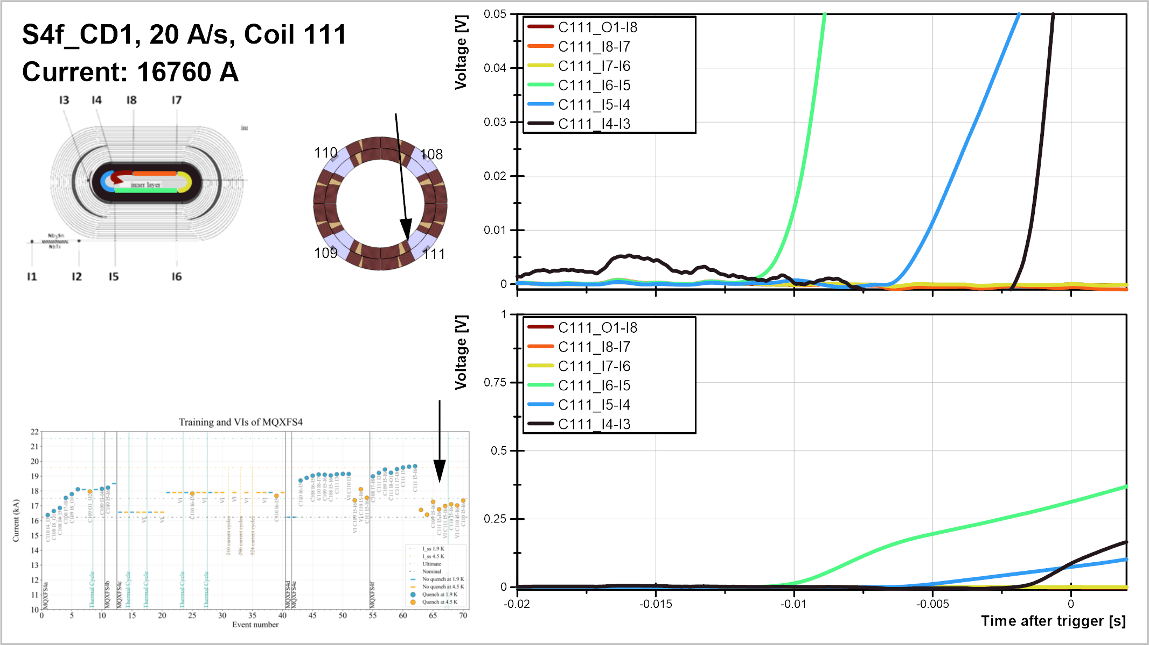

Slide 16
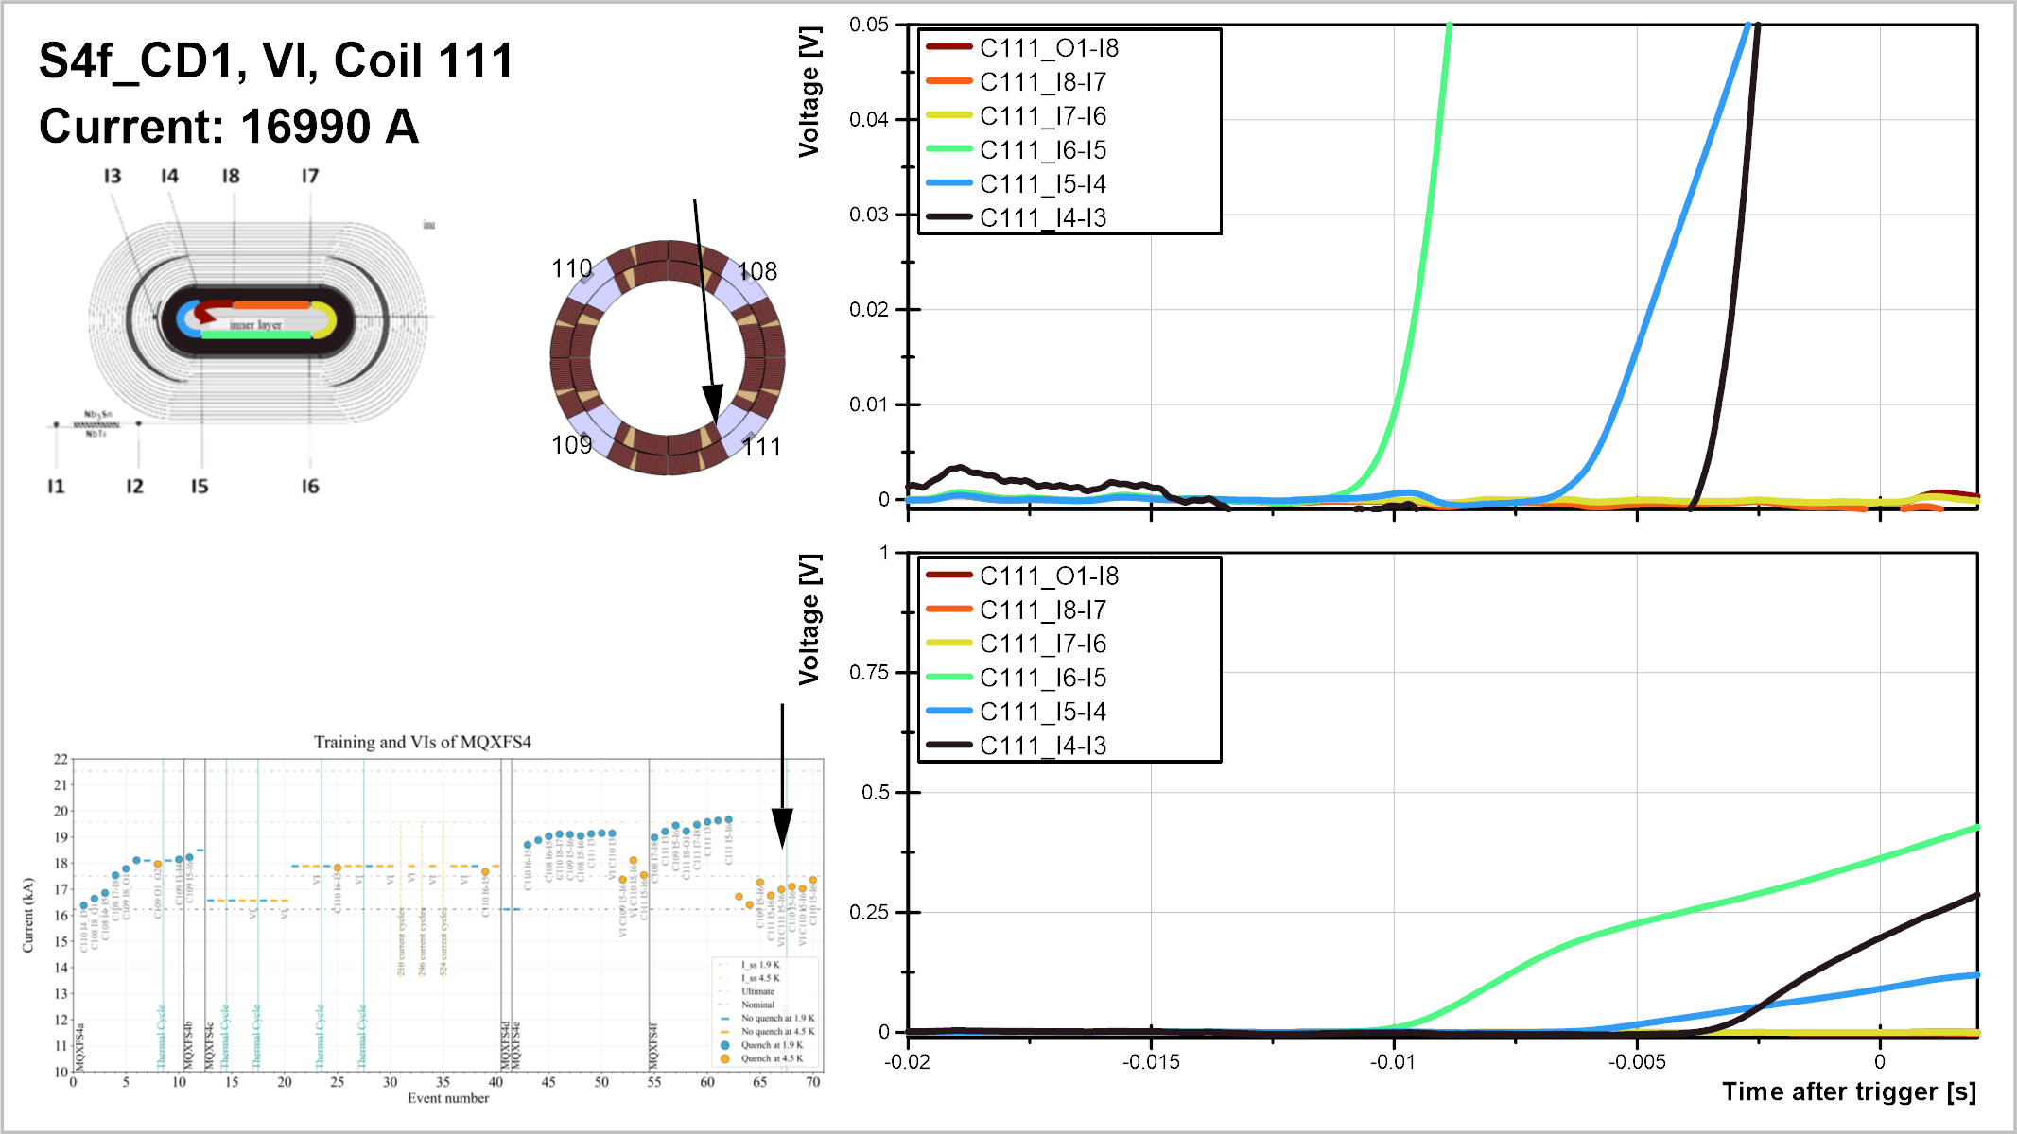

Slide 17
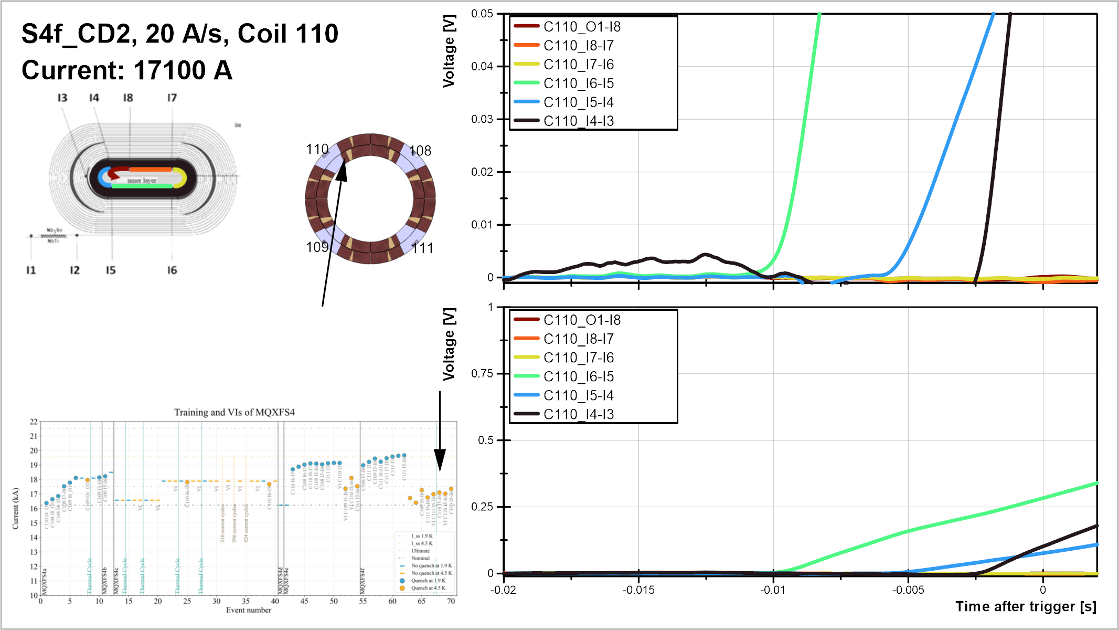

Slide 18
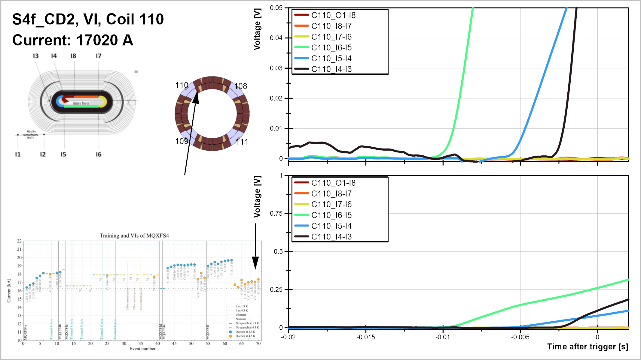

Slide 19
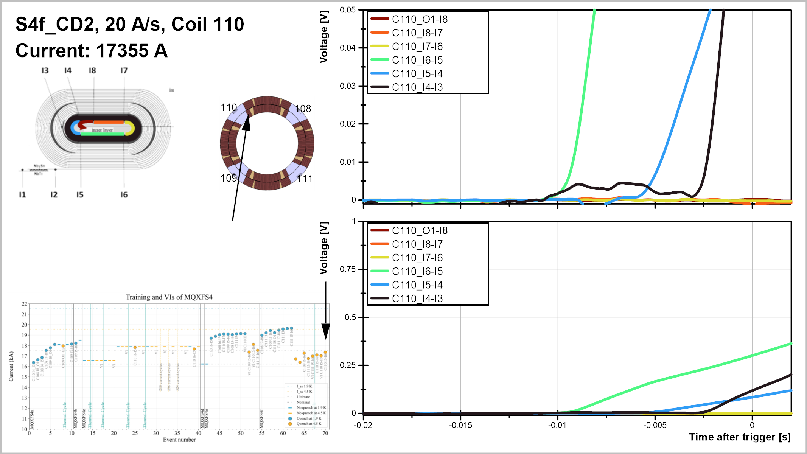

Slide 20

V-I analysis
Coming soon…

Slide 21
Next steps
This evening:
  repeat VI measurements
Tomorrow:
  Ramp rate studies at 200, 300, 400 A/s
  Launch current cycles during the night (300 cycles to nominal current)
Thursday and Friday:
  Repeat verification (20 A/s, VI, ramp rate studies)

