Slide 1
MQXFS8b test results analysis
F. Mangiarotti, G. Willering, V. Di Capua J. Feuvrier, J.L. Guyon, M. Boczan
2025.05.06
https://edms.cern.ch/document/3290649

Slide 2
Basic analysis

Slide 3
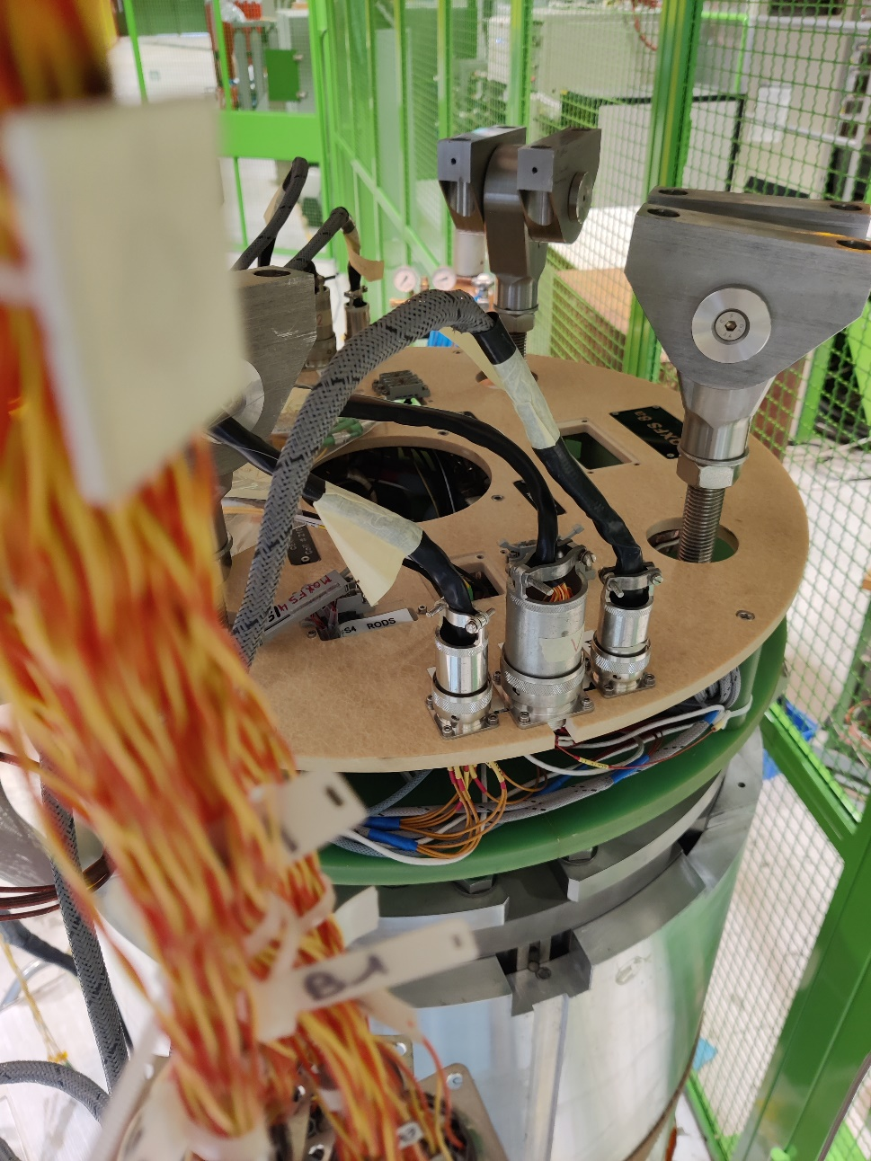
What is MQXFS8?
Two virgin RRP 108/127 coils (coils 115 and 116), with “mini-swap” QH
Two PIT 192 with bundle barrier coils previously used in MQXFS6a-b-c-d (coils 210 and 212)
New loading procedure
History:
Magnet | Az. Preload RT [MPa] | Az. Preload cold [MPa] | Ax. Preload RT [MPa] | Ax. Preload cold [MPa]
S6b | 90 | 120 | 168 | 259
S6c | 40 | 75 | 152 | 281
S6d | 80 | 120 | 146 | 280
S8a | 65 | 100 | 170 | 297
S8b | 75 | 86 | 32 | 145

Slide 4
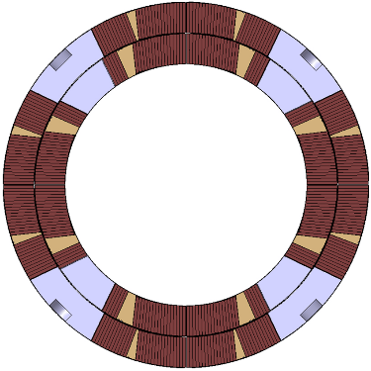
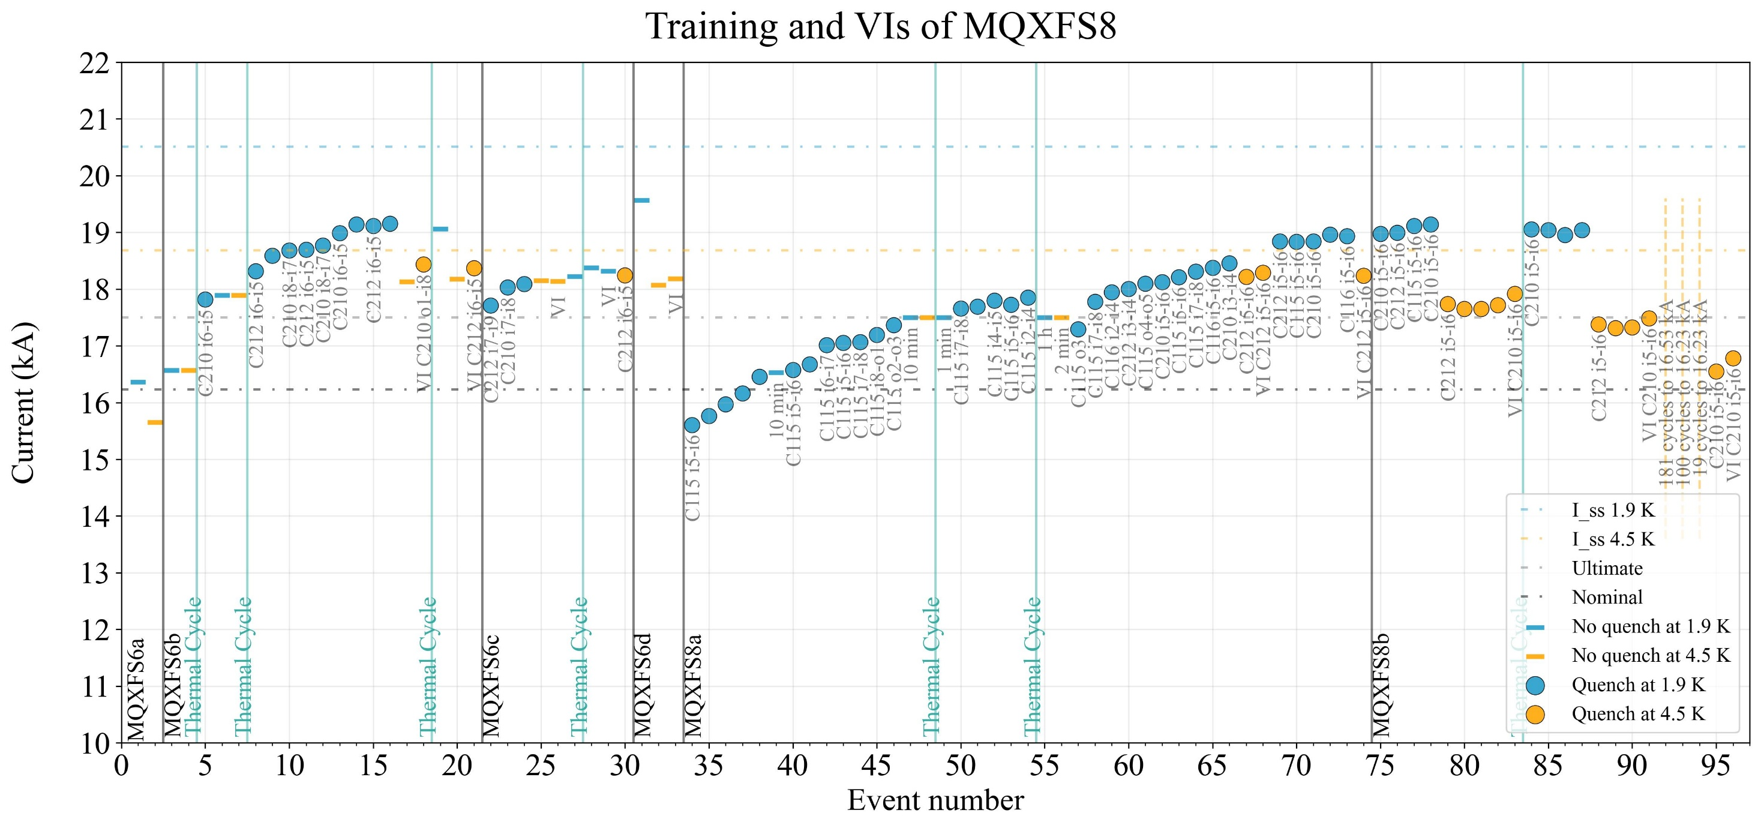
Quench plot (20 A/s and VI)
210
115
MQXFS8
116
212

Slide 5
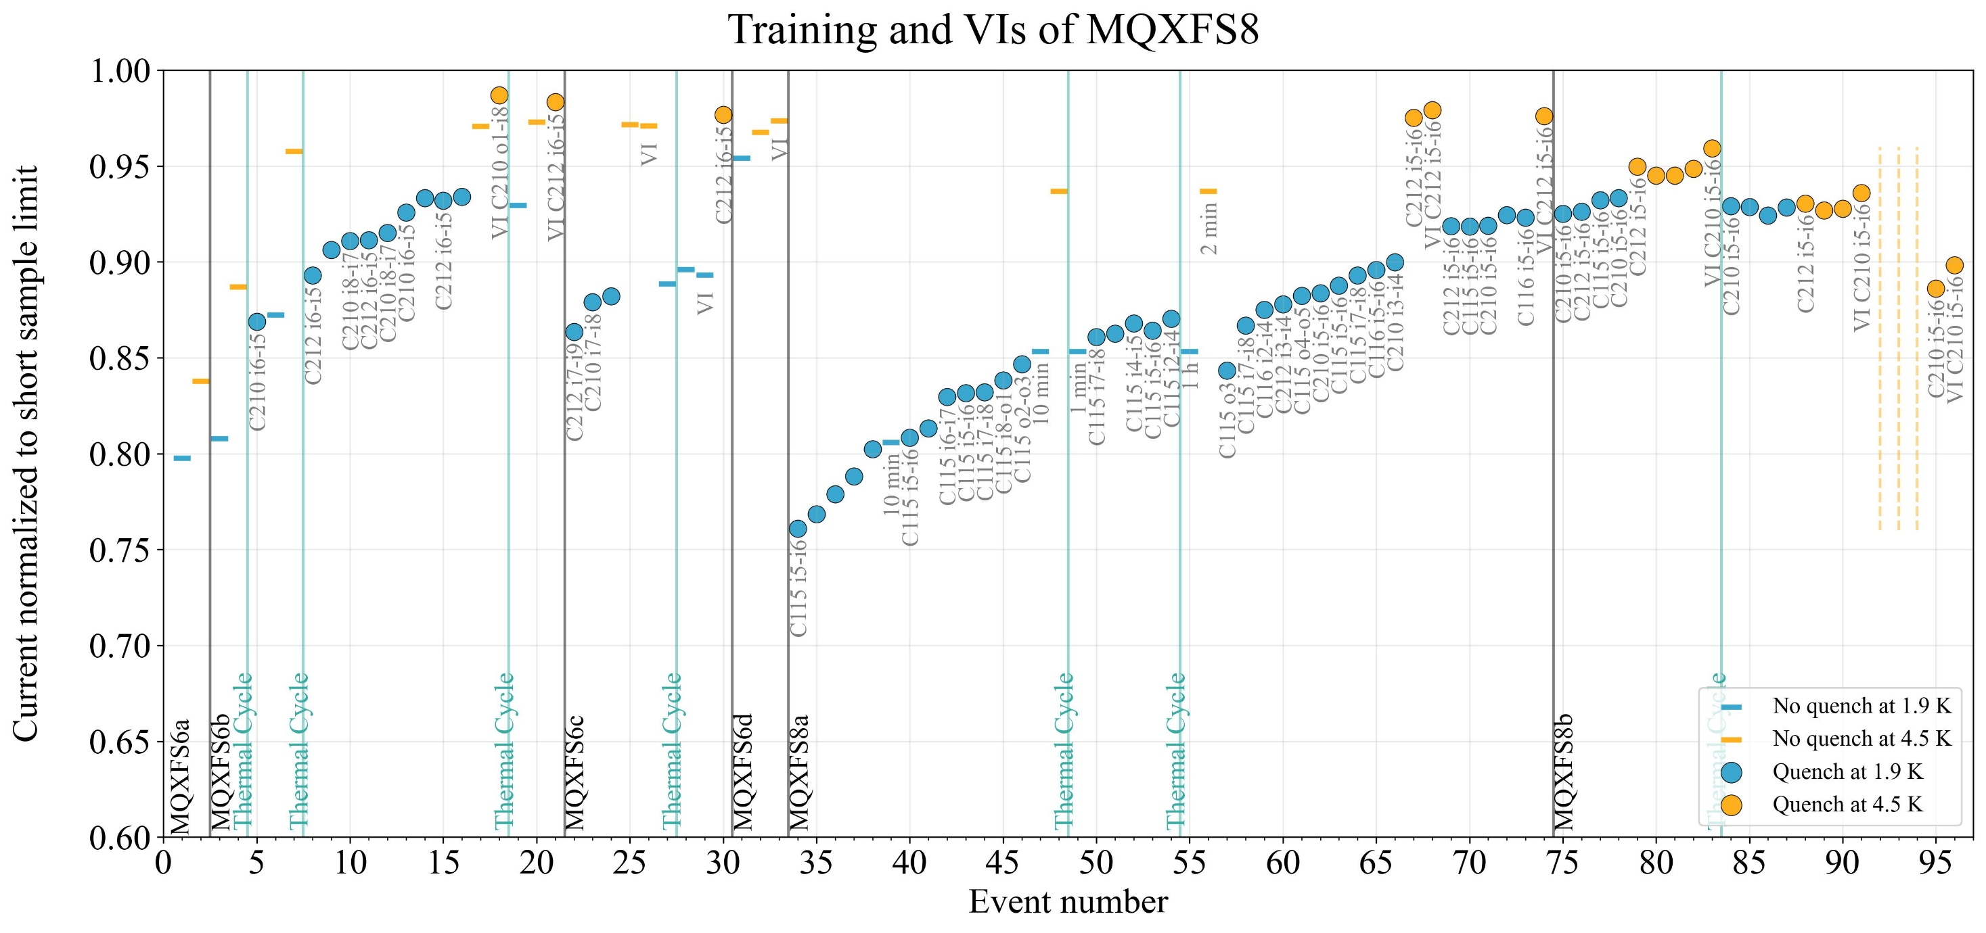
Quench plot (20 A/s and VI) - normalized
210
115
MQXFS8
116
212

Slide 6
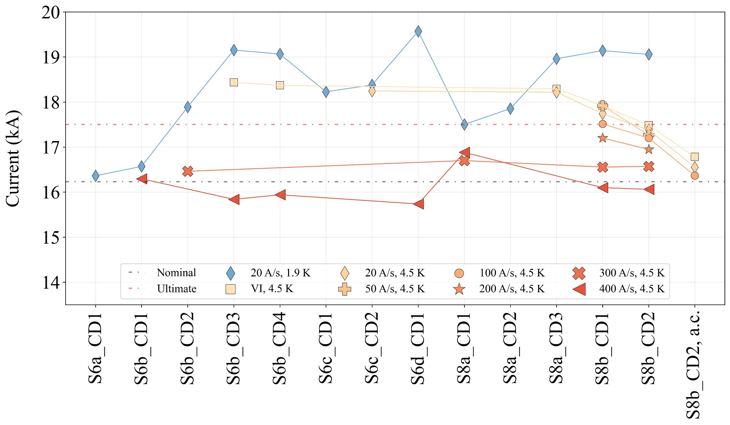
“Historical” plot
NQ
NQ
Behavior at 4.5 K very similar between MQXFS6b-c and MQXFS8a
In MQXFS8b the “slope” changes
NQ: no quench at 1.9 K
NQ
NQ
NQ

Slide 7
Quench-by-quench study

Slide 8
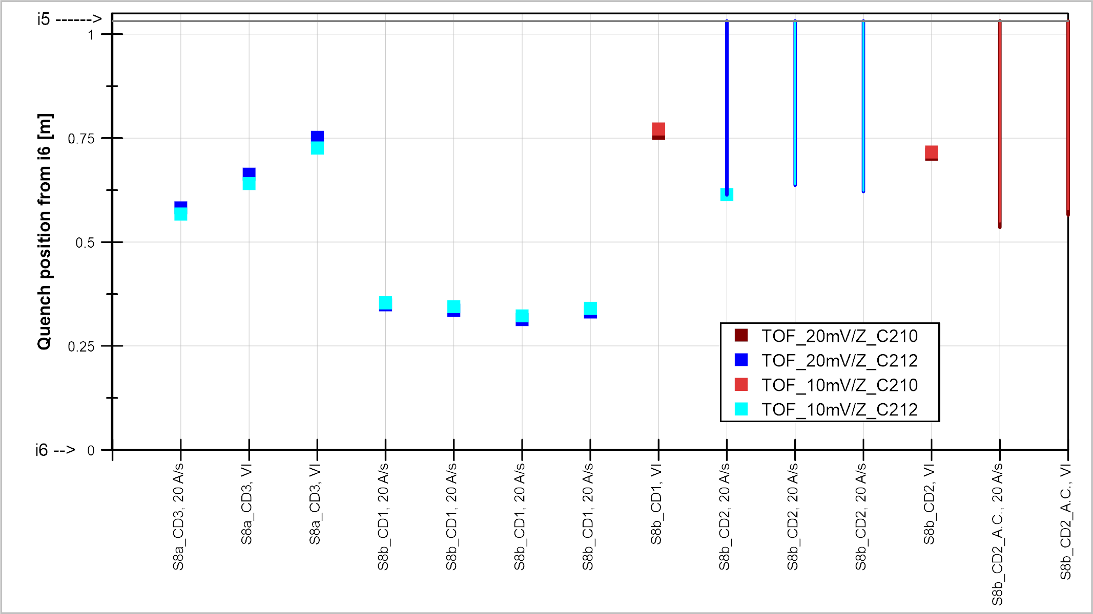
Quench localization via time of flight
Pre-load change
Thermal cycle
300 current cycles
210
115
116
212

Slide 9
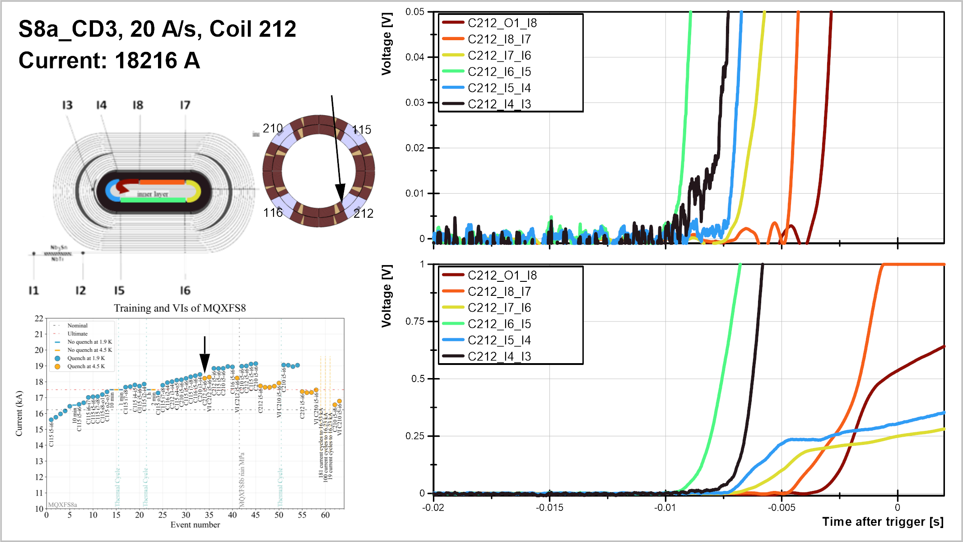

Slide 10
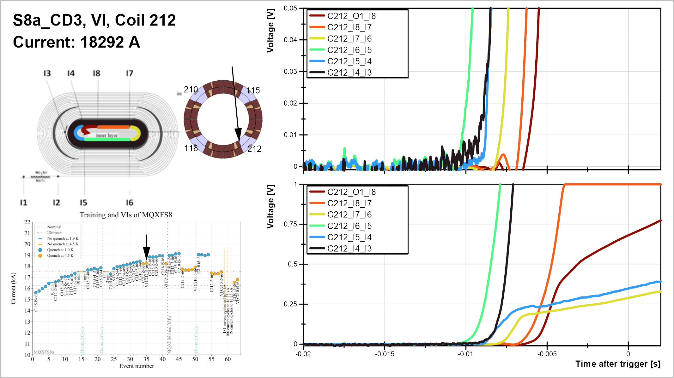

Slide 11
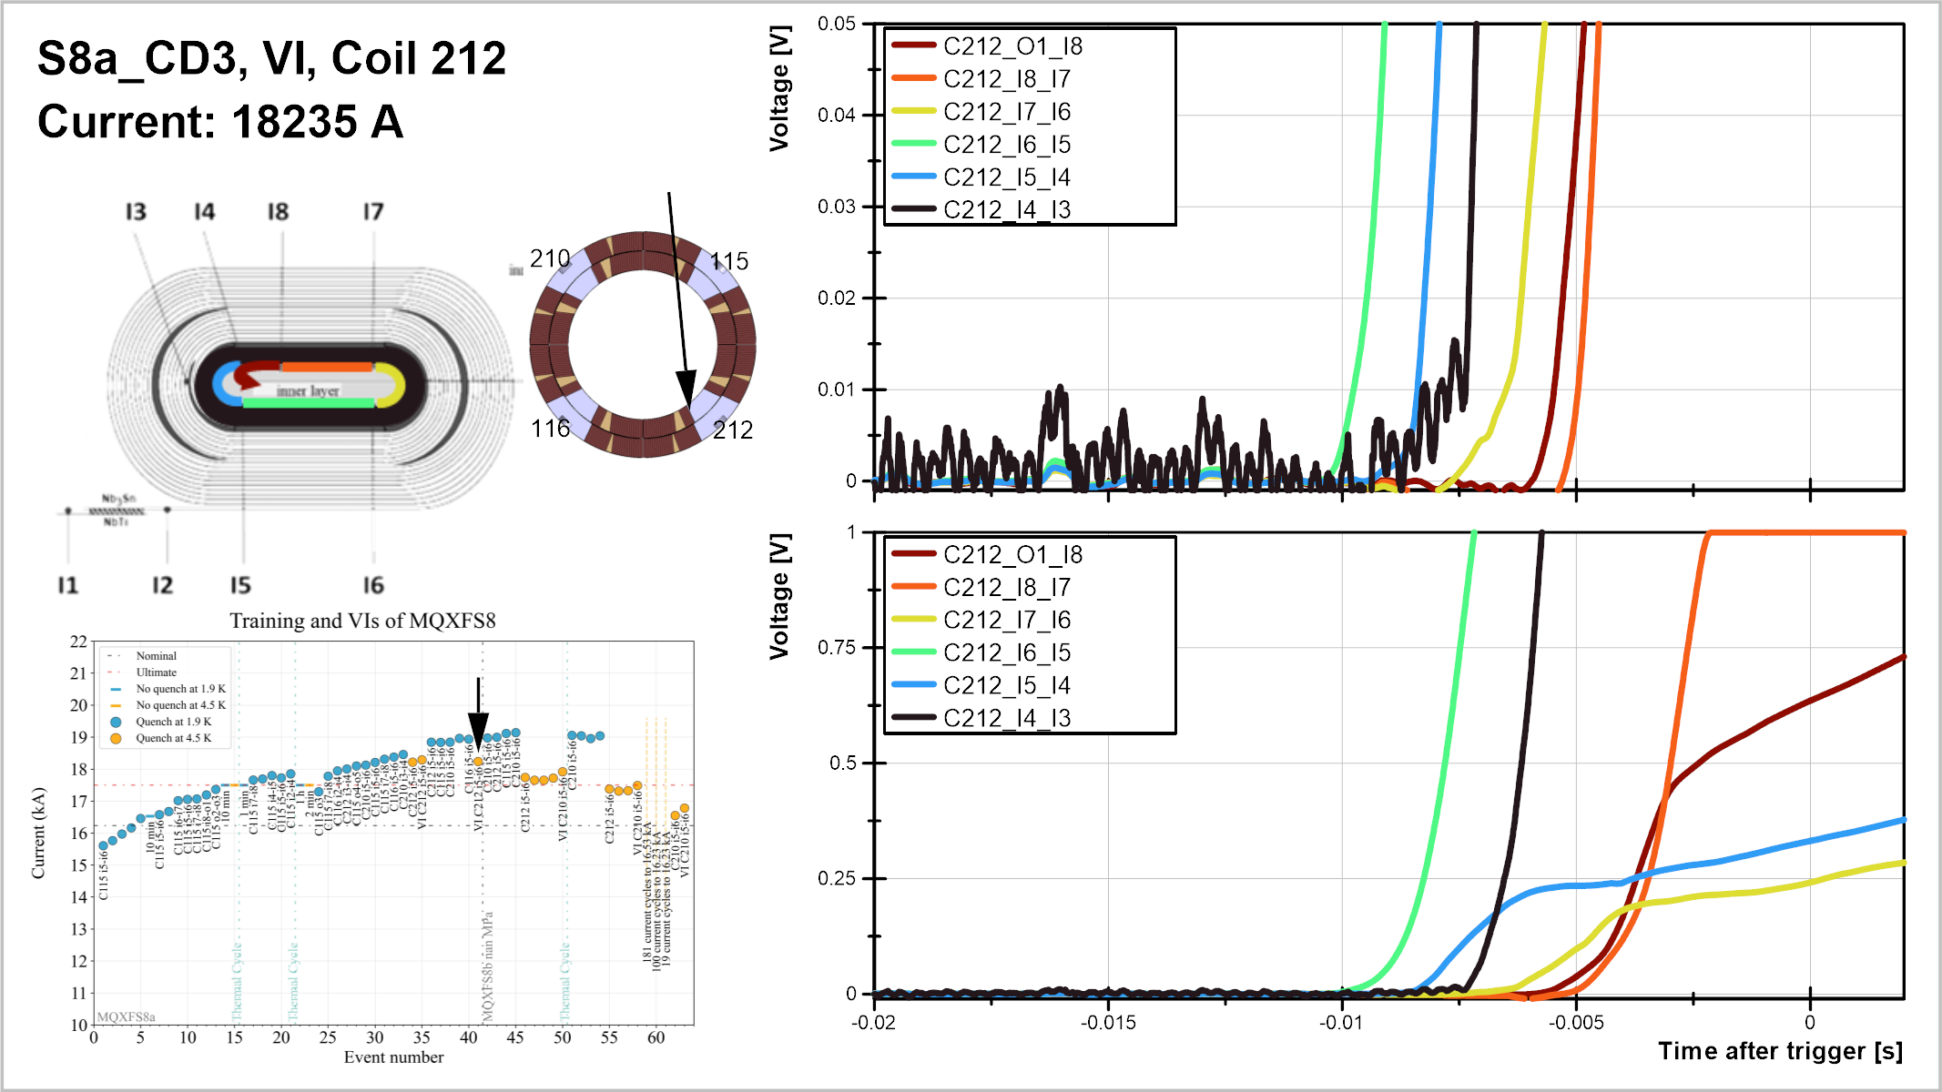

Slide 12
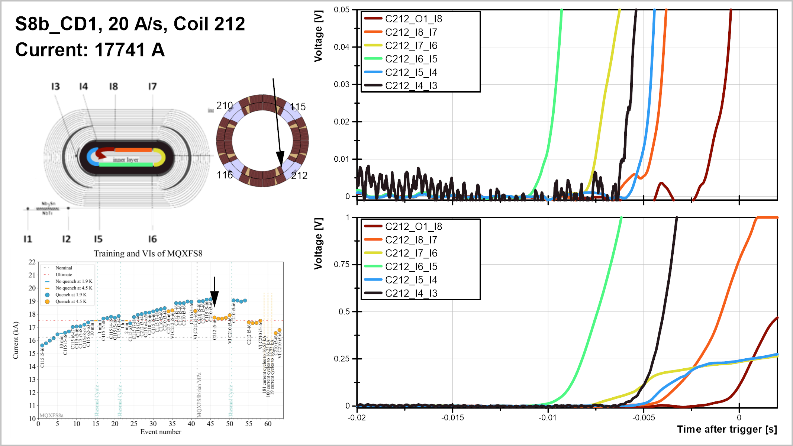

Slide 13
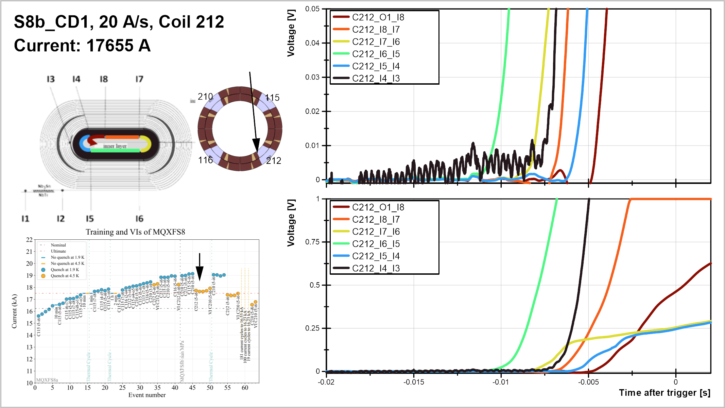

Slide 14
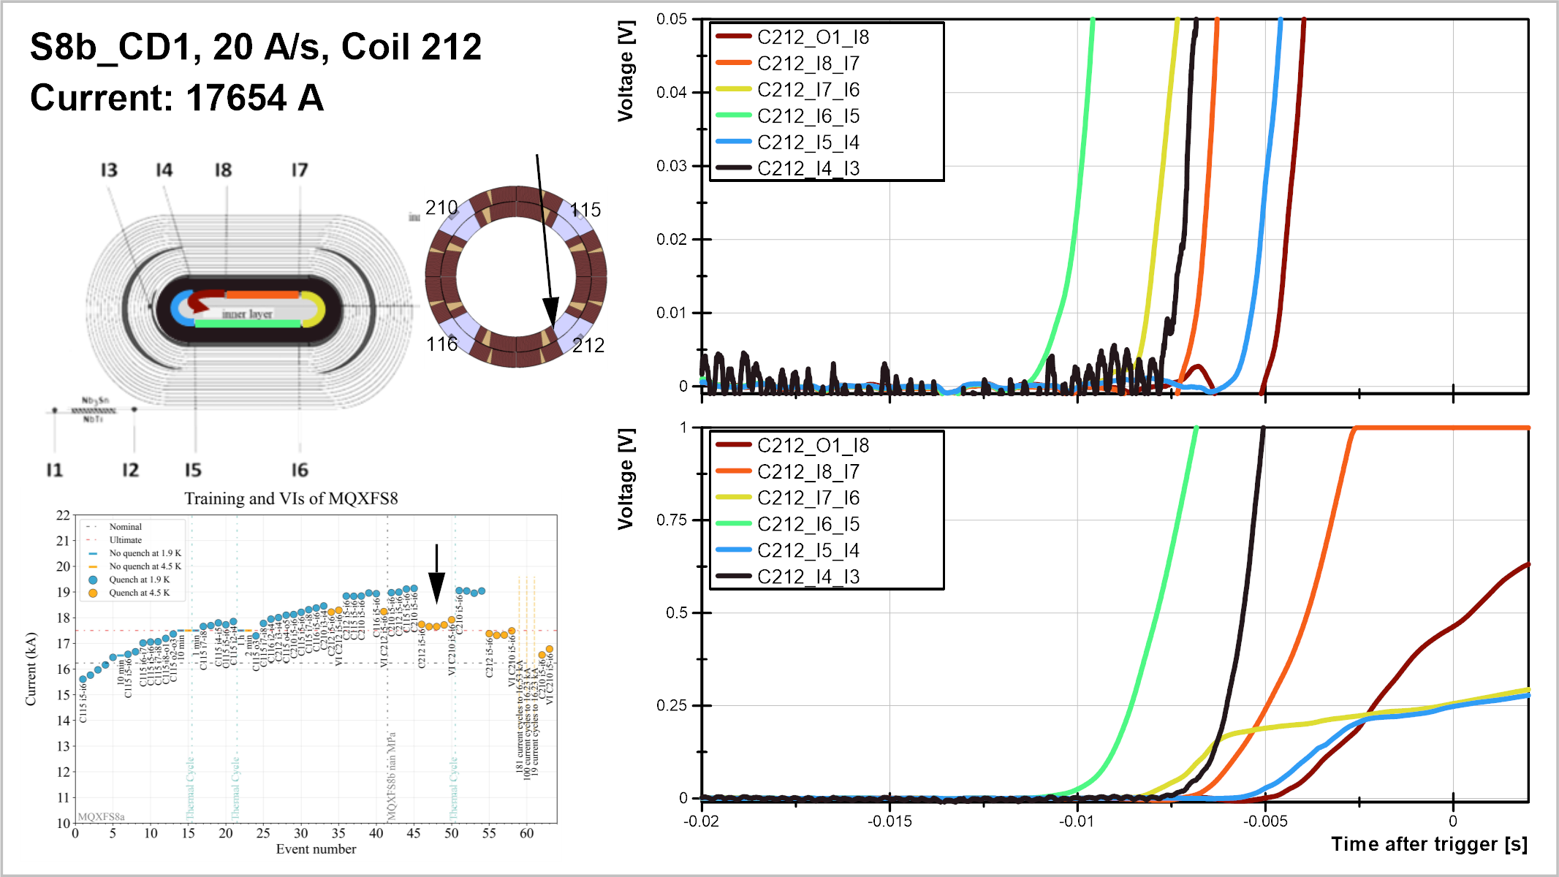

Slide 15
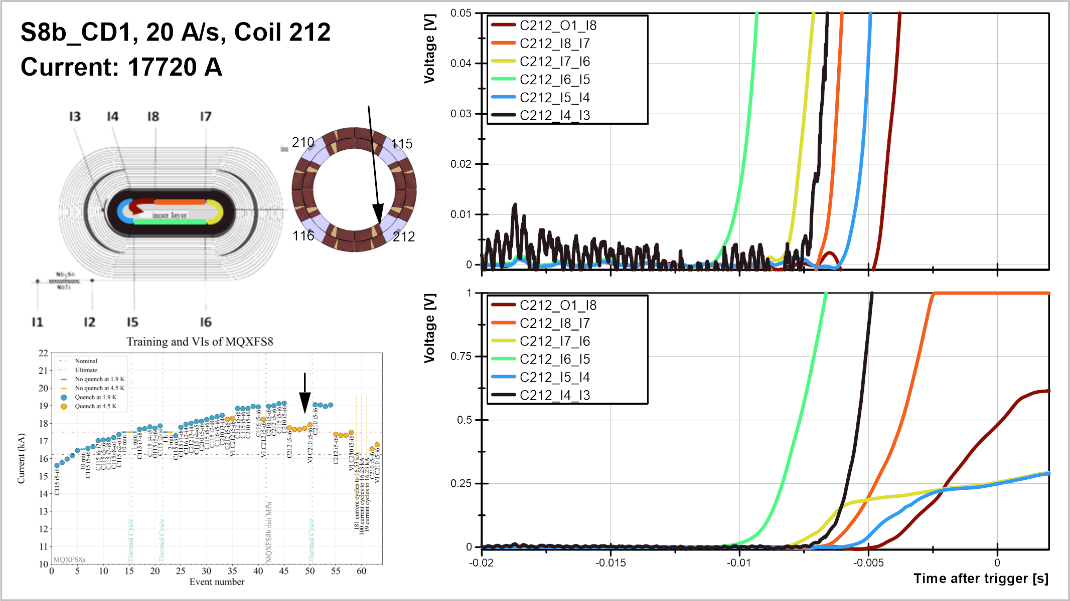

Slide 16
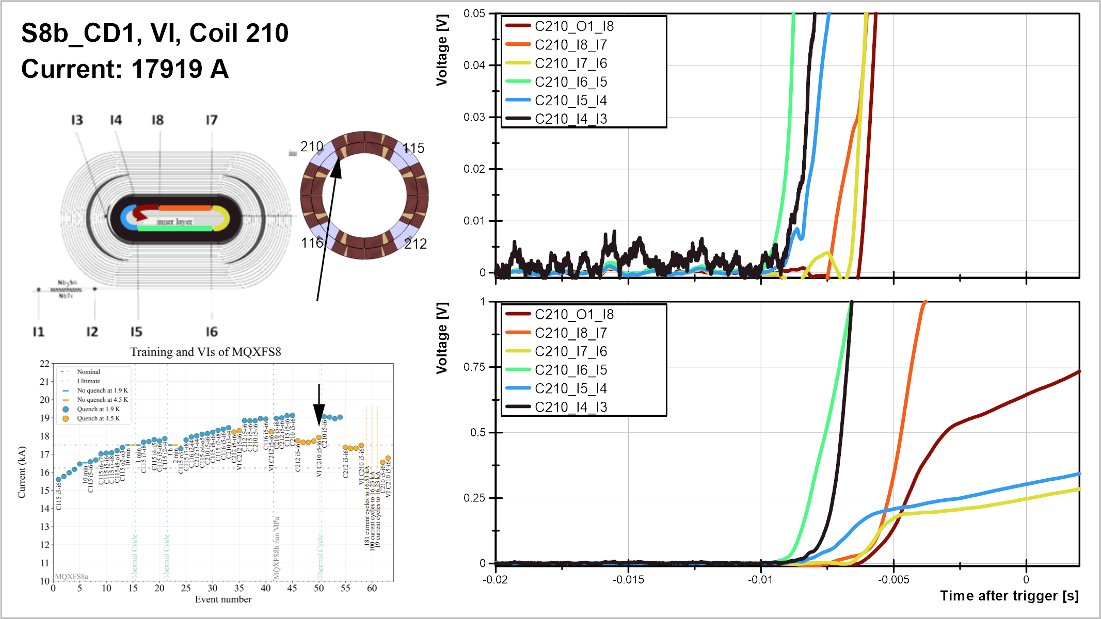

Slide 17
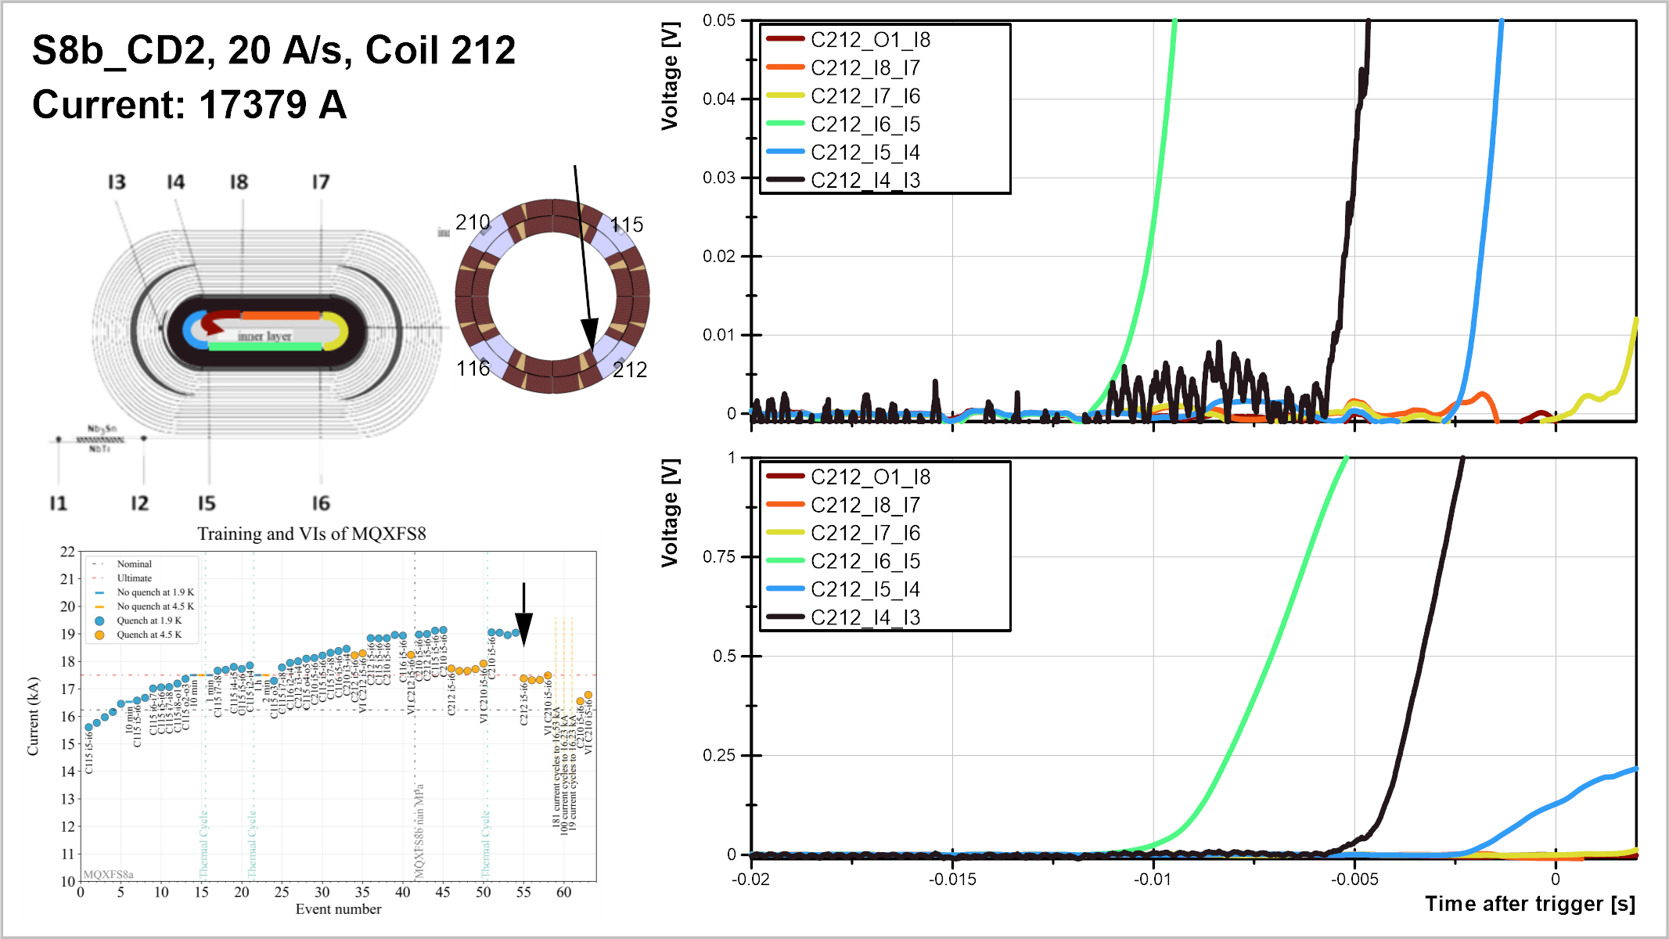

Slide 18
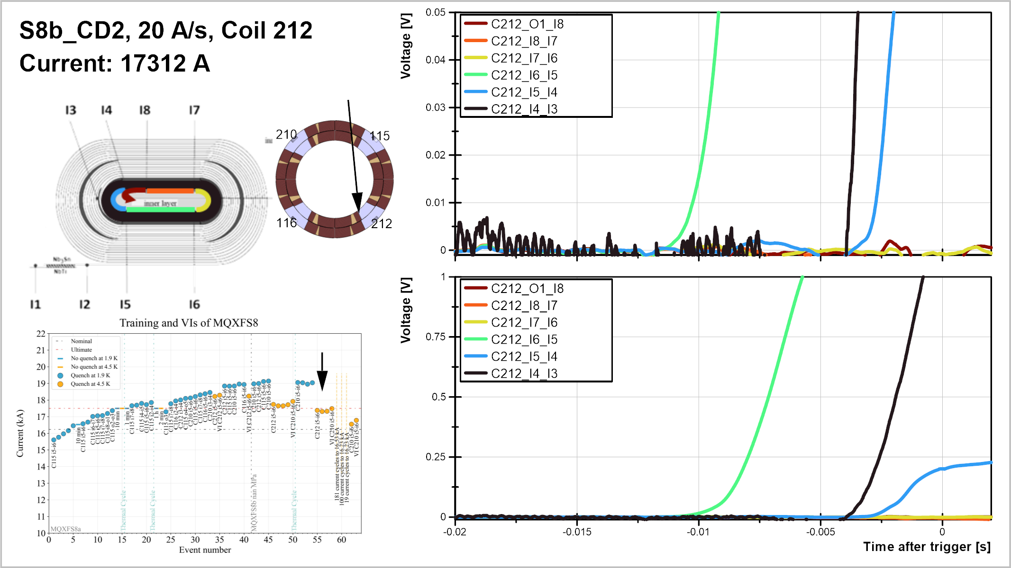

Slide 19
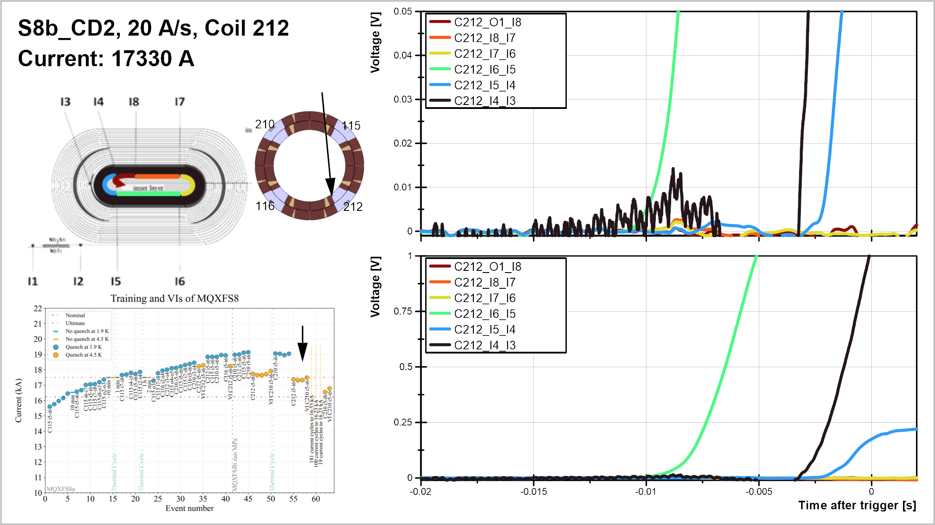

Slide 20
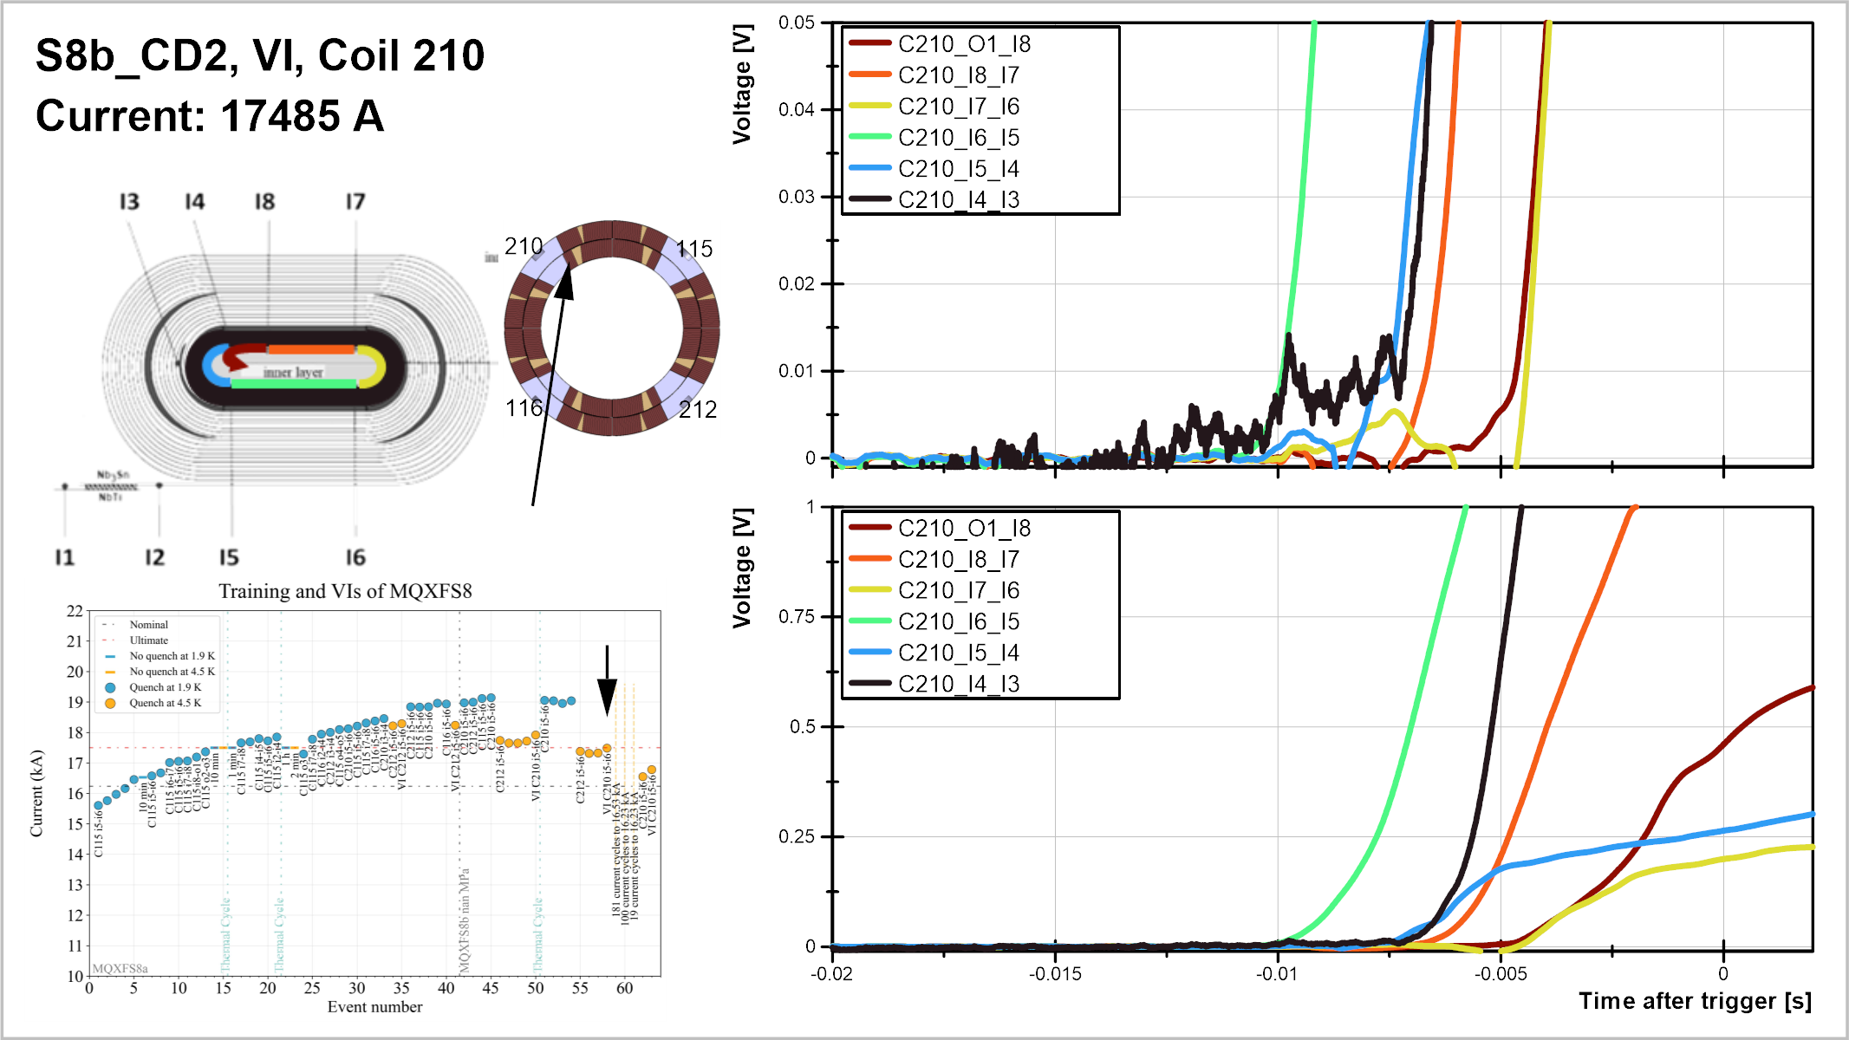

Slide 21
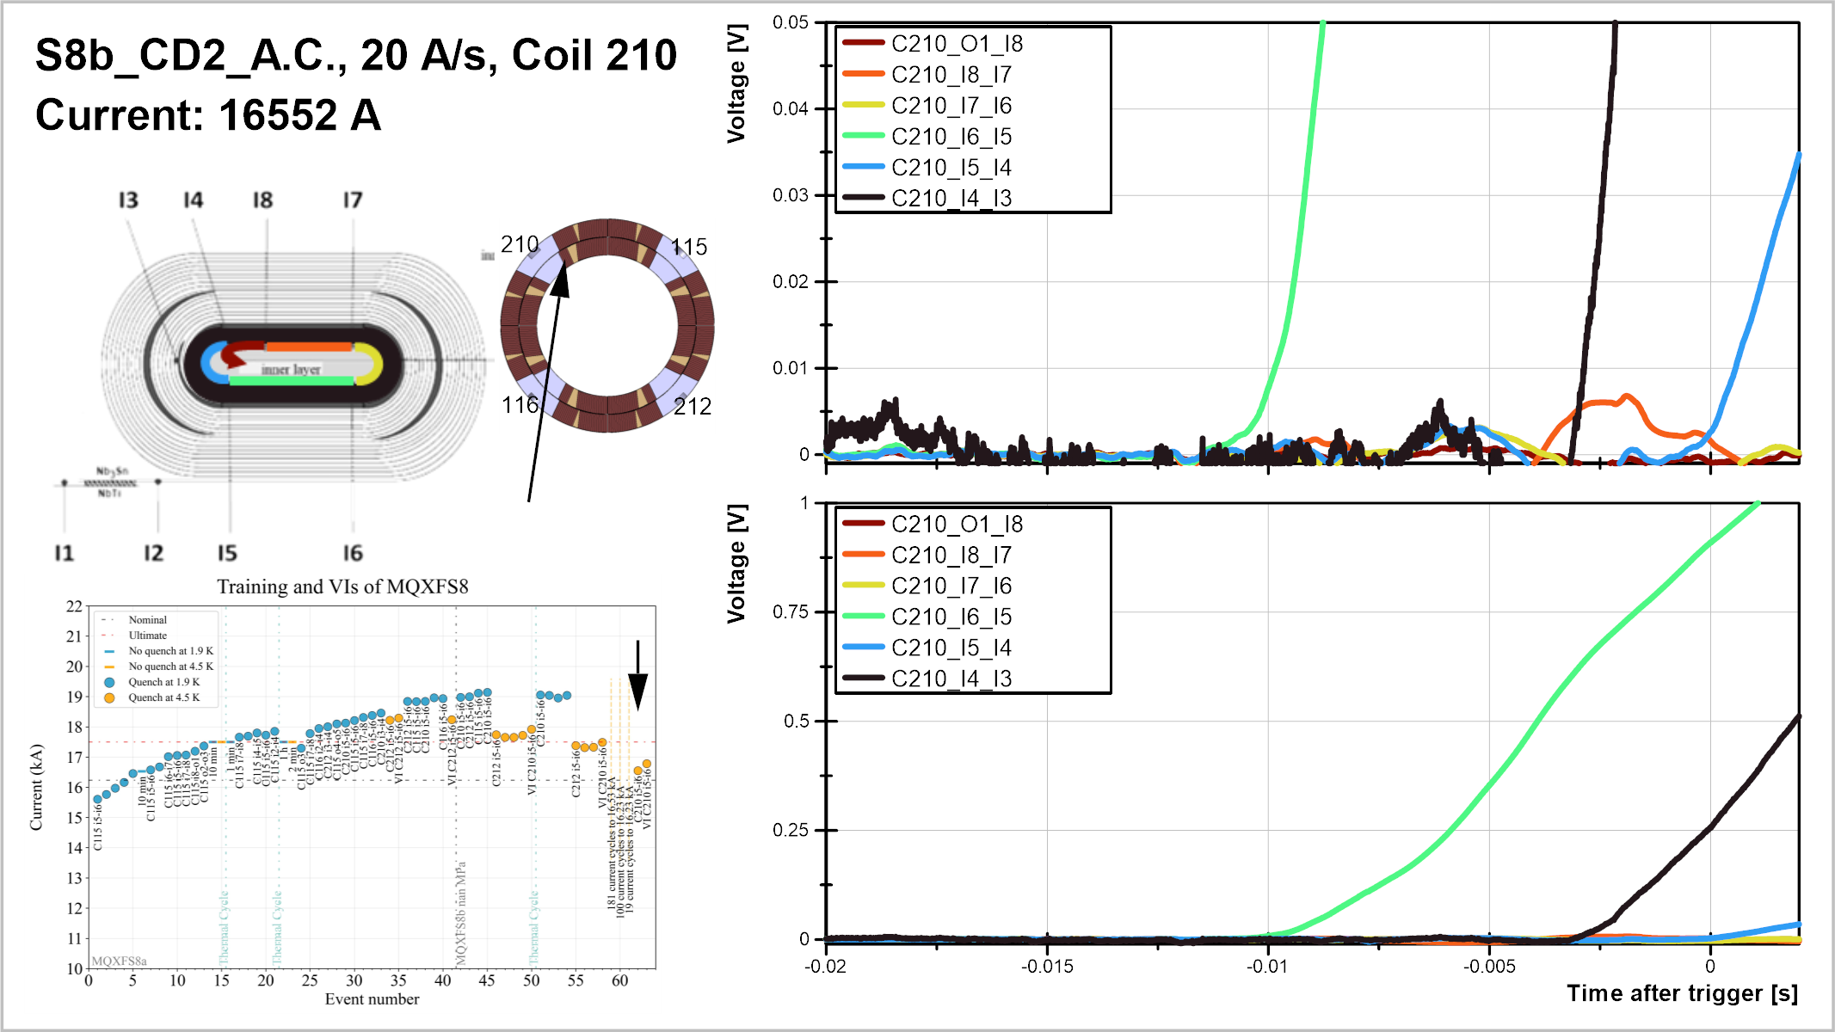

Slide 22
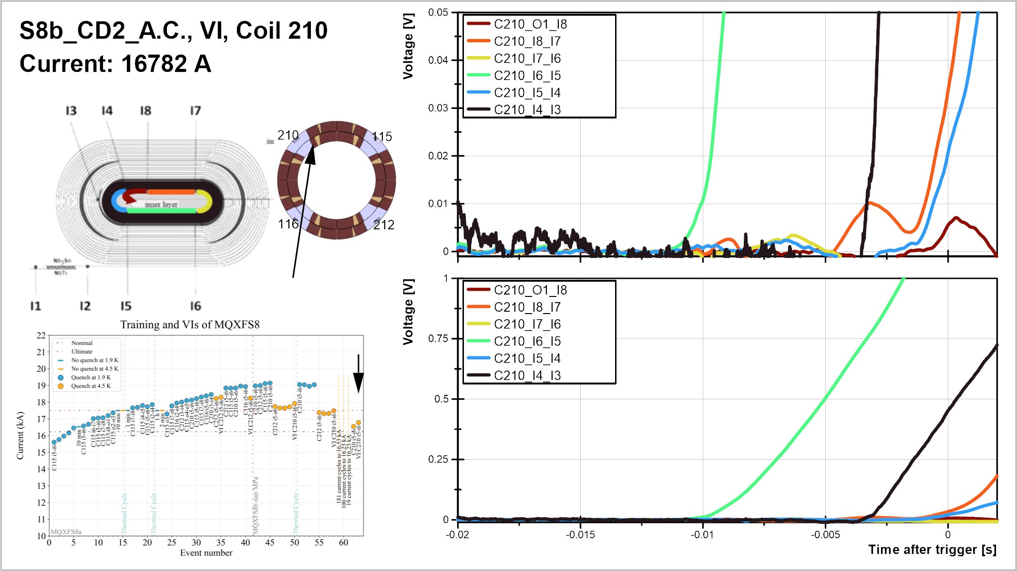

Slide 23
V-I measurements

Slide 24
V-I measurements
V-I measurements available:
  MQXFS6b: files from CD3 and CD4 used, only 210 and 212 i5-i6 and i7-i8
  MQXFS6c and 6d: one file per iteration, same channels
  MQXFS8a: last file from CD3
  MQXFS8b: one file in CD1, one in CD2 before current cycles and one after cycles.
Summary:
  Transition visible in the PIT coils, and nothing in RRP coils
  No significant change from S6 to S8a, large change from S8a to S8b, large change in S8b before/after thermal cycle, no change after current cycles
Next slides: all measured segments that reach 1 uV

