Slide 1
Drell-Yan production in universal theories beyond dimension-six SMEFT
Jay Desai
arXiv:2503.19962 Tyler Corbett, Jay Desai, O. J. P. Eboli, M. C. Gonzalez-Garcia, Matheus Martines, Peter Reimitz
Notes:
arXiv:2503.19962

Slide 2
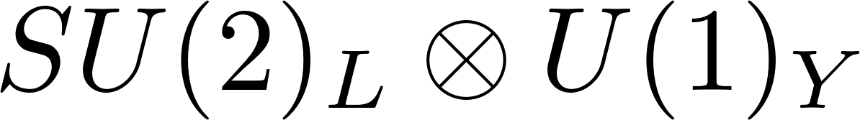
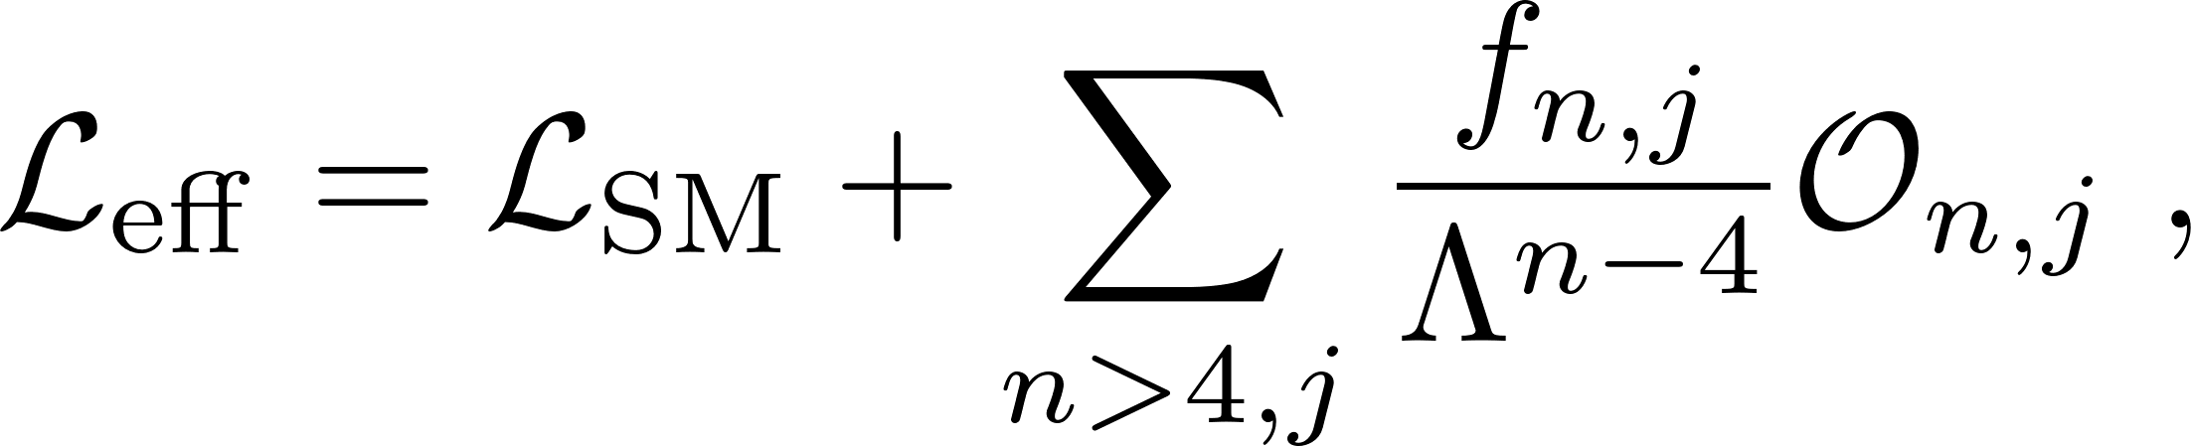
Standard Model Effective Field Theory
Under the assumption, that the scalar particle discovered in 2012 is part of an electroweak doublet, the symmetry can be linearly realized.
In SMEFT, the number of possible dimension eight operators are 44,807.
Identifying unique hypotheses that capture a sizable class of Beyond Standard Model theories while reducing the number of operators becomes important.
One such hypothesis is universality.
Notes:
where Λ is a characteristic energy scale of New Physics (NP) and On,j are higher dimension operators.
In the most general scenario, the number of dimension eight operators are prohibitively large. It precludes a general analysis.
In that case, identifying unique hypotheses that capture a sizable class of Beyond Standard Model theories while reducing the number of relevant operators becomes important. One such hypothesis is universality.

Slide 3
Universal SMEFT (USMEFT)
Universal theories refer to BSM scenarios where the New Physics (NP) either dominantly couples to SM bosons or if it couples to fermions, it does so via SM currents.
At dimension six, under the assumption of C and P conserving physics, there are 16 operators*.
In our previous work**, we presented the basis for USMEFT at dimension-eight consisting of 175 operators without imposing C nor P.
*J.D. Wells and Z. Zhang arxiv:1510.08462 [hep-ph]
**T. Corbett, J. Desai, O.J.P. Eboli, and M.C. Gonzalez-Garcia arxiv:2404.03720 [hep-ph]
Notes:
Allowing one to express the EFT exclusively in terms of bosonic operators.
And the basis was presented in the work by Wells and Zhang.

Slide 4
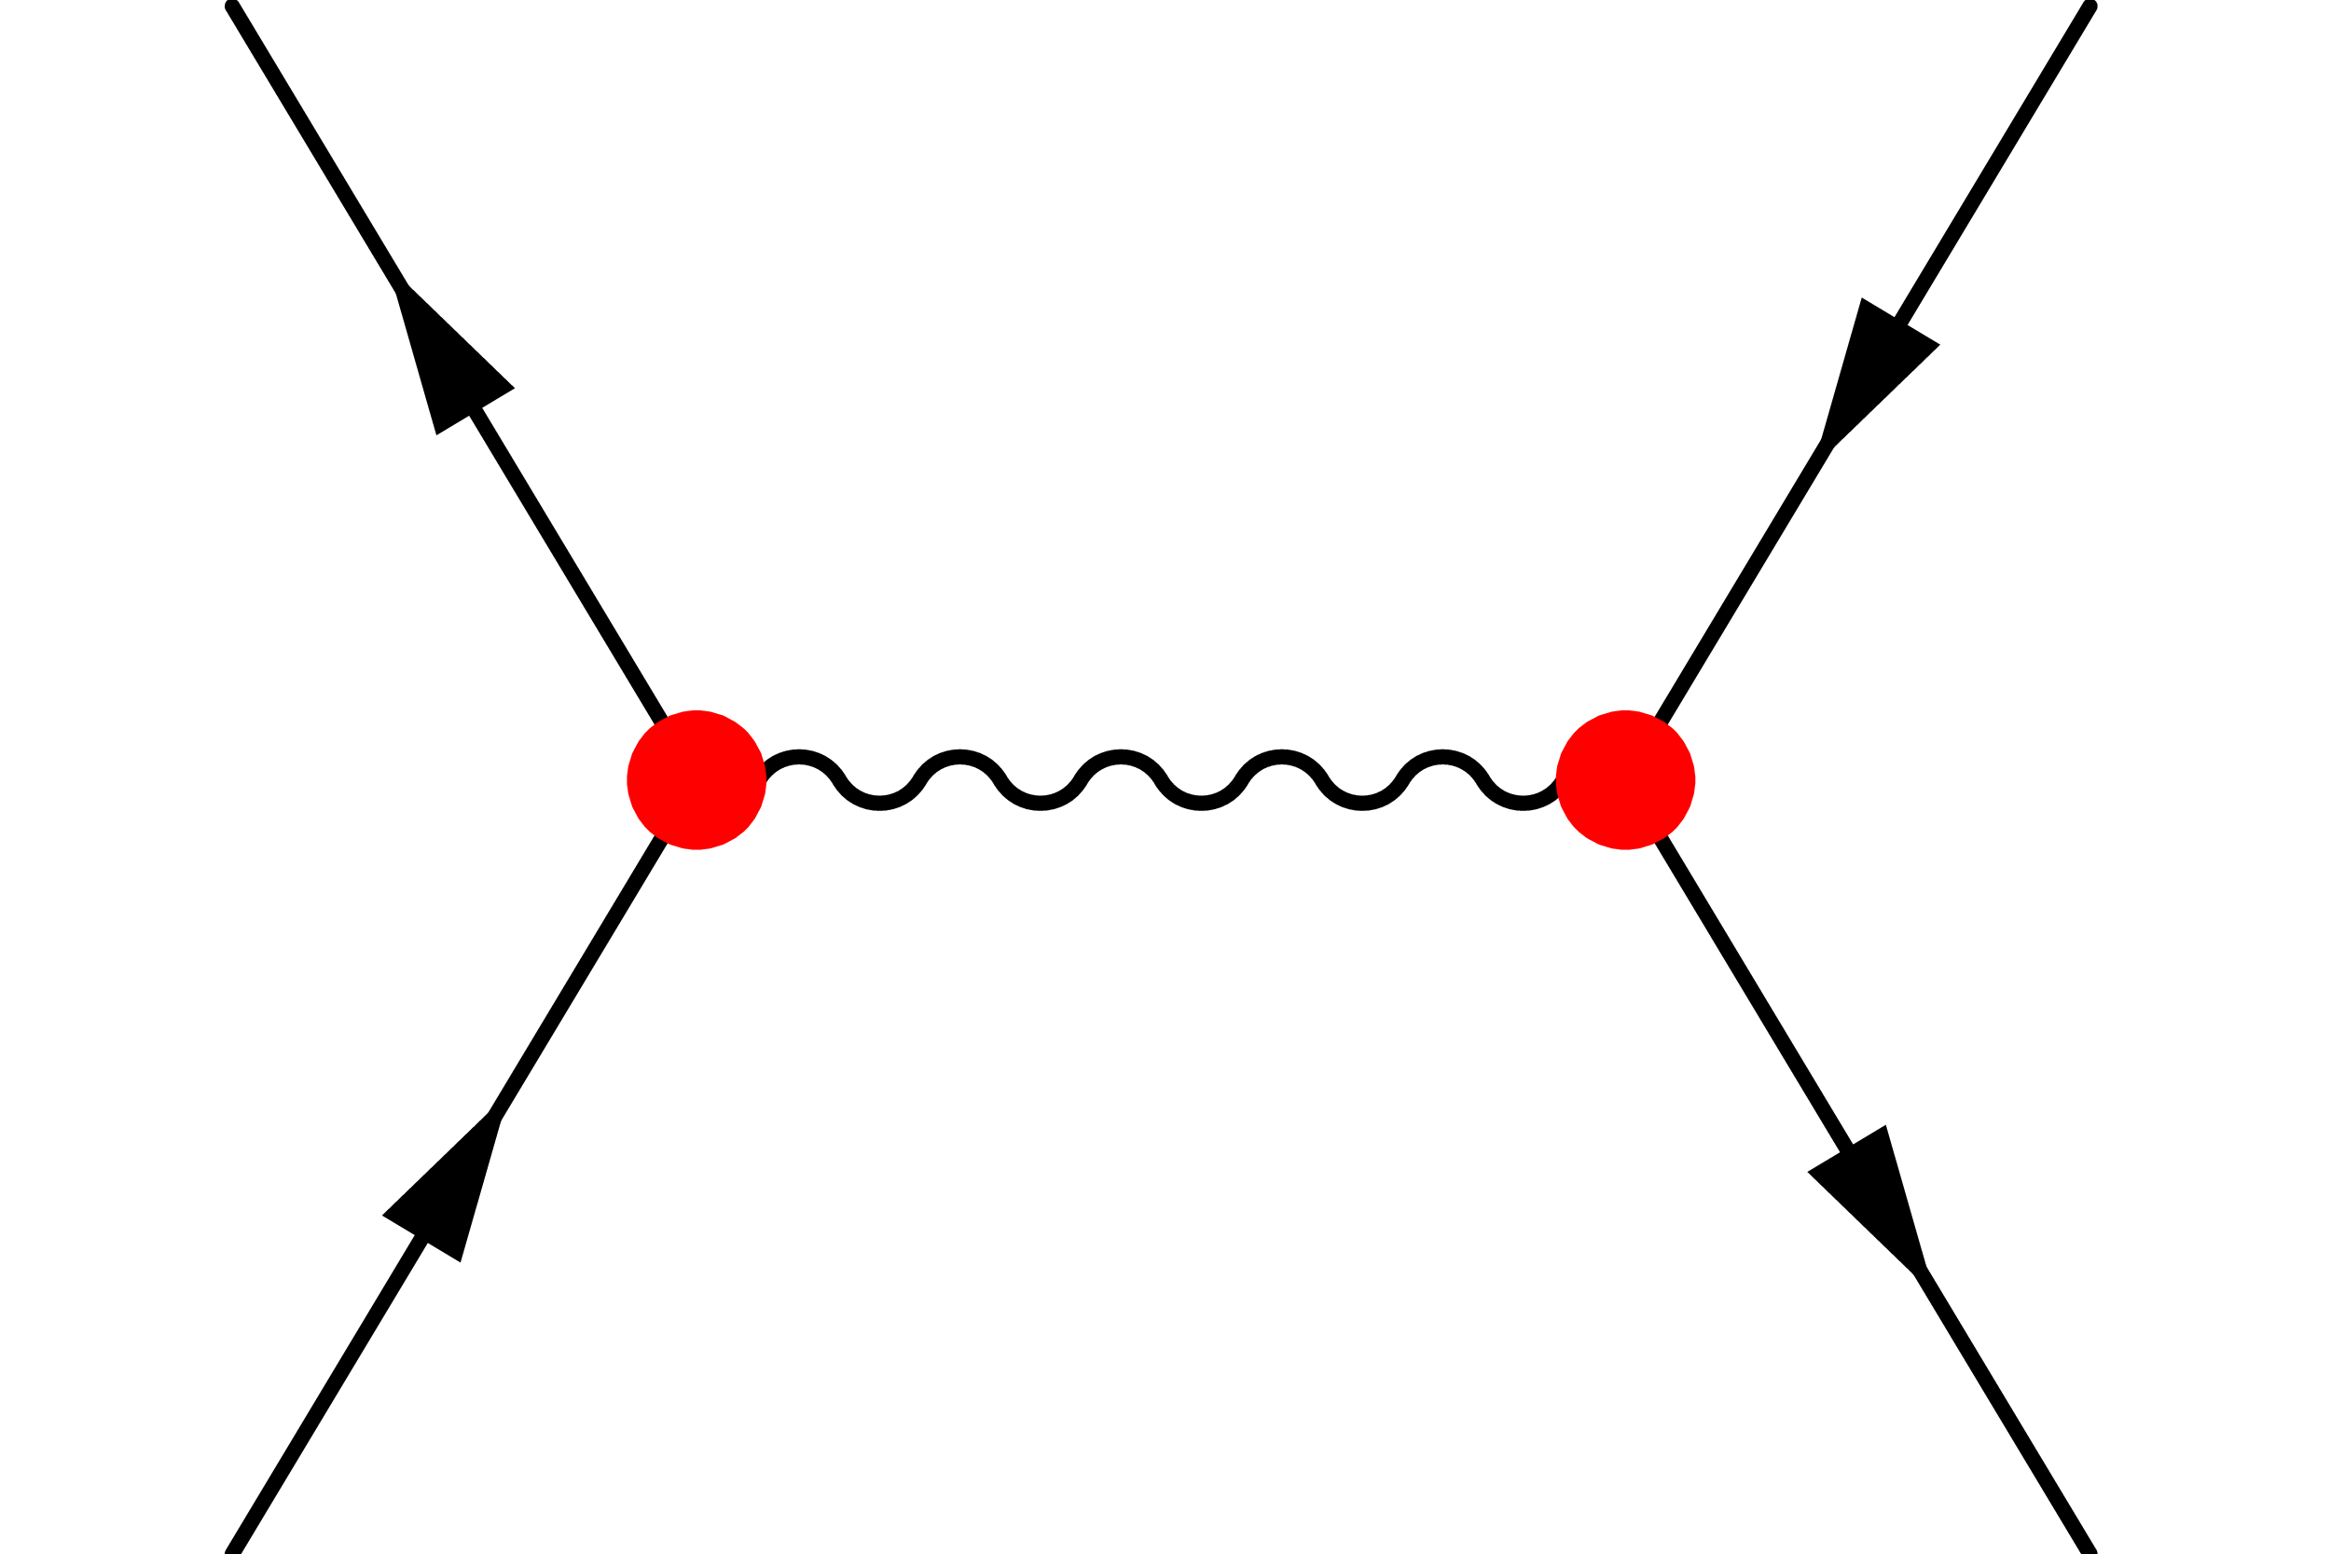
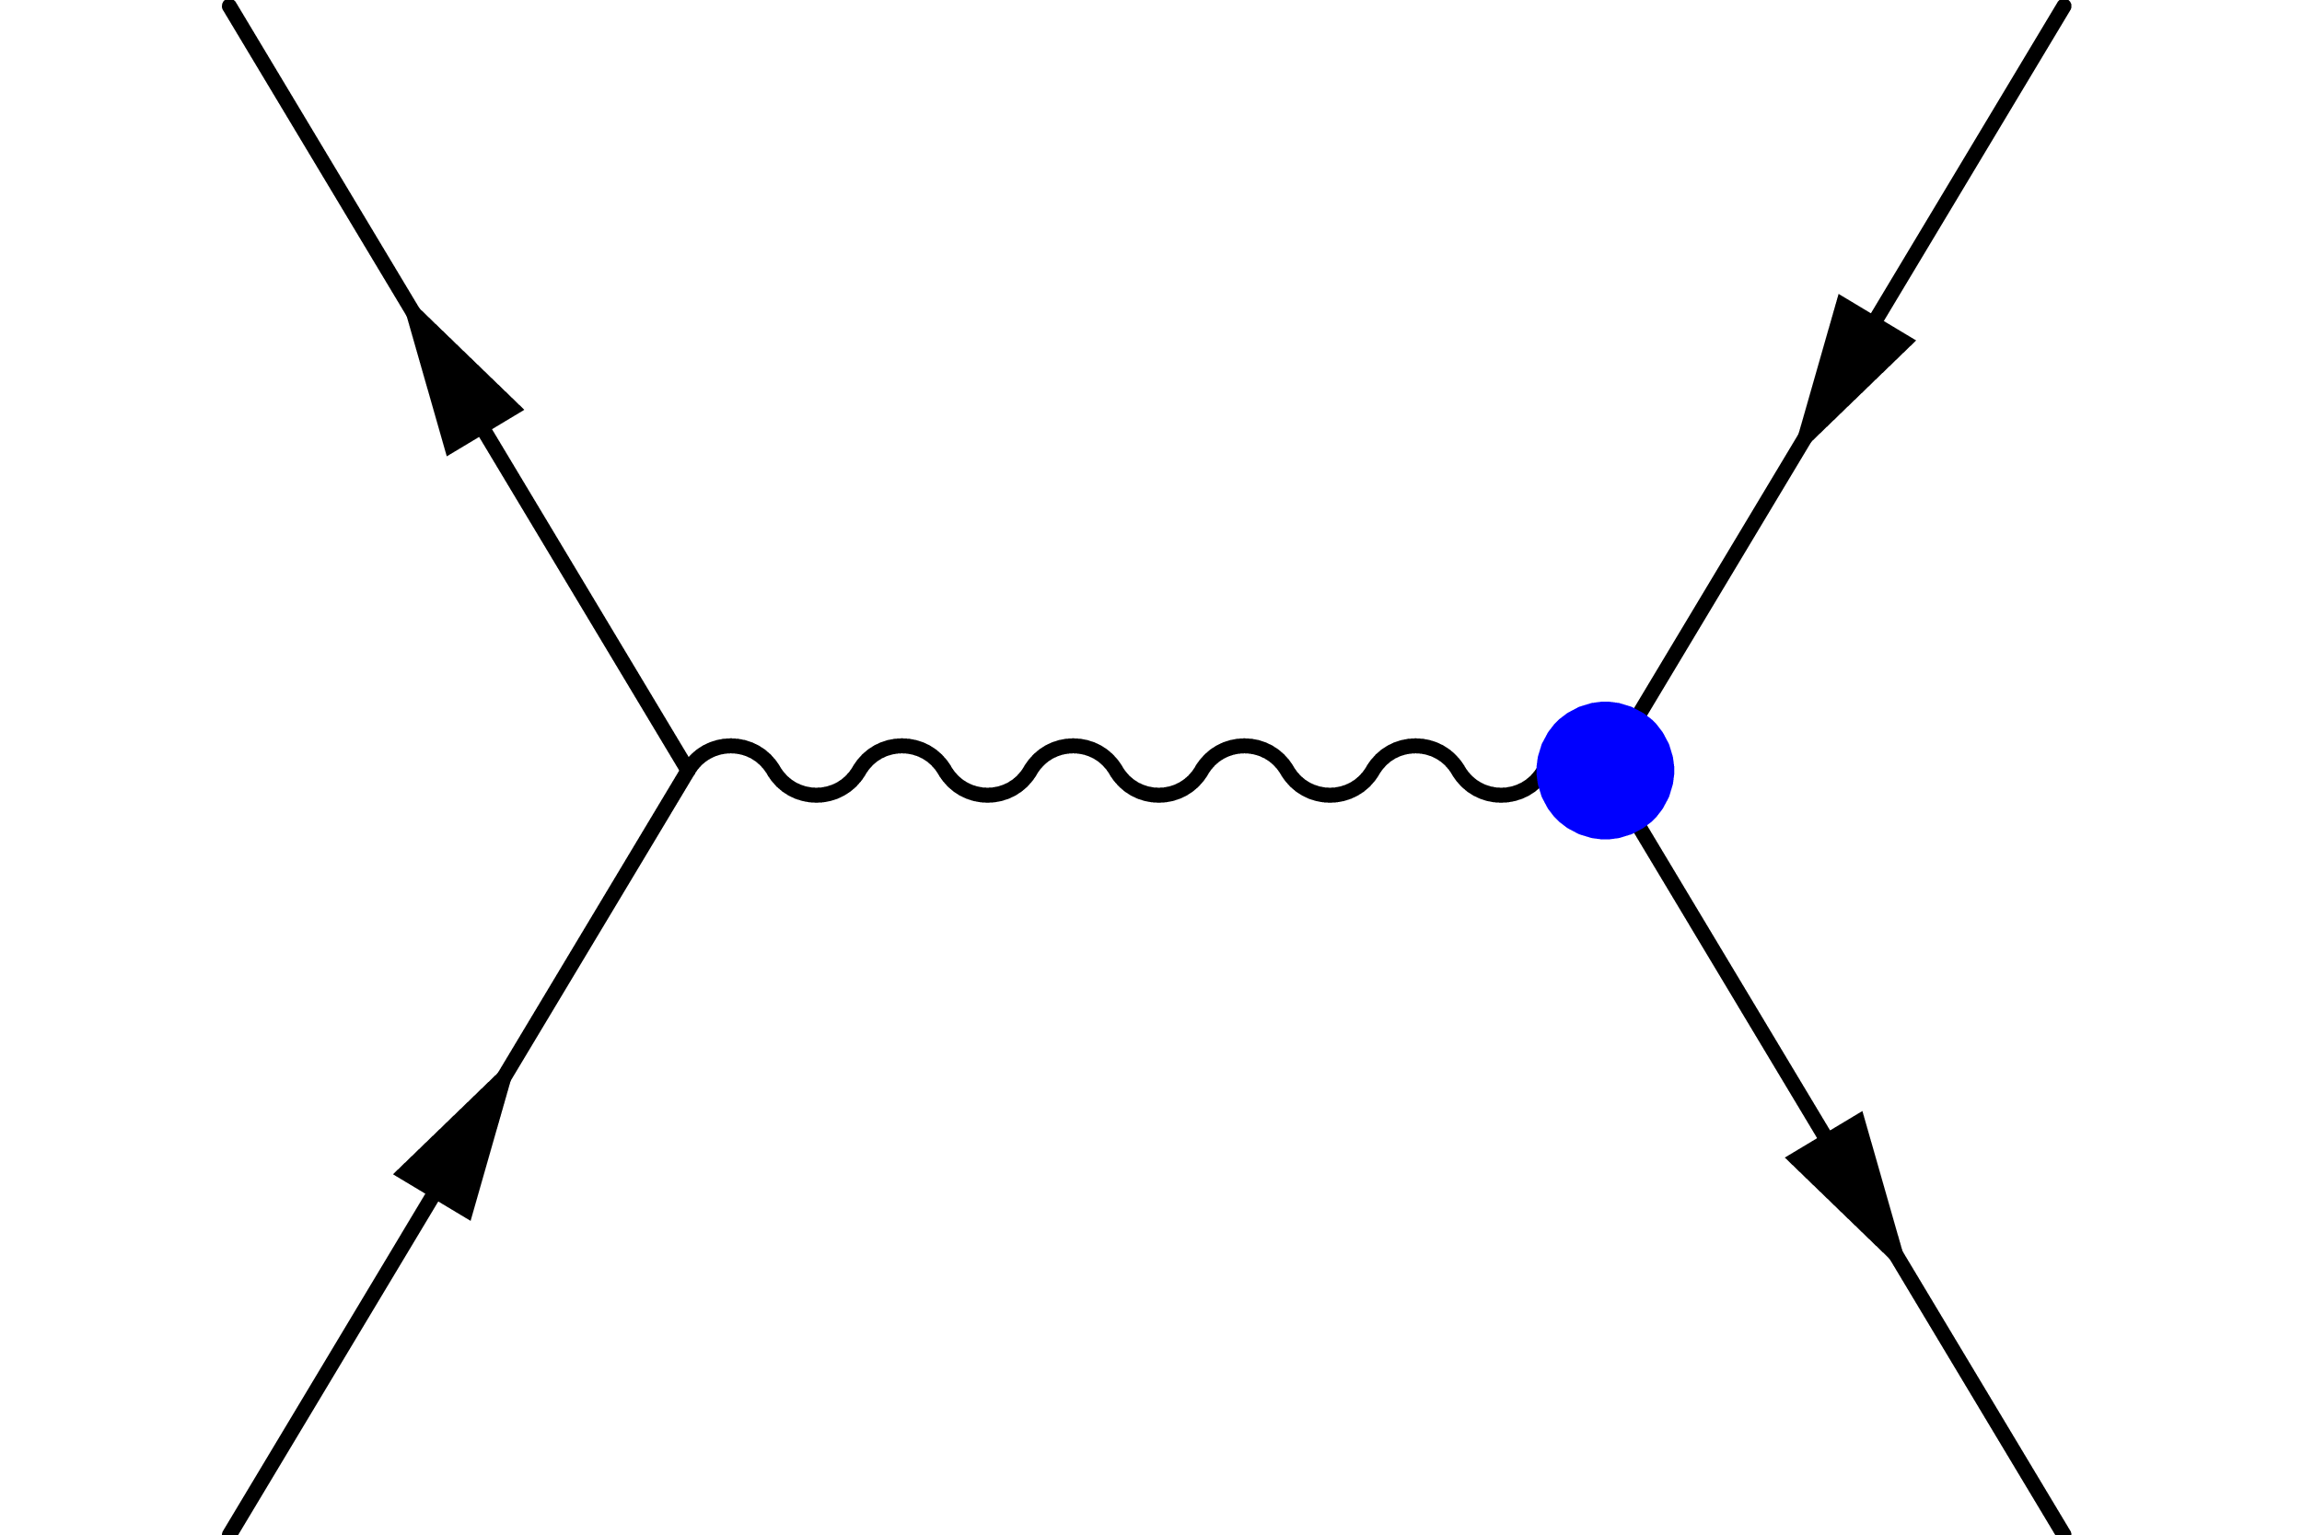
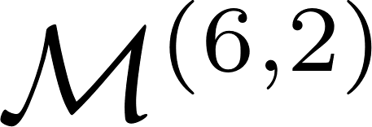

Observables in SMEFT
Within the SMEFT, to consistently include the corrections to observables at$𝒪(Λ^{−4})$ requires
insertion of dim-6 operator
insertion of dim-8 operator
Notes:
evaluating the SM contributions, the interference
between the 1/Λ2 amplitude (M(6)) with the SM amplitude, the square of the dimension-six amplitude, as
well as the interference of the 1/Λ4 amplitude with the SM.
M(8) includes amplitudes with one dimension-eight operator coefficient while M(6,2) includes the contribution of the
insertion of two dimension-six Wilson coefficients in the amplitude.

Slide 5
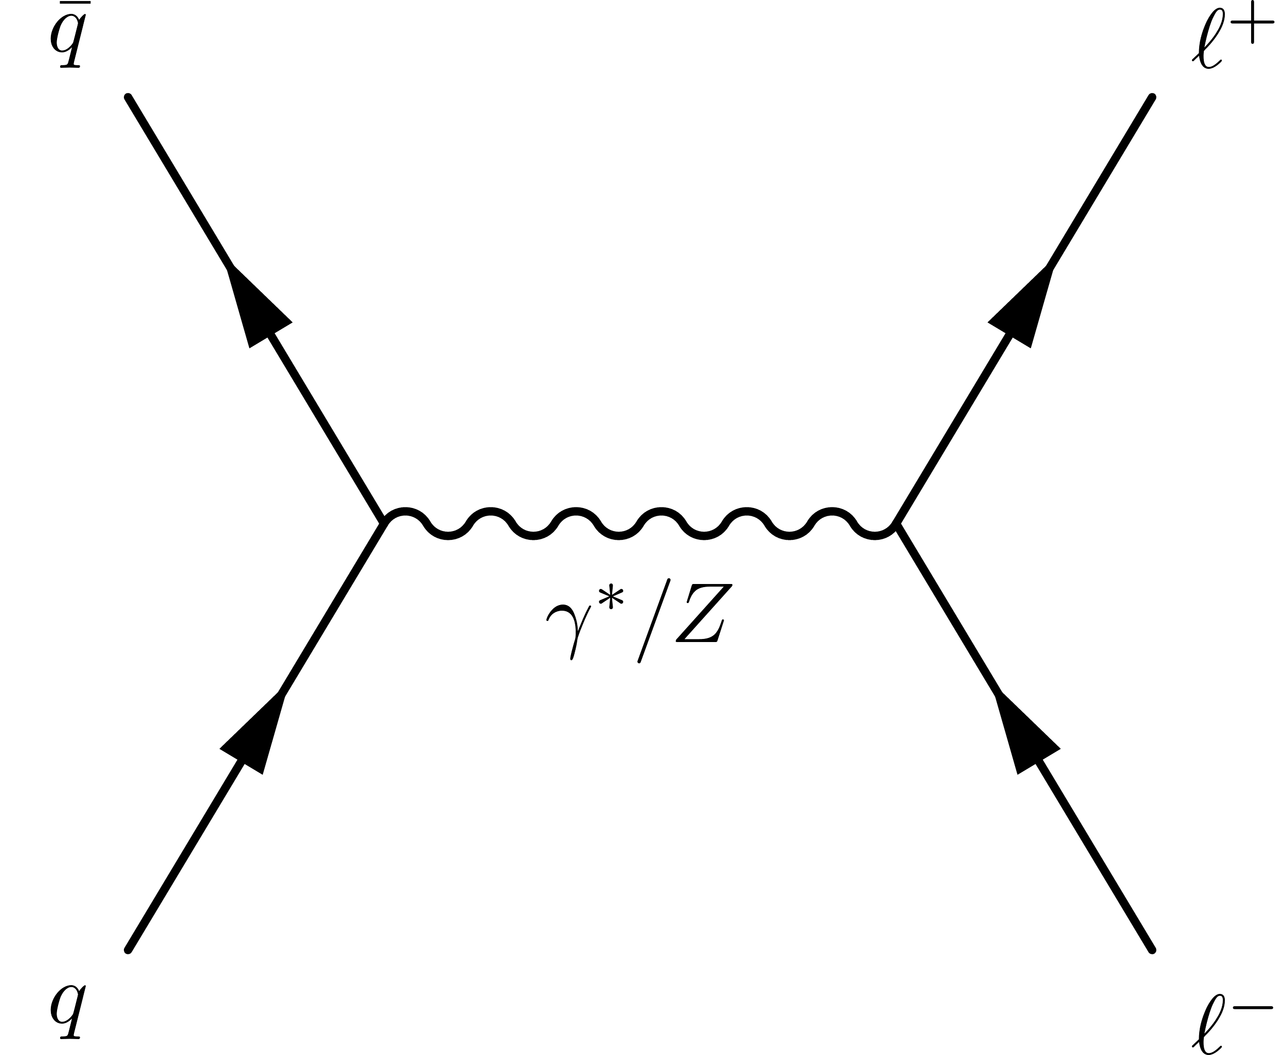
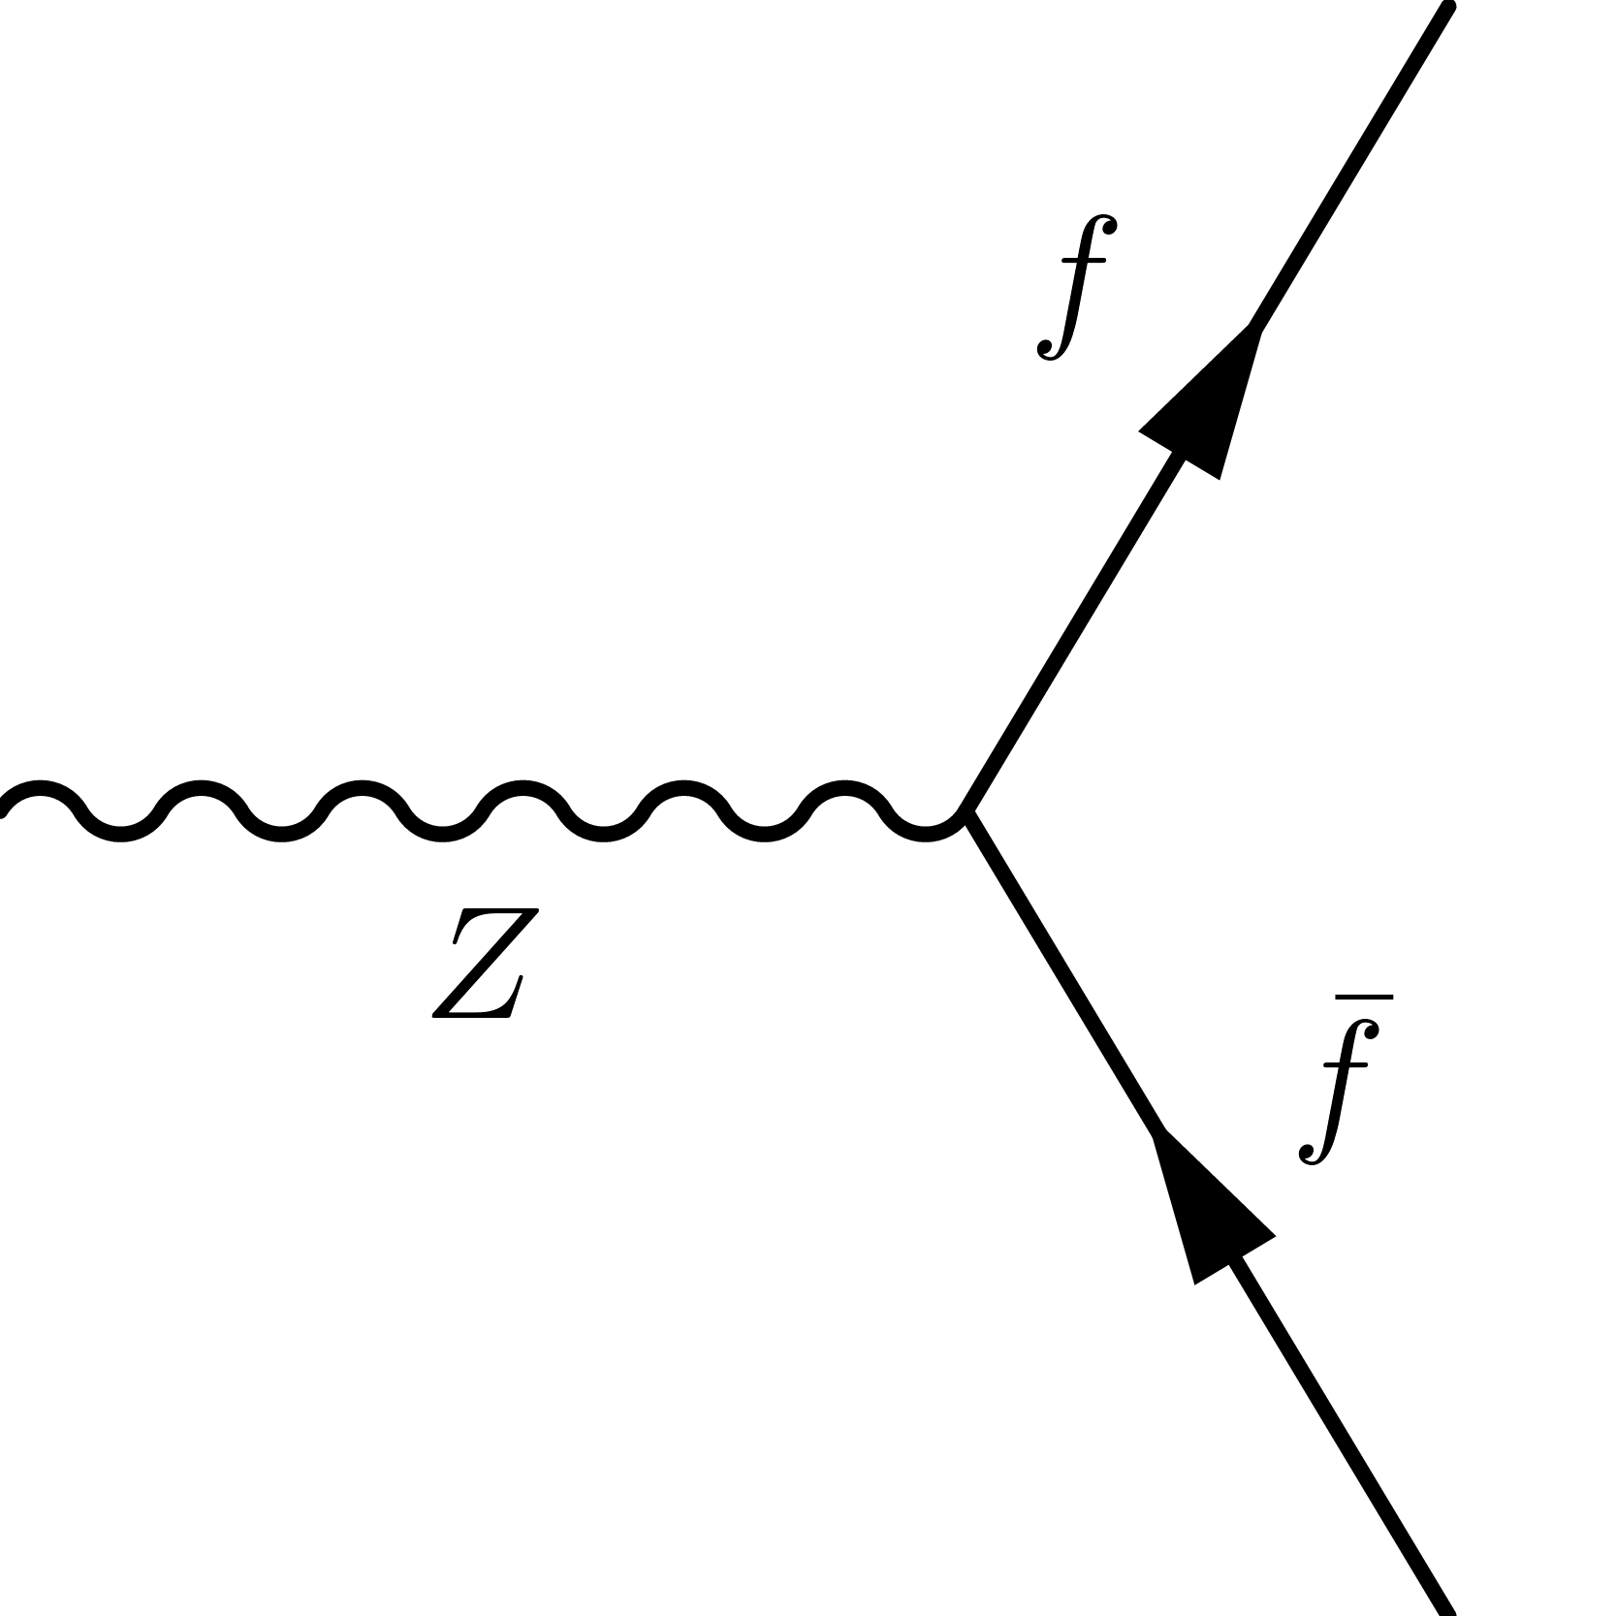
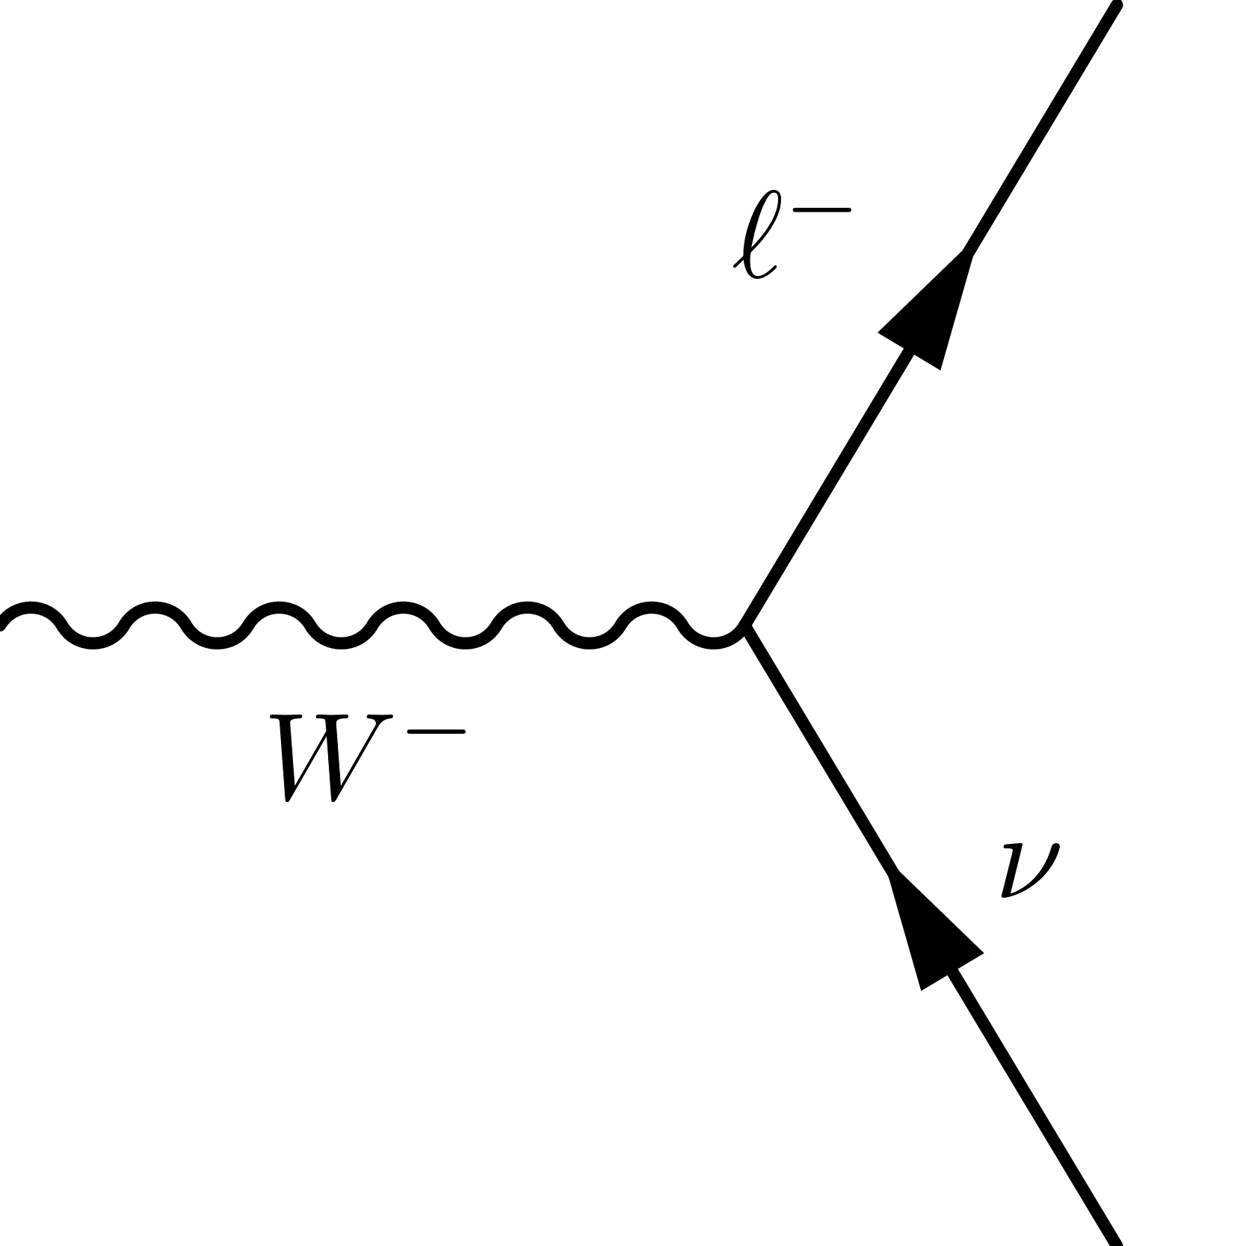
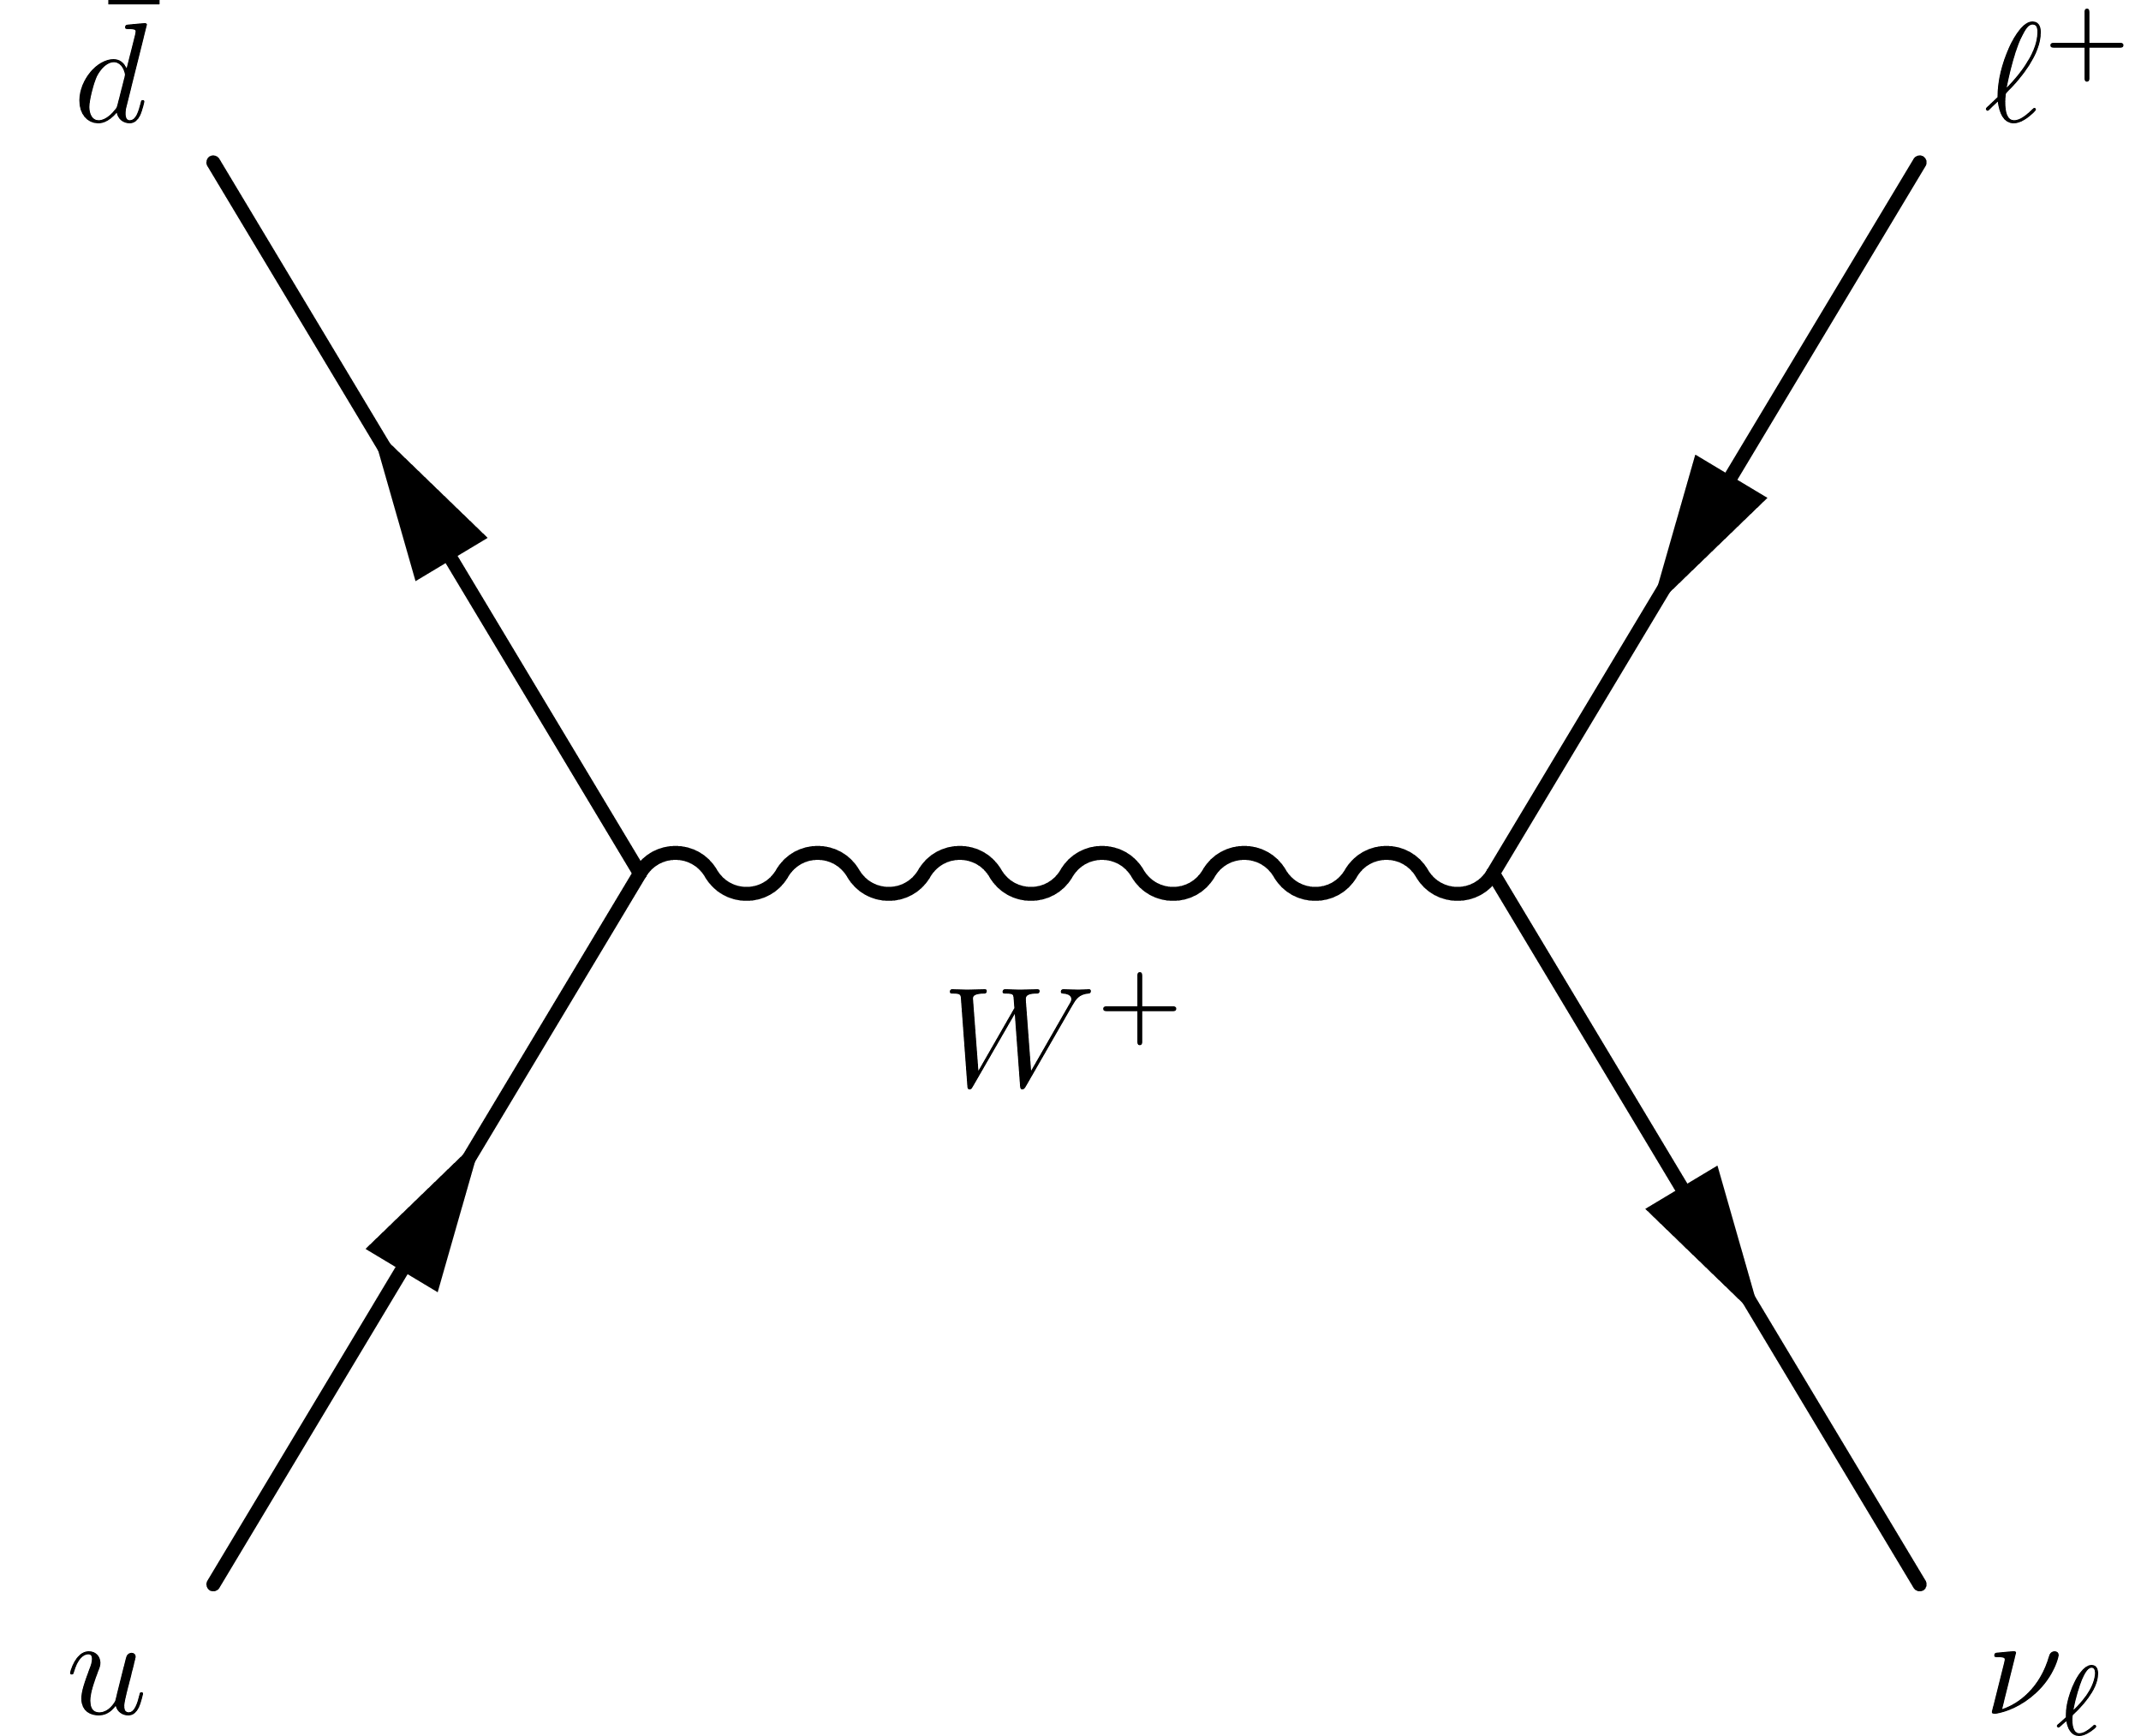
Drell Yan
Electroweak Precision
Z-pole observables
Neutral-Current
W-pole observables
Charged-Current
Notes:
The observables that we consider are Drell Yan where we include both the Neutral current and Charged current processes. In SMEFT, the higher dimension operators also introduce 4 fermion contact terms. We also include Electroweak precision where we include Z-pole and W-pole observables.

Slide 6
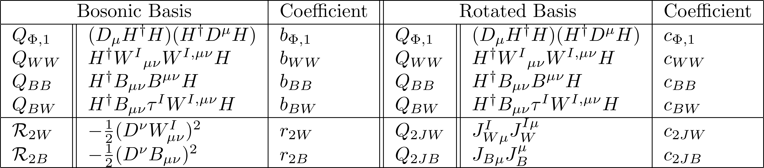
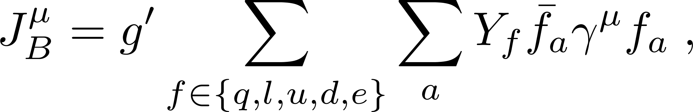
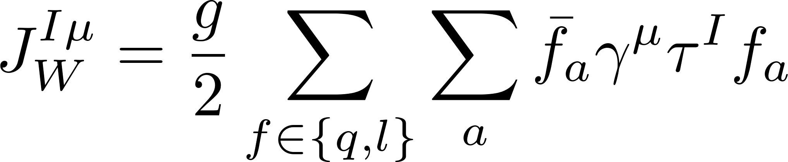
Relevant dimension-six operators
We identify six independent bosonic operators contributing to the weak boson propagators.
Using classical equations of motion, we trade two bosonic operators for operators involving fermions in the combination of SM currents.
Notes:
The 4 operators at the top are the same for both the basis, just to clarify we call the Wilson coefficients of the bosonic basis as b_i.

Slide 7
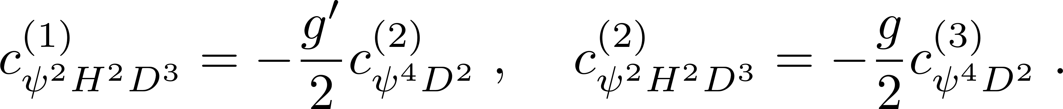
Relevant dimension-eight operators
3
8
10
Notes:
On the left hand side we show the bosonic basis. Here there are total 11 bosonic operators, 8 out of which contain operators involving higher derivatives, and they can be traded with operators involving fermions to go to the rotated basis. In the rotated basis, we find 10 fermionic operators that contribute to the processes.
We find two universality relations between the Wilson coefficients of the rotated basis from the equations of motion

Slide 8
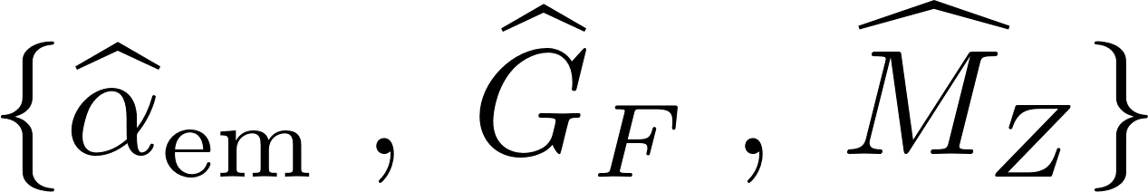
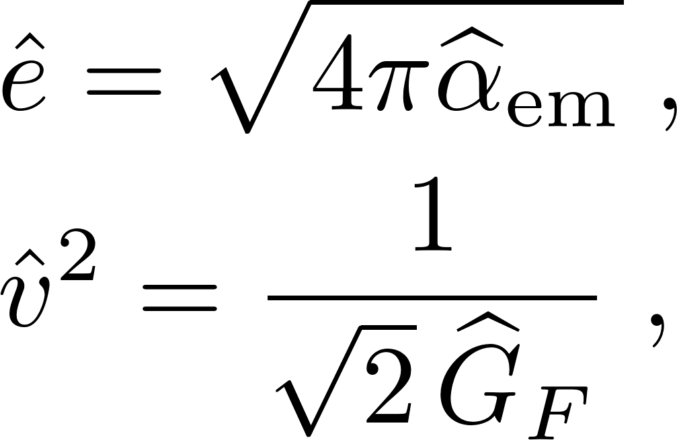
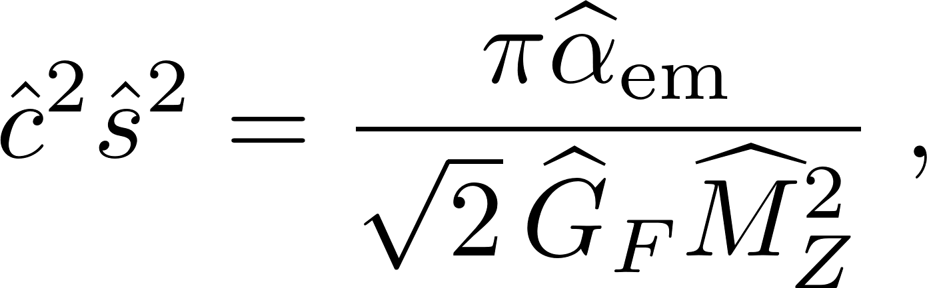
Corrections to Drell-Yan amplitudes
We have identified six dimension-six and eleven dimension-eight operators entering the Drell-Yan production in USMEFT.
We evaluate the corresponding event rates using standard numerical tools, and for that regard it is convenient to work in the rotated basis.
We adopt as input parameters
Notes:
To consistently include the new effects into realistic simulations of the experimental observables up to order $𝒪(Λ^{−4})$ .
I will also talk about how to compute those corrections in the bosonic basis using the Oblique parameters as well, just for the sake of completeness

Slide 9
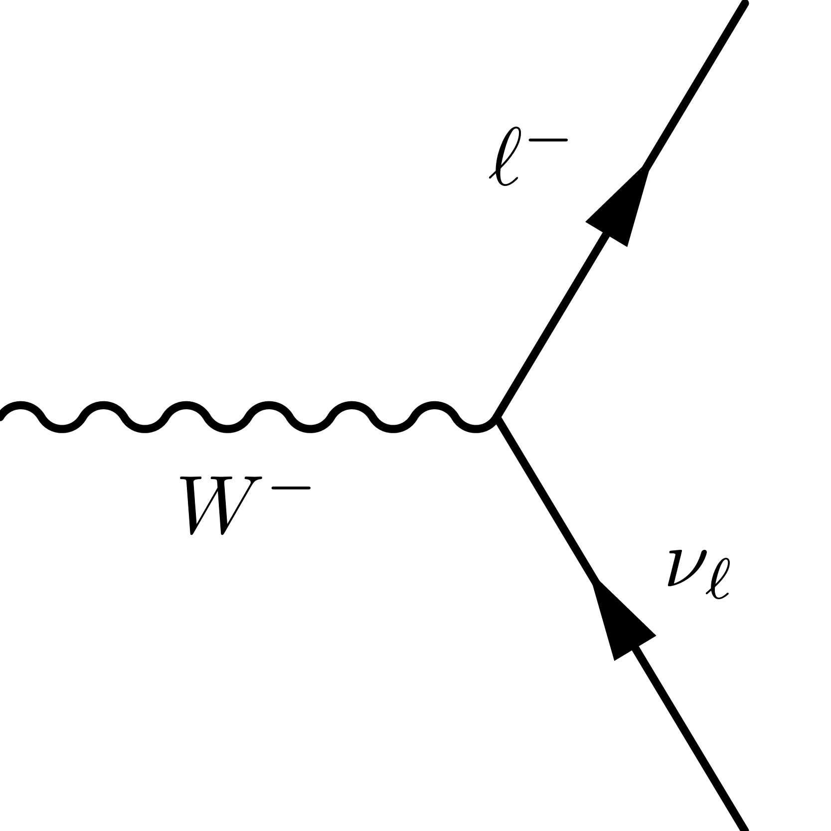
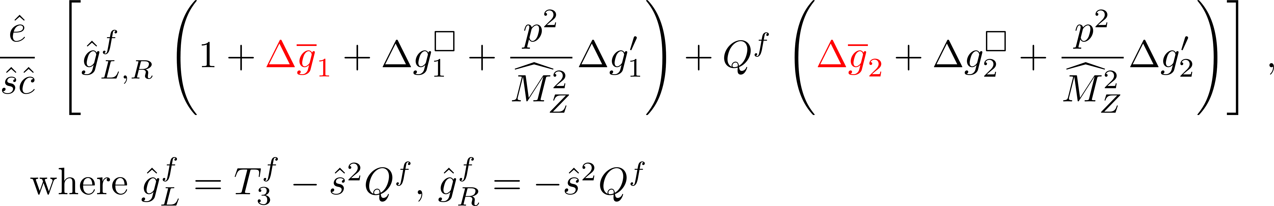
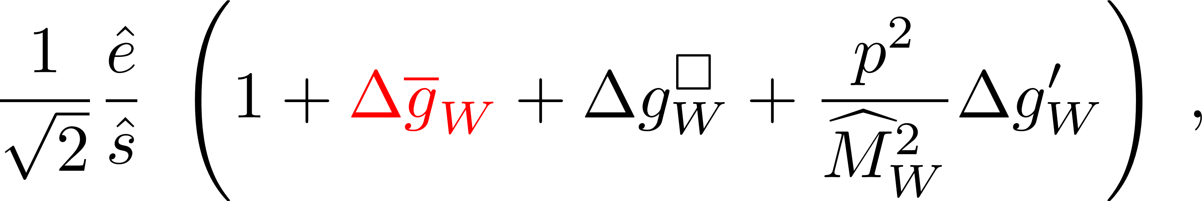
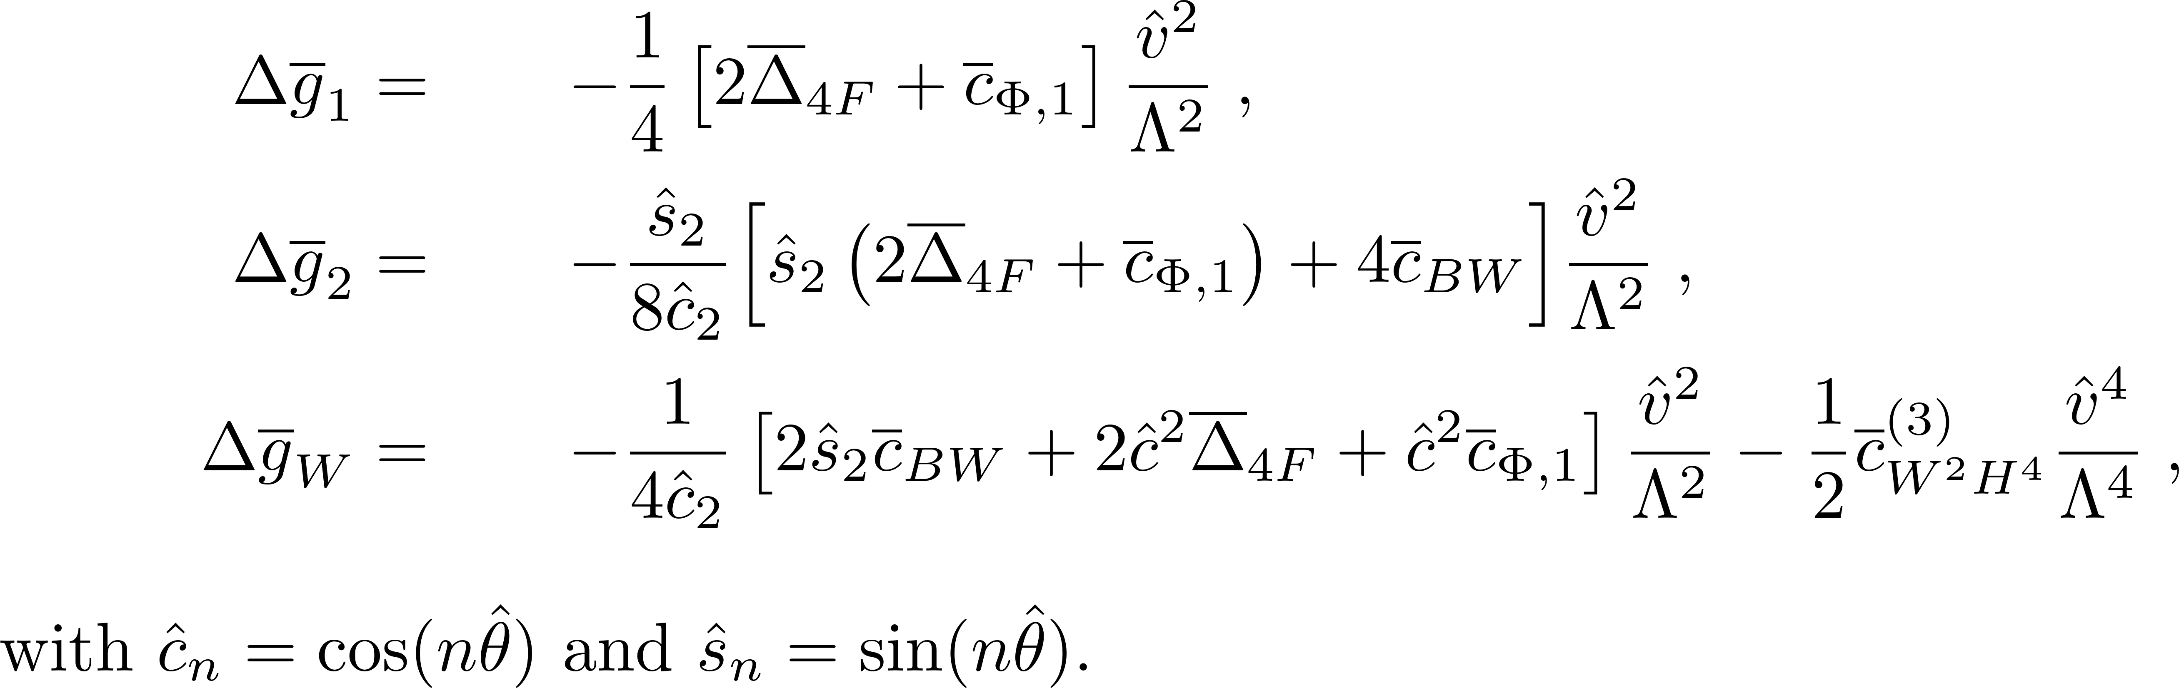
Corrections to Z and W couplings
Dimension-six at leading order
Notes:
After finite renormalization of the SM inputs and accounting for the direct contributions from the fermionic dimension-eight operators containing two fermion fields, we parametrize the Z and W couplings
Hats show that they are directly computed from the input parameters.
The $Δ{\overline{g}}_{1,2,W}$ pieces contain corrections that are dimension-six at leading order in terms of these effective combinations

Slide 10
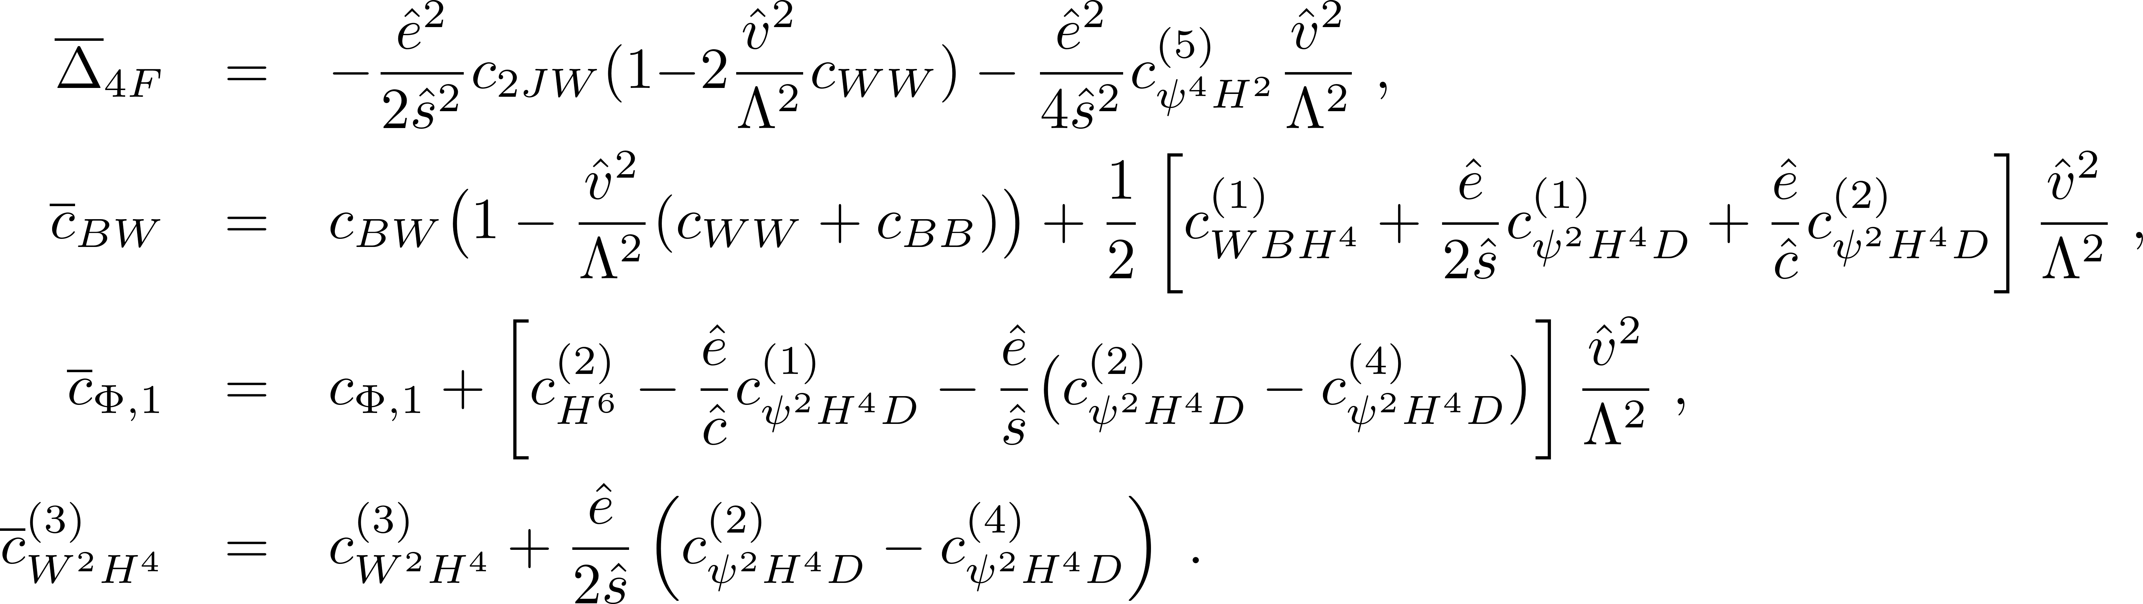
Corrections to Z and W couplings
Includes additional dimension-eight operators that are only resolvable with Higgs observables
Notes:
The effective combinations are dimension-six at leading order with additional overall renormalization contributions from operators $Q_{WW}$ and $Q_{BB}$, as well as dimension-eight operators that are only resolvable with Higgs observables

Slide 11
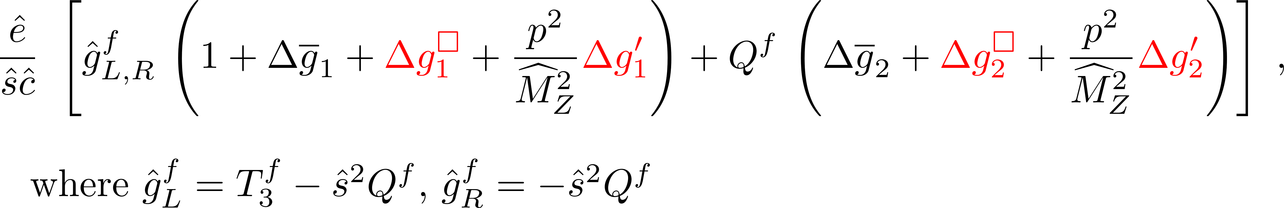
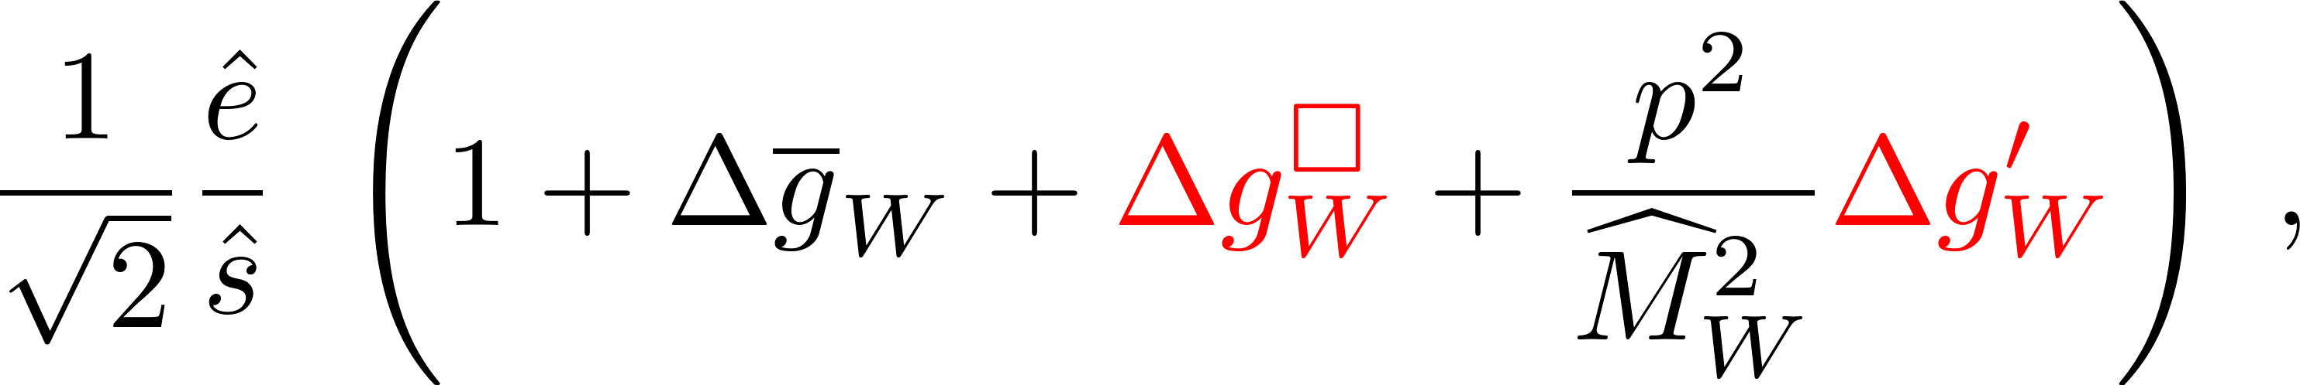
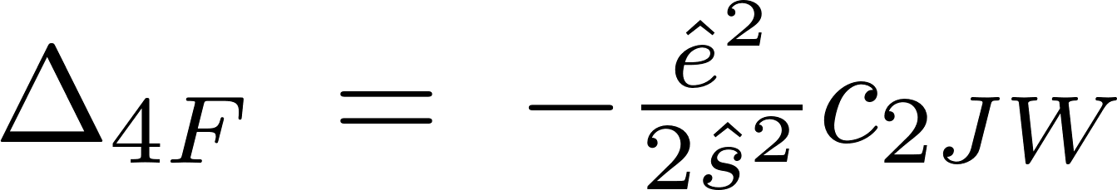
Corrections to Z and W couplings
quadratic pieces
momentum dependent
Notes:
We also have additional pieces like \Delta g1 square that contains the pieces quadratic in dimension-six Wilson coefficients and Delta g1prime consists of the WCs of the momentum dependent operators
Delta 4F parametrizes the fermionic operators that contribute to the muon decay width.

Slide 12
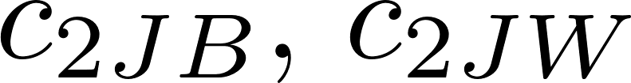
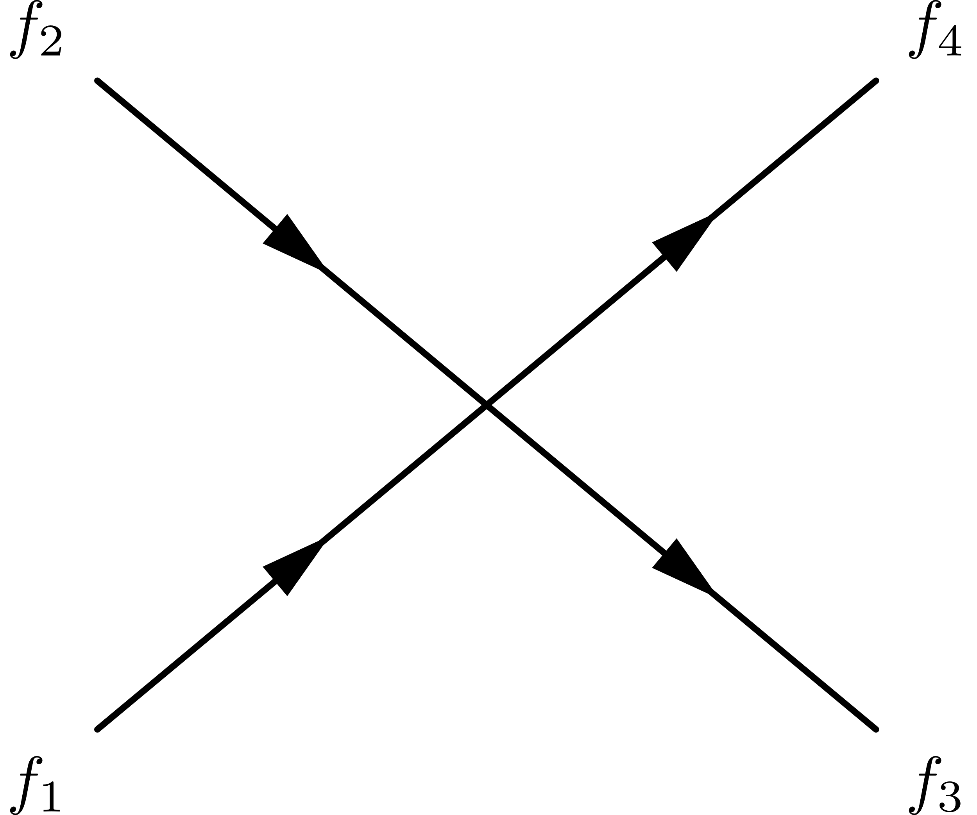
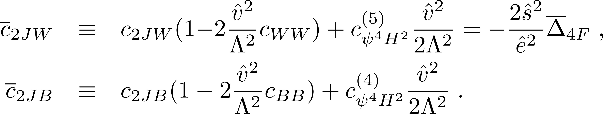
Four-fermion contact amplitudes
In addition to the corrections to Z and W couplings, there are seven contact contributions to four-fermion amplitudes in the rotated basis.
  two at dimension six:
  five at dimension eight:
We find that the four-fermion contact amplitudes depend upon the two combinations
Notes:
First two are the four-fermion operators involving higher derivatives analogous to c2JB and c2JW, the next two are the analogues with two higgs. The 7 is the one with one U(1) current and one SU(2) current.

Slide 13
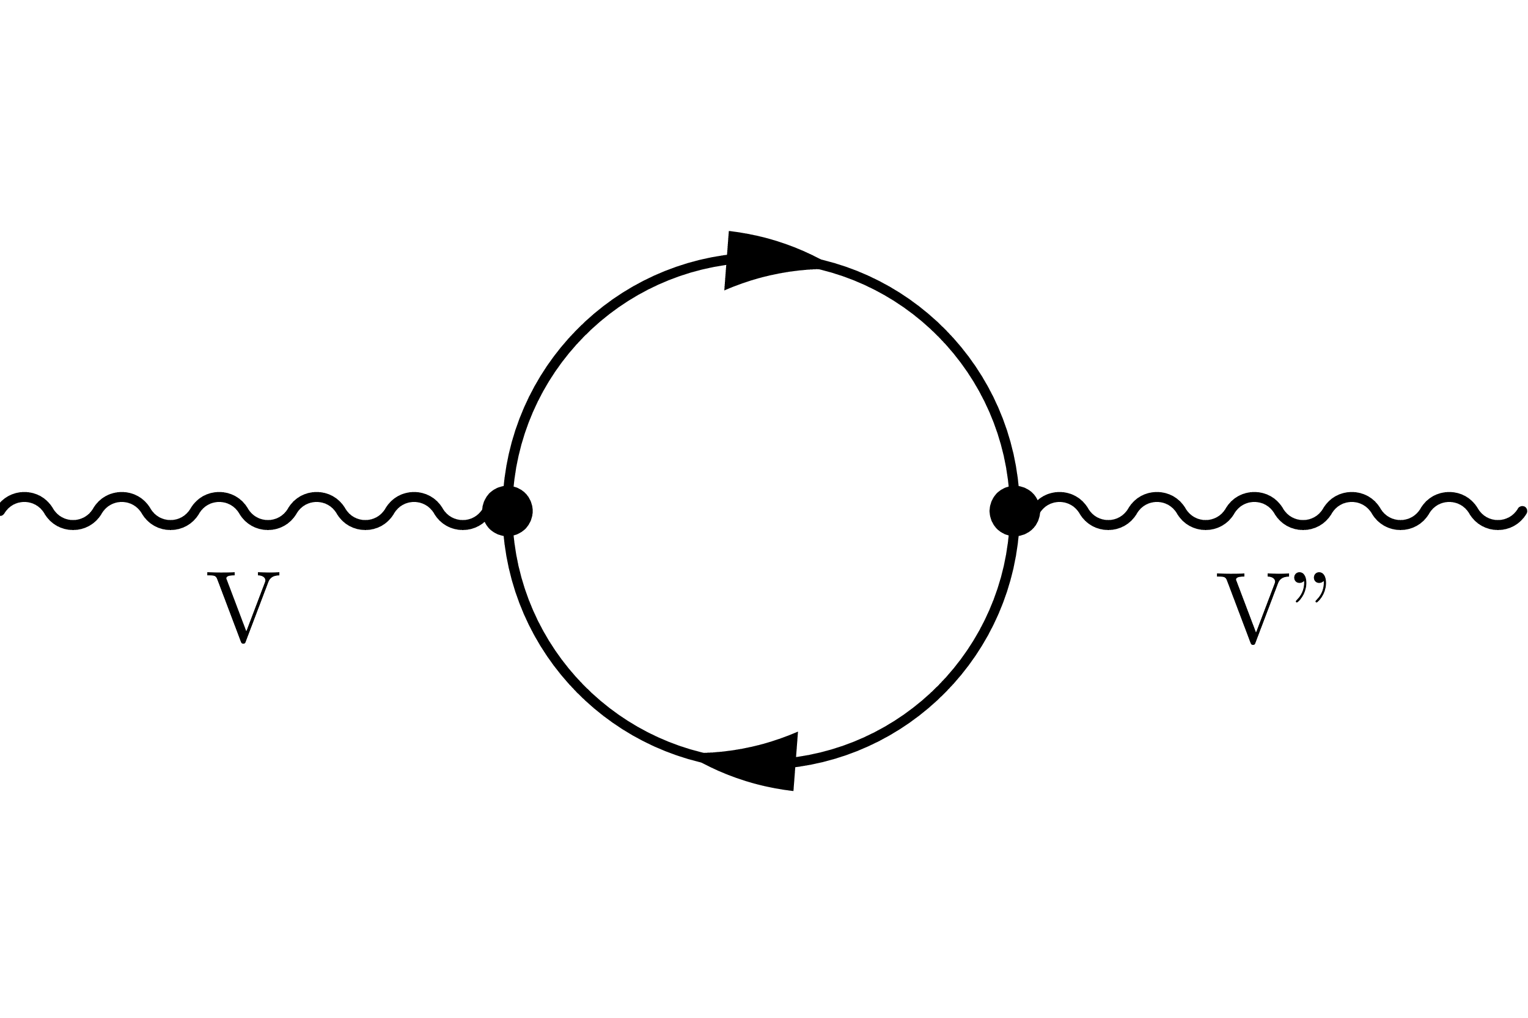
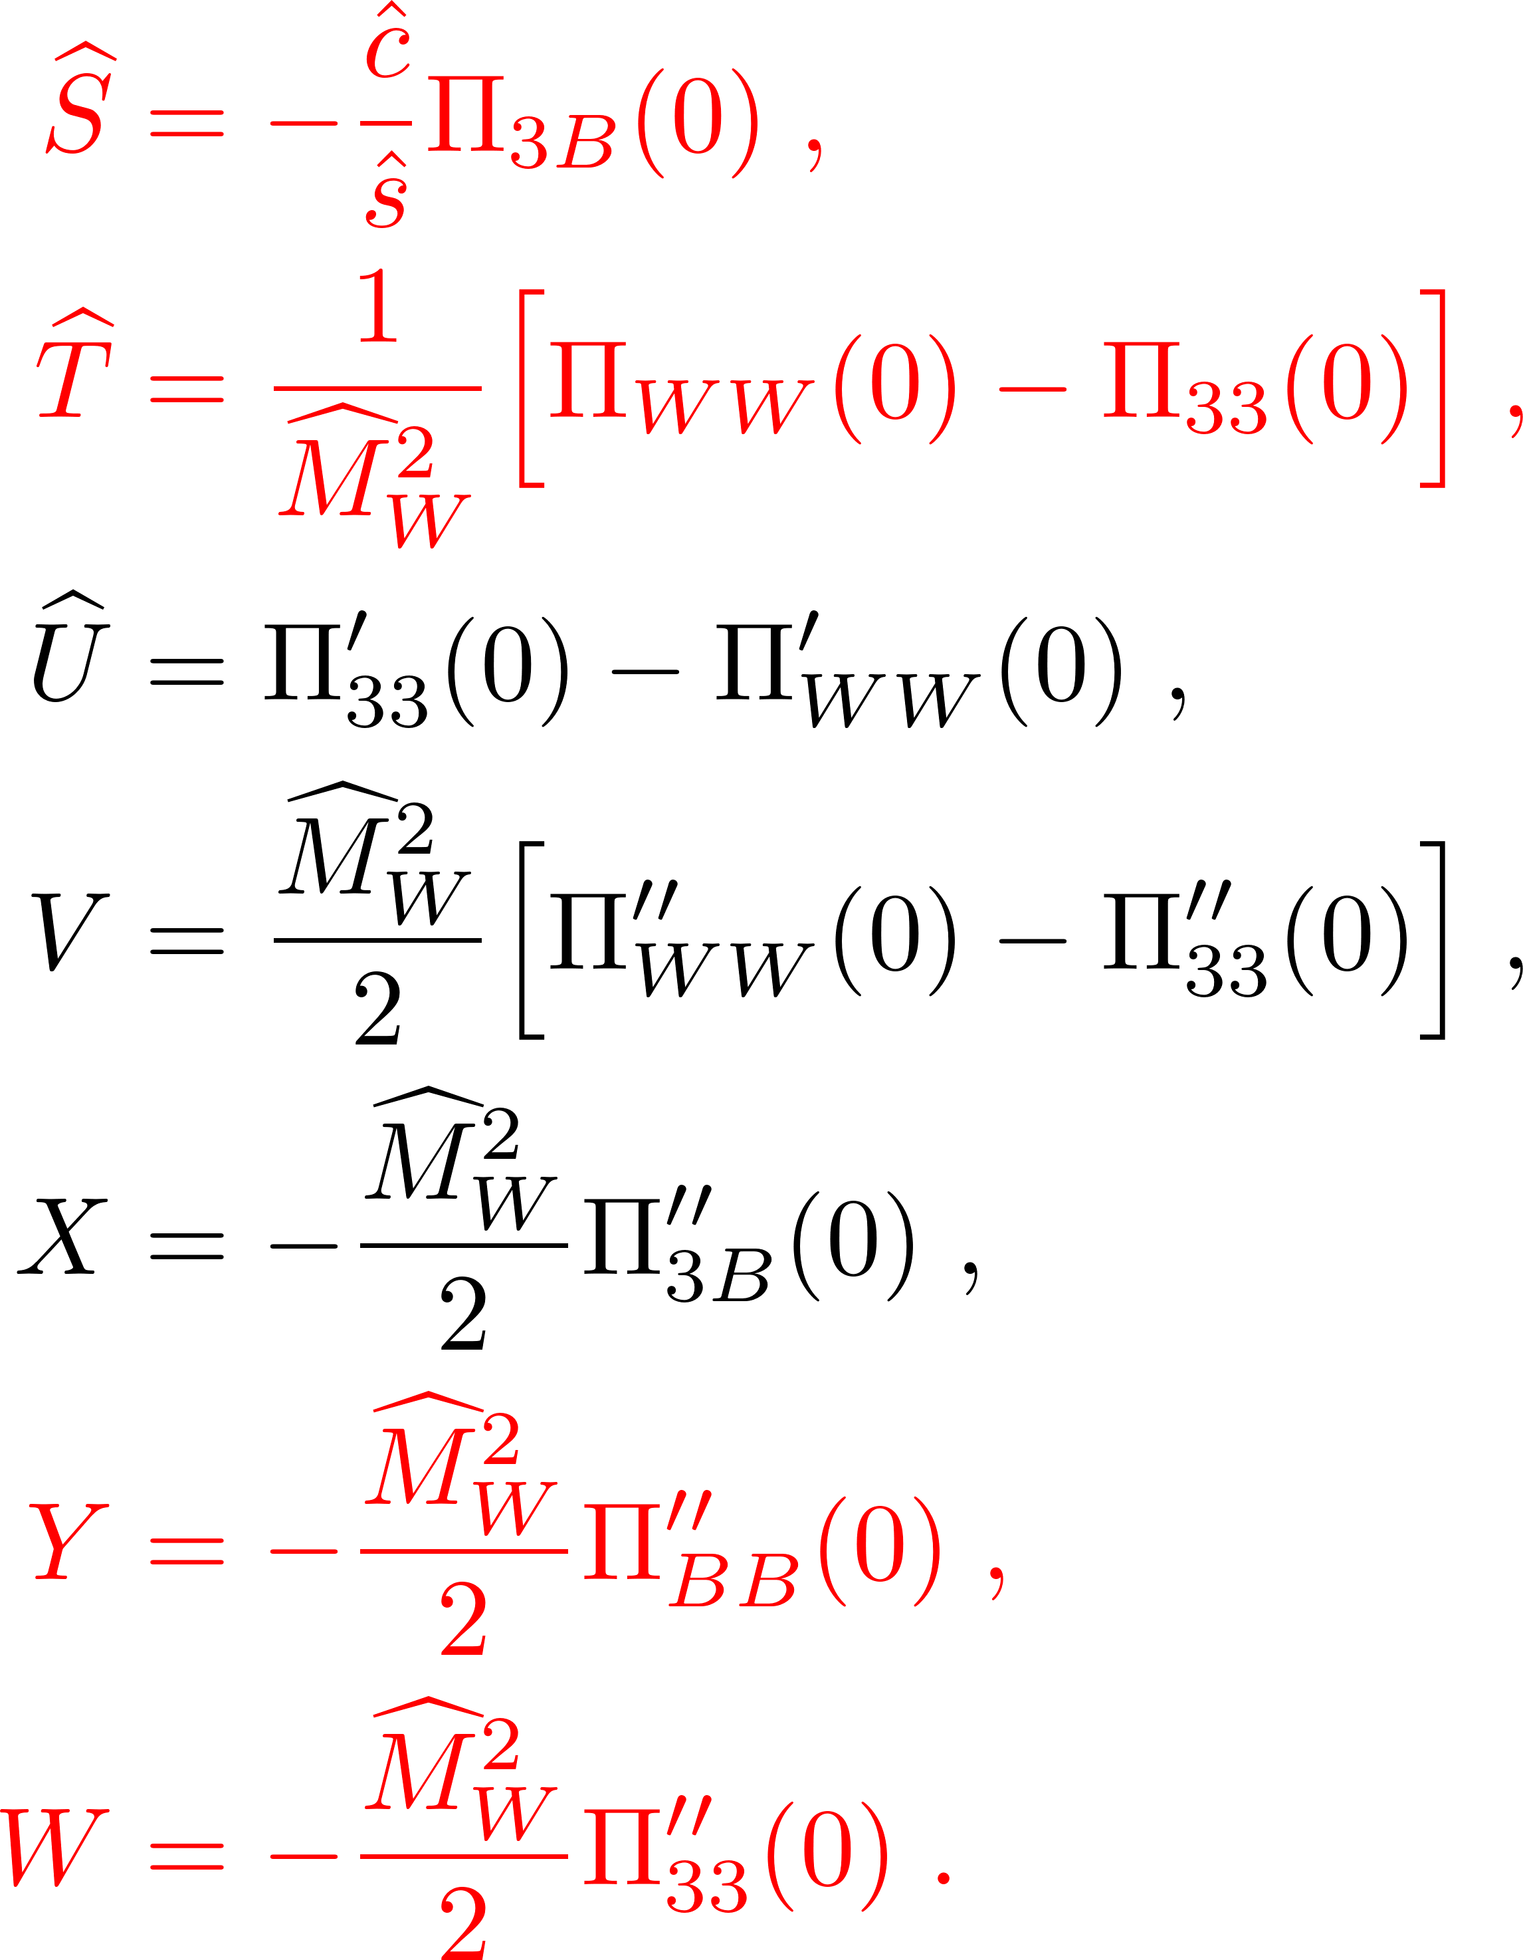
Oblique Parameters
In universal theories, for the bosonic basis, the effects of new physics can be fully parametrized in terms of the corrections to the gauge bosons self-energies. We expand the transverse vacuum polarization amplitudes as
Non-zero at dimension-six in SMEFT
Notes:
An alternative approach is to use the Oblique parameter formalism to compute corrections
To order $q^{4}$one can define 7 independent oblique parameters, $\hat{S,}\hat{T,}\hat{U,}V,X,Y,W$. At dimension-six SMEFT only $\hat{S,}\hat{T,}Y,W$ are generated.

Slide 14
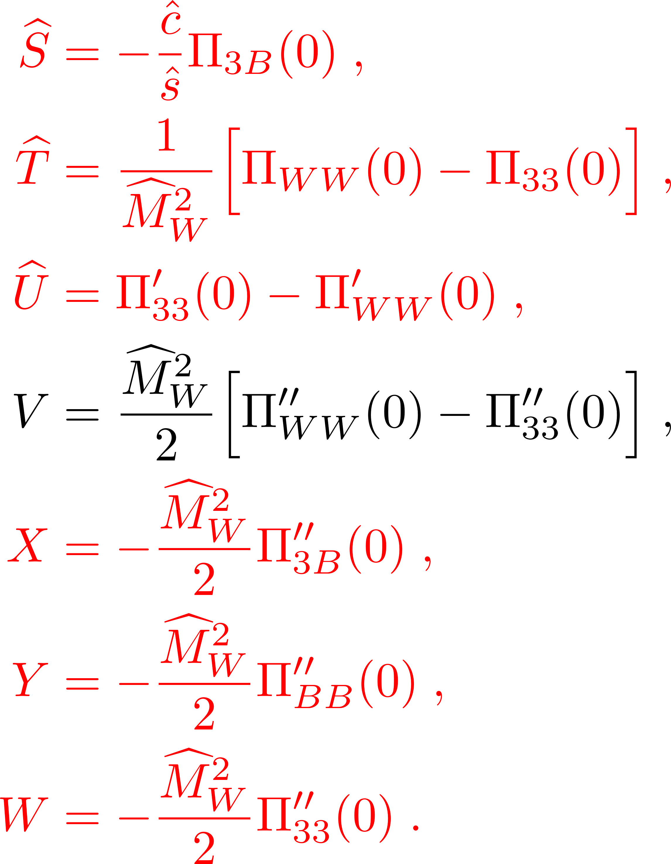
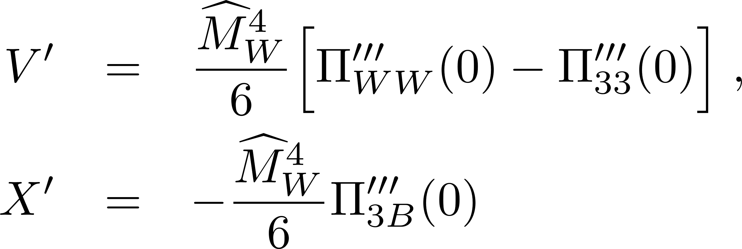
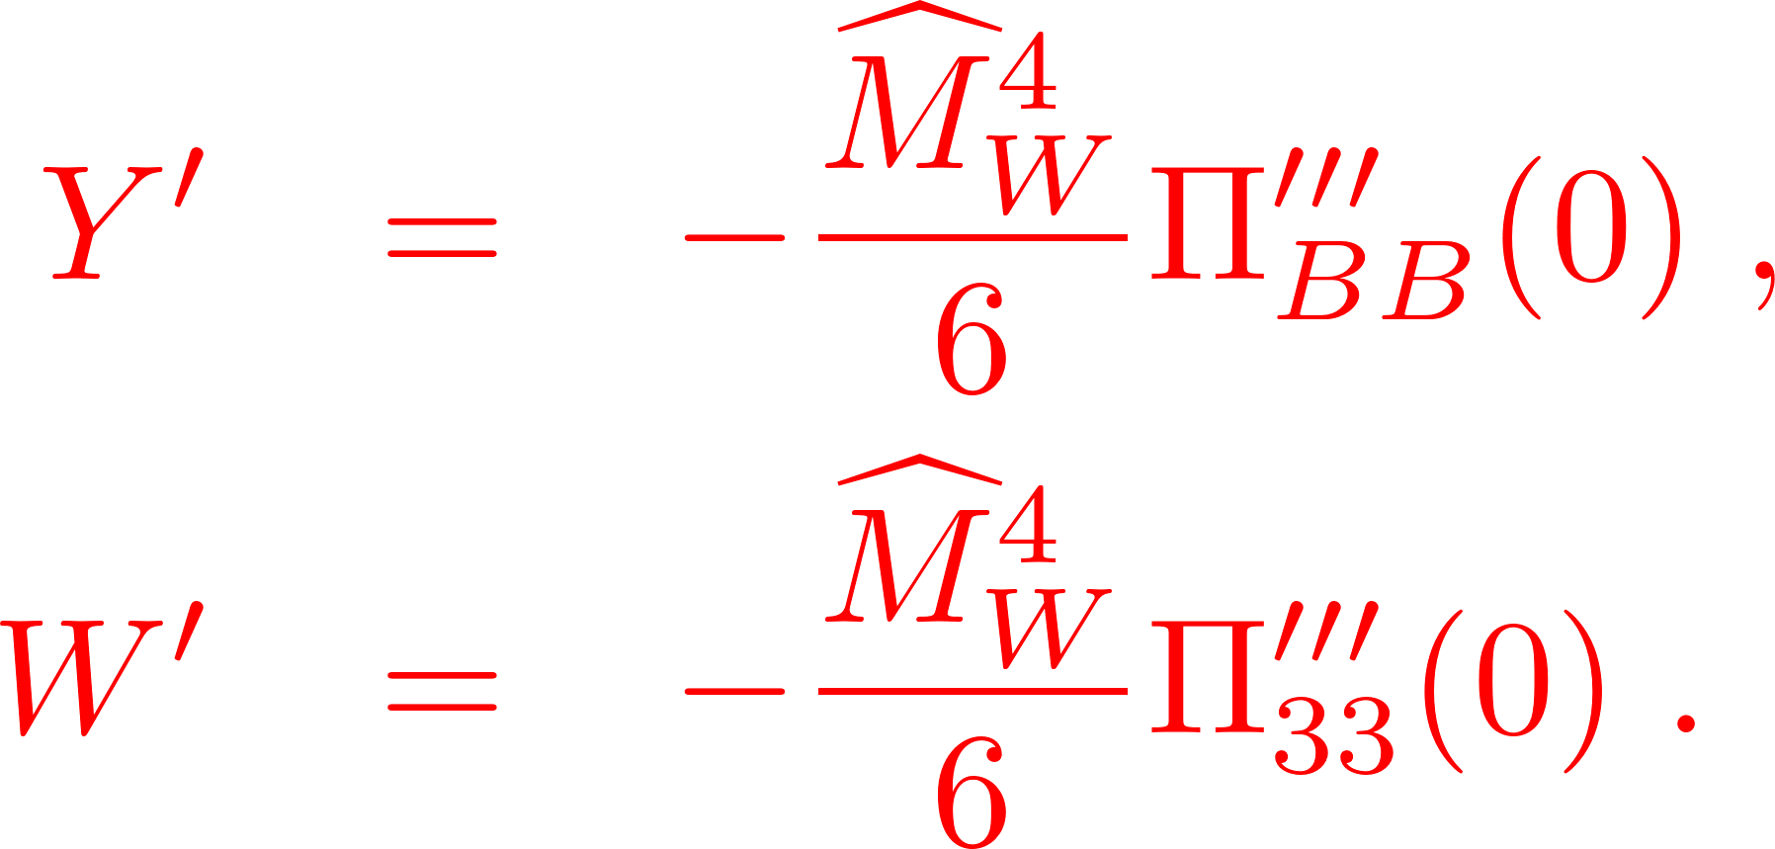
Oblique Parameters
In universal theories, for the bosonic basis, the effects of new physics can be fully parametrized in terms of the corrections to the gauge bosons self-energies. We expand the transverse vacuum polarization amplitudes as
Eight non-zero at dimension-eight in SMEFT
Notes:
To go beyond dimension six, we extend the energy expansion to q^6 and define four new Oblique parameters. There are 8 non-zero Oblique parameters up to dimension-eight.

Slide 15
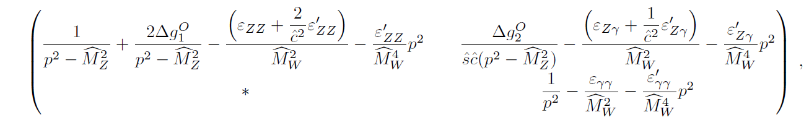
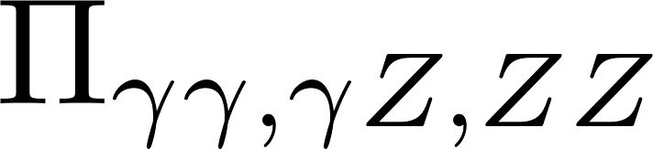
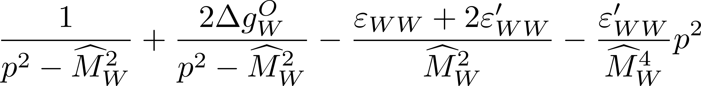

Modified propagators
Incorporating the self-energy corrections one can write modified propagators for the NC and CC interactions, we extend the results from*
The results of the parametrization in terms of Oblique parameters and the USMEFT expressions in terms of the coefficients of the operators in the rotated basis can only be compared at the linear level.
*M. Farina, G. Panico, D. Pappadopulo, J. T. Ruderman, R. Torre, and A. Wulzer et.al. arxiv:1609.08157 [hep-ph]
Notes:
Look at W piece, One can identify the ${\left(p^{2}−M_{V}^{2}\right)}^{−1}$ as generated by corrections to the couplings and the $ε$ pieces coming from four-fermion contact terms, while the last piece is the momentum dependent piece coming from psi4D2.
This will not consistently include all quadratic effects, which can be done in the rotated basis.

Slide 16
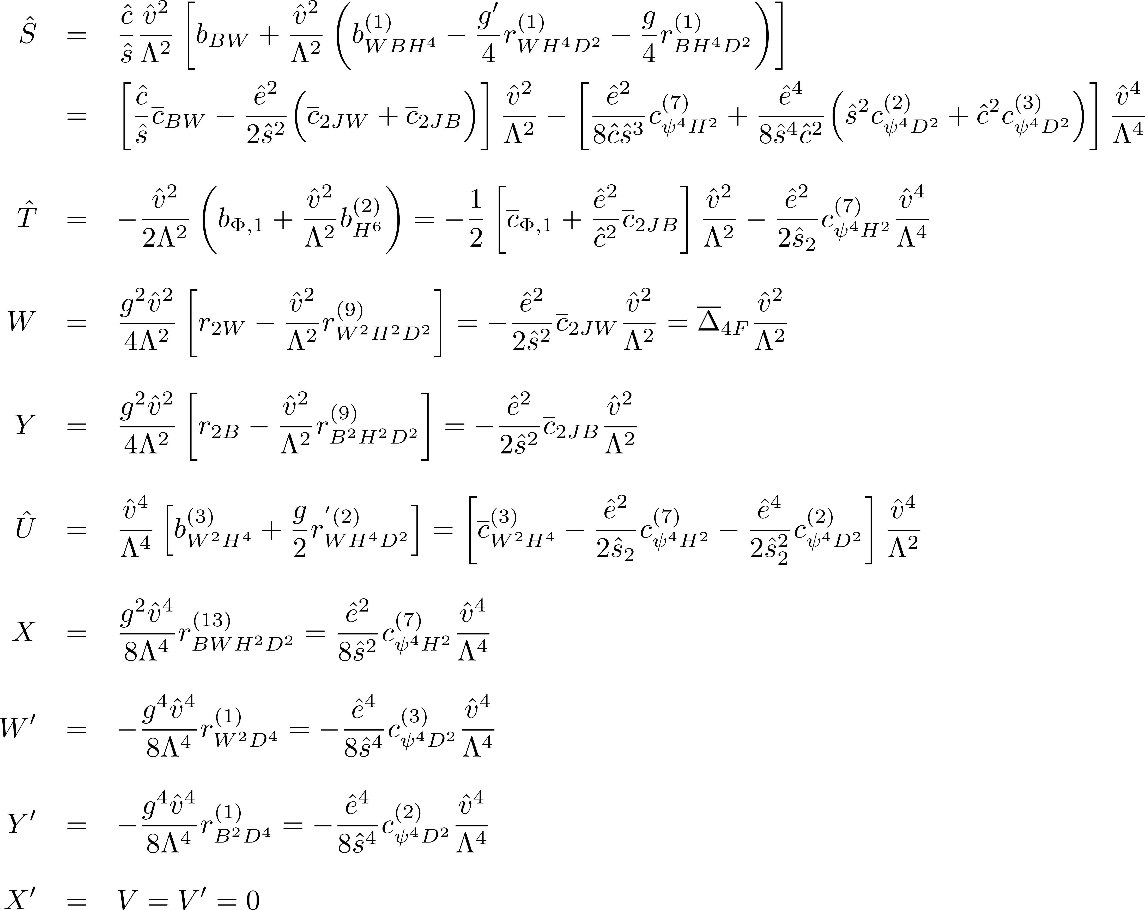
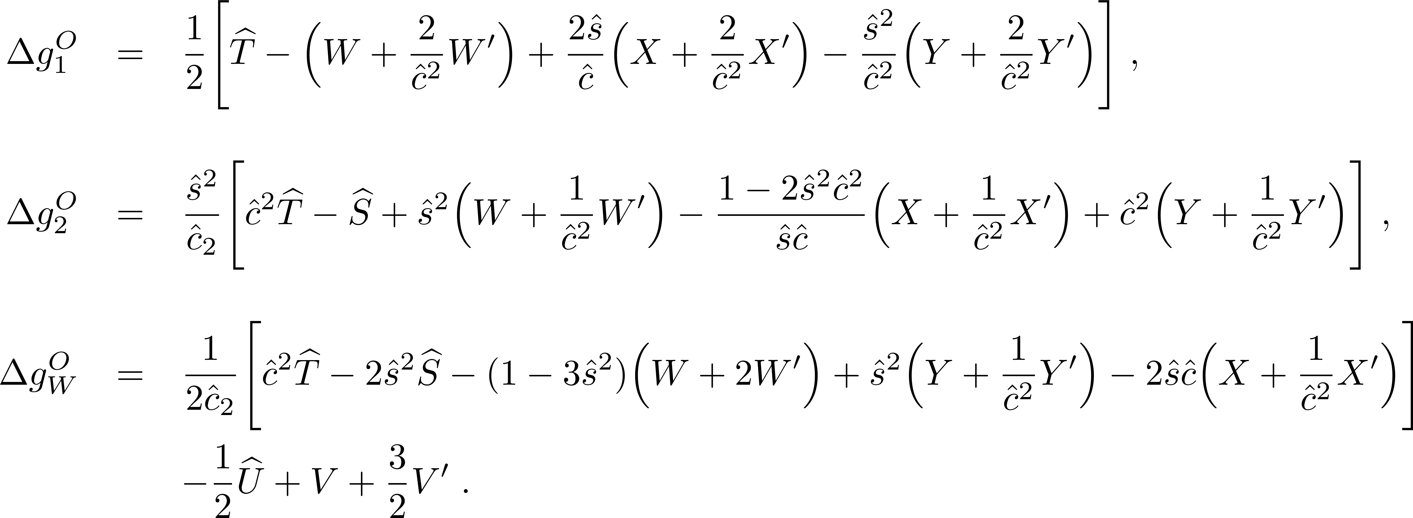
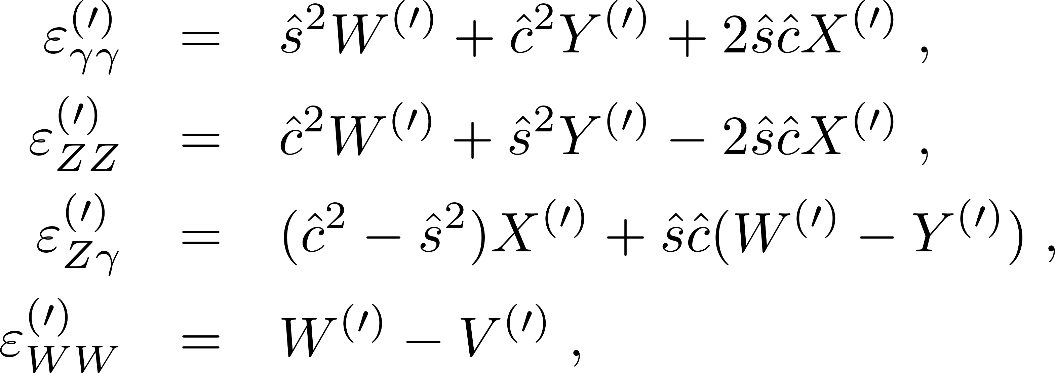
Oblique Parameters
Modified vertices to fermions
Four-fermion contact terms
Notes:
We can show the equivalence between the results computed earlier in the rotated basis vs the results using Oblique parameters and modified propagators in terms of the bosonic basis. This equivalence only holds at the linear level in both dimension-six and dimension-eight. So, for our analysis we will be working in the rotated basis, to carefully account for the quadratic contributions

Slide 17
Analysis Framework
We perform a binned log likelihood analysis to study the constraints on the combinations of the USMEFT Wilson coefficients in the rotated basis imposed by neutral- and charged-current Drell Yan in combination with EWPO.
Data can not break the degeneracy.
Notes:
At $𝒪(Λ^{−4})$ we find that even including the quadratic contributions does not break the degeneracies between the different Wilson coefficients entering the effective combinations.
For the analysis, we proceed to substitute the dimension-six WCs with their corresponding effective combinations in the quadratic terms and in the process neglect terms of 𝒪 Λ−6 .

Slide 18
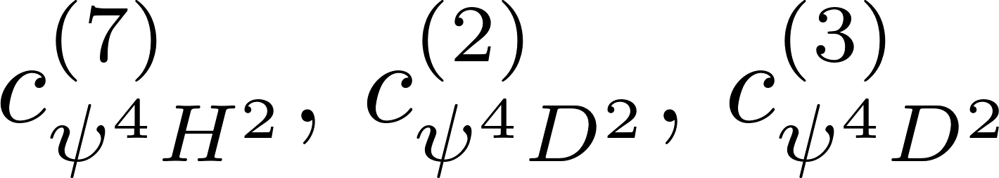
Effective combinations for DY and EWPO
We identified eight combinations of Wilson coefficients in the rotated basis which can be distinguished by primarily studying the invariant mass distribution of the lepton pairs produced in Drell-Yan processes.
They can be chosen to be the five combinations
together with the coefficients of the dimension-eight operators
Notes:
And they also contribute to Electroweak precision observables
These are the final parameters for our analysis.

Slide 19
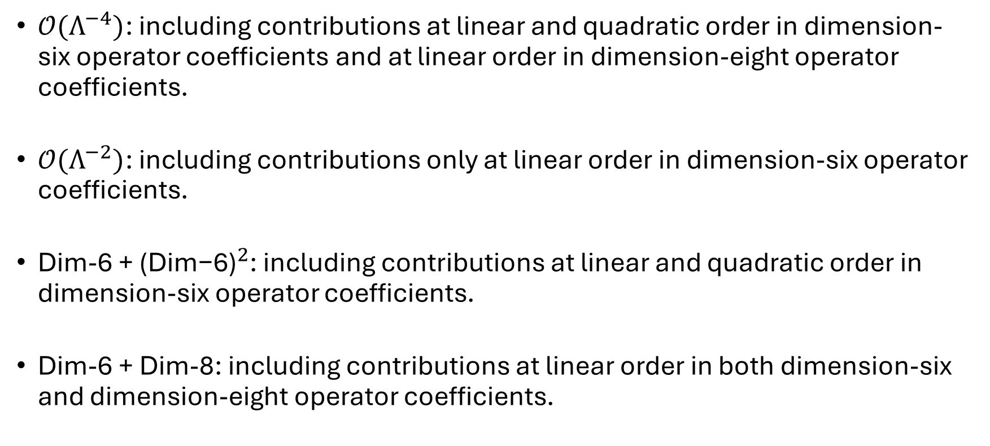
Analyses at different Orders
$𝒪(Λ^{−4})$: including contributions at linear and quadratic order in dimension-six operator coefficients and at linear order in dimension-eight operator coefficients.
$𝒪(Λ^{−2})$: including contributions only at linear order in dimension-six operator coefficients.
Dim-6 + ${\text{(}\text{Dim}\text{−6)}}^{2}$: including contributions at linear and quadratic order in dimension-six operator coefficients.
Dim-6 + Dim-8: including contributions at linear order in both dimension-six and dimension-eight operator coefficients.
Notes:
To address the dependence of the results on the order of the expansion

Slide 20
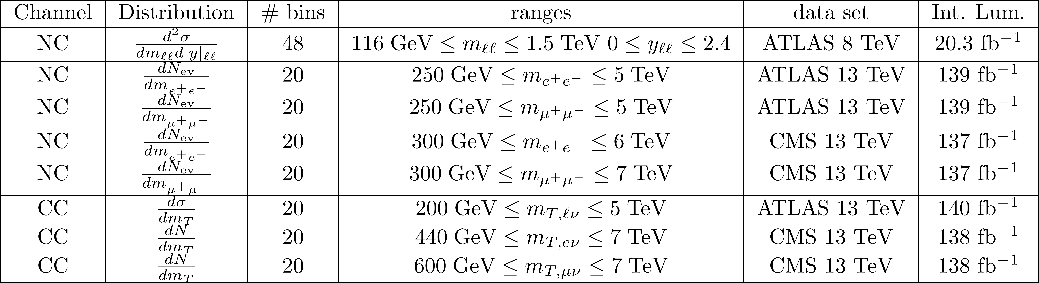
Data and simulation for Drell Yan
The $χ^{2}$ function for DY depends on the eight Wilson coefficient combinations.
Notes:
We also rebinned the data to have some minimum number of events in each bin. Where depending on the specific case, the distribution is either dependent on the invariant mass of the lepton pairs, the transverse mass of the lepton pairs in the charged current case, and rapidity.

Slide 21

Electro-Weak Precision Observables
We combine this with EWPO, where we include 12 Z-pole observables:
We also include 2 W-pole observables:
Notes:
12 Z-pole observables are from LEP. 2 W-pole observables from review from PDG

Slide 22
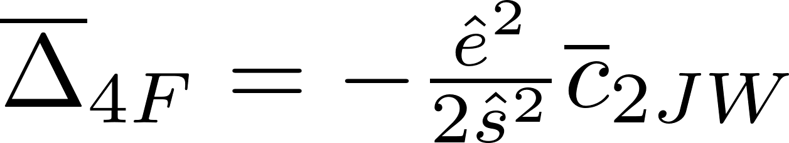
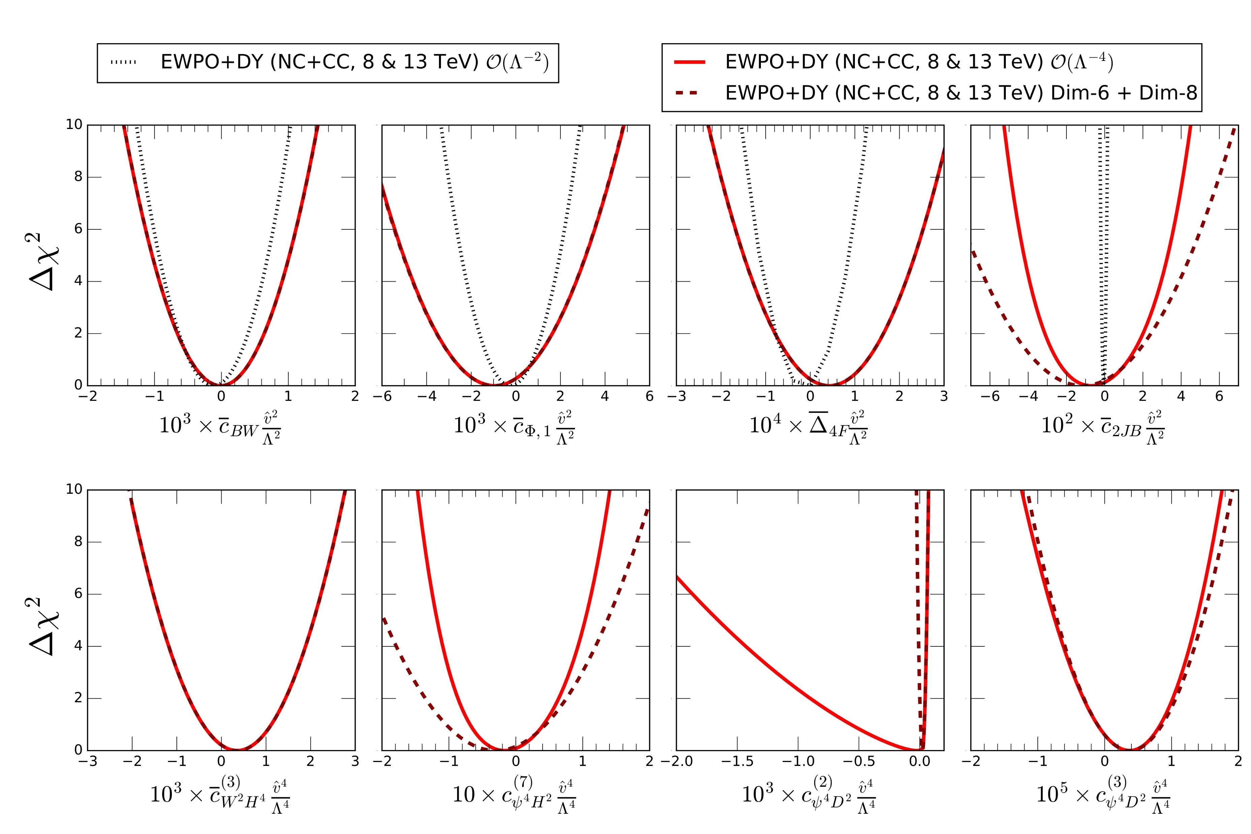
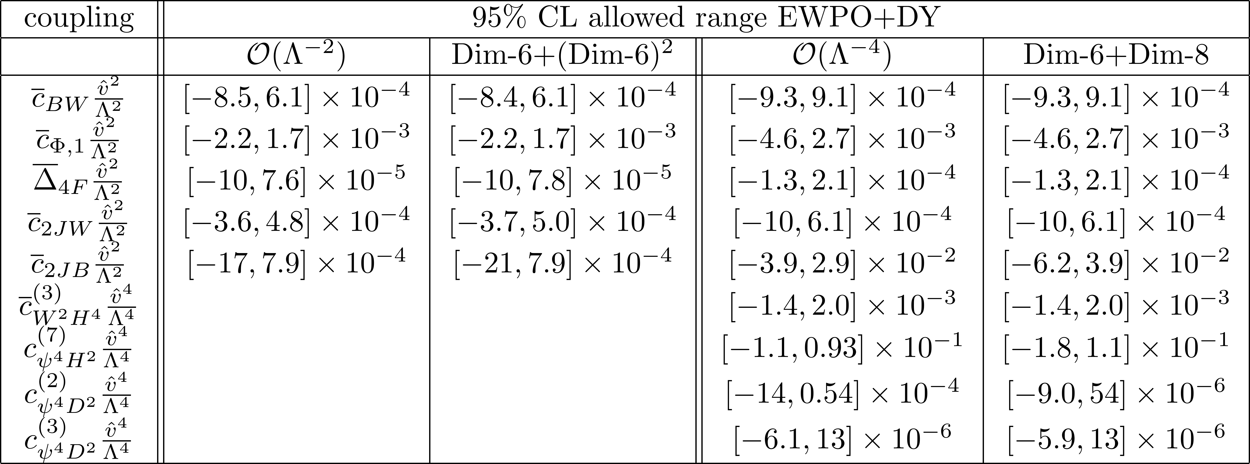
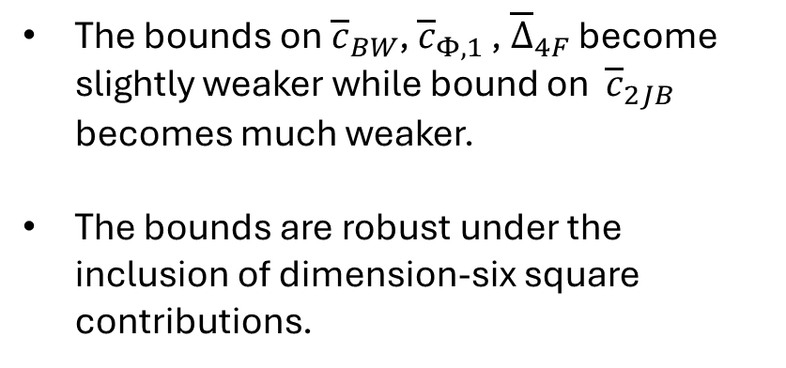
One dimensional projections
The bounds on ${\overline{c}}_{BW}$, ${\overline{c}}_{Φ,1 }$, ${\overline{Δ}}_{4F}$ become slightly weaker while bound on ${\overline{c}}_{2JB}$ becomes much weaker.
The bounds are robust under the inclusion of dimension-six square contributions.
Notes:
We show the one-dimensional projections of delta chi-squared after marginalization over the other coefficients. On the table on the right we show the 95% Confidence intervals for different orders of expansion.
This is a consequence of cancellations between dimension-six and dimension-eight contributions which results into correlations.

Slide 23
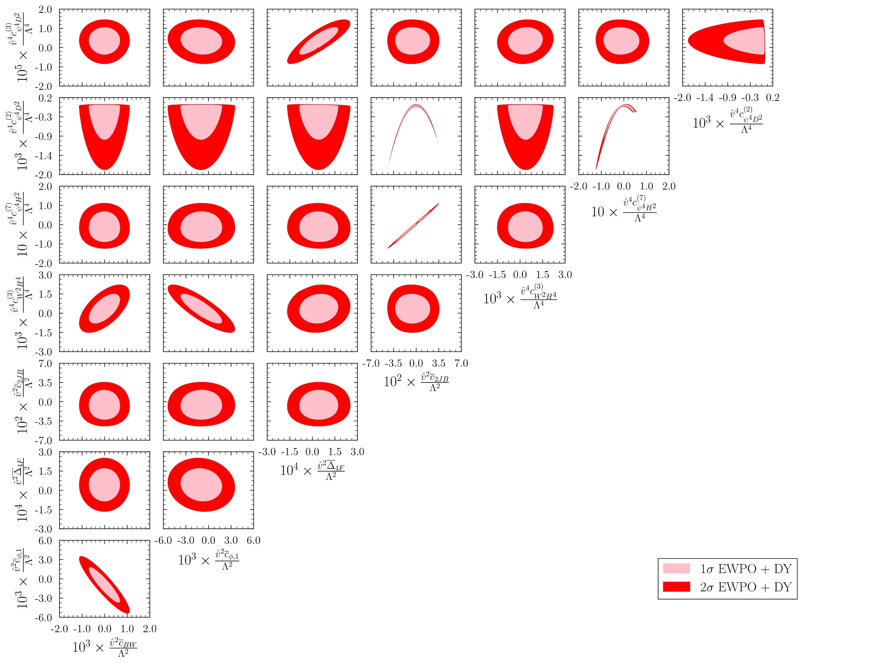
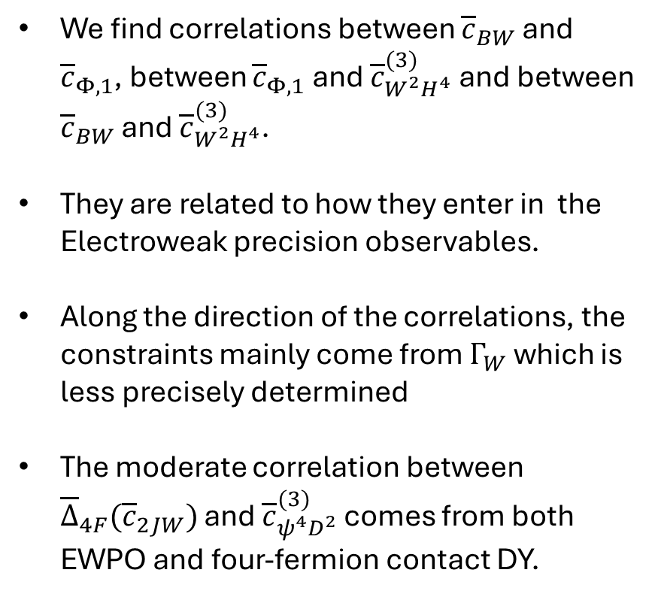
Two-dimensional projections
We find correlations between ${\overline{c}}_{BW}$ and ${\overline{c}}_{Φ,1}$, between ${\overline{c}}_{Φ,1}$ and ${\overline{c}}_{W^{2}H^{4}}^{(3)}$ and between ${\overline{c}}_{BW}$ and ${\overline{c}}_{W^{2}H^{4}}^{(3)}$.
They are related to how they enter in the Electroweak precision observables.
Along the direction of the correlations, the constraints mainly come from $Γ_{W}$ which is less precisely determined
The moderate correlation between ${\overline{Δ}}_{4F}({\overline{c}}_{2JW})$ and ${\overline{c}}_{ψ^{4}D^{2}}^{(3)}$ comes from both EWPO and four-fermion contact DY.
Notes:
We show the two-dimensional projections of delta chi-squared after marginalization over rest of the coefficients.

Slide 24
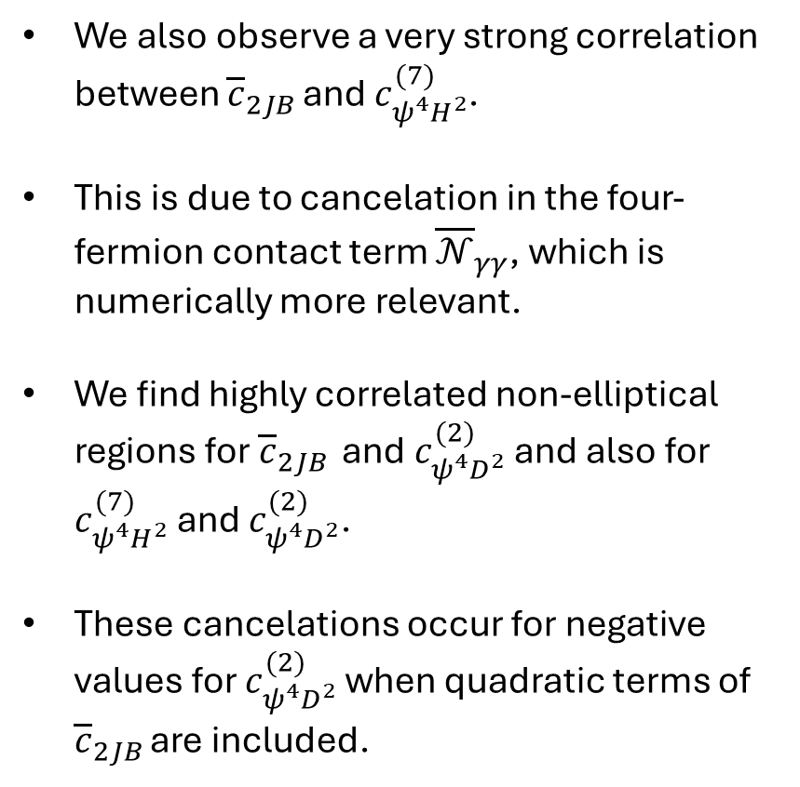
Two-dimensional projections
We also observe a very strong correlation between ${\overline{c}}_{2JB }$and $c_{ψ^{4}H^{2}}^{(7)}$.
This is due to cancelation in the four-fermion contact term ${\overline{𝒩}}_{γγ}$, which is numerically more relevant.
We find highly correlated non-elliptical regions for ${\overline{c}}_{2JB }$ and $c_{ψ^{4}D^{2}}^{(2)}$ and also for $c_{ψ^{4}H^{2}}^{(7)}$ and $c_{ψ^{4}D^{2}}^{(2)}$.
These cancelations occur for negative values for $c_{ψ^{4}D^{2}}^{(2)}$ when quadratic terms of ${\overline{c}}_{2JB }$are included.

Slide 25
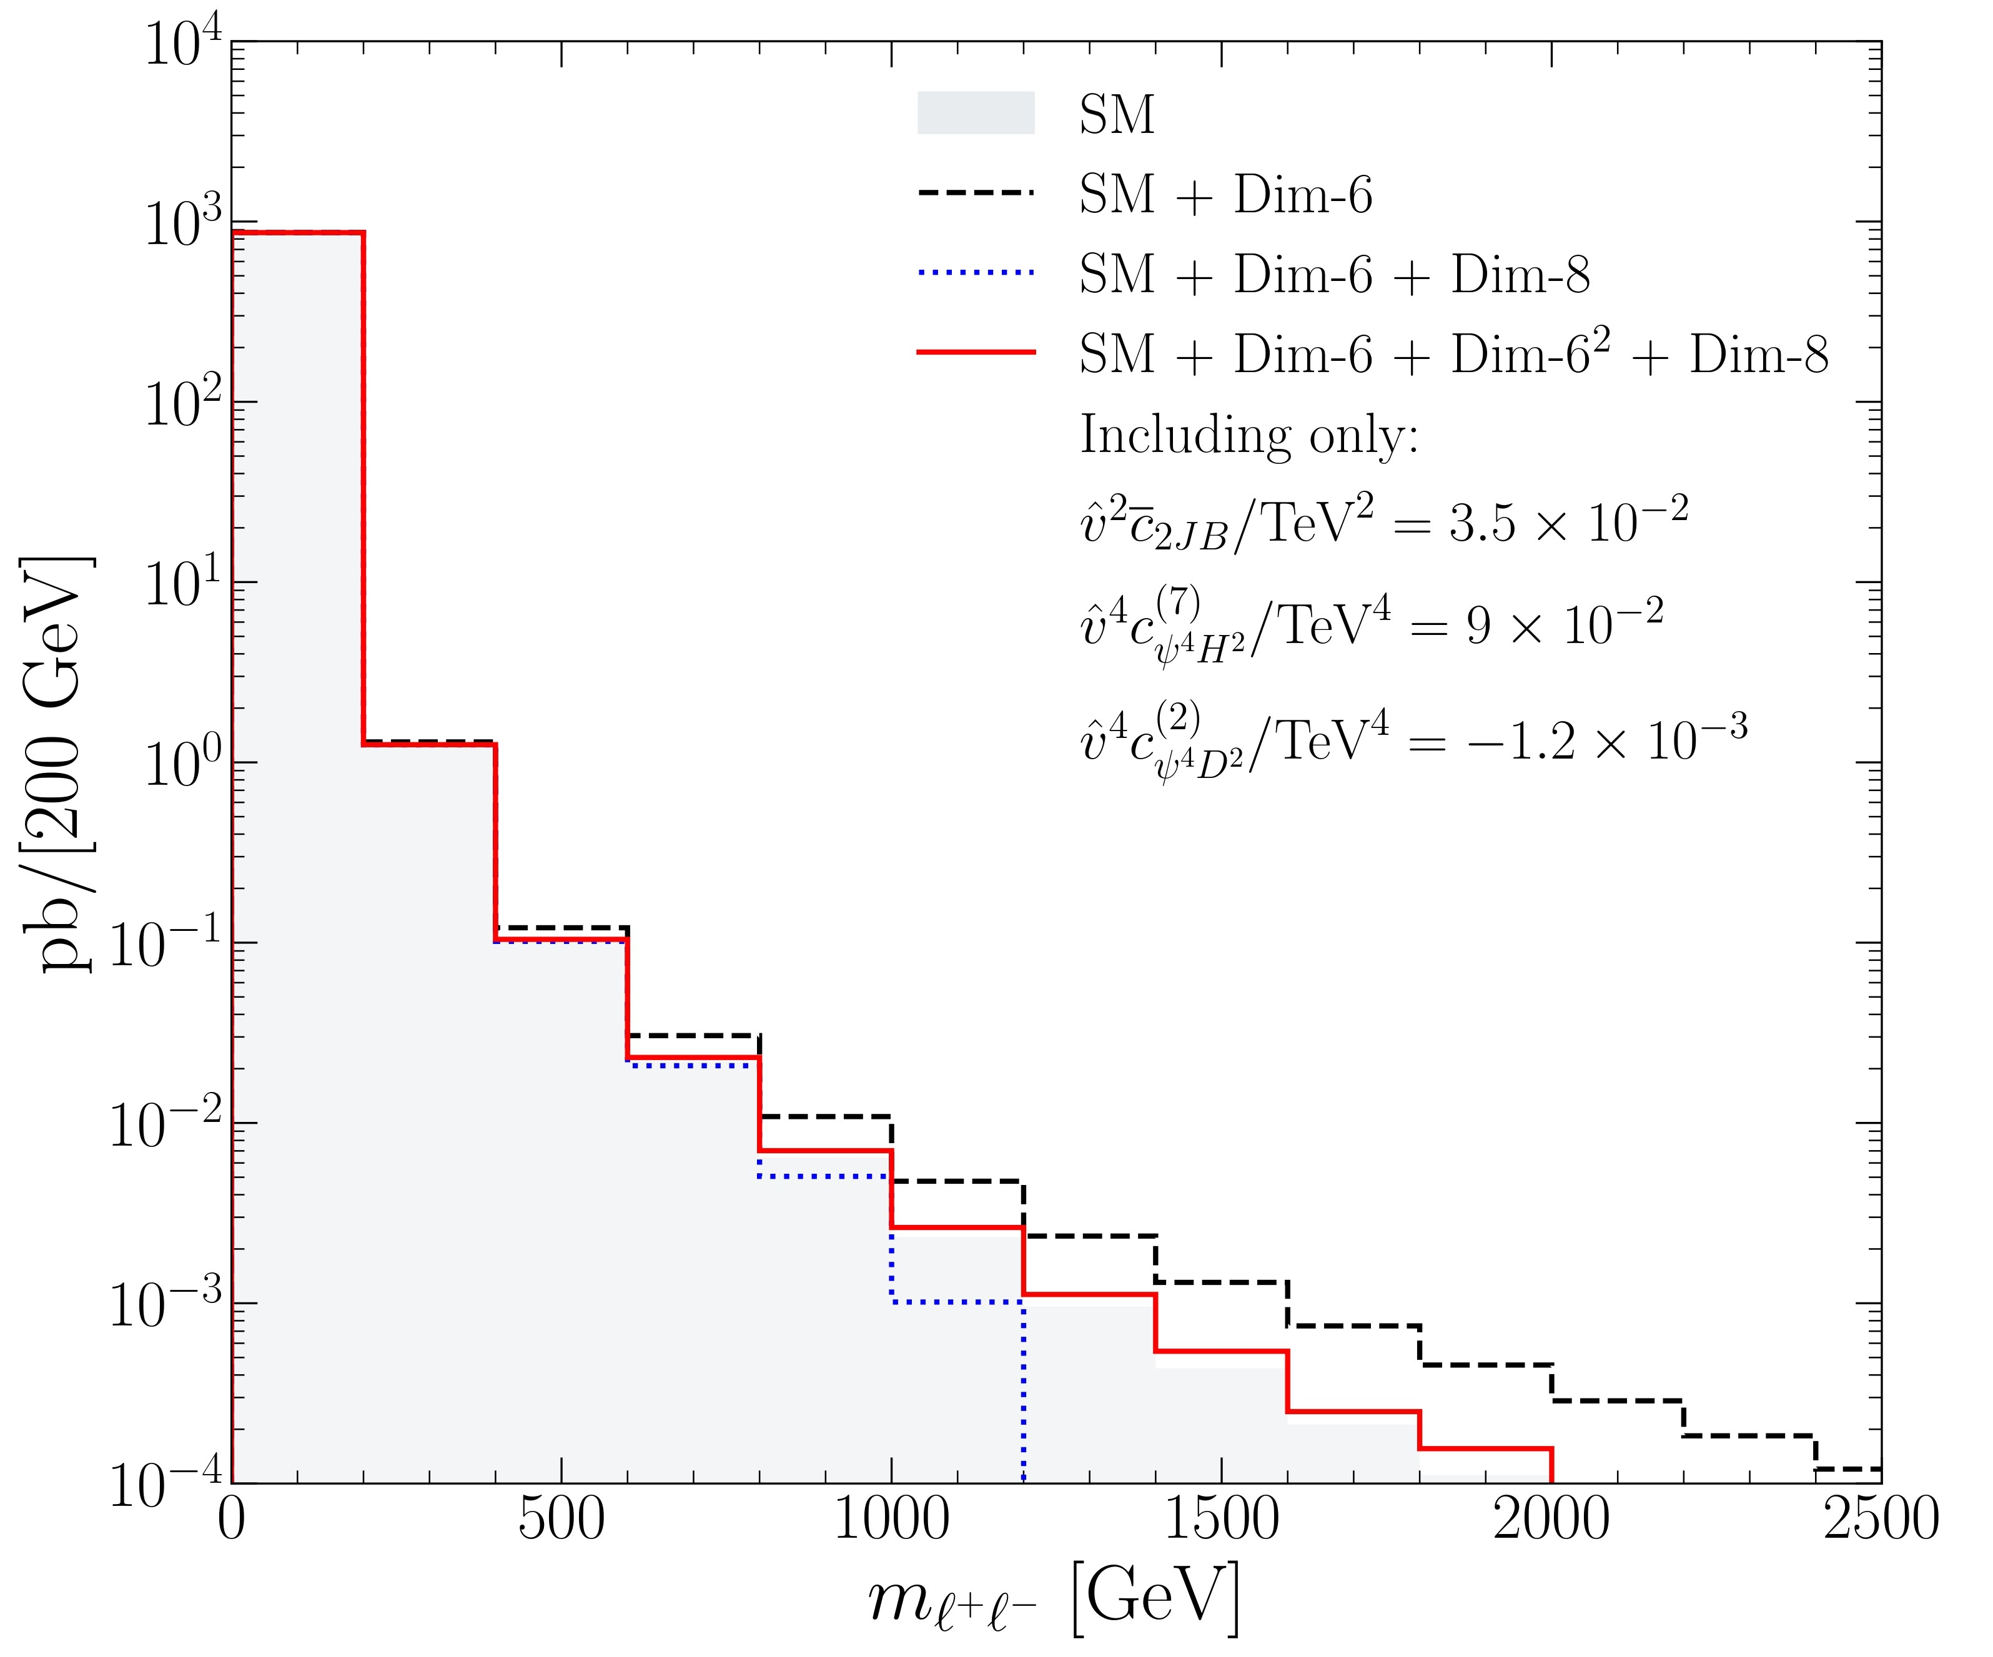
Two-dimensional projections
We also observe a very strong correlation between ${\overline{c}}_{2JB }$and $c_{ψ^{4}H^{2}}^{(7)}$.
This is due to cancelation in the four-fermion contact term ${\overline{𝒩}}_{γγ}$, which is numerically more relevant.
We find highly correlated non-elliptical regions for ${\overline{c}}_{2JB }$ and $c_{ψ^{4}D^{2}}^{(2)}$ and also for $c_{ψ^{4}H^{2}}^{(7)}$ and $c_{ψ^{4}D^{2}}^{(2)}$.
These cancelations occur for negative values for $c_{ψ^{4}D^{2}}^{(2)}$ when quadratic terms of ${\overline{c}}_{2JB }$are included.

Slide 26
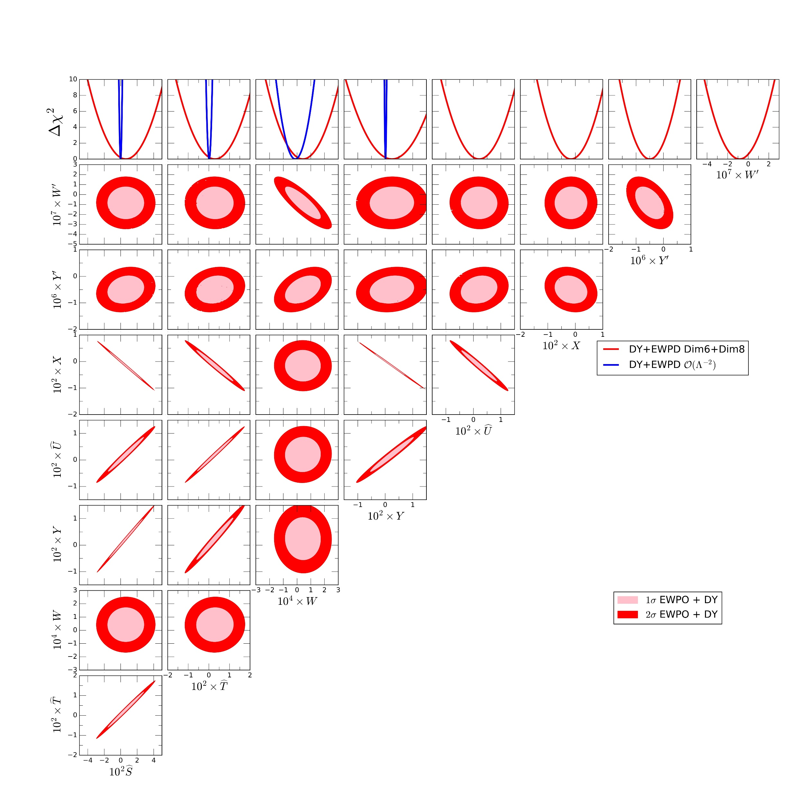
Oblique parameters results

Slide 27

Summary
We have studied constraints from Drell-Yan production and Electroweak precision in universal theories consistently including effects beyond leading order $𝒪(Λ^{−2})$.
We identified eight combinations of the 17 Wilson coefficients of C and P conserving operators that are physically distinguishable by primarily studying the invariant mass distribution of the lepton pairs and EWPO.
We also introduced an extension of the parametrization of universal effects in terms of oblique parameters obtained by linearly expanding the self-energies of the electroweak gauge-bosons to $𝒪(q^{6})$.
Our results show that the present data, that favors no deviation from the SM, can robustly constrain six out of the eight parameters while strong correlations and cancellations are present for the other combinations.

Slide 28
Thank you!

Slide 30
Backup

Slide 31





Four-fermion contact amplitudes
We define the $\overline{𝒩}$pieces containing corrections which are dimension-six at leading order with additional irresolvable contributions, $𝒩^{□}$ contains quadratic terms, and $𝒩′$ contains the coefficients of momentum-dependent four-fermion couplings.

Slide 32


Slide 33

Analysis Framework
The theoretical predictions for the analyses were obtained with MadGraph5_aMC@NLO at leading order in QCD and QED, with the UFO files for the effective Lagrangian with the seventeen operators of the rotated basis generated with FeynRules including also the $𝒪(Λ^{−2})$ and $𝒪(Λ^{−4})$ terms for the renormalization of the SM inputs.
Parton shower and hadronization was perfomed using PYTHIA8, and the fast detector simulation was carried out with Delphes. Jet analyses was done using FASTJET. The detector response for ATLAS NC data was simulated using Rivet

