Slide 1
VTRx+ Quality Assurance Programme:
A Focus on Optical Alignment
Hannah Fabik
EP-ESE-BE
April 30, 2025

Slide 2
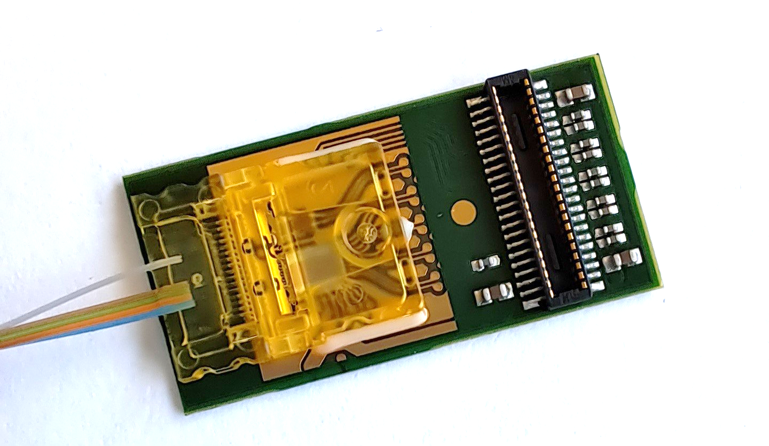
Agenda
Introduction to the VTRx+
Outline of the QA process
Analysis of failures
Alignment tolerances
Alignment algorithm verification
Functional test results
Conclusion

Slide 3
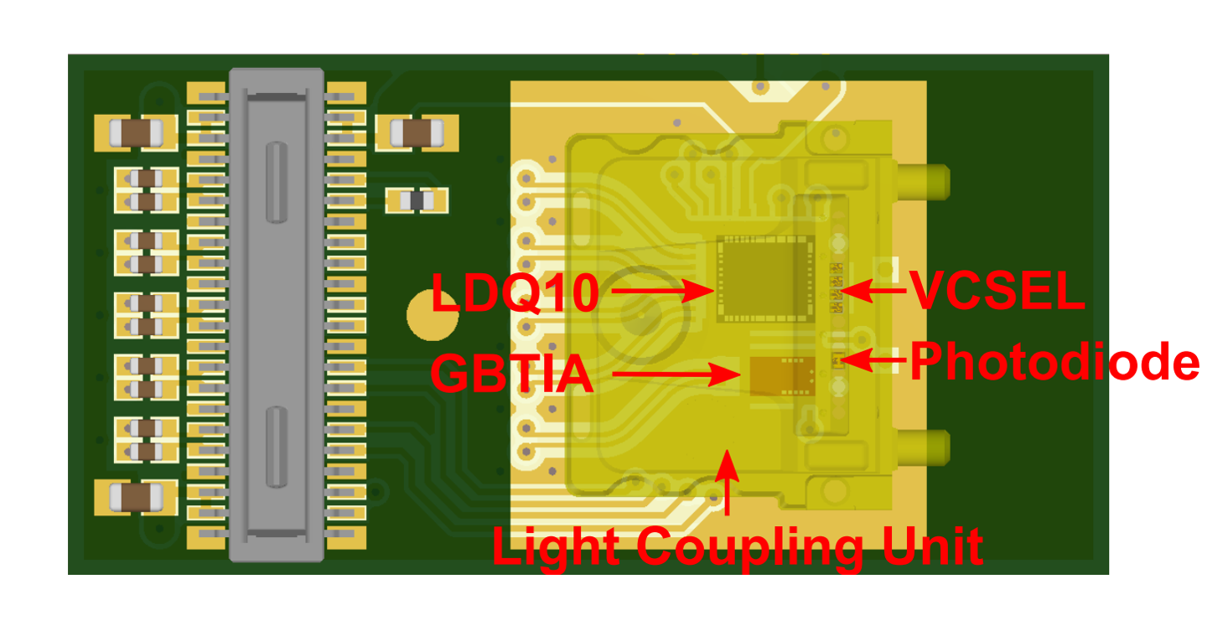
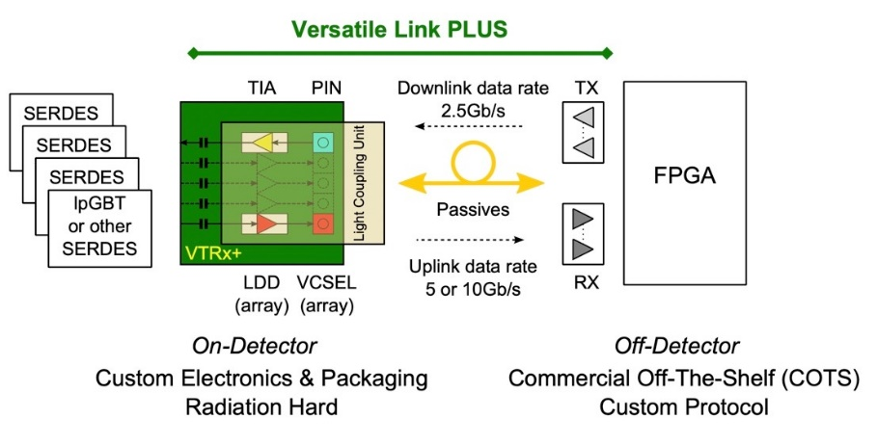
The VTRx+ module
A high-speed optical transceiver module developed for HL-LHC upgrades in CMS and ATLAS.
4 transmitter channels, 1 receiver channel
Operating conditions between -35°C and 65°C
Small size (20 mm x 10 mm x 2 mm)
Radiation-hard (1 MGy total dose)

Slide 4
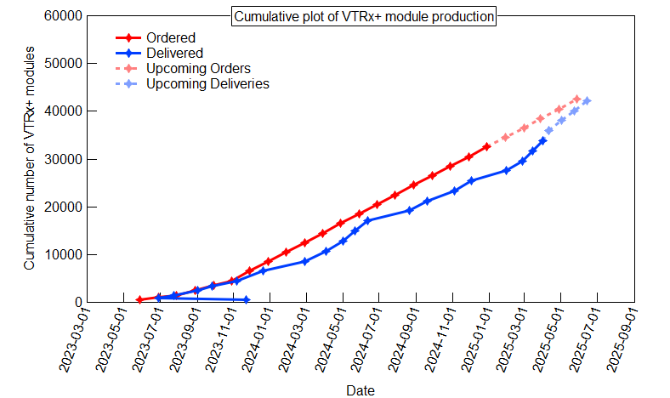
Production has been ongoing for over 2 years
Production status as of Batch 20.

Slide 5
Quality Assurance Programme

Slide 6
The QA programme has multiple stages
Pre-Production Qualification
Production Qualification
Lot Acceptance
Additional Tests
Static & dynamic transmitter
Static & dynamic receiver
Temperature
Magnetic field
Irradiation
Static & dynamic transmitter
Static & dynamic receiver
Burn-in
Visual inspection
Static & dynamic transmitter
Static & dynamic receiver
Temperature
Alignment
Complete
Manufacturer
CERN

Slide 7
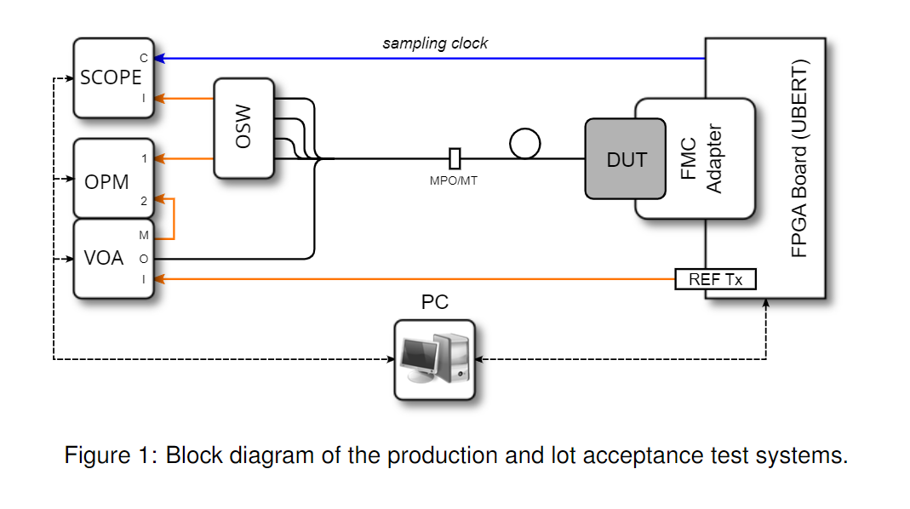
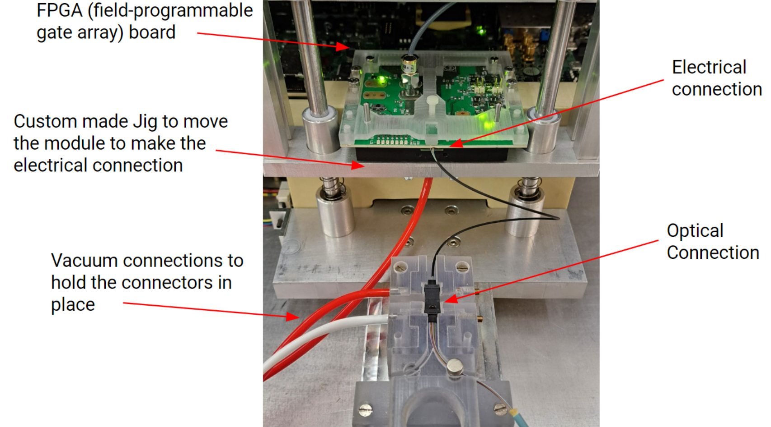
Functional tests use a custom test system
Static tests are measured through the optical power meter.
Dynamic tests are measured through the oscilloscope.

Slide 8
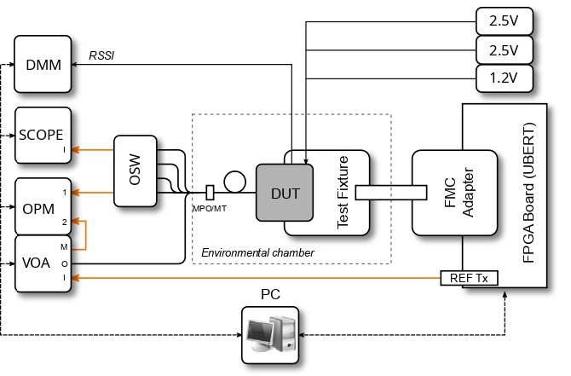
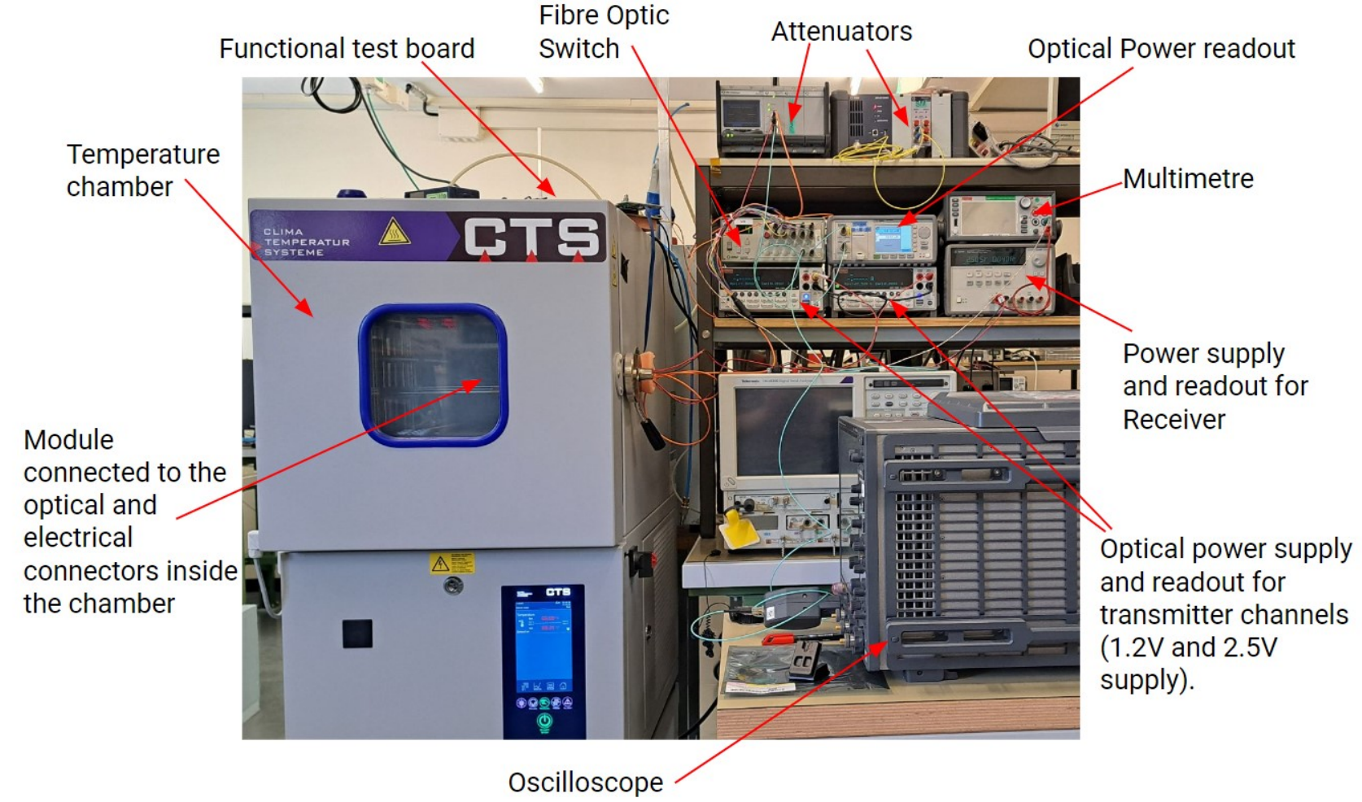
Temperature tests are conducted in a similar way
Static and dynamic measurements are made at each temperature.
Temperatures measured: -35°C, 25°C, 65°C

Slide 9
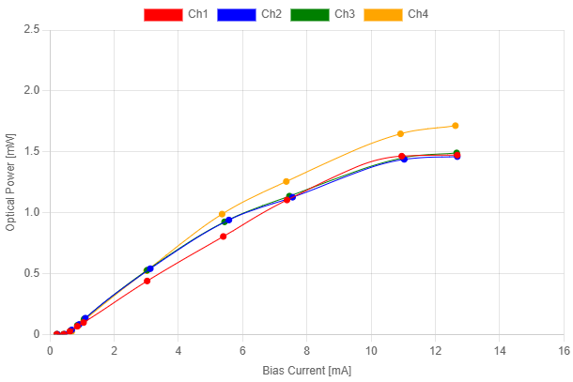
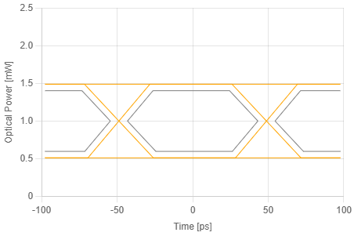
Important Optical Parameters for the Transmitter
Typical optical power [W] is the output power at 6 mA bias current.
Optical modulation amplitude (OMA) [W] is the difference in power between the high and low power levels.

Slide 10
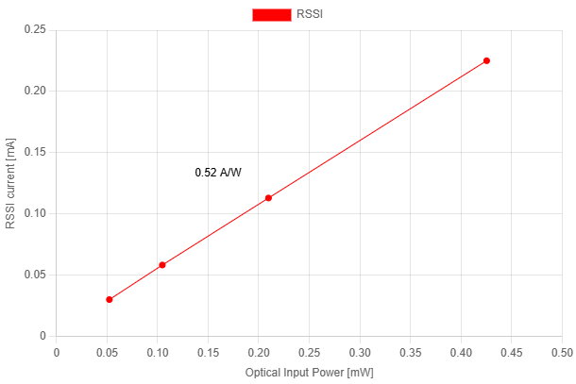
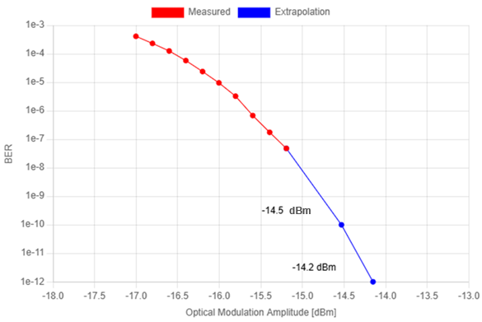
Important Optical Parameters for the Receiver
Responsivity [A/W] is the amount of current output in response to the amount of light input.
Sensitivity [dBm] is the attenuation that produces a bit error rate of 1e-10 dBm.

Slide 11
A sudden drop in yield…

Slide 12
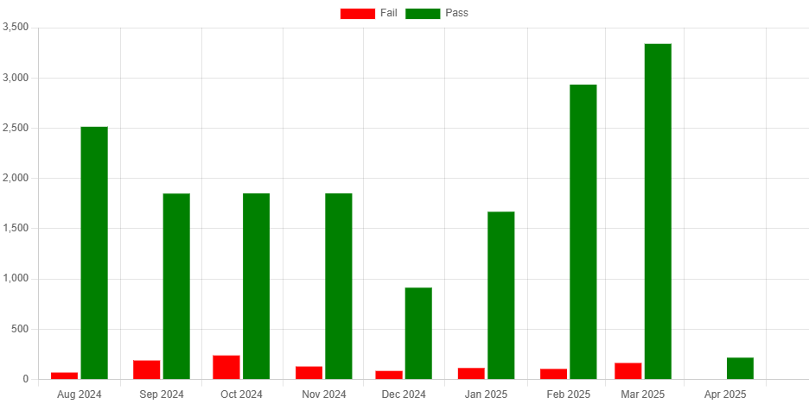
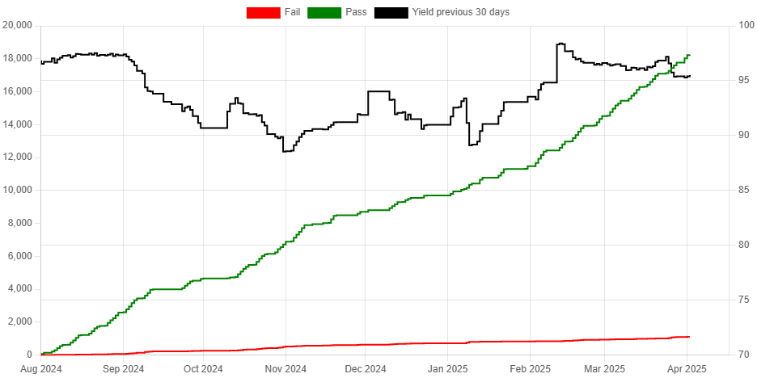
In September 2024, production yield started to drop

Slide 13
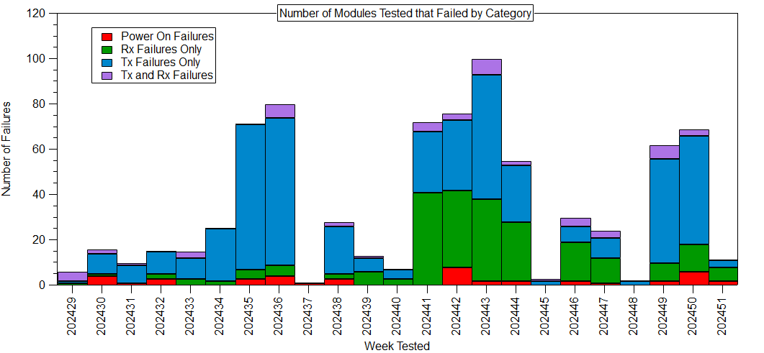
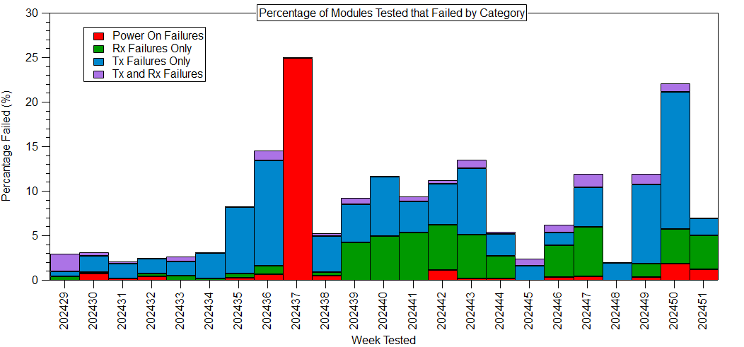
Both transmitters and receivers were failing the functional tests
September

Slide 14
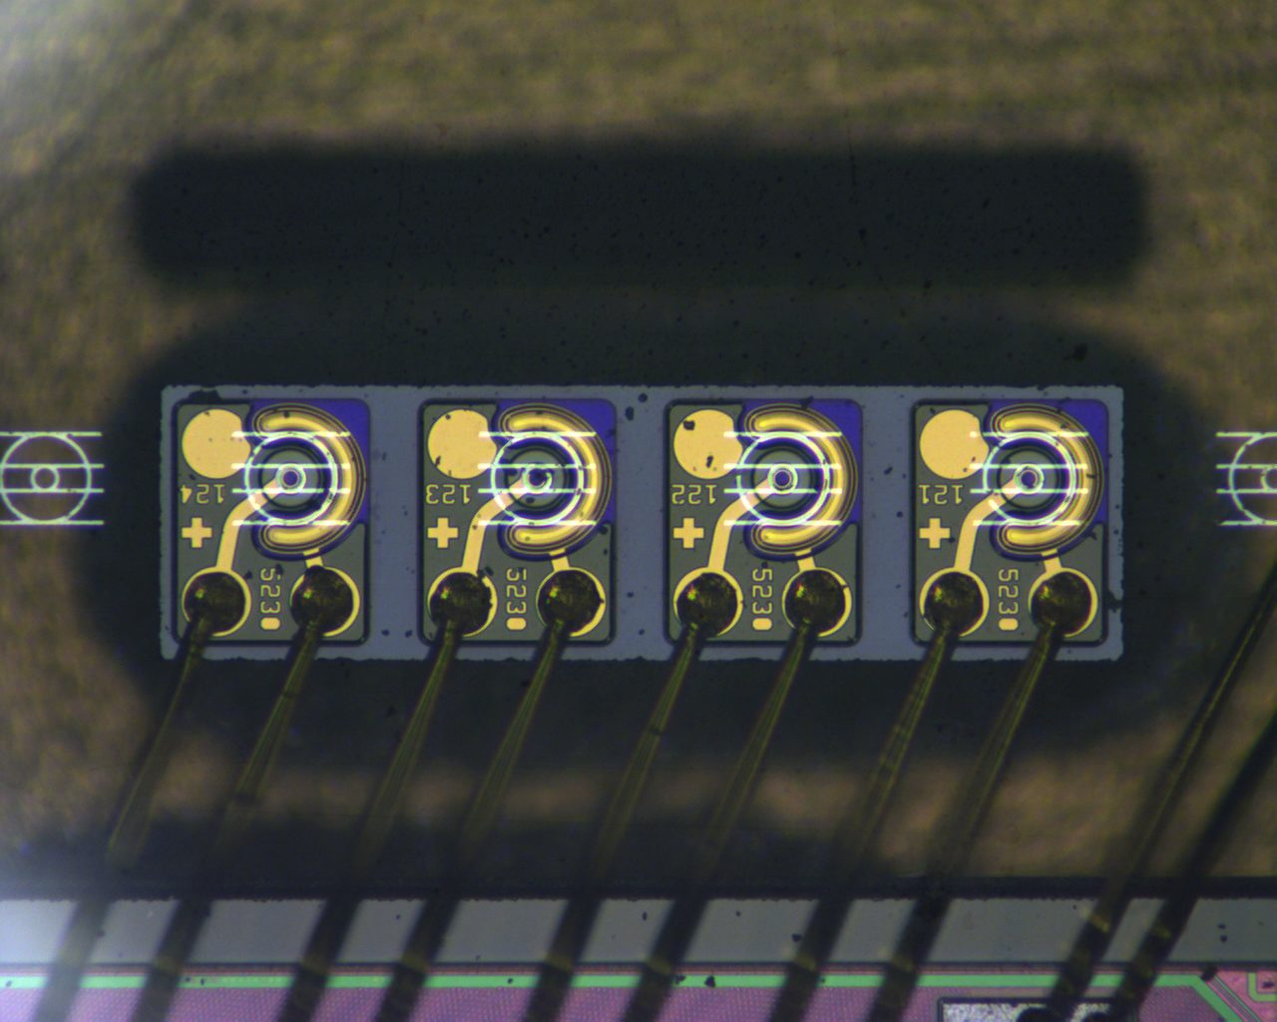
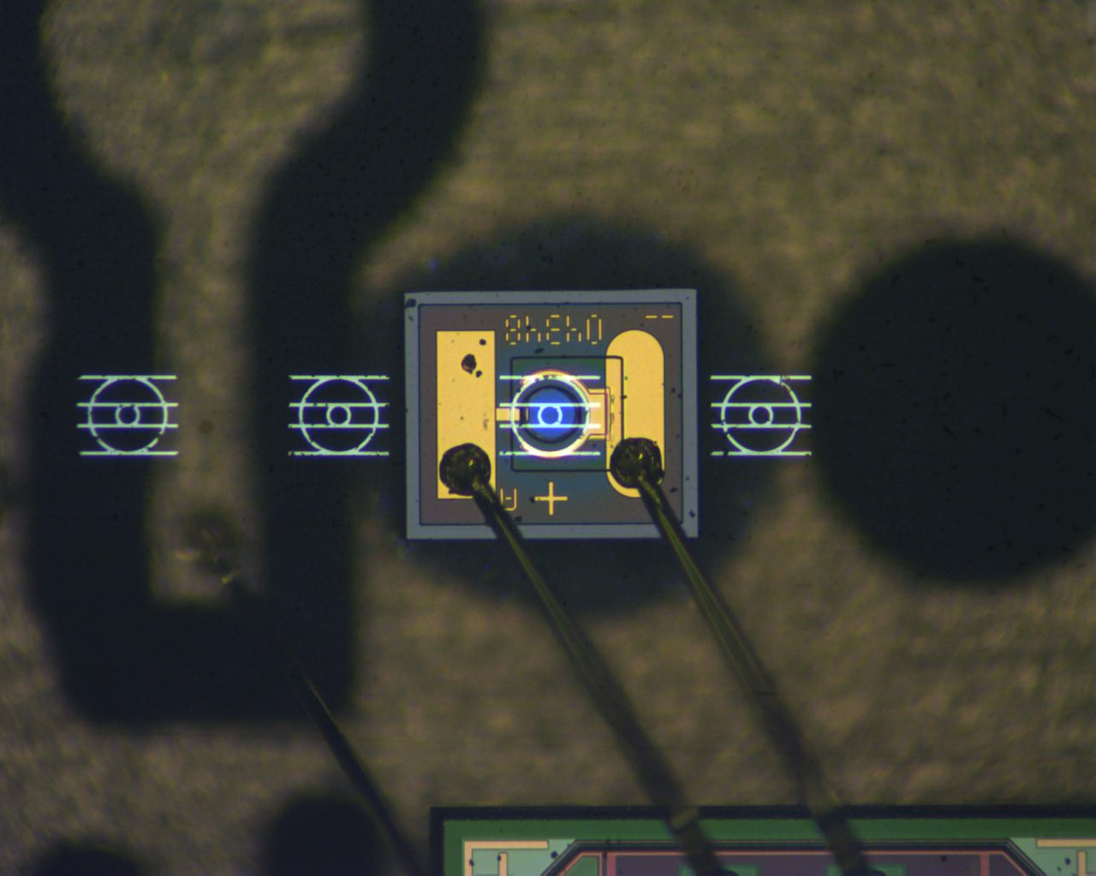
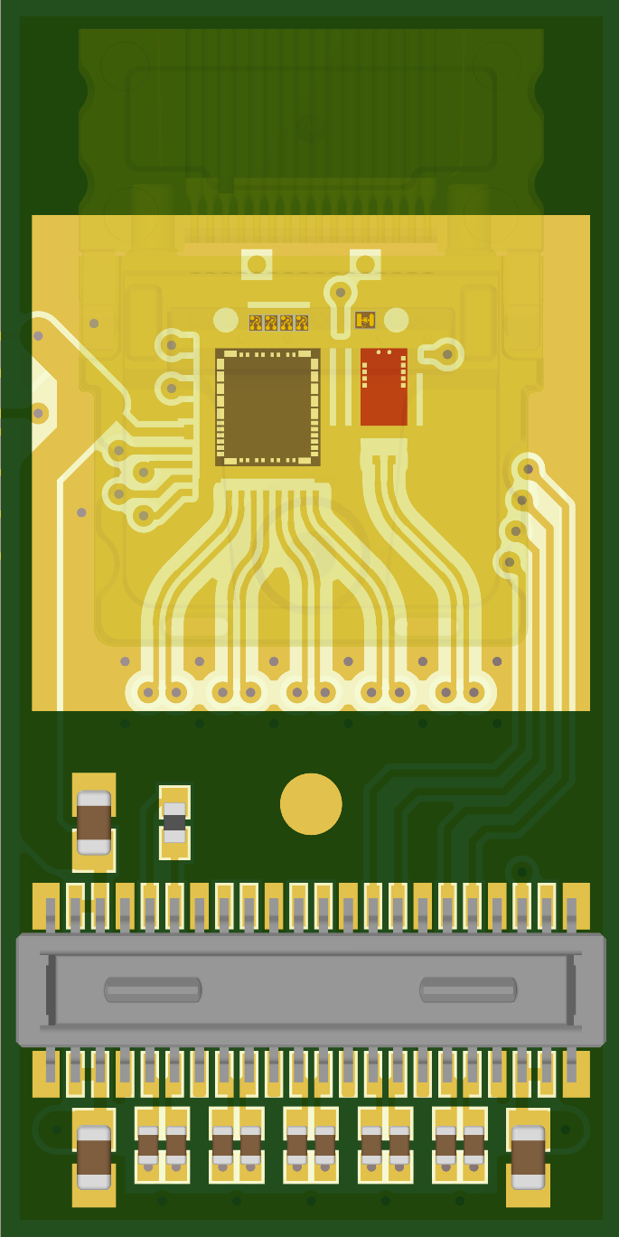
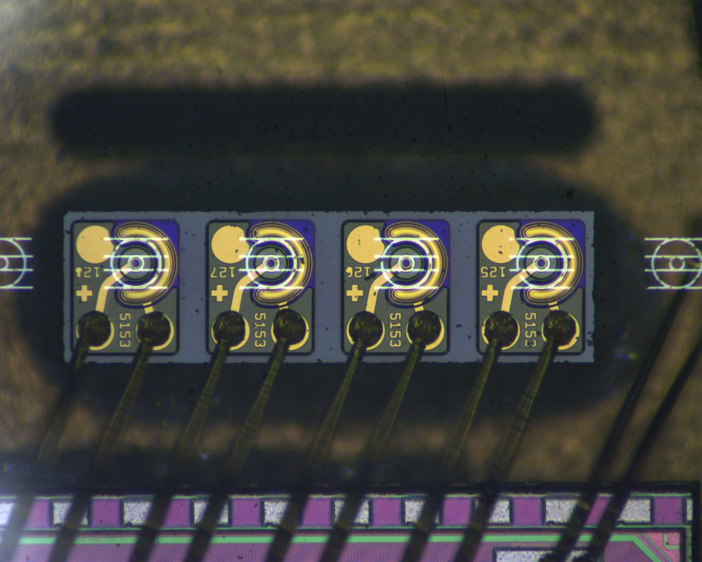
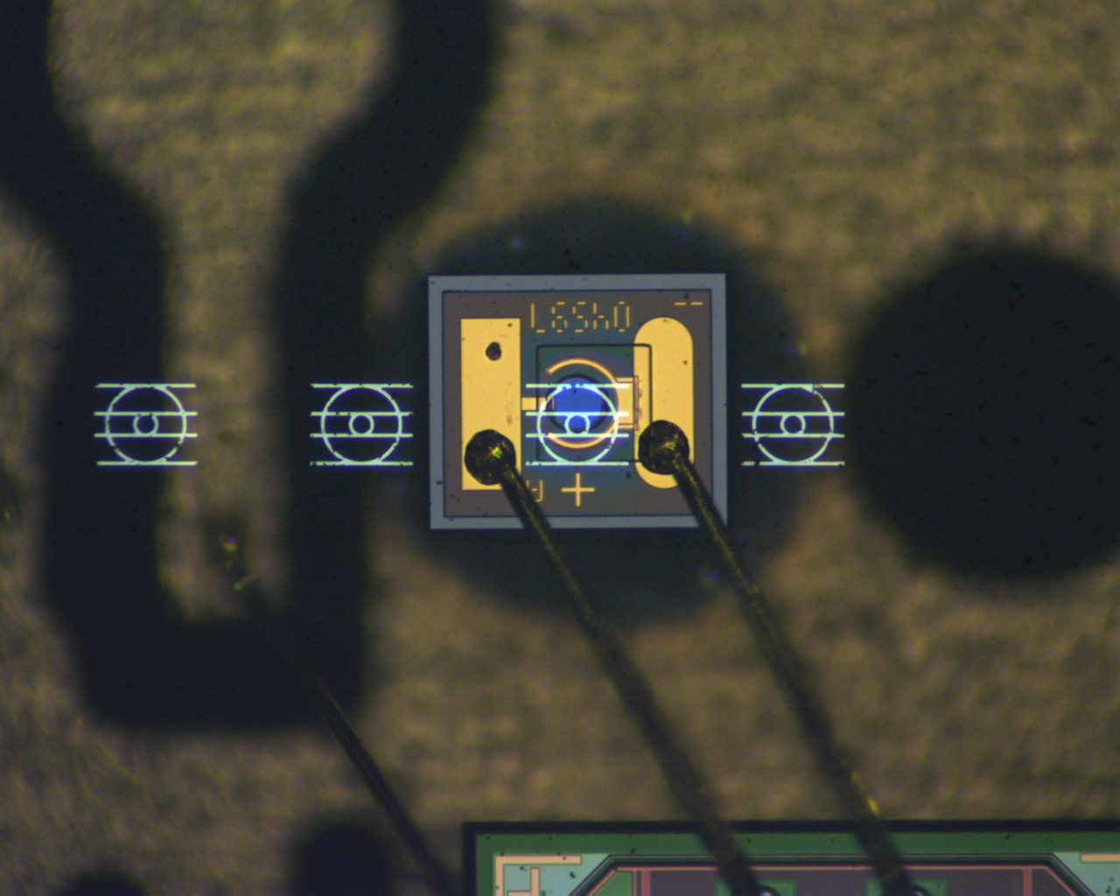
Receiver failures had offset photodiodes
ID 35451
Tx failure
ID 35511
Rx failure

Slide 15
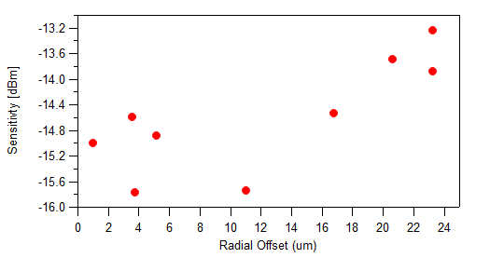
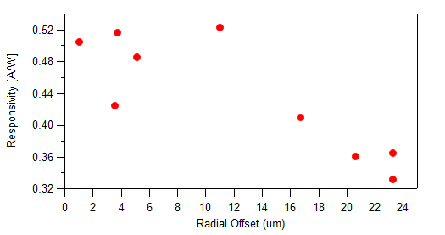
Modules with larger photodiode offsets tended to fail

Slide 16
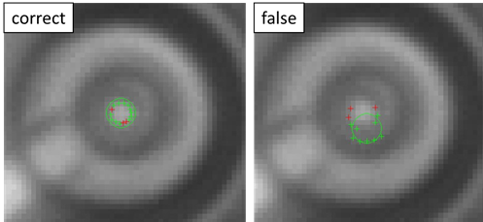
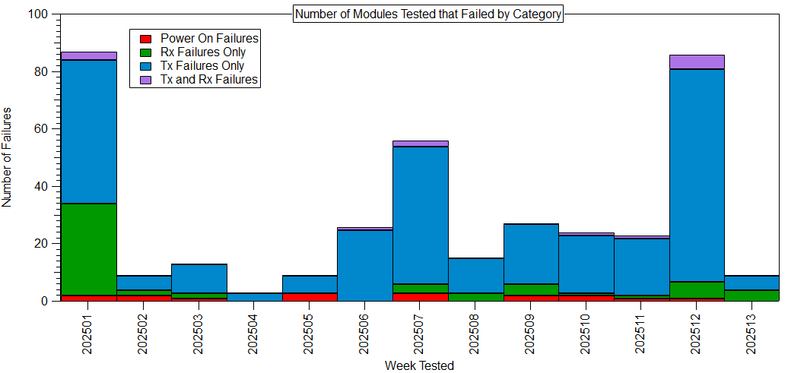
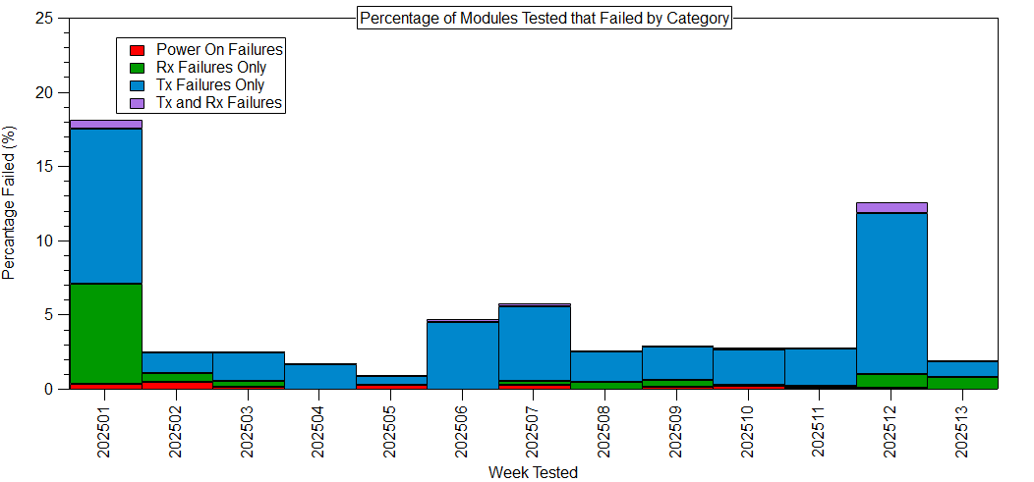
Resolution of photodiode issues
Incorrect detection of VCSEL eye on the placement machine meant reference points were off and thus the target position of the photodiode.
The company has since managed to correct the issue.

Slide 17
VCSEL – Lens Offset

Slide 18
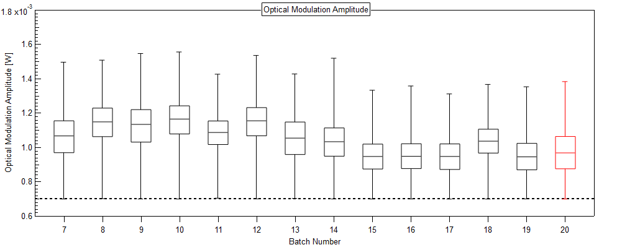
OMA is consistently lower than previous batches
Batch 15 was made in September

Slide 19
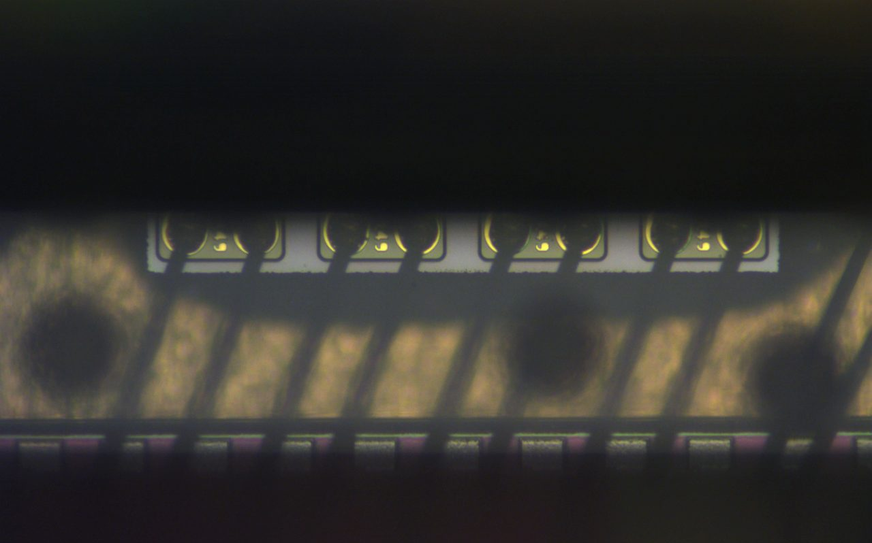
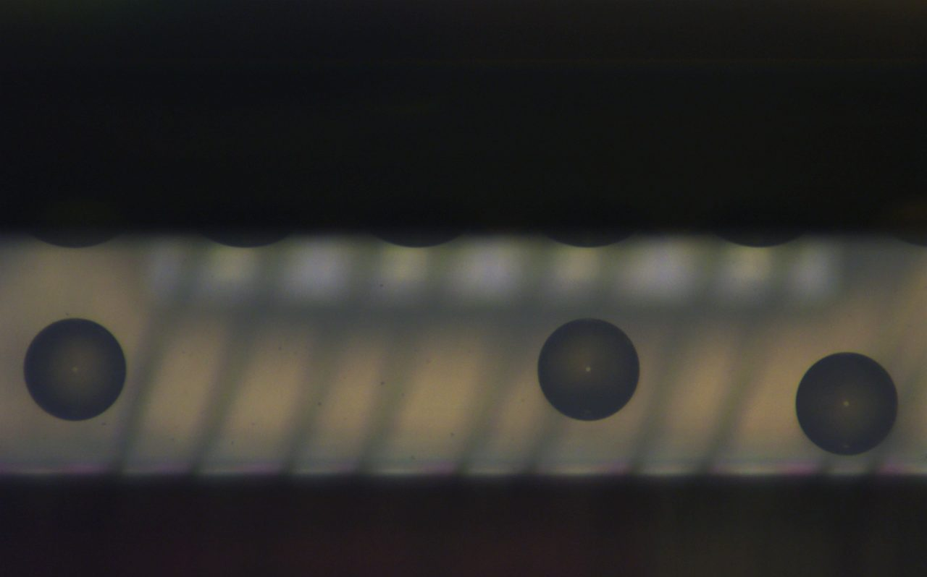
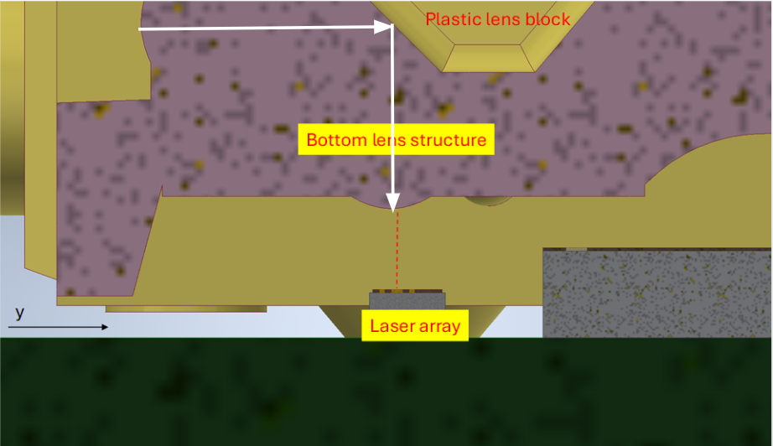
Offsets are calculated with a non-destructive method that uses image recognition
Lens
VCSEL eye
(250 μm,
300 μm)
(-80 μm,
170 μm)
VCSEL corner
Lens marker

Slide 20
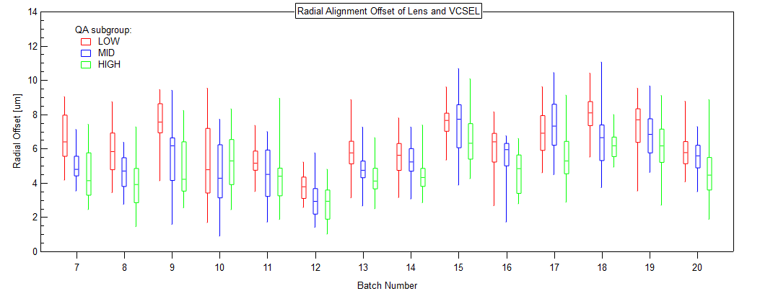
Recent batches past batch 15 have greater offsets of the lens
Batch 15 was made in September

Slide 21
Alignment Tolerances

Slide 22
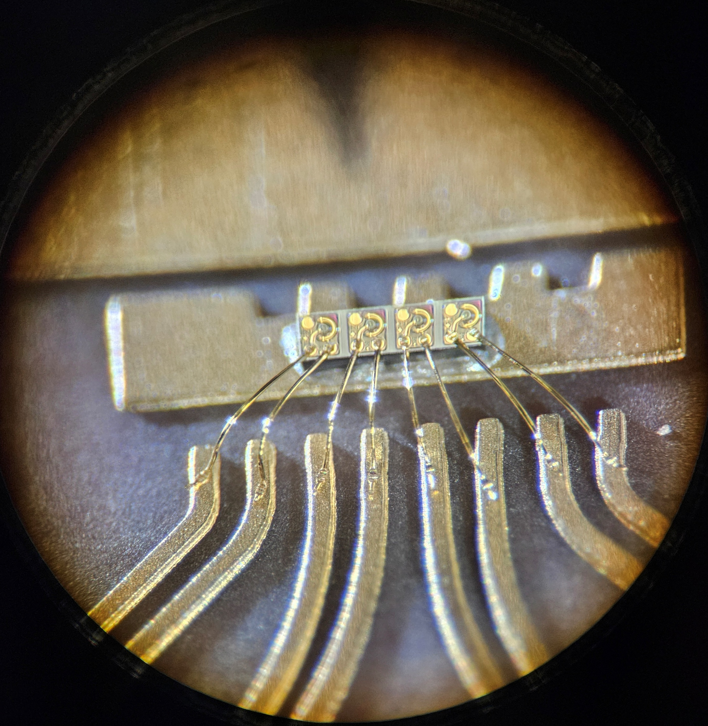
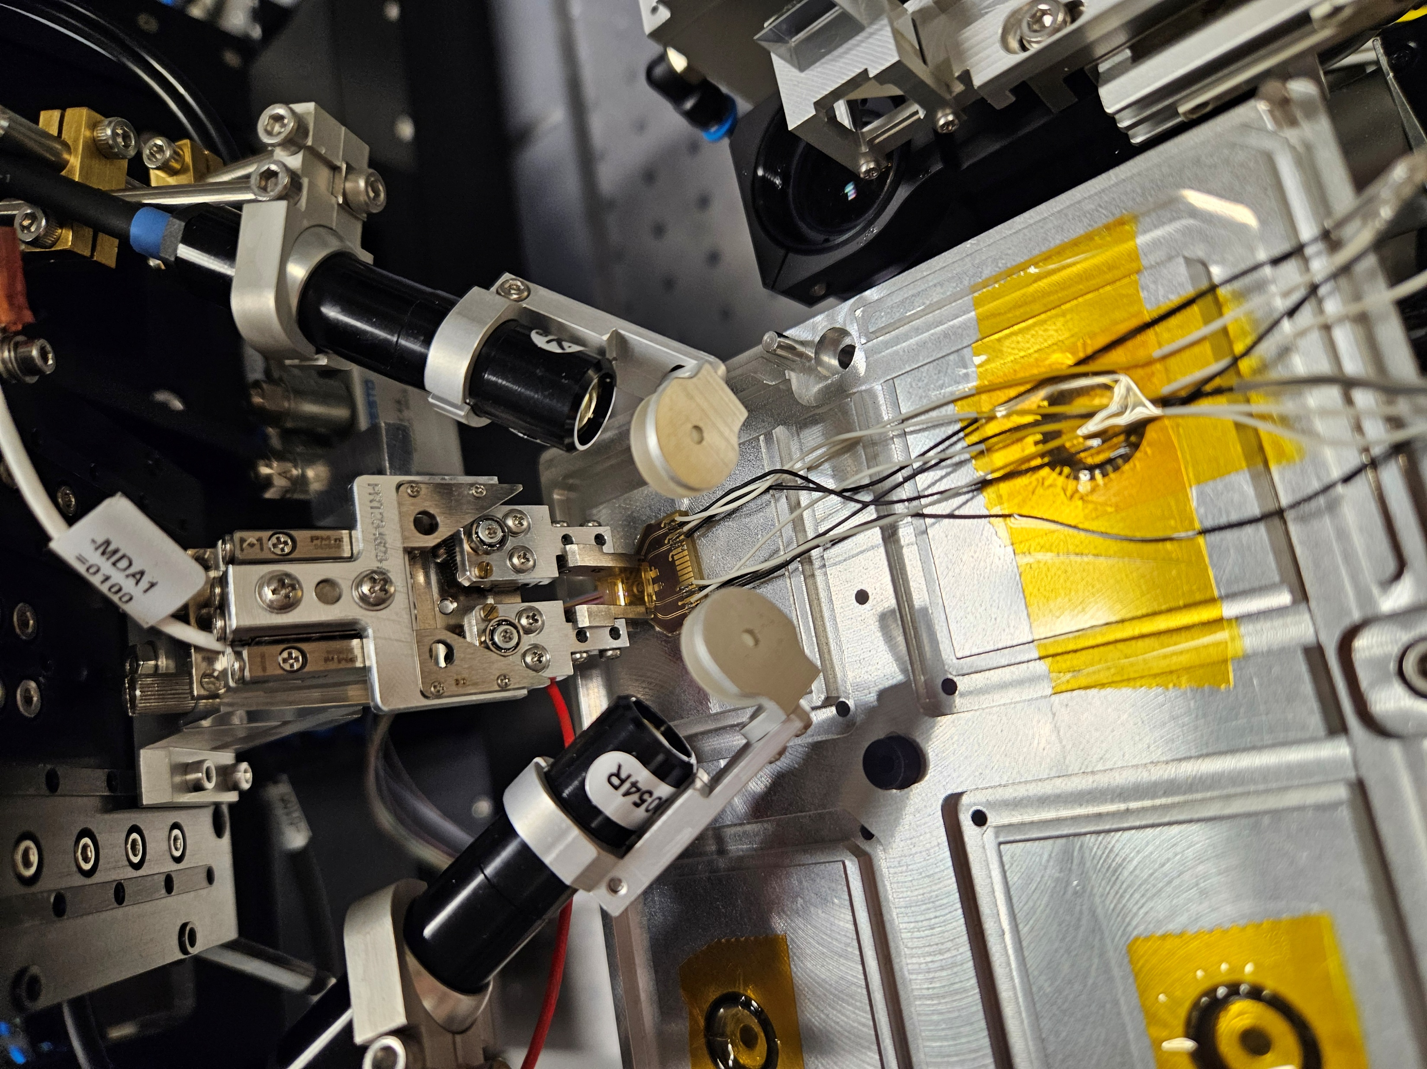
Optical components were tested on separate PCBs
y
x
The VCSEL array and photodiode were wire-bonded to separate test PCBs.
Thin wires were soldered to the PCB connection interface to allow it to lie flat on the surface.
Notes:
Point out coordinate systems used here and with the ficonTEC
Notice that it is only the VCSEL and photodiode used, no intermediate components

Slide 23
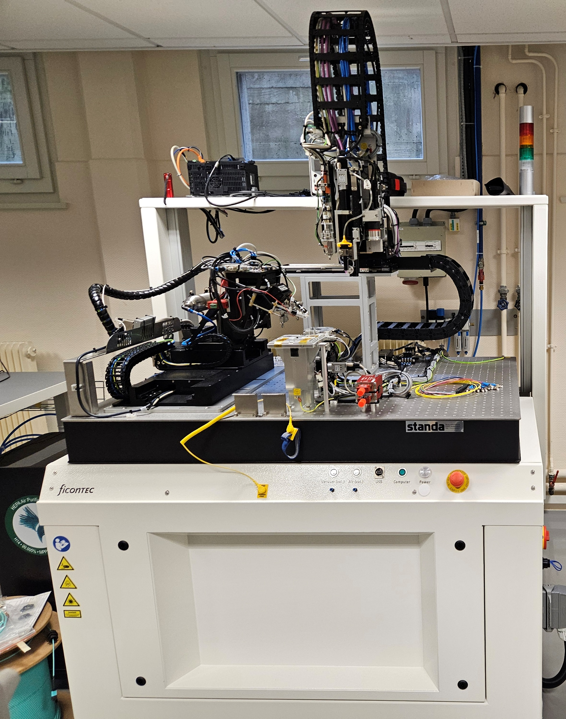
The lens was left detached from the board so that it could be moved
Lens held by pick-up tool
PCB with component on vacuum tray
OPM
ficonTEC fibre attachment machine

Slide 24
Measurement setup
VCSEL measurements
Photodiode measurements
Source meter
Laser source
Power supply
(Mode scrambler)
VCSEL
Photodiode
(Mode scrambler)
OPM
Source meter

Slide 25
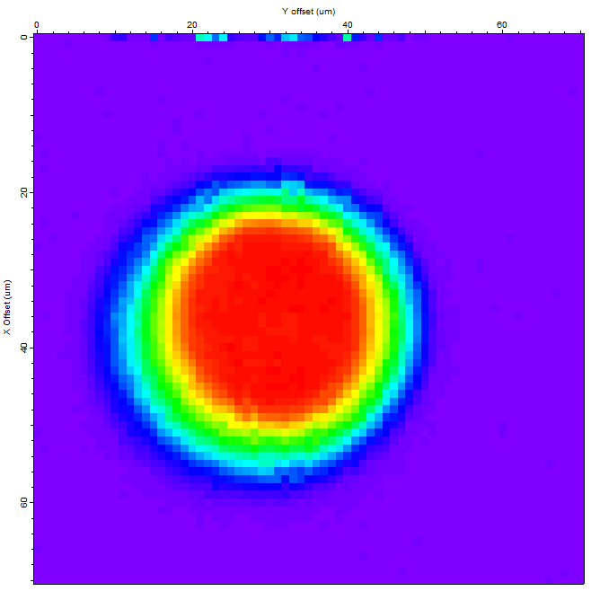
An area scan was conducted with the fibre attachment machine
VCSEL optical output power at a bias current of 2 mA.
The lens was moved over a range of 70 μm with a step size of 1 μm at a height of 32 μm up from the board.

Slide 26
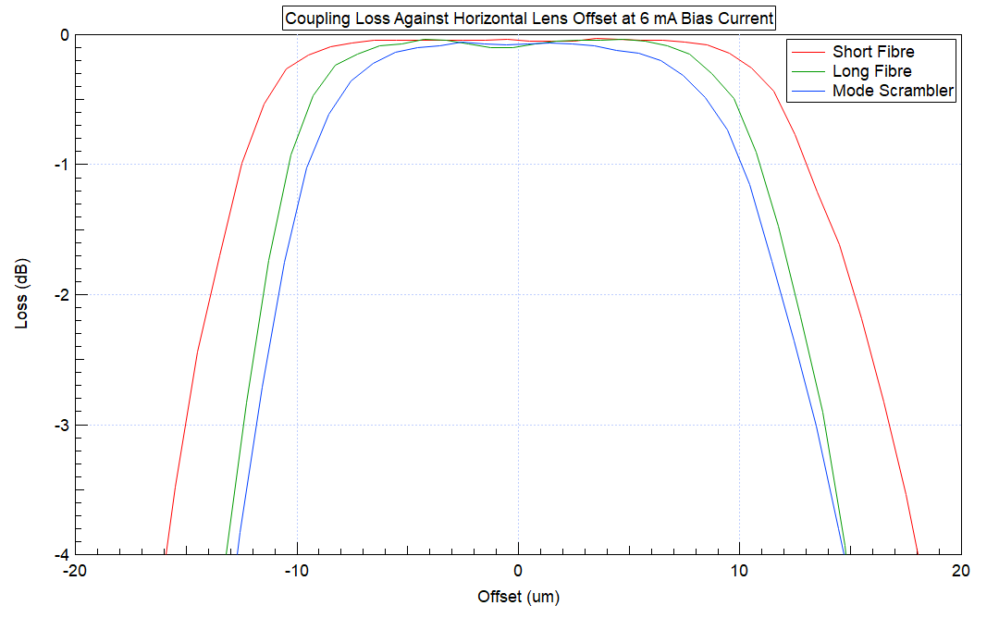
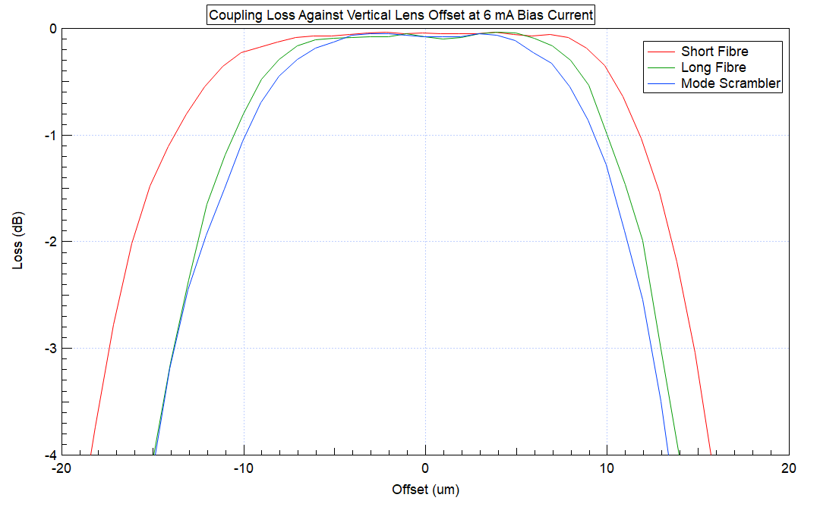
VCSEL Offset Tolerance
Optical path | Maximum offset without detectable loss (μm)
Direct connection | 8.151
Long fibre | 7.492
Mode scrambler | 6.223
The use of a long fibre and mode scrambler closer resembles a realistic scenario in which the VCSEL would be used, therefore the offset tolerance is 6 - 7 μm.

Slide 27
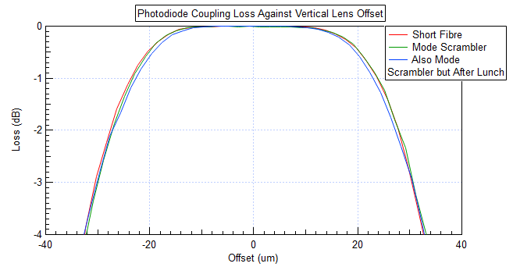
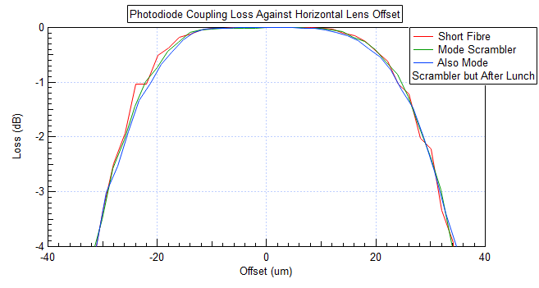
Photodiode Offset Tolerance
Optical path | Maximum offset without detectable loss (μm)
Direct connection | 10.454
Mode scrambler | 10.630
The photodiode current was not affected by the loss of light modes through the fibre. Its offset tolerance was around 10.5 μm.

Slide 28
Alignment Algorithm Accuracy

Slide 29
Modules with known lens offsets were created
-x
+x
-y
+y

Slide 30
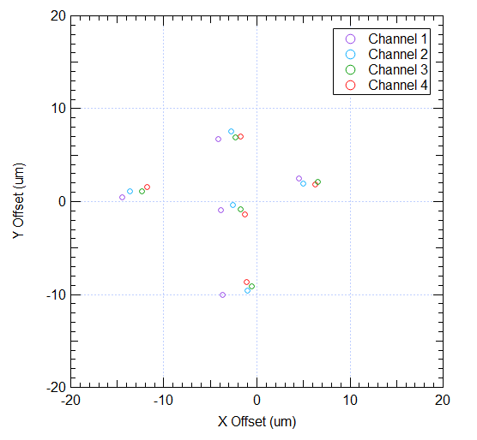
Calculated offsets were within 5 μm of the expected position
Average deviation from expected position
X Shift | -2.838 μm
Y Shift | -0.011 μm
The assembly process could also have introduced errors such that the expected offsets were not achieved.

Slide 31
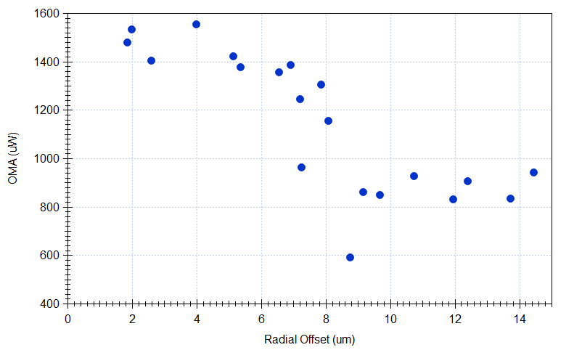
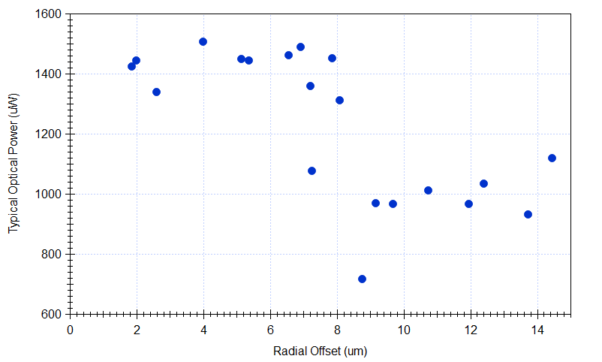
Optical parameters dropped significantly after 8 μm offset
Typical optical power shows a much sharper cut off than OMA.

Slide 32
Expected Temperature Response
+x
The PCB and lens have different coefficients of thermal expansion (~10 ppm/°C and ~50 ppm/°C respectively)
As the module is heated or cooled, the difference causes a small offset in the relative positions.
  40 ppm/°C × 3 mm × 65°C ≈ 8 μm [expansion]
  40 ppm/°C × 3 mm × -35°C ≈ 4 μm [contraction]
Lens
+y
VCSEL
Hot
Lens
Shift direction
Lens
VCSEL
3 mm
Cold
VCSEL
Lens Offset Direction | Cold Response | Hot Response
+x | NC | NC
-x | NC | NC
+y | Worse | Better
-y | Better | Worse
Glue
Lens
NC = No change

Slide 33
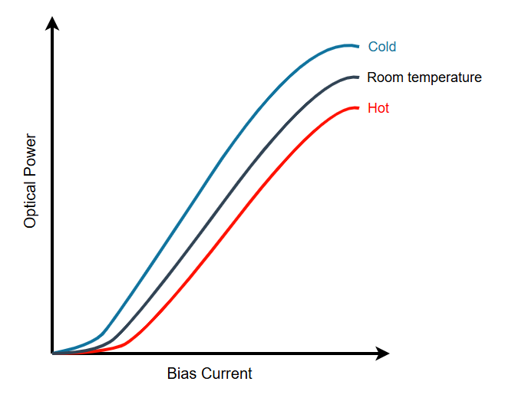
The VCSEL itself also exhibits temperature dependencies
Thermal rollover occurs at high bias currents when the extra current is converted into heat instead of optical power.
This effect is exaggerated by higher ambient temperatures.

Slide 34
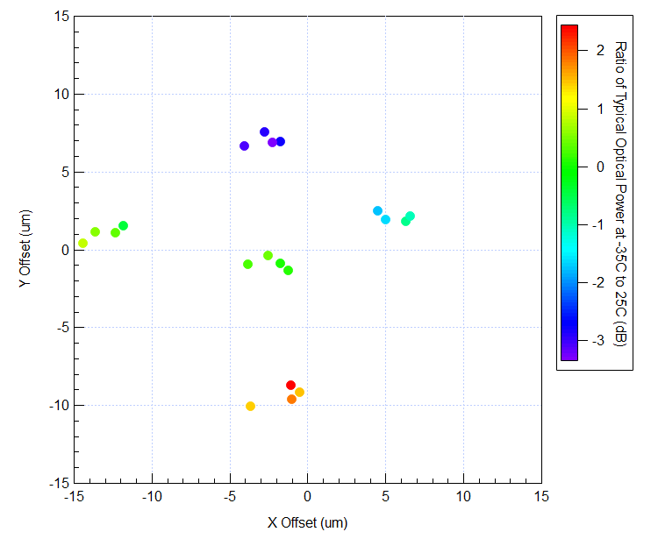
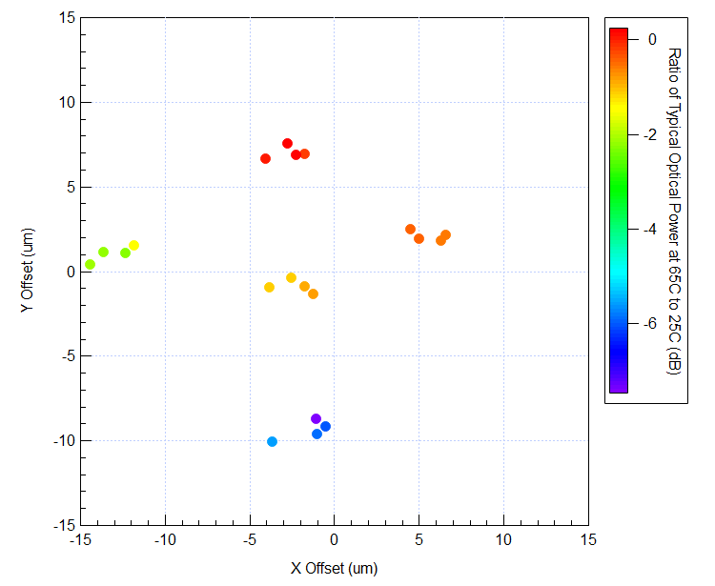
The temperature results match expectations
At -35°C, the VCSELs should perform better than room temperature (ratio > 0).
At 65°C, the VCSELs should perform worse than room temperature (ratio < 0).
Lens Offset Direction | Cold Response | Hot Response
+x | NC | NC
-x | NC | NC
+y | Worse | Better
-y | Better | Worse

Slide 35
Summary
A drop in production yield was attributed to failures of the receiver and the transmitter
Receiver failures were due to misplaced photodiodes
  Failures typically had offsets of more than 17 μm, measured with the algorithm
  The photodiode’s offset tolerance is 11 μm, measured with the ficonTEC
Transmitter failures were most likely due to misaligned lenses
  The VCSEL’s offset tolerance is 7 μm, measured with the ficonTEC
  Recent batches are more offset, measured with the algorithm
The algorithm which calculates the offset on average off by 3 μm
  Optical parameters declined after 8 μm, measured with the algorithm
  The temperature response of offset modules followed expectations
The QA programme is robust and provides detailed information about the production performance.
  Corrective actions can be taken based off the data gathered during the process.

