Slide 1
HL-LHC beam commissioning
R. De Maria

Slide 2
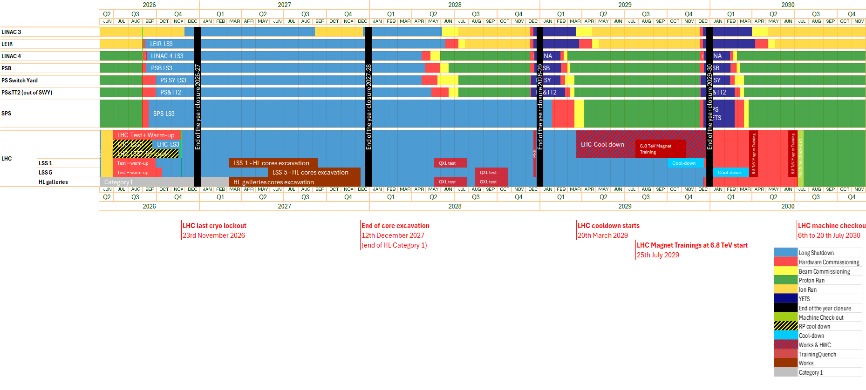
LS3 Master schedule
2030 year is a short year. This has implication on the commissioning strategy.
https://edms.cern.ch/ui/file/3222266/0.1/LS3_Master-0-1.png

Slide 3
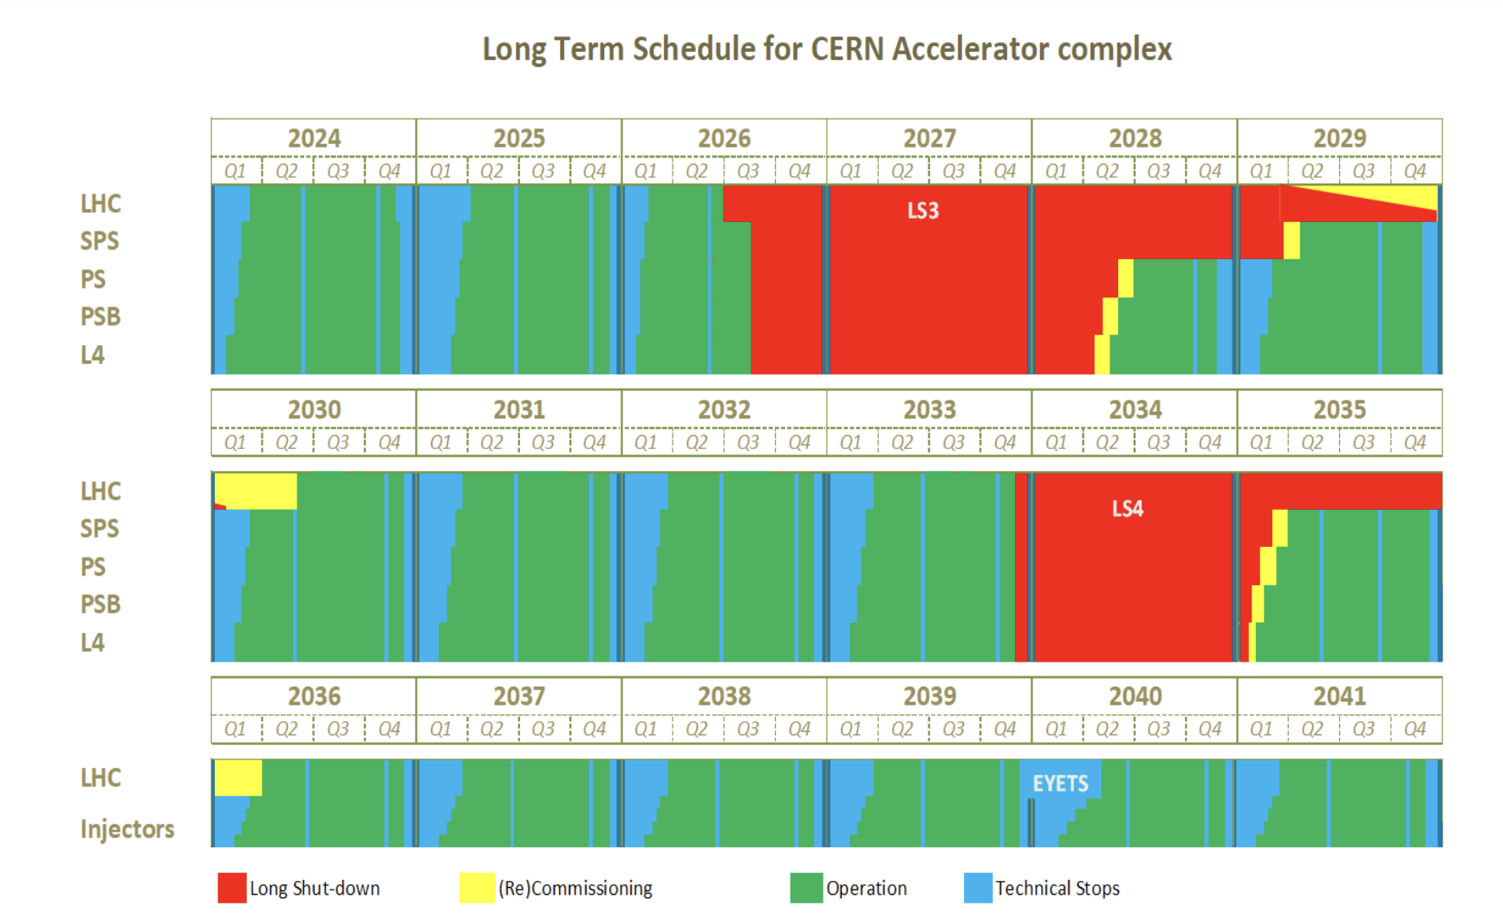
Schedule
Run | Year | Efficiency | Days Intensity ramp-up | Days Proton physics | Days Ion Physics
4 | 2030 | 0.5 | 20 | 35 | 0
 | 2031 | 0.5 | 15 | 136 | 29
 | 2032 | 0.5 | 10 | 154 | 29
 | 2033 | 0.5 | 10 | 152 | 29
5 | 2036 | 0.5 | 15 | 127 | 25
 | 2037 | 0.5 | 10 | 170 | 25
 | 2038 | 0.5 | 10 | 173 | 25
 | 2039 | 0.5 | 10 | 173 | 25
 | 2040 | 0.5 | 15 | 140 | 25
 | 2041 | 0.5 | 10 | 178 | 25
Recent update: ions operations in 2031-2041

Slide 4
HL-LHC Baseline optics cycle
2024
2025
HL Baseline
Main features established since 2013
HL-LHC baseline further updated to
follow layout changes
study options and improvements
Injection
β* = 10 m
ATS = 1
β* = 6 m
ATS = 1
End of ramp
β* = 2 m
ATS = 0.5
β* = 1 m
ATS = 1
ALICE no significant changes.
LHCb:
Run 4 no significant changes.
Run 5 flat option if upgrade.
VDM with β* ≤ 30.
No high beta runs requested
Collapse
β* = 1.2 m
ATS = 0.5
β* = 1 m
ATS = 1
Start of levelling
β* = 1.2 m
ATS = 0.5
β* = 64 cm
ATS = 1 (CC)
End levelling
β* = 30 cm
ATS = 2
β* = 60/18 cm
ATS =1/3.3
β* = 15 cm
ATS = 3.3 (CC)
References:
[1] S. Fartoukh PhysRevSTAB.16.111002
[2] R. De Maria et al. CERN-ACC-2013-0129

Slide 5
Filling schemes options
Goal: largest number of colliding bunches at 2.2 10¹¹, while keeping small bunch-by-bunch variations, low tails, small emittance, compatible with cryogenics limits.
There is a palette of beams for all scenarios.
Type | # Inj. | # bunches | # colliding bunches ATLAS/CMS Alice LHCb | Luminosity at same pile-up
4x72 STD | 13 | 2760 | 2748 2492 2574
5x48 BCMS | 13 | 2748 | 2736 2246 2370 | -0% -10% -8%
Hybrid | 13 | 2604 | 2592 2224 2313 | -6% -12% -11%
5x36 BCMS | 16 | 2484 | 2484 2121 2260 | -10% -12% -14%
8b+4e | 12 | 1972 | 1960 1886 1178 | -29% -24% -54%
Std 72b scheme more bunches, short injection time, compared to BCMS same for luminosity for ATLAS/CMS assuming same beam quality (losses, bunch-to-bunch variations,...).
BCMS 48b scheme better emittance and less e-cloud heating. BCMS proved better in Run 3 thanks to a better beam quality at 1.6 10¹¹. Extrapolation to 2.2 10¹¹ may be learned during 2025-26 MDs.
Hybrid scheme has more bunches compared to pure schemes for similar SEY, but add operational complexity.

Slide 6
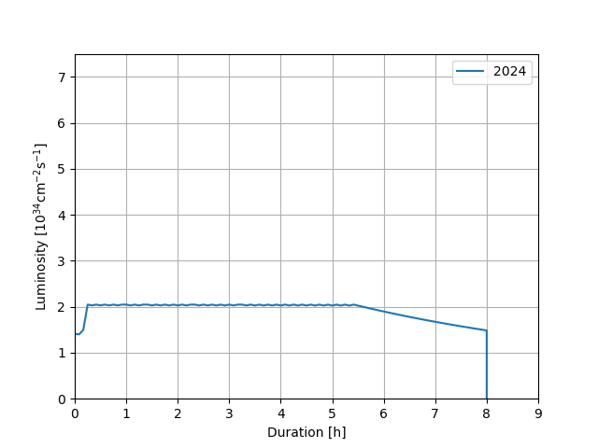
Performance evolution in Run 4 and 5
Run | Year | Days Intensity ramp-up | Days Proton physics | PPB [10¹¹] | β* [cm] | CC | PU_{max} | Int. Luminosity [fb⁻¹]

Slide 7
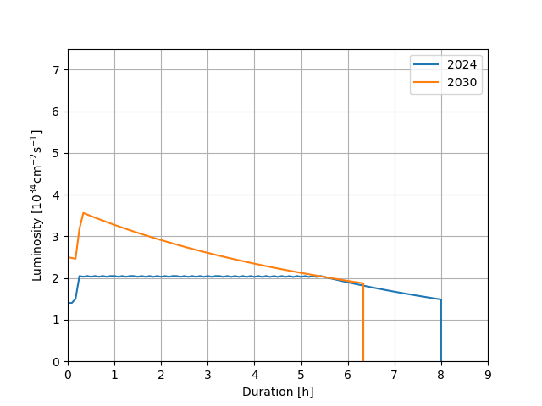
Performance evolution in Run 4 and 5
Run | Year | Days Intensity ramp-up | Days Proton physics | PPB [10¹¹] | β* [cm] | CC | PU_{max} | Int. Luminosity [fb⁻¹]
4 | 2030 | 20 | 35 | 1.8 | 30 | off | 101 | 32
Assuming reaching pile-up during beam commissioning, is it realistic?

Slide 8
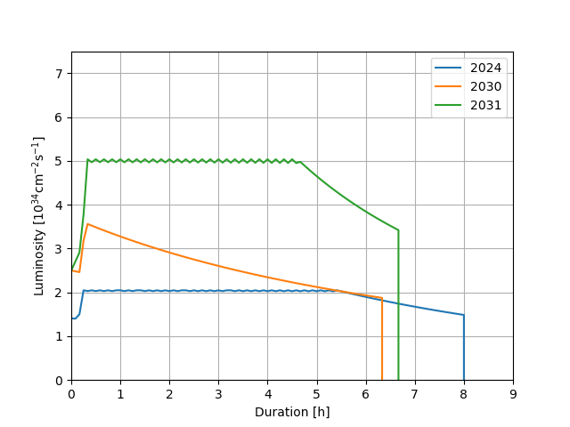
Performance evolution in Run 4 and 5
Run | Year | Days Intensity ramp-up | Days Proton physics | PPB [10¹¹] | β* [cm] | CC | PU_{max} | Int. Luminosity [fb⁻¹]
4 | 2030 | 20 | 35 | 1.8 | 30 | off | 101 | 32
 | 2031 | 15 | 136 | 2.2 | 25 | on | 132 | 206

Slide 9
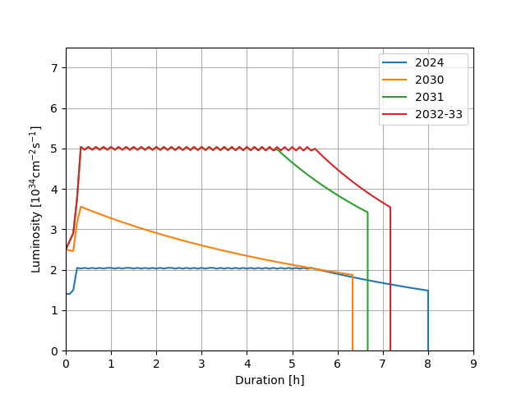
Performance evolution in Run 4 and 5
Run | Year | Days Intensity ramp-up | Days Proton physics | PPB [10¹¹] | β* [cm] | CC | PU_{max} | Int. Luminosity [fb⁻¹]
4 | 2030 | 20 | 35 | 1.8 | 30 | off | 101 | 32
 | 2031 | 15 | 136 | 2.2 | 25 | on | 132 | 206
 | 2032 | 10 | 154 |  | 20 |  |  | 237
 | 2033 |  | 152 |  |  |  |  | 234

Slide 10
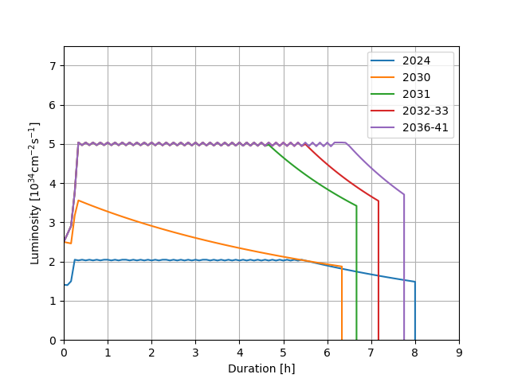
Performance evolution in Run 4 and 5
Run | Year | Days Intensity ramp-up | Days Proton physics | PPB [10¹¹] | β* [cm] | CC | PU_{max} | Int. Luminosity [fb⁻¹]
4 | 2030 | 20 | 35 | 1.8 | 30 | off | 101 | 32
 | 2031 | 15 | 136 | 2.2 | 25 | on | 132 | 206
 | 2032 | 10 | 154 |  | 20 |  |  | 237
 | 2033 |  | 152 |  |  |  |  | 234
5 | 2036 | 15 | 127 |  | 15 |  |  | 208
 | 2037 | 10 | 170 |  |  |  |  | 271
 | 2038 |  | 173 |  |  |  |  | 276
 | 2039 |  | 173 |  |  |  |  | 276
 | 2040 | 15 | 140 |  |  |  |  | 229
 | 2041 | 10 | 178 |  |  |  |  | 284
Estimates do not reach 3000 fb⁻¹ target due to additional ion days.
Run 4+5 |  | 2251
All +520 fb⁻¹ |  | 2771

Slide 11
Towards new baseline
Run | Year | Reference PU | Reference (fb-¹)
4 | 2030 | 100 | 32
 | 2031 | 132 | 206
 | 2032 | 132 | 237
 | 2033 | 132 | 234
5 | 2036 | 132 | 208
 | 2037 | 132 | 271
 | 2038 | 132 | 276
 | 2039 | 132 | 276
 | 2040 | 132 | 229
 | 2041 | 132 | 284
Sum Run 4 Run 5 |  |  | 2251
Sum all runs (+520) |  |  | 2771
New Baseline PU | New Baseline (fb-¹)
100 | 32
132 | 206
132 | 237
132 | 234
170 | 239
170 | 311
170 | 317
170 | 317
170 | 262
170 | 325
 | 2480
 | 3000
Identify parameters for the HL-LHC operation to reach the 3000 fb⁻¹ goal even with ion runs until the end of HL-LHC.
The parameters to be still developed further later, but this would allow having a first baseline that both the machine and experiments can agree on.
An intermediate PU value in Run 5 would allow reaching the 3000 fb⁻¹ goal.

Slide 12
Year 1 Commissioning goals
Recover Run 3 conditions
  Full machine towards 1.8e11p/b
  IP 1/5 optics (baseline: 30 cm beta* - round, potentially flat!)
  Same collimation strategy as in Run 3
Assess e-cloud situation: BST Project effectiveness vs sectors degradation
Provide enough time to the commissioning activities for Experiments
  interleaved commissioning at 450 GeV SB and 6.8 TeV SB
  (PU in 2030 not exceeding a peak of 100 at the beginning of the fill)
Commission Crab Cavities to beam “transparent mode” (No Crabbing)
  Operating at ~1 MV
MD studies on:
  limitations on intensity reach (2.3e11p/b)
  Crabbing commissioning at FT
G. Trad, Chamonix 2025

Slide 13
HL-LHC beam commissioning
Entirely new systems:
Crab cavities, FRAS, Triplets, D1-D2, new orbit and non-linear correctors,
new detectors, Roman Pots (PPS2 approved in CMS, no FP in ATLAS),
new tertiaries, new collimators, dump, TCDQ control upgrade, new BPMs.
Additional commissioning steps in the first year:
Polarity checks for new circuits,
LLRF for crab cavities,
additional orbit setup after first collisions.
‹#›

Slide 14
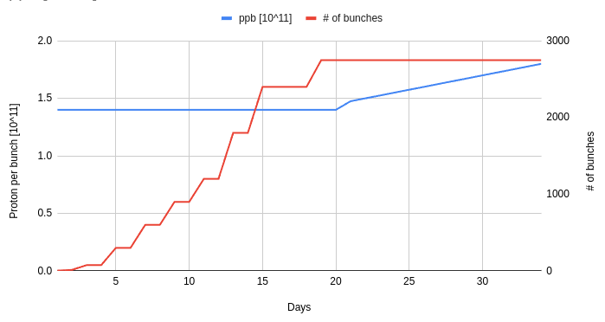
Number of bunches and ppb ramp-up
Run 4
1. Start bunch ramp-up at intermediate intensity, e.g. ~1.4·10¹¹ as trade-off between scrubbing efficiency and integrated luminosity.
2. Fill the maximum number of bunches and continue bunch charge ramp-up.
History of intensity steps:
2016: 3 – 12 – 48/72 – 288 – 570 – 860 – 1200 – 1700 – 2220
2017: 3 – 12 – 72 – 300 – 600 – 900 – 1200 – 1800 – 2400 – 2550
2018: 3/12 – 72 – 300 – 600 – 900 – 1200 – 1800 – 2400 – 2550
2022: 3/12 – 75 – 300 – 600 – 900 – 1200 – 1800 – 2400
2023: 3/12 – 75 – 400 – 900– 1200 – 1800 – 2400
Ambitious timeline, aiming to be 50% faster than the post-LS2 period, which was delayed by availability issues, including UFOs and training quenches.
The BST project is a factor to consider. It’s crucial to ensure that no new UFO hotspots are introduced (in the 100/120/140 half cells)
Plans after successful scrubbing and no cryogenic limits.
Which pile-up ramp-up would be desirable from the first days and years?
‹#›

Slide 15
Beam commissioning: main steps in the first year
Injection
Collimation
BI
RF,
ADT
Dump
Experiments
In parallel and interleaved
450 GeV
Orbit
Polarity
Optics
Orbit
CC
pilots
CC
trains
MP validation for 48-72 >1.1·10¹¹ ppb bunches
First Collisions
TS: FRAS alignment
Optics, Orbit, …
Loss maps & aperture
day 40
up to 7 TeV GeV
Intensity ramp-up
Ramp&
squeeze
Levelling steps
MP
valid.
to 1.8·10¹¹ ppb
to 2748 bunches
Physics
day 80
day 100
When and under which conditions, experiments will be able to provide luminous region positions?
‹#›

Slide 16

Strategy Proposal
450 GeV
6.8 TeV
Thread/Circulate Probe
Polarity Checks/ Optics Meas.
Ramp & Squeeze Setup
Start commissioning with Crab cavities OFF
Setup for INDIVs
Optics Meas./Corrections
Beam based initial mis-alignments identification in IR + Coarse electrical centres of CC, if possible, with Setup Beam (<5 INDIV)
Remote Alignment - FRAS
Squeeze Setup
Silver “ORBIT”
STOP: Align where possible FRAS equipped circuits (remote), likely during access + Establish “Silver Orbit”.
CC Setup : Probe + INDIVs
450 GeV Stable Beams
Collimation & Aperture
Resume Commissioning; Stable Beams at Injection, Trains Setup, Scrubbing…
TRAIN SETUP
Collisions and levelling setup
CC accurate electric centers
IP shift measured by EXP
CC TRAINS
EXP
Tests
Cycle Validation
2030 TS best fits around here!
RAMP UP, PHYSICS

Slide 17
Strategy Proposal
450 GeV
6.8 TeV
Thread/Circulate Probe
Polarity Checks/ Optics Meas.
Ramp & Squeeze Setup
Setup for INDIVs
Optics Meas./Corrections
Remote Alignment - FRAS
Squeeze Setup
If CC electric center (or residual offset after coarse alignment if available) is beyond tolerance for operation with full beam at ~1MV counterphase.
Silver “ORBIT”
CC Setup : Probe + INDIVs
450 GeV Stable Beams
Collimation & Aperture
TRAIN SETUP
Collisions and levelling setup
CC TRAINS
EXP
Tests
Cycle Validation
CC CM FRAS
Optics/Aperture Check
RAMP UP, PHYSICS

Slide 18
Strategy Proposal
450 GeV
6.8 TeV
Thread/Circulate Probe
Polarity Checks/ Optics Meas.
Ramp & Squeeze Setup
Setup for INDIVs
Optics Meas./Corrections
Remote Alignment - FRAS
Squeeze Setup
If CC electric center (or residual offset after coarse alignment if available) is beyond tolerance for operation with full beam at ~1MV counterphase.
If IP shift is beyond tolerance for a “commissioning year” (~10% of yearly HL production at best) and beyond IR correctors strength to compensate with a bump
GOLDEN “ORBIT”
CC Setup : Probe + INDIVs
450 GeV Stable Beams
Collimation & Aperture
TRAIN SETUP
Collisions and levelling setup
CC TRAINS
EXP
Tests
Cycle Validation
IR alignment
Both scenarios have a low likelihood of occurring
RAMP UP, PHYSICS

Slide 19
Beam commissioning: main steps in the 2nd year
Injection
Collimation
BI
RF-ADT
Dump
In parallel and interleaved
Experiments
450 GeV
Orbit
FRAS alignment
Optics,
Orbit
Orbit
Loss maps& aperture
MP
valid.
up to 7 TeV
Intensity ramp-up
Levelling step
CC crabbing
MP
valid.
to 2.3·10¹¹ pbb
to 2748 bunches
day 40
day 55
Physics
Commissioning for the second and following years would be shorter, with an optional re-alignment step if the alignment foreseen during the YETS requires fine-tuning.
up to 129 days
‹#›

Slide 20
Questions for discussion
Is the target of PU=170 in Run 5 OK for the detectors? (this is to ensure the 3000fb-1 goal)
If yes, would detectors prefer to have a gradual PU ramp-up already in Run 4 up to 170?
Concerning commissioning, what is the request of the detectors concerning PU ramp-up in the first year(s) of Run 4? (Wished steps in PU with integrated fb-1)
Do 8b4e or hybrid schemes pose limitations for the detectors in the HL era?
Baseline crossing scheme is H-V in IP1-5, respectively, and HL-LHC is compatible with V-H, initially conceived for energy deposition mitigations. Currently we are considering as an option V-H for improved performance with flat optics. What is the feedback or preference from the detectors?
Emittance and bunch intensity of witness bunches are respectively a factor 2 larger and a factor 2 lower than nominal bunches. Is this OK for background? Is there any more margin?
‹#›

Slide 21
Back-up

Slide 22
Considerations
Main Experiments starting with new detectors; dedicated commissioning requests are expected
Interleaved setup at both energies highly appreciated (muons and jets at FT are crucial for commissioning)
  pilots: Phase and Voltage scan, setup of LLRF setup, loops, MP interlocks
  1 Train : e-cloud conditioning check, electrical centre
  Validating frequency control
Experiments
Crab Cavity Commissioning
450 GeV
FT
Intensive commissioning plan spanning over the first 5/6 weeks of the commissioning
Precise information on collision spot may result difficult at the early stages of Stable Beams at 450 GeV
Short year, dominated by commissioning, (no Ion Run)
Intensity ramp-up cannot start without validating that offset at the CC is within tolerance
FRAS system
Ring Orbit
Moving magnetic elements invalidates
MP setup
Moving non-magnetic elements (i.e. CC CM) entails Aperture/Optics Checks
Not all elements can be remote aligned (i.e. to shift collision point in detectors)
First usage foreseen in TS to gain experience
Limited strength in IR correctors to cope with nominal xing angle, tolerances on triplet
miss-alignments (0.5mm), IP shift (0.5mm) and beam position at CC
Re-alignment could be needed if residual imperfections (inner tracker position uncertainty) exceed tolerances

Slide 23
Refined Inputs
Crab Cavities:
  Likely feasible to circulate pilots and INDIV at injection and flat-top with the cavities OFF
  Non-crabbing mode (~1 MV/cavity), 1–2 mm of electrical misalignment is tolerated (found <0.5mm in SPS)
  A coarse misalignment may be measured with a setup beam (~5×10^11 protons) at injection.
  Potential conflicts in Powering campaign could be mitigated with limited RF conditioning
Experiments:
  Previous LHC experience gives confidence that we should not be far from the tolerated offset
  With the shortened Y1 (low integrated luminosity), ongoing discussions on updating the tolerance aiming at a re-alignment only in YETS, if needed
  Experiments value having 2 months of “Stable Beams” throughout LHC beam commissioning
FRAS usage:
  TS needed if need for moving non remote elements
    Envisage a preliminary remote alignment before validating the machine at Injection (during an access)
Experience from previous commissioning coordination:
  Identifying limitations optics/aperture at FT as quick as possible is very important
  Hard to draw an efficient plan if not alternating teams possible only with for parallel setup at both energies

Slide 24
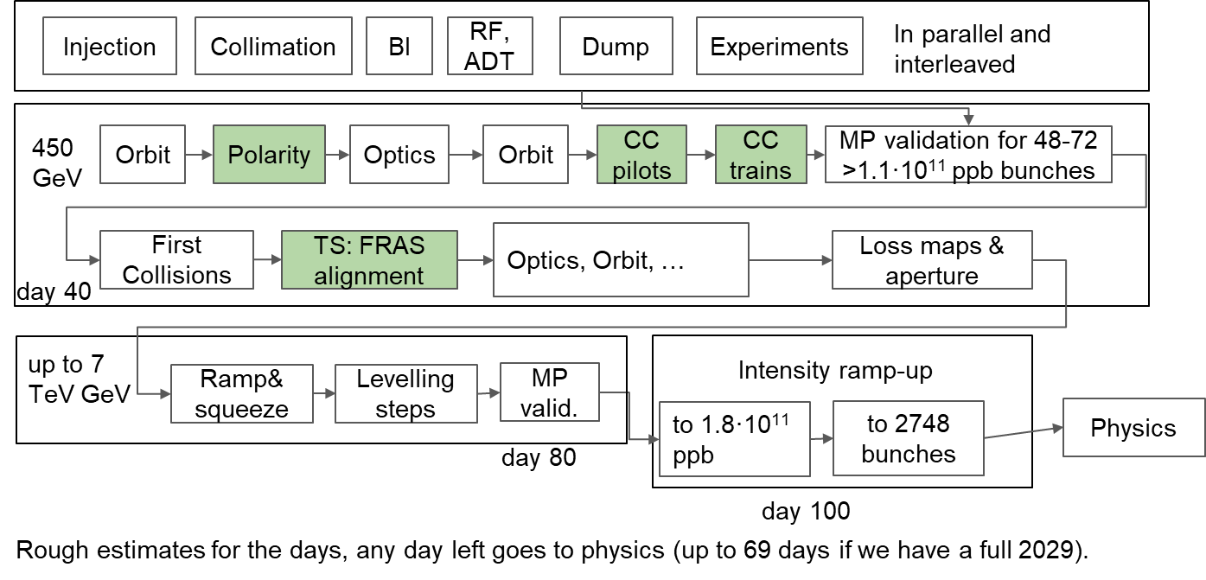
Adaptability!
Alternate commissioning at both energies, advancing Top energy setup anticipating potential issues/limitations
  Alternate activities / teams for better efficiency
Ensure commissioning time for EXP, SB requested for commissioning both at 450 GeV and top Energy
If within tolerances/relaxed tolerances CC centering and IP shifts are just measured and corrected in YETS
Establish “Golden Orbit”
  Trains at Injection (CC centering)
  Stable Beams at Injection (IP shift)
  Technical Stop -> Alignment (+ FRAS)
Cycle setup activities to FT
  MP, OMC, Collimation, RF, Levelling, OP
Intensity Ramp up
Lumi Production for 69 days with 1.8e11 p/b
  HYP: Full year 2030

Slide 25
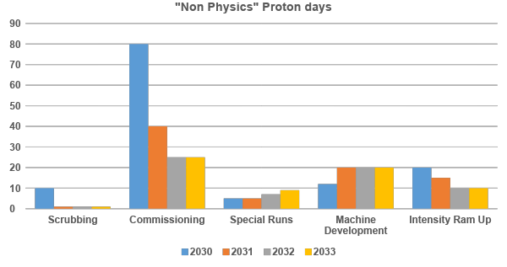
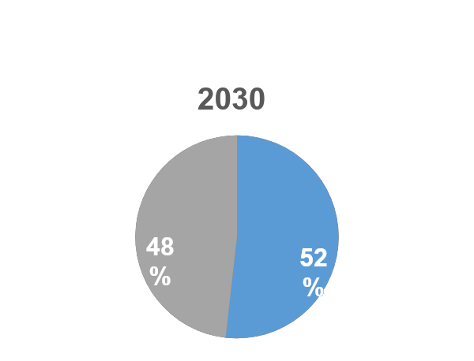
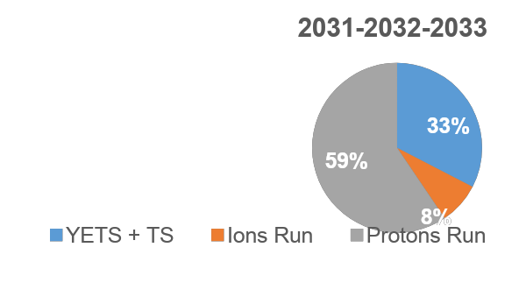
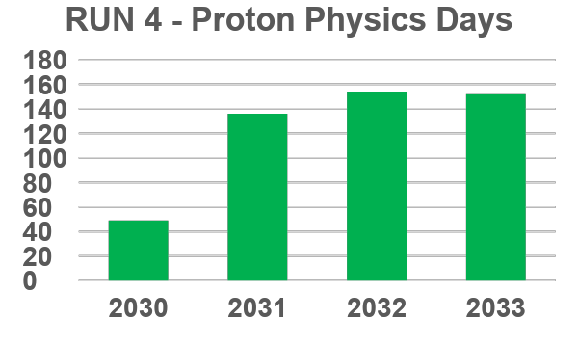
For Y1+
Dedicated Scrubbing only 1 day/year
Run 4 default commissioning time 25 days/year (extra 15 days in 2031 for crabbing setup)
Machine development 3 blocks totaling 20 days/year
2031 Intensity Ramp up 15 days (reach 2.3e11 p/b), then 10 days/year
Default YETS (15w) + TS (2x7d)

