Slide 1
PS to CTF3 area extraction
C. Bracco

Slide 2
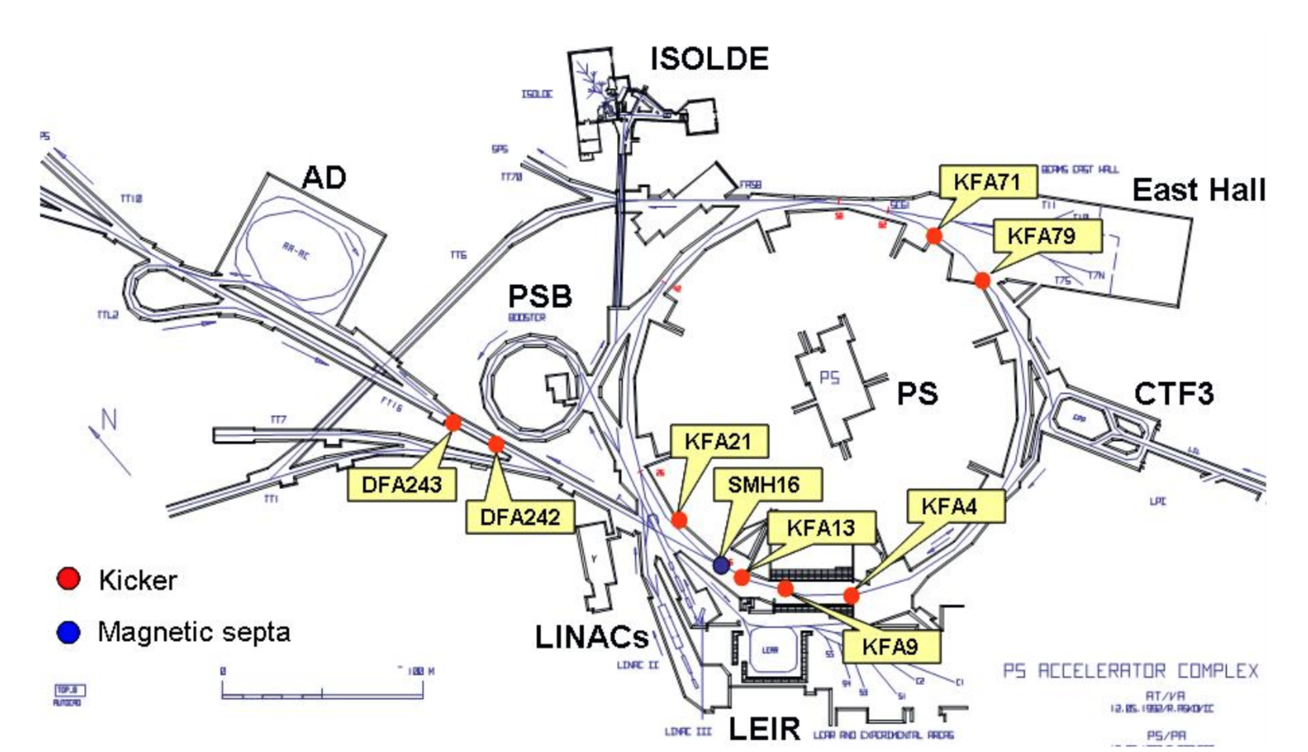
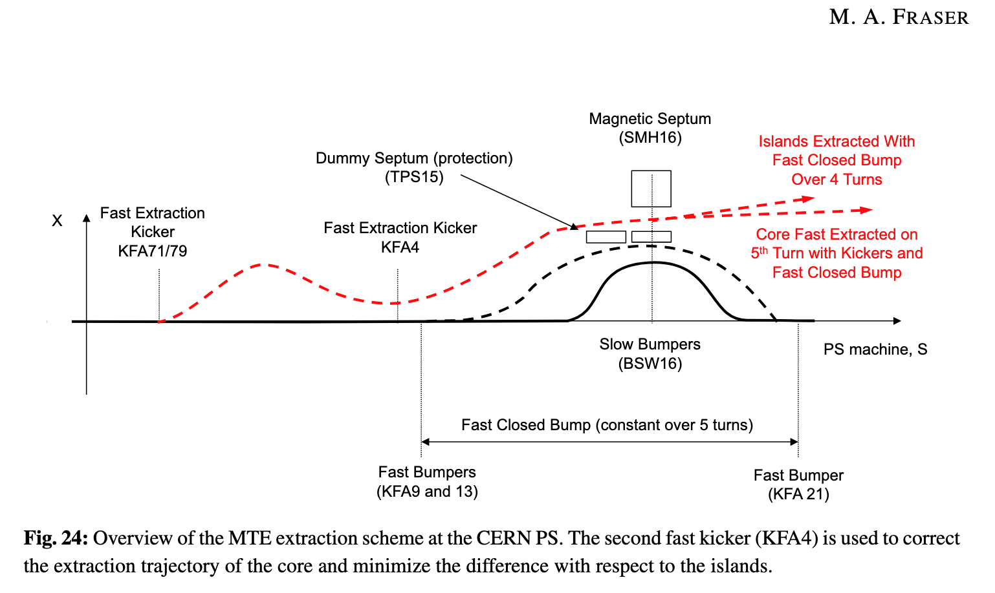
PS extraction
Single turn extraction towards TT2 (Fast kicker KFA71, septum SMH16, slow bumpers BSW16)
Slow Extraction towards EAST Area (Electrostatic septum SEH23 and bumpers BSW23, magnetic septa SMH57 and 61 and BSW57 slow bumpers)
Multi Turns Extraction towards TT2 (KFA04, KFA13, KFA21, KFA71, BFA09PED, SMH16, BSW16-12, BSW16-14, BSW16-20 and BSW16-22. )
All present types of PS extractions are performed using non-local elements (bumpers and kickers) and local magnetic septa
Notes:
Looking at the example of the multi turns injection one can appreciate how the elements which are used to extract the beam are not all installed around the extraction point. This can be identified as the location of SMH16.The kickers are located in sector 70 for the 4 islands (KFA71) and 00-09 for the core (KFA04). The bumpers, which bring the beam close to the septum blade of SMH16 by creating a closed bump, are installed around the septum.

Slide 3
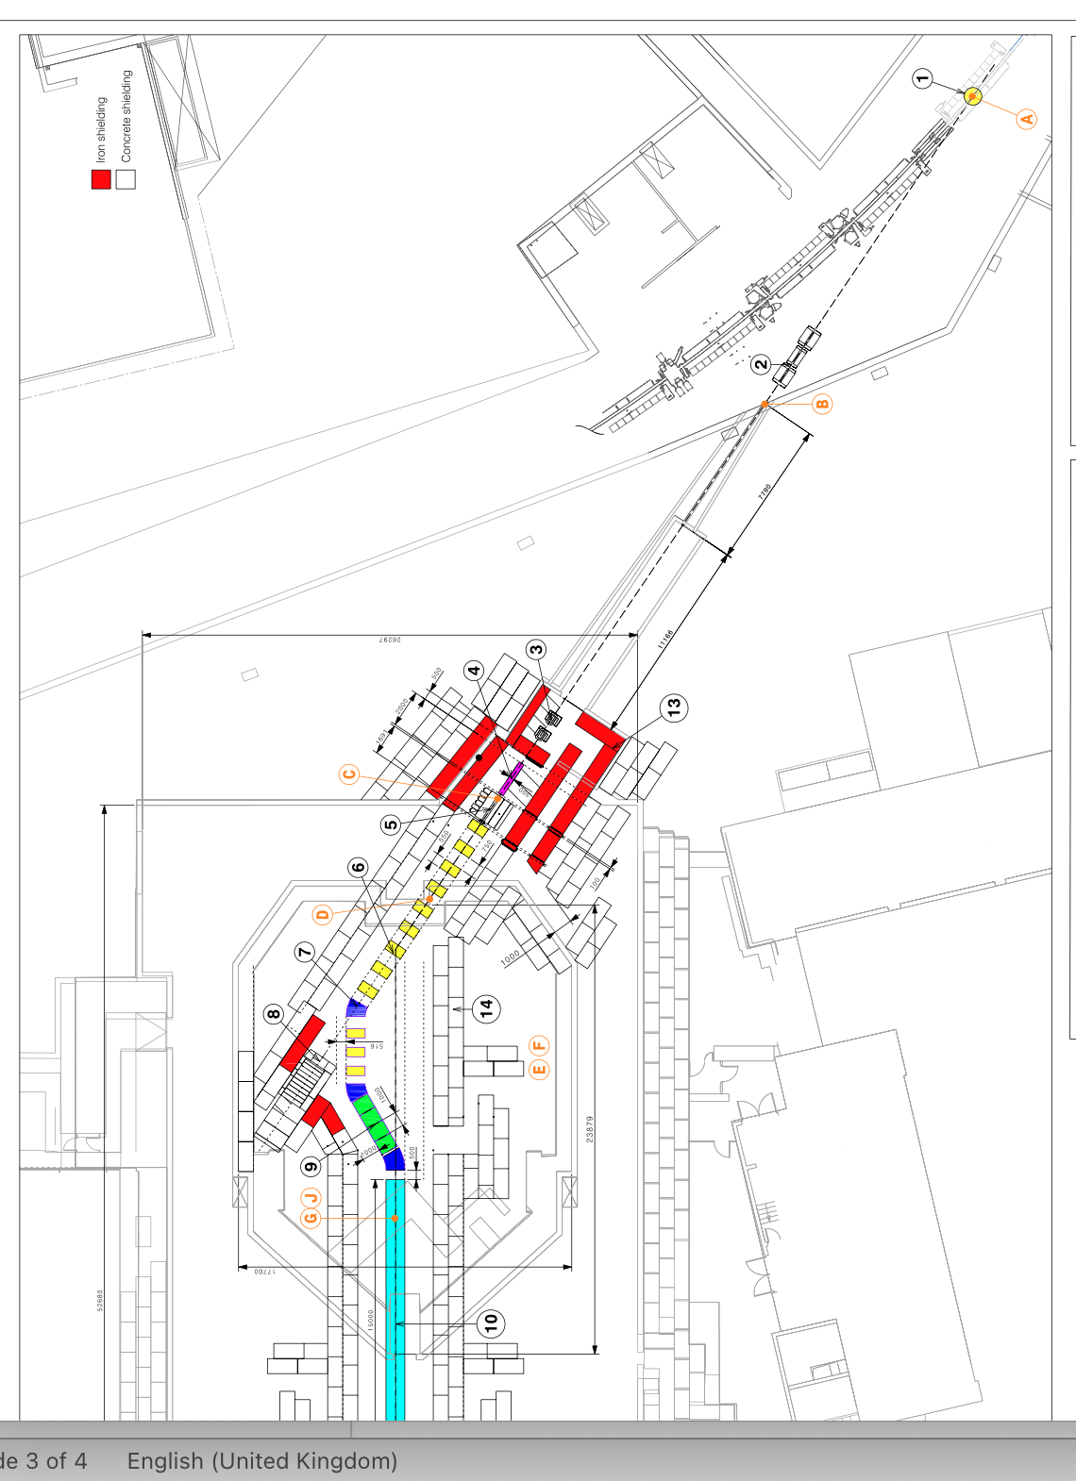
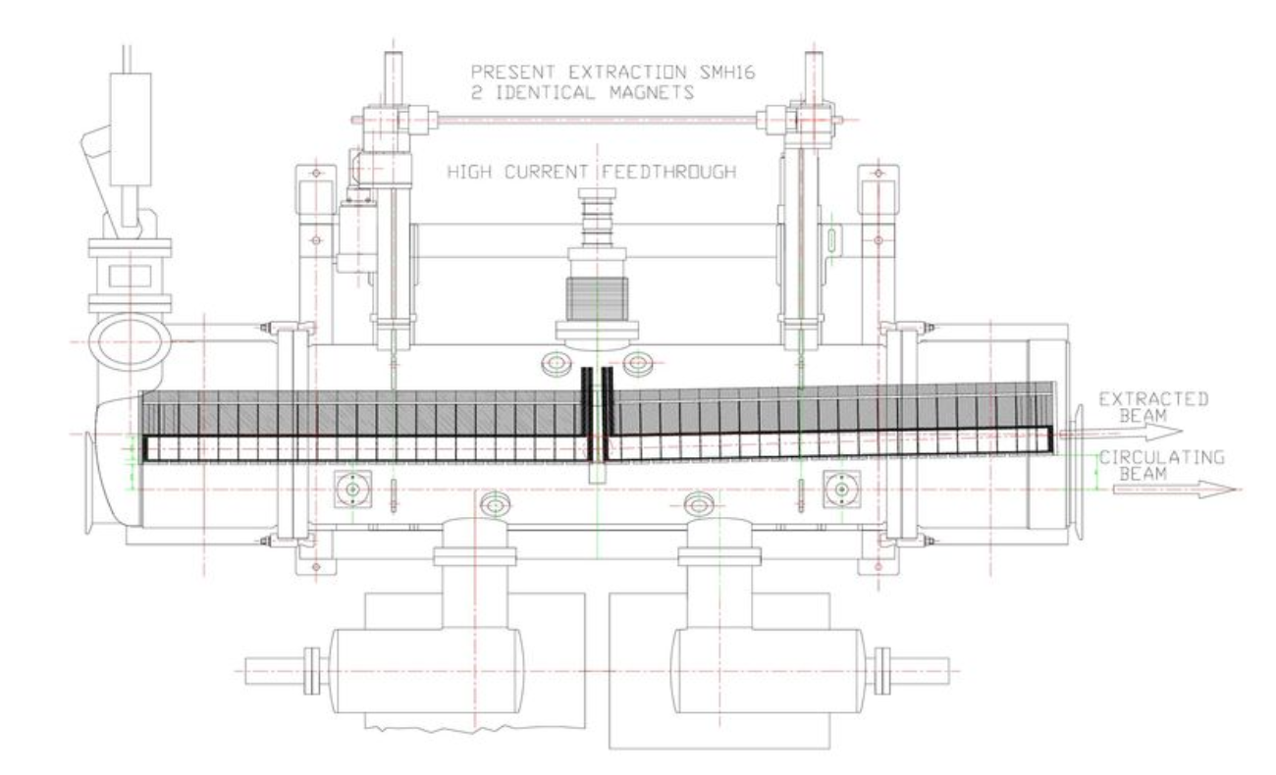
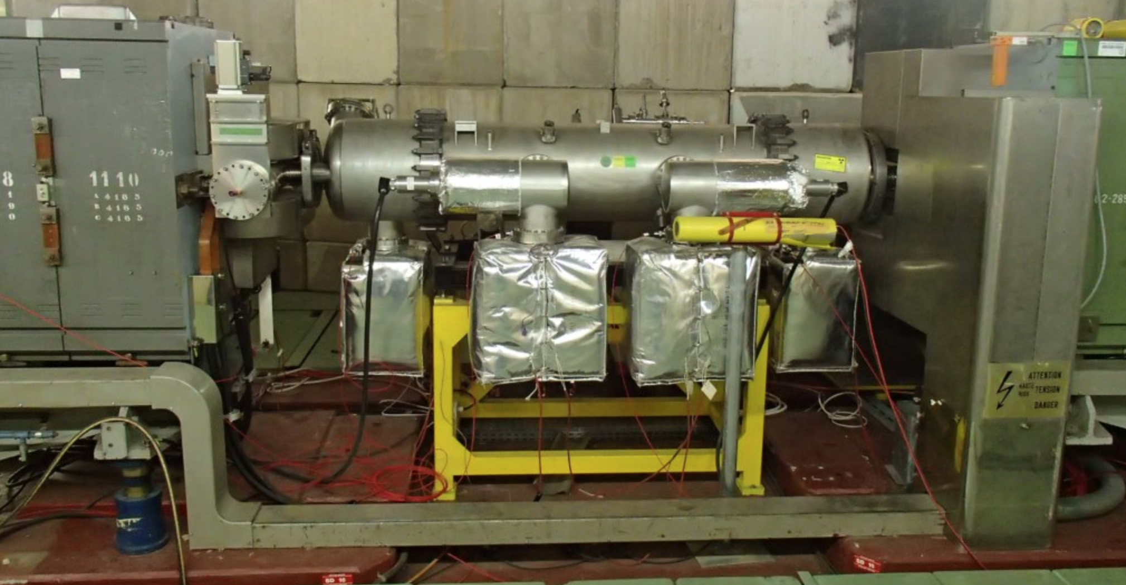
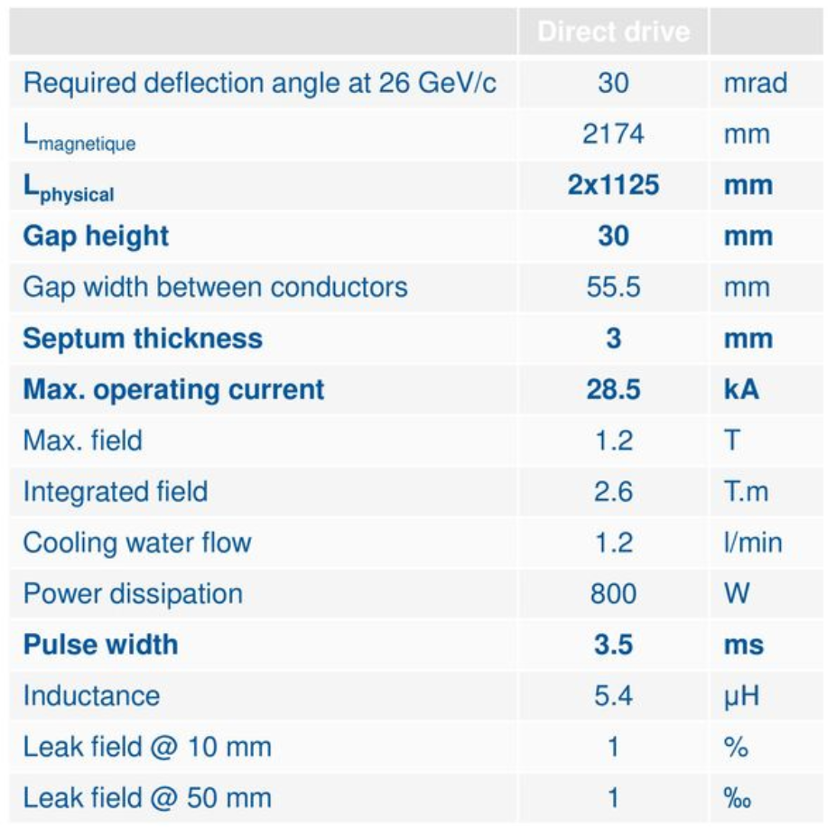
Extract towards CTF3
Idea: use existing kickers (KFA71?) + install new septum and bumpers locally at extraction point
Septum: SMH16 type
Up to 30 mrad angle allows to steer the beam to the target with no need of dipoles. Ideally the TL would only consist of correctors, quadrupoles and diagnostics
Notes:
To extract the beam we need an angle of 30 mrad. The SMH16 septum can provide this for up to 26 GeV so we are fine with the required 14 GeV. The total length is 2.25 m so we have to find the space in the PS layout. Seen the rigidity of the beam, ideally we do not want to apply any bend in the transfer line from the PS to the target but possibly only correctors to steer the beam and quadrupoles for the optics.

Slide 4
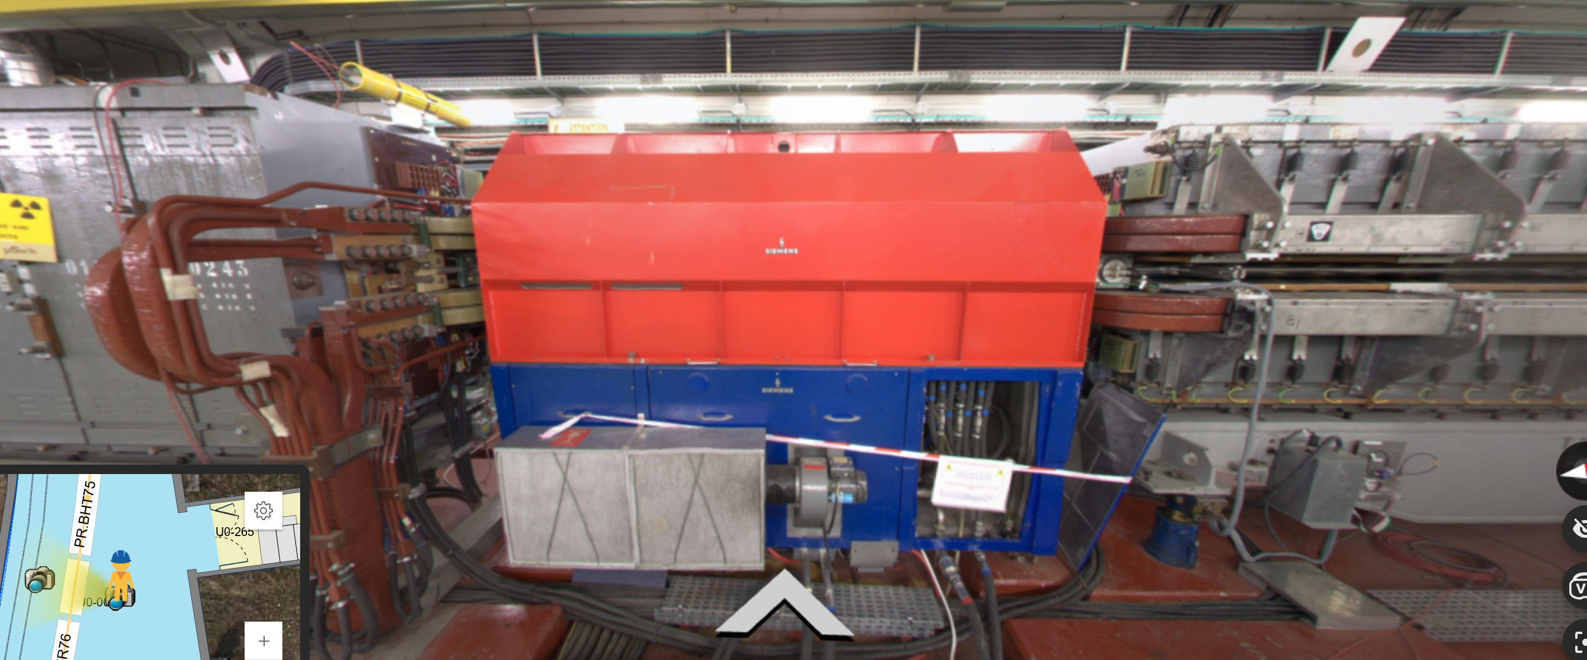
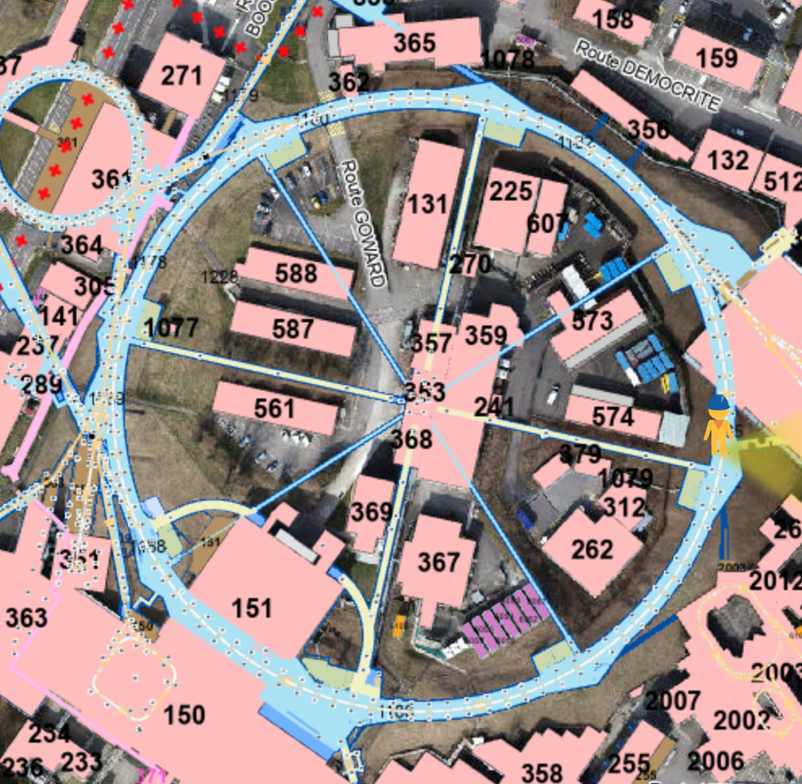
Extraction towards CTF3
Required a length of >2.25 m in the PS →10 MHz cavity Pa.C10.76 (2.45 m long)
PA.C10.76

Slide 5
Extraction towards CTF3
Required a length of >2.25 m in the PS →10 MHz cavity Pa.C10.76 (2.45 m long)
Modifications:
  Displace cavity (plus related cables, klystron, etc.) → Only available space for this cavity is the drift between BHR30 and PR.QFW31 (feasibility and cost to be evaluated)

Slide 6
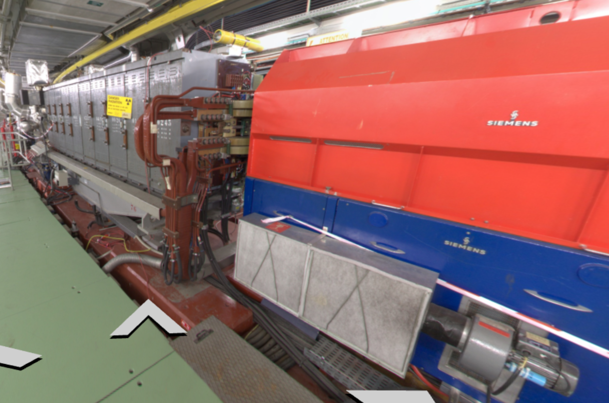
Extraction towards CTF3
Required a length of >2.25 m in the PS →10 MHz cavity Pa.C10.76 (2.45 m long)
Modifications:
  Displace cavity (plus related cables, klystron, etc.) → Only available space for this cavity is the drift between BHR30 and PR.QFW31 (feasibility and cost to be evaluated)
  Downstream dipole (PR.BHR76) not suitable for extraction (missing aperture for extracted beam)

Slide 7
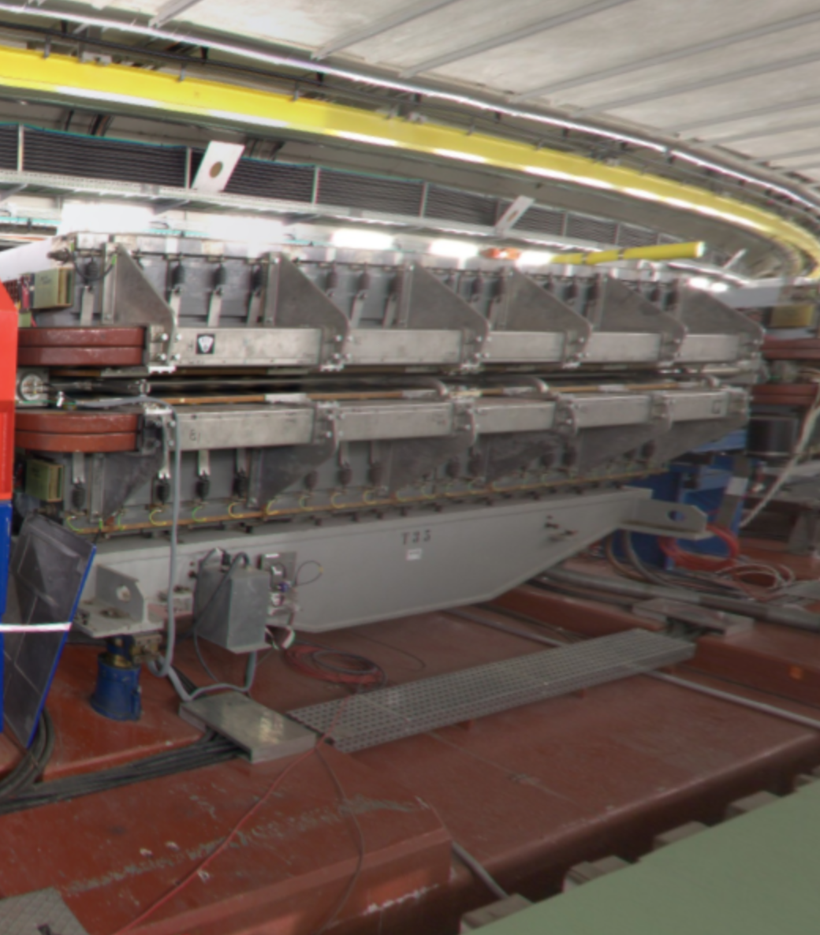
Extraction towards CTF3
Required a length of >2.25 m in the PS →10 MHz cavity Pa.C10.76 (2.45 m long)
Modifications:
  Displace cavity (plus related cables, klystron, etc.) → Only available space for this cavity is the drift between BHR30 and PR.QFW31 (feasibility and cost to be evaluated)
  Downstream dipole (PR.BHR76) not suitable for extraction (missing aperture for extracted beam)
    180 rotation? (impact on optics…)
    Hole for extracted beam (feasible?)
    New design dipole

Slide 8
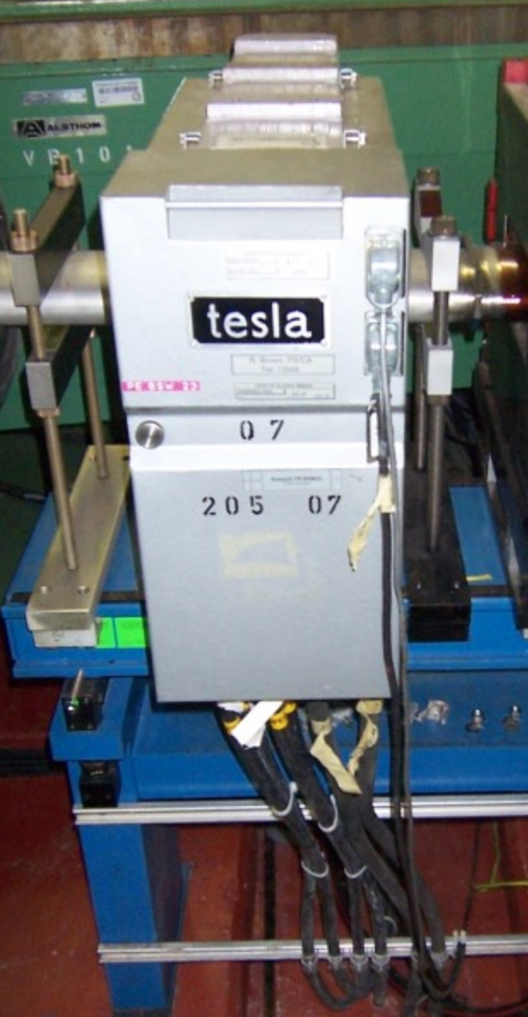
Extraction towards CTF3
Required a length of >2.25 m in the PS →10 MHz cavity Pa.C10.76 (2.45 m long)
Modifications:
  Displace cavity (plus related cables, klystron, etc.) → Only available space for this cavity is the drift between BHR30 and PR.QFW31 (feasibility and cost to be evaluated)
  Downstream dipole (PR.BHR76) not suitable for extraction (missing aperture for extracted beam)
    180 rotation? (impact on optics…)
    Hole for extracted beam (feasible?)
    New design dipole
Installation of 4 slow bumpers around new septum: BSW like (0.23 m long, not too complicated to find some room but correct. phase advance to be checked)

Slide 9
Extraction towards CTF3
No trajectory calculation (kick + bump + extraction) done yet
No optics studies done yet (# and type of quadrupoles and powering)
No estimates for type and number of correctors (magnets and powering)
Diagnostics: BPMs (~ as many as the correctors), one BTV in front of the target, one BCT at the end of the line to evaluate transmission, BLMs at quadrupoles and in general at expected aperture bottlenecks.

Slide 10
Conclusions
Possible location for installation of equipment for extraction to CTF3 identified
Several modification needed and have to be fully qualified but no clear showstopper found for the moment
The TL to the target should consist of only quadrupoles, correctors and diagnostics
Next studies:
  extracted beam trajectory and optics
  required HW: magnets, powering, diagnostics, etc.
  Evaluate impact of cavity displacement (ABP and RF colleagues)
  Rough cost estimate

