Slide 1
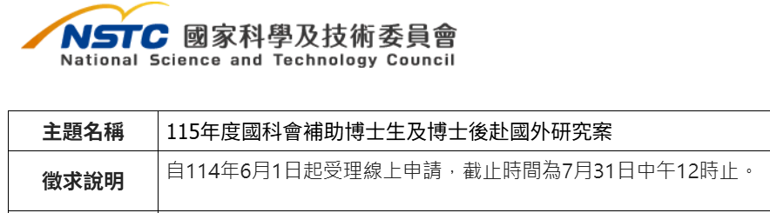


Academic-PhD student and Post-doc
Industry- X talents

Slide 2
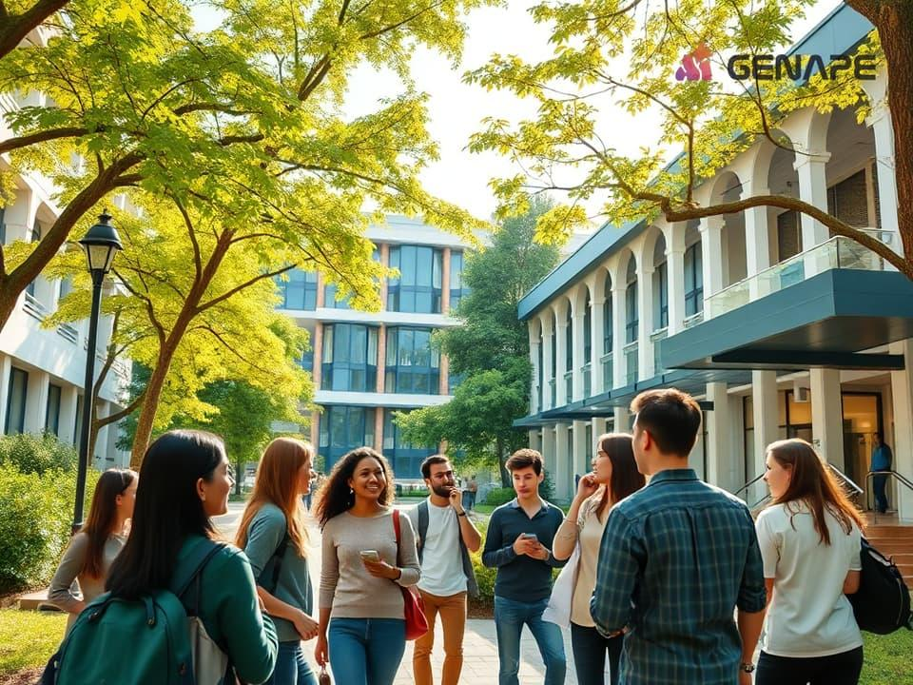
千里馬博士生與博士後
Ph.D. Students/Post-doc Study Abroad Program

Slide 3
PhD students/Post-doc
 | Eligibility | Host University | Financial Supports
PhD student | Over 1 yr in PhD program | Top Universities/RD Institutes | 7-12 Months NT0.9M/yr
Post-Doc | Within 5 yrs after graduation | Top Universities/RD Institutes | Max 2 yrs NT1.5M/yr

Slide 4
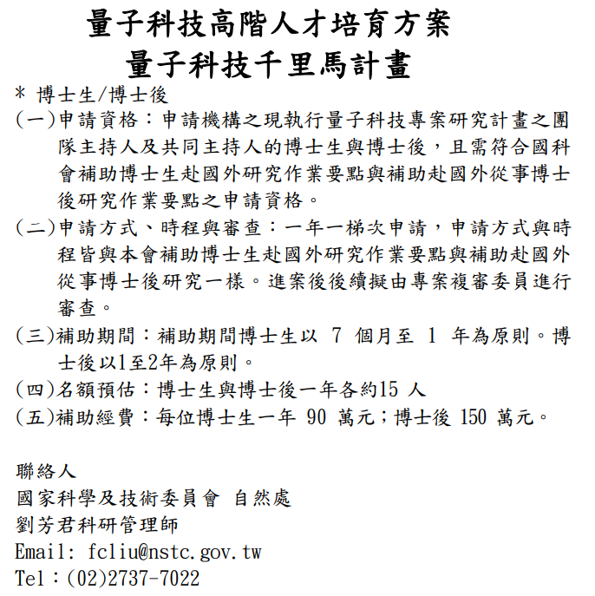

Slide 5
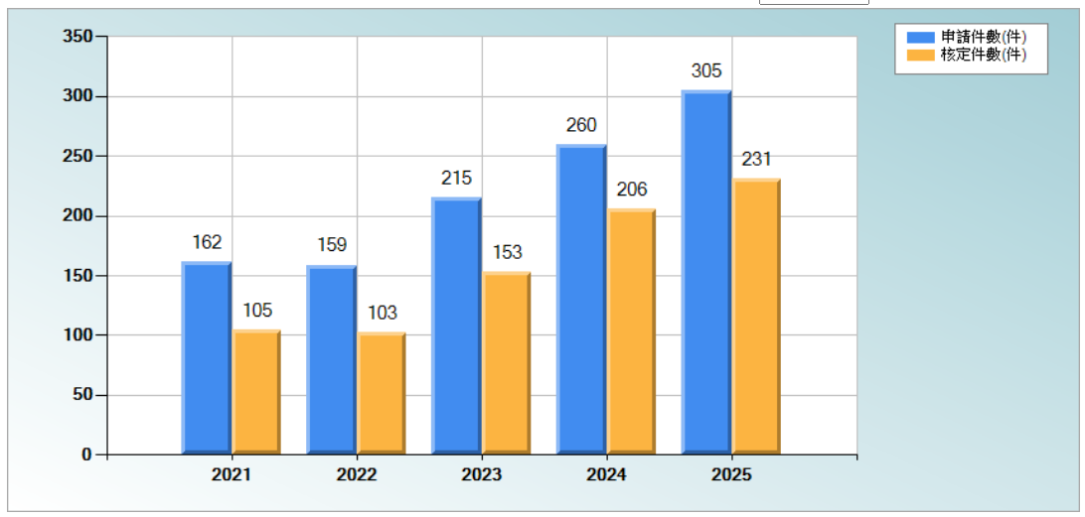
https://wsts.nstc.gov.tw/STSWeb/academia/Academia.aspx?language=C&syscode=PT_ROOT

Slide 6
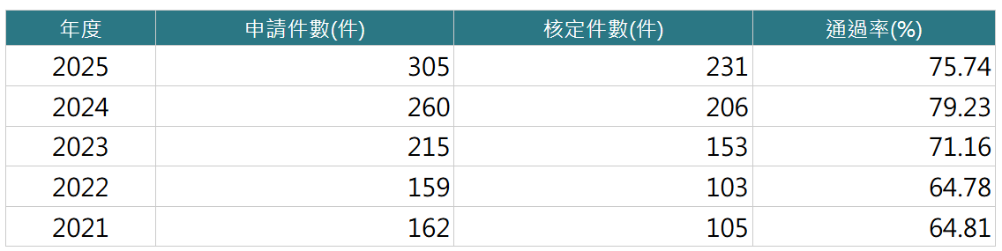
https://wsts.nstc.gov.tw/STSWeb/academia/Academia.aspx?language=C&syscode=PT_ROOT

Slide 7
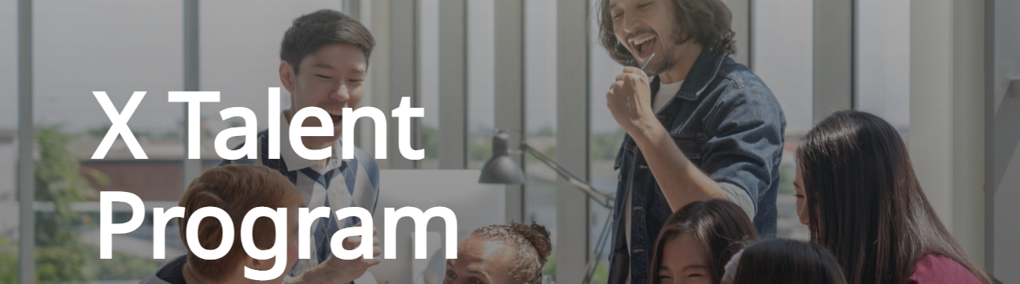
The X-program focuses on cooperating with the cutting-edge technology companies overseas, stimulating cross-country knowledge circulation and west-east business development to generate benefits for all parties. Moreover, the NSTC would grant the fellow 1,500,000 NTD (50,000 USD at most) for one year as their living allowance.
Taiwan young professionals with a high-level degree or with relevant industry experiences / proven outstanding achievements are eligible to become X Fellows.

Slide 8
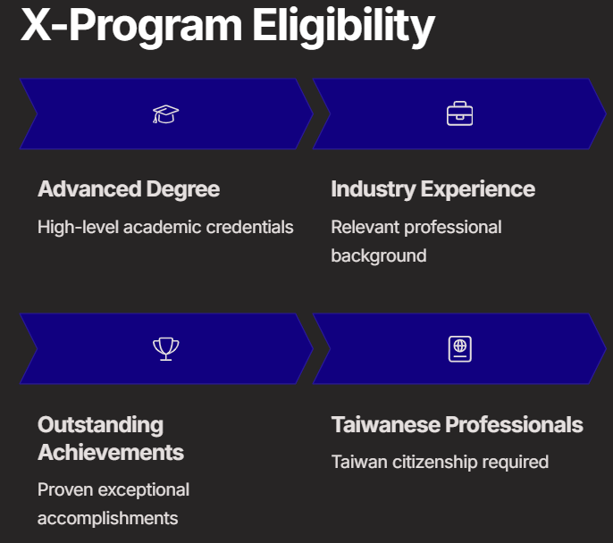

Slide 9
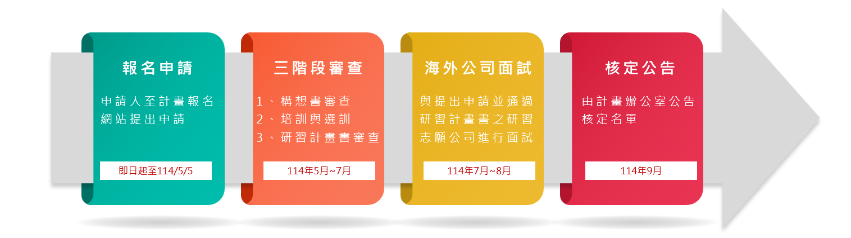

Slide 10

Create a platform here to strengthen the S&T collaboration between Taiwan and Seattle

Slide 11
U.S.-Taiwan High-Tech Forum
Annual Topics
2024: Generative AI x Conscious Technology
2023: Opportunities and Challenges in Electric Vehicles
2022: How Semiconductors, Electric Vehicles, Blockchain, WEB3.0 Shape the Future of Infrastructure
2021: Blockchain, Semiconductor and its Intersection in the Future of Finance, Work and Network Infrastructure
2020: Impacts of Trade and Pandemic on High-Tech Industry and Future Landscape
2019: Exploit the Innovation Opportunities Enabled by Intelligent Connectivity: The combination of 5G, AI and Massive IoT.

Slide 12
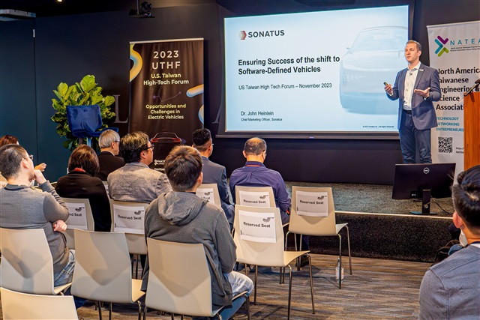
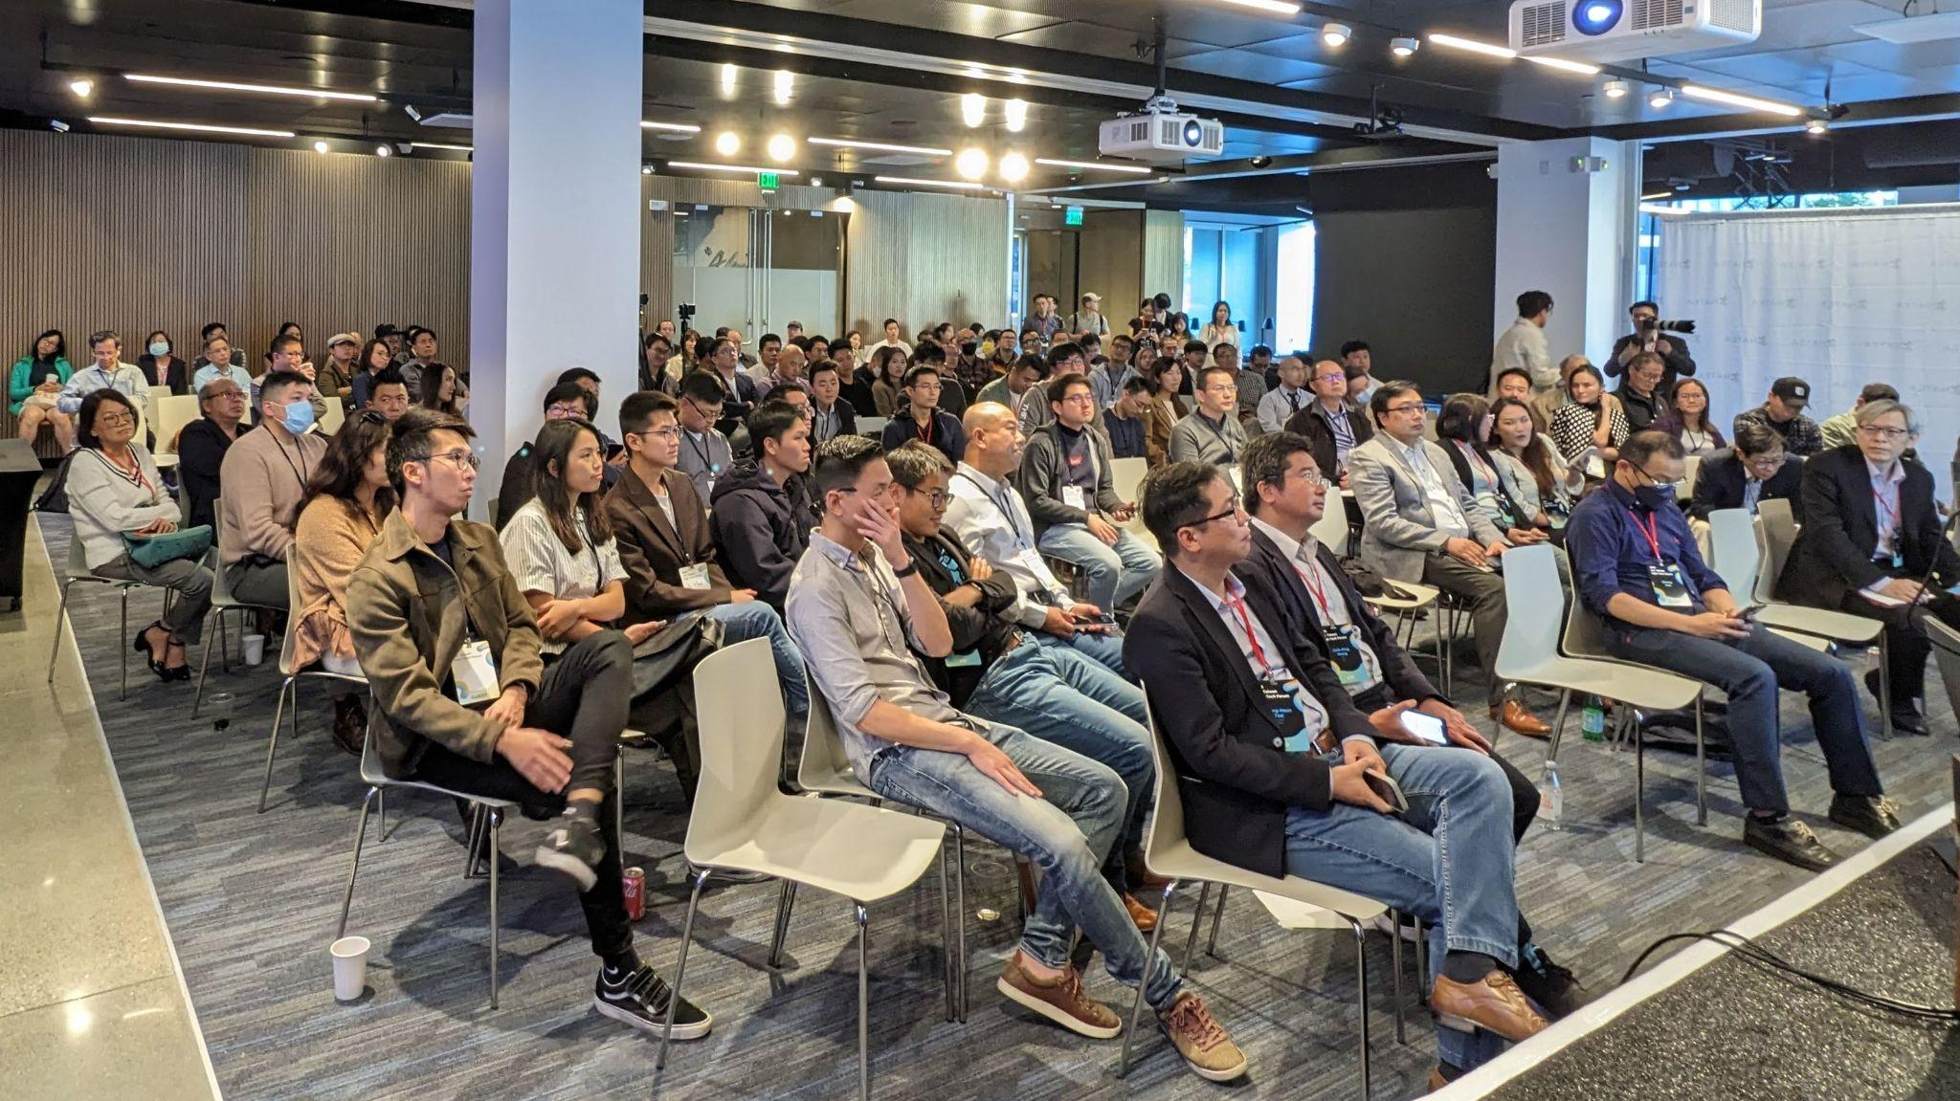
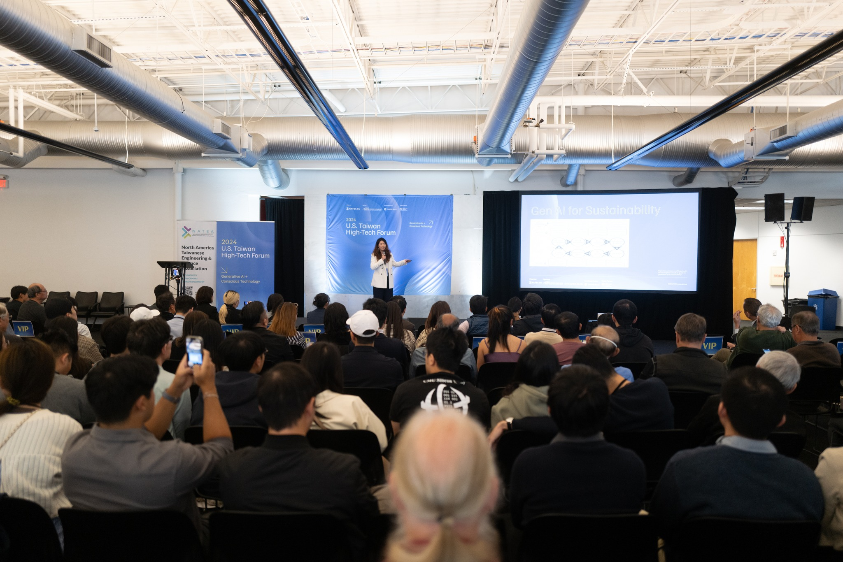
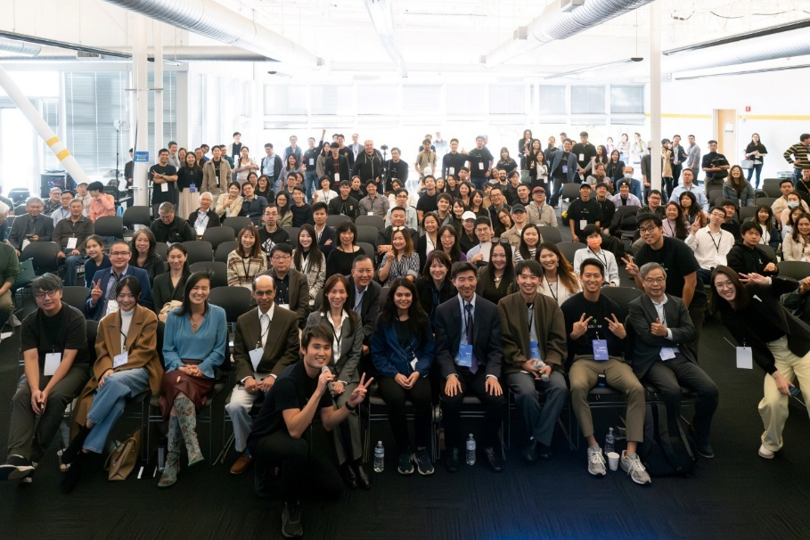
U.S.-Taiwan High-Tech Forum 活動照片回顧
2023 UTHF
2023 UTHF
2024 UTHF
2024 UTHF

