Slide 1




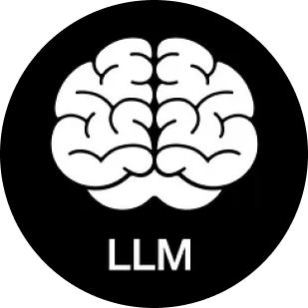
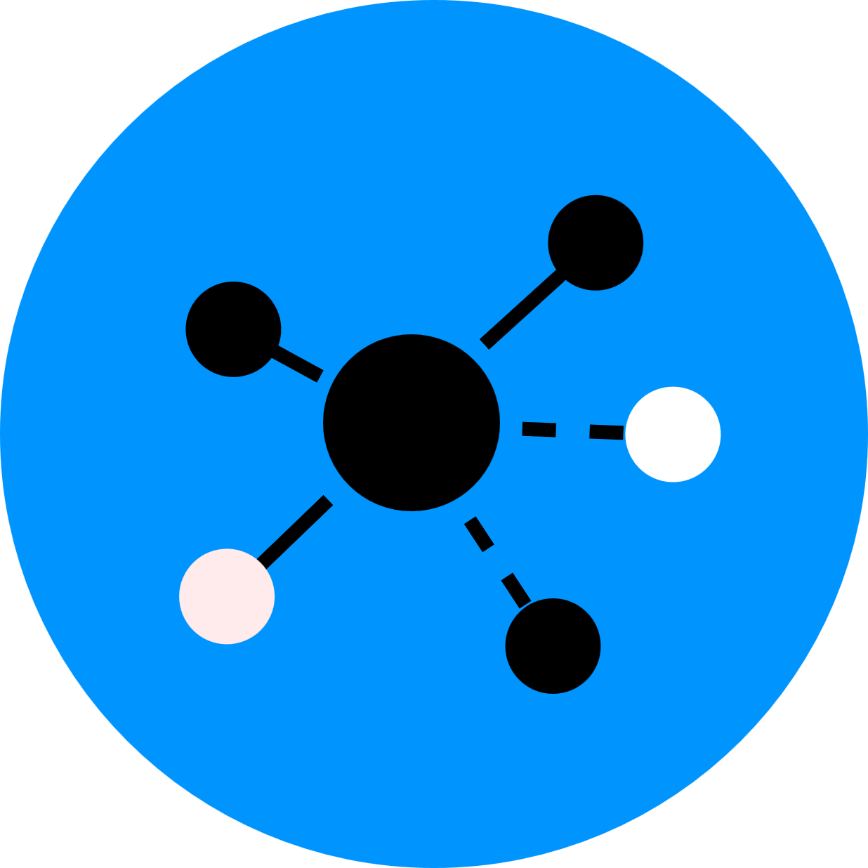

AI’s Journey: From Single Function to Agent Ecosystem
Like the story of the internet ... Just a lot faster
2008 - 2023
Rise of LLMs & AI Workflows
2024 - Now
LLMs (like GPT-4) became the communication core of AI systems
Enabled chaining of tools into intelligent workflows
From isolated outputs to task-oriented coordination
Independent AI Tools
Agents & Cross-Model Collaboration
Focused on single tasks
Models worked in isolation without interoperability
Example: AlphaGo, early vision / speech models
Model specialization and control boosting
AI Tools like Manus, Windsurf, OpenAI, Gemini start enable modular agent coordination
From standalone models to interconnected, task-driven AI ecosystems
2023 - 2024

Slide 2

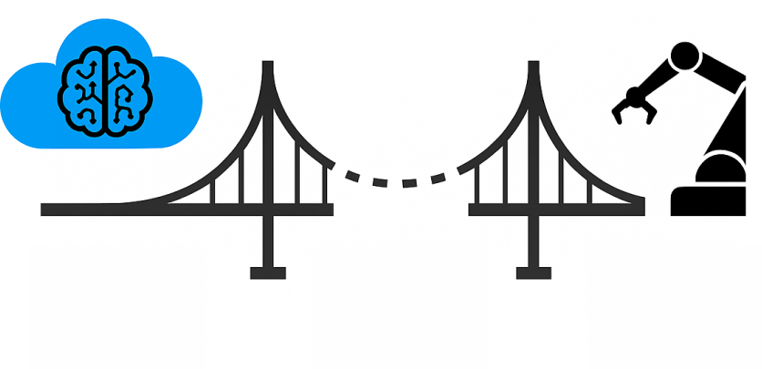


The gap in AI Agent Ecosystem?
Agents are getting smarter — but how to execute?
What’s
Missing?
AI agents today can plan, reason, decide...
But they need to act — so something or someone needs connects AI to the real world
AI Agents
Physical World
Two Critical Pieces for AI evolution
Data Collection
Real-World Execution
AI needs data to stay grounded — but much of it is fragmented, delayed, or unavailable
With edge and IoT, AI action can be executed from cloud to real-world

Slide 3


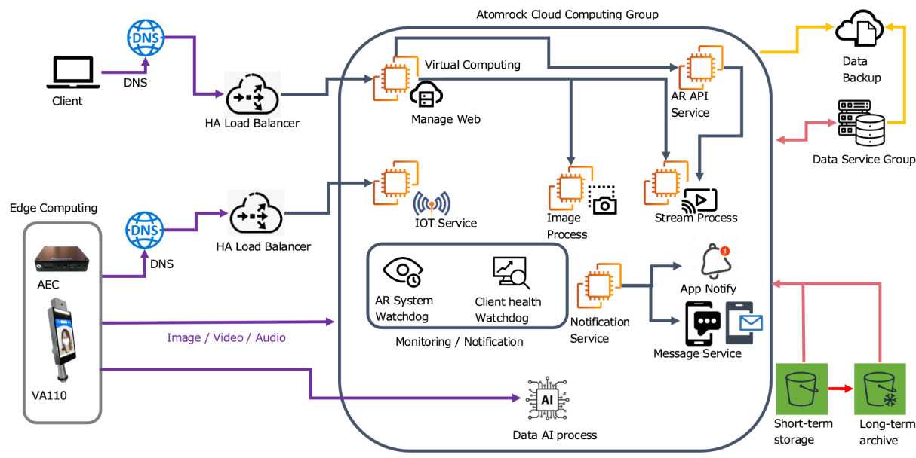

Where AI Becomes Actionable: Closing the Loop at Atomrock
Atomrock Is Bridging Cloud Intelligence and Real-World Action
Edge AI - Sensing & Execution
Multi-source video, audio, and sensor capture
Real-time AI analytics
Real-time action triggered by cloud intelligence
Cloud - The Intelligence Hub
API gateway for LLMs / agents
Advanced AI analytics
AI model orchestration
Edge device management
Where the Digital Meets the Physical,
AI decisions turn into real-world impact
In 2025+, our focus is on getting MCP to work with other AI agents / tools

Slide 4

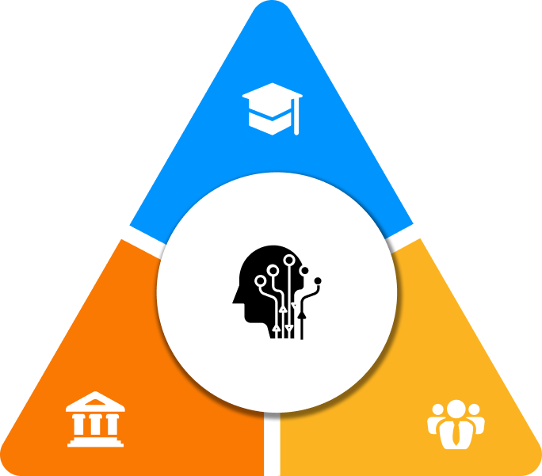
Building the Future of AI, Together
Vertical advancement + Horizontal integration
Academia – Deepen Researches
Advance research in foundation models and robotics
Publish open-source tools and benchmarks
Shape discourse on AI fairness and ethics
Collaborate across disciplines and sectors
Government – Pave the road
Set AI development goals
Release adaptive regulations that support innovation
Adopt AI in public services as leading examples
Fund pilot projects to showcase real-world impact
Bridge vertical solutions with horizontal integration platforms
Commercial - Applications
Implement AI agents in real-world workflows
Iterate on product-market fit
Enable cross-platform AI integration
Build scalable, MCP-ready vertical solutions
Vertical advancement = Pushing AI models to specialize in domains
Horizontal integration = Connecting models into coordinated agent ecosystems, across APIs, tools, agents, and real-world execution layers

