Slide 1
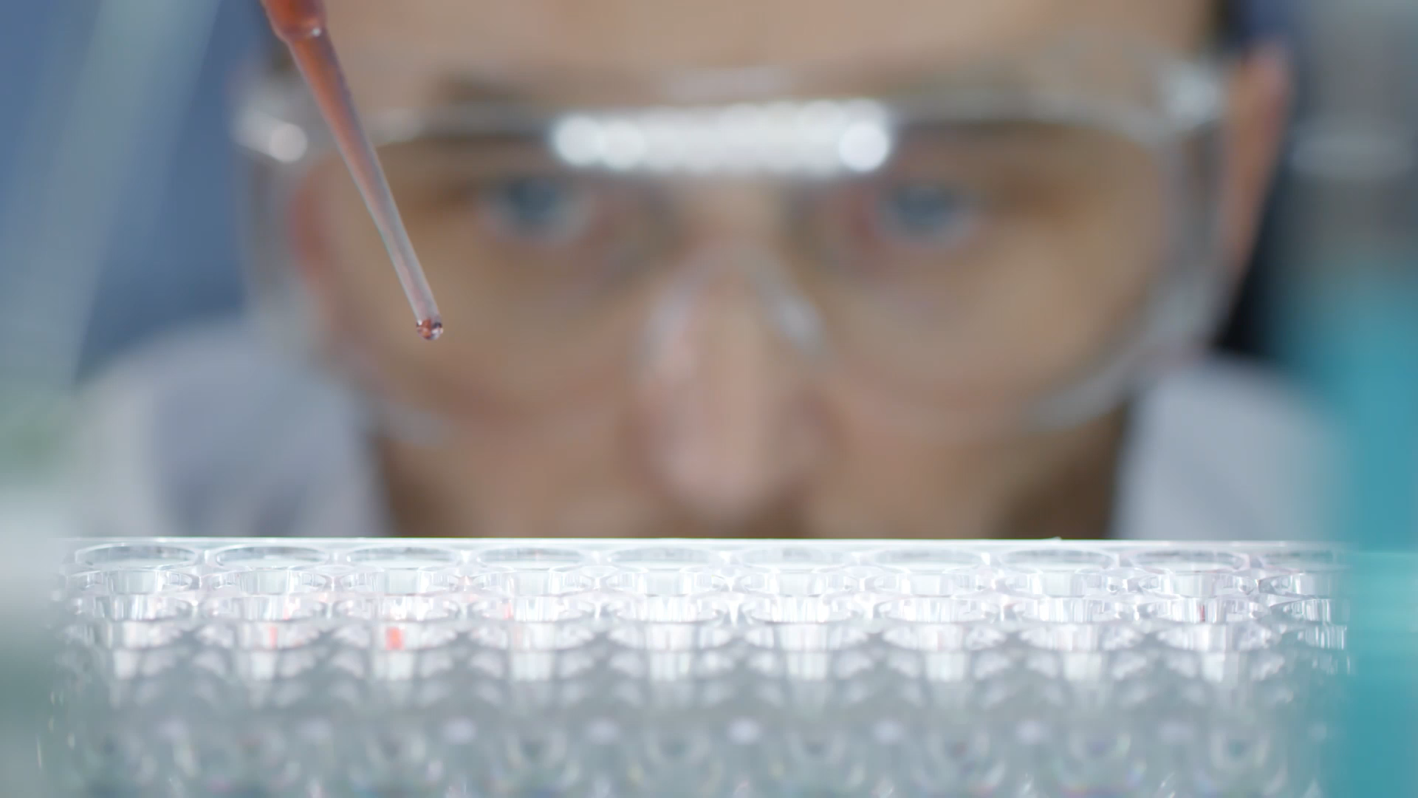
Biotech & Drug Development
Phil Tsai
6/07/2025 Taiwan Tech Connect

Slide 2
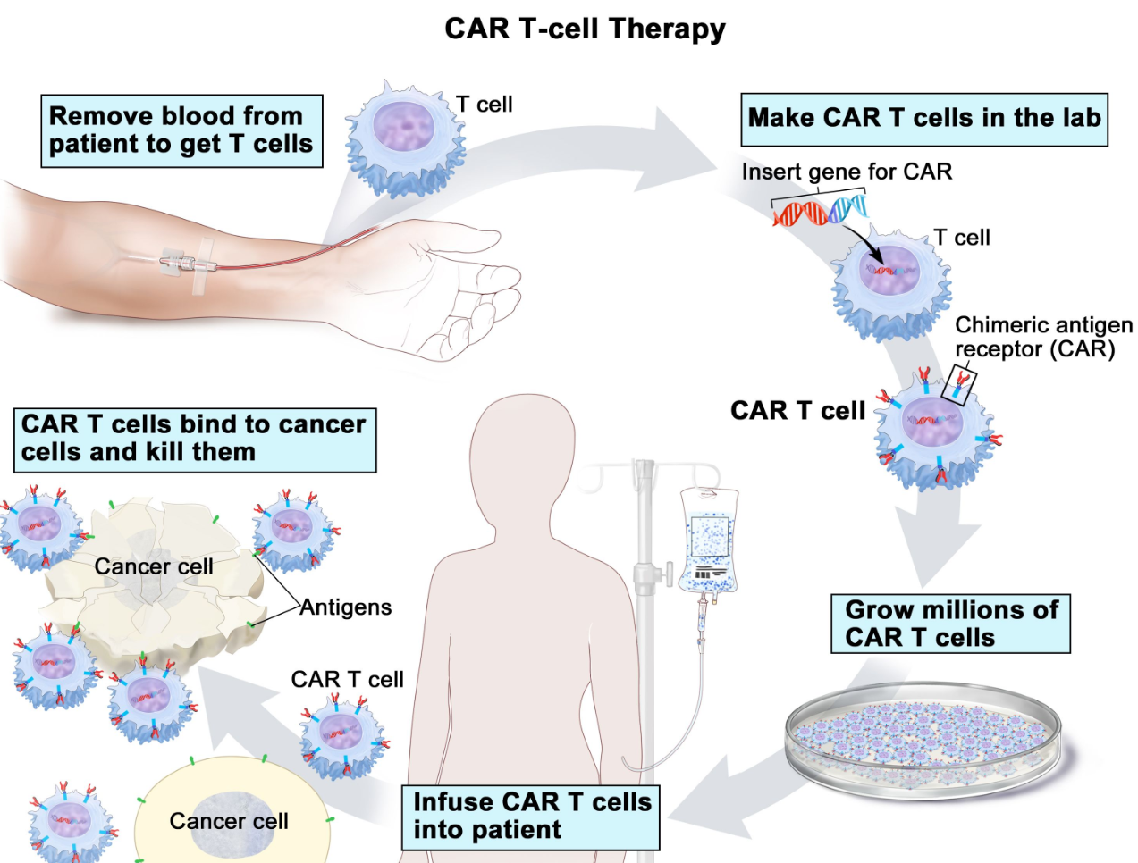
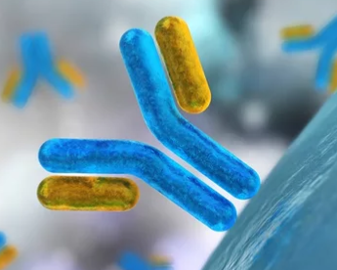

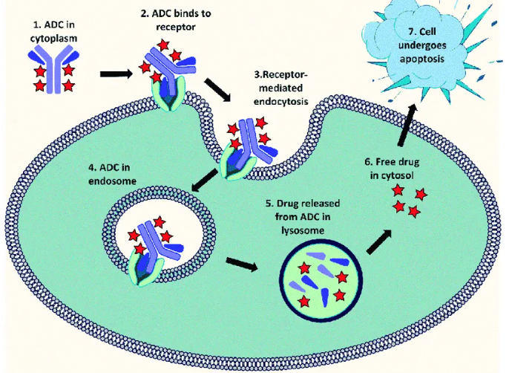
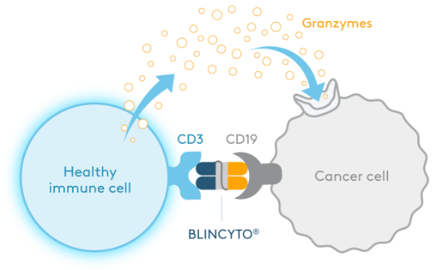
Targeted therapies from biotechnology
4
1
MAbs
Fusion proteins
2
Chimeric antigen receptor T cell (CAR-T)
3
Antibody-drug conjugates
Bispecifics
Notes:
Give an introduction on drug development in the context of recent innovations from biotechnology
Biotechnology is the use of molecular and biological systems for industrial and other purposes, such as medicines.
Will give 4 examples of drugs derived from biotechnologies for cancer and other disease therapies

Slide 3


Blocking pathway that causes disease
1
MAbs
Fusion proteins
MAb blocks CGRP ligand & migraine cascade
TNF receptor-IgG1 Fc fusion blocks soluble TNF that causes inflammation
For treating inflammatory conditions
Rheumatoid arthritis
Psoriatic arthritis
Plaque psoriasis
Long half-life helps prevent migraine attacks with 4 x 30 min IV treatment per year
Notes:
Monoclonal antibody and its variants
Antibodies are proteins that naturally occur in our body that bind specifically to a target receptor and signal to the body to take action. In our body we use that signal to fight infection, for example. In biotechnology, we use that principle to engineer antibodies and its variant fusion protein (in this case monoclonal antibody that binds specifically just one target) to treat disease. There are two examples of therapy developed based on this technology.

Slide 4

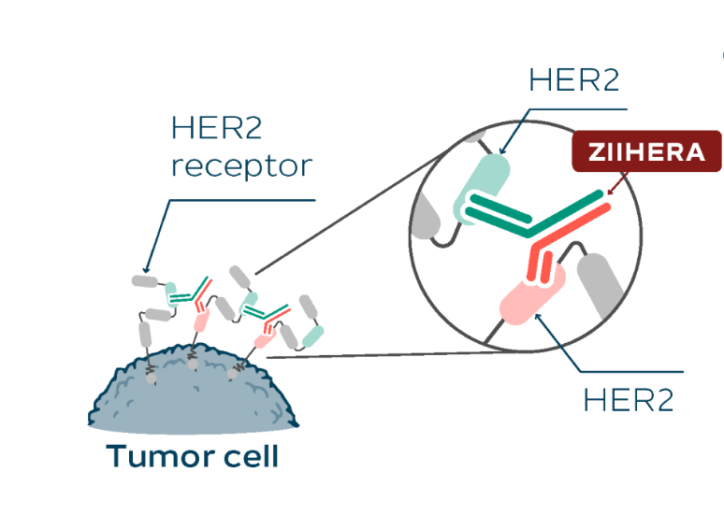
Dual binders may enhance cancer cell death
Approved for 2L advanced HER2+ biliary track cancer
2
Bispecific that binds two different targets
Notes:
Take the antibody concept a little bit further, you can imagine engineering an antibody to bind specifically to two targets. Antibody shapes like a Y. One can engineer each arm of the Y to target an unique receptor. We call this type of molecules Bispecifics. In recent year this type of molecules have demonstrated significant efficacy in cancer treatment, especially in immunotherapy.
In this example I am showing, the bispecific is engineered to bind to two distinct domains of HER2 receptor. HER2 is a genetic mutation found in a multiple tumor types (breast, lung, CRC). Zanidatamab, or brand name Ziihera, because of its binding to two HER2 domains on tumor cells that express HER2, enhances its signaling and the subsequent cell destruction.

Slide 5
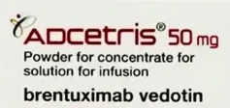
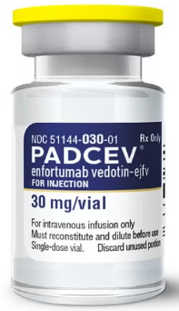
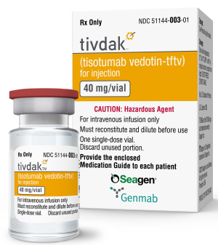
Precision-guided missile directly to tumors
Targeted therapies for cancers
Hodgkin’s lymphoma
Bladder cancer
Cervical cancer
3
Antibody-drug conjugates
Notes:
Next example is a type of drug called, Antibody drug conjugate or ADC. Tell the MOA
ADC is very dear to my heart as I have spent the past 22 years developing and manufacturing this type of medicine. I contributed to the three drugs shown on the slide: Adcetris, Padcev and Tivdak

Slide 6
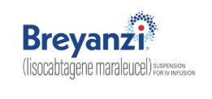
Arm your own immune system to destroy tumors
4
Personalized immunotherapy for treating multiple lymphoma and leukemia
  LBCL
  CLL
  FL
  MCL
Chimeric antigen receptor T cell (CAR-T)
Notes:
Breyanzi is a immune cell therapy and is a personalized medicine, meaning each dose is created specifically for the patient. Immunotherapy, as the name implies, uses each person’s immune system to find and destroy tumor cells, just like how it works when we have a viral infection. But what happen if the immune cells don’t recognize the tumor? Explain CAR-T

Slide 7
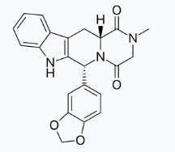
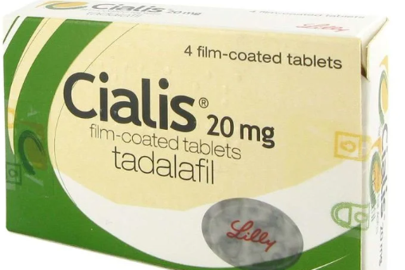
Drug that improves quality of life
Treatment of
Erectile dysfunction
Originally in development for hypertension and angina
tadalafil

Slide 8
What do these medicines have in common?
Notes:
Thru the examples I gave in the last few slides I have listed the names of the medicines. What do you think they have in common other than they are all derived from biotechnology?

Slide 9
Cutting edge technologies invented locally
Drug* | First Approval | Originated Biotech | Headquarter | Current Owner
Enbrel® | 1998 | Immunex | Seattle, WA | Amgen
Cialis® | 2003 | ICOS | Bothell, WA | Eli Lily
Recothrom® | 2008 | ZymoGenetics | Seattle, WA | BMS
Adcetris® | 2011 | Seagen | Bothell, WA | Pfizer
PADCEV® | 2019 | Seagen | Bothell, WA | Pfizer
Tukysa® | 2020 | Seagen | Bothell, WA | Pfizer
Tivdak® | 2021 | Seagen | Bothell, WA | Pfizer
Vyepti® | 2020 | Alder | Bothell, WA | Lundbeck
Breyanzi® | 2021 | Juno | Seattle, WA | Baxter/BMS
ZIIHERA® | 2024 | Zymeworks | Bellevue, WA | Zymeworks
> $12B worldwide in 2024
* Selected examples only not an exhaustive list
Notes:
These are all invented locally in the Seattle area in the last decade or so! They are important medicine for cancer patients. In many cases these therapies are the last line of defense for fighting cancer. Often times these patients have only months to live and these drugs help extend their lives.
These medicines also generated more than 12 billion worldwide and are significant financial drivers for biotech companies to continue to invest in R&D for the next generation medicine. Biotechnology is definitely thriving in this region. We have great world renown cancer academic research instutitions such as fred hutch cancer research and UW that provide the foundation to attract talent and companies

Slide 10
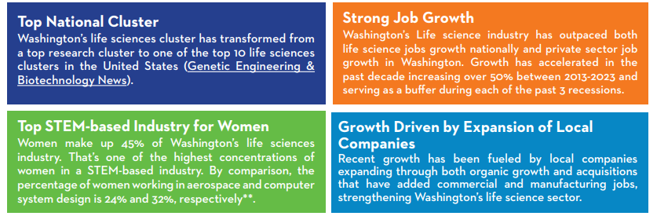
Source: Life Science Washington
Notes:
According to a recent report by Life Science Washington, Washington state is in the top 10 cluster for life sciences in the US.
In addition, as an industry we have the highest % women with STEM degree in employment, in comparison with other prominent Washington industry such as aerospace and tech

Slide 11
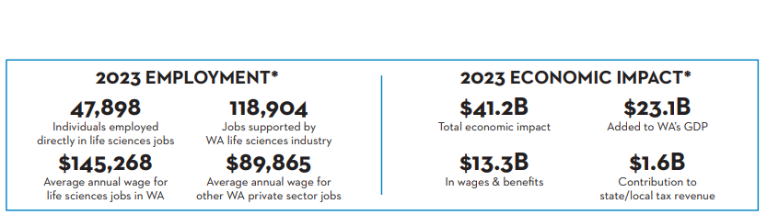
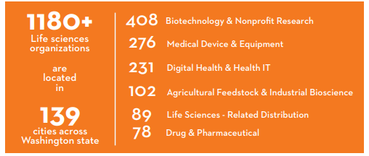
Source: Life Science Washington
Notes:
Life Sciences employ nearly 50K people and contributed to $41B to WA economy. Pretty significant.

Slide 12
Drug development is a long journey with <10% success
Discovery research
Non-clinical and translational sciences
Clinical testing (Phase 1, 2, and 3 clinical trials)
Manufacturing and supply chain scale-up
Regulatory approval for market authorization
Post market product lifecycle management
Notes:
However, biotechnology and drug development is a tough business. Most of the biotech start ups failed. Most of them ran out of funding before their idea turn into successful medicine. The reason for the failure is that human body is complicated. We have yet able to reduce the complexity of human body into laboratory or animal models. Translation of lab result to clinical result is difficult. Statistic shows only 10% of drug in development will receive market authorization by regulatory authority

Slide 13
Drug development is time consuming and costly
From discovery to regulatory approval
Average all drugs: 12-15 yrs
Average for oncology: 10-12 yrs
Average oncology drugs with accelerated approval: 6-8 yrs
Cost of drug development
$0.5-$0.9 billion direct
$2-$2.8 billion include failed candidates
Notes:
It takes 12-15 years on average to go from basic research to drug approval. For oncology the time is slightly shorter due to unmet medical needs. FDA have faster pathways for conducting clinical trial and review submission.
It takes nearly a billion to bring a drug to the market from research. It’s 2 to 3 times that if you absorb the cost associated with drug candidates that failed in clinical trials

Slide 14
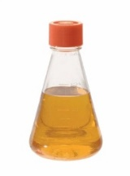
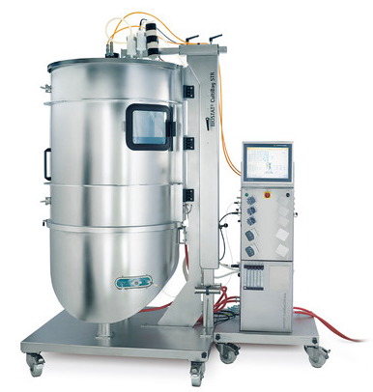
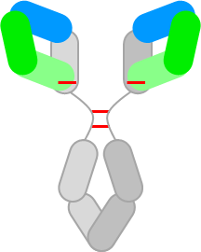
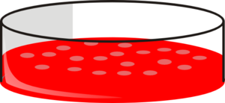


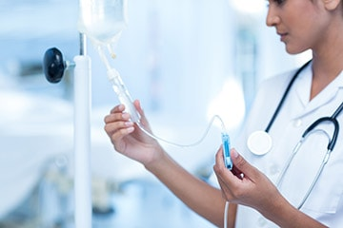
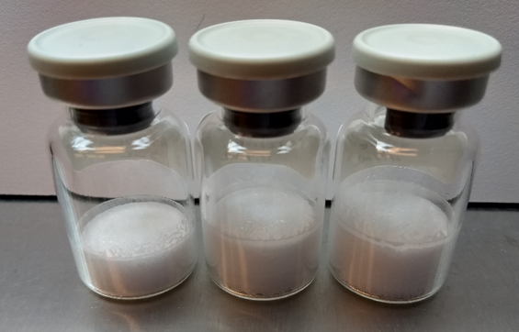
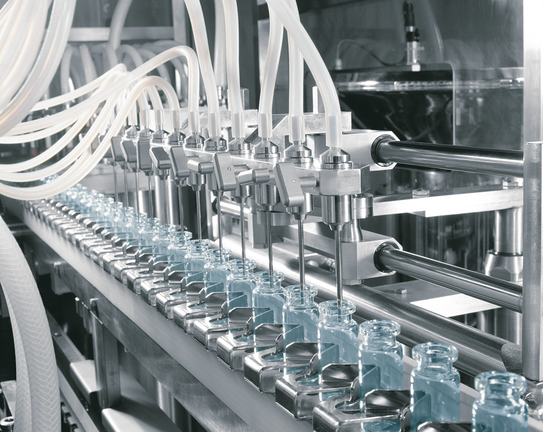
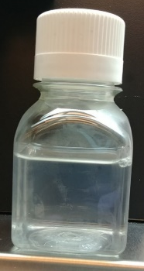
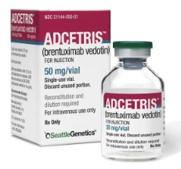
Biomanufacturing process is complicated
Cell line development
Cell Culture
Purification
Cells and Shake Flask
Bioreactor
Antibody (mAb) intermediate
IND
Drug product
Conjugation
Administration
Drug Product (DP)
Antibody-drug conjugate (ADC)
drug substance
Notes:
Manufacturing of biologic drug is complicated, too, and required many different specialized mfg technology

Slide 15
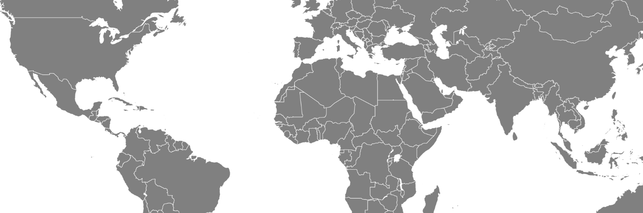
Complex supply network to support manufacture, testing and warehousing
Example: Immunome has 33 suppliers globally
Notes:
Drug supply chain often spread all over the world. It take tremendous amount of diligence and effort to ensure the drug remains safe and effacious during its production, packaging, shipping, warehousing and distribution. And that you can get the drug to the patients whenever and wherever they are needed

Slide 16
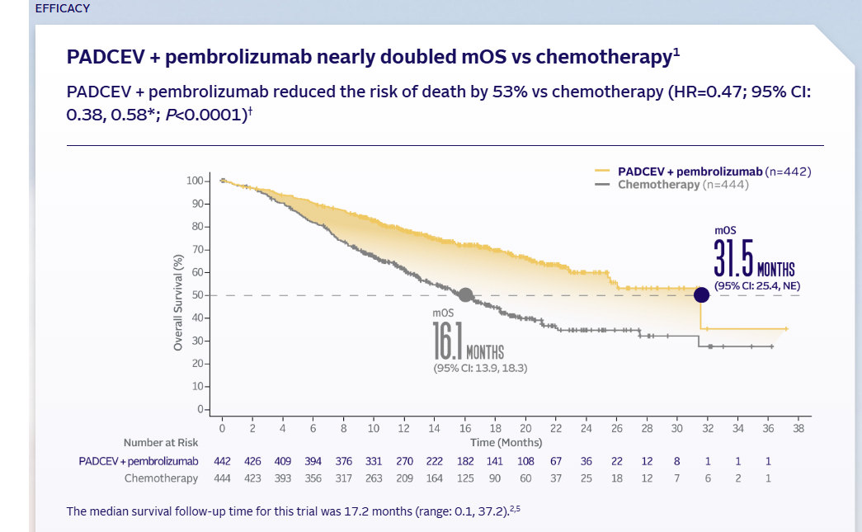
Why I do what I do
Highly effective therapy extends lives of 1L metastatic urothelial cancer patients
Source: www.padcevhcp.com
Notes:
The odds against a drug development biotech company is high. Why do people continue to create biotech companies? Why do I do what I do for the past almost 3 decades? I do what I do because I want to make a difference in cancer patient’s lives. I do what I do because of the graphic shown on this slide. My team was responsible for the manufacturing process in making PADCEV. This drug, when combined with Keytruda, will double the survival of metastatic bladder cancer patients. Everyone here has someone close to them impacted by cancer. It gives me great satisfactory and sense of accomplishment when I know that portion of drug development I touched will someone help cancer patient improve the quality and extend their lives.

Slide 17

Thank you
Question?

