Slide 1


FoCal cooling general system layout
Maciej Czarnynog
27/05/2025

Slide 2
System structure
FoCal cooling system
FoCal-E cooling system
FoCal-H cooling system
FoCal-E active volume cooling system
FoCal-E external electronics cooling system
FoCal-H electronics cooling system
FoCal-H SiPMs cooling system
FoCal-E pixel Readout crates cooling system

Slide 3
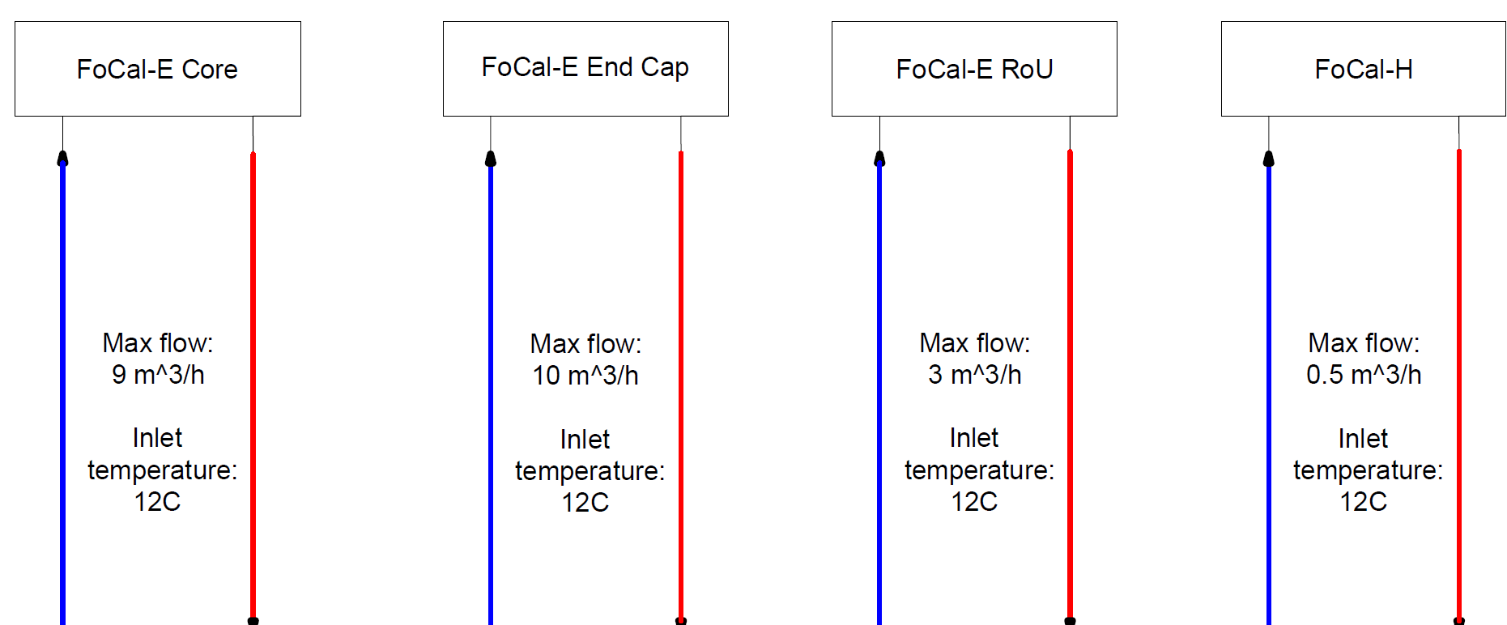
OLD FoCal cooling system layout
All loops are parallel. Maximal required flow for the whole system: 22.5 m3/h

Slide 4
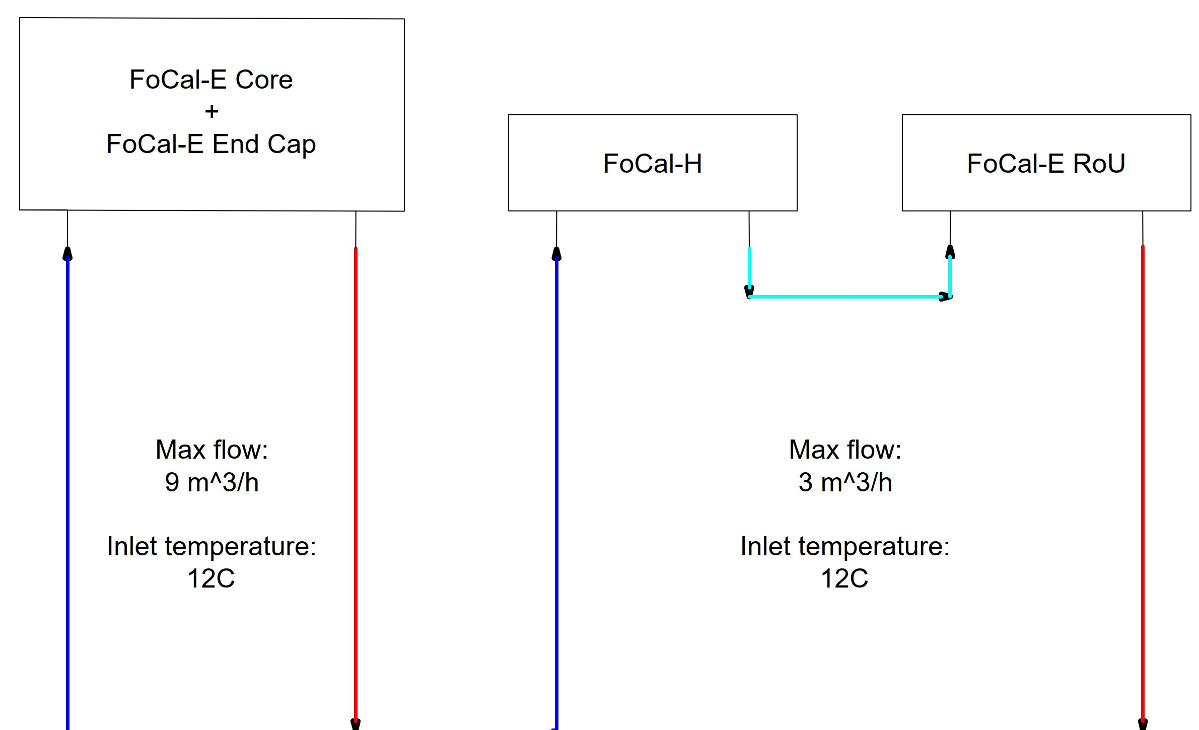
Current FoCal cooling system layout
Mixed system layout. Maximum required flow for the whole system: 12 m3/h

Slide 5
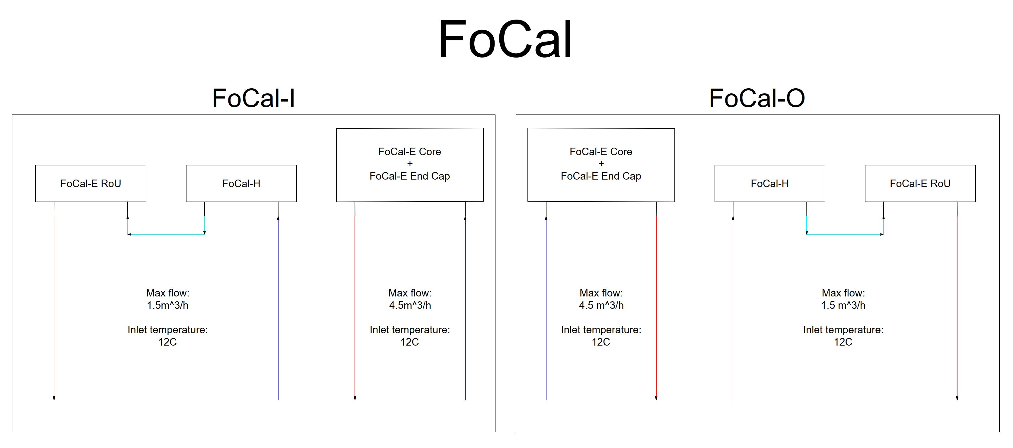
FoCal cooling - full system diagram

Slide 6
FoCal cooling
The new layout for the FoCal cooling system has been developed. In the new layout, some loops are connected in series instead of parallel, which allows for significant required coolant flow reduction.
The maximum required flow is 12m3/h - agreed with the Cooling and Ventilation (CV) Group.
Higher pressure drop comparison to the previous layout, calculation ongoing, agreed with a CV that it should not exceed 4.5 bar. (At this stage, we expected the maximum pressure drop to be lower. Final confirmation of the operational parameters during the PRR this summer.)
Using the upgraded HMPID cooling plant is possible for this layout.

Slide 7
FoCal cooling - What control possibilities would we like to have on the cooling plant level
Flow control in each loop (the current system has 4 loops).
Possibility of cutting off any loop, still keeping the rest of the system running.
Monitoring of the temperature and pressure on the inlet and outlet of each loop.
The whole system will operate with the same inlet temperature.
Access to monitored parameters from the DCS level.

Slide 8
FoCal cooling - Heat generation in each subsystem
Total heat generation in FoCal: 11 320 W.

Slide 9
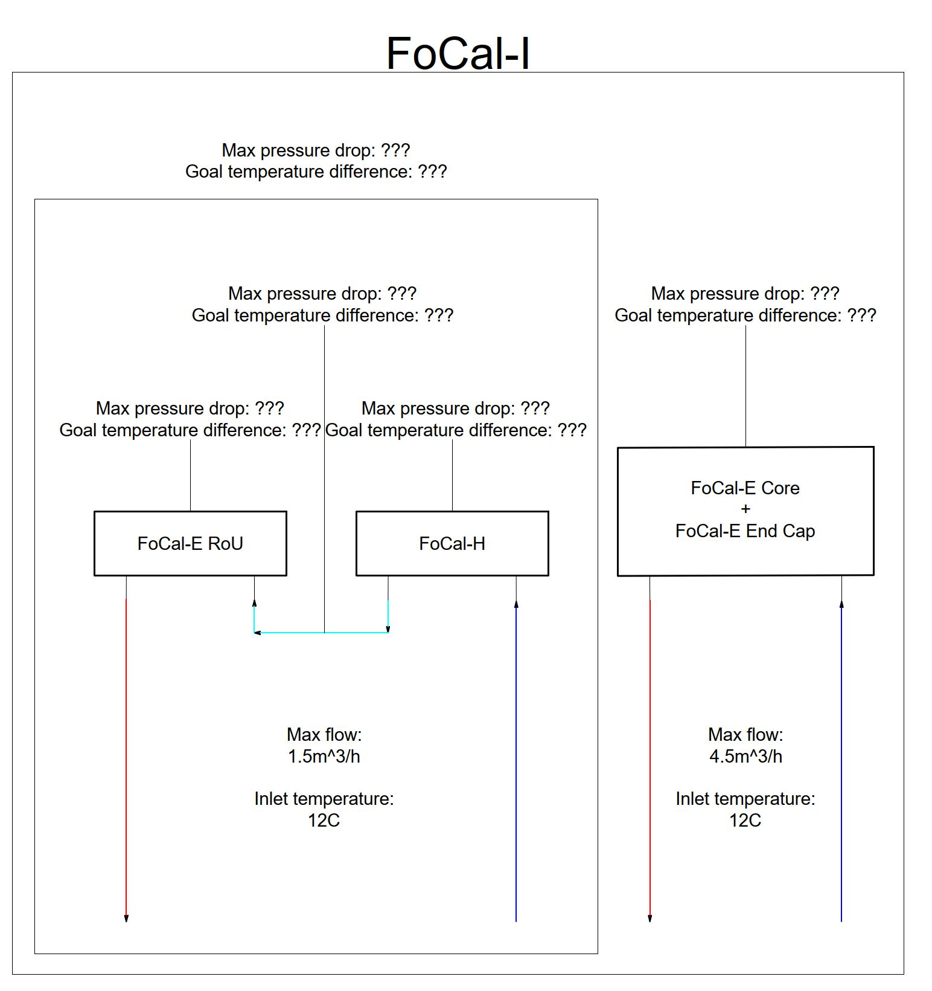
FoCal cooling
The FoCal cooling system is symmetrical: the FoCal-I and FoCal-O cooling systems are identical, and their intended operating parameters are the same. The diagram should be finalized and submitted by the middle of summer, along with additional information.

Slide 10
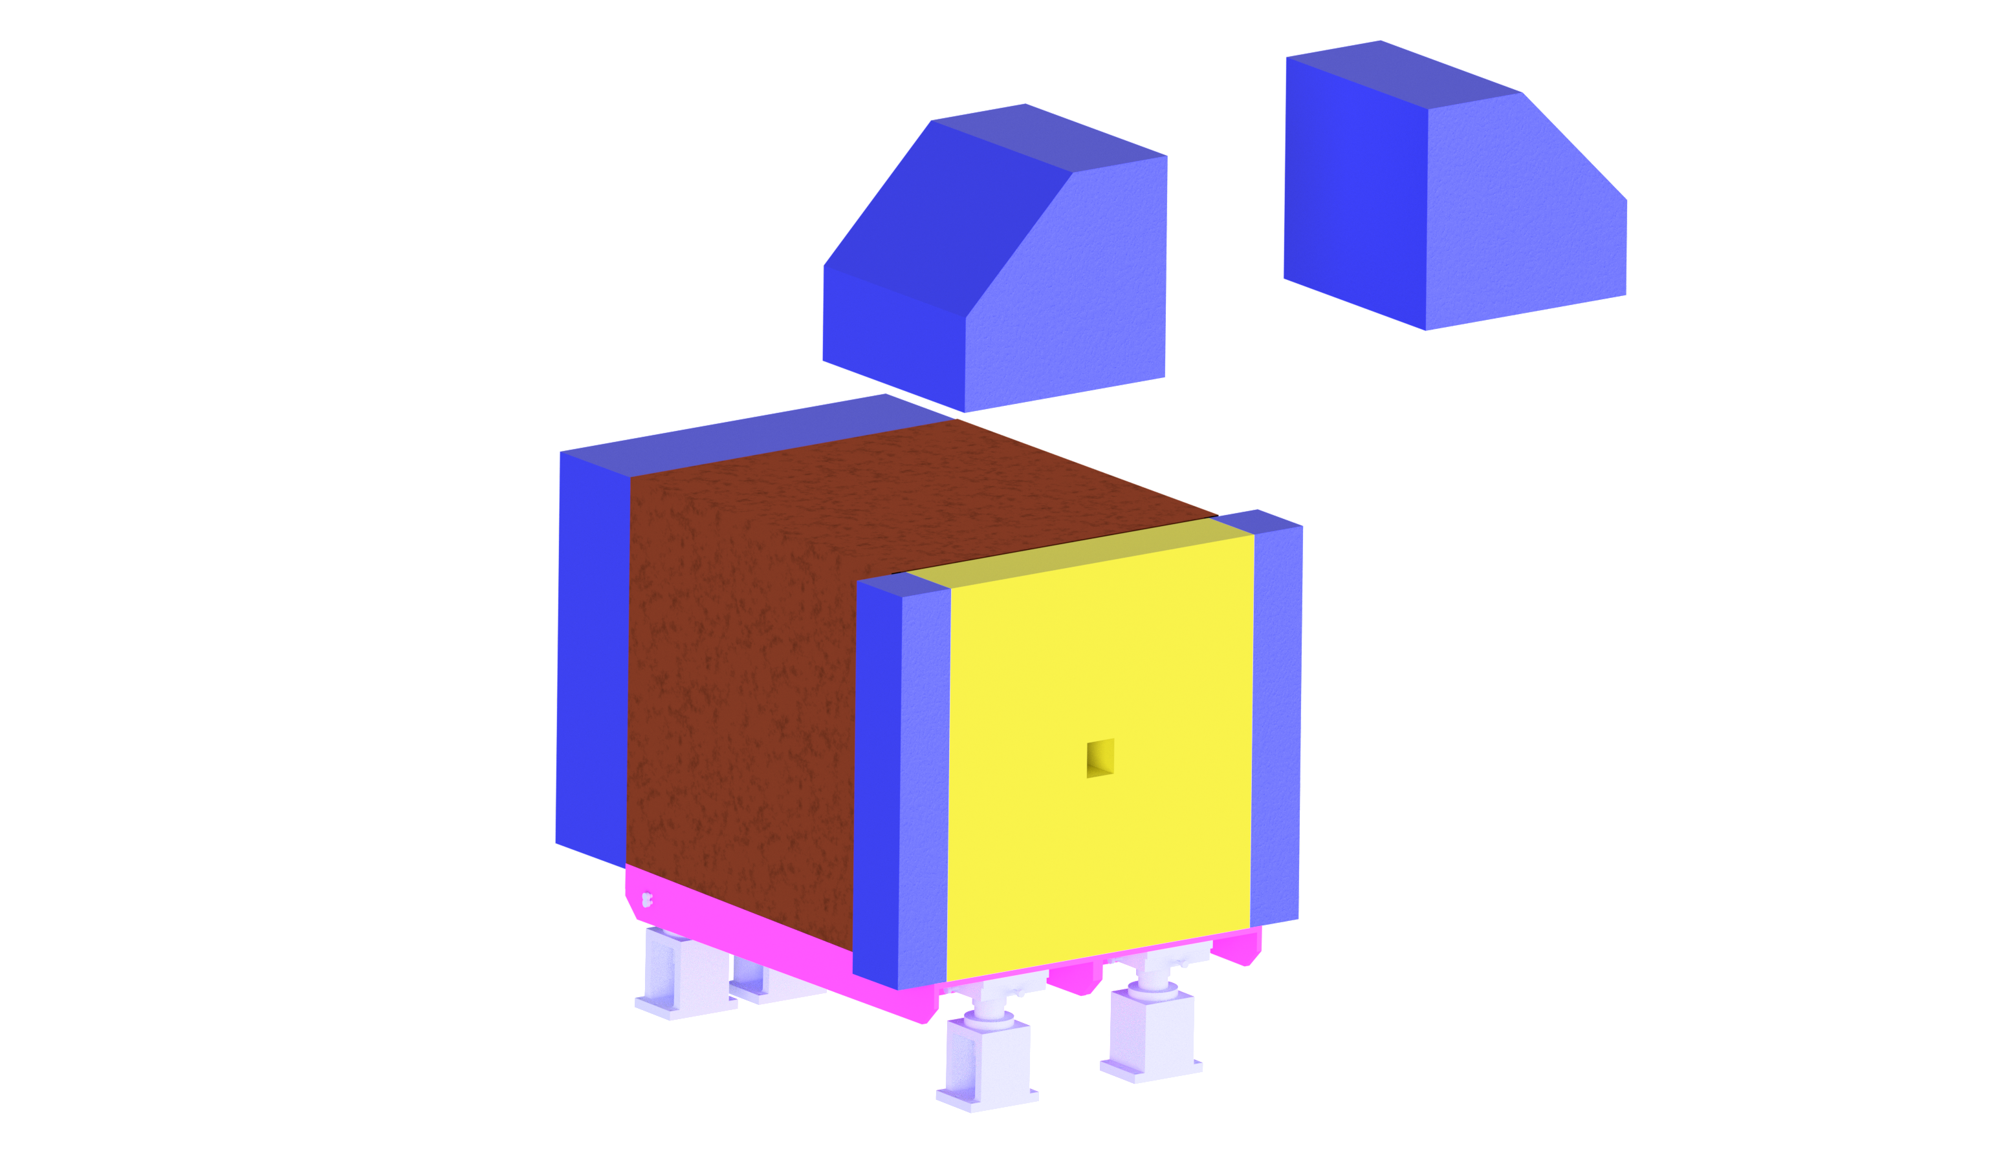
FoCal cooling - dry air supply
We want to provide a dry air supply for three areas in the FoCal detector. The total required flow is: 32 m^3/h.
Areas that require a dry air supply:
FoCal-E pixel Readout crates.
FoCal-E external electronics.
FoCal-H.

Slide 11
Scope of today's meeting
FoCal cooling system
FoCal-E cooling system
FoCal-H cooling system
FoCal-E active volume cooling system
FoCal-E external electronics cooling system
FoCal-H electronics cooling system
FoCal-H SiPMs cooling system
FoCal-E pixel Readout crates cooling system
FoCal cooling - general system layout.
FoCal-E core cooling system and FoCal-E external electronic cooling system.
FoCal-H electronics cooling system and FoCal-H SiPMs cooling system.
Readout crate cooling system will not be discussed today.

Slide 12


Author:
Maciej Czarnynoga
Email:
maciej.czarnynoga@pw.edu.pl
maciej.marek.czarnynoga@cern.ch

