Slide 1



Tuning simulations Updates
1
Elaf Musa
FCC-ee tuning WG meeting
^{30th} Apr 2024
FCCIS – The Future Circular Collider Innovation Study. This INFRADEV Research and Innovation Action project receives funding from the European Union’s H2020 Framework Programme under grant agreement no. 951754.

Slide 2
2
Table of content
Matching phase advance between nearby BPMs.
Tuning simulations using different correctors.
  For beta beating correction
    Normal trim quads at All sextupoles.
    Normal trim quads at ARC sextupoles.
    All normal quadrupoles
    ARC quadrupoles.
Adding measurement noise.
Notes:
Ttbar, 4IP lattice. These are the main results.
%$\epsilon_{x, \textrm{median}} = 1.509$ nm rad \\
%$\epsilon_{y, \textrm{median}} = 0.353$ pm rad \\
$\frac{\epsilon_{y}}{\epsilon_{x}} = 0.023$ $\%$ \\
\begin{table}[htb!]
\centering
\begin{tabular}{p{3cm}cccccc}
\hline
Type & $\Delta$X & $\Delta$Y & $\Delta$PSI & $\Delta$S & $\Delta$THETA & $\Delta$PHI \\
& ($\mu$m) & ($\mu$m) & ($\mu$rad) & ($\mu$m) & ($\mu$rad) & ($\mu$rad) \\
\vspace{.1cm} \\
\hline
Arc quadrupole* & 100 & 100 & 300 & 150 & 70 & 70 \\
Arc sextupoles* & 100 & 100 & 300 & 150 & 70 & 70 \\
\hline
Dipoles & 1000 & 1000 & 300 & 1000 & 0 & 0 \\
\hline
Girders & 200 & 200 & - & 1000 & 0 & 0 \\
\hline
IR quadrupole & 100 & 100 & 250 & 200 & 70 & 70 \\
IR sextupoles & 25 & 25 & 250 & 200 & 70 & 70 \\
%\hline
% BPM** & 40 & 40 & 100 & - \\
\hline
\end{tabular}
\end{table}

Slide 3
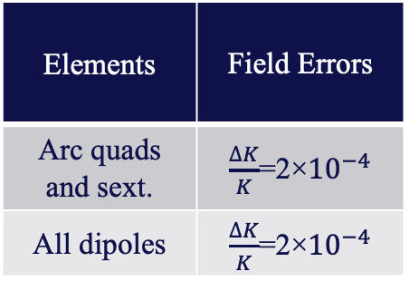
3
Tuning simulations for the baseline lattice at Z energy
  Assigned errors
Elements | Hor. & Ver. displacement | Tilt θ
Arc quads and sext. | 50 μm | 50 μrad
All dipoles | 1000 μm | 1000 μrad
Girders | 150 μm | 150 μrad
BPMs-quads. | 10 μm | -
Elements | Field Errors
Arc quads and sext. | $\frac{∆K}{K}$=2×${10}^{−4}$
All dipoles | $\frac{∆K}{K}$=2×${10}^{−4}$
Correctors:
Normal trim quads at all sextupoles
Skew quads at all sextupoles
Notes:
Ttbar, 4IP lattice. These are the main results.
%$\epsilon_{x, \textrm{median}} = 1.509$ nm rad \\
%$\epsilon_{y, \textrm{median}} = 0.353$ pm rad \\
$\frac{\epsilon_{y}}{\epsilon_{x}} = 0.023$ $\%$ \\
\begin{table}[htb!]
\centering
\begin{tabular}{p{3cm}cccccc}
\hline
Type & $\Delta$X & $\Delta$Y & $\Delta$PSI & $\Delta$S & $\Delta$THETA & $\Delta$PHI \\
& ($\mu$m) & ($\mu$m) & ($\mu$rad) & ($\mu$m) & ($\mu$rad) & ($\mu$rad) \\
\vspace{.1cm} \\
\hline
Arc quadrupole* & 100 & 50 & 300 & 150 & 70 & 70 \\
Arc sextupoles* & 100 & 50 & 300 & 150 & 70 & 70 \\
\hline
Dipoles & 1000 & 1000 & 300 & 1000 & 0 & 0 \\
\hline
Girders & 200 & 200 & - & 1000 & 0 & 0 \\
\hline
IR quadrupole & 100 & 100 & 250 & 200 & 70 & 70 \\
IR sextupoles & 100 & 100 & 250 & 200 & 70 & 70 \\
%\hline
% BPM** & 40 & 40 & 100 & - \\
\hline
\end{tabular}
\end{table}

Slide 4
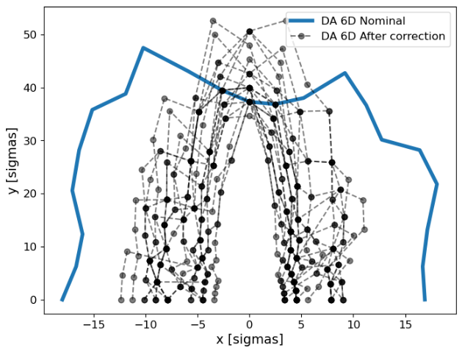
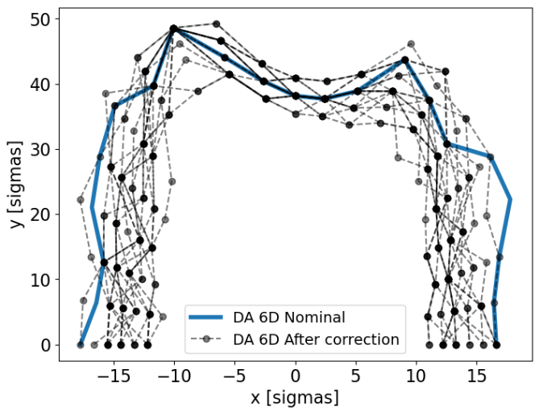
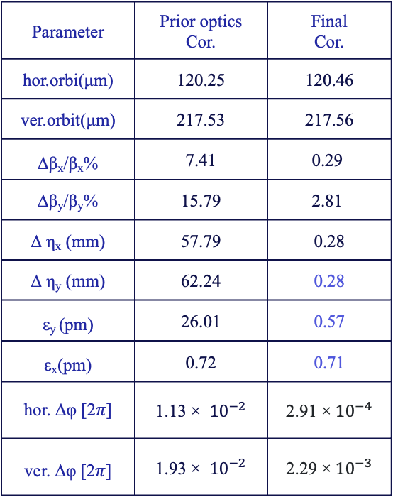
4
Tuning simulation results
Parameter | Prior optics Cor. | Final Cor.
hor.orbi(μm) | 120.25 | 120.46
ver.orbit(μm) | 217.53 | 217.56
∆β_{x}/β_{x}% | 7.41 | 0.29
∆β_{y}/β_{y}% | 15.79 | 2.81
∆ η_{x} (mm) | 57.79 | 0.28
∆ η_{y} (mm) | 62.24 | 0.28
ε_{y} (pm) | 26.01 | 0.57
ε_{x}(pm) | 0.72 | 0.71
hor. ∆φ [2𝜋] | 1.13 × ${ 10}^{−2}$ | 2.91 ×${ 10}^{−4}$
ver. ∆φ [2𝜋] | 1.93 × ${ 10}^{−2}$ | 2.29 ×${ 10}^{−3}$
Before linear optics cor
Final cor.
Notes:
The plots shows the achieved DA and momentum acceptance. for the seeds after tuning, the vertical emittance distribution and the achieved optics parameter values.
Commissioning sequence established with Optics, DA and MA were under control with nominal misalignments in the arcs.
a commissioning-like sequence is stablished

Slide 5
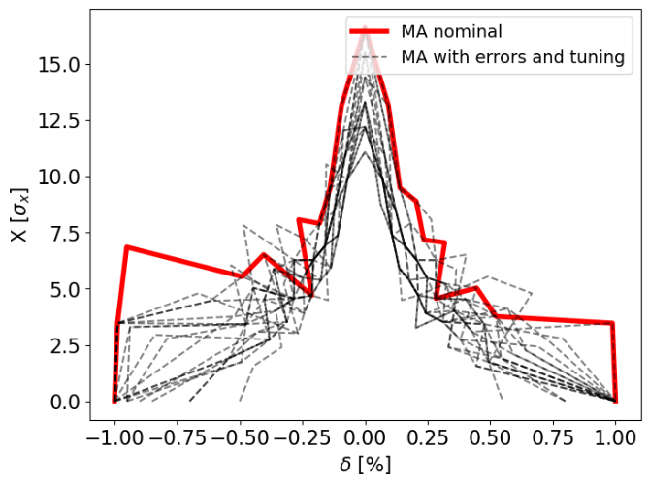
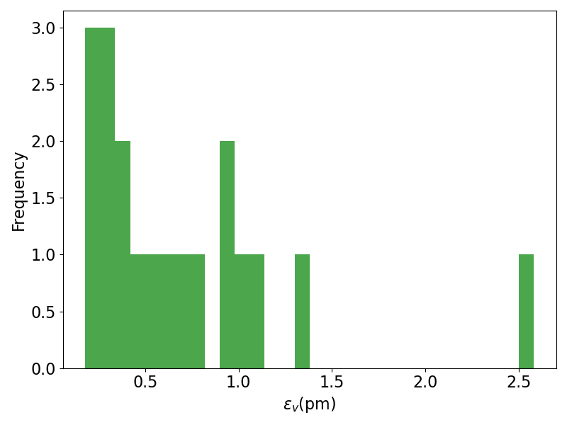
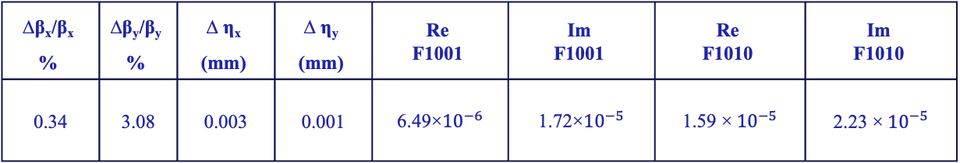
5
Tuning simulation results
Parameters after correction (at IP)
∆β_{x}/β_{x} % | ∆β_{y}/β_{y} % | ∆ η_{x} (mm) | ∆ η_{y} (mm) | Re F1001 | Im F1001 | Re F1010 | Im F1010
0.34 | 3.08 | 0.003 | 0.001 | 6.49×${10}^{−6}$ | 1.72×${10}^{−5}$ | 1.59 ×${ 10}^{−5}$ | 2.23 ×${ 10}^{−5}$
Notes:
The plots shows the achieved DA and momentum acceptance. for the seeds after tuning, the vertical emittance distribution and the achieved optics parameter values.
Commissioning sequence established with Optics, DA and MA were under control with nominal misalignments in the arcs.
a commissioning-like sequence is stablished

Slide 6
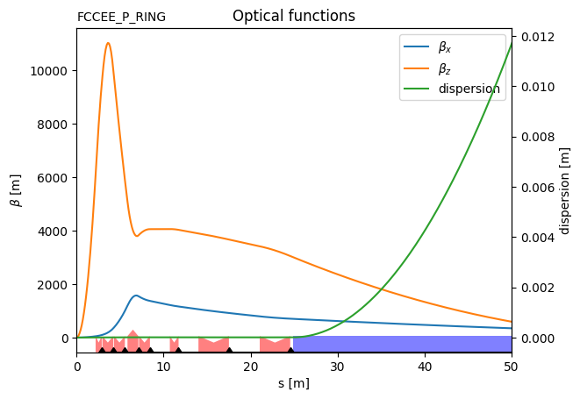
6
Tuning simulations for the baseline lattice at Z energy
Instead of measuring the phase advance from the start of the lattice to each BPM, phase advance differences between each two nearby BPMs are taken.
Phase advance from the start to each BPM
phase advance differences between each two nearby BPMs
∆φ [2𝜋]
∆φ [2𝜋]
∆φ [2𝜋]
∆φ [2𝜋]
∆φ [2𝜋]
Notes:
Ttbar, 4IP lattice. These are the main results.
%$\epsilon_{x, \textrm{median}} = 1.509$ nm rad \\
%$\epsilon_{y, \textrm{median}} = 0.353$ pm rad \\
$\frac{\epsilon_{y}}{\epsilon_{x}} = 0.023$ $\%$ \\
\begin{table}[htb!]
\centering
\begin{tabular}{p{3cm}cccccc}
\hline
Type & $\Delta$X & $\Delta$Y & $\Delta$PSI & $\Delta$S & $\Delta$THETA & $\Delta$PHI \\
& ($\mu$m) & ($\mu$m) & ($\mu$rad) & ($\mu$m) & ($\mu$rad) & ($\mu$rad) \\
\vspace{.1cm} \\
\hline
Arc quadrupole* & 100 & 50 & 300 & 150 & 70 & 70 \\
Arc sextupoles* & 100 & 50 & 300 & 150 & 70 & 70 \\
\hline
Dipoles & 1000 & 1000 & 300 & 1000 & 0 & 0 \\
\hline
Girders & 200 & 200 & - & 1000 & 0 & 0 \\
\hline
IR quadrupole & 100 & 100 & 250 & 200 & 70 & 70 \\
IR sextupoles & 100 & 100 & 250 & 200 & 70 & 70 \\
%\hline
% BPM** & 40 & 40 & 100 & - \\
\hline
\end{tabular}
\end{table}

Slide 7
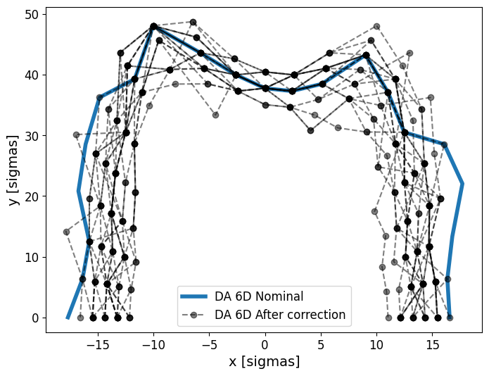
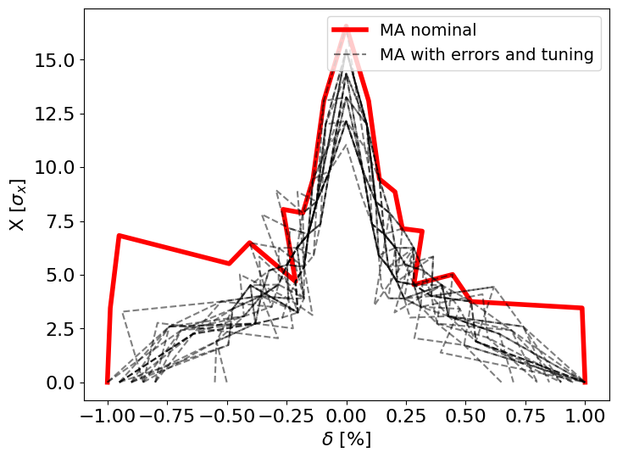
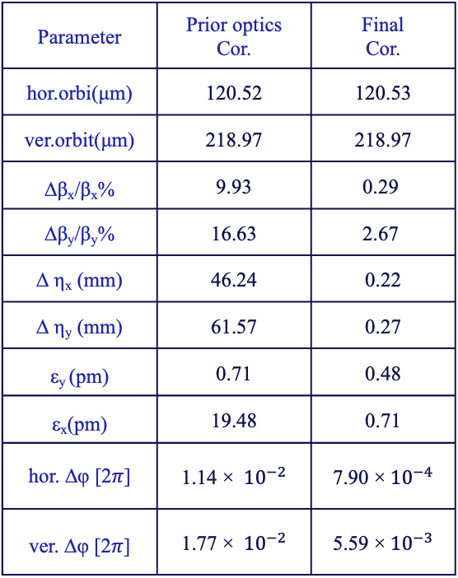
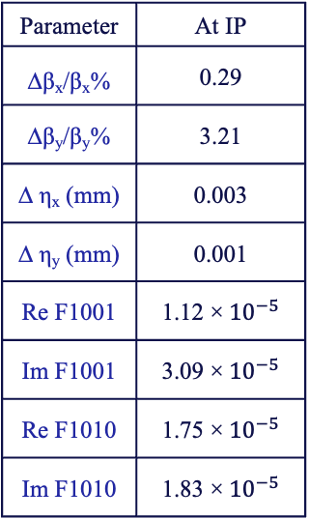
7
Tuning simulation results (with phase advance differences)
Parameter | Prior optics Cor. | Final Cor.
hor.orbi(μm) | 120.52 | 120.53
ver.orbit(μm) | 218.97 | 218.97
∆β_{x}/β_{x}% | 9.93 | 0.29
∆β_{y}/β_{y}% | 16.63 | 2.67
∆ η_{x} (mm) | 46.24 | 0.22
∆ η_{y} (mm) | 61.57 | 0.27
ε_{y} (pm) | 0.71 | 0.48
ε_{x}(pm) | 19.48 | 0.71
hor. ∆φ [2𝜋] | 1.14 × ${ 10}^{−2}$ | 7.90 ×${ 10}^{−4}$
ver. ∆φ [2𝜋] | 1.77 × ${ 10}^{−2}$ | 5.59 ×${ 10}^{−3}$
Parameter | At IP
∆β_{x}/β_{x}% | 0.29
∆β_{y}/β_{y}% | 3.21
∆ η_{x} (mm) | 0.003
∆ η_{y} (mm) | 0.001
Re F1001 | 1.12 ×${ 10}^{−5}$
Im F1001 | 3.09 ×${ 10}^{−5}$
Re F1010 | 1.75 ×${ 10}^{−5}$
Im F1010 | 1.83 ×${ 10}^{−5}$
Notes:
The plots shows the achieved DA and momentum acceptance. for the seeds after tuning, the vertical emittance distribution and the achieved optics parameter values.
Commissioning sequence established with Optics, DA and MA were under control with nominal misalignments in the arcs.
a commissioning-like sequence is stablished

Slide 8
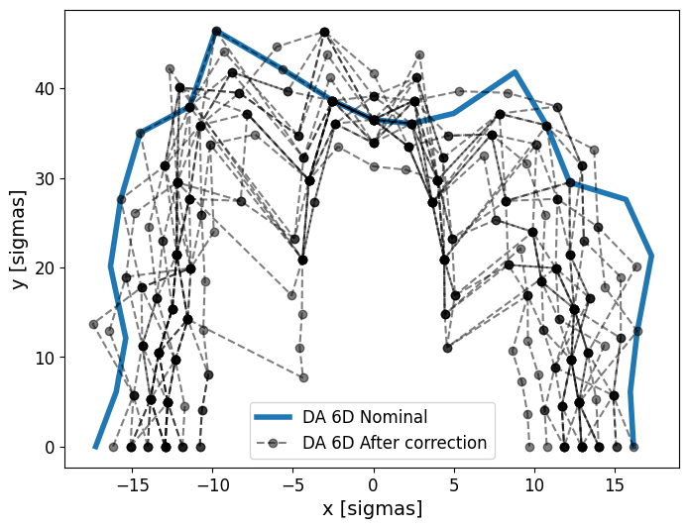
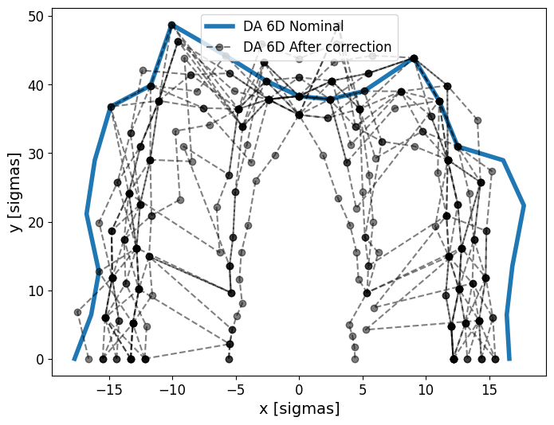
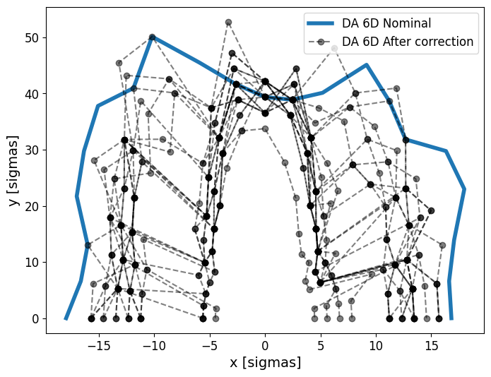
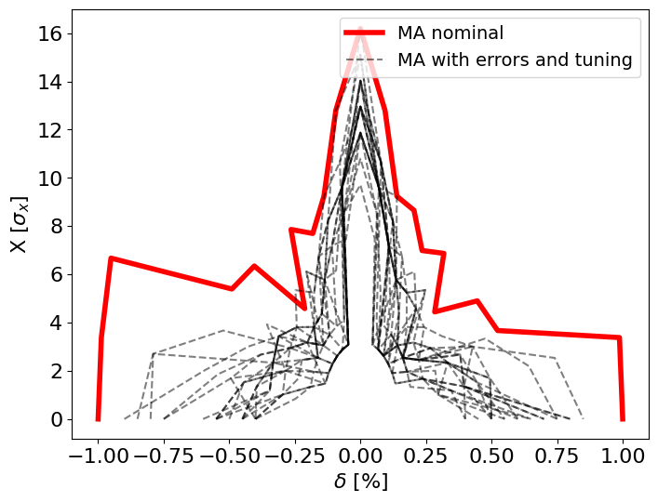
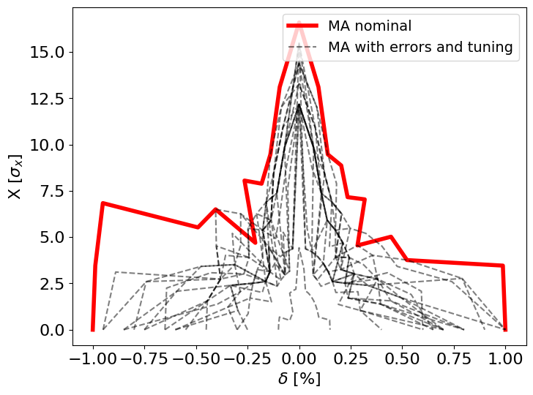
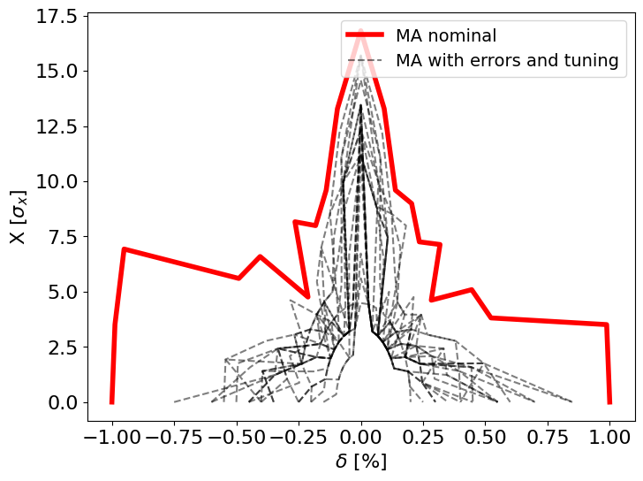
8
Using different correctors for beta beating correction
    Normal trim quads at All sextupoles.
    Normal trim quads at ARC sextupoles.
    All normal quadrupoles
    ARC quadrupoles
Notes:
Ttbar, 4IP lattice. These are the main results.
%$\epsilon_{x, \textrm{median}} = 1.509$ nm rad \\
%$\epsilon_{y, \textrm{median}} = 0.353$ pm rad \\
$\frac{\epsilon_{y}}{\epsilon_{x}} = 0.023$ $\%$ \\
\begin{table}[htb!]
\centering
\begin{tabular}{p{3cm}cccccc}
\hline
Type & $\Delta$X & $\Delta$Y & $\Delta$PSI & $\Delta$S & $\Delta$THETA & $\Delta$PHI \\
& ($\mu$m) & ($\mu$m) & ($\mu$rad) & ($\mu$m) & ($\mu$rad) & ($\mu$rad) \\
\vspace{.1cm} \\
\hline
Arc quadrupole* & 100 & 50 & 300 & 150 & 70 & 70 \\
Arc sextupoles* & 100 & 50 & 300 & 150 & 70 & 70 \\
\hline
Dipoles & 1000 & 1000 & 300 & 1000 & 0 & 0 \\
\hline
Girders & 200 & 200 & - & 1000 & 0 & 0 \\
\hline
IR quadrupole & 100 & 100 & 250 & 200 & 70 & 70 \\
IR sextupoles & 100 & 100 & 250 & 200 & 70 & 70 \\
%\hline
% BPM** & 40 & 40 & 100 & - \\
\hline
\end{tabular}
\end{table}

Slide 9
9
Using different correctors for beta beating correction
Parameter | All sext. | Arc sext. | All quads. | Arc quads.
∆β_{x}/β_{x}% | 0.29 | 0.92 | 0.29 | 1.01
∆β_{y}/β_{y}% | 2.67 | 4.14 | 2.46 | 6.29
∆ η_{x} (mm) | 0.22 | 0.54 | 0.08 | 0.54
∆ η_{y} (mm) | 0.27 | 0.51 | 0.28 | 0.50
ε_{y} (pm) | 0.48 | 0.65 | 0.35 | 0.47
Notes:
Ttbar, 4IP lattice. These are the main results.
%$\epsilon_{x, \textrm{median}} = 1.509$ nm rad \\
%$\epsilon_{y, \textrm{median}} = 0.353$ pm rad \\
$\frac{\epsilon_{y}}{\epsilon_{x}} = 0.023$ $\%$ \\
\begin{table}[htb!]
\centering
\begin{tabular}{p{3cm}cccccc}
\hline
Type & $\Delta$X & $\Delta$Y & $\Delta$PSI & $\Delta$S & $\Delta$THETA & $\Delta$PHI \\
& ($\mu$m) & ($\mu$m) & ($\mu$rad) & ($\mu$m) & ($\mu$rad) & ($\mu$rad) \\
\vspace{.1cm} \\
\hline
Arc quadrupole* & 100 & 50 & 300 & 150 & 70 & 70 \\
Arc sextupoles* & 100 & 50 & 300 & 150 & 70 & 70 \\
\hline
Dipoles & 1000 & 1000 & 300 & 1000 & 0 & 0 \\
\hline
Girders & 200 & 200 & - & 1000 & 0 & 0 \\
\hline
IR quadrupole & 100 & 100 & 250 & 200 & 70 & 70 \\
IR sextupoles & 100 & 100 & 250 & 200 & 70 & 70 \\
%\hline
% BPM** & 40 & 40 & 100 & - \\
\hline
\end{tabular}
\end{table}

Slide 10
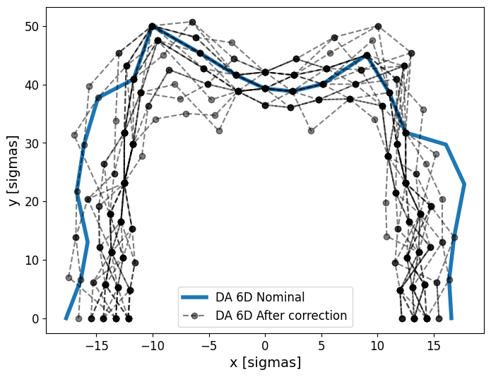
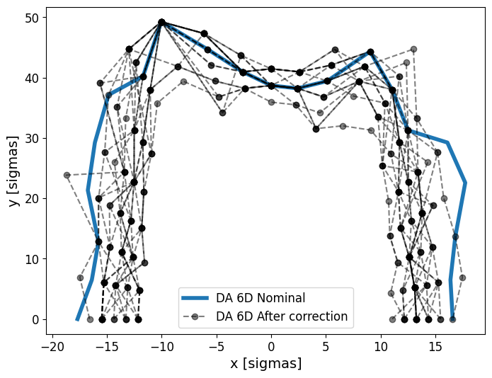
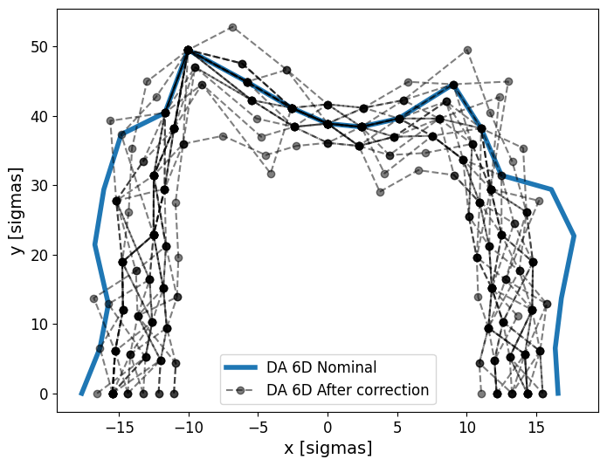
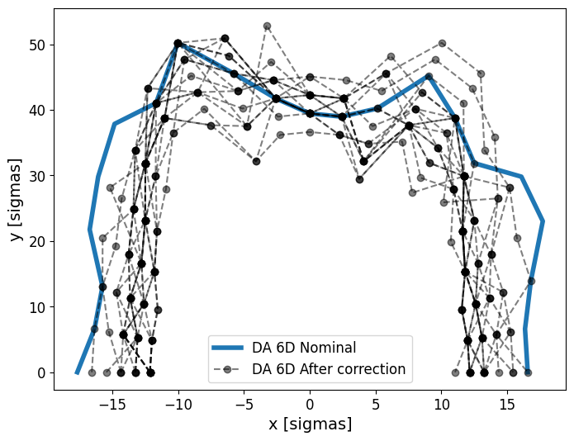
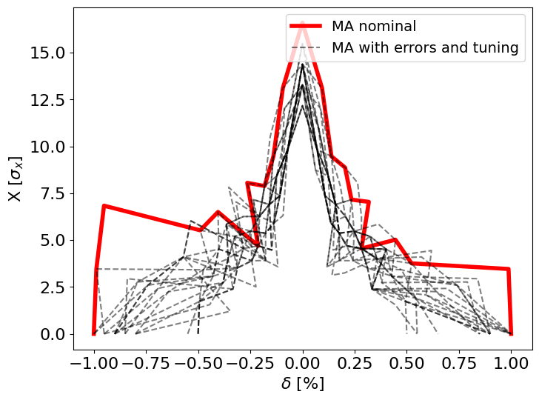
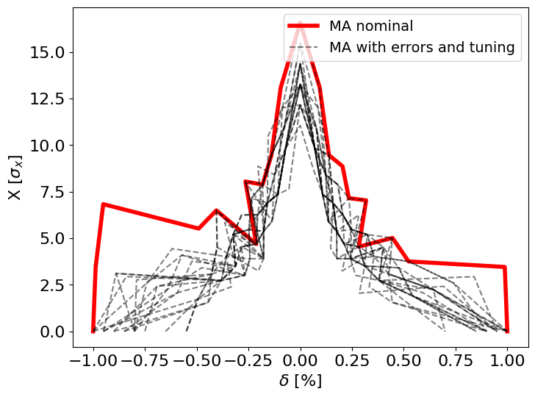
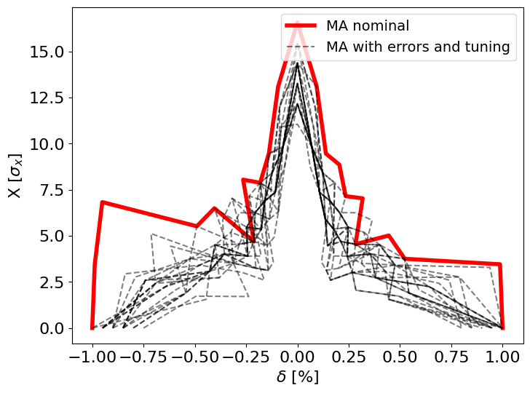
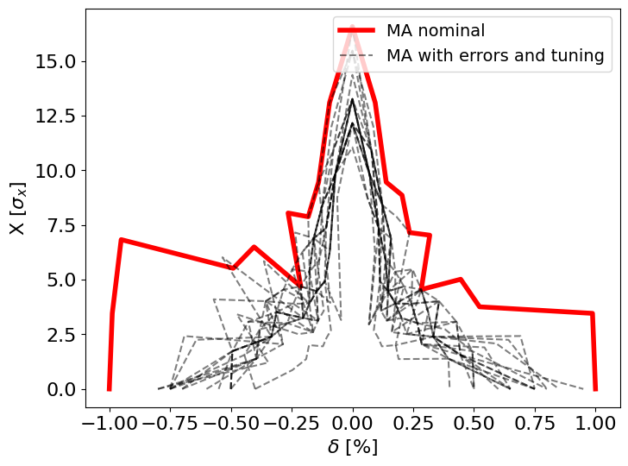
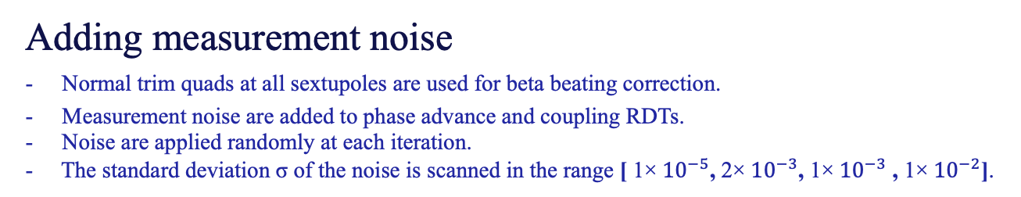




10
Adding measurement noise
Normal trim quads at all sextupoles are used for beta beating correction.
Measurement noise are added to phase advance and coupling RDTs.
Noise are applied randomly at each iteration.
- The standard deviation σ of the noise is scanned in the range [ 1×${ 10}^{−5}$, 2×${ 10}^{−3}$, 1×${ 10}^{−3}$ , 1×${ 10}^{−2}$].
σ =1×${ 10}^{−5}$
σ =1×${ 10}^{−3}$
σ =2×${ 10}^{−3}$
σ =1×${ 10}^{−2}$
3 failed seeds
Notes:
Ttbar, 4IP lattice. These are the main results.
%$\epsilon_{x, \textrm{median}} = 1.509$ nm rad \\
%$\epsilon_{y, \textrm{median}} = 0.353$ pm rad \\
$\frac{\epsilon_{y}}{\epsilon_{x}} = 0.023$ $\%$ \\
\begin{table}[htb!]
\centering
\begin{tabular}{p{3cm}cccccc}
\hline
Type & $\Delta$X & $\Delta$Y & $\Delta$PSI & $\Delta$S & $\Delta$THETA & $\Delta$PHI \\
& ($\mu$m) & ($\mu$m) & ($\mu$rad) & ($\mu$m) & ($\mu$rad) & ($\mu$rad) \\
\vspace{.1cm} \\
\hline
Arc quadrupole* & 100 & 50 & 300 & 150 & 70 & 70 \\
Arc sextupoles* & 100 & 50 & 300 & 150 & 70 & 70 \\
\hline
Dipoles & 1000 & 1000 & 300 & 1000 & 0 & 0 \\
\hline
Girders & 200 & 200 & - & 1000 & 0 & 0 \\
\hline
IR quadrupole & 100 & 100 & 250 & 200 & 70 & 70 \\
IR sextupoles & 100 & 100 & 250 & 200 & 70 & 70 \\
%\hline
% BPM** & 40 & 40 & 100 & - \\
\hline
\end{tabular}
\end{table}

Slide 11

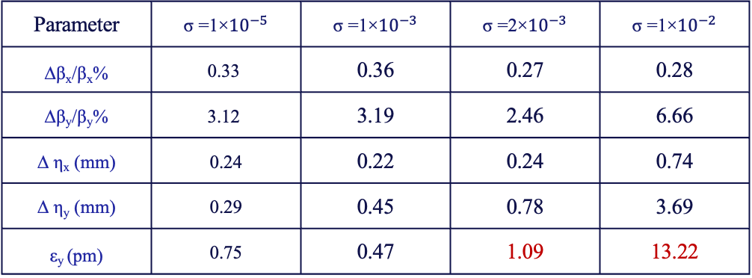
11
Adding measurement noise
- Normal trim quads at all sextupoles are used for beta beating correction.
Measurement noise are added to phase advance and coupling RDTs.
Noise are applied randomly at each iteration.
- The standard deviation σ of the noise is scanned in the range [ 1×${10}^{−5}$, 1×${10}^{−3}$, 2×${10}^{−3}$ , 1×${10}^{−2}$].
Parameter | σ =1×${10}^{−5}$ | σ =1×${10}^{−3}$ | σ =2×${10}^{−3}$ | σ =1×${10}^{−2}$
∆β_{x}/β_{x}% | 0.33 | 0.36 | 0.27 | 0.28
∆β_{y}/β_{y}% | 3.12 | 3.19 | 2.46 | 6.66
∆ η_{x} (mm) | 0.24 | 0.22 | 0.24 | 0.74
∆ η_{y} (mm) | 0.29 | 0.45 | 0.78 | 3.69
ε_{y} (pm) | 0.75 | 0.47 | 1.09 | 13.22
Notes:
Ttbar, 4IP lattice. These are the main results.
%$\epsilon_{x, \textrm{median}} = 1.509$ nm rad \\
%$\epsilon_{y, \textrm{median}} = 0.353$ pm rad \\
$\frac{\epsilon_{y}}{\epsilon_{x}} = 0.023$ $\%$ \\
\begin{table}[htb!]
\centering
\begin{tabular}{p{3cm}cccccc}
\hline
Type & $\Delta$X & $\Delta$Y & $\Delta$PSI & $\Delta$S & $\Delta$THETA & $\Delta$PHI \\
& ($\mu$m) & ($\mu$m) & ($\mu$rad) & ($\mu$m) & ($\mu$rad) & ($\mu$rad) \\
\vspace{.1cm} \\
\hline
Arc quadrupole* & 100 & 50 & 300 & 150 & 70 & 70 \\
Arc sextupoles* & 100 & 50 & 300 & 150 & 70 & 70 \\
\hline
Dipoles & 1000 & 1000 & 300 & 1000 & 0 & 0 \\
\hline
Girders & 200 & 200 & - & 1000 & 0 & 0 \\
\hline
IR quadrupole & 100 & 100 & 250 & 200 & 70 & 70 \\
IR sextupoles & 100 & 100 & 250 & 200 & 70 & 70 \\
%\hline
% BPM** & 40 & 40 & 100 & - \\
\hline
\end{tabular}
\end{table}

Slide 12
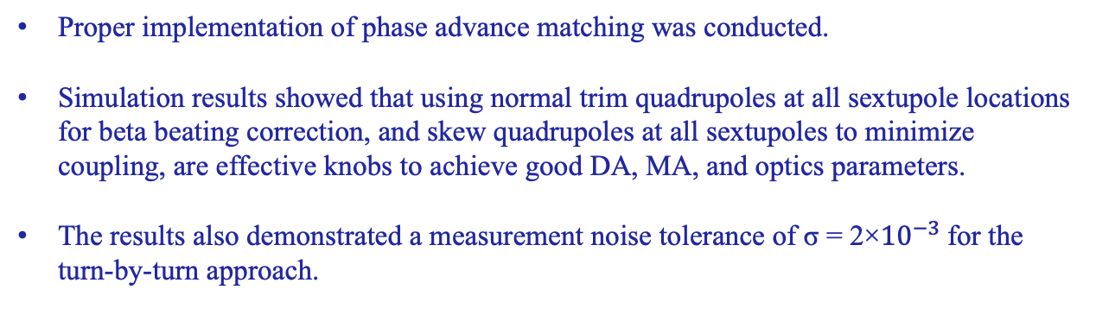
12
Conclusion
Proper implementation of phase advance matching was conducted.
Simulation results showed that using normal trim quadrupoles at all sextupole locations for beta beating correction, and skew quadrupoles at all sextupoles to minimize coupling, are effective knobs to achieve good DA, MA, and optics parameters.
The results also demonstrated a measurement noise tolerance of σ = 2×${10}^{−3}$for the turn-by-turn approach.
Notes:
Ttbar, 4IP lattice. These are the main results.
%$\epsilon_{x, \textrm{median}} = 1.509$ nm rad \\
%$\epsilon_{y, \textrm{median}} = 0.353$ pm rad \\
$\frac{\epsilon_{y}}{\epsilon_{x}} = 0.023$ $\%$ \\
\begin{table}[htb!]
\centering
\begin{tabular}{p{3cm}cccccc}
\hline
Type & $\Delta$X & $\Delta$Y & $\Delta$PSI & $\Delta$S & $\Delta$THETA & $\Delta$PHI \\
& ($\mu$m) & ($\mu$m) & ($\mu$rad) & ($\mu$m) & ($\mu$rad) & ($\mu$rad) \\
\vspace{.1cm} \\
\hline
Arc quadrupole* & 100 & 50 & 300 & 150 & 70 & 70 \\
Arc sextupoles* & 100 & 50 & 300 & 150 & 70 & 70 \\
\hline
Dipoles & 1000 & 1000 & 300 & 1000 & 0 & 0 \\
\hline
Girders & 200 & 200 & - & 1000 & 0 & 0 \\
\hline
IR quadrupole & 100 & 100 & 250 & 200 & 70 & 70 \\
IR sextupoles & 100 & 100 & 250 & 200 & 70 & 70 \\
%\hline
% BPM** & 40 & 40 & 100 & - \\
\hline
\end{tabular}
\end{table}

Slide 13
Thank you for your attention

Slide 14
Backups

Slide 15

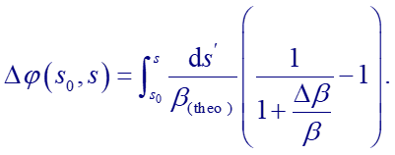
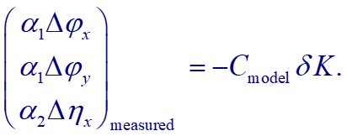
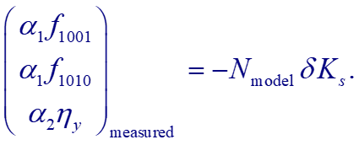
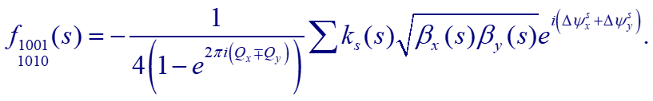
Correction algorithms
In the Turn by Turn (TbT) measurements the beam is excited and beam position data is recorded over one or multiple turns to determine optics parameters.
    1. Phase advance + 𝜂_{𝑥} correction
    2. Coupling RDTs + 𝜂_{𝑦} correction
Notes:
Unlike LOCO which correct the optics based on the orbit response. The relative phase advance is related to the beta beating as shown in the formula and it correction is as equivalent as correcting the beat beating.
From the lattice model, we can obtain the response matrix 𝐶, that relates the relative hor and ver phase advance 𝛿Δ𝜓 and relative horizontal dispersion 𝛿𝜂𝑥 to the relative strengths 𝛿𝐾 of the quadrupole. (simultaneously)
By solving the equation in the right, the relative quadrpole strength values that will minimize the error can be optioned.
Resonance Driving Terms (RDTs) are tools to describe the coupling between the horizontal and vertical motion close to the sum and difference resonance, f1001 and f1010, corresponding to the difference
and sum resonances,
and it is defined as following, similar to the phase advance the equation in the right can be solved to obtain the skew quadrpoles relative strength that will minimize the coupling and vertical dispersio.

Slide 16
Correction procedure
Switch Sextupoles Off
Beam Threading
Beam Based Alignment
Sextupoles ramp 10 %
Orbit Correction
Linear Optics
correction
Chromaticity Fitting
(Arc SF & SD)
Tune Fitting
(Arc QF & QD)
At 100% of sextupoles strengths
Notes:
Unlike LOCO which correct the optics based on the orbit response. The relative phase advance is related to the beta beating as shown in the formula and it correction is as equivalent as correcting the beat beating.
From the lattice model, we can obtain the response matrix 𝐶, that relates the relative hor and ver phase advance 𝛿Δ𝜓 and relative horizontal dispersion 𝛿𝜂𝑥 to the relative strengths 𝛿𝐾 of the quadrupole. (simultaneously)
By solving the equation in the right, the relative quadrpole strength values that will minimize the error can be optioned.
Resonance Driving Terms (RDTs) are tools to describe the coupling between the horizontal and vertical motion close to the sum and difference resonance, f1001 and f1010, corresponding to the difference
and sum resonances,
and it is defined as following, similar to the phase advance the equation in the right can be solved to obtain the skew quadrpoles relative strength that will minimize the coupling and vertical dispersio.

