Slide 1



Anomaly Detection and Signal Denoising of TbT BPM data
Q. Bruant, Y. Nasr, L. Vitileia, J. Piscart, H. Le Corre,
A. Gomez, C. Ndungu-Ndegwa,
F. Bugiotti, B. Dalena
Thanks to: J. Keintzel, M. Gael, Y. Ohnishi

Slide 2
Motivation and Context
1

Slide 3

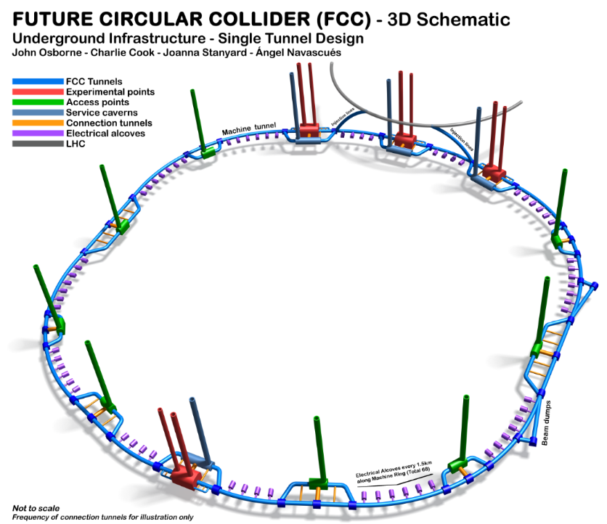
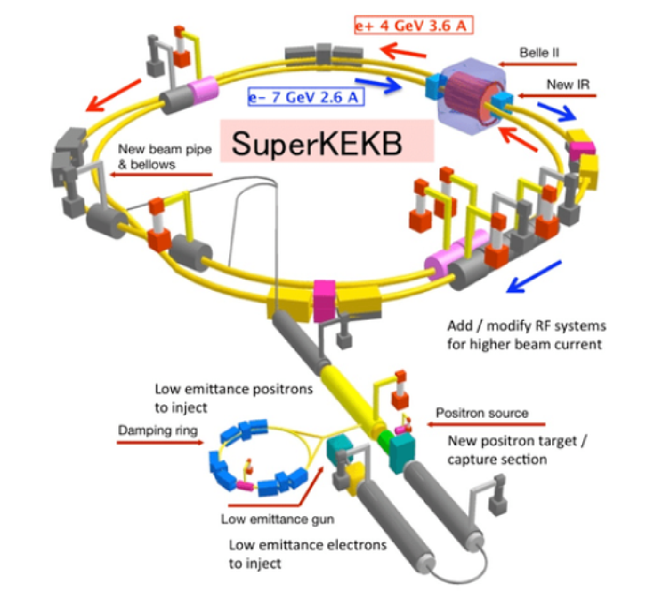

FCC and SuperKEKB
International FCC project (CERN as host lab)
Continue to study experimental high energy particle physics
Accelerator options: FCC-hh, FCC-ee, FCC-he
Existing e+e- collider:
small size FCC-ee
proofs of principle of several design choices
CDRs publié dans European Physical Journal C (Vol 1) and ST (Vol 2-4)
http://fcc-cdr.web.cern.ch/
https://doi.org/10.1093/ptep/pts083

Slide 4
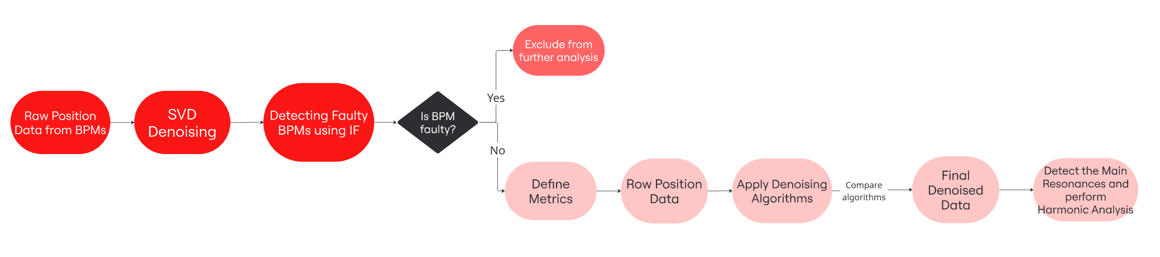
TbT BPMs data pipeline
Automatically detect faulty BPMs
Reduce noise on good BPMs
Features extraction
Features selection
Detection via DBSCAN

Slide 5
Detecting faulty BPMs
2

Slide 6
DBSCAN
Clustering algorithm
  hyperspace of features extracted from Multivariate Time Series (MTS)
One vs all approach
Distance-based approach
Main approach:
One given measurement, all BPM tracks, features selected for the measurement by library
  Outlier detection in given measurement
: outlier out of ε range from other points
ε
: first considered point in cluster
Feature 2
: point in cluster
: point in cluster with no new neighbour within ε
Feature 1

Slide 7
Features and datasets
Features are extracted automatically via the Time2Feat library.
The unsupervised mode select the features based on a PCA decomposition with and without a given feature to tell if this feature is relevant.
For HER:
Dataset: HER_2024_02_06_IK_H_Vinjkick/ HER_2024_02_06_16_22_57.data
Features: standard deviation, median, autocorrelation, FFT components, location of max, …
For LER:
Dataset: LER_2024_02_06_IK_H_Vinjkick/ LER_2024_02_06_17_02_14.data
Features: percentage of recurring values, FFT components, variance, etc…
Total number of features kept: 37/201
Total number of features kept: 31/207

Slide 8
Main Results
LER_2024_02_06_17_02_14.data
HER_2024_02_06_16_22_57.data
Faulty BPM HER (DBSCAN) | Expected faulty BPM HER | Faulty BPM LER (DBSCAN) | Expected faulty BPM LER
MQEAE35 | MQEAE35 |  | MQD3P23
MQD3E18 | MQD3E18 | MQEAP29 | MQEAP29
MQR2ORE | MQR2ORE |  | MQD3P8
 | MQEAE37 |  | MQEAP10
MQEAE33 |  | MQEAP35 | MQEAP35
MQD3E29 |  | MQW2ORP | MQW2ORP
 | MQD3E23 | MQEAP32
MQEAE25 |  | MQEAP33
MQEAE20 | MQEAE20 | MQEAP44
 |  | MQD3P29
 |  | MQI6P
 |  | MQEAP38
HER :
4/6 of expected faulty BPM are detected.
LER :
3/6 of expected faulty BPM are detected.

Slide 9
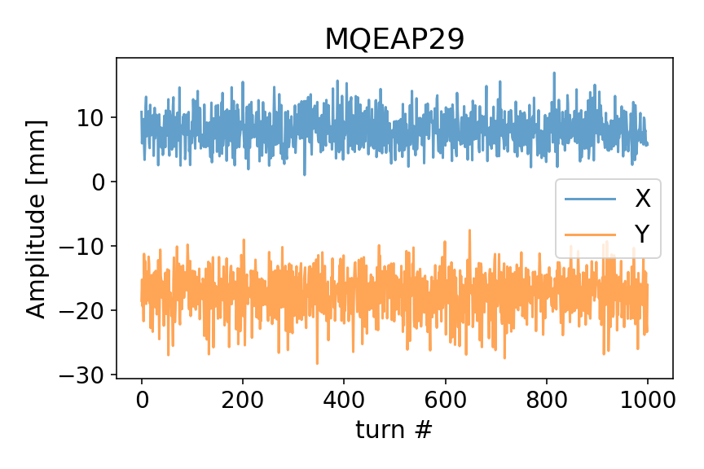
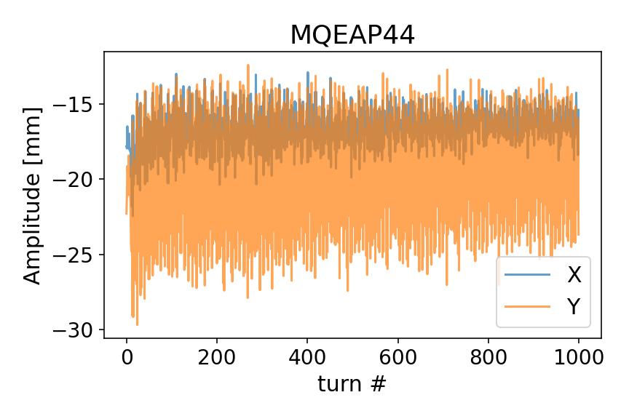
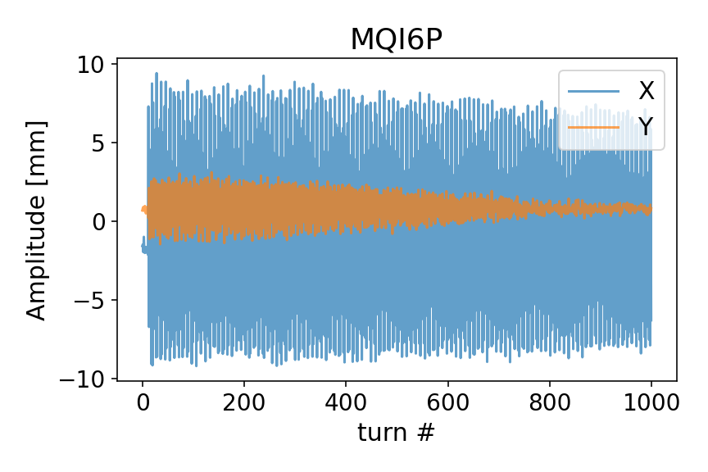
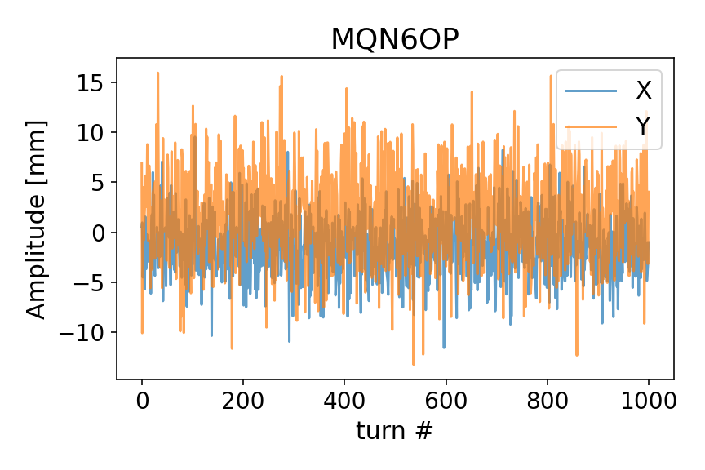
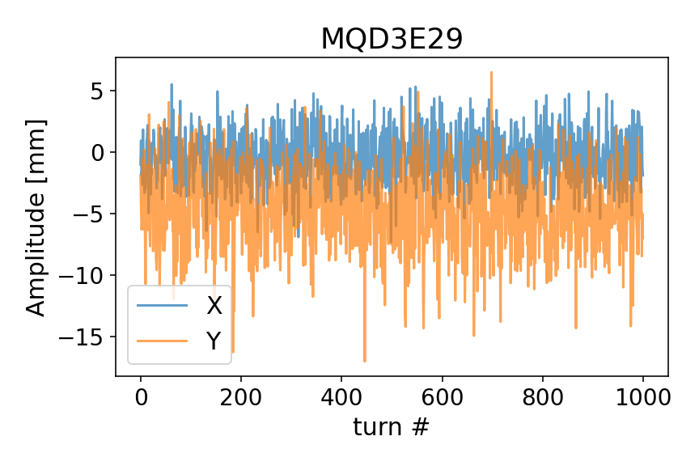
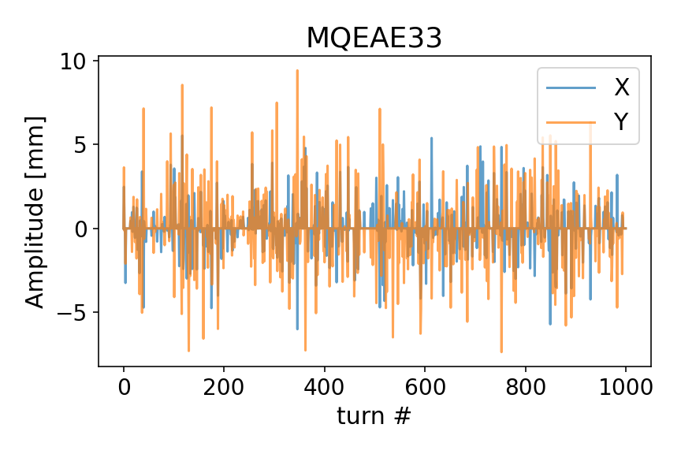
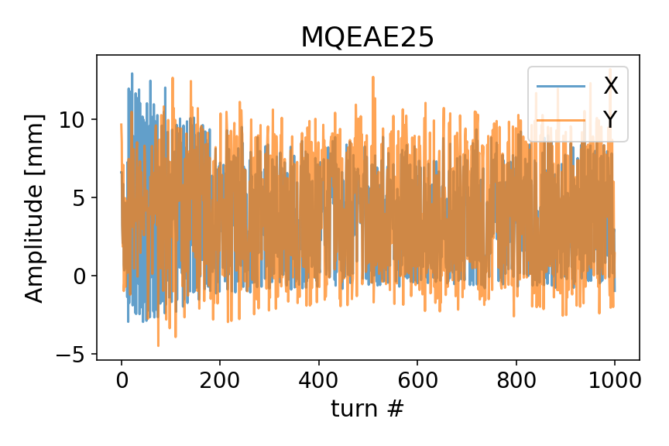
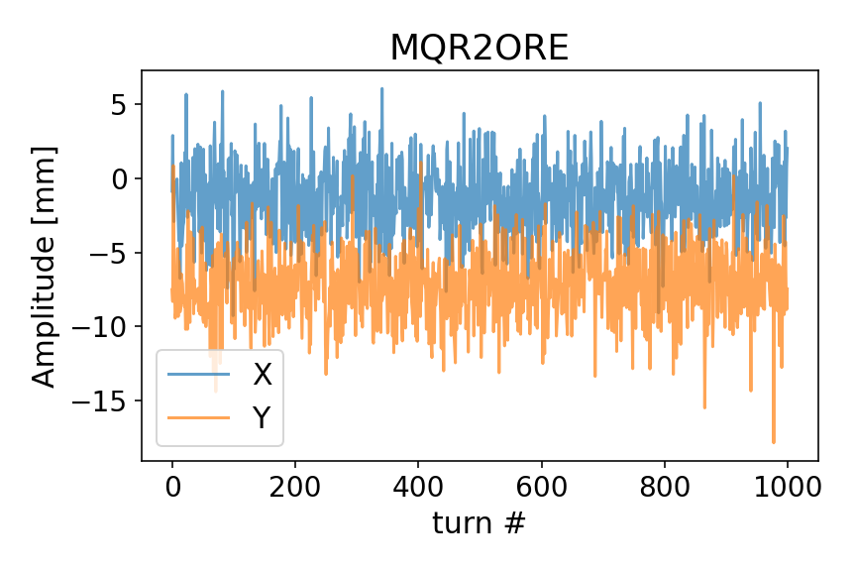
Faulty BPM plots

Slide 10
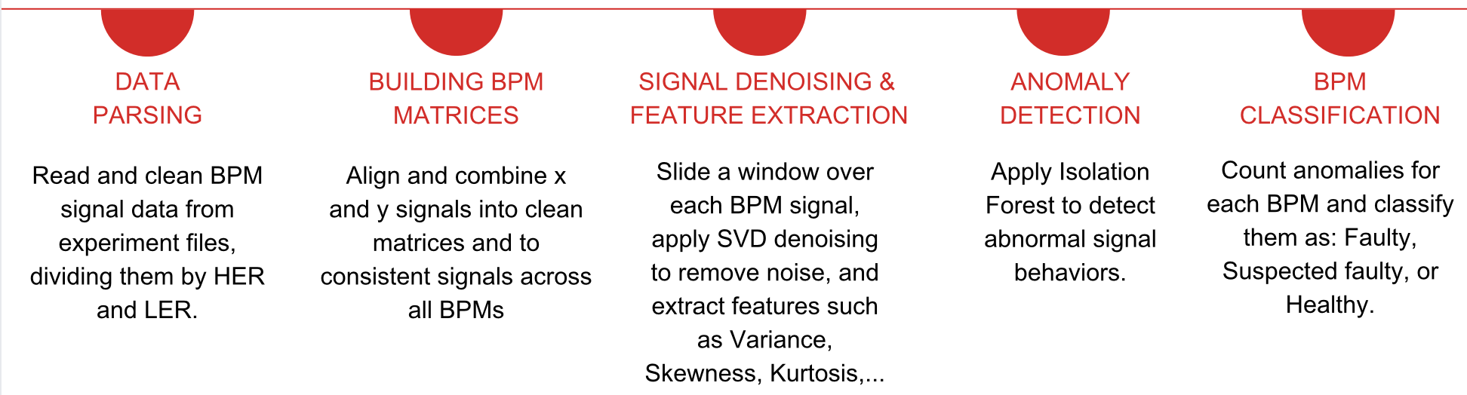
Isolation Forest + SVD
1
2
3
4
5

Slide 11
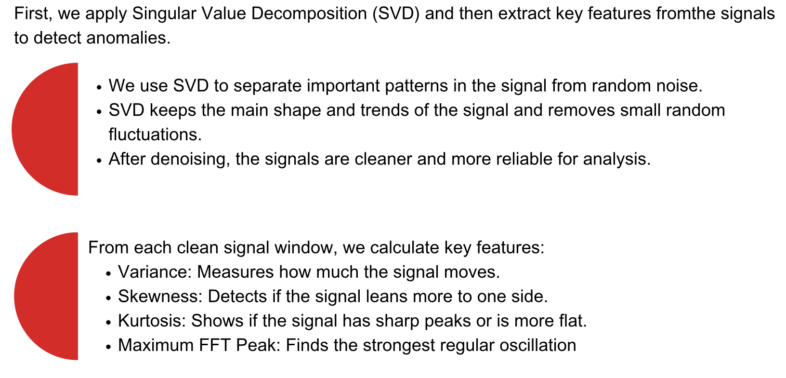
Signal Denoising & Feature Extraction

Slide 12
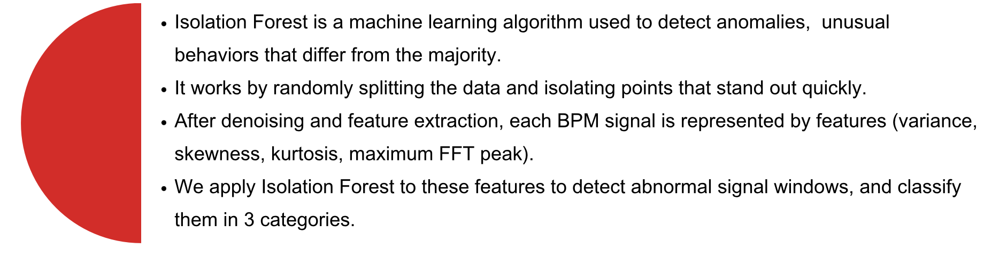
Anomaly Detection with Isolation Forest

Slide 13

Results
Ring | Expected Faulty BPMs | Correctly Detected
High Energy Ring (HER) | 6 | 5
Low Energy Ring (LER) | 6 | 4
  Detected 83% of expected faulty BPMs in HER and 67% in LER.
  Found additional BPMs showing strong anomalies, suggesting hidden faults.
  Next steps: investigate new candidates and refine detection thresholds.

Slide 14
Denoising
3

Slide 15


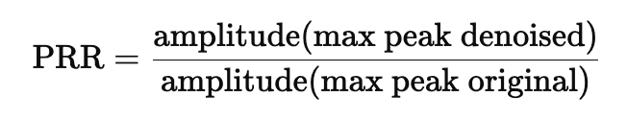
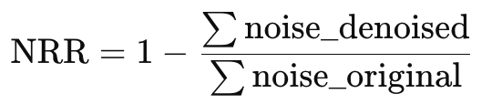


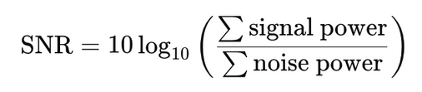


Evaluation Metrics
Peak Retention Ratio
Noise Reduction Ratio
How well the main peak is preserved
How much noise is removed
SNR Improvement
Frequency Shift
How much signal quality is improved
How much the main frequency changed

Slide 16
Algorithms
SVD
PCA
LSTM
Separates signal from noise by decomposing data into orthogonal components, and keeping the largest ones
Reduces dimensionality by identifying patterns of highest variance in the data
Uses a neural network to predict the true positions, without the random noise

Slide 17
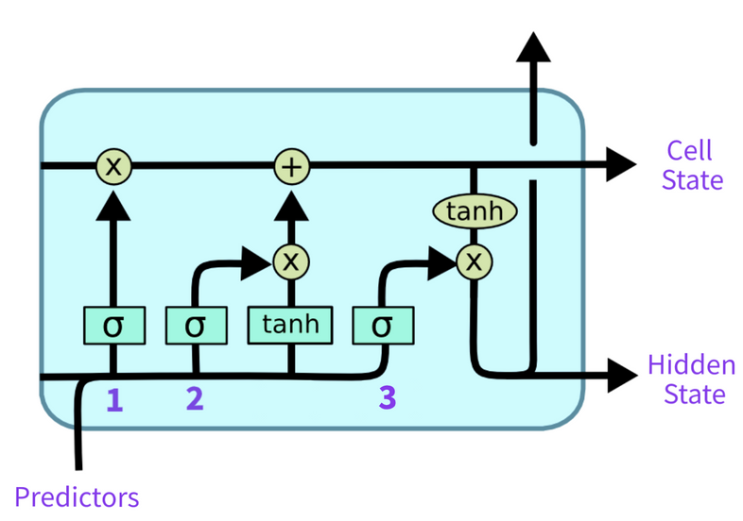
What is an LSTM
  LSTMs work in the same way as RNNs, but each cell is more complex
    The key difference is that LSTMs maintain a “cell state” in addition to the hidden state, which allows it to keep longer-term information
    This allows it to avoid the vanishing gradient problem

Slide 18
How denoising work
We combine these cells into 3 layers of 50 LSTM cells
  Having a relatively deep model allows it to learn complex relationships in the data
  We add BatchNorm and Dropout for normalization
We train the model on a series of noisy positions
  The model will learn the underlying patterns in the data
  We then use the model’s predictions as our estimate of the denoised signal

Slide 19
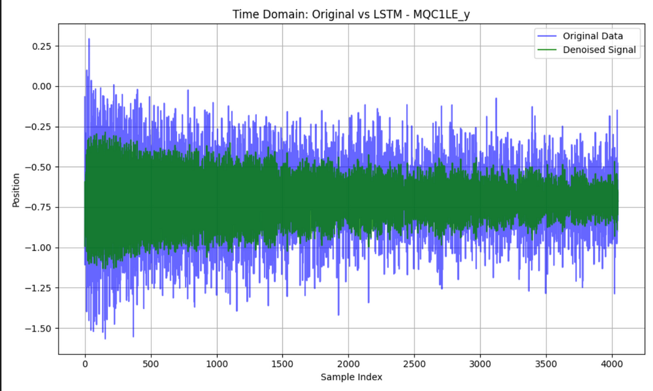
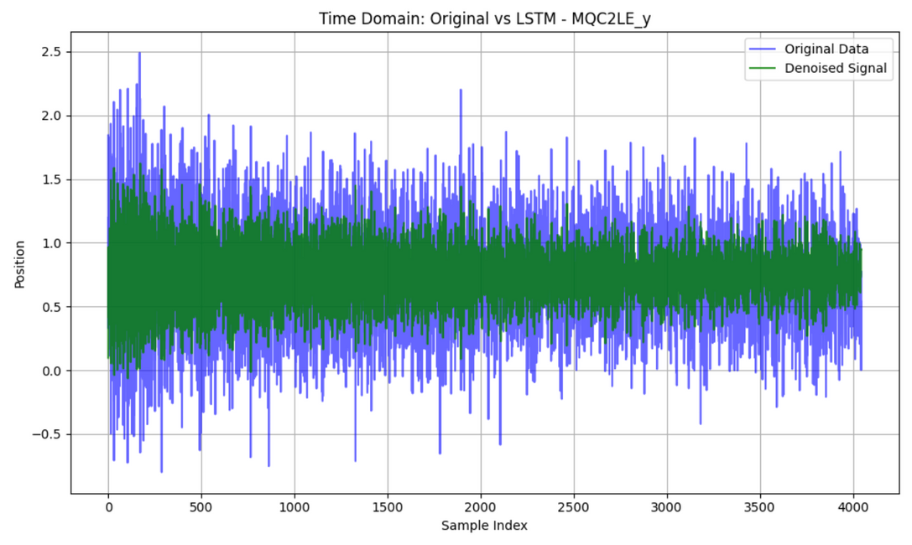
Example BPM positions
File used: HER_2024_06_25_23_52_21.data

Slide 20
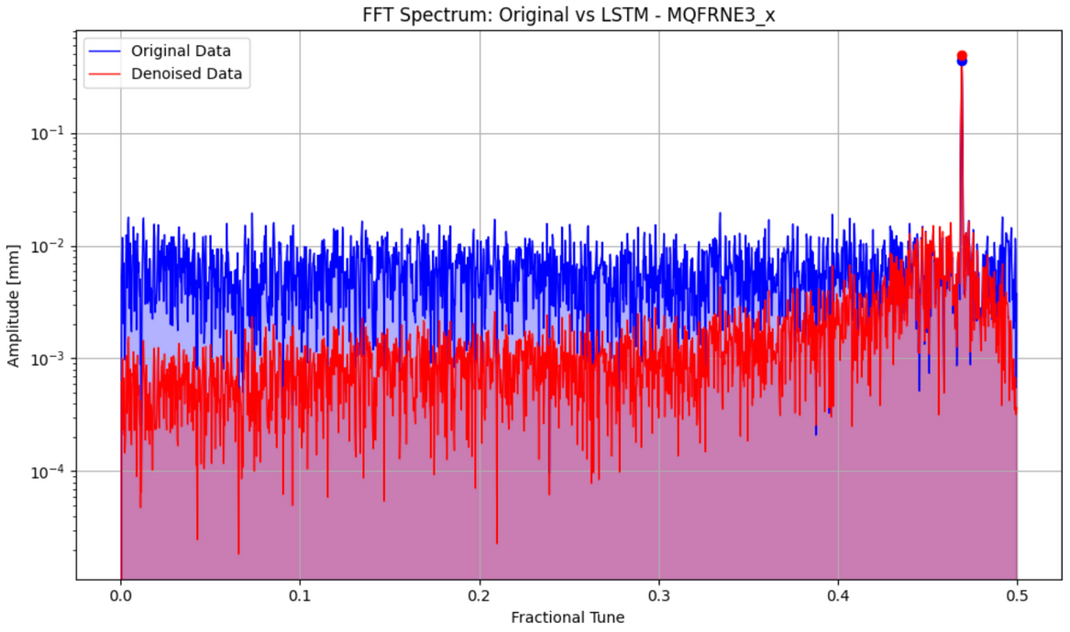
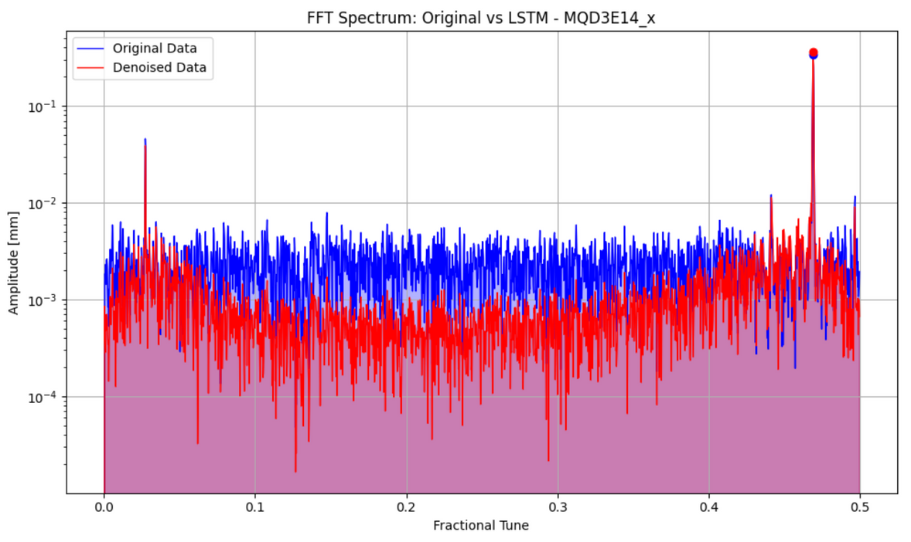
Examples Frequences
File used: HER_2024_06_25_23_52_21.data

Slide 21
Models Comparison
Metrics | SVD | PCA | LSTM
Peak Retention Ratio | 0.99 | 0.99 | 0,95
Noise Reduction Ratio | 0.45 | 0.4 | 0.57
SNR | 2.99 | 2.58 | 8,4
Frequency Shift | 0.0035 | 0.0035 | 0
Time to denoise | < 1 min | 1 min | ~ 1h

Slide 22
Perspectives
Further understanding and improvements of the algorithms
Comparison with OMC FFT spectrum
Reconstruct the Optics functions with SOMA on denoised data
Characterize the algorithms on simulated BPMs signals
Look at other AI techniques

Slide 23


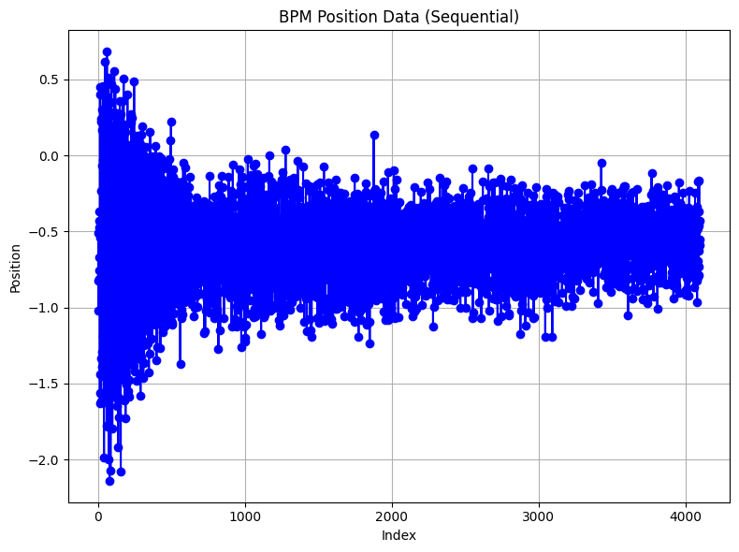
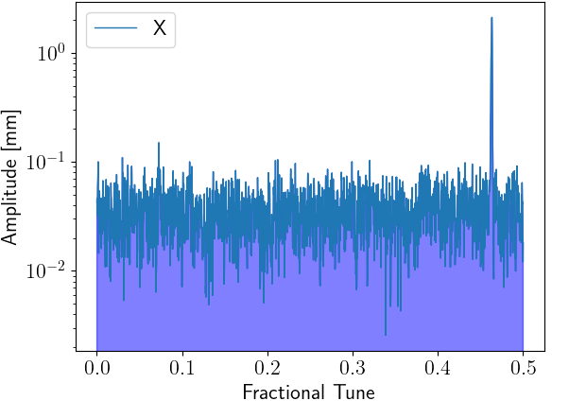
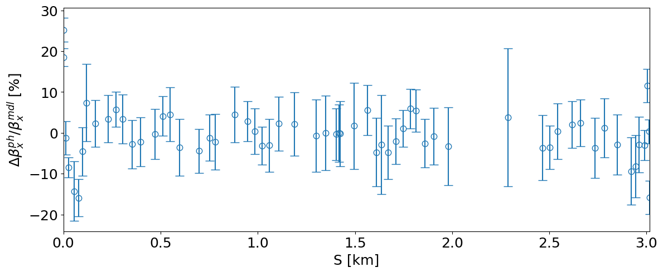
TbT BPM data
BPM data (gen. sdds format)
BPM data
Synchronization
SVD cleaning
If high singular
intrinsic errors
Else
Position [mm]
ACCELERATOR
BPM cuts
Optics parameters reconstruction
Harmonic analysis
Turn number

Slide 24
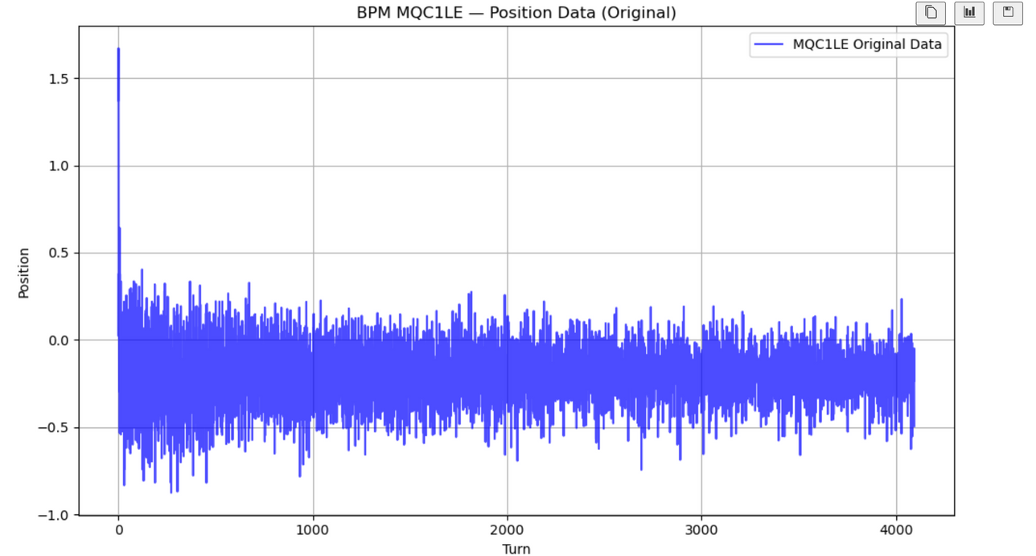
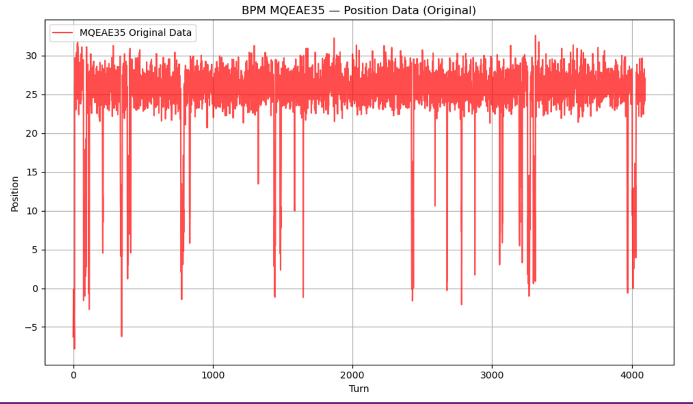
Examples
Normal BPM
Faulty BPM

