Slide 1
Preliminary results on CEPC IP coupling tuning
Wei Yuanyuan, Wang Yiwei, Zhang Yuan, Wang Bin, Bai Sha
IHEP, China
FCC-ee Tuning Meeting，30 April，2025

Slide 2
Content
CEPC baseline lattice
Introduction of IP tuning
Determine the coupling knobs
Results on coupling tuning
Summary and To-do list

Slide 3
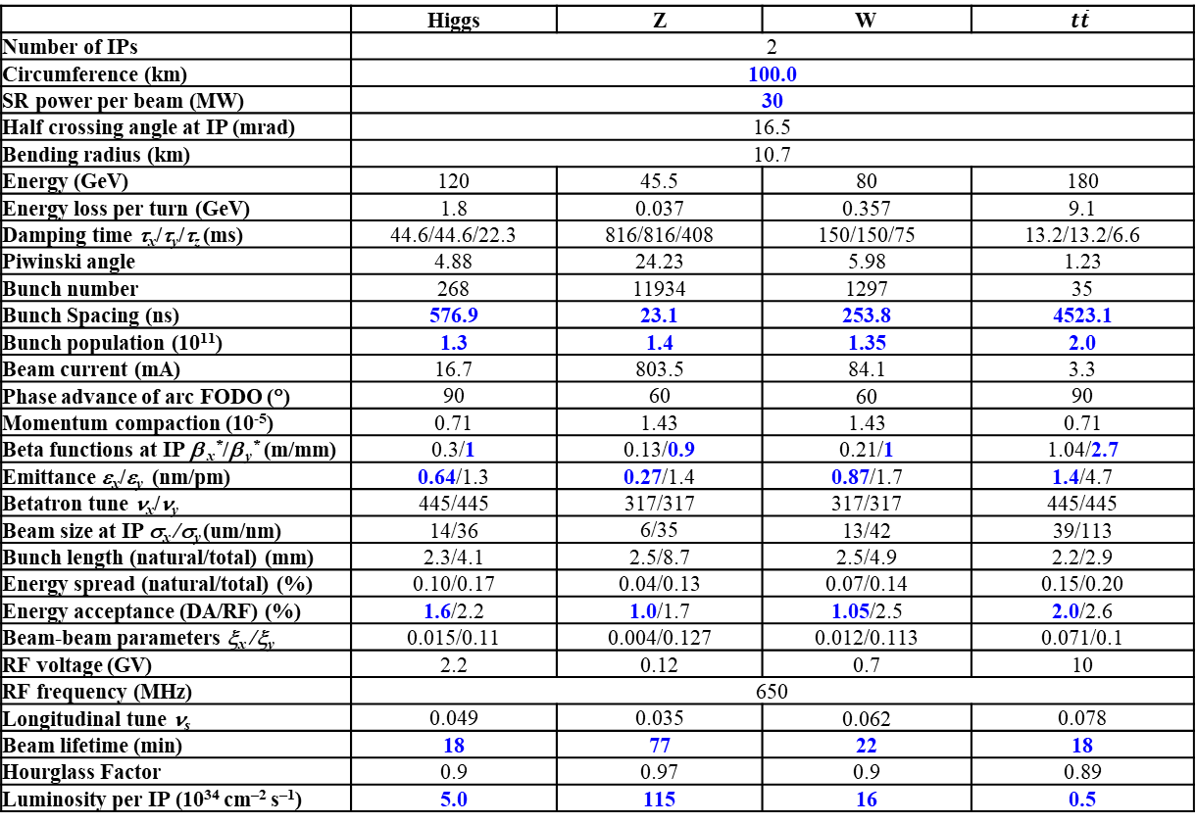
CEPC Design Parameters
 | Higgs | Z | W | $$t\overline{t}$$
Number of IPs | 2
Circumference (km) | 100.0
SR power per beam (MW) | 30
Half crossing angle at IP (mrad) | 16.5
Bending radius (km) | 10.7
Energy (GeV) | 120 | 45.5 | 80 | 180
Energy loss per turn (GeV) | 1.8 | 0.037 | 0.357 | 9.1
Damping time τ_{x}/τ_{y}/τ_{z} (ms) | 44.6/44.6/22.3 | 816/816/408 | 150/150/75 | 13.2/13.2/6.6
Piwinski angle | 4.88 | 24.23 | 5.98 | 1.23
Bunch number | 268 | 11934 | 1297 | 35
Bunch Spacing (ns) | 576.9 | 23.1 | 253.8 | 4523.1
Bunch population (10¹¹) | 1.3 | 1.4 | 1.35 | 2.0
Beam current (mA) | 16.7 | 803.5 | 84.1 | 3.3
Phase advance of arc FODO (°) | 90 | 60 | 60 | 90
Momentum compaction (10⁻⁵) | 0.71 | 1.43 | 1.43 | 0.71
Beta functions at IP β _{x}*/β _{y}* (m/mm) | 0.3/1 | 0.13/0.9 | 0.21/1 | 1.04/2.7
Emittance ε_{x}/ε_{y} (nm/pm) | 0.64/1.3 | 0.27/1.4 | 0.87/1.7 | 1.4/4.7
Betatron tune ν_{x}/ν_{y} | 445/445 | 317/317 | 317/317 | 445/445
Beam size at IP σ_{x} /σ_{y} (um/nm) | 14/36 | 6/35 | 13/42 | 39/113
Bunch length (natural/total) (mm) | 2.3/4.1 | 2.5/8.7 | 2.5/4.9 | 2.2/2.9
Energy spread (natural/total) (%) | 0.10/0.17 | 0.04/0.13 | 0.07/0.14 | 0.15/0.20
Energy acceptance (DA/RF) (%) | 1.6/2.2 | 1.0/1.7 | 1.05/2.5 | 2.0/2.6
Beam-beam parameters ξ_{x} /ξ_{y} | 0.015/0.11 | 0.004/0.127 | 0.012/0.113 | 0.071/0.1
RF voltage (GV) | 2.2 | 0.12 | 0.7 | 10
RF frequency (MHz) | 650
Longitudinal tune ν_{s} | 0.049 | 0.035 | 0.062 | 0.078
Beam lifetime (min) | 18 | 77 | 22 | 18
Hourglass Factor | 0.9 | 0.97 | 0.9 | 0.89
Luminosity per IP (10³⁴ cm^{–2} s^{–1}) | 5.0 | 115 | 16 | 0.5
𝛽y∗ and emittance chosen for luminosity
adequate bunch population Ne for the luminosity and the achievable energy acceptance for lattice design
Number of bunches Nb is adjusted to keep the beam current
Updated bunch spacing for the requirement from detector
Ref: CEPC TDR; Radiation Detection Technology and Methods (2024) 8:1–1105, https://doi.org/10.1007/s41605-024-00463-y;

Slide 4
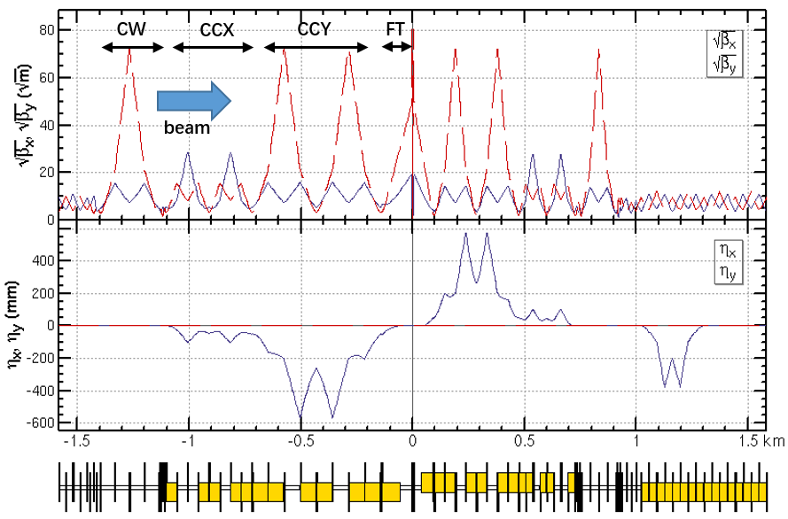
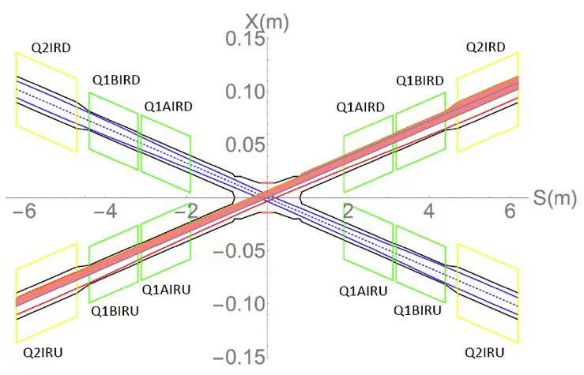
CEPC baseline lattice
CEPC baseline lattice— TDR lattice for Higgs energy w/o solenoid
Layout of IR
Layout of IP

Slide 5
What is “IP tuning”
IP tuning is a process adjusting and optimizing some important optics properties at IP by some knobs
Including knobs of local orbit, orbit angle, β * , waist shift, coupling, dispersion
One knob is to tune specific parameters at IP locally using a set of magnets
The magnets are localized in IR region and the distortion of beam parameters should be closed in this area
Parameters at IP can be tuned linearly by changing the strengths of the sets of magnets

Slide 6
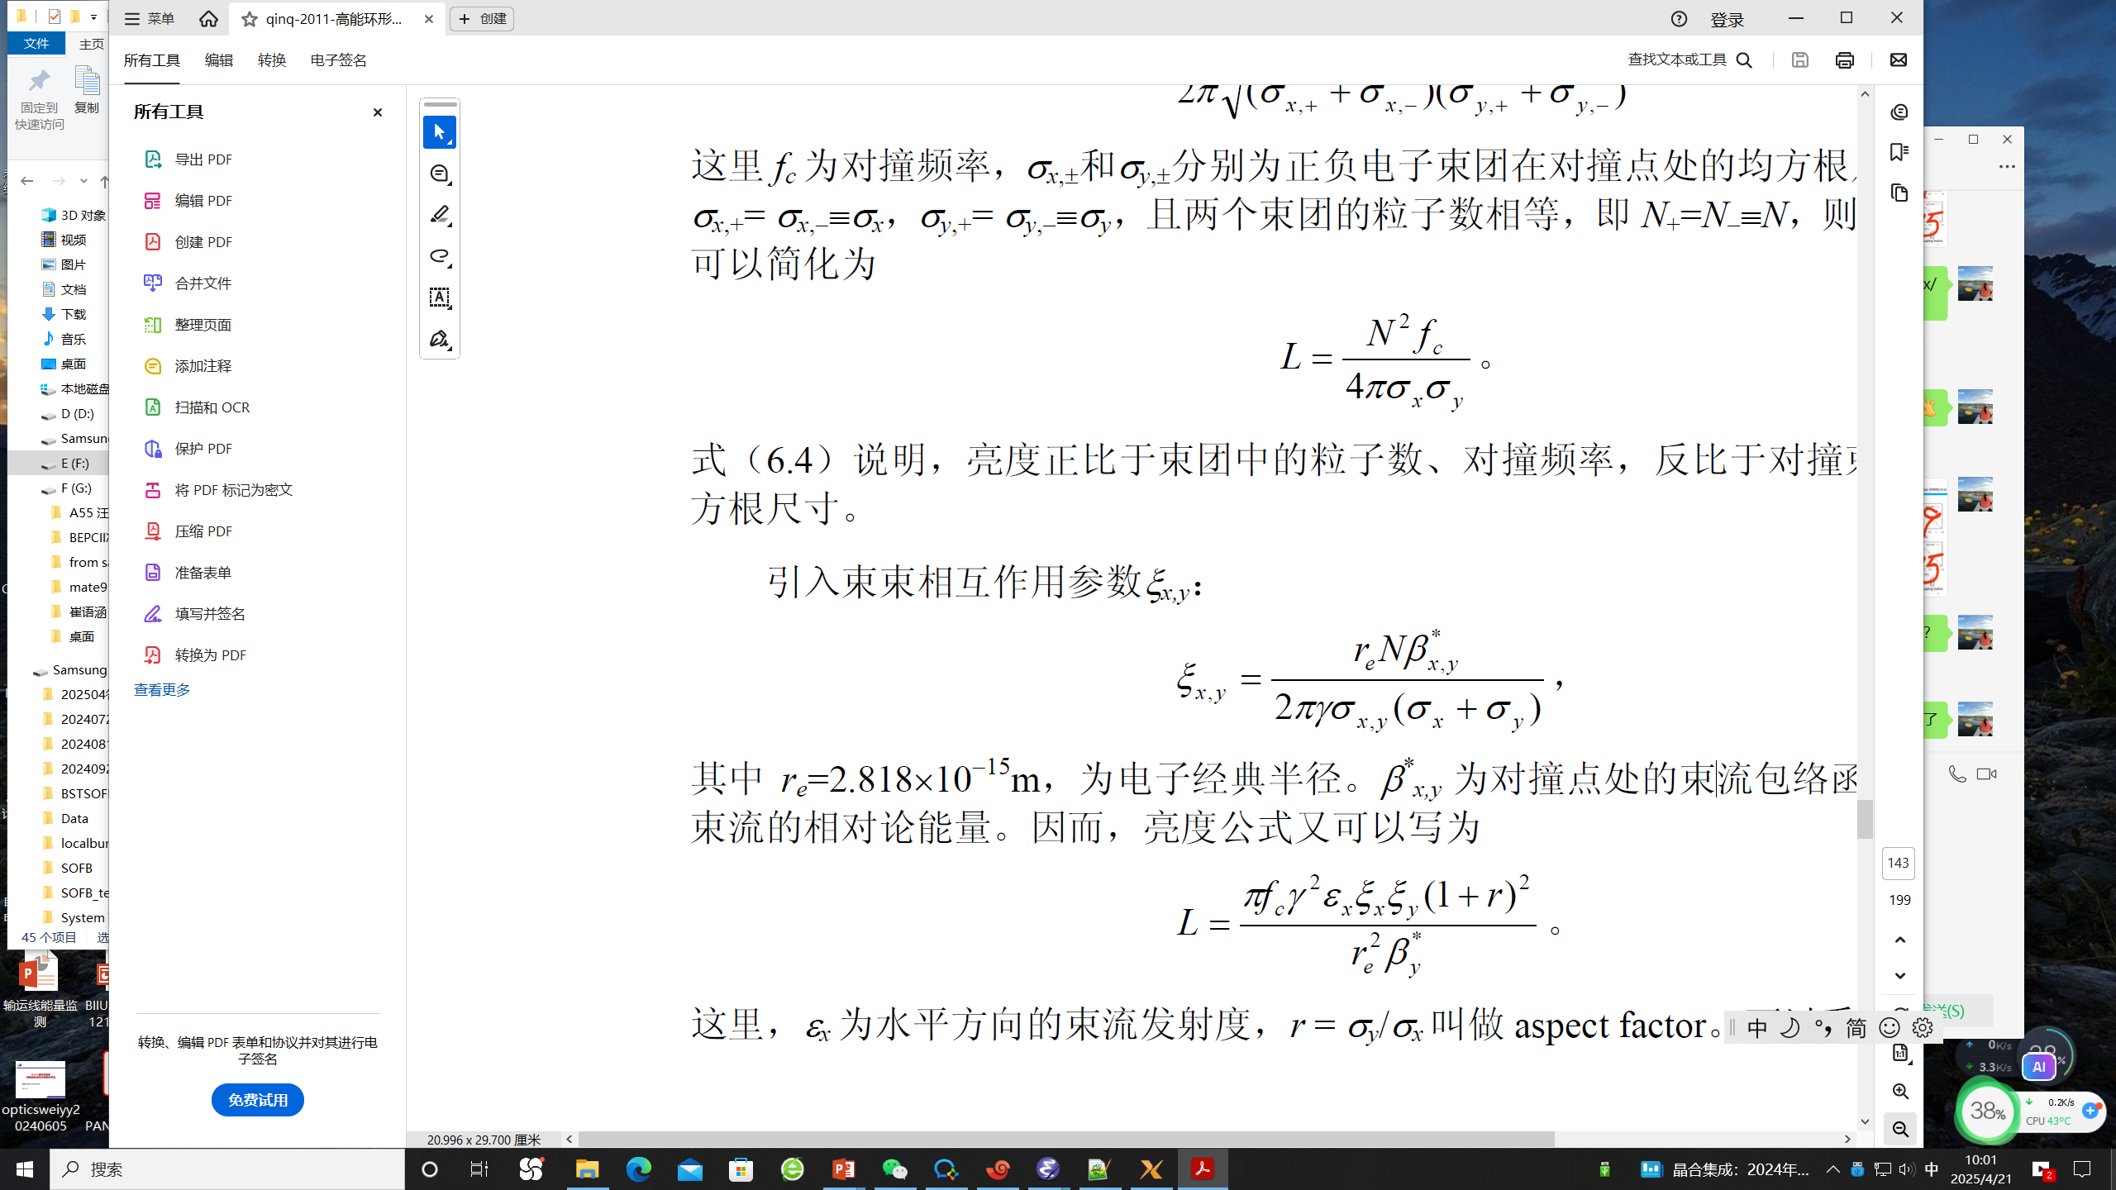
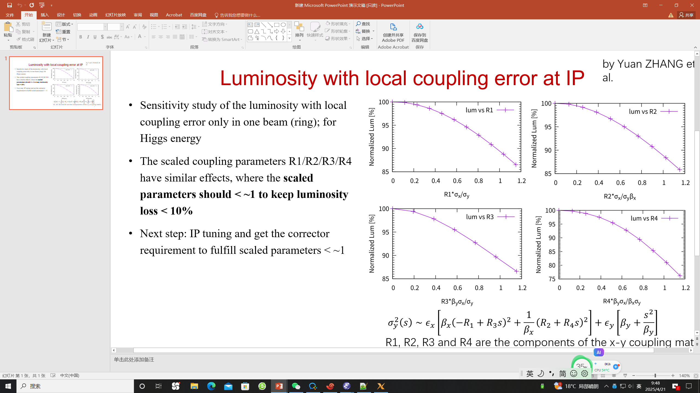
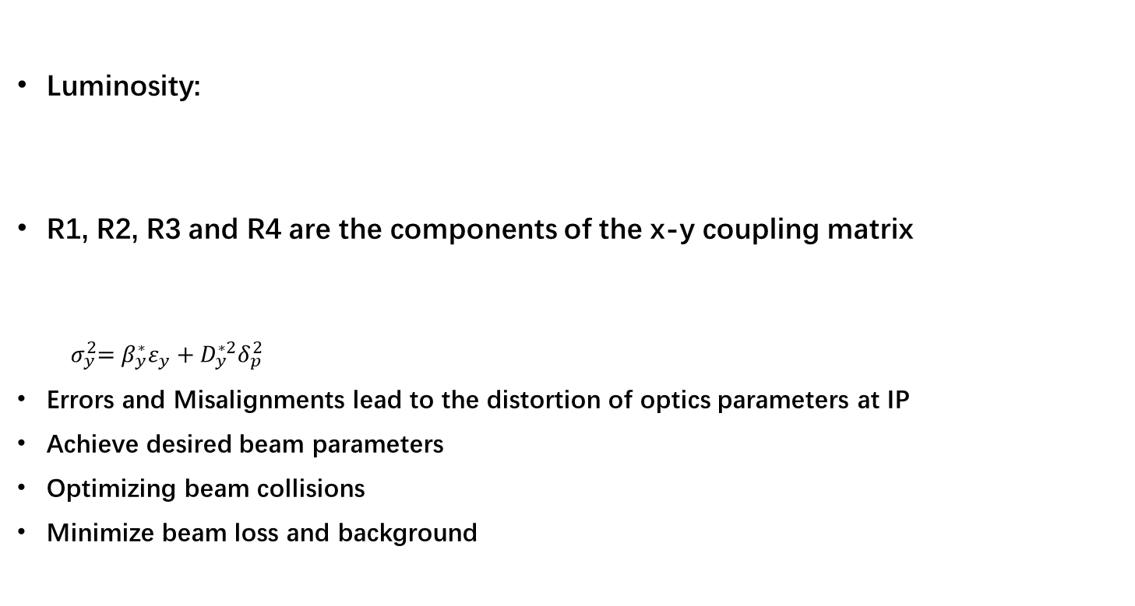
Why is IP tuning important
Luminosity:
R1, R2, R3 and R4 are the components of the x-y coupling matrix
$${ σ}_{y}^{2}=β_{y}^{∗}ε_{y}+D_{y}^{∗2}δ_{p}^{2}$$
Errors and Misalignments lead to the distortion of optics parameters at IP
Achieve desired beam parameters
Optimizing beam collisions
Minimize beam loss and background

Slide 7
ϵ_{x}=6.6478e-10 (m*rad)
Β_{x IP}=0.33 (m)
Β_{y IP}=0.001 (m)
Critical value — corresponding to 10% luminosity loss:
  R1 * =0.0022 (rad)
  R2 * =7.31e⁻⁴ (m)
  R3 * =2.22 (m⁻¹)
  R4 * =0.61 （rad)
Critical value — comparable to 1σ_{y} and 1σ’_{y} at IP
  D_{y} * =1.85e⁻⁵ (m)
  D’_{y} * =3.65e⁻⁵ (rad)
Luminosity with local coupling error at IP for Higgs energy from Zhang Yuan’s simulation

Slide 8
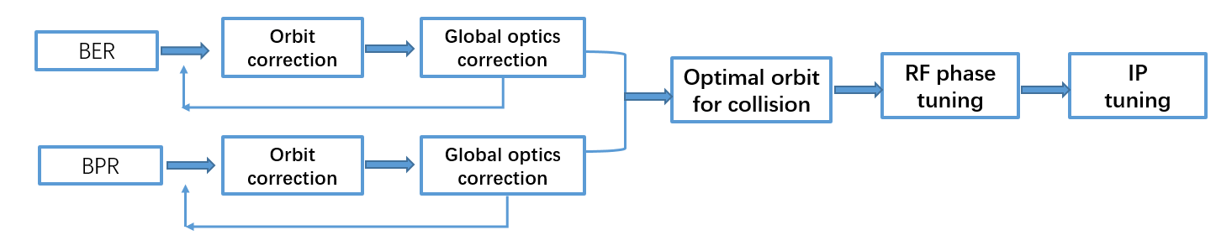
When is IP tuning performed
Whenever optimization of collisions:
  During Initial Beam Commissioning
  During Routine Operation:
    When Beam quality degrades
    Maintaining Beam Stability
The typical of beam tuning to achieve a good luminosity:

Slide 9
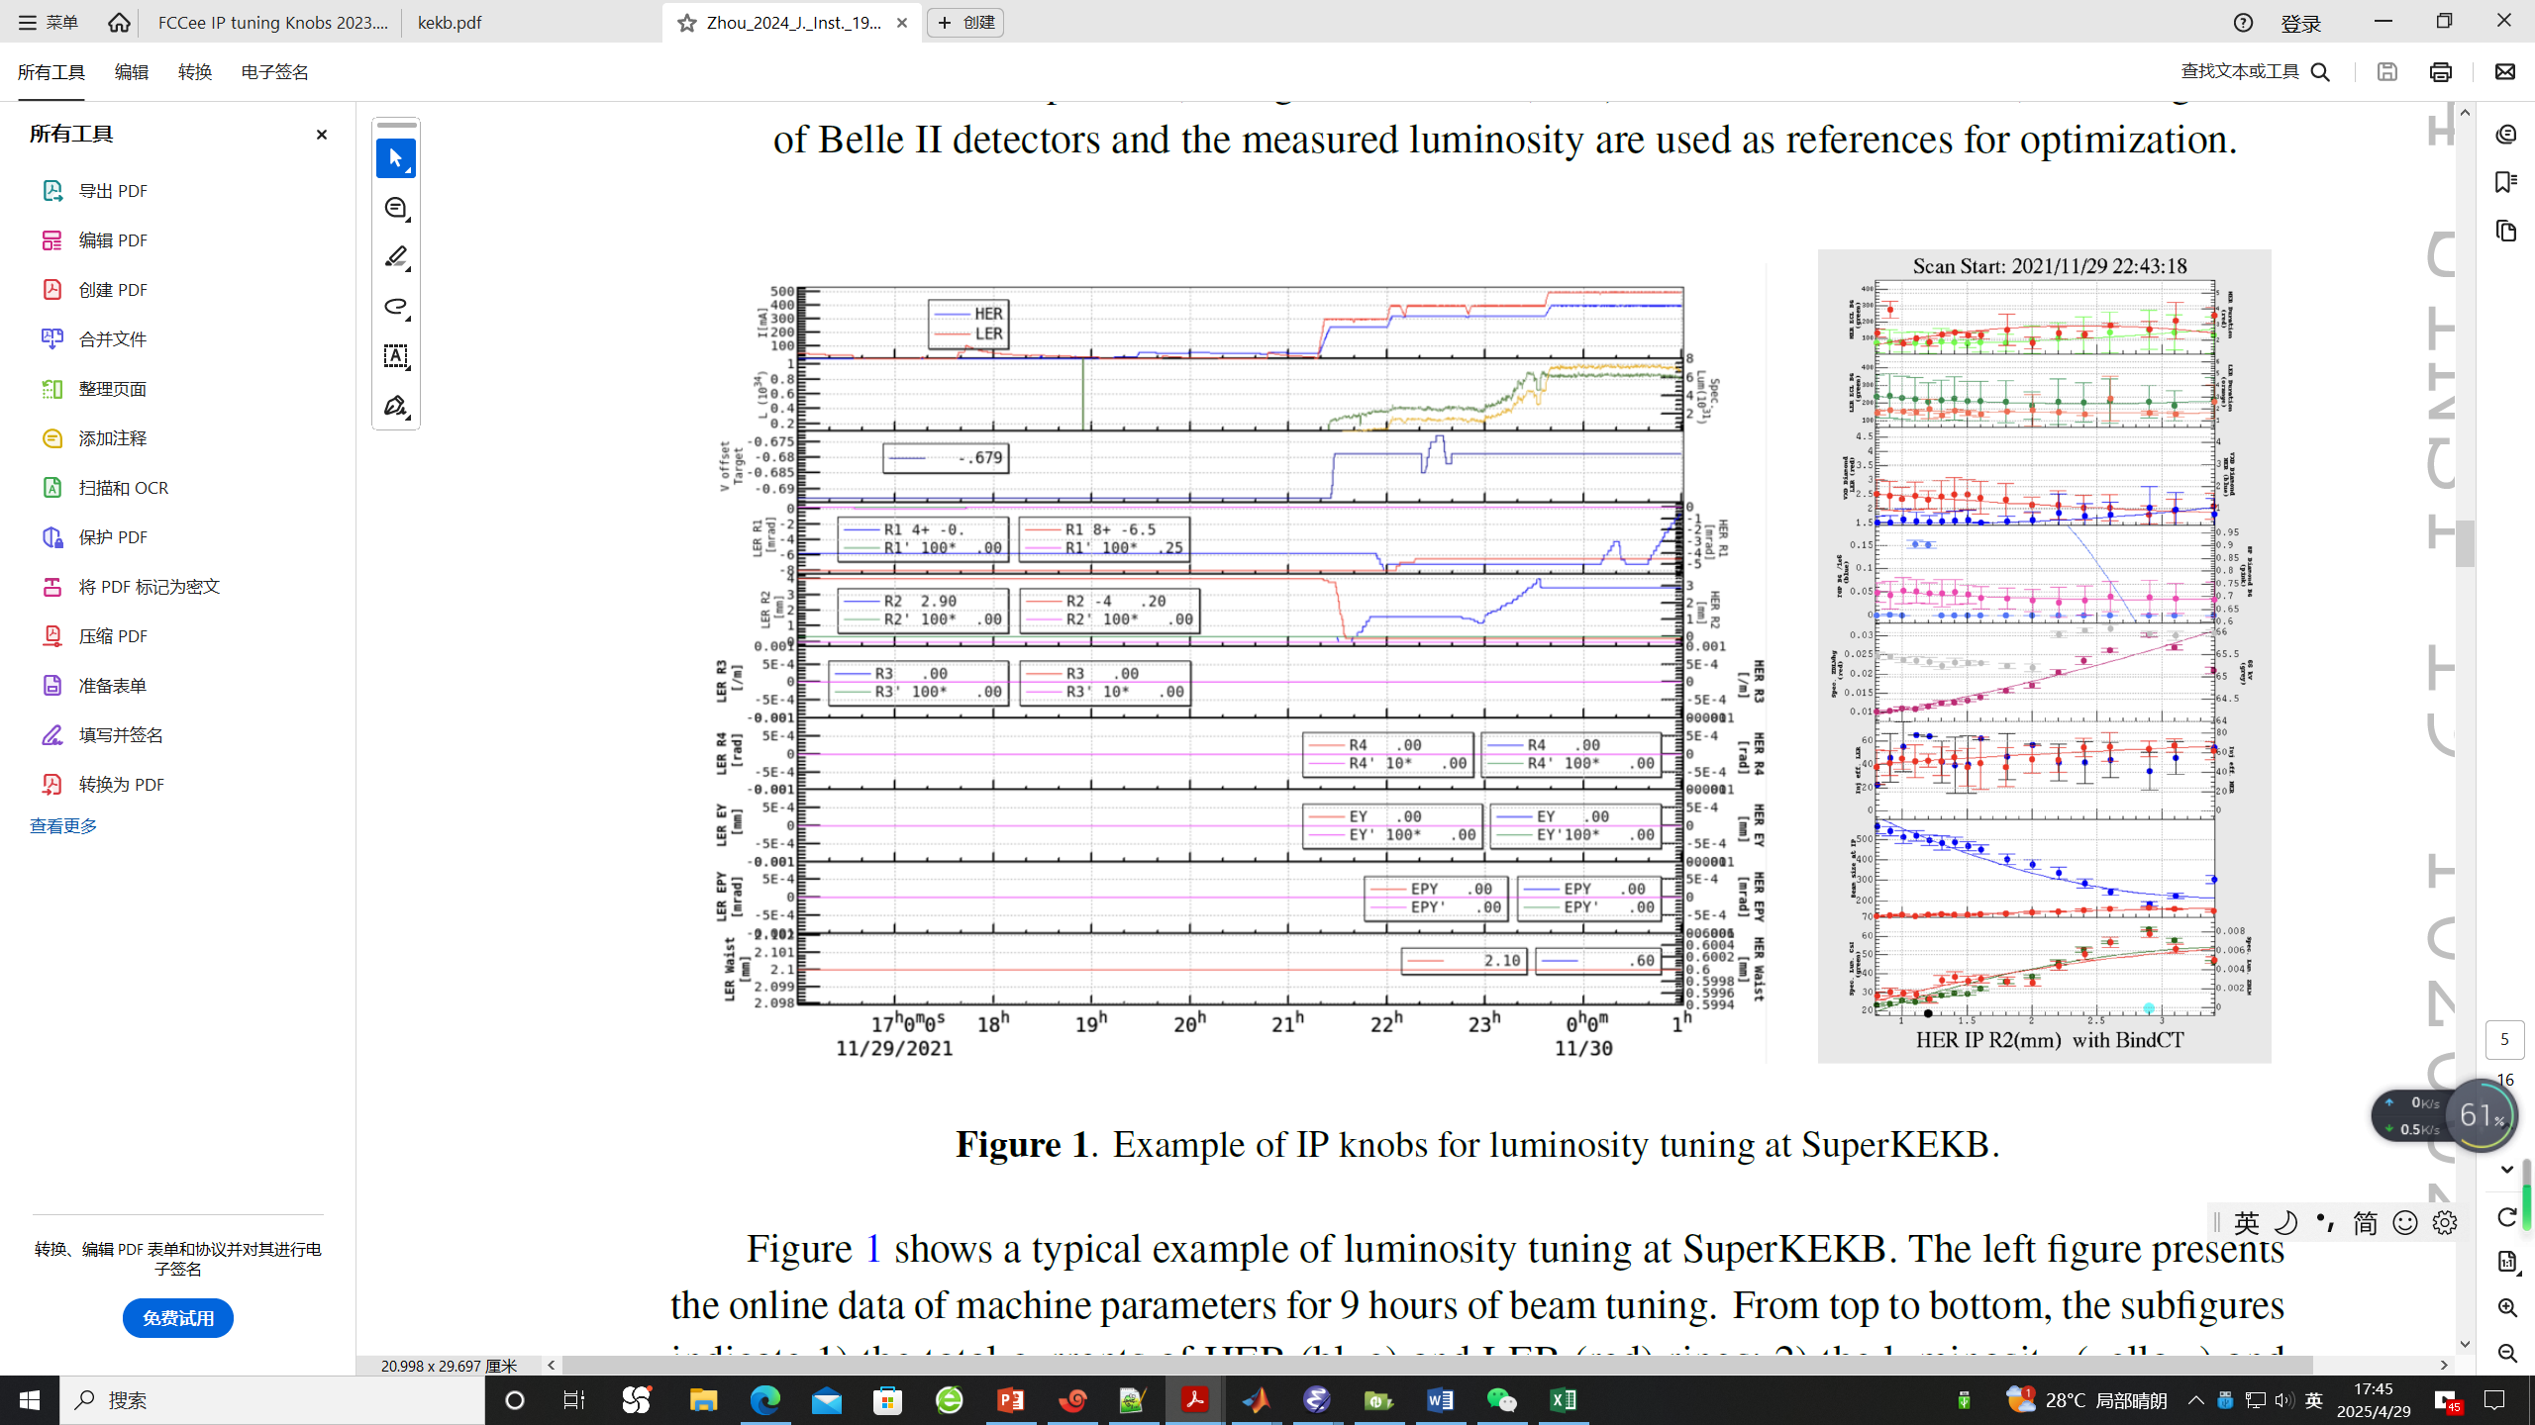
How is IP tuning performed
Determine the knobs according to the simulation
  IP orbit knob , waist shift knob, IP coupling knob, IP dispersion knob
During the IP tuning
  Input the desired parameters at IP，calculate the strength of knob magnets by fitting using SAD online
  Record the luminosity corresponding to the specific parameters
  Scan the parameters to maximize the luminosity
Example of IP knobs for luminosity tuning at SuperKEKB
D. Zhou et al 2024 JINST 19 T02002

Slide 10
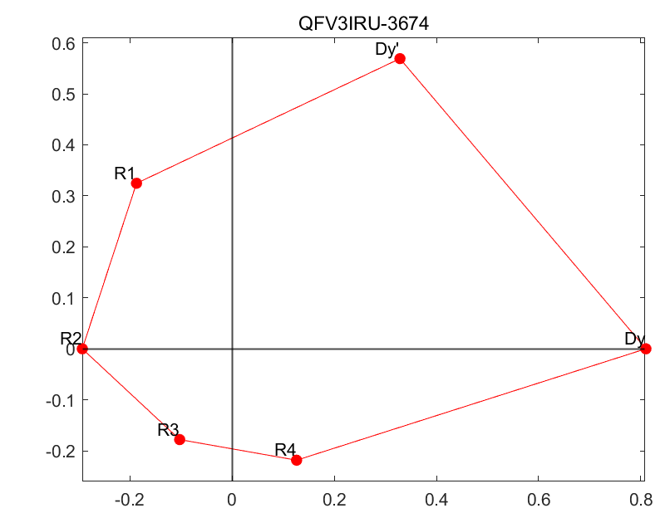
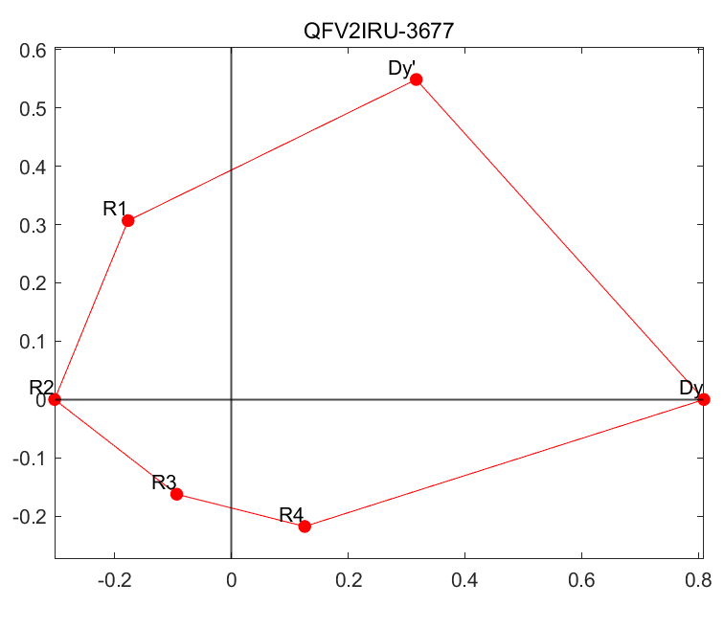
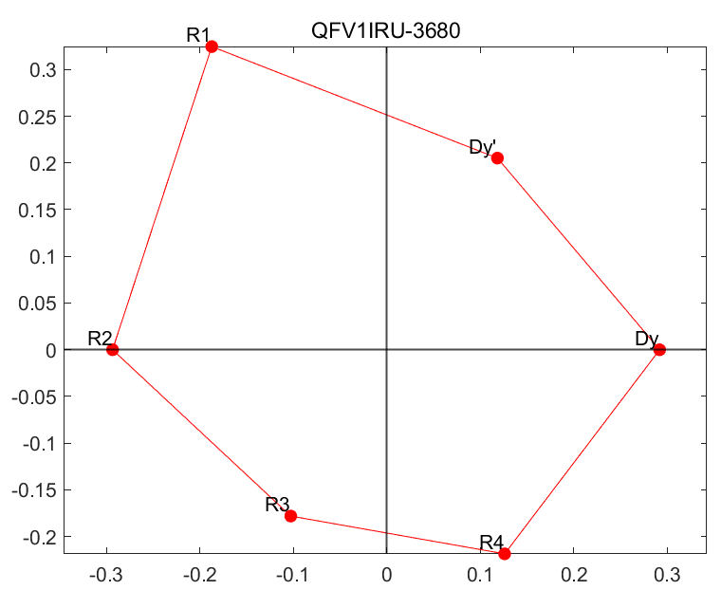
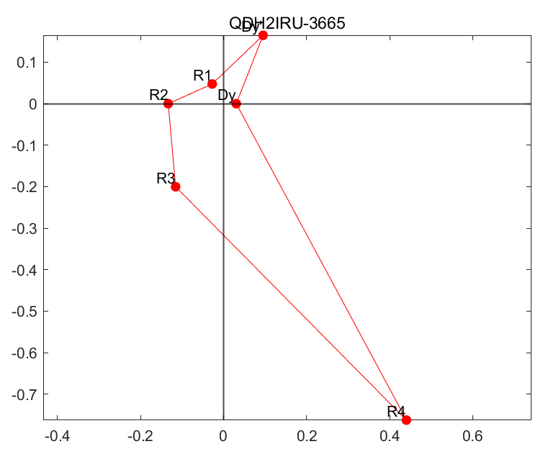
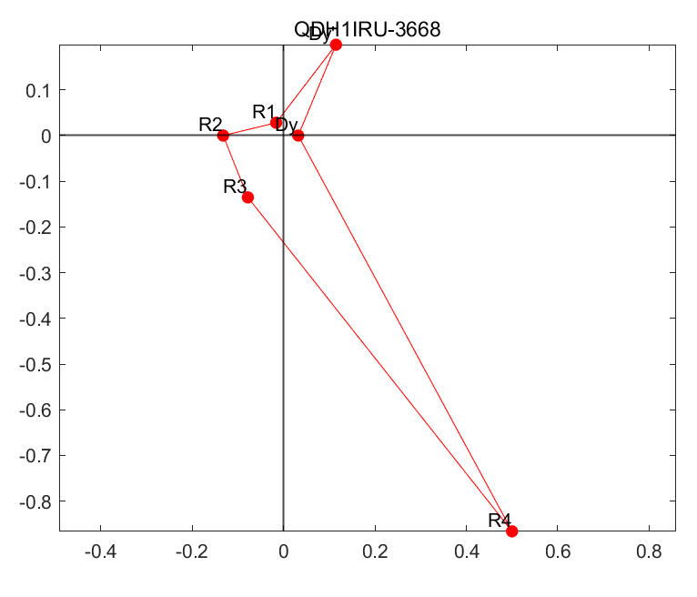
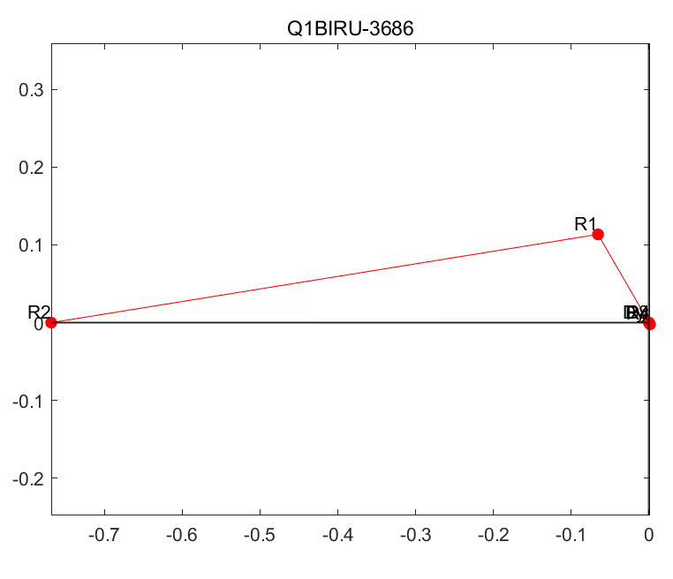
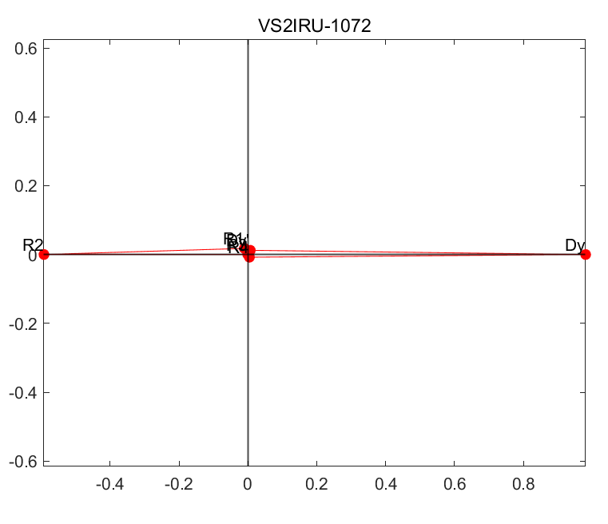
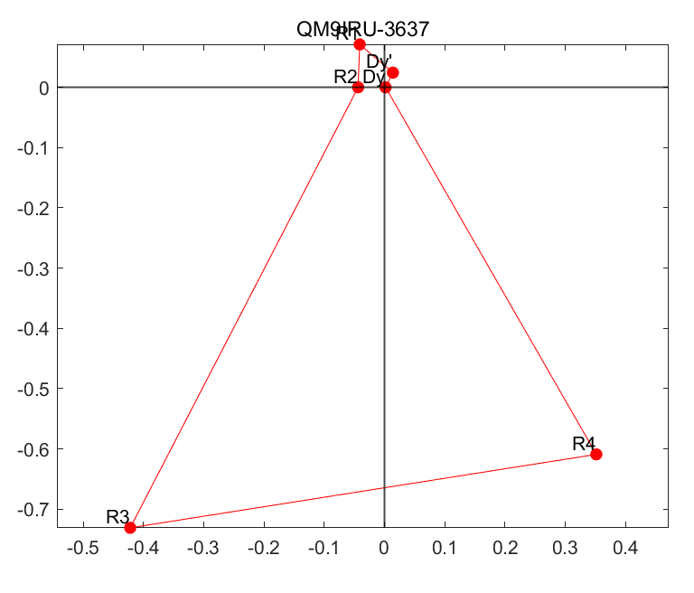
Determine the coupling knobs for CEPC
Suppose skew components at quadrupoles and sextupoles of IR
Calculate the response of { D_{y},D_{y}’,R1, R2, R3, R4} at IP to skew strength variations
Plot the 6 vectors and calculate the area enclosed by the 6 vectors for each magnet
Sort the area and find 6 magnets which are most sensitive to the parameters

Slide 11
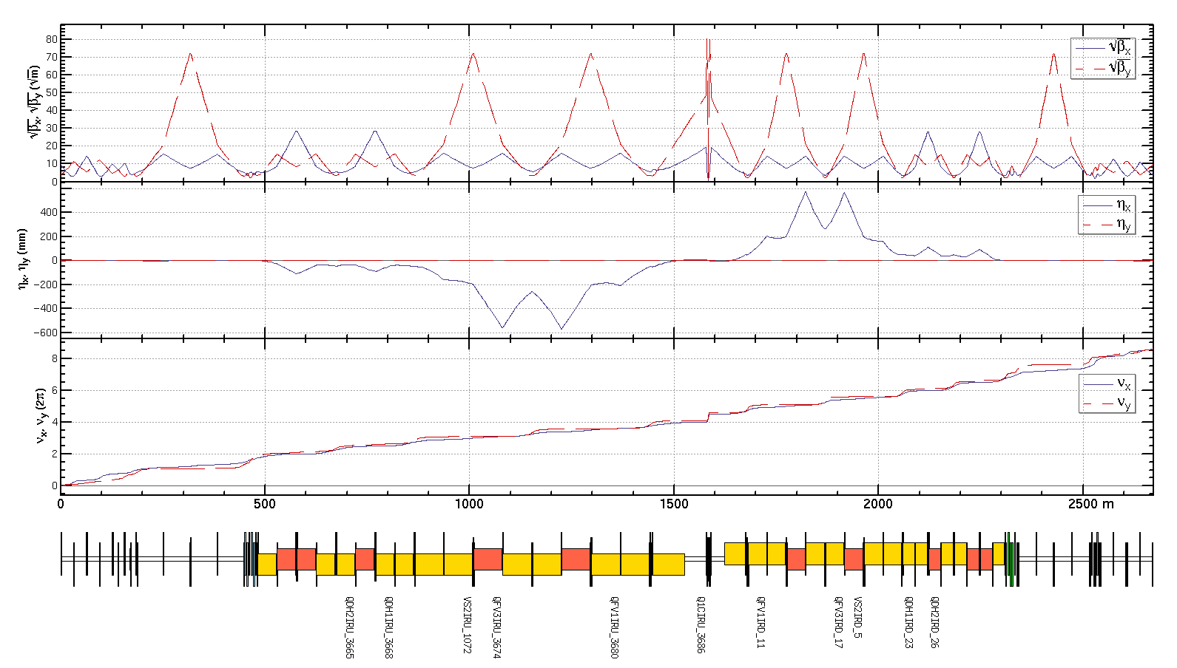
Determine the knobs
Coupling knobs:
For one side of IP including:
    1 skew coil on FF quadrupole
  dispersion free
    1 skew coil on sextuple
    4 skew coils on quadrupoles
  dispersive region
  12 skew components in total
Constrains in fitting:
    R1，R2，R3，R4
D_{y}, D’_{y} at IP
    optics not disturbed
outside the knob region

Slide 12
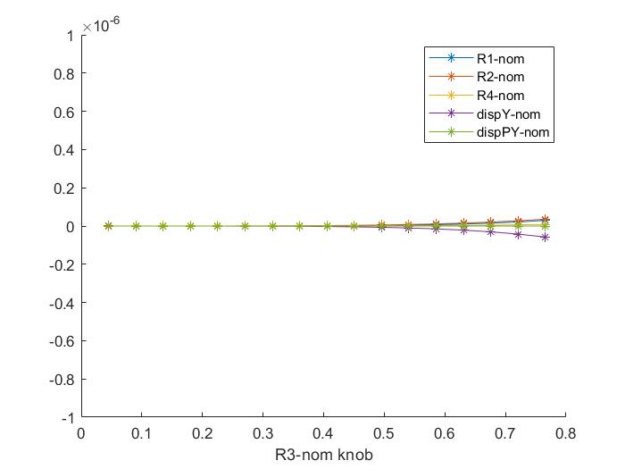
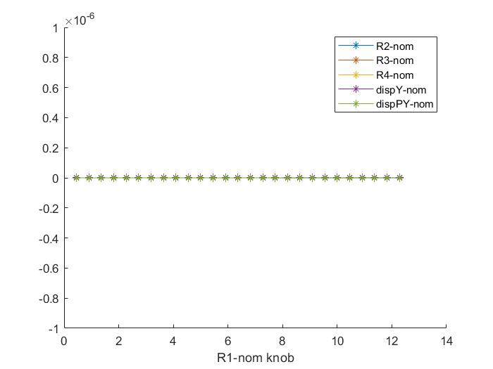
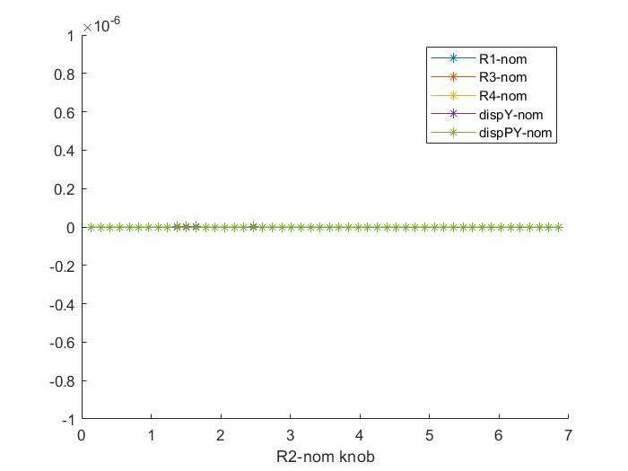
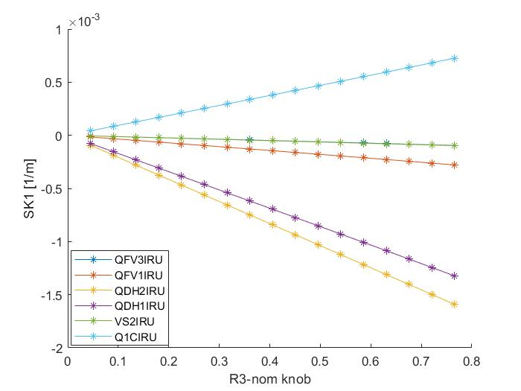
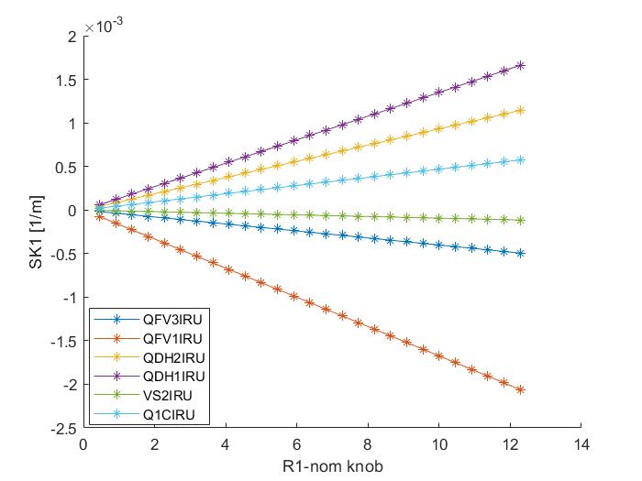
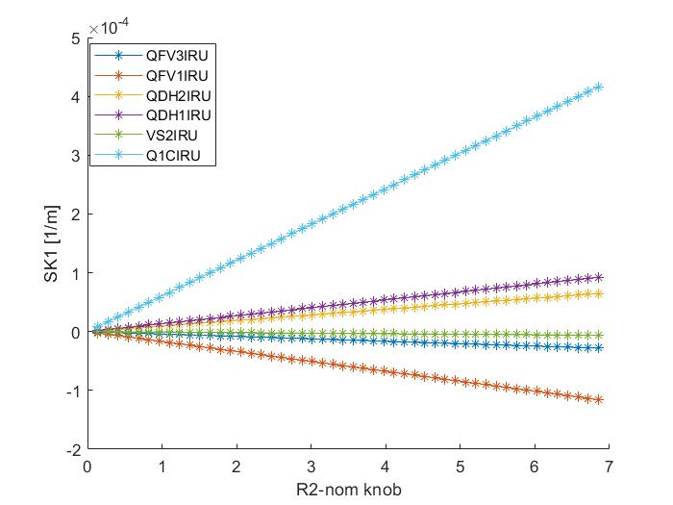
Scans of each knob and the corresponding skew strengths
Coupling parameters are normalized by the values corresponding to 10% luminosity loss (R1* ,R2* ,R3* ,R4*)
D_{y} and D’_{y} are normalized by the values comparable to 1 σ_{y} and 1σ’_{y} at IP (D_{y} * , D’_{y} * )
Scan of R1 knob (normalized by R1*)
Scan of R2 knob (normalized by R2*)
Scan of R3 knob (normalized by R3*)

Slide 13
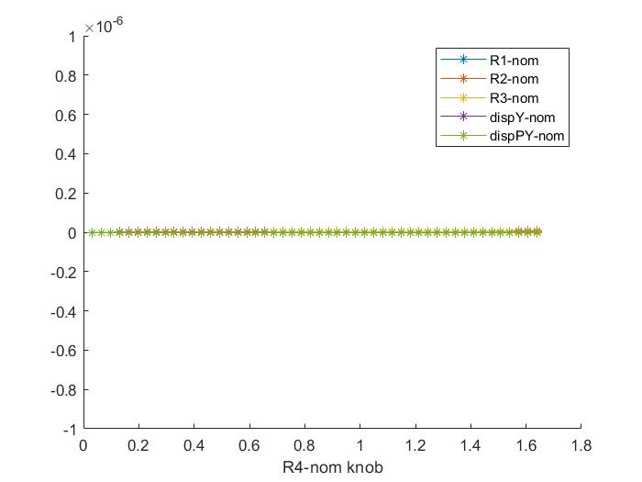
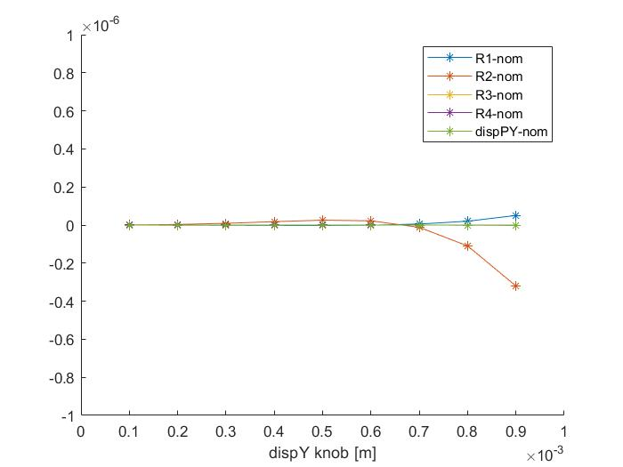
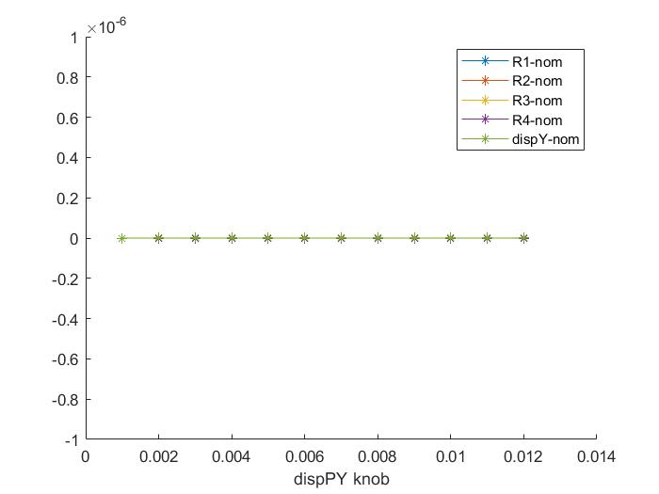
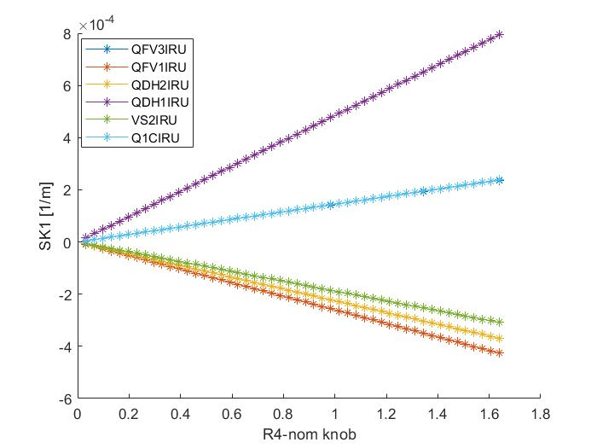
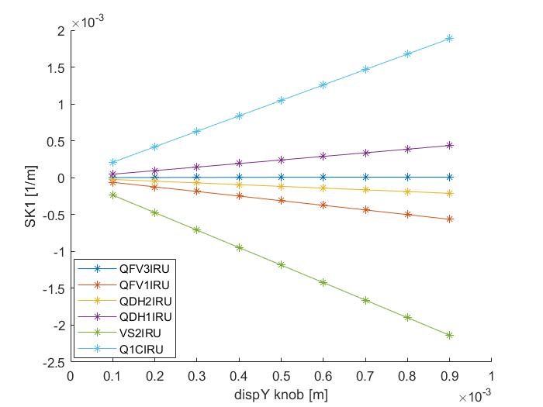
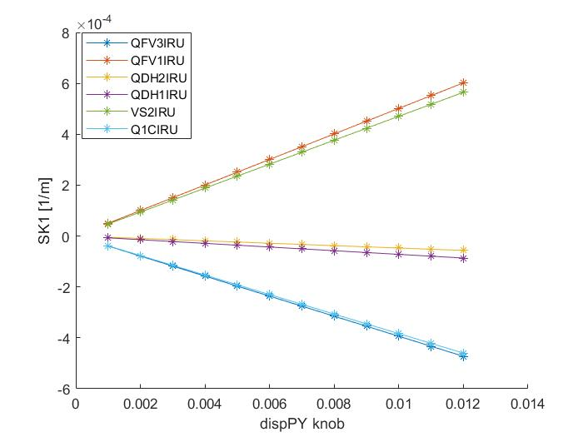
Scans of each knob and the corresponding skew strengths
Coupling parameters are normalized by the value corresponding to 10% luminosity loss (R1* ,R2* ,R3* ,R4*)
D_{y} and D’_{y} are normalized by the value comparable to 1 σ_{y} and 1σ’_{y} at IP (D_{y} * , D’_{y} * )
Scan of R4 knob (normalized by R4*)
Scan of D_{y} knob
Scan of D’_{y} knob

Slide 14
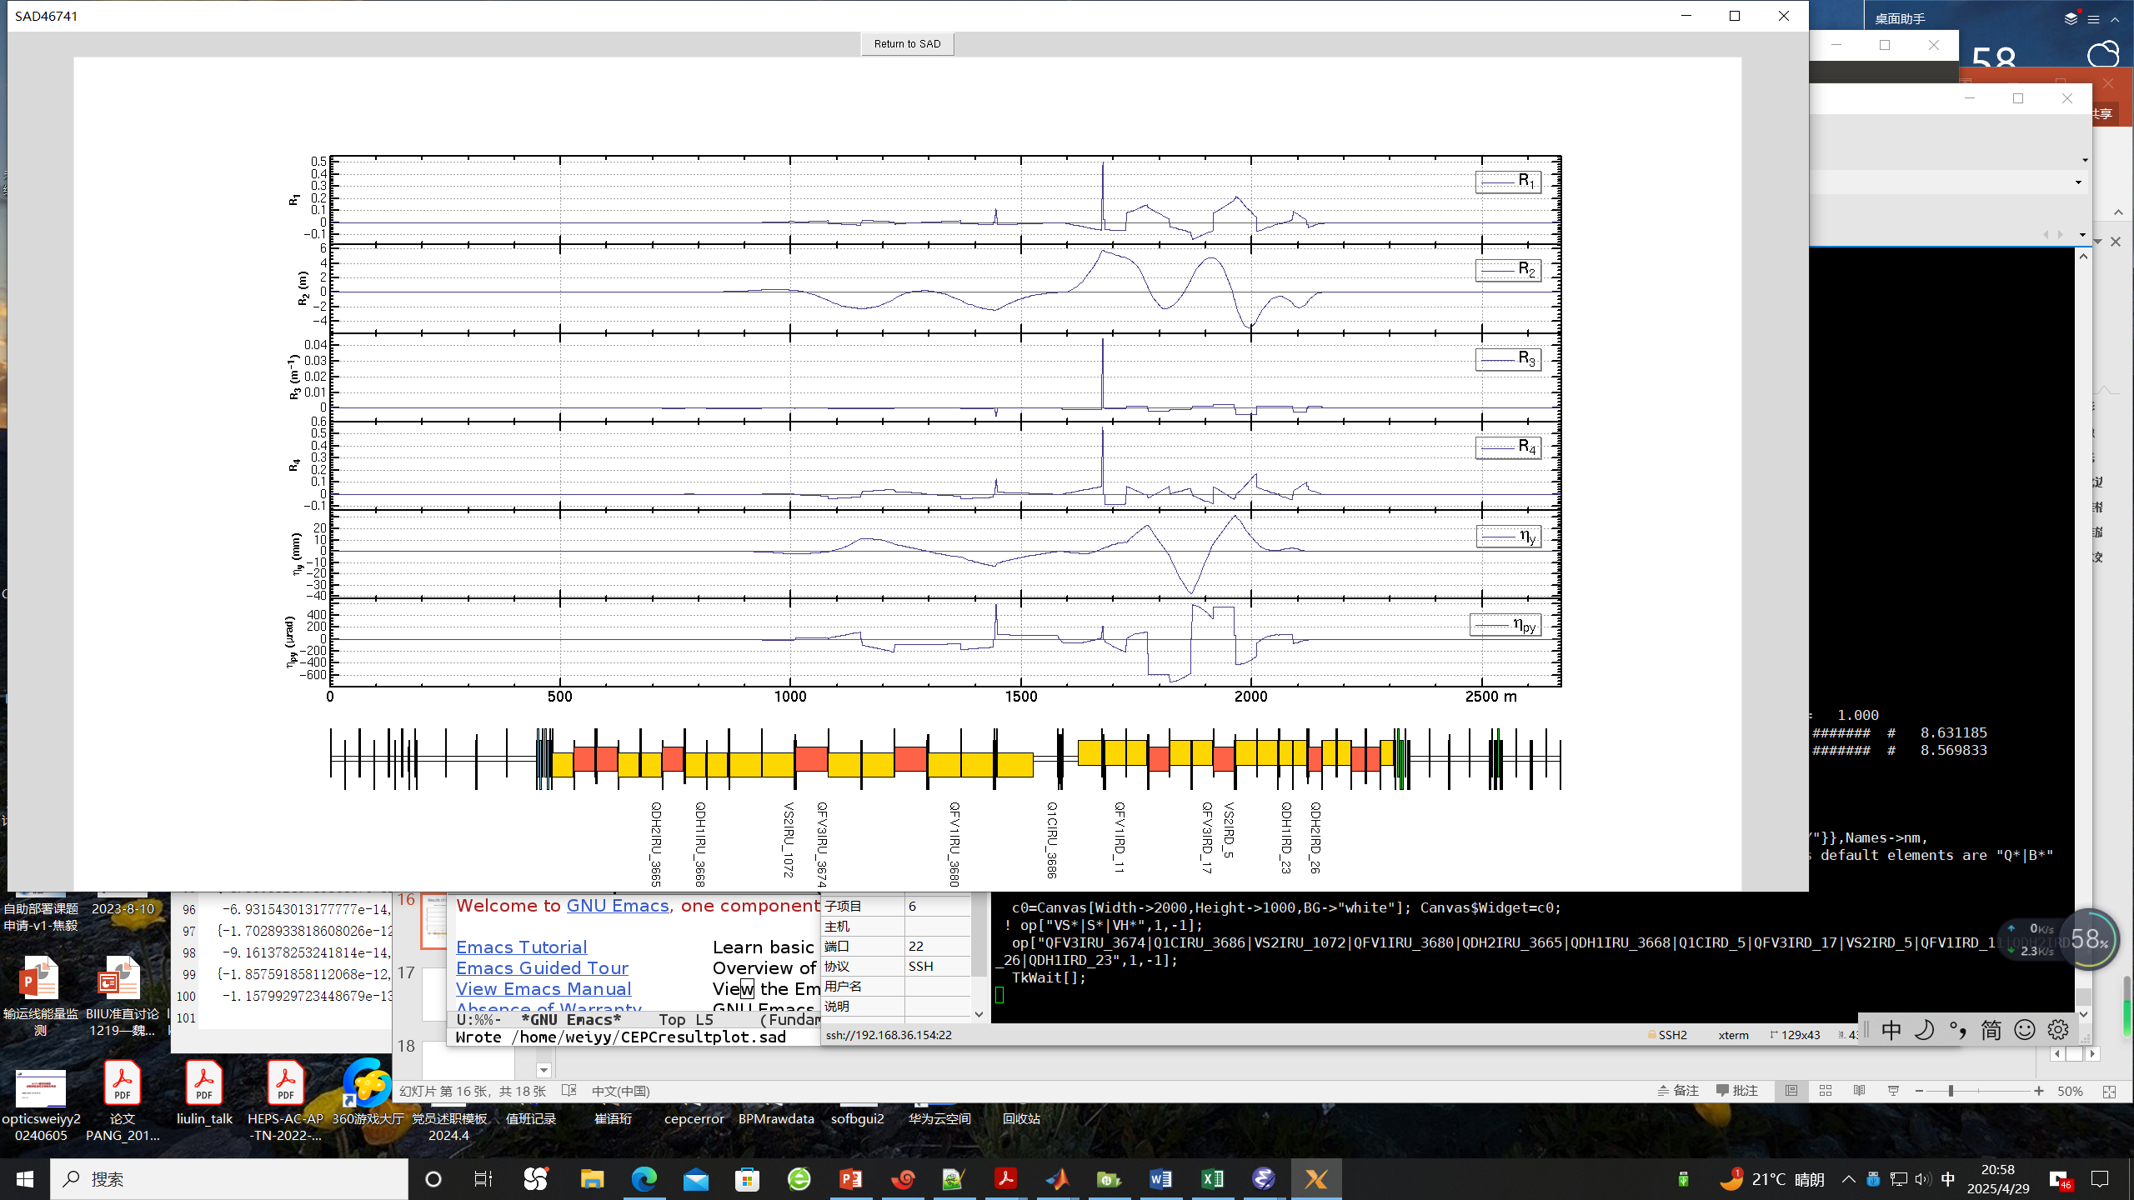
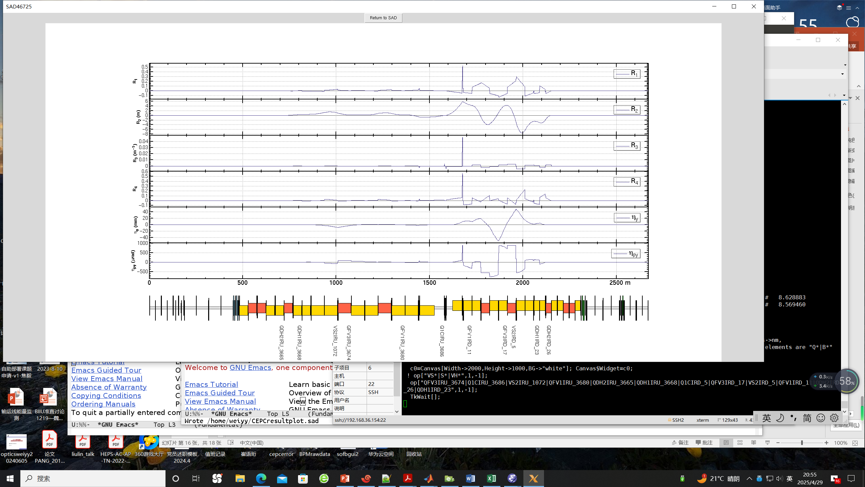
Results of IP coupling tuning
Vertical dispersion knob for D_{y,IP}=0.1（mm）*
Coupling knob for R1_{IP}=0.002 *

Slide 15
Results of IP coupling tuning
●
Errors applied for global optics correction
Simulation with errors (3σ*3) after global optics correction
Specifications for magnet design
Component | Δx (µm) | Δy (µm) | Δθ_{z} (µrad)
Dipole | 100 | 100 | 100
Quadrupole | 100 | 100 | 100
Sextupole | 100 | 100 | 100
Component | Field error (RMS)
Dipole | 0.01%
Quadrupole | 0.02%
Sextupole | 0.02%
 | R1* | R2*[m] | R3*[m⁻¹] | R4* | Dy*[m] | Dpy*
rms(*10⁻³) | 0.87 | 0.89 | 49.77 | 31.11 | 0.0052 | 0.016
 | Q1BIRU | QFV1IRU | VS2IRU | QFV3IRU | QDH1IRU | QDH2IRU
L(m) | 1.21 | 2.00 | 0.60 | 2.00 | 2.00 | 2.00
SK1(*10⁻³m⁻¹) | 1.13 | 1.00 | 0.20 | 0.25 | 1.00 | 1.00
G（T/m) | 0.37 | 0.20 | 0.14 | 0.05 | 0.20 | 0.20

Slide 16
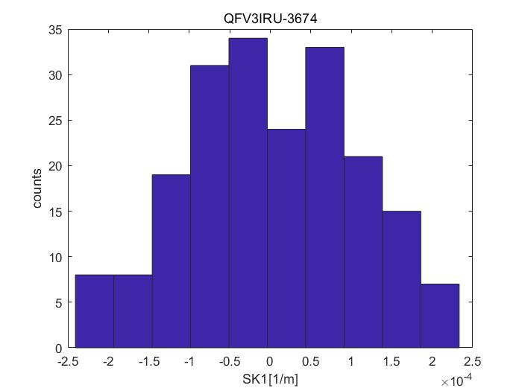
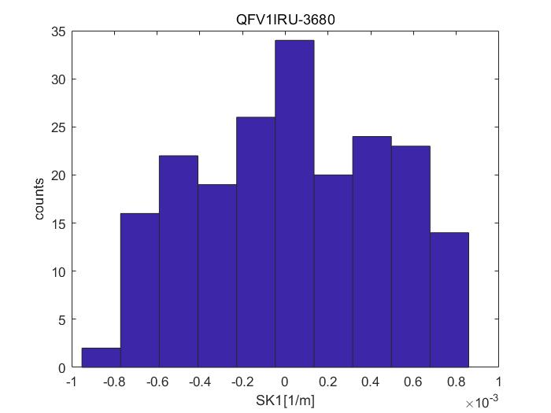
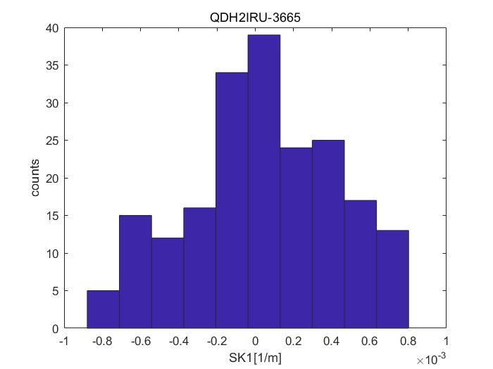
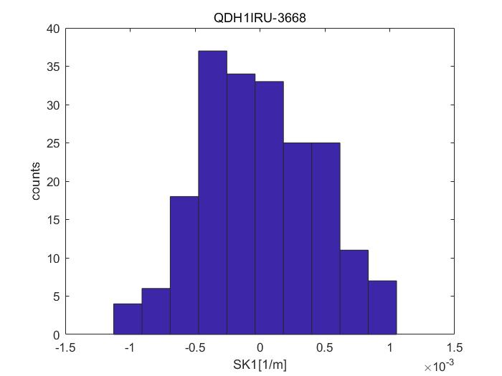
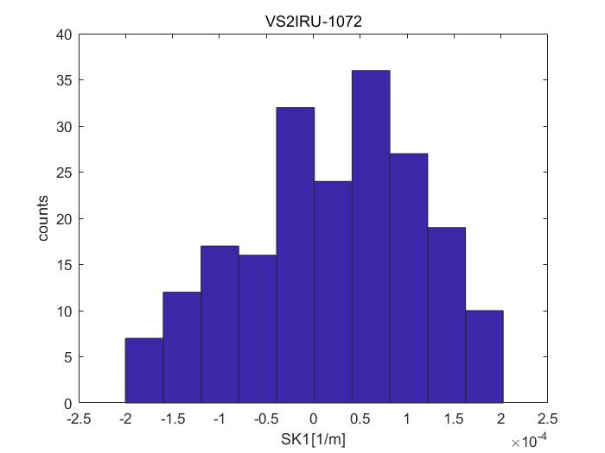
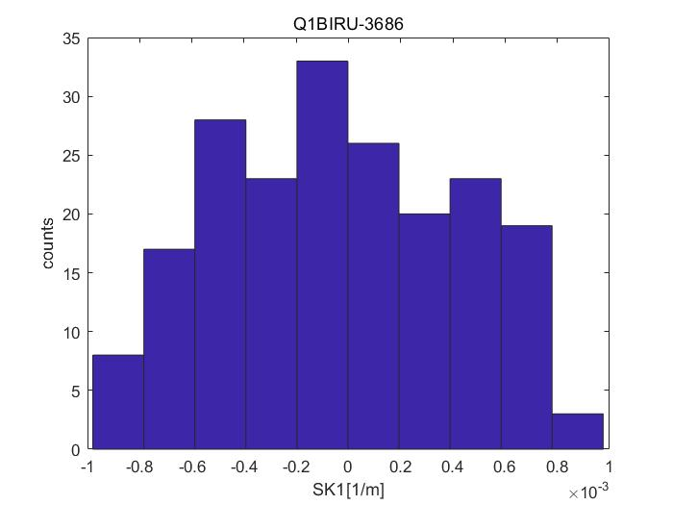
Results of IP coupling tuning
Statistic of strength of skew components (Simulation with errors (3σ*3) after global optics correction)

Slide 17
Summary
Knobs for IP coupling have been determined at CEPC
Parameters D_{y},D_{y}’,R1, R2, R3, R4 at IP can be tuned independently in the range corresponding to
10% luminosity loss
Specification for magnets design have been evaluated by applying a correction for 10 times of
the RMS residual error at IP after global optics correction
To-do list
Optimize the knobs downstream IP
Include more variables or improve the fitting method to expand the tuning range if needed
Investigate the effects of tuning on other optics parameters
Tune using lattices with errors after global optics correction and simulate the luminosity
performance before and after IP tuning
Determine the knobs for local orbit, β * waist shift
Ref: CEPC TDR; Radiation Detection Technology and Methods (2024) 8:1–1105, https://doi.org/10.1007/s41605-024-00463-y;

Slide 18
Thanks for your attention

