Slide 1


The African Academy of Sciences (AAS)
Prof SH Connell, AAS fellow
on behalf of AAS Vice president Dr Rajaa Cherkaoui El Moursli

Slide 2


A non-aligned, non-political, not-for-profit pan-African organization.
Vision: Transformed lives through science
Mission: Leverage resources through research excellence and thought leadership for sustainable development
The only continental Academy in Africa enjoying the support and recognition of the AU, (and with joint programmes with AUDA), several governments and major international partners.
Headquarters: Nairobi through a hosting agreement with the Kenya government. Five regions in South, East, Central, West and North Africa

Slide 3
800 Fellows – including Fellows, Associate Fellows, and Honorary Fellows
Founding Fellows: 33
Started: 6 July 1985 when 22 prominent scientists met in Trieste, Italy, at the inauguration of the Third World Academy of Sciences (TWAS).
A task force under the leadership of the late Professor Thomas R. Odhiambo completed and presented the constitution of the AAS being ratified 10 December 1985 at TWAS headquarters in Italy.
Thirty-three African scholars became Founding Fellows with Prof Thomas R. Odhiambo elected as the first President of the AAS.
Honorary Fellows: 20
Honorary fellows are elected from persons of eminence who have made significant contributions to the objectives of the Academy.

Slide 4
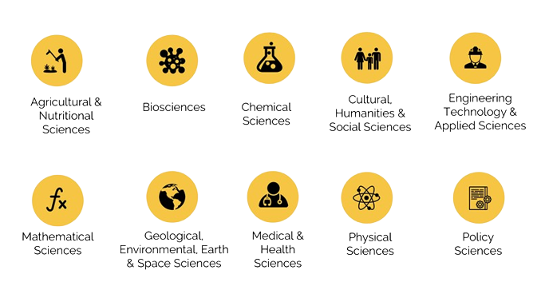
The Importance of the Diaspora
Associate Fellows: 55
Associate fellows are elected from active and outstanding non-African scientists residing elsewhere or in Africa who have made significant contributions to the development of researchers, as well as the development of science, technology and innovation in Africa.
Non-African scientists who have taken citizenship of an African nation and Africa-born scientists who may have taken citizenship outside Africa will be considered under the category, ‘Fellows’.
Affiliates: 214 We currently have 214 Affiliates grouped into seven cohorts from 26 African countries covering a wide range of scientific disciplines. AAS Affiliates are selected from young promising African scientists who have demonstrated prowess in the development and application of science in Africa.

Slide 5




The AAS
Tripartite Mandate
WHAT WE DO
Recognising excellence through The AAS’ highly prestigious fellowship and award schemes.
Providing advisory and think tank functions for shaping Africa’s Science, Technology and Innovation (STI) Strategies and
Implementing key STI programmes addressing Africa’s developmental challenges.
Policies.

Slide 6
AAS Programmes: Thematic Goals
Shifting the centre of gravity for African science to Africa
Goal 1:
Build R&D leadership & environments that support a vibrant research culture and leadership development over the long-term.
Goal 4:
Target critical gaps in the research landscape
Goal 2:
Support the development of an innovation and science-driven entrepreneurial culture
Goal 3:
Identify and support rising research leaders to stay and build their careers in Africa

Slide 7

Recognising Excellence
WHAT WE DO
1. The AAS Fellowship
Fellows are distinguished scholars who have reached the highest level of excellence in their field of expertise and have made contributions to the advancement of science and innovation on the African continent.
The AAS recognises scientific excellence through three initiatives.
2. The AAS Affiliates Programme
Affiliates are young promising African scientists who have demonstrated prowess in the development and application of science in Africa.
The Olusegun Obasanjo Prize for Scientific Discovery and Technological Innovation.
The prize is awarded every two years. It rewards and honours African scientists who have made outstanding contributions in scientific discovery or technological innovation.
Obasanjo has been described as one of the great figures of the second generation of post-colonial African leaders.

Slide 8

Advisory & Think Tank
WHAT WE DO
Thought/Advocacy Leadership & Partnership
Evidence Generation through Fellowship
Knowledge Management & Capacity Building
OBJECTIVIES
Using a pool of over 500 Fellows to shape opinions and policy through joint publications and policy papers.
Working in partnership with the AUDA and other partners to bridge policy gaps.
Package and disseminate knowledge products to external audiences, providing context on the research landscape in Africa.
16 Working Groups
Education and Gender
Africa Synchrotron Initiative
Agriculture
Antimicrobial Resistance
Big Data
Climate Change
Environment
Food & Nutritional Health
HIV/TB
Malaria
Material Science
Maternal, Neonatal & Child Health
Mental Health
Nanotechnology
Non-communicable Diseases
Science, Technology &
Innovation policy

Slide 9

The African Research Initiative for Scientific Excellence
Example of a successful initiative
(ARISE)
https://youtu.be/Cn8dHORqRis
Main Objective:
To broaden and strengthen Africa’s science base through open and direct continental competition for funding amongst the very best young African researchers with the aim of contributing to the transformation of Africa into a knowledge-based and innovation-led continent.
in the frame of AAS strategy

Slide 10

Examples of a New initiative
The long-term objective is to foster cooperation between:
The Federation of African Societies of Biochemistry and Molecular Biology (FASBMB),
The International Union of Biochemistry and Molecular Biology (IUBMB),
The Federation of European Biochemical Societies (FEBS)
that would benefit their members, trainees, and science.
Creating conditions to support PhD students in African countries and affiliated with FASBMB (via their corresponding national societies) for short stays (1-6 months) in the laboratory of a scientist in a FEBS country* who belongs to a FEBS Constituent Society, to carry out research work that is a part of their Ph.D. thesis.
…. and many others to come

Slide 11
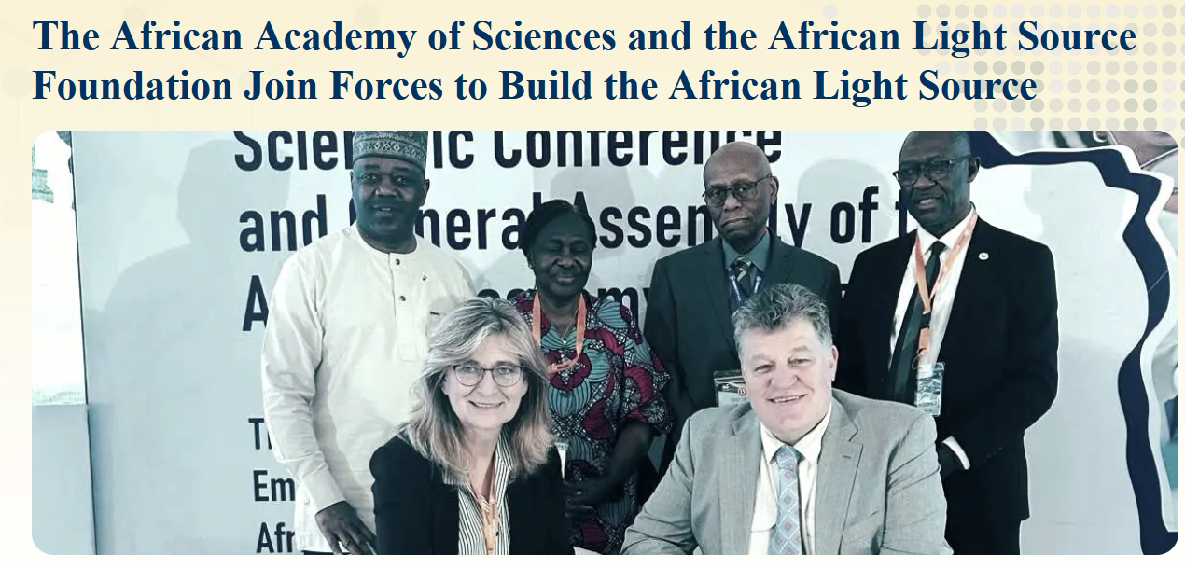
Example of an initiative related to ASFAP
2024-12-12
The African Academy of Sciences (AAS) and the African Light Source Foundation (AfLS) have forged a pivotal partnership to accelerate scientific advancement across the African continent. This important scientific research agreement, formalized by the signing of a Memorandum of Understanding (MoU) between AAS President, Professor Lise Korsten, and AfLS Chair, Professor Simon Connell, signifies a crucial stride towards the realization of the African Light Source – a cutting-edge research facility poised to revolutionize scientific inquiry across the continent.
This partnership aligns seamlessly with the AAS's overarching mission to advance science, technology, and innovation across the African continent.

Slide 12
AAS and ASFAP
AAS has suppoted the creation of ASFAP since 2020 and was represented at each of its events and town-hall
AAS endorses ASFAP startegy report
AAS will contribute, within the contour of its own strategy and actions, to the success in implementing the projects supported and put forward by ASFAP to the stakeholders

Slide 13

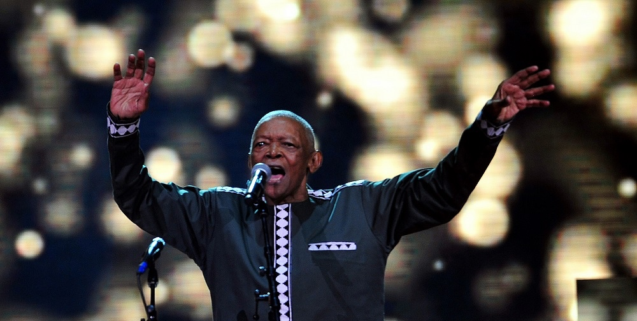
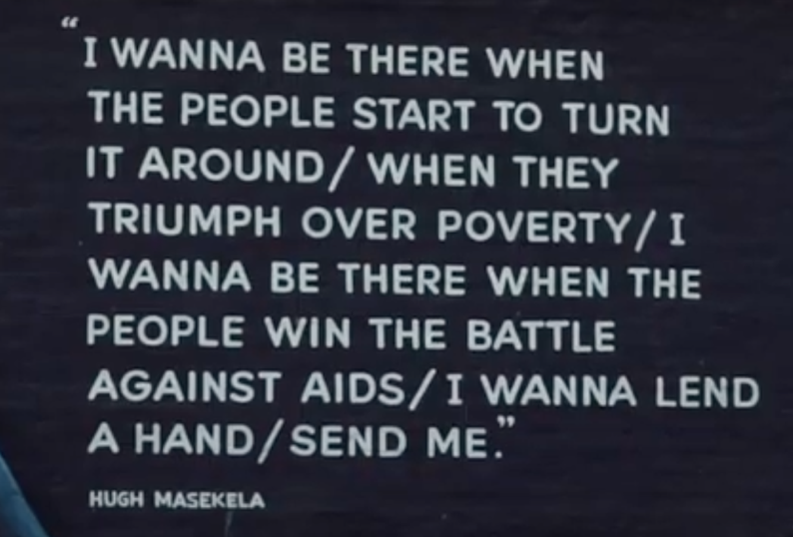
Who is the AAS ….. its us ! Please seek nomination, young emerging scientists … aspire
Thuma mina – Send Me
https://www.youtube.com/watch?v=d4Bwux-btq0
Musician Hugh Masekela

Slide 14





Thank you
Contact us
communication@aasciences.africa
www.aasciences.africa
@AASciences

