Slide 1
APS as a Welcoming Global Hub
International Engagement with Africa’s Physics Community
The Open Symposium on African Strategy for Fundamental and Applied Physics (ASFAP)
November 17, 2025
Dr. Amy K. Flatten
Director of International Affairs
American Physical Society

Slide 2

American Physical Society
Why “A Welcoming Global Hub”?
International participation in APS reflects the global nature of physics!
Over 50,000 members in 115 countries around the world
Nearly 25% of members live outside of the United States
Annual meetings attract physicists across the globe
  > 28% attendees of 2025 GPS from outside of U.S.
  Virtual meetings - enable even more international attendees
  Satellite Sites - bring APS meetings to global communities
  APS Journals: Physical Review, Reviews of Modern Physics, etc.
  Over 80% of published articles have a non-U.S. author or co-author
Physicists across the globe connect with each other through APS!

Slide 3
What Does This Really Mean?
Welcoming Global Hub
What is a Welcoming Global Hub?
By "global hub" we don't presume to be the world's physical society, but instead, offer a welcoming community for the world’s physicists to connect with each other and advance their shared interests.
A welcoming global hub should in particular provide:
    An opportunity for all physicists, regardless of race, nationality, ethnicity, gender, and sexual orientation, to contribute to and benefit from the global scientific enterprise.
    An opportunity for physicists of diverse levels of achievement and prosperity to build and strengthen relationships within the global physics community.
It includes expanded partnerships and collaborations with other national physics societies and international physics organizations.

Slide 4
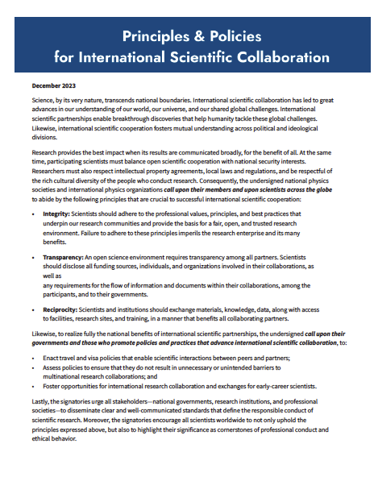

International Physics Roundtable
Partnering on Shared Interests
APS leads a partnership of physics societies worldwide to work collaboratively toward common interests
Now signed by 38 physics organizations worldwide!

Slide 5
Principles and Policies for International Scientific Collaboration
International Physics Roundtable
Partnering on Shared Interests
Statement crafted by the global physics community — initiative led by APS
Reaffirms the responsibilities of scientists and governments in maintaining open, cross-border collaboration that fuels groundbreaking research
  Integrity
  Responsibility
  Reciprocity

Slide 6
Principles and Policies for International Scientific Collaboration
International Physics Roundtable
Partnering on Shared Interests
Signed by 38 physics organizations worldwide…so far!
Including 5 Societies from Africa…so far!
African Physical Society
Physics Society of Kenya
Société Ouest Africaine de Physique
Société de Physique du Sénégal
South African Institute of Physics
Learn more at https://www.aps.org/about/international/collaboration

Slide 7
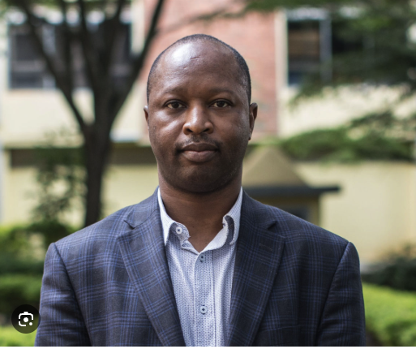
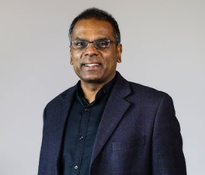
African Voices in APS Leadership
Council of Representatives
Voices from Africa in APS Governance
APS Council of Representatives – Main Governing Body
            Omololu Akin-Ojo, 2022-2025
            University of Ibadan
            Nigeria
            Nithya Chetty, 2026-2029
University of the Witwatersrand
South Africa

Slide 8
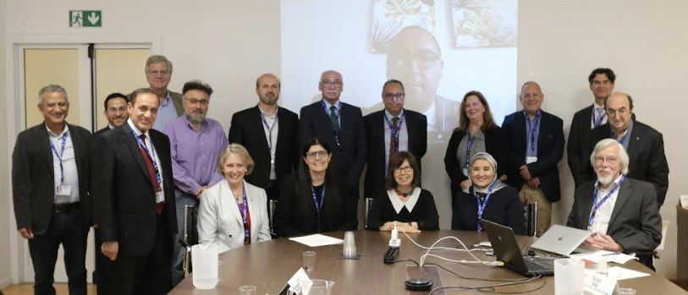
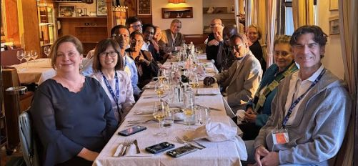
APS President’s Global Summits
International Centre for Theoretical Physics (ICTP)
Middle-East / North Africa Summit
Arab Physical Society
Bahrain
Lebanon
Morocco/University of Mohammed V
Moroccan Society for High Energy Physics
Qatar Physical Society
Saudi Arabia
SESAME
Tunisia
United Arab Emirates
Africa Summit
African Physical Society
African Strategy for Fundamental & Applied Physics
Cameroon
Democratic Republic of Congo
Ethiopia
Ghana
Rwanda
Association of Women in Science & Engineering/Rwanda
South Africa
Uganda
West African Physical Society/Senegal

Slide 9

ASFAP
APS Leadership Involvement
International Advisory Committee Members
James Gates (2021 APS President)
Young-Kee Kim (2024 APS President)
Support for Working Group Meetings
Defer to African Community on the Best Strategy
For example, African Light Source (APS does not take a position)
Must be decided by Africa’s physicists and their governments

Slide 10
APS Global Physics Summit - Satellite Events Across the Globe!
Satellite Sites - APS Global Physics Summit
Bringing APS Meetings to Physicists Worldwide
Bringing APS meetings to physics communities worldwide
Connect APS to global community
Enable physicists who cannot travel to the U.S. to participate in an in-person event
Extend reach and diversity of APS meetings
Build partnerships with physics communities abroad
Serve as a Welcoming Global Hub for physicists worldwide
Satellite Events Project Lead - Michele Irwin, APS Senior International Programs Manager!

Slide 11
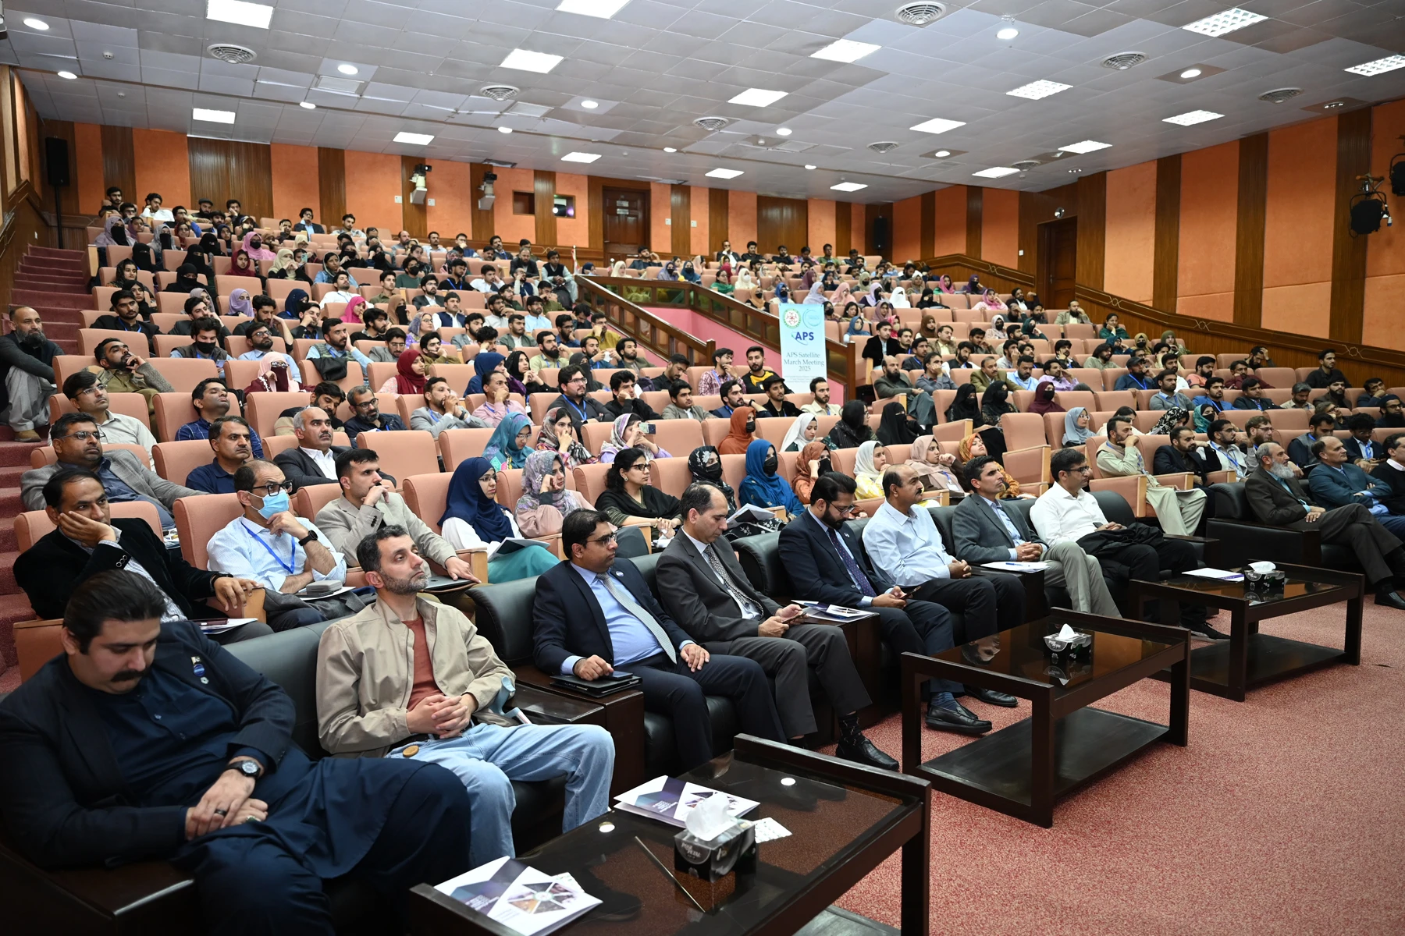
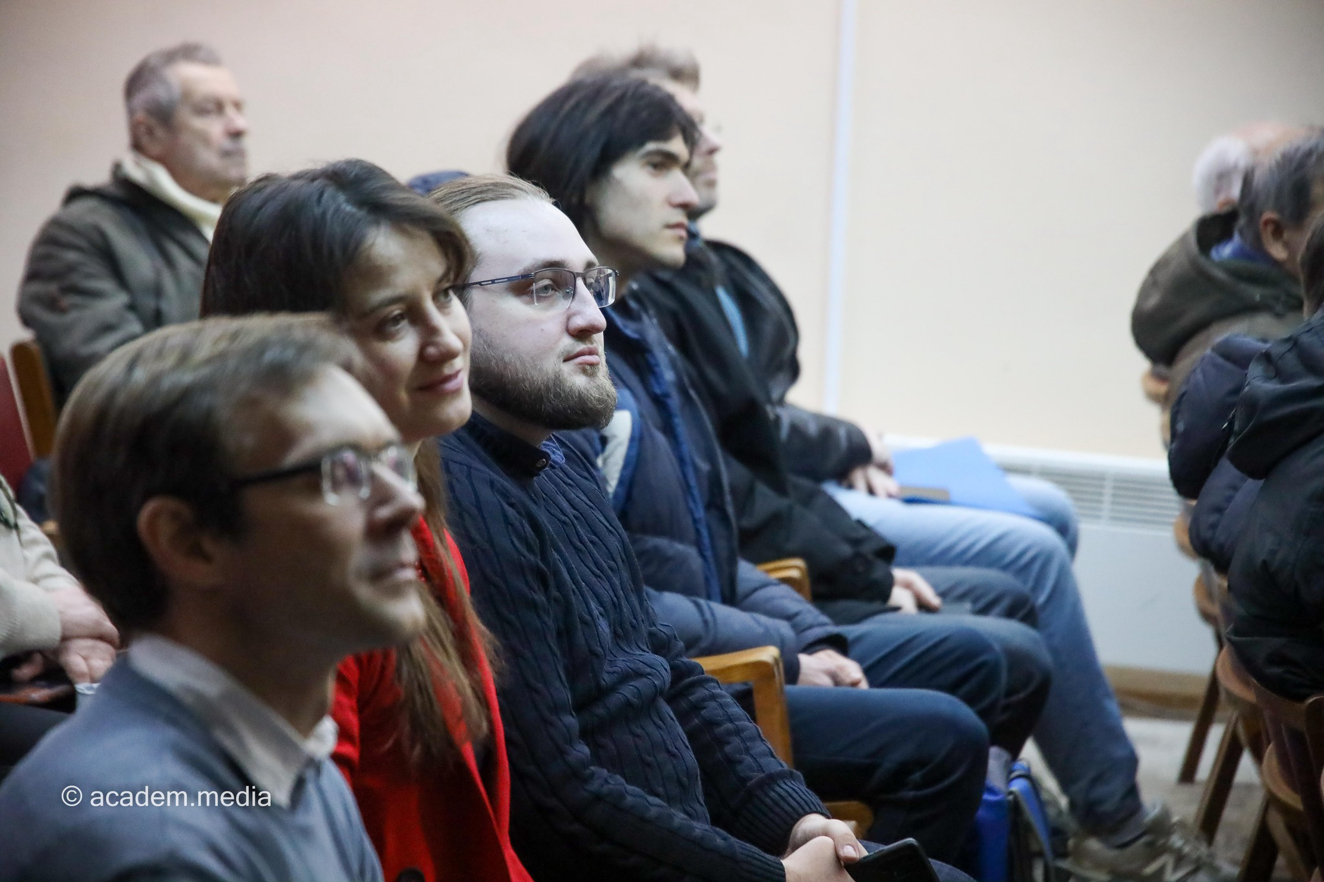
Satellite Sites - APS Global Physics Summit
Bringing APS Meetings to Physicists Worldwide
Satellite Events Abroad
17 events in 16 countries
Attended by 1,100+ individuals
11 virtual sessions organized
Pakistan
Ukraine

Slide 12
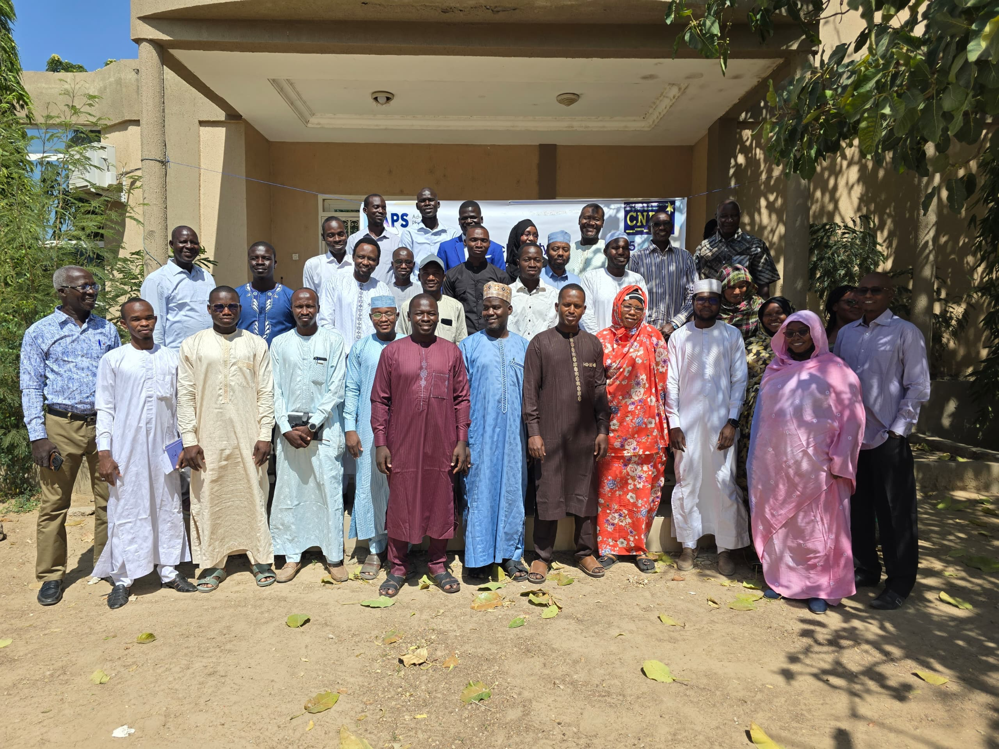
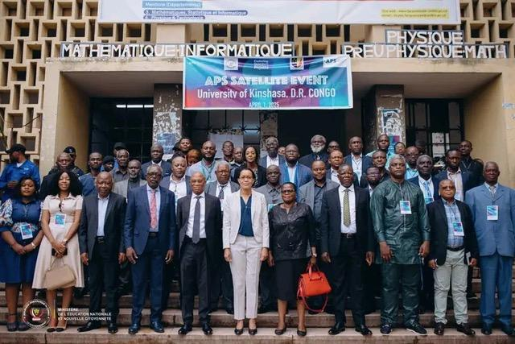
Satellite Sites - APS Global Physics Summit
Bringing APS Meetings to Physicists Worldwide
Brazil
Cameroon*
Chad
Dem. Rep. of Congo
Ghana*
Hong Kong
Jordan
Morocco
Nepal
Pakistan (2)
Philippines
Senegal*
Serbia
South Africa
Ukraine
Uzbekistan
Chad
* Organized Virtual Session
Democratic Republic of Congo

Slide 13
Satellite Sites - APS Global Physics Summit
Bringing APS Meetings to Physicists Worldwide
“…the satellite event was a valuable experience for my academic and professional development. It gave me access to high-level scientific presentations and allowed me to explore current trends in physics research…I left…with a clearer vision of the direction I want to take in my studies and research.” — Postdoctoral researcher, Chad

Slide 14
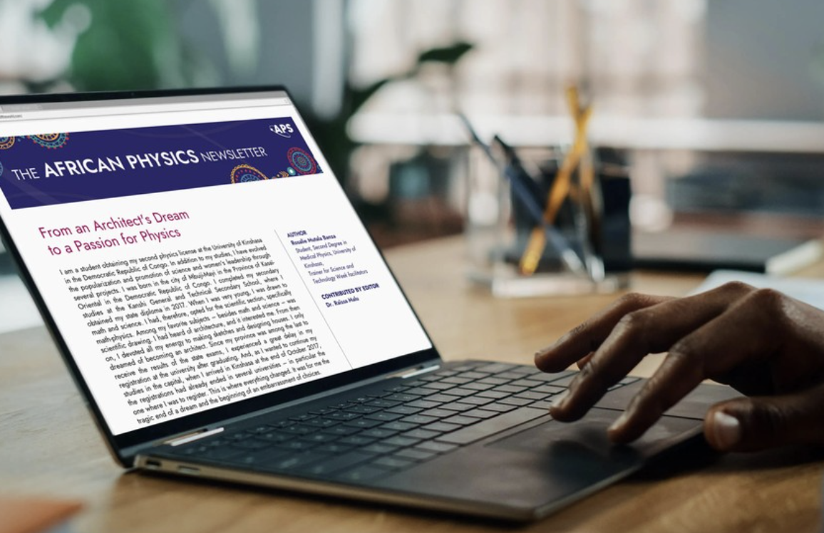
African Physics Newsletter
Fostering Pan-African Communications
The African Physics Newsletter (APN)
A publication about physics in Africa as gathered and reported by an Editorial Board of African physicists representing various regions of the continent. APS has published the newsletter since its inception in 2019.
13 Editorial Board Members consisting of African physicists serving as professors, researchers, lecturers, and physics community leaders.
11 Advisory Board Members from universities and laboratories around the world.

Slide 15
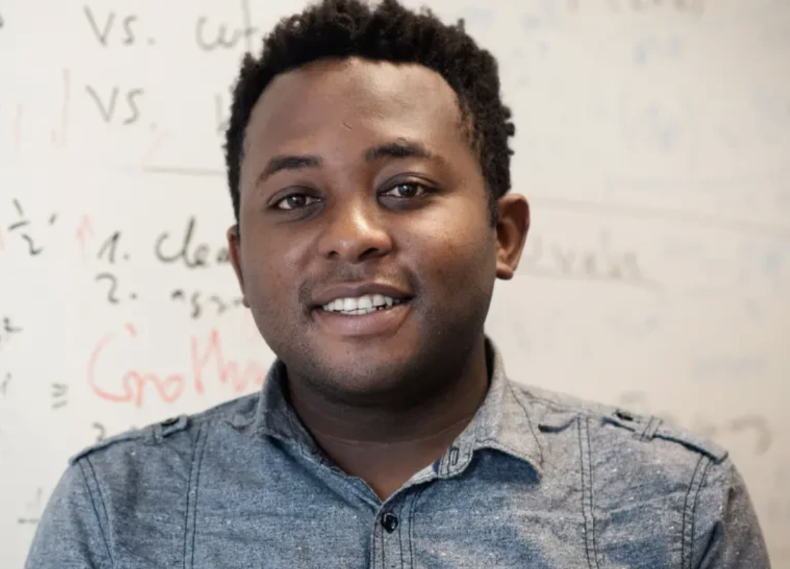
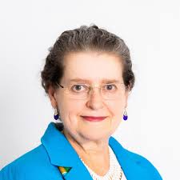
Editor-in-Chief: Stéphane Kenmoe
Universität Duisburg-Essen, Germany
African Physics Newsletter
Thank You to the Editorial Board
North Africa
Southern Africa
Mohamed Abdel Harith (Egypt)
Haddou El Ghazi (Morocco)
Mounia Laassiri (Morocco)
Iyabo Usman (South Africa)
Joyful Mdhluli (South Africa)
West Africa
Central Africa
Moses Jojo Eghan (Ghana)
Lat Grand Ndiaye (Sénégal)
Omamuyovwi Rita Jolayemi (Nigeria)
Raïssa Malu (Democratic Republic of the Congo)
Abdallah Brahim Elhadj Ali (Chad)
East Africa
Editor-at-Large
Robinson Juma Musembim (Kenya)
Tamelyn van Tonder (South Africa)
Head, Advisory Board: Irvy (Igle) Gledhill
University of the Witwatersrand, South Africa

Slide 16

African Physics Newsletter
Fostering Pan-African Communications
Read: https://www.aps.org/publications/african-physics-newsletter
Subscribe: https://info.aps.org/africanphysicsnewsletter
Interested in submitting an article? Read below. https://drive.google.com/file/d/1OG8gJqMT85d3TUz5_Bk9EB58JDGpg6LC/view

Slide 17
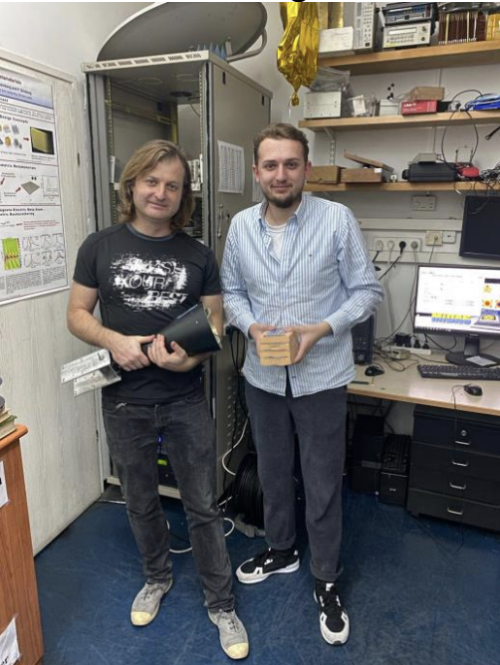
Serving Physicists Facing Political Peril
Maintaining Connections to Global Physics Community
Distinguished International Researchers in Areas of Conflict (DIRAC) Program
Provides grants for students and researchers whose work has been disrupted by political turmoil or conflict.
Helps them maintain their connections to the global physics community.
Supports virtual or in-person collaborations and student-focused support for networking, conferences, research visits, and mentorships.

Slide 18
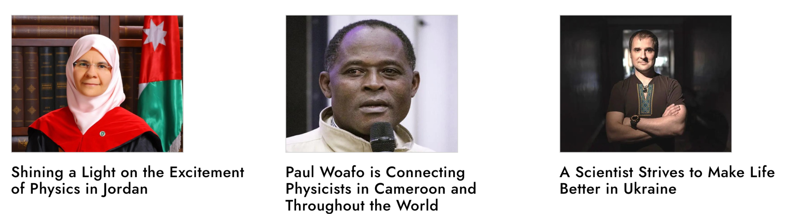
Global Spotlight Member (GSM)
Highlighting APS Members Across the Globe
The GSM initiative highlights the service and achievements of APS members outside of the U.S. who are supporting physics through mentoring, outreach, leadership, and community-building.
To be featured, APS members must be nominated by a member of the physics community.
Since the launch of the initiative, APS has highlighted five members, with some displayed below:

Slide 19
APS Meetings, Membership, and Journals
Accessibility for Physicists Worldwide
APS Meeting Registration Fee Discounts (www.aps.org/events)
Residents lower-income or lower-middle-income receive nearly a 90% discount
Residents upper-middle-income receive over a 70% discount
APS Membership (www.aps.org/membership)
Student membership is free for the first year
New membership models coming soon in 2026!
APS Journal Access (www.aps.org/publications/less-resourced-countries)
Research4Life – free or low cost access
ICTP-Electronic Journals Delivery Service – pdf by mail
Open Access publishing - Authors in low- and middle-income countries can choose to publish open access in all hybrid and gold APS journals at no cost.

Slide 20
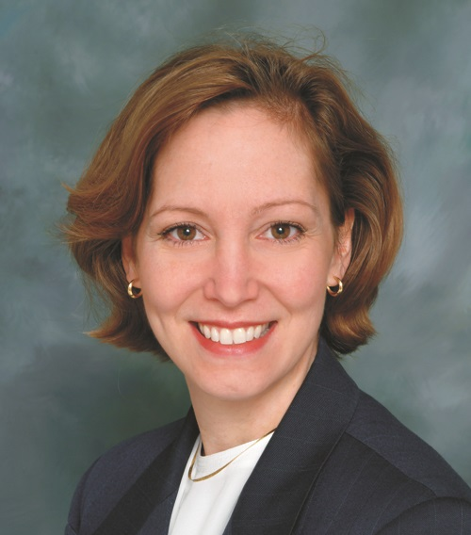

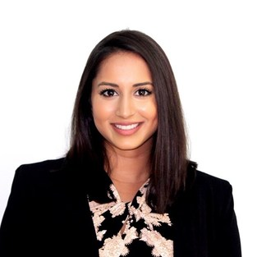

International Affairs Team
Please Connect with Us!
Amy Flatten
Director of International Affairs
Michele Irwin
Senior International Programs Manager
Shanaz Sulejmanovic
International Programs Manager
Laís Ribeiro
International Programs Associate

Slide 21
Please Reach Out
Flatten@aps.org
THANK YOU

