Slide 1

Nuclear Physics Techniques in Agriculture Sciences
Alassane Traore¹, Evance Okoth Obara², Uwineza Marie Clementine Nibamureke³, Bertrand Tchanche Fankam⁴
¹ Cheikh Anta Diop University, Senegal, ² Donghua University, Shanghai, P. R. of China, ³ University of Venda, South Africa, ⁴ Alioune Diop University, Senegal

Slide 2
Description of your working group
    The group was assigned to work around the versatile applications of nuclear Techniques specifically on Agriculture Sciences:
    Suitable Techniques
    Providing solutions Salt Tolerance with African Rice
    Sediment Delivery Ratio in Cultivated Land

Slide 3
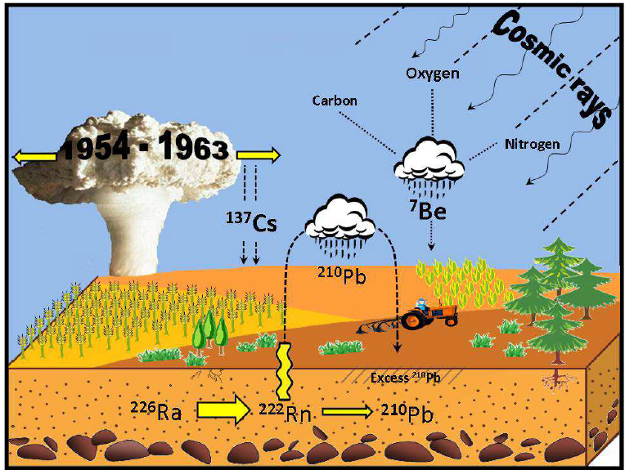
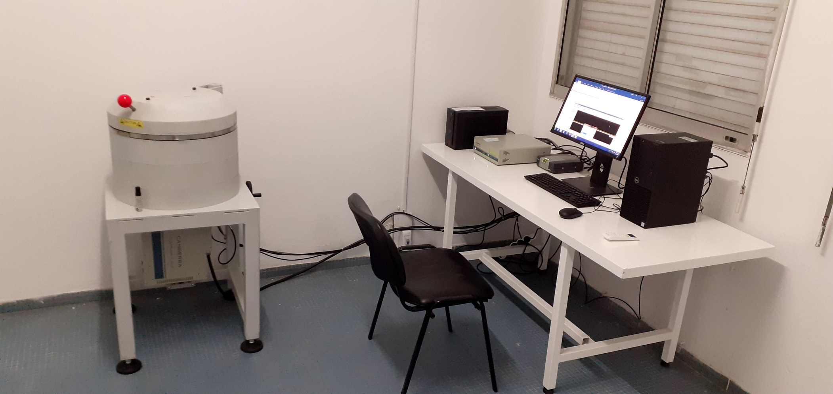
Why we need Suitable Nuclear Techniques …
The harvested area of chickpeas in Africa was estimated at
376,000 hectares in 2024, according to the available data.
Sierra Leone: 35.5%,
Guinea: ~ 32.9%,
Mali: ~ 21.8%,
Guinea-Bissau: ~ 19.5%
Mauritania: ~ 18.6%,
Nigeria: ~ 12.8%,
Senegal: ~ 12.0%,
Côte d’Ivoire: ~ 9.9%,

Slide 4
Erosion/ Sediment Cultivated Sites
up to 65% of cultivated lands in Africa are affected by soil erosion
Soil erosion is responsible for the annual loss of approximately 100 million tons in Morocco,
In Rwanda, the erosion rate can reach 250 t/ha/year on steep farmland.
The UN Economic Commission for Africa (UNECA) reports that in Ethiopia, 1.9 billion tonnes of topsoil are lost annually due to water erosion

Slide 5
Erosion/deposition Rate

Slide 6
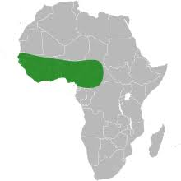
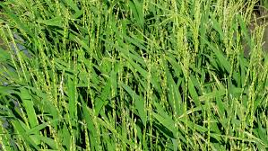
Current Research & Motivation
o. glaberrima is widely used for household consumption and rarely sold on the market. It is a very important food security crop, as short cycle varieties can be harvested during the ‘hunger period’ thus provide food when other crops and Asian rice varieties still mature.
o. Glaberrima varieties show tolerance to drought and flood, pest and diseases, and exhibit the ability to grow in acid and phosphorus-deficient, alkaline soils, and thrive without the application of chemical fertilizer. Many of these environments and conditions are not suitable for high-yielding Asian rice varieties (o. sativa) that came to dominate rice production in West Africa.

Slide 7
Scope of activities & participation
According to FAO data, West Africa has about 3.7 million hectares under rice.
From a 2023 rice-mapping study, the total rice paddy area across all of Africa in 2023 was estimated at ~ 12.8 millions ha. Based on that, West Africa’s ~3.7 M ha of rice corresponds to about 29% of Africa’s total rice paddy area.

Slide 8
Data collections
Ahloowalia, B. S., & Maluszynski, M. (2021). Global impact of mutation-derived varieties. Plant Breeding Reviews, 45, 155–190.
Dyck, V. A., Hendrichs, J., & Robinson, A. S. (Eds.). (2021). The sterile insect technique: Principles and practice in area-wide integrated pest management (2nd ed.). CRC Press.
FAO & IAEA. (2013). Nuclear techniques in animal production and health. Food and Agriculture Organization.
FAO & IAEA. (2021). Guidelines on the use of isotopes in nutrient and water management. Joint FAO/IAEA Division.
Gibson, J. J., Birks, S. J., & Yi, Y. (2020). Stable isotopes in hydrology: A review. Hydrological Processes, 34(16), 3555–3577.
Habtemariam, T., et al. (2019). Applications of nuclear techniques to improve livestock productivity. Animal Nutrition, 5(4), 358–367.
IAEA. (2014). Guidelines for using fallout radionuclides to assess soil erosion and sedimentation. International Atomic Energy Agency.
IAEA. (2022). Food irradiation: Facts and benefits. International Atomic Energy Agency.
IAEA. (2024). Isotopes techniques for nutrient and water management. IAEA Technical Reports.
IAEA. (2020). Plant mutation breeding and biotechnology. Joint FAO/IAEA Division.
Maluszynski, M., Nichterlein, K., et al. (2009). Mutagenesis in crop improvement: A review. Euphytica, 165(1), 1–30.
WHO. (2015). High-dose irradiation of food. World Health Organization.
Zapata, F. (2002). Handbook for the assessment of soil erosion using radionuclides. Kluwer Academic Publishers.

Slide 9
Analysis, Results and Conclusions

Slide 10
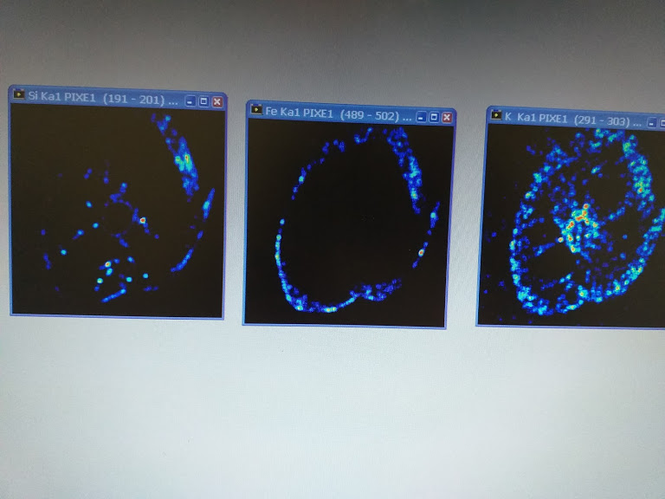
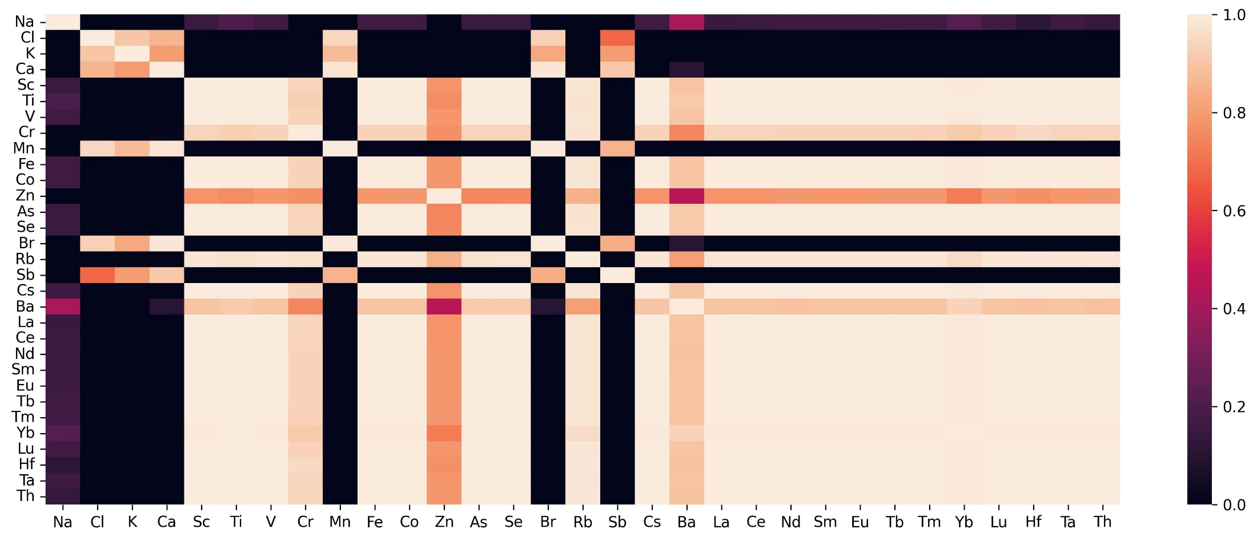
Experimental Results
Heatmap correlation root_Grain sample#4

Slide 11
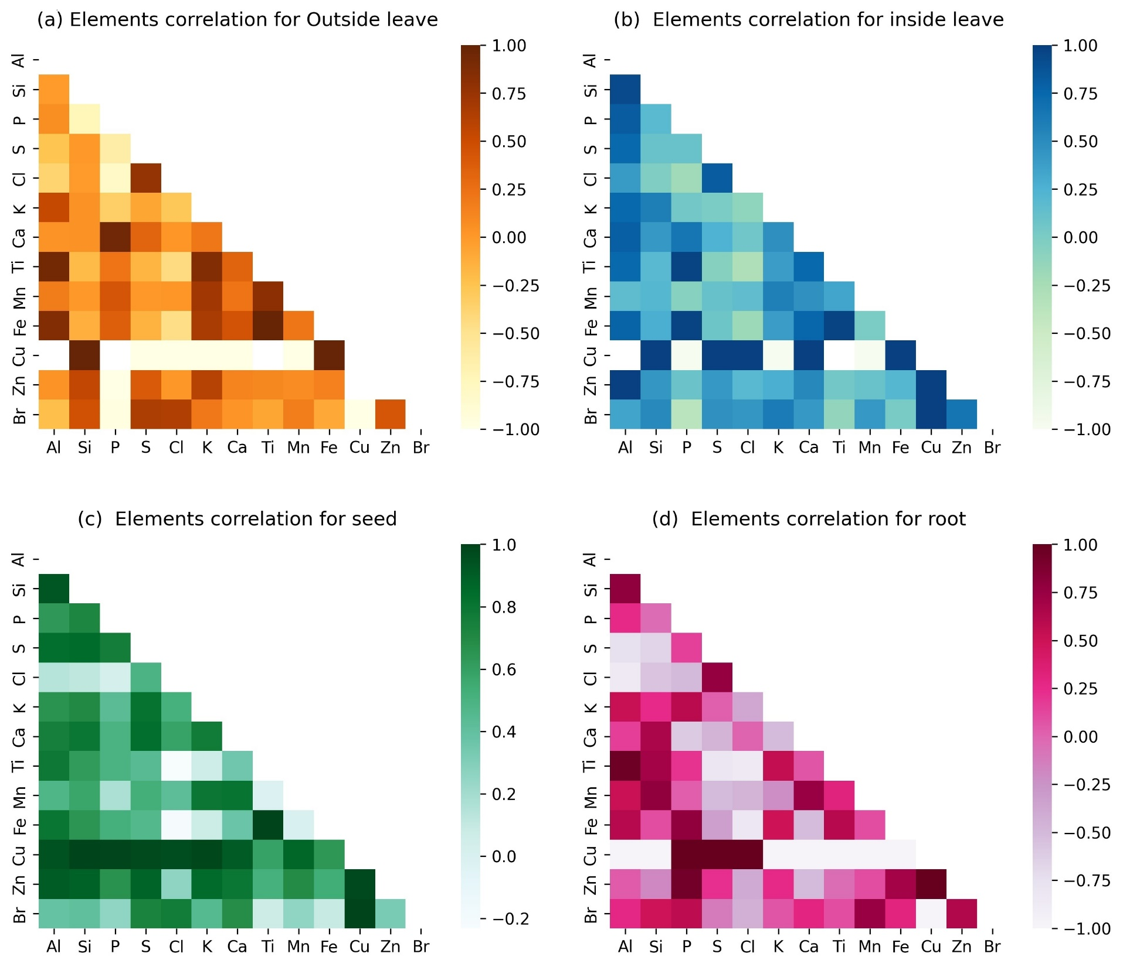
Expected …

Slide 12
Discussion & Implications
Accumulation and Distribution within plant tissues
Mechanisms underlying metal decommissioning
Compartmentalization on the cellular, tissue and organ levels in case of contaminated area or hazardous genetic effect of the rice plant
Spatial investigation of essential and Toxic Metals
Micro analytical imaging techniques
  Metabolic processes explaining
  Influence of different soils composition on plant uptake of nutrients and fertilizer types depending on seasons
  Genotypes response

Slide 13
Conclusion & Future Work forward
Perform analysis using Non-destructive analysis of roots, stems, leaves, and grains of Glaberrima rice by combining ion beam techniques: PIXE, RBS, and PIGE with Gamma Spectrometry, X-ray Spectrometry, IRMS, Alpha/Beta Spectrometry, irradiators (e-beam or X-ray or Co-60)
Future Work to reinforce Nutritional Benefits which are Absent from plants:
Expanding the effective uses of nuclear techniques in more various of varieties of plantes.
Improving zinc (Zn) mobility in rice organs is crucial for enhancing Zn bioavailability in grains and combating human Zn deficiency. Zn mobility within the plant can be limited due to strong binding to cell walls and vacuoles, making it challenging to redistribute Zn efficiently to the grains.

Slide 14
Recommendations
academic institutions
- Establish collaboration between Countries with functional laboratories and good maintenance and calibration skills
Establish or mutualizing sample preparation laboratories for biological samples
Build existing platform for sharing of information best practices on soil conservation strategies based on the use on NTA among countries and regions.
governments
Must lead to the sharing of resources, knowledge and expertise among countries, the transfer of technology available in advanced countries to countries where such technology is needed; and the creation of regional capabilities that, once developed, will, in turn, lead to further regional cooperation. This demands vision, commitment, and effective management

Slide 15
THANK YOU FOR YOUR KIND ATTENTION

