Slide 1

Physics Techniques in Agriculture, Air Quality and Waste Management Sciences
-
Overview of the Air Quality Research in Africa
Bertrand Tchanche
Alioune Diop University - Senegal

Slide 2
Agenda
Context – air pollution as an emerging crisis
Air pollution and its impacts
Progress in air quality research
Recommendations

Slide 3


Context – rapid development
Demands: growing needs in all sectors!
Education & health,
Energy & water supply,
Food supply & waste management,
mobility & transport…
Growing population of Africa from 1955 to 2023
~2.3% per annum
Adverse effects
Pressure on resources and the environment
Deteriorating air quality with adverse consequences
High urbanization rate
~ 4.5% per annum
(fast growing cities)

Slide 4
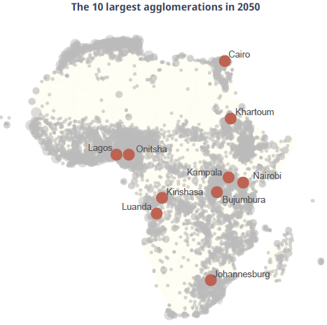
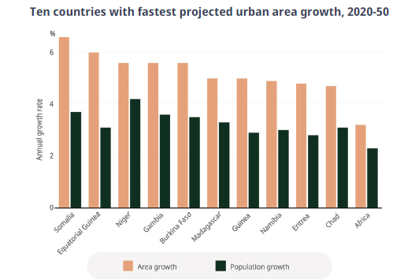
Context – rapid development
The number of urban agglomerations in Africa is growing fast (from 9 000 in 2020 to over 11 000 in 2050). Nigeria, Egypt, Ethiopia and DRC will account for 36% of all cities.
Urbanization growing faster than demography in some places
MegaCities: +10 M inhabitants
2025: 4
2050: > 17 projected
Source:
Africa’s Urbanisation Dynamics 2025 (Report)

Slide 5
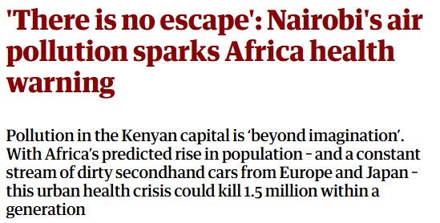
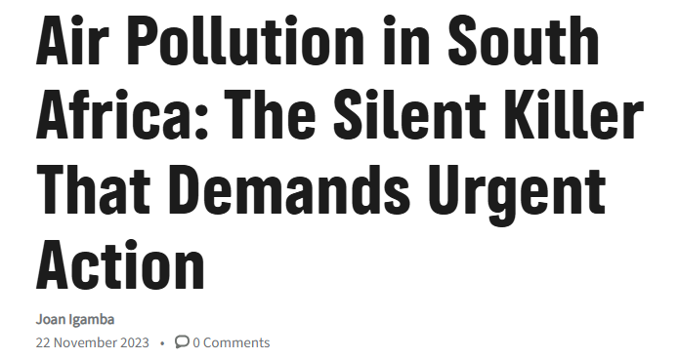
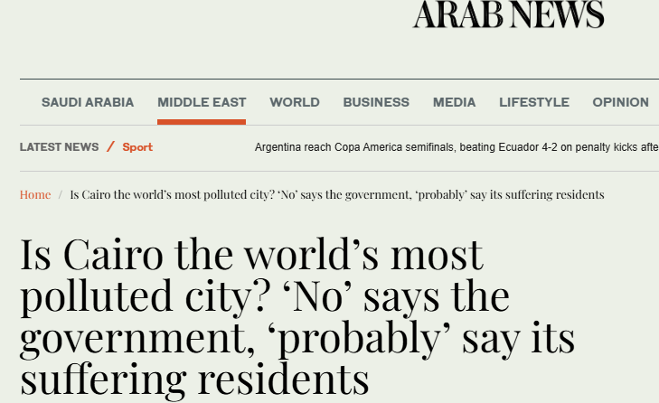
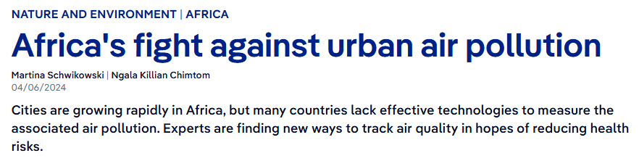
Air pollution in the news

Slide 6
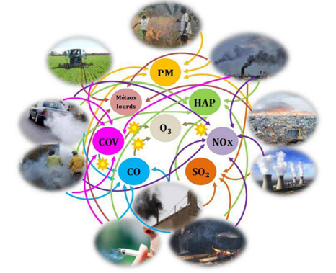
What’s air pollution?
Air pollution is the contamination of the indoor or outdoor environment either by chemical, physical or biological agents that alters the natural features of the atmosphere.
Contaminants or pollutants:
  Gaseous : SO₂, NOx, CO, O₃ …
  Solid: particles of different sizes (PM)
  Volatile organic compounds (VOCs)
  Bio-pollutants : pollen, viruses…
  Hazardous air pollutants (HAP): air toxics that cause serious health issues like cancer

Slide 7
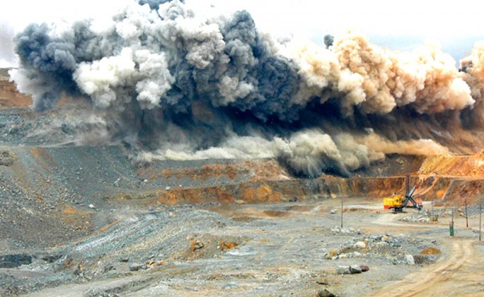
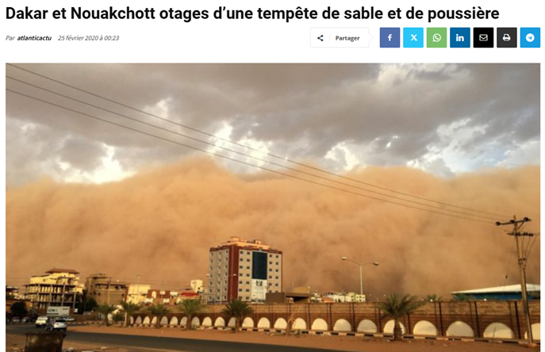
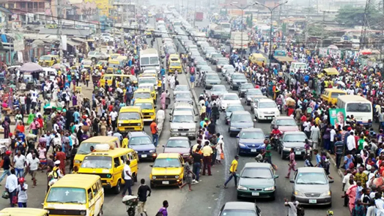
Where do air pollutants come from?
Biogenic emission sources (natural origin) :
Sahara dust, sea sprays,
volcanic emissions,
vegetation, grassland fires,
soils, etc.
Anthropogenic sources
(human activities) :
Household activities,
Open burning of SMW,
Agricultural activities
Bush fires,
Construction works,
Industrial processes,
Mining activities,
Transport,
…

Slide 8
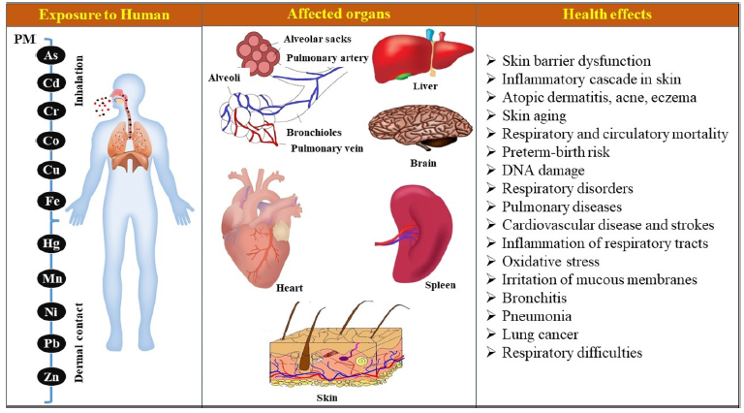
What’s the impact?
Impacts are on the environment, economy, health…
All parts of the body are affected !
Routes of exposure to particles
  Inhalation (transit through the respiratory tract)
  Ingestion (transit through the mouth and digestive tract)
  Percutaneous exposure (particles in contact with the skin)
  Ocular exposure (deposition in the eyes and irritation)
Duration
  Chronic or long-term exposure (years)
  Acute or short-term exposure hours, days)

Slide 9
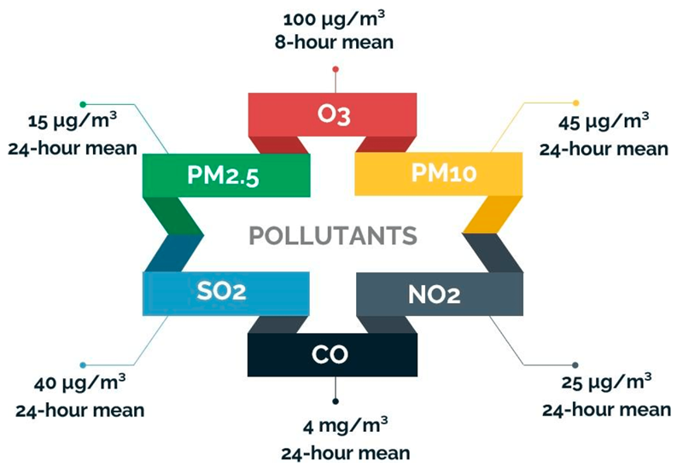
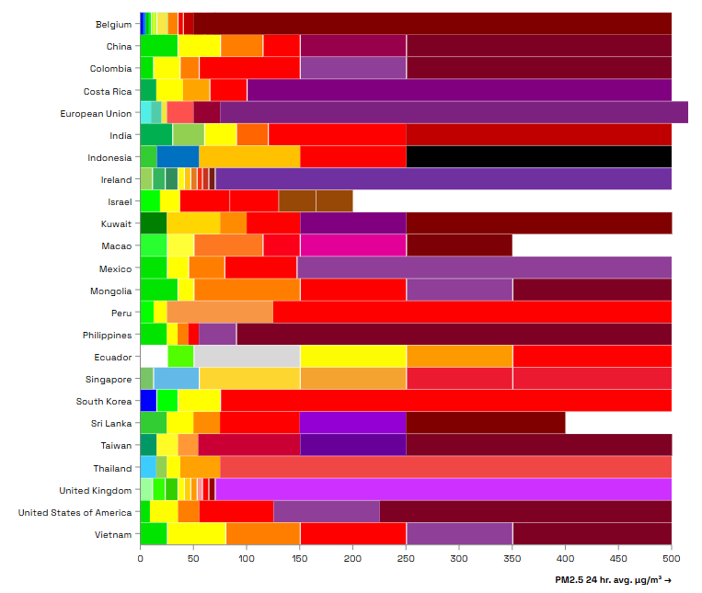
Criteria pollutants and AQ Index
Recommended 2021 air quality guideline (AQG) levels and 2005 AQG - WHO
Source: Essamlali, I.; Nhaila, H.; El Khaili, M. Supervised Machine Learning Approaches for Predicting Key Pollutants and for the Sustainable Enhancement of Urban Air Quality: A Systematic Review. Sustainability 2024, 16, 976. https://doi.org/10.3390/ su1603097

Slide 10
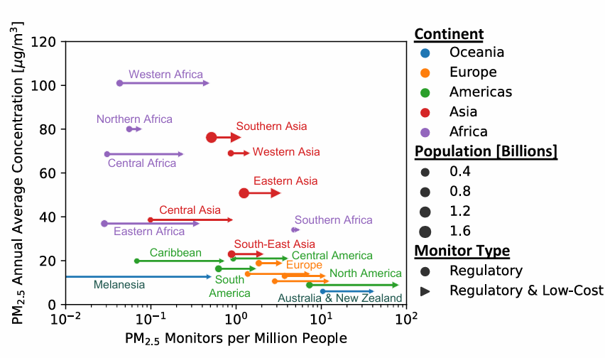

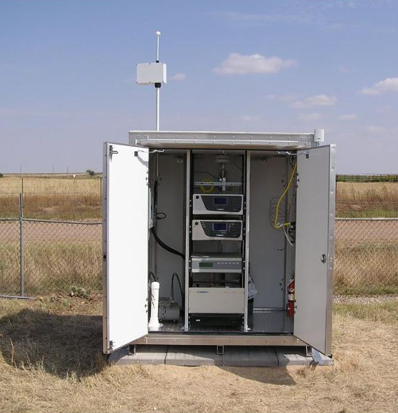
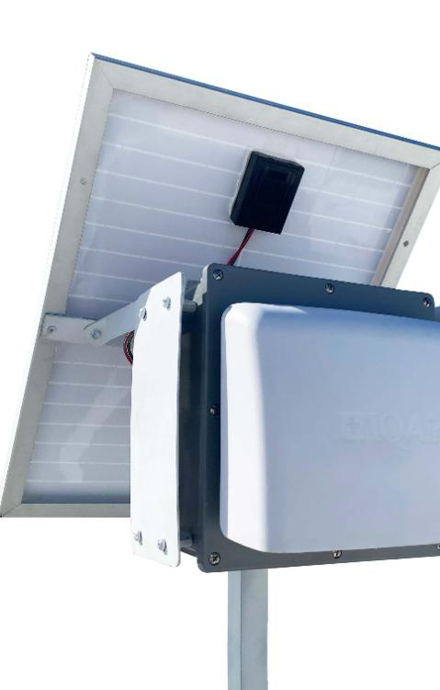
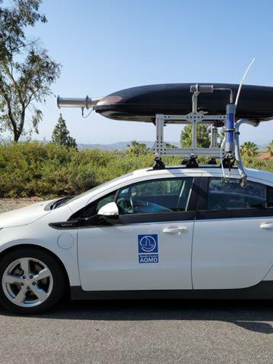
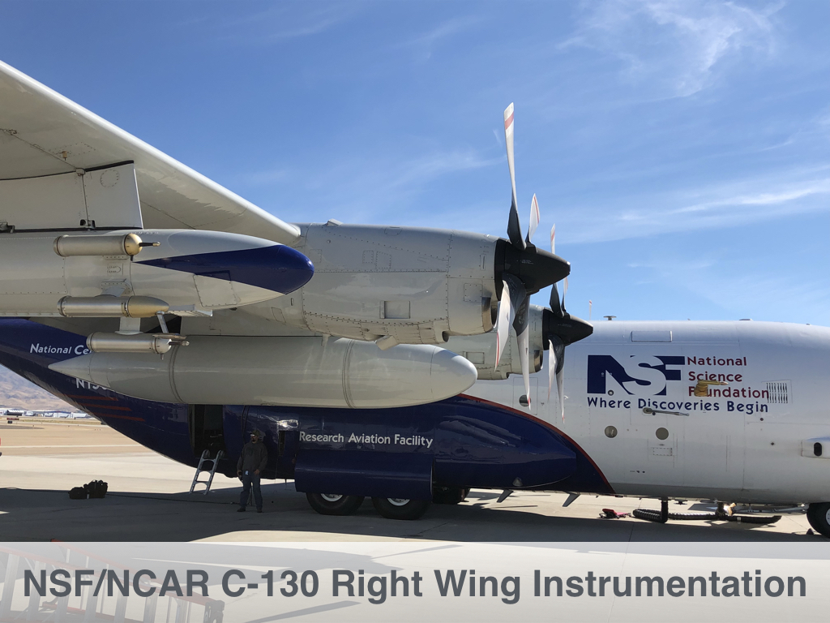
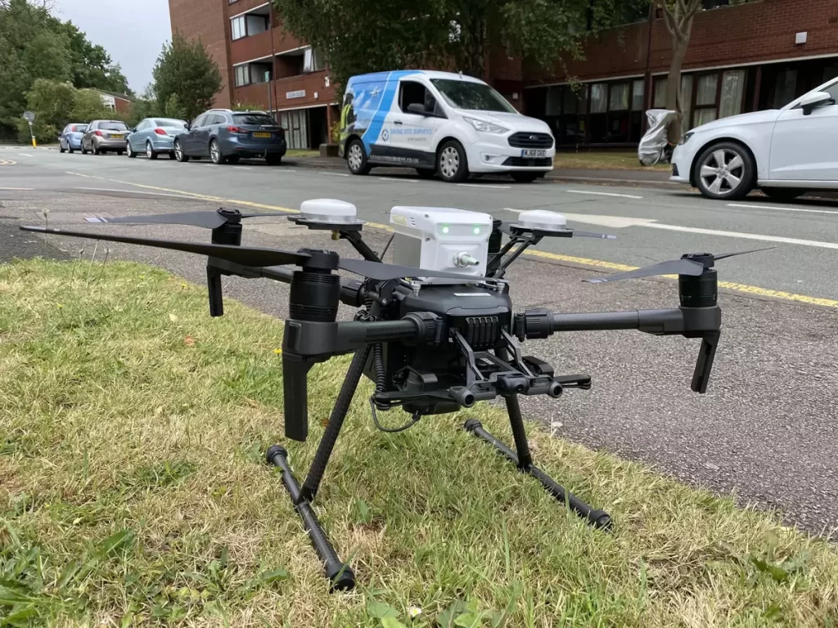
Air quality and monitoring
INSTRUMENTATION
-
Samplers, nephelometers, analysers…
Remote sensing & ground instruments…
Static & mobile monitoring…
The Global Air Quality Data Gap
Source: Malings et al. (2022) Forecasting with the GEOS-CF System and Other NASA Resources to Support Air Quality Management. Proceedings of the International Conference on Air Quality in Africa.

Slide 11
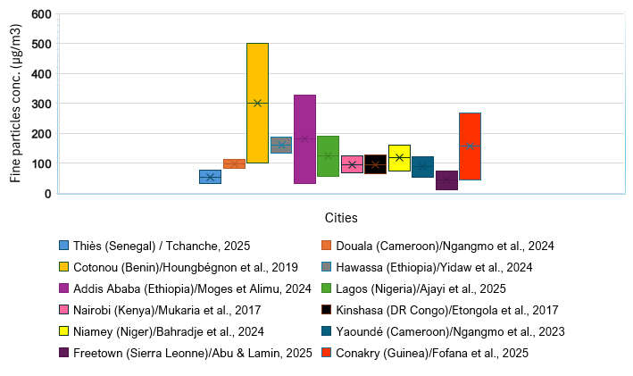
Levels of air pollution
Fine particles concentrations
are high !
Mean values:
12 – 500 µg/m³
1 up to 34 folds the TV
(TV = 15 µg/m³)

Slide 12
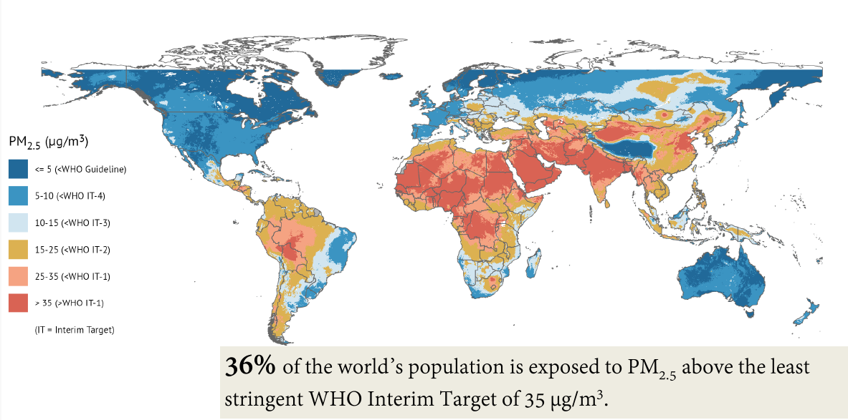
Levels of air pollution
Source: SOGA Report 2025

Slide 13
Levels of air pollution - Mortality
1.1 million deaths are attributed to poor air quality in 2019 (HEI, 2024)
Air pollution is the second leading risk factor for death across Africa.
Ambient PM_{2.5}: 5 /10 most heavily polluted : Niger, Nigeria, Egypt, Mauritania and Cameroon.
DR Congo
Egypt

Slide 14
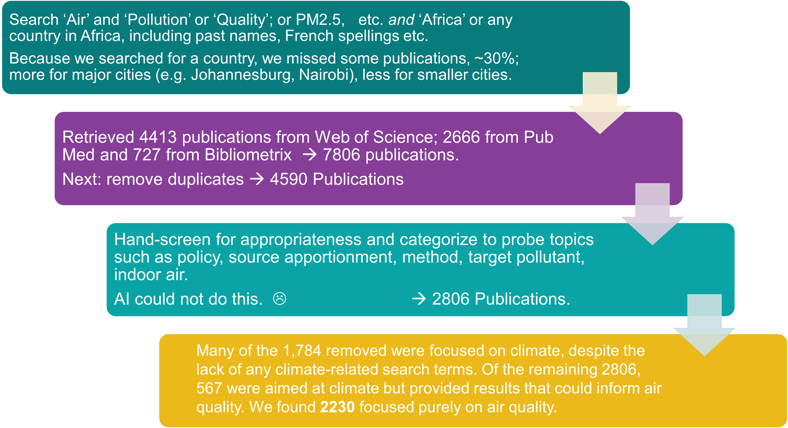
Review of air quality research
Workflow

Slide 15
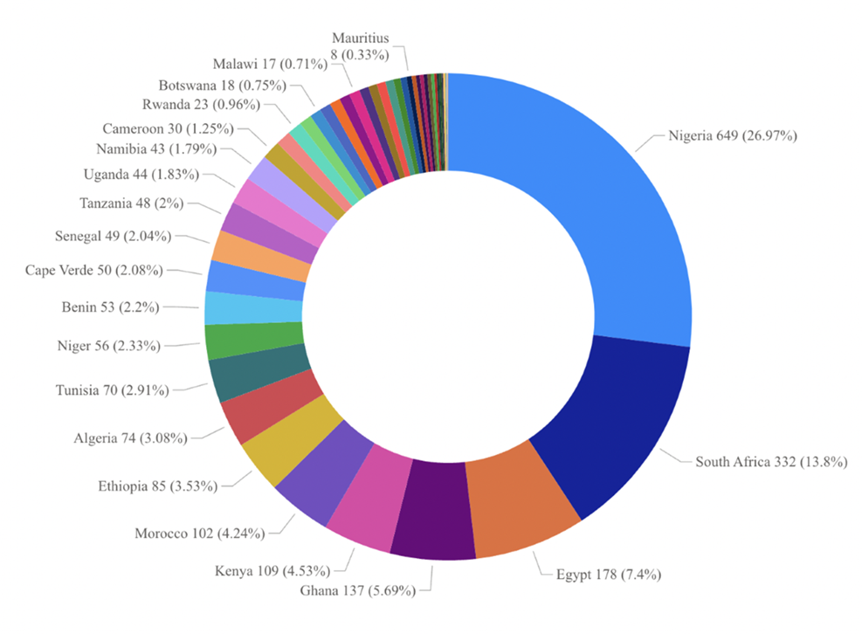
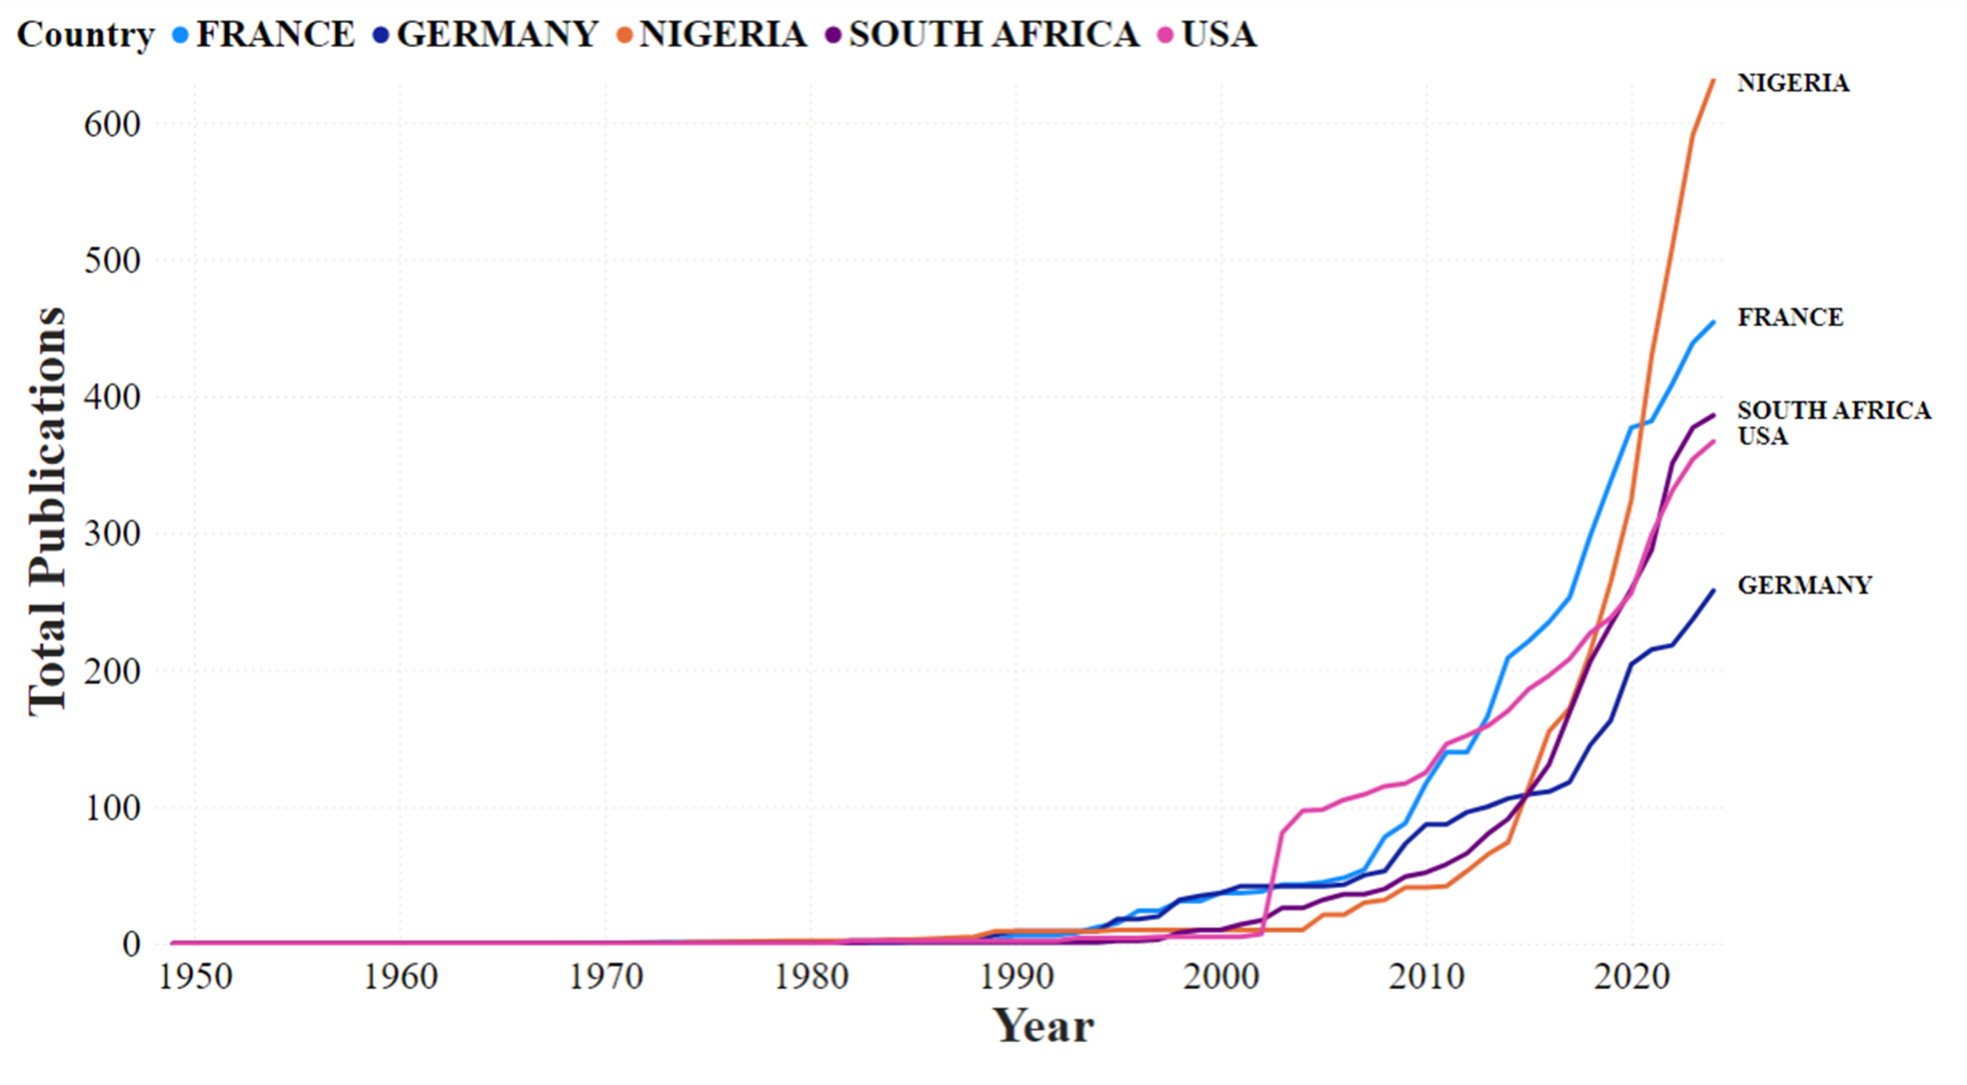
Review of air quality research
More than half are from 6 countries: Nigeria, South Africa, Egypt, Ghana, Kenya, Morocco
Publications by Year by the Top 5 Countries (from Bibliometrix)

Slide 16
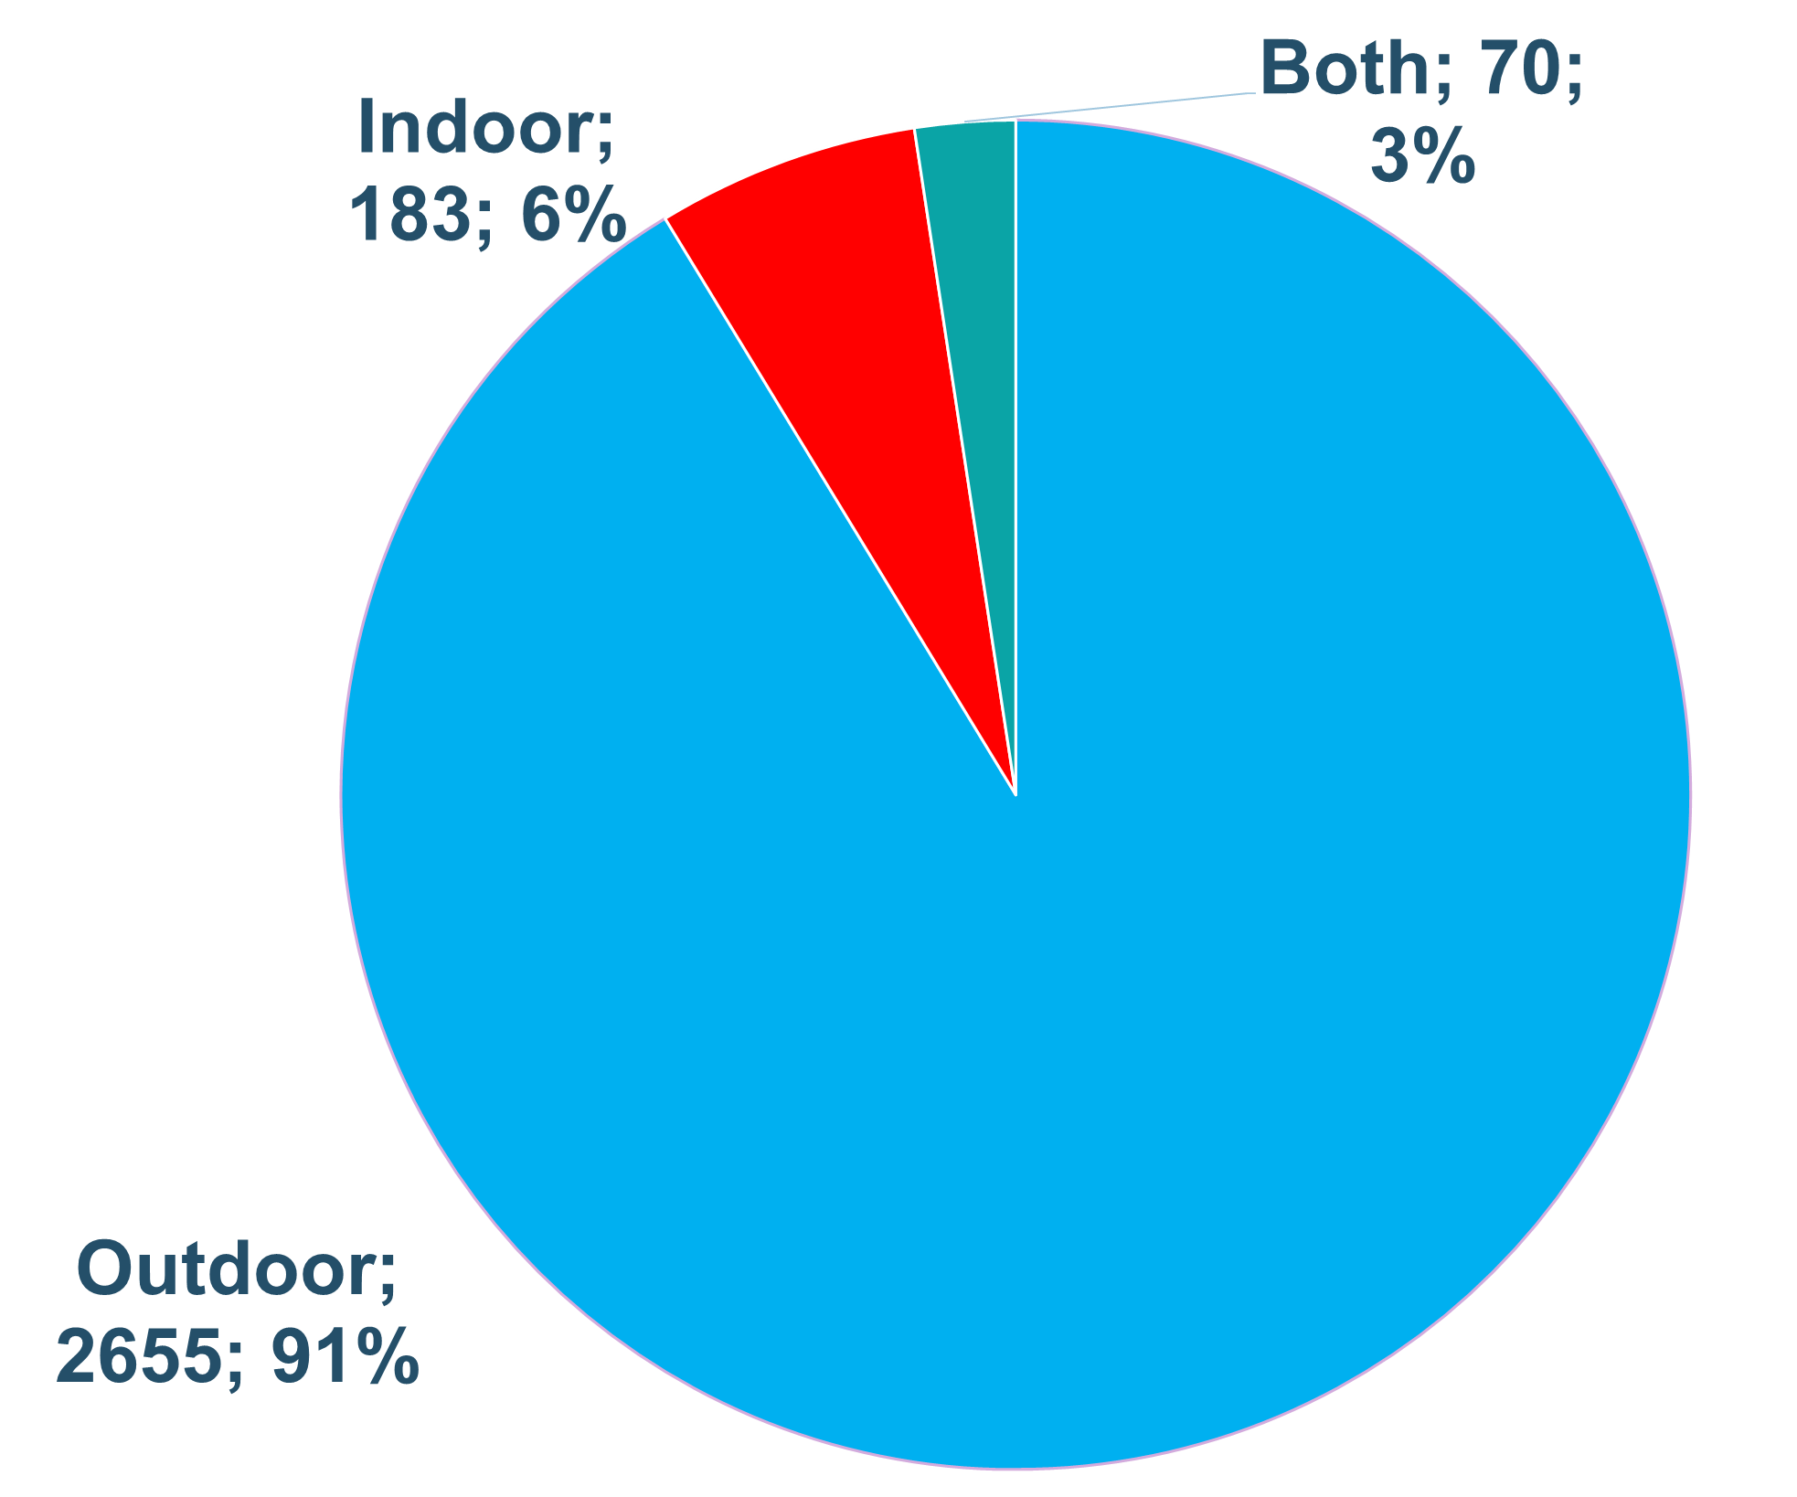
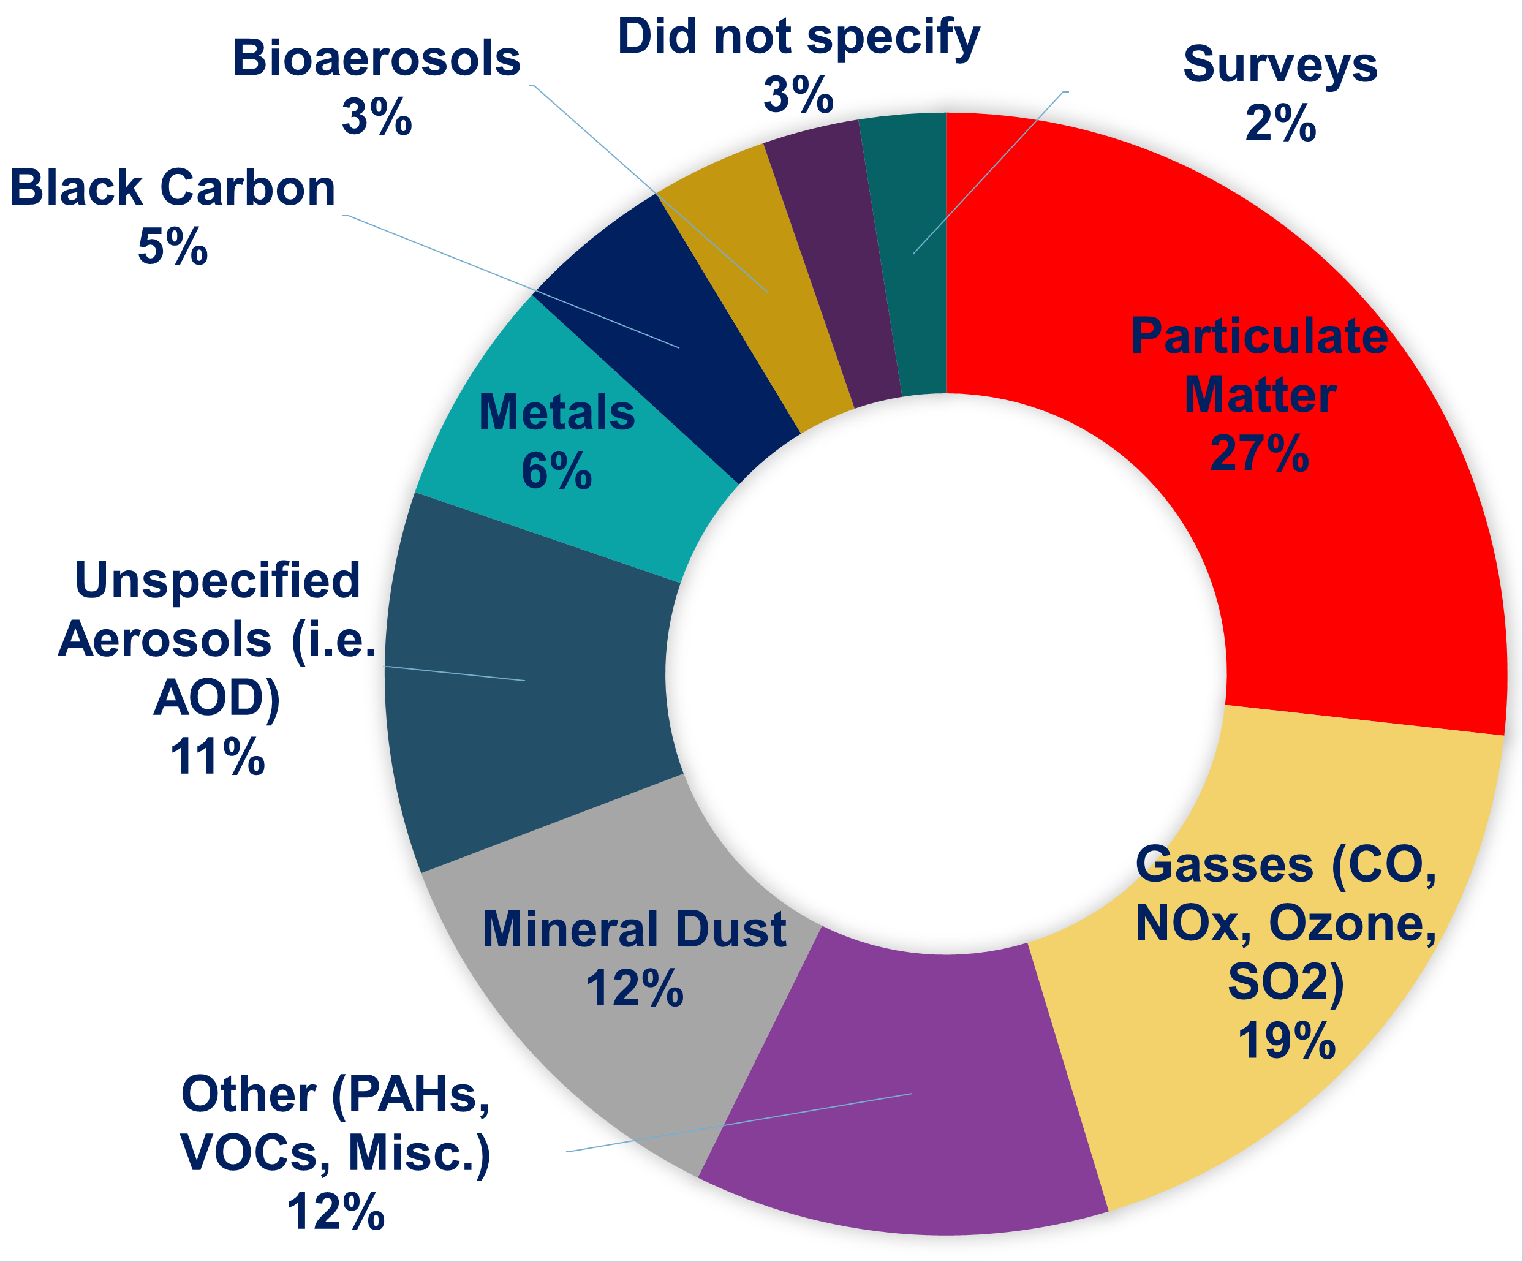
Review of air quality research
Indoor vs outdoor: More focus on outdoor and indoor understudied
Topic pollutants: focus on fine particles and gases

Slide 17
Review of air quality research
Study methods
Very few reference monitor studies.
Growing use of low-cost air sensors.
A fairly high number of studies use more sophisticated techniques

Slide 18
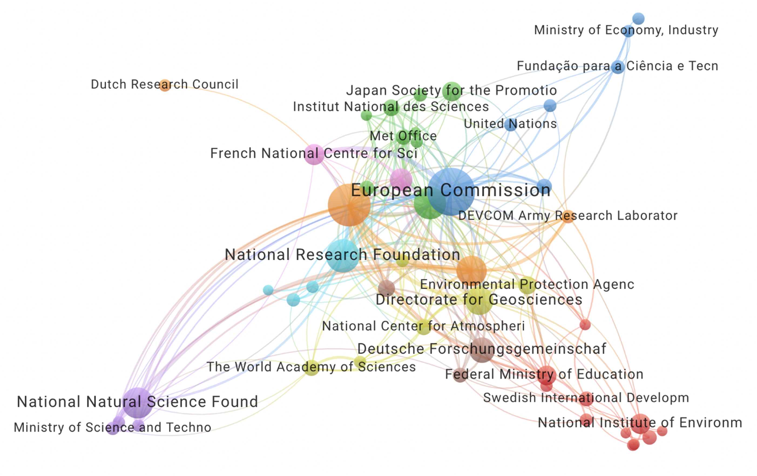
Review of air quality research
Funding sources
Circle Size Indicates the Amount.
Connections Indicate co-Funding.
Almost all is from developed economies.

Slide 19




Review of air quality research
Existing initiatives:
  African society for air quality (ASAQ) --- >
  Clean air forum
  West african school on air quality and prevention
  Clean air one atmosphere
  Clean air journal / NACA (SA)
  Air Quality and Climate Education Network (AQCEN)
  Clean-Air Africa
  Afriset
  ANGA
  Support –
    energy policy institute Chicago (EPIC), CAMSNET
    Clean air fund (office in Ghana)

Slide 20
Conclusions
  Levels of pollution are high in Africa, but limited number of monitors exist.
  Most countries lack AQM plan and NAQS (National Air Quality Standards)
  Air pollution research is growing rapidly in Africa.
  Most studies are concentrated in a few countries and in many countries there is an almost non-existent research community.
  Overall, there is a small but active and sophisticated air pollution research community.
  Africa is comprised of 54 countries. ~100 source apportionment. publications and ~200 policy and clearly ~800 health outcome studies is clearly not enough. Only ~70 papers using reference monitors.
  Even though these numbers are biased low, gaps are still clear.
  Funding is mostly coming from outside Africa.

Slide 21
Recommendations
Governments
Invest and support research (funding, facilities, in-house coll. & mobility…)
Create frameworks for collaboration and knowledge exchange at national, regional and continental level
Increase public awareness & work towards national standards
Professionals & researchers
Create thematic working groups (Aerosols, EO4AQ, Modelling (CTM…), AI & ML…)
Organize scientific events/gatherings (conferences, workshops…)
Develop local solutions…
Academic institutions
Develop Master & PhD programs (air quality management, atmospheric chemistry, air pollution & health…)
Encourage joint research programs
Establish a list of existing research teams and facilities
International partners
Increase collaboration with local teams
Increase funding allocated to Africa
Support local initiatives

Slide 22
Thank you for your attention!
Q&A
-
Please reach out -<> bertrand.tchanche@uadb.edu.sn

