Slide 1

Observers’ feedback
Oumar Ka¹ and Peter Jenni²
¹Cheikh Anta Diop University, Senegal
²Freiburg University & CERN, Switzerland

Slide 2
WHAT…
The Observers Committee is an intermediate body providing an additional link between the working groups and fora, and the Steering Committee. Members of this committee are people with experience in long term planning but also an outstanding involvement with projects in Africa and with Africa.

Slide 3
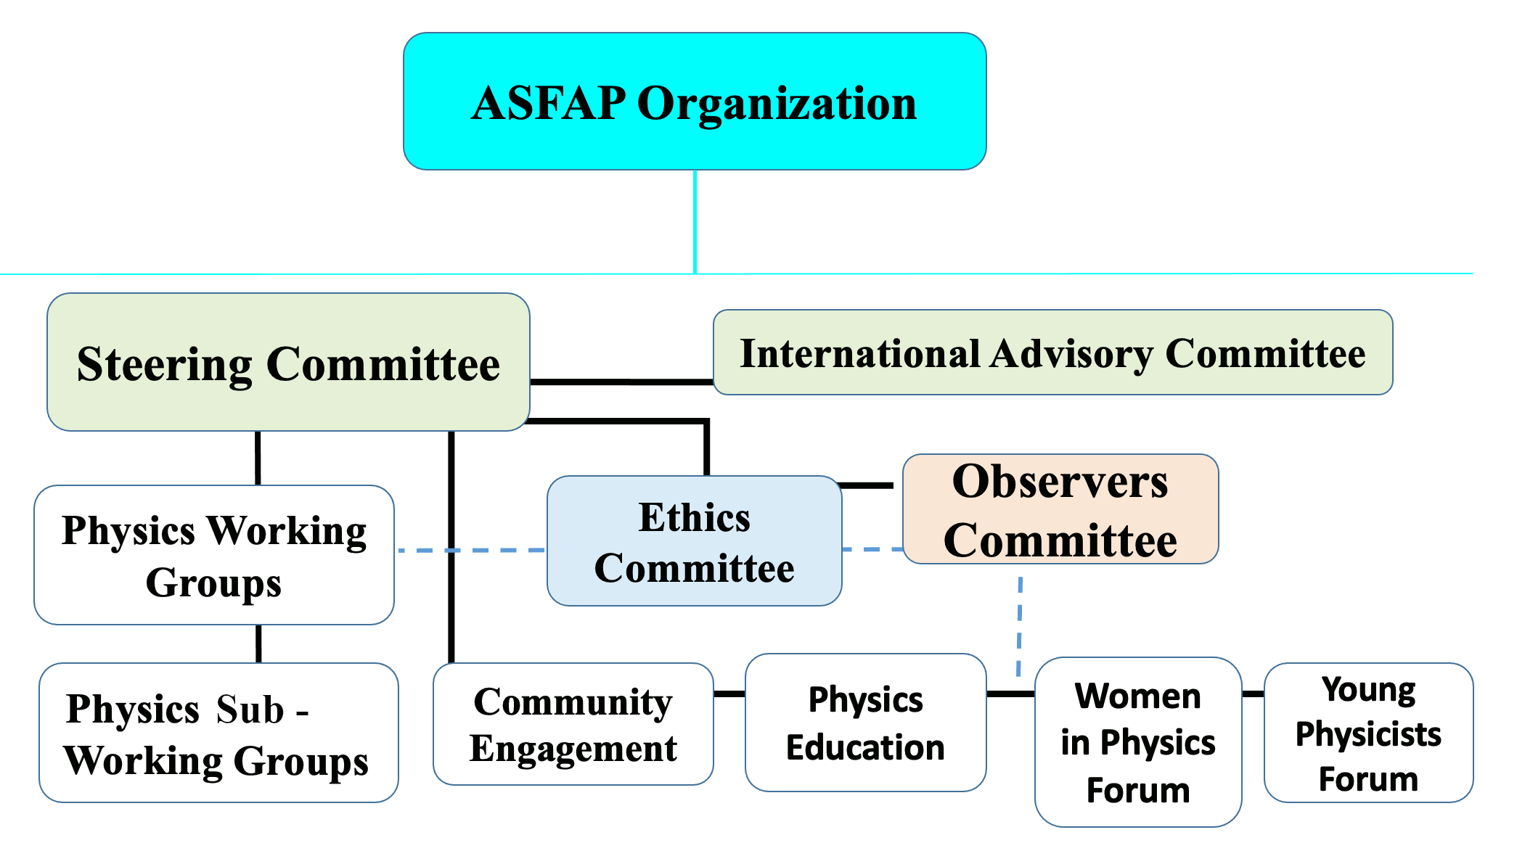

Slide 4
HOW…
Job of the Observers Committee :
initially, to help the working groups get running efficiently and smoothly;
at a later stage, to participate in working group discussions, to help review papers, to attend meetings and to edit of the report chapters together with the working groups that they were assigned to follow

Slide 5



Prof. Peter Jenni
Theoretical and Applied Mechanics
Astrophysics and Cosmology
Optics and Photonics
Particle Physics
Accelerators
Atomic and Molecular Physics
Nuclear Physics
Observers Committee x
Physics Working Groups
Medical physics
Biophysics
Materials Physics
Computing and 4IR
Prof. Oumar Ka
Energy
Instrumentatio n & Detectors
Light Sources
Earth Science
Fluid and Plasma
Prof. Peter Jenni

Slide 6
Prof. Peter Jenn
Community Engagement
Prof. Oumar Ka
Observers Committee x
Physics Education
Young Physicists Forum
Engagement Fora
Women In Physics

Slide 7
OUTCOME…
The concept of inviting independent Observers with a broad background in science strategies is a commendable approach, to support the working group with experienced community members.

Slide 8
OUTCOME…
The observers played a significant role in the working group activities although they did not interact formally among themselves.
The Observers brought their experience to the project through the reviews of working group data collections, analyses, results and report developments.
Useful in shapping the outcome of the final report.

Slide 9
RECOMMENDATIONS
Future strategies should maintain active participation of observers, drawn broadly from the international communities.
The role and the charge of the observers should be communicated to all the working groups.
The observers committee should be organized with a concerted approach in the interaction with the working groups and the steering committee.
The observers should effectively participate in the activities of their assigned groups. Email communications with the observers should be carried out through official channels—this should be generalized to broader formal communications and interactions within the strategy process.
Their recommendations should be implemented to the extent possible.
Their inputs into the strategy development should be acknowledged by the contributors, and serve to assist and facilitate the efforts of the conveners, the steering and advisory committees, by ensuring quality throughout the process.

