Slide 2
Looking back at LEP RDP
(with a bit of FCC)
J. Wenninger

Slide 3
Depolarization at LEP
LEP depolarization – parameters (as far as I managed to reconstruct them !):
  Re-used a kicker designed for transverse feedback, max vertical orbit kick ≈ 1.4 μrad @ 45 GeV.
    Depolarizer rotation of the spin max ~140 μrad /turn @ Z.
  Single kicker → free vertical betatron oscillation across the full ring.
  Typical scan range Δν_{s} = 0.002 (or 0.88 MeV) ⇔ Δf = 22 Hz.
  Scan duration 12 s : dν_{s}/dt = 1.67×10⁻⁴ ⇔ dE/dt = 73 keV/s.

Slide 4
LEP optics
The LEP optics arc phase advance was adapted periodically to meet luminosity or polarization needs.
The main optics considered here (hor/ver phase advance):
  90°/60°: the production optics in 1993-1995 for Z operation with energy calibration.
  102°/90°: the production optics for beam energies > 90 GeV (no polarization constraints).
  60°/60°: a detuned optics for polarization and energy calibration at 50-60 GeV.
Better orbit corrections were achieved with 60° vertical phase advance due to the BPM sampling, LEP had only BPMs at D-quadrupoles.
  60° vertical phase advance favorable for polarization !

Slide 5
Simple LEP RDP modeling
Simulate the turn-by-turn evolution of the beam trajectory due to the modulated vertical depolarizer kick. The depolarizer is set to a fixed frequency (spin tune) at this stage.
Track the spin/polarization vector of the reference particle on the beam trajectory turn-by-turn and element-by-element.
  Not a particle distribution tracking !
  The impact of photon emission and synchrotron oscillations over the ~10 s duration of a scan is neglected at this stage.
A simplified model, but it can be used to estimate the effect of the free betatron oscillation on the depolarization process.
  100 turns are used to estimate the enhancement due to the betatron oscillation – checked to be sufficient / representative.

Slide 6
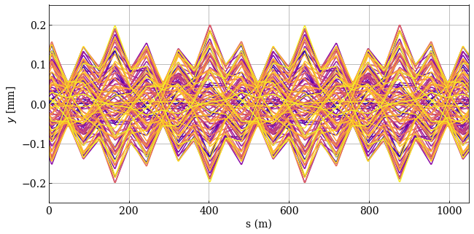
Turn-by-turn tracking
For the LEP vertical emittance of ~0.5 nm @ Z, the arc beam size is around σ = 0.27 mm for a 60° vertical phase advance optics.
In the region of interest for the fractional spin tune [0.4-0.5], the vertical oscillation amplitudes represent no more than ~1σ – not a risk for the machine/beam.
1993 90°/60°, β*= 2.5m/18cm
Overlaid 100 consecutive vertical trajectories due to the modulated kicker deflections in the ~1000 m behind the kicker.

Slide 7
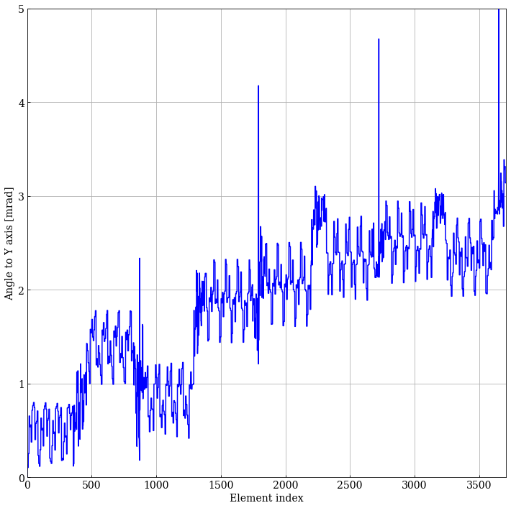
Influence of lattice & betatron oscillation
Spin angle to vertical on first turn
Tracking the spin orientation from turn to turn, one can observe the effect of the free betatron oscillation on the spin.
For the LEP lattices considered here, the largest changes in spin orientation occur around the long straight sections where the regularity of betatron oscillation and spin precession is broken (dispersion suppressors…).
  In all tested cases an enhancement of the depolarizer kick by the lattice is observed.
  The steps around the LSS are of similar magnitude than the depolarizer kick.
The level changes arise around each LSS
1998 102°/90°, β*= 2.0m/10cm
Element 0 = depolarizer

Slide 8
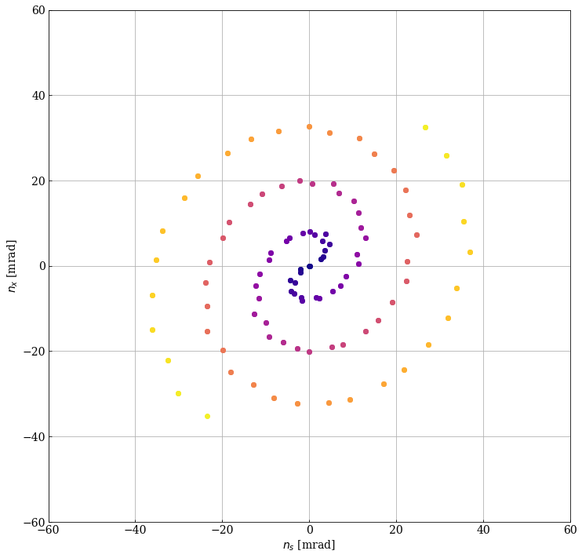
Influence of lattice & betatron oscillation (2)
Projection of the spin orientation on the x-s plane at the end of each turn (ν_{s} = 103.45)
To evaluate the impact of lattice and free betatron oscillation, track the angle of the spin wrt vertical at the end of each turn as a function of the turn number.
  Repeat for difference kicker excitation tunes – see later slide.
After 100 turns, a good estimate is obtained for the effective spin deflection per turn wrt vertical axis.
  The “double spiral” visible on the right is due to the spin tune being close to 0.5 in this example. Odd turn numbers are on one arm, even turn on the other arm.
The turn number is color-coded from dark blue (turn 1) to yellow (turn 100).
1993 90°/60°, β*= 2.5m/18cm

Slide 9

Influence of lattice & betatron oscillation (3)
The enhancement F(q_{dep}) due to the lattice and the free betatron oscillation is obtained as a function of the depolarizer excitation tune q_{dep}, θ_{dep} is the transverse (orbit) kick of the depolarizer:
where w(q_{dep}) is obtained from the simulation as the average deflection angle/turn over 100 turns.

Slide 10
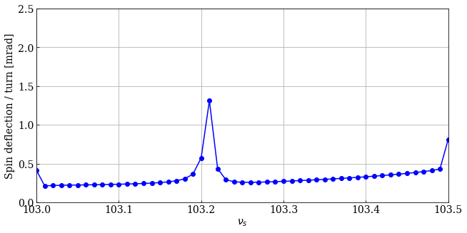
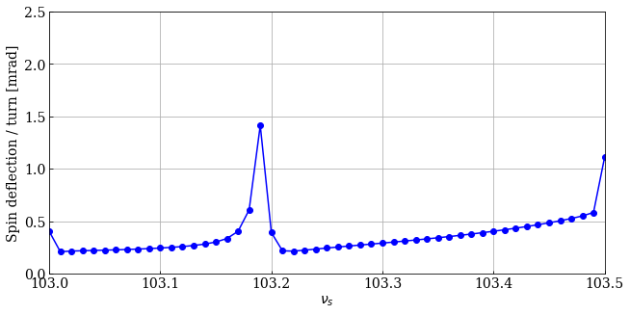
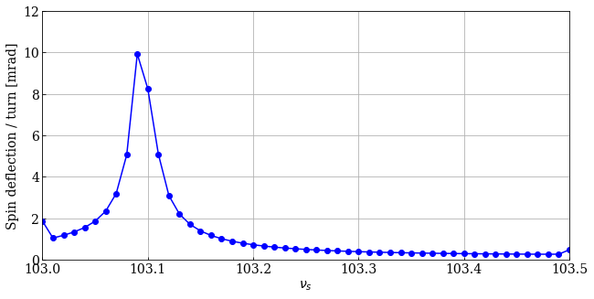
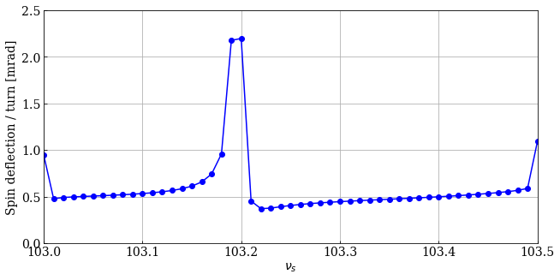
Lattice response w
ν_{s} = [0.40, 0.50] : w ~0.3-0.6 mrad/turn → F ~2-5
1993 90°/60°, β*= 2.5m/18cm
1994 90°/60°, β*= 2.5m/5cm
Q_{y} = 76.209
Q_{y} = 76.189
1998 60°/60°, de-tuned
1998 102°/90°, β*= 2m/10cm
Q_{y} = 71.096
Q_{y} = 96.195
Stronger response due to lower Qy (→ larger orbit excursions)

Slide 11



Simple (& fast) simulation of RDP
The average spin deflection estimated from the TbT simulations are used to model a simple RDP with precession around vertical axis for one turn with a single modulated deflection.
The aim is to get a fast qualitative model of RDP at LEP.
+
Spin precession over a turn
Time varying effective deflection of the depolarizer

Slide 12
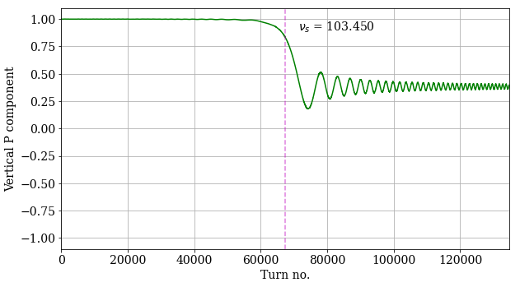
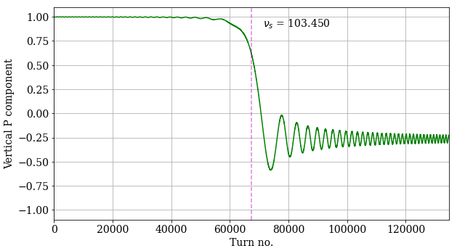
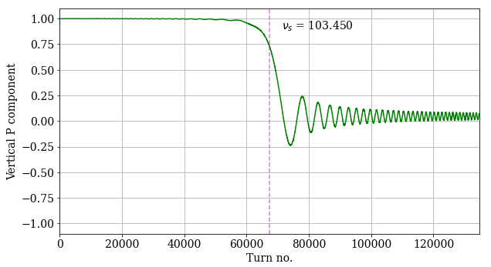
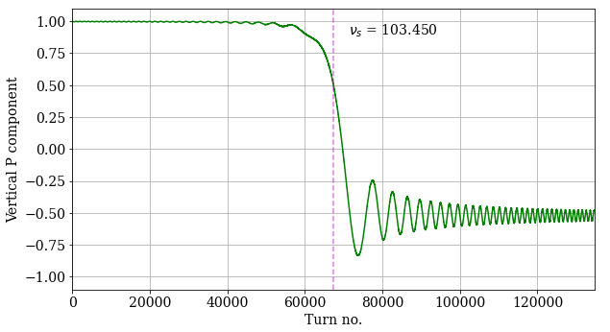
Simple RDP
For the typical LEP deflections, expect no better than a 50% spin flip, and mostly likely just depolarize to P ~ 0 !
Spin rotation / turn = 0.5 mrad
Spin rotation / turn = 0.3 mrad
Spin rotation / turn = 0.6 mrad
Spin rotation / turn = 0.4 mrad

Slide 13
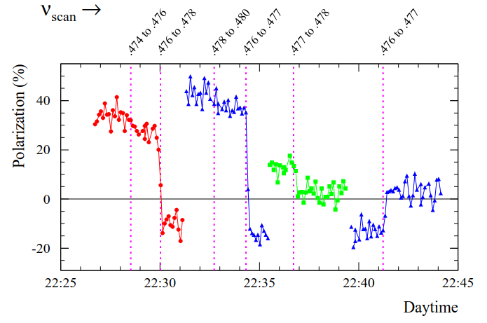
LEP RDP
The estimates obtained with those simplified simulations match quite well the LEP observations.
To achieve spin flip, the scan time should have been a factor 2-4 longer depending on the response factor F.

Slide 14
What about FCCee
Try the same exercise of free betatron oscillation RDP with FCCee GHC optics (physics optics, β* = 0.11m / 0.7mm)
First observation, with a kick of 1 μrad, cannot even find the trajectory for one turn reliably → lower transverse kick to 0.1-0.01 μrad (better, still occasional issues at 0.1).

Slide 15
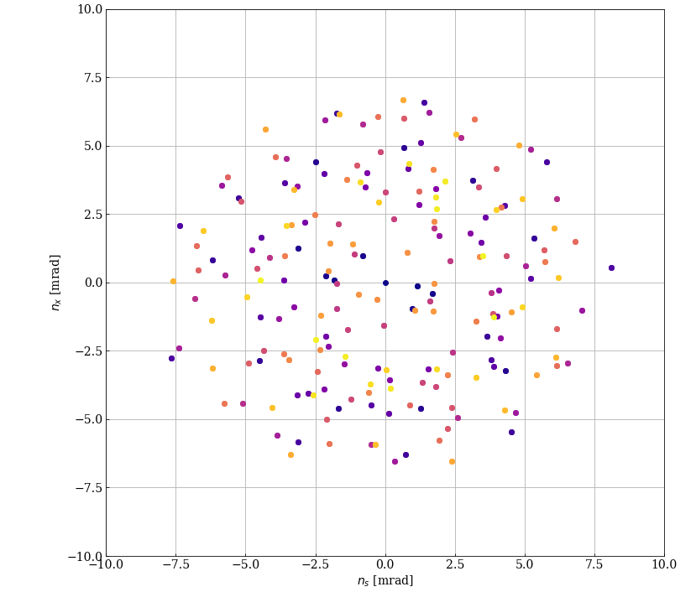
Compare…
No coherent amplitude growth at FCCe at some ν_{s}, chaotic up and down of spin orientation !!
LEP, 1.3 μrad
FCCee, 0.1 μrad, νs = 103.48

Slide 16
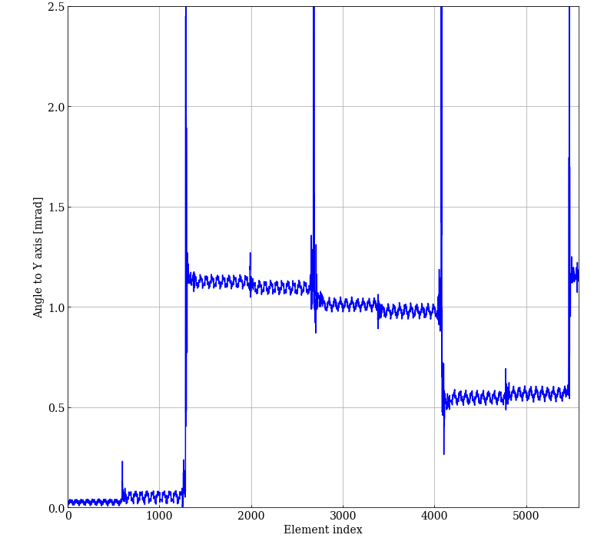
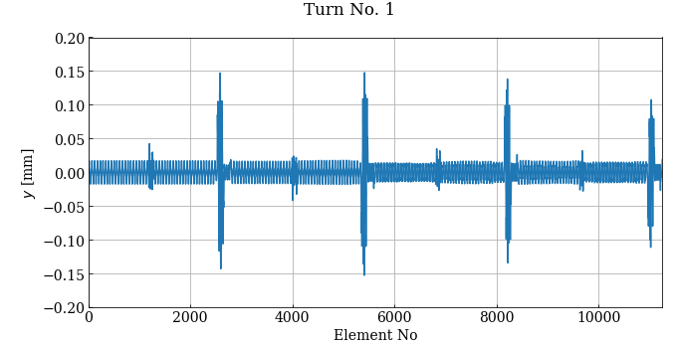
Turn-by-turn
Spin angle to Y axis – Turn 1
The 4 long sections with the bends around the 4 IPs generate very large rotations (~1 mrad vs 10 μrad by the depolarizer), but somehow the phases seem to be such that there is no continuous build-up.
  Observes upward and downward waves.
  Depends on depolarizer frequency.
Vertical trajectory – Turn 1

Slide 17
Outlook
The tracking results of the LEP lattice with LEP RDP parameters reproduce semi-quantitatively the LEP RDP results.
The free betatron oscillation amplifies the depolarizer by a factor 2-5 in the region of interest ν_{s}.
For FCCee the results are puzzling, the experimental IRs seem to dominate the spin dynamics and do not work coherently for RDP with free betatron oscillation. To be looked at in more depth.
This may pose stringent constraints on the closure of the depolarizer bump !
G. Iadarola is currently working on spin tracking in Xsuite.
He is using the LEP models (including solenoid and sol. compensation bumps) for benchmarking. The first results are encouraging !
There is a good chance that by the summer, a test version of Xsuite spin tracking may become available.

