Slide 1
Polarization Issues in LEP3
Ivan Koop
BINP, 630090 Novosibirsk, Russia
37-th FCC-FS EPOL group and FCCIS WP2.5 meeting, May 2, 2025.

Slide 2
Outline
Why the resonant depolarization (RDP) method don’t work with the LEP3 parameters
Some results of spin tracking
Corrected LEP3 parameters to meet most crucial requirements for RDP
Conclusion

Slide 3
REFERENCES
A. Blondel et al., “LEP3: A High Luminosity e+e− Collider to Study the Higgs Boson”, submitted to the 2013 European Strategy Preparatory Group, arXiv:1208.0504.
C. Anastopoulos et al., “LEP3: A High-Luminosity e+e− Higgs & Electroweak Factory in the LHC Tunnel”, arXiv:2504.00541. A possible back-up to the preferred option (FCC-ee and FCC-hh) for the next accelerator for CERN April 2, 2025.
D. Shatilov, “Luminosity optimization for LEP3, based on lattice parameters by K. Oide” , 66th FCC-ee Optics Design Meeting CERN, 15 December 2017.
K.Oide, “A preliminary lattice for LEP3” based on parameters optimized by D. Shatilov, 66th FCC-ee Optics Design Meeting CERN, 15 December 2017.

Slide 4
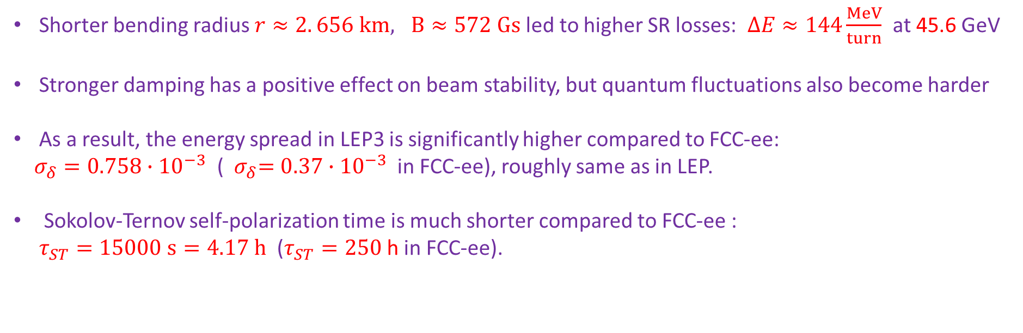
SR parameters and Sokolov-Ternov self-polarization time in LEP3
Shorter bending radius $r≈2. 656 km, B≈572 Gs$led to higher SR losses: $∆E≈144\frac{MeV}{turn}$ at 45.6 GeV
Stronger damping has a positive effect on beam stability, but quantum fluctuations also become harder
As a result, the energy spread in LEP3 is significantly higher compared to FCC-ee:
$σ_{δ}=0.758∙{10}^{−3}$ (${ σ}_{δ}=0.37∙{10}^{−3}$ in FCC-ee), roughly same as in LEP.
Sokolov-Ternov self-polarization time is much shorter compared to FCC-ee :
$τ_{ST}=15000 s=4.17 h$ ($τ_{ST}=250$ h in FCC-ee).

Slide 5
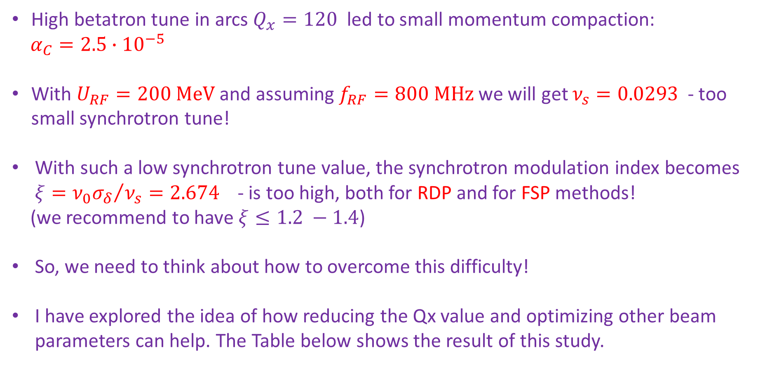
RF parameters and the depolarization issues at Z beam energy
High betatron tune in arcs $Q_{x}=120$ led to small momentum compaction:
$α_{C}=2.5∙{10}^{−5}$
With $U_{RF}=200 MeV$ and assuming $f_{RF}=800 MHz$ we will get $ν_{s}=0.0293$ - too small synchrotron tune!
With such a low synchrotron tune value, the synchrotron modulation index becomes $ξ={ν_{0}σ_{δ}}/{ν_{s}}=2.674$ - is too high, both for RDP and for FSP methods!
(we recommend to have $ξ≤1.2 −1.4$)
So, we need to think about how to overcome this difficulty!
I have explored the idea of ​​how reducing the Qx value and optimizing other beam parameters can help. The Table below shows the result of this study.

Slide 6
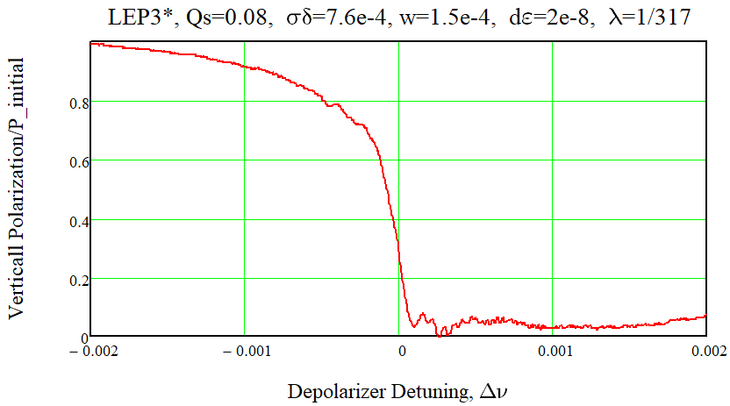
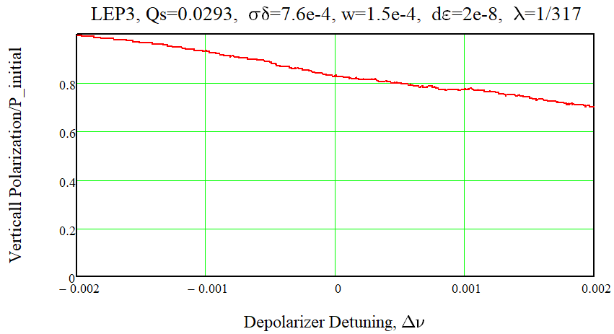
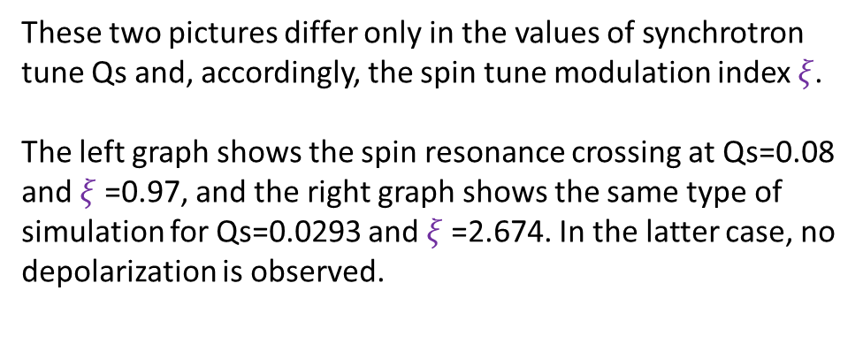
Depolarizations at Z beam energy in LEP3 and LEP3*
These two pictures differ only in the values ​​of synchrotron tune Qs and, accordingly, the spin tune modulation index $ξ$.
The left graph shows the spin resonance crossing at Qs=0.08 and $ξ$=0.97, and the right graph shows the same type of simulation for Qs=0.0293 and $ξ$=2.674. In the latter case, no depolarization is observed.

Slide 7
Parameters of e+e- colliders with different betatron tunes at Z-pole beam energy
Option Betatron tunes, integer parts | LEP1 Qx, Qy=80? | LEP3 Qx, Qy=212 | LEP3 * Qx, Qy=106 | FCC-ee Qx, Qy=222
Beam energy, GeV | 45.6 | 45.6 | 45.6 | 45.6
Circumference, km | 26.7 | 26.7 | 26.7 | 90.658816
Bending radius, km | 3.1 | 2.755 | 2.755 | 10.4
Momentum compaction, 10⁻⁵ | 18.6 | 2.5 | 10 | 2.86
Energy loss/turn, GeV | 0.12 | 0.144 | 0.144 | 0.0394
Damping time, turns | 380 | 317 | 317 | 1232
Energy spread %, SR/BS | 0.070 / ?? | 0.076 / ?? | 0.076/ ?? | 0.037 / 0.089
RF frequency, MHz | 352 | 800 | 800 | 400
Total RF voltage, GV | 0.240 | 0.200 | 0.300 | 0.079
Synchrotron tune Qs | 0.065 | 0.0293 | 0.081 | 0.031
Emittances, h(nm)/v(pm) | 20/400 | 0.61/1.4 | 4.96/9.9 | 0.71/1.4
Beta functions at IP, h/v , mm | 2000/50 | 500/1 | 70/1 | 110/0.7
Number of bunches | 12 (single ring!) | 2400 | 1370 | 15880
Bunch population, N/10¹¹ | 1.8 | 0.8 | 1.4 | 1.51
Beam-beam parameters, h/v | 0.044/0.044 | 0.100/0.240 ?! | 0.013/0.126 | 0.0023 / 0.096
Luminosity, L/10³⁴ cm⁻² s⁻¹ | 0.002 | 68 | 32 | 140
Spin tune modulation index | 1.1 | 2.674 ?! | 0.97 | 1.24
Polarization time, hours | 4.2 | 4.16 | 4.16 | 252
SR power / beam, MW | 0.3 | 50 | 50 | 50

Slide 8
Conclusion
When the betatron frequency is reduced (by about a factor of 2), the loss of luminosity at the Z pole is not very significant, only about a factor of 2 compared to the original LEP 3 parameters.
But with this set of global parameters of LEP3* the RDP is restored, and works again, as in LEP1.
Further optimization of the beam parameters can improve the luminosity regime in LEP3* and we can achieve somewhat higher luminosity values, say above 3.5 * 10³⁵ cm⁻² s⁻¹ .
Here I would like to point out that increasing the dispersion function in arcs will have few positive effects: sextupoles will become weaker and energy stability will improve.

